Slide 1
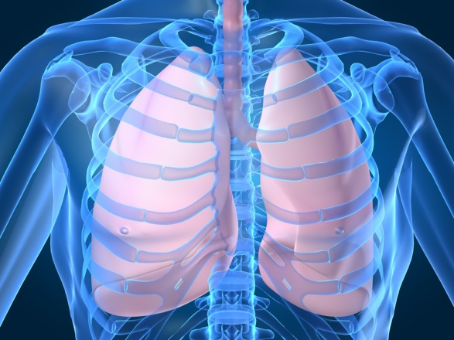
Upper Respiratory System
Digital Laboratory
It’s best to view this in Slide Show mode, especially for the quizzes.
This module will take approximately 90 minutes to complete.

Slide 2
After completing this exercise, you should be able to:
Distinguish, at the light microscope level, each of the following:
Describe the general features of structures in the upper respiratory tract:
Respiratory epithelium (pseudostratified ciliated columnar with goblet cells)
Basement membrane (thick)
Lamina propria with glands, vessels, nerves, diffuse lymphoid tissue
Supporting elements (bone, cartilage, smooth and/or skeletal muscle
Distinguish, at the light microscope level, each of the following organs and their specific features (in addition to those listed above):
Concha – venous plexus , cancellous bone
Epiglottis - epithelium (stratified squamous non keratinized on anterior side and tip, respiratory epithelium on posterior side), elastic cartilage
Larynx –
False (ventricular) vocal fold – mucus and serous glands
True vocal fold - stratified squamous epithelium, vocal ligament, vocalis muscle, lack of blood vessels
Laryngeal ventricle
Hyoid bone
Epiglottis
Thyroid cartilage
Cricoid cartilage
Trachea – submucosa with glands, C-shaped hyaline cartilage, trachealis muscle
Bronchus – submucosa with glands, hyaline cartilage broken up, smooth muscle
Distinguish, at the electron microscope level, each of the following:
Review respiratory epithelium and cilia

Slide 3
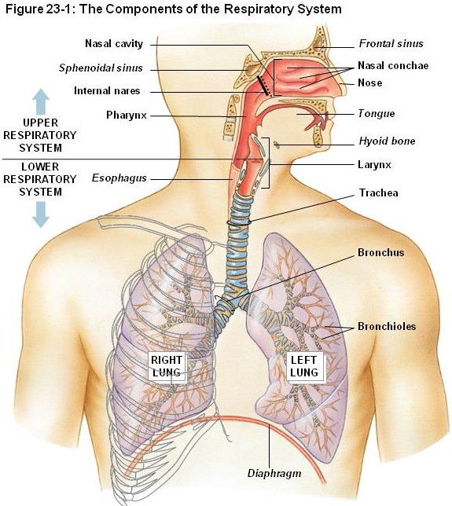
GROSS ANATOMY OF THE UPPER RESPIRATORY TRACT
The major structures of the upper respiratory tract are:
Nasal cavity
Pharynx
Larynx
Trachea
Bronchi
Different sources define upper vs. lower respiratory systems differently. Clinicians use these terms to describe upper respiratory infections (colds) and lower respiratory infections (pneumonia). Based on histological similarity, we will address everything up to and including the bronchi as upper respiratory, and will focus on structures in the lungs in the next module.

Slide 4
GROSS ANATOMY OF THE UPPER RESPIRATORY TRACT
The major function of the respiratory system is gas exchange. To accomplish this, the lungs contain numerous air-filled sacs called alveoli; each surrounded by a thin layer of well-vascularized connective tissue.
Because O₂ and CO₂ are small and hydrophobic, movement of gas molecules across the alveolar barrier into the bloodstream is accomplished by diffusion. Diffusion is maximized when the distance traveled by the diffusing molecules is small. To achieve this goal, the inner lining of the alveoli is simple squamous (alveolar epithelial cell, we will look at alveoli in detail in the next module).

Slide 5
GROSS ANATOMY OF THE UPPER RESPIRATORY TRACT
The downside to a simple squamous epithelium is that it is thin and fragile, making it susceptible to infectious agents, dry conditions, and change in temperature. One major function of the upper respiratory tract is to filter, moisturize, and warm the incoming air to reduce damage to the delicate lining of the alveoli. This is largely achieved via a specialized lining of the structures of the upper respiratory tract, referred to as the respiratory mucosa.

Slide 6
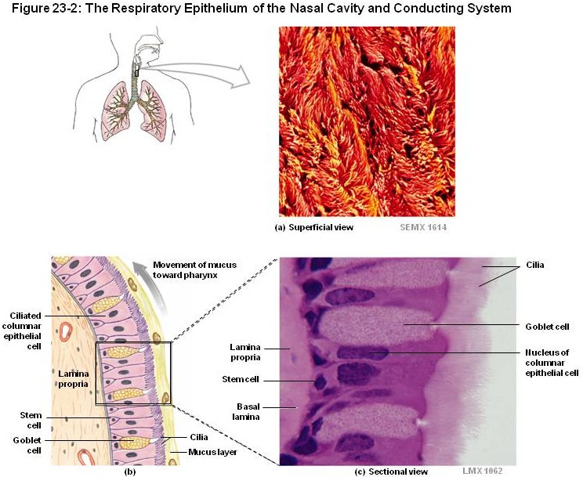
RESPIRATORY MUCOSA
The inner lining of the respiratory system (excluding the alveoli) is composed of respiratory mucosa, which includes
Pseudostratified ciliated columnar epitheium with goblet cells
Thick basement membrane
Lamina propria – irregular connective tissue with glands and diffuse lymphoid tissue
The supporting structures of the respiratory system (bone, cartilage, smooth muscle) will be addressed when we examine specific regions of the respiratory system.

Slide 7
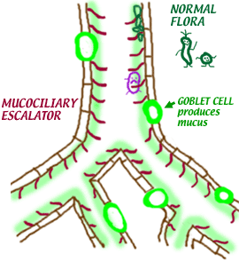
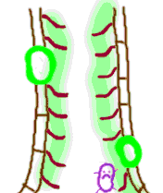
RESPIRATORY MUCOSA
The inner lining of the respiratory system (excluding the alveoli) is composed of respiratory mucosa, which includes
Pseudostratified ciliated columnar epitheium with goblet cells
Thick basement membrane
Lamina propria – irregular connective tissue with glands and diffuse lymphoid tissue
The epithelial goblet cells and glands in the lamina propria secrete mucus, which prepares the incoming air before exposure to the delicate alveoli (filtering, moisturizing). This mucus is produced continuously; cilia move this mucus toward the pharynx, where it is swallowed.
Because most of the cilia beat upward toward the pharynx (exception would be the nasal cavity), this process is commonly referred to as the mucociliary escalator.

Slide 8
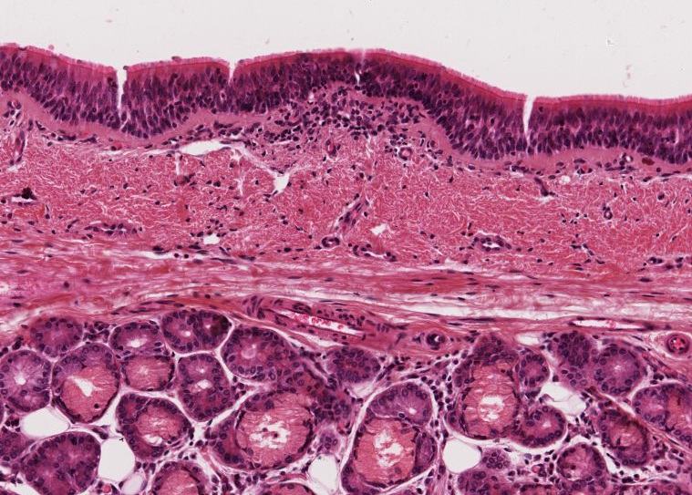
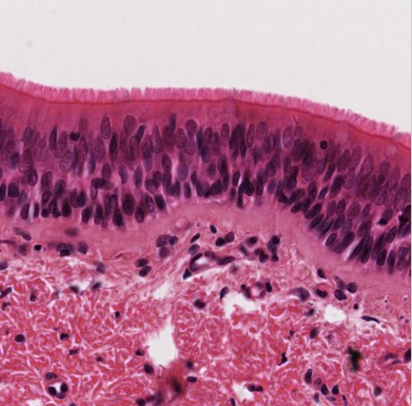
RESPIRATORY MUCOSA
As we mentioned, the inner lining of the respiratory system is largely composed of respiratory mucosa, which includes
Pseudostratified ciliated columnar epitheium with goblet cells (above green bracket)
Thick basement membrane (green bracket)
Lamina propria – irregular connective tissue with glands and diffuse lymphoid tissue (below green bracket)
These cilia are phenomenal….oooooeee!!!
This particular specimen is sliced thick, so goblet cells are not easily seen.
At the bottom of the low-power image to the left, you can see numerous mucus glands. That image also has a little cluster of diffuse lymphoid tissue in the middle, just under the basement membrane.

Slide 9
RESPIRATORY EPITHELIUM
Video of respiratory mucosa – slide 15B
Link to SL 015B
Be able to identify:
Respiratory Mucosa
Respiratory epithelium (pseudostratified ciliated columnar with goblet cells)
Thick basement membrane
Lamina propria

Slide 10
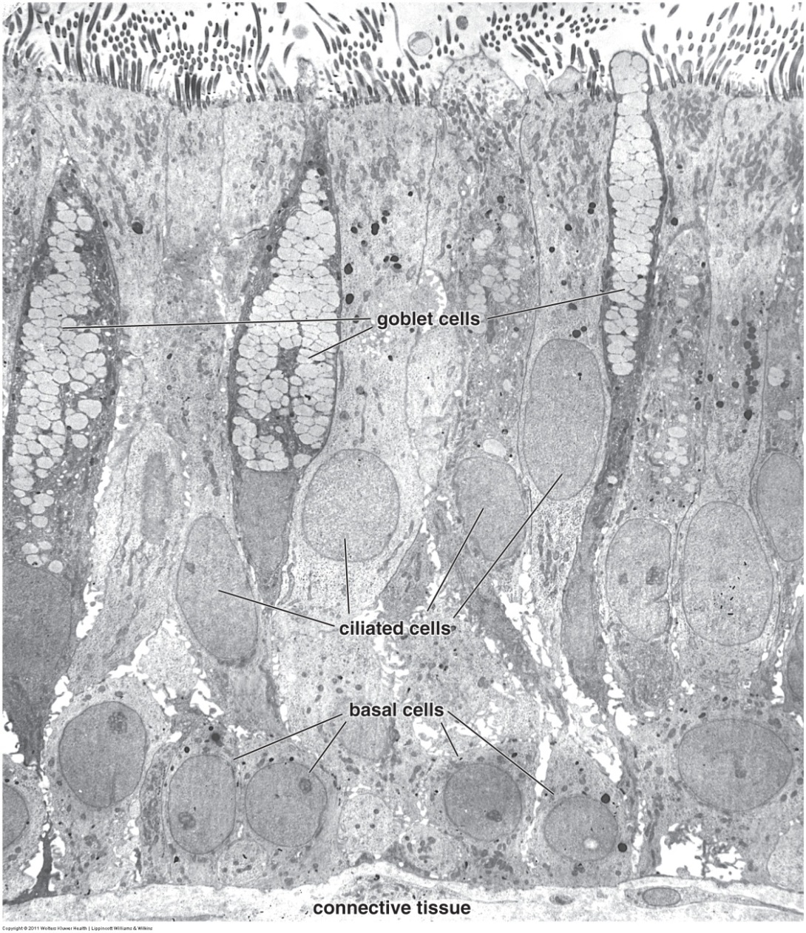
RESPIRATORY MUCOSA
In this electron micrograph, you can see several cell types of the respiratory epithelium, including ciliated cells, basal cells, and goblet cells. Not readily evident are brush cells and Kulchitsky cells, which you don’t have to worry about identifying.

Slide 11
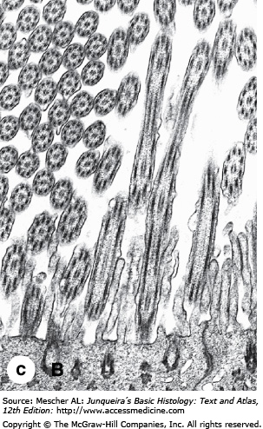
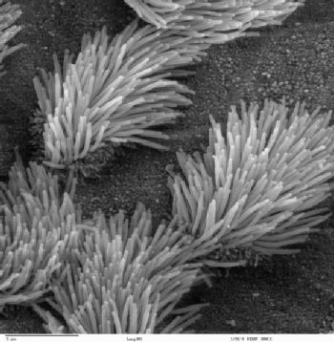
RESPIRATORY MUCOSA
Remind yourself of the basic ultrastructural features of cilia. On the left, you can see the 9+2 arrangement of the microtubules within the cross sections of the cilia (upper left portion of image). Basal bodies (one is outlined) are seen at the base of each cilium.
This is a scanning view of the inner surface of the upper respiratory tract, showing cells with numerous cilia, and cells without cilia which are likely goblet cells. Very nice!!!!

Slide 12
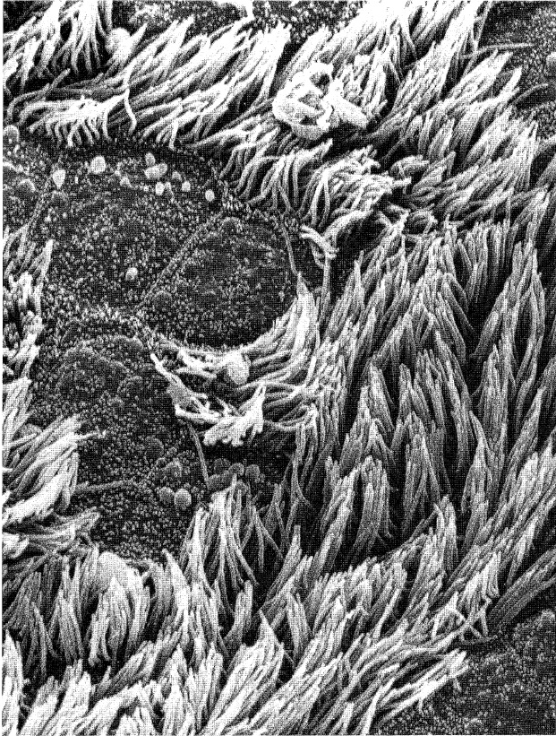
RESPIRATORY MUCOSA
Another scanning view of the inner surface of the upper respiratory tract, showing cells with numerous cilia, and cells without cilia which are likely goblet cells.
Phenomenal !!!!

Slide 13
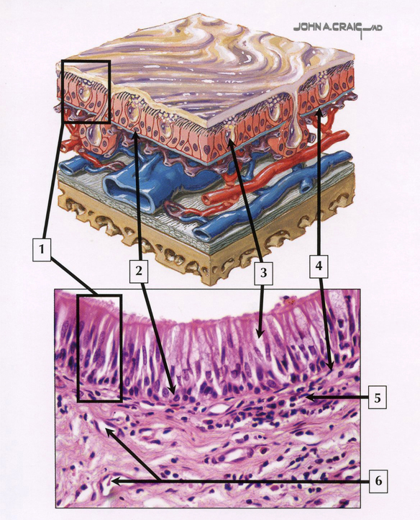
QUIZ
Self-check: Identify 1-6. (advance slide for answers)

Slide 14
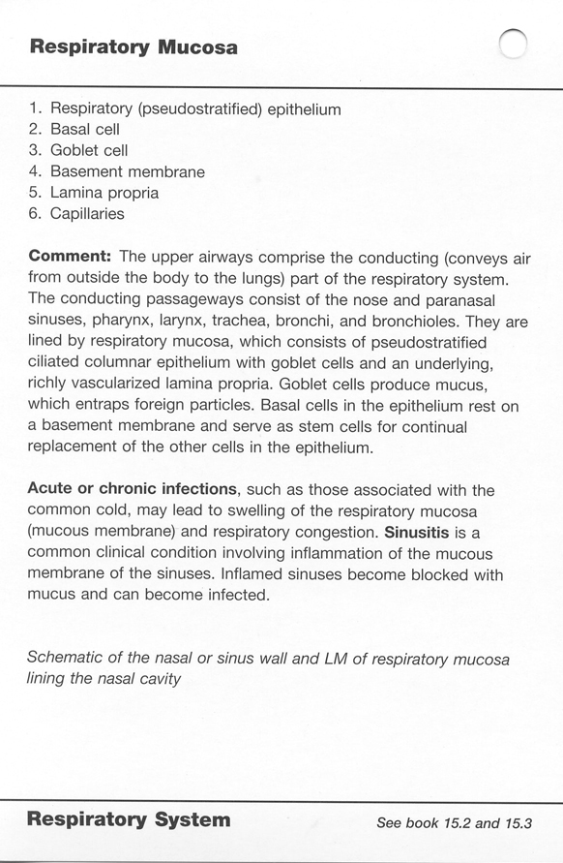

Slide 15
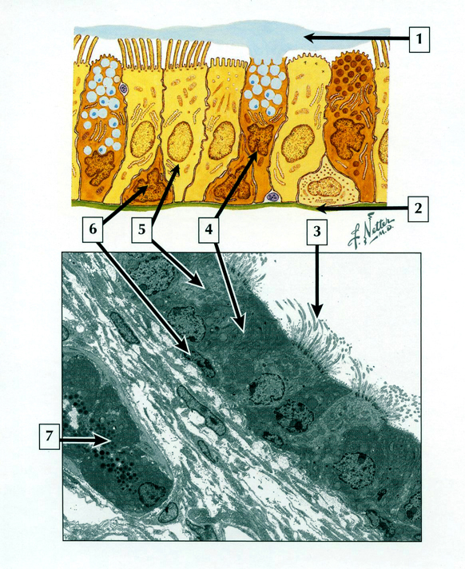
QUIZ
Self-check: Identify 1-6. (advance slide for answers)

Slide 16
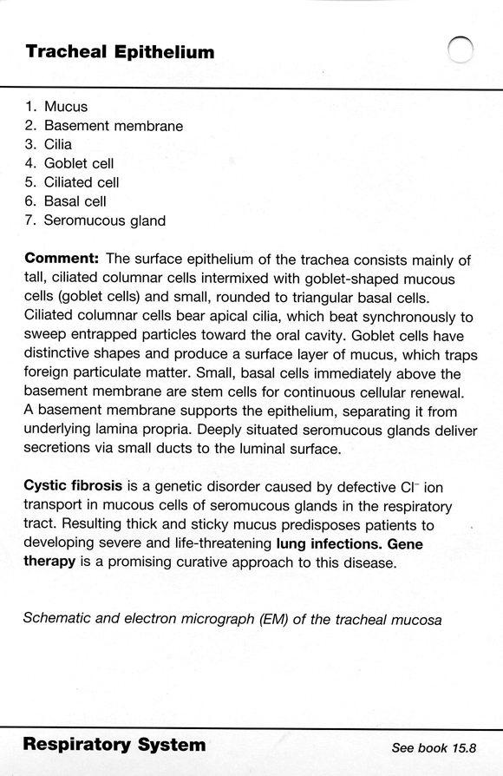

Slide 17
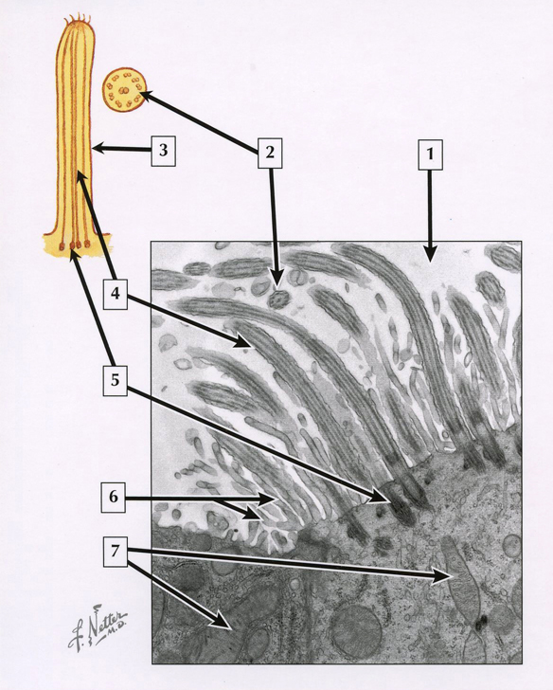
QUIZ
Self-check: Identify 1-7. (advance slide for answers)

Slide 18
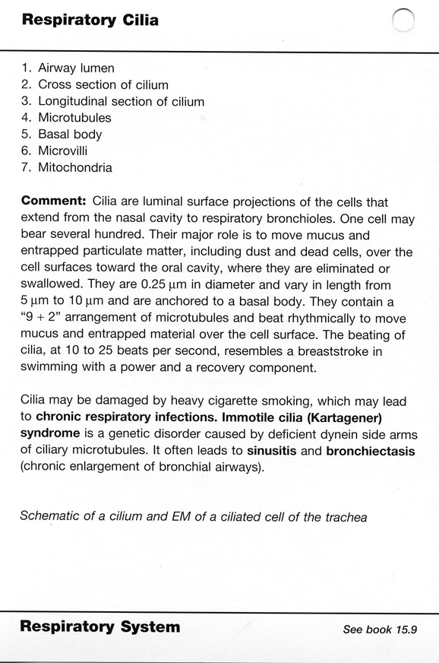

Slide 19
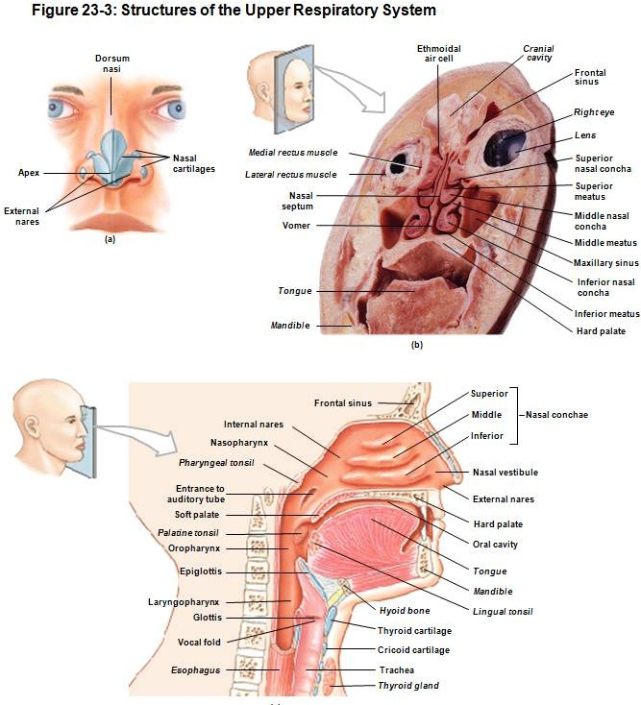
CONCHAE
As mentioned, the upper respiratory tract is designed to filter, warm, and moisturize incoming air.
The nasal cavity is well suited for this function because it contains:
Respiratory epithelium
Numerous venous plexuses
Projections of the lateral wall of the nasal cavity are called conchae. These structures increase turbulence within the nasal cavity, maximizing the efficiency of air processing.

Slide 20
CONCHA
In this coronal section, a concha is outlined in green. Note how narrow the nasal cavity is due to the presence of these concha. This is designed to maximize the conditioning of inspired air.
Since we are in the skull, concha are supported by cancellous bone (as opposed to the other parts of the respiratory tract, which are supported by cartilage).

Slide 21
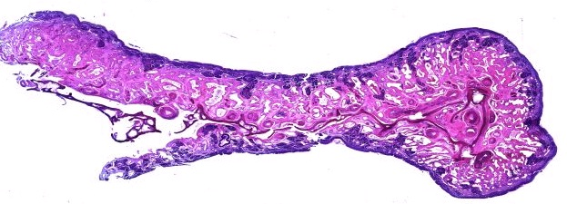
CONCHA
The next set of images and the video shows a concha similar to the one outlined in green and shown in the scanning view below.

Slide 22
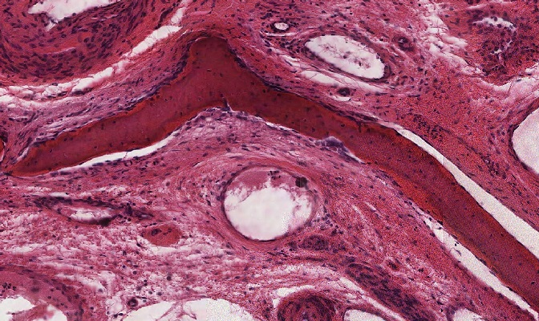
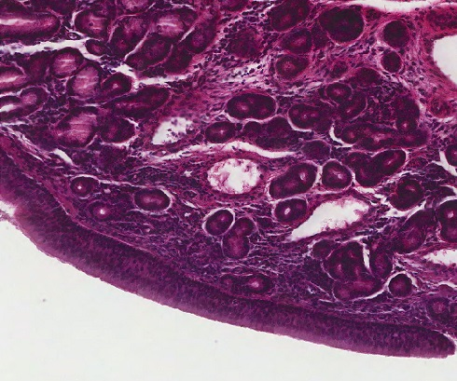
CONCHA
bone
bone
bone
G
Our slide of the concha is over-stained. However, I hope you can appreciate that the lining of the concha is a respiratory mucosa, which includes the respiratory epithelium, and a lamina propria that has numerous glands (G) and blood vessels (V). As already mentioned, unlike the rest of the respiratory tract, which is supported by cartilage and smooth muscle, concha are supported by cancellous bone.
V
V
Lamina propria
V
G
G
Respiratory epithelium

Slide 23
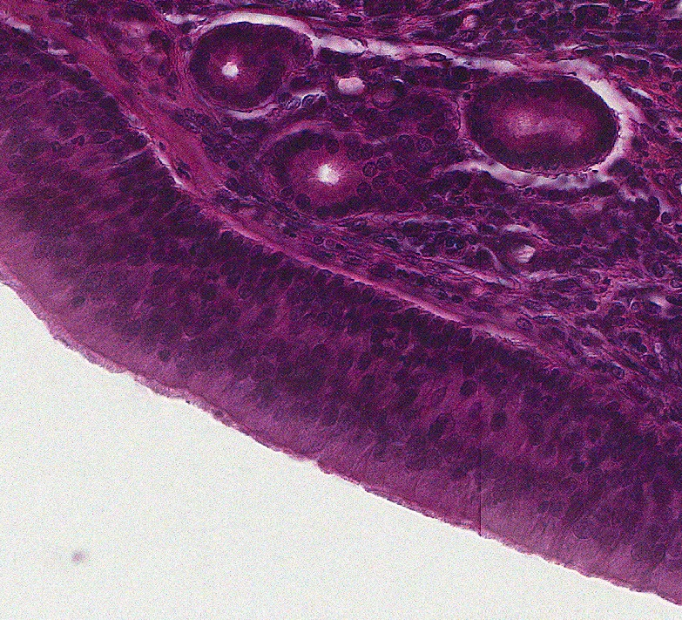
CONCHA
bone
bone
bone
Respiratory epithelium
In case anyone doubted that the respiratory epithelium was indeed pseudostratified ciliated columnar (with goblet cells). Also note the three serous acini (outlined above, there are many in the low-magnification image to the left).

Slide 24
CONCHA
Video showing concha – slide 110
Link to SL 110
Be able to identify:
Concha
Mucosa
Respiratory epithelium
Thick basement membrane
Lamina propria
Glands
Venous plexus
Bone

Slide 25
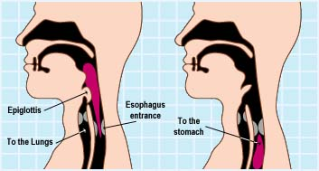
EPIGLOTTIS
The epiglottis helps guide swallowed food toward the esophagus by covering the opening into the larynx. The drawing below shows the epiglottis in the closed position (left) and open position (right).
The supporting element of the epiglottis is elastic cartilage, which is firm but flexible. Most of the remaining elements of the epiglottis are typical; connective tissues, glands, etc. The exception to this is the surface epithelium (see next several slides).

Slide 26
EPIGLOTTIS
A little about orientation of the epiglottis. In the open position (right drawing), the “top” side of the epiglottis (red arrow) faces mostly anteriorly, so is often called the anterior side (shocking!!!)
The “bottom” side is the posterior side (yellow arrow).
Of course, in the closed position (left drawing) this makes absolutely no sense, so don’t think about it like that and you won’t get confused.

Slide 27
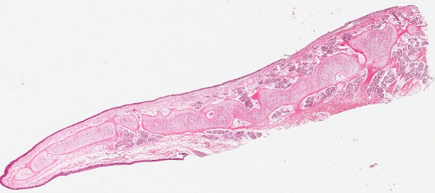
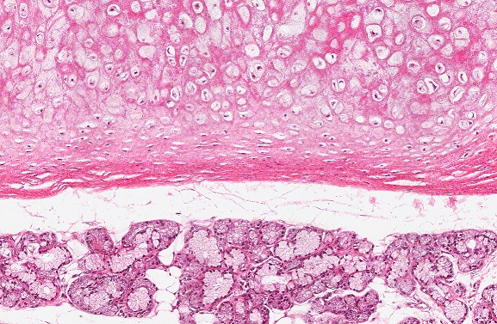
EPIGLOTTIS
Elastic cartilage
posterior
Elastic cartilage
Elastic cartilage
anterior
Elastic cartilage
In the low-powered image of the epiglottis above, the anterior and posterior surfaces of the epiglottis are indicated. The supporting element of the epiglottis is elastic cartilage. The image to the right is a medium-powered image showing elastic cartilage and numerous glands.
Serous and mucous glands

Slide 28
EPIGLOTTIS
During swallowing, the epiglottis covers the opening to the larynx. During this process, the anterior side of the epiglottis comes to face the pharynx, and is exposed to food sliding down toward the esophagus. Because of this, the anterior surface is covered by a stratified squamous non-keratinized epithelium (like the pharynx). The posterior side of the epiglottis faces the lumen of the larynx during swallowing, and, therefore, is covered by respiratory epithelium (mostly, see next slide).

Slide 29
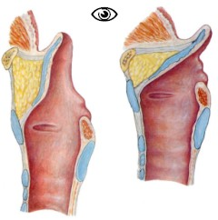
EPIGLOTTIS
In these drawings and image, anterior is to the right. Note that, during swallowing, the tip of the epiglottis extends beyond the posterior wall of the larynx. Because of this, both sides of the tip of the epiglottis are exposed to food, and, therefore, covered by stratified squamous non-keratinized epithelium (red arrows). The blue arrows indicate the portion lined by respiratory epithelium.

Slide 30
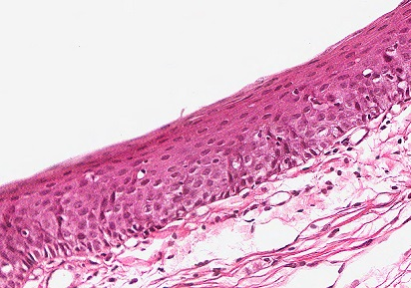
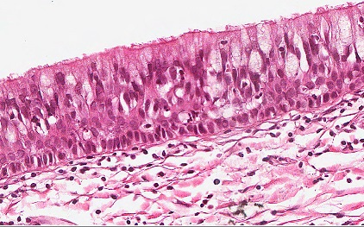
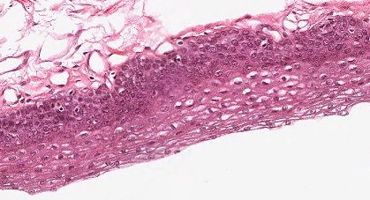
EPIGLOTTIS
In this view, remember that the anterior side is down, the posterior side is up (the tip is to the left). Here, you can see that the anterior side, and the tip of the posterior side, is lined by stratified squamous non-keratinized epithelium, while the inferior portion of the posterior side is lined by respiratory epithelium.

Slide 31
EPIGLOTTIS
Video showing longitudinal section of epiglottis – slide 17
Link to SL 017
Be able to identify:
Epiglottis
Epithelium
Stratified squamous
Respiratory
Lamina propria
Connective tissue, nerves, vessels, serous and mucus glands
Elastic cartilage

Slide 32
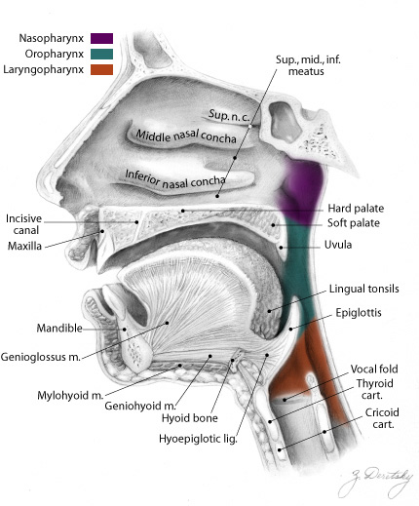
EPIGLOTTIS
This next slide was taken from the tip of the epiglottis (yellow and black lines), and, therefore, is lined entirely with stratified squamous non-keratinized epithelium. This slide was stained for elastic fibers, which are highlighted within the elastic cartilage.

Slide 33
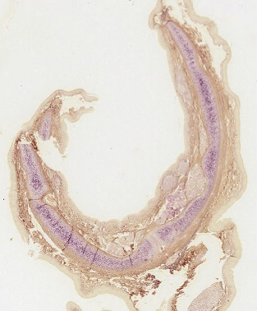
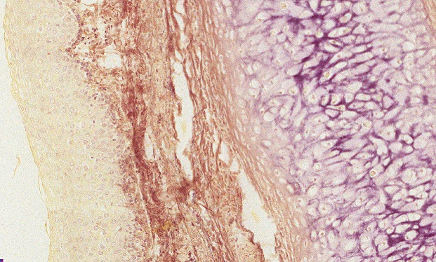
EPIGLOTTIS
Images showing the epiglottis stained for elastic fibers. Obviously, the elastic cartilage contains large amounts of elastic fibers, which stain purple/black. The epithelium is poorly stained.
posterior
Stratified squamous epithelium
Elastic cartilage
Note that the epiglottis is curved posteriorly.
Both sides are lined by stratified squamous epithelium at the tip; only one side is shown here because there’s not much to see (the other side is also pale-stained stratified squamous epithelium).

Slide 34
EPIGLOTTIS
Video showing cross section of epiglottis, elastic stain – slide 184
Link to SL 184
Be able to identify:
Epiglottis
Elastic cartilage

Slide 35
LARYNX
The larynx is positioned anterior to the esophagus, and is the gateway for inspired air to enter the trachea and the rest of the respiratory tract. As mentioned, the opening to the larynx is covered by the epiglottis during swallowing.

Slide 36
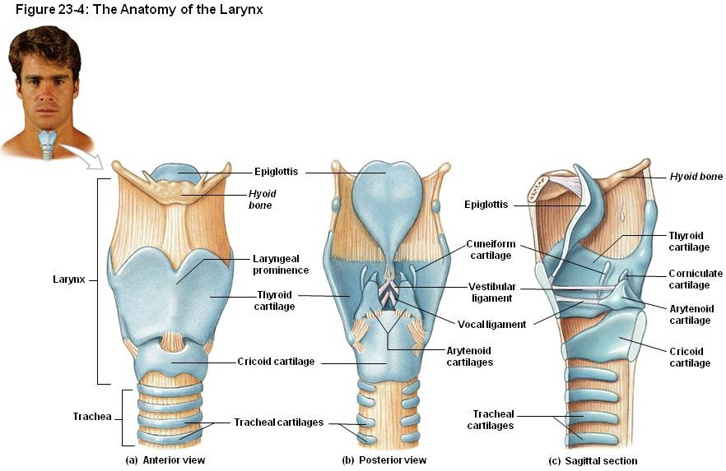
LARYNX
The larynx is supported by the hyoid bone, cartilage, and supporting ligaments. Study these views of the supporting elements:
Hyoid bone epiglottis thyroid cartilage
cricoid cartilage vestibular ligament vocal ligament
This drawing shows just the supporting elements, i.e. the hyoid bone, cartilage, and some of the ligaments that connect these skeletal elements. These supporting elements are covered by mucosa, i.e. epithelium and lamina propria. The views in the next drawings show the larynx with mucosa intact.

Slide 37
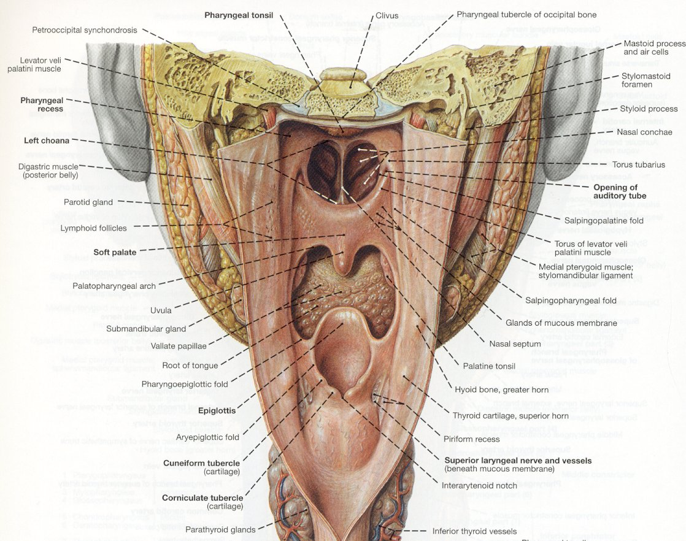
LARYNX
The next several drawings are gross depictions of the larynx with the mucosa intact.
In this drawing, the posterior wall of the pharynx and esophagus has been opened, showing you the larynx (yellow box).
Clemente 893

Slide 38
LARYNX
If we take scissors and cut through the posterior wall of the larynx along the dotted line, and open it up, you will see a view shown on the next slide…..
Clemente 893

Slide 39
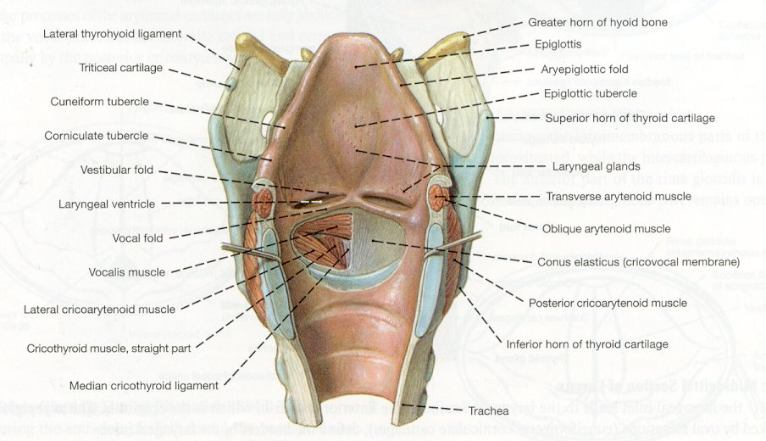
LARYNX
In this drawing, the posterior wall of the larynx has been opened. Note:
vocal fold vestibular fold epiglottis
hyoid bone vocalis muscle laryngeal ventricle
(other muscles of the larynx)
Clemente 907
Terminology alert: the vocal and vestibular ligaments are ligaments, when they are covered with mucosa, the entire structure (ligament + mucosa) is referred to as a fold (e.g. vocal fold).

Slide 40
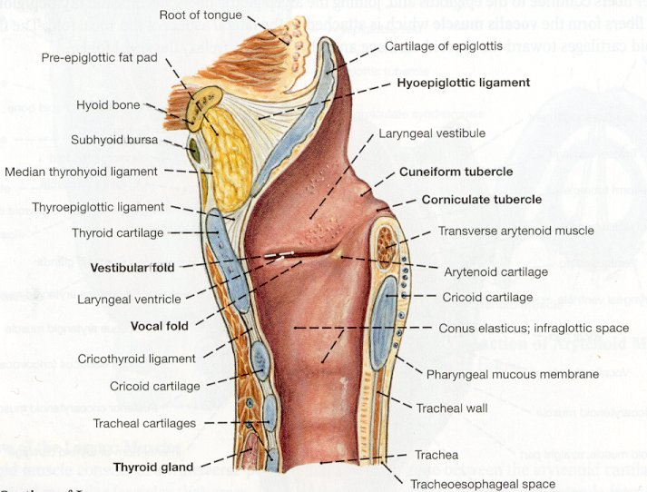
LARYNX
This is a sagittal section through the larynx, anterior is to the left, the esophagus (not shown) is to the right. Note:
hyoid bone epiglottis vestibular fold vocal fold laryngeal ventricle thyroid cartilage cricoid cartilage
The next drawing and the digital slide are coronal sections, similar to that represented by the dotted yellow line.
Clemente 909

Slide 41
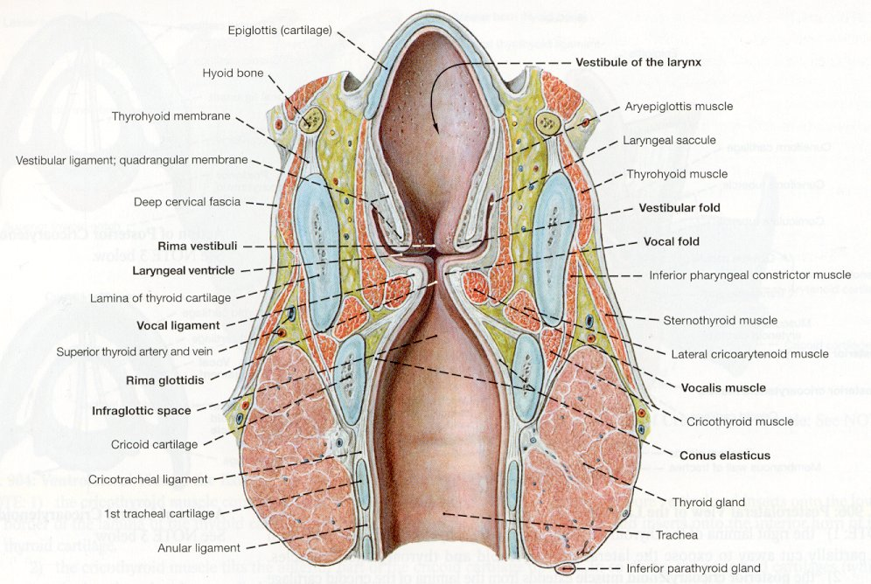
LARYNX
Coronal section similar to the digital slide on the next screen. Note:
epiglottis hyoid bone thyroid cartilage
cricoid cartilage vocalis muscle (other muscles) vocal fold laryngeal ventricle vestibular fold
Proper identification of structures of the larynx depends largely on position. If you are at all confused about the orientation of this drawing, you’ll have a tough time, so I suggest you go back and review the last few slides before proceeding.
Clemente 908

Slide 42
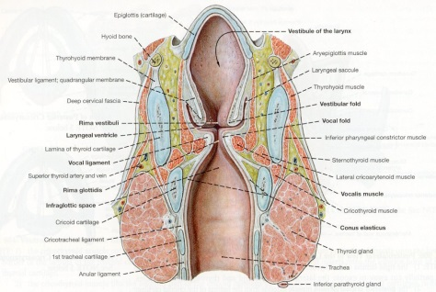
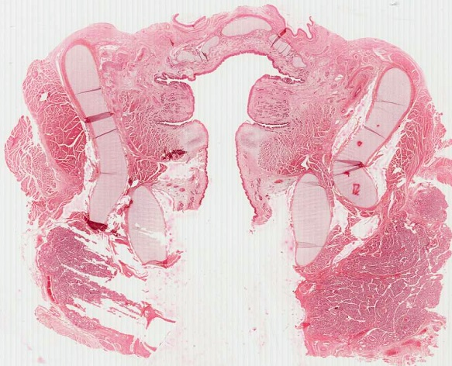
LARYNX
Our main slide of the larynx is a coronal section, similar to the view in the drawing on the previous slide. The hyoid bone is not visible on this slide. The thyroid gland is included, and is indicated at the bottom.
epiglottis
Lumen / air
This specimen was taken from an infant, so the tissues are not very well developed. As I mentioned, position is a key component in identification of structures on this slide.
Thyroid cartilage
Skeletal muscle
Skeletal muscle
Skeletal muscle
Thyroid cartilage
Skeletal muscle
Cricoid cartilage
Cricoid cartilage
Thyroid gland

Slide 43
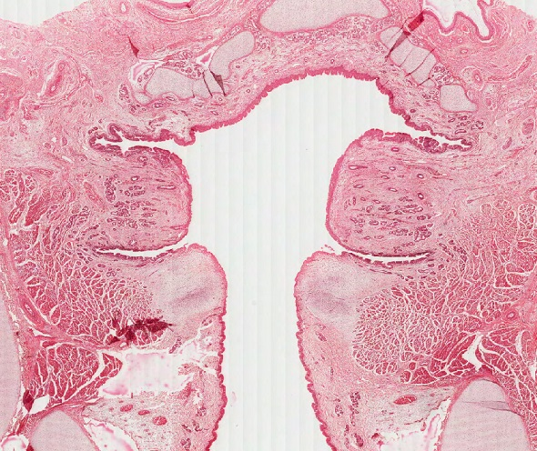
LARYNX
A slightly magnified view shows the vestibular (ventricular, false) vocal folds and (true) vocal folds. The laryngeal ventricle is the space between the two folds (arrows).
epiglottis
Remember this is a coronal section, so the folds are cut in cross section.
Also, remember that the folds include the epithelium and underlying connective tissue, including the vocal ligament.
Lumen / air
vestibular (ventricular, false) vocal fold
(true) vocal fold

Slide 44
LARYNX
Video overviewing larynx – slide 36B
Link to SL 036B
Be able to identify:
Larynx
Epiglottis
Thyroid cartilage
Cricoid cartilage
Skeletal muscle
Vestibular (ventricular, false) fold
Vocal fold (true vocal fold)
Laryngeal ventricle

Slide 45
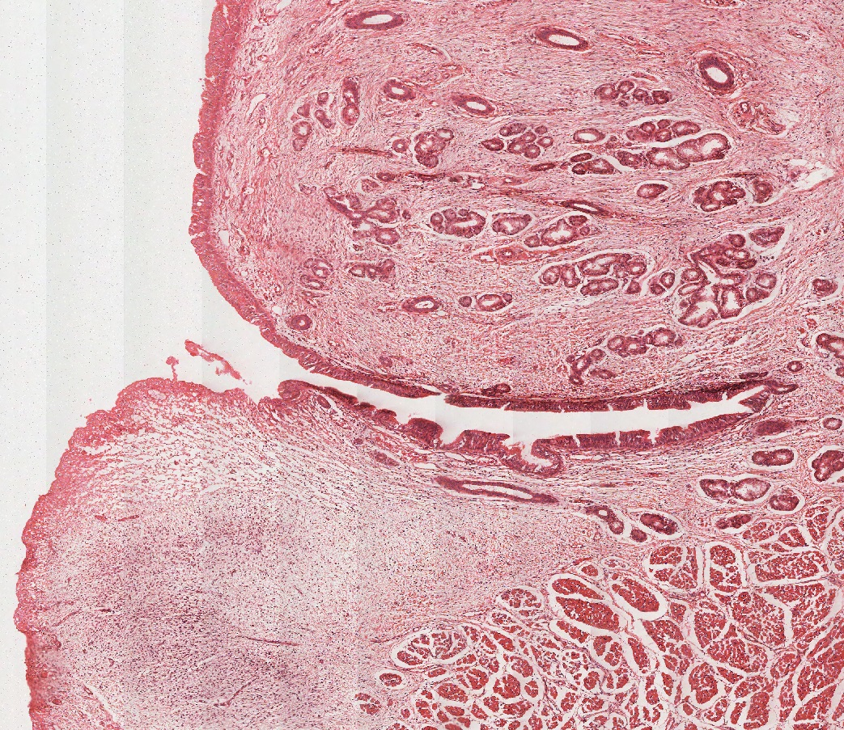
LARYNX
Looking in more detail at the laryngeal folds, you can see that the false vocal fold contains numerous glands, while the true vocal fold is devoid of glands.
vestibular (ventricular, false) vocal fold
(true) vocal fold

Slide 46
LARYNX
Another way to differentiate the false from the true vocal folds is by characterizing the epithelium covering the surface. Most of the larynx is covered with respiratory epithelium (green arrows), including the false vocal fold and the laryngeal ventricle. The tip of the true vocal fold is covered by stratified squamous epithelium (black arrows).
epiglottis
This makes sense, because the true vocal folds will be exposed to frictional forces as they move against each other during violent speech (and other activities, such as increasing abdominal pressure).
vestibular (ventricular, false) vocal fold
(true) vocal fold

Slide 47
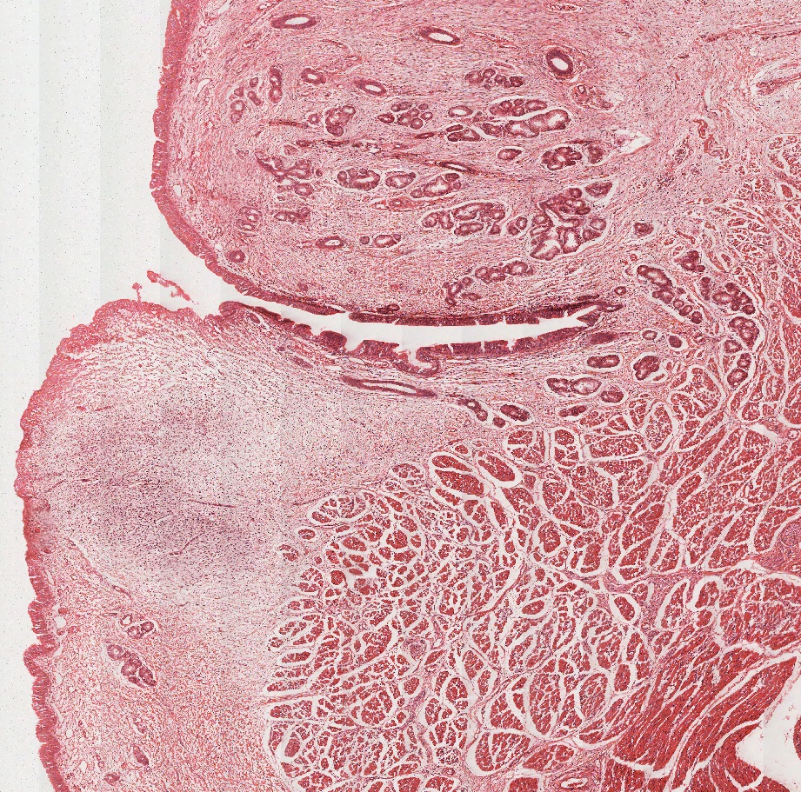
LARYNX
Back to this medium-powered view, the areas covered by respiratory (green arrows) and stratified squamous (black arrows) epithelium are indicated.
vestibular (ventricular, false) vocal fold
(true) vocal fold

Slide 48
LARYNX
More details of the true vocal fold. The vocal ligament is outlined in blue, and the vocalis muscle is outlined in green. Like the true vocal fold, these are cross-sections in this orientation.
The outlines here are approximate. You should know where they are, but don’t get bent out of shape wondering exactly where the vocalis muscle ends and other laryngeal muscles begin.
Other laryngeal muslces here

Slide 49
LARYNX
Video detailing vestibular and vocal folds – slide 36B
Link to SL 036B
Be able to identify:
Larynx
Vestibular fold
Respiratory epithelium
Glands
Vocal fold
Stratified squamous epithelium
No glands
Vocal ligament
Vocalis muscle
Laryngeal ventricle

Slide 50
LARYNX
The next slide is an oblique cut through the larynx, and shows only one side of the larynx:
Take our coronal section drawing, rotate it 90º counterclockwise, then show only one side of the larynx to get the view below.
false vocal fold
true vocal fold

Slide 51
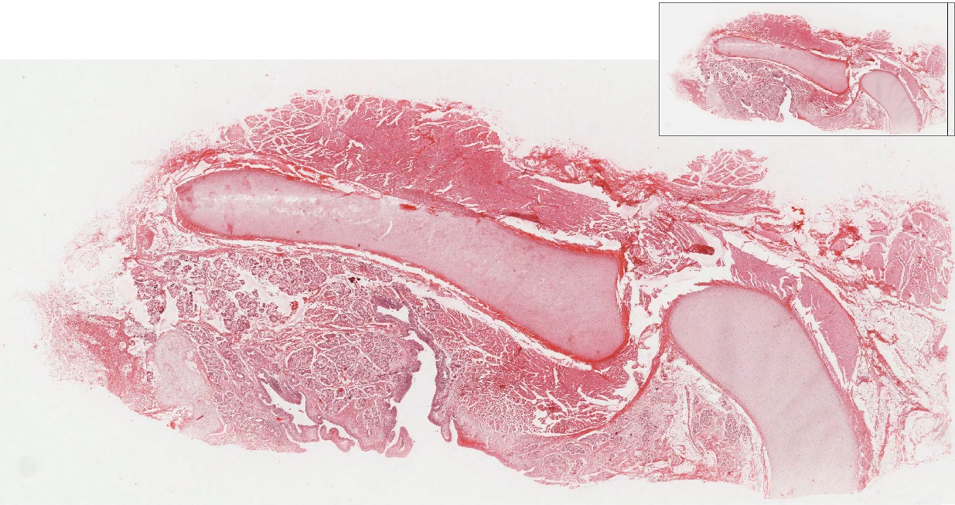
LARYNX
A scanning view of this slide, showing ½ the larynx. Cartilages and folds are indicated.
Thyroid cartilage
epiglottis
false vocal fold
Cricoid cartilage
true vocal fold
Lumen is here
This is an oblique cut, so you are seeing the front portion of the cricoid cartilage.

Slide 52
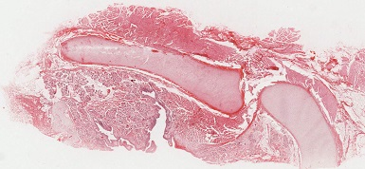
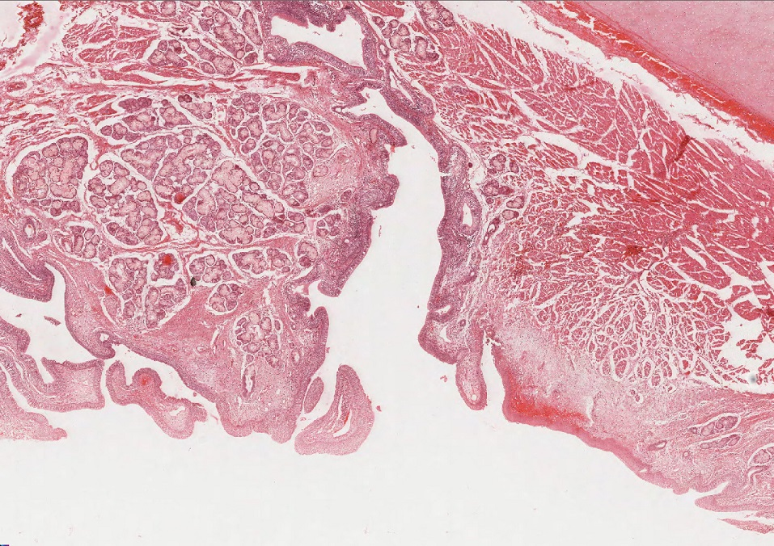
LARYNX
Focusing on the folds reveals that the false vocal fold has numerous glands. Also indicated are the vocalis muscle and vocal ligament.
false vocal fold
Vocalis muscle
Vocal ligament

Slide 53
LARYNX
Video showing oblique cut through larynx – slide 36A
Link to SL 036A
Be able to identify:
Larynx
Vestibular fold
Respiratory epithelium
Glands
Vocal fold
Stratified squamous epithelium
No glands
Vocal ligament
Vocalis muscle
Laryngeal ventricle

Slide 54
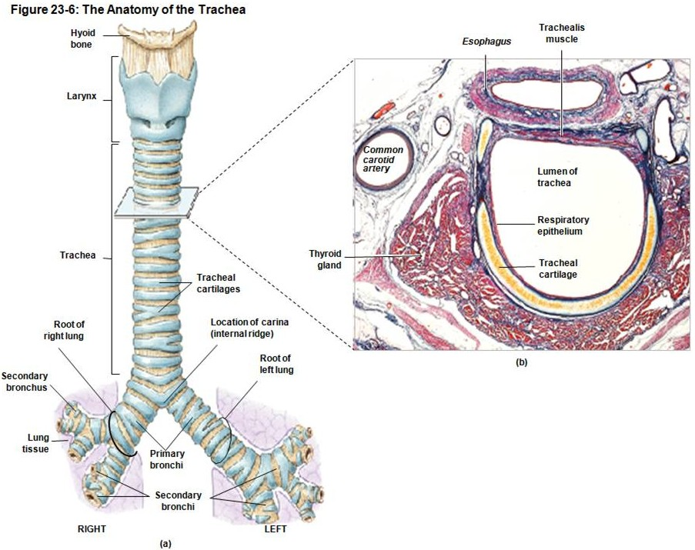
TRACHEA
The trachea is a single tube passing inferiorly from the larynx until it bifurcates into the primary bronchi. The trachea is supported by about a dozen C-shaped pieces of cartilage, incomplete posteriorly to allow a bolus of food to pass through the esophagus. The trachealis muscle (smooth muscle) spans the open, posterior end of the cartilages, and contracts under parasympathetic stimulus during actions such as coughing.

Slide 55
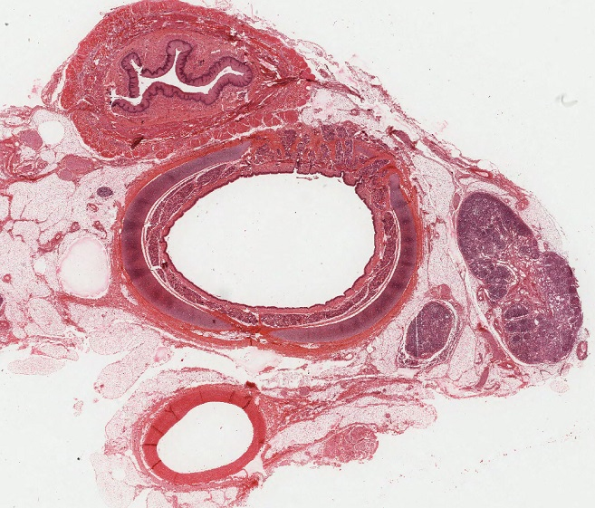
TRACHEA
Scanning view of our slide of the trachea, showing the esophagus, a lymph node, and an elastic artery.
esophagus
trachea
Lymph node
Elastic artery

Slide 56
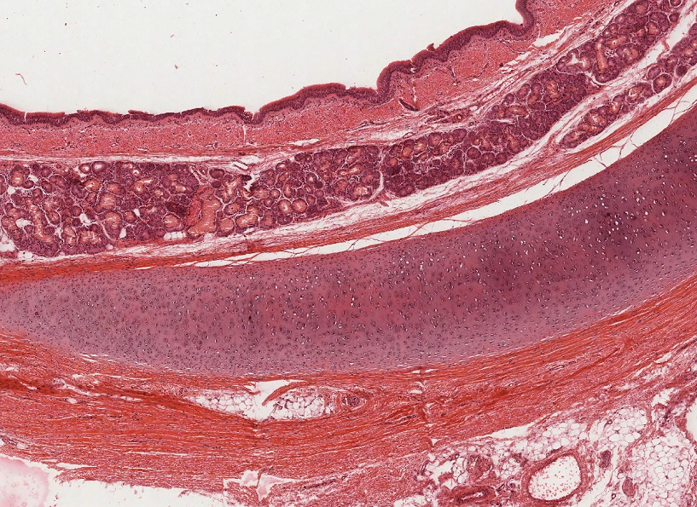
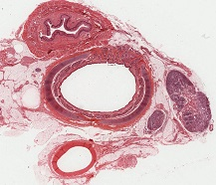
TRACHEA
The wall of the trachea can be divided into mucosa (blue bracket), submucosa (yellow bracket), cartilage (white bracket), and adventitia (black bracket). The mucosa includes respiratory epithelium. Note the numerous glands in the submucosa, and that the cartilage is hyaline cartilage.
Again, don’t get in a tizzy about the exact border between the mucosa and submucosa.

Slide 57
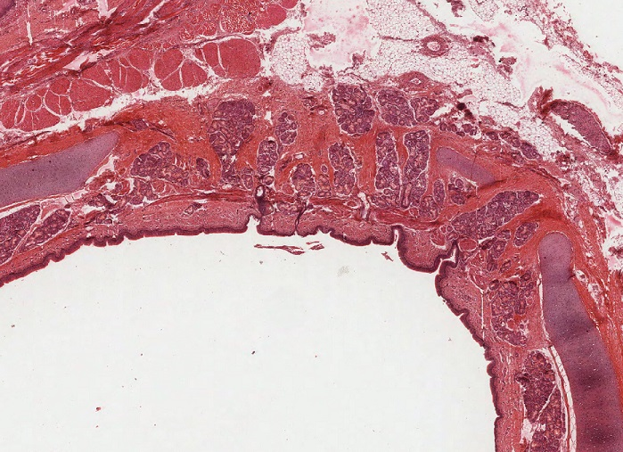
TRACHEA
As mentioned, the posterior aspect of the trachea is highlighted by the trachealis muscle (arrows), which connects the open ends of the C-shaped cartilages. This muscle contracts to narrow the lumen to assist in activities such as coughing.

Slide 58
TRACHEA
Video of trachea – slide 15B
Link to SL 015B
Be able to identify:
Trachea
Mucosa
Respiratory epithelium
Lamina propria
Submucosa
Glands
C-shaped hyaline cartilage
Trachealis muscle
Adventitia
Review elastic artery, peripheral nerve, lymph node, unilocular adipose, skeletal and smooth muscle, stratified squamous non-keratinized epithelium

Slide 59
BRONCHUS
The trachea divides to form the right and left primary bronchi, which further divide into secondary (lobar) and then tertiary (lobular) bronchi. As these divisions occur, the cartilage breaks up into smaller pieces, and the smooth muscle component becomes interspersed between cartilage.
Other than the fact that the cartilage is one piece or multiple pieces, the trachea and extrapulmonary bronchi (bronchi not in the lung) are histologically similar. So much so that if you see one or the other on the exam, either answer, trachea or bronchus, is accepted.
Also, no chance you’ll be able to differentiate primary from secondary or tertiary bronchi on a slide (but you should in the gross lab).

Slide 60
BRONCHUS
As one might expect, the larger bronchi near the trachea will have either a single C-shaped cartilage, or something that is just beginning to break up into smaller cartilage pieces. Here, this upper primary bronchus has cartilage in almost one piece. The smooth muscle here (not visible at this magnification) is essentially one strip similar to the trachealis.
Now you can see how hard it would be to say this isn’t the trachea.

Slide 61
BRONCHUS
Video showing proximal primary bronchus – slide 20
Link to SL 020
Be able to identify:
bronchus
Mucosa
Respiratory epithelium
Thick basement membrane
Lamina propria
Glands
Hyaline cartilage plates
Smooth muscle

Slide 62
BRONCHUS
This section was taken from the hilus of the lung, with the bronchus outlined. You can see that the cartilage here consists of several pieces. The smooth muscle (not visible at this magnification) becomes interspersed between cartilage pieces.
Can’t tell for sure whether this is a primary or secondary bronchus – don’t worry about it.

Slide 63
BRONCHUS
Video showing hilar bronchus – slide 24
Link to SL 024
Be able to identify:
bronchus
Mucosa
Respiratory epithelium
Thick basement membrane
Lamina propria
Glands
Hyaline cartilage plates
Smooth muscle

Slide 64
The next set of slides is a quiz for this module. Before continuing, we suggest you remind yourself of the list of objectives covered in this module, and mentally visualize what each region or structure will look like:
Distinguish, at the light microscope level, each of the following:
Describe the general features of structures in the upper respiratory tract:
Respiratory epithelium (pseudostratified ciliated columnar with goblet cells)
Basement membrane (thick)
Lamina propria with glands, vessels, nerves, diffuse lymphoid tissue
Supporting elements (bone, cartilage, smooth and/or skeletal muscle
Distinguish, at the light microscope level, each of the following organs and their specific features (in addition to those listed above):
Concha – venous plexus , cancellous bone
Epiglottis - epithelium (stratified squamous non keratinized on anterior side and tip, respiratory epithelium on posterior side), elastic cartilage
Larynx –
False vocal fold – mucus and serous glands
True vocal fold - stratified squamous epithelium, vocal ligament , vocalis muscle, lack of blood vessels
Laryngeal ventricle
Hyoid bone
Epiglottis
Thyroid cartilage
Cricoid cartilage
Trachea – submucosa with glands, C-shaped hyaline cartilage , trachealis muscle
Bronchus – submucosa with glands, hyaline cartilage broken up, smooth muscle
Distinguish, at the electron microscope level, each of the following:
Review respiratory epithelium and cilia

Slide 65
QUIZ
Self-check: Identify 1-6. (advance slide for answers)

Slide 67
QUIZ
Self-check: Identify 1-5. (advance slide for answers)

Slide 69
QUIZ
Self-check: Identify 1-6. (advance slide for answers)

Slide 71
QUIZ
Self-check: Identify the outlined structure. (advance slide for answers)
vocalis muscle

Slide 72
QUIZ
Self-check: Identify the structure / organ from which these images were taken. (advance slide for answers)
epiglottis

Slide 73
QUIZ
Self-check: Identify the outlined structure. (advance slide for answers)
Vocal ligament

Slide 74
QUIZ
Self-check: Identify the structure / organ from which this image was taken. (advance slide for answers)
Thyroid gland

Slide 75
QUIZ
Self-check: Identify the structure / organ from which these images were taken. (advance slide for answers)
concha

Slide 76
QUIZ
Self-check: Identify the outlined structure. (advance slide for answers)
vocal ligament

Slide 77
QUIZ
Self-check: Identify the outlined structure. (advance slide for answers)
false vocal fold (vestibular fold)

Slide 78
QUIZ
Self-check: Identify the outlined structure. (advance slide for answers)
true vocal fold

Slide 79
QUIZ
Self-check: Identify the structure / organ from which these images were taken. (advance slide for answers)
Urinary bladder

Slide 80
QUIZ
Self-check: Identify the structure / organ from which this image was taken. (advance slide for answers)
epiglottis

Slide 81
QUIZ
Self-check: Identify the structure / organ from which this image was taken. (advance slide for answers)
trachea/bronchus

Slide 82
QUIZ
Self-check: Identify the outlined structure. (advance slide for answers)
Vocal ligament

Slide 83
QUIZ
Self-check: Identify the structure / organ from which this image was taken. (advance slide for answers)
concha

Slide 84
QUIZ
Self-check: Identify the outlined structure. (advance slide for answers)
vocalis muscle

Slide 85
QUIZ
Self-check: Identify the outlined structure. (advance slide for answers)
false vocal fold (vestibular fold)

Slide 86
QUIZ
Self-check: Identify the structure / organ from which these images were taken. (advance slide for answers)
trachea/bronchus

Slide 87
QUIZ
Self-check: Identify the structure / organ from which these images were taken. (advance slide for answers)
elastic artery

Slide 88
QUIZ
Self-check: Identify the space indicated by the X. (advance slide for answers)
Laryngeal ventricle
X

Slide 89
QUIZ
Self-check: Identify the structure / organ from which this image was taken. (advance slide for answers)
trachea / bronchus

Slide 90
QUIZ
Self-check: Identify the structure indicated by the arrows. (advance slide for answers)
Trachealis muscle

Slide 91
QUIZ
Self-check: Identify the outlined structure. (advance slide for answers)
True vocal fold

Slide 92
QUIZ
Self-check: Identify the structure / organ from which this image was taken. (advance slide for answers)
trachea/bronchus

Slide 93
QUIZ
Self-check: Identify the outlined structures. (advance slide for answers)
Peripheral nerves

Slide 94
QUIZ
Self-check: Identify the outlined structures. (advance slide for answers)
False vocal fold (Vestibular fold)

Slide 95
QUIZ
Self-check: Identify the structure / organ from which this image was taken. (advance slide for answers)
esophagus

Slide 96
QUIZ
Self-check: Identify the structure / organ from which this image was taken. (advance slide for answers)
trachea / bronchus

Slide 97
QUIZ
Self-check: Identify the structure / organ from which this image was taken. (advance slide for answers)
concha

Slide 98
QUIZ
Self-check: Identify the outlined structure. (advance slide for answers)
Vocalis muscle ligament

