Slide 1
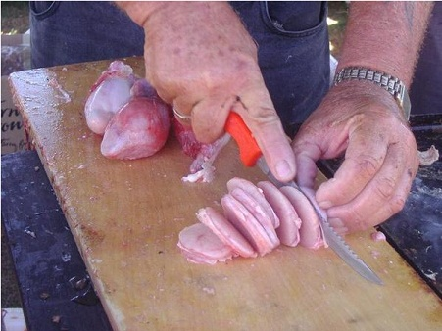
Testis and Genital Ducts
Digital Laboratory
It’s best to view this in Slide Show mode, especially for the quizzes.
This module will take approximately 90 minutes to complete.

Slide 2
After completing this exercise, you should be able to:
identify, at the light microscope level, each of the following:
Testis
  Regions
    Tunica albuginea
    Mediastinum testis
    Seminiferous tubules
  Cell types
    Germ cells
      Spermatogonia
      Primary spermatocytes
      Secondary spermatocytes not seen on our slides
      Spermatids
      Spermatozoa
    Sertoli cells
    Interstitial cells of Leydig (Leydig cells)
    Myoid cells
  Ducts within testis
    Straight tubules
    Rete testis
    Efferent ductules
  Epididymis
  Vas deferens (ductus deferens)
  (within spermatic cord, cord includes cremaster muscle, testicular artery and pampiniform plexus of veins)
identify, at the electron microscope level, each of the following:
  Spermatid
    Acrosome
    Manchette
  Sertoli cell
Leydig cell

Slide 3
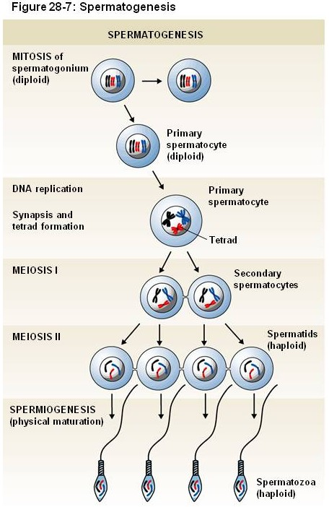
MALE REPRODUCTIVE SYSTEM
A quick review of mitosis, meiosis, and spermatozoa production:
Spermatogonium (diploid, 2N) – a cell that divides mitotically, produces progeny that enter meiosis
Primary spermatocyte (diploid, 4N) - a cell that has begun meiosis, i.e. is in meiosis I
Secondary spermatocyte (haploid, 2N) - a cell that has completed the first meiotic division, i.e. is in meiosis II
Spermatid (haploid, N) – a cell that has completed meiosis but has not transformed into a mature spermatozoon
Spermatozoon (haploid, N) - genetically identical to a spermatid, but has undergone physical transformations including a streamlined appearance, production of a flagellum, an acrosome

Slide 4
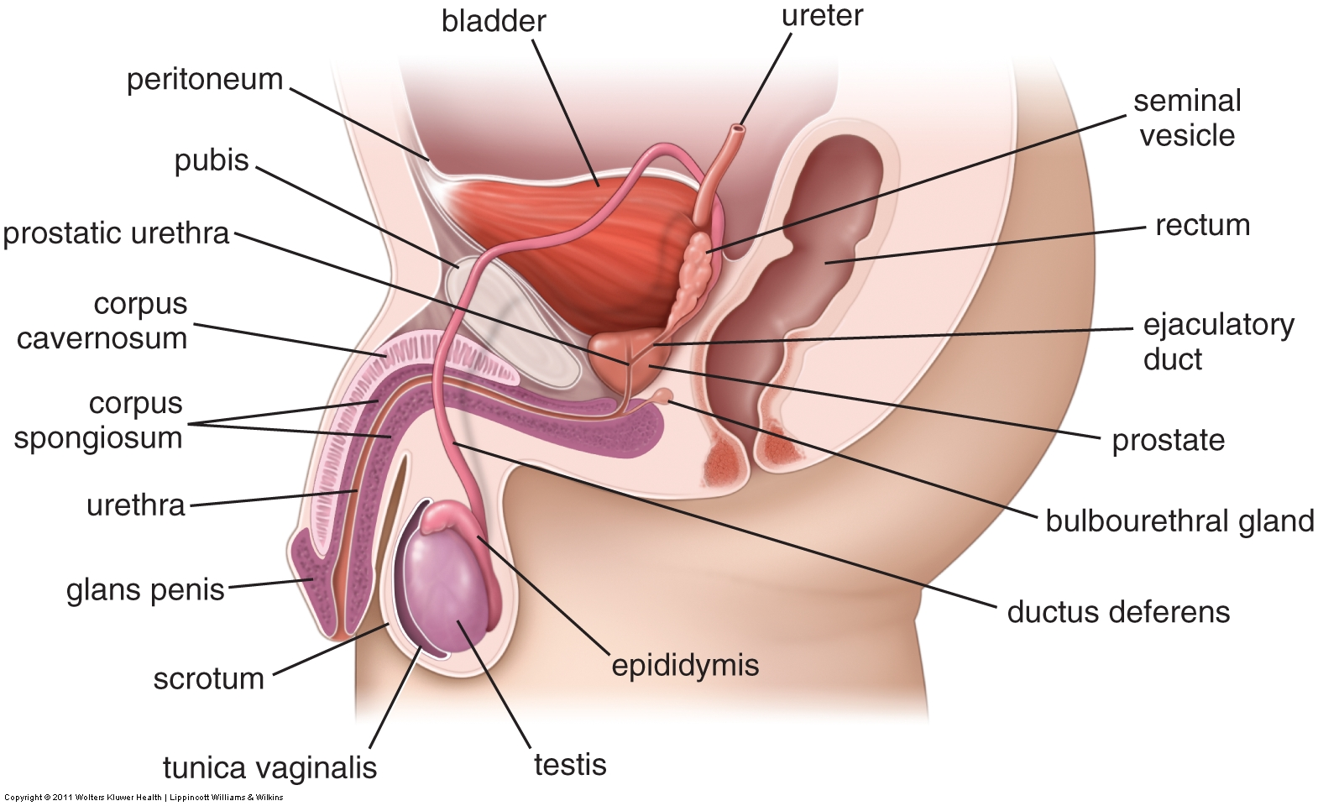
MALE REPRODUCTIVE SYSTEM
The urogenital diaphragm (indicated by the dotted green line) is a thin sheet of mostly skeletal muscle that includes the external urethral sphincter.
Membranous refers to the part of the urethra that passes through the urogenital diaphragm. The membranous urethra is about 1cm in length.
Major structures of the male reproductive system that allow for production and transmission of sperm include:
Testis – produces spermatozoa
Epididymis – storage and final maturation of spermatozoa
Ductus (vas) deferens – transports spermatozoa to the prostatic urethra
Urethra – has three parts in the male, prostatic, membranous, and penile, named for the structure that the urethra passes through

Slide 5
MALE REPRODUCTIVE SYSTEM
These accessory glands and the penis will be covered in the second male reproduction module.
Accessory glands that are adjacent to the main pathway secrete fluids:
Seminal vesicles – produces 65% of semen; on each side, the duct of the seminal vesicle joins with the vas deferens to become the ejaculatory duct, which passes through the prostate to drain into the prostatic urethra
Prostate – produces 30% of semen, surrounds prostatic urethra
Bulbourethral (Cowper’s) gland – secretes mucus during arousal for lubrication of the urethra

Slide 6
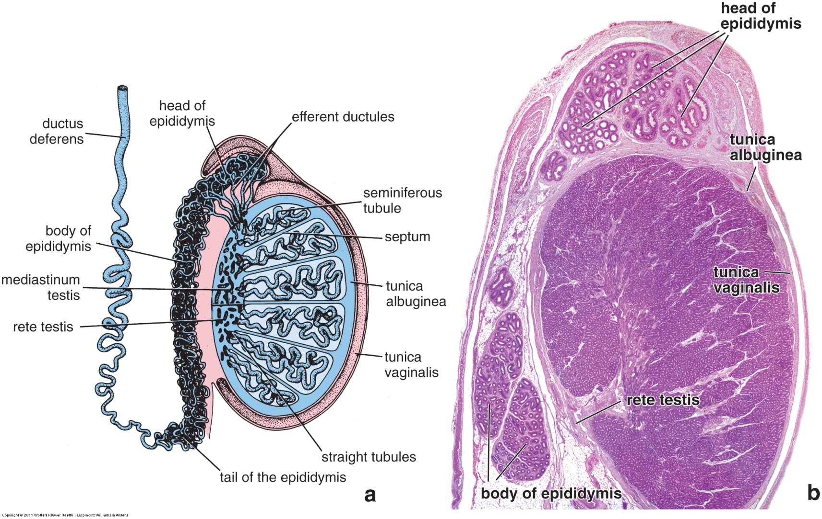
MALE REPRODUCTIVE SYSTEM
Posterior ← → anterior
Fluid is here
Each testis is bounded by an outer dense irregular connective tissue called the tunica albuginea (light blue). The posterior aspect of the tunica albuginea is thickened and is referred to as the mediastinum testis.
The testis is housed within the scrotum, surrounded on three sides (lateral and anterior) by the tunica vaginalis. The tunica vaginalis is like a sealed flat bag filled with a small amount of fluid; one side of the bag covers the tunica albuginea, so it is actually the outer epithelial lining of the testis (laterally and anteriorly), while the other side is the inner lining of the scrotum. This bag does not cover the posterior aspect of the testis, allowing tubules, blood vessels, and nerves to enter and exit the testis.

Slide 7
MALE REPRODUCTIVE SYSTEM
Posterior ← → anterior
If you inserted a needle in the direction of the blue arrow, you would pass through:
Skin of the scrotum (epidermis, dermis, the dartos muscle of the scrotum) → epithelium of outer layer of tunica vaginalis → fluid → epithelium of inner layer of tunica vaginalis → tunica albuginea → tissue containing seminiferous tubules

Slide 8
MALE REPRODUCTIVE SYSTEM
Each testis contains numerous seminiferous tubules; the inner lining of these tubules is an epithelium containing spermatogenic cells and supportive Sertoli cells. The seminiferous tubules are surrounded by loose connective tissue containing blood vessels and testosterone-secreting cells of Leydig.
As spermatozoa are released from the seminiferous tubules, the pathway they travel is:
Seminiferous tubules → straight tubules → rete testis → efferent ductules → epididymis → vas (ductus) deferens

Slide 9
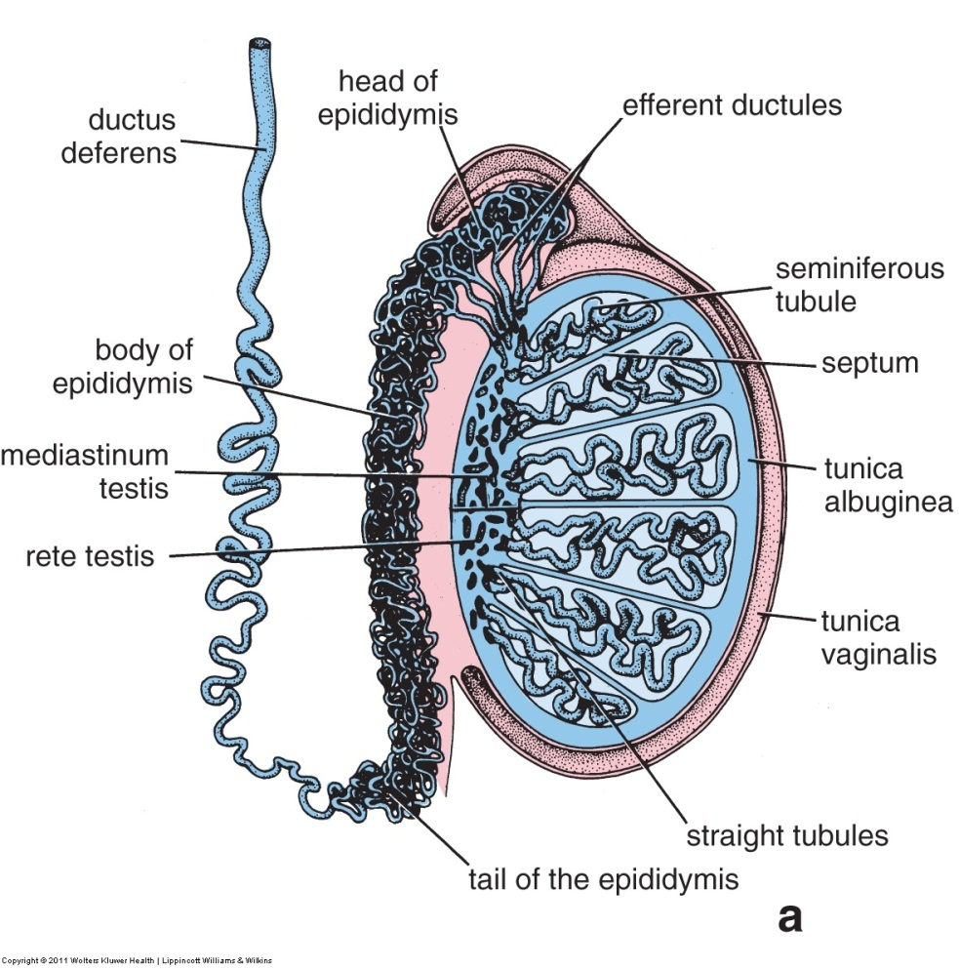
MALE REPRODUCTIVE SYSTEM
SL55
SL156
We have two slides of the testis and adjacent structures:
--SL55 includes the seminiferous tubules, the mediastinum testis containing the rete testis, and the epididymis
--SL156 includes the seminiferous tubules, efferent ductules, and epididymis
Neither slide includes the scrotum

Slide 10
MALE REPRODUCTIVE SYSTEM
OVERVIEW OF OUR TESTIS SLIDES
Video of testis slide overview – SL55
Video of testis slide overview – SL156
Link to SL 055 and SL 156
Be able to identify:
  Tunica albuginea
  Mediastinum testes
  Other structures generally, just to get oriented

Slide 11

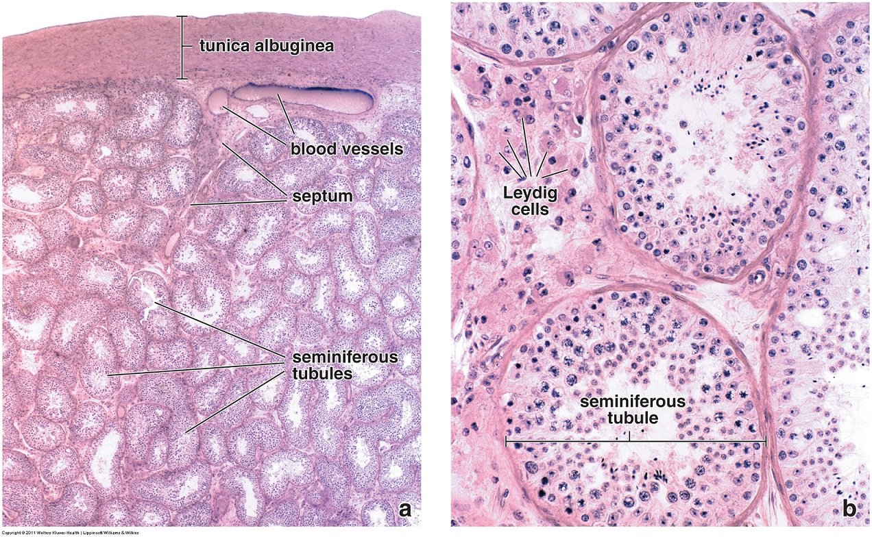
SEMINIFEROUS TUBULES
In these images of the testis, you can see that the seminiferous tubules consist of an epithelium, the basement membrane of which is indicated by the red arrows. The connective tissue between the tubules contains the steroid-secreting Leydig cells.

Slide 12
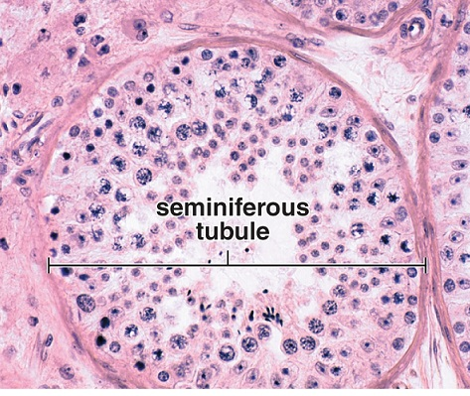
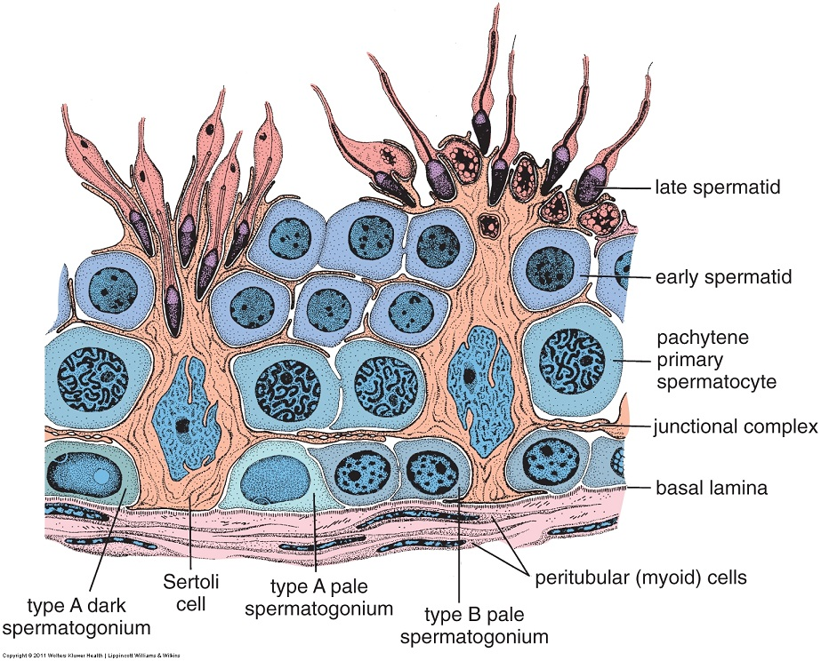
SEMINIFEROUS TUBULES
The drawing is an enlargement of the region within the rectangle. Note:
--developing spermatozoa, including spermatogonia, primary spermatocytes, and early and late spermatids (meiosis II progresses rapidly, so secondary spermatocytes are rarely seen)
--supportive Sertoli cells, the cytoplasm of which is extensive (shown in “orange”), and envelops the spermatogenic cells
--myoid cells adjacent to the basement membrane (basal lamina)

Slide 13
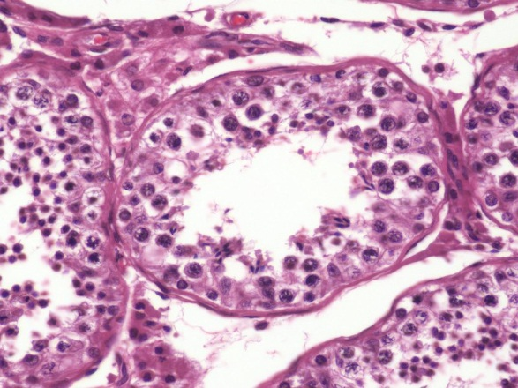

SEMINIFEROUS TUBULES – SERTOLI CELLS
Sertoli cytoplasm
Sertoli cells are characterized by their large euchromatic nucleus, with a prominent nucleolus, and extensive cytoplasm that spans from the basement membrane all the way to the lumen of the tubule. Their nuclei are usually positioned in the “second” row from the basement membrane (staggering of nuclei results in indistinct and uneven rows).
In the two pseudo-magnified images, the nuclear envelope (yellow arrow) and nucleolus (blue arrow) are indicated at the top, and at least part of the cytoplasm is between the dotted lines at the bottom.

Slide 14
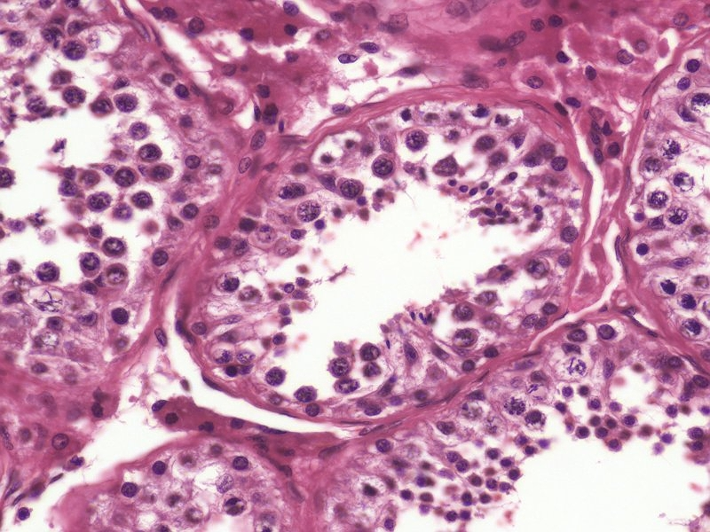
SEMINIFEROUS TUBULES – SERTOLI CELLS
The nuclei of Sertoli cells are often described as triangular or flame-shaped.
Two more Sertoli cells with “narrower” nuclei for your viewing pleasure.

Slide 15
SEMINIFEROUS TUBULES – SERTOLI CELLS
Video of Sertoli cells – SL156
Video of Sertoli cells – SL55
Link to SL 156 and SL 055
Be able to identify:
  Sertoli cells

Slide 16
SEMINIFEROUS TUBULES – DEVELOPING SPERMATOZOA
This is a reminder slide before looking at developing spermatogonia.
A quick review of mitosis, meiosis, and spermatozoa production:
Spermatogonium (diploid, 2N) – a cell that divides mitotically, produces progeny that enter meiosis
Primary spermatocytes (diploid, 4N) - a cell that has begun meiosis, i.e. is in meiosis I
Secondary spermatocyte (haploid, 2N) - a cell that has completed the first meiotic division, i.e. is in meiosis II
Spermatid (haploid, N) – a cell that has completed meiosis but has not transformed into a mature spermatozoon
Spermatozoa (haploid, N) - genetically identical to spermatids, but have undergone physical transformations including a streamlined appearance, production of a flagellum, an acrosome

Slide 17
SEMINIFEROUS TUBULES – DEVELOPING SPERMATOZOA
You don’t have to worry about differentiating type A and B spermatogonia, just recognize them as spermatogonia.
Spermatogonia are identified because they are adjacent to the basement membrane. Although the density of their nuclei varies somewhat, they lack a recognizable nucleolus, and do not have “clumpy” chromatin (see primary spermatocyte on the next slide).

Slide 18
SEMINIFEROUS TUBULES – DEVELOPING SPERMATOZOA
In these primary spermatocytes, you can see a thin rim of cytoplasm. Actually, the two on the right have a relatively large amount for primary spermatocytes.
Most developing spermatozoa have little cytoplasm, and, therefore, differentiating these cells from each other largely depends on the nuclear profile.
Primary spermatocytes are identified because they are on the luminal side of Sertoli cells, and have a larger nucleus than spermatogonia that contains “clumpy” chromatin.

Slide 19
SEMINIFEROUS TUBULES – DEVELOPING SPERMATOZOA
Spermatozoa are released into the lumen immediately upon maturation, therefore, they will be seen free within the lumen, and not part of the epithelium as are these spermatids. None are visible here, but you will see a lot of them in the epididymis.
When spermatids finish meiosis, they are small cells with small, round nuclei (black arrows). As they begin to mature into spermatozoa, they become smaller (blue arrows), and then narrower (green arrows); note that throughout all these stages, they are still officially spermatids.

Slide 20
SEMINIFEROUS TUBULES – DEVELOPING SPERMATOZOA
Notice the large number of spermatids in the left seminiferous tubule.
Complete spermatogenesis (from spermatogonia to mature spermatozoa) takes approximately 74 days in humans, and occurs in “waves” in different regions of the tubules. Therefore, it is not unusual to see a section with a large number of one cell type, and not all sections will demonstrate all cell types.
Another image with cells identified:
Spermatogonia – blue arrows
Primary spermatocytes – green arrows
Spermatids – outlined

Slide 21
SEMINIFEROUS TUBULES – DEVELOPING SPERMATOZOA
Video of developing spermatozoa – SL156
Video of developing spermatozoa – SL55
Link to SL 156 and SL 055
Be able to identify:
  Spermatogonia
  Primary spermatocytes
  Spermatids
  (secondary spermatocytes are not seen on our slides)
  Mature spermatozoa are better seen in the epididymis

Slide 22
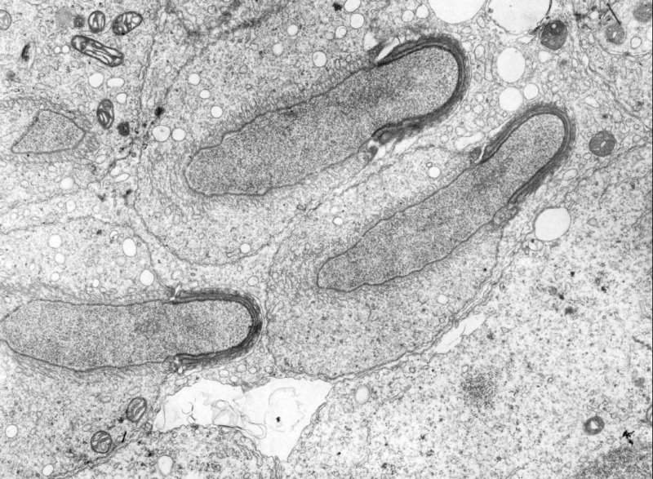
SEMINIFEROUS TUBULES – EM of SPERMATIDS
Spermatid cytoplasm
Sertoli cell cytoplasm
nucleus
Sertoli cell cytoplasm
This electron micrograph of a seminiferous tubule shows three spermatids, the nucleus and cytoplasm of one are indicated. The blue arrow indicates the acrosome, a lysosome-like vesicle that contains enzymes that break apart the corona radiata and zona pellucida surrounding the ovulated oocyte. Microtubules on the opposite end of the nucleus are beginning to organize into a manchette (outlined), which is likely involved in nuclear and cell elongation, and flagella formation, during spermatid maturation. Like all developing spermatozoa, the spermatids are surrounded by Sertoli cells.

Slide 23
SEMINIFEROUS TUBULES – MYOID CELLS
Myoepithelial cells (e.g. in the mammary glands) are also contractile and have a flattened nucleus. However, these cells arise from the epithelium, and, therefore, are on the epithelial side of the basement membrane.
The interstitial tissue of the testis contains myoid cells and Leydig cells. The myoid cells are specialized connective tissue cells that are similar to smooth muscle cells. They produce some of the extracellular components (e.g. collagen) of connective tissue, but also contract to produce mild peristaltic contractions to move mature spermatozoa toward the ducts.
Myoid cells are recognized by their flattened nuclei on the connective tissue side of the basement membrane.

Slide 24
SEMINIFEROUS TUBULES – LEYDIG CELLS
Leydig (interstitial) cells (outlined) secrete testosterone, a steroid hormone. Although steroid secreting cells are typically pale in H&E sections due to the removal of the lipid precursors on tissue preparation, Leydig cells are a notable exception. Although many are indeed pale, most exhibit a fairly intense cytoplasmic eosinophilia due to their extensive smooth endoplasmic reticulum.

Slide 25
SEMINIFEROUS TUBULES – MYOID and LEYDIG CELLS
Video of myoid cells and Leydig cells – SL156
Video of myoid cells and Leydig cells – SL55
Link to SL 156 and SL 055
Be able to identify:
  Myoid cells
  Leydig cells

Slide 26
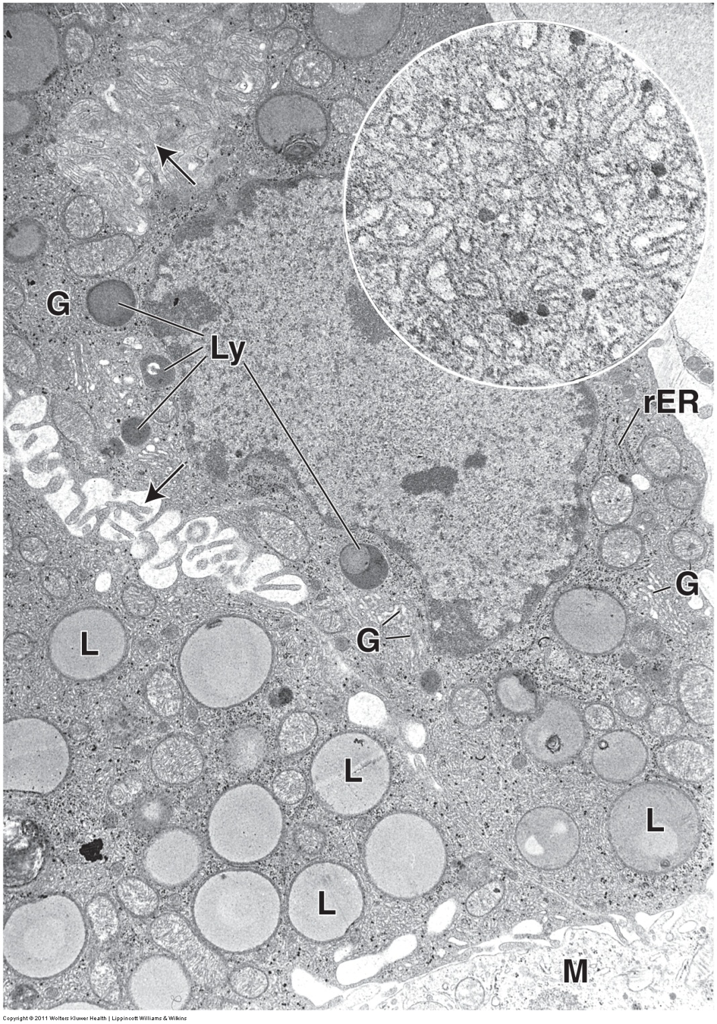
SEMINIFEROUS TUBULES – EM of LEYDIG CELLS
Leydig cells secrete testosterone, a steroid hormone. By now, you should expect that these cells have lipid droplets (L) which are the precursors for steroid production, as well as smooth endoplasmic reticulum (inset, note that the dense granules are mostly glycogen, and not ribosomes). The mitochondria (blue arrows) are small at this magnification; nevertheless, if you squint hard enough, you can tell that they contain tubular instead of shelf-like cristae.
Other cellular features are present, including rough endoplasmic reticulum (rER), Golgi (G), and several lysosomes (Ly). The black arrows indicate microvilli, the upper one showing a tangential cut through the edge of the cell, so the microvilli are not very clear. M is an adjacent macrophage.

Slide 27
TESTIS
How about a quick quiz before moving on to the ducts?

Slide 28
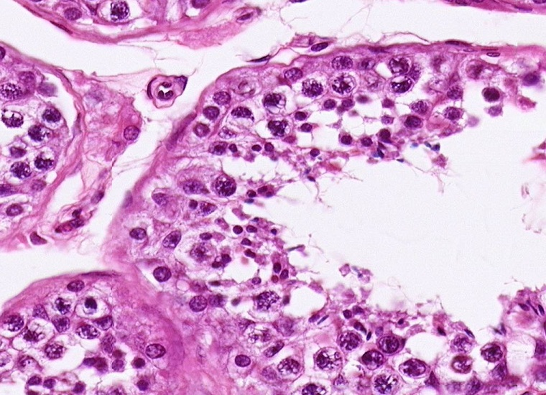
quiz
Self-check: Identify the cell indicated by the arrow. (advance slide for answers)
Myoid cell

Slide 29
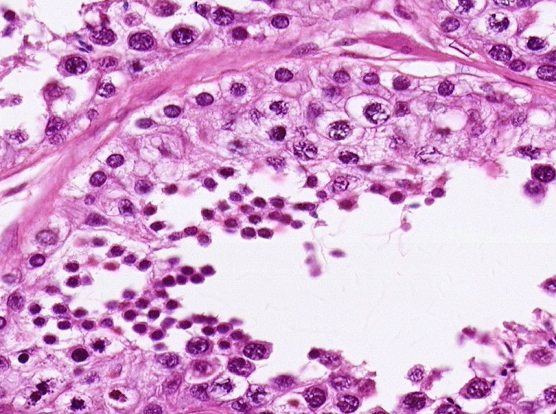
quiz
Self-check: Identify the cells indicated by the arrows. (advance slide for answers)
Primary spermatocytes

Slide 30
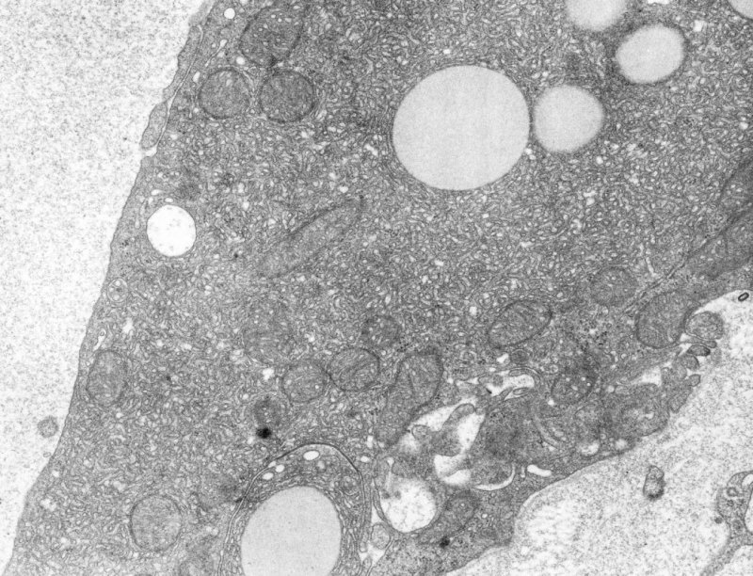
quiz
Self-check: This was taken from the testis. Identify the predominant cell. (advance slide for answers)
Leydig cell

Slide 31
quiz
Self-check: Identify the cells indicated by the arrows. (advance slide for answers)
spermatids

Slide 32
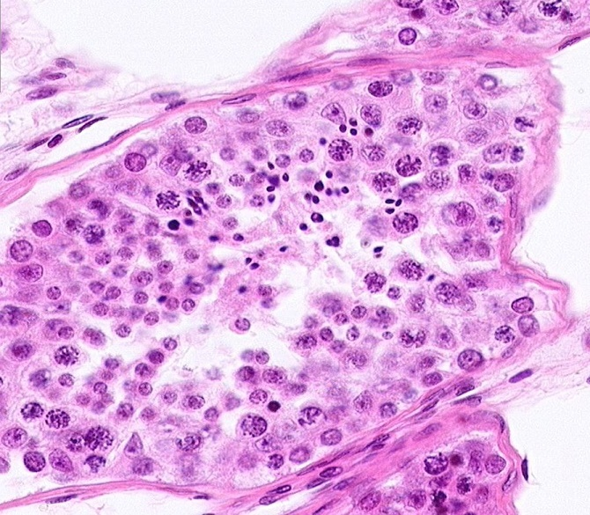
quiz
Self-check: Identify the cells indicated by the arrows. (advance slide for answers)
Sertoli cells

Slide 33
quiz
Self-check: Identify the cells indicated by the arrows. (advance slide for answers)
spermatogonia

Slide 34
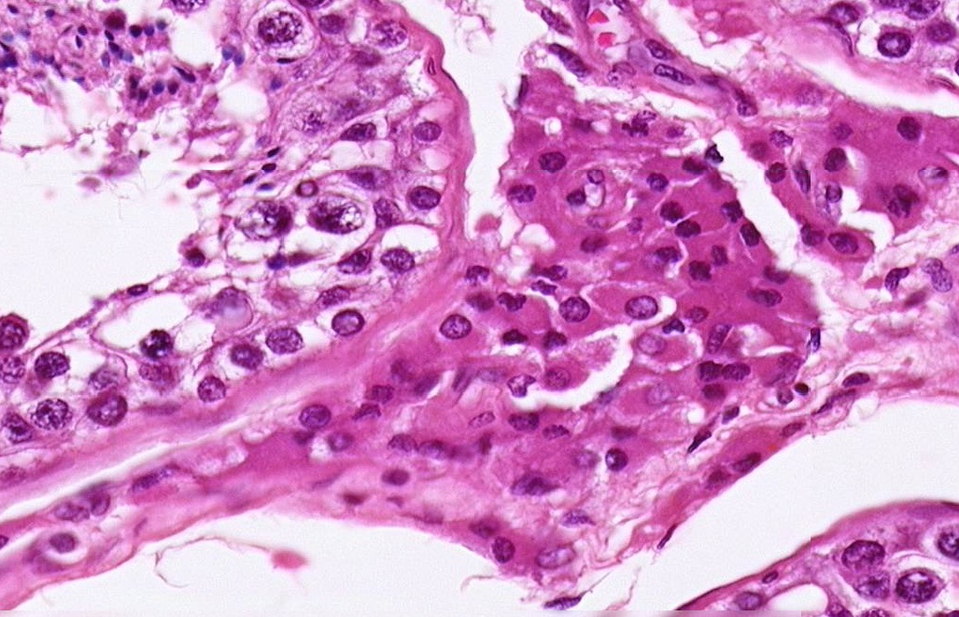
quiz
Self-check: Identify the cells in the outlined region. (advance slide for answers)
Leydig cells

Slide 35
MALE REPRODUCTIVE SYSTEM - DUCTS
Another reminder slide, this time reminding you of the duct system.
Each testis contains numerous seminiferous tubules; the inner lining of these tubules is an epithelium containing developing spermatozoa and supportive Sertoli cells. The seminiferous tubules is surrounded by loose connective tissue containing blood vessels and testosterone-secreting cells of Leydig.
As spermatozoa are released from the seminiferous tubules, the pathway they travel is:
Seminiferous tubules → straight tubules → rete testis → efferent ductules → epididymis → vas (ductus) deferens

Slide 36

MALE REPRODUCTIVE SYSTEM – RETE TESTIS
The rete testis are tubes within the mediastinum testis. They are an anastomosing network of wide-diameter tubes, lined by cuboidal epithelium. Because they are in the mediastinum testes, which is part of the tunica albuginea, the rete testis are embedded in a dense connective tissue.

Slide 37
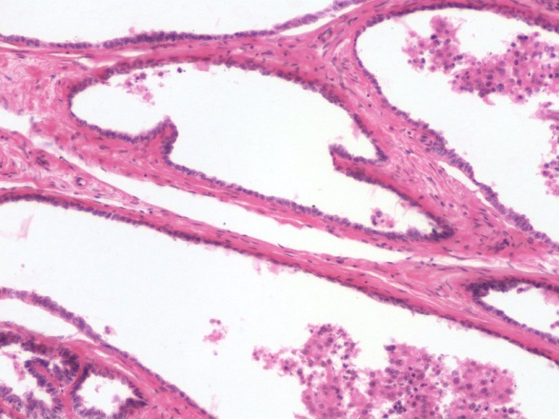
MALE REPRODUCTIVE SYSTEM – RETE TESTIS
The rete testis are interconnecting channels within the mediastinum testis, lined by cuboidal epithelium. Because they are in the mediastinum testes, which is part of the tunica albuginea, the rete testis are embedded in a dense connective tissue.

Slide 38
MALE REPRODUCTIVE SYSTEM – STRAIGHT TUBULES
The seminiferous tubules are connected to the rete testis by VERY short tubes called straight tubules, aka tubuli recti (orange arrows). These tubules are lined by Sertoli cells (i.e. they are essentially seminiferous tubules that have “lost” their meiotic cells).

Slide 39
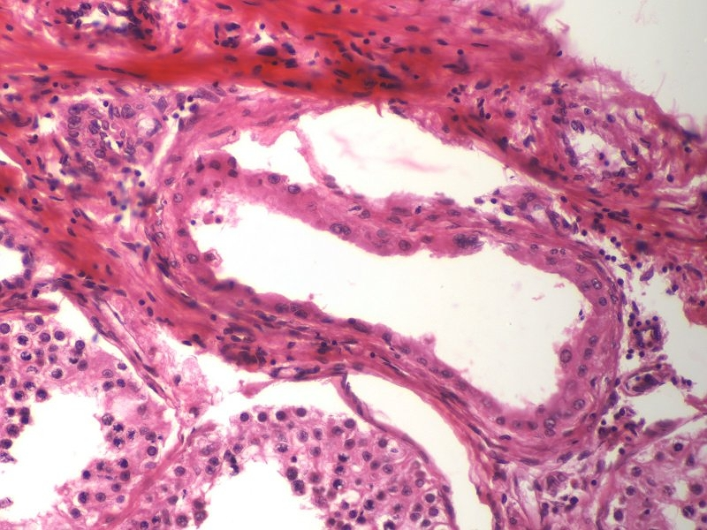
MALE REPRODUCTIVE SYSTEM – STRAIGHT TUBULES
I have searched far and wide for an image like this to use for an exam, and haven’t found one yet. Such a shame.
straight tubule
ST
ST
In this fortuitous image, two seminiferous tubules (ST) are in the lower left, and the mediastinum testis is in the upper right (not shown). In the middle is a straight tubule. Note it is lined by Sertoli cells, cubiodal cells with eosinophilic cytoplasm, many of them display the characteristic prominent nucleolus.

Slide 40
MALE REPRODUCTIVE SYSTEM
Yet another reminder slide, this time showing the orientation of the two slides we have in our slide set.
We need to look at SL55 to find the rete testis and straight tubules.
SL55
SL156
We have two slides of the testis and adjacent structures:
--SL55 includes the seminiferous tubules, the mediastinum testis containing the rete testis, and the epididymis
--SL156 includes the seminiferous tubules, efferent ductules, and epididymis
Neither slide includes the scrotum

Slide 41
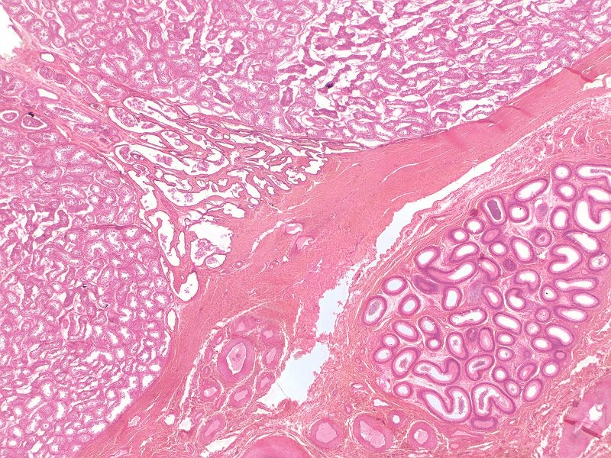
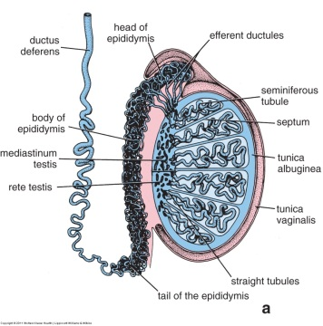
MALE REPRODUCTIVE SYSTEM – RETE TESTIS
ST
TA
SL55
RT
Epi
ST
To find the rete testis and straight tubules on slide 55, a little orientation to what you will see is helpful.
ST – seminiferous tubules
RT – rete testis within mediastinum testis
TA – tunica albuginea
Epi - epididymis
If you are extremely lucky, straight tubules may be found at the edges of the mediastinum testis (i.e. between ST and RT, in the area of the black arrows)

Slide 42

MALE REPRODUCTIVE SYSTEM – RETE TESTIS
SL55
Video of rete testis – SL55
Link to SL 055
Be able to identify:
  Rete testis
  Straight tubules (if you’re a gunner)

Slide 43
MALE REPRODUCTIVE SYSTEM – EFFERENT DUCTULES
The efferent ductules connect the rete testis to the epididymis. Because these ductules are outside the mediastinum testis, they are surrounded by a dense connective tissue that is not as compact as that which surrounds the rete testis.

Slide 44
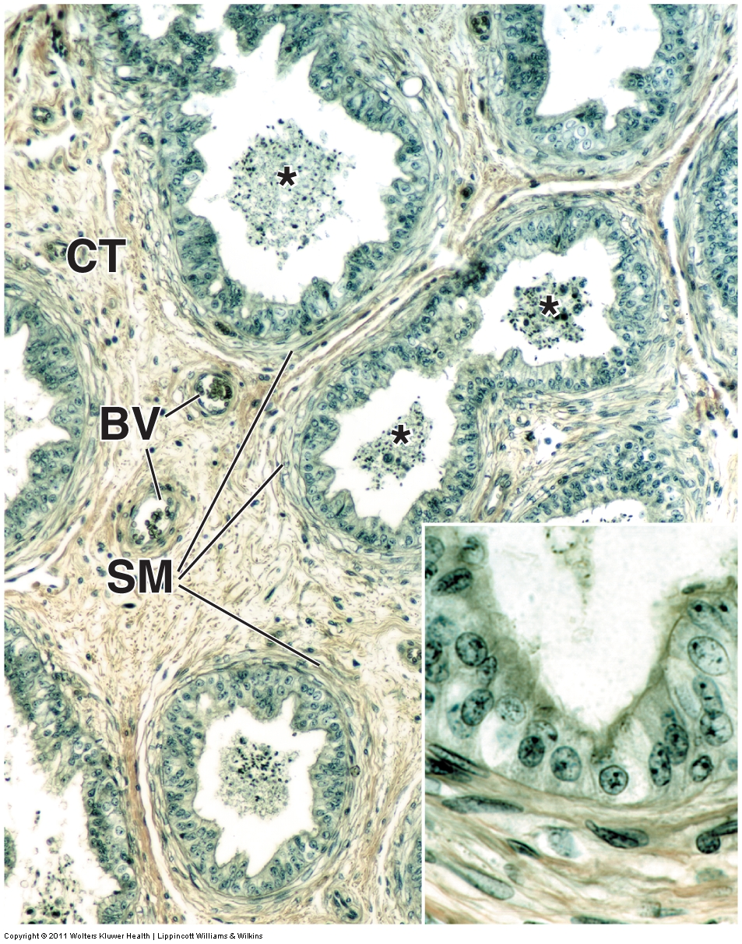
MALE REPRODUCTIVE SYSTEM – EFFERENT DUCTULES
The efferent ductules are lined by a pseudostratified epithelium. However, the cells here alternate between tall ciliated cells and shorter cells with microvilli, giving the epithelium a characteristic undulating appearance. Each tubule is supported by a thin layer of smooth muscle (SM), and a dense irregular connective tissue (CT).
Efferent ductules resorb most of the fluid produced by the seminiferous tubules. Movement of spermatozoa is assisted by both the cilia and peristaltic movements of the smooth muscle.
BV – blood vessels
* - clumps of spermatozoa

Slide 45
MALE REPRODUCTIVE SYSTEM – EPIDIDYMIS
The epididymis receives spermatozoa from the efferent ductules, and is the major site for storage of sperm between ejaculations. Final maturation of the spermatozoa, notably motility, occurs in the epididymis. The regions of the epididymis, head, body, tail, are similar in histological sections.

Slide 46
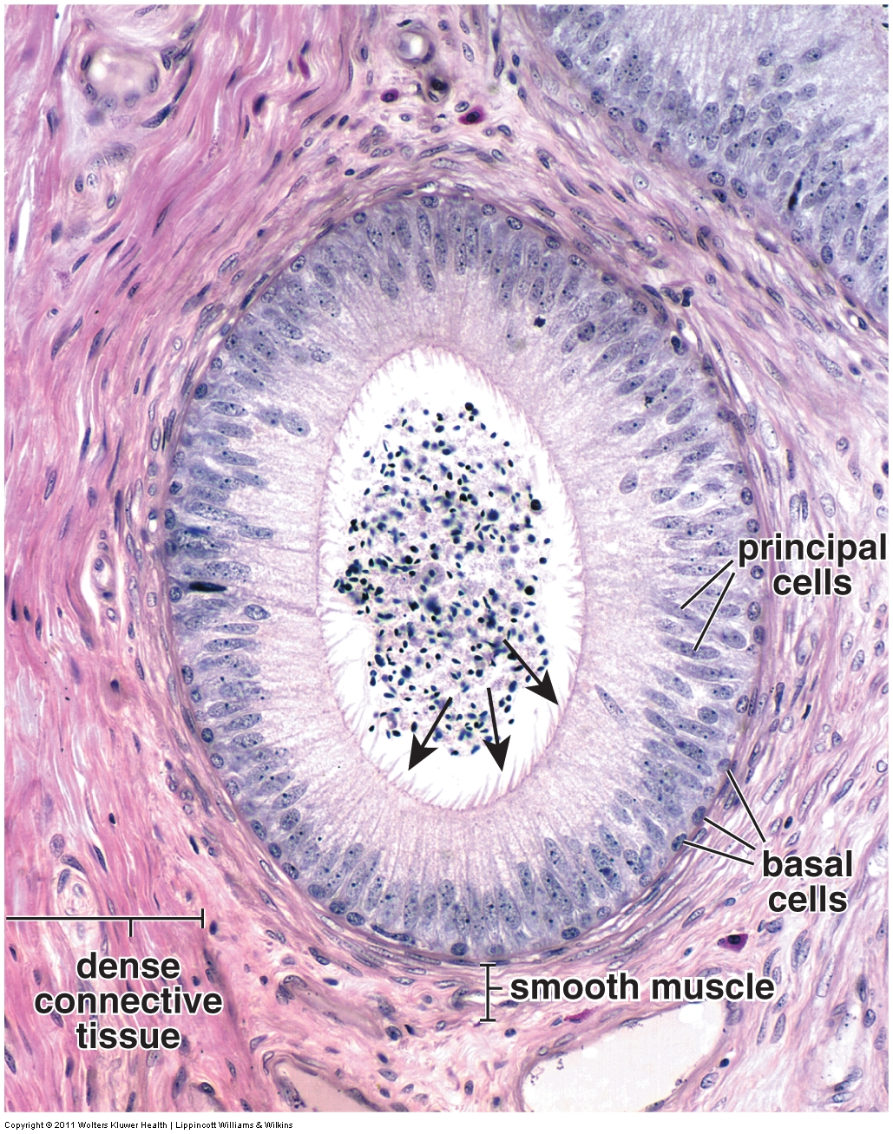
MALE REPRODUCTIVE SYSTEM – EPIDIDYMIS
Like the efferent ductules, the epididymis is also lined by a pseudostratified epithelium. Here, the apical (principal) cells are all very tall columnar, giving the apical edge an even appearance. These cells also have stereocilia (arrows). The epididymis is also supported by a thin layer of smooth muscle and a dense connective tissue.

Slide 47
MALE REPRODUCTIVE SYSTEM
Our reminder slide again.
We need to look at SL156 to compare the efferent ductules to the epididymis. SL55 also has the epididymis for your viewing pleasure.
SL55
SL156
We have two slides of the testis and adjacent structures:
--SL55 includes the seminiferous tubules, the mediastinum testis containing the rete testis, and the epididymis
--SL156 includes the seminiferous tubules, efferent ductules, and epididymis
Neither slide includes the scrotum

Slide 48
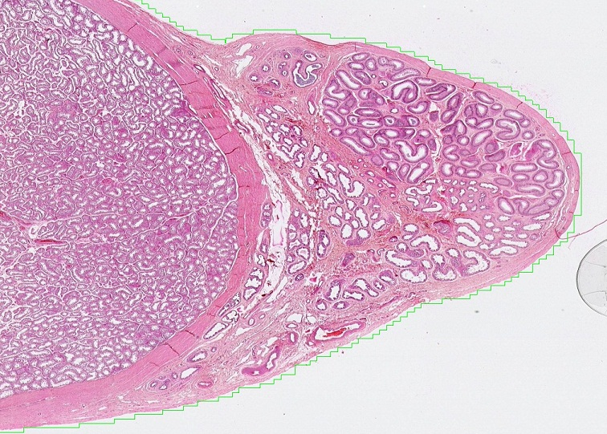
MALE REPRODUCTIVE SYSTEM – RETE TESTIS
TA
Epi
ST
SL156
ED
Note the orientation of the slide is different from the drawing.
To find the efferent ductules and epididymis on slide 156, a little orientation to what you will see is helpful.
ST – seminiferous tubules
TA – tunica albuginea
ED – efferent ductules
Epi - epididymis

Slide 49
MALE REPRODUCTIVE SYSTEM – EFFERENT DUCTULES and EPIDIDYMIS
Video of efferent ductules and epididymis – SL156
SL156
Note the orientation of the slide is different from the drawing.
Link to SL 156 and SL 055 (epididymis only)
Be able to identify:
  Efferent ductules
  Epididymis

Slide 50
MALE REPRODUCTIVE SYSTEM – VAS DEFERENS
During arousal, the vas (ductus) deferens propels spermatozoa from the epididymis to the prostatic urethra.

Slide 51
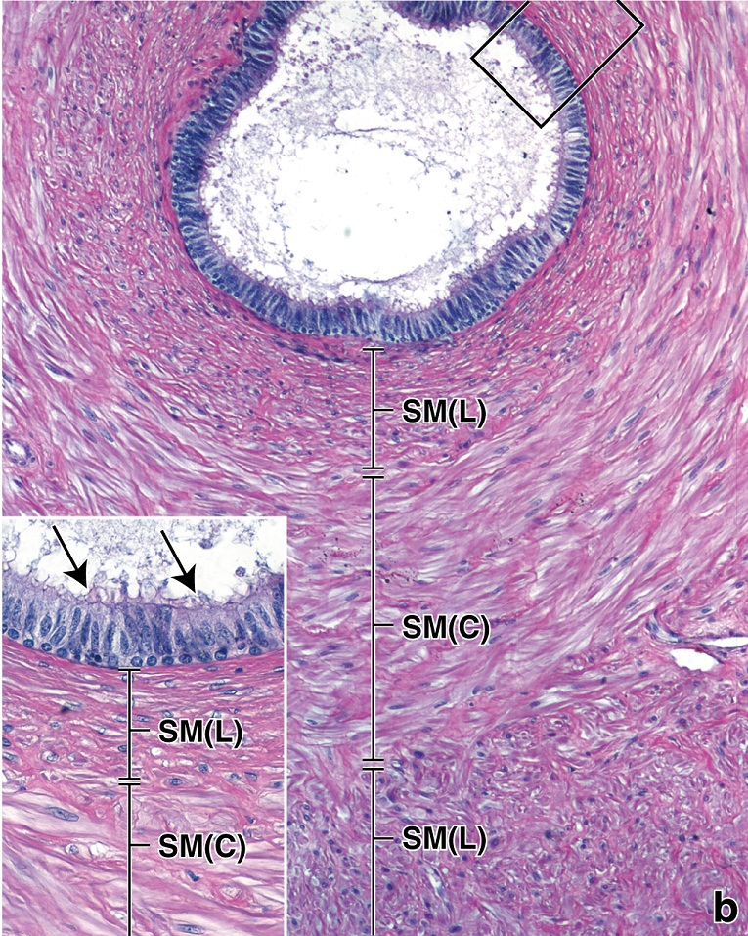
MALE REPRODUCTIVE SYSTEM – VAS DEFERENS
The epithelium of the vas (ductus) deferens is quite similar to the epididymis; pseudostratified, with cuboidal basal cells and tall principal cells with stereocilia. There are three features that differentiate the vas deferens from the epididymis and efferent ductules:
The stereocilia are typically shorter, and the cells not as tall, as those found in the epididymis.
The epithelium contains a few longitudinal ridges (arrows). Note that these are fewer, larger folds, as opposed to the numerous smaller undulations of the efferent ductules.
The wall is composed of three layers of thick smooth muscle, responsible for the peristaltic action that propels sperm toward the prostatic urethra during arousal. These muscle layers are oriented as inner and outer longitudinal (L) layers, with a middle circular (C) layer.

Slide 52
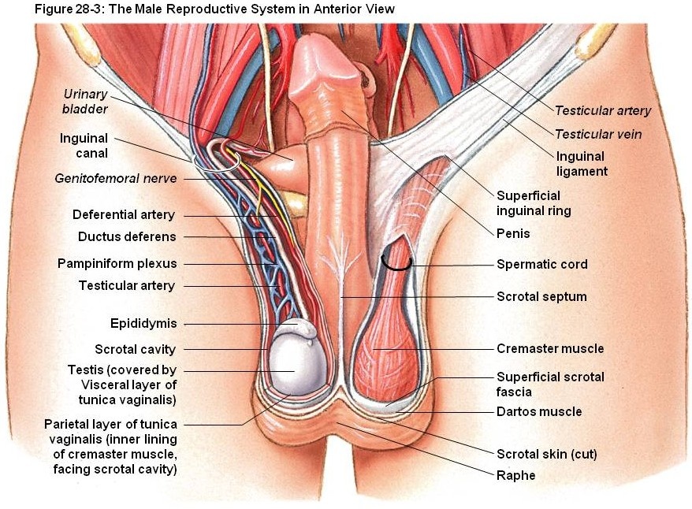
MALE REPRODUCTIVE SYSTEM – VAS DEFERENS
Much of the vas (ductus) deferens is within the spermatic cord, which contains a testicular artery, numerous veins called the pampiniform plexus of veins, nerves, skeletal muscle called the cremaster muscle, and supporting connective tissue and coverings.

Slide 53
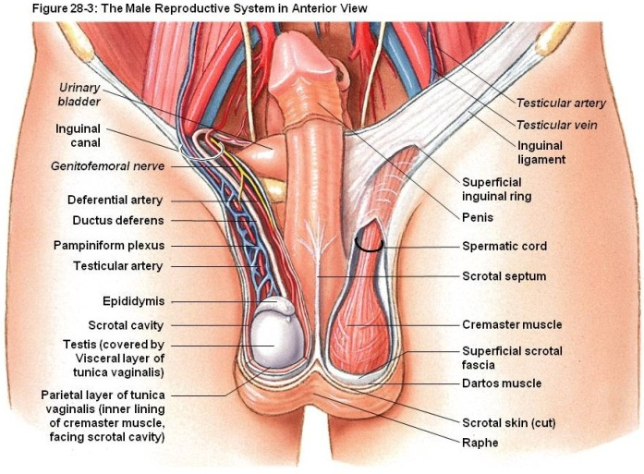
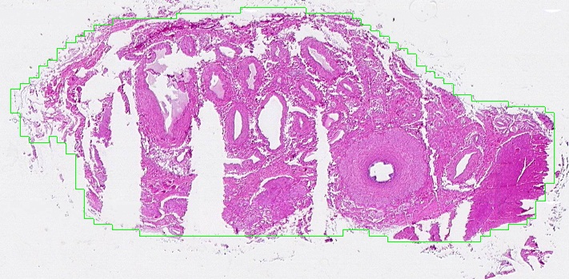
MALE REPRODUCTIVE SYSTEM – VAS DEFERENS
TA
CM
Our slides are from the spermatic cord:
The vas (ductus) deferens is outlined in yellow.
The cremasteric muscle (CM) is a skeletal muscle, specifically named based on its location here. You will be studying skeletal muscle in the spring, so only a brief glance at it now is necessary.
The testicular artery (TA) is surrounded by numerous veins of the pampiniform plexus. Again, since you have not studied blood vessels yet, a cursory glance at these structures is given here.

Slide 54
MALE REPRODUCTIVE SYSTEM – VAS DEFERENS
Video of vas deferens – SL47
Video of vas deferens, trichrome stain – SL159
Link to SL 047 and SL 159
Be able to identify:
  Vas (ductus) deferens
  For gunners, spermatic cord, cremaster muscle, testicular artery, pampiniform plexus of veins

Slide 55
The next set of slides is a quiz for this module. You should review the structures covered in this module, and try to visualize each of these in light and electron micrographs.
Identify, at the light microscope level, each of the following:
Testis
  Regions
    Tunica albuginea
    Mediastinum testis
    Seminiferous tubules
  Cell types
    Germ cells
      Spermatogonia
      Primary spermatocytes
      Secondary spermatocytes not seen on our slides
      Spermatids
      Spermatozoa
    Sertoli cells
    Interstitial cells of Leydig (Leydig cells)
    Myoid cells
  Ducts within testis
    Straight tubules
    Rete testis
    Efferent ductules
  Epididymis
  Vas deferens (ductus deferens)
  (within spermatic cord, cord includes cremaster muscle, testicular artery and pampiniform plexus of veins)
Identify, at the electron microscope level, each of the following:
  Spermatid
    Acrosome
    Manchette
  Sertoli cell
Leydig cell

Slide 56
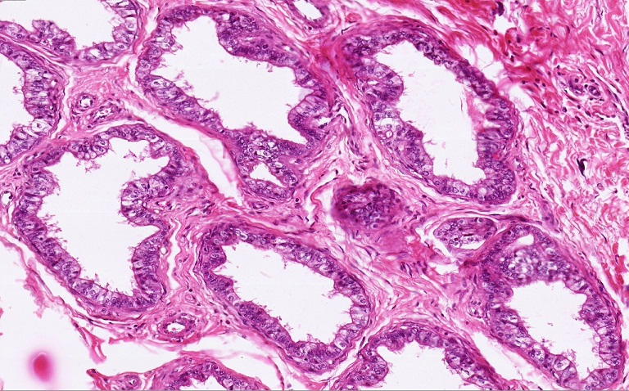
Final quiz
Self-check: Identify the structures on this slide. (advance slide for answers)
Efferent ductules

Slide 57
Final quiz
Self-check: Identify the cells indicated by the arrows. (advance slide for answers)
Sertoli cells

Slide 58
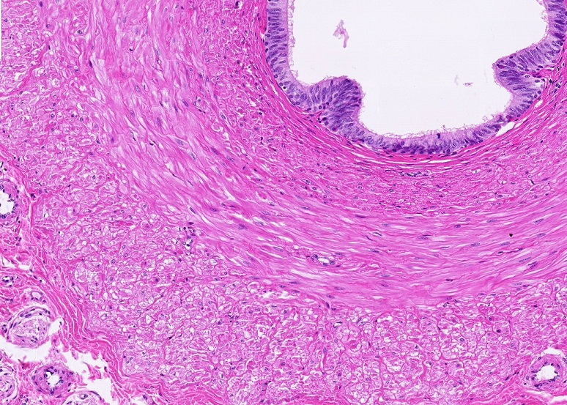
Final quiz
Self-check: Identify the structure. (advance slide for answers)
Vas deferens

Slide 59
Final quiz
Self-check: Identify the cells indicated by the arrows. (advance slide for answers)
spermatids

Slide 60
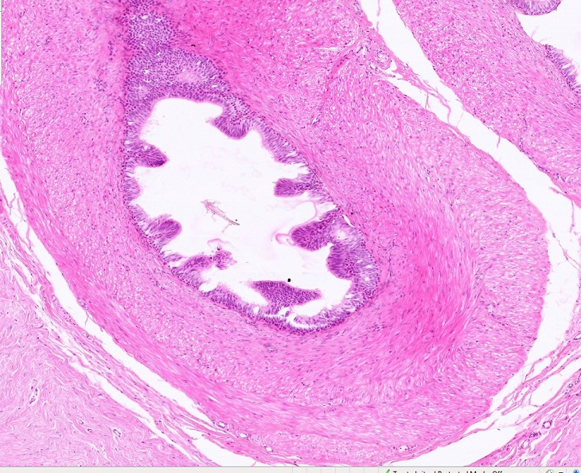
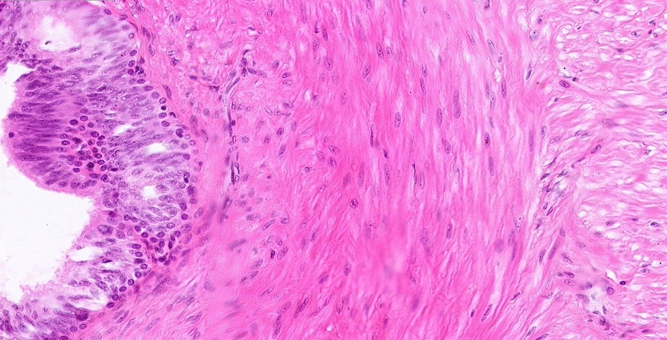
Final quiz
Self-check: Identify the structure. (advance slide for answers)
Vas deferens

Slide 61
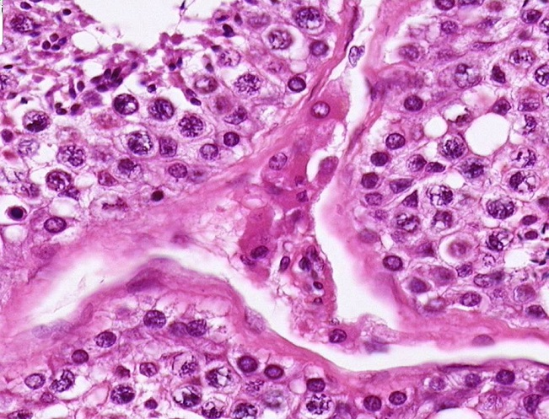
Final quiz
Self-check: Identify the cells indicated by the arrows. (advance slide for answers)
Leydig cells

Slide 62
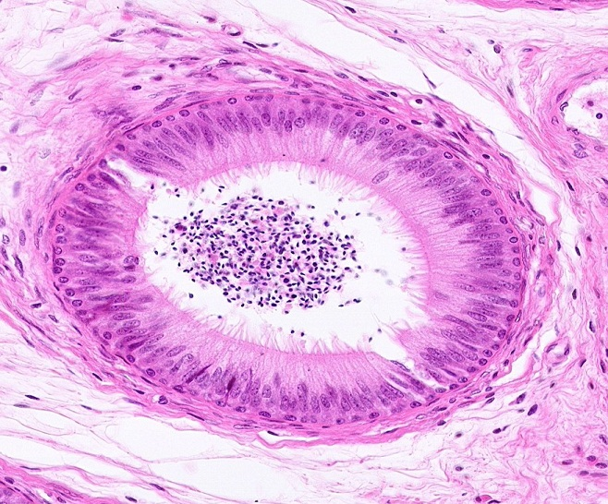
Final quiz
Self-check: Identify the structure. (advance slide for answers)
epididymis

Slide 63
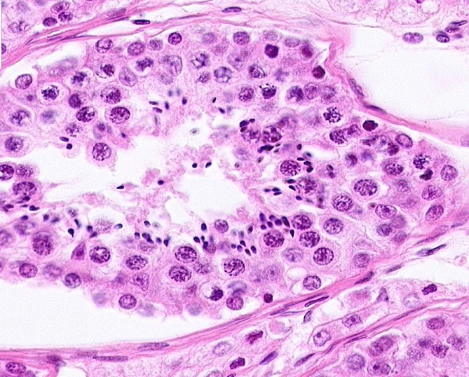
Final quiz
Self-check: Point to a Sertoli cell. (advance slide for answers)
I think I have all the obvious ones. There are a few more that are out of focus, so we can’t say for sure.

Slide 64
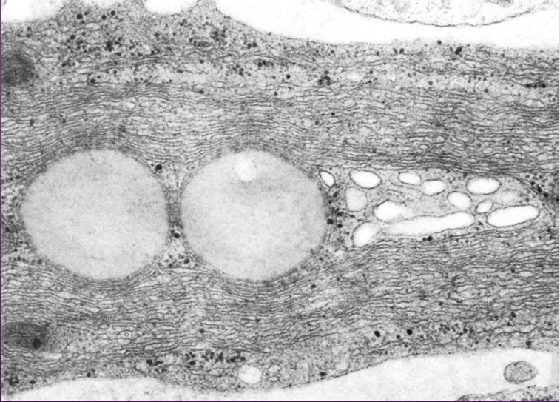
Final quiz
Self-check: In this image from the male reproductive system, identify the predominant cell. (advance slide for answers)
Leydig cell

Slide 65
Final quiz
Self-check: Identify the cells indicated by the arrows. (advance slide for answers)
spermatogonia

Slide 66
Final quiz
Self-check: Identify the cells indicated by the arrows. (advance slide for answers)
Myoid cells

Slide 67
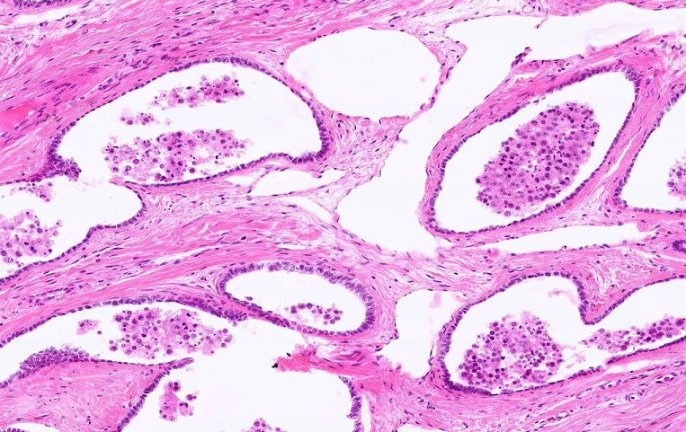
Final quiz
Self-check: Identify the structure. (advance slide for answers)
Rete testis

Slide 68
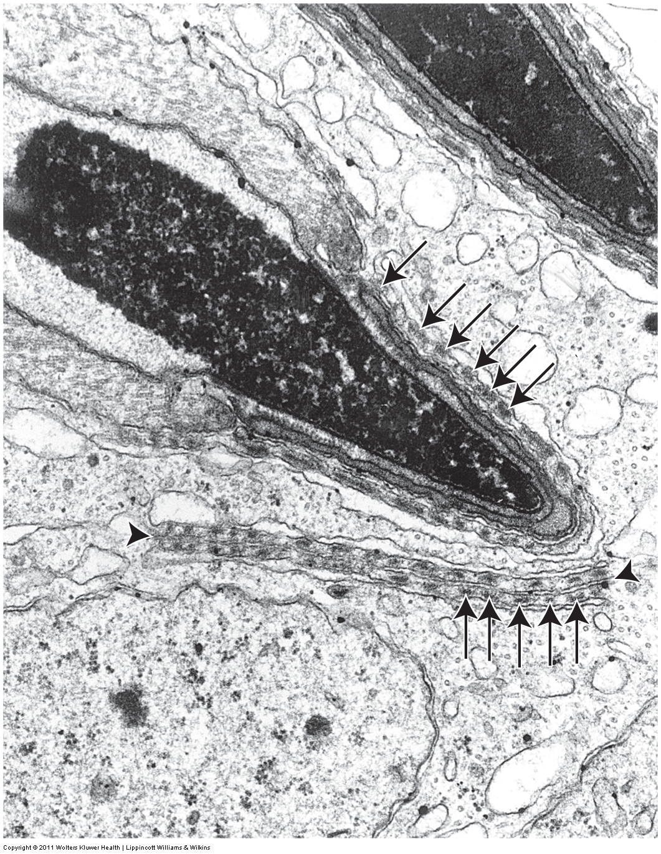
Final quiz
Self-check: Identify the structures and cells X and Y. (ignore black arrows and black arrowhead, advance slide for answers)
X
Y
X = spermatid
Y = Sertoli cell
red arrows = acrosome
Outlined regions = developing manchette

Slide 69
Final quiz
Self-check: Identify the cells indicated by the arrows. (advance slide for answers)
Primary spermatocytes

Slide 70
Final quiz
Self-check: Identify the cells in the outlined region. (advance slide for answers)
spermatids

Slide 71
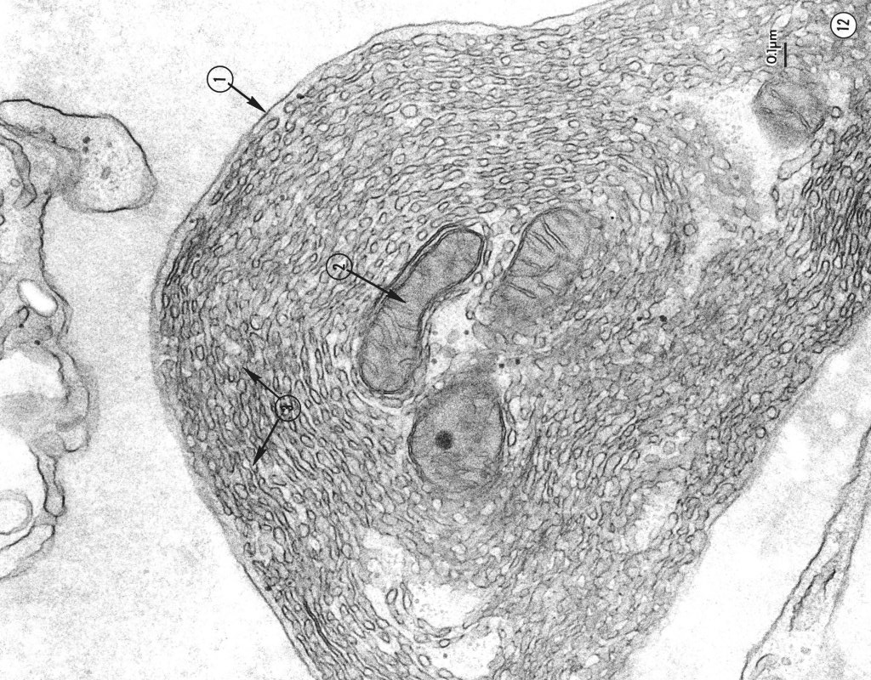
Final quiz
Self-check: This was taken from the male reproductive system. Identify the predominant cell. (advance slide for answers)
Leydig cell

Slide 72
Final quiz
Self-check: Identify the cells indicated by the arrows. (advance slide for answers)
spermatogonia

Slide 73
Final quiz
Self-check: Identify the cells indicated by the arrows. (advance slide for answers)
Primary spermatocytes

Slide 74
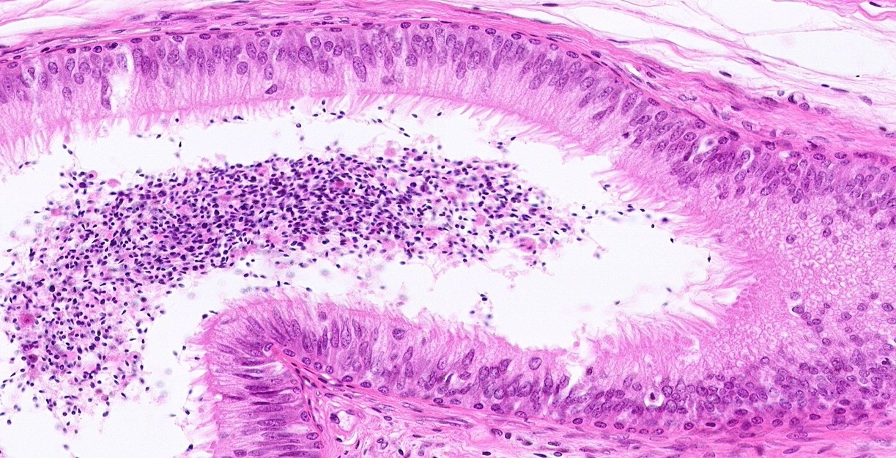
Final quiz
Self-check: Identify the structure. (advance slide for answers)
epididymis
Note mature spermatozoa here

Slide 75
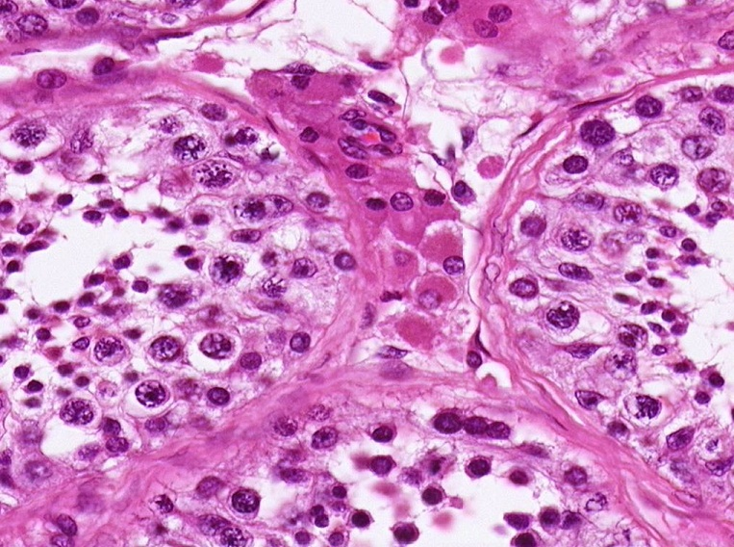
Final quiz
Self-check: Identify the cells in the outlined region. (advance slide for answers)
Leydig cells

Slide 76
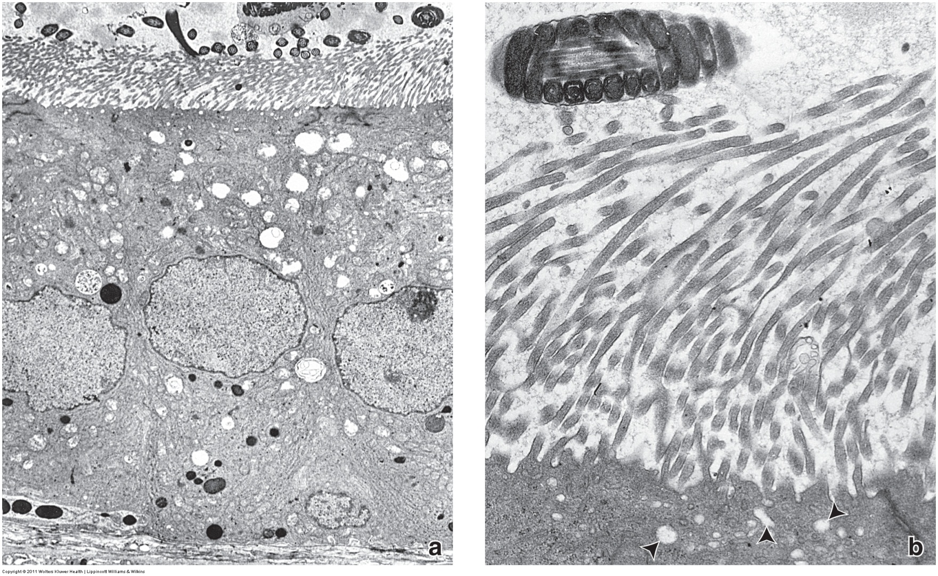
Final quiz
Self-check: Both of these were taken from the same structure in the male reproductive system. Which of the following are the most likely source of these images? (advance slide for answers)
Seminiferous tubule Straight tubule Rete testis
Efferent duct Epididymis Vas deferens
epididymis and/or vas deferens (efferent duct is possible, but less likely)

Slide 77
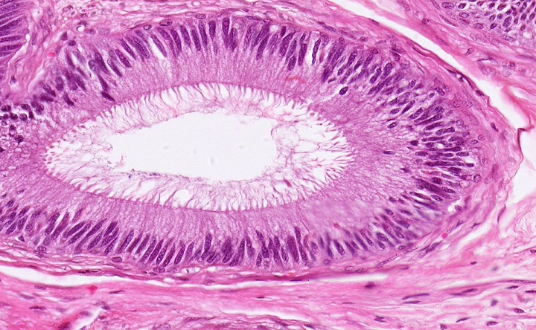
Final quiz
Self-check: Identify the structure. (advance slide for answers)
epididymis

Slide 78
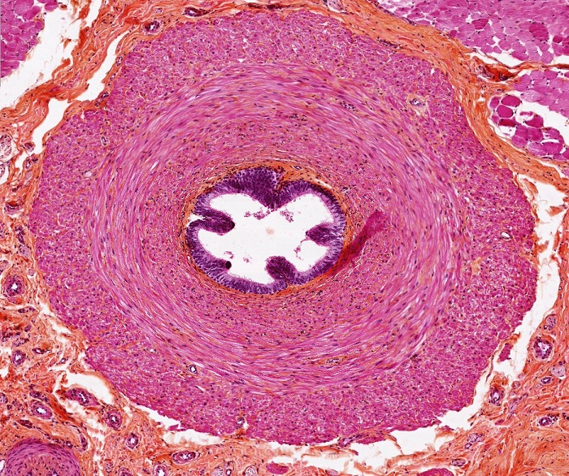
Final quiz
Self-check: Identify the structure. (advance slide for answers)
Vas deferens

Slide 79
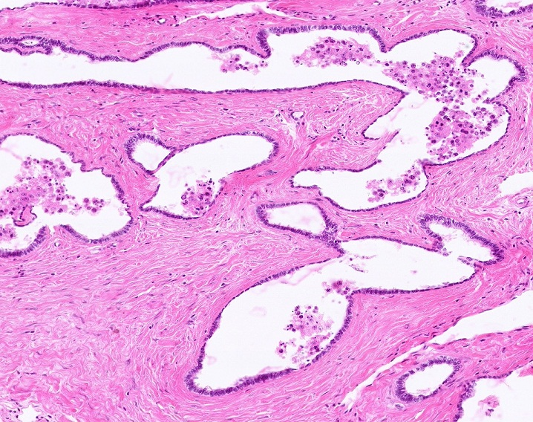
Final quiz
Self-check: Identify the structure. (advance slide for answers)
Rete testis

Slide 80
Final quiz
Self-check: Identify the structure at X (advance slide for answers)
Lipid droplet
X

Slide 81
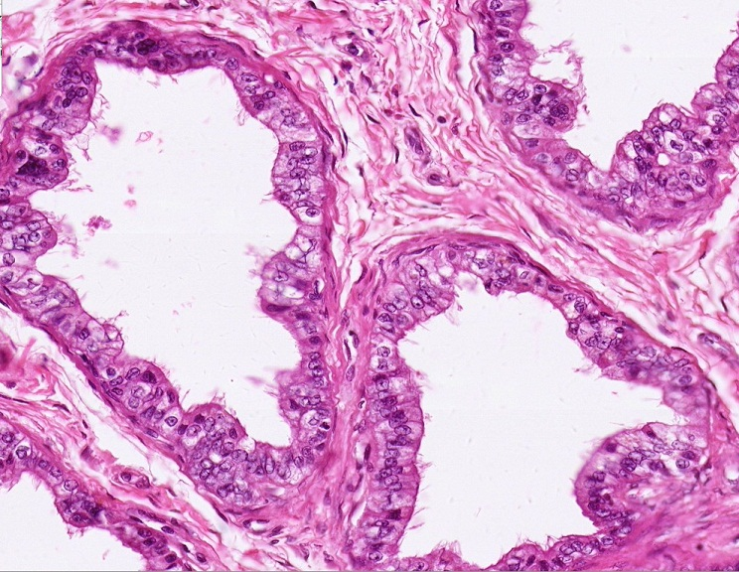
Final quiz
Self-check: Identify the structures on this slide. (advance slide for answers)
Efferent ductules

Slide 82
Final quiz
Self-check: Identify the cells indicated by the arrows. (advance slide for answers)
Sertoli cells

Slide 83
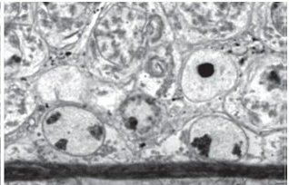
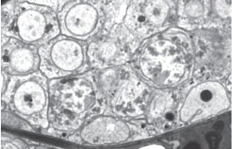
Final quiz
Self-check: In this image from the seminiferous tubules, identify cells A-C. (advance slide for answers)
A = Sertoli cells
B = primary spermatocytes
C = spermatogonia
D = spermatids
Kind of a gunner slide since you didn’t see this before.
B
A
C
D
D
B
A
C

