Slide 1

Skeletal Muscle
Digital Laboratory
It’s best to view this in Slide Show mode, especially for the quizzes.
This module will take approximately 75 minutes to complete.
The quiz for this module is long, and includes significant previous material from this and other blocks.
Lowrie

Slide 2
After completing this exercise, you should be able to:
identify, at the light microscope level, each of the following:
  Skeletal muscle
  Myofibers (muscle fibers, muscle cells)
  Myofibrils
  Fascicle
  Endomysium
  Perimysium
  Epimysium
  Bands and lines seen in skeletal muscle
  A band
  I band
  H band
  Z line
  M line
  Sarcomere
identify, at the electron microscope level, each of the following:
  Skeletal muscle
  Myofibers (muscle fibers, muscle cells)
  Myofibrils
  Myofilaments
  Thick filaments
  Thin filaments
  Sarcolemma
  Bands and lines noted above for light microscopy
  Glycogen and Mitochondria
  FYI…
  (Sarcoplasmic reticulum)
  (Triad)
  (Terminal cisternae of sarcoplasmic reticulum (x2))
  (Transverse tubule (T-tubule) (x1))

Slide 3
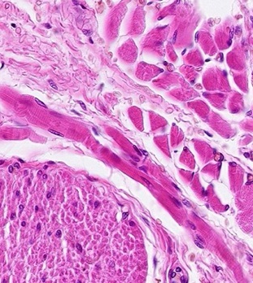
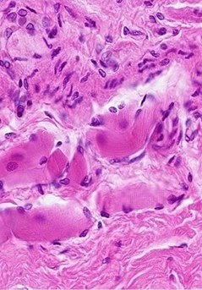
SKELETAL MUSCLE & SMOOTH MUSCLE
Recall that in the Fundamentals block, we had mini-modules on skeletal and smooth muscle so that you could recognize these tissues on slides from that block. The next 12 slides are from the portion describing skeletal muscle and comparing it to smooth muscle and dense irregular connective tissue. I recommend that you review these now. However, if you’re absolutely sure you can recognize these no problem in light micrographs and slides (I have provided examples for your viewing pleasure), you can click here to skip them. Otherwise, proceed as normally.
Hint: If you are hoping for answers to what you’re looking at, then you aren’t 100% certain, and you probably should go through the slides.
FYI, a technical note: When looking at these slides now, I had the notion to make minor changes in them to fit the module that I am creating for this block. However, if I did so, then everyone would feel they had to go through them to see what I changed. Therefore, I am leaving these 12 slides completely intact as they were. Because of this, some of the statements may seem out of context for today’s assignment.

Slide 4
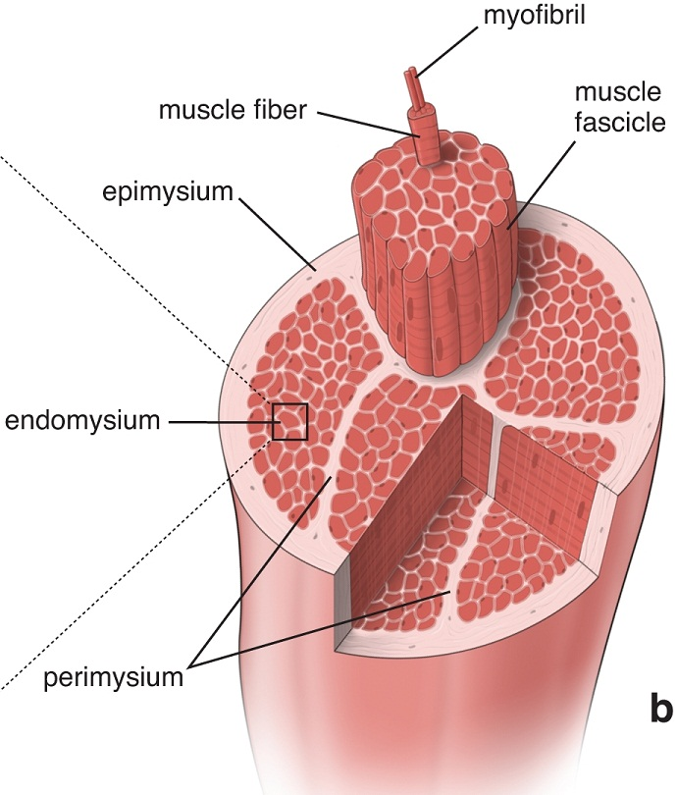
SKELETAL MUSCLE
Muscles like the biceps brachii are composed of skeletal muscle cells bundled in connective tissue sheaths; this organization is similar to the bundling of axons in nerves. The details of the organization of the sheaths is not relevant here.
What is important to appreciate now is that skeletal muscle cells are very large, both in length and diameter, and are called muscle fibers. In a muscle, the muscle fibers are all arranged in the same orientation.
Also note that each muscle fiber (cell) is packed with longitudinal structures called myofibrils, which are composed of contractile proteins.

Slide 5
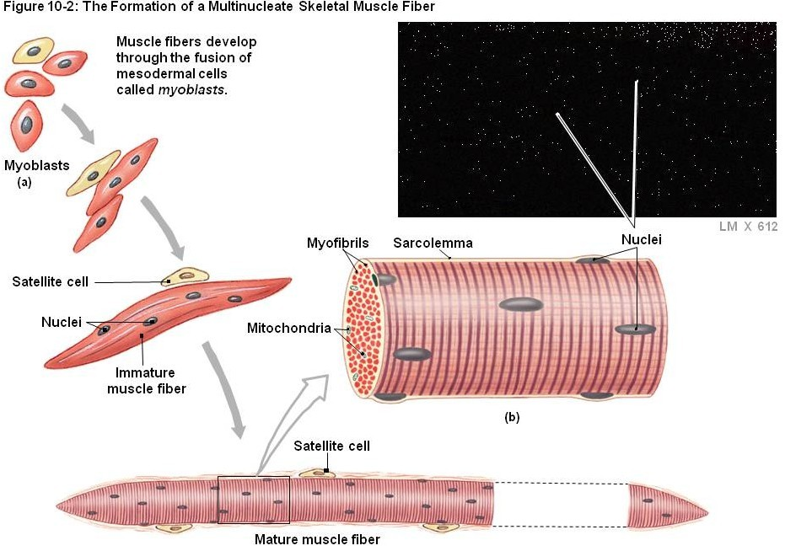
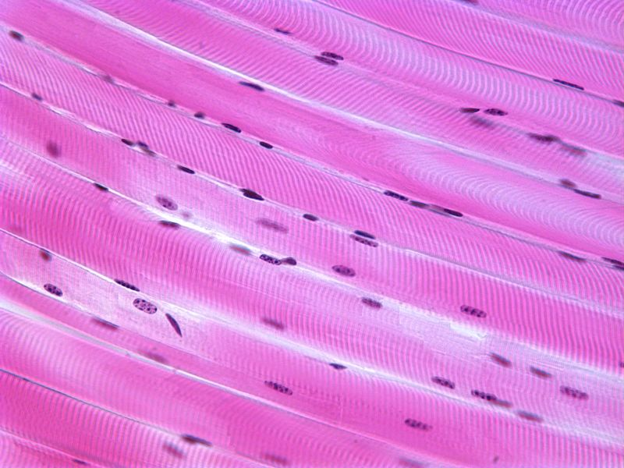
Formation of a skeletal muscle fiber (muscle cell)
A longitudinal section of skeletal muscle like the one shown above will have a characteristic dark-light banding pattern.
However, also note that a good, high magnification view of skeletal muscle in cross section will show stippling within the cell due to sectioning of the myofibrils.
Skeletal muscle cells (fibers) develop from the fusion of myoblasts, resulting in large, multinuclear cells (each cell is a syncytium – how cool is that). The cells then assemble their contractile machinery in the cytoplasm. These come in the form of myofibrils, which have an alternate dark-light banding pattern when viewed from the side. The fact that the cell is chock-full of these myofibrils pushes the nuclei to the periphery of the cell.

Slide 6
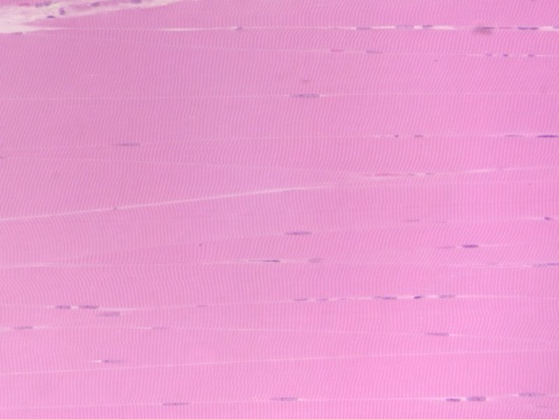
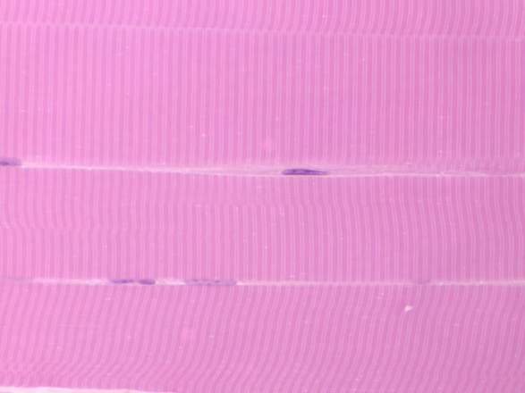
SKELETAL MUSCLE
Here are two images from our slide set, taken at medium and very high magnification (oil). Both are longitudinal views of skeletal muscle. The muscle fibers (cells) are indicated by the brackets. Typically, within a single muscle, all fibers are the same diameter, so the apparent difference you see is due to sectioning (e.g. the section goes through the middle of some fibers, cuts the edge of others).
Note the fact that these are long, wide-diameter cells (compare to the size of the nuclei), with an alternating dark-light pattern, with most nuclei situated in the periphery of the cell.
Actually, some nuclei belong to the muscle cells, while others are of fibroblasts. Difficult to tell for sure, but the muscle nucleus is typically more euchromatic than the fibroblast nucleus, so I’m going with the nucleus indicated by the black arrow belonging to the muscle cell, and the one indicated by the blue arrow belonging to a fibroblast that is in the loose connective tissue between cells. Just an educated guess. Nothing to worry about now.

Slide 7
SKELETAL MUSCLE
Video of skeletal muscle – SL86
Link to SL 086
Be able to identify:
  Skeletal muscle

Slide 8
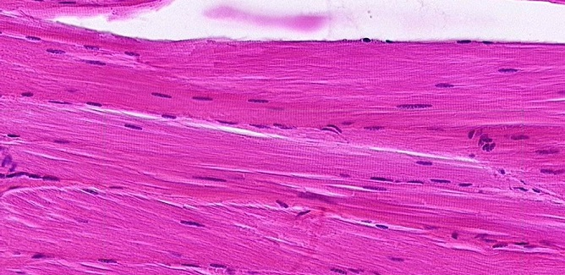
SKELETAL MUSCLE
The previous slide was a plastic section, and oriented so the muscle fibers were all cut longitudinally. Like real life, the rest of our slides aren’t so perfect. Here you have a typical longitudinal view of skeletal muscle. The diameter of a single fiber (cell) is indicated by the brackets. Note the intense cytoplasmic eosinophilia, caused by the tremendous amount of contractile proteins in these cells.
Here you can still see striations, and that most nuclei are toward the periphery of the cell. However, cell borders are not as obvious; in fact, it’s actually the nuclei that help you “see” the cell borders. The nuclei are elongated, but plump, like a bratwurst.

Slide 9
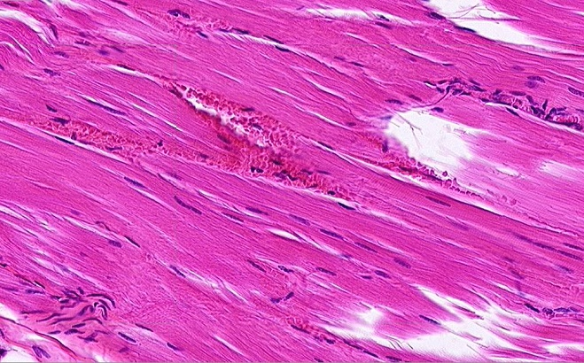
SKELETAL MUSCLE
Life is even less fair. The previous image was selected because it was a region in which the cells were at a perfect longitudinal angle. Turning the angle ever so slightly eliminates the striations you would like to rely on.
Here you can still see that the diameter of a cell is wide (yellow brackets), based on the positioning of the nuclei and the loose connective tissue that separates the cells.
Fortunately, you should have the option of scanning around the slide to find nice striations – but no guarantees.

Slide 10
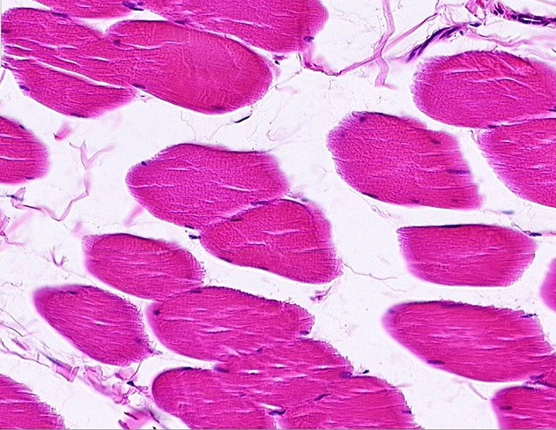
SKELETAL MUSCLE
In the same slide (and others in our set), some of the fibers are oriented in cross-section; so, like smooth muscle, you need to be able to recognize skeletal muscle in cross-section as well.
In cross sections, usually it is easier to see the cell borders and peripheral nuclei. Also, if you look closely, you can see stippling within the cytoplasm (outlined cell is best for this), which represents the myofibrils cut in cross section.

Slide 11
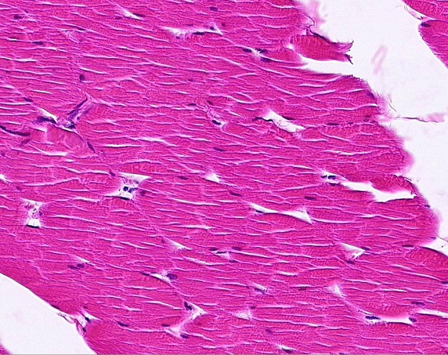
SKELETAL MUSCLE
Alas, like longitudinal sections, perfect cross-sections are not always the norm. Here, even a slight angle takes away the obvious stippling (some short “bands” may be visible), and cell borders (brackets indicate cells) are not as distinct.

Slide 12
SKELETAL MUSCLE
Video of skeletal muscle – SL27
Link to SL 027 and SL 061 and SL 060
Be able to identify:
  Skeletal muscle

Slide 13
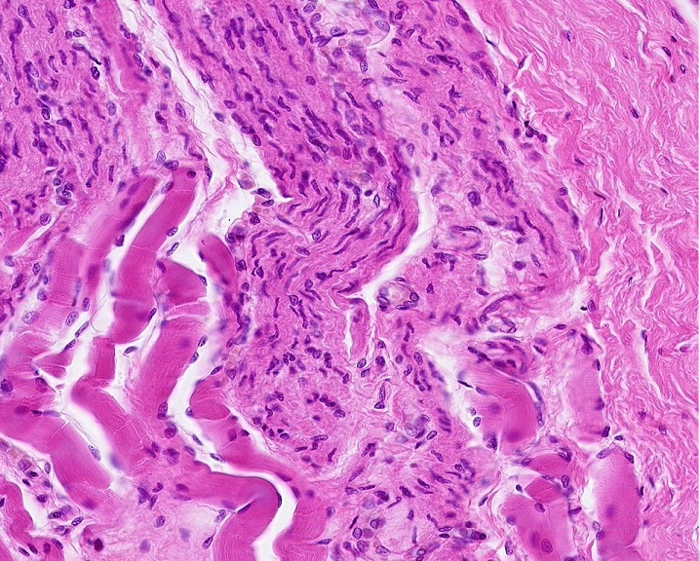
SKELETAL MUSCLE & SMOOTH MUSCLE
And in real, real life, or at least practical exam real life, you will have to distinguish skeletal muscle from smooth muscle, and connective tissue. Fortunately for you, we have just the slide. This is a section of the esophagus, in a region of transition from skeletal (voluntary) muscle to smooth (autonomic) muscle.
Skeletal muscle is typically more eosinophilic (on the red side, as opposed to pink), with large-diameter cells, peripheral nuclei.
Smooth muscle cells are smaller, so more nuclei, evenly distributed. On a more subtle note, the nuclei are more heterochromatic than those of skeletal muscle, and some even look “twisted” (arrow).
Dense irregular connective tissue has fewer cells, so fewer nuclei, with extracellular elements such as collagen fibers.
Smooth muscle
Dense irregular c.t.
Skeletal muscle

Slide 14
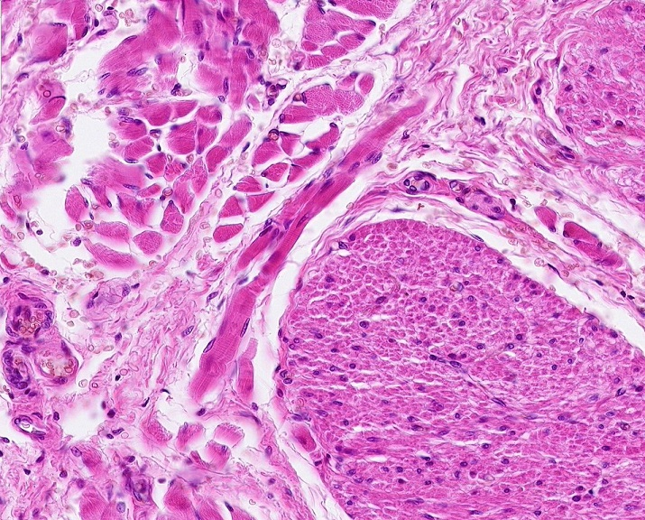
SKELETAL MUSCLE & SMOOTH MUSCLE
Same slide of the esophagus, most of the fibers here are in cross-section.
Skeletal muscle is typically more eosinophilic, with large-diameter cells, peripheral nuclei.
Smooth muscle cells are smaller, so more nuclei, relatively evenly distributed. The increase in the number of nuclei is not so obvious in cross-section, but if you look closely, you can see individual cells, some with central nuclei and a small rim of cytoplasm (blue arrows), others are smaller in diameter without nuclei representing tapered ends of cells (black arrows). I guesstimate that there are hundreds of cells in the upper half of the outlined region. (Arrows on peripheral cells so as not to obscure your view.)
Dense irregular connective tissue has fewer cells, so fewer nuclei, with extracellular elements such as collagen fibers.
Skeletal muscle
Dense irregular c.t.
Smooth muscle

Slide 15
SKELETAL MUSCLE & SMOOTH MUSCLE
Video of skeletal muscle and smooth muscle – SL15A
Link to SL 015A
Be able to identify:
  Skeletal muscle
  Smooth muscle (review)
  Dense irregular connective tissue (review)

Slide 16
SKELETAL MUSCLE - ORGANIZATION
Recall this drawing of a muscle such as the rectus femoris. A muscle is composed of muscle cells, called muscle fibers, or myofibers, all running parallel within the muscle. Within a muscle, a number of muscle fibers are bundled together into fascicles (dotted outline).
The connective tissue component of a muscle can be divided into three types:
Endomysium – between individual muscle fibers
Perimysium – around fascicles
Epimysium – surrounds the entire muscle
The epimysium is the deep fascia that surrounds muscles in the gross anatomy lab.
Consistent with connective tissue organization in other organs you have seen, the density of the connective tissue decreases as you progress toward the inner portions of the muscle. In other words, epimysium is dense irregular connective tissue, endomysium is loose connective tissue, and perimysium is somewhere in between (the famous “loosy-densy” connective tissue).

Slide 17
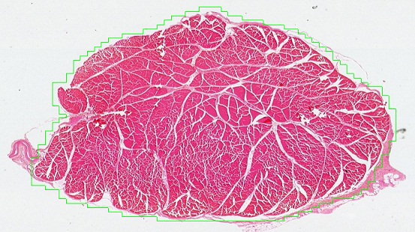
SKELETAL MUSCLE - ORGANIZATION
In this low power image of an entire muscle, a fascicle is outlined, and the epimysium (black arrows) and perimysium (blue arrow) are indicated.
The epimysium is the deep fascia that surrounds muscles in the gross anatomy lab.

Slide 18
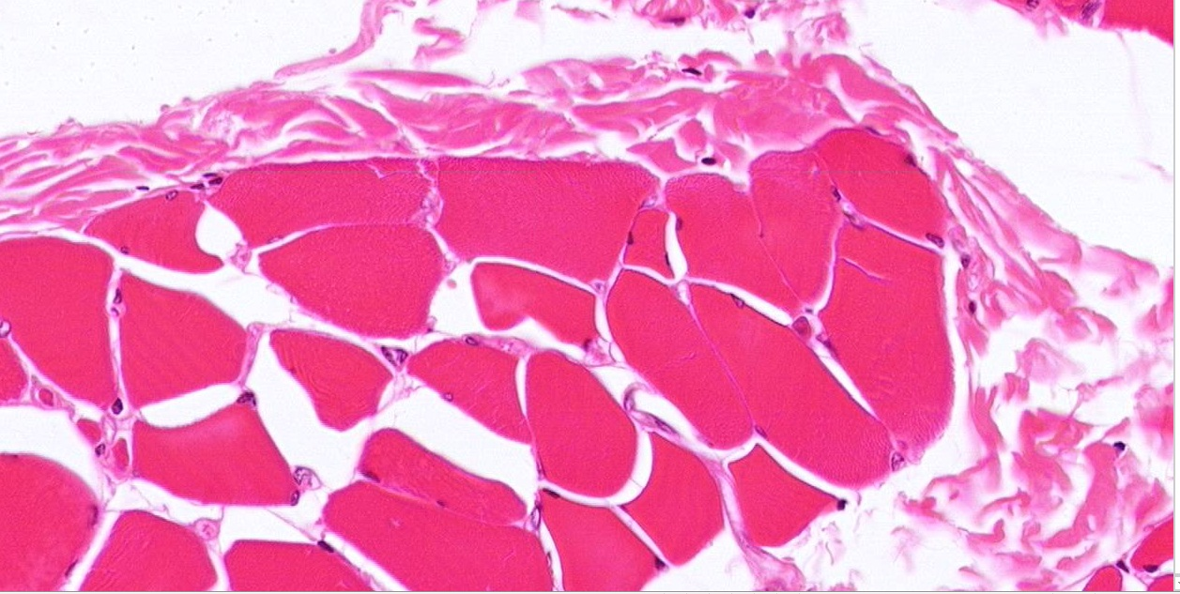
SKELETAL MUSCLE - ORGANIZATION
This higher powered micrograph from the edge of a muscle shows a portion of a fascicle; a single muscle fiber is outlined. The epimysium (black arrow), perimysium (blue arrow) and endomysium (green arrow) are indicated.
Apart from the difference in density, these layers really don’t look much different. They are all irregular connective tissues, either loose, dense, or something in between. They are named based on their position in the muscle and among the muscle fibers.

Slide 19
SKELETAL MUSCLE - ORGANIZATION
Video of skeletal muscle showing epimysium, perimysium, endomysium – SL60
Link to SL 060
Be able to identify:
  Skeletal muscle
    Fascicle
    Endomysium
    Perimysium
    Endomysium

Slide 20
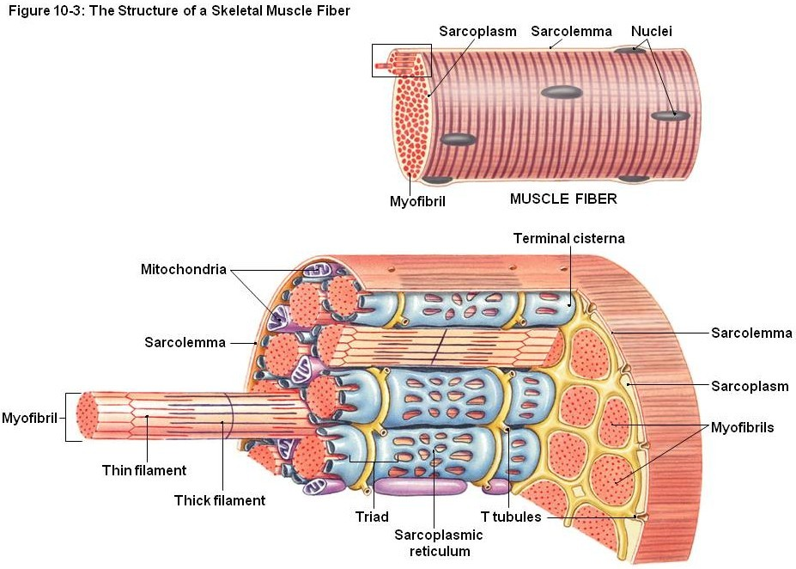
SKELETAL MUSCLE CELLS
As we mentioned, skeletal muscle cells are very large cells, both in diameter and length, and are, therefore, called muscle fibers, or myofibers. Their cytoplasm is packed with contractile proteins, which are organized into rod-like structure called myofibrils.
Like neuroscientists, people who study muscle have a big ego. Therefore, they rename all the cellular components with their “sarco” prefix, presumably because these components in muscles are better than those same components in the liver or bone.
Therefore:
sarcolemma = plasmalemma
sarcoplasm = cytoplasm
sarcoplasmic reticulum = (smooth) endoplasmic reticulum
Because in skeletal muscle we have rods within rods within rods, it’s easy to lose perspective and get lost in the terminology. Don’t forget that each part of the drawing here (top and bottom) shows a single muscle cell.

Slide 21

SKELETAL MUSCLE CELLS
In the same slide (and others in our set), some of the fibers are oriented in cross-section. As is the case for smooth muscle, you need to be able to recognize skeletal muscle in cross-section.
A single muscle cell is outlined, two more are indicated by the green brackets. In cross sections, usually it is easier to see the cell borders and peripheral nuclei. Also, if you look closely, you can see stippling within the cytoplasm (outlined cell is best for this), which represents the myofibrils cut in cross section.
No sense recreating the wheel. This is a slide from the previous module with the inset added. The region within the box has been artificially magnified, so I could put a few arrows on three of the hundreds of cross sections of myofibrils. Saaaweeeet.

Slide 22
SKELETAL MUSCLE CELLS
Video of skeletal muscle showing myofibrils in cross section – SL60
Link to SL 027
Be able to identify:
  Skeletal muscle
    Myofibers
    Myofibrils

Slide 23
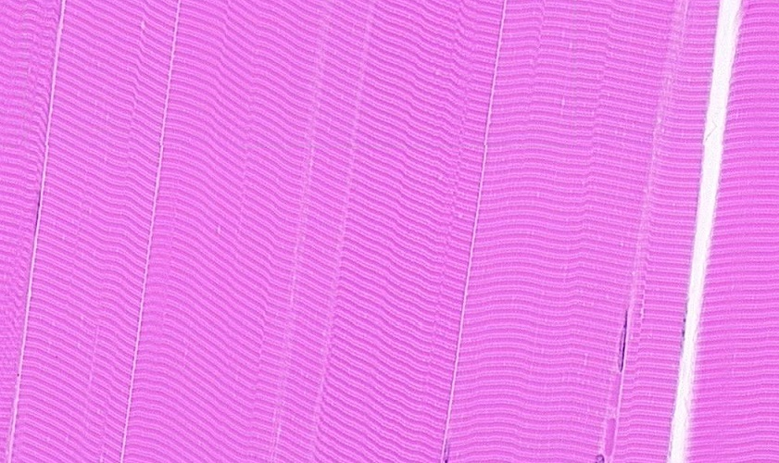
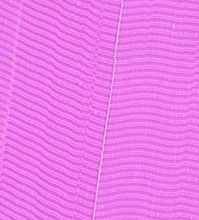
SKELETAL MUSCLE CELLS
The image on the left is a longitudinal section of about 6-8 skeletal muscle fibers (cells); the green bracket indicates one cell. The dark-light-dark-light-etc. banding pattern you see, which will be explained in detail on the next set of slides, is created by the fact that each myofibril in a cell has a dark-light-dark-light-etc. banding pattern, and the myofibrils are arranged so that their dark bands line up side-by-side, as do the light bands.
TOTALLY AWESOME!!!!
Some 30-50 or so myofibrils span the diameter of a single cell. Because they are “in register”, you can’t see most myofibrils. However, during fixation, some of them “slide”, putting them out of register with their neighbors. Between the arrows is probably a single myofibril that has slid, giving you an idea of the diameter of a single myofibril.

Slide 24
SKELETAL MUSCLE CELLS
Video of skeletal muscle showing myofibrils in longitudinal section – SL86
Link to SL 086
Be able to identify:
  Skeletal muscle
    Myofibers
    Myofibrils

Slide 25
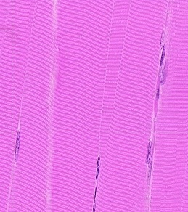
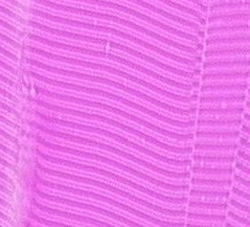
SKELETAL MUSCLE CELLS – BANDING PATTERN
The banding pattern you see in light micrographs of skeletal muscle is created by the collective banding of each myofibril (e.g. between yellow arrows). A bands (green bracket) and I bands (black bracket) are dark and light, respectively. Also readily seen is the dark line within the I band, the Z line (black arrows). Less obvious is a pale region within the A band, referred to as the H band or H zone (maroon arrows). The functional contractile unit of skeletal muscle, the scaromere, extends from Z line to Z line (blue bracket)

Slide 26
SKELETAL MUSCLE CELLS – BANDING PATTERN
Video of skeletal muscle showing banding pattern – SL86
Link to SL 086
Be able to identify:
  Skeletal muscle
    A band
    I band
    Z line
    H band (H zone)
    sarcomere

Slide 27
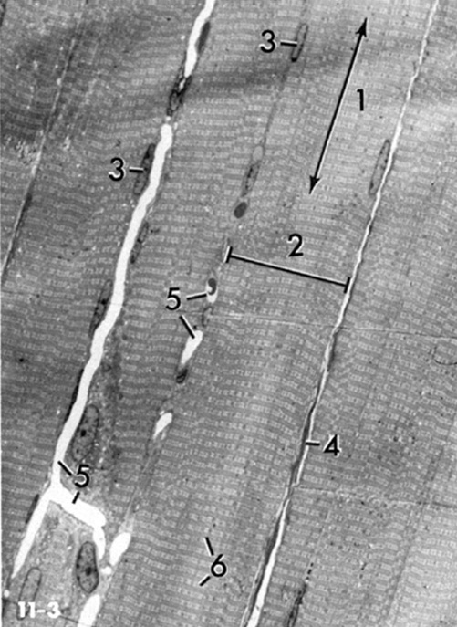
SKELETAL MUSCLE CELLS – BANDING PATTERN
Moving into the World of EMs. Not much to say here, just showing you an EM (right) of comparable magnification to the light micrographs you have been looking at recently.
Longitudinal axis of muscle cell
Width of muscle cell
Nuclei of muscle cell
Endomysium
Capillaries
Striations

Slide 28
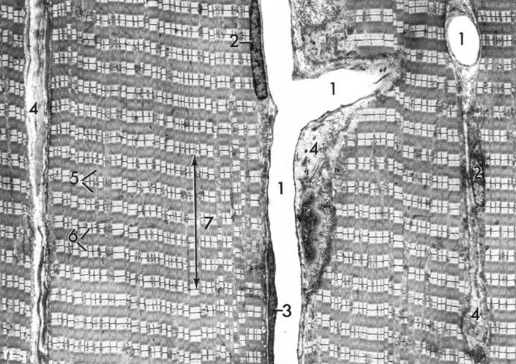
SKELETAL MUSCLE CELLS – BANDING PATTERN
This EM was taken at slightly higher magnification than the previous slide. The width of a single muscle cell is indicated by the red double-arrow. Note the A and I bands, as well as the Z line and H zone (later between yellow arrows)
Capillary lumen
Muscle cell nuclei
Endothelial cell nucleus (capillary-lining cell)
Endomysium
A bands
I bands (lines actually touching Z lines)
Longitudinal axis of cell

Slide 29
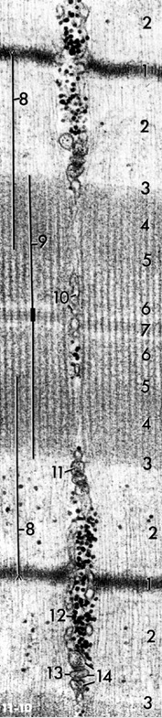

SKELETAL MUSCLE CELLS – BANDING PATTERN
Enlargement of a single sarcomere is shown to the right. The extent of a single sarcomere is indicated by the purple double-arrow.
Full labeling on next slide…

Slide 30
SKELETAL MUSCLE CELLS – BANDING PATTERN
Z line
I band (note single I band extends on both sides of Z line)
Border between A and I band
A band (actually, 4,5,6, and 7 are all in A band)
Ignore this for now
H zone
Ignore the rest of these for now
Note that adjacent sarcomeres share a Z line.
Also, as indicated in #2 above, a single I band consists of parts of two adjacent sarcomeres.
Take note of the filamentous proteins that run along the longitudinal axis of the sarcomere in this image. These are the myofilaments, and will be discussed in the next set of slides.

Slide 31
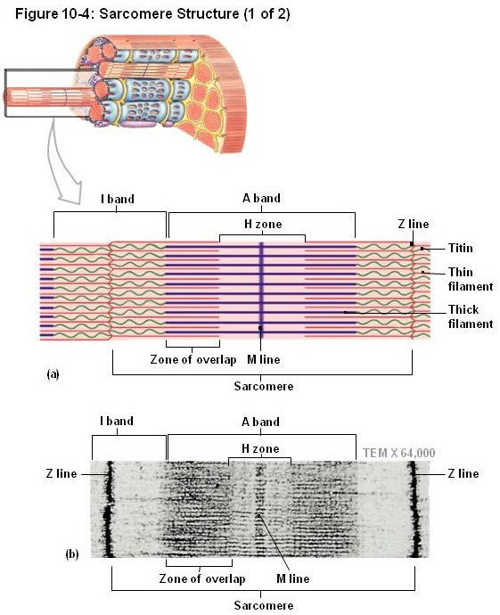
SKELETAL MUSCLE CELLS – MYOFILAMENTS
There are two types of myofilaments:
Thin filaments – made up of actin (yes, the cytoskeletal element called microfilaments)
Thick filaments – made up of myosin (neither microtubules nor intermediate filaments)
As you can see in the schematic drawing and electron micrograph, myofilaments are oriented along the long axis of the myofibrils (and myofibers).
Each myofilament is anchored by a collection of proteins that form specific lines:
The Z line anchors the thin filaments
The M line anchors the thick filaments
Or, from a different perspective, the Z line has numerous thin filaments extending from it in both directions, and the M line has numerous thick filaments extending from it in both directions.
Also note that thin and thick filaments extend past each other, creating a zone of overlap.

Slide 32
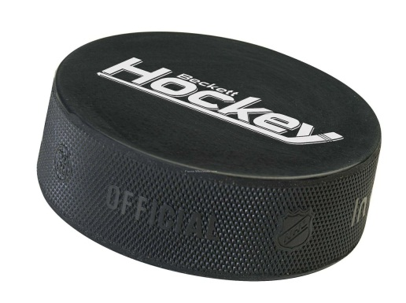
SKELETAL MUSCLE CELLS – MYOFILAMENTS
It should also be pointed out that the myofibrils are cylindrical, not flat structures. Therefore, although we use the terms Z lines and M lines when looking at longitudinal sections of muscle, these structures are actually disk shaped, and are often called Z disks or M disks.
Also, they do have some thickness, though they are very thin, so they are really puck-shaped.

Slide 33
SKELETAL MUSCLE CELLS – MYOFILAMENTS
Just to be sure, in this enlarged EM:
Thin filaments (orange arrows) – made up of actin (hey, these are thin, but several look a little chubby)
Thick filaments (purple arrows) – made up of myosin
Only a few examples are pointed out here. If you start at the blue block arrow and work upward, you probably will encounter 20-30 thick filaments.

Slide 34
SKELETAL MUSCLE CELLS – BANDING PATTERN
Now we can identify more stuff….
Z line
I band (note it extends on both sides of Z line)
Border between A and I band
A band (actually, 4,5,6, and 7 are all in A band)
Ends of thin filaments
H zone
M line
Extent of thin filaments
Extent of thick filaments
10-14. Ignore these for now
Note the zone of overlap as well (4), the darkest region of the A band, except maybe the M line.
You will learn more about the detailed structure and function of these myofilaments in your reading assignment and large-group sessions.

Slide 35
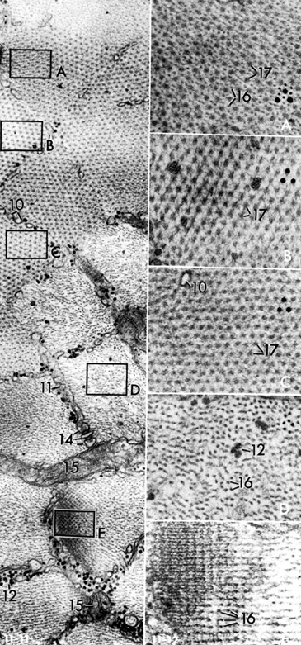
SKELETAL MUSCLE CELLS – BANDING PATTERN
To solidify your understanding, you probably want to think about what cross-sections through each region would look like. This is purely FYI, since I won’t put cross-sectional EMs on an exam (though I have been known to put glass slides of skeletal muscle in cross section on exams). However, this exercise should help you remember the structure on longitudinal sections.
Zone of overlap – note both thick (17) and thin (16) filaments
M line – note only thick filaments (17); proteins linking thick filaments are slightly visible (arrows)
H zone – only thick filaments (without proteins that bind them, though I can’t deny that it sure looks like some are there)

Slide 36
SKELETAL MUSCLE CELLS – BANDING PATTERN
I band – thin filaments (16) only (12 is glycogen)
Z line – thin filaments (16) cross linked by Z line proteins

Slide 37
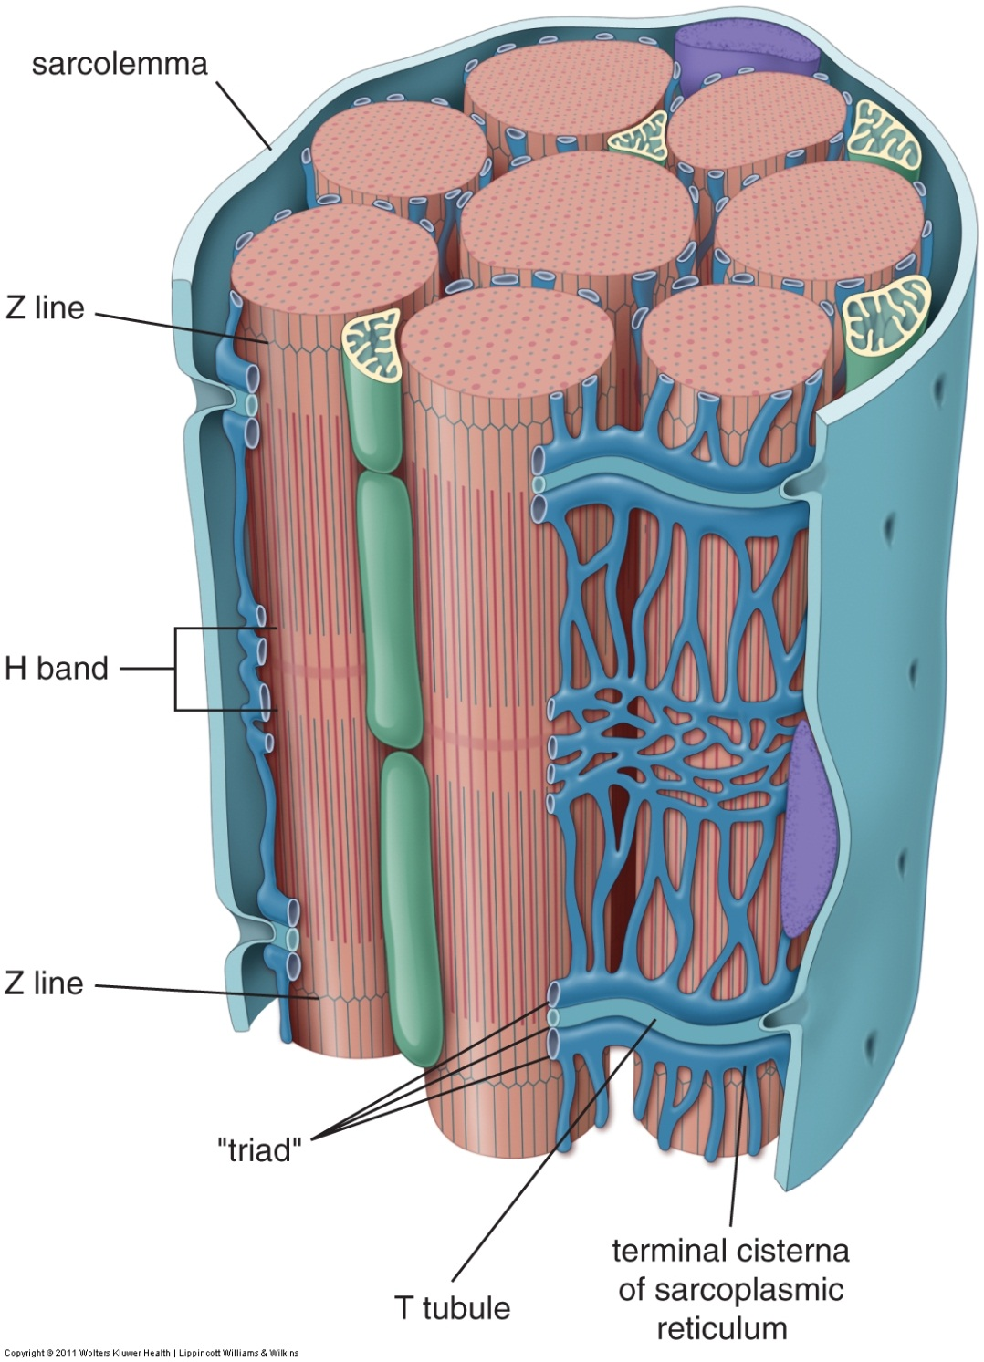
SKELETAL MUSCLE CELLS – TUBULE SYSTEM
As you will learn in the large-group sessions, muscle contraction requires calcium. The large diameter of skeletal muscle requires an elaborate cellular architecture to ensure that all myofibrils receive this calcium signal at the same time. This architecture has two major components:
Invaginations of the sarcolemma (plasma membrane) called T tubules. Action potentials that travel along the surface sarcolemma use the T tubule system to bring the excitation wave to the center of the cell.
The sarcoplasmic reticulum (endoplasmic reticulum) is elaborate, highlighted by dilations called terminal cisterna, which flank the T tubules. The sarcoplasmic reticulum stores calcium, which is released when calcium channels in the bilayer of the reticulum are exposed to action potentials travelling down the T tubules.
The three tubules together, a central T tubule flanked by two terminal cisternae, form a “triad”. Human skeletal muscle has a “triad”, while human cardiac muscle (and muscle in other animals) has only one terminal cisternae, and, therefore, form “diads”.

Slide 38

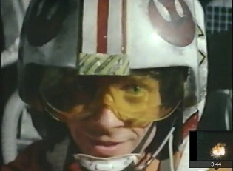
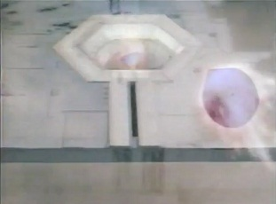
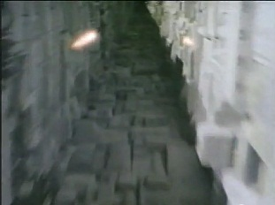
SKELETAL MUSCLE CELLS – TUBULE SYSTEM
If you’re a Star Wars nerd, you might think of the action potential traveling along the muscle surface sarcolemma as the shot fired by Luke (A, maroon arrows), which then makes a 90º turn to travel down the T tubule system (B, brown arrows) into the depths of the cell. More on that in the large-group sessions.
B
A

Slide 39
SKELETAL MUSCLE CELLS – BANDING PATTERN
Now we can identify even more stuff….
Z line
I band (note it extends on both sides of Z line)
Border between A and I band
A band (actually, 4,5,6, and 7 are all in A band)
Ends of thin filaments
H zone
M line
Extent of thin filaments
Extent of thick filaments
Profiles of sarcoplasmic reticulum
terminal cisternae of sarcoplasmic reticulum
Glycogen particles
T tubule profile
Triad
The specific identification of these components is not something to worry about for the practical exam, but it’s good that you’ve seen them so you have a mental image when learning the function.
You will learn more about the detailed structure and function of these tubules in your reading and large-group sessions.

Slide 40
The next set of slides is a quiz for this module. You should review the structures covered in this module, and try to visualize each of these in light and electron micrographs.
identify, at the light microscope level, each of the following:
  Skeletal muscle
  Myofibers (muscle fibers, muscle cells)
  Myofibrils
  Fascicle
  Endomysium
  Perimysium
  Epimysium
  Bands and lines seen in skeletal muscle
  A band
  I band
  H band
  Z line
  M line
  Sarcomere
identify, at the electron microscope level, each of the following:
  Skeletal muscle
  Myofibers (muscle fibers, muscle cells)
  Myofibrils
  Myofilaments
  Thick filaments
  Thin filaments
  Sarcolemma
  External lamina
  Sarcoplasmic reticulum
  Triad
  Terminal cisternae of sarcoplasmic reticulum (x2)
  Transverse tubule (T-tubule) (x1)
  Bands and lines noted above for light microscopy
  Glycogen and Mitochondria

Slide 41
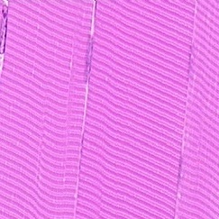
Final quiz
Self-check: Identify the regions indicated by the brackets. (advance slide for answers)
A bands

Slide 42
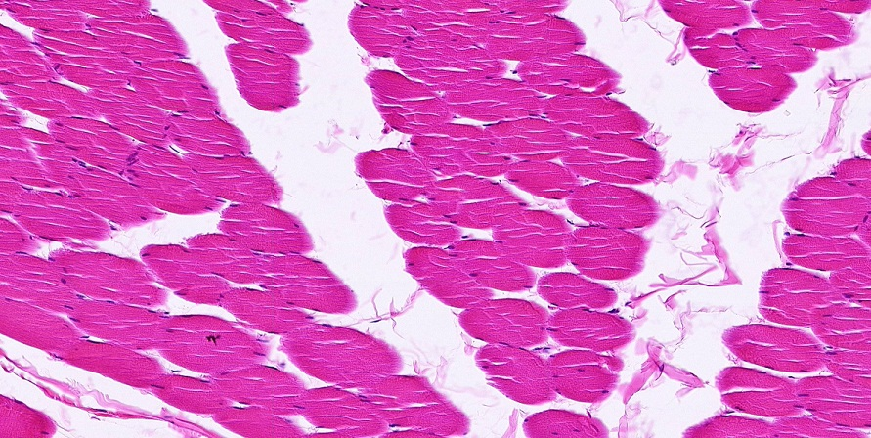
Final quiz
Self-check: Identify the predominant tissue on this slide. (advance slide for answers)
Skeletal muscle

Slide 43
Final quiz
Self-check: How many myofibrils on this slide. (advance slide for answers)
About 10

Slide 44
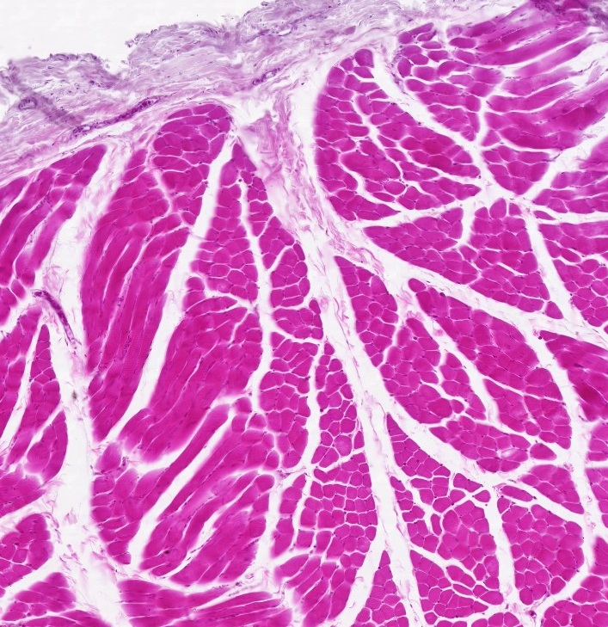
Final quiz
Self-check: Identify structure indicated by the arrows. (advance slide for answers)
perimysium

Slide 45
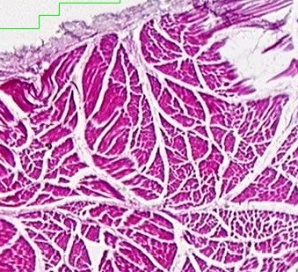
Final quiz
Self-check: Identify the outlined structure. (advance slide for answers)
fascicle

Slide 46
Final quiz
Self-check: Identify the regions indicated at X and Y. (advance slide for answers)
X = zone of overlap
Y = H zone

Slide 47
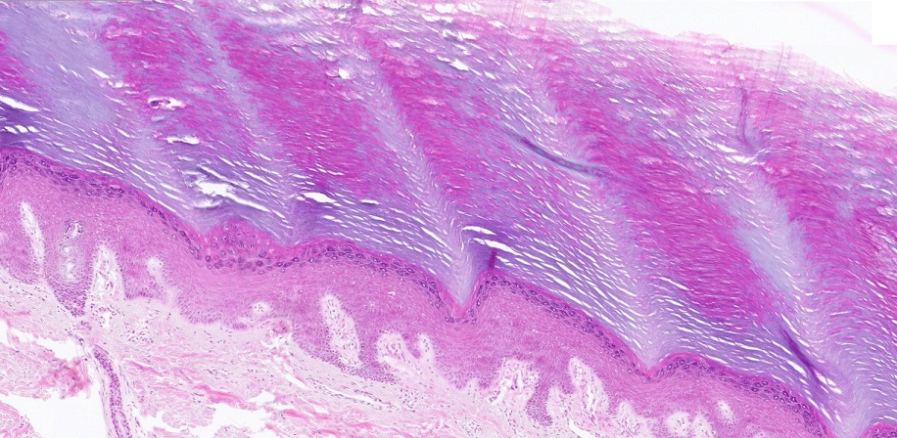
Final quiz
Self-check: From where was this image taken? Be specific. (advance slide for answers)
Thick skin, so palms of hands or soles of feet

Slide 48
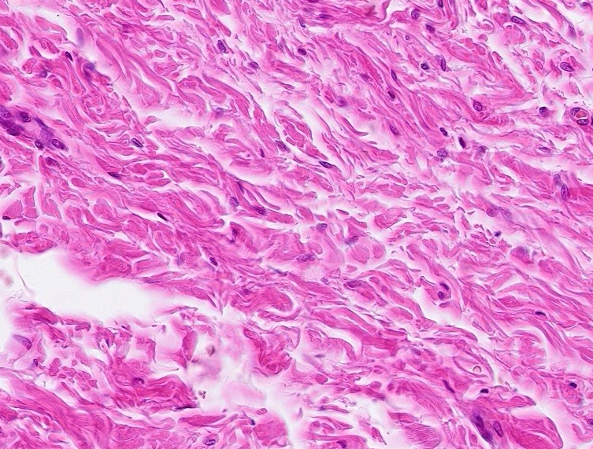
Final quiz
Self-check: Identify the predominant tissue on this slide. (advance slide for answers)
Dense irregular connective tissue

Slide 49
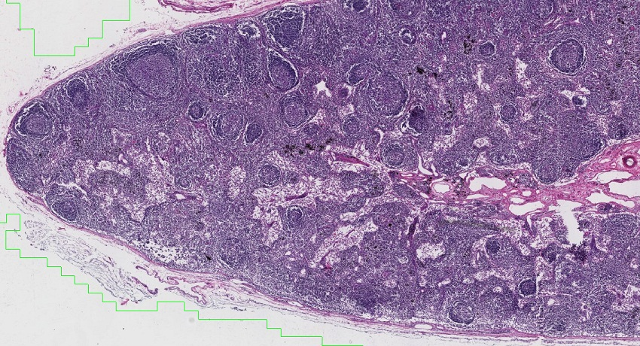
Final quiz
Self-check: Identify the organ on this slide. (advance slide for answers)
Lymph node

Slide 50
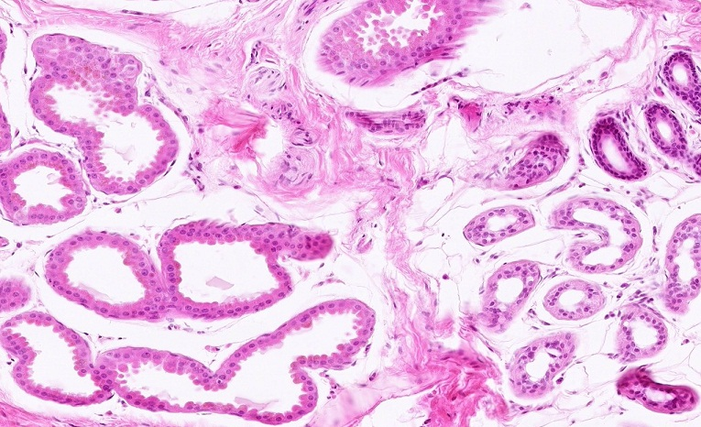
Final quiz
Self-check: Identify the outlined structures. (advance slide for answers)
Ducts (from sweat glands)

Slide 51
Final quiz
Self-check: Identify the structures indicated by the arrows. (advance slide for answers)
Thin filaments

Slide 52
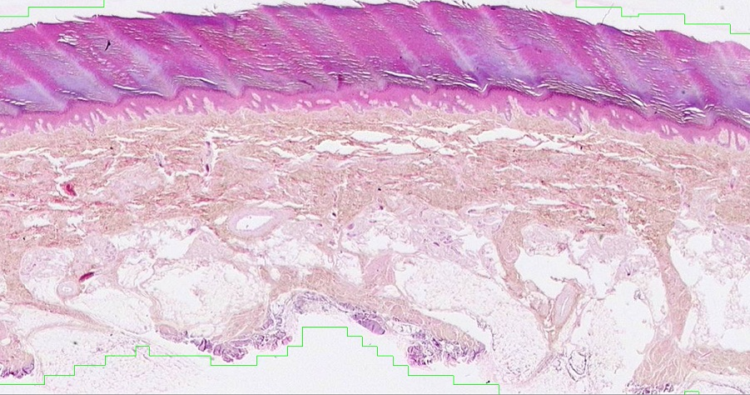
Final quiz
Self-check: Where would you find a Meissner’s corpuscle. (advance slide for answers)
A
B
B
C
D

Slide 53
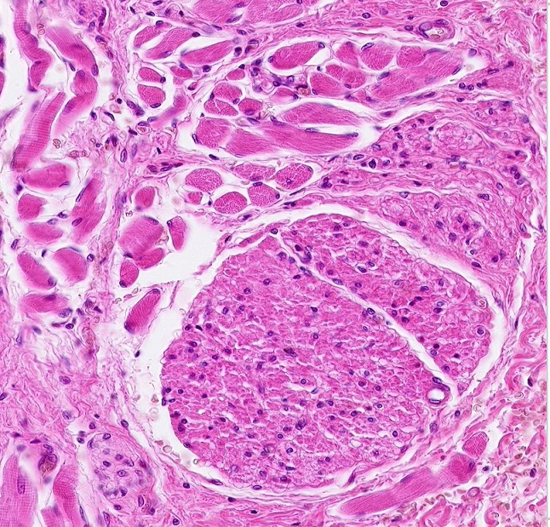
Final quiz
Self-check: Identify the predominant tissue in the outlined region. (advance slide for answers)
Skeletal muscle

Slide 54
Final quiz
Self-check: How many cells are on this slide. (advance slide for answers)
1

Slide 55
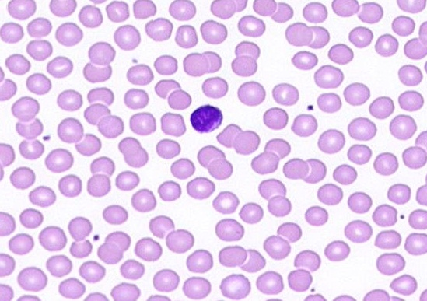
Final quiz
Self-check: Identify the cell indicated by the arrow. (advance slide for answers)
lymphocyte

Slide 56
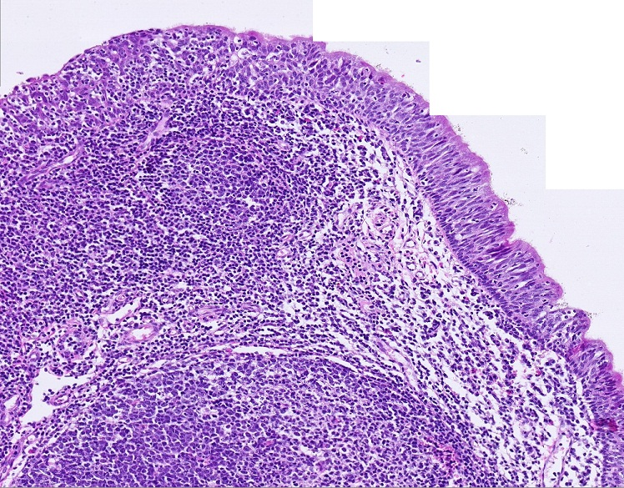
Final quiz
Self-check: Identify the organ on this slide. (advance slide for answers)
Pharyngeal tonsil

Slide 57
Final quiz
Self-check: How many muscle cells on this slide. (advance slide for answers)
1 or 2

Slide 58
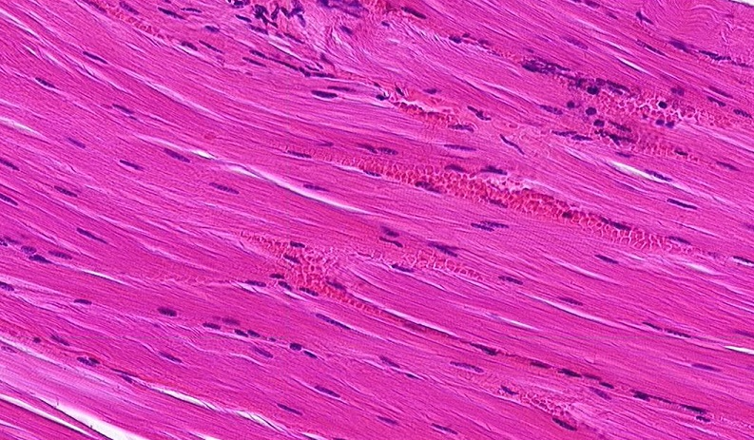
Final quiz
Self-check: Identify the predominant tissue on this slide. (advance slide for answers)
Skeletal muscle

Slide 59
Final quiz
Self-check: Identify the structures indicated by the arrows. (advance slide for answers)
Z lines

Slide 60
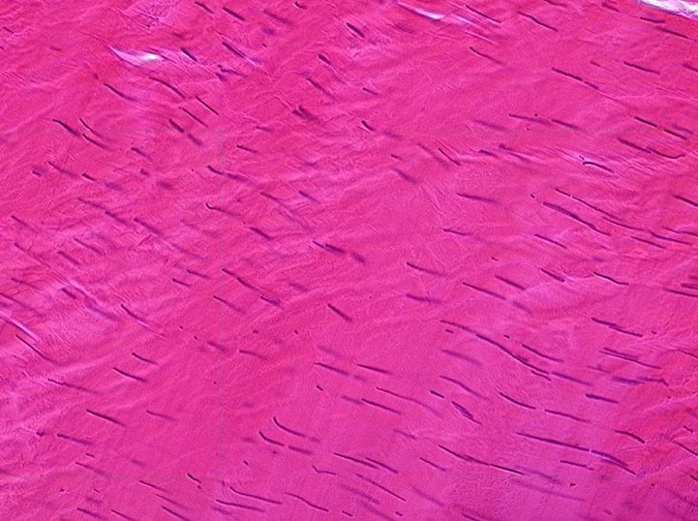
Final quiz
Self-check: Identify the tissue on this slide. (advance slide for answers)
Dense regular connective tissue

Slide 61
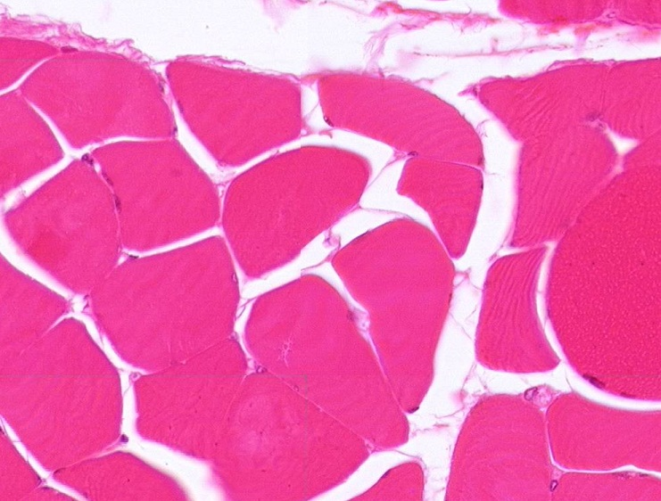
Final quiz
Self-check: Identify structure indicated by the arrows. (advance slide for answers)
endomysium

Slide 62
Final quiz
Self-check: Identify the structure indicated by the X. (advance slide for answers)
nucleus
X

Slide 63
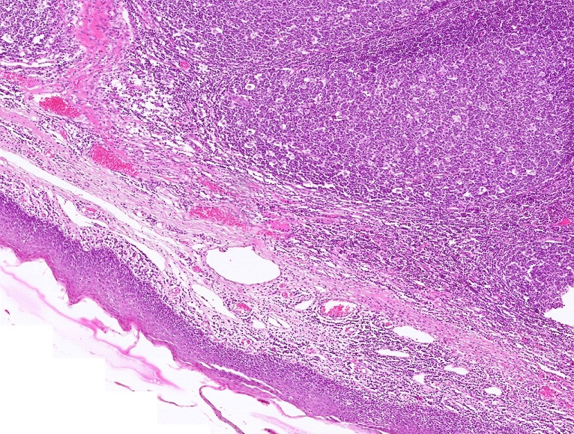
Final quiz
Self-check: Identify the organ on this slide. (advance slide for answers)
Palatine tonsil

Slide 64
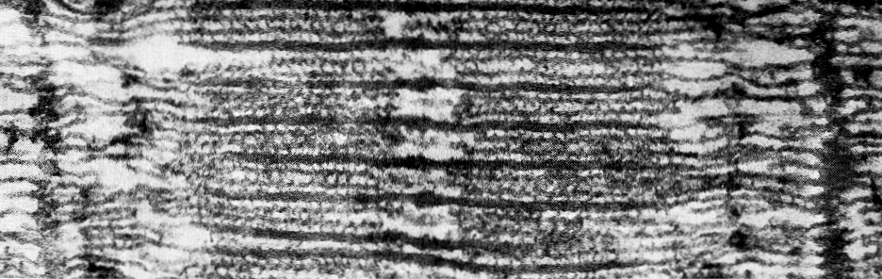
Final quiz
Self-check: Identify the structures indicated by the arrows. (advance slide for answers)
Thin filaments
Z lines are here

Slide 65
Final quiz
Self-check: Identify the structure indicated by the brackets. (advance slide for answers)
sarcomere

Slide 66
Final quiz
Self-check: Identify the structures indicated by the arrows. (advance slide for answers)
Z lines

Slide 67
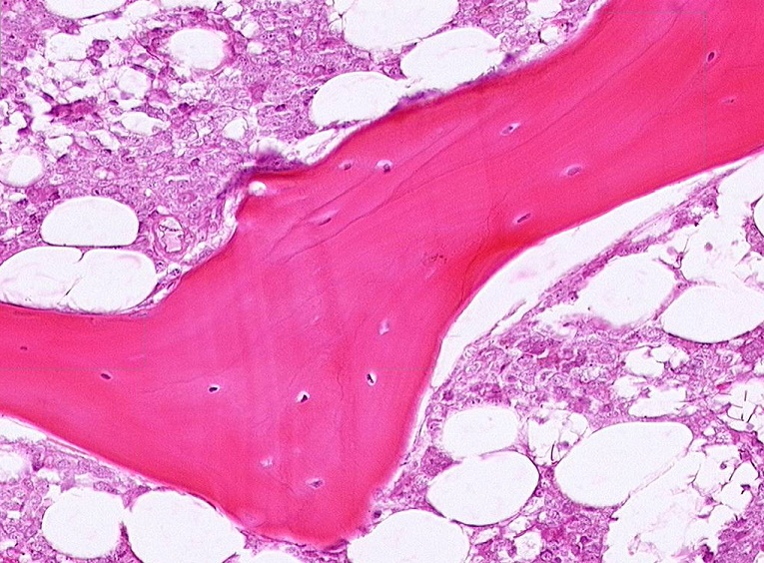
Final quiz
Self-check: Identify the predominant tissue in the outlined region. (advance slide for answers)
bone

Slide 68
Final quiz
Self-check: Identify the region indicated by the brackets. (advance slide for answers)
I band

Slide 69
Final quiz
Self-check: Identify the predominant tissue in the outlined region. (advance slide for answers)
Unilocular adipose

Slide 70
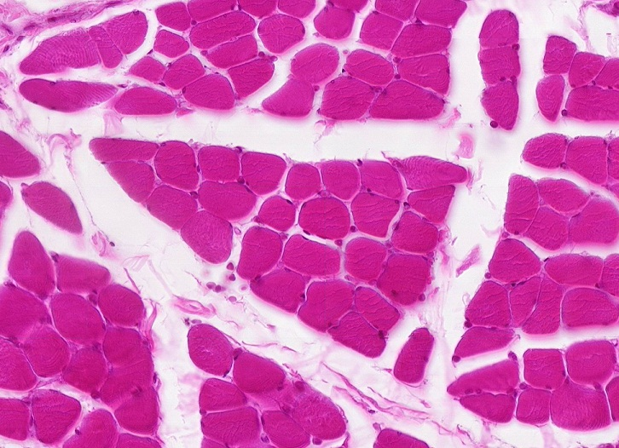
Final quiz
Self-check: Identify the predominant tissue on this slide. (advance slide for answers)
Skeletal muscle

Slide 71
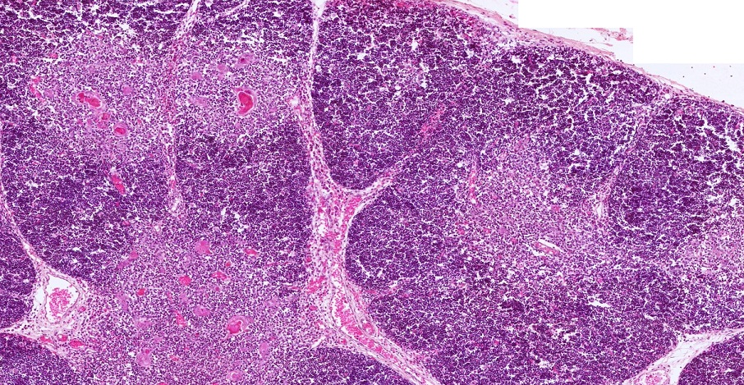
Final quiz
Self-check: Identify the organ on this slide. (advance slide for answers)
thymus

Slide 72
Final quiz
Self-check: How many myofibrils are on this slide. (advance slide for answers)
2

Slide 73

Final quiz
Self-check: Identify the cells indicated by the arrows. (advance slide for answers)
Plasma cells

Slide 74

Final quiz
Self-check: Identify the outlined structure. (advance slide for answers)
Peripheral nerve

Slide 75
Final quiz
Self-check: Identify the structures indicated by the arrows. (advance slide for answers)
M lines

Slide 76

Final quiz
Self-check: The discontinuity indicated by the series of arrows is a fixation artifact from sliding of adjacent ????. (advance slide for answers)
myofibrils

Slide 77
Final quiz
Self-check: Identify the cells indicated by the arrows. (advance slide for answers)
neutrophils

Slide 78

Final quiz
Self-check: Identify the tissue on this slide. (advance slide for answers)
Skeletal muscle

Slide 79
Final quiz
Self-check: Identify the region indicated by the brackets. (advance slide for answers)
A band

Slide 80

Final quiz
Self-check: Identify the predominant tissue on this slide. (advance slide for answers)
Smooth muscle

Slide 81

Final quiz
Self-check: Identify the predominant tissue on this slide. (advance slide for answers)
Elastic cartilage

Slide 82
Final quiz
Self-check: How many myofilaments on this slide. (advance slide for answers)
A google

Slide 83

Final quiz
Self-check: Identify the predominant tissue on this slide. (advance slide for answers)
fibrous cartilage

Slide 84
Final quiz
Self-check: Identify the predominant tissue in the outlined region. (advance slide for answers)
Smooth muscle

Slide 85
Final quiz
Self-check: Identify structure indicated by the arrows. (advance slide for answers)
epimysium

Slide 86
Final quiz
Self-check: Identify the structure indicated by the brackets. (advance slide for answers)
Myofiber (muscle fiber, muscle cell)

Slide 87

Final quiz
Self-check: Identify the predominant tissue on this slide. (advance slide for answers)
Hyaline cartilage

Slide 88
Final quiz
Self-check: Identify the region indicated by the brackets. (advance slide for answers)
I band

Slide 89

Final quiz
Self-check: Identify the tissue on this slide. (advance slide for answers)
Smooth muscle

Slide 90
Final quiz
Self-check: Identify the structure indicated by the brackets. (advance slide for answers)
sarcomere

Slide 91

Final quiz
Self-check: From where was this image taken? Be specific. (advance slide for answers)
Skin from the axilla or groin

Slide 92

Final quiz
Self-check: Identify the outlined structure. (advance slide for answers)
Pacinian corpuscle

Slide 93

Final quiz
Self-check: Identify the predominant tissue in the outlined region. (advance slide for answers)
bone

Slide 94
Final quiz
Self-check: Identify the structures indicated by the arrows. (advance slide for answers)
Thick filaments

Slide 95

Final quiz
Self-check: Identify the organ on this slide. (advance slide for answers)
spleen

