Slide 1
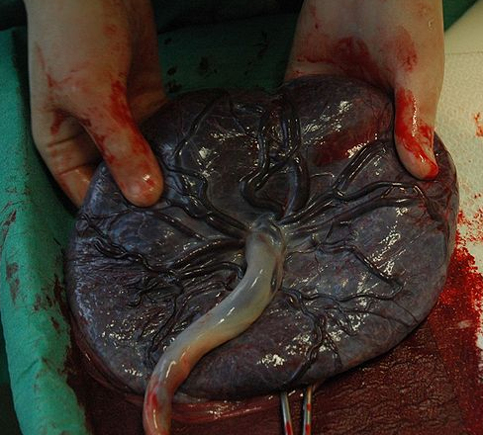
Placenta and Umbilical Cord
Digital Laboratory
It’s best to view this in Slide Show mode, especially for the quizzes.
This module will take approximately 75minutes to complete.

Slide 2
After completing this exercise, you should be able to:
identify, at the light microscope level, each of the following:
Placenta – note you will not need to distinguish the developmental age of placenta
Fetal portion
Chorion
Amnion
Stem villi
Branch villi
Mesenchyme
Cytotrophoblast
Syncytiotrophoblast
Syncytial knots
Anchoring villi (same substructures as stem villi)
Maternal portion
Basal plate
Fibrinoid
Decidual tissue
Myometrium
Decidua parietalis
Decidual cells
Umbilical cord
Amnion
Mesenchyme
Umbilical arteries and veins
identify, at the electron microscope level, each of the following:
Placenta
Cytotrophoblasts
Syncytiotrophoblast

Slide 3
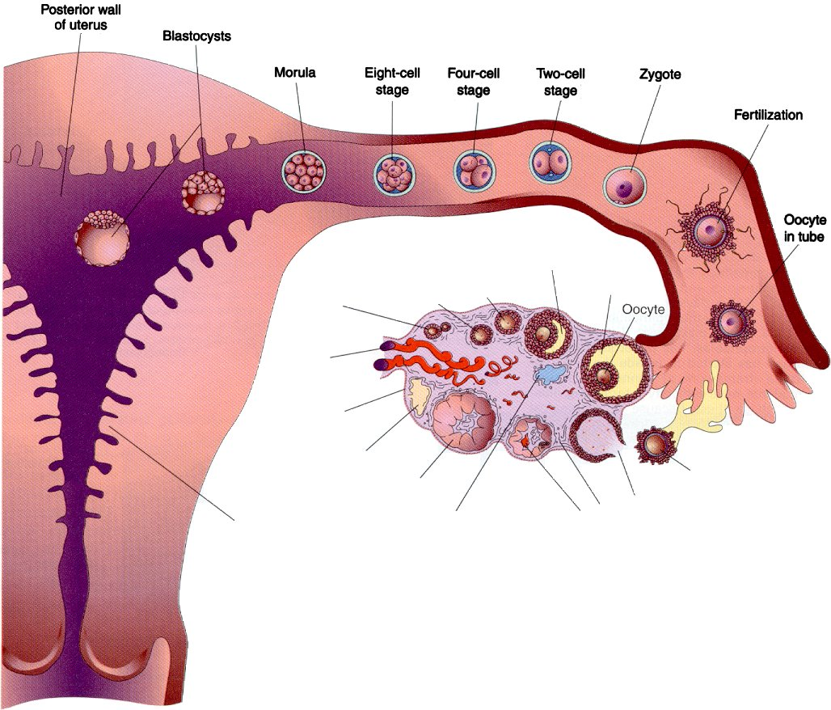
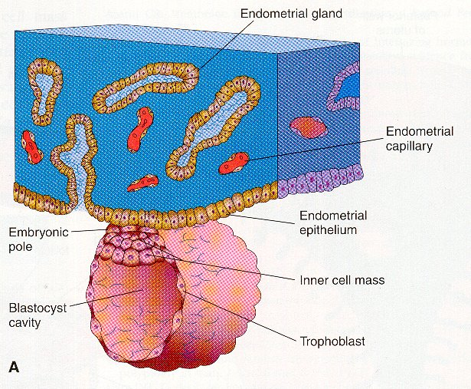
EMBRYOLOGY REVIEW
Review early embryology by clicking on this audio file.

Slide 4
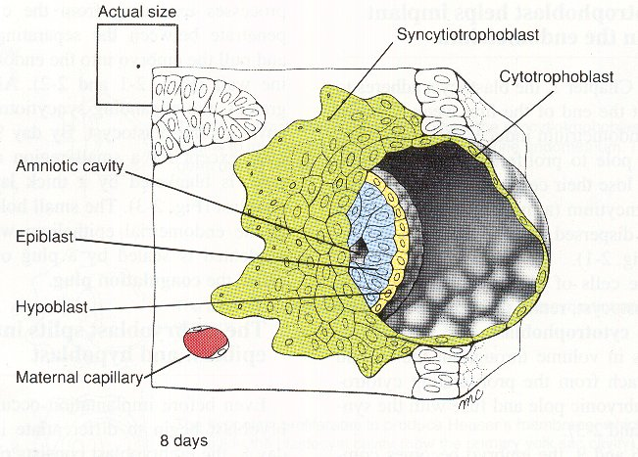
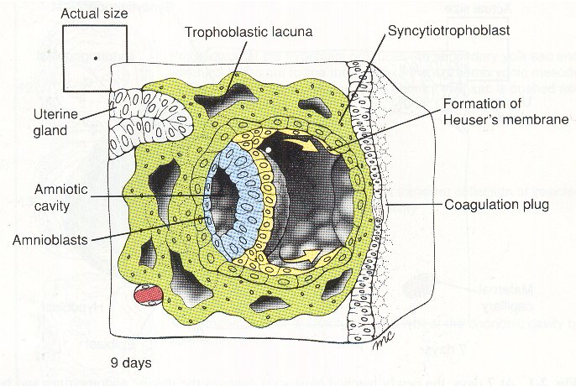
EMBRYOLOGY REVIEW
Review early embryology by clicking on this audio file.
Endometrial epithelium

Slide 5
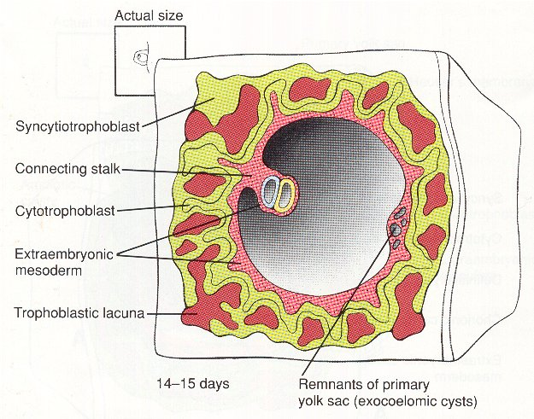
EMBRYOLOGY REVIEW
Review early embryology by clicking on this audio file.

Slide 6
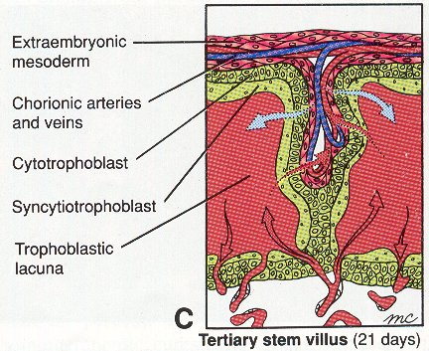
EMBRYOLOGY REVIEW
Review early embryology by clicking on this audio file.
Chorionic cavity = extraembryonic coelom
Chorionic cavity
Chorionic cavity

Slide 7
EMBRYOLOGY REVIEW
Review early embryology by clicking on this audio file.
amniotic cavity
germ disk
amnioblasts/
amniotic membrane
extraembryonic mesoderm
yolk sac

Slide 8
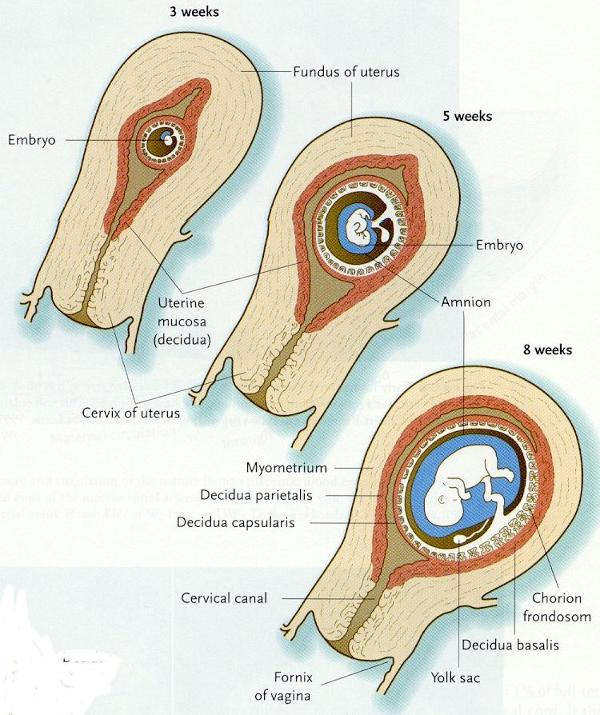
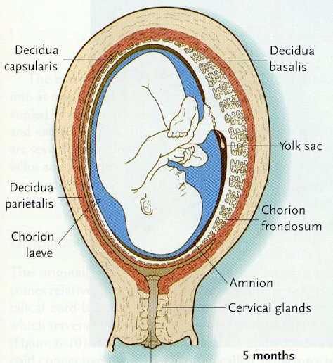
EMBRYOLOGY REVIEW
Review early embryology by clicking on this audio file.

Slide 9
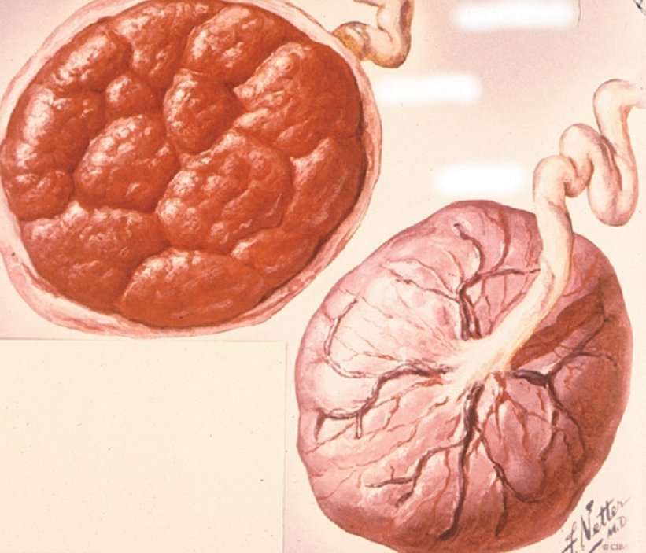
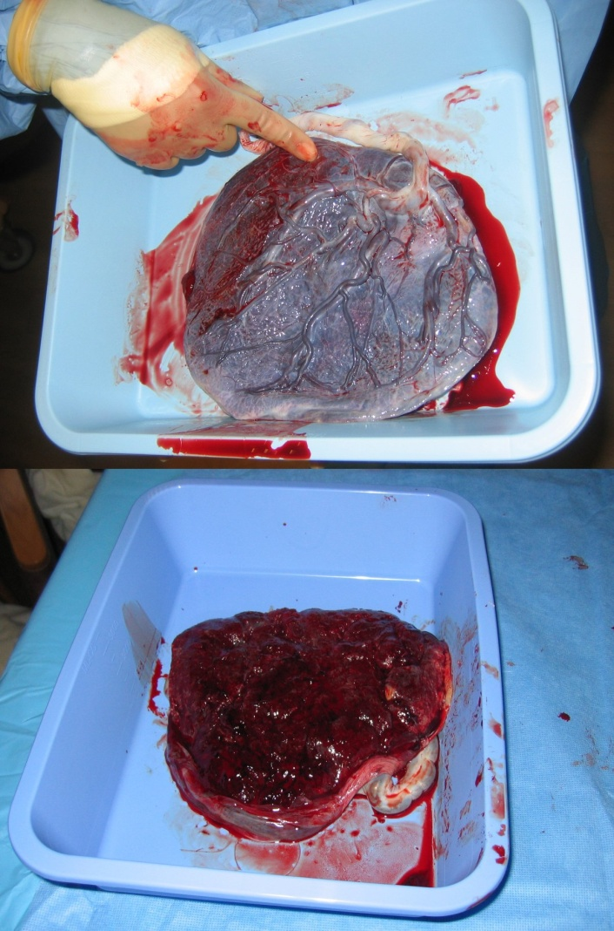
GROSS ANATOMY OF THE PLACENTA
The placenta that is ejected has two sides:
a rough maternal side composed of decidual (endometrial) tissue
A smooth fetal side composed of the amniotic membrane
Fetal side
maternal side
maternal side
Fetal side

Slide 10
GROSS ANATOMY OF THE PLACENTA
The placenta is formed by the joining of three structures:
Amnion (amniotic membrane)
Chorion (including region containing villi)
Maternal decidua
The chorion is tightly attached to the maternal decidua when the conceptus implants into the uterine lining. In contrast, the amnion is only loosely opposed to the chorion, and these layers will separate during tissue preparation.

Slide 11
GROSS ANATOMY OF THE PLACENTA
The placenta is formed by the joining of three structures:
Amnion (amniotic membrane)
Chorion
Maternal decidua
Our discussion of the placenta will start on the fetal side with the amnion and chorion, and progress in the direction of the arrow.
The first placental slide is oriented opposite this drawing, so the amniotic fluid is to the right, and the maternal tissue is to the left. The images are from a region similar to that within the blue box, and includes the amnion, chorion, and villi.

Slide 12
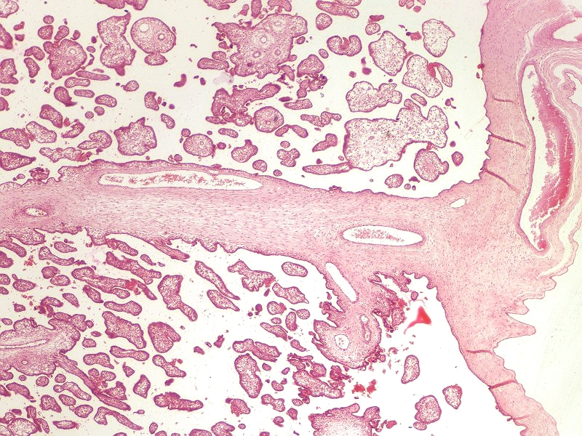
AMNION AND CHORION
The fetal side is composed of the amnion and the chorion.
chorion
villi
chorion
amnion
Amniotic fluid would be here

Slide 13
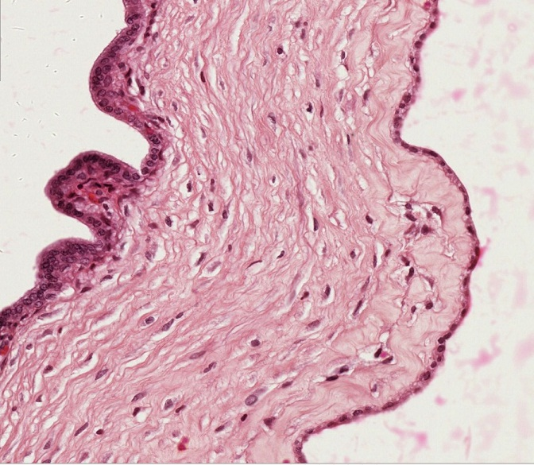
AMNION AND CHORION
The green dotted line represents the approximate location of the obliterated chorionic cavity, which is NOT obliterated in this image.
Extraembryonic mesoderm of chorion
Extraembryonic mesoderm of amnion
Amniotic fluid would be here
The chorion is composed of three layers:
Extraembryonic mesenchyme
Cytotrophoblasts (yellow arrows)
Syncytiotrophoblasts (red arrows)
Closer examination of the amnion reveals it consists of two layers:
Amniotic epithelium (amnioblasts, blue arrows)
Extraembryonic mesenchyme

Slide 14
AMNION AND CHORION
Video showing amnion and chorion in placenta at 5 months – SL145
Link to SL 145
Be able to identify:
Amnion
Amnioblasts
Extraembryonic mesenchyme
Chorion
Extraembryonic mesenchyme
Trophoblasts
Cytotrophoblast and syncytiotrophoblasts differentiated on a subsequent slide

Slide 15
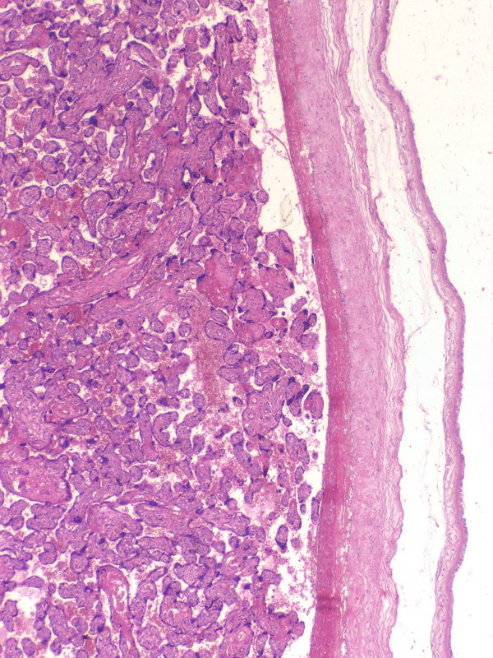
AMNION AND CHORION
chorion
This is a different slide than the previous one, so it looks a little different.
The space between the amnion and chorion is the extraembryonic coelom, or chorionic cavity. This is a potential space in the placenta that is recreated in our tissue sections.
Placental villi
amnion
Chorionic cavity
Amniotic fluid would be here

Slide 16
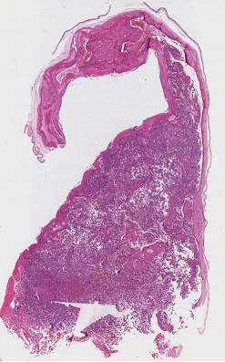
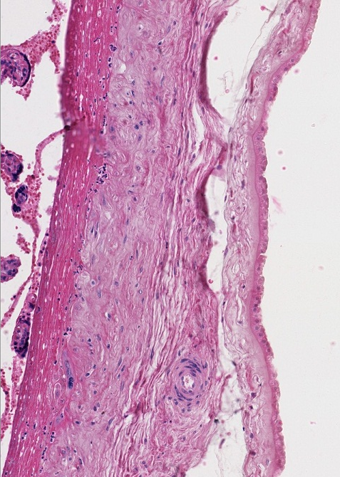
AMNION AND CHORION
X
Clotted blood
X
Extraembryonic mesoderm of amnion
Amniotic fluid would be here
The chorionic cavity indicated by the Xs.
Maternal blood has clotted against the trophoblast cells, making it difficult to identify them in this image.
Extraembryonic mesoderm of chorion
X
Closer examination of the amnion reveals it consists of two layers:
Amniotic epithelium (amnioblasts, blue arrows)
Extraembryonic mesenchyme
The chorion is composed of three layers:
Extraembryonic mesenchyme
Cytotrophoblasts
Syncytiotrophoblasts

Slide 17
AMNION AND CHORION
Video showing amnion and chorion in placenta at term – SL146
Link to SL 146
Be able to identify:
Amnion
Amnioblasts
Extraembryonic mesenchyme
Chorion
Extraembryonic mesenchyme
Trophoblasts
Cytotrophoblast and syncytiotrophoblasts differentiated on a subsequent slide

Slide 18
VILLI AND INTERVILLOUS SPACE
chorion
Villi that project directly from the chorion are called stem villi. You can see numberous branches from the stem villi, called branch villi. The empty space between the villi is normally filled with maternal blood, and is called the intervillous space.
villi
stem villus
amnion
Amniotic fluid would be here

Slide 19
VILLI AND INTERVILLOUS SPACE
chorion
In the placenta at term, note the number of villi has increased dramatically, providing more surface area that increases the efficiency of nutrient and waste exchange, supporting the increasing demands of the growing fetus.
villi
amnion
Amniotic fluid would be here

Slide 20
VILLI AND INTERVILLOUS SPACE
The next images are taken from within the villous space (blue box).

Slide 21
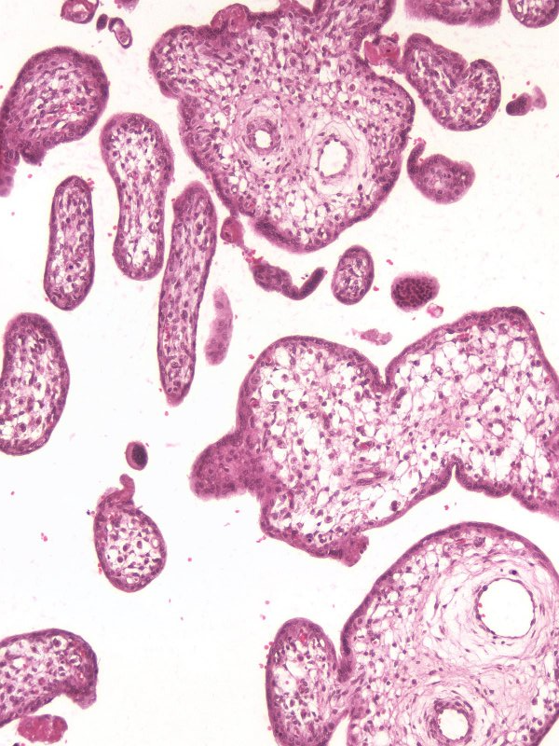
VILLI AND INTERVILLOUS SPACE
villus
This region shows villi and the intervillous space.
Remember the intervillous space develops from the trophoblastic lacunae that formed within the syncytiotrophoblast.
villus
The next slide is an enlarged region in the blue box.
villus

Slide 22
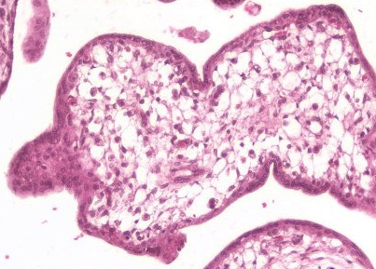
VILLI AND INTERVILLOUS SPACE
syncytiotrophoblast
Like the chorion, villi contain:
mesenchyme with blood vessels
cytotrophoblasts – large, euchromatic nuclei with pale cytoplasm
syncytiotrophoblasts – clustered nuclei with darker cytoplasm
cytotrophoblast
mesenchyme
blood vessels
We’ll see better cytotrophoblasts on the next slide.

Slide 23
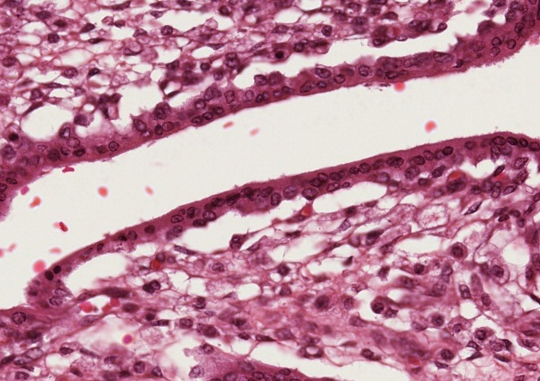
VILLI AND INTERVILLOUS SPACE
syncytiotrophoblast
In this magnified image:
mesenchyme with blood vessels
cytotrophoblasts – large, euchromatic nuclei with pale cytoplasm
syncytiotrophoblasts – clustered nuclei with darker cytoplasm
cytotrophoblasts
Intervillous space (with mama’s blood)
Red blood cell in blood vessel
cytotrophoblasts
mesenchyme

Slide 24
VILLI AND INTERVILLOUS SPACE
Video showing villi – SL145
Link to SL 145
Be able to identify:
Villi
Stem villi
Branch villi
Mesenchyme
Cytotrophoblast
Syncytiotrophoblast
Intervillous space
Where is fetal blood? Where is maternal blood?

Slide 25
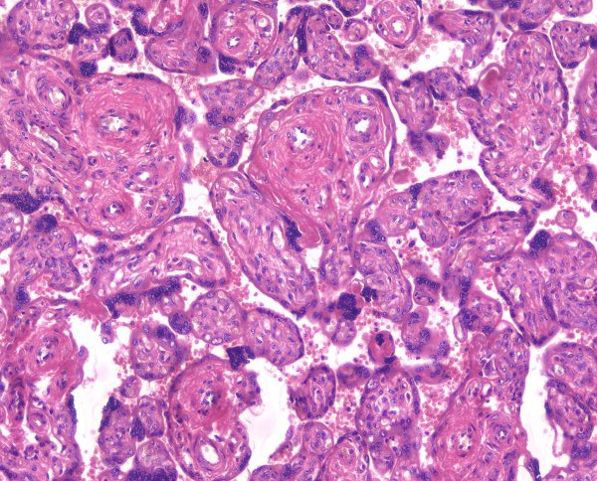
VILLI AND INTERVILLOUS SPACE
As the placenta matures, changes occur to increase exchange efficiency:
Villi branch extensively
Cytotrophoblasts decrease in number
Syncytiotrophoblast nuclei cluster, forming syncytial knots (yellow circles) - this allows the remainder of the syncytiotrophoblast to thin
Fetal blood vessels move to the edge of the villi, where the basal lamina of the endothelial cells fuses with the trophoblast basement membrane

Slide 26
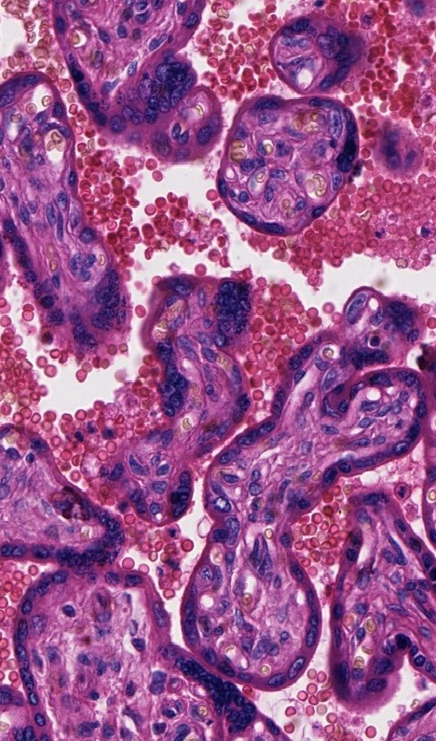
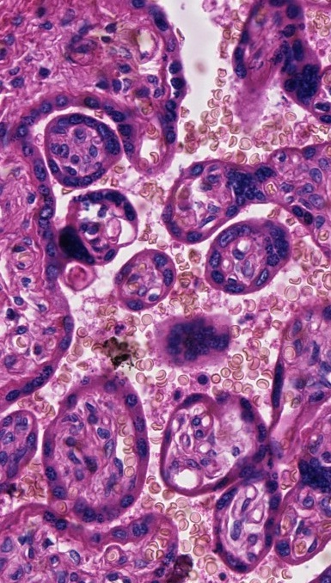
VILLI AND INTERVILLOUS SPACE
Better images of syncytial knots (yellow circles) – the one in the right image is sectioned so it appear to be floating within the intervillous space.

Slide 27
VILLI AND INTERVILLOUS SPACE
Video showing villi – SL146
Link to SL 146
Be able to identify:
Same as previous slide, including
Increased number of villi
Lack of cytotrophoblasts
Syncytial knots
Areas of fused basal lamina

Slide 28
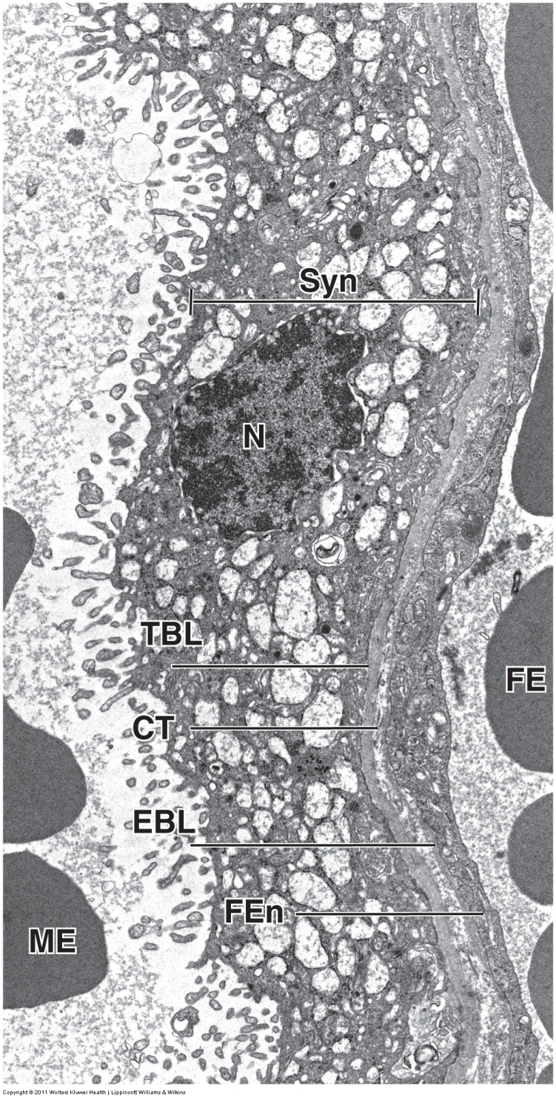
VILLI AND INTERVILLOUS SPACE
This electron micrograph focuses on the barrier between maternal blood (ME) and fetal blood (FE) at term. The syncytiotrophoblast (syn) is thin, with multiple nuclei (only one, N, shown here). This mass is very active metabolically, with microvilli, rough and smooth ER, Golgi, secretory vesicles, and lipid droplets. There is no cytotrophoblast in this section. The basement membrane of the trophoblast (TBL) and the endothelial cell of the fetal blood vessel (EBL) are separated by a thin layer of connective tissue here.

Slide 29
MATERNAL SIDE OF PLACENTA
The next images are taken from the maternal side of the placenta (blue box).

Slide 30
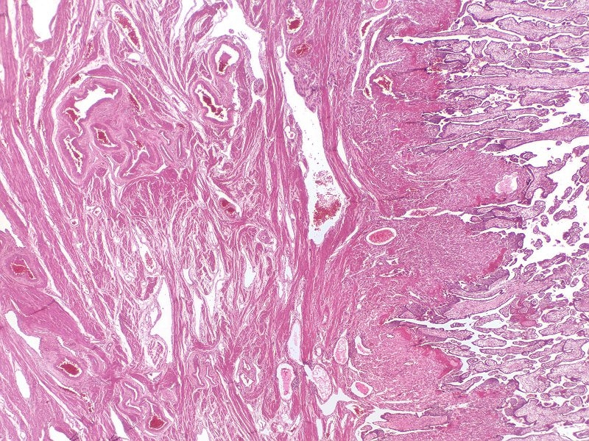
MATERNAL SIDE OF PLACENTA
The maternal side of the placenta shows:
Villi
Decidua
Myometrium
myometrium
decidua
villi
The next slide shows an image taken from a region similar to the one within the yellow rectangle.

Slide 31
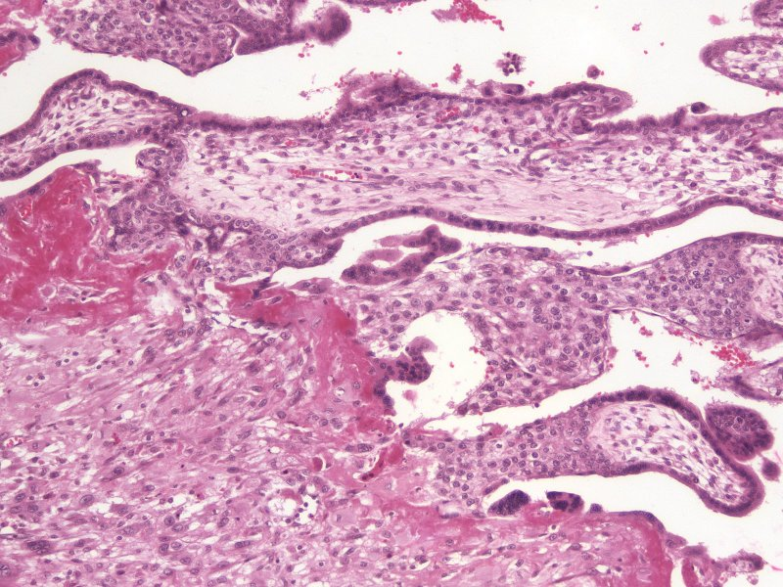
MATERNAL SIDE OF PLACENTA
Some villi extend across the intervillous space and make contact with the syncytiotrophoblasts that line the decidual tissue. These anchoring villi have many cytotrophoblasts (e.g. many within red dashed line), which are moving between the syncytiotrophoblasts and decidual tissue to form the cytotrophoblastic shell. Maternal decidual cells and blood form highly eosinophilic fibroid.
The cytotrophoblastic shell is not readily apparent on our slides.
Anchoring villus
The syncytiotrophoblasts, cytotrophoblastic shell, and maternal decidual tissue is collectively called the basal plate.

Slide 32
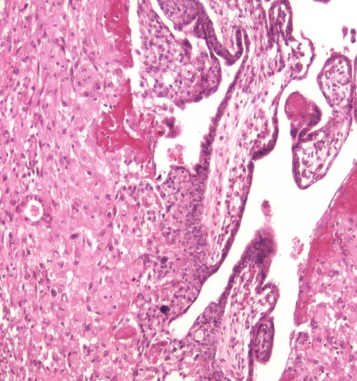
MATERNAL SIDE OF PLACENTA
decidua
villi
In this image, review anchoring villi with cytotrophoblasts, and fibrinoid.
In the decidua, you can see many large cells with eosinophilic cytoplasm. These cells are:
Decidual cells
Cytotrophoblasts
Syncytiotrophoblast
It is difficult to distinguish these three on our slides, though multinuclear masses are clearly syncytiotrophoblast.

Slide 33
MATERNAL SIDE OF PLACENTA
Video showing maternal side of placenta – SL145
Link to SL 145
Be able to identify:
Villi
Anchoring villi
cytotrophoblasts
Decidua
Fibrinoid
Large, eosinophilic cells (decidual or trophoblastic cells)
Myometrium

Slide 34
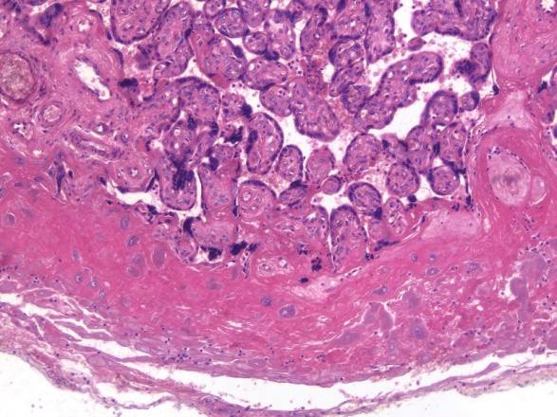
MATERNAL SIDE OF PLACENTA
At term, there is substantial fibrinoid in the decidua, with many eosinophilic cells.

Slide 35
VILLI AND INTERVILLOUS SPACE
Video showing maternal side of placenta – SL146
Link to SL 146
Be able to identify:
Villi
Anchoring villi
cytotrophoblasts
Decidua
Fibrinoid
Large, eosinophilic cells (decidual or trophoblastic cells)
Myometrium

Slide 36
DECIDUA PARIETALIS
The next images are taken from the decidual parietalis (blue box).

Slide 37
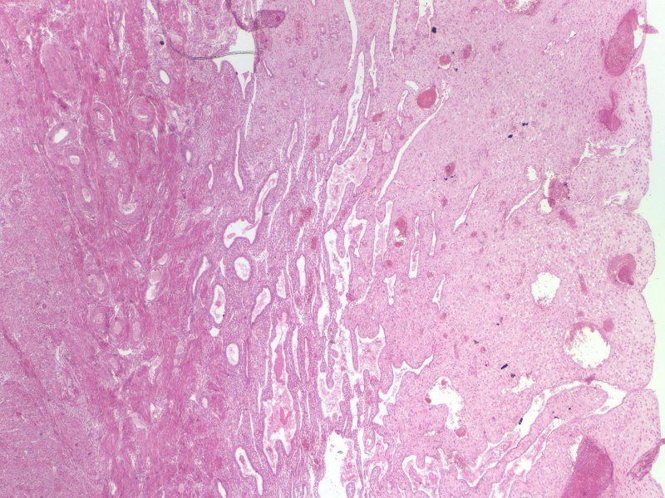
DECIDUA PARIETALIS
In this low power image, you can see the myometrium and decidua.
myometrium
decidua
Note the numerous endometrial glands.
The next slide is an image similar to the region in the yellow rectangle.

Slide 38
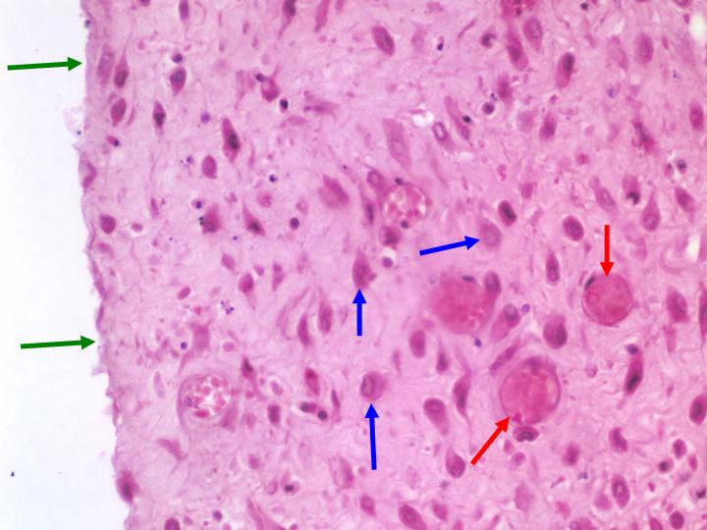
DECIDUA PARIETALIS
In this image, you can see
Thin endometrial epithelium (green arrows)
Extensive vasculature (red arrows)
Decidual cells (blue arrows) – large, with eosinophilic cytoplasm. Unlike the previous slide, these must be decidual cells because they are in the decidua parietalis.

Slide 39
DECIDUA PARIETALIS
Video showing decidua parietalis – SL147
Link to SL 147
Be able to identify:
Decidua parietalis
Endometrial glands
Extensive vasculature
Decidual cells

Slide 40
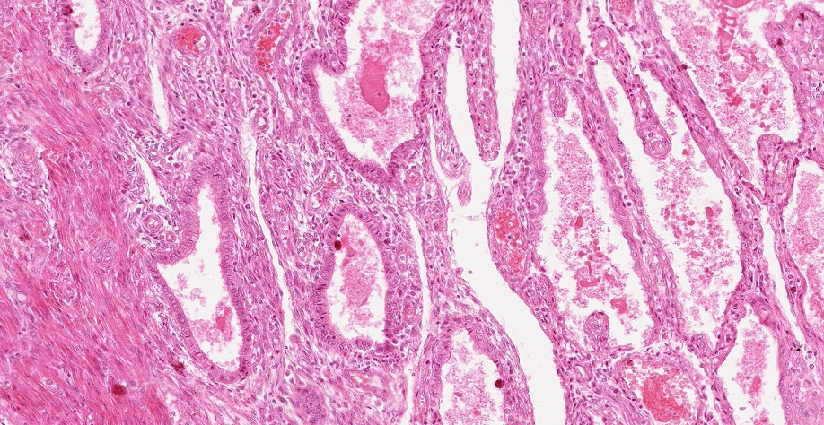
DECIDUA PARIETALIS
At birth, the placenta and the remainder of the functional region of the endometrium slough off, leaving the basal region behind to regenerate the endometrium (similar to the normal menstrual cycle). In this image of the decidua parietalis, you can see that epithelial cells of the functional zone have atrophied (black bracket), while those in the basal region remain columnar.
myometrium

Slide 41
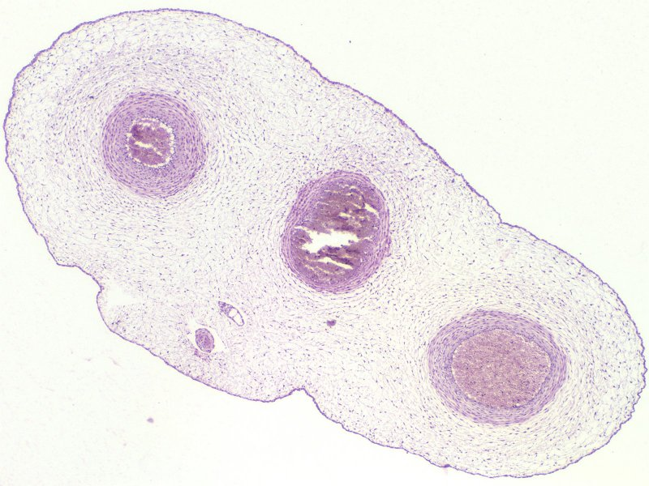
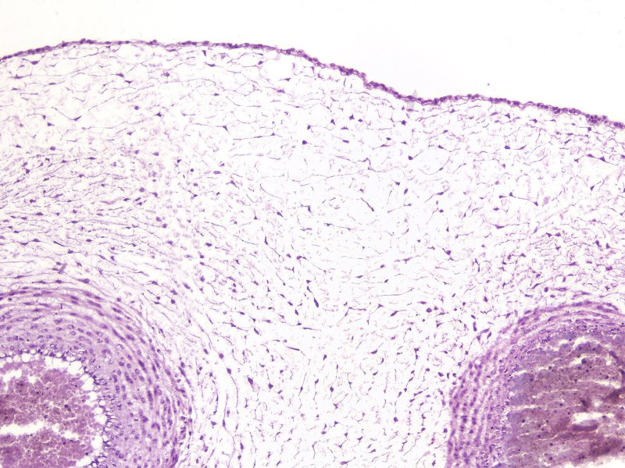
UMBILICAL CORD
The left image is a scanning view of the umbilical cord at 5 months. The image to the right is an enlargement of a region similar to that in the blue box. Note:
The outer layer of the umbilical cord is epithelial (amnioblasts)
The core of the umbilical cord is mesenchyme
There is a central umbilical vein, flanked by two umbilical arteries

Slide 42
UMBILICAL CORD
Video showing umbilical cord at 5 months – SL35
Link to SL 035
Be able to identify:
Umbilical cord
Amnioblasts
Mesenchyme
Umbilical vein
Umbilical arteries

Slide 43
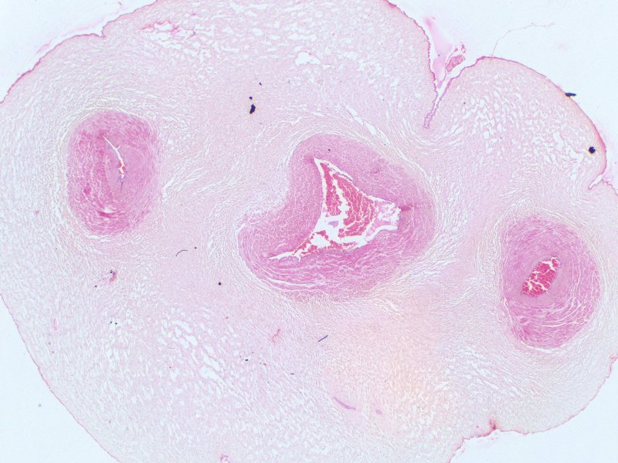
UMBILICAL CORD
Umbilical cord at term. Note that the mesenchyme is more fibrous and the blood vessels are more developed.

Slide 44
UMBILICAL CORD
Video showing umbilical cord at term – SL148
Link to SL 148
Be able to identify:
Umbilical cord
Amnioblasts
Mesenchyme
Umbilical vein
Umbilical arteries

Slide 45
The next set of slides is a quiz for this module. You should review the structures covered in this module, and try to visualize each of these in light micrographs:
identify, at the light microscope level, each of the following:
Placenta – note you will not need to distinguish the developmental age of placenta
Fetal portion
Chorion
Amnion
Stem villi
Branch villi
Mesenchyme
Cytotrophoblast
Syncytiotrophoblast
Syncytial knots
Anchoring villi (same substructures as stem villi)
Maternal portion
Basal plate
Fibrinoid
Decidual tissue
Myometrium
Decidua parietalis
Decidual cells
Umbilical cord
Amnion
Mesenchyme
Umbilical arteries and veins
identify, at the electron microscope level, each of the following:
Placenta
Cytotrophoblasts
Syncytiotrophoblast

Slide 46
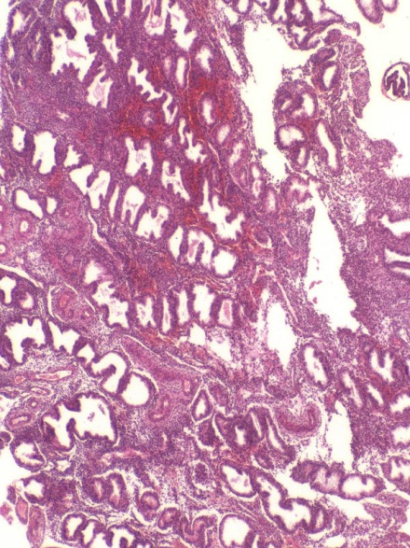
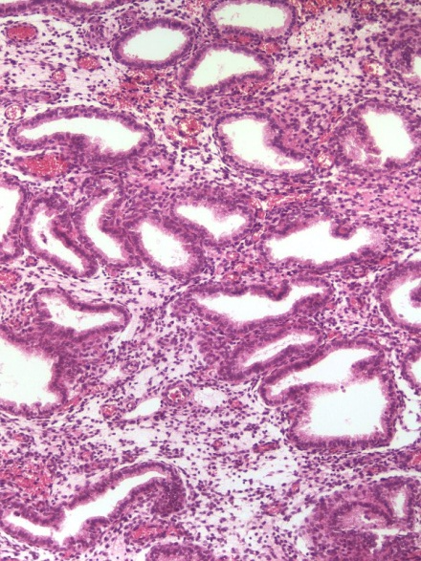
Final quiz
Self-check: Identify the organ. (advance slides for answers)
Uterus, secretory phase

Slide 47
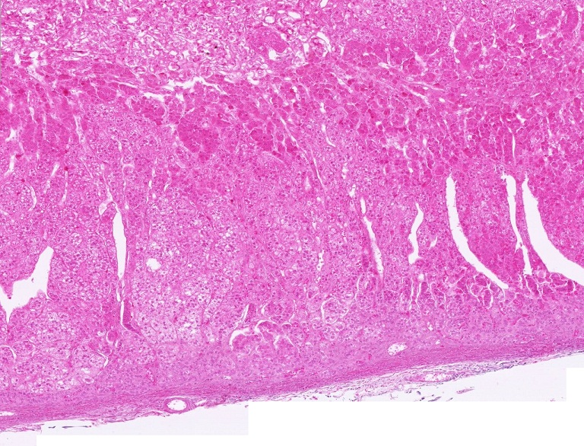
QUIZ
Self-check: Identify the region indicated by the brackets. (advance slides for answers)
Adrenal medulla

Slide 48
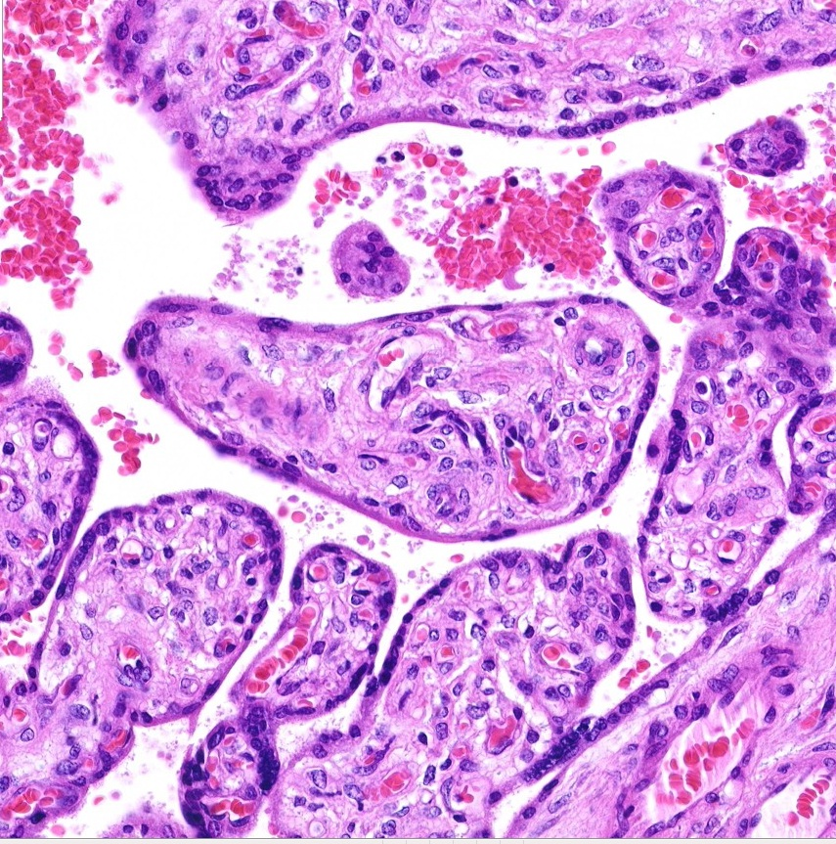
Final quiz
Self-check: Identify the cells indicated by the arrows. (advance slides for answers)
syncytiotrophoblast

Slide 49
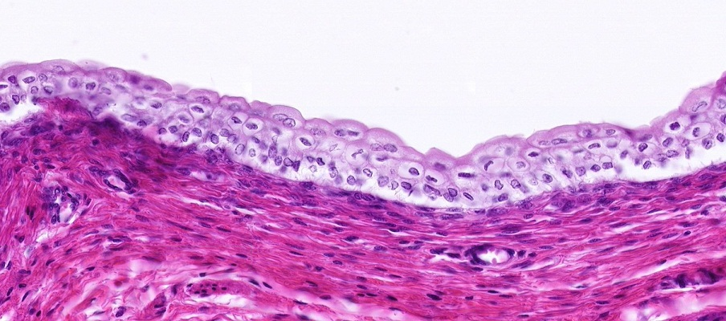
QUIZ
Self-check: Identify the tissue closest to the arrows (advance slides for answers)
Transitional epithelium

Slide 50
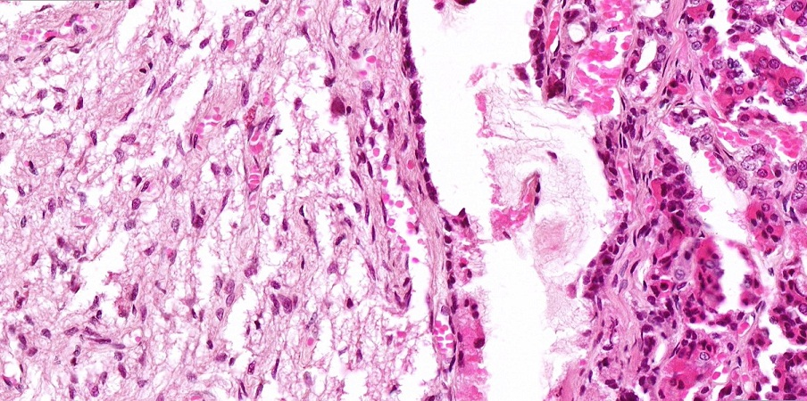
Final quiz
Self-check: Identify the outlined organ. (advance slides for answers)
Posterior pituitary

Slide 51
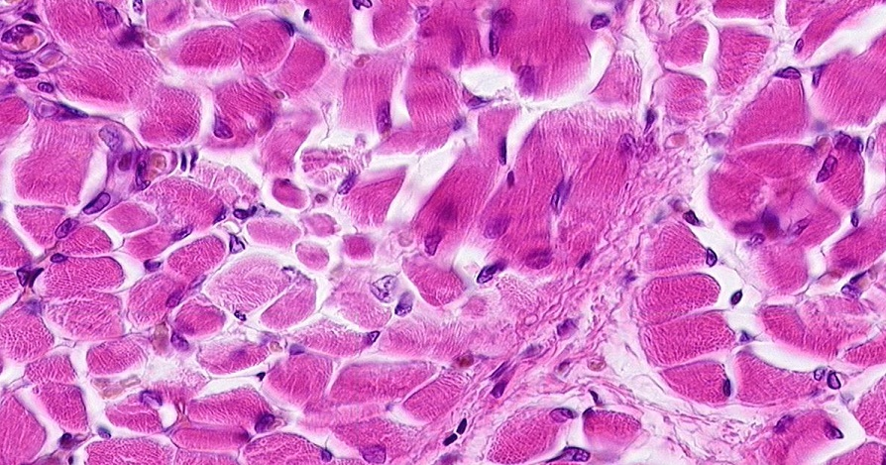
QUIZ
Self-check: Identify the TISSUE on this slide. (advance slides for answers)
Skeletal muscle

Slide 52
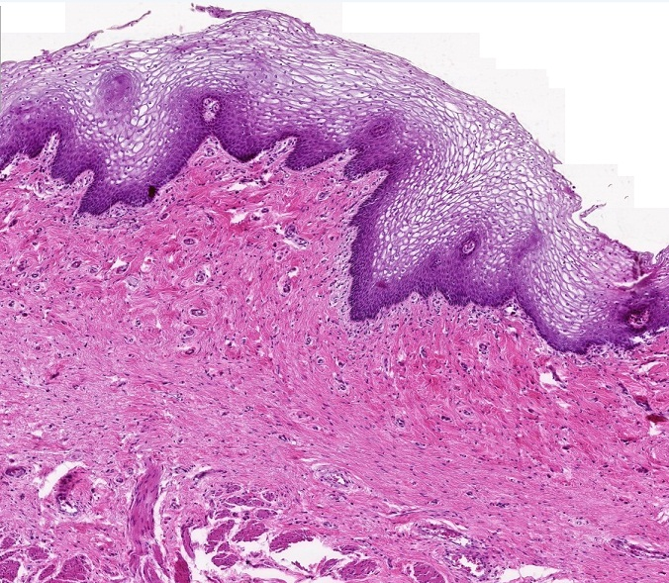
Final quiz
Self-check: Identify the organ. (advance slides for answers)
vagina

Slide 53
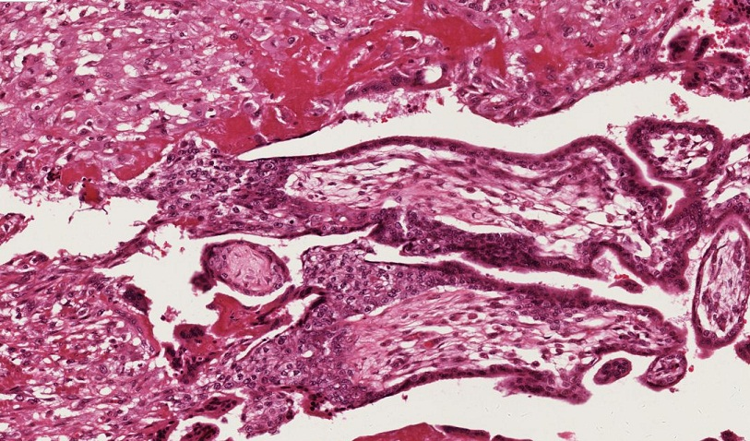
Final quiz
Self-check: Identify the structure in the outlined region. (advance slides for answers)
Anchoring villus

Slide 54
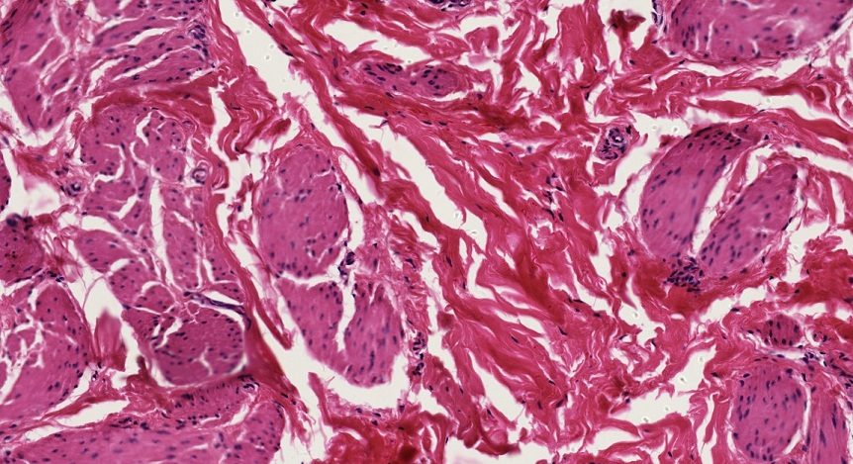
QUIZ
Self-check: Identify the TISSUE in the outlined region. (advance slides for answers)
Smooth muscle

Slide 55
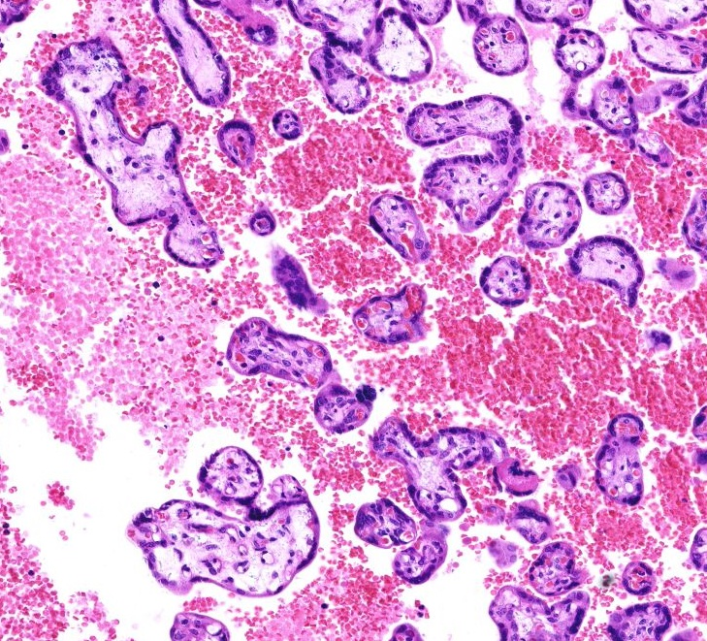
Final quiz
Self-check: Identify the outlined structure. (advance slides for answers)
Syncytial knot

Slide 56
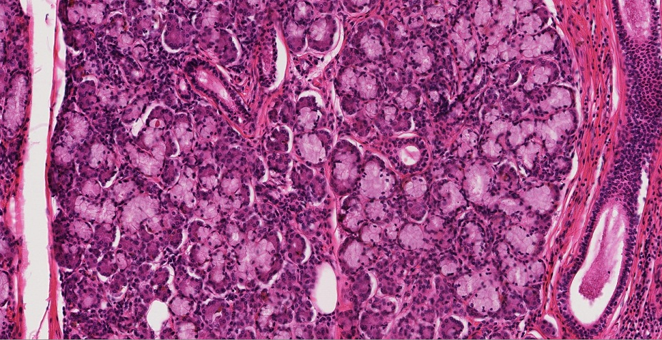
QUIZ
Self-check: Identify the structures on this slide. (advance slides for answers)
Mucous glands and serous demilunes

Slide 57
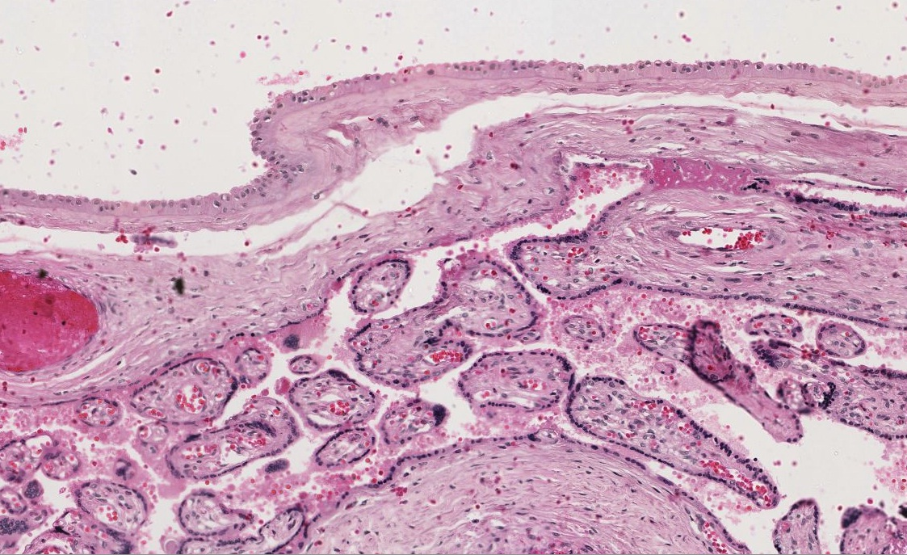
Final quiz
Self-check: Identify the structures indicated by the brackets. (advance slides for answers)
amnion
chorion

Slide 58
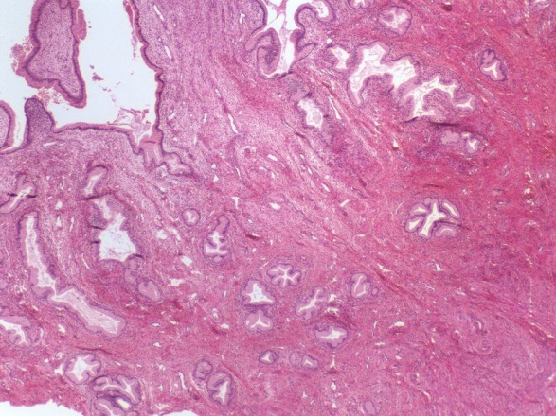
Final quiz
Self-check: Identify the organ. (advance slides for answers)
Cervix of uterus

Slide 59
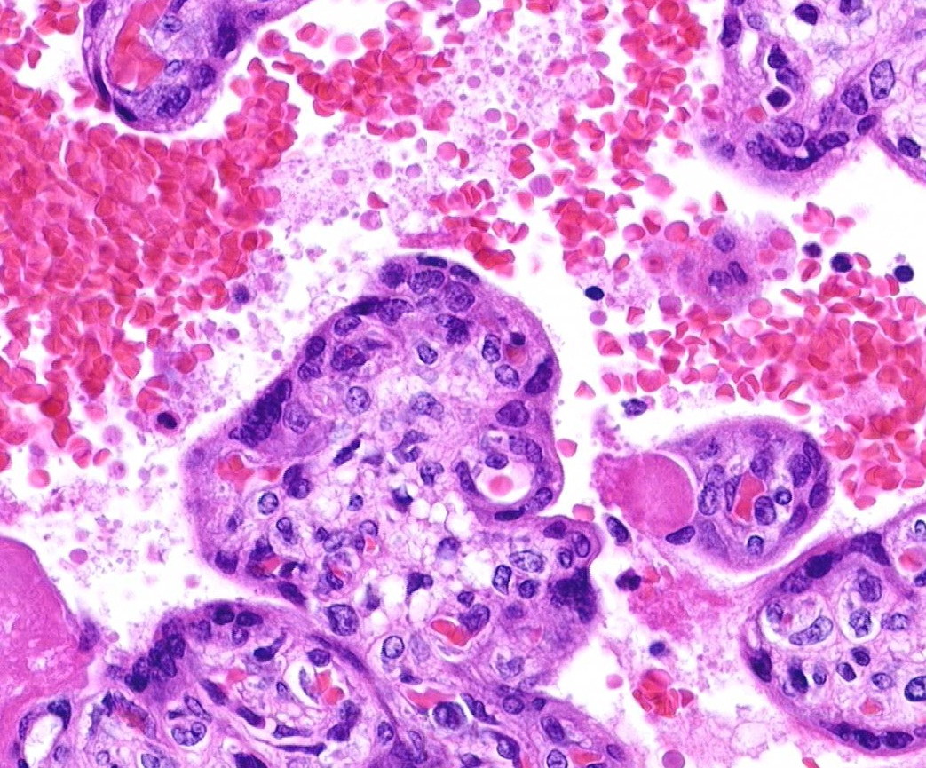
Final quiz
Self-check: Identify the cells indicated by the arrows. (advance slides for answers)
cytotrophoblasts

Slide 60
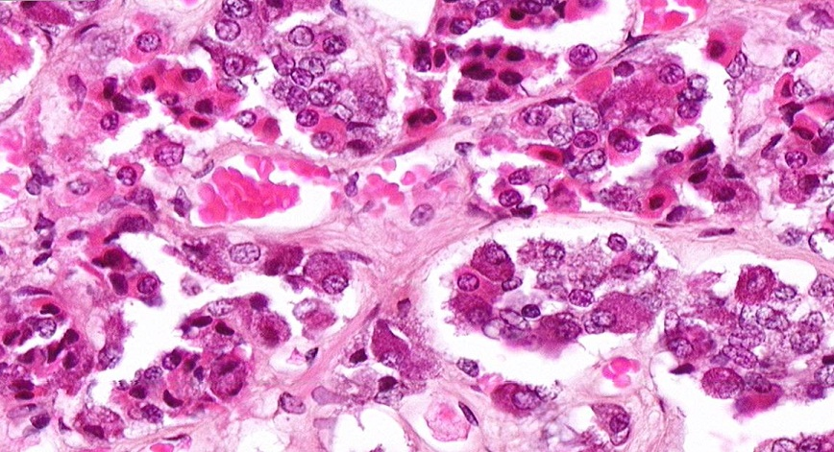
Final quiz
Self-check: Identify the cell indicated by the arrow. (advance slides for answers)
chromophobe

Slide 61
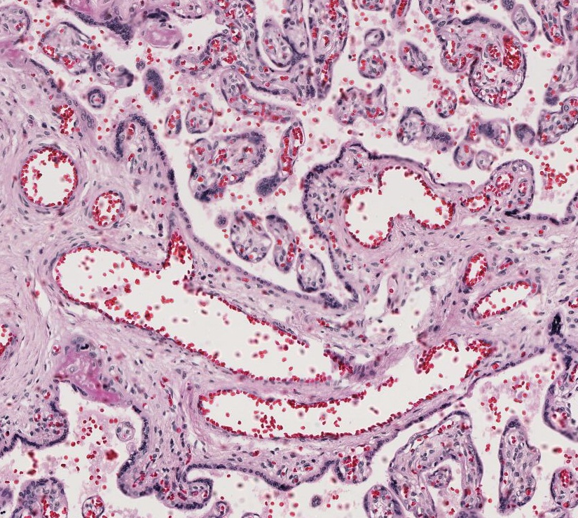
Final quiz
Self-check: Whose red blood cells, fetus’ or mama’s. (advance slides for answers)
Mama’s
Fetus’

Slide 62
Final quiz
Self-check: Identify the structure indicated by the arrows. (advance slides for answers)
Stem villus

Slide 63
QUIZ
Self-check: Identify the region indicated by the brackets. (advance slides for answers)
Zona glomerulosa

Slide 64
Final quiz
Self-check: Identify the organ. (advance slides for answers)
Uterus proliferative phase

Slide 65
Final quiz
Self-check: Identify the cells indicated by the arrows. (advance slides for answers)
Decidual cells

Slide 66
Final quiz
Self-check: Identify the cells indicated by the arrows. (advance slides for answers)
syncytiotrophoblast

Slide 67
QUIZ
Self-check: Identify the TISSUE closest to the arrows (advance slides for answers)
Stratified squamous keratinized epithelium

Slide 68
Final quiz
Self-check: Identify the material in outlined regions. (advance slides for answers)
fibrinoid

Slide 69
Final quiz
Self-check: Identify the TISSUE in the outlined region. (advance slides for answers)
mesenchyme

Slide 70
Final quiz
Self-check: Identify the cells indicated by the arrows. (advance slides for answers)
Secretory (peg) cells of the oviduct

Slide 71
Final quiz
Self-check: Identify the cells indicated by the arrows. (advance slides for answers)
Basophils

Slide 72
QUIZ
Self-check: Identify the TISSUE in the outlined region. (advance slides for answers)
Smooth muscle

Slide 73
QUIZ
Self-check: Identify the structures in the outlined regions. (advance slides for answers)
serous glands

Slide 74
QUIZ
Self-check: Identify the structure in the outlined region. (advance slides for answers)
Peripheral nerve

Slide 75
Final quiz
Self-check: Fetal or maternal side? (advance slides for answers)
fetal

Slide 76
Final quiz
Self-check: Identify the organ. (advance slides for answers)
Parathyroid gland

Slide 77
Final quiz
Self-check: Identify outlined structures or tissues. (advance slides for answers)
mesenchyme
Umbilical artery

Slide 78
Final quiz
Self-check: Identify the organ. (advance slides for answers)
Uterus menstrual phase

Slide 79
Final quiz
Self-check: Identify the cells indicated by the arrows. (advance slides for answers)
acidophils

Slide 80
Final quiz
Self-check: Identify the cells indicated by the arrows. (advance slides for answers)
cytotrophoblast

Slide 81
Final quiz
Self-check: Identify material in outlined regions and structure indicated by arrows. (advance slides for answers)
Anchoring villus
fibrinoid

Slide 82
Final quiz
Self-check: Identify cells A-C and use red arrows to point to the basement membrane. (advance slides for answers)
syncytiotrophoblast
A
cytotrophoblast
Fetal endothelial cell (of blood vessel wall)
B
C

Slide 83
Final quiz
Self-check: Identify the organ. (advance slides for answers)
oviduct

