Slide 1
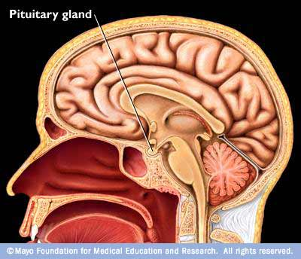
Pituitary Gland
Digital Laboratory
It’s best to view this in Slide Show mode, especially for the quizzes.
This module will take approximately 30 minutes to complete.

Slide 2
After completing this exercise, you should be able to:
identify, at the light microscope level, each of the following:
the pituitary gland, stained with all stains presented in this module, or labeled with hormone antibodies by immunocytochemistry
the following regions and components of the pituitary gland, stained or labeled as stated above
Adenohypophysis/pars distalis/anterior pituitary
Acidophils
Basophils
Chromophobes
Sinusoids
Neurohypophysis/pars nervosa/posterior pituitary
Pituicytes
Herring bodies (best seen with PAS stain)
Pars intermedia
Colloid
identify, at the electron microscope level
secretory granules (You are not required to identify specific cell types based on the morphology of the granules.)

Slide 3
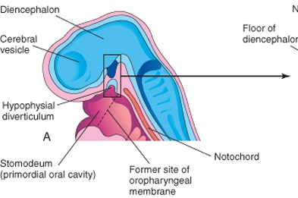
THE ORIGINS OF THE PITUITARY GLAND
Neural tissue
ventricle
Developing pituitary gland
anterior
posterior
The pituitary gland develops from neural tissue and oral ectoderm, both of which are epithelial. For orientation: The ventricle (space with cerebrospinal fluid, think neural canal in embryology) is exaggerated. The wall of the developing brain, i.e. the neural tissue, is indicated by the pale blue border (the dark region is discussed on the next slide). The oral cavity is also large, indicated by the red shades. The roof of the oral cavity is a thin black line, expanded in the pale blue region marked hypophyseal diverticulum. The light pink area surrounding the neural tissue is mesenchyme. The diencephalon is the part of the brain that will form the thalamus and hypothalamus.

Slide 4
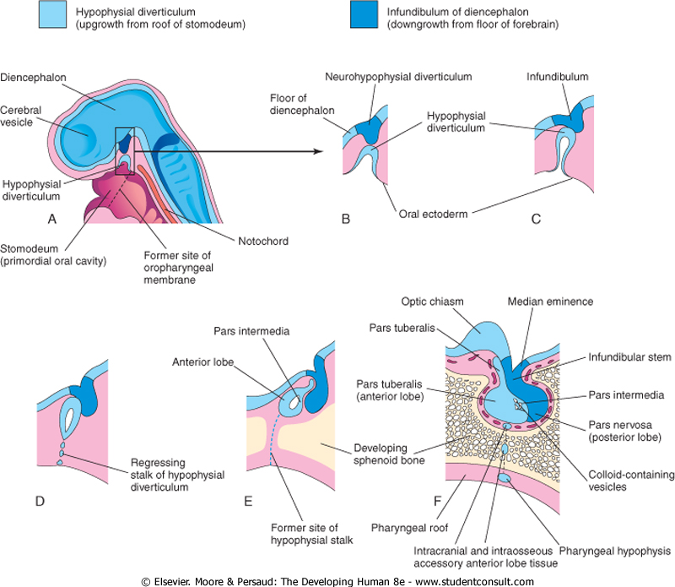
PITUITARY GLAND DEVELOPMENT
anterior
posterior
The floor of the diencephalon in the area of the future hypothalamus grows inferiorly; this neurohypophyseal diverticulum forms the posterior pituitary (pars nervosa), which remains connected to the hypothalamus via the infundibulum. At the same time, the hypophyseal diverticulum from the oral ectoderm migrates superiorly, breaking off from the oral cavity to form a fluid filled vesicle, which wraps around the infundibulum. The anterior wall of this vesicle develops robustly, forming the anterior lobe (pars distalis), while the posterior wall of this vesicle is fairly vestigial, forming a thin pars intermedia. The remnant of the lumen of this vesicle is called Rathke’s pouch, and fills with colloid. The mesenchyme surrounding these structures forms bones of the floor of the skull (sphenoid bone).

Slide 5
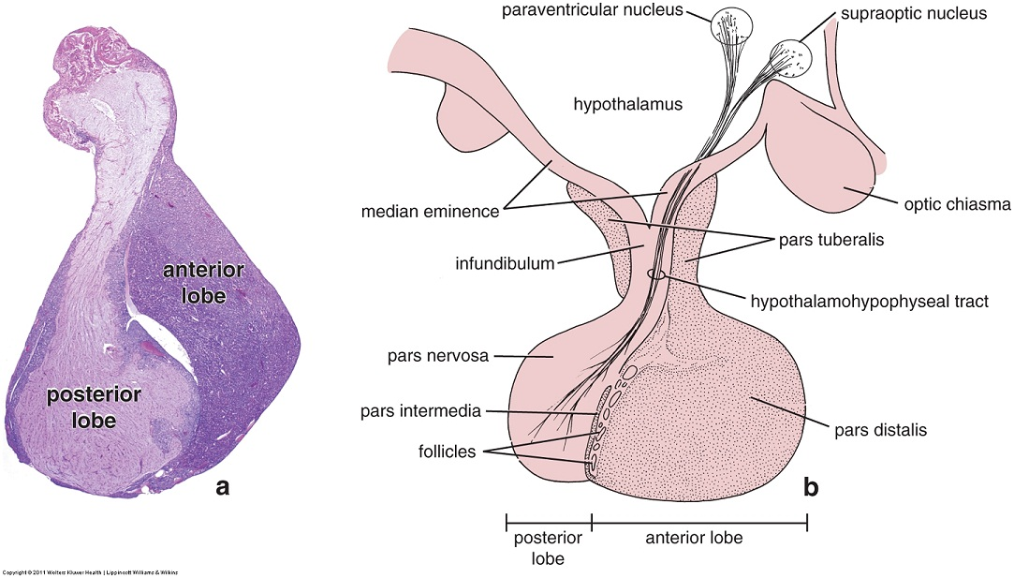
OVERVIEW OF THE PITUITARY GLAND
posterior
anterior
These images are low power views of a pituitary gland that has been de-attached from the hypothalamus. Note the old switcherooo of anterior-posterior orientation from previous diagrams (though I really hope the labels in the image gave it away for you!). The posterior lobe is really an extension of the hypothalamus; in higher power views, you will see that it looks a lot like neural tissue. The anterior lobe derives from oral ectoderm and has a glandular appearance, which is more darkly stained than the neural tissue of the posterior lobe (a).

Slide 6
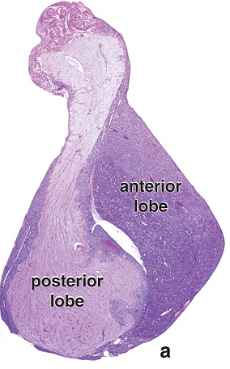
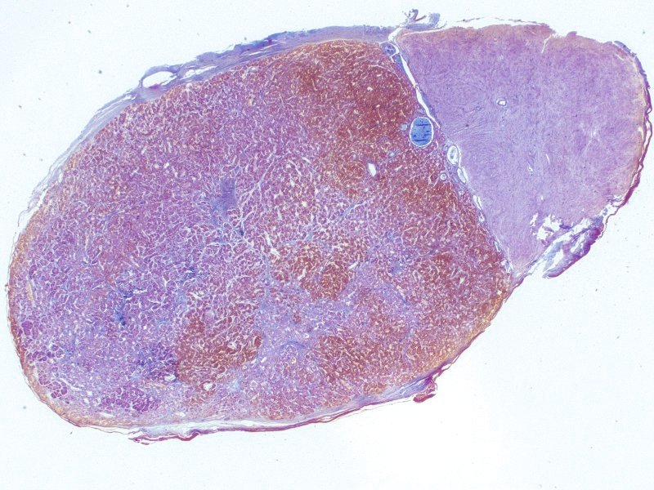
OVERVIEW OF THE PITUITARY GLAND
intermediate
lobe
colloid
Posterior
lobe
Anterior
lobe
Our slides are sectioned in a relatively horizontal plane, and, therefore, do not cut through the infundibulum. However, even at low power, you should immediately recognize this as the pituitary gland due to the juxta-positioning of the neural-like posterior lobe and the more glandular appearing anterior lobe (often with colloid between, as seen here).

Slide 7
OVERVIEW OF THE PITUITARY GLAND
Video of pituitary gland showing overview – SL121
Link to SL 121
Be able to identify:
Pituitary gland
Anterior lobe (pars distalis)
Posterior lobe (pars nervosa)
Intermediate lobe
colloid

Slide 8
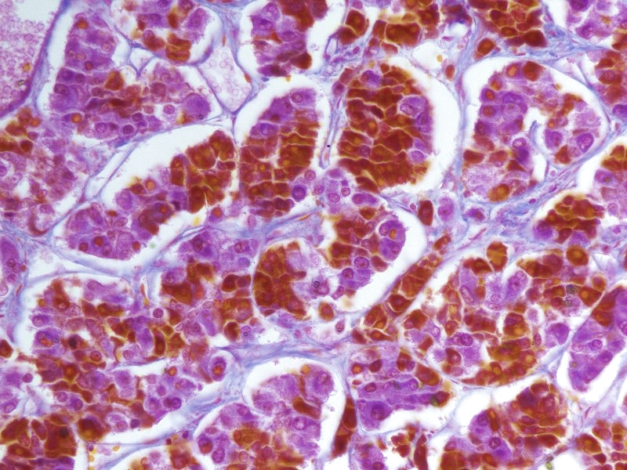
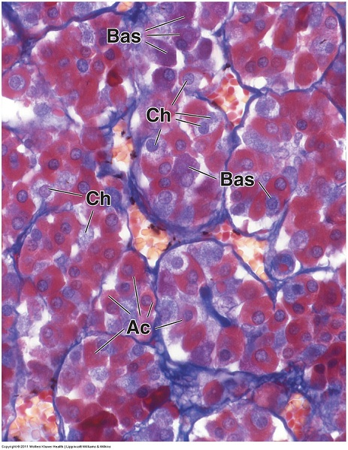
PITUITARY GLAND – ANTERIOR LOBE
The anterior lobe of the pituitary has three major cell types:
Acidophils (Ac) – stain orange or red, includes somatotrophs and mammotrophs (aka lactotrophs)
Basophils (Bas) – stain blue or purple, includes gonadotrophs, thyrotrophs, and corticotrophs
Chromophobes (Ch) - pale cytoplasm, may be cells that already have released granule content
The two sections above were stained with trichrome stains (three dyes), which particularly highlight the differences in staining properties of adenohypophyseal cells. (You don’t have to worry about the details of these stains.)

Slide 9
PITUITARY GLAND – ANTERIOR LOBE
Video of pituitary gland showing cells of anterior lobe stained with Mallory’s trichrome – SL121
Link to SL 121
Be able to identify:
Acidophils
Basophils
Chromophobes

Slide 10
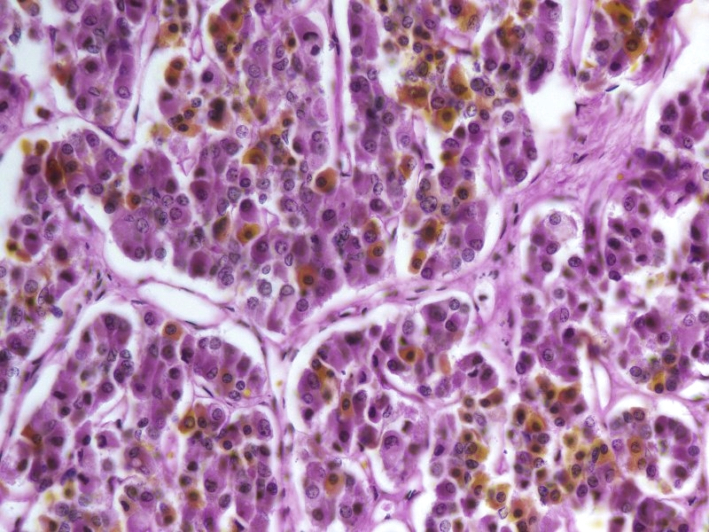
PITUITARY GLAND – ANTERIOR LOBE
This section was stained with PAS and Orange G. Hormones secreted by basophils are glycosylated, so granule content makes these cells PAS+ (purple). Orange G is simply a counterstain for the acidophils.
With this stain:
Acidophils – (orange arrows) cytoplasm stains orange, somatotrophs and mammotrophs (lactotrophs)
Basophils – (yellow outline) cytoplasm is PAS+ (purple), gonadotrophs, thyrotrophs, corticotrophs
Chromophobes – (red arrows and outline) pale cytoplasm

Slide 11
PITUITARY GLAND – ANTERIOR LOBE
Video of pituitary gland showing cells of anterior lobe stained with PAS – SL122
Video of pituitary gland showing cells of anterior lobe stained with PAS extra – SL122
Link to SL 122
Be able to identify:
Acidophils
Basophils
Chromophobes

Slide 12
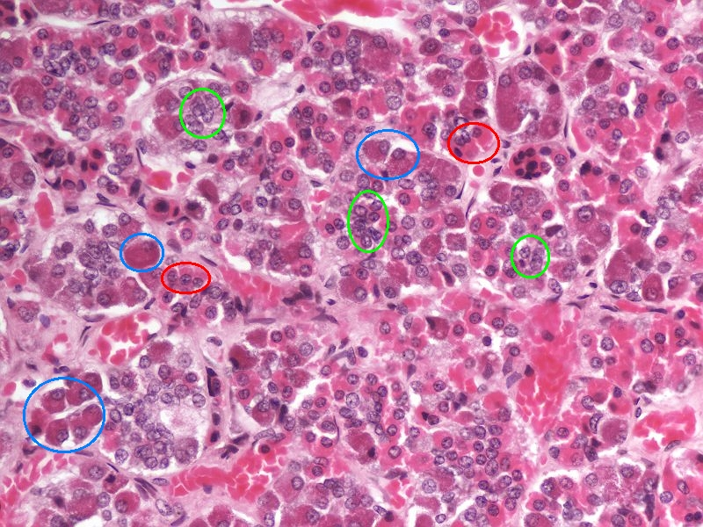
PITUITARY GLAND – ANTERIOR LOBE
This is H&E. Feels good to be back home…..red is eosinophilic and blue is basophilic!
Upon H&E staining, the three major cell types:
Acidophils (red circles) – eosinophilic cytoplasm, includes somatotrophs and mammotrophs (lactotrophs)
Basophils (blue circles) – basophilic cytoplasm, includes gonadotrophs, thyrotrophs, corticotrophs
Chromophobes (green circles) - pale cytoplasm

Slide 13
PITUITARY GLAND – ANTERIOR LOBE
Video of pituitary gland showing cells of anterior lobe stained with H&E – SL123
Link to SL 123
Be able to identify:
Acidophils
Basophils
Chromophobes

Slide 14
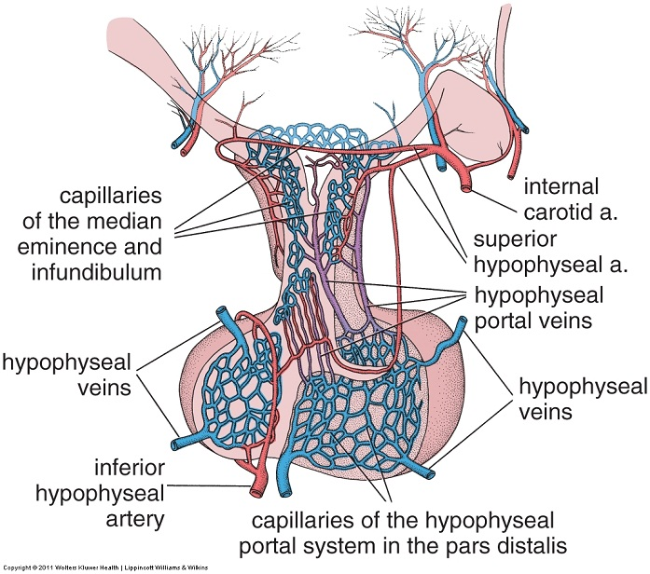
PITUITARY GLAND – ANTERIOR LOBE
posterior
anterior
The anterior pituitary utilizes a portal circulatory system. As you probably know, blood typically passes through one capillary bed in a systemic circuit. In a portal system, however, there are two capillary beds to maximize delivery of specific substances from one organ to the other. In the hypophyseal portal system hypothalamic cells secrete releasing and inhibiting factors, which enter the first capillary bed in the median eminence and infundibulum. These capillaries merge inferiorly to form the hypophyseal portal veins, which carry blood to the pars distalis and branch into a second capillary bed in this location. In this way, hypothalamic factors can have a more direct influence on secretory activity of pars distalis cells.

Slide 15
PITUITARY GLAND – ANTERIOR LOBE
The capillaries in the anterior pituitary are fenestrated sinusoids (black outlines)…
Fenestrated – the walls are more porous than most capillaries
Sinusoids – they have a wider diameter than most capillaries
The red blood cells are the disks inside the capillaries.
At this magnification, you cannot see the fenestrations, however, you can see that they are indeed wide-diameter, thin-walled vessels. We’ll spend more time on the different types of capillaries in the Cardiovascular, Renal, and Pulmonary Block (aka CRaP).

Slide 16
PITUITARY GLAND – ANTERIOR LOBE
Video of pituitary gland showing fenestrated sinusoids– SL121
Video of pituitary gland showing fenestrated sinusoids – SL123
Link to SL 121 and SL 123
Be able to identify:
sinusoids

Slide 17
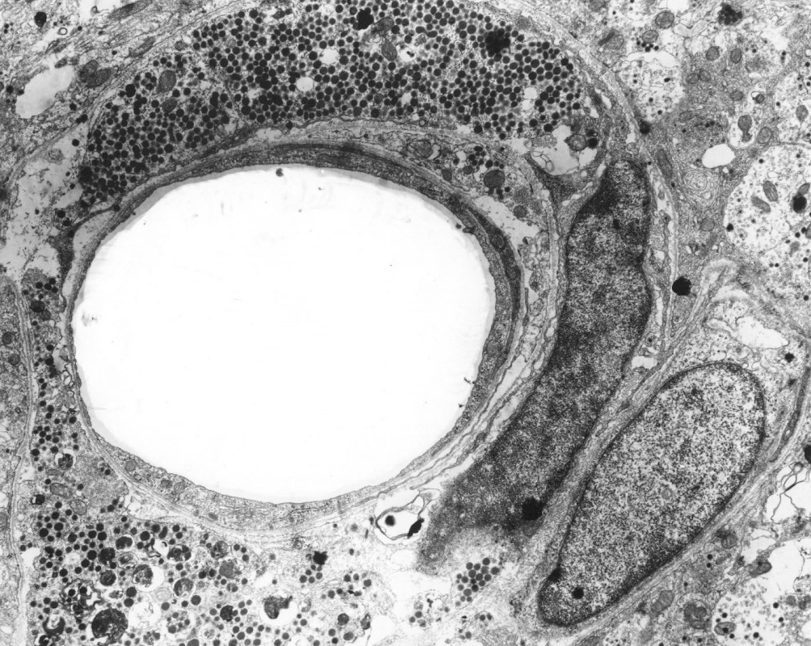
PITUITARY GLAND – ANTERIOR LOBE
Capillary lumen
This is an EM taken from the median eminence, one area of the hypothalamus that releases factors that affect the anterior pituitary. You can see a cell at the top and one or two cells at the bottom that have a large number of secretory granules. These granules represent stored hypothalamic factors that are ready to be released.

Slide 18
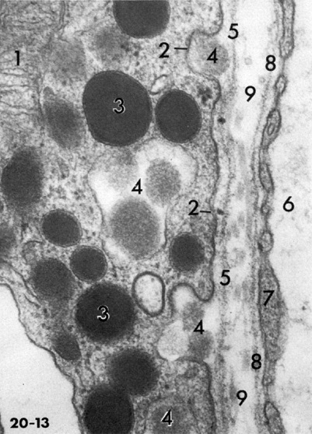
PITUITARY GLAND – ANTERIOR LOBE
This is an EM taken of the anterior lobe of the pituitary gland. A gonadotroph, filled with secretory granules (3), is on the left. The right edge of this image is the lumen of a sinusoid, with the fenestrations in the walls indicated by the arrows (endothelial cell is #7). #5 and #8 are basal lamina, #9 is connective tissue between the gonadotroph and sinusoid. Note #4, which is exocytosis of granule contents caught in action!!! It doesn’t get better than that. (The #4 in the apparent “middle” of the image looks different becaue of the plane of section.)
A note of caution: Many authors us the term “sinusoid” to refer to vessels with larger gaps between the endothleial cells. Here, we use the term to speak of the diameter of the vessel. This distinction will be discussed in detail in the cardiovascular block.

Slide 19
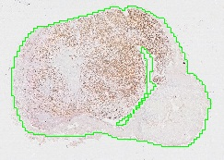
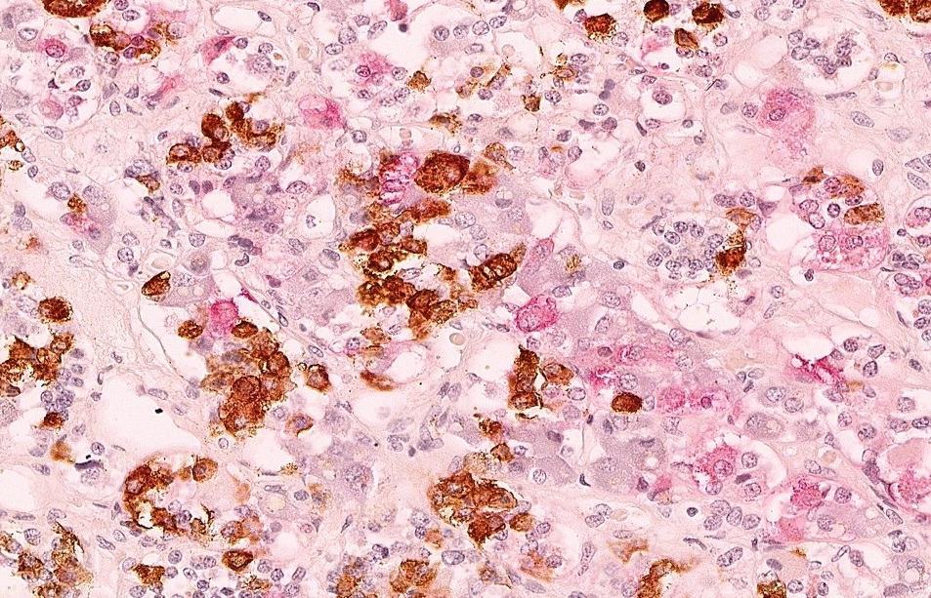
PITUITARY GLAND – ANTERIOR LOBE
Area in the blue box is enlarged to the right
With basic histological stains such as H&E, you can only distinguish between acidophils and basophils. Using immunocytochemistry (see Ross, Chapter 1), however, you can differentiate among specific cell types by use of antibodies to the hormones secreted by each cell type. On this slide, immunocytochemical techniques resulted in a brown reaction product in somatotrophs, which secrete growth hormone, and a pink reaction product in thyrotrophs, which secrete thyroid stimulating hormone.

Slide 20
PITUITARY GLAND – ANTERIOR LOBE
Video of pituitary gland showing immunocytochemistry – SL171
Link to SL 171
Be able to identify:
Understand immunocytochemistry, don’t memorize which color was which hormone

Slide 21
PITUITARY GLAND – INTERMEDIATE LOBE
intermediate
lobe
colloid
Posterior
lobe
Anterior
lobe
As the name implies, the intermediate lobe (pars intermedia) is situated between the anterior and posterior lobes. Recalling the development of the pituitary, one would expect that the intermediate lobe resembles the anterior lobe. The next slide is an enlargement of the area with the yellow box.

Slide 22
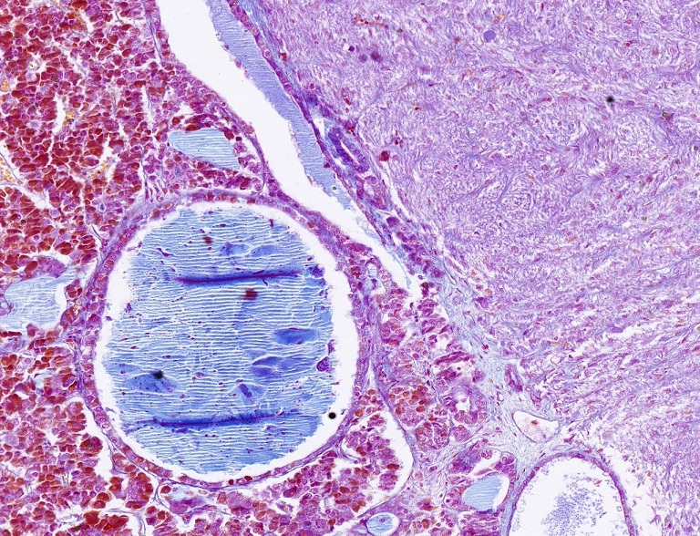
PITUITARY GLAND – INTERMEDIATE LOBE
colloid
Here you can see more detail of the colloid and intermediate lobe (yellow outline). Note that the cells of the intermediate lobe are, for the most part, similar to the cells in the anterior lobe. In humans, the intermediate lobe is not prominent.

Slide 23
PITUITARY GLAND – INTERMEDIATE LOBE
Video of pituitary gland showing intermediate lobe and colloid – SL121
Link to SL 121
Be able to identify:
intermediate lobe
colloid

Slide 24
PITUITARY GLAND – POSTERIOR LOBE
posterior
anterior
The hormones released by the posterior pituitary are actually synthesized in neuronal cell bodies located in the hypothalamus (paraventricular and supraoptic hypothalamic nuclei). After synthesis and accumulation in synaptic vesicles, vasopressin and oxytocin are transported down the axons of of the hypothalamo-hypophyseal tract by anterograde transport and reach the synaptic boutons, which are distally located in the posterior pituitary. Signals perceived at the cell bodies, in the hypothalamic nuclei, result in action potentials that travel down the axons and trigger the release of vasopressin and oxytocin hormone-containing vesicles in the posterior pituitary.

Slide 25
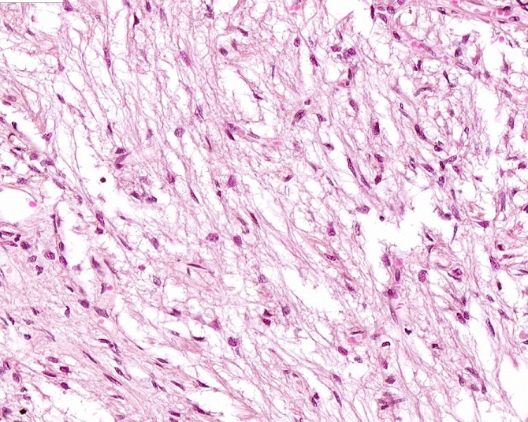
PITUITARY GLAND – POSTERIOR LOBE
Arrows indicate red blood cells
Because the posterior pituitary consists largely of unmyelinated axons, its appearance is quite similar to a peripheral nerve, with numerous pale eosinophilic threads. The neuronal cell bodies that belong to these axons are in the hypothalamus. The synaptic terminals of the neurons are not readily visible on this H&E-stained tissue. Most of the nuclei that you see in this section belong to specialized glial cells called pituicytes.

Slide 26
PITUITARY GLAND – POSTERIOR LOBE
Video of pituitary gland showing cells of posterior lobe stained with H&E – SL123
Link to SL 123
Be able to identify:
Posterior pituitary
Pituicytes

Slide 27
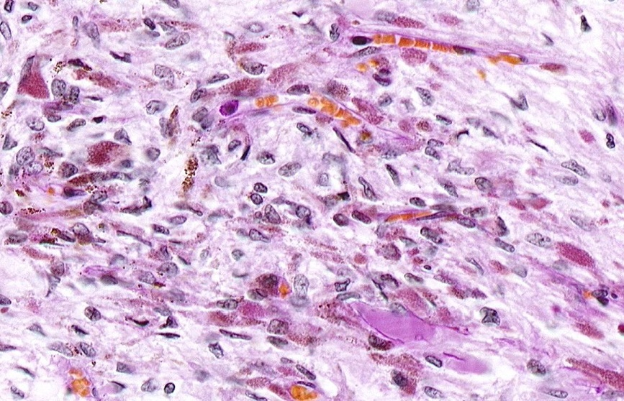
PITUITARY GLAND – POSTERIOR LOBE
Arrows indicate red blood cells
The synaptic accumulations within the posterior pituitary are called Herring bodies (outlined). The vesicles in these bodies contain glycoprotein hormones and, therefore, are PAS⁺. Note their proximity to blood vessels; where their contents can be released immediately into the bloodstream. This slide is counterstained with orange G, which stains the red blood cells.

Slide 28
PITUITARY GLAND – POSTERIOR LOBE
Video of pituitary gland showing cells of posterior lobe – SL122
Link to SL 122
Be able to identify:
Posterior pituitary
Herring bodies

Slide 29
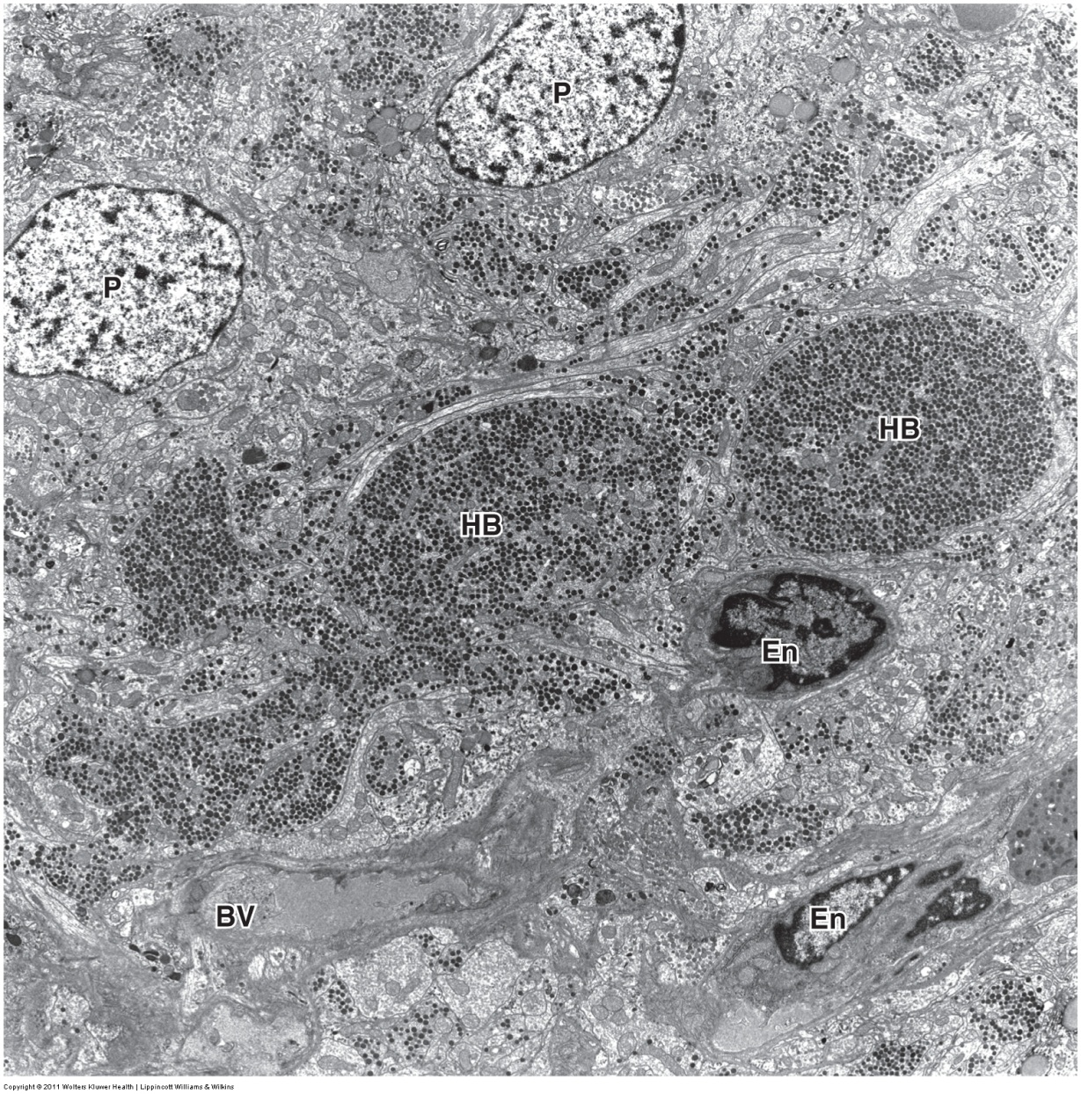
PITUITARY GLAND – POSTERIOR LOBE
This electron micrograph of the posterior pituitary illustrates Herring bodies (HB). Note that, unlike in the anterior pituitary, here there are no cellular nuclei associated with accumulations of granules containing hormones. Remember - the cell body is in the hypothalamus. The nuclei you do see belong to pituicytes (P) and endothelial cells (En) of blood vessels (BV).

Slide 30
The next set of slides is a quiz for this module. You should review the structures covered in this module, and try to visualize each of these in light and electron micrographs.
identify, at the light microscope level, each of the following:
the pituitary gland, stained with all stains presented in this module, or labeled with hormone antibodies by immunocytochemistry
the following regions and components of the pituitary gland, stained or labeled as stated above
Adenohypophysis/pars distalis/anterior pituitary
Acidophils
Basophils
Chromophobes
Sinusoids
Neurohypophysis/pars nervosa/posterior pituitary
Pituicytes
Herring bodies (best seen with PAS stain)
Pars intermedia
Colloid
identify, at the electron microscope level, between the hypothalamus and pituitary, using the distribution of secretory granules as a guide

Slide 31
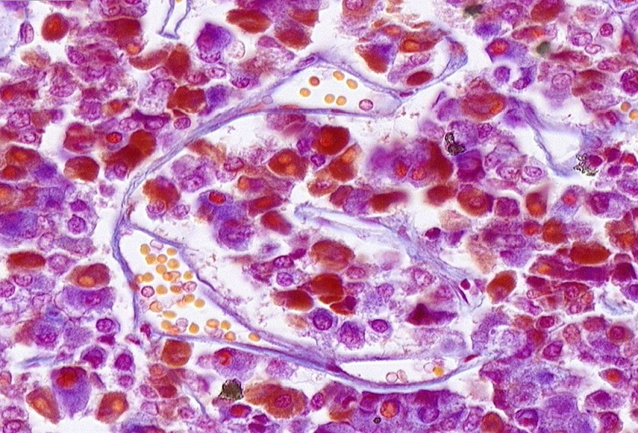
Final quiz
Self-check: Identify the structure indicated by the arrows. (advance slide for answers)
Sinusoid

Slide 32
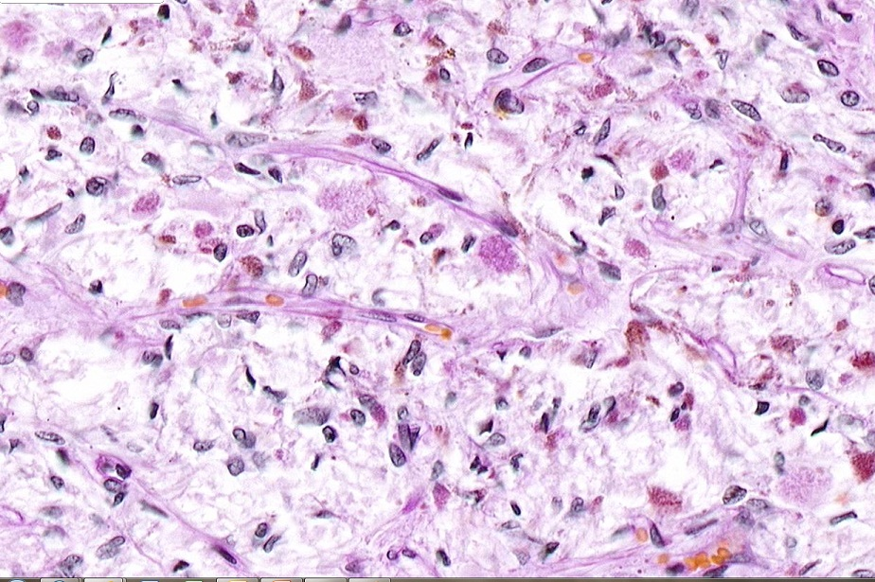
Final quiz
Self-check: Identify the structure indicated by the arrow. (advance slide for answers)
Herring body

Slide 33
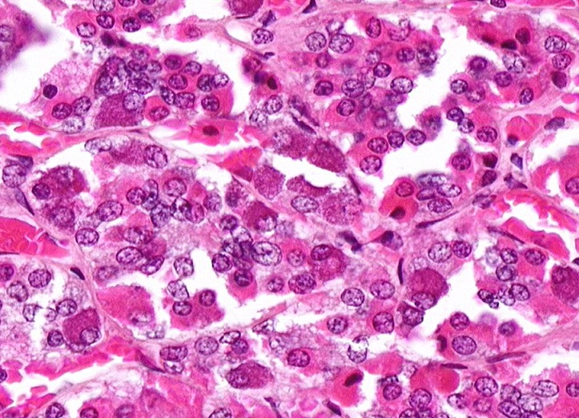
Final quiz
Self-check: Identify the cells. (advance slide for answers)
basophil
acidophil

Slide 34
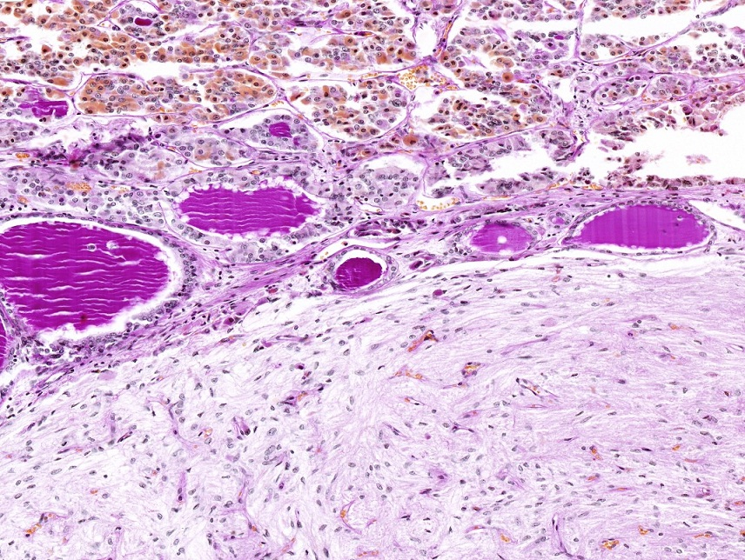
Final quiz
Self-check: Identify the organ. Identify the substance indicated by the arrows. (advance slide for answers)
Pituitary gland
colloid

Slide 35
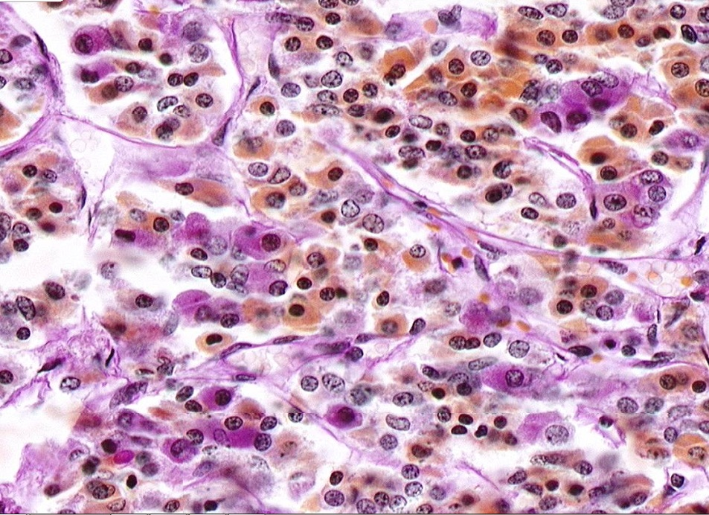
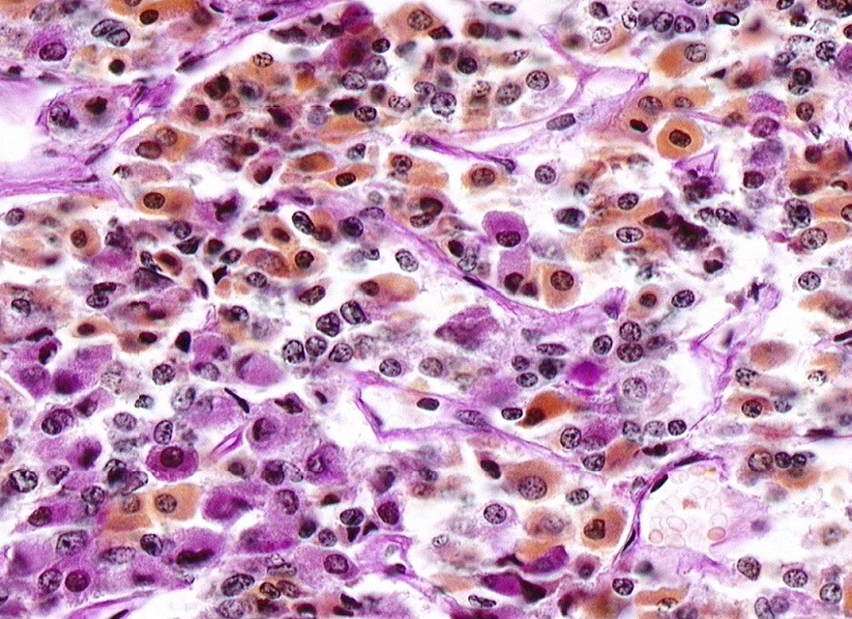
Final quiz
Self-check: Identify the type of stain and cells. (advance slide for answers)
PAS stain
chromophobes

Slide 36
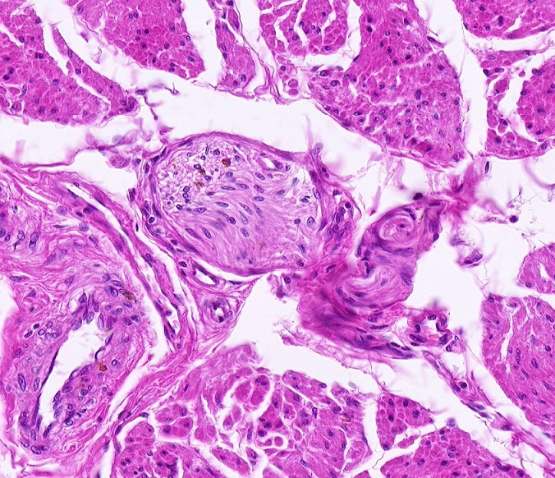
Final quiz
Self-check: Identify the outlined structure. (advance slide for answers)
Peripheral nerve

Slide 37
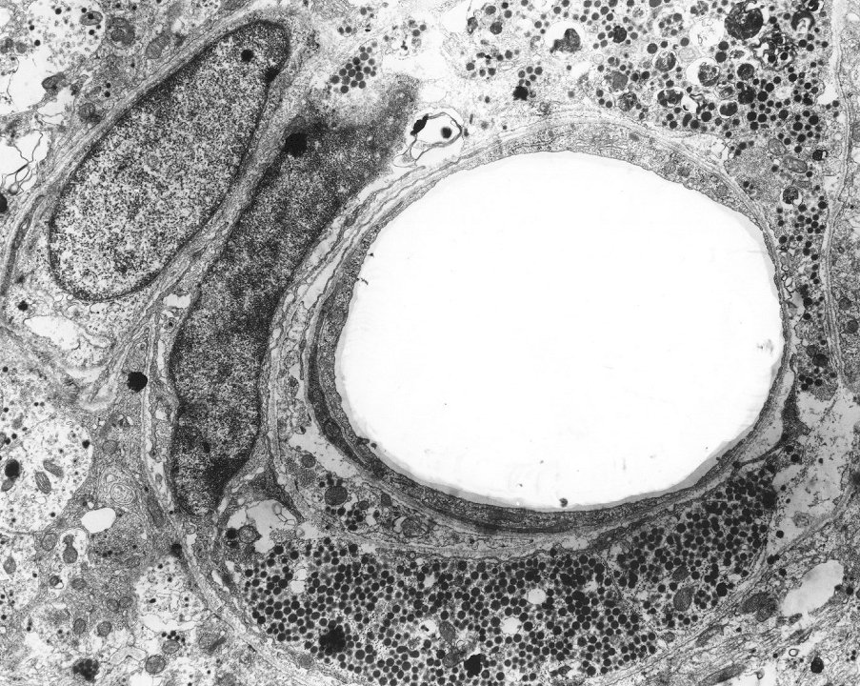
Final quiz
Self-check: This section is from the median eminence of the hypothalamus. Identify the location of the granules, and describe what would be found within the granules.
Granules (two indicated by red arrows) in the hypothalamus contain releasing factors that are released into the portal system to induce secretion of hormones from the anterior pituitary.

Slide 38
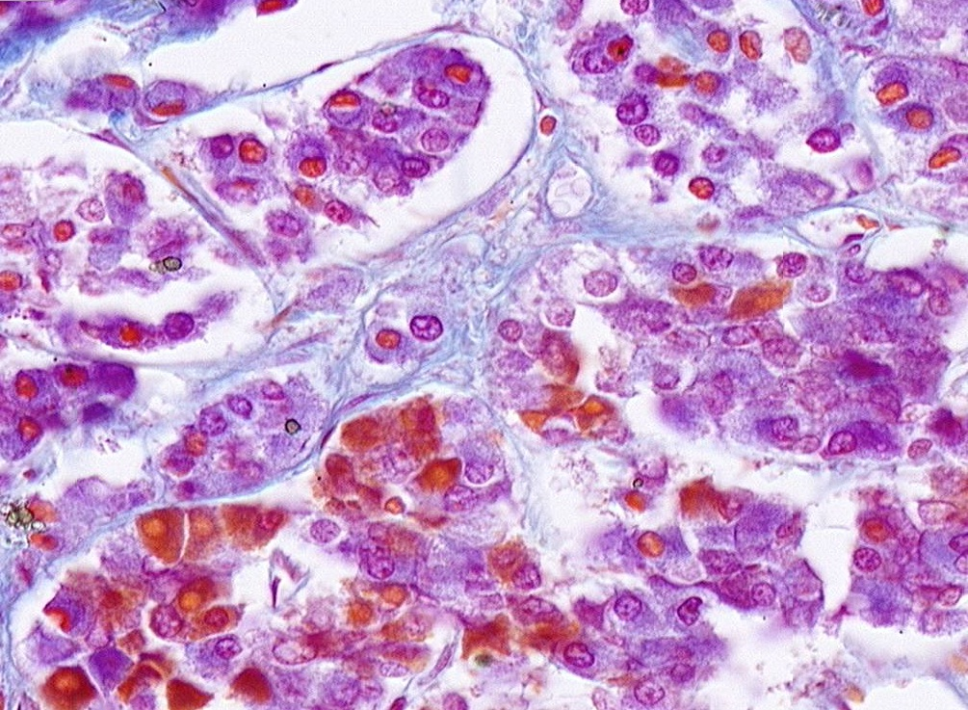
Final quiz
Self-check: Identify the cell indicated by the arrows (advance slide for answers)
chromophobe

Slide 39
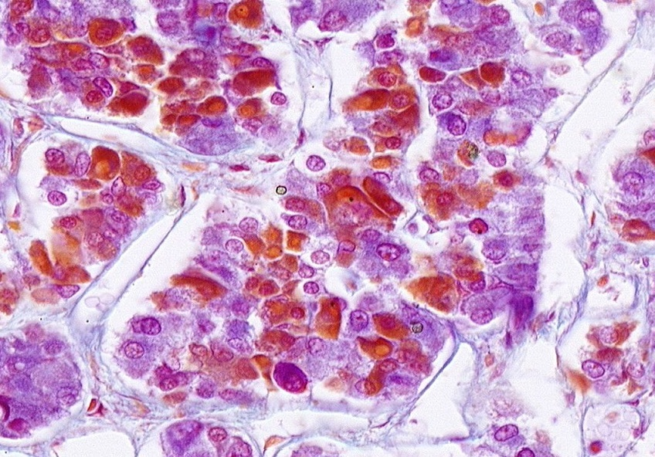
Final quiz
Self-check: Identify cell types. (advance slide for answers)
basophil
acidophil

Slide 40
Final quiz
Self-check: Identify the cells. (advance slide for answers)
acidophil
basophil

Slide 41
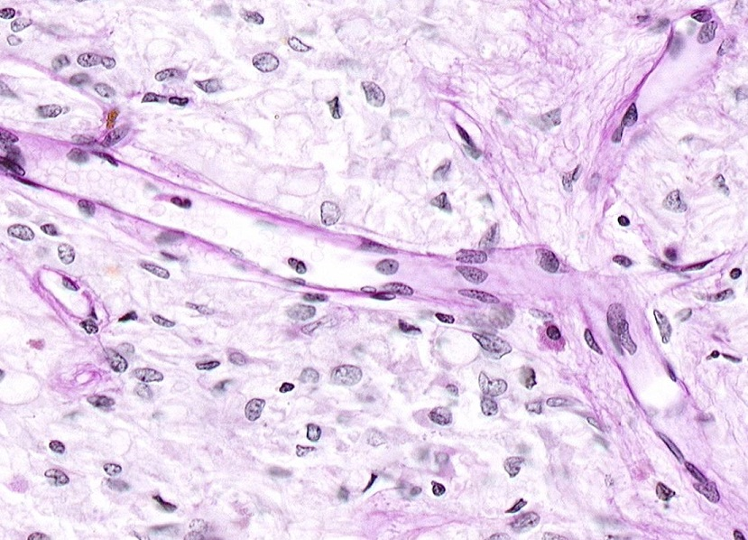
Final quiz
Self-check: Identify the organ. Be specific. Identify the cell indicated by the arrow. (advance slide for answers)
pituicyte
Posterior pituitary gland

Slide 42
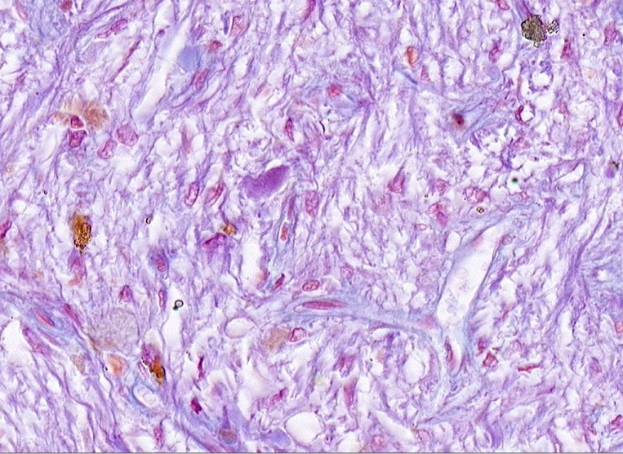
Final quiz
Self-check: Identify the organ. Be specific. Identify the structure indicated by the arrow. (advance slide for answers)
Posterior pituitary
Herring body (probably)

Slide 43
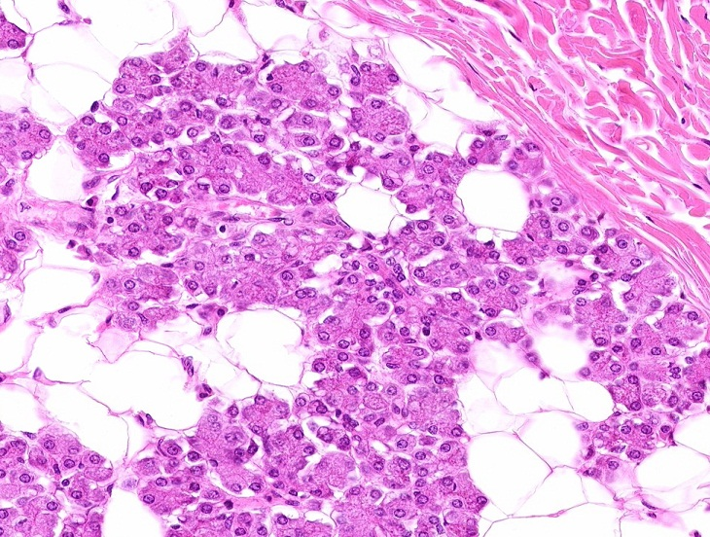
Final quiz
Self-check: Identify the tissues in the outlined regions. (advance slide for answers)
Dense irregular connective tissue
Unilocular adiopose tissue
Serous gland / serous acini

