Slide 1
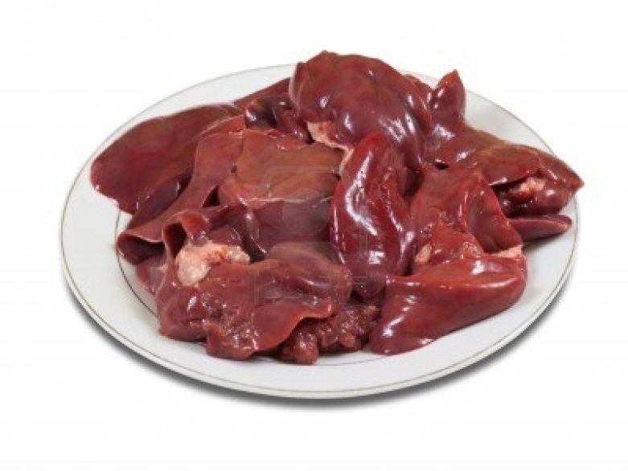
Pancreas, Liver, Gall Bladder
Digital Laboratory
It’s best to view this in Slide Show mode, especially for the quizzes.
This module will take approximately 120 minutes to complete.

Slide 2
After completing this exercise, you should be able to:
Distinguish, at the light microscope level, each of the following:
Pancreas
Serous acini
Ducts
Intercalated ducts
Centroacinar cells
Excretory ducts
Pancreatic islets (of Langerhans)
Liver
Capsule (of Glisson)
Lobule (classic liver lobule)
Central vein (terminal hepatic venule)
Portal triad
Hepatic artery
Hepatic portal vein
Intrahepatic bile duct
(nerves and lymphatic vessels – seen at porta hepatis SL103)
Hepatocytes
Kupffer cells
Sinusoids
Endothelial cells
Veins
Central vein
Sublobular vein
Hepatic vein
Gall bladder
Extrahepatic bile duct (bile duct, cystic duct , hepatic ducts…all look same histologically)
Hepatopancreatic ampulla (of Vater)
Continues on next page…..

Slide 3
After completing this exercise, you should be able to:
Distinguish, at the electron microscope level, each of the following:
liver
Hepatocyte
Sinusoid
Endothelial cell
Space of Disse
Bile canaliculus
pancreas
Exocrine cells
Endocrine cells

Slide 4
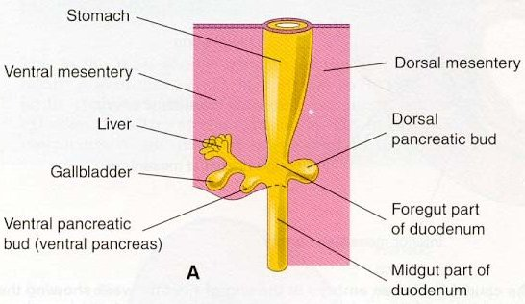
EMBRYOLOGY OF THE PANCREAS, LIVER, AND GALL BLADDER
When creating a module of the accessory organs of the gastrointestinal tract, one can hardly resist the urge to discuss a little embryology. Recall that the early gut tube has an inner lining of endoderm (an epithelium), surrounded by mesenchyme (embryonic connective tissue). It is suspended from the body wall by mesenteries, which are composed of mesenchyme.
The pancreas, liver, and gall bladder are glands, and, therefore, are evaginations of the endoderm into the mesenchyme of the duodenum. These organs grow out of the duodenal wall and into the connective tissue of the mesentery. The pancreas and liver are huge endodermal outgrowths, so when looking at these organs, most of what you will see are epithelial cells, with sparse connective.
You’ve seen this already; salivary glands are mostly acini, which are epithelium. There is connective tissue between the acini, but in the main lobes and lobules, it’s pretty sparse.

Slide 5
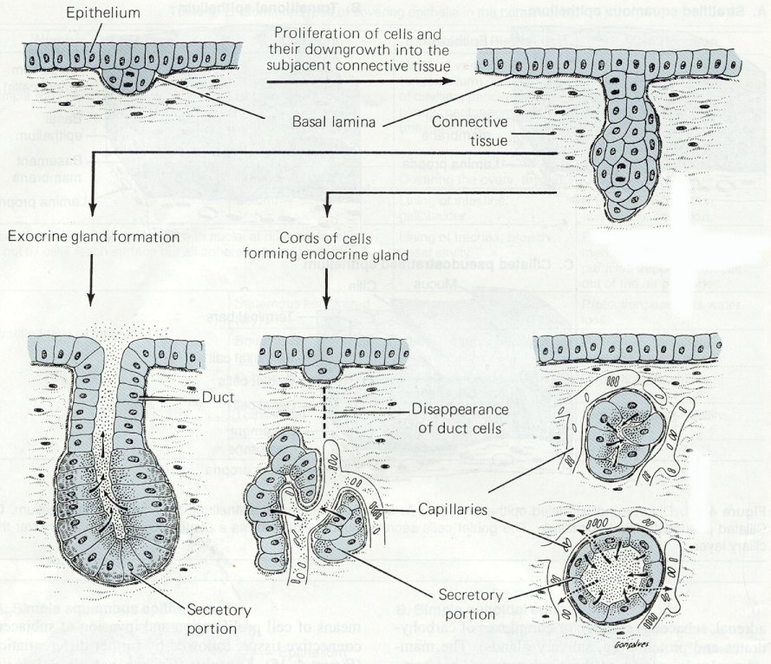
GLANDS
The liver and pancreas are glands, so a review of the histology of gland development is useful. The gall bladder develops in a similar manner.
Glands in the body develop through an interaction of an epithelium and underlying connective tissue. Here, the epithelial cells that line the inner surface of the duodenum proliferate, and then invaginate (evaginate) into the underlying connective tissue. Note the basement membrane invaginates with the epithelium. From here, two things can happen:
For exocrine gland formation, a lumen develops, and secretory cells secrete their substances out their apical side (arrows).
For endocrine glands, the secretory cells lose their connection to the original epithelium, forming clusters of cells that secrete out their basal side, across the basement membrane, and into the bloodstream.
In the pancreas, some cells become exocrine, while others become endocrine. In the liver, the same cells (hepatocytes) remain structurally exocrine, but perform both exocrine and endocrine functions.

Slide 6
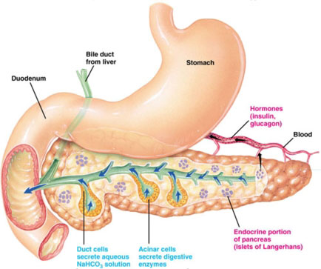
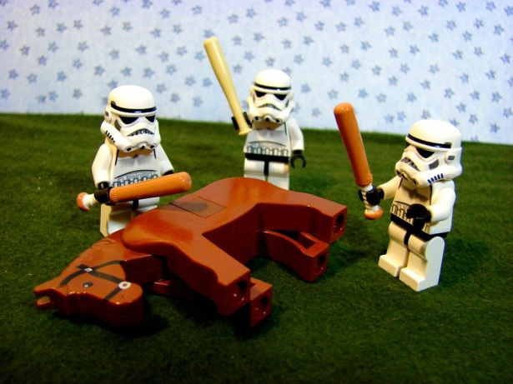
PANCREAS
This excellent image shows the pancreas (and liver) developing from the duodenum, and, therefore, is connected to it by the pancreatic ducts. The glandular cells in the pancreas are either exocrine (acinar) or endocrine (Islets of Langerhans).
from:
www.gopetsamerica.com
seriously
The arrows indicate the direction of product secretion. Again, note that exocrine secretion is apical; product is secreted into a lumen that ultimately leads to the duodenal lumen. Endocrine products are released “basally”, into the connective tissue and bloodstream.

Slide 7
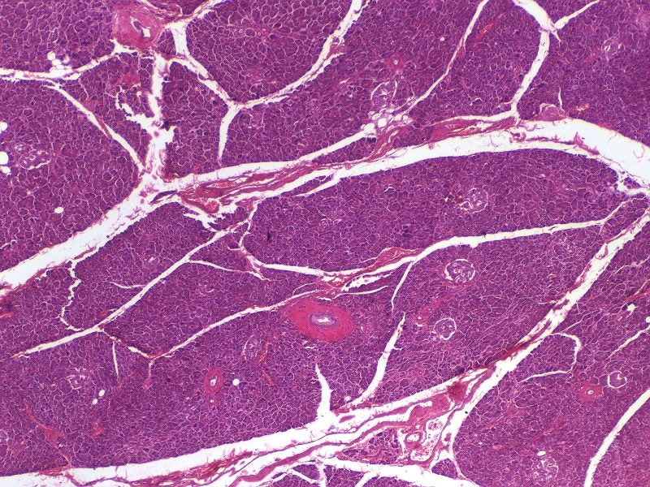
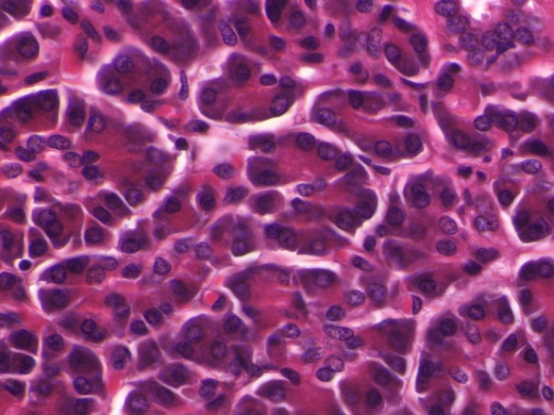
EXOCRINE PANCREAS
The exocrine portion of the pancreas secretes a large amount of digestive enzymes. In general, the features of the exocrine pancreas are quite similar to the salivary glands; cells organized into acini, nuclei in the basal aspect of the cell. These cells also have cytoplasmic basophilia around the nucleus, and eosinophilia in their apical cytoplasm. I hope you immediately recognize that this staining is much more intense than you have seen in the salivary glands; this is because the pancreas is producing large quantities of digestive enzymes.
This particular slides is a little overstained. Nevertheless, intense staining in the pancreas is the norm.

Slide 8
EXOCRINE PANCREAS
Video of pancreatic acini – SL108
Video of pancreatic acini – SL54
Link to SL 108 and SL 054
Be able to identify:
Exocrine pancreas (serous acini)

Slide 9
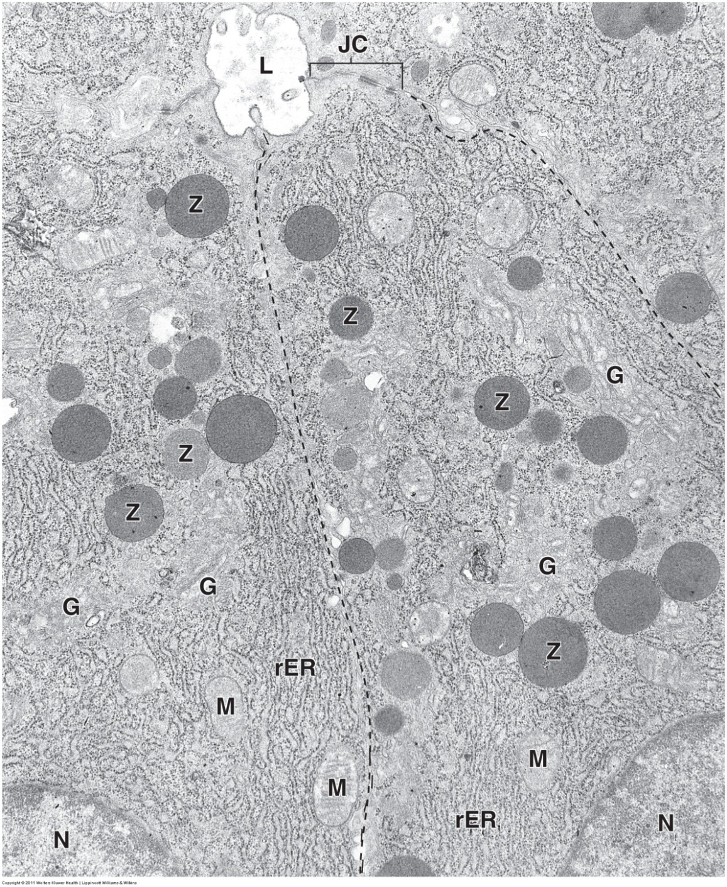
EXOCRINE PANCREAS
Similar to what we have seen in the salivary glands and chief cells of the stomach, the acinar cells of the pancreas have the characteristic features of protein-secreting cells.
L = lumen
N = nucleus
M = mitochondria
JC = junctional complex
G = Golgi apparatus
Z = zymogen (secretory) granules
rER = rough endoplasmic reticulum

Slide 10
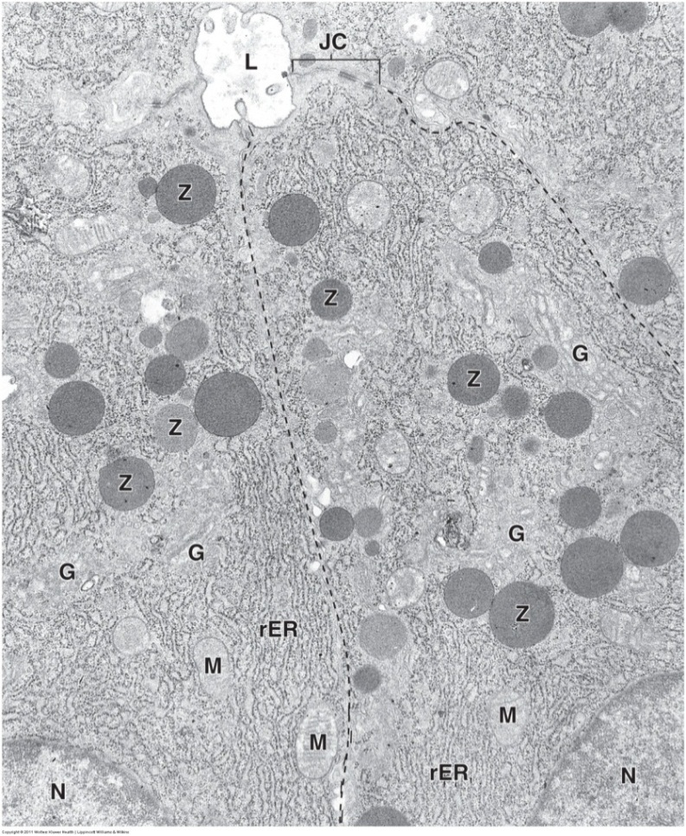
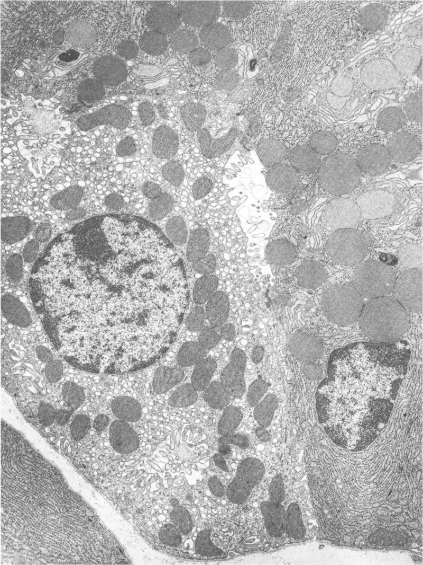
EXOCRINE PANCREAS
As you are probably figuring out about now, the presence of rER, Golgi, and secretory granules is characteristic of all cells that are involved in regulated protein secretion. Here, these pancreatic acinar cells produce lots of protein, so their rER is prominent, and their granules are large. Unfortunately, this is also true for chief cells (image below).
However, note that you should be able to identify both of these as protein-secreting cells, and, based on the presence of the lumen and position of the granules, be able to generate a list of possible options for the identity of these cells, while ruling out others (i.e. rule out endocrine pancreas based on the lumen, rule out enteroendocrine cells based on the position of the granules).
Chief cell
In terms of deciding which tissue is the source of an image, this will depend on surrounding cells or structures in the image. For example, in the case of the chief cell, the adjacent parietal cell, which you should recognize, is a giveaway. If a specific identity of a cell is required and the source of the tissue cannot be determined from the image, the source of the image will be provided.

Slide 11
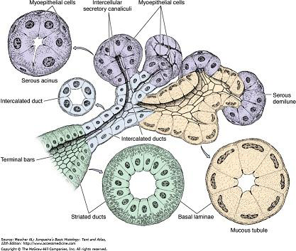
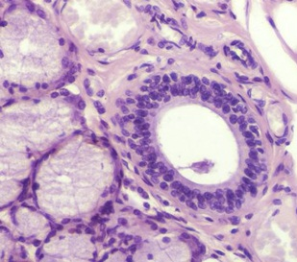
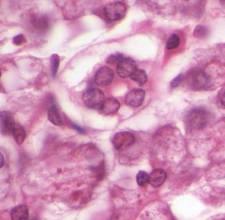
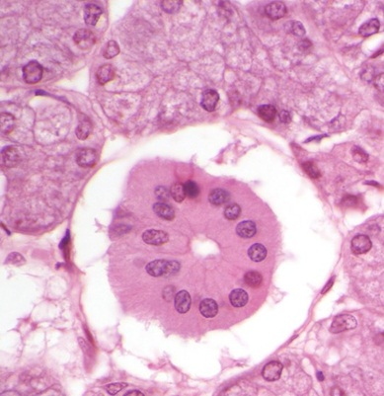
EXOCRINE PANCREAS - DUCTS
Recall that the duct system in salivary glands consisted of:
Intercalated ducts, which were simple conduits for fluid.
Striated ducts, which had epithelial cells with numerous basolateral infoldings for ion transport.
Excretory ducts, in which the epithelium became stratified and the surrounding connective tissue was more prominent.
excretory
striated
intercalated

Slide 12
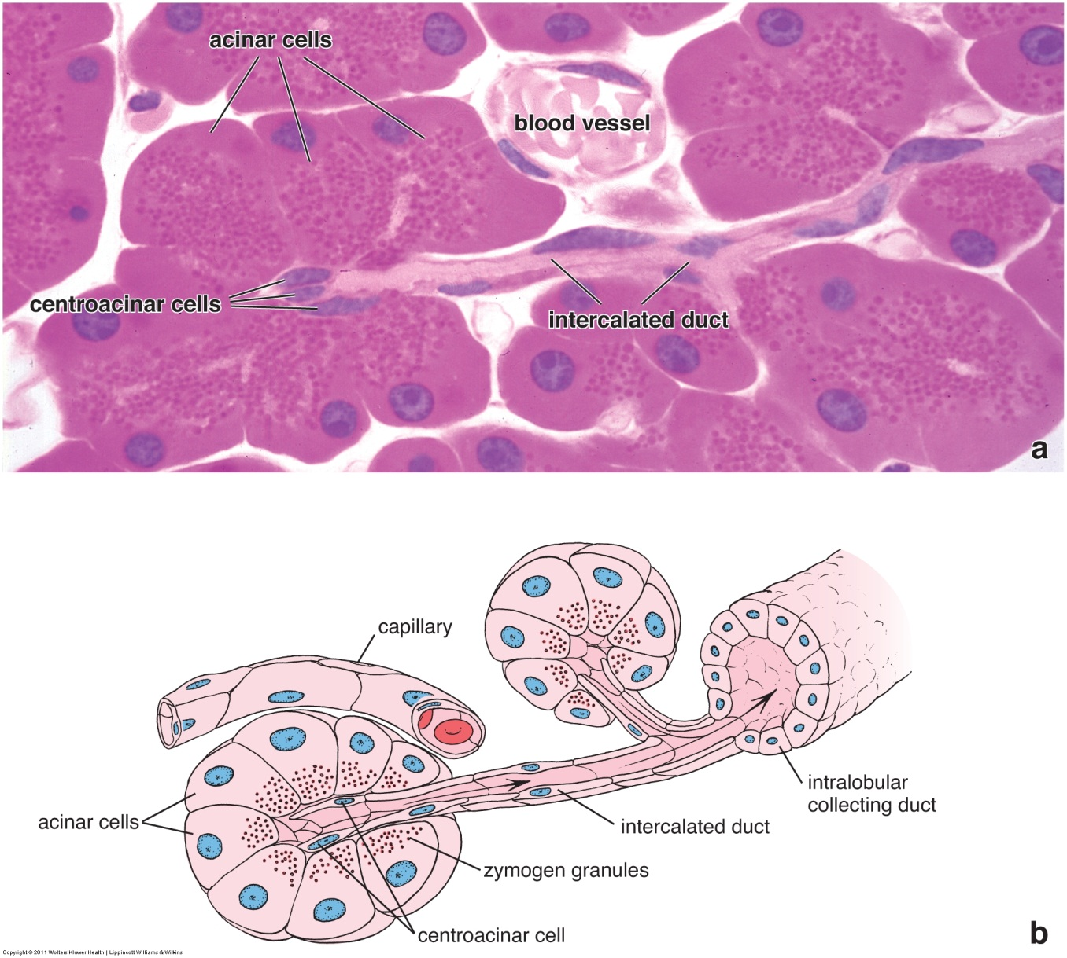
EXOCRINE PANCREAS - DUCTS
In the pancreas, the duct system is slightly different:
The intercalated ducts begin within the acinus; duct cells of this initial portion are referred to as centroacinar cells. The intercalated ducts of the pancreas (including the centroacinar cells) are not mere conduits of fluid, but release a bicarbonate secretion that helps neutralize acidic chyme from the stomach.
There are no striated ducts in the pancreas.
The epithelium of the excretory ducts (labeled intralobular collecting duct) remains simple throughout, all the way to the duodenum. (This is also true of the biliary system; gall bladder and bile ducts.)

Slide 13
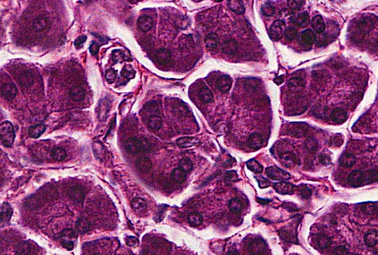
EXOCRINE PANCREAS - DUCTS
The previous image of an intercalated duct from the Ross text is outstanding. Intercalated ducts are challenging to find on our slides.
In the center of this image, you can see two adjacent acini (blue dashed semicircles) that appear to have intercalated ducts connecting them (their ducts are merging). A centroacinar cell nucleus (arrow) is visible in the left acinus. The structure outlined in yellow is likely a cross-section of an intercalated duct. Note that the cells lining the intercalated ducts are very low cuboidal, and do not stain as intensely as the acinar cells.
The intercalated duct cells, including the centroacinar cells, secrete bicarbonate. Since they are not major protein-secreting cells, it makes sense that these cells are pale, especially in comparison to the intensely-stained acinar cells.

Slide 14
EXOCRINE PANCREAS - DUCTS
Since actual intercalated ducts are difficulty to find, what you will want to look for are centroacinar cells within excretory acini. These can be seen as individual (arrows) or clusters (outlined) of nuclei within the center of an acinus. Again, note the pale staining of the cytoplasm in these cells, especially in the context of the dark-staining acinar cells.

Slide 15
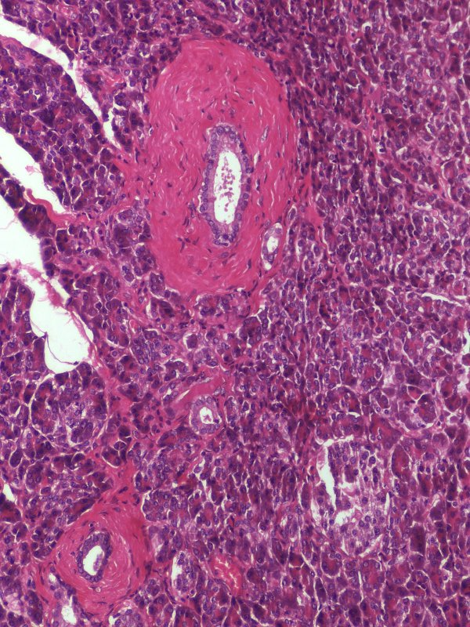
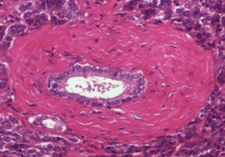
EXOCRINE PANCREAS - DUCTS
The excretory ducts of the pancreas (and liver) are lined by a simple epithelium throughout. Here, you can see a smaller duct (blue outline) and two larger ducts (yellow outline). Note that even the ducts with extensive connective tissue support maintain a simple epithelial lining.
Enlargement of the upper duct (below) demonstrates that the epithelial cells exhibit pale eosinophilic cytoplasm.

Slide 16
EXOCRINE PANCREAS
Video of pancreatic ducts – SL54
Link to SL 108 and SL 054
Be able to identify:
Intercalated ducts (if you can find one)
Centroacinar cells
Excretory ducts

Slide 17
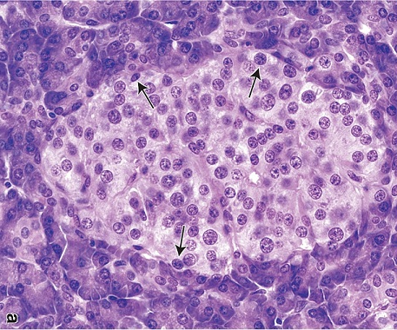
ENDOCRINE PANCREAS
Exocrine acini
Exocrine acini
Exocrine acini
Exocrine acini
The endocrine portion of the pancreas forms clusters of cells called pancreatic islets (Islets of Langerhans - yellow outline). Although the cells within the islets secrete protein hormones, and, therefore, exhibit cytoplasmic basophilia and eosinophilia, their staining is not nearly as intense as that of the exocrine acinar cells. (FYI arrows are identifying possible α cells, really can’t say for sure)
If you stop to think about it, this makes sense. Protein hormone production does require rER, Golgi, secretory vesicles; therefore, Islet cells will exhibit some staining. However, you don’t need much hormone to circulate in the body to elicit an appropriate response in target cells. After all, it’s only a message.
The exocrine acinar cells, however, have to deal with large volumes of meals daily (especially on holidays). They secrete large amounts of digestive enzymes, so they contain more rER, Golgi, and secretory vesicles than islet cells, and, therefore, stain much more intensely.

Slide 18
ENDOCRINE PANCREAS
Video of pancreatic islets – SL108
Link to SL 108 and SL 054
Be able to identify:
Pancreatic islets (of Langerhans)

Slide 19
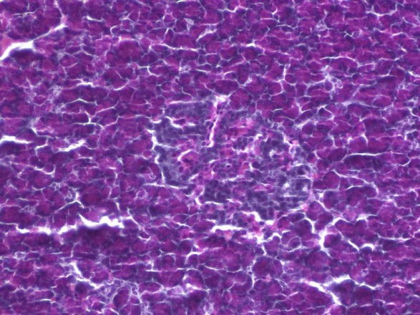
ENDOCRINE PANCREAS – SPECIAL STAIN
Exocrine acini
Exocrine acini
Exocrine acini
Exocrine acini
Routine H&E cannot distinguish between the different cells within the islets of Langerhans. However, this specially-stained slide shows:
α cells – stain red, secrete glucagon
β cells – stain blue, secrete insulin
δ cells (and other islet cells) - not specially stained here, release somatostatin
Don’t memorize the staining here; the point of this slide is to show you that special stains can be used to identify the different cell types within the pancreatic islets.

Slide 20
ENDOCRINE PANCREAS – SPECIAL STAIN
Video of pancreatic islets special staining – SL109
Link to SL 109
Be able to identify:
Nothing specific, just realize cells in the pancreatic islets can be specifically identified with special stains, antibodies, etc.

Slide 21
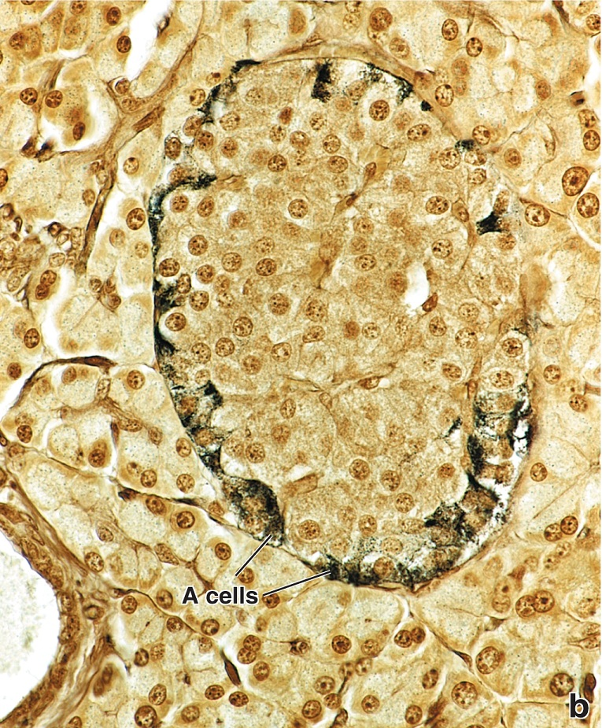
ENDOCRINE PANCREAS – SPECIAL STAIN
This is another special stain for your viewing pleasure showing alpha cells.

Slide 22
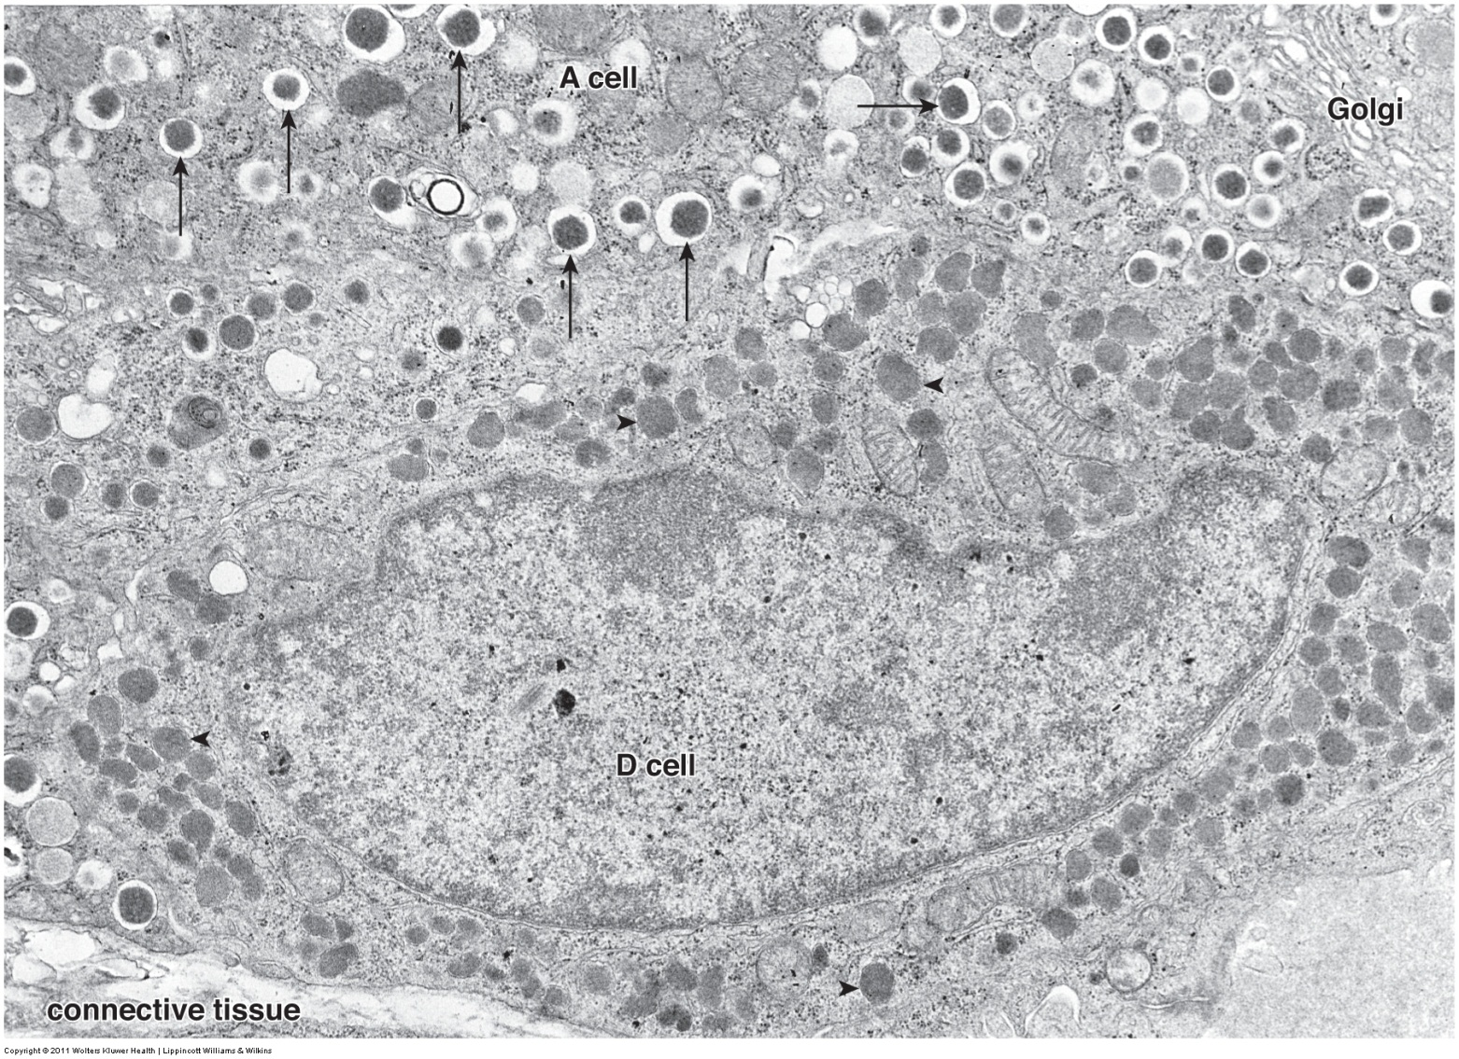
ENDOCRINE PANCREAS
Just FYI, this EM demonstrates that cells from the Islets of Langerhans have the protein machinery expected of cells with regulated secretion: rER (not easily seen), Golgi, secretory granules (arrows)
Remember, H&E staining is relative. The islet cells do have rER and granules, but not to the same extent as acinar cells of the exocrine pancreas.

Slide 23
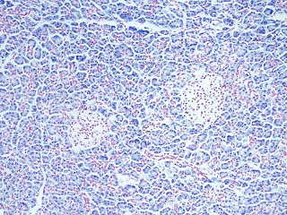
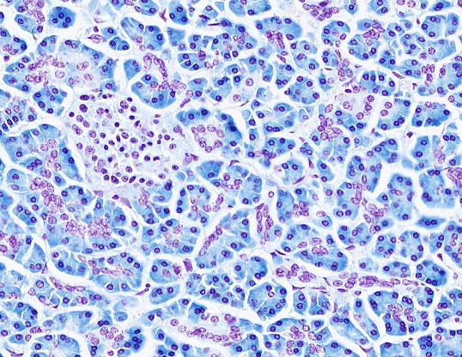
PANCREAS – RNA STAIN
To underscore the difference in exocrine and endocrine pancreatic cells, and to highlight centroacinar cells, this slide was specially prepared so that:
DNA is stained red
RNA is stained blue
Although the cytoplasm of the pancreatic islet cells (islet outlined in solid red) do exhibit RNA staining, the exocrine acinar cell cytoplasm contains much more RNA. Furthermore, this slide more clearly demonstrates centroacinar cells (red dotted outline). An intercalated duct (arrows) is also visible.

Slide 24
PANCREAS – RNA STAIN
Video of pancreas RNA stain – SL002A
Link to SL 002A
Be able to identify:
Serous acini
Intercalated ducts
Centroacinar cells
Pancreatic islets (of Langerhans)

Slide 25
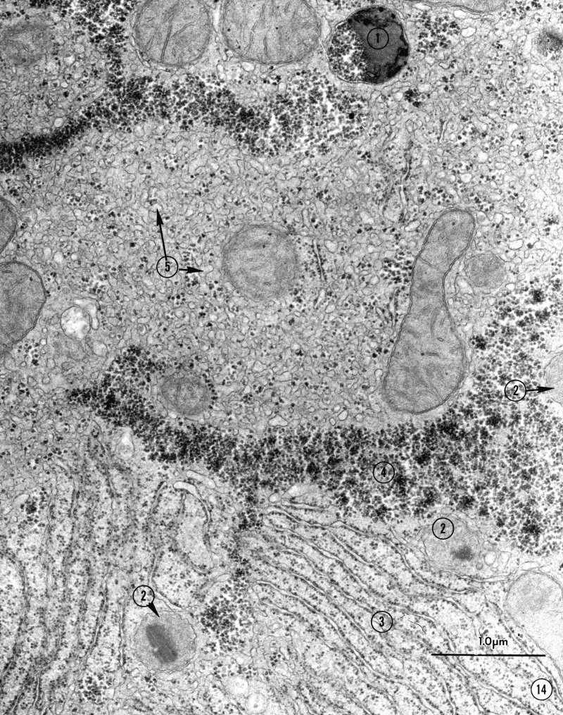
LIVER - HEPATOCYTES
Because of its dual blood supply and bile duct system, the organization of the liver is quite complicated. Furthermore, the secretory cells, or hepatocytes, are not organized into easily recognizable acini.
Before we get too heavily invested in that organization, let’s spend a moment to focus on the hepatocytes. From a cellular standpoint, hepatocytes are incredibly dynamic, involved in metabolic regulation, production of plasma proteins, bile production, and degradation of toxins. Therefore, this is a really neat cell to study because it contains many of the organelles you have come to know and love. In this EM from a portion of a hepatocyte, note:
Lysosome
Peroxisome
Rough endoplasmic reticulum
Glycogen
Smooth endoplasmic reticulum
Peroxisomes and lysosomes are hard to distinguish. But, the diversity of organelles and the presence of glycogen suggests to you that this is a hepatocyte.

Slide 26
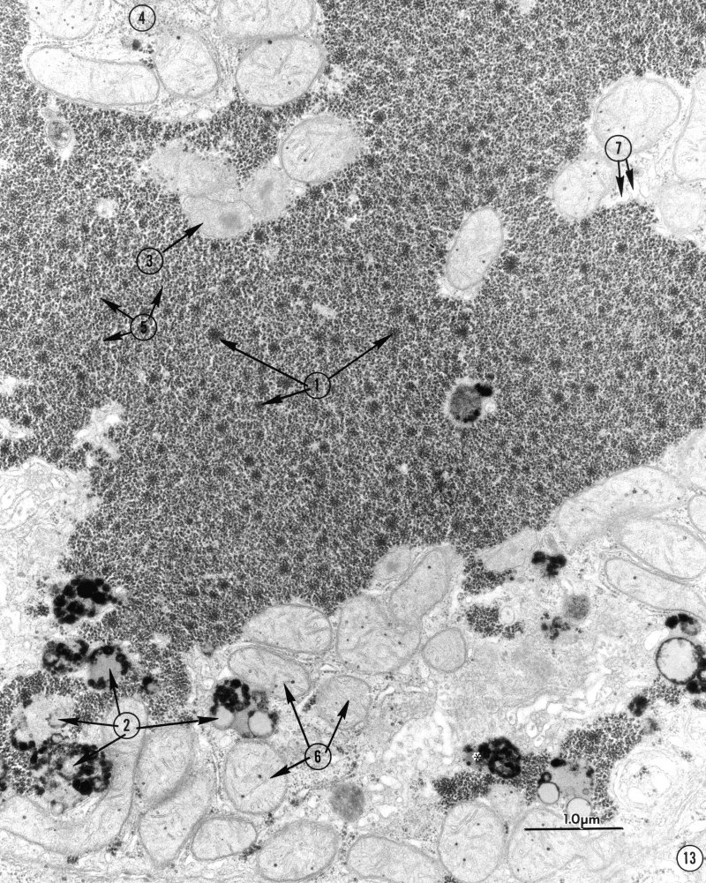
LIVER - HEPATOCYTES
Another image from a portion of the cytoplasm of a hepatocyte
Glycogen
Lysosome
Peroxisome
Ribosomes
Glycogen
Mitochondria
Smooth endoplasmic reticulum
Again, lots of organelles, glycogen, all point to a hepatocyte of the liver.

Slide 27
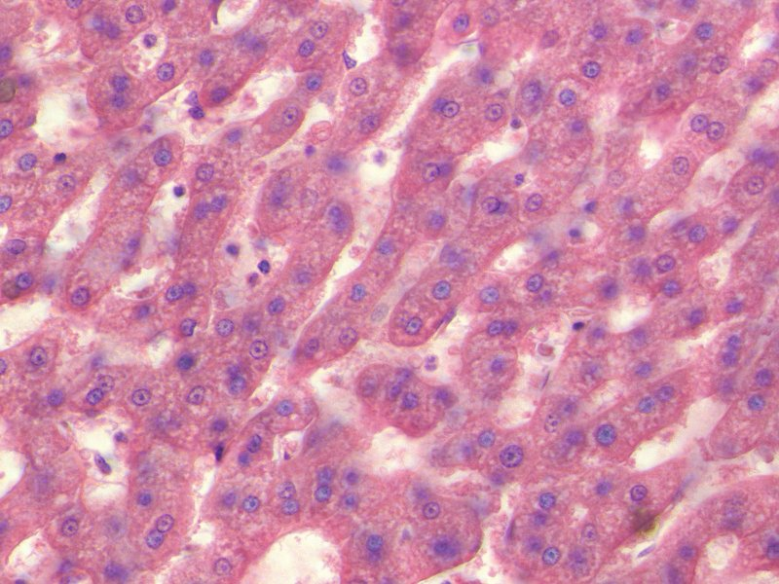
LIVER - HEPATOCYTES
When looking at hepatocytes in light micrographs (a single hepatocyte is outlined), you can see that they are cuboidal or polygonal-shaped cells, with a central euchromatic nucleus (some cells are binucleate). The cytoplasm is eosinophilic due to numerous mitochondria and cellular proteins. Rough ER may create regions of cytoplasmic basophilia in some cells, but this is not as obvious as in the exocrine pancreas or chief cells. Glycogen washes away during tissue preparation, so the cytoplasm exhibits clear areas.

Slide 28
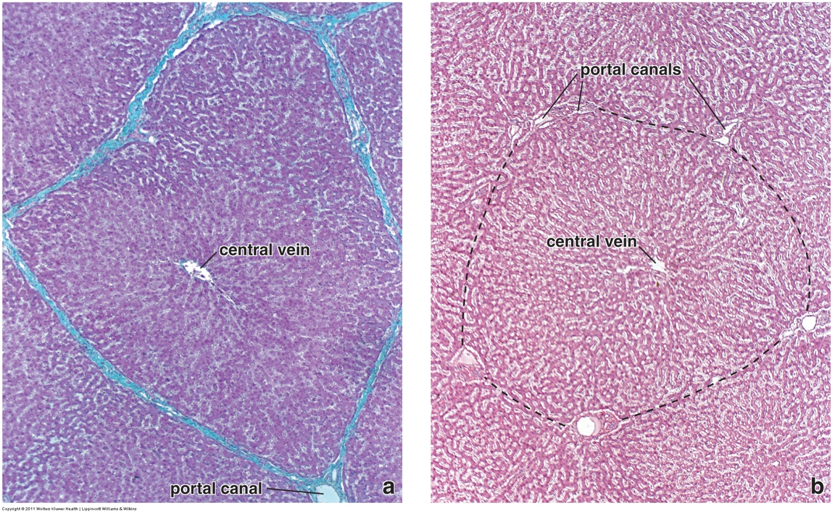
LIVER – CLASSIC LOBULE
As mentioned, the organization of the liver is somewhat complicated. When looking at light micrographs at low magnification, you can see that the hepatocytes are grouped together into polygon-shaped lobules. These are referred to as classic liver lobules. The image to the left is from a pig liver. The connective tissue that bounds each lobule is extensive, and has been stained in light blue. The image to the right is a routine H&E section from a human liver. In humans, there is less connective tissue in the liver, so the borders are not obvious. Fortunately, the boundaries of the lobule (outlined) can be “visualized” by connecting the more visible portal canals, which we will see contain vessels and intrahepatic bile ducts. In the center of the lobule is a central vein.

Slide 29
LIVER – CLASSIC LOBULE
Video of an overview of the liver – SL102
On the video, I forgot to show you the capsule….you’ll need to look at the edge of the specimen on SL102 to see the connective tissue capsule of Glisson
Link to SL 102
Be able to identify:
Liver
Lobule
Capsule (of Glisson)

Slide 30
LIVER – CLASSIC LOBULE
Of course, if you are thinking about development of the liver, and comparing it to development of other glands, you’re probably assuming that all hepatocytes within a lobule arose from the same duct, kind of like all acini in a lobule or lobe of a salivary gland ultimately develop from a single duct within that lobule or lobe. In other words, the enxocrine product of the hepatocytes (i.e. bile) would flow toward the center of this classic liver lobule.
And, as you suspected based on the wording above, if you were thinking that, you would be incorrect.

Slide 31
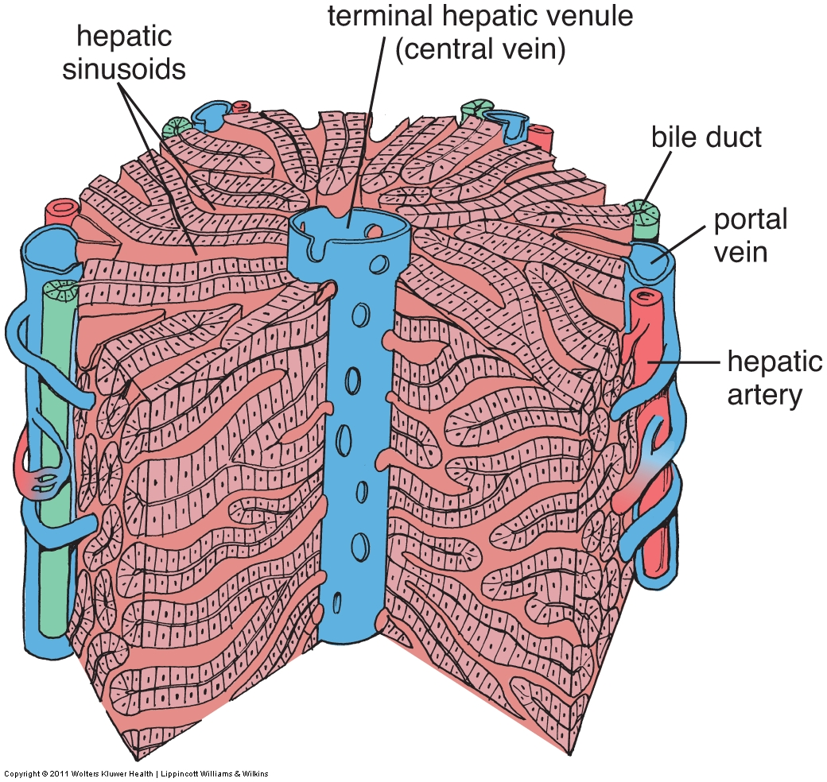
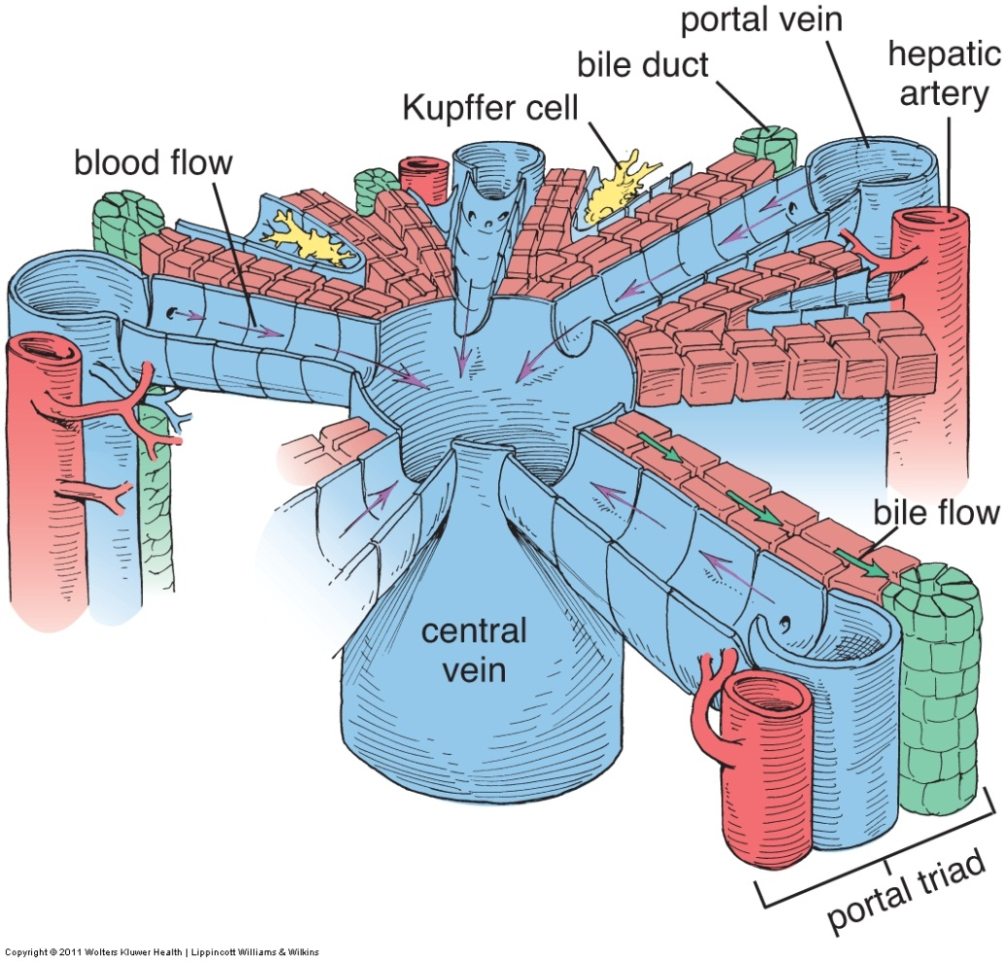
LIVER – PORTAL LOBULE
Turns out that there are several bile ducts that drain a classic liver lobule. In this diagram, you can see that the bile ducts are at the “corners” of the polygon. The liver secretory units are end pieces composed of hepatocytes organized into plates. The “blind end” of these plates are near the center of the classic lobule (adjacent to the central vein). Liver excretory product, bile, is released into the lumen of the secretory units, called canaliculi, and then flows toward the periphery to the bile ducts (green arrows in image on the right). Those canaliculi that end on a “wall” of a lobule drain into ductules that move within the “wall” to reach the main bile ducts at the corners (i.e. in the direction of the purple lines drawn in the figures).
As with the salivary glands, the hepatocytes are continuous with the epithelial cells of the ducts.
BTW, the term “bile duct” here is generic. For the structures within the liver here, it’s better to call them intrahepatic bile ducts to avoid confusion with the (main) bile duct.

Slide 32
LIVER – PORTAL LOBULE
This image might give you a better conceptual view of the flow of bile. The canaliculi (black arrows) are bounded by the hepatocytes, and are located within the classic liver lobule. At the walls, these transition into bile ductules, which run toward the corners to connect to the intrahepatic bile ducts (purple arrows), which are in the portal area
At the corners, you have seen “portal canals”, “portal area” and “portal triad” labeled on these different images. Basically the same thing – we’ll clarify what is in there shortly.

Slide 33
LIVER – PORTAL LOBULE
What you see on a histology slide, and what was described at the beginning of this secion, is the classic liver lobule, which is defined by the connective tissue that surrounds the lobule. In this description, the bile duct is situated in the portal canals at the “corners” of the lobule.
What we described just now is the portal liver lobule. In this case, the portal canal, with its bile duct, is at the center of the portal lobule. All hepatocytes within the triangular area ultimately excrete their bile into the intrahepatic bile duct within the portal canal in the center of the portal lobule.
We’ll describe the liver acinus when we talk about blood supply to the liver.

Slide 34
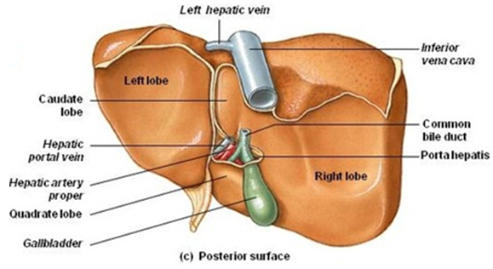
LIVER – BLOOD SUPPLY (ENDOCRINE LIVER)
BTW, this anatomical vs. developmental distinction is also manifest at the gross level as well. Recall that, at the gross level, the right and left lobes of the liver are divided by the falciform ligament, with the caudate and quadrate lobes being part of the right lobe. Because the biliary tree is to the right of these two smaller lobes, from an embryonic standpoint, the caudate and quadrate lobes belong to the left lobe.
Be careful here – the gross anatomists get their underwear/panties in a bunch if you say the caudate or the quadrate lobe is part of the left lobe of the liver.

Slide 35
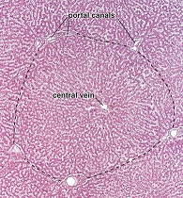
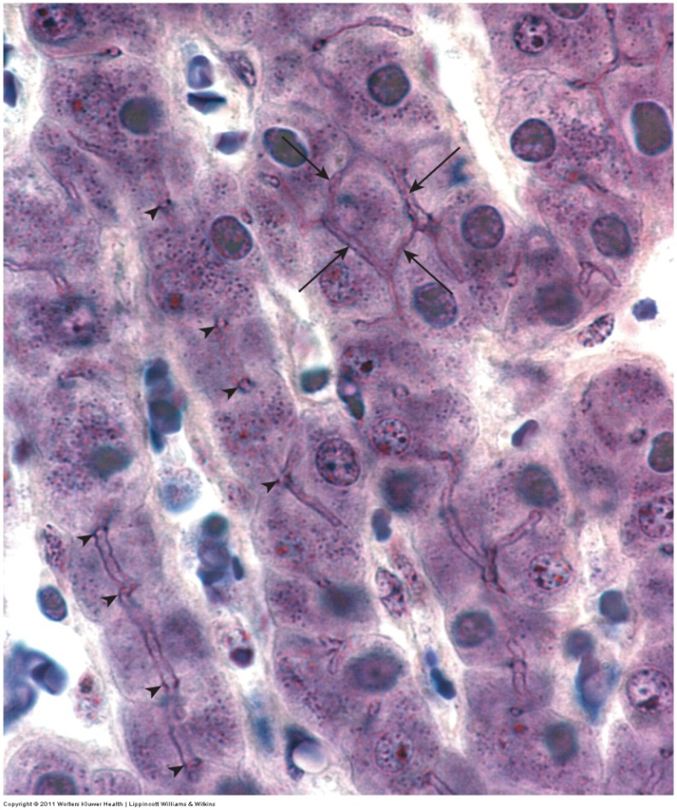
EXOCRINE LIVER (BILE)
As mentioned, the lumen where bile is first secreted by the hepatocytes is called a canaliculus (green arrows in drawing to the right). The canaliculi are formed by the plasma membrane of the hepatocytes, since they are the secretory end pieces.
Just like the lumen of an acinus in the salivary or gastric glands is lined by the apical plasma membrane of the acinar cells.
Canaliculi are very small, so they are not visible on our routine H&E slides (left). However, this fine image from the Ross text (right) demonstrates the canaliculi (arrows and arrowheads) running within and between hepatocytes.

Slide 36
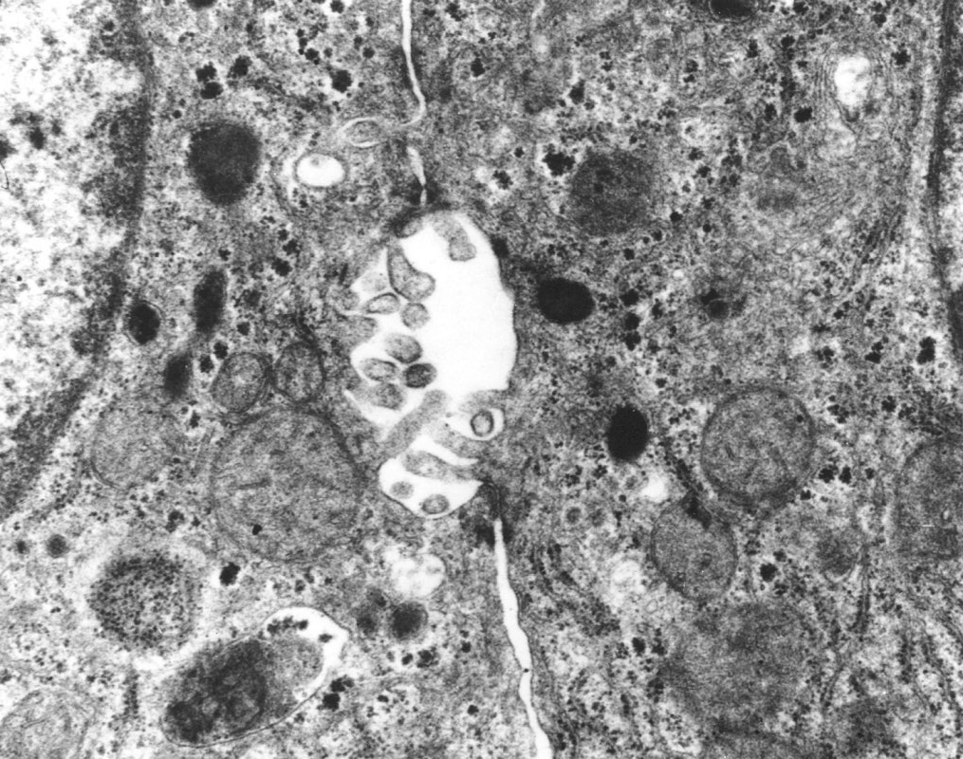
EXOCRINE LIVER (BILE)
Fortunately for you, someone invented the electron microscope. In this micrograph, two adjacent hepatocytes are shown. A portion of the nucleus of one is in the upper-left corner. In the center is the lumen of a canaliculus (L), or bile canaliculus (to distinguish from other canaliculi such as in parietal cells). Note that the wall of the lumen is formed by the plasma membrane of the hepatocytes (i.e. there are no endothelial cells or other cells that line the lumen). A few microvilli project into the lumen of the canaliculus. Junctional complexes (outlined) seal the canaliculus.
L
Bile is produced by the hepatocytes, and secreted into the canaliculus. The junctional complex provides a nice seal – good thing, bile is pretty nasty stuff.

Slide 37
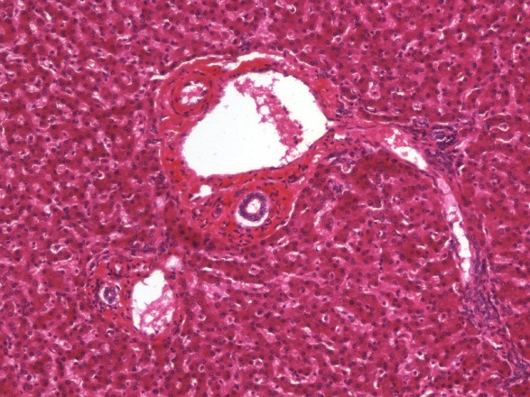
EXOCRINE LIVER (BILE)
At the wall of the classic liver lobule, the hepatocytes give way to simple cuboidal epithelial cells that line the intrahepatic bile ducts. The smallest ducts in the “walls”, the ductules, are not readily visible in our slides. However, the intrahepatic bile ducts (outlined) can be found easily as a component of the portal triad. They are lined by a simple cuboidal epithelium, surrounded by the connective tissue of the portal area.
The other two structures (X and Y) are vessels we will name very soon. Note their inner epithelium is simple squamous, not cuboidal like the epithelium of the intrahepatic bile duct. Together, these three structures constitute a portal triad.
X
Y

Slide 38
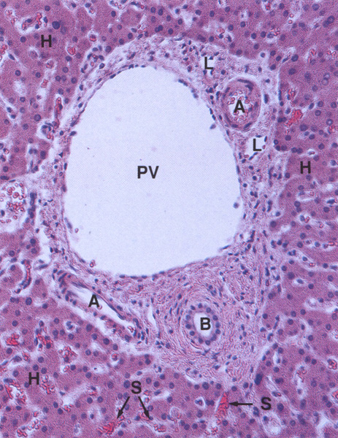
EXOCRINE LIVER (BILE)
Seems to me like a better image than what I can generate from our slides is in order. This nice micrograph from Wheater’s Histology shows an intrahepatic bile duct (B) lined by cuboidal epithelium. Everything else ignore for now.

Slide 39
EXOCRINE LIVER (BILE)
Video of the intrahepatic bile ducts of the liver – SL102
Link to SL 102
Be able to identify:
Liver
Portal triad
Intrahepatic bile duct

Slide 40
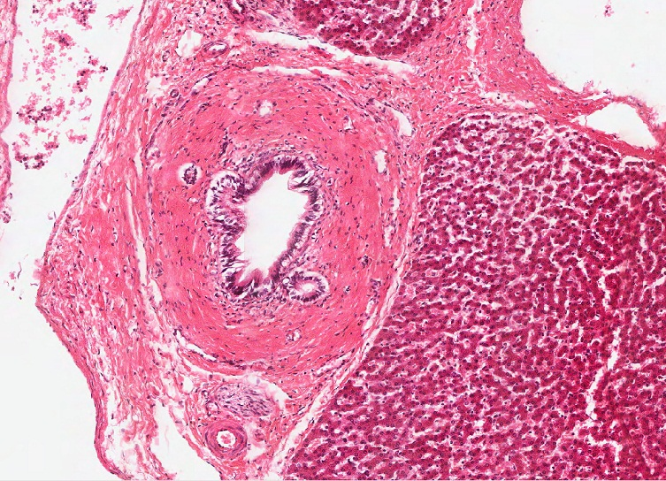
EXOCRINE LIVER (BILE)
The intrahepatic bile ducts in the portal triad merge with other similar ducts to form larger ducts. Here in this low magnification image, you can see a large intrahepatic bile duct.

Slide 41
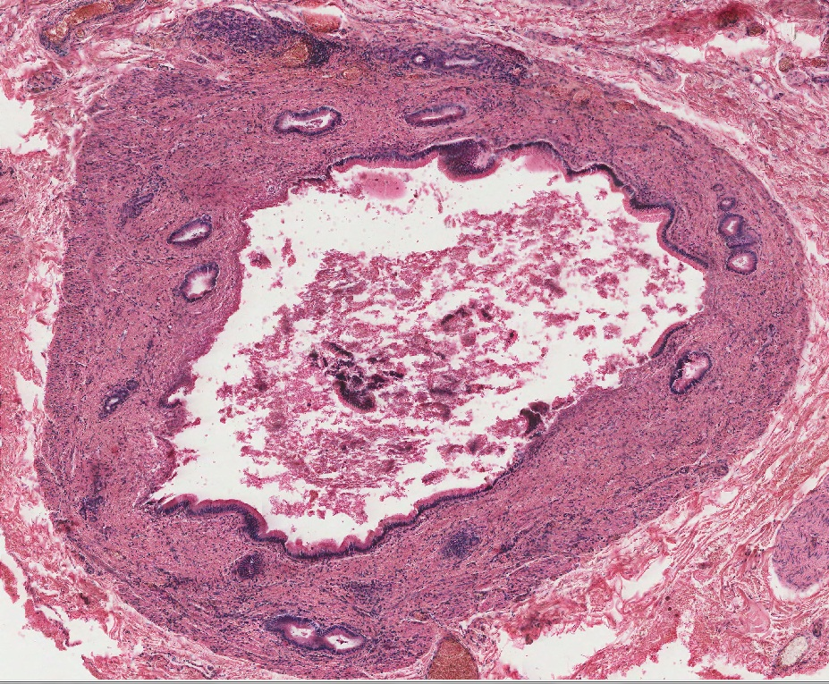
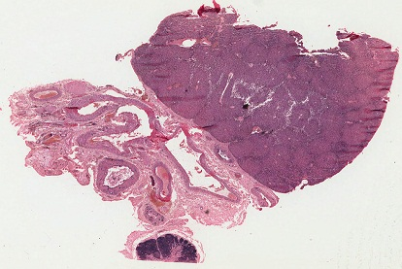
EXOCRINE LIVER (BILE)
As you know, the intrahepatic ducts ultimately leave the liver via the porta hepatis on the inferior aspect of the liver. This slide shows the liver and porta hepatic (outlined in green). Here, one of the main bile passages is shown. Although sloughed off in places, where it is intact you can appreciate, even at low power, that the epithelium that lines this duct is simple columnar, with eosinophilic cytoplasm (arrows). The remainder of the wall is dense irregular connective tissue.
liver
You can’t tell whether this is the right or left hepatic duct, or the common hepatic duct.

Slide 42
EXOCRINE LIVER (BILE)
Just in case you forgot, the porta hepatis is the opening on the visceral surface of the liver where the bile passages, and branches of the hepatic artery and hepatic portal vein enter / leave the liver.

Slide 43
EXOCRINE LIVER (BILE)
Video of the extrahepatic bile duct in the porta hepatis – SL103
Link to SL 103
Be able to identify:
Extrahepatic bile duct

Slide 44
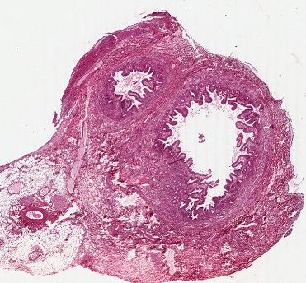
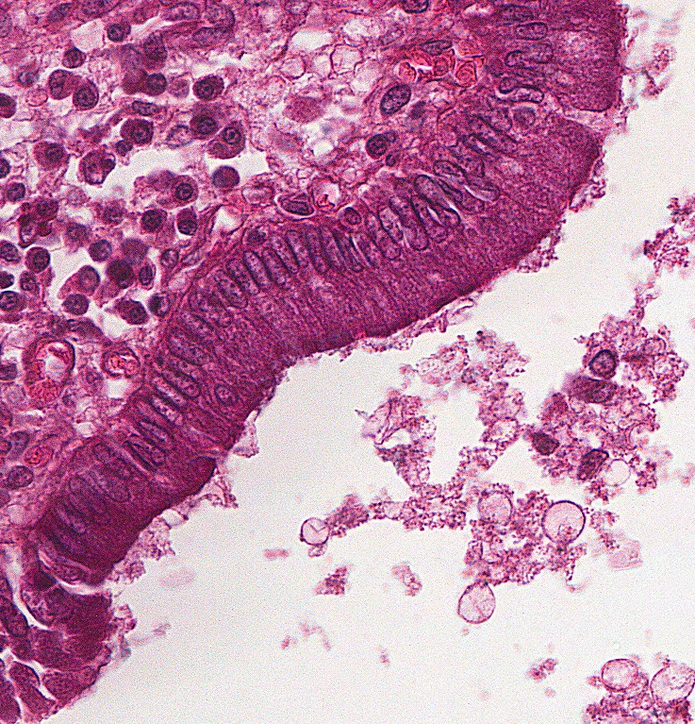
EXOCRINE LIVER (BILE)
This slide is a section near the junction of the cystic duct (CD) and common hepatic duct (CHD) just before they merge to form the bile duct. Similar to the parotid ducts, the bile ducts are lined by a mucus-secreting simple columnar epithelium throughout.
CD
CHD
As mentioned on the previous slide, no way to tell which bile duct this is from a slide. You only know because I told you.

Slide 45
EXOCRINE LIVER (BILE)
Video of the extrahepatic bile duct– SL107
Link to SL 107
Be able to identify:
Extrahepatic bile duct

Slide 46
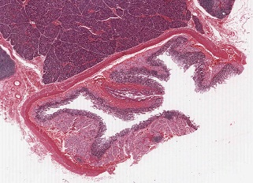
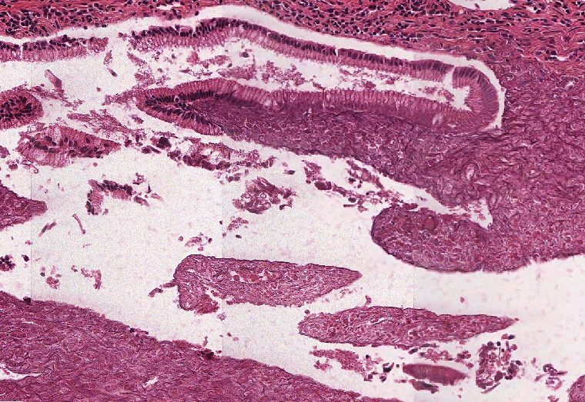
EXOCRINE LIVER (BILE)
As you know, the ultimate destination of the bile duct is the ampulla of Vater in the duodenum. Again, though the epithelium is sloughed off in many places, where it is intact you can still see that it is lined by a simple columnar epithelium.

Slide 47
EXOCRINE LIVER (BILE)
Video of the ampulla of Vater – SL54
Link to SL 054
Be able to identify:
Hepatopancreatic ampulla (of Vater)

Slide 48
We’re still doing the liver, but it might not be a bad time to stretch a little.

Slide 49
LIVER – BLOOD SUPPLY (ENDOCRINE LIVER)
Now let’s focus on the blood supply to the liver…it’s not as easy as you would think. The liver receives a dual blood supply; oxygenated blood is supplied by branches of the proper hepatic artery (hepatic artery proper), while oxygen-poor but nutrient-rich blood is supplied by the hepatic portal vein. Both of these vessels enter the liver via the porta hepatis.
The hepatic veins exit the liver on it’s dorsal surface to drain into the inferior vena cava. Therefore, blood runs THROUGH the liver (not There and Back Again like the blood supply to other organs).
Within the liver, the proper hepatic artery and hepatic portal vein branch together in the connective tissue and portal triads, while the hepatic veins are located separately.

Slide 50
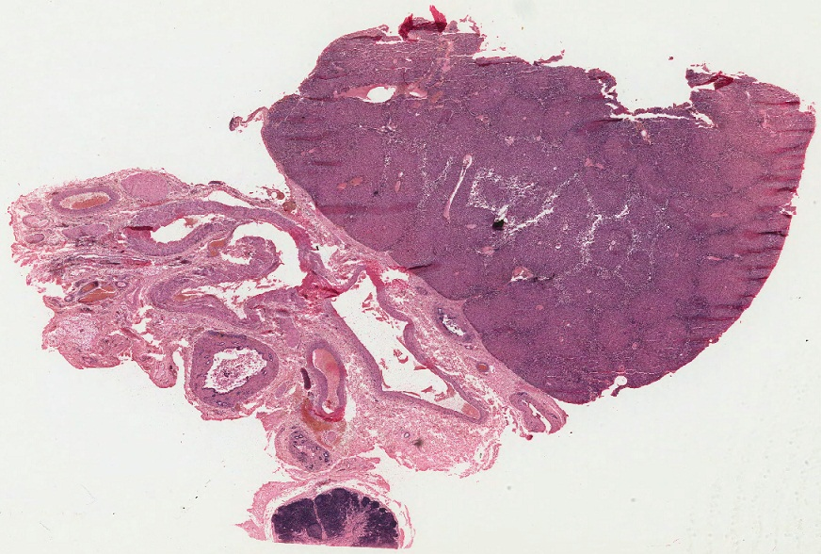
LIVER – BLOOD SUPPLY (ENDOCRINE LIVER)
So, we’ll start with the porta hepatis. From now on, we’ll dispense with the formalities of the phrase “branches of the…”
HA – hepatic artery
HPV – hepatic portal vein
BD – extrahepatic bile duct
N – autonomic nerve
L – lymphatic channel
N
HA
L
HPV
HPV
HPV
BD
HA
The hepatic portal vein provides 70-80% of the blood supply to the liver. Therefore, you would expect it to be much larger than the hepatic artery.
Note that the hepatic artery and hepatic portal vein, and the nerves, are “entering” the liver, while the bile duct and lymphatic channels are “leaving” the liver.
At this point, the hepatic portal vein is a large vein, so it will have some smooth muscle in the tunica adventitia.

Slide 51
LIVER – BLOOD SUPPLY (ENDOCRINE LIVER)
Video of the porta hepatis – SL103
Link to SL 103
Be able to identify:
Porta hepatis
Extrahepatic bile duct
Hepatic artery
Hepatic portal vein
(nerves and lymphatic vessels)

Slide 52
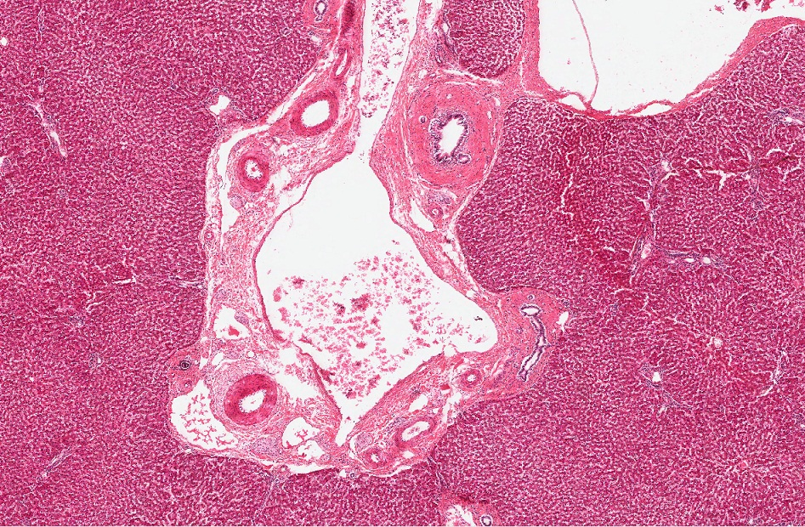
LIVER – BLOOD SUPPLY (ENDOCRINE LIVER)
In the liver, the hepatic artery and hepatic portal vein branch within the connective tissue septa, together with the bile ducts leaving the liver.
HA – hepatic artery
HPV – hepatic portal vein
BD – intrahepatic bile duct
HPV
HA
BD
HA
HPV
BD
HA
At this stage, nerves and lymphatic vessels are still visible, but not at this magnification.
However, note that because the intrahepatic bile duct has columnar epithelium, it is easily distinguished from the vessels, even at this low magnification. You can also readily identify the hepatic portal vein as the largest structure in this grouping.

Slide 53
LIVER – BLOOD SUPPLY (ENDOCRINE LIVER)
At the level of the classic liver lobule, you can now readily identify the hepatic artery (X) and hepatic portal vein (Y) within the portal triad.
X
Y
Nerves and lymphatic vessels are present, but they are too small to be seen in light micrographs. Because we typically see three structures at the “corners” of a classic liver lobule, the term portal triad is commonly used.

Slide 54
LIVER – BLOOD SUPPLY (ENDOCRINE LIVER)
Video of the portal triad – SL102
Link to SL 102
Be able to identify:
Portal triad
Intrahepatic bile duct
Hepatic artery
Hepatic portal vein

Slide 55
LIVER – BLOOD SUPPLY (ENDOCRINE LIVER)
The hepatic artery and hepatic portal vein in the triad send branches into the walls of the classic liver lobule (black arrows). Both of these types of vessels then flow into the liver sinusoids (purple arrows). These vessels are discontinuous capillaries (see subsequent slide), lined by endothelial cells, and contain MIXED blood.
Up until now, the hepatic artery carrying oxygen-rich blood and hepatic portal vein carrying oxygen-poor but nutrient-rich blood have remained separate. The blood mixes within the liver sinusoids.
This image does a great job showing branches of the hepatic artery and hepatic portal vein in the walls, but not a very good job showing mixing of blood in the sinusoids. I would make it purple.

Slide 56
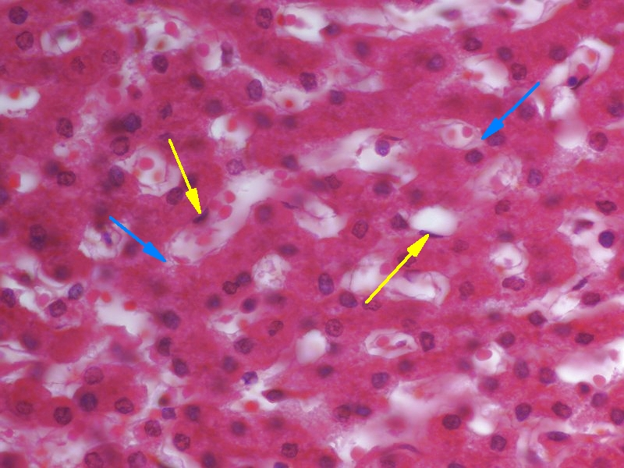
LIVER – BLOOD SUPPLY (ENDOCRINE LIVER)
In H&E images, you can see the sinusoids of the liver, with red blood cells within the lumen. Close examination reveals that these are indeed lined with endothelial cells (endothelial cell nuclei indicated by the yellow arrows). There is a space between the endothelial cells and hepatocytes (blue arrows), called the perisinusoidal space (better known as the space of Disse).
Remember, you can NOT see canaliculi in our light micrographs. Ross had a very cool image we showed you before (below), but that is a rare bird indeed.

Slide 57
LIVER – BLOOD SUPPLY (ENDOCRINE LIVER)
Video of the liver sinusoids – SL102
Link to SL 102
Be able to identify:
Sinusoids
Endothelial cells

Slide 58
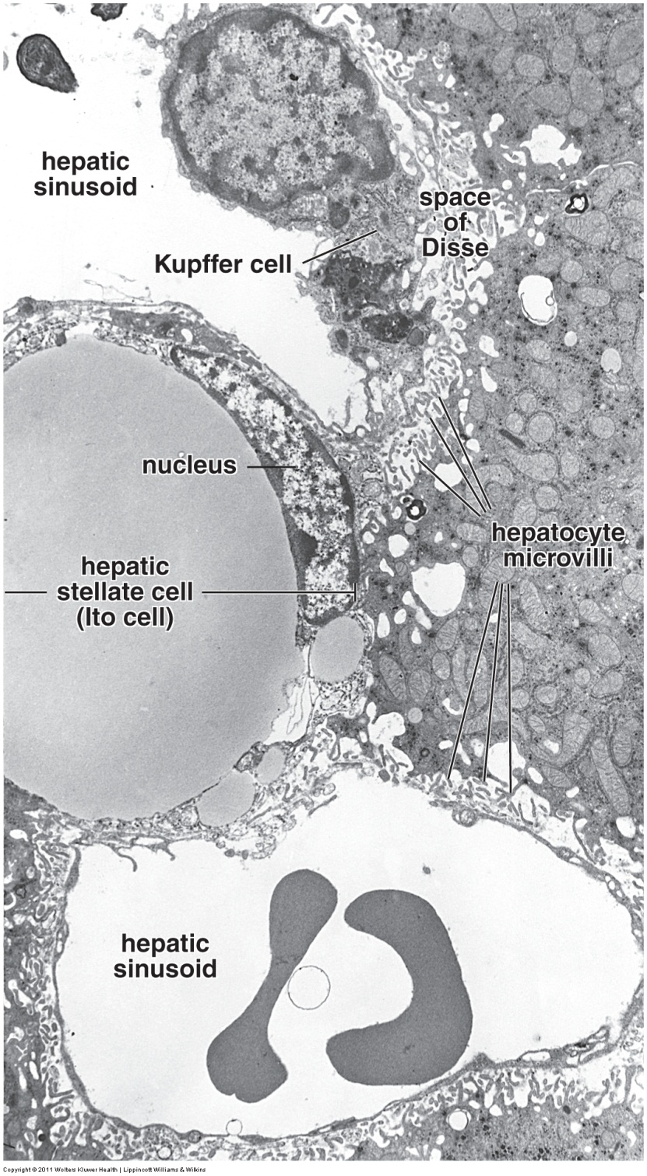
LIVER – BLOOD SUPPLY (ENDOCRINE LIVER)
Liver sinusoids are large-diameter capillaries. They are discontinuous, which means that, although the endothelial cells (black arrows) may form some junctions, they have large gaps between them. The endothelial cells also have fenestrations without diaphragms, and their basal lamina is discontinuous.
There is a gap between the hepatocyte plasma membrane and the discontinuous endothelial cells called the perisinusoidal space (space of Disse), which contains numerous microvilli of the hepatocyte. The sinusoids are very permeable; essentially, only formed elements are unable to pass through the endothelial cell gaps. Therefore, plasma is free to enter the space of Disse, bathing the membrane of the hepatocyte.
Lipid droplet
Ignore the Kupffer cell for now. It is a resident macrophage of the liver.
Stellate cells (cells of Ito) are distinct if you can find them because they contain a large lipid droplet, similar to unilocular adipose. These cells are important because they store vitamin A.

Slide 59
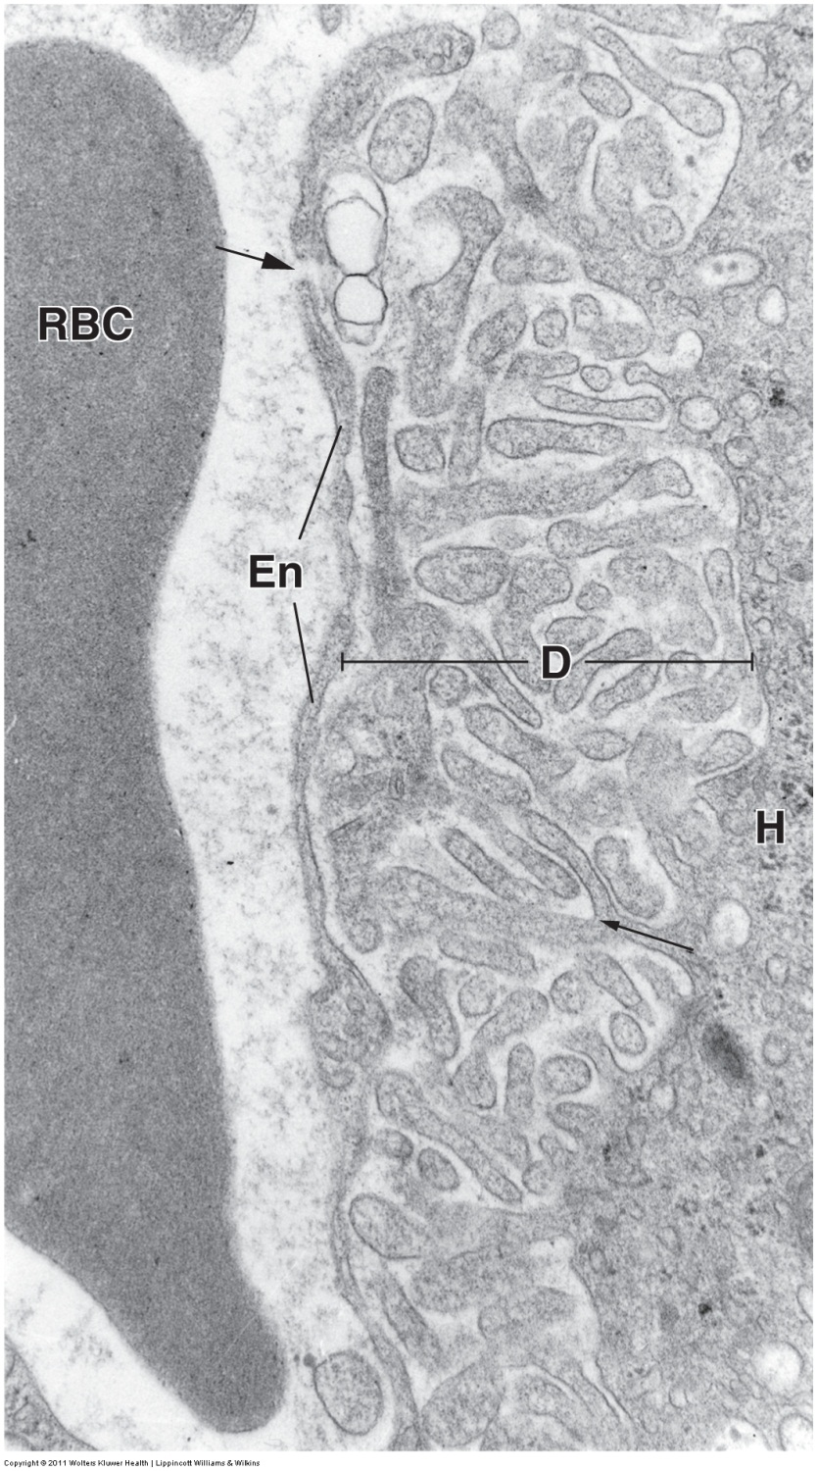
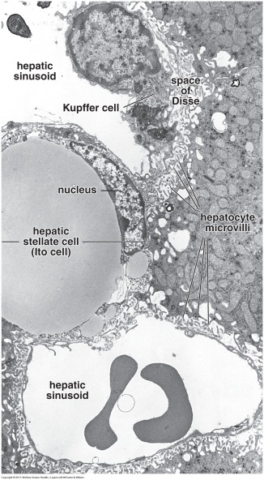
LIVER – BLOOD SUPPLY (ENDOCRINE LIVER)
Enlargement of the wall of the liver sinusoid shows gaps (upper arrow) between the endothelial cells. The edge of the hepatocyte is along the right edge of the image (H), with microvilli extending into the space of Disse (D). The lower arrow indicates a branching point of the microvilli.
Remember that blood flows on the basal side of a gland. So, the side of the hepatocyte facing the sinusoid can be considered the basal side.
The canaliculus can be considered on the apical side.
FYI, I say “can be” here because some histologists say that the liver cell itself is not as obviously polarized as, say, a chief cell, so they get all in a tizzy when I say apical side and basal side when discussing the liver. I think using these terms is very helpful, so I do it anyway.

Slide 60
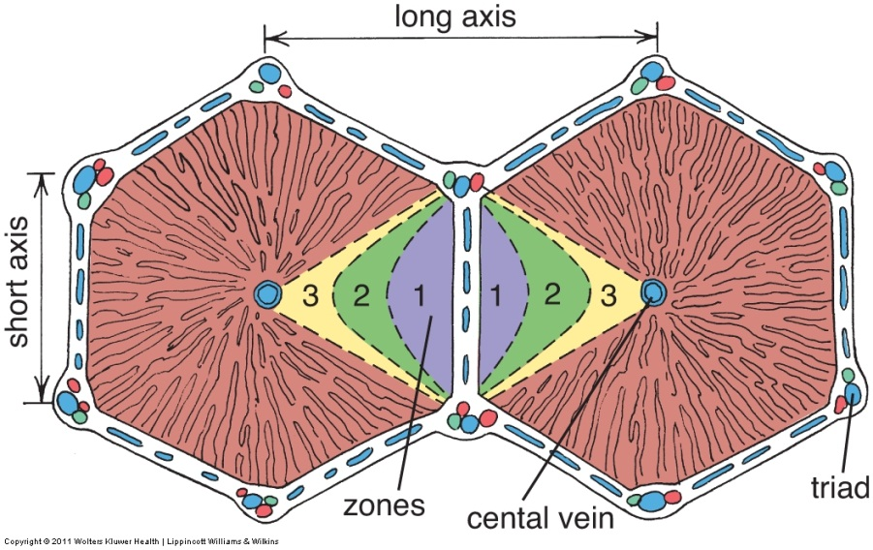
LIVER – BLOOD SUPPLY (ENDOCRINE LIVER)
As we just discussed, blood flows through the hepatic artery and hepatic portal vein in the porta hepatis toward the liver lobules. Up until the point when blood is in the smallest vessels within the walls of a classic liver lobule, the blood is “untainted” from the standpoint of exposure to hepatocytes.
Once blood enters the liver sinusoids and begins to flow toward the central vein, hepatocytes begin to change it’s composition. This includes removal of glucose and other nutrients from the blood, and addition of blood proteins and other liver products into the blood. This gives us the third way to organize the liver, the liver acinus. In this organization, the “wall” of a classic liver lobule is the center (contains “untainted blood”), and blood flows toward the periphery of the liver acinus (toward the central vein).
This may seem like a silly distinction right now. However, realize that hepatocytes are very metabolically active, and change the blood composition extensively as it flows through the sinusoids. Therefore, the hepatocytes near the edge of a classic liver lobule are exposed to blood that is quite different from the blood that is bathing the hepatocytes near the central veins (see zone map to the right). Indeed, there are some pathologies that manifest themselves preferentially in one zone over the other.

Slide 61
LIVER – BLOOD SUPPLY (ENDOCRINE LIVER)
All the sinusoids within a classic liver lobule drain into a central vein (aka terminal hepatic venule, green arrow). Similar to a small venule, this vessel is lined by endothelial cells, and a very thin layer of loose irregular connective tissue.
In some places you can see the sinusoids connecting to the central vein.
Kinda cool.

Slide 62
LIVER – BLOOD SUPPLY (ENDOCRINE LIVER)
Central veins (terminal hepatic venules) run vertically within the liver lobule (relative to the lobule, not necessarily the body). The central vein joins at right angles with a sublobular vein, which runs along the “bottom” of a series of lobules, collecting blood from each.
This image only shows one central vein, but you can easily imaging a row of lobules all draining into a central vein.

Slide 63
LIVER – BLOOD SUPPLY (ENDOCRINE LIVER)
The sublobular veins join at right angles to larger hepatic veins. Ultimately, the hepatic veins empty into the inferior vena cava.
Note that the central vein, sublobular vein, and hepatic veins are NOT bundled together with the intrahepatic bile ducts and hepatic arteries. They are solo.
Be careful, hepatic vein, hepatic portal vein….these are different.

Slide 64
LIVER – BLOOD SUPPLY (ENDOCRINE LIVER)
As you know, we can identify the central vein (terminal hepatic vein) in the center of a liver lobule. We can also identify the central vein, as well as the sublobular and hepatic vein, by taking advantage of the fact that they join each other at right angles, when given all three in the same section. Here, you can see the smaller central veins (black arrows) draining at right angles into a sublobular vein (yellow arrows), which drains at right angles into a hepatic vein (hepatic vein perpendicular to the plane of section of this image).
Another useful tip:
Recall that, as veins become larger, the amount of connective tissue in their walls increases. This is true here as well. Even in this low power image, you can appreciate that the hepatic vein has a much thicker wall than the sublobular vein. The sublobular veins have thicker walls than the central veins (which have essentially none); this may not be obvious at this magnification.
Hepatic vein
(in cross section)

Slide 65
LIVER – BLOOD SUPPLY (ENDOCRINE LIVER)
Video of liver veins – SL102
Link to SL 102
Be able to identify:
Central veins (terminal hepatic venule)
Sublobular vein
Hepatic vein

Slide 66
LIVER – SOME PARTING COMMENTS
We have already mentioned that Kupffer cells are resident macrophages of the liver. These cells actually form part of the lining of the sinusoids, though they do not form junctions with the endothelial cells. The are involved in red blood cell breakdown.
Kupffer cells are not readily visible on routine H&E sections. However, trypan blue dye injected into an animal will be taken up by the phagocytic activity of these cells, making them easy to visualize after this procedure (red arrows).

Slide 67
LIVER – SOME PARTING COMMENTS
Video of Kupffer cells – SL67
Link to SL 067
Be able to identify:
Kupffer cells (yes, sometimes we just show the specially prepared slide without stating that it is specially prepared…you should recognize them)

Slide 68
LIVER – SOME PARTING COMMENTS
Glycogen within the liver can be visualized using PAS staining. In the image on the left, the cytoplasm of the hepatocytes contains abundant glycogen, and are PAS positive. On the right is a similar PAS preparation of a liver taken from an animal that has fasted - obviously, the hepatocytes from this animal have much less glycogen

Slide 69
LIVER – SOME PARTING COMMENTS
Video of glycogen – SL007A
Link to SL 007A
Be able to identify:
Nothing really, this was just a really cool slide showing liver function

Slide 70
LIVER – SOME PARTING COMMENTS
As you know, hepatocytes produce bile. In this slide, pathology in this individual (obstructive jaundice) prevented the release of bile. In this case, bile products accumulate within the hepatocytes (blue arrows).
This is not a special stain, this is H&E. The bile is visible because it is yellow-brown.

Slide 71
LIVER – SOME PARTING COMMENTS
Video of glycogen – SL104B
Link to SL 104B and SL 104A
Be able to identify:
Nothing really, this was just a really cool slide showing liver function

Slide 72
LIVER – SOME PARTING COMMENTS
Finally, you may be aware that the fetal liver is a hematopoietic organ. In this image from a fetal liver, the hepatocytes have pale cytoplasm (black outline). Areas of hematopoiesis can be recognized as numerous pyknotic (condensed) nuclei (green outline).
Note that, typically, the adult liver does not function in hematopoiesis. However, it may be called upon to do so in certain pathological conditions.

Slide 73
LIVER – SOME PARTING COMMENTS
Video of fetal liver – SL69
Link to SL 069
Be able to identify:
Nothing really, this was just a really cool slide showing liver function

Slide 74
GALL BLADDER
The gall bladder is embedded on the visceral surface of the liver, covered by a layer of visceral peritoneum. Therefore, the outer layer of the gall bladder may or may not have a visceral peritoneum; so it may be a serosa or adventitia

Slide 75
GALL BLADDER
The gall bladder lacks a muscularis mucosa, so it has a three layered structure:
Mucosa (black bracket) – simple columnar epithelium plus lamina propria
Muscularis (red bracket) – smooth muscle interspersed with connective tissue
Adventitia or serosa (green bracket) – this depends on whether the section is from the side in contact with the liver, or the side covered by visceral peritoneum
The epithelial cells are very active in concentrating bile. Therefore, like intestinal absorptive cells, they are tall columnar cells that are highly eosinophilic.
The mucosa is thrown up into folds (*), which give the appearance of mucous glands. These are due to sectioning, and not true glands.
*
Not very muscular…but, really, how hard can it be to squirt bile?
Some hormones, e.g. cholecystokinin (CCK), from the intestine stimulates the smooth muscle here.

Slide 76
GALL BLADDER
Video of gall bladder – SL106
Link to SL 105 and SL 106 and SL 069
Be able to identify:
Gall bladder
Note SL069 is fetal, so muscle layers are not well developed yet (no Big Macs yet)

Slide 77
GALL BLADDER
As mentioned, the epithelial cells that line the gall bladder are simple columnar, and are involved in concentration of bile. Therefore, they have characteristics of cells actively transporting ions: microvilli, junctional complexes, and extensive basolateral infoldings.
Once the epithelial cells become active, fluid accumulates in the space between the basal aspect of the cells and the basement membrane, expanding those spaces significantly (compare active gall bladder to the right to the less active one on the left). Fluid then flows into the underlying connective tissue (in direction of the arrows).

Slide 78
The next set of slides is a quiz for this module. You should review the structures covered in this module, and try to visualize each of these in light and electron micrographs.
Distinguish, at the light microscope level, each of the following:
Pancreas
Serous acini
Ducts
Intercalated ducts
Centroacinar cells
Excretory ducts
Pancreatic islets (of Langerhans)
Liver
Capsule (of Glisson)
Lobule (classic liver lobule)
Central vein (terminal hepatic venule)
Portal triad
Hepatic artery
Hepatic portal vein
Intrahepatic bile duct
(nerves and lymphatic vessels – seen at porta hepatis SL103)
Hepatocytes
Kupffer cells
Sinusoids
Endothelial cells
Veins
Central vein
Sublobular vein
Hepatic vein
Gall bladder
Extrahepatic bile duct (bile duct, cystic duct , hepatic ducts…all look same histologically)
Hepatopancreatic ampulla (of Vater)
Continues on next page…..

Slide 79
After completing this exercise, you should be able to:
Distinguish, at the electron microscope level, each of the following:
liver
Hepatocyte
Sinusoid
Endothelial cell
Space of Disse
Bile canaliculus
pancreas
Exocrine cells
Endocrine cells

Slide 80
Final quiz
Self-check: Identify the organ and structure. (advance slide for answers). Do NOT let me down.
Pancreas
Islet of Langerhans

Slide 81
Final quiz
Self-check: In this image from the liver, identify the structure at X. (advance slide for answers).
canaliculus
X

Slide 82
Final quiz
Self-check: Identify the cell at the tip of the arrows. (advance slide for answers).
Endothelial cell

Slide 83
Final quiz
Self-check: Identify the outlined structure. (advance slide for answers).
Intrahepatic bile duct

Slide 84
Final quiz
Self-check: In this image from the liver, identify the structure at X. (advance slide for answers).
X
sinusoid

Slide 85
Final quiz
Self-check: Identify the outlined structure. (advance slide for answers).
Central vein

Slide 86
Final quiz
Self-check: In this image from the pancreas, the lumen is indicated (L). Identify the cells in this micrograph (advance slide for answers).
Aciniar cells (exocrine pancreas)
L

Slide 87
Final quiz
Self-check: Identify the outlined structure. (advance slide for answers).
Hepatic vein

Slide 88
Final quiz
Self-check: Identify the outlined cells (advance slide for answers).
Aciniar cells (exocrine pancreas)

Slide 89
Final quiz
Self-check: The black arrows are located in which spaces? (advance slide for answers).
Sinusoids

Slide 90
Final quiz
Self-check: Identify the outlined structure. (advance slide for answers).
Portal triad (portal canal, portal area)

Slide 91
Final quiz
Self-check: Identify the cells at the tips of the RED arrows. (advance slide for answers).
Endothelial cells

Slide 92
Final quiz
Self-check: Identify the outlined structure. (advance slide for answers).
Sublobular vein

Slide 93
Final quiz
Self-check: In this image from the liver, identify the structure at X. (advance slide for answers).
canaliculus
X

Slide 94
Final quiz
Self-check: Identify the cell indicated by the arrow (advance slide for answers).
Centroacinar cell

Slide 95
Final quiz
Self-check: Identify the outlined structure. (advance slide for answers).
(pancreatic) Excretory duct

Slide 96
Final quiz
Self-check: Identify the outlined structure. (advance slide for answers).
Central vein (terminal hepatic venule)

Slide 97
Final quiz
Self-check: What is the space at the tips of the arrows? (advance slide for answers).
CLICK HERE FOR A CLUE
Perisinusoidal space (space of Disse)

Slide 98
Final quiz
Self-check: Identify the outlined structure. (advance slide for answers).
Hepatic portal vein

Slide 99
Final quiz
Self-check: Identify the organ and structure. (advance slide for answers). Do NOT let me down.
Pancreas
Islet of Langerhans

Slide 100
Final quiz
Self-check: Identify the outlined cell. (advance slide for answers).
hepatocyte

Slide 101
Final quiz
Self-check: Identify the cell at the tip of the arrows. (advance slide for answers).
Kupffer cell

Slide 102
Final quiz
Self-check: Identify the outlined structure. (advance slide for answers).
Central vein

Slide 103
Final quiz
Self-check: Identify the cell at the tip of the arrows. (advance slide for answers).
Kupffer cell

Slide 104
Final quiz
Self-check: What is the space at the tips of the arrows? (advance slide for answers).
sinusoid

Slide 105
Final quiz
Self-check: Identify the outlined structure. (advance slide for answers).
Sublobular vein

Slide 106
Final quiz
Self-check: Identify the organ on this slide. (advance slide for answers).
Parotid gland

Slide 107
Final quiz
Self-check: Identify the outlined structure. (advance slide for answers).
Hepatic portal vein

Slide 108
Final quiz
Self-check: Identify the outlined structure. (advance slide for answers).
Extrahepatic bile duct

Slide 109
Final quiz
Self-check: Identify the outlined cells (advance slide for answers).
Aciniar cells (exocrine pancreas)

Slide 110
Final quiz
Self-check: Identify the outlined structure. (advance slide for answers).
Hepatic artery

Slide 111
Final quiz
Self-check: In this image from the liver, identify the cell at the tip of the RED arrow. (advance slide for answers).
Endothelial cell

Slide 112
Final quiz
Self-check: Identify the cell at the tip of the arrows. (advance slide for answers).
Endothelial cell

Slide 113
Final quiz
Self-check: Identify the organ on this slide. (advance slide for answers).
Gall bladder

Slide 114
Final quiz
Self-check: Identify the outlined structure. (advance slide for answers).
Intrahepatic bile duct

Slide 115
Final quiz
Self-check: Identify the cell at the tip of the arrows. (advance slide for answers).
Kupffer cell

Slide 116
Final quiz
Self-check: Identify the outlined structure. (advance slide for answers).
Intrahepatic bile duct

Slide 117
Final quiz
Self-check: What is the space at the tips of the arrows? (advance slide for answers).
Perisinusoidal space (space of Disse)

Slide 118
Final quiz
Self-check: Identify the outlined structure. (advance slide for answers).
Central vein

Slide 119
Final quiz
Self-check: Identify the outlined cells (advance slide for answers).
Centroacinar cells

Slide 120
Final quiz
Self-check: Identify the organ on this slide. (advance slide for answers).
Gall bladder

Slide 121
Final quiz
Self-check: Identify the outlined structure. (advance slide for answers).
Hepatic artery

Slide 122
Final quiz
Self-check: Identify the cell at the tip of the arrows. (advance slide for answers).
Endothelial cell

Slide 123
Final quiz
Self-check: Identify the outlined structure? (advance slide for answers).
Central vein

Slide 124
Final quiz
Self-check: Identify the cell at the tip of the arrows. (advance slide for answers).
hepatocyte

Slide 125
Final quiz
Self-check: Identify the outlined cells (advance slide for answers).
Centroacinar cells

Slide 126
Final quiz
Self-check: Identify the outlined structure. (advance slide for answers).
Classic liver lobule

Slide 127
Final quiz
Self-check: Identify the outlined structure. (advance slide for answers).
Hepatic artery

Slide 128
Final quiz
Self-check: In this image from the liver, identify the region at X. (advance slide for answers).
Space of Disse
X
X

Slide 129
Final quiz
Self-check: Identify the outlined structure. (advance slide for answers).
Hepatic portal vein

Slide 130
Final quiz
Self-check: Identify the cells at the tips of the RED arrows. (advance slide for answers).
hepatocytes

Slide 131
Final quiz
Self-check: Identify the cell at the tip of the arrows. (advance slide for answers).
hepatocyte

Slide 132
Final quiz
Self-check: Identify the region at the tip of the arrows. (advance slide for answers).
Space of Disse

Slide 133
Final quiz
Self-check: In this image from the pancreas, identify cells at X. (advance slide for answers).
Centroacinar cells
X
X

Slide 134
Final quiz
Self-check: What is the space occupied by the X? (advance slide for answers).
X
sinusoid

Slide 135
Final quiz
Self-check: Identify the outlined cells (advance slide for answers).
Aciniar cells (exocrine pancreas, acinus)

