Slide 1
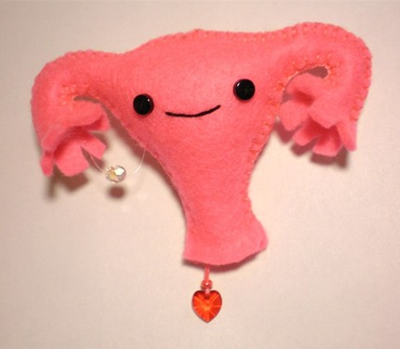
Oviducts, Uterus, Vagina
Digital Laboratory
It’s best to view this in Slide Show mode, especially for the quizzes.
This module will take approximately 90 minutes to complete.

Slide 2
After completing this exercise, you should be able to:
identify, at the light microscope level, each of the following:
Oviduct (uterine tube, Fallopian tube)
Mucosa
Ciliated cells
Secretory (peg) cells
Muscularis
Serosa
Be aware of regions (fimbria, ampulla, etc.) but you do not need to distinguish histologically
Uterus
Body
Layers
Endometrium
Functional zone
Basal zone
Myometrium
Perimetrium
Stages
Proliferative
Early secretory
Late secretory
Menstrual (note difficult to distinguish from poorly preserved slide)
Cervix
Supravaginal portion
Vaginal portion
Vagina
Mucosa
Muscularis
Adventitia

Slide 3
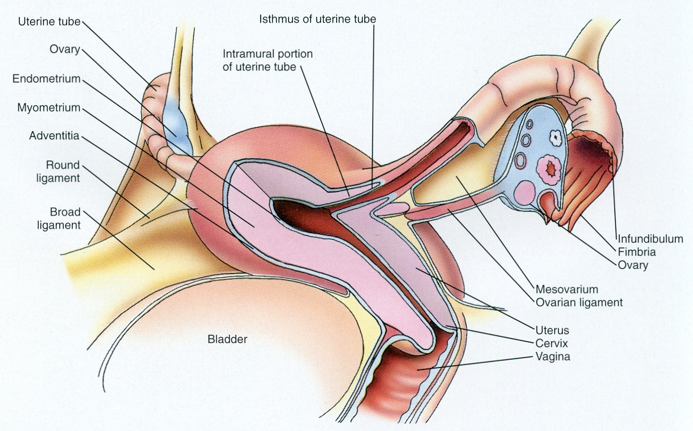
FEMALE REPRODUCTIVE SYSTEM
This is a reminder slide from the digital lab on the ovaries.
Anterior
Posterior
Major structures of the female reproductive system that allow for production and transmission of the oocyte include:
ovary – produces oocytes
oviduct (uterine tube, Fallopian tube) – transport of oocyte, usual site of fertilization
uterus – site of implantation, and contracts during childbirth
vagina – organ of copulation and birth canal

Slide 4
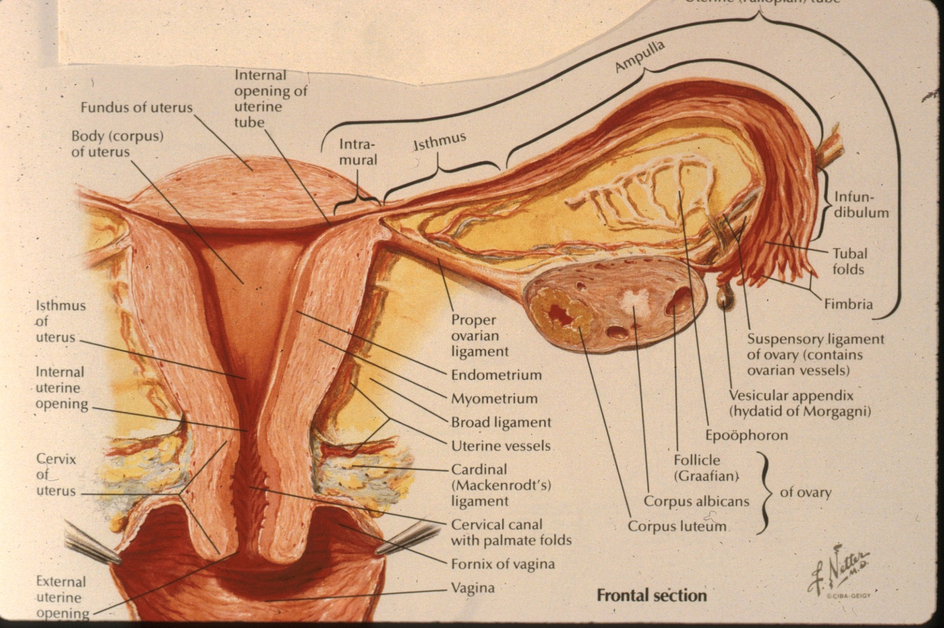
FEMALE REPRODUCTIVE SYSTEM - OVIDUCTS
The oviducts are connected to the uterus, but laterally are open to the peritoneal cavity. Grossly, there are several regions of the oviducts (intramural, isthmus, ampulla, infundibulum). As we will see, the mucosa of the oviducts are thrown up into folds. The end of the oviducts near the ovaries have more prominent folds, which taper down as the oviduct progresses toward the uterus. However, we do not ask you to distinguish the different portions of the oviduct specifically.

Slide 5
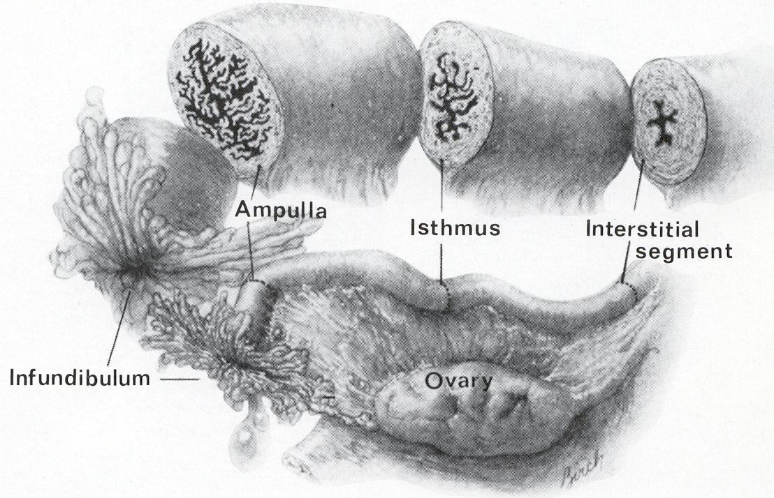
FEMALE REPRODUCTIVE SYSTEM - OVIDUCTS
This drawing demonstrates that the mucosal folding in the oviduct is more pronounced in the ampulla, and almost nonexistent close to the uterus. However, remember that, histologically, we don’t ask you to distinguish the regions of the oviduct.

Slide 6
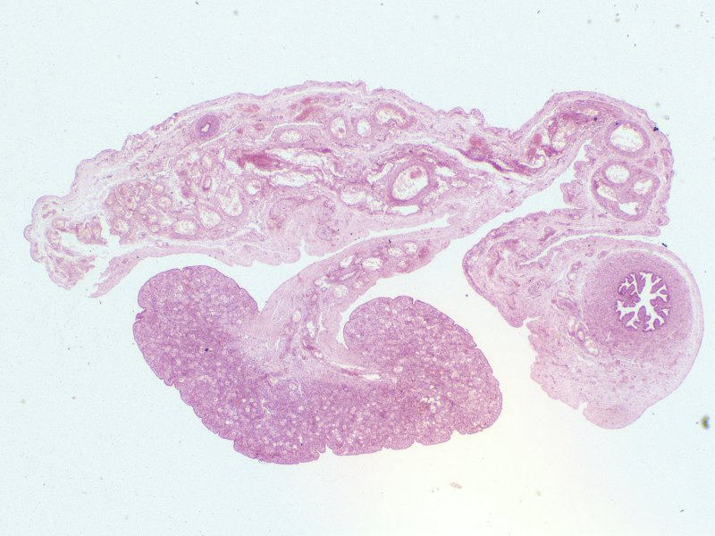
FEMALE REPRODUCTIVE SYSTEM - OVIDUCTS
This is a reminder slide from the digital lab on the ovaries. Recall that the oviduct is attached to the mesosalpinx.
mesosolpinx
mesometrium
mesovarium
oviduct
ovary
This slide shows the fetal ovary, oviduct, and broad ligament (the same slide we looked at in the ovary lab). The floor of the pelvis is to the left, and the top of the image is ventral.

Slide 7
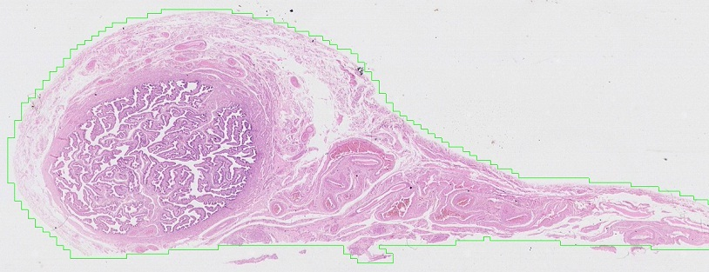
FEMALE REPRODUCTIVE SYSTEM - OVIDUCTS
Those folds look an awful lot like the seminal vesicles of the male.
oviduct
mesosolpinx
This slide shows the oviduct and mesosalpinx. Both are covered with an epithelium continuous with the peritoneal membrane.

Slide 8
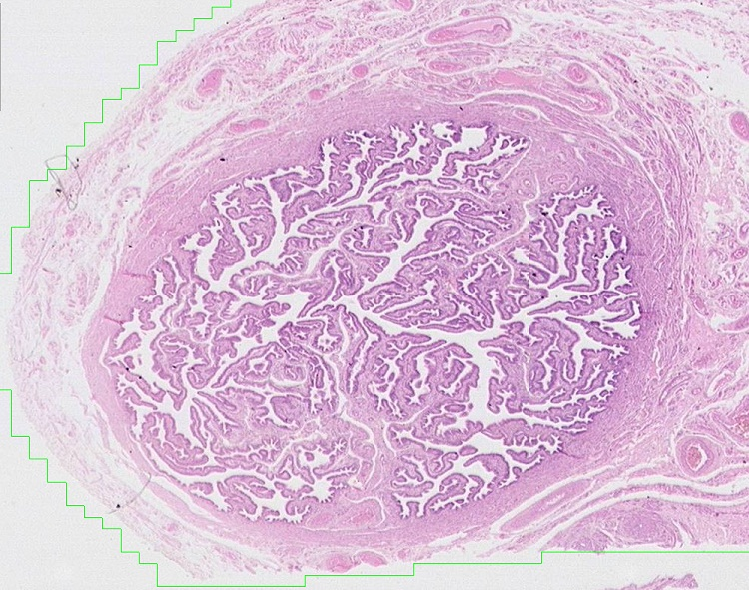
FEMALE REPRODUCTIVE SYSTEM - OVIDUCTS
serosa
muscularis
mucosa
The wall of the oviduct has three regions:
mucosa – epithelium with underlying loose connective tissue, this is thrown up into folds
muscularis – smooth muscle layer around the periphery of the mucosa
serosa – connective tissue containing blood vessels, nerves, etc., covered by an epithelium

Slide 9
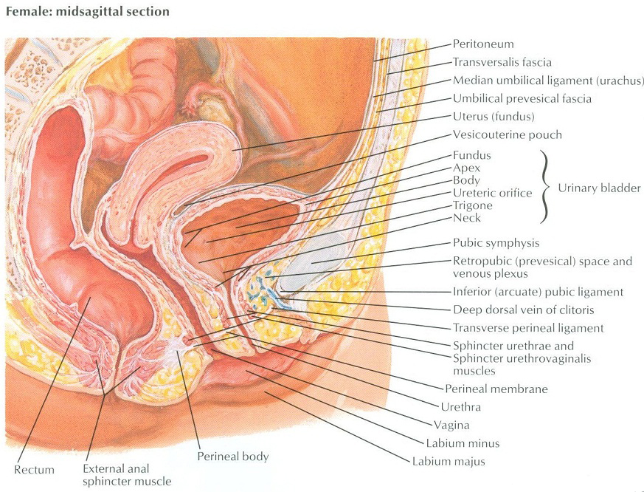
FEMALE REPRODUCTIVE SYSTEM - OVIDUCTS
In this drawing, the arrows indicate the peritoneal lining covering the inner aspects of the abdominal wall, and draping over the top of visceral structures (including the oviducts).
In regions where the organ is covered by the peritoneal lining, the outer layer is a connective tissue covered by the epithelium of the peritoneum. In these cases, such as the oviducts, most of the uterus, and top of the bladder, we call the outer layer of the organ a serosa. In regions where there is no peritoneal epithelium, e.g. the vagina, lower portions of the rectum and bladder, the outer layer is connective tissue, and we call this an adventitia.

Slide 10
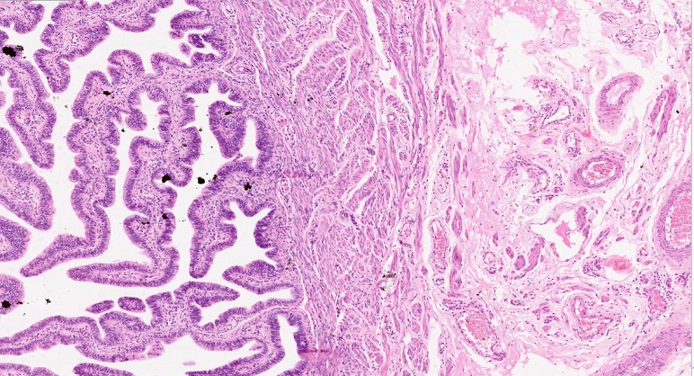
FEMALE REPRODUCTIVE SYSTEM - OVIDUCTS
muscularis
mucosa
serosa
Medium-power view of the wall of the oviduct, showing the three layers.
Not much to say here…

Slide 11
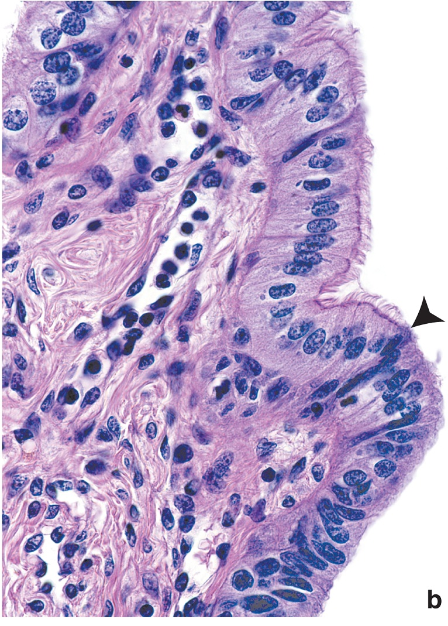
FEMALE REPRODUCTIVE SYSTEM - OVIDUCTS
The peg cells are best characterized as lacking cilia, with a nucleus that is located in the apical portion of the cell, typically causing a bulging of the surface. This is more distinct on the next slide.
The epithelium of the oviduct is a simple epithelium containing ciliated cells (above the arrowhead) and non-ciliated secretory (peg) cells (arrowhead). Note that these two cell types are typically intermixed more evenly within the epithelium, and are not necessarily in distinct regions as shown on this slide.

Slide 12
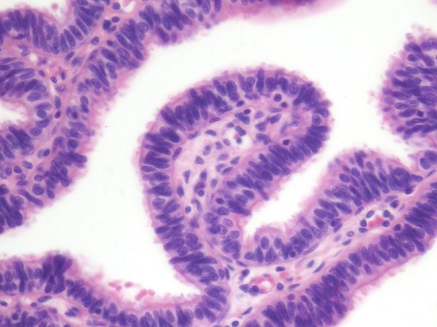
FEMALE REPRODUCTIVE SYSTEM - OVIDUCTS
The epithelium of the oviduct is a simple epithelium containing ciliated cells and non-ciliated secretory (peg) cells.
The peg cells are best characterized as lacking cilia, with a nucleus that is located in the apical portion of the cell, typically causing a bulging of the surface (black arrows).

Slide 13
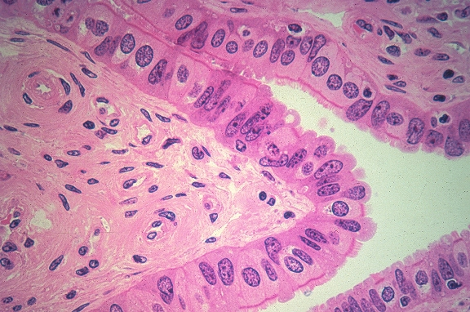
FEMALE REPRODUCTIVE SYSTEM - OVIDUCTS
Secretory (Peg) cells
Lamina propria
Ciliated cells
Outstanding micrograph showing secretory and ciliated cells. That right there is worth the price of tuition.

Slide 14
FEMALE REPRODUCTIVE SYSTEM - OVIDUCTS
Video of oviduct – SL134
Link to SL 134
Be able to identify:
Oviduct
Mucosa
Ciliated cells
Secretory (peg) cells
Muscularis
Serosa

Slide 15
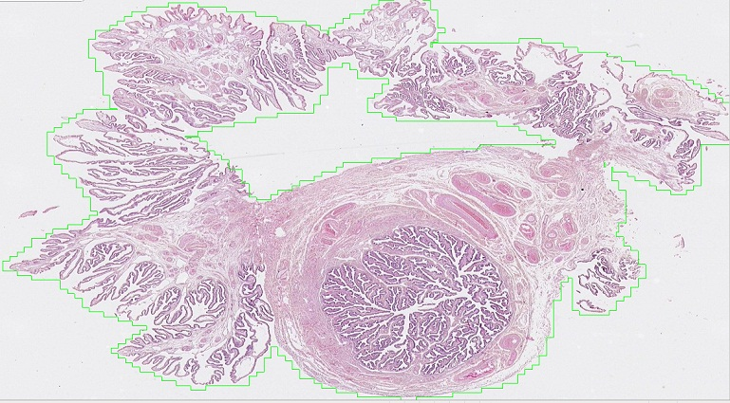
FEMALE REPRODUCTIVE SYSTEM - OVIDUCTS
fimbria
oviduct
The next slide is a cut similar to the blue line in the drawing on the left. Note that this cuts the oviduct in cross section, as before, but also includes the open finger-like projections of the fimbria. Histologically, the fimbria has a similar structure as the oviducts, with the muscularis layer not as obvious.

Slide 16
FEMALE REPRODUCTIVE SYSTEM - OVIDUCTS
Video of oviduct with fimbria – SL133
Link to SL 133
Be able to identify:
Oviduct
Mucosa
Ciliated cells
Secretory (peg) cells
Muscularis
Serosa

Slide 17
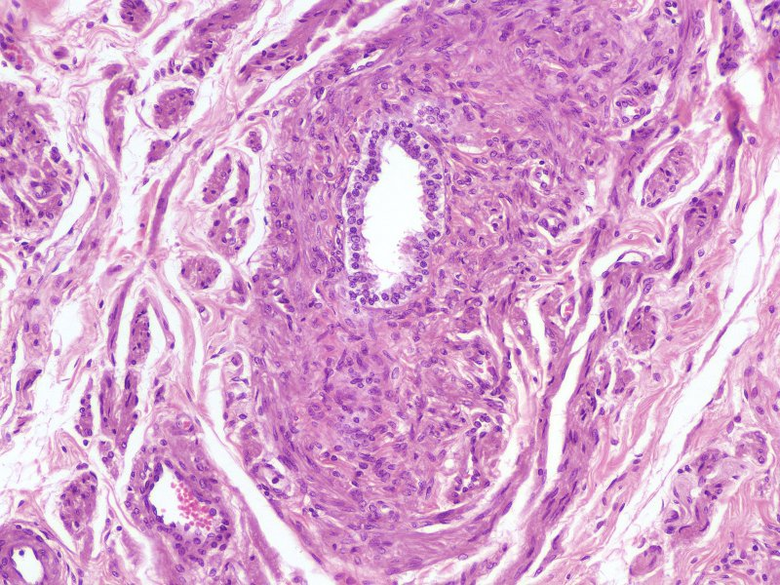
FEMALE REPRODUCTIVE SYSTEM - OVIDUCTS
Remnants of the male reproductive tract (i.e. the mesonephric or Wolffian ducts) persist in the broad ligament as structures called the epoophoron or paraoophoron. Histologically, these are fairly indistinct tubes, lined by simple cuboidal epithelium surrounded by connective tissue. They are mentioned here because they can form benign cysts, called Gartner’s or vaginal cysts.

Slide 18
FEMALE REPRODUCTIVE SYSTEM - OVIDUCTS
Video of oviduct showing remnants of mesonephric ducts – SL134
Link to SL 134
Be able to identify:
Remnants of mesonephric ducts if you have nothing better to do

Slide 19
FEMALE REPRODUCTIVE SYSTEM - UTERUS
The uterus is the site of implantation of the embryo, and contains thick smooth muscle that contracts during childbirth. Histologically, we divide the uterus into the body and cervix (superior and inferior to the internal uterine opening, respectively). Both regions consist of three layers:
Endometrium – inner lining, consists of epithelium and connective tissue, similar to the mucosa
Myometrium – very thick layer of smooth muscle in body (and fundus), less muscular in cervix
Perimetrium – thin outer connective tissue layer, covered by an epithelium on most of its surface

Slide 20
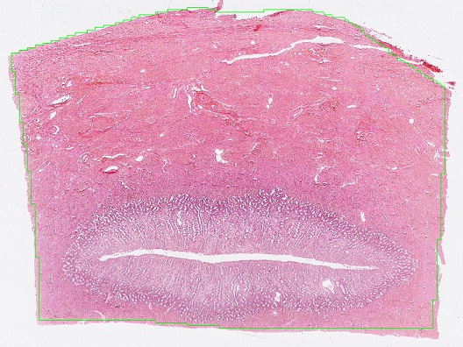
FEMALE REPRODUCTIVE SYSTEM - UTERUS
Serosa or adventitia
myometrium
endometrium
lumen
The uterus is the site of implantation of the embryo, and contains thick smooth muscle that contracts during childbirth. Histologically, we divide the uterus into the body and cervix (superior and inferior to the internal uterine opening, respectively). Both regions consist of three layers:
Endometrium – inner lining, consists of epithelium and connective tissue, similar to the mucosa
Myometrium – very thick layer of smooth muscle
Perimetrium – thin outer connective tissue layer, covered by an epithelium on most of its surface

Slide 21
FEMALE REPRODUCTIVE SYSTEM - UTERUS
Video of overview of uterus layers – SL141
Video of overview of uterus layers – SL140
Link to SL 141 and SL 140 and SL 139 and SL 058
Be able to identify:
Uterus
Endometrium
Myometrium
Perimetrium

Slide 22
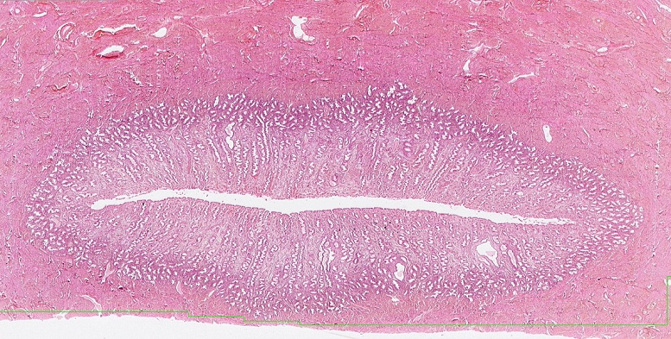
FEMALE REPRODUCTIVE SYSTEM - UTERUS
Basal zone
Functional zone
lumen
Functional zone
Basal zone
Focusing on the endometrium, you can see that the basal portion of this tissue, near the myometrium, stains more darkly. This region is the basal zone, while the paler region is the functional zone. During menstruation, the functional zone is sloughed off, and the epithelial cells and connective tissues of the basal zone regenerate the functional zone in the next menstrual cycle.

Slide 23
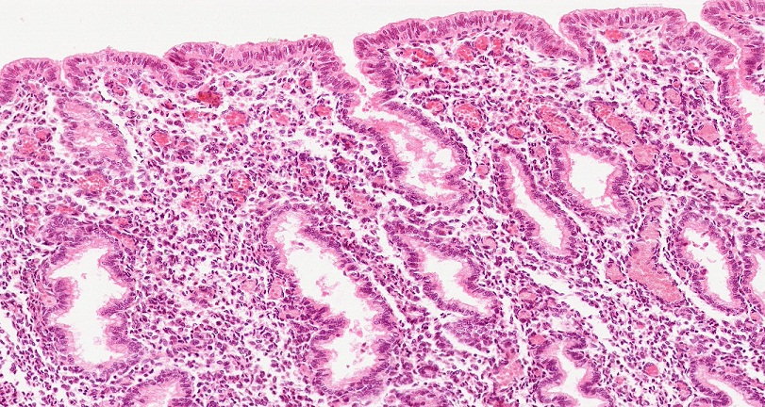
FEMALE REPRODUCTIVE SYSTEM - UTERUS
lumen
Looking more closely, the epithelium of the endometrium is a simple columnar epithelium; many of the cells are ciliated. The lamina propria is very cellular, and the cells are referred to as stromal cells. There are numerous white blood cells in the lamina propria – connective tissue with high numbers of white blood cells is referred to as diffuse lymphoid tissue. Glands are numerous in the lamina propria, extending all the way to the basal layer, and are lined by columnar cells similar to the cells that line the uterine lumen. The surface and glandular epithelial cells have pale eosinophilia when they are actively secreting.
The cells that form the base of the glands are the source for the epithelium that regenerates the functional zone of the endometrium.

Slide 24
FEMALE REPRODUCTIVE SYSTEM - UTERUS
Video of overview of endometrium– SL141
Link to SL 141
Be able to identify:
Uterus
Endometrium
Basal zone
Functional zone
Surface and glandular epithelial cells
Stroma

Slide 25
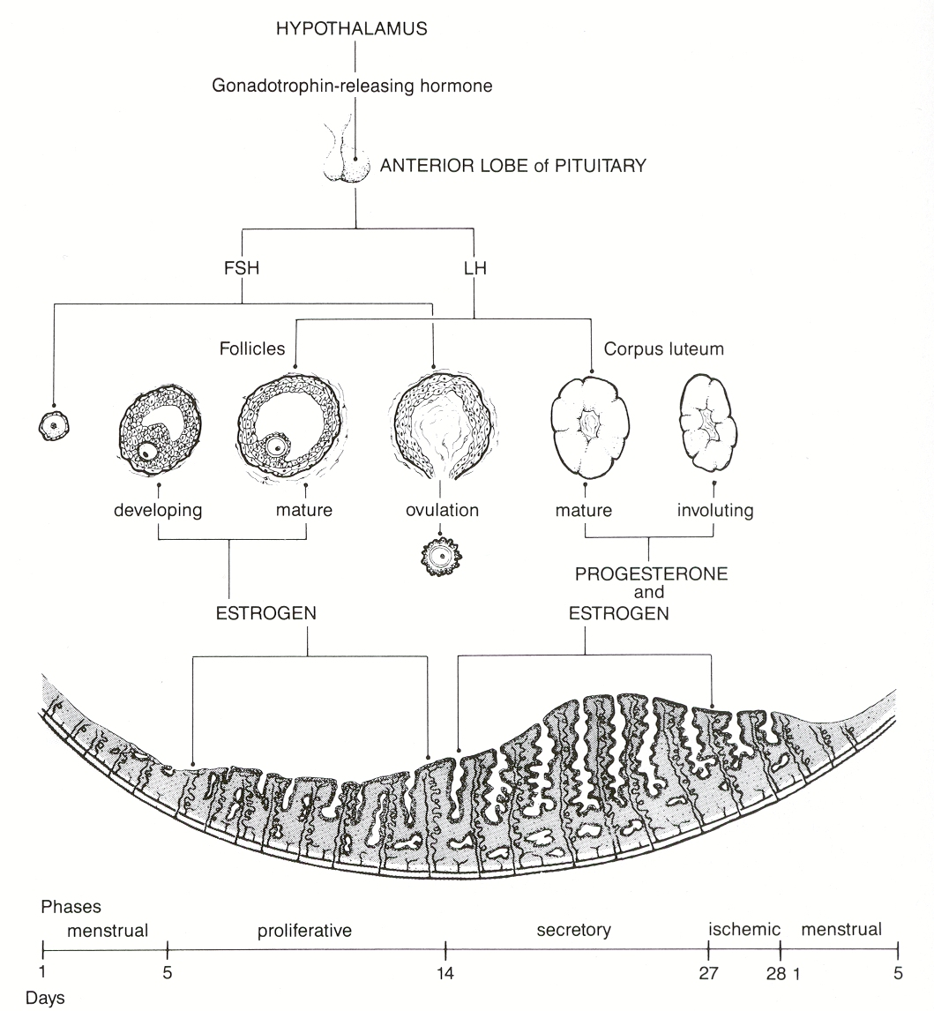
FEMALE REPRODUCTIVE SYSTEM - UTERUS
The uterus undergoes changes during the menstrual cycle in response to hormones released by the ovary. Most of these changes occur in the endometrium.
At the end of a cycle, the corpus luteum degenerates into the corpus albicans. This results in a drop in circulating progesterone (and estrogen) levels. The endometrial lining of the uterus, which depends on these hormones, sloughs off. This sloughing, menstruation, takes place during the first five days of the menstrual cycle.
Around day 5, developing follicles in the ovary are producing enough estrogen to induce the proliferative phase of the uterus. In this phase, the functional zone is replaced; histologically, the glands are not elaborate.
After ovulation, progesterone released by the corpus luteum induces the endometrial epithelium to become secretory, and stromal tissue to become more vascularized and edematous. This will persist until the corpus luteum degenerates, and the drop in progesterone will result in another menstrual phase, continuing the cycle.

Slide 26
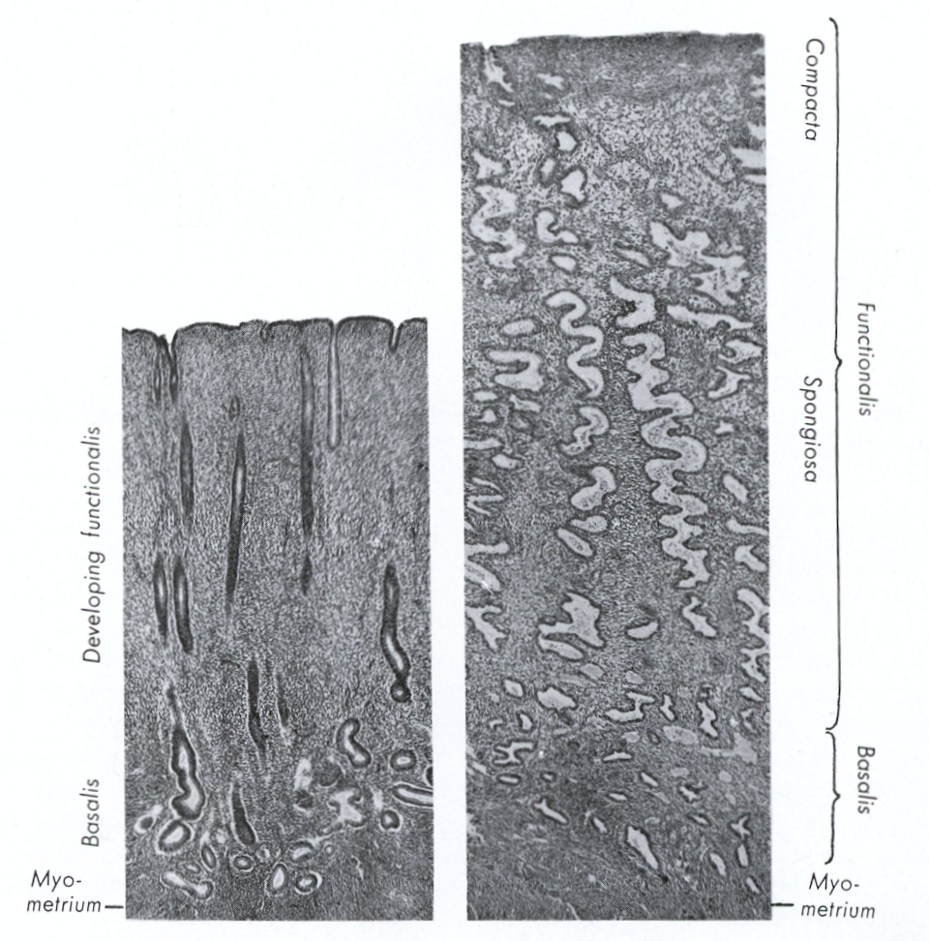
FEMALE REPRODUCTIVE SYSTEM - UTERUS
In these low power images of the endometrium in the proliferative and secretory phases, note that the proliferative endometrial glands are straighter and have a narrow lumen. In contrast, the glands in the secretory endometrium have dilated lumens that give them a “sawtooth” appearance, and are more numerous.
The stroma of the endometrium also undergoes changes, such as increased blood supply, in the secretory uterus. However, these changes are more subtle, so we will focus on the obvious glandular differences.
Proliferative
Secretory

Slide 27
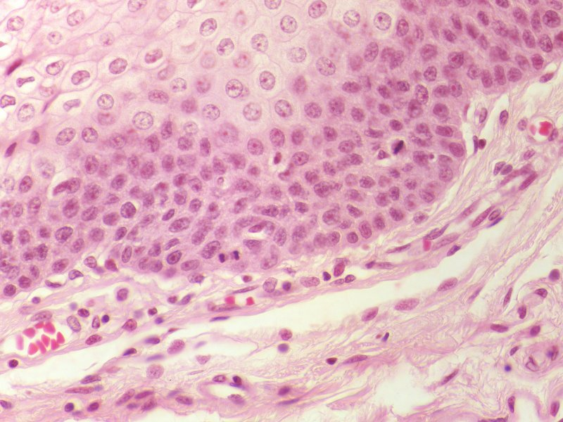
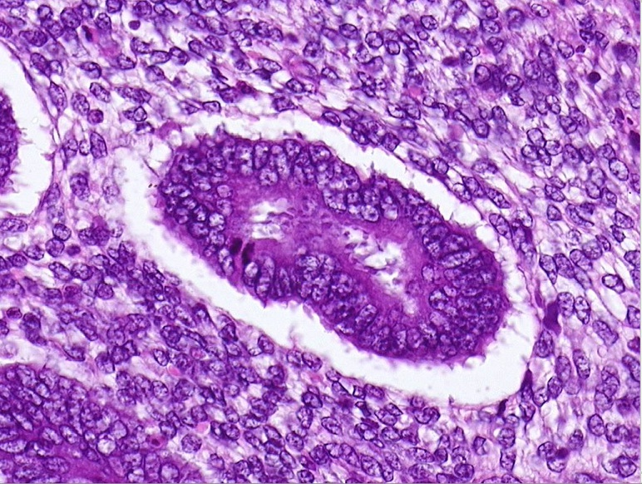
FEMALE REPRODUCTIVE SYSTEM - UTERUS
You may recall looking for mitotic figures; these structures are recognized as condensed DNA without a nuclear profile (black arrows). Obviously, these structures can be found in the epithelium and stroma of the proliferative phase of the uterus (green arrow).

Slide 28
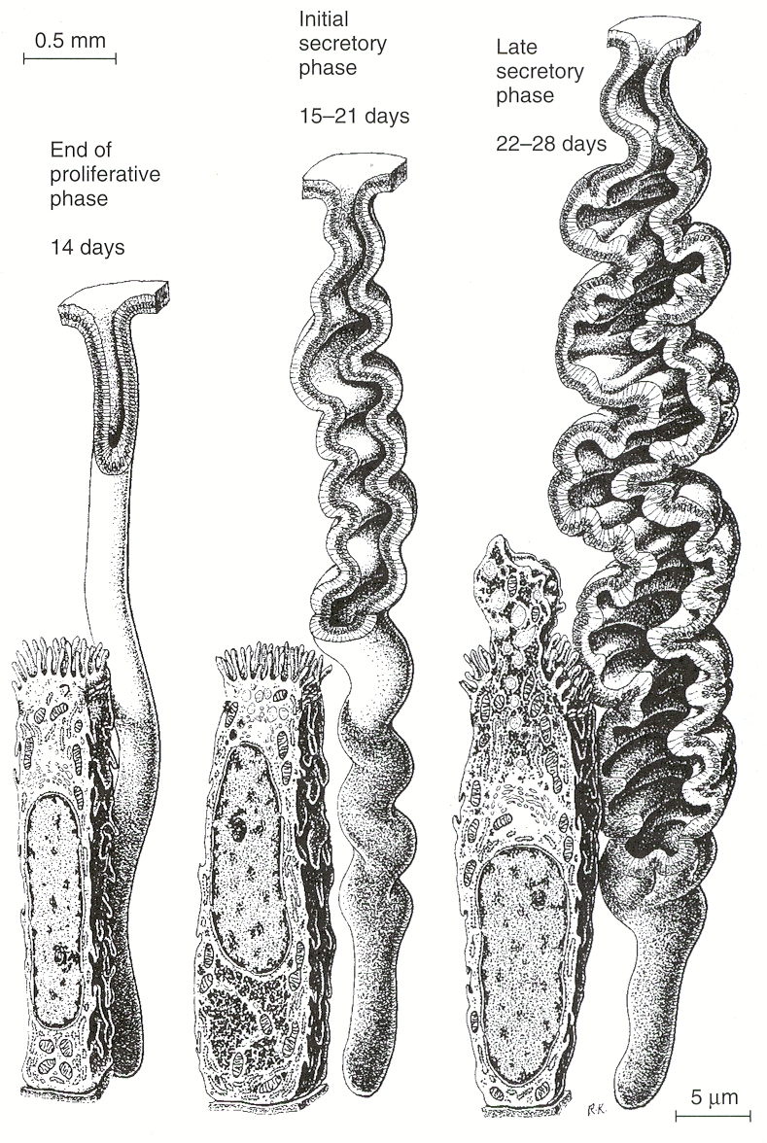
FEMALE REPRODUCTIVE SYSTEM - UTERUS
These drawings show the changes of the endometrial glands at the gross and cellular level.
As mentioned before, the proliferative phase (left) is characterized by narrow, straight glands. The cells are columnar, and do not contain secretory material.
In the early portion of the secretory phase (middle), the glands begin to become tortuous, with a wider lumen. Secretory components, in particular glycogen, are located in the basal aspect of the cell (red arrow).
During the second portion of the secretory phase, the cells move their secretory products to the apical side of the cell (blue arrow), and release the contents into the lumen of the gland. This makes the gland more dilated and tortuous.
Recall that glycogen will wash out on standard H&E preparations.

Slide 29
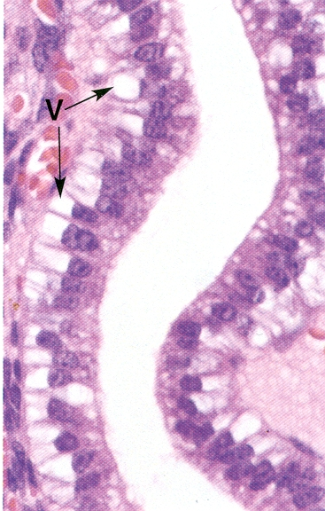
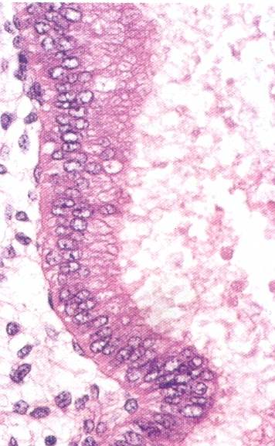
FEMALE REPRODUCTIVE SYSTEM - UTERUS
Both of these images are from the uterine endometrium in the secretory phase.
The left image is from the first ½ of the secretory phase; here you can see that secretory product, mostly glycogen (V) has displaced the nucleus away from the basal aspect of the cell.
In the late secretory phase, the secretory product moves to the apical aspect of the cell and is released, so the nucleus returns to it’s normal position in the basal aspect of the cell.
Lumen
Lumen
Recall that glycogen will wash out on standard H&E preparations.
Gland cells days 15-21
Gland cells fully secretory

Slide 30
FEMALE REPRODUCTIVE SYSTEM - UTERUS
Video of uterus in the proliferative phase – SL139
Link to SL 139 and SL 138
Be able to identify:
Uterus – proliferative phase

Slide 31
FEMALE REPRODUCTIVE SYSTEM - UTERUS
Video of uterus in the early secretory phase – SL140
Link to SL 140
Be able to identify:
Uterus – early secretory phase

Slide 32
FEMALE REPRODUCTIVE SYSTEM - UTERUS
Video of uterus in the late secretory phase – SL141
Link to SL 141
Be able to identify:
Uterus – late secretory phase

Slide 33
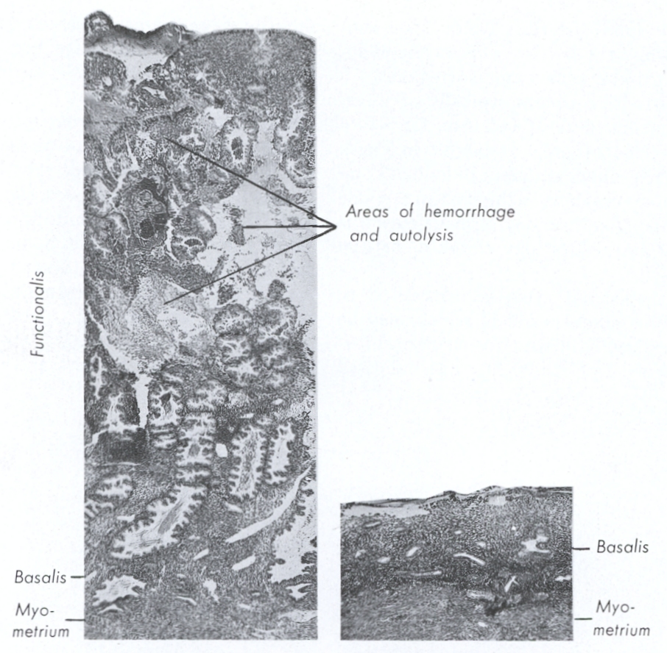
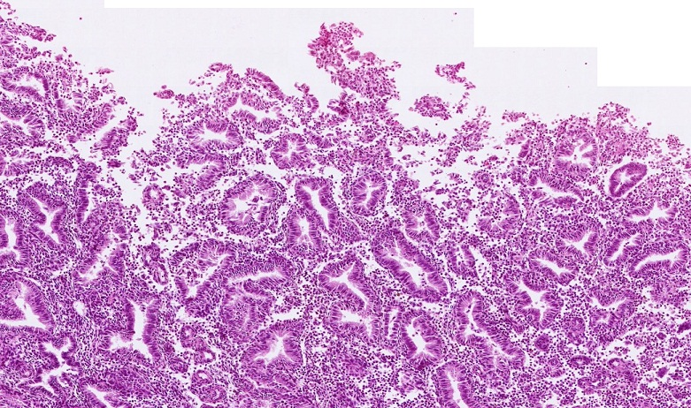
FEMALE REPRODUCTIVE SYSTEM - UTERUS
During the menstrual phase, the functional zone of the endometrium is sloughed off, leaving only the basal zone. Histologically, this appears as an incomplete epithelial layer of the endometrium. The increased cellularity in the stroma is due to an increase in the number of white blood cells.
The “tears” in the tissue of the menstrual uterus look a lot like artifacts. However, careful tissue preparation, and given the fact that this is the endometrium, a tissue known to undergo this process, makes definitive identification easier. Be aware that other phases (proliferative, secretory) may have “tears”, so you have to use common sense – is there just one “tear” or is the entire surface epithelium disrupted.

Slide 34
FEMALE REPRODUCTIVE SYSTEM - UTERUS
Video of uterus in the menstrual phase – SL58
Link to SL 058
Be able to identify:
Uterus – menstrual phase

Slide 35
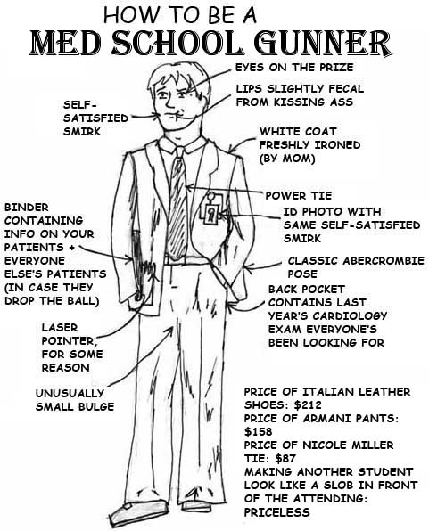
FEMALE REPRODUCTIVE SYSTEM - UTERUS
If I see the uterus on the exam, do I have to say what stage it is in?
Only if you want credit for your answer.
However, do NOT worry about whether the uterus is early or late in a stage, e.g. “secretory uterus” is fine.

Slide 36
FEMALE REPRODUCTIVE SYSTEM - UTERUS
Also note that the outer wall of the cervix is facing the vagina, and, therefore, is lined by vaginal epithelium, namely, stratified squamous non-keratinized. This will assist you in identification.
The cervix of the uterus (black box) contain the same three layers as the body of the uterus. However, there are distinctions:
Endometrium – consists of mucous glands and surface epithelial cells that secrete mucus
Myometrium – very thin layer of muscle, mostly connective tissue
Perimetrium – is covered by little, if any, peritoneum, so it is an adventitia

Slide 37
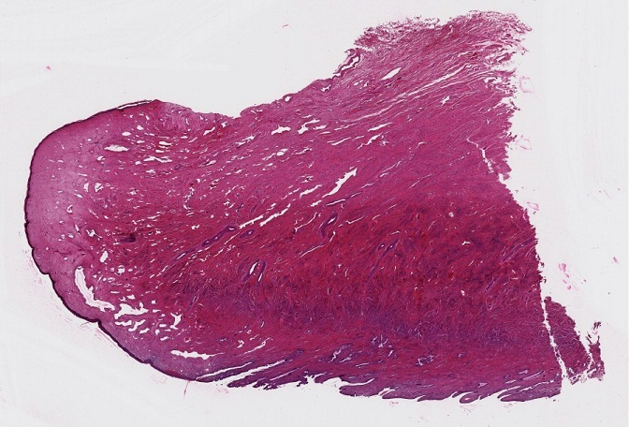
FEMALE REPRODUCTIVE SYSTEM - UTERUS
Our slide is from one “wall” of the cervix. The side facing the lumen of the cervical uterus is indicated by the black arrows, while the side facing the vagina is indicated by the blue arrows.

Slide 38
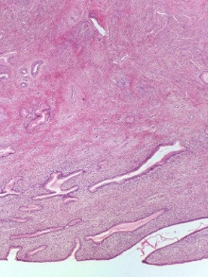
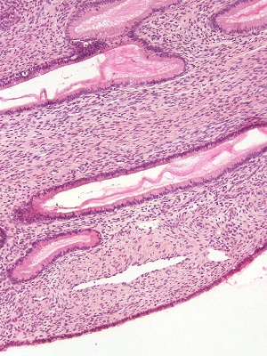
FEMALE REPRODUCTIVE SYSTEM - UTERUS
myometrium
endometrium
The cervix is composed of an endometrium on its uterine luminal side that consists of columnar mucus-secreting epithelial cells and mucous glands in a loose cellular lamina propria. The myometrium has much less smooth muscle than found in the body of the uterus.

Slide 39
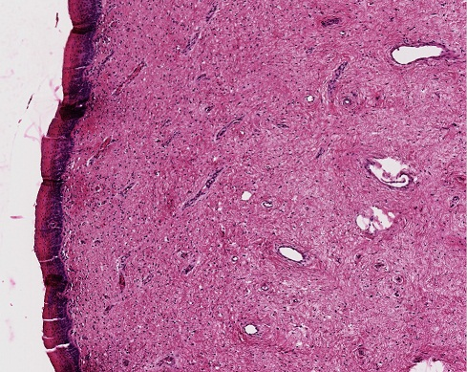
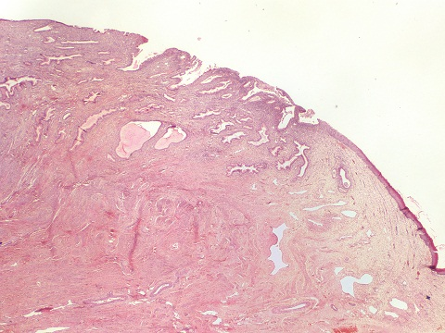
FEMALE REPRODUCTIVE SYSTEM - UTERUS
The vaginal side of the cervix (blue arrows and black box) is lined by a stratified squamous non-keratinized epithelium, with a loosy-dense connective tissue that contains numerous blood vessels (we’ll look at the vagina in the next set of slides). The transition zone (brown box) shows the obvious transition between the two “sides” of the cervix.

Slide 40
FEMALE REPRODUCTIVE SYSTEM - UTERUS
Video of cervix – SL142
Link to SL 142
Be able to identify:
Cervix of uterus

Slide 41
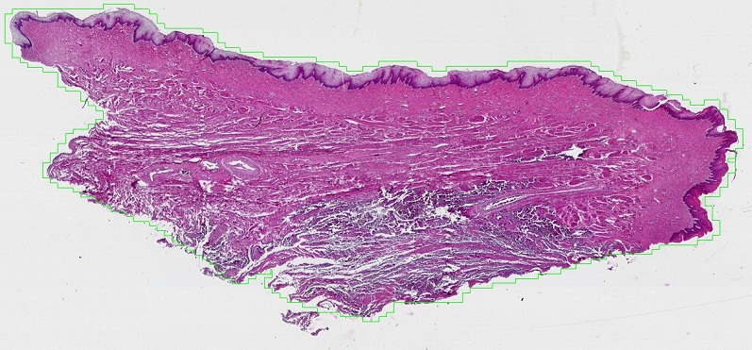
FEMALE REPRODUCTIVE SYSTEM - VAGINA
lumen
mucosa
muscularis
adventitia
Like the oviduct and uterus, the wall of the vagina has three regions:
mucosa – epithelium with underlying elastic connective tissue
muscularis – smooth muscle layer around the periphery of the mucosa
adventitia – connective tissue containing blood vessels, nerves, etc.

Slide 42
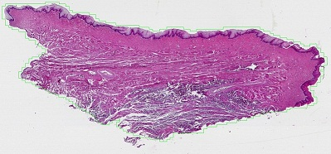
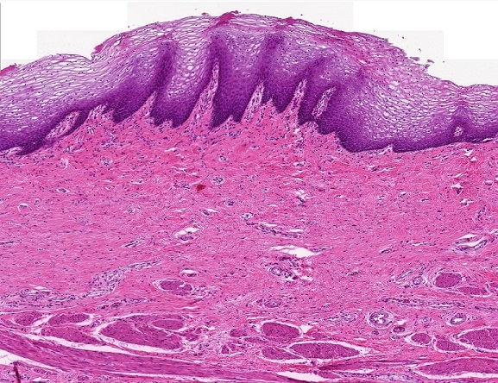
FEMALE REPRODUCTIVE SYSTEM - VAGINA
Remember glycogen washes away in tissue preparation.
muscularis
In this image, you can see that the epithelium of the vagina is stratified squamous, non-keratinized, specialized for moist friction. The mature epithelial cells contain cytoplasmic glycogen; these pale cells are a characteristic feature that will help you distinguish the vagina from other tissues with this epithelium (e.g. esophagus). To assist in resisting friction, the underlying connective tissue contains papilla (green arrow) that project into the epithelium. As one would expect in an organ of copulation and childbirth, this connective tissue is quite dense, and contains numerous elastic fibers, but no glands (glandular secretions during arousal come from the cervix and external genitalia). The muscularis is a mixture of smooth muscle and dense irregular connective tissue.

Slide 43
FEMALE REPRODUCTIVE SYSTEM - VAGINA
Video of vagina – SL144
Link to SL 144
Be able to identify:
vagina

Slide 44
FEMALE REPRODUCTIVE SYSTEM - VAGINA
Where the adventitia of the vagina is adjacent to either the adventitia of the bladder or the urethra, the adjacent adventitias merge.
The next two slides are sections that include portions of the urinary tract. We won’t focus on the bladder today, and the histology of the vagina is the same. Nevertheless, it is useful to describe the nature of these sections.
SL071 – a section through the anterior wall of the vagina, the posterior wall of the bladder
SL120 – a section through the anterior wall of the vagina and the entire urethra

Slide 45
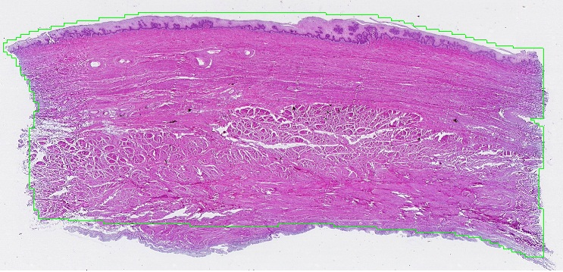
FEMALE REPRODUCTIVE SYSTEM - VAGINA
Lumen of vagina
Lumen of bladder
Section through the anterior wall of the vagina and the posterior wall of the bladder. The dotted line indicates the approximate border between the two, although the adventitial layers are fused.
You don’t have to worry about the details of the bladder now, but you probably know that its surface is transitional epithelium. Unfortunately, the scanners cut this off. The wall of the bladder includes a large amount of smooth muscle.

Slide 46
FEMALE REPRODUCTIVE SYSTEM - VAGINA
Video of vagina and bladder – SL071
Link to SL 071
Be able to identify:
vagina

Slide 47
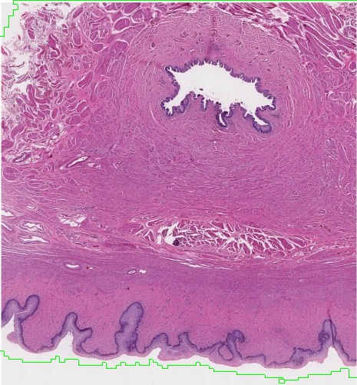
FEMALE REPRODUCTIVE SYSTEM - VAGINA
Section through the anterior wall of the vagina and the entire urethra. The border of the urethra is indicated by the dotted line.
The female urethra is essentially the same as the membranous urethra in the male:
A mucosa with an ill-defined epithelium and a lamina propria with numerous blood vessels
A muscularis containing smooth muscle and connective tissue
An adventitia
lumen
Lumen of urethra
Lumen of vagina

Slide 48
FEMALE REPRODUCTIVE SYSTEM - VAGINA
Video of vagina and urethra – SL120
Link to SL 120
Be able to identify:
Vagina
Urethra (you do not have to differentiate between the female urethra and male membranous urethra)

Slide 49
The next set of slides is a quiz for this module. You should review the structures covered in this module, and try to visualize each of these in light micrographs:
identify, at the light microscope level, each of the following:
Oviduct (uterine tube, Fallopian tube)
Mucosa
Ciliated cells
Secretory (peg) cells
Muscularis
Serosa
Be aware of regions (fimbria, ampulla, etc.) but you do not need to distinguish histologically
Uterus
Body
Layers
Endometrium
Functional zone
Basal zone
Myometrium
Perimetrium
Stages
Proliferative
Early secretory
Late secretory
Menstrual (note difficult to distinguish from poorly preserved slide)
Cervix
Supravaginal portion
Vaginal portion
Vagina
Mucosa
Muscularis
Adventitia

Slide 50
Disclaimer:
We have been slowly moving into areas in histology where it would be fairer to quiz you on entire slides so that you can see all the relevant clues for identification. This is because we have amassed a significant database of different organs that look similar.
In some cases, this is challenging to test in this format (maybe Digital Histology Labs V1.2). However, note that these snapshots of organs are still useful, maybe more so, because it forces you to focus on a single identifying feature to differentiate structures and organs. In this regard, the actual exam may be easier because you will be able to use all the features of an organ for identification.

Slide 51
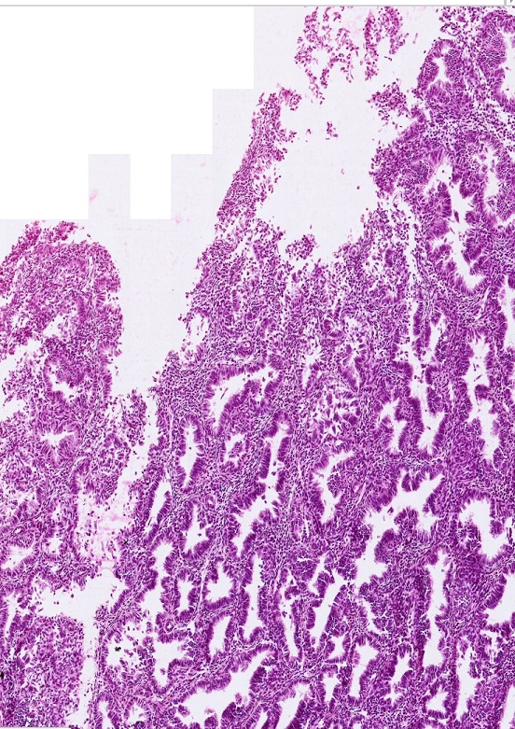
Final quiz
Self-check: Identify the organ on this slide. (advance slide for answers)
Uterus – menstrual phase

Slide 52
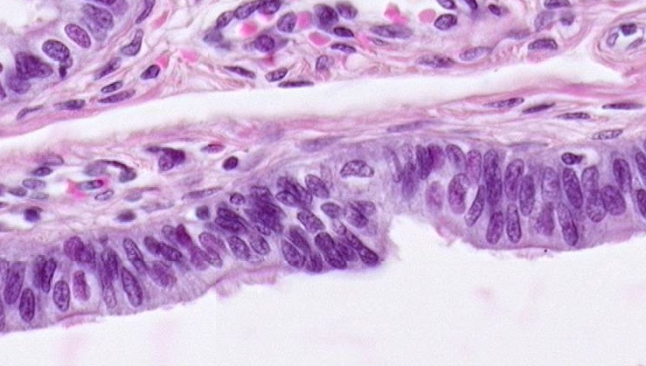
Final quiz
Self-check: Identify the cells indicated by the arrows. (advance slide for answers)
Secretory (peg) cell of the oviduct

Slide 53
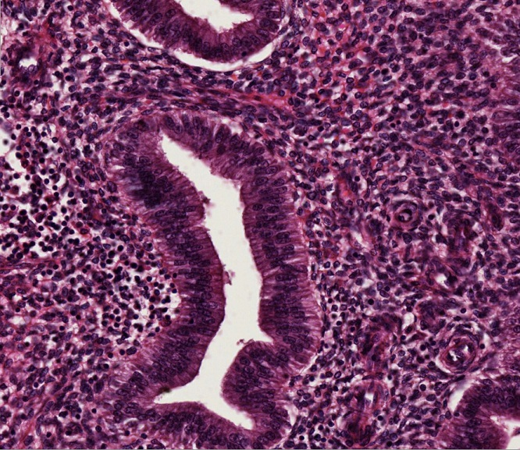
Final quiz
Self-check: Identify the organ on this slide. (advance slide for answers)
Uterus – (early) secretory phase

Slide 54
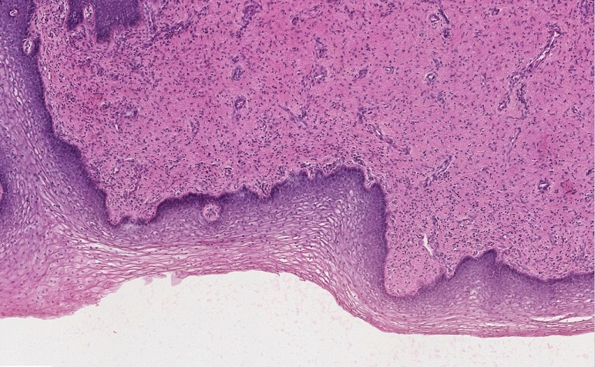
Final quiz
Self-check: Identify the organ on this slide. (advance slide for answers)
vagina

Slide 55
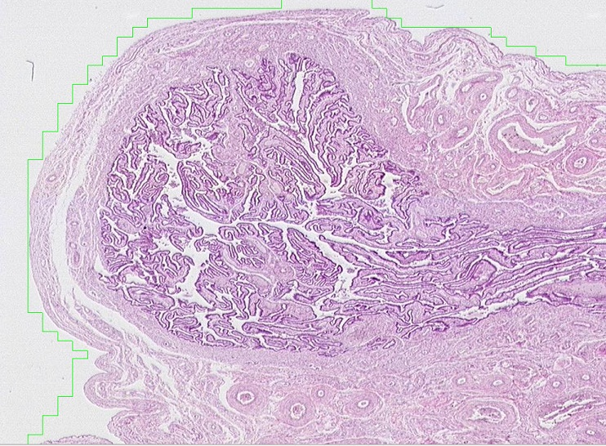
Final quiz
Self-check: Identify the organ on this slide. (advance slide for answers)
oviduct

Slide 56
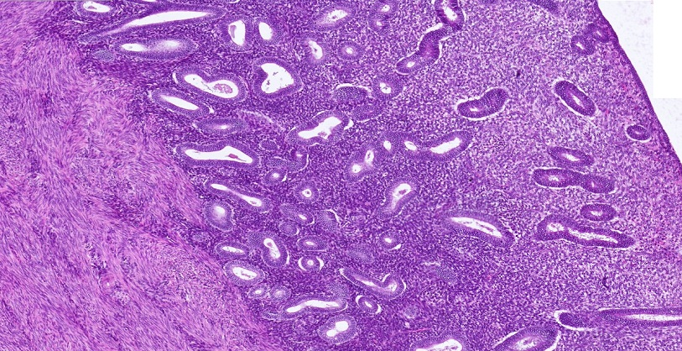
Final quiz
Self-check: Identify the region indicated by the bracket. (advance slide for answers)
Functional region of the endometrium of the uterus

Slide 57
Final quiz
Self-check: Identify the cells indicated by the arrows. (advance slide for answers)
Ciliated cells of the oviduct

Slide 58
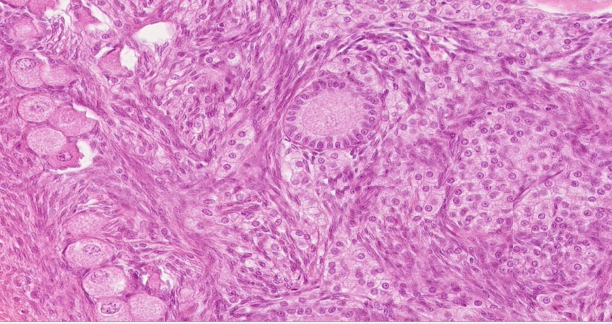
Final quiz
Self-check: Identify the structures in the outlined regions. (advance slide for answers)
Primary follicle
Interstitial gland
Primordial follicle

Slide 59
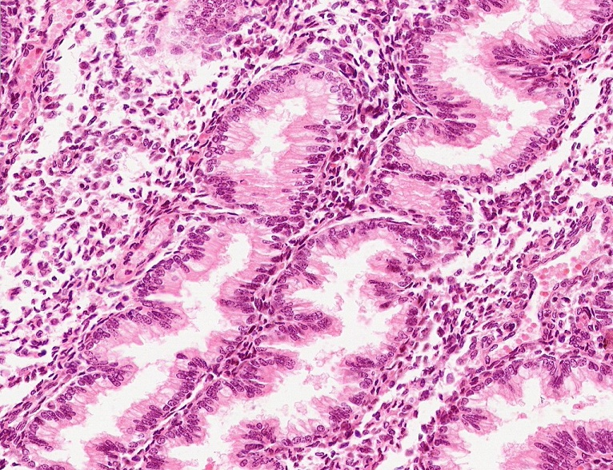
Final quiz
Self-check: Identify the organ on this slide. (advance slide for answers)
Uterus – (late) secretory phase

Slide 60
Final quiz
Self-check: Identify the organ on this slide. (advance slide for answers)
Uterus – proliferative phase

Slide 61
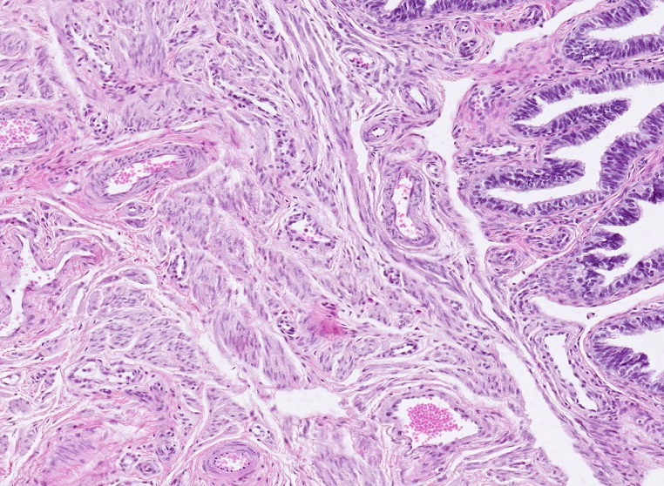
Final quiz
Self-check: Identify the organ on this slide. (advance slide for answers)
oviduct

Slide 62
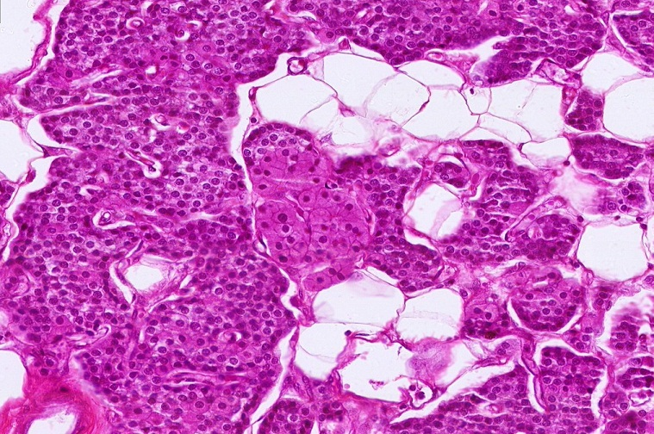
Final quiz
Self-check: Identify the organ on this slide. (advance slide for answers)
Parathyroid gland

Slide 63
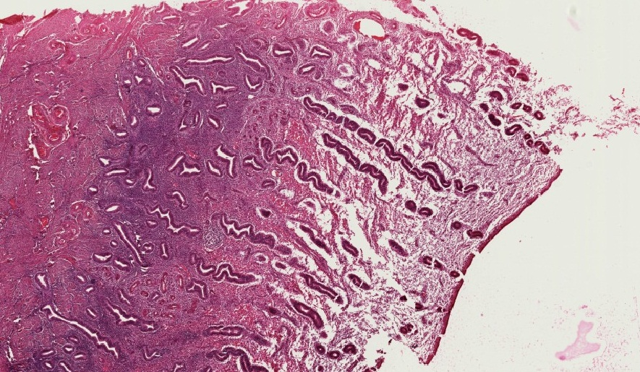
Final quiz
Self-check: Identify the region indicated by the bracket. (advance slide for answers)
Basal region of the endometrium of the uterus

Slide 64
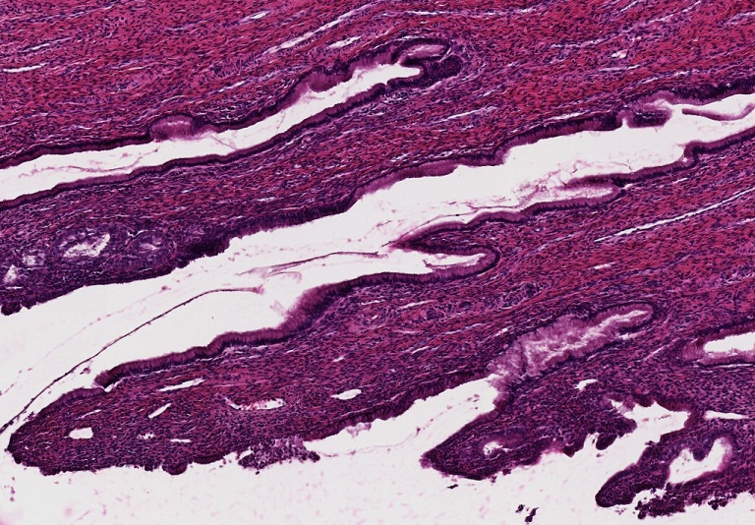
Final quiz
Self-check: Identify the organ on this slide. (advance slide for answers)
Cervix of uterus

Slide 65
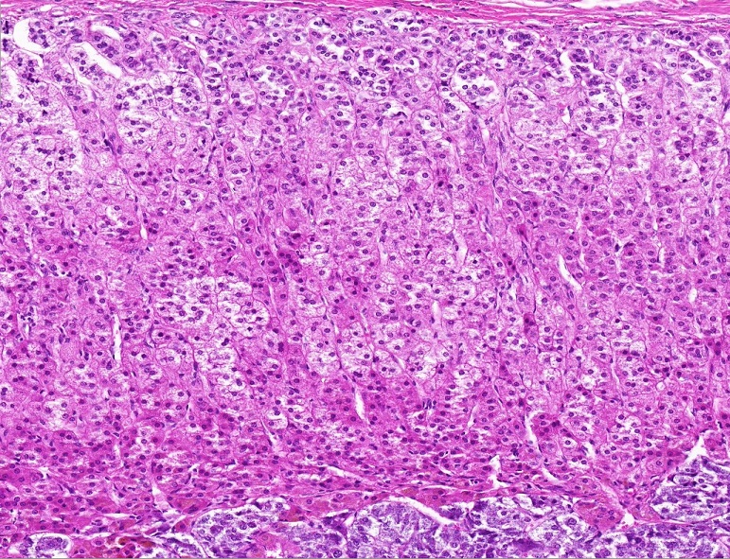
Final quiz
Self-check: Identify the organ on this slide. (advance slide for answers)
adrenal gland

Slide 66
Final quiz
Self-check: Identify the organ on this slide. (advance slide for answers)
Female urethra
or
Male membranous urethra

Slide 67
Final quiz
Self-check: Identify the organ on this slide. (advance slide for answers)
vagina

Slide 68
Final quiz
Self-check: Identify the region indicated by the bracket. (advance slide for answers)
Myometrium of the uterus

Slide 69
Final quiz
Self-check: Identify the organ on this slide. (advance slide for answers)
Oviduct (with fimbria)

Slide 70
Final quiz
Self-check: Identify the organ on this slide. (advance slide for answers)
oviduct

Slide 71
Final quiz
Self-check: Identify the organ on this slide. (advance slide for answers)
Cervix of uterus

Slide 72
Final quiz
Self-check: Identify the predominant TISSUE on this slide. (advance slide for answers)
Smooth muscle

Slide 73
Final quiz
Self-check: Identify the organ on this slide. (advance slide for answers)
Uterus – menstrual phase

Slide 74
Final quiz
Self-check: Identify the organ on this slide. (advance slide for answers)
Uterus – proliferative phase

Slide 75
Final quiz
Self-check: Identify the region indicated by the bracket. (advance slide for answers)
Functional region of the endometrium of the uterus

Slide 76
Final quiz
Self-check: This image was taken from the female reproductive system. Identify the region from which it was taken. (advance slide for answers)
Myometrium of the uterus

Slide 77
Final quiz
Self-check: Identify the two predominant TISSUES on this slide. (advance slide for answers)
Smooth muscle
Dense irregular connective tissue (elastic tissue)

Slide 78
Final quiz
Self-check: Identify the organ on this slide. (advance slide for answers)
Uterus – (early) secretory phase

Slide 79
Final quiz
Self-check: Identify the organ on this slide. (advance slide for answers)
Uterus – (late) secretory phase

Slide 80
Final quiz
Self-check: Identify the region indicated by the bracket. (advance slide for answers)
basal region of the endometrium of the uterus

Slide 81
Final quiz
Self-check: Identify the organ on this slide. (advance slide for answers)
Uterus – (late) secretory phase

Slide 82
Final quiz
Self-check: Identify the predominant TISSUE on this slide. (advance slide for answers)
Skeletal muscle (with loose connective tissue)

Slide 83
Final quiz
Self-check: Identify the organ on this slide. (advance slide for answers)
Uterus – proliferative phase

Slide 84
Final quiz
Self-check: Identify the organ on this slide. (advance slide for answers)
Uterus – proliferative phase

