Slide 1
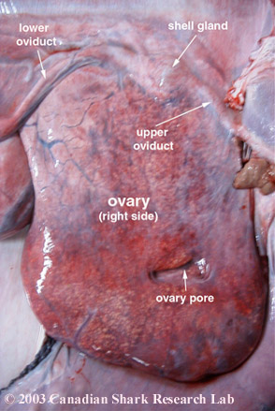
Ovary
Digital Laboratory
It’s best to view this in Slide Show mode, especially for the quizzes.
This module will take approximately 90 minutes to complete.

Slide 2
After completing this exercise, you should be able to:
identify, at the light microscope level, each of the following:
Ovary
Regions and structures
Cortex
Medulla
Germinal epithelium
Tunica albuginea
Mesovarium
Cell types and extracellular structures
Oocyte
Zona pellucida
Follicular cells
Granulosa cells
Cumulus oophorus
Corona radiata
Theca interna
Theca externa
Follicles
Primordial follicle
Primary follicle
Secondary follicle
Antrum
Tertiary (Graafian) follicle
Corpora
Corpus luteum
Granulosa luteal cells
Theca luteal cells
Corpus albicans
Interstitial glands
Atretic follicles
Eosinophilic bands
Glassy membranes
Corpora fibrosa
identify, at the electron microscope level, each of the following:
Oocyte
Zona pellucida
Granulosa cells
Basement membrane
Theca interna cells

Slide 3
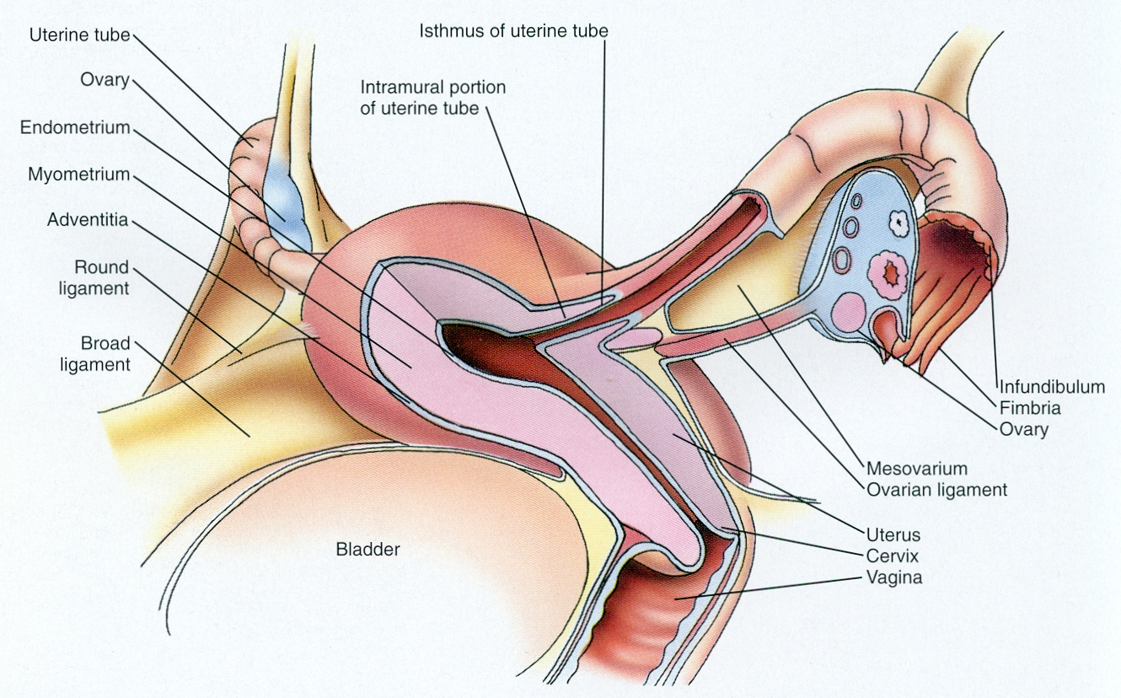
FEMALE REPRODUCTIVE SYSTEM
All of these structures are in the pelvic cavity, and are covered by a layer of peritoneum.
Anterior
Posterior
Major structures of the female reproductive system that contribute to the production and transmission of the oocyte include:
ovary – produces oocytes
oviduct (uterine tube, Fallopian tube) – transport of oocyte, usual site of fertilization
uterus – site of implantation, and contracts during childbirth
vagina – organ of copulation and birth canal

Slide 4
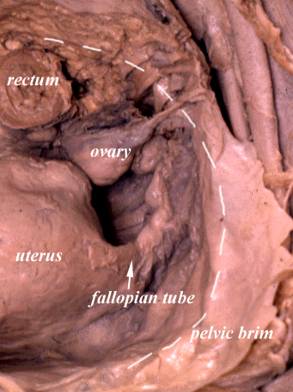
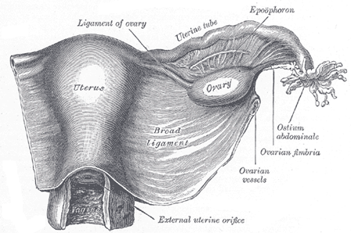
FEMALE REPRODUCTIVE SYSTEM
Right side of female
Left side of female
These images show the female reproductive structures and their peritoneal coverings. Note that as the sheet of peritoneum drapes over the uterine tubes, lateral to the uterus, there is a double-layer of peritoneum, with connective tissues, vessels, and nerves between them – this is called the broad ligament. If you think about the ovary within the broad ligament, and imagine grabbing the ovary and pulling it and the posterior peritoneal covering posteriorly for a short distance, you would create an additional fold coming off of the broad ligament, called the mesovarium. The point where the horizontal mesovarium is attached to the vertical portion of the broad ligament separates this vertical portion into two parts, the mesosalpinx (above the mesovarium) and mesometrium (below the mesovarium).

Slide 5
FEMALE REPRODUCTIVE SYSTEM
Maybe this will help with visualization. The standing man represents the female reproductive structures. His legs, trunk and head are the uterus, and his arms are the oviducts. The beach sand is the floor of the pelvis. Now think about draping a bed sheet over this man, creating something similar to the ghost. Note that below his arms (oviducts), to the side of his trunk (uterus), are two layers of the bed sheet, with a space between the two layers of the sheet (for connective tissue, vessels, nerves, etc.). This double-layered sheet to the sides of the uterus is the vertical portion of the broad ligament.
Now add two beach balls (ovaries) to the side of the trunk (uterus), between the two layers of the sheet (i.e. within the vertical broad ligament). If the balls are then moved toward you, they will pull out the posterior side of the bed sheet, and create a new double-layered sheet that runs horizontally (toward you). This horizontal double-layer is the mesovarium, and where it joins the vertical part, divides this vertical part into two (above the junction is mesosalpinx, below is mesometrium).

Slide 6
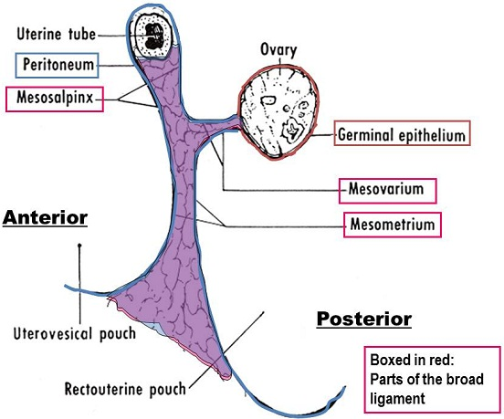
FEMALE REPRODUCTIVE SYSTEM
The drawing to the right is a lateral view of a section indicated by the red line (view indicated by large blue arrow). Note that:
--the floor of the pelvic cavity is the bottom of the drawing, and the peritoneum comes off the floor of the pelvic cavity to sweep over the reproductive structures
--the peritoneum and germinal epithelium are a continuous epithelium
--the uterovesical and rectouterine pouches are part of the peritoneal cavity, so they are filled with fluid; they are spaces between the uterus and bladder, and the uterus and rectum, respectively

Slide 7
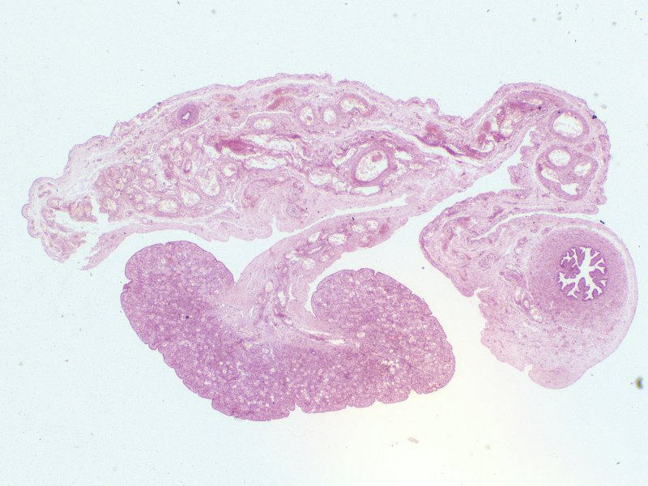
FEMALE REPRODUCTIVE SYSTEM
mesosolpinx
mesometrium
mesovarium
oviduct
ovary
This slide shows the ovary, oviduct, and broad ligament (similar to the cut we have been looking at). The floor of the pelvis is to the left, and the top of the image is ventral.

Slide 8
FEMALE REPRODUCTIVE SYSTEM
Video of overview of ovary, oviduct, and broad ligament (fetal) – SL13
Link to SL 013
Be able to identify:
Mesovarium
mesometrium and mesosalpinx are not on the list, but you should understand these, or you’re not “getting it”

Slide 9
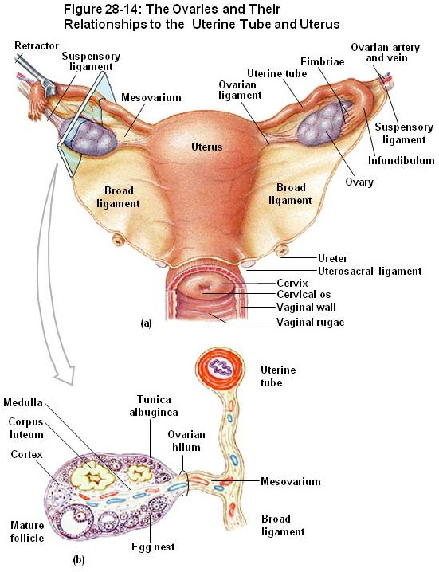
FEMALE REPRODUCTIVE SYSTEM - OVARY
The bottom image is similar to the sagittal section you looked at previously. The ovary contains an outer cortex and inner medulla. Like the testis, the outermost portion of the ovary is composed of a thick connective tissue, the tunica albuginea, covered by an epithelium, the germinal epithelium.

Slide 10
FEMALE REPRODUCTIVE SYSTEM – OVARY
mesovarium
cortex
medulla
cortex
In this image that shows a monkey ovary, the mesovarium, cortex, and medulla are indicated. The outer region of the cortex includes the tunica albuginea and germinal epithelium (not labeled).

Slide 11
FEMALE REPRODUCTIVE SYSTEM
Video of overview of ovary – SL137
Link to SL 137
Be able to identify:
Ovary
Cortex
Medulla
Germinal epithelium
Tunica albuginea
Mesovarium

Slide 12
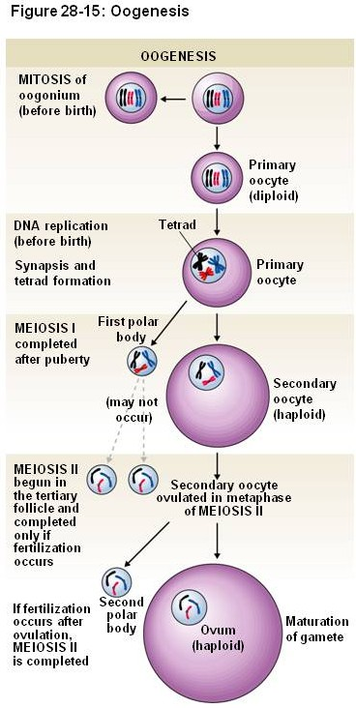
FEMALE REPRODUCTIVE SYSTEM
Now that you have an overview of the gross structures of the female reproductive tract and the ovary, take a quick review of mitosis, meiosis, and oocyte production:
oogonium (diploid, 2N) – a cell that divides mitotically, produces progeny that enter meiosis
Primary oocyte (diploid, 4N) - a cell that has begun meiosis, i.e. is in meiosis I
Secondary oocyte (haploid, 2N) - a cell that has completed the first meiotic division, i.e. is in meiosis II
ovum (haploid, N) – a cell that has completed meiosis
Meiosis in the female is a little more complicated than in the male. The differences are on the next slide…

Slide 13
FEMALE REPRODUCTIVE SYSTEM
During fetal development – ALL Oogonia (diploid, 2N) divide by mitosis and ALL enter meiosis I, becoming primary oocytes (diploid, 4N). These are arrested in meiosis I until puberty.
At puberty (and every month thereafter) – just before ovulation, (usually) one primary oocyte finishes meiosis I, becoming a secondary oocyte (haploid, 2N), where it arrests in meiosis II and is ovulated
At fertilization – the secondary oocyte finishes meiosis II (haploid, N, but at this time the sperm nucleus is in the cell, contributing a haploid, N complement)
If unfertilized, the secondary oocyte does not divide
Also note division of the cytoplasm is unequal, so that only one cell gets most of the cytoplasm. Smaller cells, called polar bodies, are not used.

Slide 14
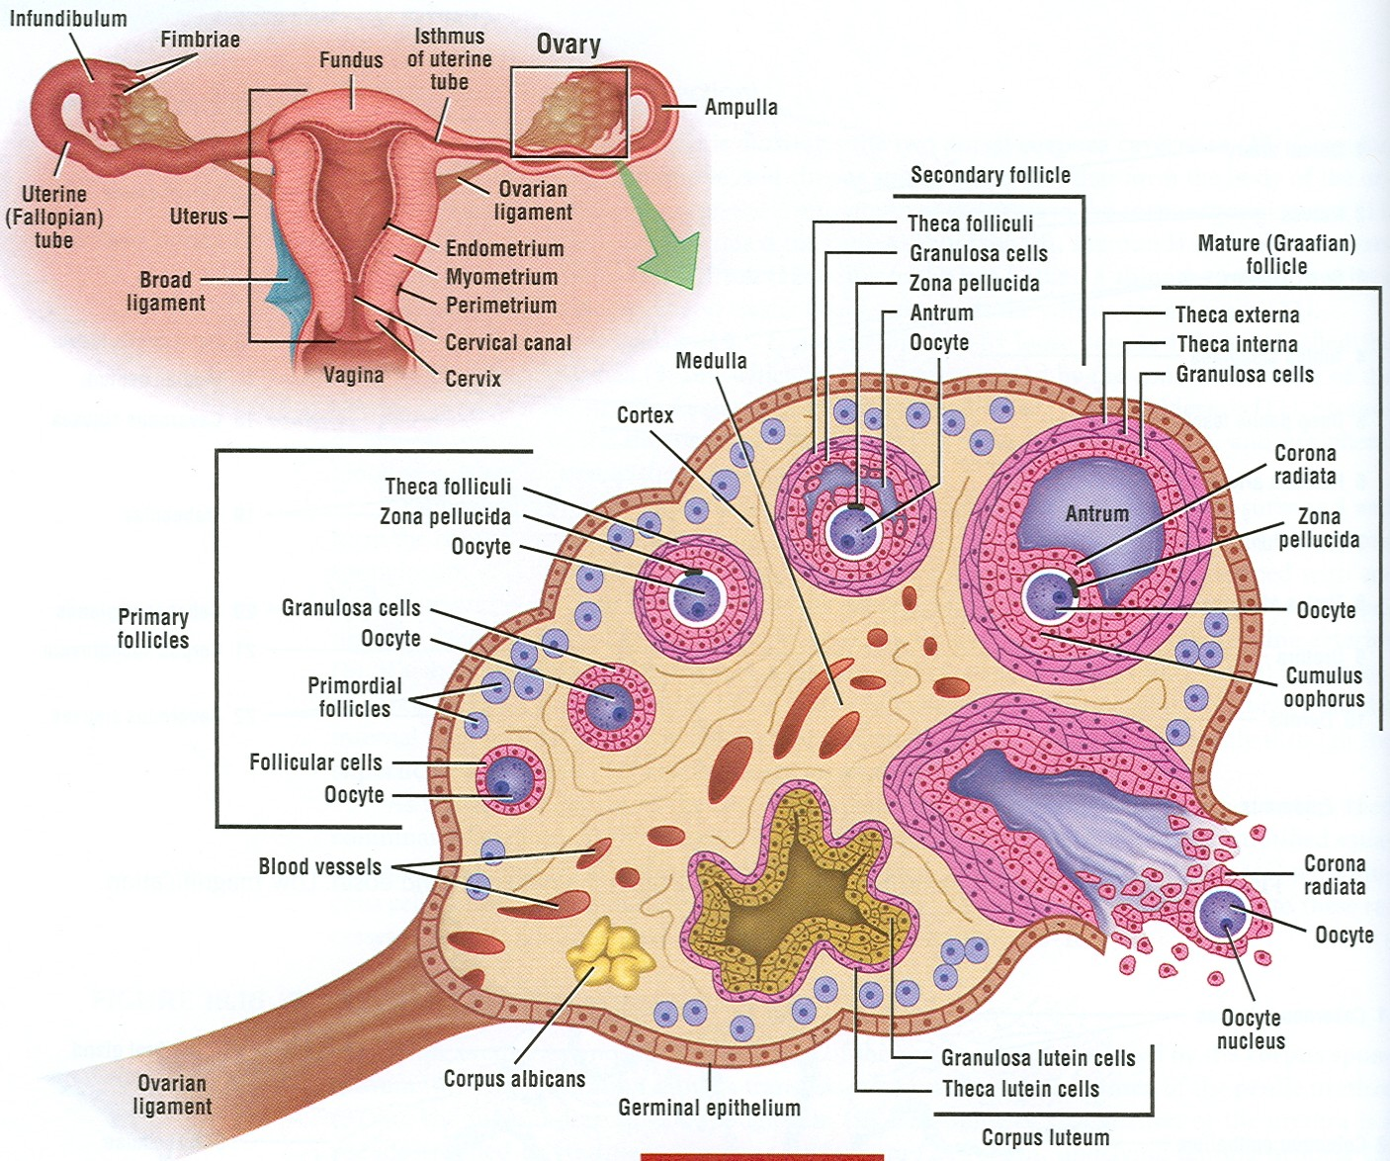
FEMALE REPRODUCTIVE SYSTEM - FOLLICLES
The oocytes develop within the ovary as part of follicles, which include the oocyte, supportive cells (follicular cells or granulosa cells, and thecal cells), and extracellular components, notably the zona pellucida.
Before we get into the details of the histology of the different types of follicles, let’s take a look at the most mature follicle, the Graafian follicle, because it demonstrates all the structures within a follicle clearly.

Slide 15
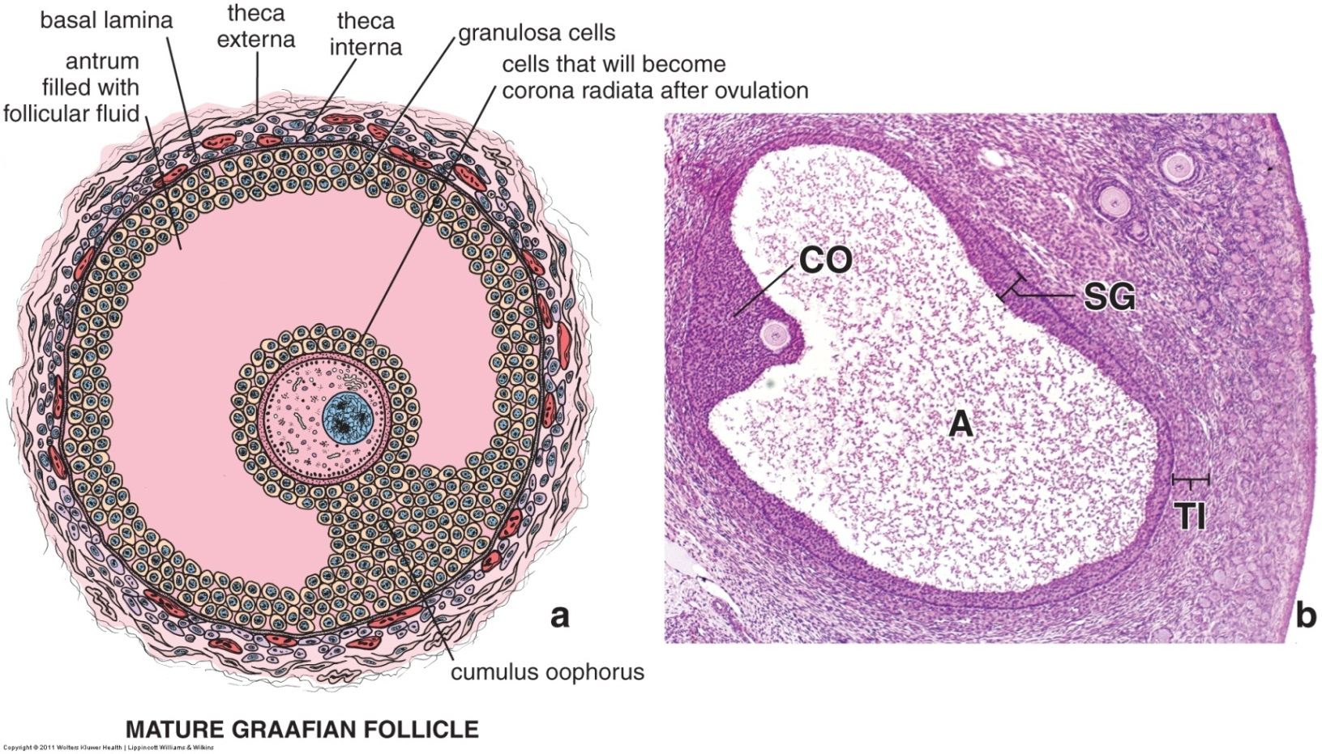
FEMALE REPRODUCTIVE SYSTEM - FOLLICLES
This is a drawing and image of a Graafian follicle. The oocyte is the largest cell shown, and contains a large, euchromatic nucleus (blue, with three black spots in drawing), and extensive eosinophilic cytoplasm (pink). The smaller cells surrounding the oocyte are called granulosa cells; the collection of granulosa cells immediately surrounding the oocyte are referred to as the corona radiata. The granulosa cells that attach the corona radiata to the remainder of the follicle is the cumulus oophorus (CO). Between the oocyte and granulosa cells of the corona radiata is an extracellular glycoprotein layer called the zona pellucida (black arrows). Fluid has accumulated within the follicle, in a space called the antrum (A). Surrounding the outer layer of granulosa cells are theca interna (steroid producing, mostly estrogen) and theca externa cells (fibroblast-like). There is a basement membrane between the granulosa cells (SG) and theca interna cells (TI).

Slide 16
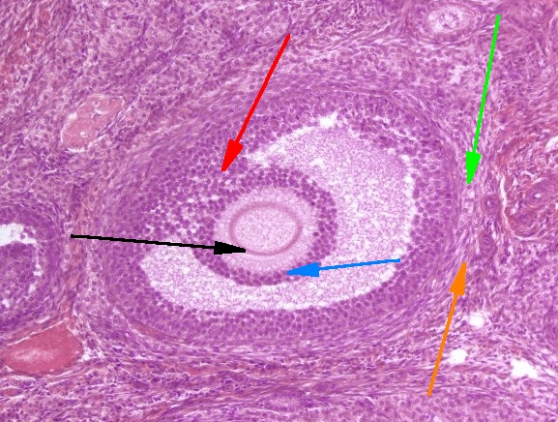
FEMALE REPRODUCTIVE SYSTEM - FOLLICLES
This section shows a small Graafian follicle (or a secondary follicle). The nucleus of the oocyte is out of the plane of section.
The structures identified by the arrows are:
Black – zona pellucida
Blue – corona radiata
Red – cumulus oophorus
Green – theca interna
Orange - theca externa
antrum
oocyte

Slide 17
FEMALE REPRODUCTIVE SYSTEM - FOLLICLES
Video of overview of follicle structure – SL136
Link to SL 136
Be able to identify:
Follicle
Oocyte
Nucleus and cytoplasm
Zona pellucida
Granulosa cells
Cumulus oophorus
Corona radiata
Theca interna
Theca externa

Slide 18
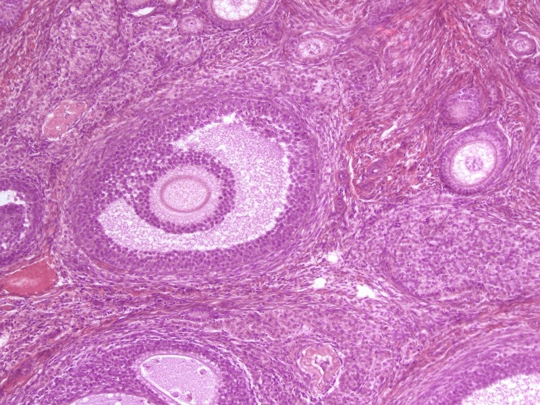
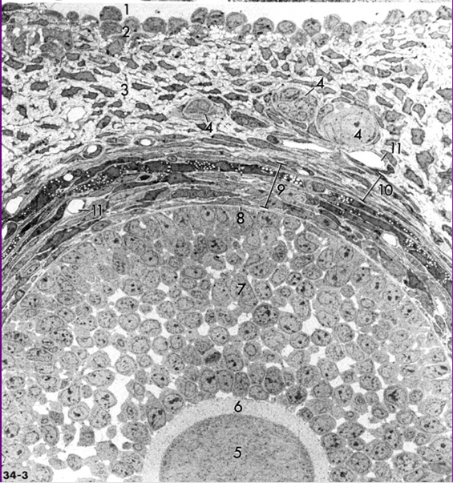
FEMALE REPRODUCTIVE SYSTEM - FOLLICLES
This EM is an enlargement of a region similar to that shown inside the rectangle. Note the EM does NOT include the antrum. This follicle in the EM is close to the wall of the ovary, and thus includes the germinal epithelium (2) and peritoneal cavity (1).
The nucleus of the oocyte is out of the plane of section.
The granulosa cells are an epithelium, the basement membrane of these cells is indicated at 8. The theca interna (9 – some with lipid droplets) and externa (10) are on the connective tissue side of the basement membrane. 6 is the zona pellucida.
Granulosa cells
Oocyte

Slide 19
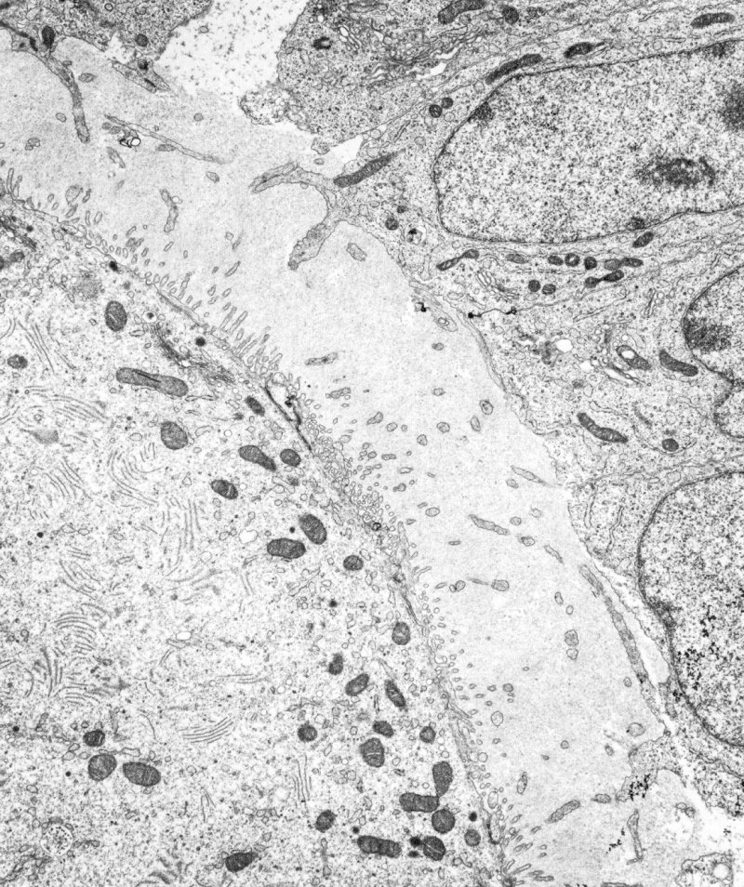
FEMALE REPRODUCTIVE SYSTEM - FOLLICLES
This EM is an enlargement of the region inside the rectangle.
Granulosa cells of corona radiata
Zona pellucida
Note the cellular processes in the zona. The oocyte and granulosa cells extend processes toward each other, that make contact for cell-cell signaling.
oocyte

Slide 20
FEMALE REPRODUCTIVE SYSTEM - FOLLICLES
Follicle maturation occurs largely through proliferation and organization of the cells and extracellular structures surrounding the oocyte.
Remember, all the oocytes in the ovary, with the exception of the one in a Graafian follicle just before ovulation, are arrested in meiosis I and are , therefore, primary oocytes.

Slide 21
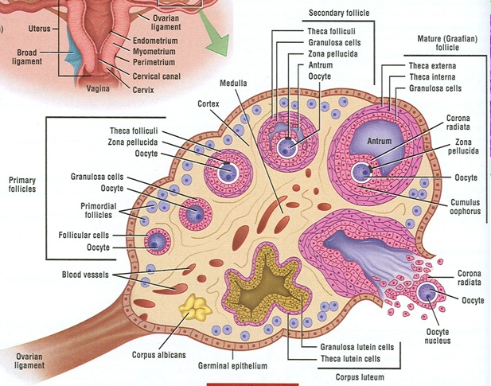
FEMALE REPRODUCTIVE SYSTEM - FOLLICLES
Primordial follicle – oocyte surrounded by single layer of squamous cells, called follicular cells.
Primary follicle – follicular cells become cuboidal, initially a single layer, but become stratified, connective tissue cells organize around the basement membrane of the granulosa cells to become thecal cells (interna and externa)
Secondary follicle – a fluid-filled antrum forms among the granulosa cells
Tertiary (Graafian) follicle – antrum large, surrounding oocyte and corona radiata on all sides except at the location of the cumulum oophorus, which connects the corona to the outer granulosa cells
This is an overview showing all four stages on one slide. We’ll go over each stage in the next set of slides. All these follicles are surrounded by connective tissue of the ovary.

Slide 22
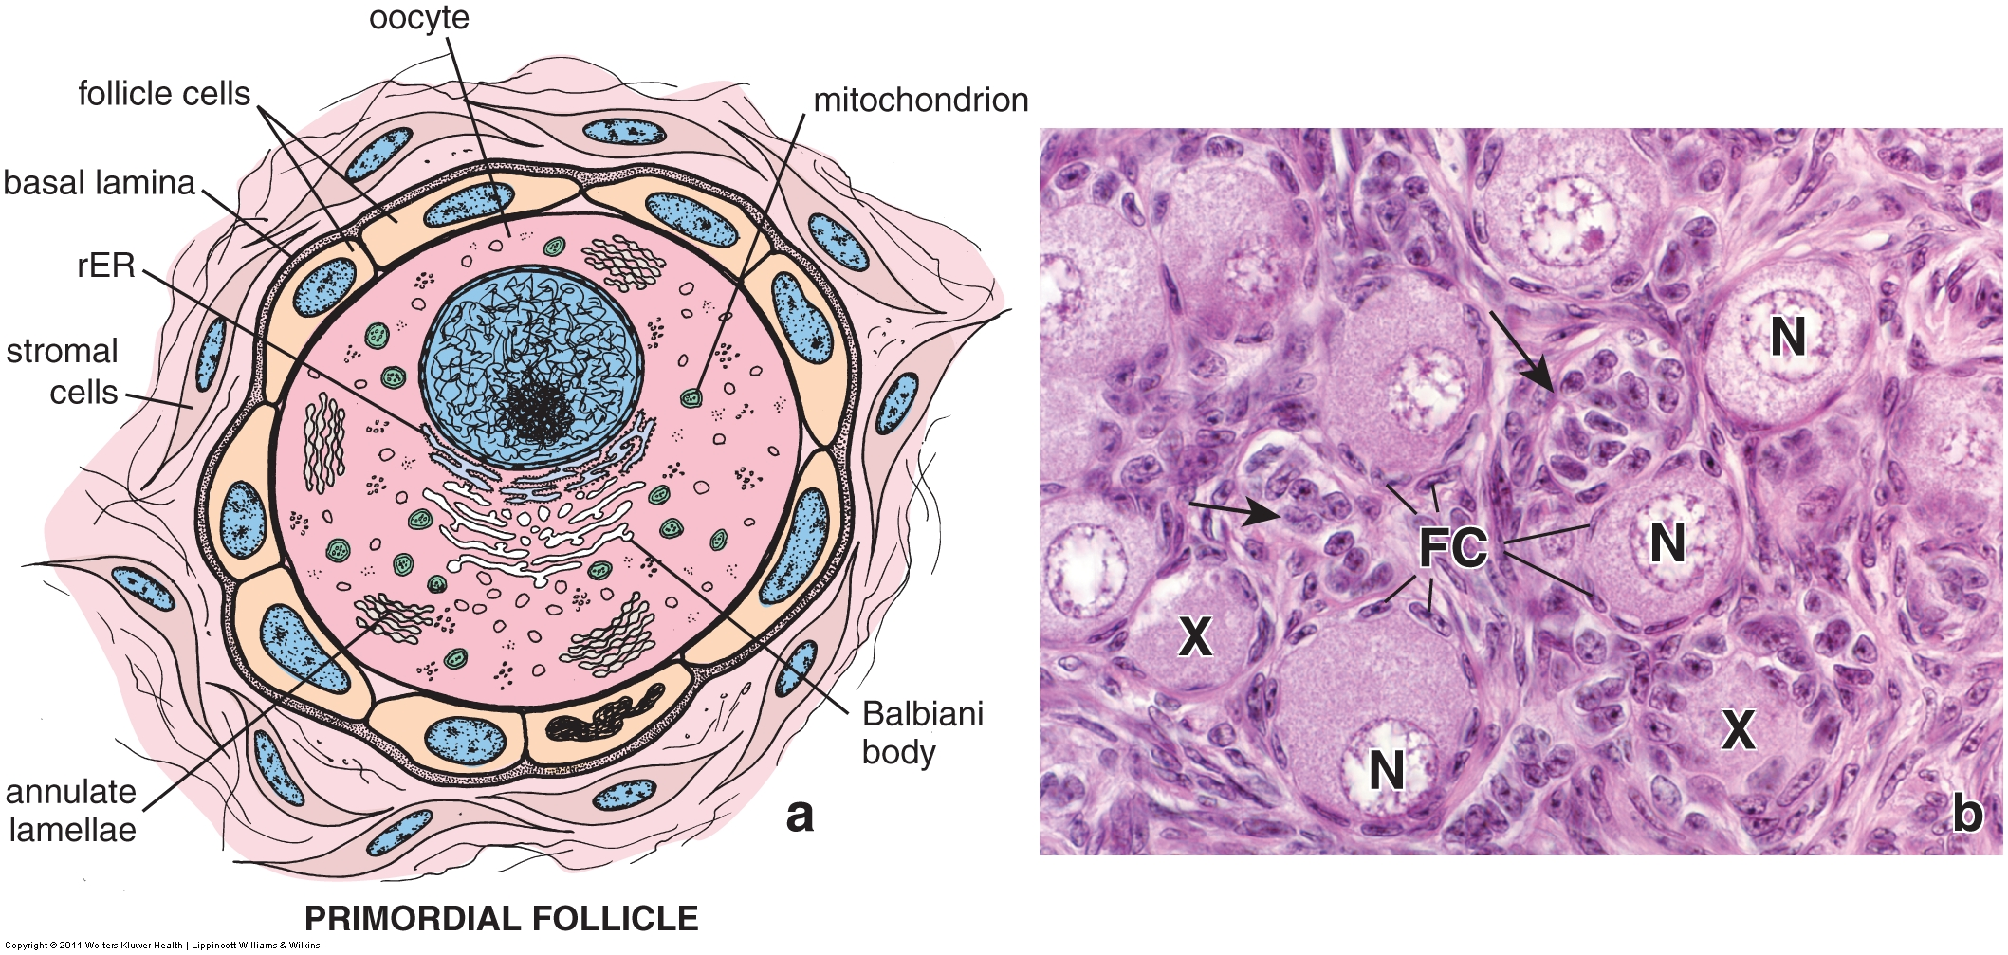
FEMALE REPRODUCTIVE SYSTEM - FOLLICLES
Primordial follicle – oocyte surrounded by single layer of squamous cells, called follicular cells (FC). N = nucleus of oocyte; X oocyte cytoplasm, where nucleus is out of the plane of section. Arrows show tangential cuts through edge of follicles.
Primordial follicles are typically found in the periphery (cortex) of the ovary.
Primordial follicles are formed during fetal development, and then become arrested, remaining in this stage until after birth.

Slide 23
FEMALE REPRODUCTIVE SYSTEM - FOLLICLES
Video of primordial follicle – SL136
Link to SL 136
Be able to identify:
Primordial follicle
Oocyte
Follicular cells

Slide 24
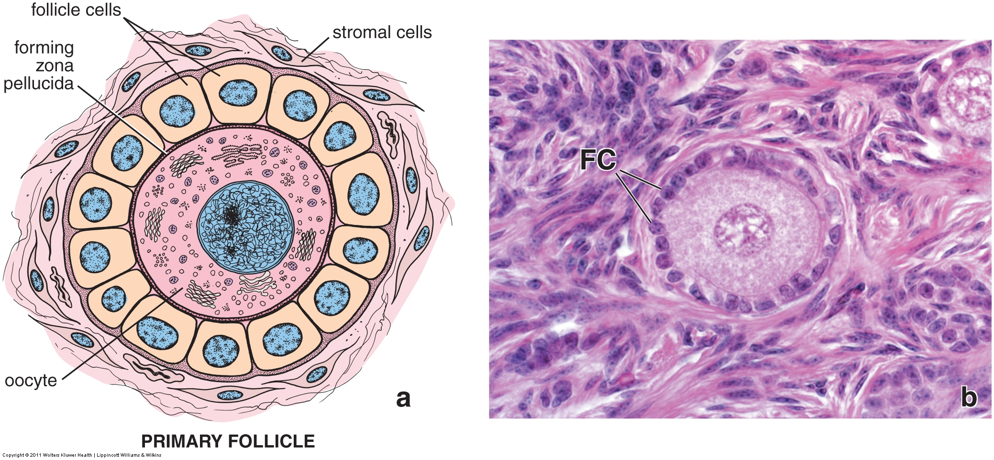
FEMALE REPRODUCTIVE SYSTEM - FOLLICLES
Primary follicle – the squamous follicular cells (FC) have become cuboidal. The zona pellucida and thecal cells begin to develop here, but are not obvious yet.
The change in the follicular cells from squamous to cuboidal is the key to differentiating primordial from primary follicles.

Slide 25
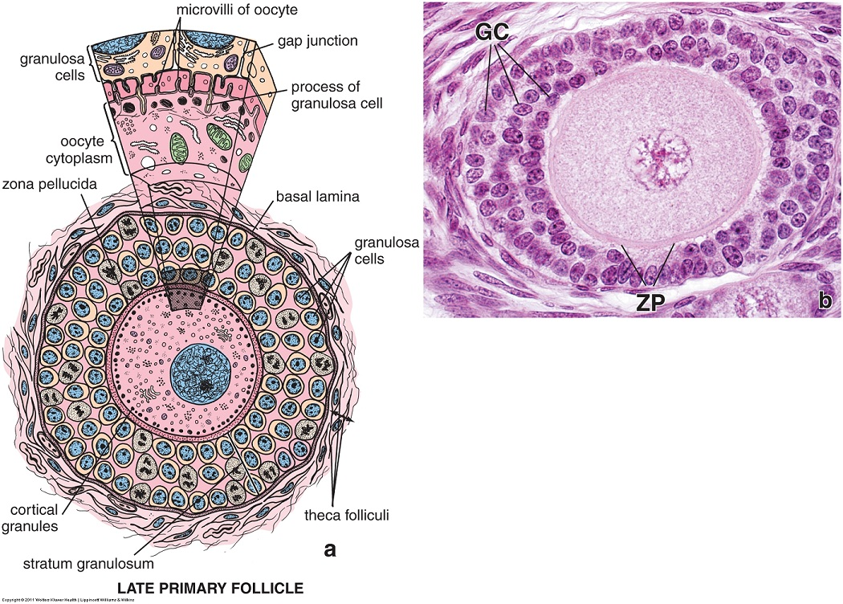
FEMALE REPRODUCTIVE SYSTEM - FOLLICLES
Primary follicle – proliferation of the follicular cells creates a stratified layer. The follicular cells are now referred to as granulosa cells (GC). By this stage, the zona pellucida (ZP) is more easily seen. You can call this a late primary follicle if you desire.
You should be aware that many authors use the terms follicular cells and granulosa cells interchangeably. For example, Rhodin uses follicular cells for all follicles, even in mature (Graafian) follicles, while Ross specifically states that the name change occurs when these epithelial cells become stratified. You should go by Ross, but if you read another source, don’t get all in a tizzy.

Slide 26
FEMALE REPRODUCTIVE SYSTEM - FOLLICLES
Video of primary follicle – SL136
Link to SL 136
Be able to identify:
Primary follicle
Oocyte
Follicular cells / Granulosa cells
Zona pellucida

Slide 27
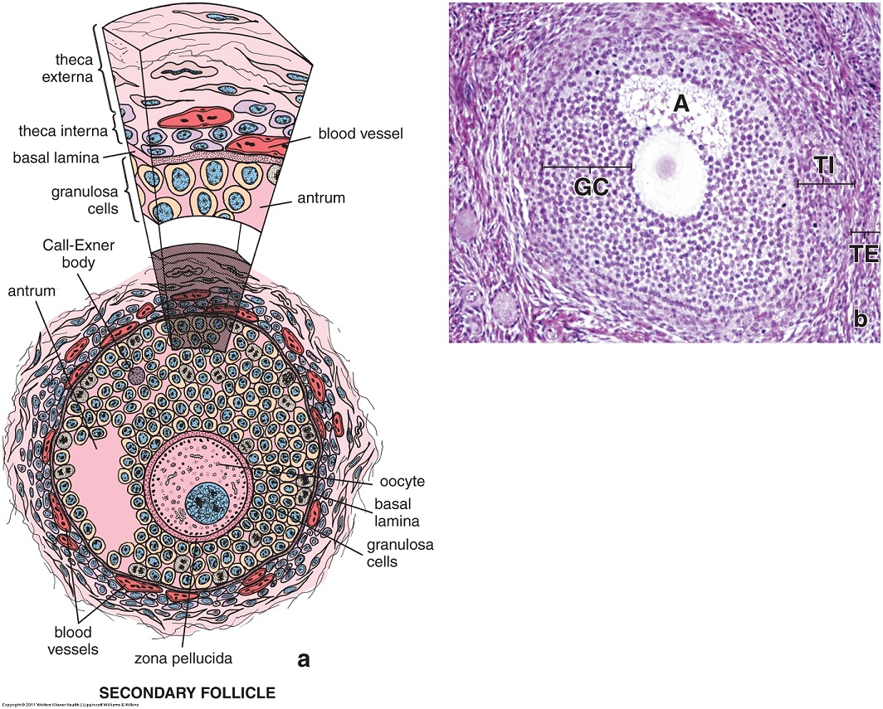
FEMALE REPRODUCTIVE SYSTEM - FOLLICLES
Secondary follicle (aka antral follicle) – is characterized by the appearance of a fluid-filled space, the antrum, within the granulosa cells (GC). The zona pellucida is more pronounced (not in this image), and the thecal cells have become more organized, forming distinct theca interna (TI) and theca externa (TE) layers.

Slide 28
FEMALE REPRODUCTIVE SYSTEM - FOLLICLES
Video of secondary follicle – SL136
Link to SL 136
Be able to identify:
Secondary follicle
Oocyte
Follicular cells / Granulosa cells
Zona pellucida
Antrum
Theca interna
Theca externa

Slide 29
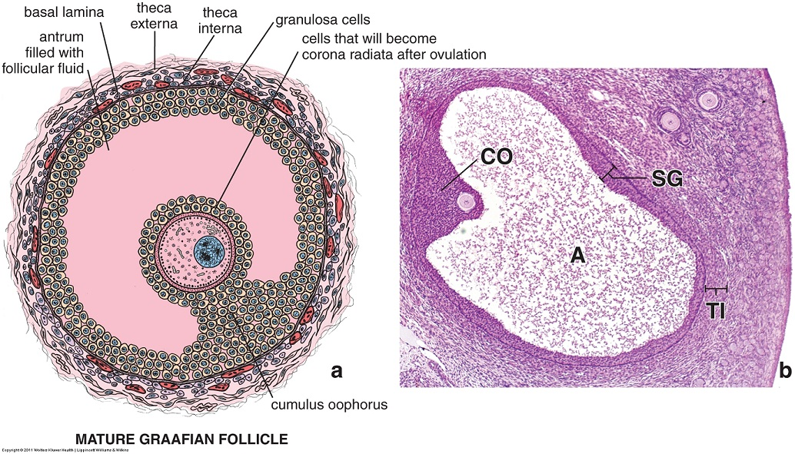
FEMALE REPRODUCTIVE SYSTEM - FOLLICLES
Graafian follicle (aka tertiary follicle) – is characterized by a very large antrum. The granulosa cells have become segregated into a corona radiata surrounding the oocyte, as well as a cumulus oophorus that connects the oocyte/corona to the rest of the granulosa cells around the periphery of the antrum. The thecal cells are fully developed. The final Graafian follicle just before ovulation is approximately 1 cm in diameter, extending from one end of the ovary to the other, almost doubling the size of the ovary.

Slide 30
FEMALE REPRODUCTIVE SYSTEM - FOLLICLES
Video of Graafian follicle – SL136
Link to SL 136
Be able to identify:
Graafian follicle
Oocyte
Follicular cells / Granulosa cells
Corona radiata
Cumulus oophorus
Zona pellucida
Antrum
Theca interna
Theca externa

Slide 31
FEMALE REPRODUCTIVE SYSTEM - FOLLICLES
A final note on follicles: Don’t confuse primary, secondary, etc., follicles with primary, secondary oocytes. The oocyte is a single cell, while the follicles contain the oocyte, granulosa and thecal cells, zona pellucida, etc.
Remember that all oocytes in the female become arrested in meiosis I during fetal development, and, therefore, are primary oocytes within primordial follicles.
Completion of meiosis I and arrest in meiosis II doesn’t occur until just before ovulation. Therefore, all these follicles, primordial, primary, secondary, include a primary oocyte. The exception to this is the very mature Graafian follicle just before ovulation.

Slide 32
FEMALE REPRODUCTIVE SYSTEM - FOLLICLES
In addition, you should appreciate the general timeline and different appearance of the follicles in an ovary. A fetal ovary (SL 013) will include mostly primordial follicles, with a few primary follicles. An active ovary (SL 136 and SL 137) will contain all types of follicles. A post-menopausal ovary (SL 132 ) will contain no active follicles.

Slide 33
FEMALE REPRODUCTIVE SYSTEM - OVARY
Review the Graafian follicle and its structure again.
This drawing also shows ovulation. During this process, the oocyte, zona pellucida, and corona radiata are released into the peritoneal cavity near the oviduct. This structure is not of concern here.
The structures that are left behind are the outer granulosa cells, the thecal cells, and the basement membrane between them. These structures collapse and reorganize into a corpus luteum (yellow body); the cells being renamed granulosa luteal and theca luteal cells, respectively. These cells now produce (mostly) progesterone, which is important for inducing and maintaining the secretory phase of the uterine cycle. Typically, there is a clot where the antrum was located.
In the absence of fertilization and hCG, the corpus luteum will degenerate 12 days later, forming a connective tissue-like structure called the corpus albicans (white body).
In humans, most of the time there is a single ovulation, so only one corpus luteum (on one side) exists at a time. The corpora albicantia last for several months, so each ovary in a reproductive woman will contain a few of them.

Slide 34
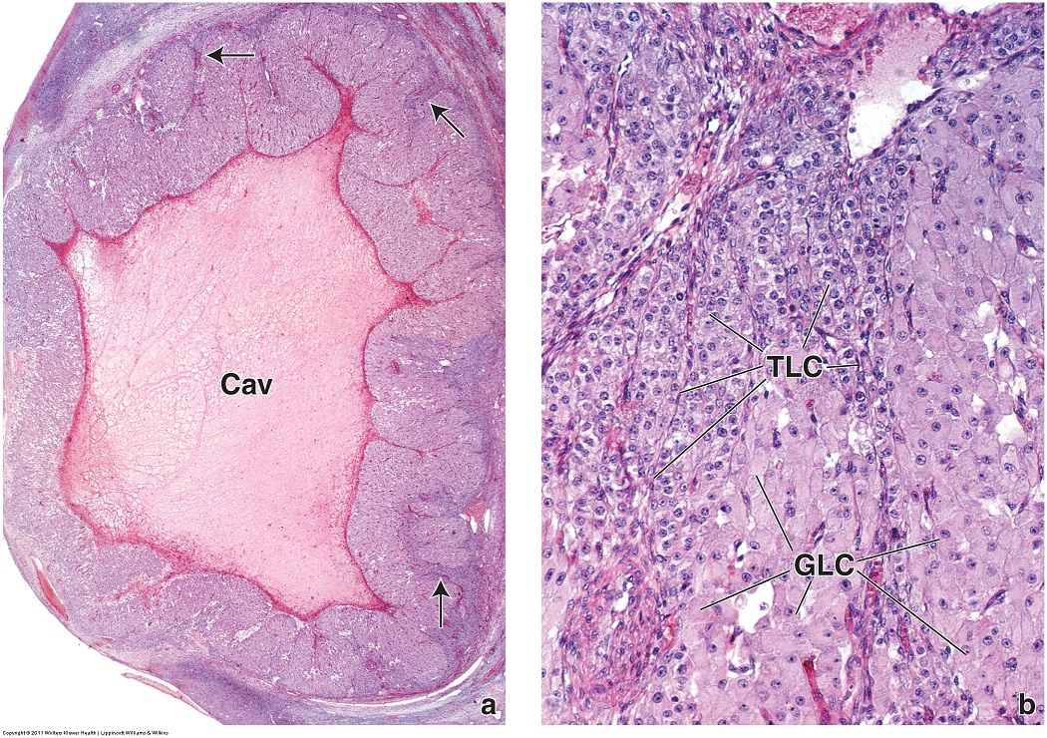
FEMALE REPRODUCTIVE SYSTEM – CORPUS LUTEUM
Because the corpus is the collapsed wall of the follicle, the thecal cells are thrown into folds (arrows) that partition the granulosa cells.
Corpus luteum – is a very large structure, dominating sections through regions of the ovary. The central cavity (Cav) contains clotted blood, while the walls contain granulosa luteal cells (GLC) and thecal lutea cells (TLC). Although both appear steroid-secreting histologically (large euchromatic nucleus, pale eosinophilic cytoplasm), the granulosa cells typically have more cytoplasm. The basement membrane between the granulosa and thecal cells breaks down.

Slide 35
FEMALE REPRODUCTIVE SYSTEM – CORPUS LUTEUM
Video of corpus luteum – SL129
Video of corpus luteum – SL130
Link to SL 129 and SL 130
Be able to identify:
Corpus luteum
Granulosa luteal cells
Thecal luteal cells

Slide 36
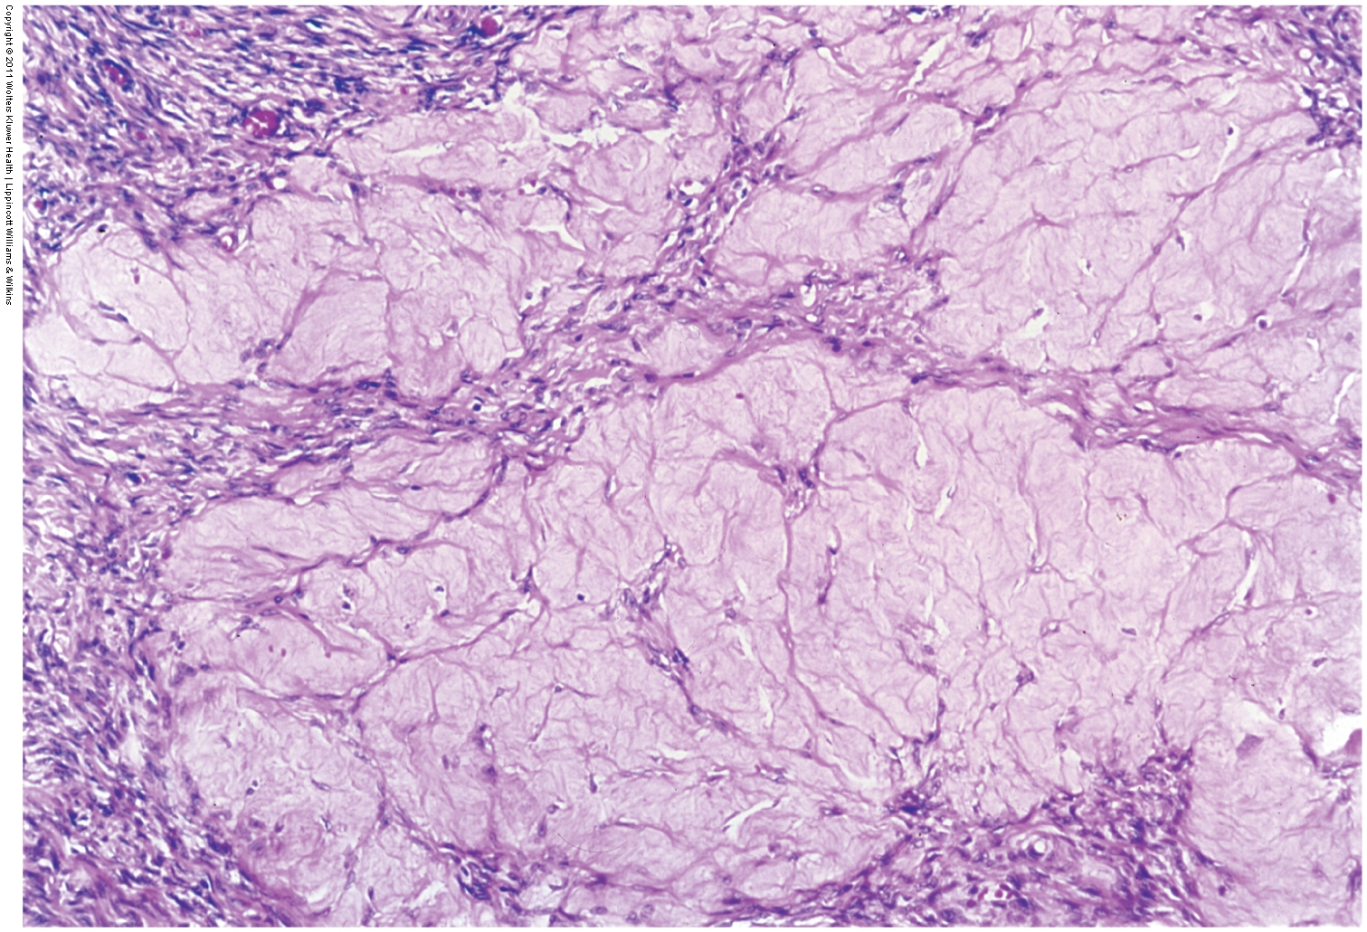
FEMALE REPRODUCTIVE SYSTEM – CORPUS ALBICANS
Histologically, the corpus albicans is often described as eosinophilic. However, because much of the ovarian tissue stains fairly well, the corpus albicans often is pale in comparison to the surrounding tissues.
Corpus albicans – is a fibrous, connective tissue-like “scar” that is the remnant of the corpus luteum once steroid production ceases.

Slide 37
FEMALE REPRODUCTIVE SYSTEM – CORPUS ALBICANS
Video of corpus albicans – SL132
Link to SL 132 and SL 130 and SL 131A and SL 131B
Be able to identify:
Corpus albicans

Slide 38
FEMALE REPRODUCTIVE SYSTEM - ATRESIA
Progression from a primordial follicle to a Graafian follicle, ovulation and the resulting corpora luteum and corpus albicans are part of “normal” follicular development.
Fetuses generate millions of primordial follicles, but only a few hundred of these reach maturation.
The remainder undergo atresia, a degenerative process that some believe helps in selection of the best oocytes. Atresia can occur at any stage of follicular development, and gives rise to several structures in the ovary.
atresia

Slide 39
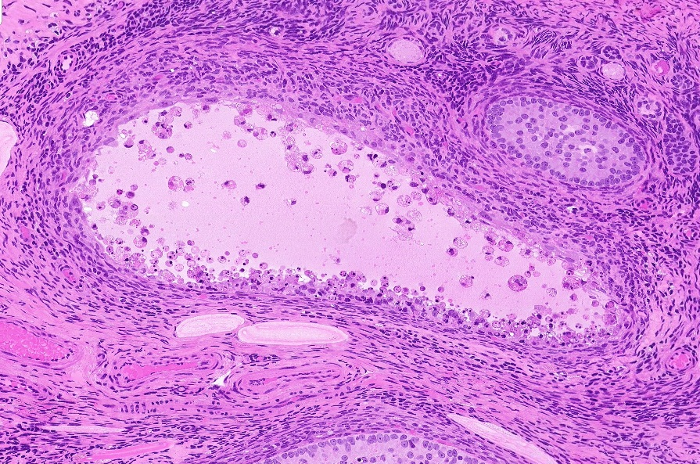
FEMALE REPRODUCTIVE SYSTEM - ATRESIA
Apoptotic cells typically demonstrate condensed and broken down nuclei, a term referred to as pyknosis.
During atresia of a follicle, all or parts of the follicle are visibly degenerating. In this atretic follicle, the dotted line is in the approximate location of the basement membrane (line placed only on the left side of the follicle). The granulosa cells have lost cell-cell adhesion, and demonstrate apoptotic features; condensed chromatin, vesicular cytoplasm. The oocyte is not present. Thecal cells do not look as far advanced in their degeneration.

Slide 40
FEMALE REPRODUCTIVE SYSTEM - ATRESIA
Video of atretic follicles – SL137
Link to SL 137
Be able to identify:
Atretic follicles

Slide 41
FEMALE REPRODUCTIVE SYSTEM - ATRESIA
Remnants of atresia persist in the ovary, some of them for quite some time. These include:
--Interstitial glands
--Eosinophilic bands (zona pellucida)
--Glassy membranes
--Corpora fibrosa
atresia

Slide 42
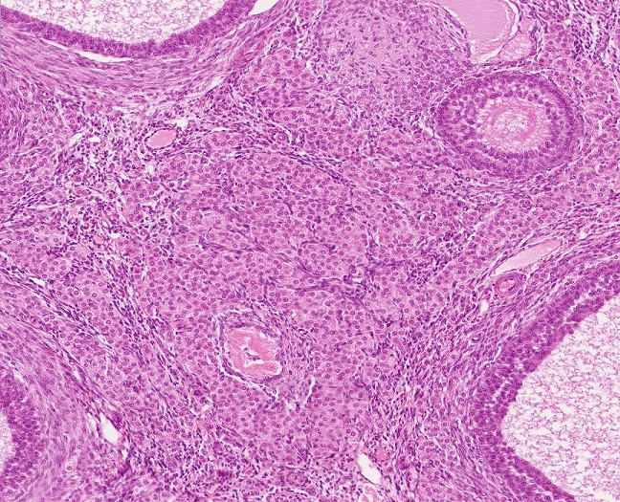
FEMALE REPRODUCTIVE SYSTEM - ATRESIA
Because they are steroid-secreting, interstitial glands consist of large cells with a pale eosinophilic cytoplasm, and typically are clustered together.
Interstitial glands are remnants of theca interna cells of atretic follicles. These cells remain as steroid-secreting cells (mostly estrogen) within the interstitial tissue of the ovary.

Slide 43
FEMALE REPRODUCTIVE SYSTEM - ATRESIA
Video of interstitial glands – SL136
Link to SL 136
Be able to identify:
Interstitial glands

Slide 44
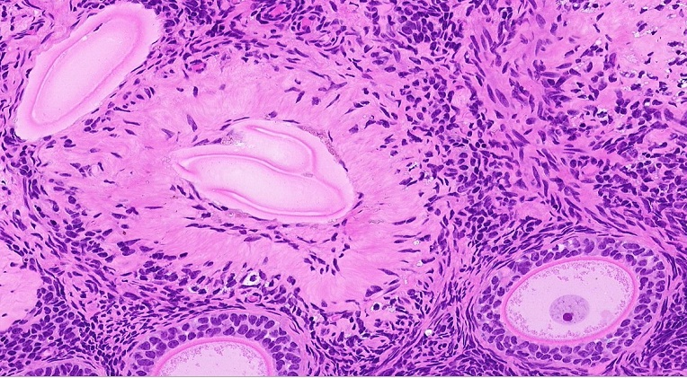
FEMALE REPRODUCTIVE SYSTEM - ATRESIA
Oocyte was here
Eosinophilic bands (black arrows) are remnants of the zona pellucida. As the name implies, they are brightly eosinophilic, and either oval or wavy. A normal zona pellucida (yellow arrow) is shown for comparison; note the eosinophilic bands are a similar color, but “shinier”.
Because slide staining varies, it helps to find a normal zona pellucida for comparison to help distinguish eosinophilic bands from other atretic or connective tissue structures.

Slide 45
FEMALE REPRODUCTIVE SYSTEM - ATRESIA
Video of eosinophilic bands – SL137
Link to SL 137
Be able to identify:
Eosinophilic bands

Slide 46
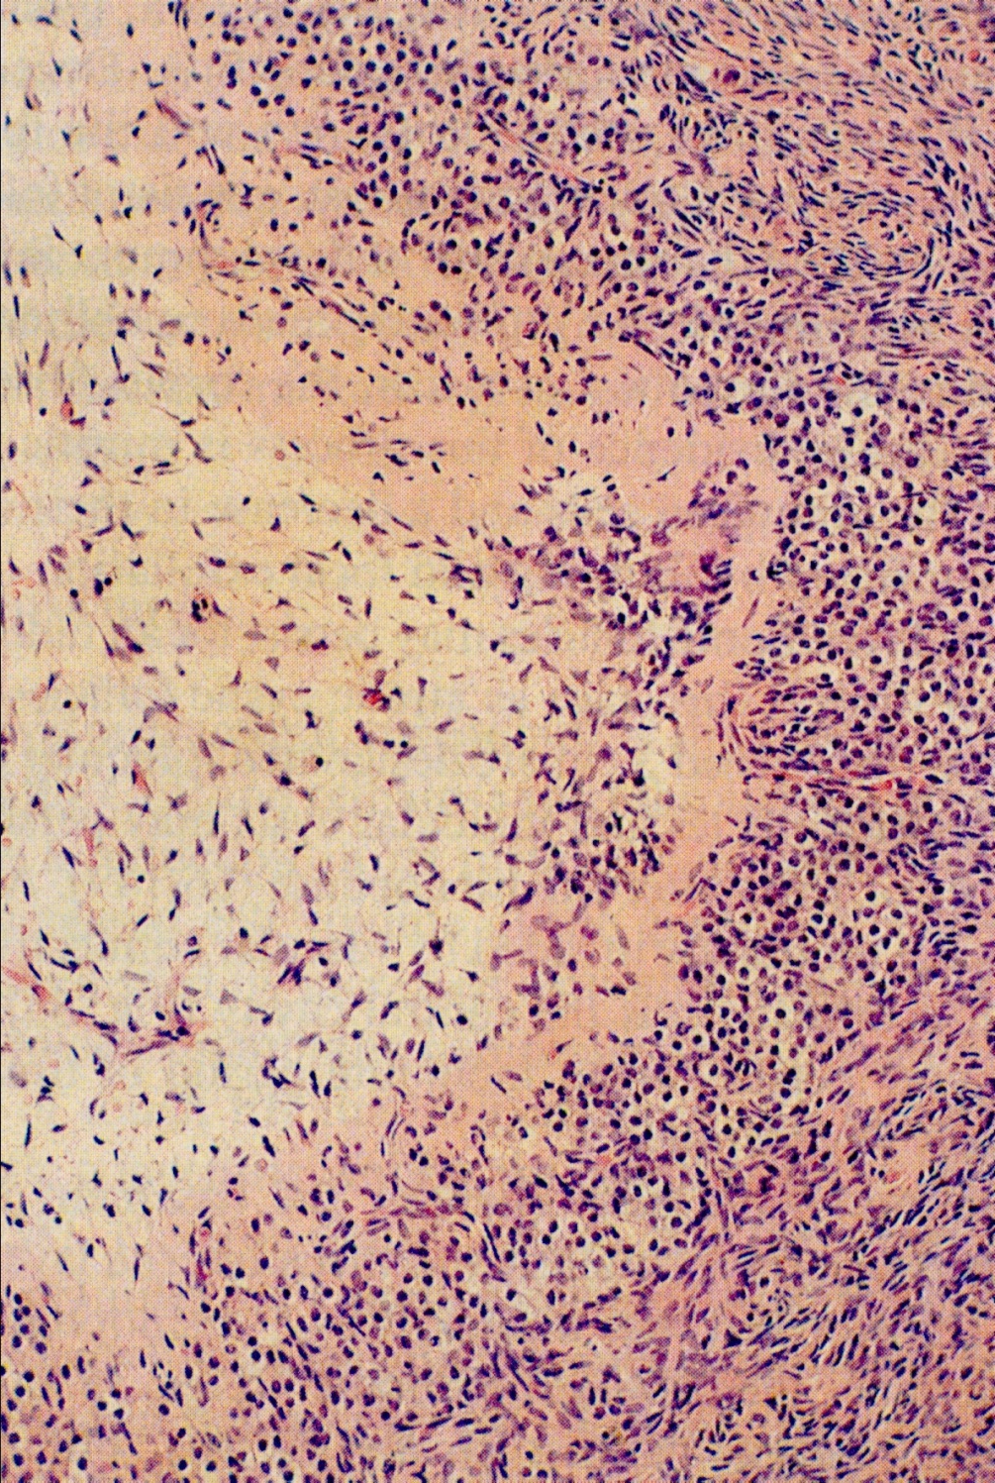
FEMALE REPRODUCTIVE SYSTEM - ATRESIA
Glassy membranes (black arrows) are remnants of the basement membrane between the granulosa and thecal cells. As the name implies, it has a “glassy” appearance, and is typically wavy. These are not common, and very hard to find on our slides.
Looks an awful lot like the eosinophilic bands. Kinda stinks, don’t it.
However, remember that eosinophilic bands are remnants of the zona pellucida, Because the oocyte has broken down, eosinophilic bands will have nothing “inside” them (see graffiti from two slides previous).
Glassy membranes are remnants of the basement membrane, and have degenerating granulosa cells on their “inside” (left side of this image).

Slide 47
FEMALE REPRODUCTIVE SYSTEM - ATRESIA
Video of glassy membranes – SL129
Link to SL 129
Be able to identify:
Glassy membrane

Slide 48
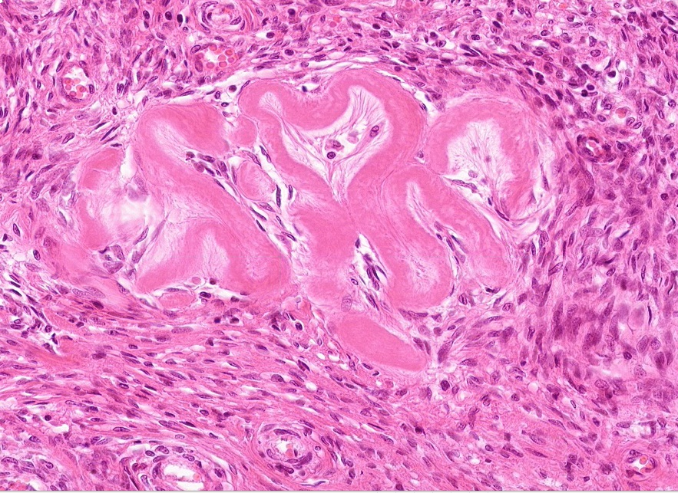
FEMALE REPRODUCTIVE SYSTEM - ATRESIA
Also kinda looks like an eosinophilic band from a degerating zona pellucida. However, corpora fibrosa are larger, wavier, and not as shiny as eosinophilic bands. Corpora fibrosa have the same eosinophilic appearance as corpus albicans.
Corpora fibrosa (black arrows) are large, wavy, eosinophilic bands. These are more commonly seen in senile ovaries, and are thought to be remnants of thecal cells that persist for some time after atresia.

Slide 49
FEMALE REPRODUCTIVE SYSTEM - ATRESIA
Video of corpora fibrosa – SL132
Link to SL 132
Be able to identify:
Corpora fibrosa

Slide 50
The next set of slides is a quiz for this module. You should review the structures covered in this module, and try to visualize each of these in light and electron micrographs.
identify, at the light microscope level, each of the following:
Ovary
Regions and structures
Cortex
Medulla
Germinal epithelium
Tunica albuginea
Mesovarium
Cell types and extracellular structures
Oocyte
Zona pellucida
Follicular cells
Granulosa cells
Cumulus oophorus
Corona radiata
Theca interna
Theca externa
Follicles
Primordial follicle
Primary follicle
Secondary follicle
Antrum
Tertiary (Graafian) follicle
Corpora
Corpus luteum
Granulosa luteal cells
Theca luteal cells
Corpus albicans
Interstitial glands
Atretic follicles
Eosinophilic bands
Glassy membranes
Corpora fibrosa
identify, at the electron microscope level, each of the following:
Oocyte
Zona pellucida
Granulosa cells
Basement membrane
Theca interna cells

Slide 51
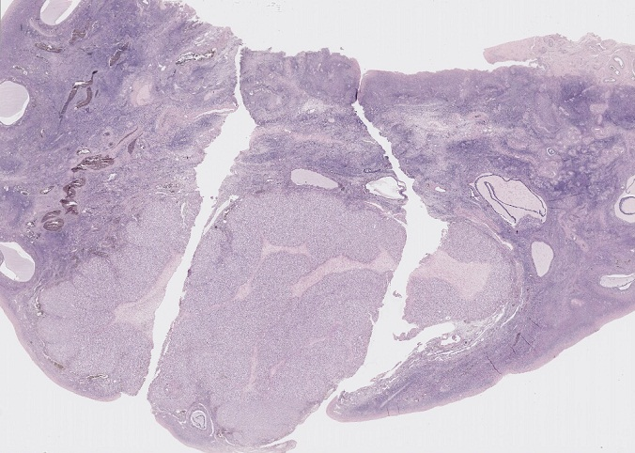
Final quiz
Self-check: Identify the structure in the outlined region. (advance slide for answers)
Corpus luteum

Slide 52
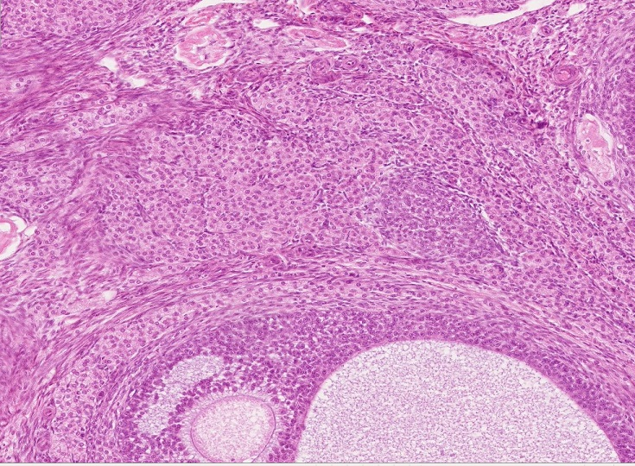
Final quiz
Self-check: Identify the cells in the outlined region. (advance slide for answers)
Interstitial gland

Slide 53
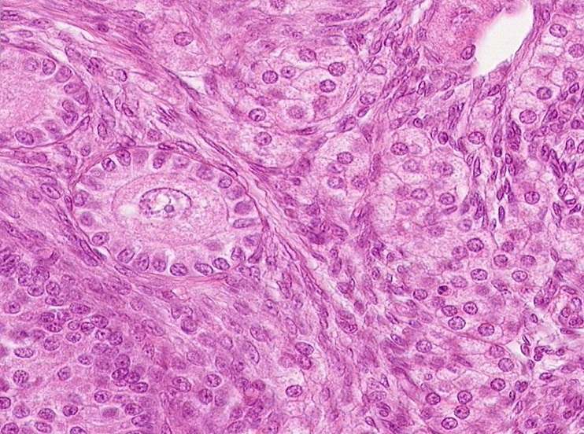
Final quiz
Self-check: Identify the outlined structure on this slide. (advance slide for answers)
Primary follicle

Slide 54
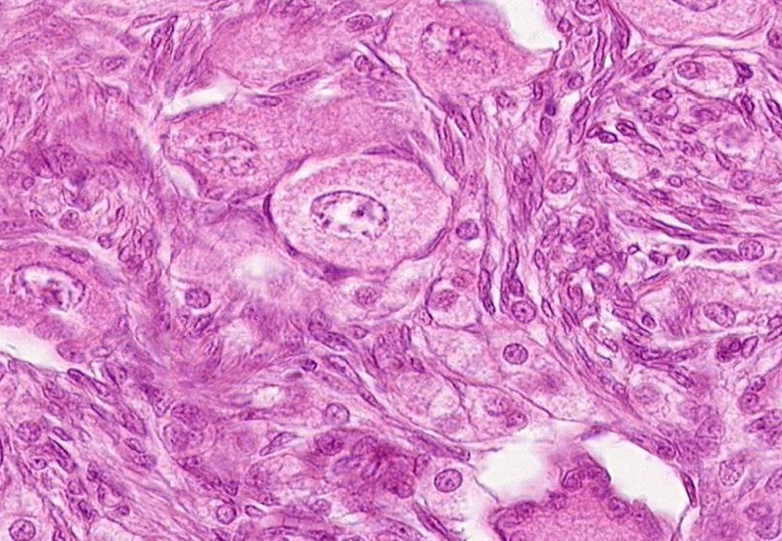
Final quiz
Self-check: Identify the structure in the outlined region. (advance slide for answers)
Primordial follicle

Slide 55
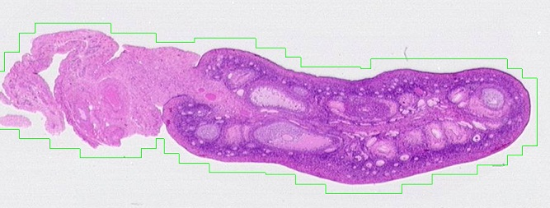
Final quiz
Self-check: Identify the outlined structure on this slide. (advance slide for answers)
mesovarium

Slide 56
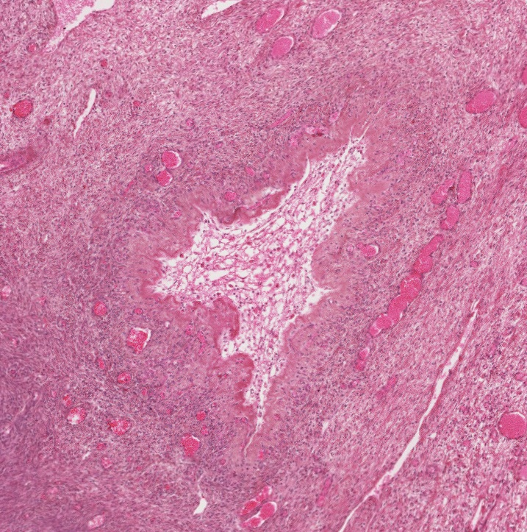
Final quiz
Self-check: Identify the outlined structure on this slide. (advance slide for answers)
Atretic follicle

Slide 57
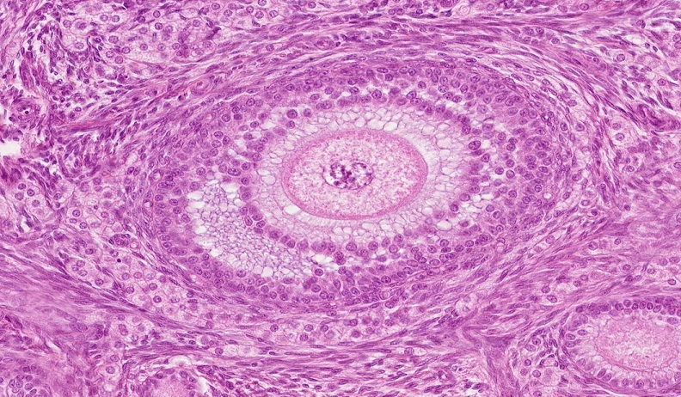
Final quiz
Self-check: Point to the location of the zona pellucida on this slide. (advance slide for answers)

Slide 58
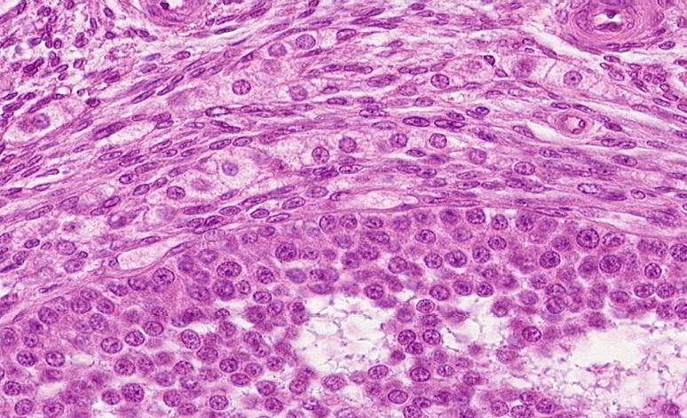
Final quiz
Self-check: Identify the cells indicated by the arrows. (advance slide for answers)
Theca interna

Slide 59
Final quiz
Self-check: Point to the location of the basement membrane of the predominant follicle on this slide. (advance slide for answers)

Slide 60
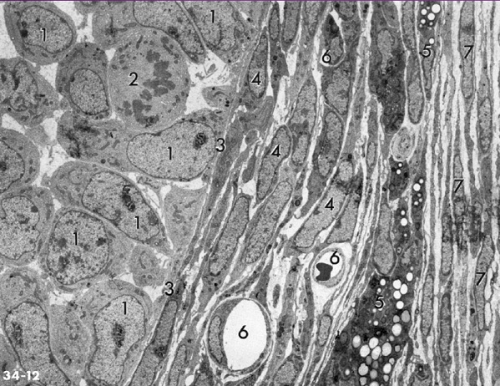
Final quiz
Self-check: This EM was taken from the ovary. Identify structures 1-7 on this slide. (advance slide for answers)
Granulosa cells
Granulosa cells (in mitosis)
Basement membrane
Theca interna
Also theca interna (note lipid droplets)
Capillary
Theca externa
BTW, you have seen blood vessels in the theca, but not in the granulosa. This is because the granulosa is an epithelium, and blood vessels stay on the connective tissue side of the basement membrane. The exception to this is the corpus luteum – in that structure, the basement membrane breaks down.

Slide 61
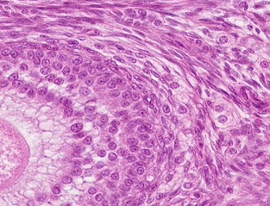
Final quiz
Self-check: Identify the cells indicated by the arrows. (advance slide for answers)
Theca externa

Slide 62
Final quiz
Self-check: Point to the nuclear membrane of the oocyte. (advance slide for answers)

Slide 63
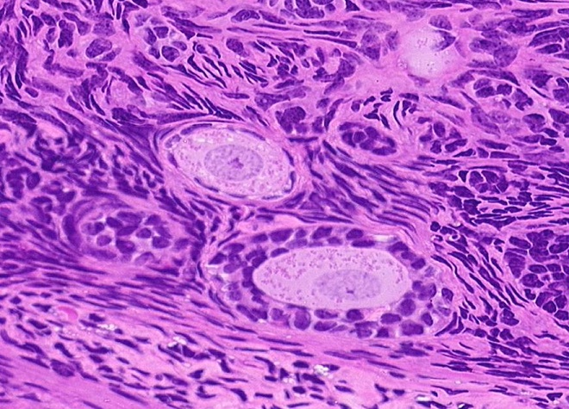
Final quiz
Self-check: Identify the cells indicated by the arrows. (advance slide for answers)
Follicular cells

Slide 64
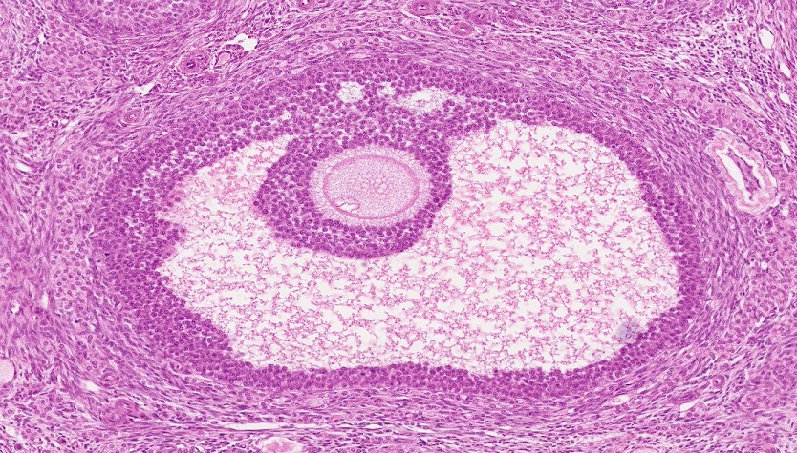
Final quiz
Self-check: Identify X. (advance slide for answers)
Antrum
X

Slide 65
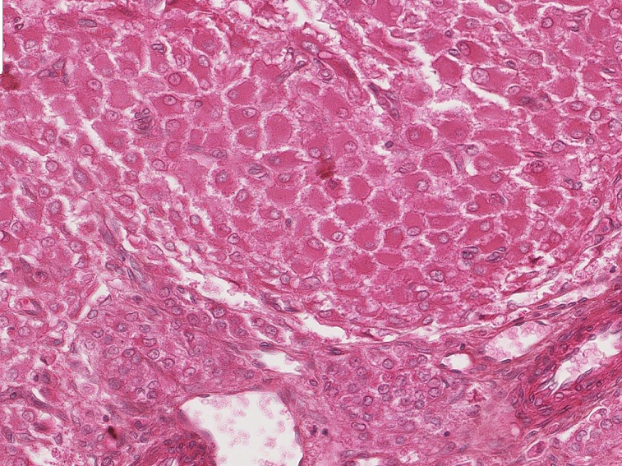
Final quiz
Self-check: Identify the outlined cells. (advance slide for answers)
Theca luteal cells

Slide 66
Final quiz
Self-check: Identify the structure in the outlined region. (advance slide for answers)
Primordial follicle

Slide 67
Final quiz
Self-check: Identify the structure in the outlined region. (advance slide for answers)
Interstitial
gland

Slide 68
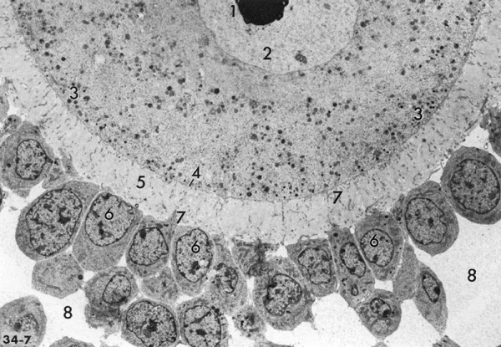
Final quiz
Self-check: Identify structures 1-8 on this slide. (advance slide for answers)
Oocyte nucleolus
Oocyte nucleus
Cortical granules (you should have known this from embryology)
Oocyte membrane
Zona pellucida
Granulosa cells
Cell processes
Antrum

Slide 69
Final quiz
Self-check: Identify the structure at the tips of the arrows. (advance slide for answers)
Glassy membrane

Slide 70
Final quiz
Self-check: Identify the outlined structure. (advance slide for answers)
Late secondary or Graafian follicle

Slide 71
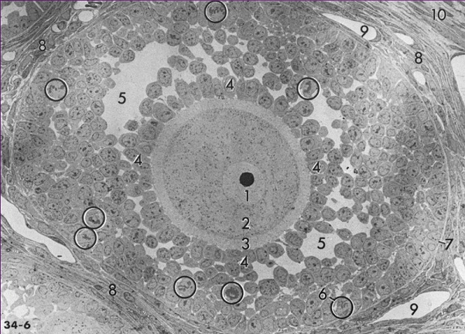
Final quiz
Self-check: Identify structures 1-5, 7, 8, 10 on this slide. (advance slide for answers)
Oocyte nucleus
Oocyte cytoplasm
Zona pellucida
Granulosa cells
Antrum
(mitosis of granulosa cells)
Basement membrane
Theca interna
(capillary)
Theca externa

Slide 72
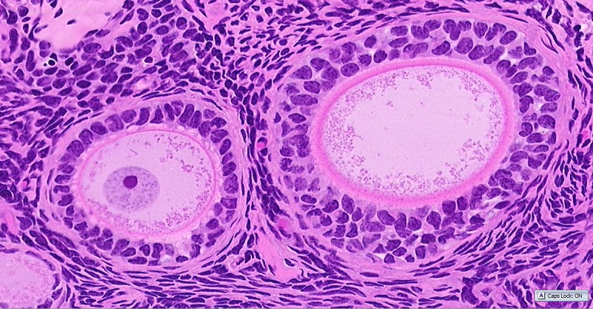
Final quiz
Self-check: Point to the basement membrane in each follicle. (advance slide for answers)

Slide 73
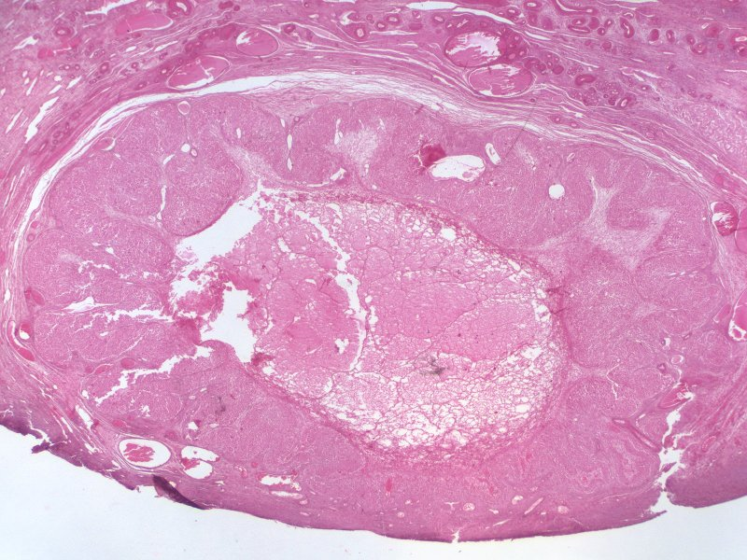
Final quiz
Self-check: Identify the structure on these slides. (advance slide for answers)
Corpus luteum

Slide 74
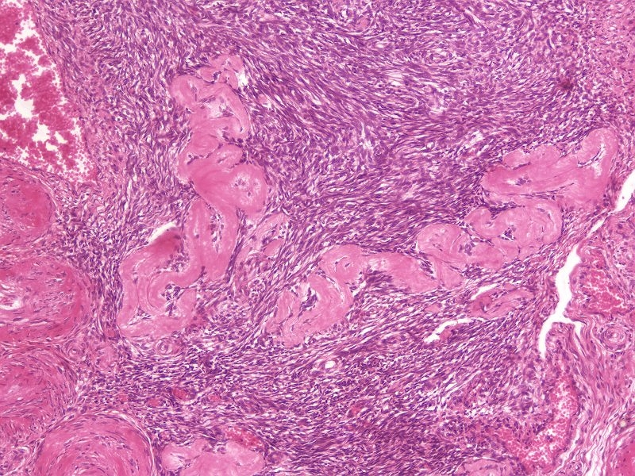
Final quiz
Self-check: Identify the structures indicated by the arrows. (advance slide for answers)
Corpora fibrosa

Slide 75
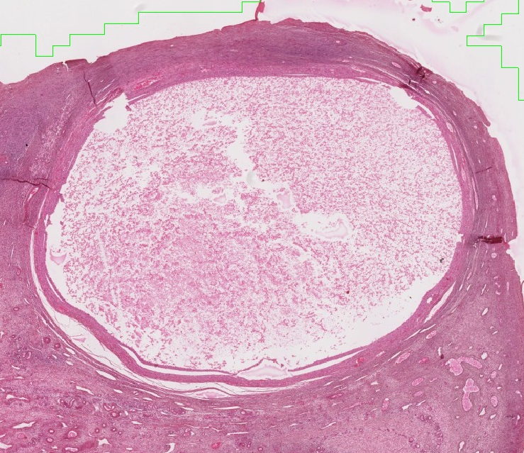
Final quiz
Self-check: Identify the outlined structure on this slide. (advance slide for answers)
Atretic follicle

Slide 76
Final quiz
Self-check: Identify the cells at the tips of the arrows. (advance slide for answers)
Follicular cells

Slide 77
Final quiz
Self-check: Identify the outlined structures on this slide. (advance slide for answers)
primary follicles
These are sweeeeeeeet!!!!!

Slide 78
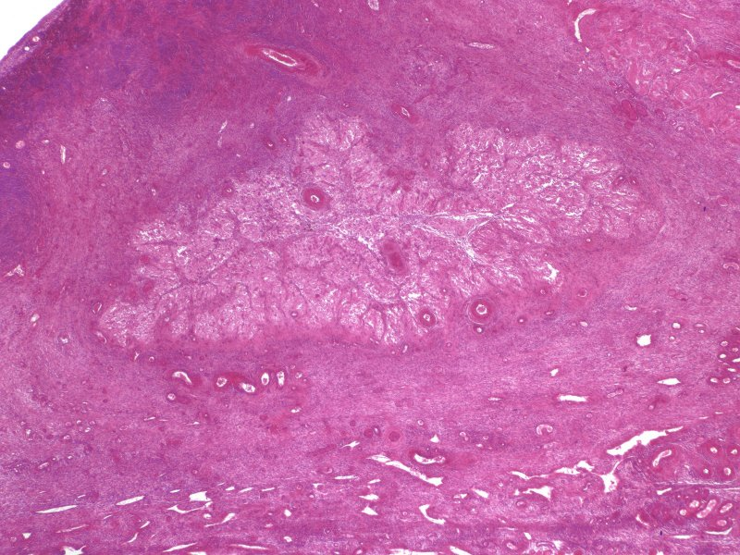
Final quiz
Self-check: Identify the outlined structure on this slide. (advance slide for answers)
Corpus albicans

Slide 79
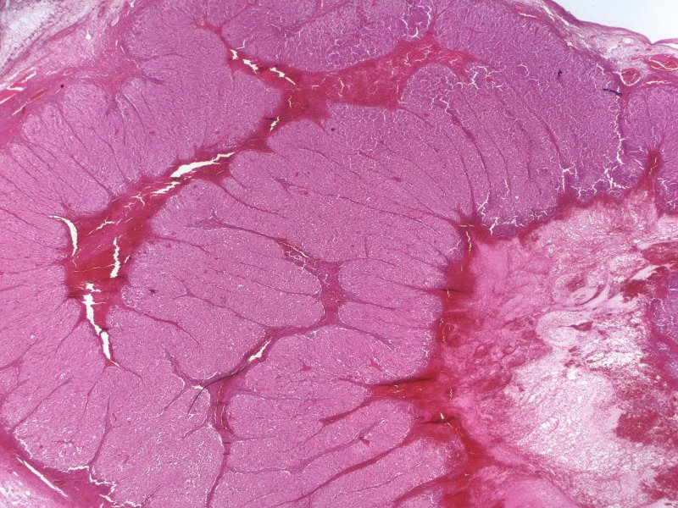
Final quiz
Self-check: Identify the predominant structure on this slide. (advance slide for answers)
Corpus luteum

Slide 80
Final quiz
Self-check: identify the structure indicated by the arrows. (advance slide for answers)
Corona radiata

Slide 81
Final quiz
Self-check: Identify the outlined cells. (advance slide for answers)
Granulosa luteal cells

Slide 82
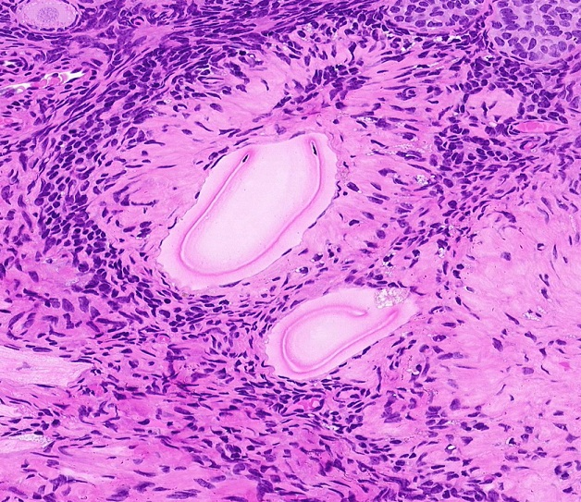
Final quiz
Self-check: Identify the structures indicated by the arrows. (advance slide for answers)
Eosinophilic bands (remnants of zona)

Slide 83
Final quiz
Self-check: Identify the outlined structure on this slide. (advance slide for answers)
Secondary follicle

Slide 84
Final quiz
Self-check: Point to the location of the basement membrane. (advance slide for answers)

Slide 85
Final quiz
Self-check: Identify the cells indicated by the arrows. (advance slide for answers)
Theca externa

Slide 86
Final quiz
Self-check: Identify the structure indicated by the arrow. (advance slide for answers)
nucleolus

Slide 87
Final quiz
Self-check: identify the structure in the outlined region. (advance slide for answers)
Cumulus oophorus

Slide 88
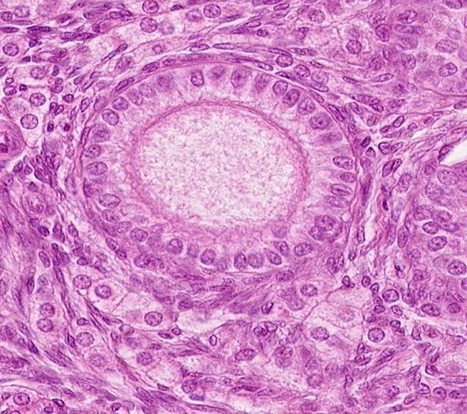
Final quiz
Self-check: Identify the outlined structure on this slide. (advance slide for answers)
Primary follicle

Slide 89
Final quiz
Self-check: Identify the structure indicated by the arrows. (advance slide for answers)
mesovarium

Slide 90
Final quiz
Self-check: Name (and classify, if you wish) the tissue indicated by the arrows. (advance slide for answers)
Germinal epithelium (here it is simple columnar, but cuboidal and squamous to the left)

Slide 91
Final quiz
Self-check: Point to the zona pellucida. (advance slide for answers)

Slide 92
Final quiz
Self-check: Identify the structure at X. (advance slide for answers)
antrum
X

Slide 93
Final quiz
Self-check: Identify the outlined cells. (advance slide for answers)
Theca luteal cells

Slide 94
Final quiz
Self-check: Identify the cells at the tips of the arrows. (advance slide for answers)
Granulosa (follicular) cells

Slide 95
Final quiz
Self-check: Identify the space at X. (advance slide for answers)
X
Peritoneal cavity

Slide 96
Final quiz
Self-check: Identify the cells indicated by the arrows. (advance slide for answers)
Theca interna

Slide 97
Final quiz
Self-check: Identify the outlined structure on this slide. (advance slide for answers)
Primary follicle

Slide 98
Final quiz
Self-check: Point to the nuclear membrane of the oocyte. (advance slide for answers)
It’s not there

Slide 99
Final quiz
Self-check: Identify the outlined structures on this slide. (advance slide for answers)
Atretic follicles

Slide 100
Final quiz
Self-check: Identify the outlined cells. (advance slide for answers)
Granulosa luteal cells

Slide 101
Final quiz
Self-check: Identify the outlined structure on this slide. (advance slide for answers)
Atretic follicle

Slide 102
Final quiz
Self-check: Point to the zona pellucida in each follicle. (advance slide for answers)

Slide 103
Final quiz
Self-check: Identify the outlined sructure on this slide. (advance slide for answers)
Corpus albicans

Slide 104
Final quiz
Self-check: Point to the nuclear envelope. (advance slide for answers)

