Slide 1
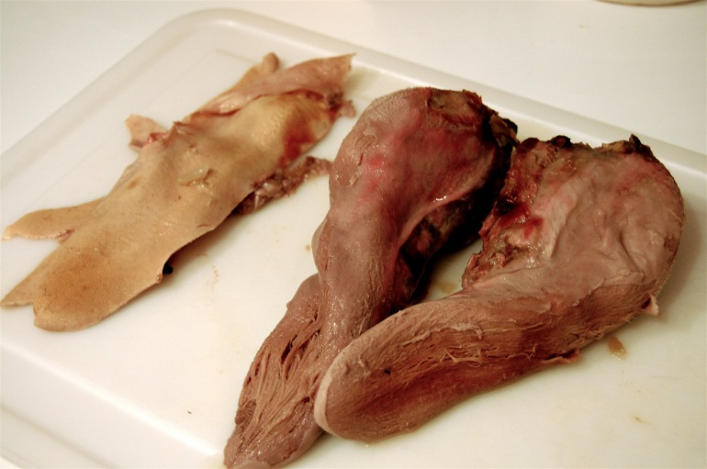
Oral Cavity: Tongue, Salivary Glands
Digital Laboratory
It’s best to view this in Slide Show mode, especially for the quizzes.
This module will take approximately 60 minutes to complete.

Slide 2
After completing this exercise, you should be able to:
Distinguish, at the light microscope level, each of the following:
Tongue
Papilla
Filiform
Fungiform
Circumvallate
Serous glands
Taste buds
Salivary glands
Structures in each gland
Acini
Serous acini
Mucus acini
Serous demilunes
Ducts
Intercalated
Striated
Excretory
Types of salivary glands
Parotid
Submandibular
Sublingual

Slide 3
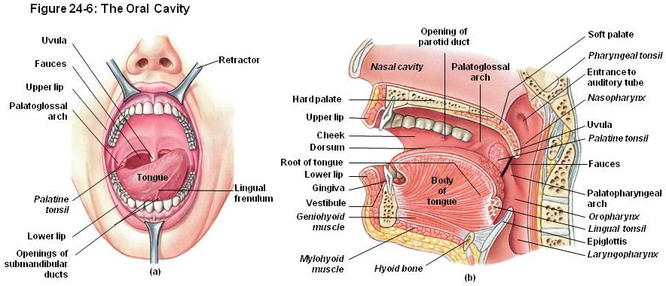
TONGUE
Because much of the tongue is in the posterior aspect of the oral cavity, it is much larger than one would think. Note that the dorsum is the upper surface; the ventral surface is exposed in the left image and indicated by the black arrow in the right image.
lumen

Slide 4
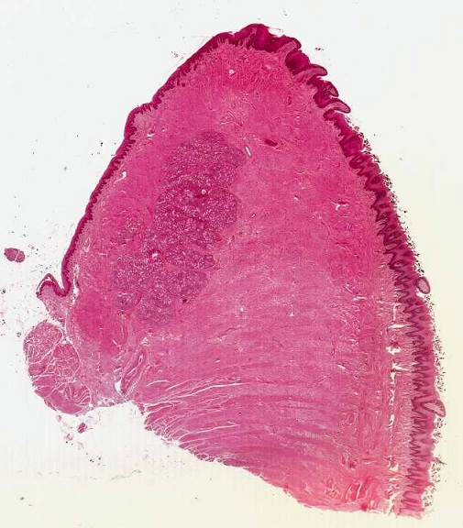
TONGUE
tip
The core of the tongue is thick, skeletal muscle oriented in all three dimensions. The surface mucosa consists of a stratified squamous epithelium and an underlying dense irregular connective tissue. Mixed mucus and serous glands are found within the connective tissue, but also extend into the muscle.
ventral surface
Dorsal surface
lumen

Slide 5
TONGUE
Video of tip of the tongue showing general features – SL70
Link to SL 070
Be able to identify:
tongue

Slide 6
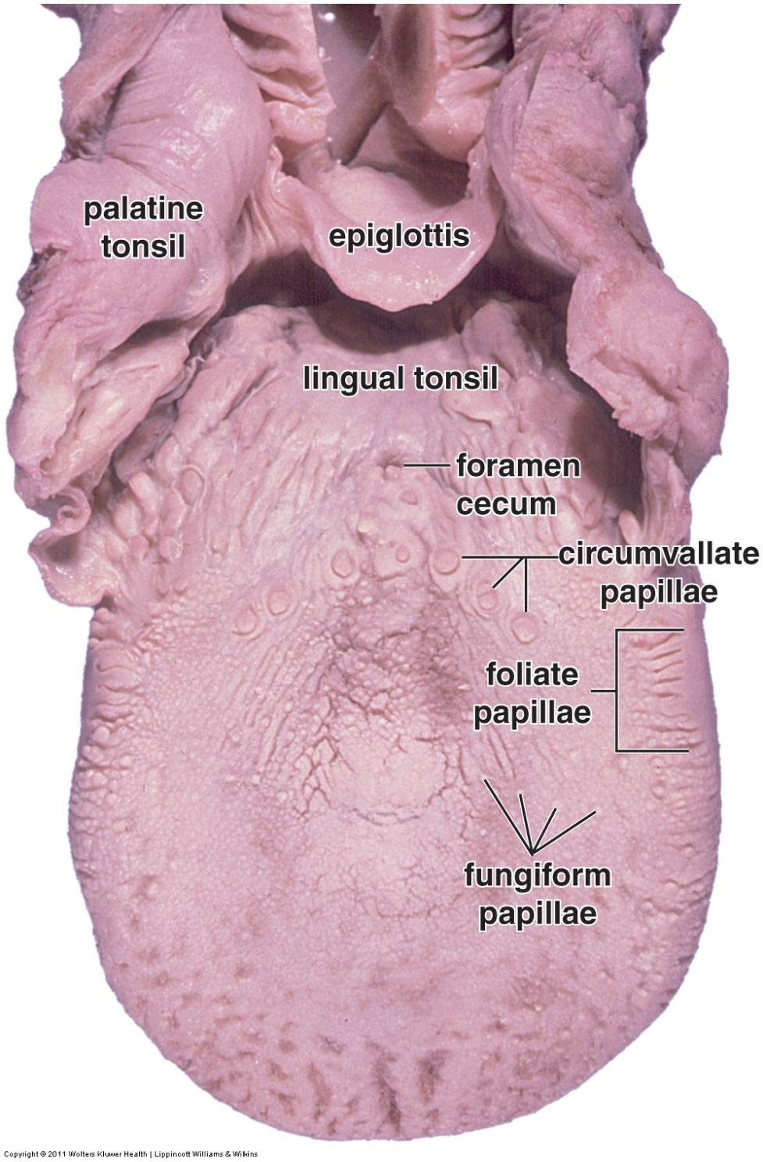
TONGUE
The dorsal surface of the tongue features projections called papilla. There are four types of papillae:
Filiform papilla (not labeled) are conical projections; are the only papilla that do NOT contain taste buds; are scattered throughout the anterior 2/3 of the tongue
Fungiform papilla are mushroom-shaped; are scattered throughout the anterior 2/3 of the tongue
Foliate papilla are ridge-shaped, and are found on the lateral side of the tongue
Circumvallate papilla are large, about 12-15 of these form a V-shape that divides the anterior 2/3 of the tongue from the posterior 1/3 of the tongue.
lumen
We do not have slides of foliate papilla, not even in the secret exam vaults.

Slide 7
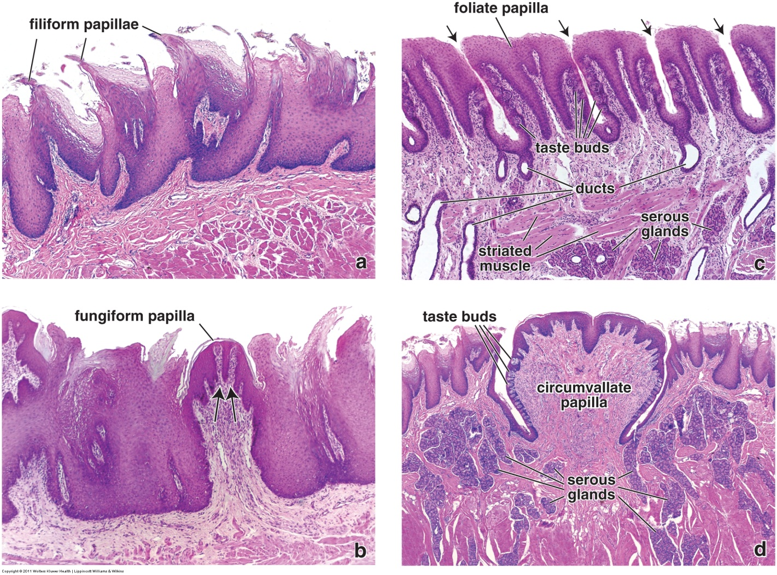
TONGUE
The dorsal surface of the tongue features projections called papilla. There are four types of papillae:
Filiform papilla are conical projections; these are lightly keratinized
Fungiform papilla are mushroom-shaped, have a core of connective tissue, and are lightly keratinized
Foliate papilla are ridge-shaped, and are found on the lateral side of the tongue
Circumvallate papilla are large (image d is at lower magnification than images a-c), have a core of connective tissue, are lightly keratinized, have many taste buds, are surrounded by a deep trench; serous glands, called von Ebner’s glands, are situated near the trench
Please re-read;
I changed some text.
Magnification for your edification:
a-c = 45X
d = 25X
Note the size of the circumvallate papilla. Check the previous slide to verify.
lumen

Slide 8
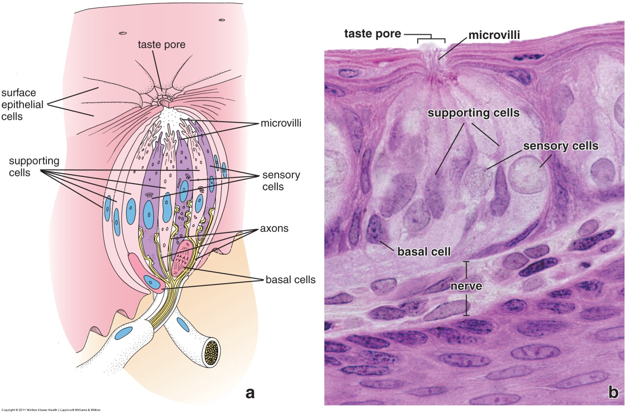
TONGUE
Taste buds are found on all papilla except for filiform papilla. They are globe-shaped structures modifications of the epithelium, and contain several cell types. Ultimately, ingested molecules react with receptors on the microvilli of sensory cells, which transmit a signal to a peripheral nerve (FYI, for now, cranial nerves VII, IX, X).
On our slides, just recognizing a taste bud would be dandy.
lumen

Slide 9
TONGUE
Video of tip of the tongue showing filiform and fungiform papilla – SL70
Link to SL 070
Be able to identify:
Tongue
Filiform papilla
Fungiform papilla

Slide 10
TONGUE
Video of base of the tongue showing circumvallate papilla – SL72
Link to SL 072
Be able to identify:
Tongue
Circumvallate papilla
Serous glands

Slide 11
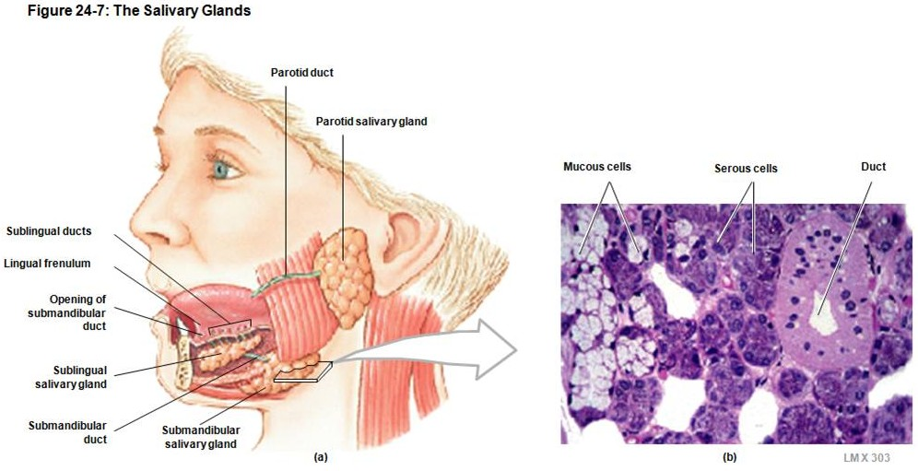
SALIVARY GLANDS
Saliva is a liquid composed of water, mucus, ions, buffers, antibodies (IgA), and some digestive enzymes. There are three salivary glands:
--parotid gland
--submandibular gland
--sublingual gland
We looked at these in Fundamentals , so some of this will be familiar. First, we’ll review serous and mucous glands. This will be followed by a description of the types of ducts in salivary glands, and a final discussion of how to differentiate the three salivary glands from each other.
lumen

Slide 12
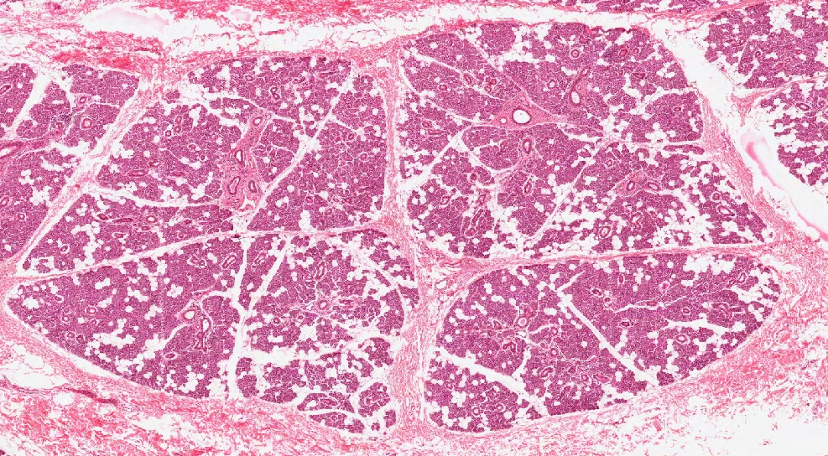
SALIVARY GLANDS
FYI, glandular organs can be divided into lobes (black outline) and lobules (blue outline).
The definition of a lobe or lobule is based on branching during development. All acini in a lobule ultimately draining into the same duct, which then drain into a common duct that drains all lobules in the lobe. However, when looking at sections, the precise outline of a lobe or lobule is not necessarily an exact science. Therefore, do not lose any sleep trying to define lobes and lobules in the salivary glands.
That said, you should be aware that lobes and lobules do have some clinical significance. For example, if a tumor is isolated to one lobule (aka bronchopulmonary segement) in the lung, that single lobule can be removed as a unit, without disturbing function of the remaining lobules.

Slide 13
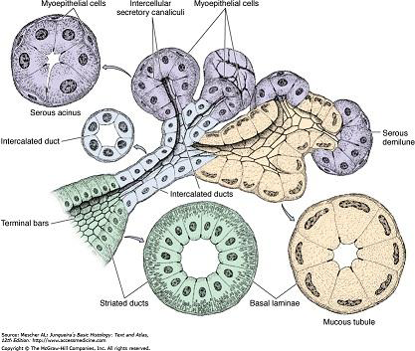
SALIVARY GLANDS - ACINI
This is a drawing of the secretory units of a salivary gland. The secretory cells are organized into acini (or possibly tubules), which surround a lumen. Recall that the apical side of the cell faces the lumen, while the basement membrane (basal lamina) surrounds the acini.
The secretory cells are either serous (produce a watery secretion), or mucous.
lumen

Slide 14
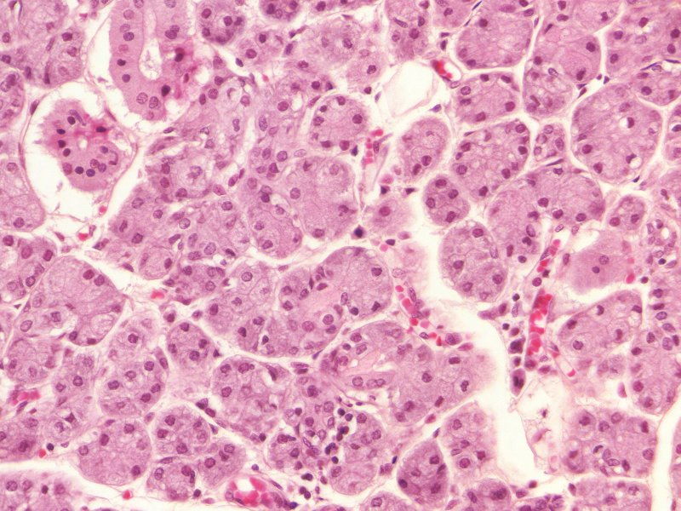
SALIVARY GLANDS - ACINI
Two acini are circled. They vary in size to some extent, but much of this is due to sectioning. The lumen is usually not visible, though you can see lumen in the two ducts to the left. A single cell is outlined in yellow.
Due to sectioning, not all cells in an acinus have nuclei.
For the acinus outlined in the middle of the slide, it’s easy to imagine cellular borders using the nuclei as a guide….much more challenging in the acinus on the right.
two ducts to the left
Flaky material
Flaky material
Flaky material
Also remember that the glandular cells are epithelial. All that flaky material between the acini is connective tissue.

Slide 15
SALIVARY GLANDS - ACINI
Also recall that there are two types of acini; serous and mucous. This slide shows serous acini, which secrete a watery solution, and are characterized by:
--pink cytoplasm with some cytoplasmic basophilia due to protein production
--nuclei are round and at the basal aspect of cell

Slide 16
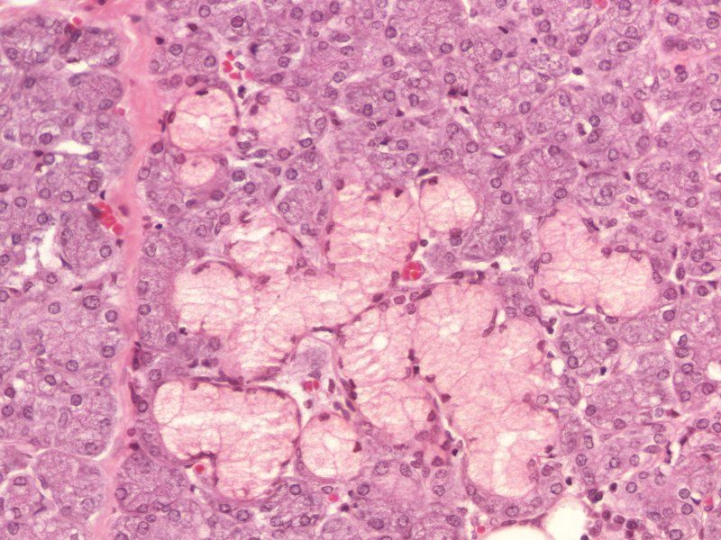
SALIVARY GLANDS - ACINI
Here, there are some mucous acini (one with a nice lumen is outlined). Note --cytoplasm is pale due to washed-out mucous secretory vesicles
--nuclei flattened toward the base of the cell (due to numerous secretory vesicles)

Slide 17
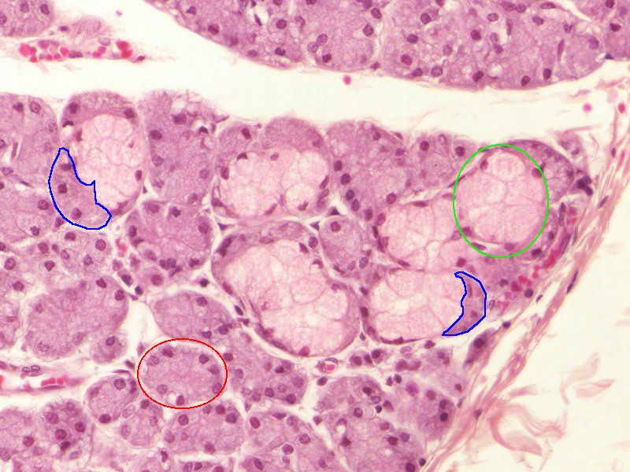
SALIVARY GLANDS - ACINI
Also recall that some glands are mixed. Here, you see serous (orange) and mucous (green) acini in the same gland. Even individual acini can be mixed; recall that some mucus acini have serous demilunes (blue).

Slide 18
SALIVARY GLANDS - ACINI
Video of submandibular gland showing serous and mucous acini – SL92
Link to SL 092
Be able to identify:
acini
Serous acini
Mucus acini
Serous demilunes

Slide 19
SALIVARY GLANDS - DUCTS
In salivary glands, ducts carry fluid to the oral cavity. In addition, the ducts near the secretory end pieces (acini) are also involved in modification of the salivary content as it passes through them. The ducts in salivary glands are (listed in order of flow of saliva):
Intercalated ducts – short, narrow tubules lined by simple cuboidal epithelium; have some activity in HCO₃⁻ secretion and Cl⁻ absorption; challenging to find
Striated ducts – these are approximately the same diameter as acini, or even slightly larger, and are lined by simple columnar epithelium; cells are actively involved in reabsorption of Na⁺, and K⁺ secretion; basolateral infoldings of the plasma membrane of these cells gives them a striated appearance; nuclei are toward the center of the cell
Excretory ducts (not shown in figure) – initially lined by simple columnar epithelium, which transitions to stratified cuboidal / stratified columnar; near the oral cavity the epithelium becomes stratified squamous; connective tissue support increases as tubes get larger
lumen

Slide 20
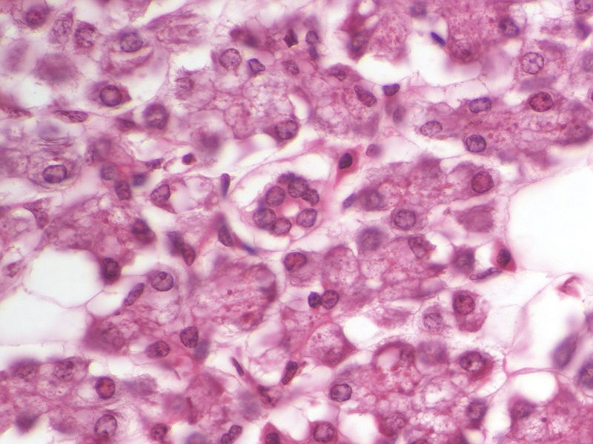
SALIVARY GLANDS - DUCTS
Intercalated ducts (one outlined in green) are typically narrower than acinar units. Although they are difficult to find because they are short, they can be readily recognized because they are composed of a simple cuboidal epithelium; the minimal cytoplasm of these cells suggests that activity in these ducts is limited. A small amount of loose connective tissue provides support.
This is a nice image of an intercalated duct, but the acini are not attractive. Two very ugly acini are outlined in black so you can get a sense of the size of the intercalated duct.

Slide 21
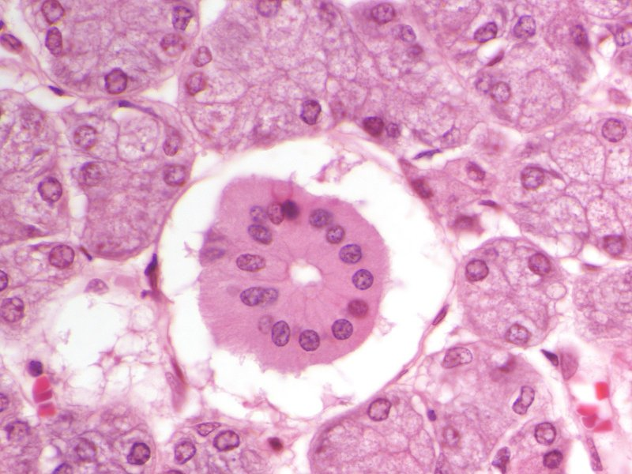
SALIVARY GLANDS - DUCTS
Striated ducts are approximately the same diameter as the secretory units (acini). They are composed of a simple, tall columnar epithelium. These cells are very active in ion transport, so they have eosinophilic cytoplasm, and elaborate basolateral foldings of their plasma membrane to provide surface area for the ion pumps. These foldings can just barely be seen as striations, though you have to squint really hard to appreciate them. The presence of these basolateral foldings “pushes” the nucleus toward the center of the cell, which is very easy to see. The cytoplasm of these cells is eosinophilic.
Here, the acini are well preserved, the one above the duct is typical size.
Also note that the epithelial cells pull away from the surrounding connective tissue during fixation. This artifact is characteristic of striated ducts, but is not always the case.

Slide 22
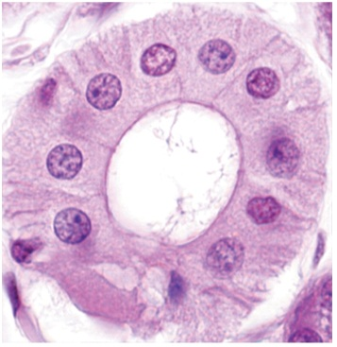
SALIVARY GLANDS - DUCTS
Striated ducts – this image from the Ross text shows the striations a little nicer… a few darker and lighter ones are indicated by the arrows. Totally awesome.
The basolateral infoldings in these cells are fairly elaborate; unfortunately, even a good light micrograph shows only a few of the striations.
For my money, to ID these on our slides, I’m looking for nuclei that are centrally located, which is unusual for epithelial cells that line a tube (nuclei are usually basally located in acini and other ducts).

Slide 23
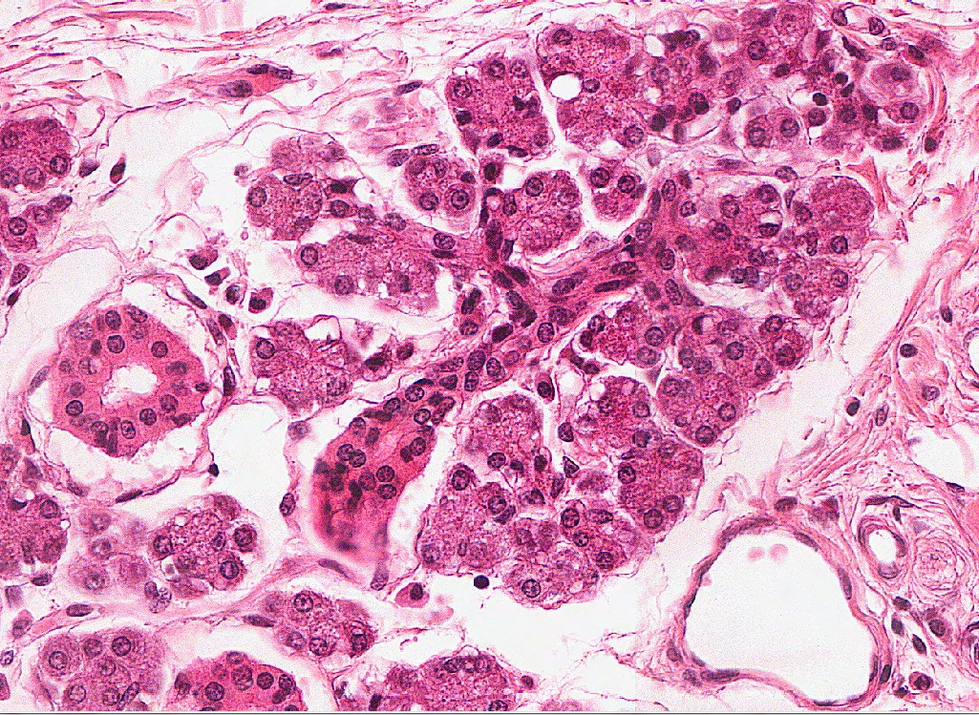
SALIVARY GLANDS - DUCTS
A careful search of your slide will reveal fortuitous images of acini and ducts in continuity. Even luckier if it’s in almost the same orientation as the textbook drawing. Here, you can see acini (black outlines – toggle to animate) draining into intercalated ducts (yellow dotted lines), which lead into a striated duct (green line)
Here, the acini are well preserved, so you can get the sense that the striated ducts are approximately the same diameter as the acini.
Even though each individual structure isn’t textbook, the fact that they are all connected for you to see in one image is totally sweet. Maybe even rad.

Slide 24
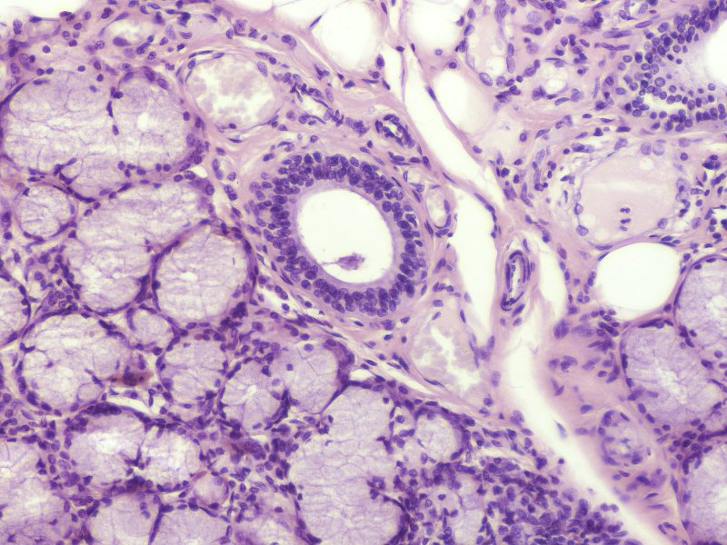
SALIVARY GLANDS - DUCTS
Excretory ducts (outlined) are basic ducts, that are simple conduits to the oral cavity. They can be intralobular, interlobular, or interlobar, but, again, don’t get bent out of shape about this. As one would suspect, the smaller ducts are lined by a simple columnar epithelium, which becomes stratified cuboidal to stratified columnar. The thickness of the supporting connective tissue also increase with increasing duct size.

Slide 25
SALIVARY GLANDS - DUCTS
Video of parotid gland showing ducts – SL91
Link to SL 091
Be able to identify:
ducts
Intercalated
Striated
Excretory

Slide 26
SALIVARY GLANDS - IDENTIFICATION
As mentioned earlier, there are three salivary glands:
--parotid
--submandibular
--sublingual
You will dissect these and their ducts in the Brain, Mind, and Behavior course when you look at other head and neck structures. For now, lets distinguish them histologically.

Slide 27
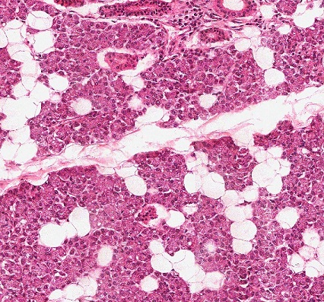
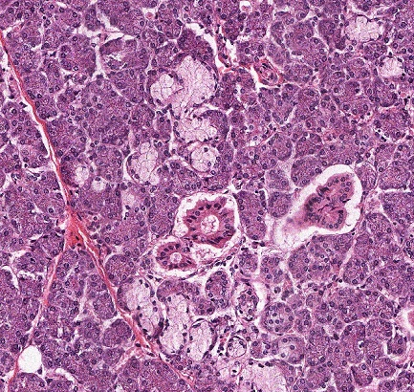
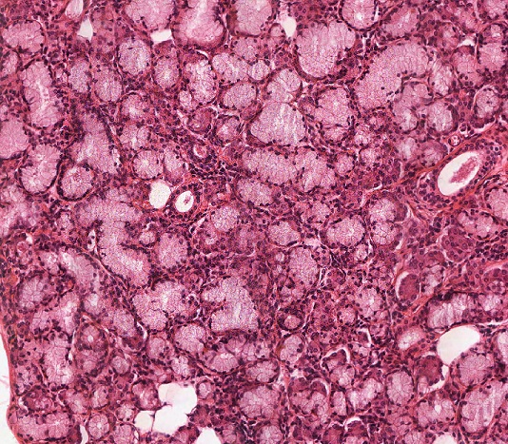
SALIVARY GLANDS - IDENTIFICATION
The easiest way to distinguish the three salivary glands is to compare the ratio of serous to mucous glands:
--parotid gland is all serous acini
--submandibular gland is mostly serous acini, with some mucous acini
--sublingual gland is mostly mucous acini, with a few serous acini
parotid gland
submandibular gland
sublingual gland
There are other helpful tips here:
--the parotid gland has unilocular adipose tissue interspersed within the acini...this is pretty reliable; however, be careful not to confuse these with mucous glands
--the parotid gland has longer intercalated ducts, but these are pretty hard to find anyway
--the sublingual ducts are short, so ducts within the sublingual gland are fewer…I wouldn’t put much stock in this tip unless you’re really desperate

Slide 28
SALIVARY GLANDS - IDENTIFICATION
Video of parotid gland – SL91
Video of submandibular gland – SL92
Video of sublingual gland – SL93
Link to SL 091 and SL 092 and SL 093
Be able to identify:
Parotid gland
Submandibular gland
Sublingual gland

Slide 29
The next set of slides is a quiz for this module. You should review the structures covered in this module, and try to visualize each of these in light and electron micrographs.
Distinguish, at the light microscope level, each of the following:
Tongue
Papilla
Filiform
Fungiform
Circumvallate
Serous glands
Taste buds
Salivary glands
Structures in each gland
Acini
Serous acini
Mucus acini
Serous demilunes
Ducts
Intercalated
Striated
Excretory
Types of salivary glands
Parotid
Submandibular
Sublingual

Slide 30
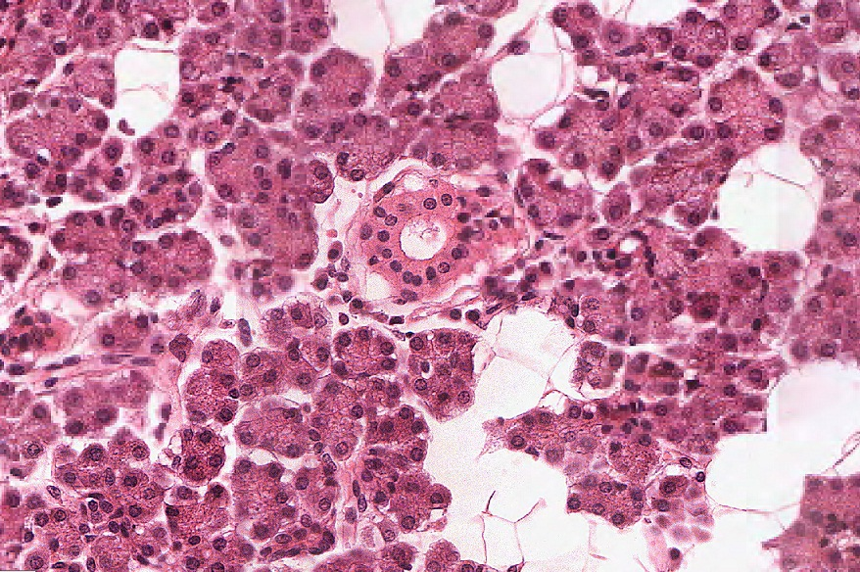
Final quiz
Self-check: Identify the outlined structure. (advance slide for answers)
Serous acinus

Slide 31
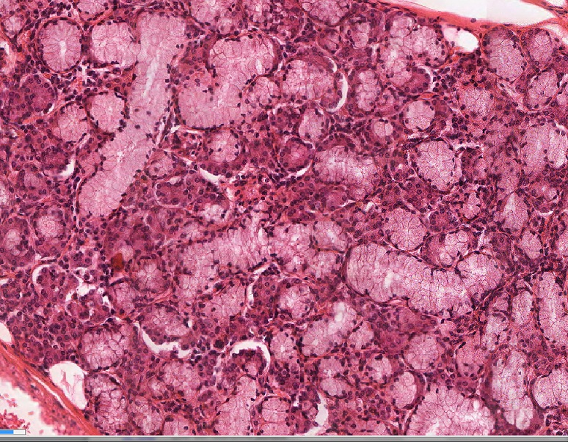
Final quiz
Self-check: Identify the organ on this slide. (advance slide for answers)
Sublingual gland

Slide 32
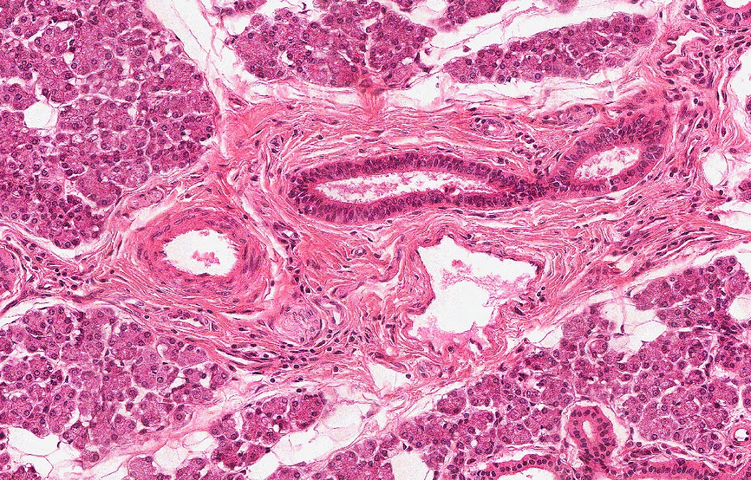
Final quiz
Self-check: Identify the outlined structure. (advance slide for answers)
Vein / venule
(outside chance it’s a lymphatic channel, but probably not one this size here)

Slide 33
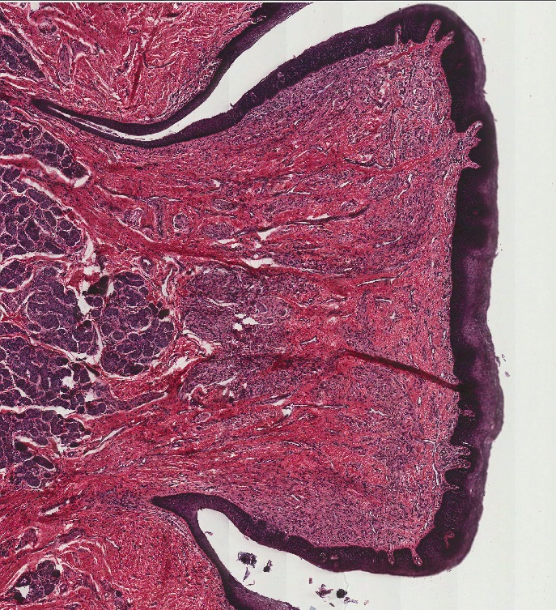
Final quiz
Self-check: Identify the outlined structure. (advance slide for answers)
Circumvallate papilla

Slide 34
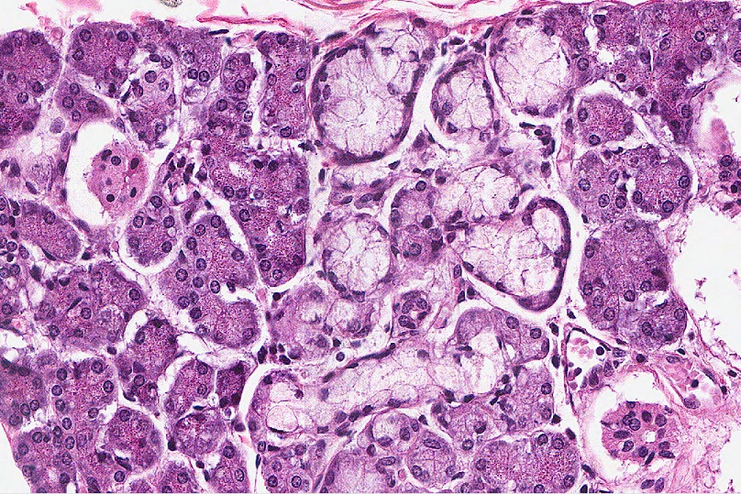
Final quiz
Self-check: Identify the organ on this slide. (advance slide for answers)
Submandibular gland

Slide 35
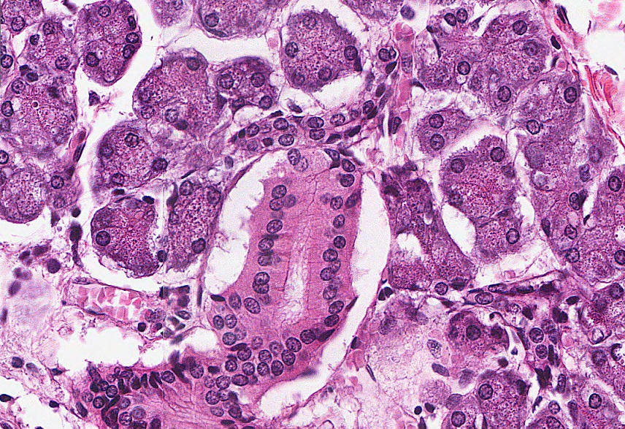
Final quiz
Self-check: Identify the outlined structure. (advance slide for answers)
Striated duct

Slide 36
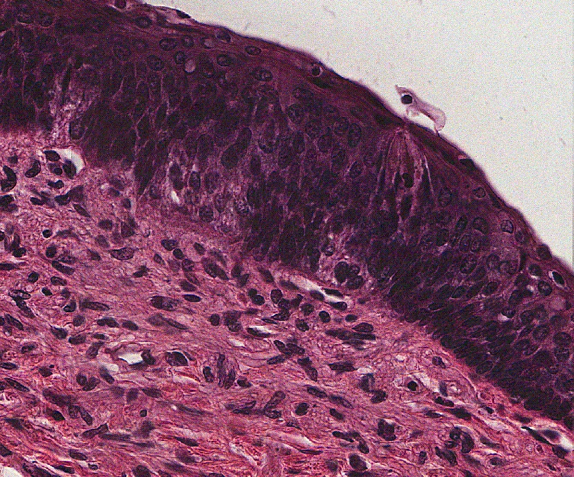
Final quiz
Self-check: Identify the outlined structure. (advance slide for answers)
Taste bud

Slide 37
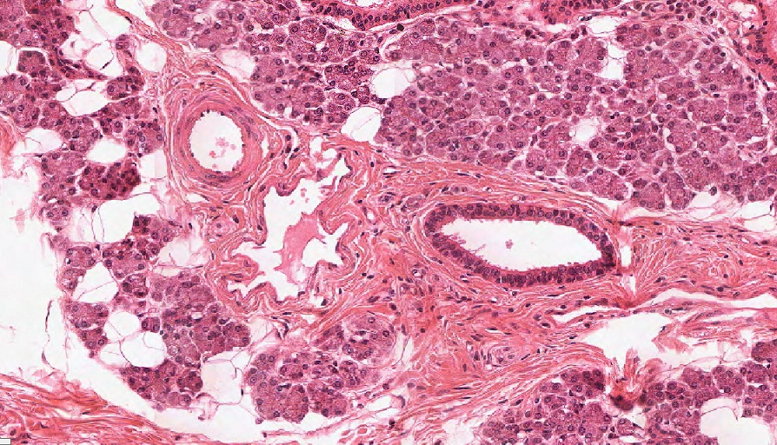
Final quiz
Self-check: Identify the outlined structure. (advance slide for answers)
Artery / arteriole

Slide 38
Final quiz
Self-check: Identify the outlined structure. (advance slide for answers)
Intercalated duct

Slide 39
Final quiz
Self-check: Identify the outlined structure. (advance slide for answers)
Excretory duct

Slide 40
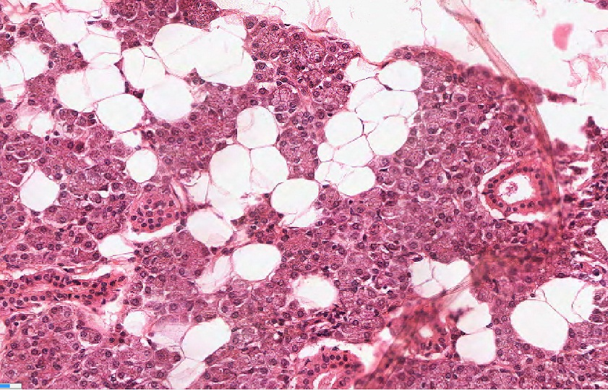
Final quiz
Self-check: Identify the outlined structures. (advance slide for answers)
Unilocular adipose cells

Slide 41
Final quiz
Self-check: Identify the outlined structure. (advance slide for answers)
Artery / arteriole

Slide 42
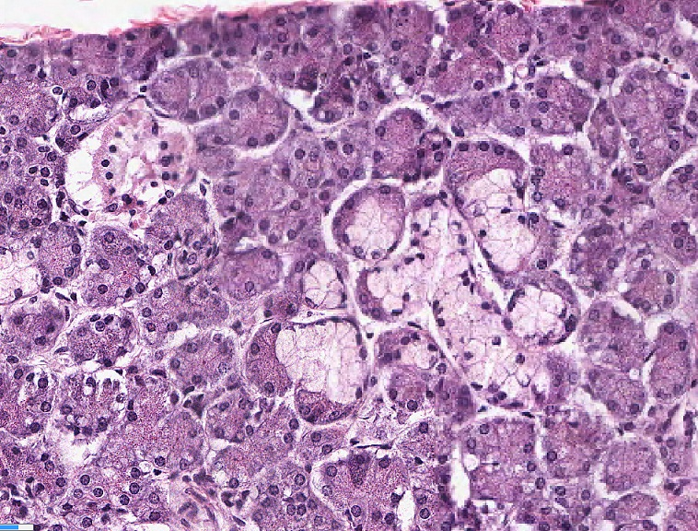
Final quiz
Self-check: Identify the outlined structure. (advance slide for answers)
mucous acinus

Slide 43
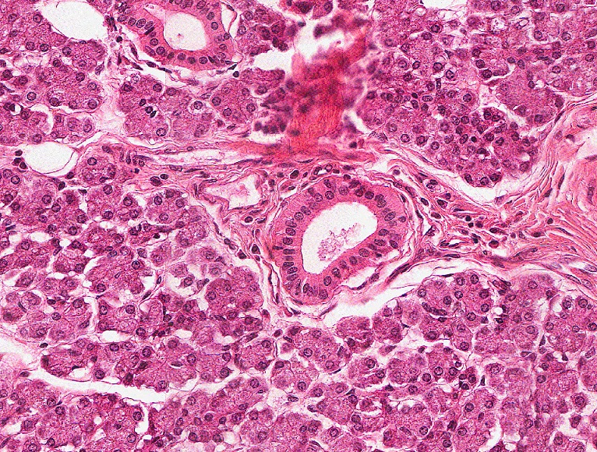
Final quiz
Self-check: Identify the outlined structure. (advance slide for answers)
Striated duct

Slide 44
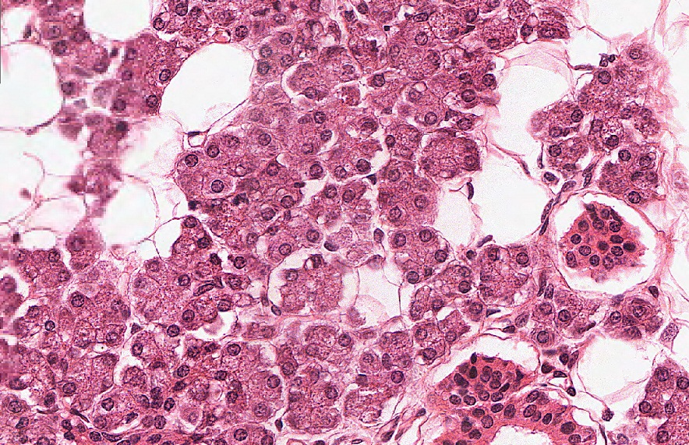
Final quiz
Self-check: Identify the outlined structure. (advance slide for answers)
Serous acinus

Slide 45
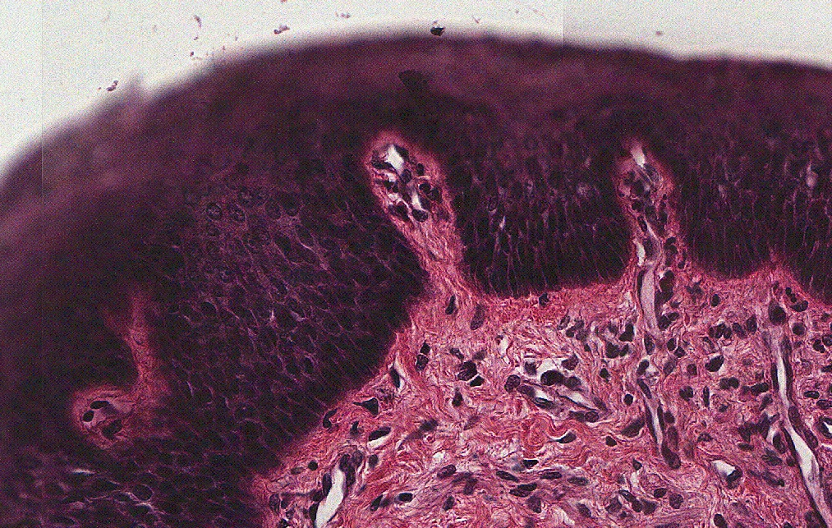
Final quiz
Self-check: Identify the outlined structure. (advance slide for answers)
Connective tissue

Slide 46
Final quiz
Self-check: Identify the outlined structure. (advance slide for answers)
Serous acinus

Slide 47
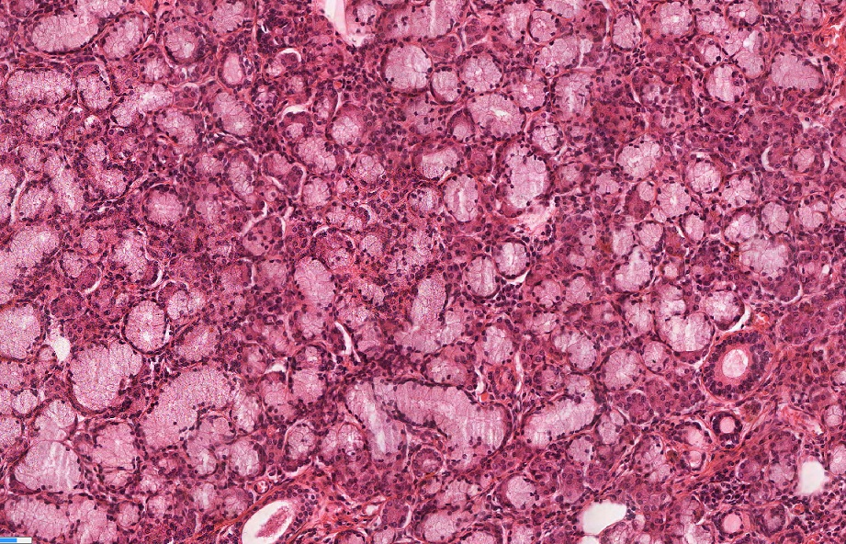
Final quiz
Self-check: Identify the organ on this slide. (advance slide for answers)
Sublingual gland

Slide 48
Final quiz
Self-check: Identify the outlined structures. (advance slide for answers)
Serous (von Ebner’s) glands

Slide 49
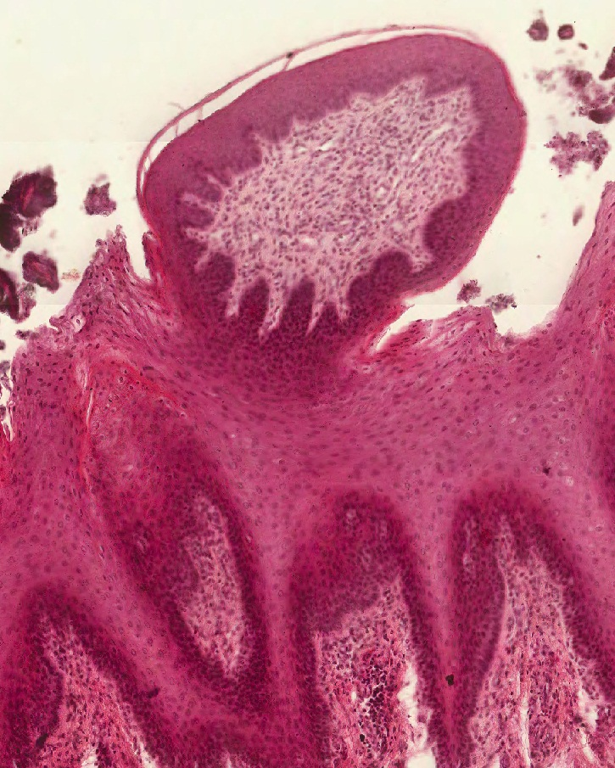
Final quiz
Self-check: Identify the outlined structure. (advance slide for answers)
Fungiform papilla

Slide 50
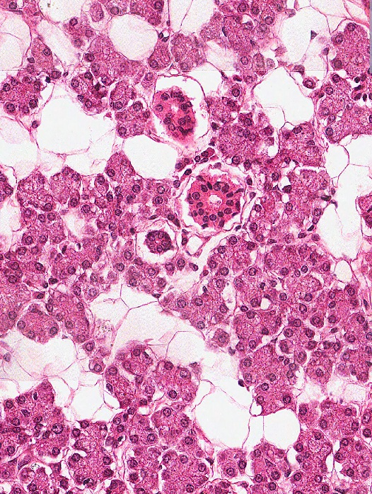
Final quiz
Self-check: Identify the outlined structure. (advance slide for answers)
Intercalated duct

Slide 51
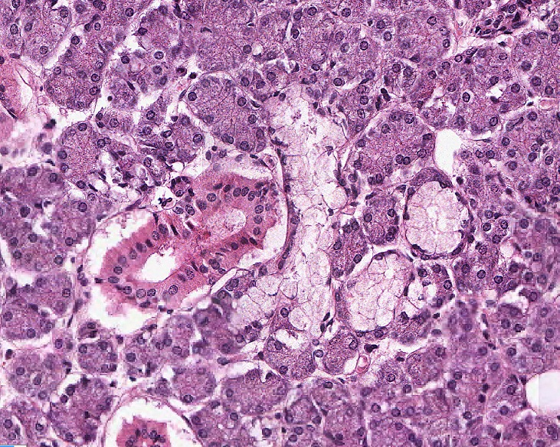
Final quiz
Self-check: Identify the organ on this slide. (advance slide for answers)
Submandibular gland

Slide 52
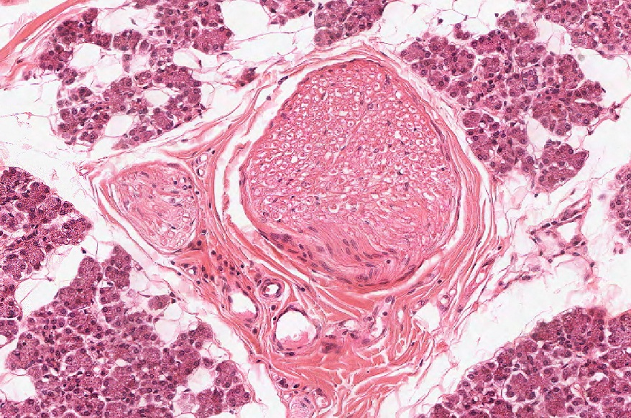
Final quiz
Self-check: Identify the outlined structure. (advance slide for answers)
Peripheral nerve

Slide 53
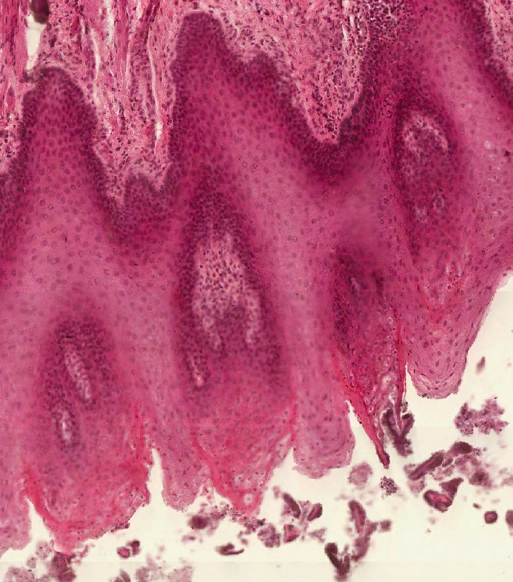
Final quiz
Self-check: Identify the outlined structure. (advance slide for answers)
Filiform papilla

Slide 54
Final quiz
Self-check: Identify the outlined structure. (advance slide for answers)
Excretory duct

Slide 55
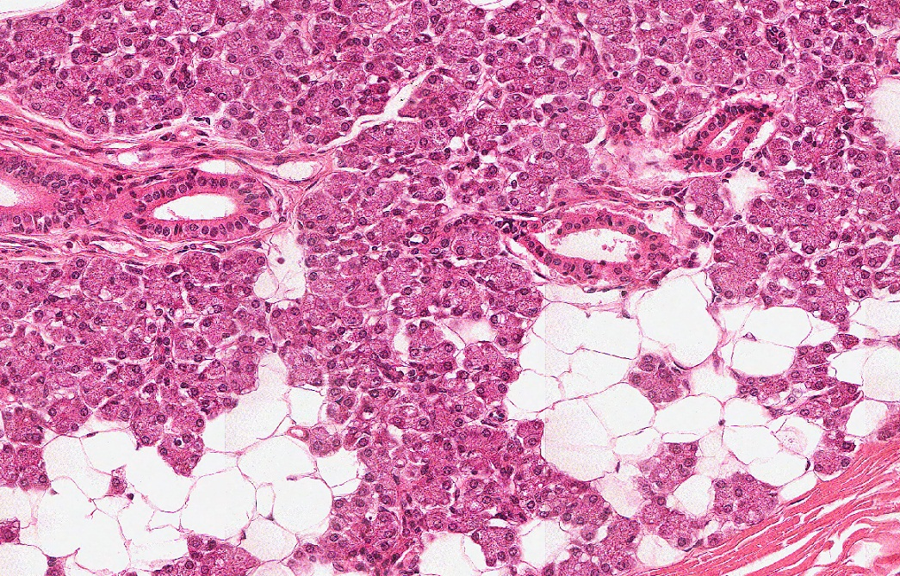
Final quiz
Self-check: Identify the organ on this slide. (advance slide for answers)
Parotid gland

Slide 56
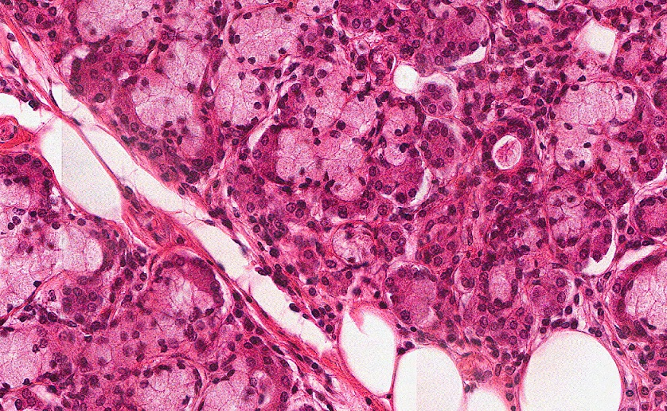
Final quiz
Self-check: Identify the outlined structure. (advance slide for answers)
Serous demilune

Slide 57
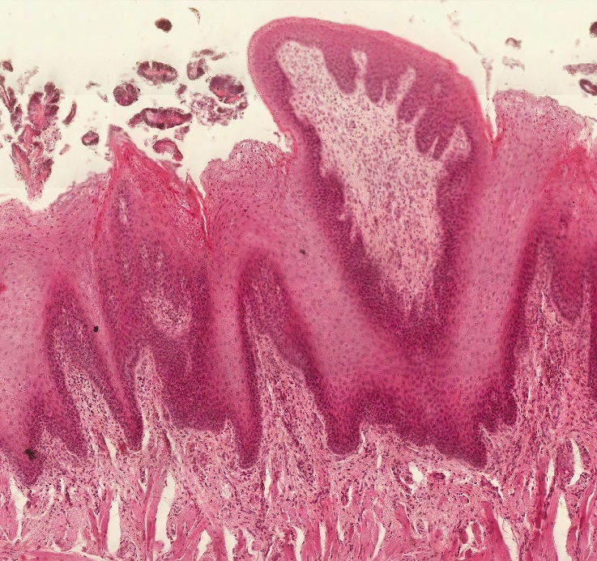
Final quiz
Self-check: Identify the outlined structure. (advance slide for answers)
Fungiform papilla

Slide 58
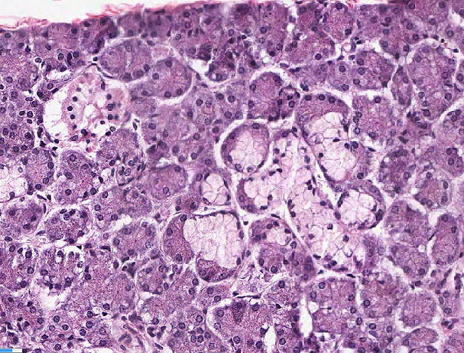
Final quiz
Self-check: Identify the organ on this slide. (advance slide for answers)
Submandibular gland

Slide 59
Final quiz
Self-check: Identify the outlined structure. (advance slide for answers)
Striated duct

Slide 60
Final quiz
Self-check: Identify the outlined structure. (advance slide for answers)
Mucous acinus

Slide 61
Final quiz
Self-check: Identify the outlined structure. (advance slide for answers)
tulip

Slide 62
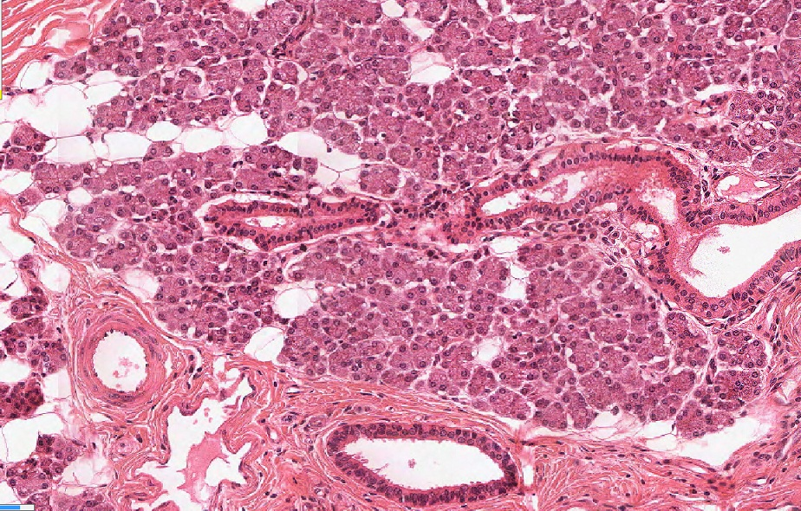
Final quiz
Self-check: Identify the organ on this slide. (advance slide for answers)
Parotid gland

Slide 63
Final quiz
Self-check: Identify the outlined structure. (advance slide for answers)
Filiform papilla

Slide 64
Final quiz
Self-check: Identify the outlined structure. (advance slide for answers)
Serous demilune

Slide 65
Final quiz
Self-check: Identify the outlined structure. (advance slide for answers)
Peripheral nerve

Slide 66
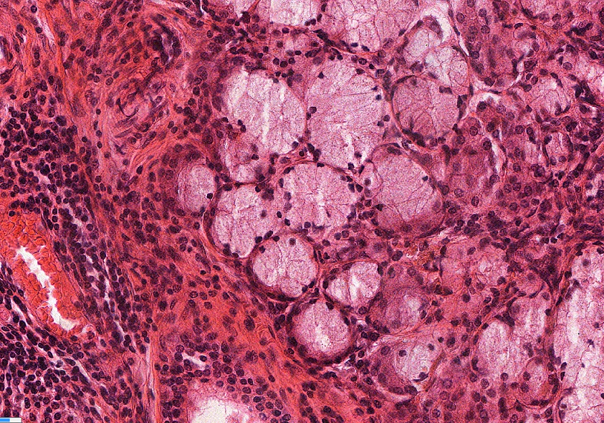
Final quiz
Self-check: Identify the outlined structure. (advance slide for answers)
Mucous acinus

Slide 67
Final quiz
Self-check: Identify the outlined structure. (advance slide for answers)
serous acinus

