Slide 1
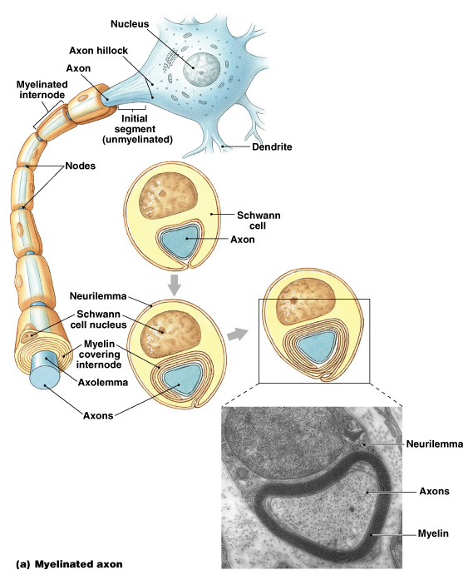
Neural Tissues
Digital Laboratory
It’s best to view this in Slide Show mode, especially for the quizzes.
This module will take approximately 90 minutes to complete.

Slide 2
After completing this exercise, you should be able to:
Distinguish, at the light microscope level, each of the following components of neural tissue:
In spinal cord gray matter (note several stains were used)
Nerve cell body
Nucleolus
Nissl substance (RER)
Axon
Axon hillock
Dendrites
In spinal cord white matter (note several stains were used)
Axons and dendrites (indistinguishable)
In prepared nerve specimen
Myelinated axon
Node of Ranvier
Peripheral nerve (in any orientation)
Connective tissue of peripheral nerve
Epineurium
Perineurium
Endoneurium
Fascicle
Axon
Myelin
Schwann cell nuclei
Ganglia
Neuronal cell bodies
Satellite cells
Bundles of axons and dendrites
Distinguish, at the electron microscope level, each of the following components of neural tissue:
Peripheral nerve
Schwann cell
Myelin
Axon
Myelinated
Ensheathed (unmyelinated)

Slide 3
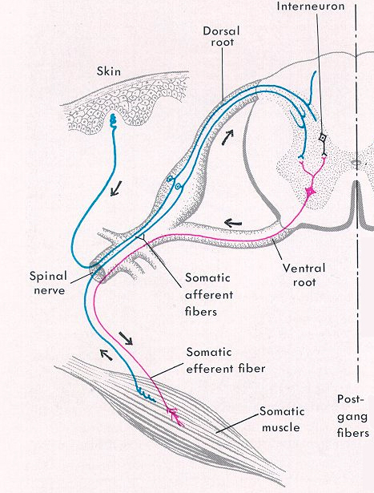
In this lab, we will examine cells, ganglia, nerves, and sensory endings of the peripheral nervous system
Organization of the nervous system
0
This diagram shows a cross section through the spinal cord, the dorsal root and ventral root nerves, spinal ganglia (red arrow) and sensory nerve endings (green arrow).
In this lab, the major foci will be:
--the spinal cord
--peripheral nerves
--ganglia

Slide 4
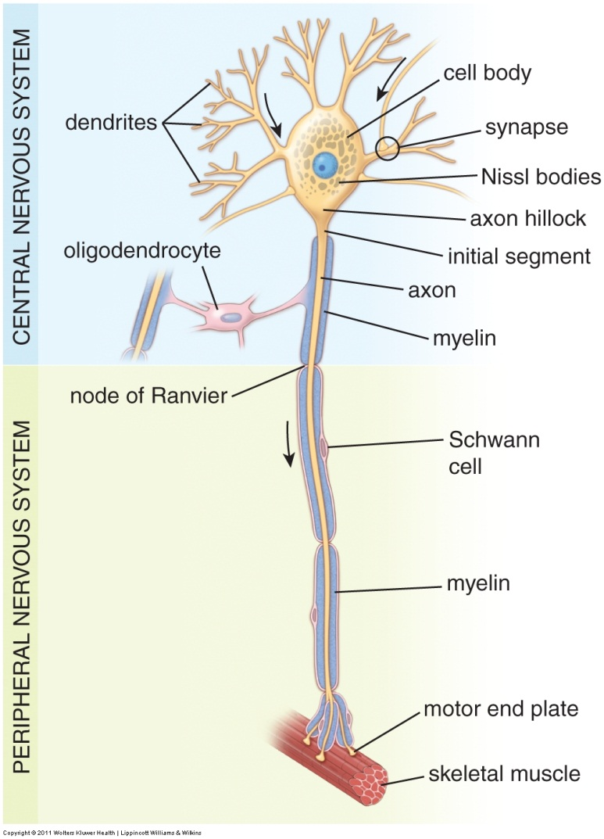
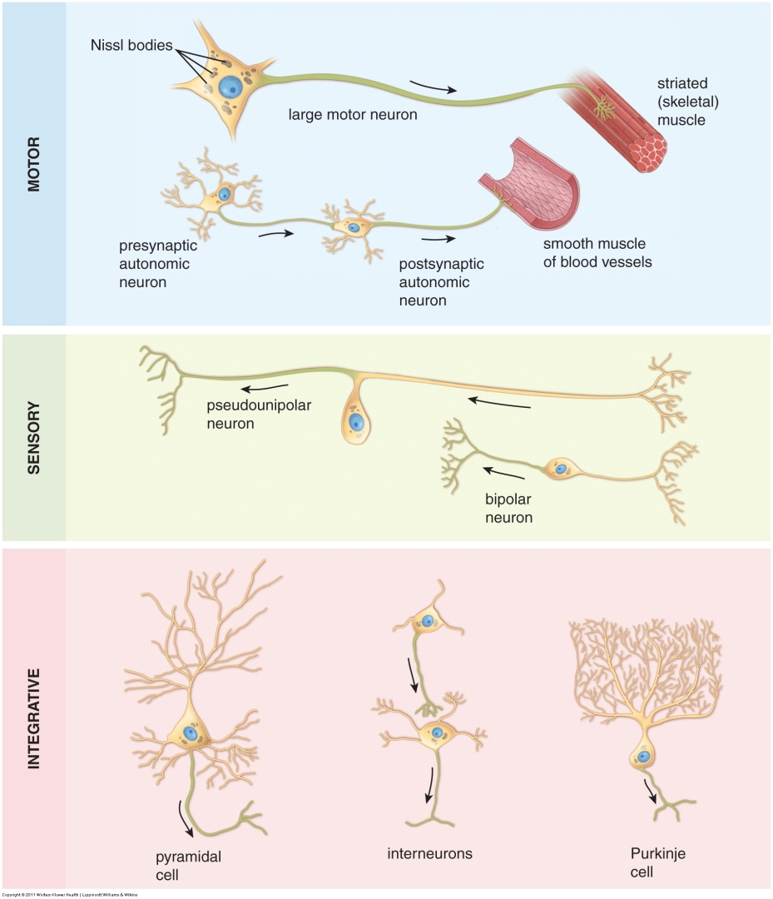
Organization of the nervous system
Illustrations of some neurons. Note the cell body, dendrites, axon. Don’t worry about the details, but appreciate the wide variety of shapes of neurons. Also, recall that glial cells (e.g. oligodendrocyte) are support cells that are found throughout the nervous system.

Slide 5
Organization of the nervous system
0
Back to this drawing, note that, for the most part, neuronal cell bodies gather together in specific locations (orange arrows), while axons (and long dendrites) gather together in others (pink arrows).
This slide only shows a few cells – obviously in real tissue, there are many cells or cell processes in each region.
Also note that in regions where cell bodies are gathered, there are also axons and dendrites that are “coming from and going to” the cell bodies.

Slide 6
0
SPINAL CORD
The first set of slides is from the spinal cord.
The spinal cord has two major regions:
--gray matter, which has neuronal cell bodies
--white matter, which has axons and long dendrites
Gray matter and white matter are shaded appropriately on this image.

Slide 7
Spinal cord – gray matter
Video of spinal cord showing gray and white matter – SL181
Link to SL 181
Be able to identify:
Gray matter
White matter
Note these are not in the objectives, but you need to do this to proceed

Slide 8
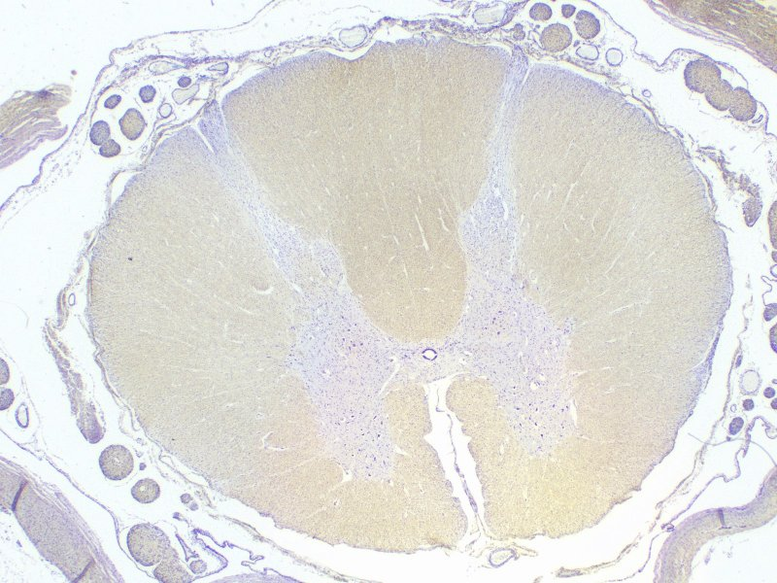
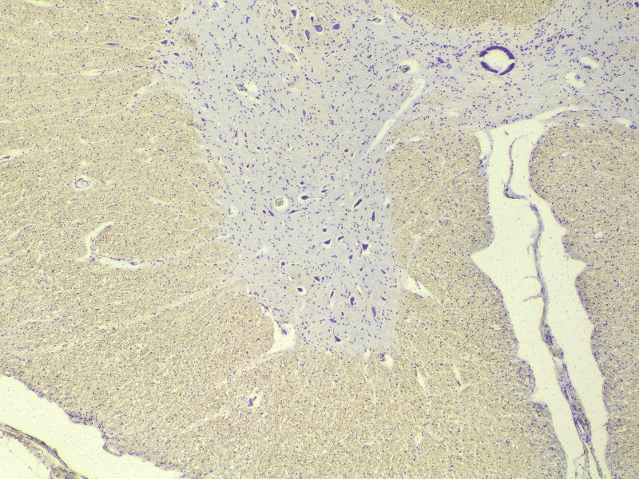
SPINAL CORD – Gray matter
We’re going to look first at large, multipolar neurons, which are neurons with an axon and several dendrites. An excellent example is the motor neurons of the peripheral nervous system, which have cell bodies located in the spinal cord.
The scanning view below shows a cross section through the spinal cord, with the grey matter (marked by dotted line), which contains the cell bodies, and the white matter, which contains bundles of myelinated axons.
The boxed area is enlarged at right. Now the large neuronal cell bodies are evident, as purple blotches (arrows indicate some examples)

Slide 9
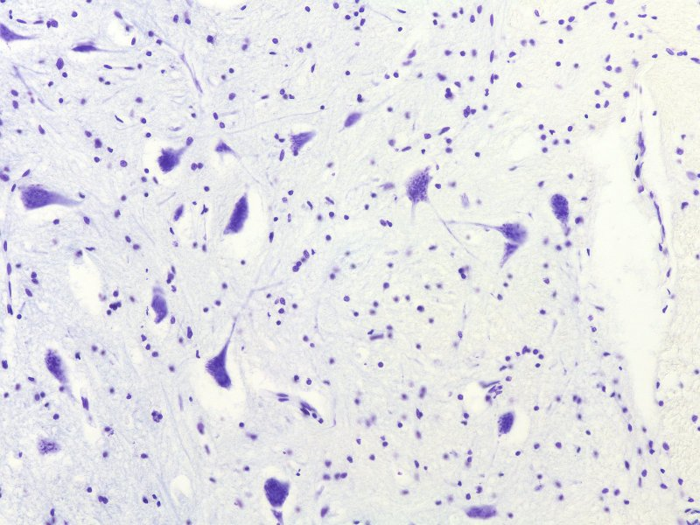
SPINAL CORD – Gray matter
This medium power view shows several multipolar motorneuron cell bodies (green arrows).
(The smaller, round nuclei (red arrows) are associated with oligodendrocytes, non-neuronal cells. Advance for a higher power view….

Slide 10
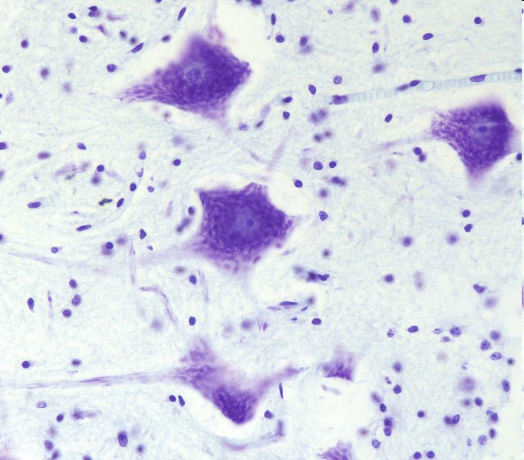
SPINAL CORD – high power view of gray matter
The nucleus of a neuron is large and round, with a prominent nucleolus (yellow arrow), and abundant euchromatin (pale area surrounding nucleolus). The black arrows delimit the nucleus.
The cytoplasm in the cell body, or perikaryon, is rich in clusters of rough endoplasmic reticulum, which in neurons are termed Nissl substance or Nissl bodies (the blue/purple flaky material).
Dendrites (green arrows) contain Nissl substance, while axons (next slide) can be recognized because they lack Nissl substance.
The small, condensed nuclei (red arrows) belong to glial cell. Their cytoplasm is either not visible or barely visible.

Slide 11
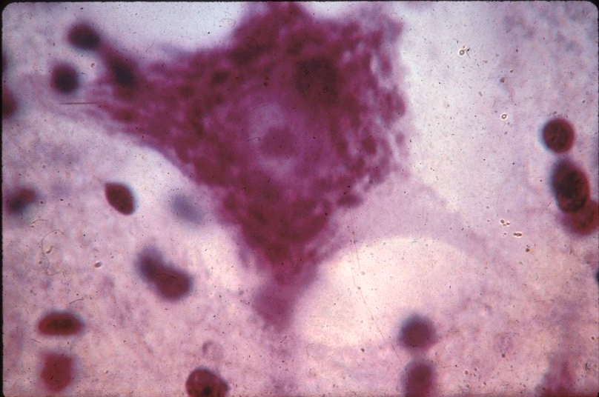
SPINAL CORD – high power view of gray matter
0
Although dendrites are easy to identify definitively because of their number and the presence of Nissl substance, axons are much more difficult to find. In this fortuitous image, an axon is indicated by the arrow. The “tapered” beginning of the axon is the axon hillock (outlined). Note the lack of Nissl substance in the axon.
Notes:
11

Slide 12
Spinal cord – gray matter
Video of spinal cord showing neuronal cell bodies and glial cells – SL181
Link to SL 181
Be able to identify:
Neuronal cell bodies
Cytoplasm with Nissl substance
Nucleus
Nucleolus
Axon
Dendrite
Glial cells

Slide 13
Spinal cord – gray matter
Video of spinal cord showing neuronal cell bodies and glial cells – SL045B
Link to SL 045B
Be able to identify:
Nothing specific, appreciate density of axons and dendrites in gray matter

Slide 14
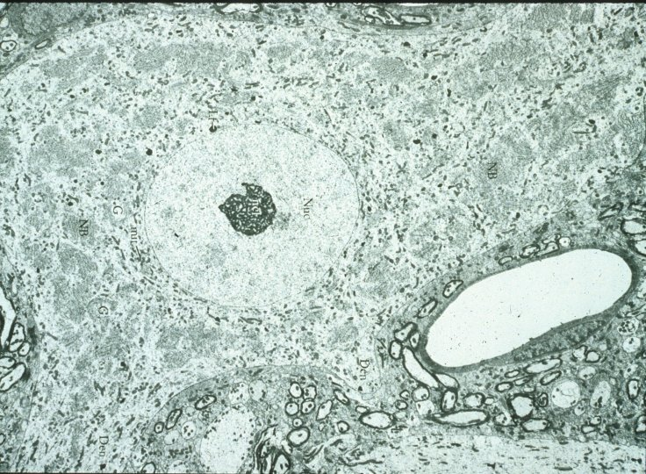
Spinal cord – gray matter
0
Nissl substance
This transmission EM shows the cell body of a motorneuron.
The small, dark, ring shapes (near the capillary, for example) are myelin sheaths surrounding neuronal processes.
Euchromatic nucleus
Nucleolus
capillary
Notes:
14

Slide 15
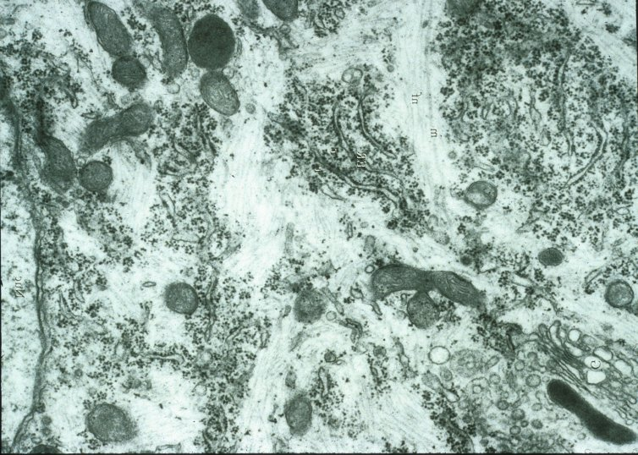
Spinal cord – gray matter
0
Nissl substance
(rER)
mitochondria
This high magnification transmission EM shows the Nissl substance (rER).
Notes:
15

Slide 16
SPINAL CORD – white matter
0
The white matter of the spinal cord (e.g. blue box) contains myelinated axons (and some dendrites) that are sending information up and down the central nervous system.
Because the fibers are oriented cranial-caudal, they are cut in cross-section in our sections of the spinal cord.

Slide 17
Spinal cord – WHite matter
Video of spinal cord showing white matter detail – SL181
Link to SL 181
Be able to identify:
Nothing, since there is not much to see in the white matter on this slide

Slide 18
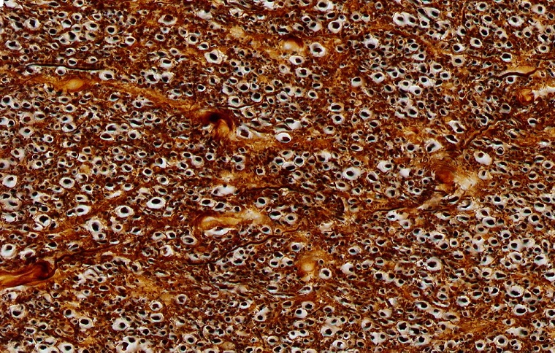
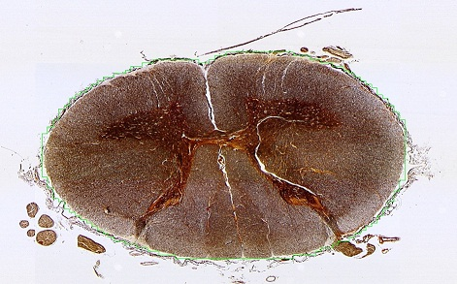
SPINAL CORD – white matter
0
Special stains can be used to visualize the components of the white matter. Here, the section was labeled with a silver stain, which stains proteins. In this section, the stain nicely highlights axons (yellow arrows), which are surrounded by pale regions representing myelin that was dissolved during preparation.

Slide 19
Spinal cord – WHite matter
Video of spinal cord showing white matter silver stain – SL045A
Link to SL 045A and SL 045B
Be able to identify:
Axons
Myelin

Slide 20
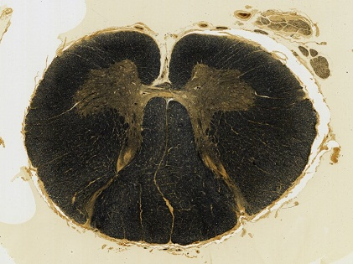
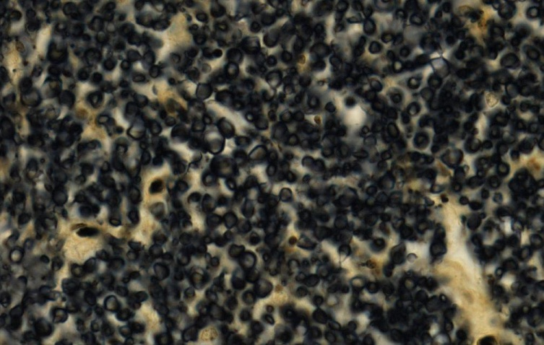
SPINAL CORD – white matter
0
Special stains can be used to visualize the components of the white matter. This slide has been carefully prepared to preserve and stain myelin (between arrows).

Slide 21
Spinal cord – WHite matter
Video of spinal cord showing white matter myelin stained – SL168
Link to SL 168
Be able to identify:
Axons
Myelin

Slide 22
Peripheral nerves
0
Nerves contain axons (and sometimes long dendrites) together with supporting cells, embedded within connective tissue and surrounded by a highly cellular connective tissue layer. Neuronal cell bodies are not found in nerves.
The diagram shows several locations where nerves can be found.
From a histological standpoint, all peripheral nerves are essentially the same, so don’t worry about whether a peripheral nerve is a dorsal root, spinal nerve, etc.

Slide 23
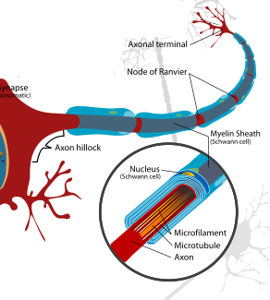
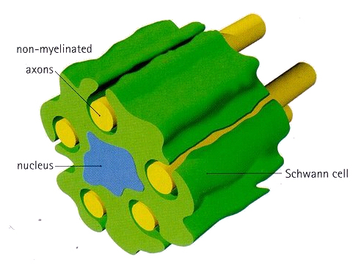
Peripheral nerves – individual axons
ensheathment
myelination
In the peripheral nervous system, individual axons (and large dendrites) are surrounded by Schwann cells. During embryogenesis, the Schwann cell initially surrounds several axons with portions of its cytoplasm and plasma membrane. This arrangement is termed ensheathment (left image, the red arrows will be explained on the next slide).
Smaller caliber axons remain ensheathed. When large axons are present, the Schwann cell selects a single axon to support, and wraps its cytoplasm and plasma membrane around the axon numerous times. After the cytoplasm is squeezed out, the remaining layers of Schwann cell membrane are called myelin. A single axon is myelinated by many Schwann cells; regions of bare axon not surrounded by myelin are called nodes of Ranvier (right image).
Notes:
23

Slide 24
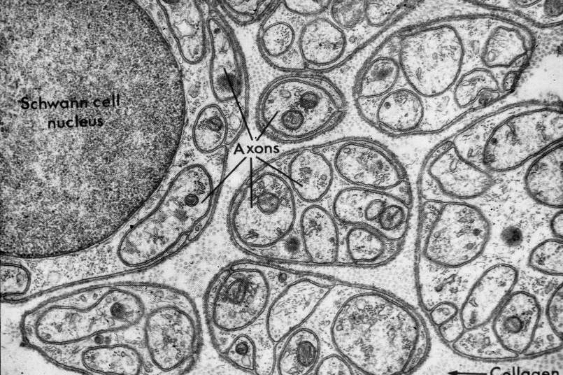
Peripheral nerves – individual axons
0
TEM of ~40 axons ensheathed by several Schwann cells. Each Schwann cell may ensheath several axons. The cytoplasm of some Schwann cells is indicated (Scc). Schwann cell nuclei may be visible, but often are out of the plane of the section.
Scc
Scc
Scc
Close observation indicates “gaps” in the Schwann cell (red arrows), indicating that the Schwann cell surrounds the axons, which remain outside the Schwann cell (see previous slide). Looking at a single axon, you see “dark-light-dark” (between green arrows) – this is actually two plasma membranes, one for the axon, one belonging to the Schwann cell. The dark-light-dark indicated by the purple arrow is actually the Schwann cell plasma membrane and its external lamina (similar to basal lamina). It might be a good idea to trace a Schwann cell plasma membrane around a few axons to help you differentiate it from the axonal membranes and from the external lamina of the Schwann cell.
The stippled structures (e.g. outlined in blue) between the Schwann cells are collagen (reticular) fibers.
Notes:
24

Slide 25
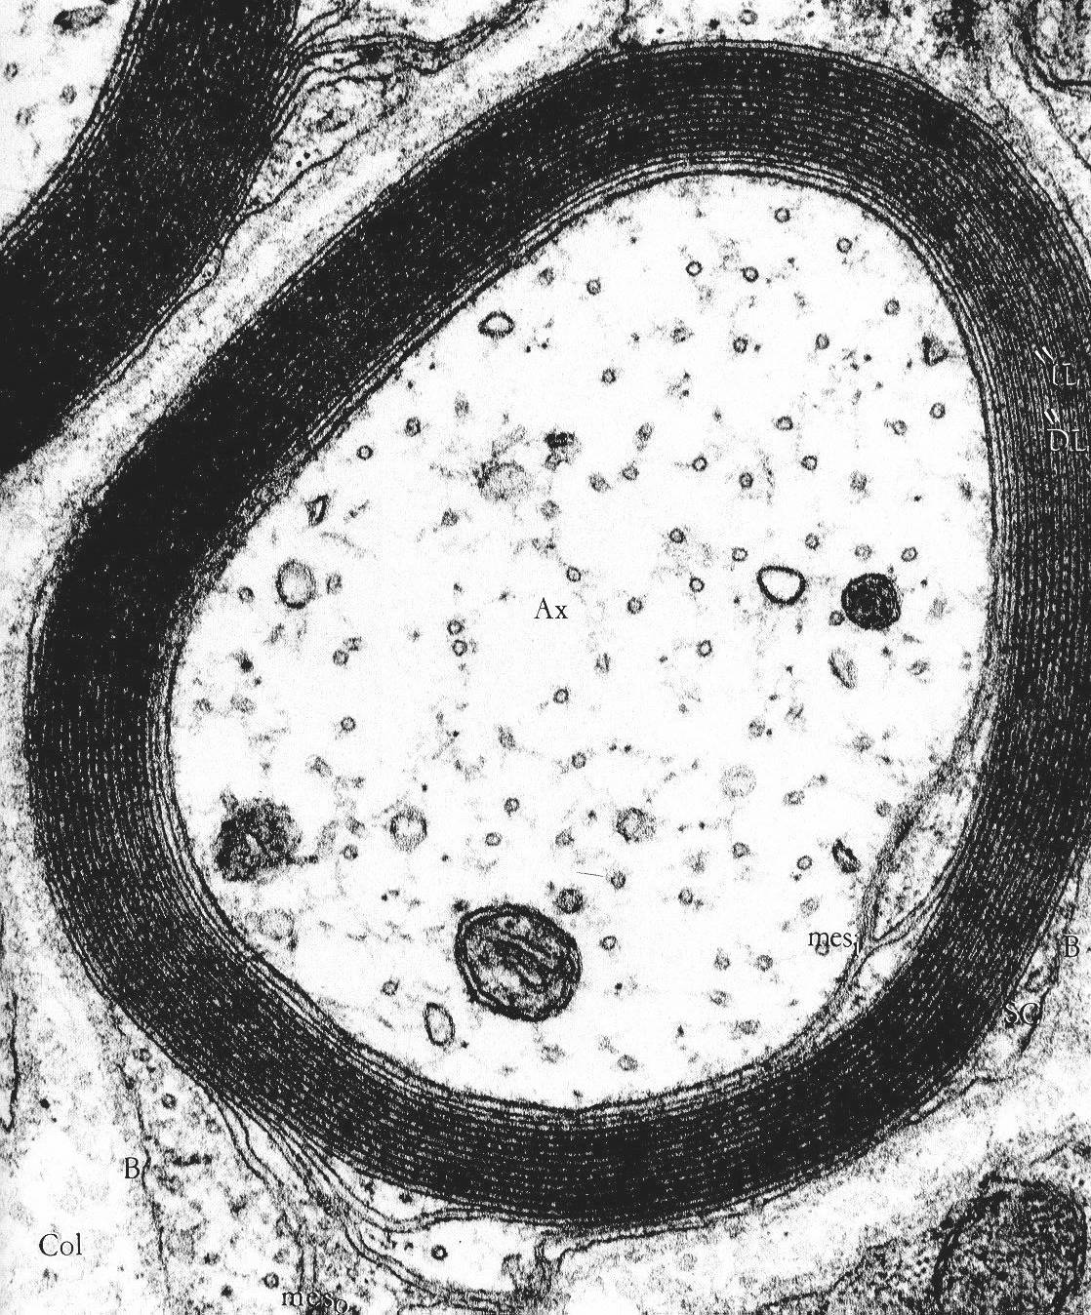
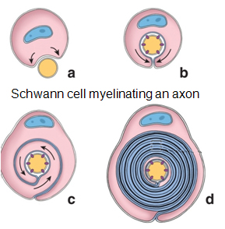
Peripheral nerves – individual axons
0
Electron micrograph of a myelinated axon (Ax) in cross-section.
The numerous membranes between the purple arrows all belong to a single Schwann cell, with the exception of the innermost one, which is the axonal membrane. The main structure of the Schwann cell, including its nucleus, is out of the plane of section; its external lamina is visible (blue arrows)
The cytoplasm of the axon contains organelles, and cross-sections of microtubules (red arrow) and neurofilaments (intermediate filaments).
Schwann cell myelinating an axon
Notes:
25

Slide 26
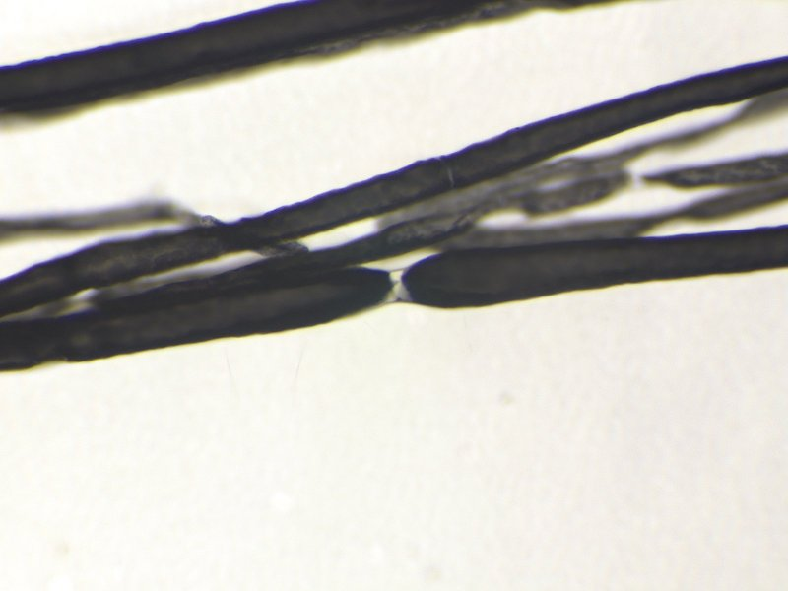
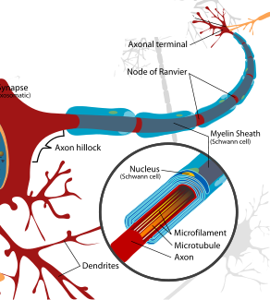
Peripheral nerves – individual axons
This light micrograph shows a longitudinal view of a nerve bundle that has been teased apart to separate individual axons, and then stained with osmium tetroxide, which labels the myelin membrane. The bare portion of one axon, a node of Ranvier, is indicated.

Slide 27
Peripheral nerves – individual axons
Video of teased nerve stained for myelin – SL044
Link to SL 044
Be able to identify:
Axons
Myelin
Node of Ranvier

Slide 28
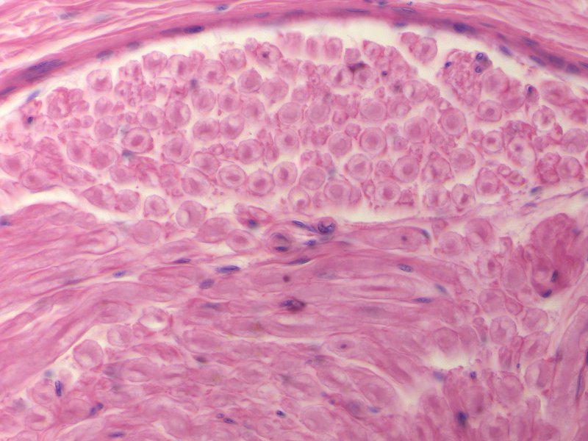
Peripheral nerves – H&E
This light micrograph shows a large nerve in H&E. The top portion of the image shows the individual nerves in cross-section, while the bottom shows them in longitudinal section. In H&E, the axons stain eosinophilic (green arrows), though they usually look a little purple. Much of the myelin washes out in tissue preparation, so the area around the axon is pale-pink (edge of the myelin indicated by the blue arrows).
Notes:
28

Slide 29
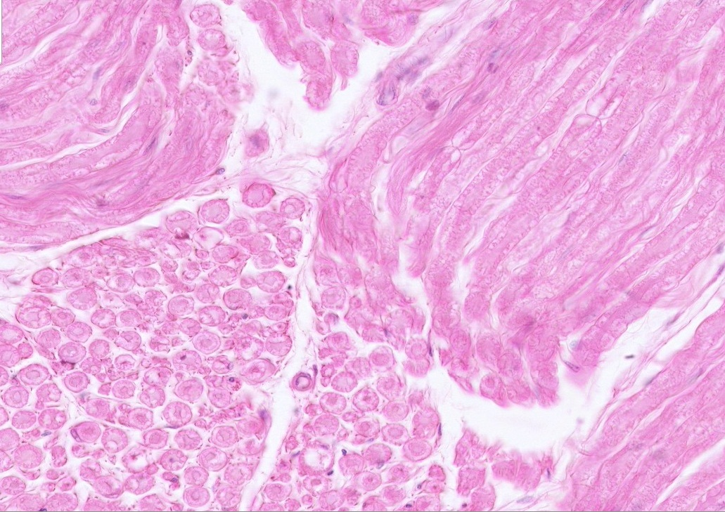
Peripheral nerves – H&E
A light micrograph similar to the previous slide, showing nodes of Ranvier (blue circles). Note the myelin tapers near the node, and that the axon is continuous through the node. So cool!!!

Slide 30
Peripheral nerves – H&E
Video of axilla showing peripheral nerves – SL12
Link to SL 012
Be able to identify:
Axons
Myelin
Node of Ranvier

Slide 31
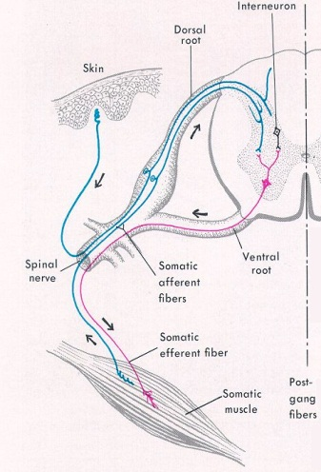
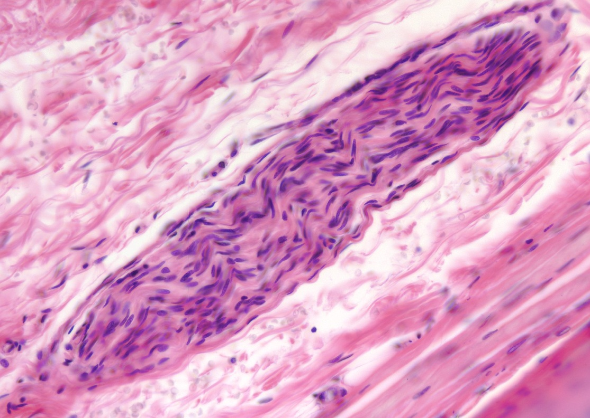
Peripheral nerves – H&E
Smaller peripheral nerves (outlined) can be found throughout the body. The details of the axon and myelin sheath are lost in nerves this size. However, several distinguishing features allow us to distinguish the nerve from the surrounding connective tissue:
pale eosinophilia - again, due to the washed out myelin
wavy appearance – nerves are elastic, and recoil on tissue preparation
a distinct perineurium (arrows) – we’ll discuss this layer later in the module
numerous nuclei – most of these are Schwann cells

Slide 32
Peripheral nerves – H&E
Video of esophagus showing peripheral nerves – SL16
Video of esophagus showing peripheral nerves – SL23
Video of lung hilus showing peripheral nerves – SL24
Video of spermatic cord showing peripheral nerves – SL47
Link to SL 016 & SL 023 & SL 024 & SL 047
Be able to identify:
Peripheral nerve

Slide 33
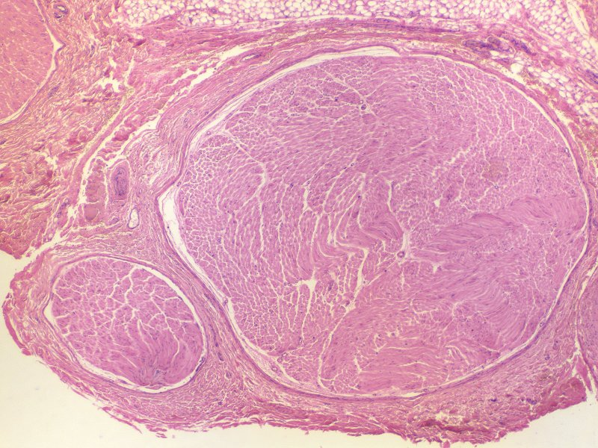
Peripheral nerves – Connective tissue organization
This is a light micrograph taken at low power from the same slide of the axilla / brachial plexus you looked at previously. For orientation, the small image to the right is the same high magnification image you saw before; the blue box indicates the position of a similar region in the larger image.

Slide 34
Peripheral nerves – Connective tissue organization
Endoneurium is throughout this region
(see next slide)
Peripheral nerves are axons bundled together by connective tissues:
endoneurium – a loose connective tissue between axons
perineurium (arrows) – a cellular layer that bundles many axons into structures called fascicles (two fascicles, one small, one large, are on this image)
epineurium (brackets) – a dense connective tissue, often containing adipose, that bundles fascicles together

Slide 35
Peripheral nerves – Connective tissue organization
Back to the high power image we looked at before, of a portion of a fascicle - you can see:
--the endoneurium (green arrows) is between the myelinated axons and is loose connective tissue
--the perineurium (between black arrows) is a highly cellular layer with scant ECM, which has some characteristic features of epithelium, including occludens junctions
--small amounts of epineurium in the upper left and right corners
Notes:
35

Slide 36
Peripheral nerves – Connective tissue organization
Video of axilla showing connective tissues of peripheral nerves – SL12
Link to SL 012
Be able to identify:
Endoneurium
Perineurium
Fascicle
Epineurium

Slide 37
Peripheral nerves – Connective tissue organization
Endoneurium is throughout here
As larger nerves, i.e. bundles of fascicles, branch, they become smaller peripheral nerves (outlined), which are essentially a single fascicle. Therefore, these contain only endoneurium and perineurium (black arrow); there is no epineurium. These fascicles are surrounded by connective tissues of the organ or structure in which they are located. The perineurium clearly delineates the peripheral nerve from the surrounding connective tissue, and is useful in distinguishing peripheral nerves from connective and other tissues you will encounter later (e.g. smooth muscle).

Slide 38
Peripheral nerves – Connective tissue organization
Video of spermatic cord showing connective tissue of peripheral nerves – SL47
Link to SL 016 & SL 023 & SL 024 & SL 047
Be able to identify:
perineurium

Slide 39
Ganglia
0
Ganglia consist of clusters of neuronal cell bodies, together with supporting cells, contained within a connective tissue capsule.
We will be looking at several different ganglia in this module. For completeness, we will indicate which ganglion is shown. Note that we do not expect you to name specific ganglia for a histology exam - just recognizing a structure as a ganglion will suffice.

Slide 40
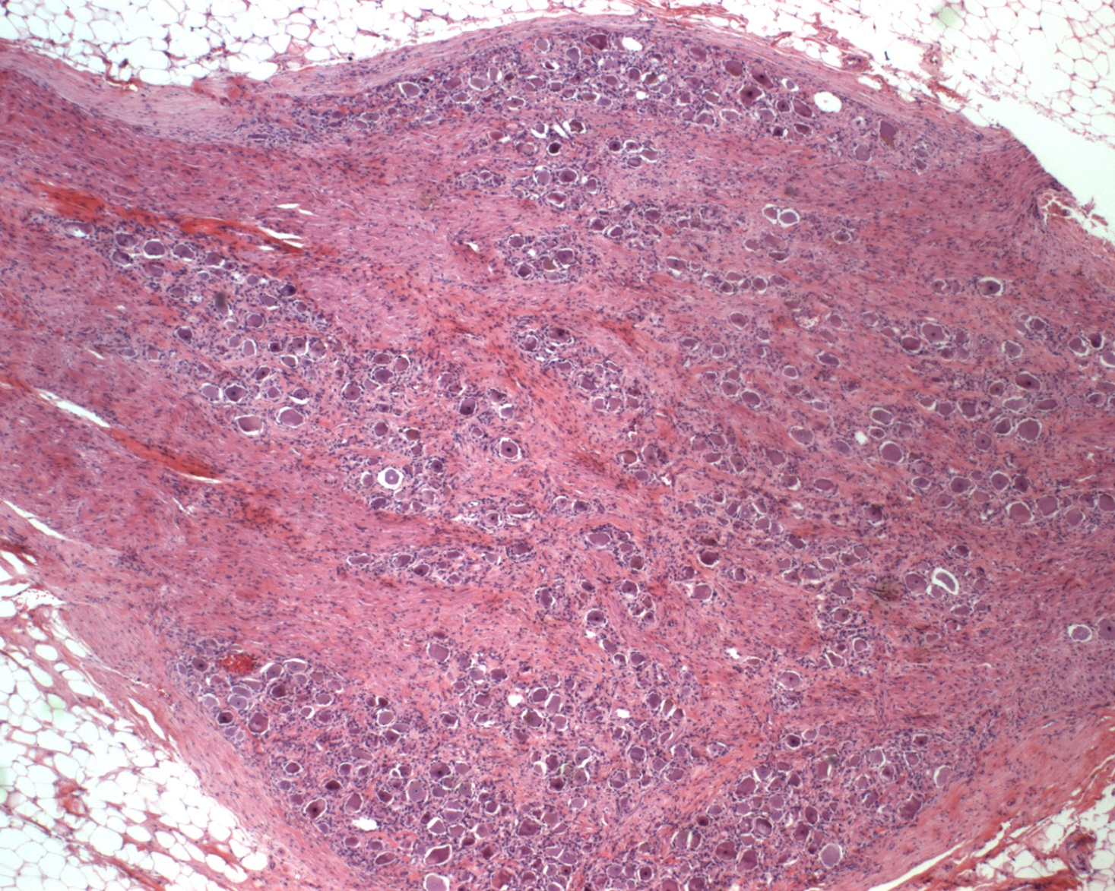
Dorsal Root Ganglion
Ganglia
This dorsal root ganglion is adjacent to the spinal cord, and contains sensory neuronal cell bodies (black arrows). In this low-power image, you can barely see the nuclei of supporting cells. Between the cell bodies are axons and dendrites. The ganglion is contained within a connective tissue capsule (blue arrows).

Slide 41
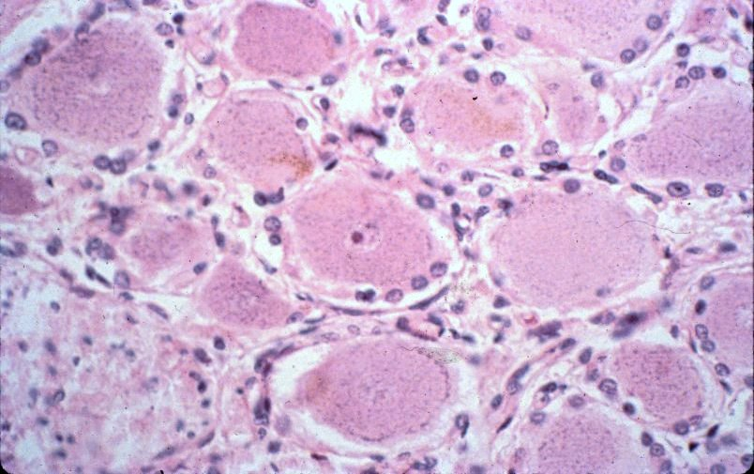
Ganglia
A high magnification image shows large neuronal cell bodies with euchromatic nuclei (black arrows mark the edge of one nucleus) and prominent nucleolus (blue arrow). The nuclei surrounding the neurons belong to supporting cells called satellite cells (green arrows). The tissue between the neurons is mostly axons and dendrites, with a small amount of loose connective tissue.

Slide 42
Ganglia
Video of dorsal root ganglion – SL50
Link to SL 050
Be able to identify:
Ganglion
Neuronal cell bodies
Satellite cells
Axons and dendrites

Slide 43
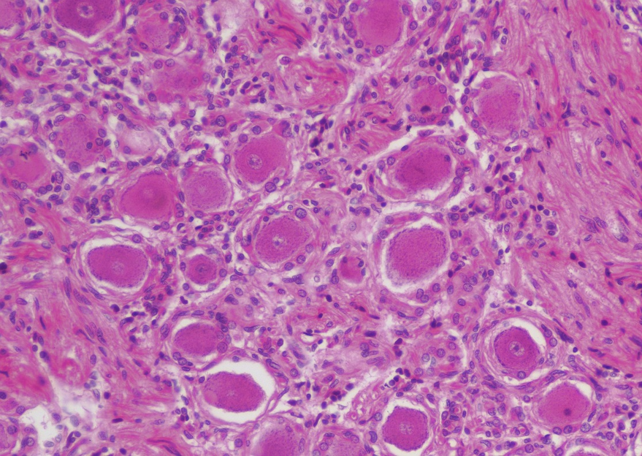
Ganglia
This is an image of the semilunar ganglion, a structure belonging to one of the cranial nerves, which is analogous to the dorsal root ganglion. Black arrows = nuclear membrane, blue arrow is nucleolus, green arrows indicate satellite cells.

Slide 44
Ganglia
Video of semilunar ganglion – SL49
Link to SL 049
Be able to identify:
Ganglion
Neuronal cell bodies
Satellite cells
Axons and dendrites

Slide 45
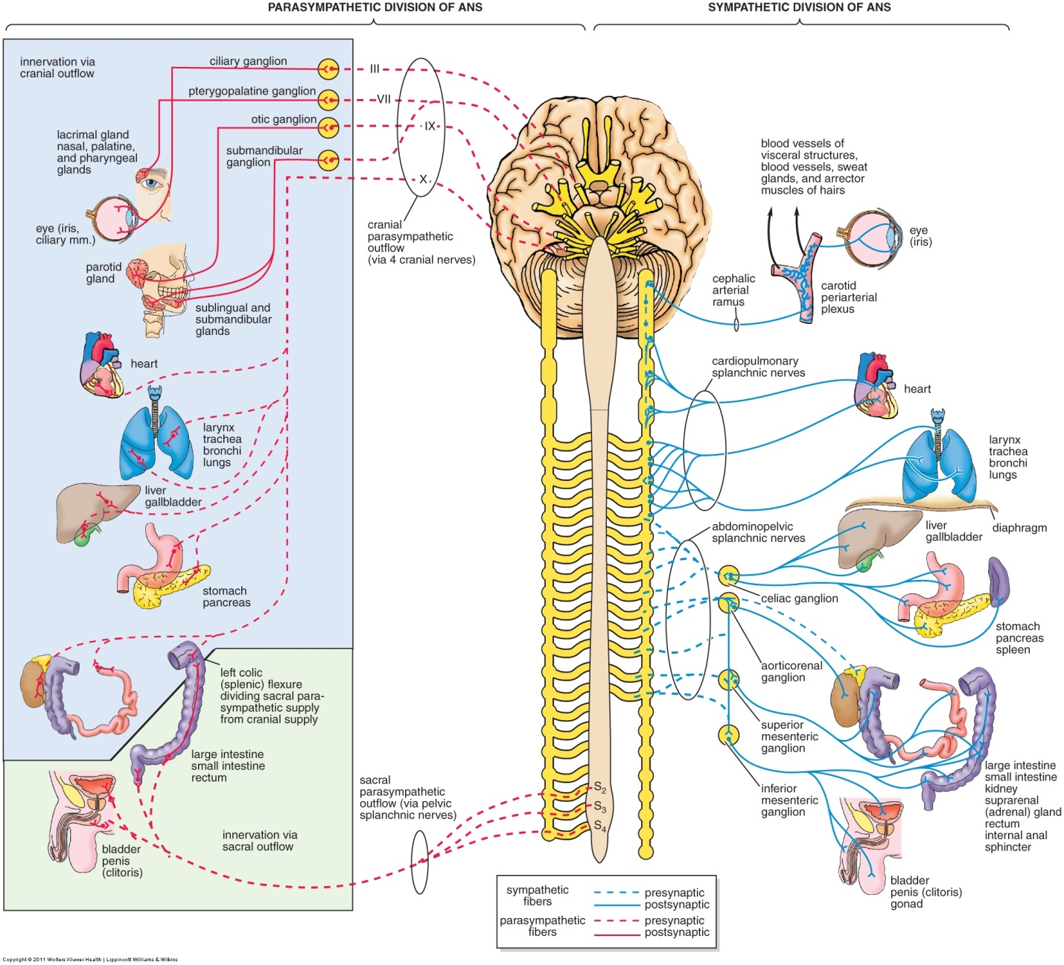
Ganglia
FYI for this module (you’ll learn more about this organization in other parts of the course)...Autonomic ganglia are located away from the central nervous system or within the wall of the organ.

Slide 46
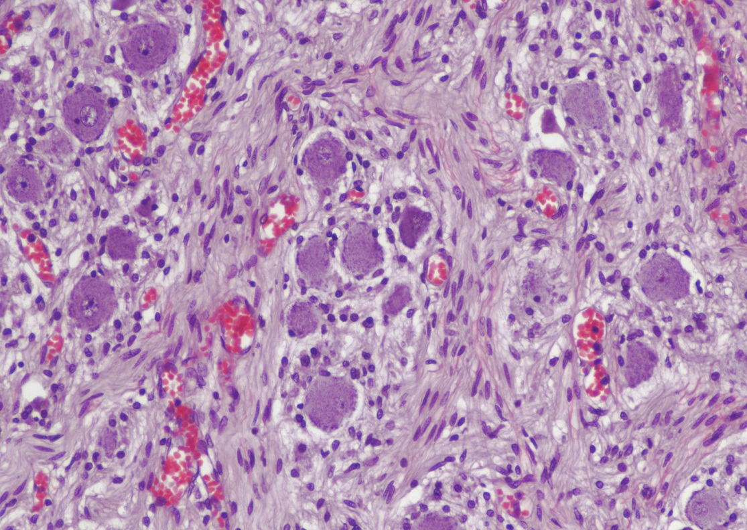
Ganglia
This is an image from a ganglion of the sympathetic chain, a structure belonging to one of the cranial nerves, which is analogous to a dorsal root ganglion. Black arrows indicate the nuclear membrane, blue arrow is nucleolus, green arrows indicate satellite cells.

Slide 47
Ganglia
Video of sympathetic ganglion – SL51
Link to SL 051
Be able to identify:
Ganglion
Neuronal cell bodies
Satellite cells
Axons and dendrites

Slide 48
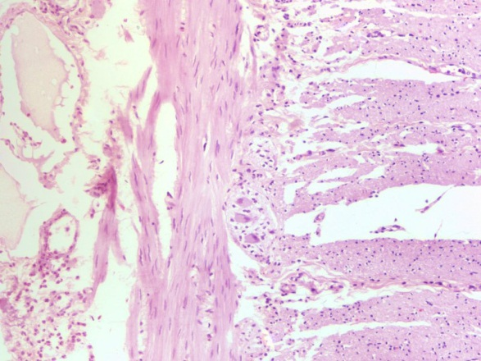
Ganglia
This is an image of a parasympathetic ganglion (between green arrows). Note the perineurium (at tips of green arrows), and the neuronal cell bodies with basophilic cytoplasm.

Slide 49
Ganglia
Video of colon showing parasympathetic ganglion – SL53
Video of jejunum showing parasympathetic ganglion – SL14
Video of esophagus showing parasympathetic ganglion – SL16
Link to SL 053 & SL 014 & SL 016 & SL 023
Be able to identify:
Ganglion
Neuronal cell bodies
Axons and dendrites

Slide 50
The next set of slides is a quiz for this module. You should review the structures covered in this module, and try to visualize each of these in light and electron micrographs.
Distinguish, at the light microscope level, each of the following components of neural tissue:
In spinal cord gray matter (note several stains were used)
Nerve cell body
Nucleolus
Nissle substance (RER)
Axon
Axon hillock
Dendrites
In spinal cord white matter (note several stains were used)
Axons and dendrites (indistinguishable)
In prepared nerve specimen
Myelinated axon
Node of Ranvier
Peripheral nerve (in any orientation)
Connective tissue of peripheral nerve
Epineurium
Perineurium
Endoneurium
Fascicle
Axon
Myelin
Schwann cell nuclei
Ganglia
Neuronal cell bodies
Satellite cells
Bundles of axons and dendrites
Distinguish, at the electron microscope level, each of the following components of neural tissue:
Peripheral nerve
Schwann cell
Myelin
Axon
Myelinated
Ensheathed (unmyelinated)
Note that the term “neural tissue” is nowhere to be found on this list, except in the headings, where a term like “epithelium” would be. Just saying.

Slide 51
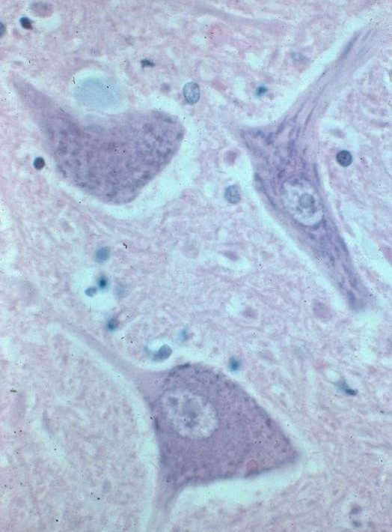
Final quiz
A
0
Identify structures A and B
A = dendrite
B = axon
What histological characteristics of this neuron reflect its high synthetic activity?
B
Abundant Nissl substance
(rER) and euchromatic chromatin
Notes:
51
51

Slide 52
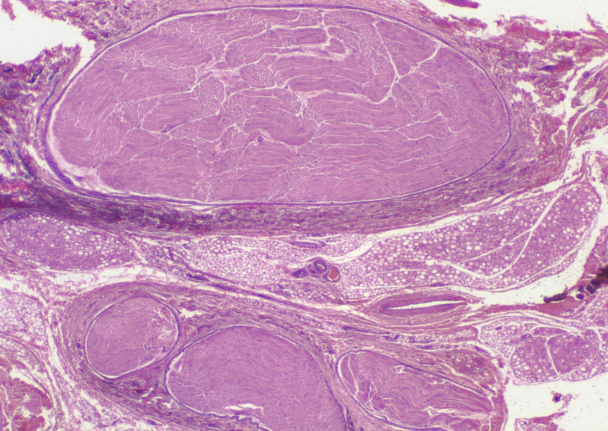
Final quiz
Self-check: Identify the outlined REGION. (advance slide for answer)
epineurium

Slide 53
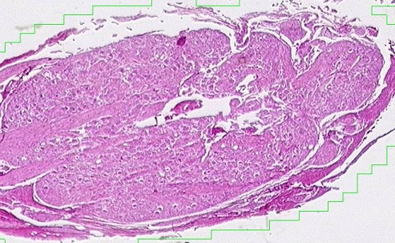
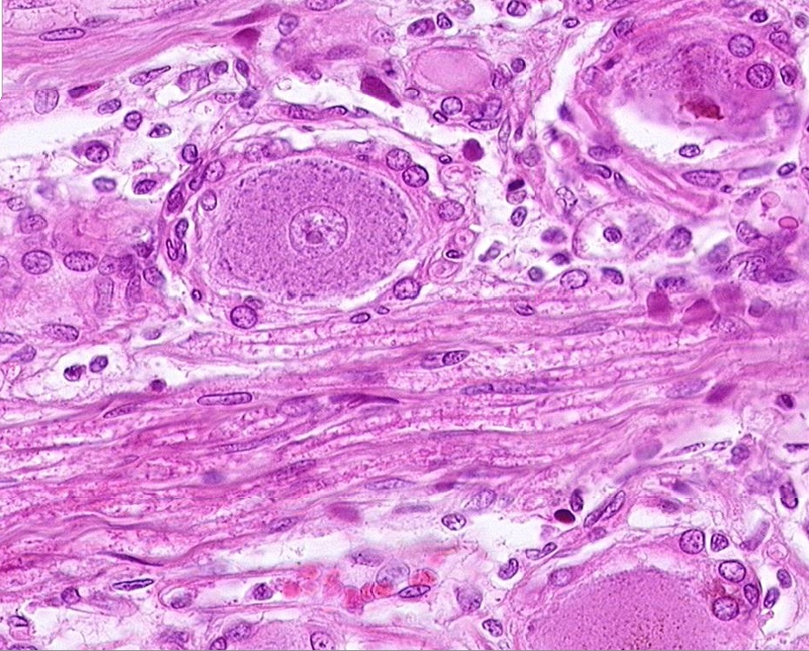
Final quiz
Self-check: Identify the structure on this slide. (advance slide for answers)
ganglion

Slide 54
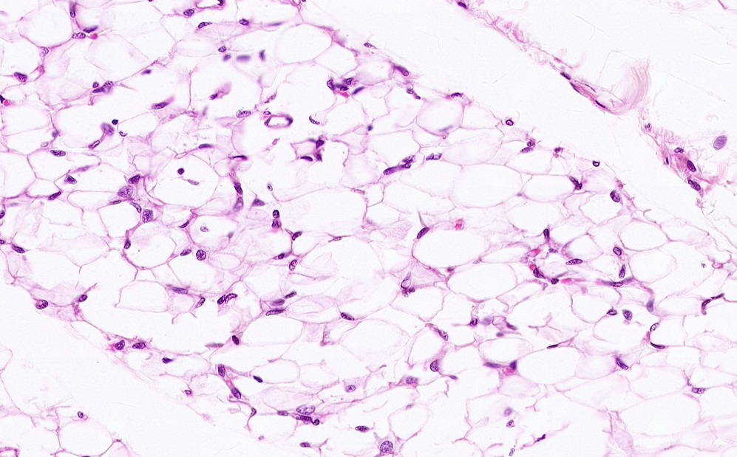
Final quiz
Self-check: Identify the tissue. (advance slide for answers)
UnilocularAdipose tissue

Slide 55
Final quiz
Self-check: Identify the structure. (advance slide for answer)
perineurium
Notes:
55

Slide 56
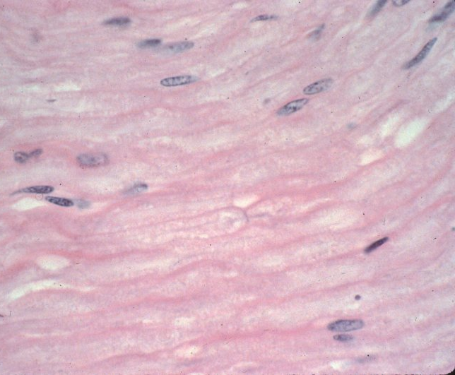
Final quiz
0
Nuclei at A might belong to what kinds of cells?
Schwann cells, fibroblasts. Less likely: endothelial cells, white blood cells. NOT neurons!
A
C
What is the structure at B?
A node of Ranvier
B
What is the dark thread-like line at C?
An axon
What occupies the space between the arrowheads?
Myelin membrane
Notes:
56

Slide 57
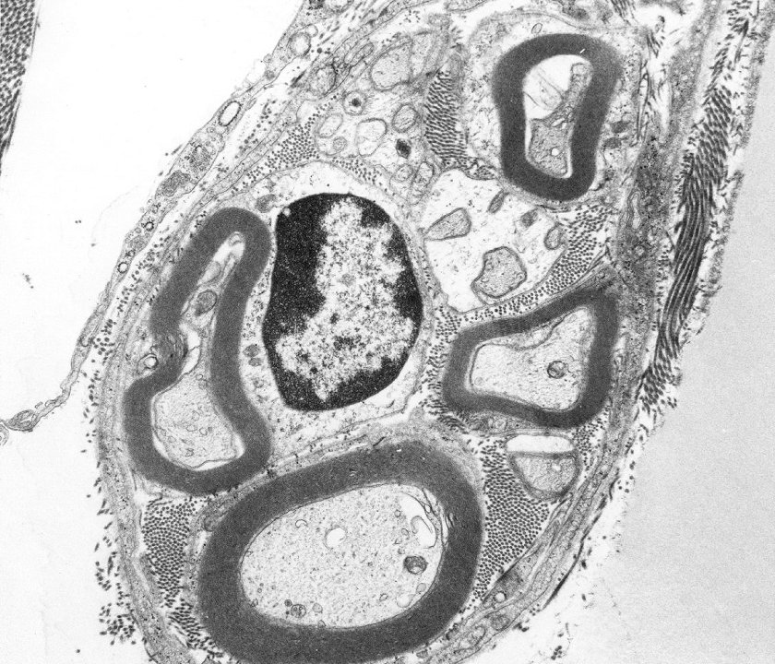
Final quiz
Self-check: Identify A-D. (advance slide for answers)
Schwann cell nucleus
Schwann cell cytoplasm
Myelinated axon
Unmyelinated axon
B
D
A
C

Slide 58
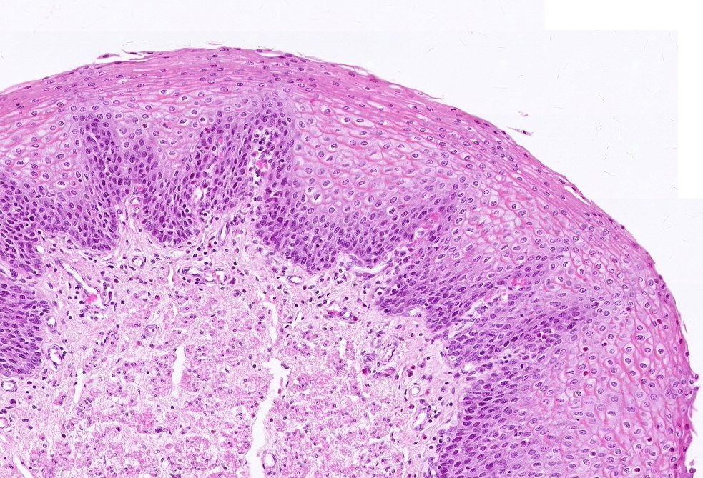
Final quiz
Self-check: Identify the tissue closest to the arrows. (advance slide for answers)
Stratified squamous (non keratinized)

Slide 59
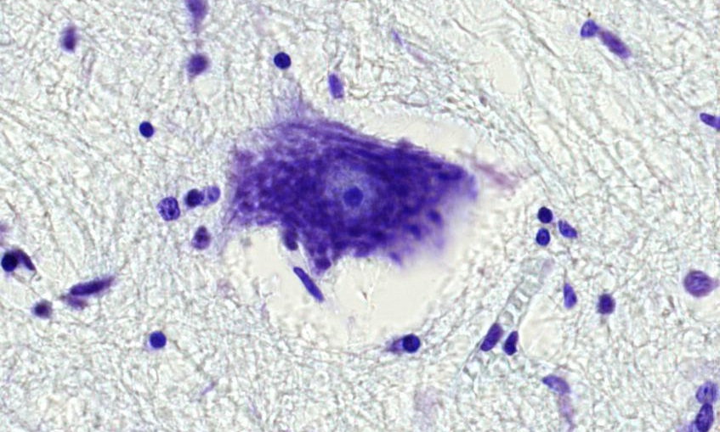
Final quiz
Self-check: Identify the structures. (advance slide for answers)
Most likely a glial cell nucleus
nucleolus
Nissl substance (rER)

Slide 60
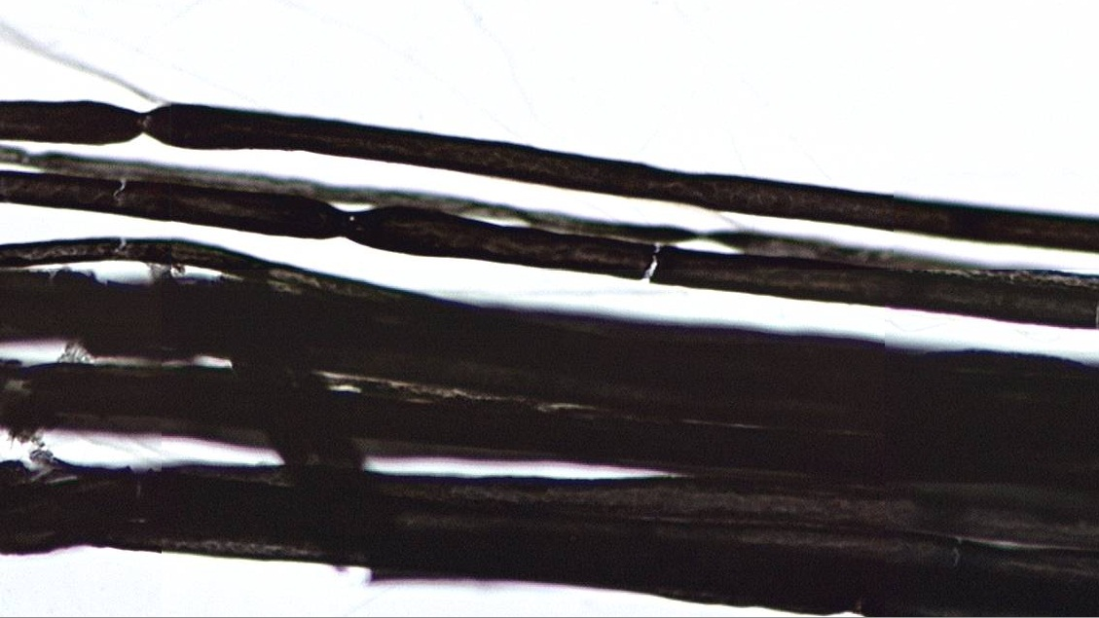
Final quiz
Self-check: Identify the structure. (advance slide for answers)
These are nodes
Artifact – broken nerve, note the right angles

Slide 61
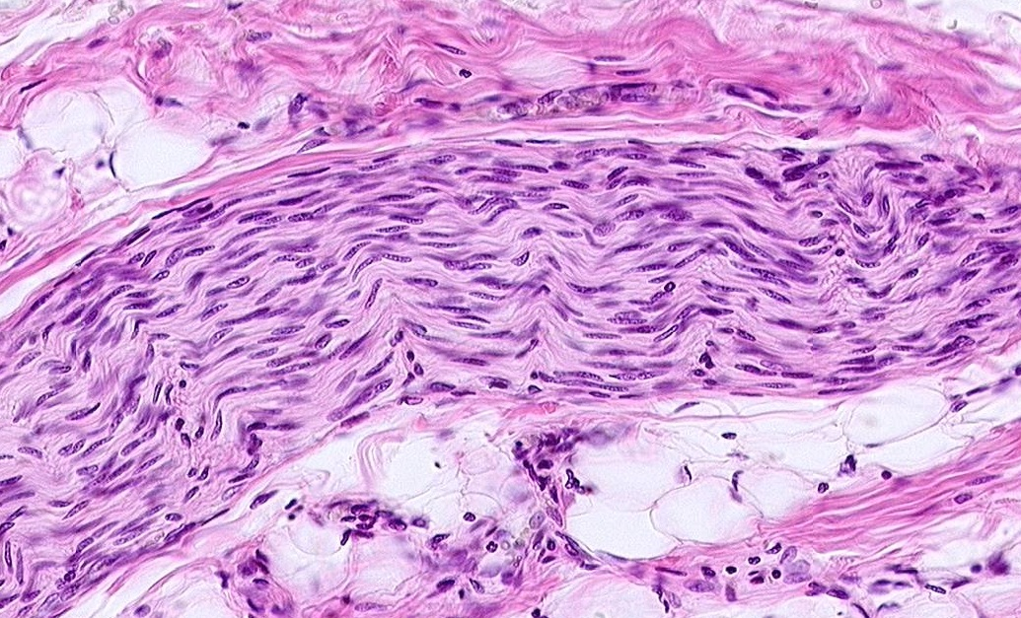
Final quiz
Self-check: Identify the structure. (advance slide for answers)
Peripheral nerve

Slide 62
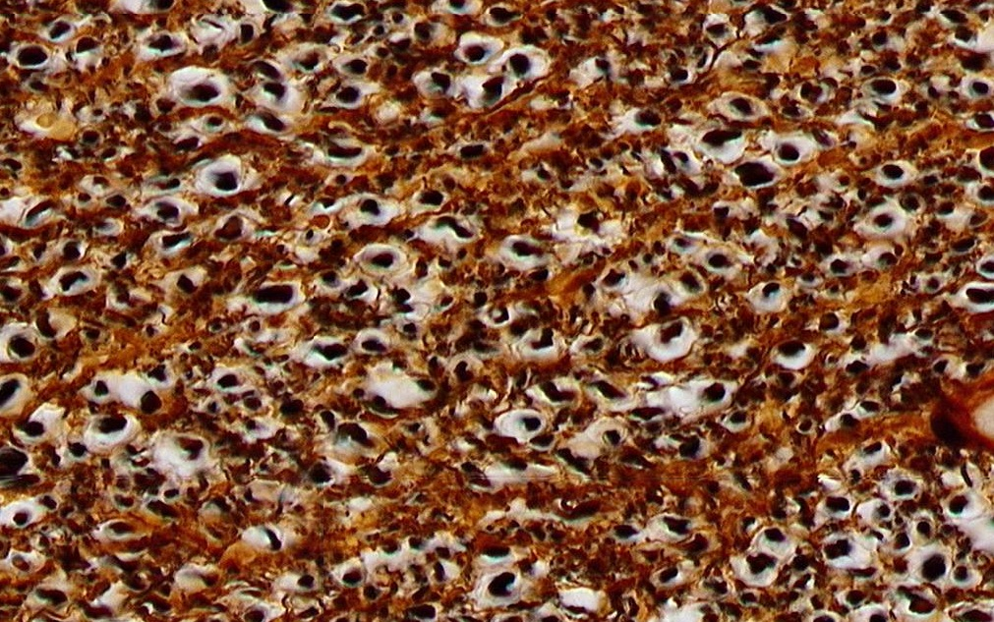
Final quiz
Self-check: Identify the structures. (advance slide for answers)
axon
myelin

Slide 63
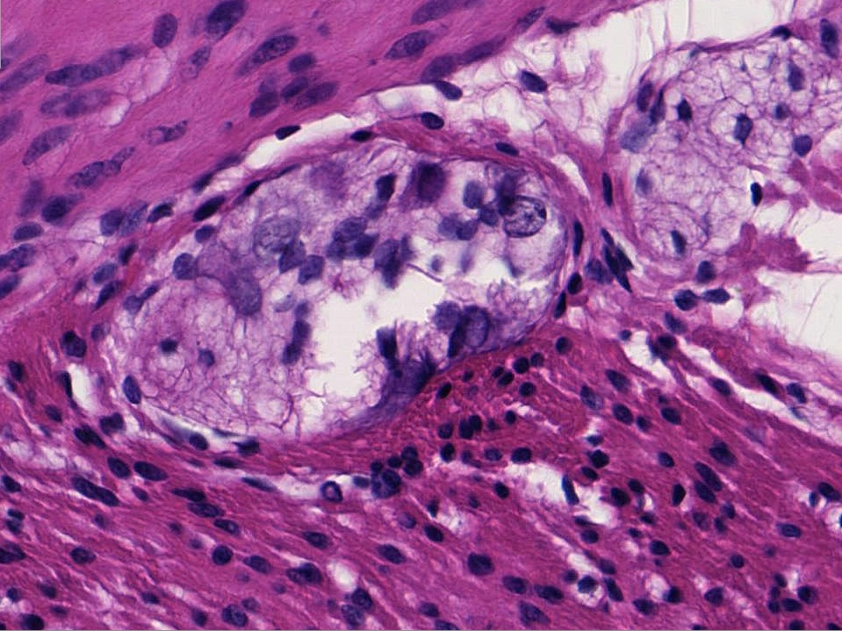
Final quiz
Self-check: Identify the structures. (advance slide for answers)
ganglion
neuron

Slide 64
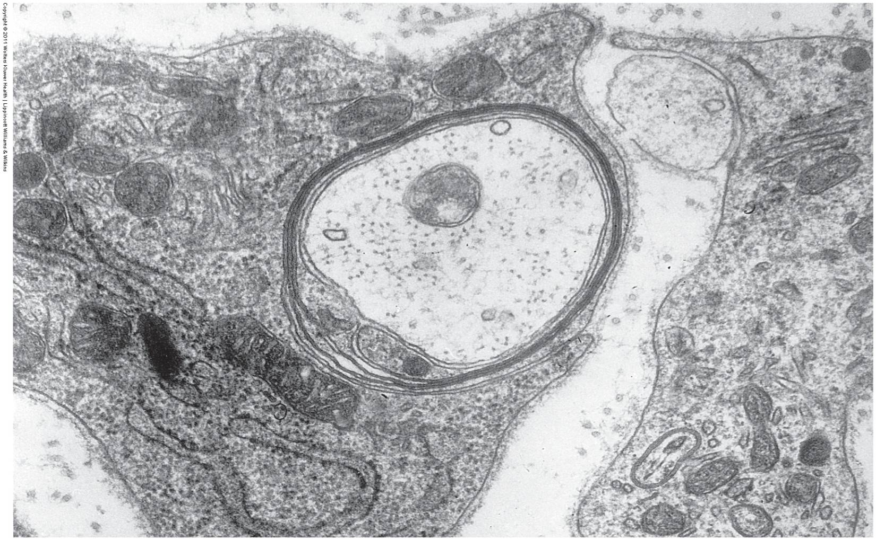
Final quiz
Self-check: Identify. (advance slide for answers)
X
Schwann cell
X
axon

Slide 65
Final quiz
Self-check: Identify the structures or cells. (advance slide for answers)
Nuclear membrane
Satellite cells
Axon or dendrite

Slide 66
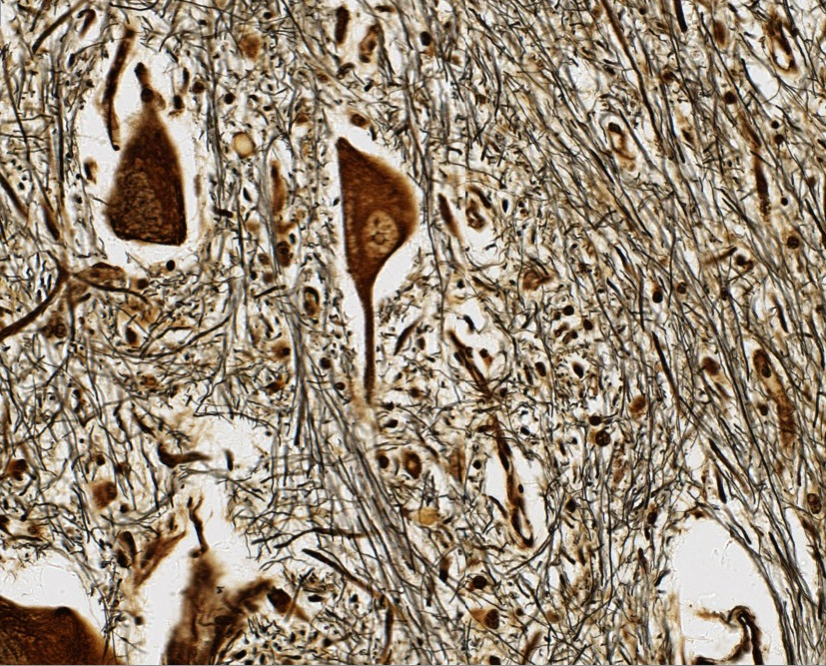
Final quiz
Self-check: Identify the structures. (advance slide for answers)
Hmmm….definitely an axon or dendrite, can’t tell which one
nucleus
Either an axon or dendrite

Slide 67
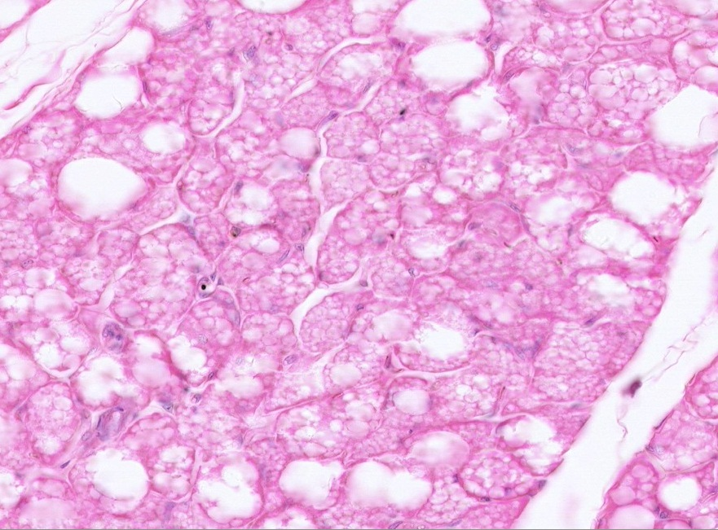
Final quiz
Self-check: Identify the outlined tissue (advance slide for answers)
Multilocular adipose

Slide 68
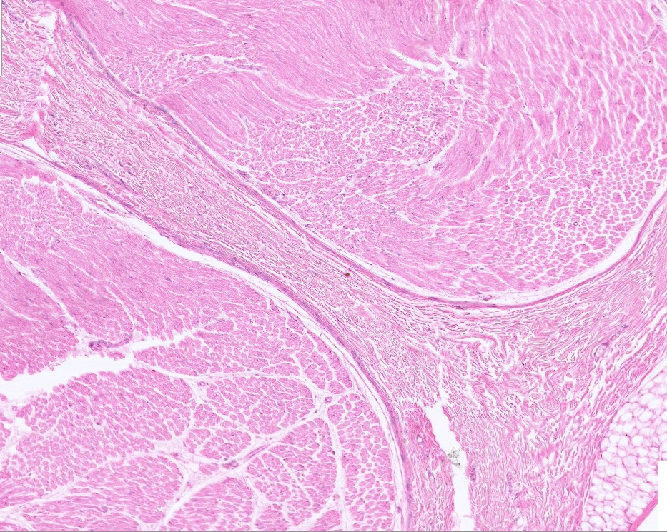
Final quiz
Self-check: Identify the structures. (advance slide for answers)
epineurium
perineurium

Slide 69
Final quiz
Self-check: Identify 1, 2, 5, 7. (advance slide for answers)
Nucleus of Schwann cell
Schwann cell cytoplasm
(cytoplasm of another Schwann cell)
Golgi
Axons or dendrites
External lamina
Collagen

Slide 70
Final quiz
Self-check: Identify the structure and cells. (advance slide for answers)
Most likely Schwann cells
ganglion
neuron

Slide 71
Final quiz
Self-check: Identify the structures. (advance slide for answers)
endoneurium
axon
axon
myelin
perineurium
epineurium

Slide 72
Final quiz
Self-check: Identify the structure. (advance slide for answers)
Peripheral nerve
Schwann cell nuclei (most likely)
perineurium

Slide 73
Final quiz
Self-check: Identify the outlined TISSUE. (advance slide for answer)
Multilocular adipose
Notes:
73

Slide 74
Final quiz
Self-check: Identify the structures. (advance slide for answers)
axon
myelin

Slide 75
Final quiz
Self-check: Identify the structures or tissues. (advance slide for answers)
Dense irregular connective tissue
Peripheral nerve

Slide 76
Final quiz
Self-check: Identify the structure. (advance slide for answers)
ganglion

Slide 77
Final quiz
Self-check: Identify all. (advance slide for answers)
Neuron, (actually touching the nucleolus)
Loose connective tissue
ganglion
Most likely Schwann cells

