Slide 1
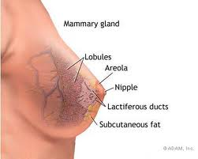
Mammary Gland
Digital Laboratory
It’s best to view this in Slide Show mode, especially for the quizzes.
This module will take approximately 45 minutes to complete.

Slide 2
After completing this exercise, you should be able to:
Distinguish, at the light microscope level, each of the following organs and their specific features:
Mammary gland
Lobes and lobules
Acini
Ducts
Stroma
Cells and structures
Secretory cells
Myoepithelial cells
(Plasma cells and other lymphocytes)
Stages
Immature / Inactive
Mammary gland of pregnancy
Lactating mammary gland
Regressing (difficult to distinguish from poorly preserved tissue)
Nipple
Lactiferous ducts / sinuses
Distinguish, at the electron microscope level, each of the following organs and their specific features:
Mammary gland
Acinar cells
Lipid product
Protein product
Myoepithelial cells

Slide 3
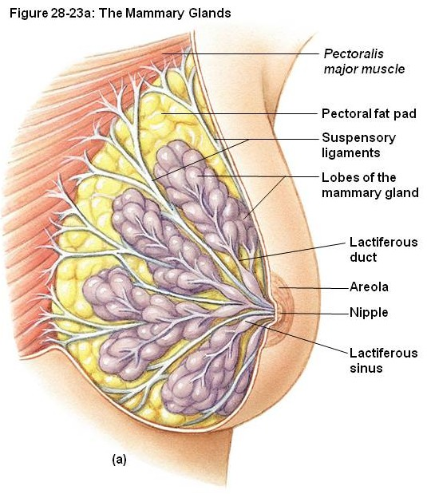
Gross anatomy of the mammary gland
Each breast contains 12-15 glands, each with a separate opening onto the nipple. The glands can be divided into lobes (blue outline) and lobules (black outline). These contain clusters of secretory cells surrounded by loose connective tissue, which lead to lactiferous ducts. Near the nipple, a dilation of the duct called the lactiferous sinus is a reservoir for milk between feedings.
The nipple is a conical elevation which contains sebaceous glands, and smooth muscle for erection.
Here we’ll look at 4 different stages of mammary gland development
Immature / inactive
Mammary gland of pregnancy
Mammary gland of breastfeeding
Regressing

Slide 4
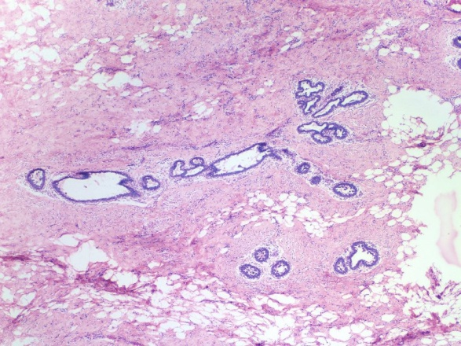
Immature mammary gland
The immature (pre-pubertal) mammary gland is mostly stroma, consisting of connective tissue mixed with some adipose tissue. There are some rudimentary ducts and secretory units.
The male and immature female mammary glands are indistinguishable.
stroma
Ducts and secretory units
stroma

Slide 5
Immature mammary gland
Video showing immature mammary gland – SL149
Link to SL 149
Be able to identify:
Immature mammary gland
Rudimentary ducts and glands
Stroma
Connective tissue (dense irregular and loose)
Adipose

Slide 6
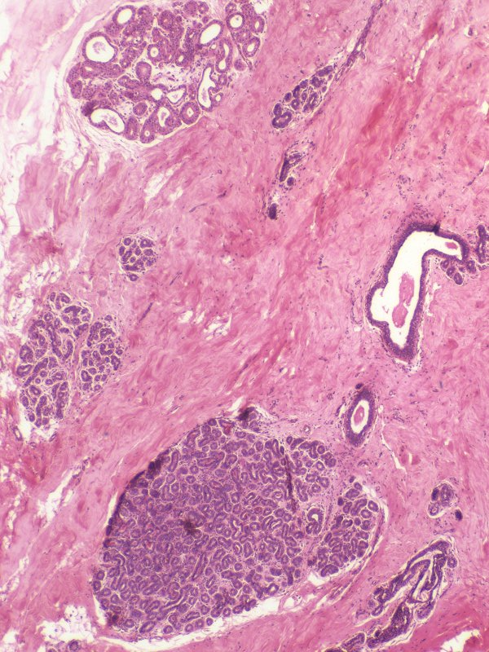
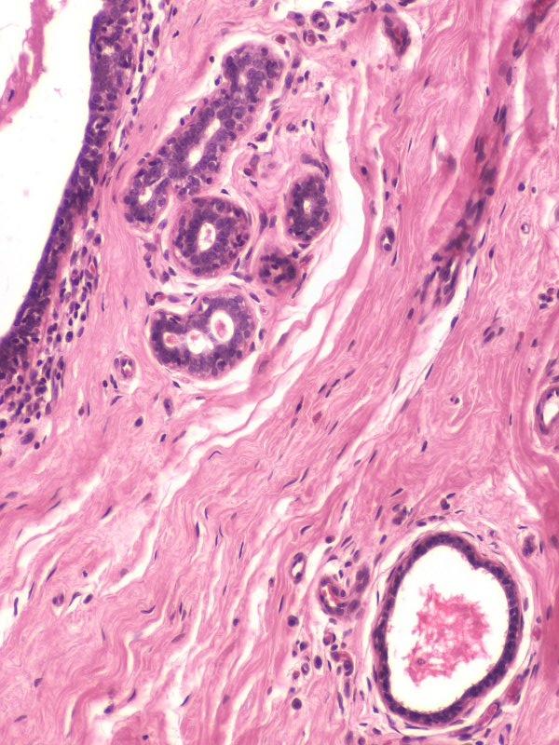
Inactive mammary gland
The inactive mammary gland in the female, post-puberty, has some elaboration of the glands and ducts. A select region showing this elaboration is shown in the left image. However, because this increase is relatively modest, most regions of the inactive mammary gland appear like the image to the right. Therefore, it is difficult to distinguish immature and inactive mammary glands with certainty.
duct
stroma
duct
stroma
duct

Slide 7
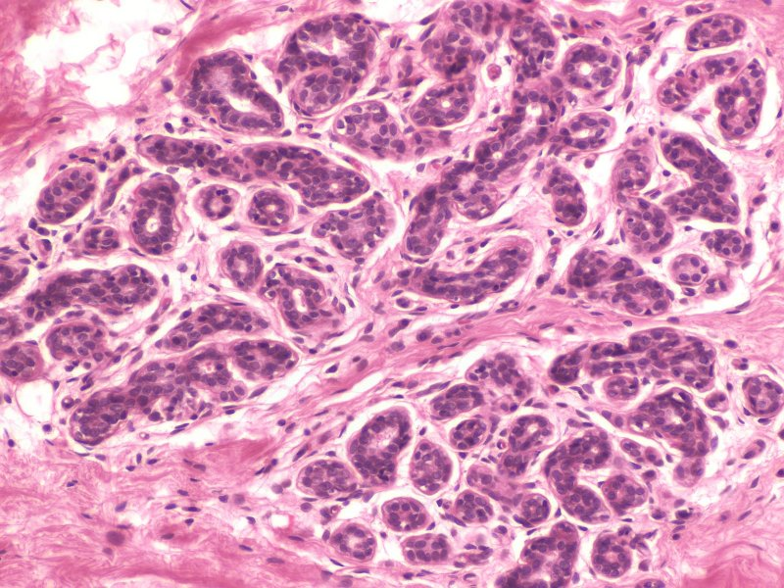
Inactive mammary gland
In this image focusing on a region of glandular tissue, note acinar secretory units (blue oval), with secretory cells. Ducts are indicated on the previous slide. The stroma at this stage is mostly loose or dense irregular connective tissue.
stroma

Slide 8
Inactive mammary gland
Video showing inactive mammary gland – SL150
Link to SL 150
Be able to identify:
Inactive mammary gland (indistinguishable from immature)
Ducts and glands
Stroma
Connective tissue (dense irregular and loose)
Adipose

Slide 9
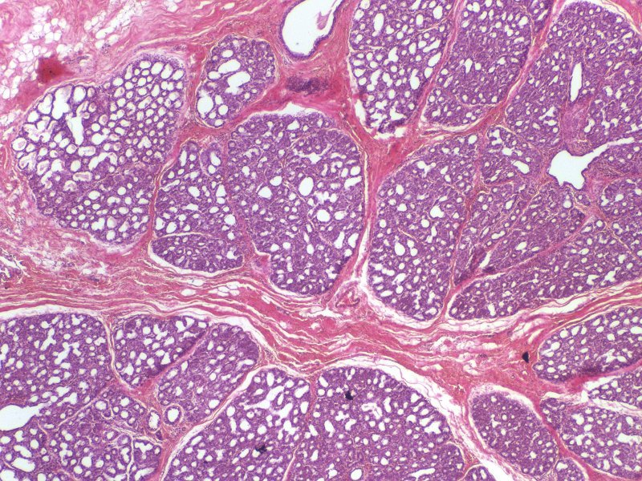
mammary gland OF pregnant woman
During pregnancy, estrogen and progesterone levels increase significantly. These hormones stimulate extensive elaboration of the ducts and glands, which replace the stromal tissue. Lobes (blue outline) and lobules (green outline) are readily apparent.
stroma
stroma

Slide 10
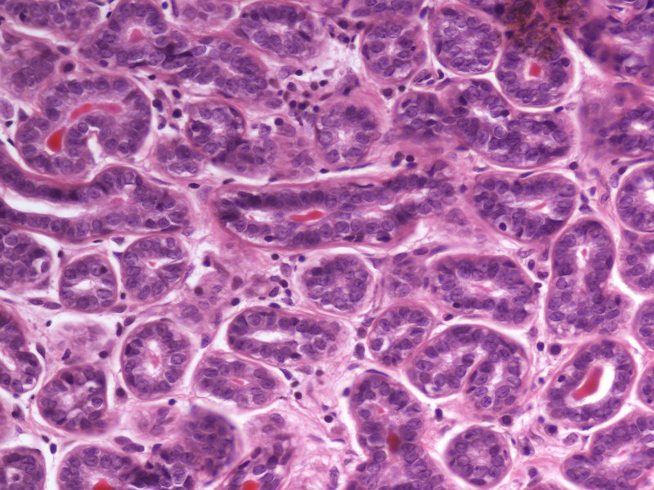
mammary gland OF pregnant woman
Enlargement of a secretory region. The acinar cells (green arrow) are cuboidal, with round nuclei and cytoplasmic basophilia. Myoepithelial cells (yellow arrows) have smaller or flattened nuclei on the epithelial side of the basement membrane (light blue arrows). Sparse connective tissue stroma is between the acini.
A pregnant woman’s mammary glands produce colostrum, which is similar to milk without the adipose, and contains a mild laxative.
stroma
stroma

Slide 11
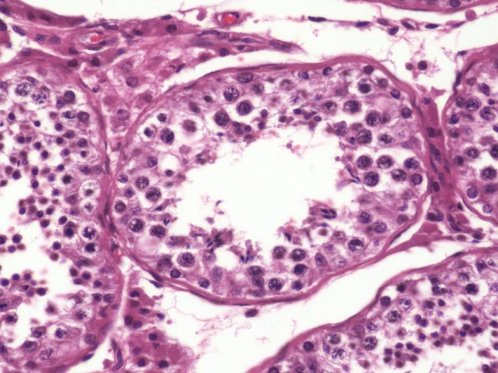
mammary gland OF pregnant woman
Myoepithelial cells of the mammary gland and myoid cells in the testes both are involved in contraction. However, the myoepithelial cells (yellow arrow) are derived from the epithelium, and, therefore, are located on the epithelial side of the basement membrane, while the myoid cells are derived from connective tissue and are positioned on the connective tissue side of the basement membrane.

Slide 12
mammary gland of pregnant woman
Video showing mammary gland of pregnancy – SL151
Link to SL 151
Be able to identify:
Mammary gland from a pregnant woman
Ducts and glands
Epithelial cells
Acinar cells
Myoepithelial cells
Stroma
Plasma cells

Slide 13
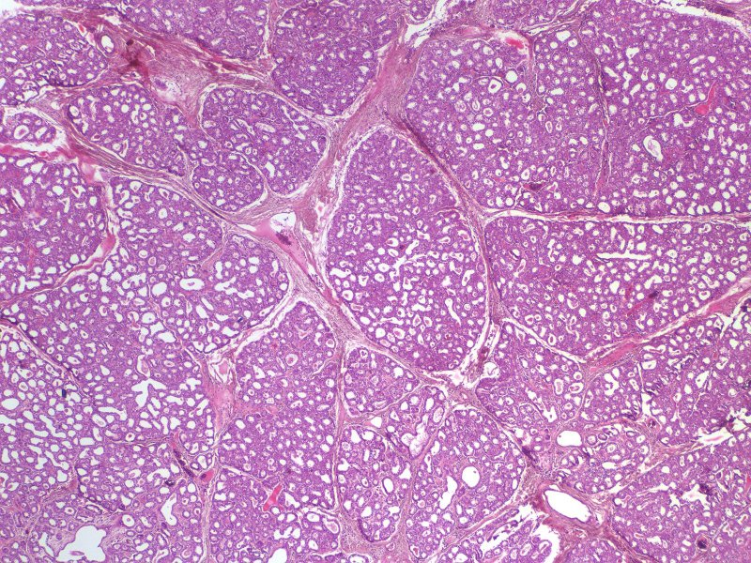
mammary gland OF lactating woman
After birth, when a woman is lactating, milk is produced. Although there is some proliferation of the ducts and glands, overall, it is often difficult to distinguish mammary glands from pregnant and lactating women based on the amount of secretory tissue.

Slide 14
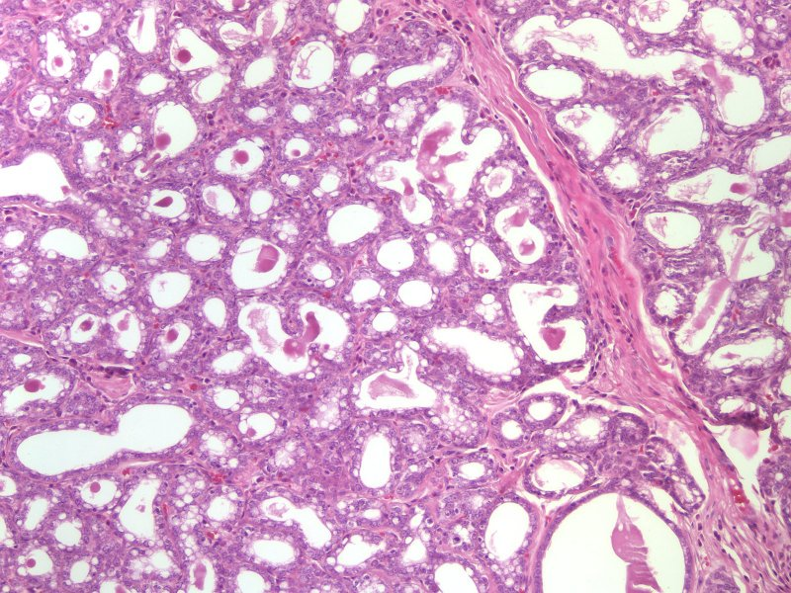
mammary gland OF lactating woman
However, lactating women produce milk, which contains substantial lipid. This is evident both within the acinar cells as well as within the lumen of the glands and ducts (arrows).

Slide 15
mammary gland OF lactating woman
Video showing mammary gland from a lactating woman – SL153
Link to SL 153
Be able to identify:
Mammary gland from a lactating woman
Ducts and glands
Epithelial cells
Acinar cells
Myoepithelial cells
Stroma
(Immune cells - you haven’t had the Infection and Immunity block yet, but you have seen plasma cells a couple times now)

Slide 16
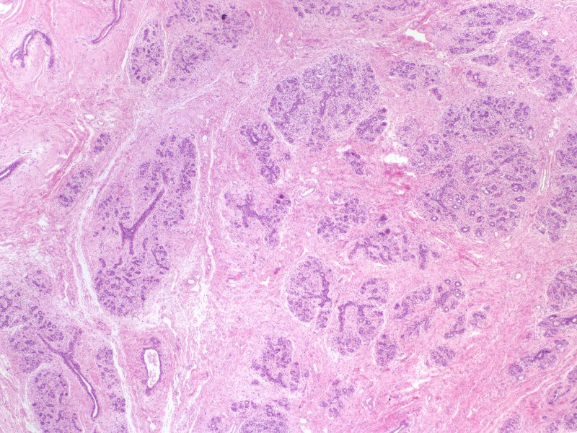
Regressing mammary
After lactation, the secretory units regress. Here, you can see the faint outlines of lobules, with sparse secretory tissue within them.

Slide 17
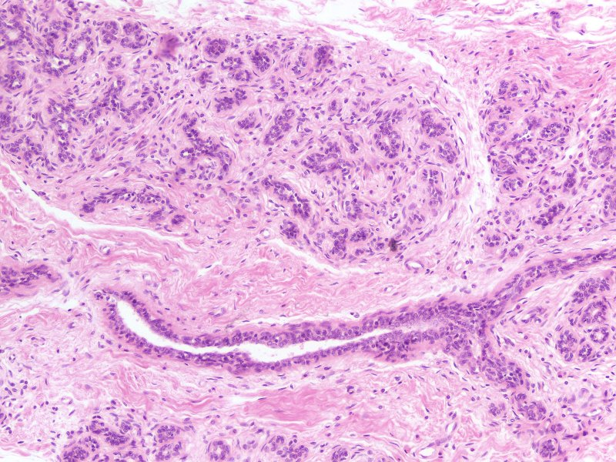
Regressing mammary
In this image taken at greater magnification, you can see the epithelial component within the lobules is being replaced by connective tissue.
Immature or inactive mammary glands do not have elaborate secretory components either. However, in this regressing tissue, you can see the remnant of the lobules – this is not the case with immature or inactive mammary glands.

Slide 18
mammary gland OF lactating woman
Video showing regressing mammary gland – SL154
Link to SL 154
Be able to identify:
Regressing mammary gland

Slide 19
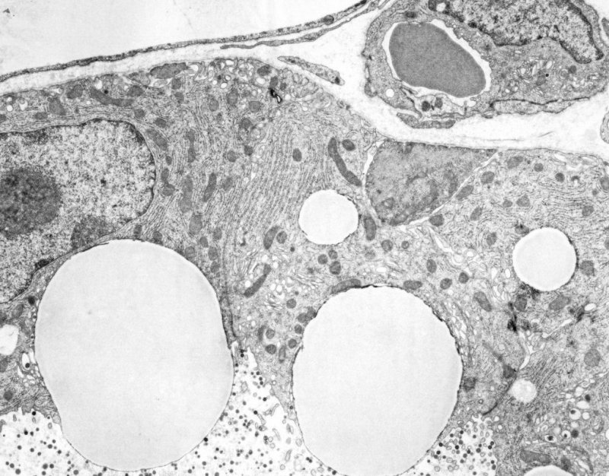
mammary gland OF lactating woman
In this electron micrograph taken from the mammary gland of a lactating woman, 2-3 acinar cells are shown. The lumen is toward the bottom, and the stromal connective tissue is at the top. Note large lipid droplets (L), rough endoplasmic reticulum (red outline), milk proteins in lumen (red arrows), and myoepithelial cell (M).
Red blood cell
Endothelial cell of blood vessel
M
L
L

Slide 20
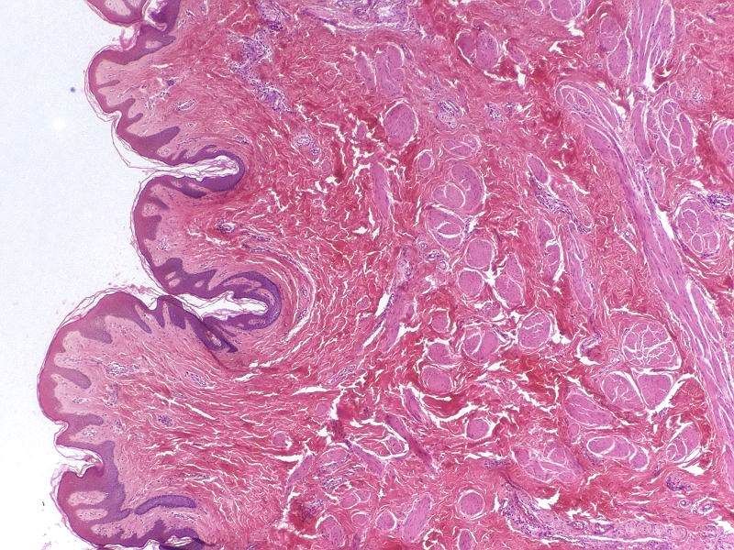
Nipple
In this image taken from the nipple, note the surface stratified squamous keratinized epithelium (black arrows), dense irregular connective tissue (green arrows), and smooth muscle (yellow arrows).

Slide 21
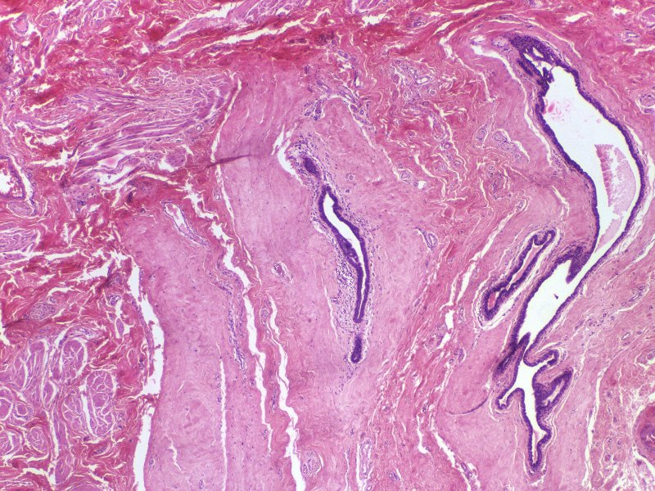
Nipple
In this image of the same slide in the region just underneath the epithelium, you can see dense irregular connective tissue (green arrows), and smooth muscle (yellow arrows). The lactiferous sinuses (black arrows) have fairly dense connective tissue surrounding them.

Slide 22
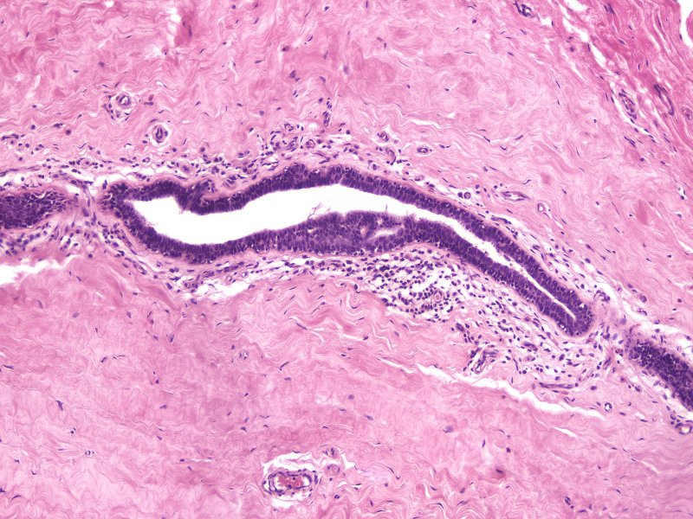
Nipple
This is a high power image of a lactiferous sinus. Note the stratified cuboidal / stratified columnar epithelium supported by dense irregular connective tissue.
Your objectives ask you to identify lactiferous ducts. The histology of the ducts and sinuses is the same, the difference is in the diameter of the lumen. However, we do NOT expect you to make that call to distinguish the two.

Slide 23
Nipple of breast
Video showing nipple of breast – SL155
Link to SL 155
Be able to identify:
Nipple
Stratified squamous keratinized epithelium
Smooth muscle
Lactiferous ducts

Slide 24
The next set of slides is a final quiz for this module. You should review the structures covered in this module, and try to visualize each of these in light and electron micrographs.
Distinguish, at the light microscope level, each of the following organs and their specific features:
Mammary gland
Lobes and lobules
Acini
Ducts
Stroma
Cells and structures
Secretory cells
Myoepithelial cells
(Plasma cells and other lymphocytes)
Stages
Immature / Inactive
Mammary gland of pregnancy
Lactating mammary gland
Regressing (difficult to distinguish from poorly preserved tissue)
Nipple
Lactiferous ducts / sinuses
Distinguish, at the electron microscope level, each of the following organs and their specific features:
Mammary gland
Acinar cells
Lipid product
Protein product
Myoepithelial cells

Slide 25
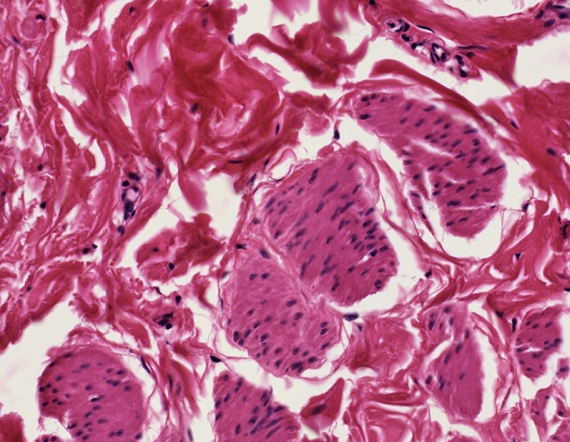
QUIZ
Self-check: Identify the TISSUES in the outlined regions. (advance slides for answers)
Dense irregular connective tissue
Smooth muscle

Slide 26
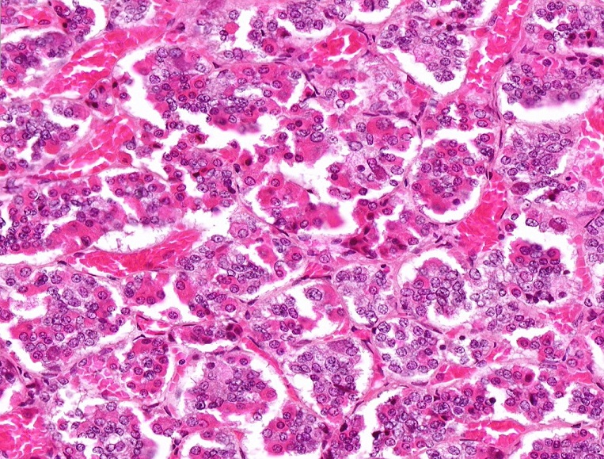
QUIZ
Self-check: Identify. (advance slides for answers)
Anterior pituitary gland

Slide 27
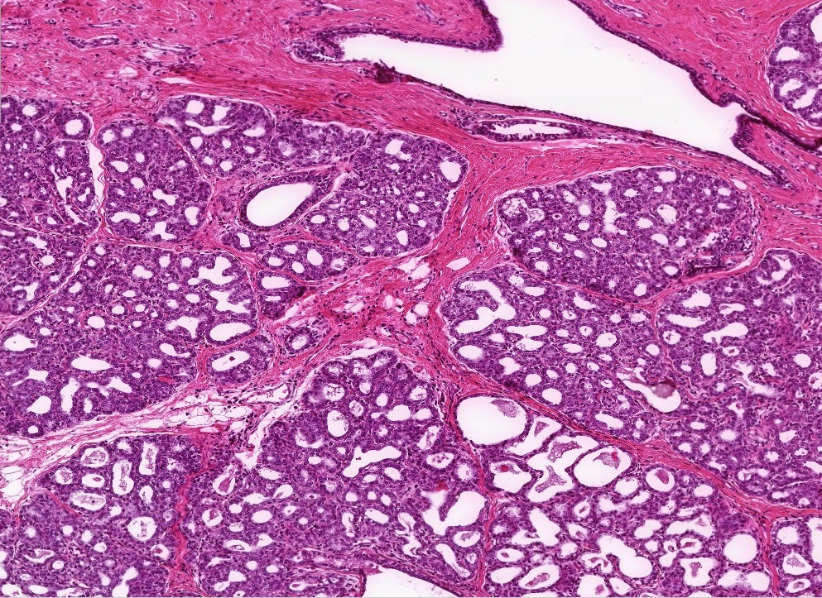
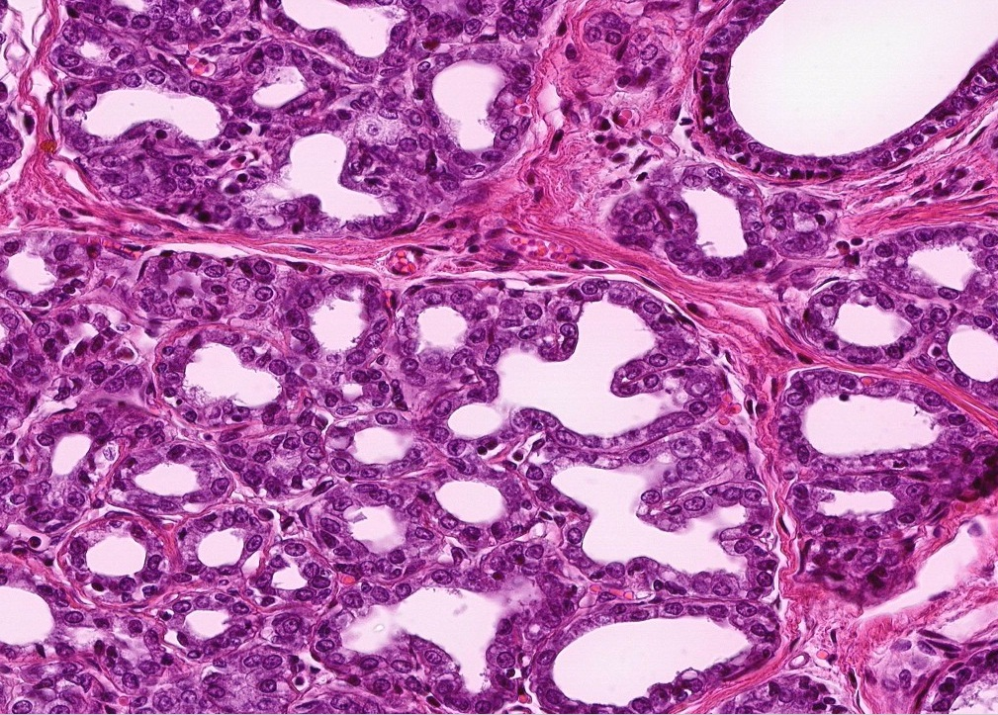
QUIZ
Self-check: Identify. (advance slides for answers)
Mammary gland of pregnancy

Slide 28
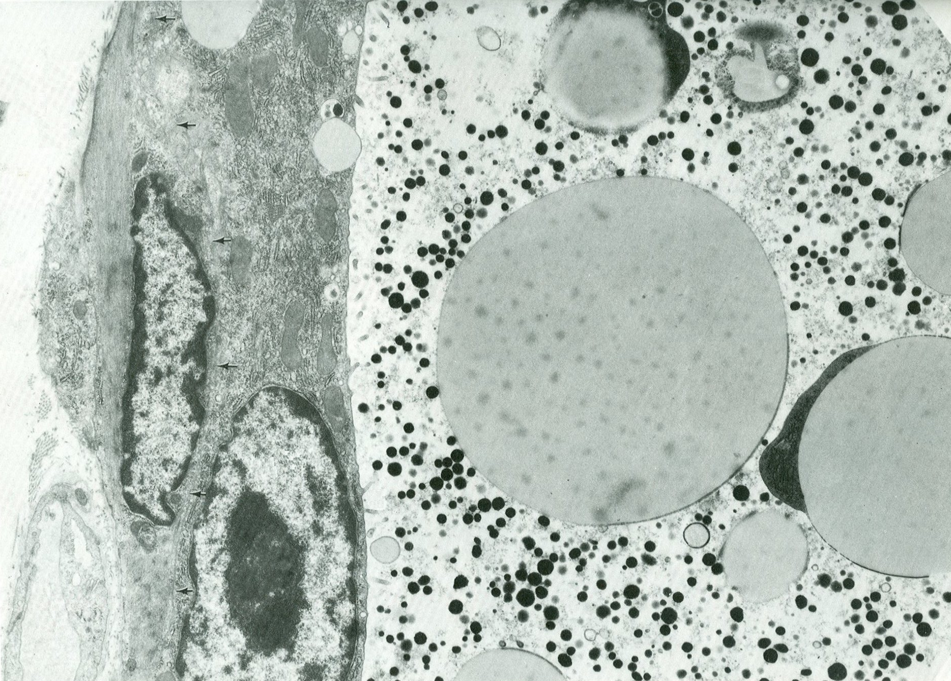
QUIZ
Self-check: Identify cells X and Y, and substances A and B. (advance slides for answers)
X = myoepithelial cell
Y = acinar cell
A = lipid droplets
B = protein
A
B
A
X
Y

Slide 29
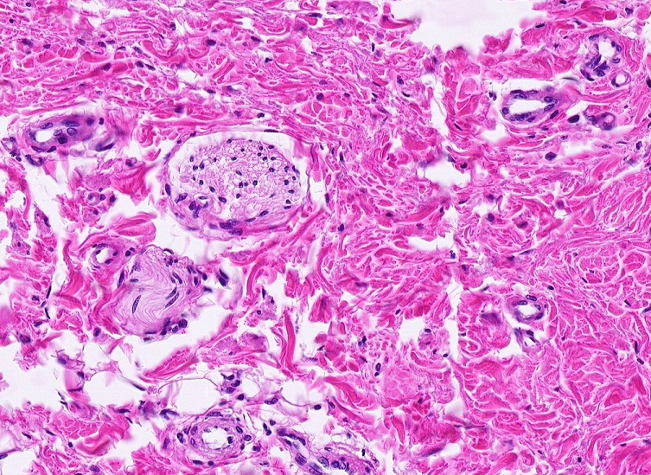
QUIZ
Self-check: Identify the structures in the outlined regions. (advance slides for answers)
Peripheral nerves

Slide 30
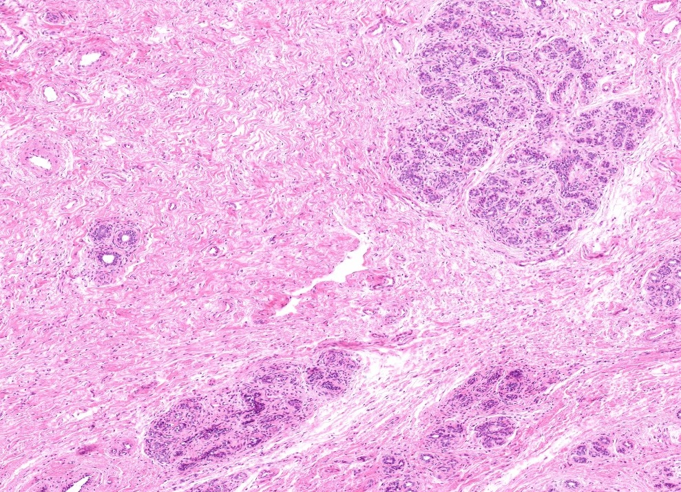
QUIZ
Self-check: Identify. (advance slides for answers)
Regressing mammary gland

Slide 31
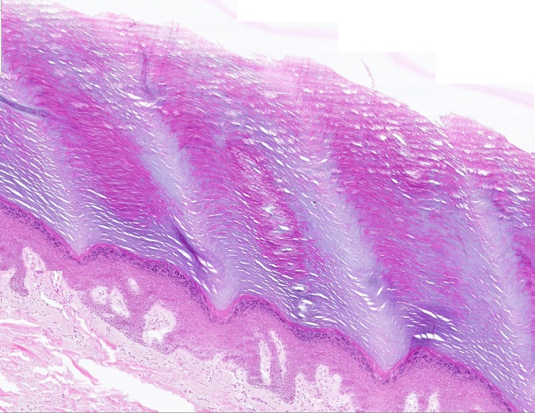
QUIZ
Self-check: Identify the epithelium on this slide. (advance slides for answers)
Stratified squamous keratinized

Slide 32
QUIZ
Self-check: Identify the cells indicated by the arrows. (advance slides for answers)
Plasma cells (these aren’t very good examples)

Slide 33
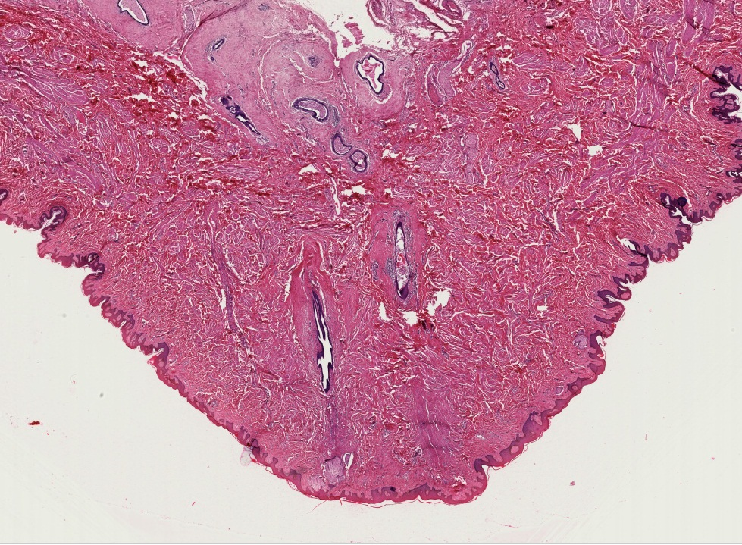
QUIZ
Self-check: Identify. (advance slides for answers)
Lactiferous sinus

Slide 34
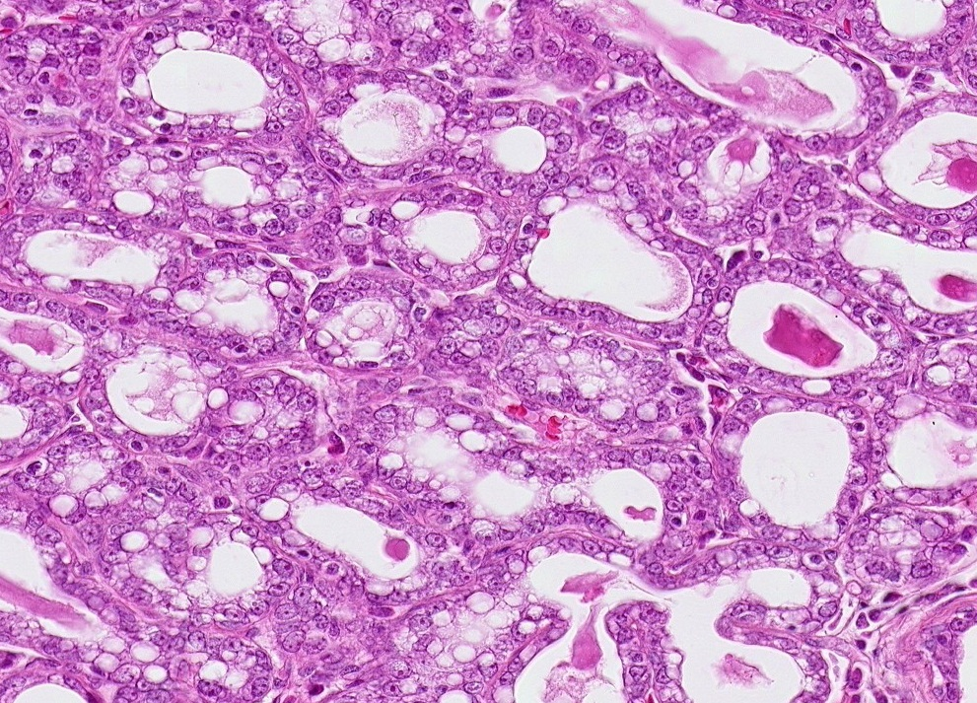
QUIZ
Self-check: Identify. (advance slides for answers)
Lactating mammary gland

Slide 35
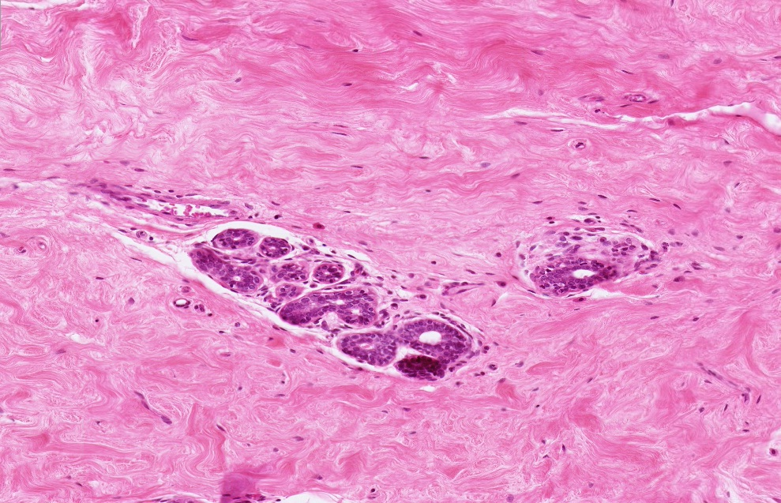
QUIZ
Self-check: Identify. (advance slides for answers)
Immature or inactive mammary gland

Slide 36
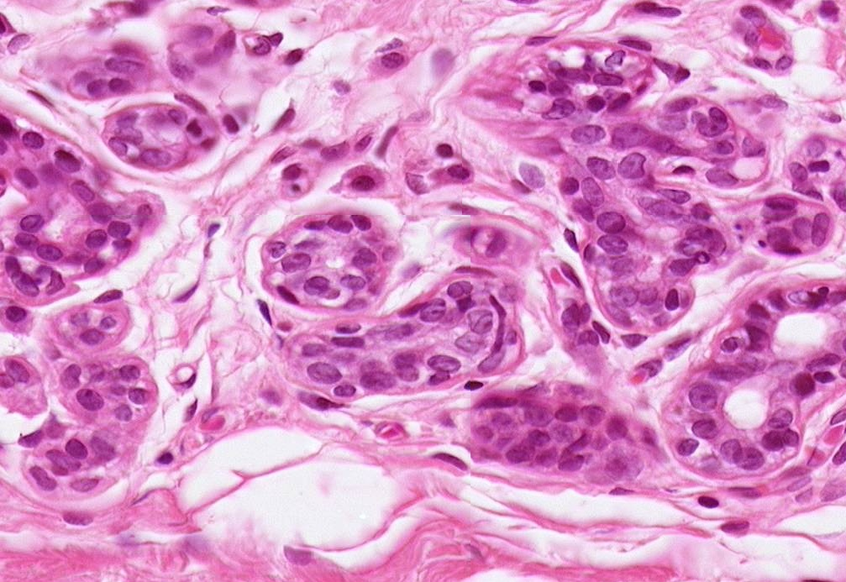
QUIZ
Self-check: Identify the cells. (advance slides for answers)
Myoepithelial cells
Acinar cells

Slide 37
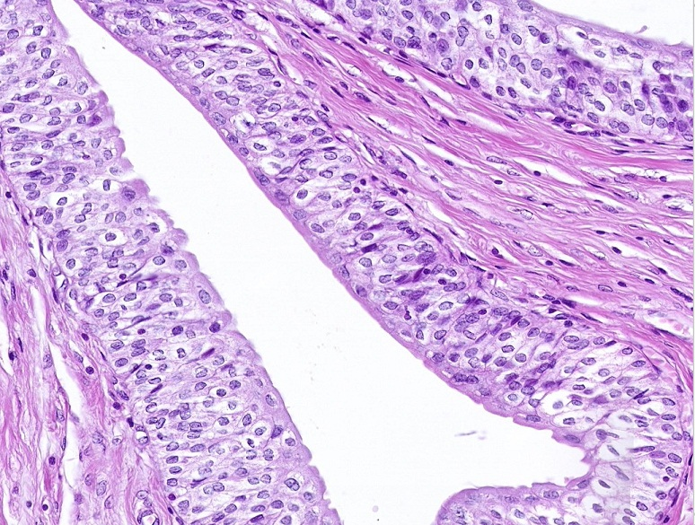
QUIZ
Self-check: Identify the epithelium on this slide. (advance slides for answers)
Transitional epithelium

Slide 38
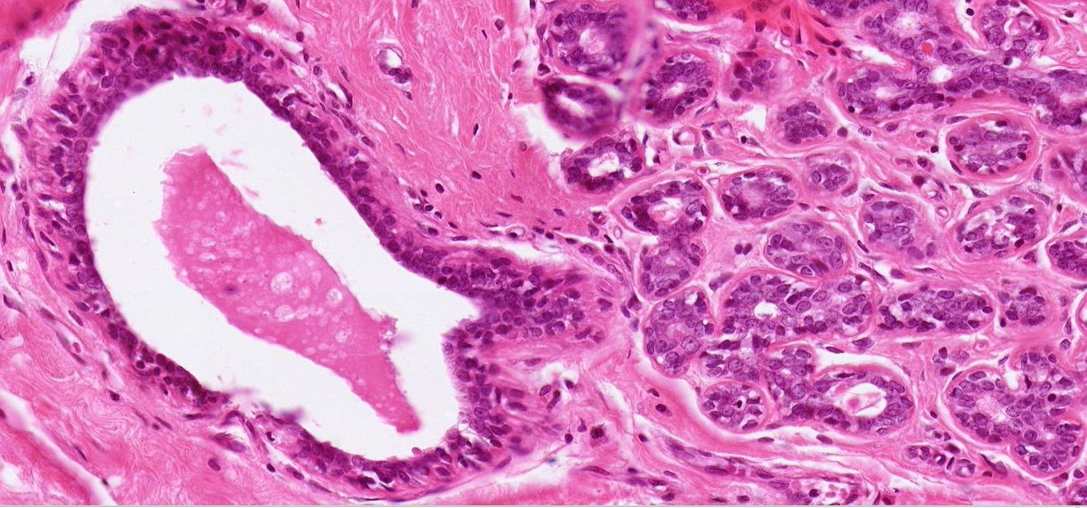
QUIZ
Self-check: Identify outlined structures. (advance slides for answers)
duct
acinus

Slide 39
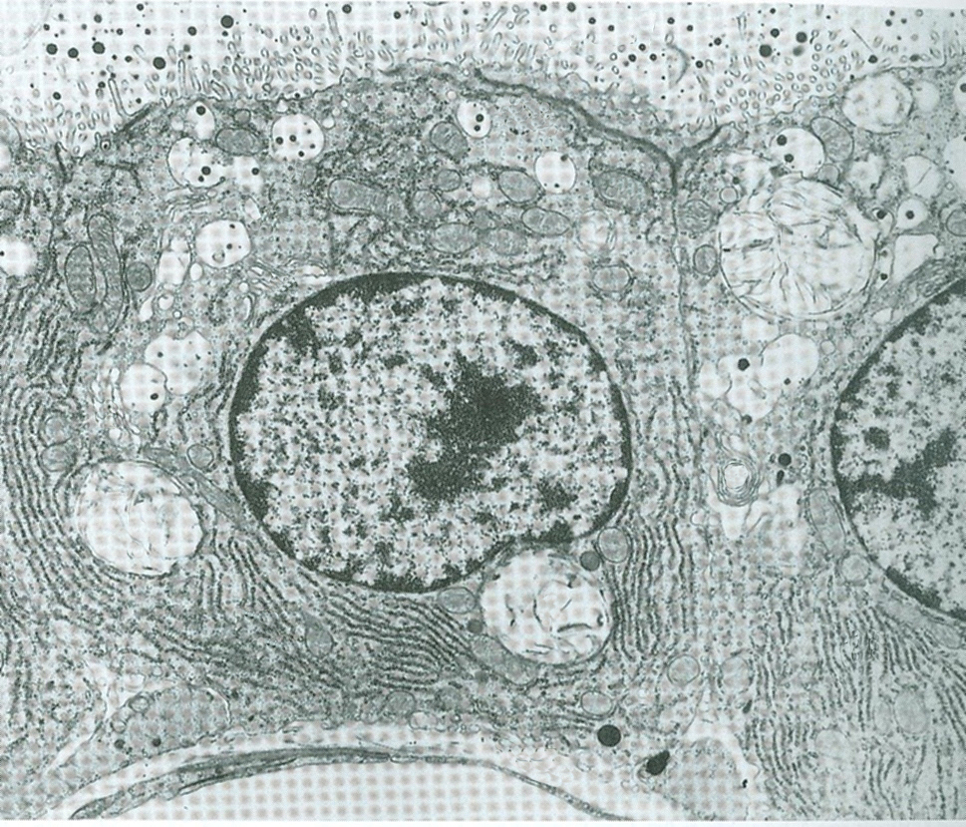
QUIZ
Self-check: Identify cell X, and structures at arrows. (advance slides for answers)
Milk proteins
Acinar cell
Lipid droplet (yeah, it looks funny)
X
capillary

Slide 40
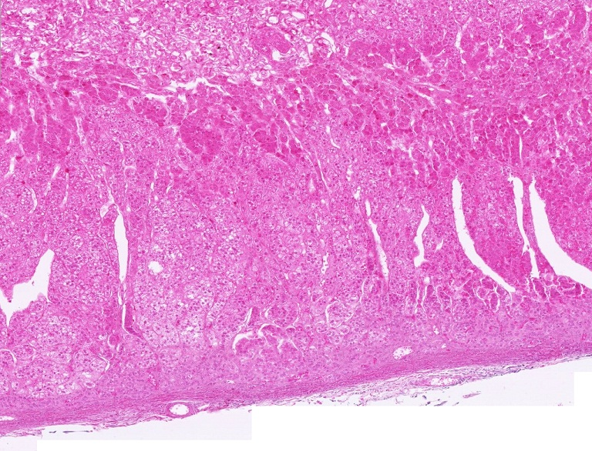
QUIZ
Self-check: Identify the region indicated by the brackets. (advance slides for answers)
Zona fasciculata

Slide 41
Nipple of breast
Self-check: This slide was from a dilation and curettage (D and C) procedure. Which phase of the menstrual cycle is represented on these slides? (they are the same)
Link to SL 100A and SL 100B
Secretory phase

Slide 42
Nipple of breast
Self-check: This slide was also taken from a dilation and curettage (D and C) procedure. What organ is represented on this slide? (don’t look at the title – cover upper left corner with your hand if you must))
Link to SL 101
cervix

