Slide 1
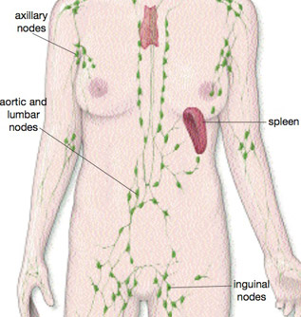
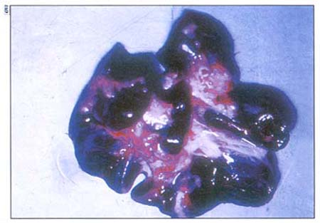
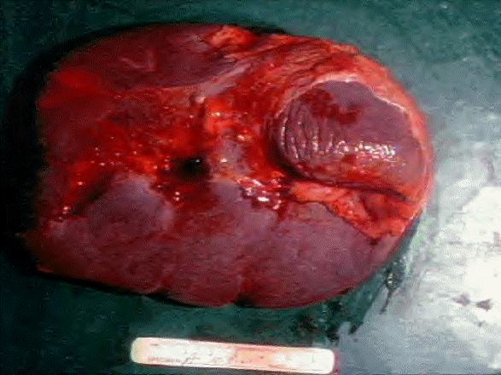
Lymph Node and Spleen: Digital Laboratory
It’s best to view this in Slide Show mode, especially for the quizzes.
This module will take approximately 90 minutes to complete.

Slide 2
After completing this exercise, you should be able to:
Distinguish, at the light microscope level, each of the following::
Lymph node
Hilus
Capsule
Trabeculae
Cortex
Subcapsular sinus
Trabecular sinus
Nodules (including primary and secondary, and cell types; see previous modules)
Paracortical zone
High endothelial venules
Medulla
Medullary cords
Medullary sinuses
Afferent lymphatic vessels
Efferent lymphatic vessels
Distribution of cell types in different regions (esp. T and B cells)
Spleen
Capsule
Trabeculae
Trabecular arteries and veins
White pulp
Nodules (including primary and secondary, and cell types; see previous modules)
Central arteries
Periarteriolar lymphoid sheath (PALS)
Penicillar arteries
Red pulp
Splenic cords
Venous sinusoids
Pulp veins
Distribution of cell types in different regions (esp. T and B cells)
Distinguish, in electron micrographs, each of the following :
Be able to interpret electron micrographs of lymphoid organs if given the source tissue

Slide 3
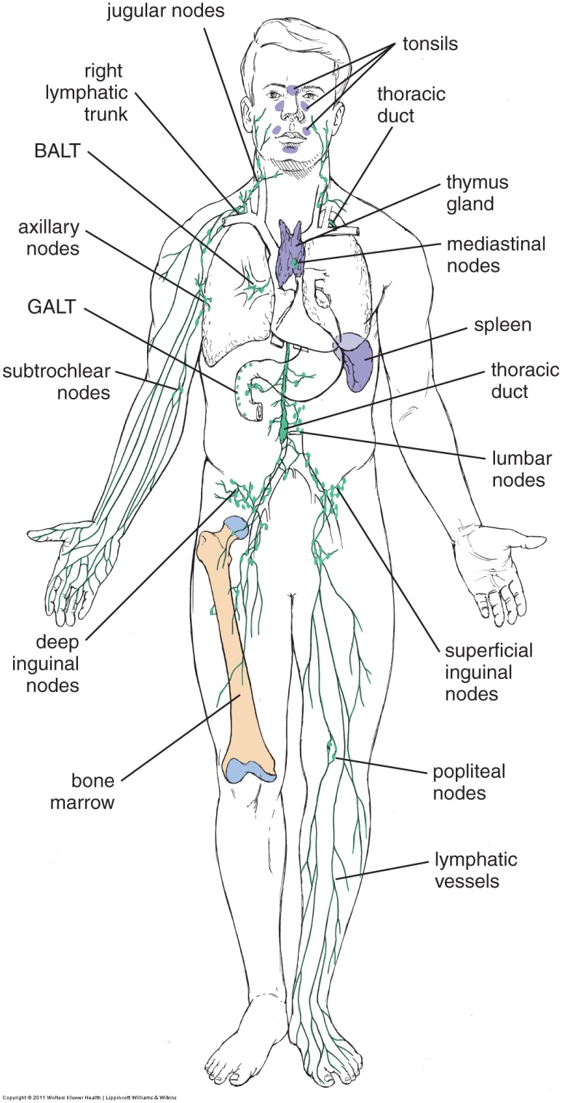
Lymph Nodes and Spleen
The previous modules looked at the sites of blood cell development and maturation (bone marrow and thymus), as well as places all around the body where the immune response is working against pathogens.
In this module, we will focus on two specific organs that are involved in filtration of body fluids and stimulating the immune response; lymph nodes, which are associated with lymphatic fluid and channels, and the spleen, which filters blood.

Slide 4
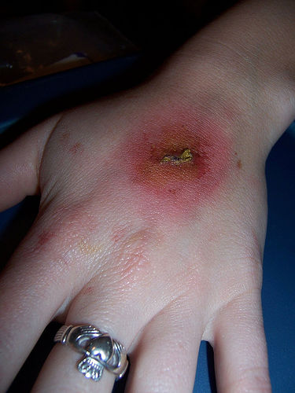
Lymph Nodes
arteriole
Before we describe the histology of a lymph node, we need to address a few housekeeping things that you probably already know.
Blood flows away from the heart through arteries; the smallest arteries are arterioles. Blood flows from arterioles into capillaries, the vessels where molecular exchange occurs, and then returns to the heart via venules and veins.
There is a net efflux of fluids from the lumen of the capillaries into the tissues (see arrows). Excess tissue fluid enters lymphatic channels, which return this lymph back into the bloodstream.
Lymphatic vessel
When you get a cut, bad guys and debris enter the tissues/interstitial fluid. These flow into the lymphatic channels, and then into lymph nodes.

Slide 5
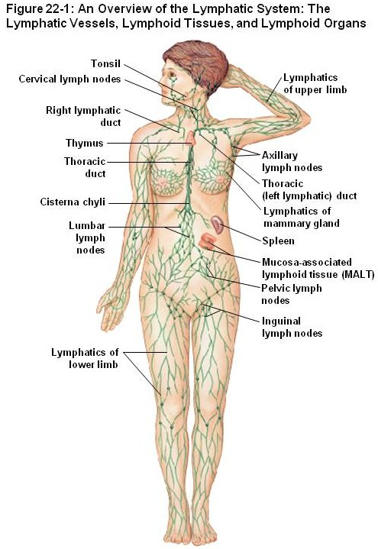
Lymph Nodes
Lymph nodes are in-line filters for the lymphatic fluid that is returning to the bloodstream. As we will see, that means lymphatic fluid flows through a lymph node.
Thankfully, all lymphatic fluid passes through at least one lymph node before returning to the circulation.

Slide 6
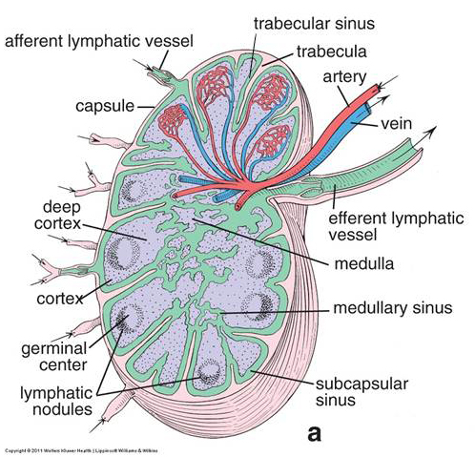
Lymph Nodes
As we mentioned, lymphatic fluid (green) flows through the lymph node. Afferent lymphatic vessels bring lymphatic fluid to the lymph node (i.e. these vessels are usually peripheral to the node), while efferent lymphatic vessels bring fluid away from the node (i.e. efferent vessels are proximal to the node). In the lymph node, lymph flows through a series of specialized capillaries called sinuses.
Lymph nodes also have a blood supply, consisting of an artery and vein that enter/leave the same location as the efferent lymphatic vessel, and supply/drain capillary beds within the organ.
Afferent = toward
Efferent = away
Note that an efferent lymphatic vessel of one node may be an afferent vessel of another node downstream.

Slide 7
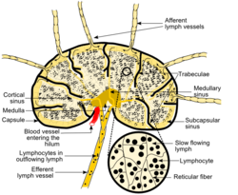
Lymph Nodes - overview
A lymph node is supported by a connective tissue capsule, that projects into the substance of the organ as trabeculae. The indentation where the artery enters the organ, and the vein and efferent lymphatic vessels leave, is referred to as the hilus (purple outline).
Lots of organs have a hilus; lymph nodes, spleen, lungs. Note that this indentation means that in sections, the hilus and associated structures may be closer to the “middle” of the organ than one might initially think (see blue dotted line in drawing to the right).
Yes, from Wikipedia

Slide 8
Lymph Nodes - overview
Like the adrenal gland and other organs, lymph nodes have a cortex (black outlined region) and medulla, albeit less distinct than in other organs.
Again, note that the indention at the hilus may create slides where these regions are not initially intuitive, e.g. cortical tissue in the “middle” of the slide.
Yes, from Wikipedia

Slide 9
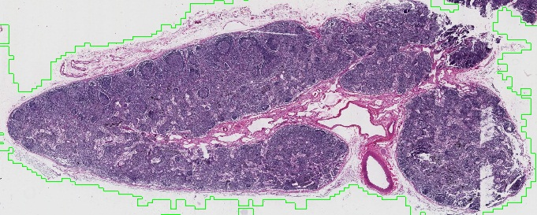
Lymph Nodes - overview
hilus
In our slide of a lymph node, the hilus is indicated, and contains arteries, veins, and efferent lymphatic vessels. The cortex can be identified by the numerous nodules (black arrows) and the fact that it is a relatively “solid” tissue. Contrast this with the medulla (a portion of which is outlined), the sinuses of which are the pale regions you see.

Slide 10
Lymph Nodes - overview
Video of lymph node overview – SL77
Link to SL 077
Be able to identify:
Lymph node
Capsule
Trabecula
Hilus
Cortex
Medulla

Slide 11
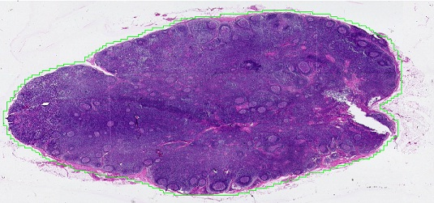
Lymph Nodes - overview
Our other slide of a lymph node has been sectioned mostly through the cortex. Therefore, you can see nodules not only in the periphery but also in the center of the section.

Slide 12
Lymph Nodes - overview
Video of lymph node overview – SL78
Link to SL 078
Be able to identify:
Lymph node
Capsule
Trabecula
(Hilus)
Cortex
(Medulla)

Slide 13
Lymph Nodes – lymphatic flow
As we mentioned, lymph flows through a lymph node (green pathways in figure). Lymphatic fluid enters and leaves the lymph node via afferent and efferent lymphatic vessels, respectively. Within the lymph node, fluid flows through sinuses with intuitive names based on position, so that the direction of flow is:
Afferent lymphatic vessels → subcapsular sinuses → trabecular sinuses → medullary sinuses → efferent lymphatic vessel(s)
Lymph node sinuses are similar to capillaries, but have a wide diameter, a very porous wall, and supporting cells within the lumen (yes, within).
At a conceptual level, all sinuses in the lymph node are essentially the same; the subcapsular and trabecular sinuses are longer and straighter, while the medullary sinuses are wider and more convoluted.

Slide 14
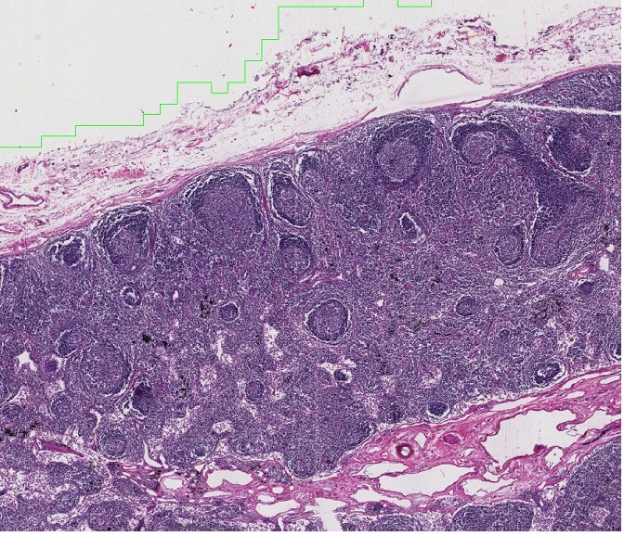
Lymph Nodes – lymphatic flow
In this image taken at medium power, the approximate locations (or actual examples) of the lymphatic vessels are indicated by the arrows. In the direction of lymphatic flow:
afferent lymphatic vessel → subcapsular sinus → trabecular sinus → medullary sinus → efferent lymphatic vessel

Slide 15
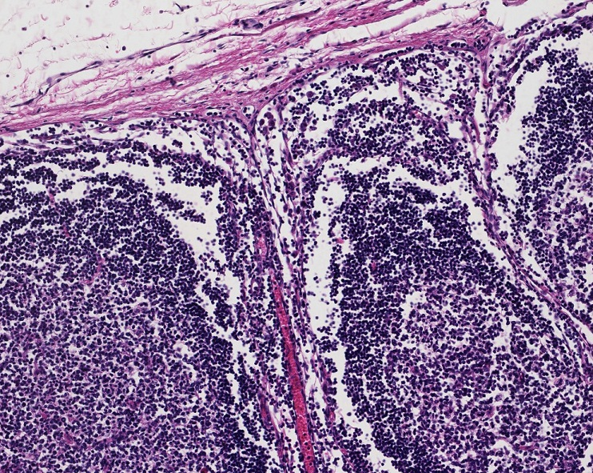
Lymph Nodes – lymphatic flow
Hmmm, seems to me like the borders of these channels are hard to see because of all the lymphocytes and because the walls are porous. YEP.
Focusing in on the cortex, you can see the subcapsular sinuses (blue arrows) just underneath the connective tissue capsule. These turn approximately at right angles to follow the trabecula as trabecular sinuses (green arrows).

Slide 16
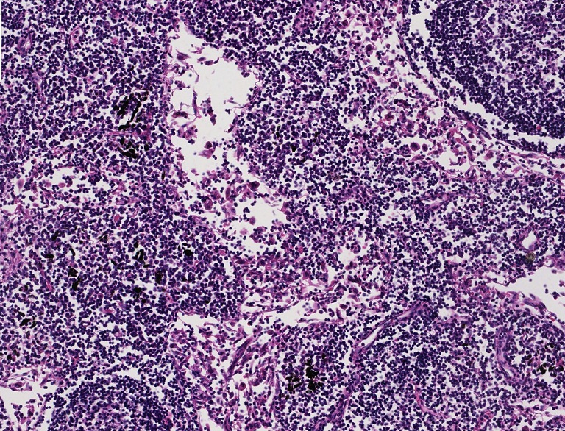
Lymph Nodes – lymphatic flow
cords
There are less cells in the medullary sinuses, and they are wider, so it’s a little easier to see these.
cords
In the medulla, the medullary sinuses (orange arrows) are wider than the subcapsular or trabecular sinuses. The tissue of the medulla (i.e. between the sinuses), which is chock-full of lymphocytes but no nodules, is referred to as medullary cords (the nodule you see in the upper right is in the cortex – remember sectioning).

Slide 17
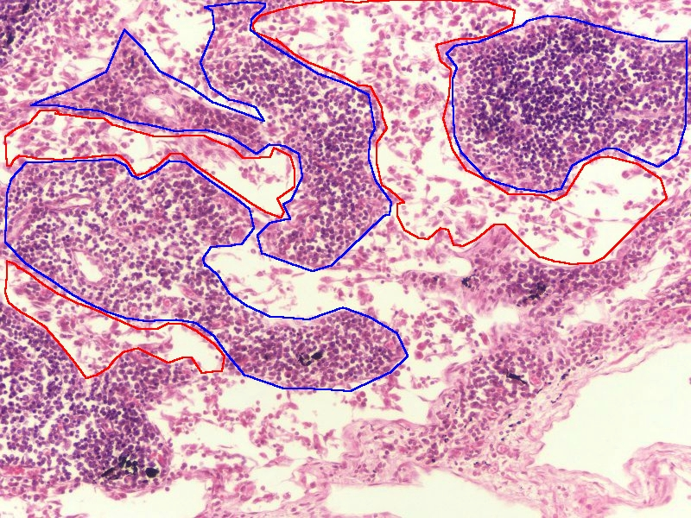
Lymph Nodes – lymphatic flow
This image shows the medullary sinuses (red outline) and medullary cords (blue outline).

Slide 18
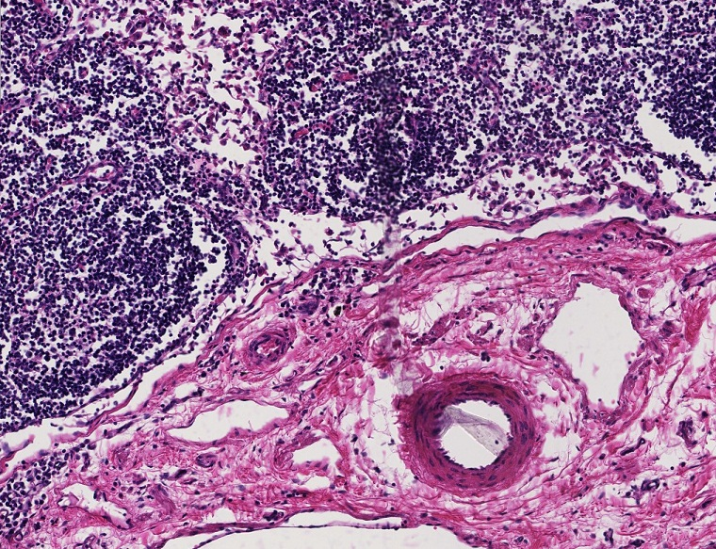
Lymph Nodes – lymphatic flow
cords
cords
Here you can see a medullary sinus (orange arrows) draining into a space (black arrows) that eventually leads to the efferent lymphatic vessels (red arrows)
Not sure what to call that space of the black arrows, either it’s still medullary sinus, or maybe a “submedullary sinus”.

Slide 19
Lymph Nodes – lymphatic flow
Video of lymph node sinuses – SL77
Link to SL 077
Be able to identify:
Lymph node
Afferent lymphatic vessels
Subcapsular sinus
Trabecular sinus
Medullary sinus
Medullary cords
Efferent lymphatic vessels

Slide 20
Lymph Nodes – lymphatic flow
Video of lymph node sinuses – SL78
Link to SL 078
Be able to identify:
Lymph node
Afferent lymphatic vessels
Subcapsular sinus
Trabecular sinus
(Medullary sinus)
(Medullary cords)
(Efferent lymphatic vessels)

Slide 21
Lymph Nodes – blood flow
As is the case with most organs, the artery enters the organ, and the vein leaves it, in the same location (blood flowing in opposite directions). Within the lymph node, the vessels branch together, with the arteries giving rise to capillary beds in the substance of the lymph node.

Slide 22
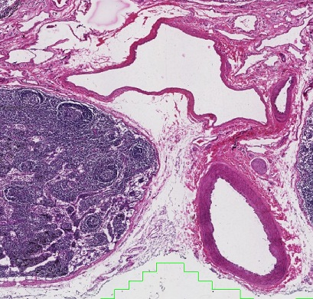
Lymph Nodes – Blood flow
V
The artery is easily recognized by the thick wall consisting largely of smooth muscle (see upcoming video). The vein is a little more challenging because it’s thin wall is quite similar to efferent lymphatic channels that are also in the hilus. Here, we are using size relative to the adjacent artery and a lack of valves to call this a vein.
A
The largest structures you see in the hilus are the artery (A) and vein (V) that supply blood to the lymph node.

Slide 23
Lymph Nodes – blood flow
Video of lymph node vessels – SL77
Link to SL 077
Be able to identify:
Lymph node
Artery
Vein
Efferent lymphatic vessels

Slide 24
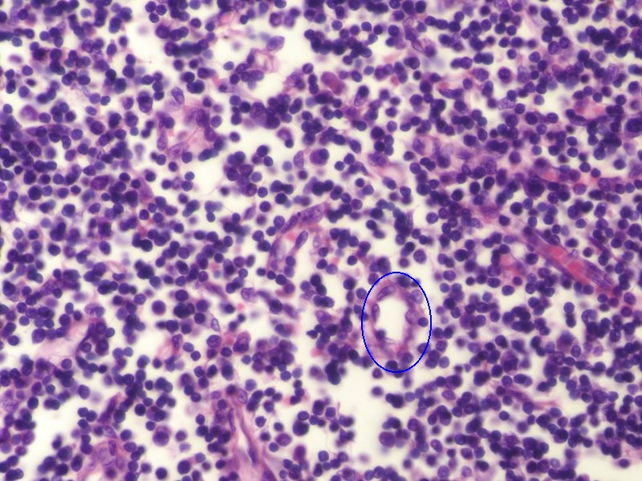
Lymph Nodes – Blood flow
As the name implies, high endothelial venules are recognized because their endothelial cells are slightly “fatter” than typical endothelial cells, which, as you know, are squamous.
Blood vessels of the lymph node are typical in that they supply capillary beds to the organ, which are important for nutrient and waste exchange. One specialized feature of the lymph node, called high endothelial venules (HEV, blue outline, aka post-capillary venules) are favorite places for white blood cells to move from the bloodstream and into the substance of the lymph node, a process called diapedesis.

Slide 25
Lymph Nodes – blood flow
Video of lymph node high endothelial venules – SL77
Link to SL 077 and SL 078
Be able to identify:
Lymph node
High endothelial venules

Slide 26
Lymph Nodes – substance
The darker regions of the lymph node, i.e. between the sinuses, is what we will call the substance of the organ. Here, numerous white blood cells are supported by a network of very loose connective tissue laid down by resident fibroblasts and follicular cells.

Slide 27
Lymph Nodes – substance
cords
The border drawn is imperfect due to sectioning, you can obviously see nodules below the line, in what we are calling the medulla.
cords
In this image, the approximate border between the cortex and medulla is indicated. In the medulla, you have already been introduced to the medullary cords. The cortex contains numerous nodules, most of them are secondary. Similar to other areas of lymphoid tissue (e.g. tonsils), the nodules a rich in B lymphocytes, but also contain T cells, macrophages, follicular cells, dendritic reticular cells, and fibroblasts. The area between the nodules is called the paracortical zone, or deep cortex, and contains mostly T lymphocytes (as well as B cells and the other cells mentioned).

Slide 28
Lymph Nodes – substance
Video of lymph node substance – SL77
Link to SL 077 and SL 078
Be able to identify:
Lymph node
Cortex
Nodules
Paracortical zone
Medulla
Medullary cords

Slide 29
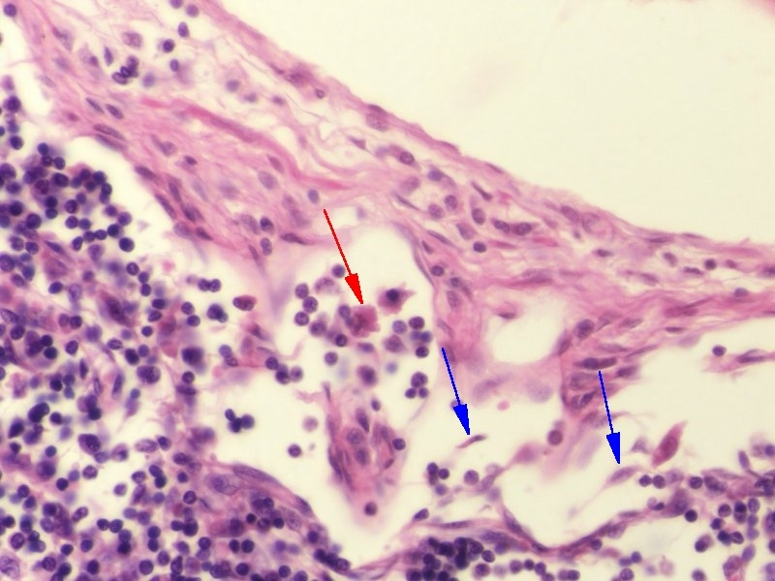
Lymph Nodes – CELLS
Within the lumen of the subcapsular and trabecular sinuses, you will see lymphocytes (round nuclei) as well as reticular cells (blue arrows) and macrophages (red arrow). The reticular cells are similar to fibroblasts, in that they secrete (and wrap around) the type III collagen fibers that support the lymph node. They also may play a role in the immune response by secreting substances that attract lymphocytes and other immune cells.

Slide 30
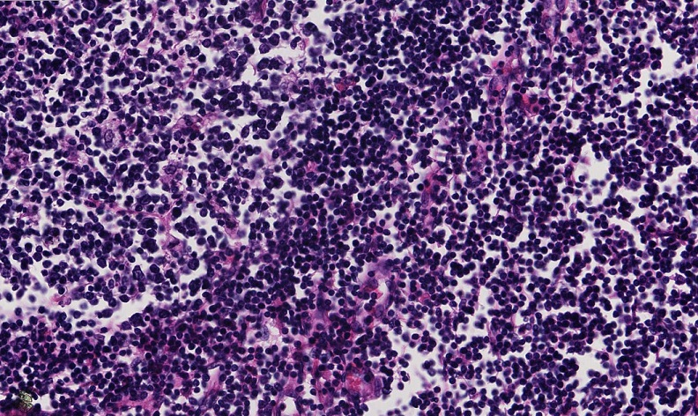
Lymph Nodes – CELLS
In this image from the cortex, a portion of the nodule is to the left of the dashed line, and the paracortical zone is to the right of the line. Both regions contain abundant lymphocytes; again, the nodules contain mostly B cells, while T cells dominate the paracortical region. Also in both regions are macrophages (arrow) as well as more difficult to find and distinguish reticular, dendritic, and follicular dendritic cells.

Slide 31
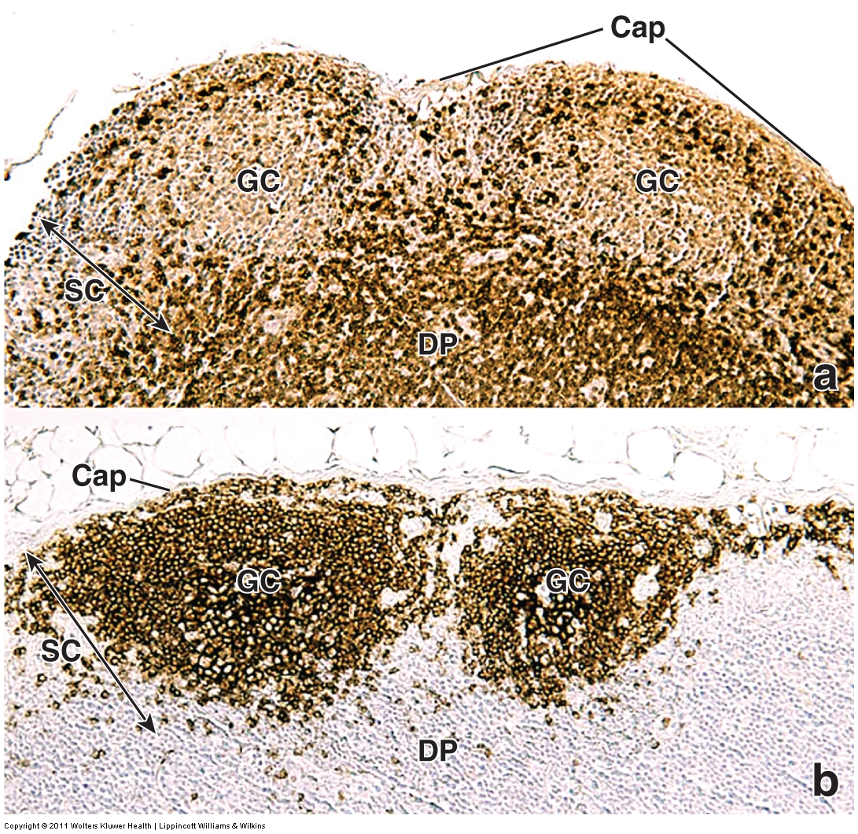
Lymph Nodes – CELLS
In case you doubted us, this image from the Ross text shows immunocytochemistry targeting T lymphocytes (upper panel) and B lymphocytes (lower panel) in a lymph node.
Cap – capsule
GC – germinal center
SC – superficial cortex
DP – deep cortex

Slide 32
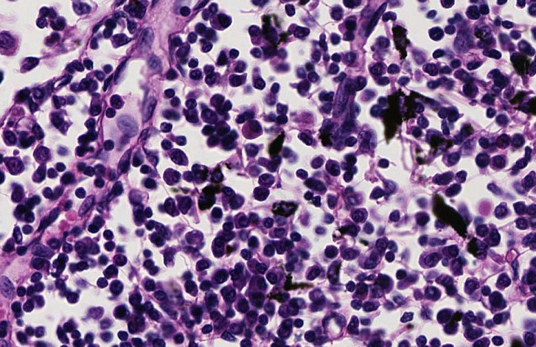
Lymph Nodes – CELLS
In the medulla of the lymph node, you will see cells similar to those present in the cortex. Of particular note is the presence of plasma cells (arrow, several are in the outlined region), which are abundant in the medullary cords but rarely found in the cortex. Although the over-staining of this slide makes it challenging, note the cytoplasmic basophilia, and off-centered nucleus.

Slide 33
Lymph Nodes – cells
Video of lymph node cells – SL77
Link to SL 077 and SL 078
Be able to identify:
Lymph node
Cortex
Lymphocytes
Macrophages
Reticular cells
Medulla
Plasma cells

Slide 34
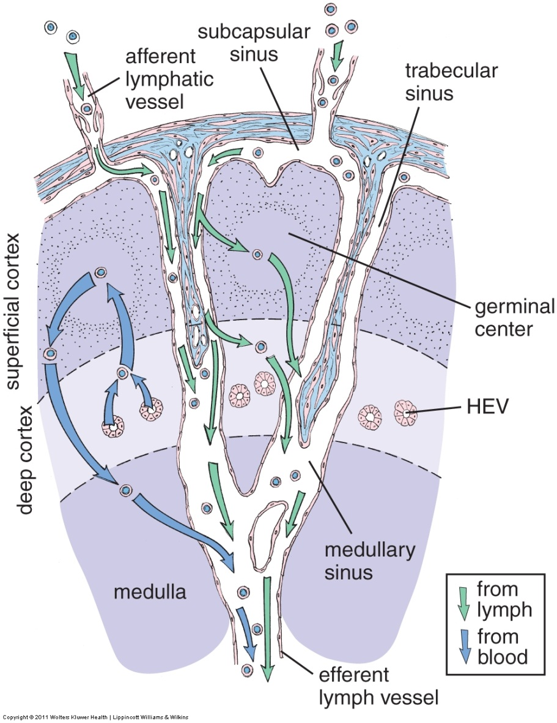
Lymph Nodes – functional overview
Although you will get a detailed functional explanation in lecture, it helps to get some context here. This image shows a portion of a lymph node, with the cortex and medulla shown.
Lymphatic fluid flows into the nodes via afferent channels, and flows through the sinuses. Because the walls of the sinuses are very permeable, lymph flows freely through the substance of the organ as well. Lymph carries tissue fluids, as well as white blood cells, pathogens, and particulate substances.
Blood flows into the organ, and, most notably, white blood cells can enter the substance of the node through the high endothelial venules HEV).
In the germinal centers and paracorticortical region, macrophages and dendritic cells trap and present antigens from the lymph to B and T lymphocytes, initiating an immune response. Stimulated B cells leave the cortex and migrate to the medulla, where they become resident plasma cells that actively secrete antibodies. Other stimulated B and T cells can leave the lymph node via efferent lymphatic vessels to populate other areas of the body.
When you get a cut or get sick, infectious agents flowing in lymph enter lymph nodes, stimulating T and B cells, which increases the size of the node – swollen nodes (“swollen glands”).

Slide 35
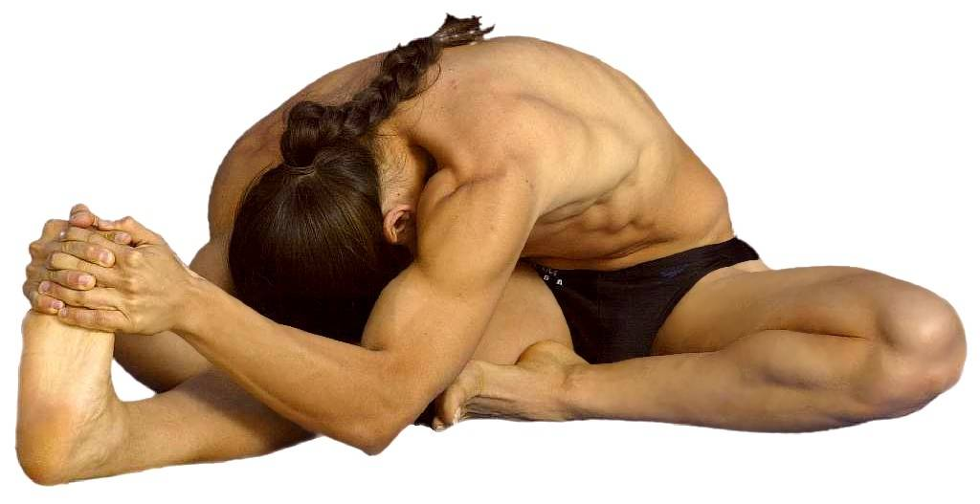
Might not be a bad time to stretch

Slide 36
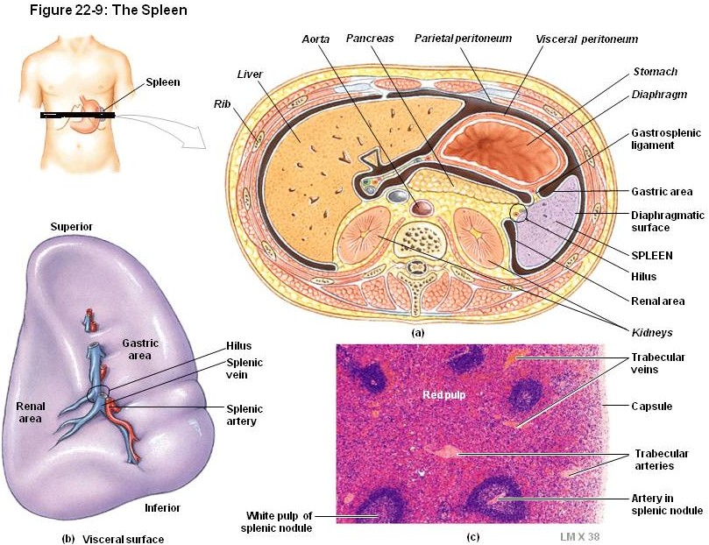
Spleen - overview
The spleen is located in the upper left abdominal quadrant. The splenic artery and vein pierce the medial aspect of the spleen at its hilus.

Slide 37
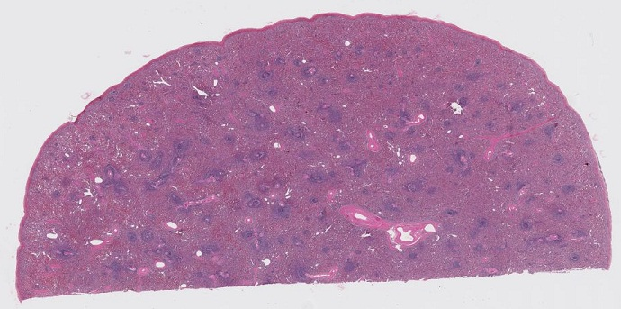
Spleen - overview
The spleen is supported by a relatively thick connective tissue capsule (blue arrows), which projects into the substance of the organ as trabeculae (black arrows), through which trabecular arteries and veins traverse to reach the internal portion of the organ. H&E staining clearly demonstrates the two major regions of the spleen; the eosinophilic red pulp, and the basophilic white pulp.
White pulp is so-named because it appears white on fresh (unstained) spleens. Here, the numerous lymphocytes in the white pulp make those regions basophilic in H&E sections.

Slide 38
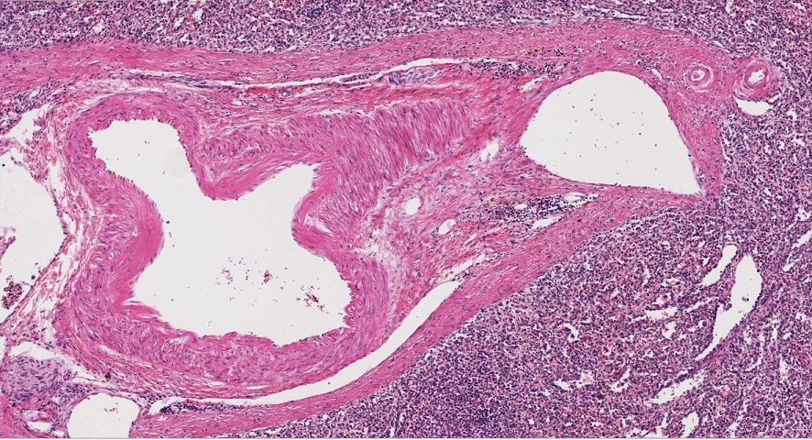
Spleen - overview
V
A
In the trabeculae, the same artery/vein rules apply. When comparing vessels of similar size, the artery (A) will have a thicker wall, with more smooth muscle, relative to the vein (V). Both are embedded within the thick connective tissue of a trabecula (blue outline).
The spleen is filtering blood, so it does not have afferent lymphatic channels, and only has sparse efferent lymphatic vessels (all organs and tissues have efferent lymphatics, right??). Therefore, we don’t need to worry about identifying lymphatic vessels in the spleen.

Slide 39
Spleen - overview
Video of spleen overview – SL66B
Link to SL 066B and SL 066A
Be able to identify:
Spleen
Capsule
Trabeculae
Trabecular arteries
Trabecular veins
White pulp
Red pulp

Slide 40
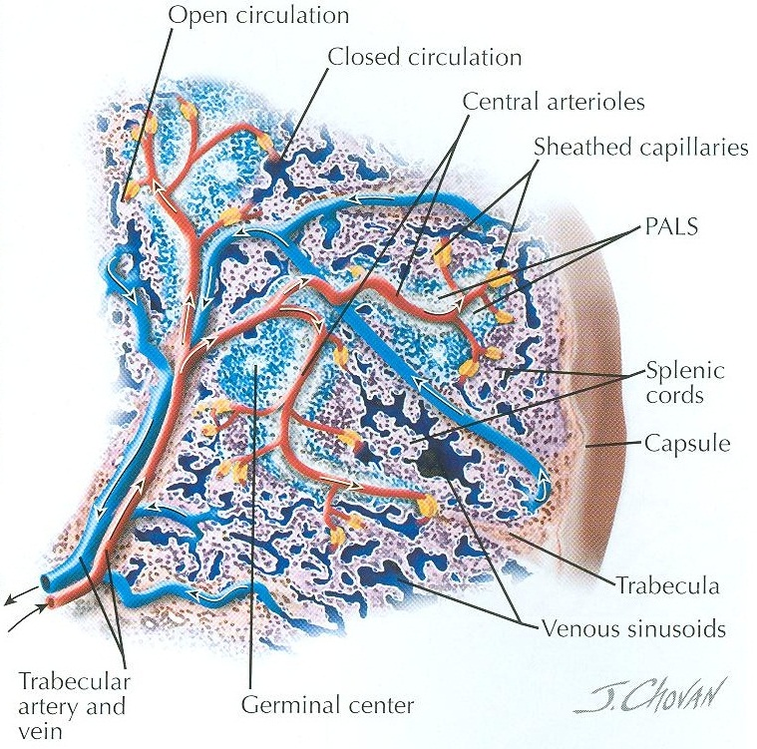
Spleen – Blood flow
The vasculature is key to understanding the organization and function of the spleen. In this drawing, the white pulp is blue/white, and the red pulp is light pink.
Blood enters the spleen through trabecular arteries, which branch into central arteries (arterioles). These central arteries run within the white pulp of the spleen, immediately surrounded by a region of T cells called the periarteriolar lymhoid sheath (PALS, white regions), as well as nodules dominated by B cells (blue regions) . The central arterioles give rise to penicillar arterioles (black arrow), which bring blood to the red pulp, ending in specialized sheathed capillaries. The sheathed capillaries then either drain into the venous sinusoids (sinuses) of the red pulp (closed circulation), or empty into the splenic cords of the red pulp (open circulation). Either way, the venous sinuses of the red pulp drain into trabecular veins.
Here in the red pulp, we have sinuses and cords. This is similar to what we had in the medulla of the lymph node; sinuses are vessels (though here they contain blood), while the cords are the tissue of the spleen.

Slide 41
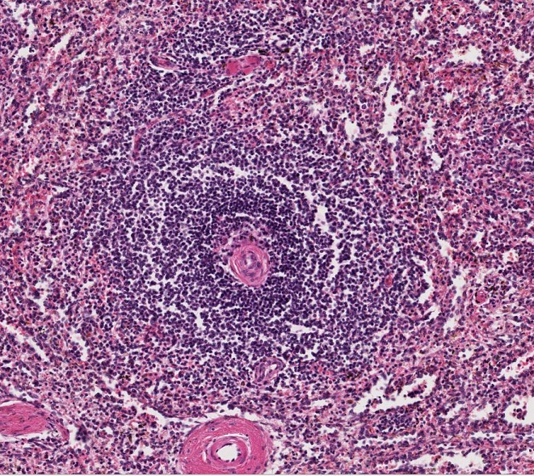
Spleen – White pulp
White pulp provides the main immune function of the spleen. An area of white pulp is within the outlined region; as you can see, it is dominated by lymphocytes. The vessel that is in the center of the nodule is the central artery (arteriole, orange arrow). The lymphocytes immediately surrounding the central artery are T lymphocytes of the periarteriolar lymphoid sheath (PALS, approximately within the brackets). Peripheral to the PALS are mostly B cells. Smaller vessels in the periphery of the nodule or within the red pulp are penicillar arterioles (red arrow), which are branches of the central artery that are headed toward the red pulp.

Slide 42
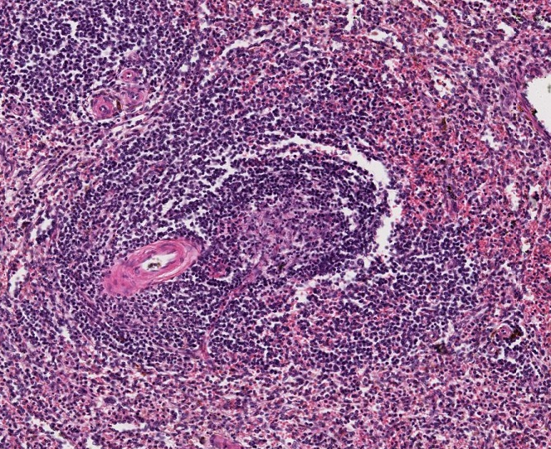
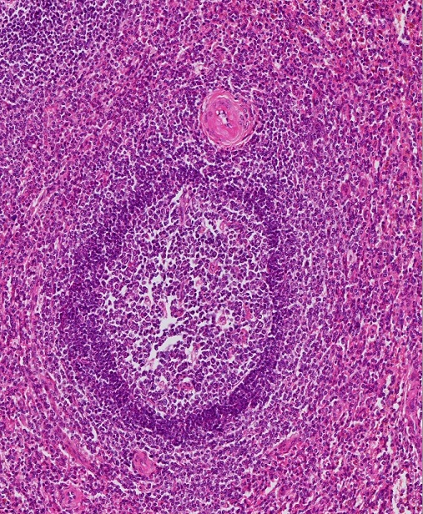
Spleen – White pulp
When B cells in the nodule are stimulated, they form a germinal center (I hope you recognize these by now). This creates non-symmetrical growth of the white pulp surrounding the central artery, so that this artery gets pushed toward the periphery of the nodule (arrow). In fact, many central arteries are actually off-center, but are recognized as the largest artery within the nodule.

Slide 43
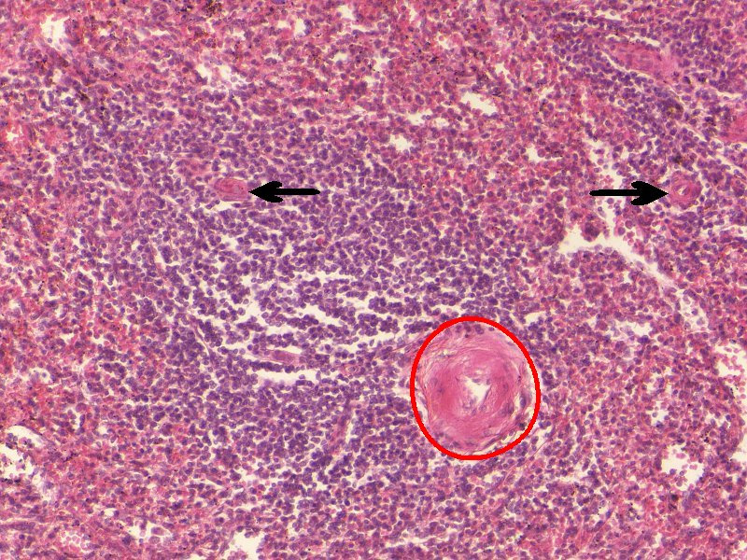
Spleen – White pulp
Another image with the central artery (encircled) and penicillar arterioles (black arrows) identified.
FYI, the arteries in this specimen have some pathology that gives them the sclerotic appearance you see in this particular image.

Slide 44
Spleen – White pulp
Video of spleen white pulp – SL66B
Link to SL 066B and SL 066A and SL 079
Be able to identify:
Spleen
White pulp
Central artery (arteriole)
Penicillar arteriole
Periarteriolar lymphoid sheath (PALS)
Nodule

Slide 45
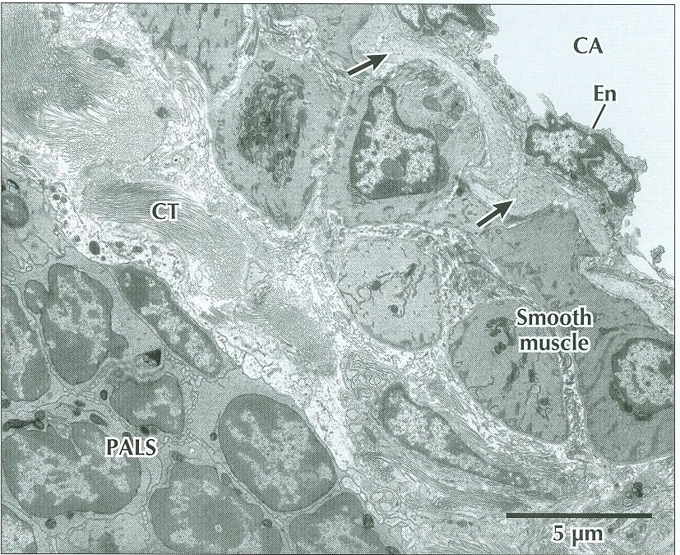
Spleen – White pulp
The arrows indicate the internal elastic lamina, a portion of the vessel we’ll learn about later.
This is an electron micrograph taken from the white pulp in the spleen, and includes a portion of the wall of the central artery (CA). The endothelial cell (EN), smooth muscle, and connective tissue (CT) of the vessel wall are indicated. The lymphocytes immediately adjacent to the central artery are T cells of the periarteriolar lymphoid sheath (PALS).

Slide 46
Spleen – Blood flow
In terms of blood flow, the next vessel we should encounter is the sheathed capillary, which drains into the venous sinuses of the red pulp. However, we do not have enough good examples of these vessels to speak of, so they will not be discussed here. I hope you are still able to sleep at night.

Slide 47
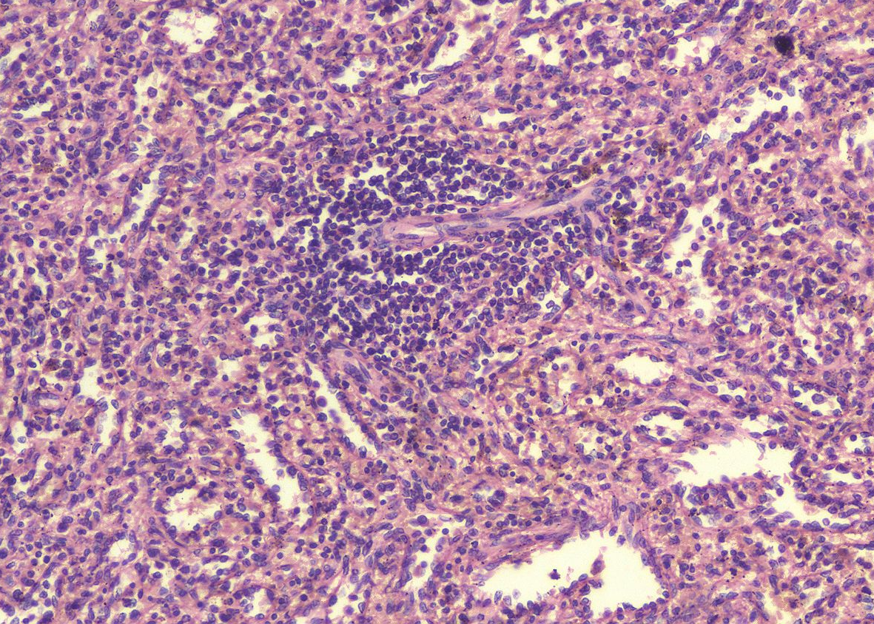
Spleen – red pulp
White pulp
SC
VS
SC
VS
A major function of the red pulp of the spleen is to filter out aged red blood cells. Therefore, on fresh tissue this region is red, and in H&E sections these regions are eosinophilic. The red pulp contains venous sinusoids (VS), between which are splenic tissues called splenic cords (of Bilroth, SC).

Slide 48
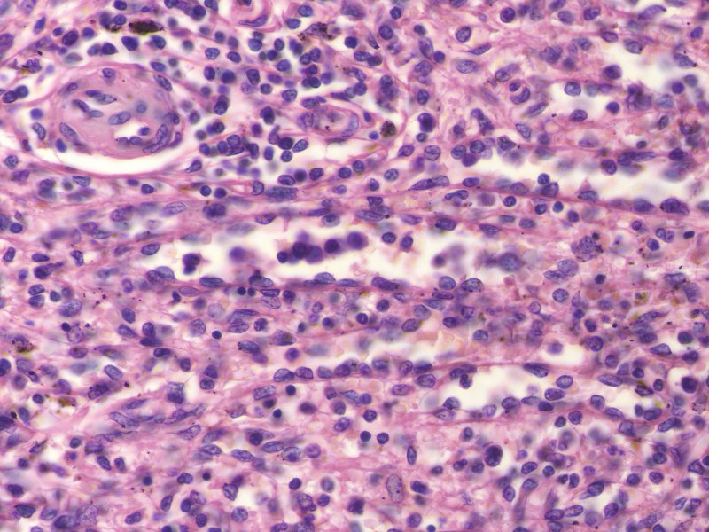
Spleen – red pulp
VS
SC
VS
SC
VS
VS
SC
In this image taken at higher magnification, one can clearly see the venous sinusoids (VS) and splenic cords (SC), separated by pink lines (green arrows) that represent the squamous portion of the endothelial cells and the basement membrane. The nuclei of the endothelial cells of the sinusoids are bulging into the lumen (black arrow).

Slide 49
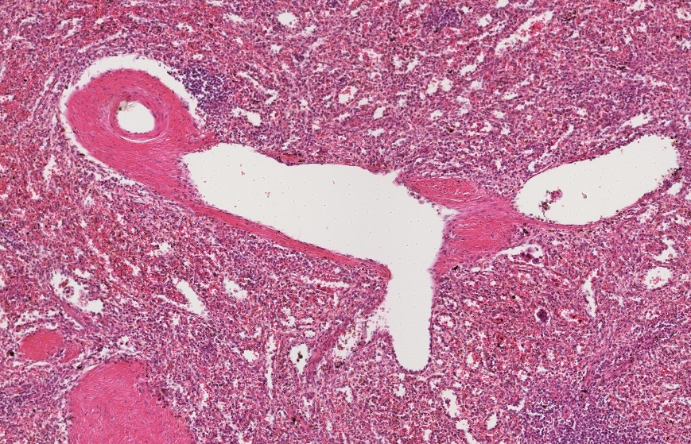
Spleen – red pulp
TA
TV
PV
The venous sinusoids coalesce and are tributaries to large pulp veins (PV), which contain little connective tissue and empty directly into trabecular veins (TV). TA = trabecular artery

Slide 50
Spleen – red pulp
Video of spleen red pulp – SL66A
Link to SL 066B and SL 066A and SL 079
Be able to identify:
Spleen
Red pulp
Venous sinuses (venous sinusoids, splenic sinuses)
Splenic cords (of Bilroth)
Pulp veins

Slide 51
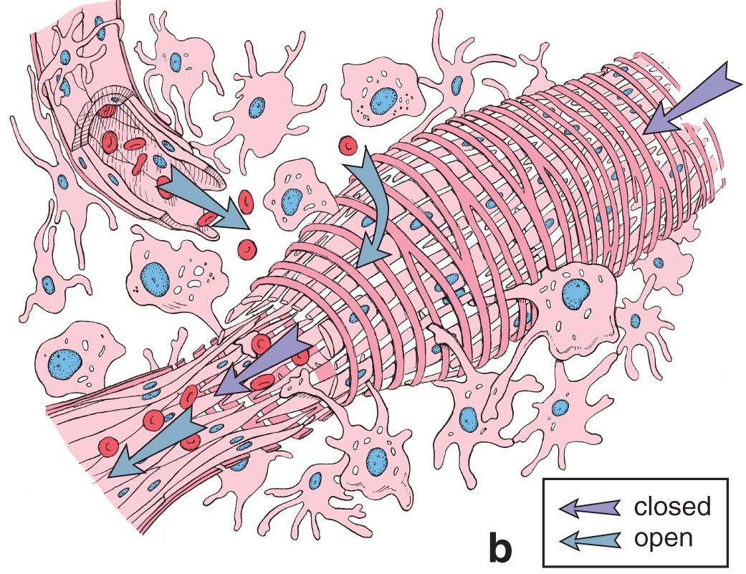
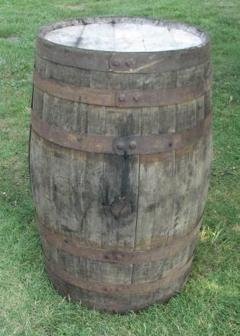
Spleen – red pulp
Schematic drawing of a venous sinusoid of the spleen. Note the endothelial cells are very elongated, with slit-like gaps between the cells. The basement membrane (black arrows) of the sinusoids is also incomplete, and organized into rings that encircle the vessel at right angles to the endothelial cells.
Many liken the organization of the venous sinusoids to a leaky barrel. The endothelial cells are similar to the wooden beams, and the basement membrane similar to the metal staves.

Slide 52
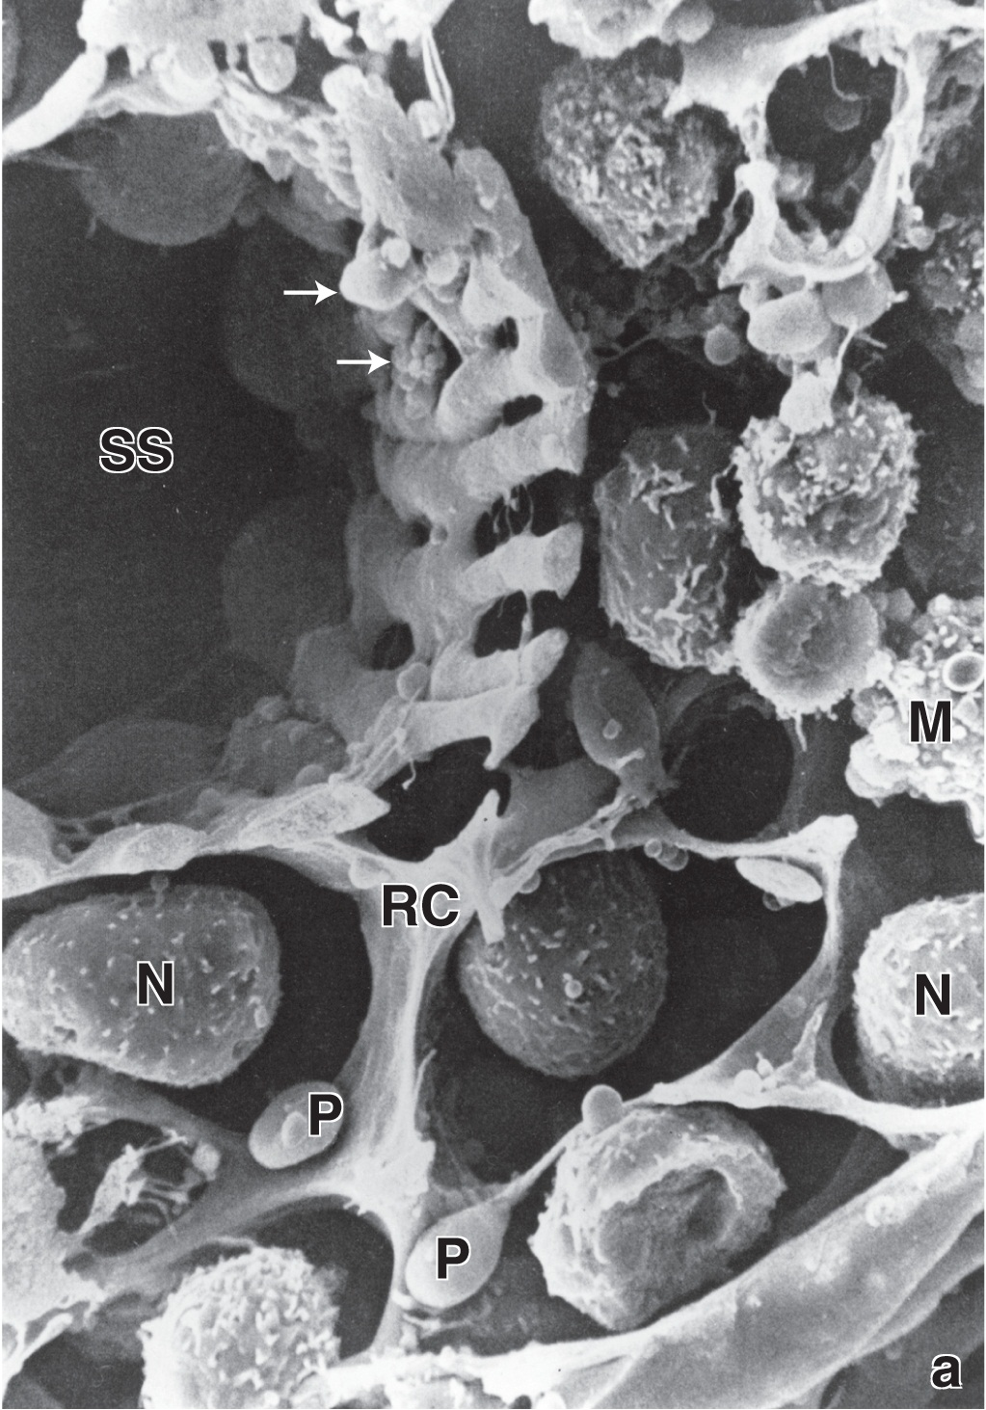
Spleen – red pulp
This is a scanning electron micrograph of the red pulp of the spleen. A venous sinusoid (SS) is indicated. Note the porosity of the endothelial wall of this vessel. Processes of macrophages (white arrows) are projecting through the gaps.
In the splenic cord are reticular cells (RC), neutrophils (N), macrophages (M), and platelets (P).

Slide 53
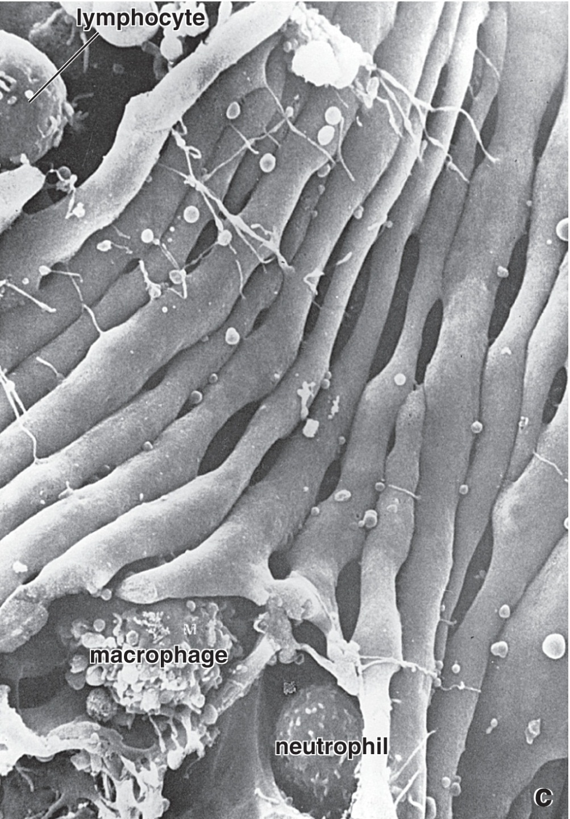
Spleen – red pulp
This is a scanning electron micrograph of a venous sinusoid of the spleen as viewed from the inside. Note the very elongated endothelial cells, with slit-like gaps between them.

Slide 54
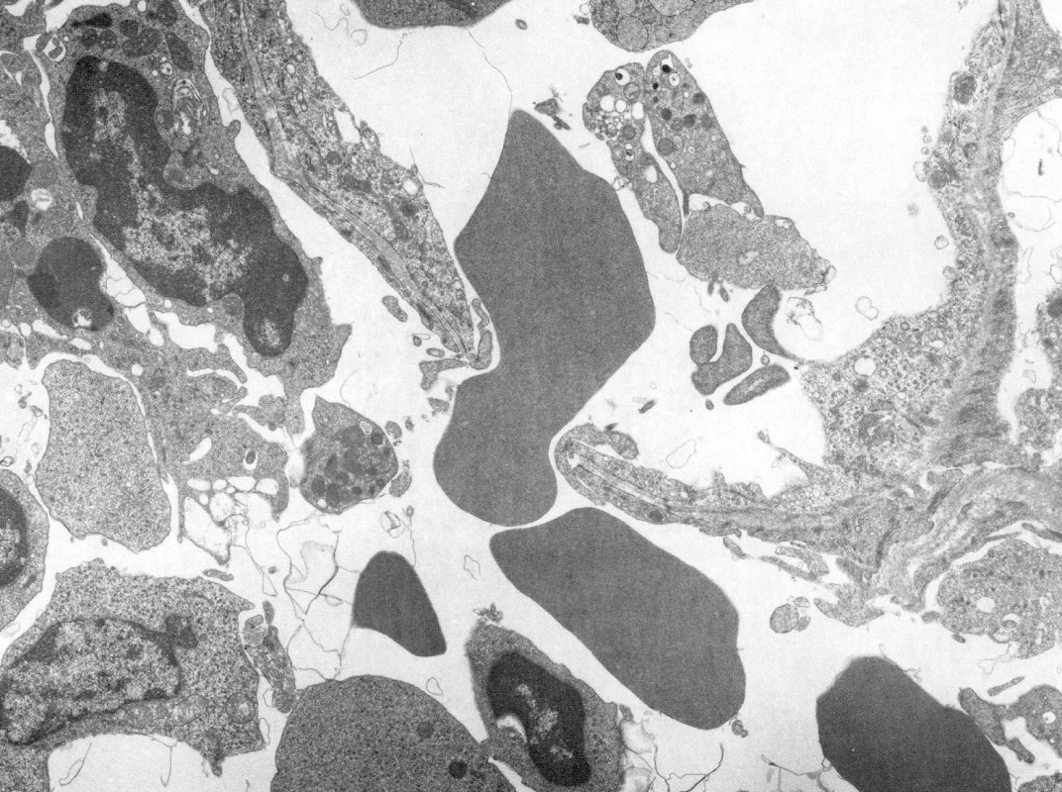
Spleen – red pulp
VS
It really doesn’t get better than this.
RBC
SC
In this transmission electron micrograph from the red pulp of the spleen, the venous sinusoid (VS) and splenic cord (SC) are indicated. In this fortuitous image, a red blood cell (RBC) is seen passing from the cords into the sinus to return to the circulation. Presumably, only healthy red cells can navigate through these openings, while aged ones have difficulty and are recycled.

Slide 55
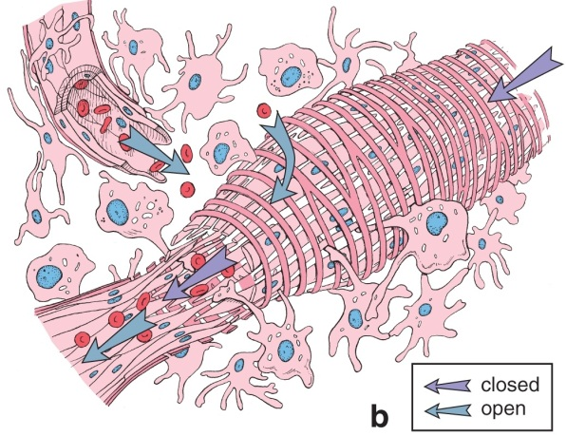
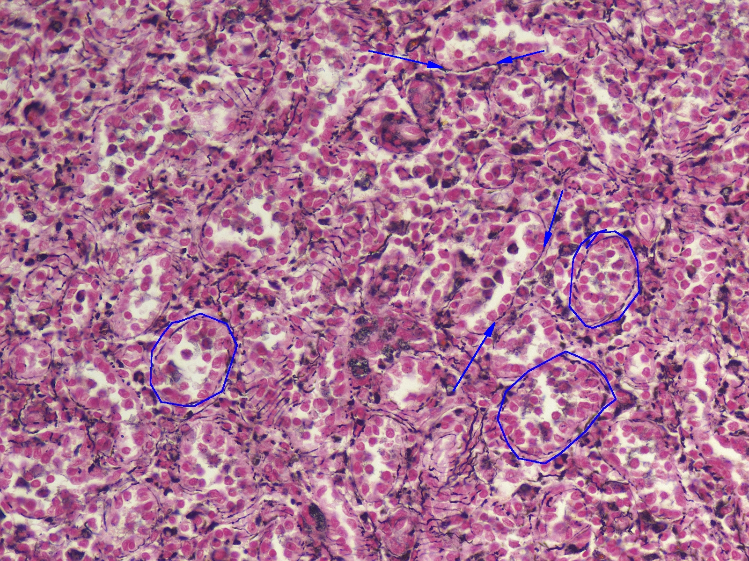
Spleen – red pulp
SC
SC
VS
VS
VS
VS
SC
SC
SC
VS
VS
Special stains were used on this slide to highlight the reticular fibers of the basement membrane of the spleen, which show up as thin, black threads (between blue arrows). Venous sinusoids (VS) are outlined, and splenic cords (SC) are also indicated.

Slide 56
Spleen – red pulp
Video of spleen red pulp reticular stain – SL32
Link to SL 032
Be able to identify:
Spleen
Red pulp
Reticular fibers
Venous sinuses (venous sinusoids, splenic sinuses)
Splenic cords (of Bilroth)

Slide 57
Spleen – Functional overview
In a very broad sense, the two regions of the spleen, the white and red pulp, perform two major functions; immunity to blood-borne pathogens and red blood cell turnover, respectively. To accomplish this, incoming blood flows through the central arterioles, which are surrounded by T and B cells in the white pulp, stimulating an immune response to pathogens and antigens. Blood then flows through penicillar arteries and sheathed capillaries to the red pulp. Here, there are two theories of splenic circulation. In the open model, blood spills into the splenic cords, and healthy cells work their way back into the venous sinuses of the circulation to return through trabecular veins, leaving behind aged red blood cells for turnover by macrophages. In the closed model, the sheathed capillaries directly connect to the venous sinuses, and the intimate relationship of macrophages in the cords with the venous sinuses allow them to remove aged red blood cells.

Slide 58
The next set of slides is a quiz for this module. You should review the structures covered in this module, and try to visualize each of these in light and electron micrographs:
Distinguish, at the light microscope level, each of the following::
Lymph node
Hilus
Capsule
Trabeculae
Cortex
Subcapsular sinus
Trabecular sinus
Nodules (including primary and secondary, and cell types; see previous modules)
Paracortical zone
High endothelial venules
Medulla
Medullary cords
Medullary sinuses
Afferent lymphatic vessels
Efferent lymphatic vessels
Distribution of cell types in different regions (esp. T and B cells)
Spleen
Capsule
Trabeculae
Trabecular arteries and veins
White pulp
Nodules (including primary and secondary, and cell types; see previous modules)
Central arteries
Periarteriolar lymphoid sheath (PALS)
Penicillar arteries
Red pulp
Splenic cords
Venous sinusoids
Pulp veins
Distribution of cell types in different regions (esp. T and B cells)
Distinguish, in electron micrographs, each of the following :
Be able to interpret electron micrographs of lymphoid organs if given the source tissue

Slide 59
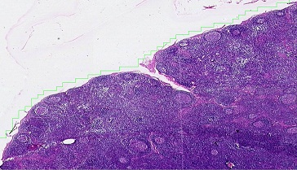
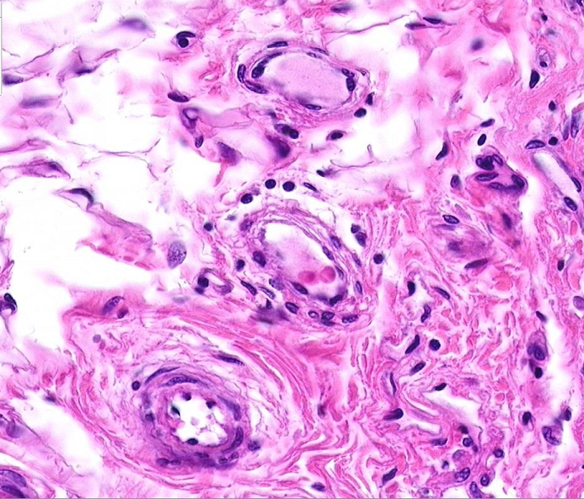
Final quiz
Self-check: Identify the outlined structures. (advance slide for answer)
Afferent lymphatic vessel
Vein/venule
Artery/arteriole

Slide 60
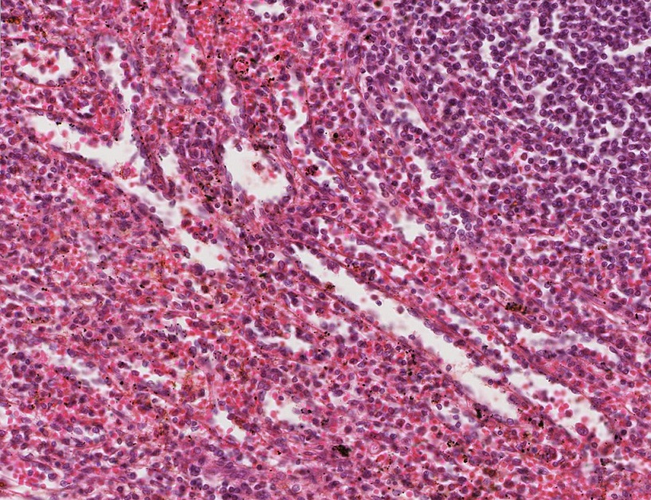
Final quiz
Self-check: Identify the outlined regions. (advance slide for answer)
Venous sinusoids

Slide 61
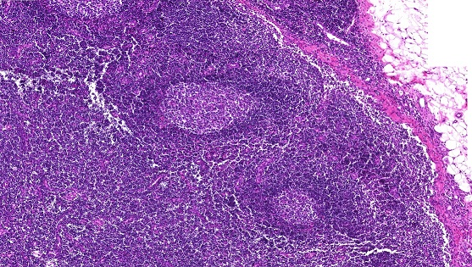
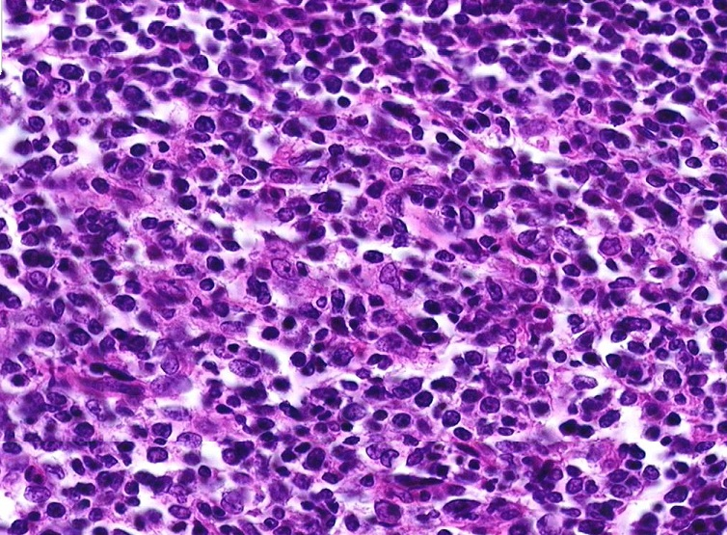
Final quiz
Self-check: Identify the organ, and the cells indicated by the arrows. (advance slide for answer)
Lymph node
macrophages
B lymphocytes (blast cells)

Slide 62
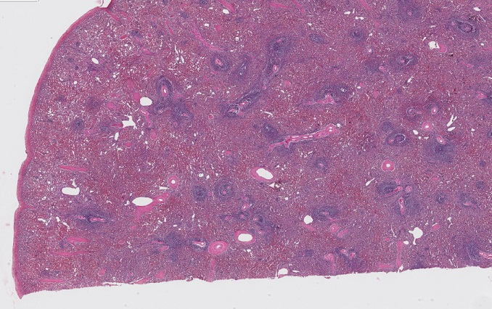
Final quiz
Self-check: Identify the organ and the structure indicated by the arrows. (advance slide for answer)
spleen
capsule

Slide 63
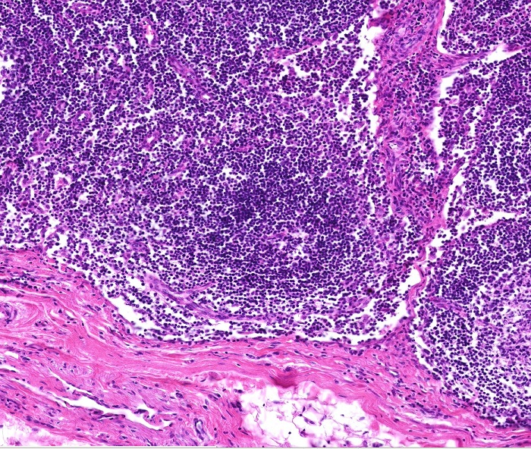
Final quiz
Self-check: Identify the structure indicated by the brackets. (advance slide for answer)
Trabecular sinus

Slide 64
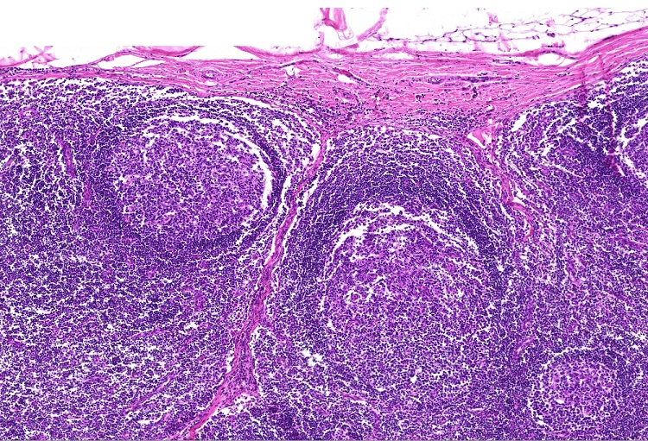
Final quiz
Self-check: Identify the structure indicated by the brackets. (advance slide for answer)
Subcapsular sinus

Slide 65
Final quiz
Self-check: Identify the organ. (advance slide for answer)
Lymph node

Slide 66
Final quiz
Self-check: Identify the cells indicated by the arrows. (advance slide for answer)
B lymphocytes / blast cells

Slide 67
Final quiz
Self-check: Identify the cells indicated by the arrows. Be specific. (advance slide for answer)
T lymphocytes

Slide 68
Final quiz
Self-check: Identify the structure indicated at X. (advance slide for answer)
vein
X

Slide 69
Final quiz
Self-check: Identify the cells indicated by the arrows. (advance slide for answer)
macrophages

Slide 70
Final quiz
Self-check: Identify the structure indicated at X. (advance slide for answer)
artery
X

Slide 71
Final quiz
Self-check: Identify the organ. (advance slide for answer)
Palatine tonsil

Slide 72
Final quiz
Self-check: Identify the outlined structure. (advance slide for answer)
Afferent lymphatic vessel

Slide 73
Final quiz
Self-check: Identify the cell indicated by the arrow. (advance slide for answer)
monocyte

Slide 74
Final quiz
Self-check: Identify the outlined regions. (advance slide for answer)
Splenic cords (of Billroth)

Slide 75
Final quiz
Self-check: Identify the organ. (advance slide for answer)
thymus

Slide 76
Final quiz
Self-check: Identify the outlined structure. (advance slide for answer)
artery

Slide 77
Final quiz
Self-check: Identify the outlined structures. (advance slide for answer)
Medullary cords

Slide 78
Final quiz
Self-check: Identify the cell indicated by the arrow. (advance slide for answer)
basophil
The granules are washed away, so a little tricksy.

Slide 79
Final quiz
Self-check: Identify the outlined structure. (advance slide for answer)
afferent lymphatic vessel

Slide 80
Final quiz
Self-check: Identify the cell indicated by the arrow. (advance slide for answer)
eosinophil

Slide 81
Final quiz
Self-check: Identify the structure indicated by the arrow. (advance slide for answer)
Central artery

Slide 82
Final quiz
Self-check: Identify the cells indicated by the arrows. (advance slide for answer)
Reticular cells

Slide 83
Final quiz
Self-check: Identify the cells indicated by the arrows. (advance slide for answer)
lymphocytes

Slide 84
Final quiz
Self-check: Identify the cell indicated by the arrow. (advance slide for answer)
macrophage

Slide 85
Final quiz
Self-check: Identify the outlined regions. (advance slide for answer)
Red pulp

Slide 86
Final quiz
Self-check: This micrograph was taken from the spleen. The vessel in the center is a central artery. Identify cells A and B . (advance slide for answer)
L = Lumen of vessel
A
A
A = endothelial cell
B = T lymphocytes of the periarteriolar lymphoid sheath (PALS)
L
B
B

Slide 87
Final quiz
Self-check: Identify the structure indicated by the brackets. (advance slide for answer)
Subcapsular sinus

Slide 88
Final quiz
Self-check: Identify the structure indicated by the brackets. (advance slide for answer)
Trabecular sinus

Slide 89
Final quiz
Self-check: Identify the outlined structure. (advance slide for answer)
Trabecular artery

Slide 90
Final quiz
Self-check: Identify the cell indicated by the arrow. (advance slide for answer)
lymphocyte

Slide 91
Final quiz
Self-check: Identify the organ. (advance slide for answer)
spleen

Slide 92
Final quiz
Self-check: Identify the outlined structures. (advance slide for answer)
Medullary sinuses

Slide 93
Final quiz
Self-check: Identify the outlined regions. (advance slide for answer)
Splenic cords (of Billroth)

Slide 94
Final quiz
Self-check: Identify the cell indicated by the arrow. (advance slide for answer)
neutrophil

Slide 95
Final quiz
Self-check: Identify the structures indicated by the arrows. (advance slide for answer)
Afferent lymphatic vessels

Slide 96
Final quiz
Self-check: Identify the outlined regions. (advance slide for answer)
Venous sinusoids

Slide 97
Final quiz
Self-check: Identify the structure indicated by the brackets. (advance slide for answer)
Subcapsular sinus

Slide 98
Final quiz
Self-check: Identify the structures indicated by the arrows. (advance slide for answer)
Penicillar arteries

Slide 99
Final quiz
Self-check: Identify the structure indicated by the X. (advance slide for answer)
Pulp vein
X

Slide 100
Final quiz
Self-check: Identify the structure indicated at X. (advance slide for answer)
Efferent lymphatic vessel
X

Slide 101
Final quiz
Self-check: Identify the organ. (advance slide for answer)
Lymph node

Slide 102
Final quiz
Self-check: Identify the organ. (advance slide for answer)
thymus

Slide 103
Final quiz
Self-check: Identify the cell indicated by the arrow. (advance slide for answer)
Plasma cell

Slide 104
Final quiz
Self-check: Identify the organ. (advance slide for answer)
Pharyngeal tonsil

Slide 105
Final quiz
Self-check: This slide was prepared by immunocytochemistry using an antibody to what specific cell type. (advance slide for answer)
T lymphocytes

Slide 106
Final quiz
Self-check: Identify the outlined structure. (advance slide for answer)
High endothelial venule

Slide 107
Final quiz
Self-check: Identify the outlined structure. (advance slide for answer)
Trabecular vein

Slide 108
Final quiz
Self-check: With regard to this organ specifically, identify the outlined regions. (advance slide for answer)
White pulp

Slide 109
Final quiz
Self-check: Identify the structure indicated by the arrows. (advance slide for answer)
Connective tissue septum

Slide 110
Final quiz
Self-check: This slide was prepared by immunocytochemistry using an antibody to what specific cell type. (advance slide for answer)
B lymphocytes

Slide 111
Final quiz
Self-check: Identify the outlined structure. (advance slide for answer)
artery

Slide 112
Final quiz
Self-check: Identify the structure indicated by the arrows. (advance slide for answer)
Trabecula

Slide 113
Final quiz
Self-check: Identify cell X. (advance slide for answer)
neutrophil
X

