Slide 1
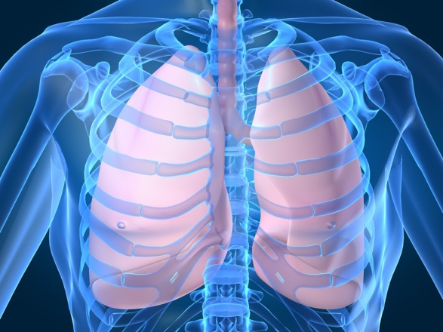
Lungs
Digital Laboratory
It’s best to view this in Slide Show mode, especially for the quizzes.
This module will take approximately 90 minutes to complete.

Slide 2
After completing this exercise, you should be able to:
Distinguish, at the light microscope level, each of the following organs and their specific features
Bronchus – respiratory epithelium, lamina propria, glands, hyaline cartilage, smooth muscle
(this is review, but we will see bronchi within the lung here)
Bronchiole - respiratory epithelium, lamina propria, smooth muscle
(regular) bronchiole
Terminal bronchiole
Respiratory bronchiole
Alveolar ducts
Alveolar sacs
Alveoli
Pulmonary artery
Bronchial (bronchiolar) artery
Pulmonary vein
Visceral Pleura
Alveolar macrophage / Dust Cell
Distinguish, at the electron microscopic level, each of the following cells or structures
Type I pneumocytes (type I alveolar cells)
Type II pneumocytes (type II alveolar cells)
Lamellar bodies
Basal lamina
Endothelial cells
Components of connective tissue (fibroblast, elastic fibers, etc.) if present
Alveolar macrophage (Dust cell)

Slide 3
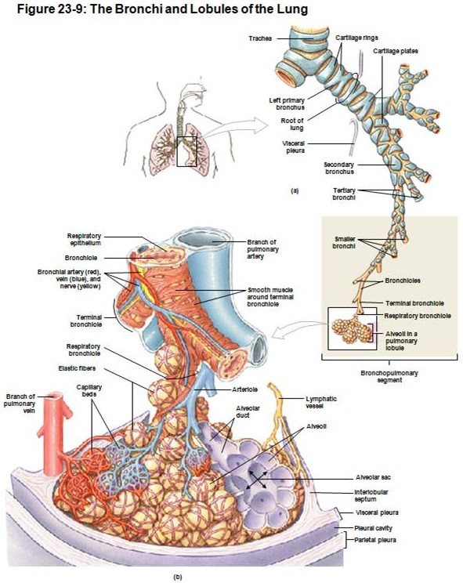
GROSS ANATOMY OF THE LUNG
Look and learn. Note:
Bronchi
Bronchioles
(regular) Bronchioles
Terminal bronchioles
Respiratory bronchioles
Alveoli
Alvoelar ducts
Alveolar sacs
As the respiratory passages divide and decrease in diameter, changes include:
Breakup and then loss of cartilage
Decrease in number of glands
Relative increase in smooth muscle
Decrease in height of the epithelium

Slide 4
GROSS ANATOMY OF THE LUNG
Look and learn. Note:
Bronchi
Bronchioles
(regular) Bronchioles
Terminal bronchioles
Respiratory bronchioles
Alveoli
Alvoelar ducts
Alveolar sacs
Bronchi have cartilage and glands, whereas bronchioles have neither of these.
Bronchioles narrow in diameter as they get closer to the alveoli. The smallest bronchioles have some alveoli associated with them and are called respiratory bronchioles. The bronchioles immediately proximal to respiratory bronchioles are called terminal bronchioles, while the remaining bronchioles are simply called bronchioles.
Alveolar ducts are long passages with alveoli, alveolar sacs are circular spaces leading to alveoli.

Slide 5
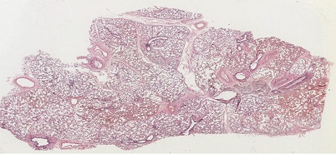
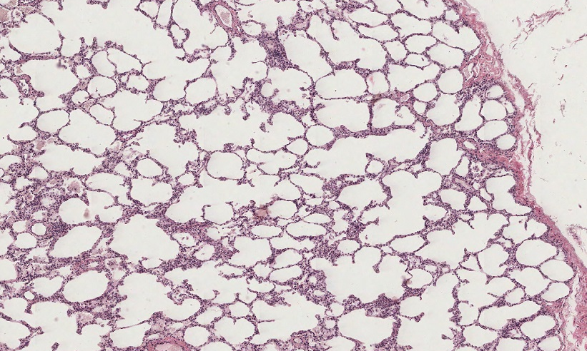
BRONCHI AND BRONCHIOLES
We’ll start with bronchi and bronchioles, but first things first. How do we know we’re looking at the lung. Fortunately, lungs have alveoli, which, as you know, are air sacs with thin membranes designed to maximize surface area and minimize diffusion distance. On sections of lung, alveoli come is various sizes, and some are open, some collapsed. Although all are connected to bronchioles, due to sectioning, some appear as individual structures (double arrows), while others are connected to a cluster of other alveoli (lines). More on this later…

Slide 6
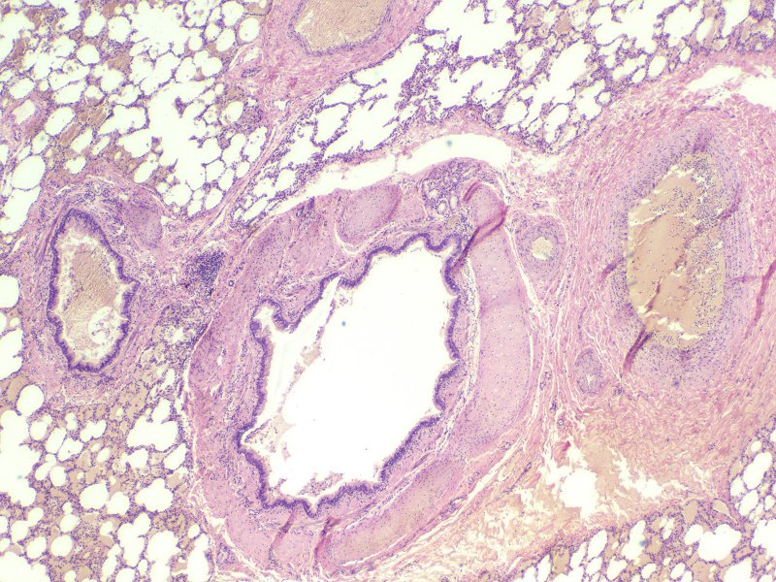
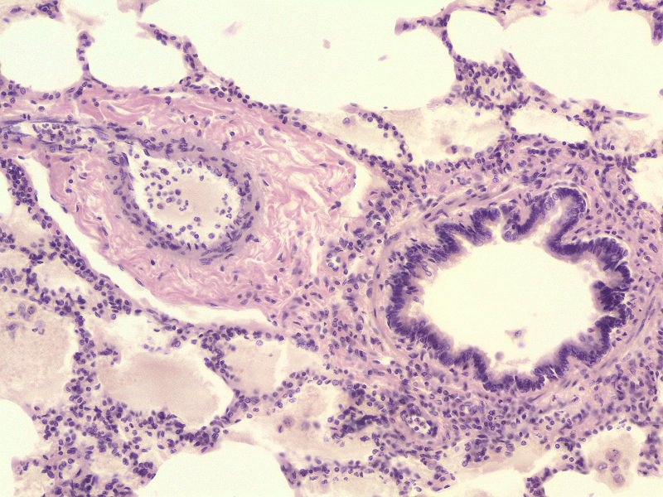
BRONCHI AND BRONCHIOLES
blood vessels
bronchus
bronchiole
You’ve already looked at bronchi in the last module, so let’s look at them again within the lung, and contrast them with bronchi.
First off, when you look at a section of lung (and the hilus for that matter), you’ll see many structures with thick walls and a lumen. Your first task will be to decide whether they belong to the respiratory tree (bronchi, bronchioles), or whether they are blood vessels (arteries and veins). This may seem simple, but many have trouble with this first step.
Fortunately, both bronchi and bronchioles have a pseudostratified or columnar epithelium; these taller, thinner cells results in nuclei that are close together, creating a basophilic inner lining. Contrast this with blood vessels, which, you recall, have a simple squamous epithelium of the tunica intima. Therefore, the inner lining of blood vessels has nuclei that are spread out, so blood vessels are less basophilic near the lumen.
We’ll deal with specific vessel identification later. For now, let’s compare bronchi and bronchioles.

Slide 7
BRONCHI AND BRONCHIOLES
By definition, bronchi become bronchioles when they lose their cartilage and glands. Right at about the location of the red arrow in this drawing.

Slide 8
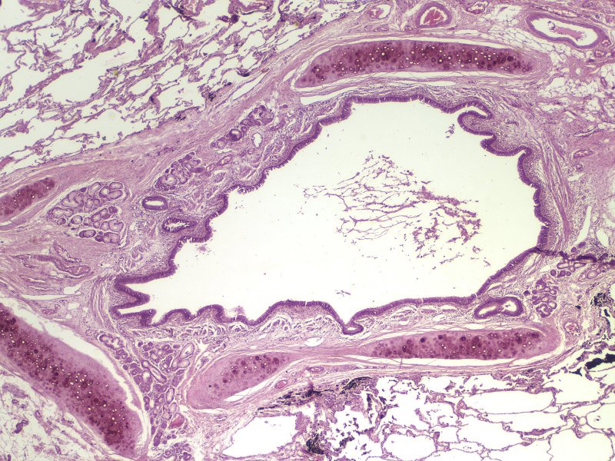
BRONCHI AND BRONCHIOLES
cartilage
bronchus
bronchus
As mentioned on the previous slide, bronchi have cartilage and glands, whereas bronchioles have neither of these.
However, it is sometimes difficult to determine for sure whether glands are present. It’s far easier to see cartilage, so that is a more reliable way to differentiate bronchi from bronchioles.
That’s it, it really is that simple.
BTW, don’t compare size here in these images, since the lower one was taken at higher magnification.
bronchiole

Slide 9
BRONCHI AND BRONCHIOLES
Video showing bronchi vs. bronchioles – slide 112
Link to SL 112B and SL 113 and SL 059 and SL 114
Be able to identify:
bronchus
Mucosa
Respiratory epithelium
Thick basement membrane
Lamina propria
Glands
Hyaline cartilage plates
Smooth muscle
bronchiole
Mucosa
Respiratory epithelium
Thick basement membrane
Lamina propria
Smooth muscle

Slide 10
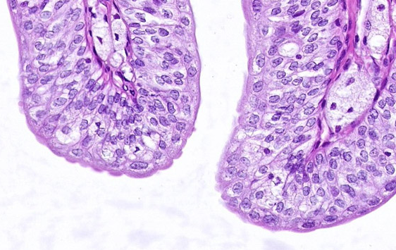
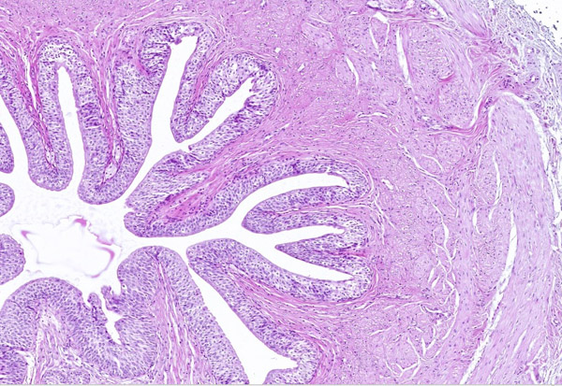
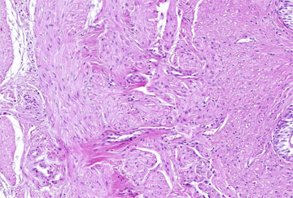
QUIZ
Self-check: Identify the structure / organ from which these slides were taken. (advance slides for answers)
ureter

Slide 11
RESPIRATORY AND TERMINAL BRONCHIOLES
The transition from bronchioles to alveoli is gradual. The smallest bronchioles have some alveoli associated with them and are called respiratory bronchioles. The bronchioles immediately proximal to respiratory bronchioles are called terminal bronchioles.

Slide 12
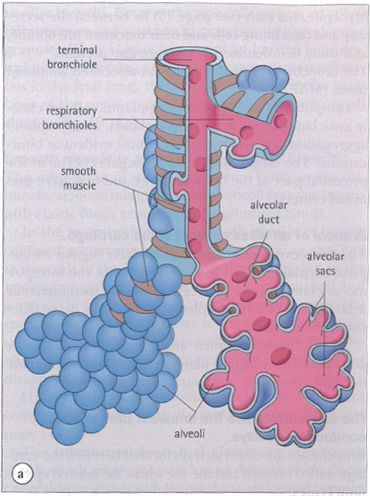
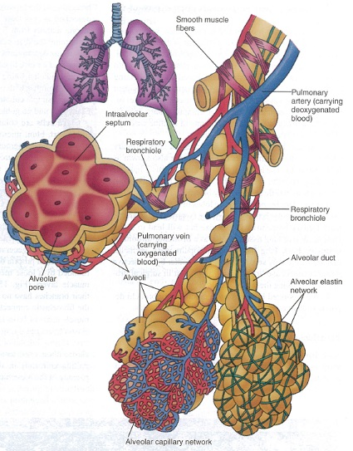
RESPIRATORY AND TERMINAL BRONCHIOLES
Two more drawings to make sure we’re not missing the point. Respiratory bronchioles are bronchioles that have a few alveoli associated with them, before the give way to all alveoli. Terminal bronchioles are the last (smallest) bronchioles without alveoli, so they are just proximal to the respiratory bronchioles.
Remember that bronchioles are relatively thick walled, and lined by respiratory epithelium (though that epithelium at this point may have shortened to simple columnar instead of pseudostratified. Alveoli are thin walled, lined by simple squamous epithelium. Therefore, respiratory bronchioles will have an epithelial lining that alternates from respiratory epithelium to simple squamous. Terminal bronchioles are lined entirely by respiratory epithelium.

Slide 13
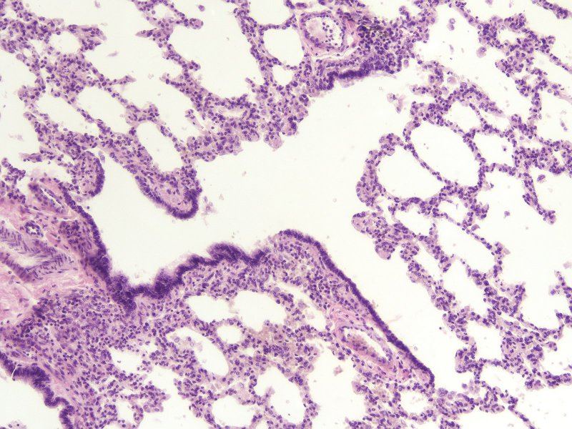
TERMINAL AND RESPIRATORY BRONCHIOLES
Here you can see respiratory bronchioles (green lines) partially lined with respiratory epithelium, and partially lined with alveoli.
The terminal bronchiole (X) is connected to the respiratory bronchiole and is completely lined with respiratory epithelium (yes, I see the very top part is not, but it’s likely transitioning into a respiratory bronchiole at that point.
X
Note the pattern of alveoli in the respiratory bronchioles varies here. The more horizontal one has a top border that actually alternates between alveolar (blue arrows) and respiratory epithelium red arrows). The more vertical respiratory bronchiole actually has respiratory epithelium on one side and alveolar epithelium on the other. Both fit the definition of respiratory bronchiole.
Also, note the alveoli along these respiratory bronchioles are collapsed.

Slide 14
TERMINAL AND RESPIRATORY BRONCHIOLES
Video showing terminal and respiratory bronchioles – slide 114
Link to SL 112B and SL 113 and SL 059 and SL 114
Be able to identify:
Terminal bronchioles
Respiratory bronchioles
Note these are difficult to find, and may require some interpretation (imagination).

Slide 15
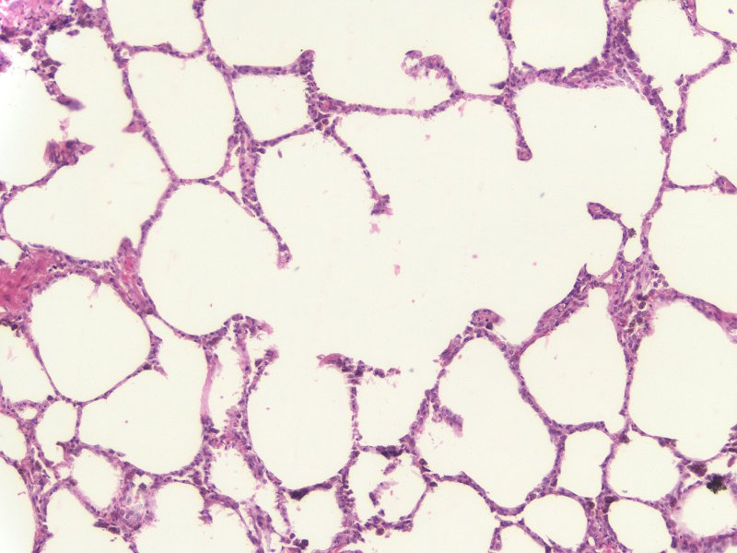
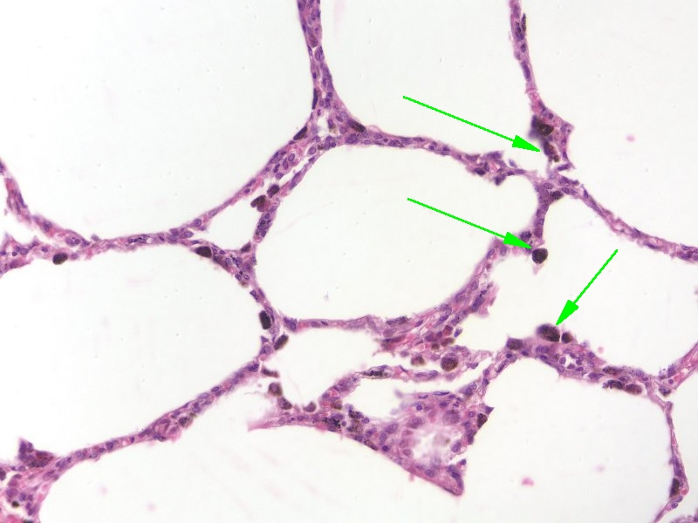
ALVEOLI, ALVEOLAR DUCTS, ALVEOLAR SACS
The alveoli are the terminal structures of the respiratory tract. They are lined with simple squamous epithelium, with connective tissue within their walls.
alveolus
Ignore the green arrows for now.
alveolus
alveolus
Remember, we said that the simple squamous epithelium means the nuclei lining these alveoli are spread out, so alveoli do not have a basophilic inner lining.
alveolus

Slide 16
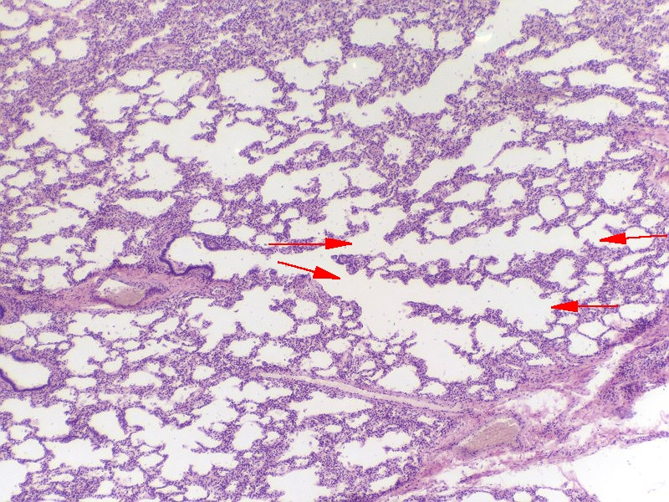
ALVEOLI, ALVEOLAR DUCTS, ALVEOLAR SACS
The terminal portions of the respiratory tract that lead into individual alveoli can be classified based on shape as either elongated alveolar ducts (between red arrows) or “rounder” alveolar sacs. By definition, neither of these should have respiratory epithelium (or they would be called respiratory bronchioles).
Alveolar sac

Slide 17
ALVEOLI, ALVEOLAR DUCTS, ALVEOLAR SACS
Video showing alveolar ducts and sacs – slide 112
Link to SL 112B and SL 113 and SL 059 and SL 114
Be able to identify:
Alveoli
Alveolar ducts
Alveolar sacs

Slide 18
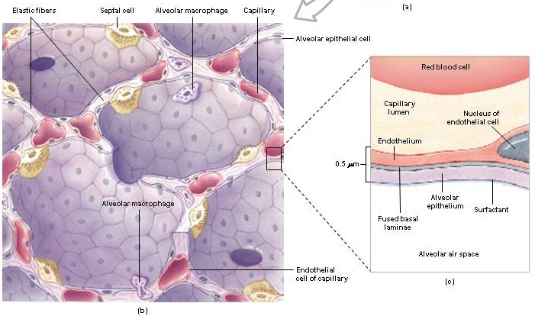
ULTRASTRUCTURE OF ALVEOLI
More details about alveolar structure….
In the drawing, you can see that the alveolar cells are of three types:
type I alveolar cells (type I pneumocytes) – simple squamous, labeled alveolar epithelial cell, part of blood-air barrier
type II alveolar cells (type II pneumocytes – cuboidal, labeled septal cell, produces surfactant
Alveolar macrophages (dust cells)
The walls of the alveoli contain loose connective tissue with lots of elastic fibers and capillaries.

Slide 19
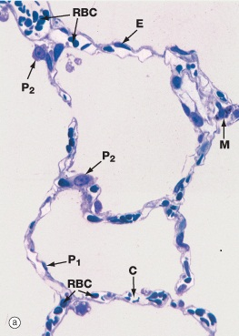
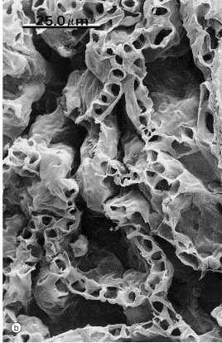
ULTRASTRUCTURE OF ALVEOLI
Our slides are sectioned too thick to see much detail in the alveoli. However, this sweet image from Wheater’s text is a thin resin section which shows good cellular detail:
P1 – type I pneumocyte (squamous, lines alveoli)
P2 – type II pneumocyte (cuboidal, also part of alveolar lining)
M – alveolar macrophage
C – capillary
E – endothelial cell
The type I and II cells are both part of the alveolar lining, i.e. they are part of the same epithelial sheet, and are joined by tight junctions (see later EMs). Type II cells are typically seen at “corners” of the alveoli.
In contrast, you know macrophages are relatively mobile. The same is true here; resident macrophages, called dust cells, can be found in the interstitial tissue, in the lumen of the alveoli, or along the surface epithelium.
Scanning EM of similar cut – sweet!!!

Slide 20
ALVEOLI, ALVEOLAR DUCTS, ALVEOLAR SACS
Video showing alveoli from our slide set – slide 112
Link to SL 112B and SL 113 and SL 059 and SL 114
Be able to identify:
Alveoli
Alveolar ducts
Alveolar sacs

Slide 21
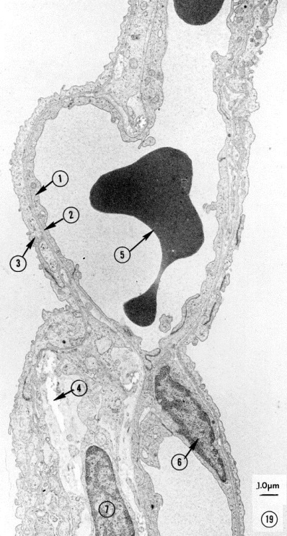
ULTRASTRUCTURE OF ALVEOLI
Understanding ultrastructural details of the alveoli at the EM level is crucial for understanding lung function and pathology. First, it helps to be able to determine whether this is actually lung tissue. Fortunately, the air-filled alveoli create lots of “space” on an EM, which is a characteristic feature of lungs.

Slide 22
ULTRASTRUCTURE OF ALVEOLI
The next objective is to determine which spaces are air, and which are blood. This is easy enough when you see a red blood cell (5), and is the best place to start your analysis. If you mentally cross an alveolar wall (blue brackets), you will be in the air spaces (alveolar lumen). If, from the air space at the bottom, you cross the alveolar wall indicated by the green bracket, you are back in the blood space (X, even though you do not see a RBC in that space).
air
air
X
air

Slide 23
ULTRASTRUCTURE OF ALVEOLI
The other thing you can do is guess a little. For example, if you look at the light micrograph again, you’ll see that the alveolar lumens are much larger than the capillary lumens. Therefore, on EMs, the blood capillary compartments are small, round and/or enclosed, while the air compartments are “open” or more “vast”. (If that makes any sense at all. If not, use the method on the previous slide).
air
air
X
air

Slide 24
ULTRASTRUCTURE OF ALVEOLI
Once you have that worked out, you can start determining the cellular structures….
air
air
air
Electron micrograph from the lung:
Endothelial cell
Fused basal lamina
Type I pneumocyte
Elastic tissue
RBC in capillary
Endothelial cell nucleus
Fibroblast in inter-alveolar space
Right now I’m guessing you have a good handle on #5 and #6, but you want to see #1-3 a little closer, and are unsure of #4 and #7.
Let’s take a closer look at #1-3 to start…..

Slide 25
ULTRASTRUCTURE OF ALVEOLI
air
air
blood
Pseudo-magnified view of #1-3. You don’t see the nuclei for the endothelial cell (#1) or the type I pneumocyte (#3), but you can easily see that they are squamous cells. The tips of the red and blue arrows are touching the plasma membranes of the endothelial cell and type I pneumocyte, respectively.
The pale region between the cells (#2) is the fused basement of these two cells…if you look closely, you’ll see a dark line representing the lamina densa.

Slide 26
ULTRASTRUCTURE OF ALVEOLI
air
air
Type I pneumocyte cytoplasm
Endothelial cell cytoplasm
blood
Because you paid big bucks for this education, I magnified this even more. Red arrows are the plasma membrane of the endothelial cell, blue arrows are the plasma membrane of a type I pneumocyte, pale region between the cells is the fused basal lamina (bracket).

Slide 27
ULTRASTRUCTURE OF ALVEOLI
air
blood
*
Now, if you follow these cells to the left, the type I pneumocytes (there are two of them jointed by a tight junction) follow the air space (blue arrow), while the endothelial cells follow the capillary lumen (i.e. they separate at the *).
At the point when the two epithelia separate, the basal lamina separates at the * as well, part follows the type I call, the other part follows the endothelial cell. This is hard to see, but it is there if you squint really hard. The area between these two cells (shaded faint purple), where #4 and #7 are, is all connective tissue - has to be. Thus, elastic fibers (#4) and a fibroblast (#7).

Slide 28
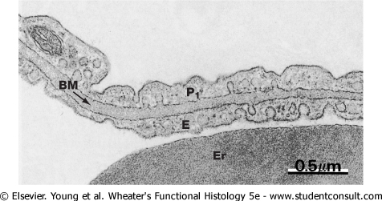
ULTRASTRUCTURE OF ALVEOLI
Here’s a better electron micrograph focusing in on the air-blood barrier:
P1 – type I pneumocyte
E – endothelial cell
BM – fused basal lamina
Er - erythrocyte
Thought not the case here, endothelial cells usually have more caveoli/pinocytotic vesicles than type I pneumocytes.
air

Slide 29
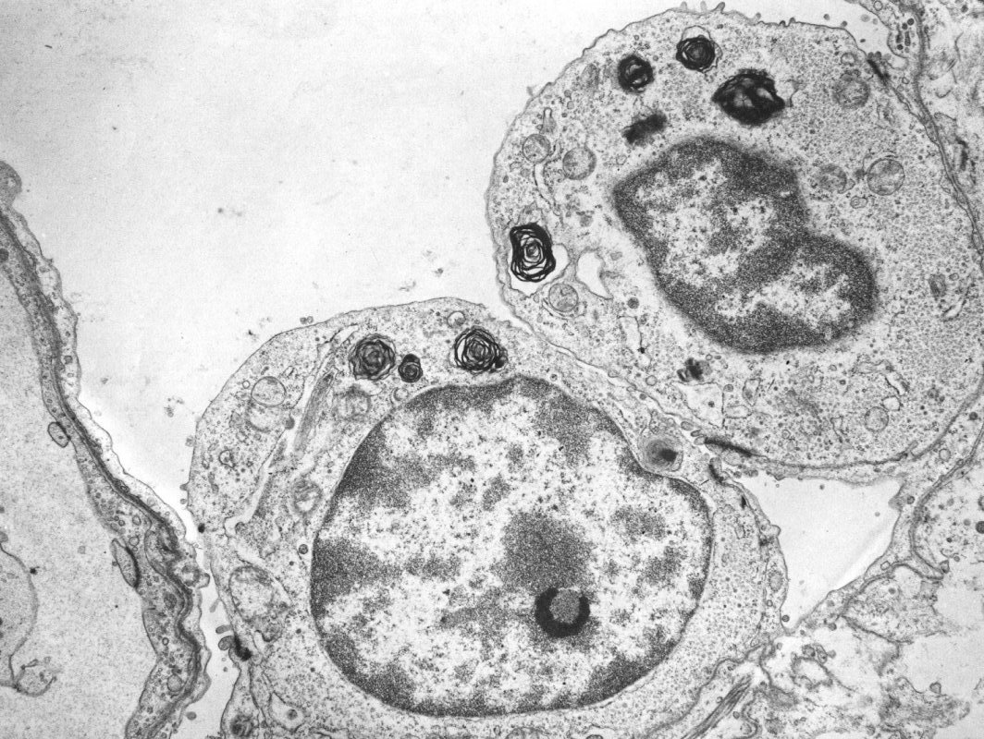
ULTRASTRUCTURE OF ALVEOLI
Type II pneumocytes have lamellar bodies (orange arrows) and form tight junctions (red arrows) with type I cells (blue arrows).
Remember; type II pneumocytes are part of the alveolar epithelium, so being joined to type I cells by tight junctions should be no surprise.
air
blood

Slide 30
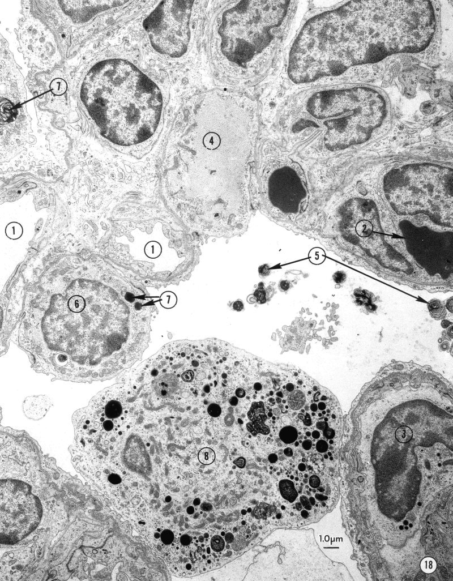
ULTRASTRUCTURE OF ALVEOLI
Electron micrograph from the fetal lung:
Capillary
RBC in capillary
WBC in capillary
Glycogen
Lamellar bodies in alveolar space
Type II pneumocyte
Lamellar bodies in type II pneumocyte
Macrophage (dust cell)
Type II pneumocytes have lamellar bodies and form tight junctions (red arrows) with type I cells (blue arrows).
Alveolar macrophages also have lamellar bodies, but often in lysosomes showing different stages of digestion. Macrophages do not make tight junctions with type I or type II cells.
This is a fetal lung; amniotic fluid in the alveoli prevent the lamellar bodies from unraveling upon release.

Slide 31
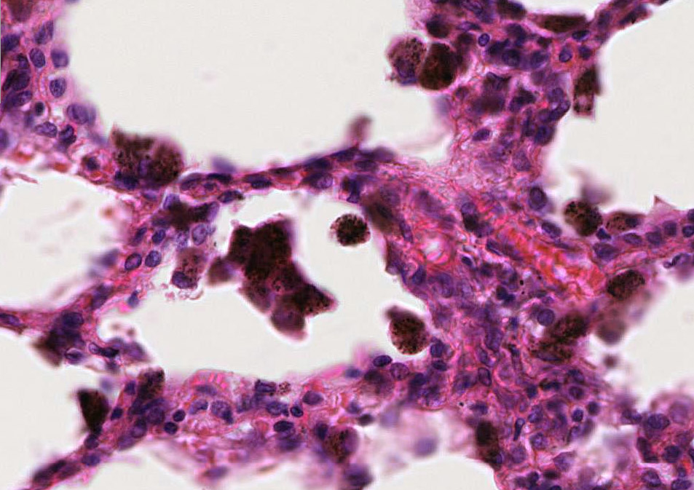
ALVEOLAR MACROPHAGES (DUST CELLS)
As you know, macrophages are large, and phagocytose cells and debris. Resident macrophages in the lung, alveolar macrophages (blue arrows), accumulate inhaled debris not filtered by the mucociliary escalator of the upper respiratory system. Because they accumulate debris, they are seen as brown/black, even when not stained – thus the name dust cells.
Note the location of dust cells: with the alveolar lumen, along the walls of the alveoli, in the connective tissue….basically everywhere.

Slide 32
ALVEOLAR MACROPHAGES (DUST CELLS)
Video showing alveolar macrophages (dust cells) – slide 113
Link to SL 113 and SL 059
Be able to identify:
Alveolar macrophages (Dust cells)

Slide 33
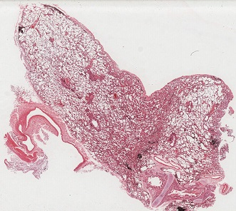
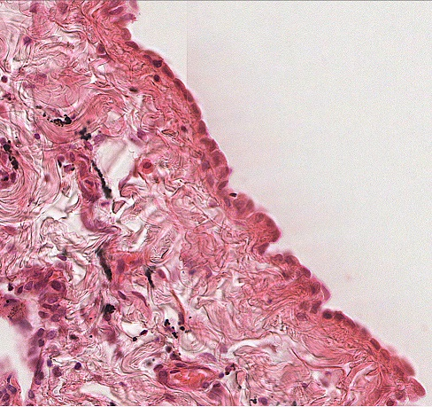
VISCERAL PLEURA
As you know, the outer lining of the viscera is an epithelium, usually simple squamous or low cuboidal. In the lungs, this is the visceral pleura (arrows)
You’ll see variation here. Many times there are visible cells, as shown here. Other times, the outer layer will appear smooth, but with no visible cells. Still other times the epithelium will be torn off.

Slide 34
VISCERAL PLEURA
Video showing visceral pleura – slide 114
Link to SL 113 and SL 059 and SL 114
Be able to identify:
Visceral pleura
You also may want to look at SL 184, which is the elastic stain. The left tissue is lung – purple/black is elastic fibers.

Slide 35
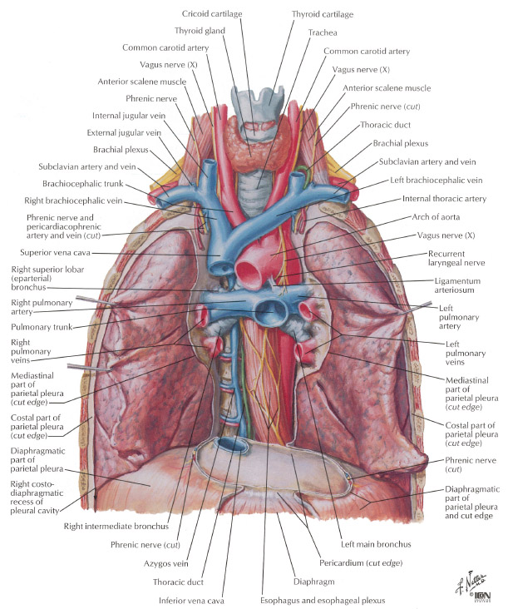
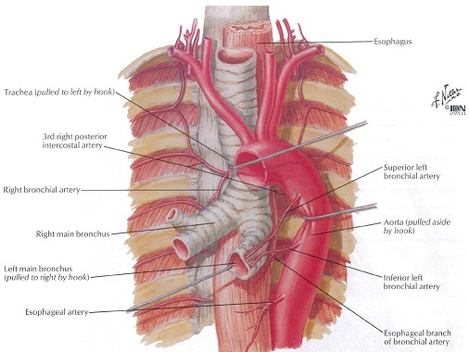
VASCULATURE OF THE LUNG
The lungs are relatively unique in that they get a dual blood supply.
Most of the blood to the lungs is deoxygenated, delivered from the right side of the heart through the pulmonary arteries. This blood is destined to become oxygenated in the alveoli, and, therefore, does not give rise to capillaries until that point.
A small amount of blood is carried to the lungs by the bronchial (bronchiolar) arteries, branches of the aorta. Because this oxygenated blood is necessary to supply the cells of the trachea, bronchi, and bronchioles, these vessels branch into arterioles and capillaries within the walls of these structures.
This may seem like an obvious and trivial point to make, but you’ll see on the next slides that it is important to understand.

Slide 36
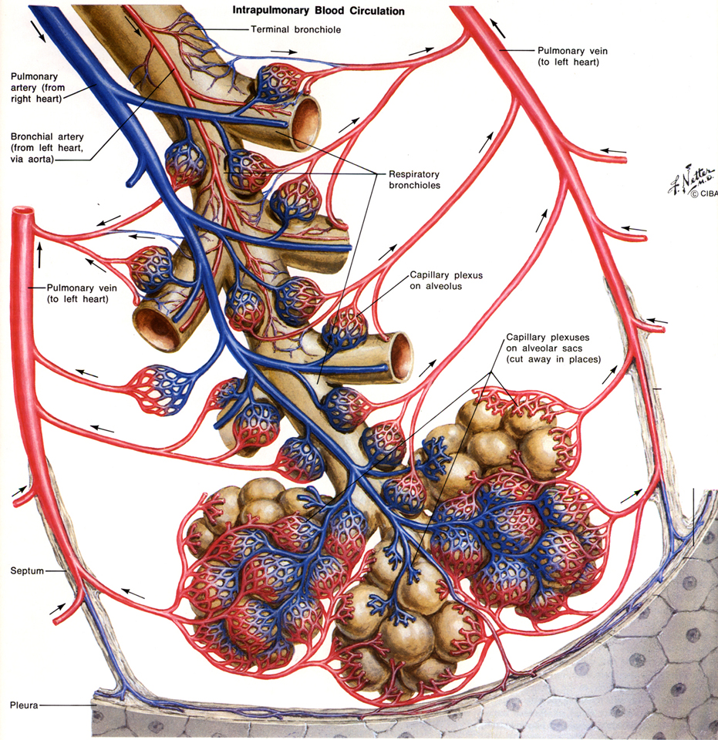
VASCULATURE OF THE LUNG
Shown here is a segment of lung supplied by a terminal bronchiole. Things to note:
Both arteries (pulmonary and bronchial) and branches of the respiratory tree are positioned in the center of the segment, while the pulmonary veins return along the partitions between adjacent segments.
The pulmonary artery is approximately the same size as the respiratory tree (or close), while the bronchial artery is much smaller and within the wall of the respiratory tree.
The pulmonary arteries are under low pressure, so it’s difficult to distinguish these from veins based on thickness of their walls. We will use the position of these vessels described above to identify these structures.

Slide 37
VASCULATURE OF THE LUNG
So, based on what we just described on the previous slide, when looking at histological sections, you should note that:
You will see the bronchus/bronchiole, pulmonary artery, and bronchial artery together in the same bundle, while the pulmonary veins will be their lonesome……how sad :=(
The pulmonary artery will be approximately the same size as the bronchus/bronchiole, while the bronchial arteries will be much smaller and within the wall of the bronchus/bronchiole.
Remember, because the pulmonary arteries are under low pressure, they have thinner walls than most arteries, so it’s hard to tell these vessels apart by look at their pure histology. Identify them by position (and size).

Slide 38
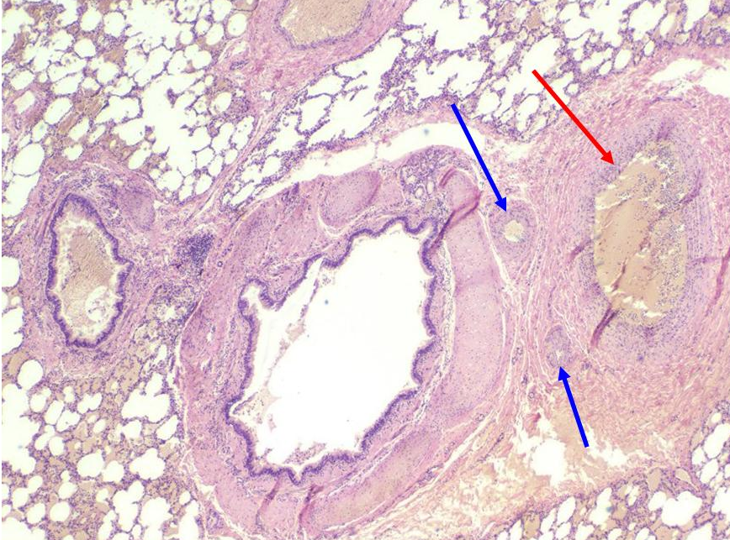
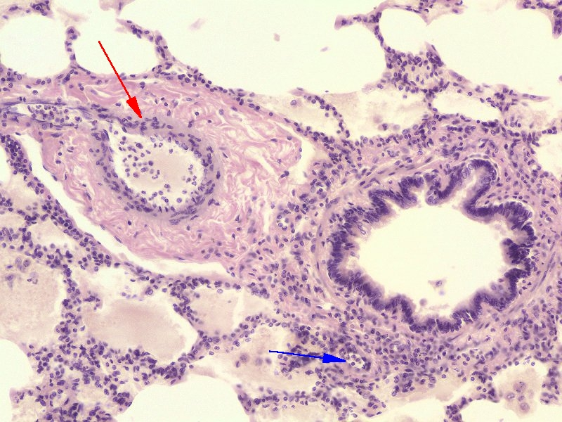
VASCULATURE OF THE LUNG
bronchiole
bronchus
Here are two images showing a region in the center of a pulmonary segment.
The bronchus/bronchiole, (branch of the) pulmonary artery, and bronchial / bronchiolar artery are bundled together (orange outline) in the middle of a lobule. The pulmonary artery (red arrows) has the same approximate diameter as the bronchus or bronchiole that accompanies it. The bronchial / bronchiolar artery (blue arrows) is within the wall of, and much smaller in diameter than, the bronchus or bronchiole it supplies.

Slide 39
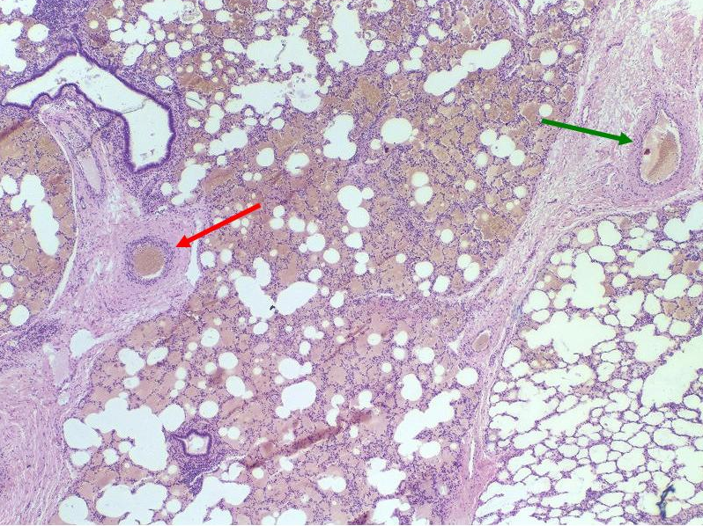
VASCULATURE OF THE LUNG
This image was taken at lower magnification to include the center and edge of a segment.
The pulmonary veins (green arrow) are found in the partitions between the lobules, away from the bundled bronchus/bronchiole, pulmonary and bronchial / bronchiolar arteries. (red arrow is pulmonary artery)
There are small lymphatic vessels associated with the bronchi and bronchioles, as well as in the partitions between lobules; these are difficult to definitively identify on our slides.

Slide 40
VASCULATURE OF THE LUNG
Video showing pulmonary vasculature – slide 112
This is an older video, turn down the volume a little to avoid the Giffin Effect.
Link to SL 112B and SL 113 and SL 059 and SL 114
Be able to identify:
Pulmonary arteries
Bronchial / bronchiolar arteries (arterioles)
Pulmonary veins
Note: Slide 112A from which this video was made using the old Bacus system is not available on the Aperio system.

Slide 41
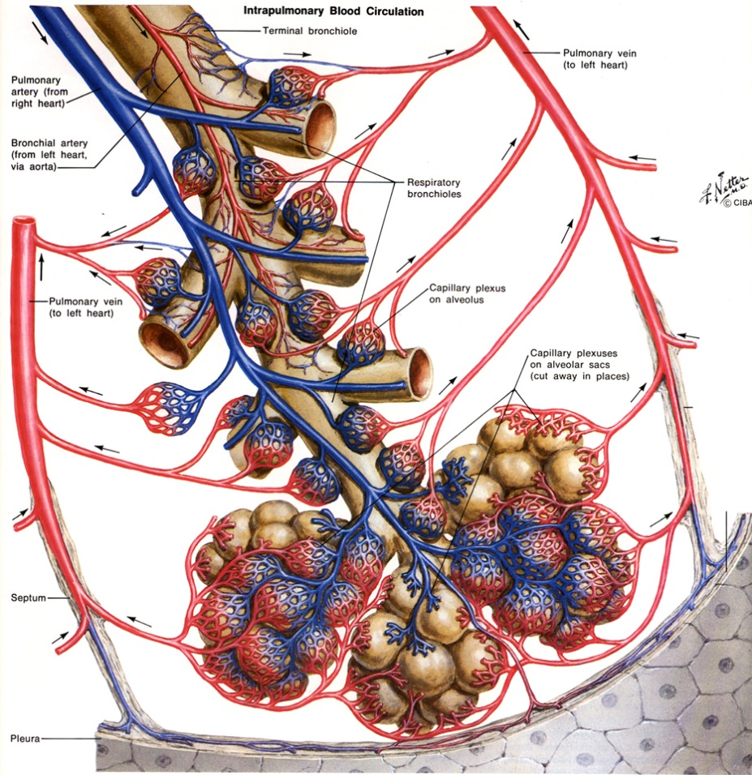
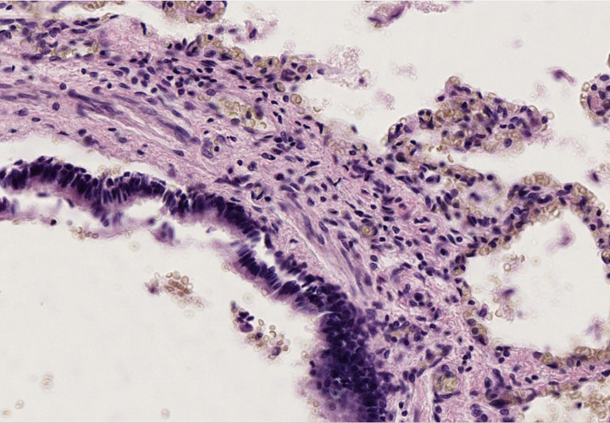
VASCULATURE OF THE LUNG
A little physiology FYI: The pulmonary arteries and bronchial arteries near the alveoli drain into the capillaries supplying the alveoli, which then feed into the pulmonary veins.
However, proximal bronchial arteries (i.e. those away from the alveoli) supply capillaries that feed into bronchial veins (see orange arrow in drawing, likely bronchial vein indicated in image to the right). You do not have to definitively identify bronchial veins.
Therefore blood leaving alveolar capillaries is 100% saturated, but gets “diluted” by deoxygenated blood returning via these bronchial veins, so that blood ultimately draining into the left atrium is slightly unsaturated (this is called an anatomical shunt).

Slide 42
The next set of slides is a quiz for this module. You should review the structures covered in this module, and try to visualize each of these in light and electron micrographs.
Distinguish, at the light microscope level, each of the following organs and their specific features
Bronchus – respiratory epithelium, lamina propria, glands, hyaline cartilage, smooth muscle
(this is review, but we will see bronchi within the lung here)
Bronchiole - respiratory epithelium, lamina propria, smooth muscle
(regular) bronchiole
Terminal bronchiole
Respiratory bronchiole
Alveolar ducts
Alveolar sacs
Alveoli
Pulmonary artery
Bronchial (bronchiolar) artery
Pulmonary vein
Visceral Pleura
Alveolar macrophage / Dust Cell
Distinguish, at the electron microscopic level, each of the following cells or structures
Type I pneumocytes (type I alveolar cells)
Type II pneumocytes (type II alveolar cells)
Lamellar bodies
Basal lamina
Endothelial cells
Components of connective tissue (fibroblast, elastic fibers, etc.) if present
Alveolar macrophage (Dust cell)

Slide 43
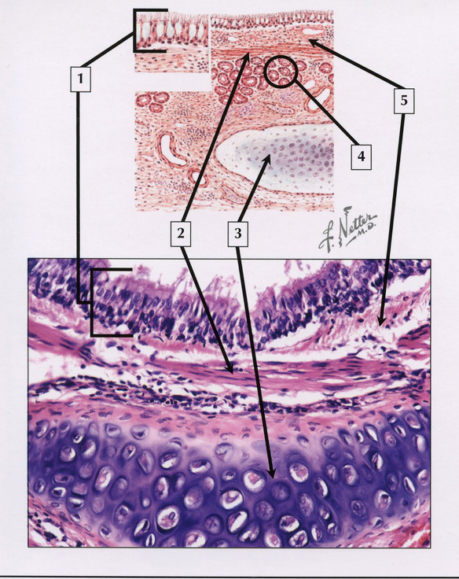
QUIZ
Self-check: Identify the entire structure, and 1-5. (advance slides for answers)

Slide 44
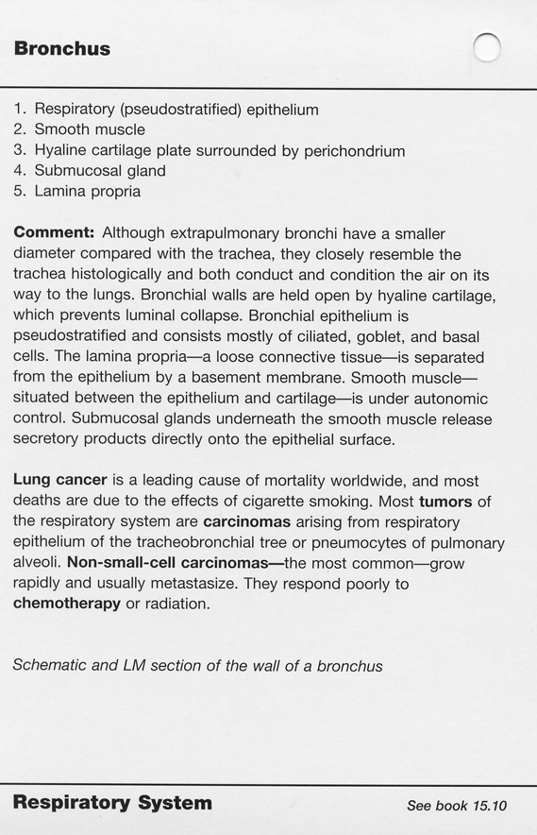

Slide 45
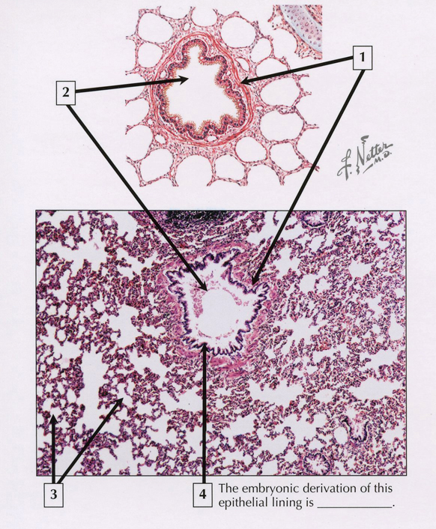
QUIZ
Self-check: Identify entire structure in middle, and 1-3, (and 4?) (advance slides for answers)

Slide 46
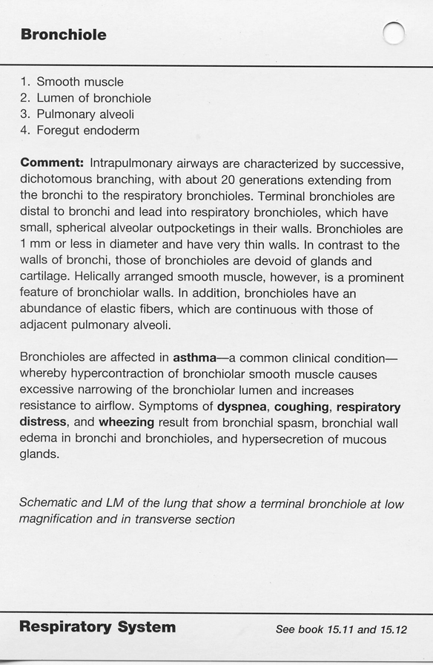

Slide 47
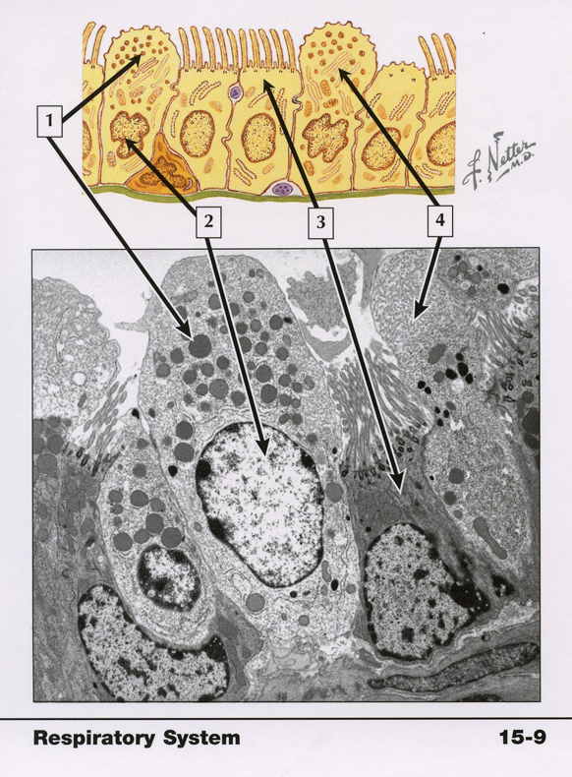
QUIZ
Self-check: Identify 1-4. (advance slides for answers)
Note, this is a section of a terminal bronchiole. You didn’t look at these specifically in this module, but maybe you can figure these out.

Slide 48
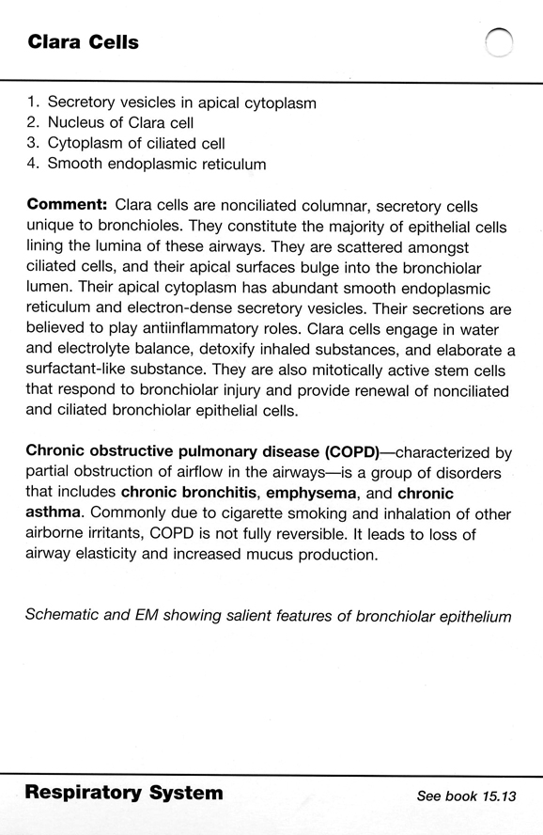

Slide 49
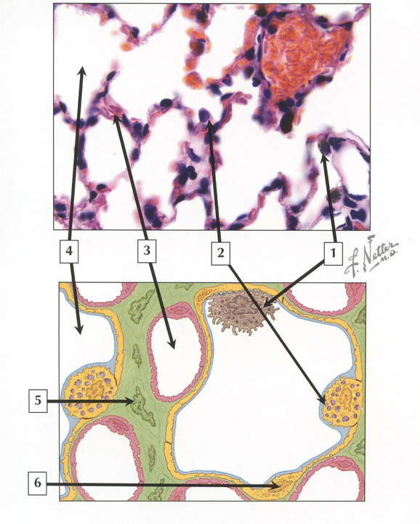
QUIZ
Self-check: Identify 1-6. (advance slides for answers)

Slide 50
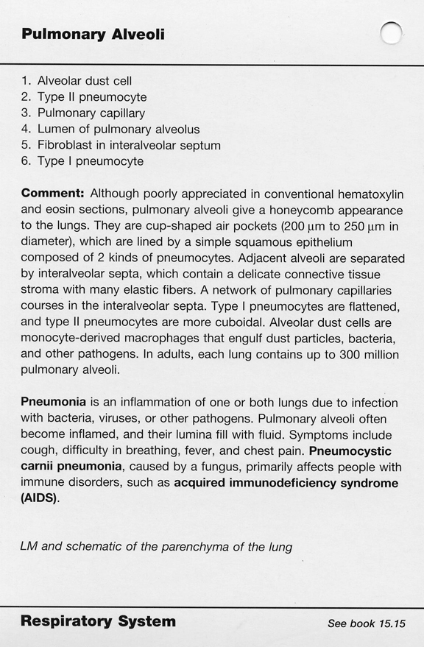

Slide 51
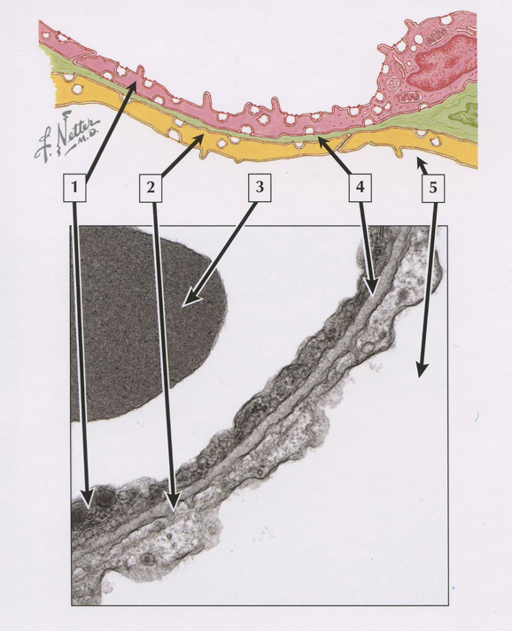
QUIZ
Self-check: Identify 1-5. (advance slides for answers)

Slide 52
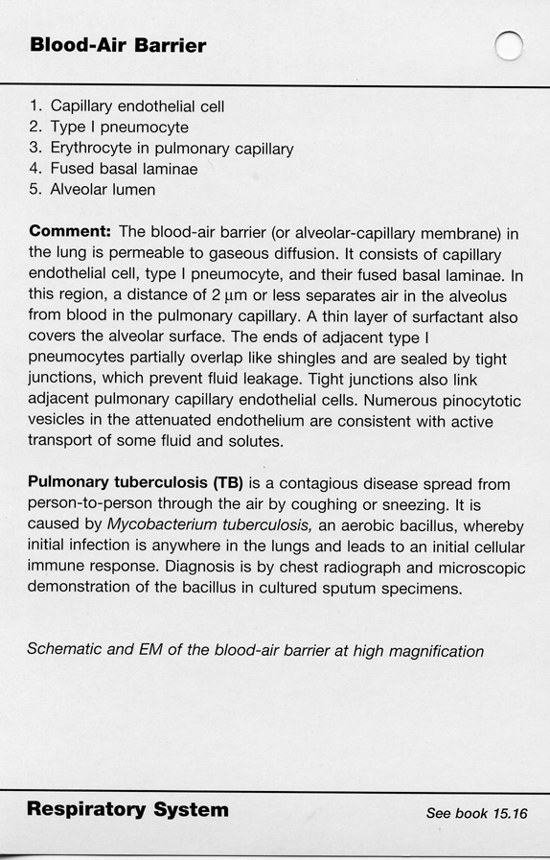

Slide 53
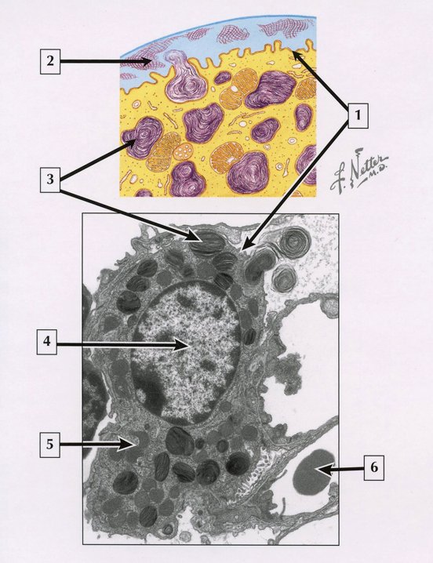
QUIZ
Self-check: Identify 1-6. (advance slides for answers)

Slide 54
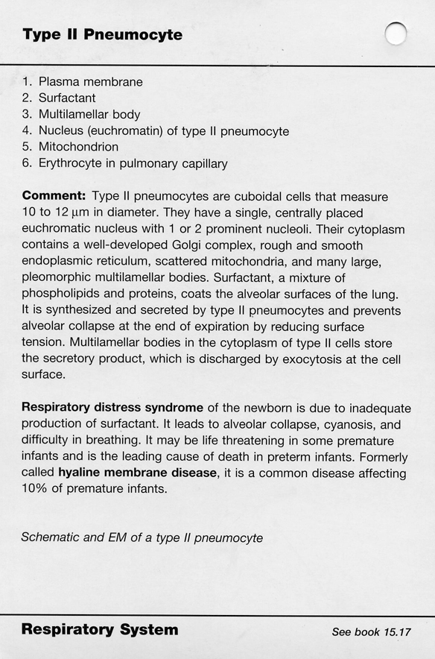

Slide 55
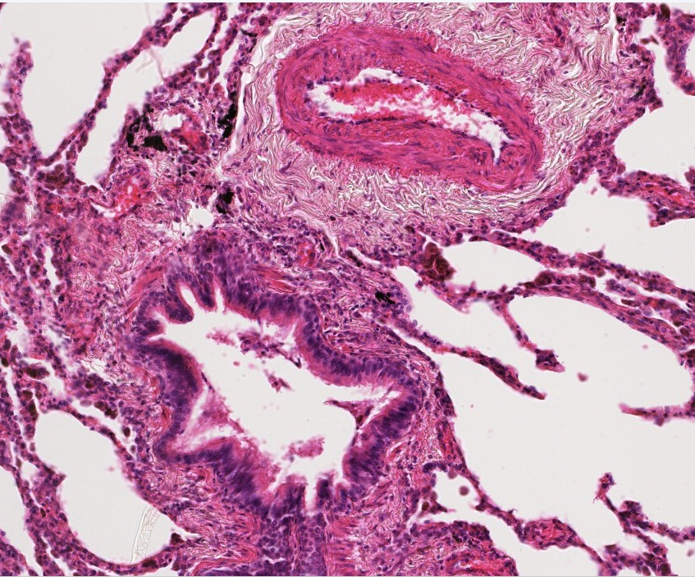
QUIZ
Self-check: Identify. (advance slides for answers)
Bronchiolar
(bronchial) artery

Slide 56
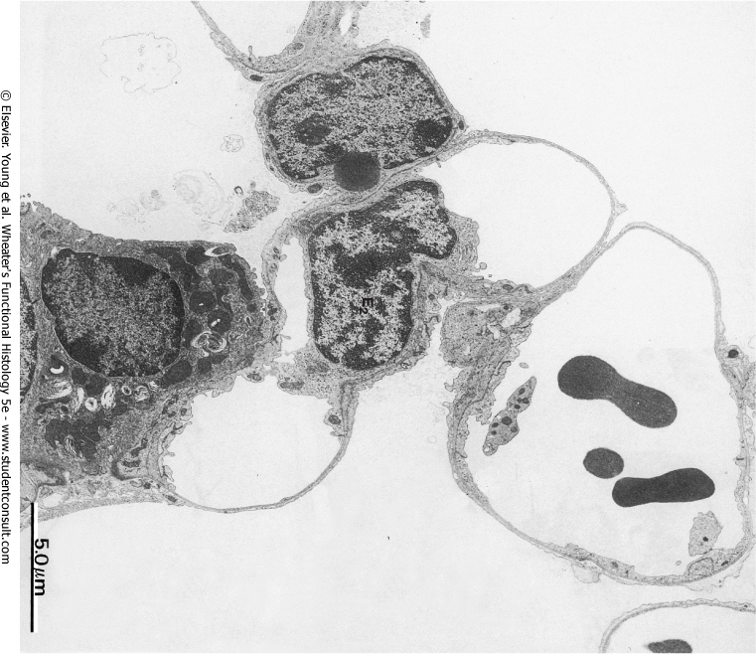
QUIZ
Self-check: Which are blood, and which are air? (advance slides for answers)
Blood or air?
Blood or air?
air
Blood or air?
Blood or air?
Blood or air?

Slide 57
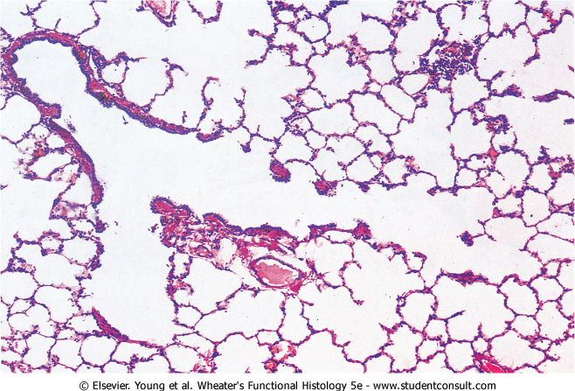
QUIZ
Self-check: Identify the outlined structure. (advance slides for answers)
Terminal bronchiole

Slide 58
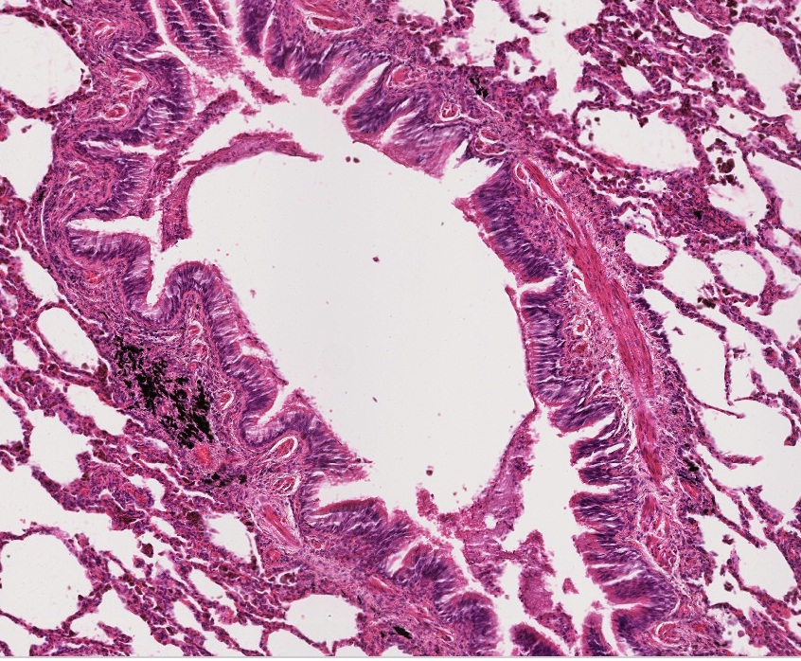
QUIZ
Self-check: Identify the structure at X. (advance slides for answers)
bronchiole
X

Slide 59
QUIZ
Self-check: Identify the cell at X. (advance slides for answers)
Type II pneumocyte
X

Slide 60
QUIZ
Self-check: Identify these cells. (advance slides for answers)
Alveolar macrophages / dust cells

Slide 61
QUIZ
Self-check: Identify the structure at X. (advance slides for answers)
Pulmonary vein
X

Slide 62
QUIZ
Self-check: Identify the cell. (advance slides for answers)
fibroblast

Slide 63
QUIZ
Self-check: Identify the structure. (advance slides for answers)
Bronchiolar
(bronchial) artery

Slide 64
QUIZ
Self-check: Identify the structure at X. (advance slides for answers)
X
bronchus

Slide 65
QUIZ
Self-check: Identify the outlined structure. (advance slides for answers)
Pulmonary artery

Slide 66
QUIZ
Self-check: Identify the cell indicated by the arrows. (advance slides for answers)
Type I pneumocyte

Slide 67
QUIZ
Self-check: Identify the outlined structure. (advance slides for answers)
bronchiole

Slide 68
QUIZ
Self-check: Identify the outlined structure. (advance slides for answers)
Alveolar duct

Slide 69
QUIZ
Self-check: Identify the structures indicated by the arrows. (advance slides for answers)
Lamellar bodies

Slide 70
QUIZ
Self-check: Identify the outlined structure. (advance slides for answers)
Pulmonary vein

Slide 71
QUIZ
Self-check: Identify the cell. (advance slides for answers)
Type II pneumocyte
(lamellar bodies washed out)

Slide 72
QUIZ
Self-check: Identify the structure. (advance slides for answers)
X
Pulmonary artery

Slide 73
QUIZ
Self-check: Identify the cell. (advance slides for answers)
Type I pneumocyte

Slide 74
QUIZ
Self-check: Identify the structure closest to the arrows. (advance slides for answers)
Visceral pleura

Slide 75
QUIZ
Self-check: Identify the outlined structure. (advance slides for answers)
Respiratory bronchiole

Slide 76
QUIZ
Self-check: Identify the cell indicated by the arrows. (advance slides for answers)
Endothelial cell

Slide 77
QUIZ
Self-check: Identify the outlined structure. (advance slides for answers)
Alveolar duct

Slide 78
QUIZ
Self-check: Identify this cell. (advance slides for answers)
Alveolar macrphage
X

Slide 79
QUIZ
Self-check: Identify the cell indicated by the arrows. (advance slides for answers)
Type I pneumocyte

Slide 80
QUIZ
Self-check: Identify the outlined structure. (advance slides for answers)
Respiratory bronchiole

Slide 81
QUIZ
Self-check: Identify the outlined structure. (advance slides for answers)
Connective tissue

Slide 82
QUIZ
Self-check: Identify the structure at X. (advance slides for answers)
X
Pulmonary artery

Slide 83
QUIZ
Self-check: Identify the outlined structure. (advance slides for answers)
Alveolar sac

Slide 84
QUIZ
Self-check: Identify structure between arrows. (advance slides for answers)
Fused basal lamina

Slide 85
QUIZ
Self-check: Identify the cell at X. (advance slides for answers)
X
Endothelial cell

Slide 86
QUIZ
Self-check: Identify the outlined structure. (advance slides for answers)
Alveolar sac

Slide 87
QUIZ
Self-check: Identify cells and structure. (advance slides for answers)
X
Type II pneumocyte

Slide 88
QUIZ
Self-check: Identify the outlined structure. (advance slides for answers)
Respiratory bronchiole

Slide 89
QUIZ
Self-check: Identify the outlined structure. (advance slides for answers)
Elastic fibers

Slide 90
QUIZ
Self-check: Identify the outlined structure. (advance slides for answers)
Alveolar duct

Slide 91
QUIZ
Self-check: Identify the tissue. (advance slides for answers)
Smooth muscle

Slide 92
QUIZ
Self-check: Identify cells and structure. (advance slides for answers)
Type I pneumocyte

Slide 93
QUIZ
Self-check: Identify the outlined structure. (advance slides for answers)
Terminal bronchiole

Slide 94
QUIZ
Self-check: Identify the outlined structure. (advance slides for answers)
Alveolar sac

Slide 95
QUIZ
Self-check: Identify the cell. (advance slides for answers)
Endothelial cell

Slide 96
QUIZ
Self-check: Identify the outlined structure. (advance slides for answers)
Pulmonary artery

Slide 97
QUIZ
Self-check: Identify the cell at X. (advance slides for answers)
Type II pneumocyte
X

Slide 98
QUIZ
Self-check: Identify the outlined structure. (advance slides for answers)
Bronchiole

Slide 99
QUIZ
Self-check: Identify the outlined structure. (advance slides for answers)
Alveolus

Slide 100
QUIZ
Self-check: Identify the cell at X. (advance slides for answers)
X
Type II pneumocyte

Slide 101
QUIZ
Self-check: Identify the cell at X. (advance slides for answers)
X
Endothelial cell

Slide 102
QUIZ
Self-check: Identify the outlined structure. (advance slides for answers)
Respiratory bronchiole

Slide 103
QUIZ
Self-check: Identify the cell. (advance slides for answers)
Type I pneumocyte

Slide 104
QUIZ
Self-check: Identify the structure. (advance slides for answers)
Bronchiolar
(bronchial) artery

Slide 105
QUIZ
Self-check: Identify the outlined structure. (advance slides for answers)
Terminal
bronchiole

Slide 106
QUIZ
Self-check: Identify the cell indicated by the arrows. (advance slides for answers)
Endothelial cell

Slide 107
QUIZ
Self-check: Identify the structure at X. (advance slides for answers)
X
bronchiole

Slide 108
QUIZ
Self-check: Identify the structure. (advance slides for answers)
Lamellar body

Slide 109
QUIZ
Self-check: Identify the cell indicated by the arrow. (advance slides for answers)
Alveolar macrophages / dust cells

Slide 110
QUIZ
Self-check: Identify the cell. (advance slides for answers)
Endothelial cell

Slide 111
QUIZ
Self-check: Identify the structure. (advance slides for answers)
Bronchial
(bronchiolar) artery

Slide 112
QUIZ
Self-check: Identify the structure indicated by the arrow. (advance slides for answers)
Bronchial artery

Slide 113
QUIZ
Self-check: Identify the cell. (advance slides for answers)
Type I pneumocyte

Slide 114
QUIZ
Self-check: Identify the structure at X. (advance slides for answers)
bronchiole
X

Slide 115
QUIZ
Self-check: Identify the cell at X. (advance slides for answers)
Type I pneumocyte
X

Slide 116
QUIZ
Self-check: Identify the outlined structure. (advance slides for answers)
Pulmonary vein

Slide 117
QUIZ
Self-check: Identify the outlined structure. (advance slides for answers)
Connective tissue

Slide 118
QUIZ
Self-check: Identify the structure at X. (advance slides for answers)
Pulmonary artery
X

Slide 119
QUIZ
Self-check: Identify the outlined structures. (advance slides for answers)
Pulmonary vein
Pulmonary vein
These might be the same vessel.

Slide 120
QUIZ
Self-check: Identify the outlined structure. (advance slides for answers)
Bronchiole, likely terminal based on apparent continuity with respiratory bronchiole

