Slide 1
The Kidney
Part Two – Renal Tubules
Digital Laboratory
It’s best to view this in Slide Show mode, especially for the quizzes.
This module will take approximately 60 minutes to complete.

Slide 2
After completing this exercise, you should be able to (blue text in this module, tan text in subsequent kidney modules):
describe the gross anatomical features of the kidneys
Cortex
Medulla, including renal pyramid, renal papilla, renal columns
Hilus, sinus, renal pelvis, and major and minor calyces
recognize and discriminate between the pars convoluta and the pars radiata.
diagram blood circulation through the kidneys, and identify the major renal vessels on a histological section:
Renal artery and vein
Interlobar artery and vein
Arcuate artery and vein
Interlobular artery and vein
Afferent arteriole, glomerulus, efferent arteriole
Peritubular capillaries and vasa recta.
distinguish, at both the light and electron microscopic level, each of the following renal tubular structures:
proximal convoluted tubule
thick descending limb of the loop of Henle
thin limb of the loop of Henle
thick ascending limb of the loop of Henle
distal convoluted tubules
collecting (connecting) ducts, papillary ducts
Identify glomeruli at the light microscopic level, as well as identify each of the following in an electron micrograph:
endothelial cells
podocytes, including their primary and secondary pedicels (foot processes)
filtration slits
parietal epithelium
lamina densa
mesangial cells
blood space
urinary space.
Identify a juxtaglomerular apparatus, including the macula densa and juxtaglomerular cells

Slide 3
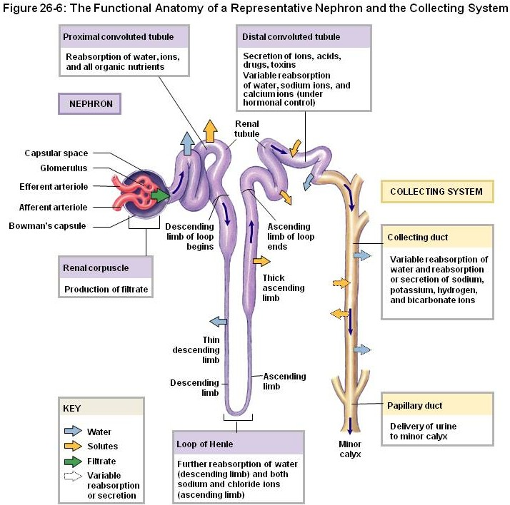
Overview of the microscopic anatomy OF THE kidney
Remind yourself of the parts of the nephron. We will cover all of these except for the renal corpuscle, which will be the focus of the next module:
renal corpuscle
proximal convoluted tubule (PCT)
loop of Henle
thick descending limb
thin limb
descending thin limb
ascending thin limb
thick ascending limb
distal convoluted tubule (DCT)
collecting duct

Slide 4
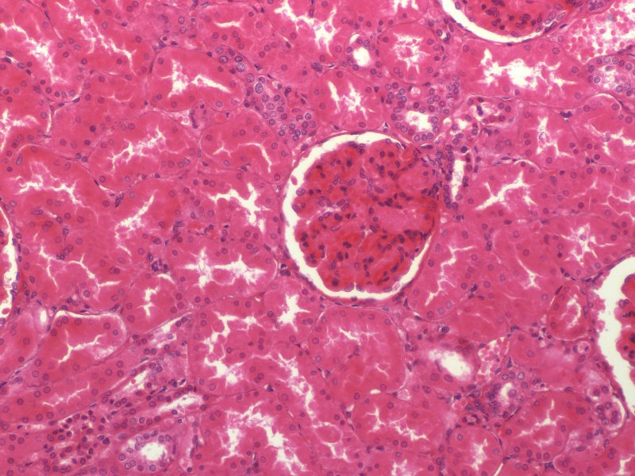
Overview of the microscopic anatomy OF THE kidney
When looking at a high-powered view of the kidney in the light microscope, you see a variety of tubes in cross-, longitudinal-, and oblique section. Two examples are outlined in yellow. These tubes are lined by a simple cuboidal epithelium, the lumen contains provisional urine. The basement membrane of the epithelium is in the location of (covered by) the yellow dotted outline. There is sparse connective tissue, with blood vessels, between the tubules. The specific characteristics of the epithelial cells will help you identify the specific tubule, which is the focus of this module. The round tuft in the center is a corpuscle, the topic of the next module.
lumen

Slide 5
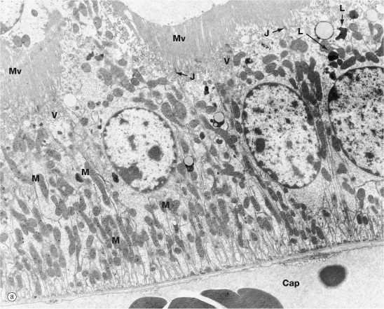
Overview of the microscopic anatomy OF THE kidney
Typically when working through a set of tissues or organs, we start out at low magnification (i.e. light micrographs), and then drill down to cellular detail (i.e. electron micrographs). Turns out that the tubules of the kidneys have many light microscopic characteristics (e.g. eosinophilia) that are due to cellular features seen in electron micrographs (numerous mitochondria). Because there are many of these features that are crucial for proper identification of these kidney tubules, it is more practical to look at the characteristics of the cells in a tubule at the electron microscopic level first, and then describe how these features affect the appearance of the tubules when viewed with the light microscope.

Slide 6
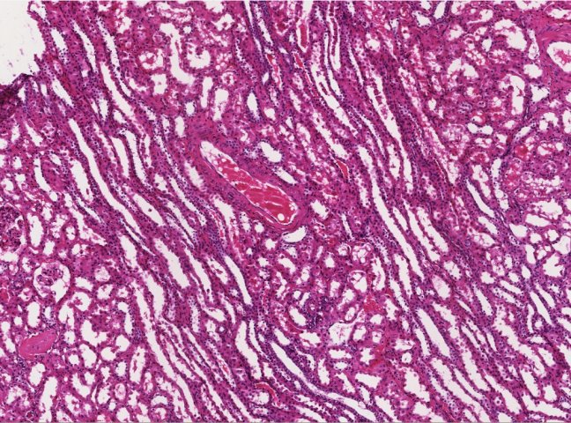
Overview of the microscopic anatomy OF THE kidney
Remind yourself of the regions of the cortex: pars radiata and pars convoluta
Regions in blue are medullary rays, parts in between are pars convoluta

Slide 7
Tubules in the cortex and outer medulla
Tubules in the pars radiata (medullary rays) and outer cortex
descending thick limb
ascending thick limb
collecting duct
Tubules in the pars convoluta
proximal convoluted tubule (PCT)
distal convoluted tubule (DCT)
(connecting ducts)
This table shows you where you can find each of the tubes of the nephron.
Tubules that are color-coded the same (e.g. PCT and descending thick limb) look similar at both the light and electron microscopic levels. In a light micrograph, the location of these tubules (i.e. in the pars convoluta or pars radiata) will clue you in as to which of these you are identifying. In electron micrographs, magnification is typically too high for you to determine whether you are in the pars convoluta or pars radiata.
We will not ask you to differentiate connecting ducts from collecting ducts. Simply refer to all ducts with that histology as collecting ducts.

Slide 8
proximal convoluted tubules and descending thick limbs of the loop of Henle
Characteristics of PCTs and descending thick limbs:
--large cells
--numerous microvilli (Mv)
--numerous mitochondria (M)
--numerous basolateral infoldings (see next slide)
lumen
Cap = capillary
J = junctional complex
V = pinocytotic vesicles
L = lysosomes
Remember, this is an electron micrograph, so the magnification is too high to determine whether you are looking at a PCT in the pars convoluta, or the descending thick limb in a medullary ray.
Wheater’s Fig. 16.18

Slide 9
proximal convoluted tubules and descending thick limbs of the loop of Henle
Characteristics of PCTs and descending thick limbs:
--large cells
--microvilli
--numerous mitochondria
--numerous basolateral infoldings
Higher magnification of area in red box showing basolateral infoldings
(red arrows indicate plasma membrane, large dark structures are mitochondria).

Slide 10
proximal convoluted tubules and descending thick limbs of the loop of Henle
As mentioned on a previous slide, it’s useful to think about the cellular features visible on electron micrographs of renal tubules, because that allows you to make predictions about how those tubules would look under the light microscope. If this isn’t obvious to you for this first category, the following table does the work for you.
The characteristics of PCTs and descending thick limbs in electron micrographs result in characteristic features of these tubules in light micrographs:
EM characteristics Light micrograph characteristics
--large cells --nuclei spread out
--numerous microvilli --fuzzy apical surface obstructing lumen
--numerous mitochondria --eosinophilic cytoplasm
--numerous basolateral infoldings --borders between cells not apparent

Slide 11
proximal convoluted tubules and descending thick limbs of the loop of Henle
Light micrograph characteristics
--nuclei spread out
--fuzzy apical surface obstructing lumen
--eosinophilic cytoplasm
--borders between cells not apparent
In this light micrograph of the pars convoluta, note the histological features of the proximal convoluted tubules. Most of the tubules seen in this image are PCTs, but I have two nice ones outlined in yellow just in case.

Slide 12
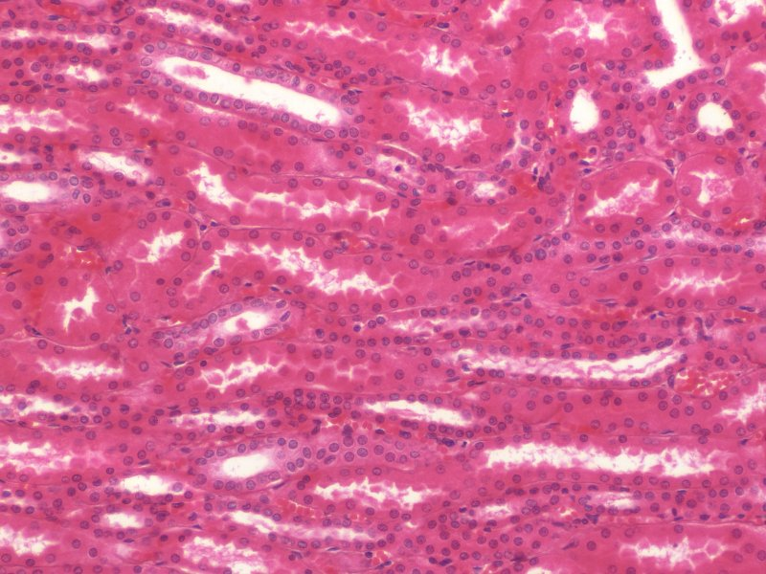
proximal convoluted tubules and descending thick limbs of the loop of Henle
Light micrograph characteristics
--nuclei spread out
--fuzzy apical surface obstructing lumen
--eosinophilic cytoplasm
--borders between cells not apparent
In light micrographs of the pars radiata (or outer medulla), note the histological features of the descending thick limbs outlined in yellow.

Slide 13
proximal convoluted tubules and descending thick limbs of the loop of Henle
Video showing proximal convoluted tubule and thick descending limb - SL116
Link to SL 116
Be able to identify:
Proximal convoluted tubule
Thick descending limb of the loop of Henle

Slide 14
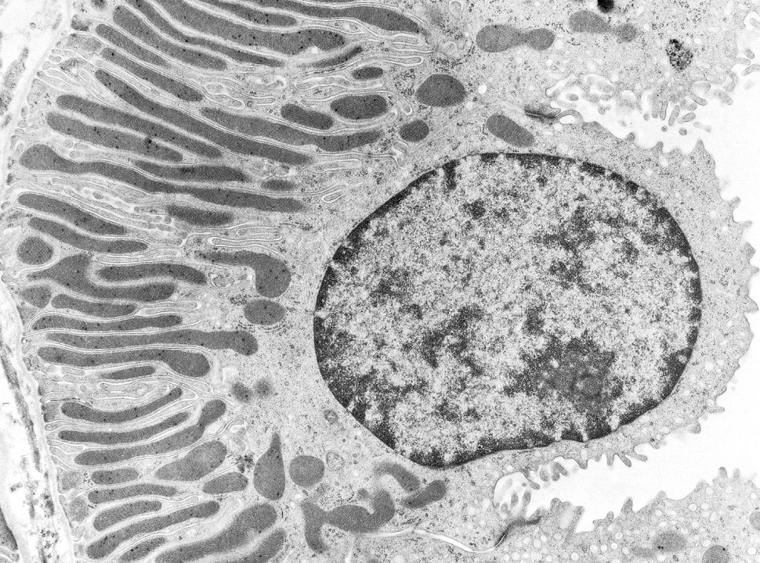
Distal convoluted tubules and ascending thick limbs of the loop of Henle
Again, for DCTs and ascending thick limbs, we’ll start with electron micrographs….
Characteristics of DCTs and ascending thick limbs:
--small cells
--few microvilli
--numerous mitochondria (in most cells, elongated dark structures on basal side of cells)
--numerous basolateral infoldings (outlined)
few microvilli

Slide 15
distal convoluted tubules and ascending thick limbs of the loop of Henle
The characteristics of DCTs and ascending thick limbs in electron micrographs result in characteristic features of these tubules in light micrographs:
EM characteristics Light micrograph characteristics
--small cells --nuclei close together
--few microvilli --sharp apical surface wide lumen
--numerous mitochondria --eosinophilic cytoplasm
--numerous basolateral infoldings --borders between cells not apparent

Slide 16
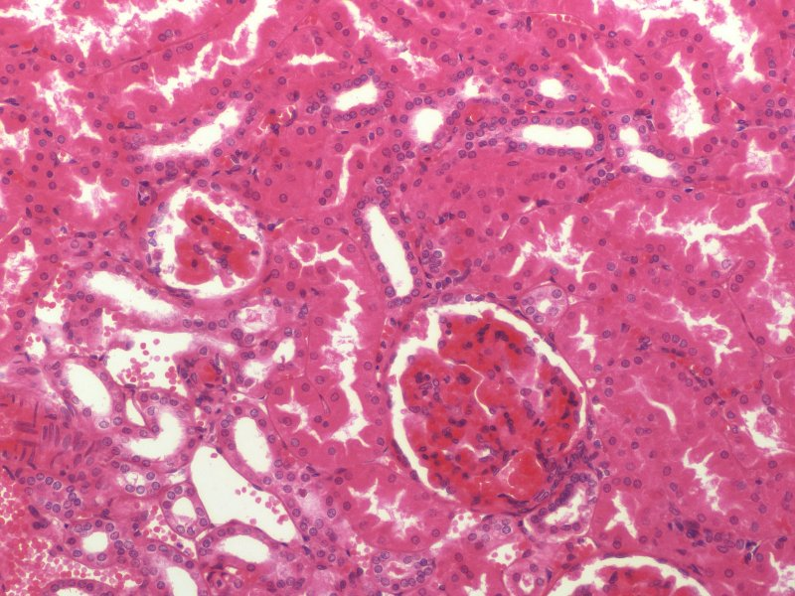
distal convoluted tubules and ascending thick limbs of the loop of Henle
Light micrograph characteristics
--nuclei close together
--sharp apical surface, wide lumen
--eosinophilic cytoplasm
--borders between cells not apparent
In light micrographs of the pars convoluta, note the histological features of the distal convoluted tubules outlined in yellow.
Distal convoluted tubules are shorter than proximal convoluted tubules; therefore, they are fewer profiles of DCTs than PCTs (so harder to find).

Slide 17
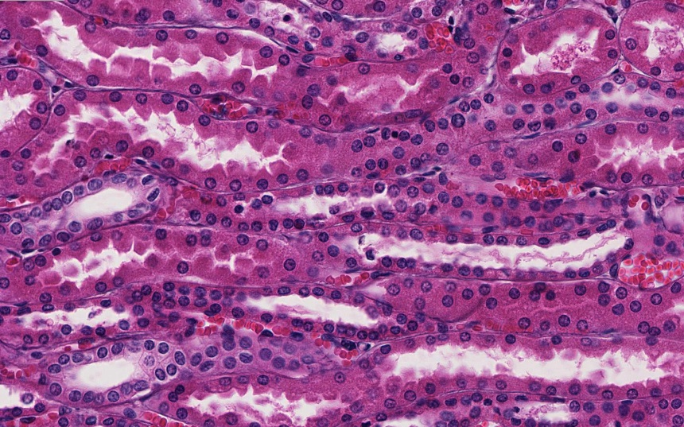
distal convoluted tubules and ascending thick limbs of the loop of Henle
Light micrograph characteristics
--nuclei close together
--sharp apical surface, wide lumen
--eosinophilic cytoplasm
--borders between cells not apparent
In light micrographs of the pars radiata or outer medulla, note the histological features of the thick ascending limbs outlined in yellow.

Slide 18
DISTAL convoluted tubules and Ascending thick limbs of the loop of Henle
Video showing distal convoluted tubule and thick ascending limb - SL116
Link to SL 116
Be able to identify:
Distal convoluted tubule
Thick ascending limb of the loop of Henle

Slide 19
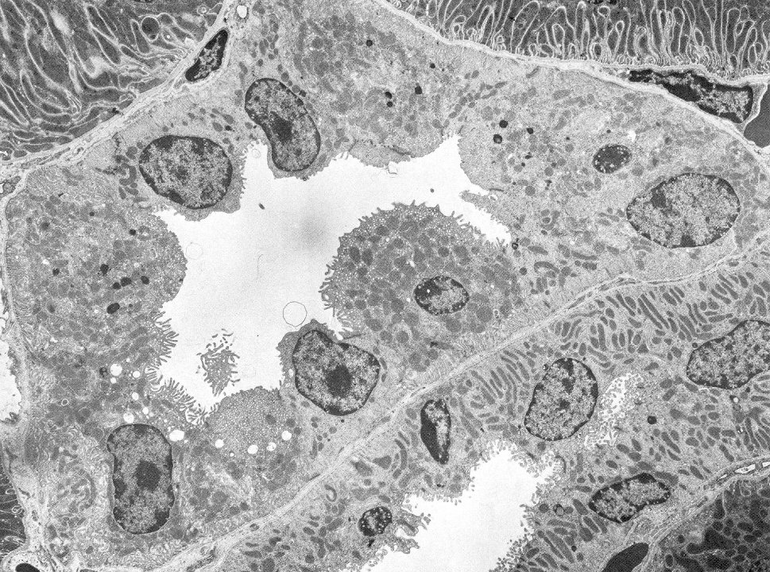
Collecting ducts
Characteristics of collecting ducts:
--small cells
--few microvilli (in most cells)
--few mitochondria (in most cells)
--few basolateral infoldings
Yep, I see cell X with many microvilli, and cell Y with numerous mitochondria. There are a few cell types here, but MOST have the above features.
Y
X

Slide 20
Collecting ducts
The characteristics of collecting ducts in electron micrographs result in characteristic features of these tubules in light micrographs:
EM characteristics Light micrograph characteristics
--small cells --nuclei close together
--few microvilli --sharp apical surface wide lumen
--few mitochondria --pale cytoplasm
--few basolateral infoldings --borders between cells visible

Slide 21
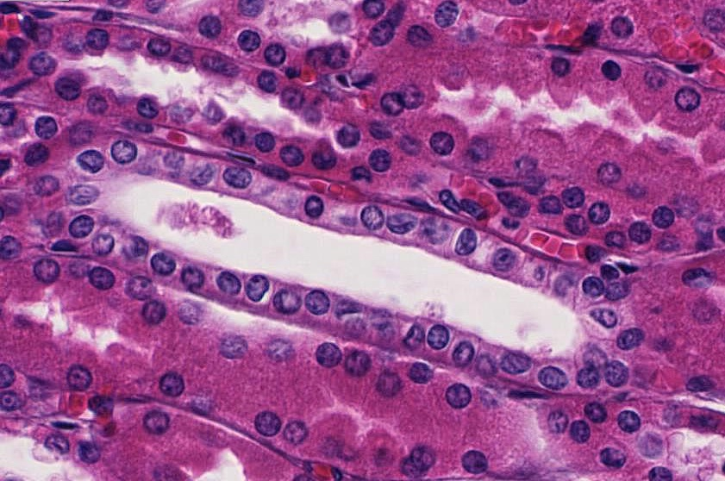
Collecting ducts
Light micrograph characteristics
--nuclei close together
--sharp apical surface, wide lumen
--pale cytoplasm
--borders between cells visible
In light micrographs of the pars radiata or outer medulla, note the histological features of the collecting duct outlined in yellow.
Also, note the small tubes with red blood cells (arrows), these are peritubular capillaries.

Slide 22
Collecting ducts
Video showing collecting duct - SL116
Link to SL 116
Be able to identify:
Collecting duct
Peritubular capillaries

Slide 23
Tubules in the cortex and outer medulla
Review video showing all ducts and outer medulla - SL116
Link to SL 116
Be able to identify:
Proximal convoluted tubule
Distal convoluted tubule
Descending thick limb
Ascending thick limb
Collecting duct
Peritubular capillaries

Slide 24
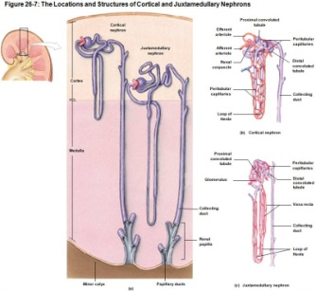
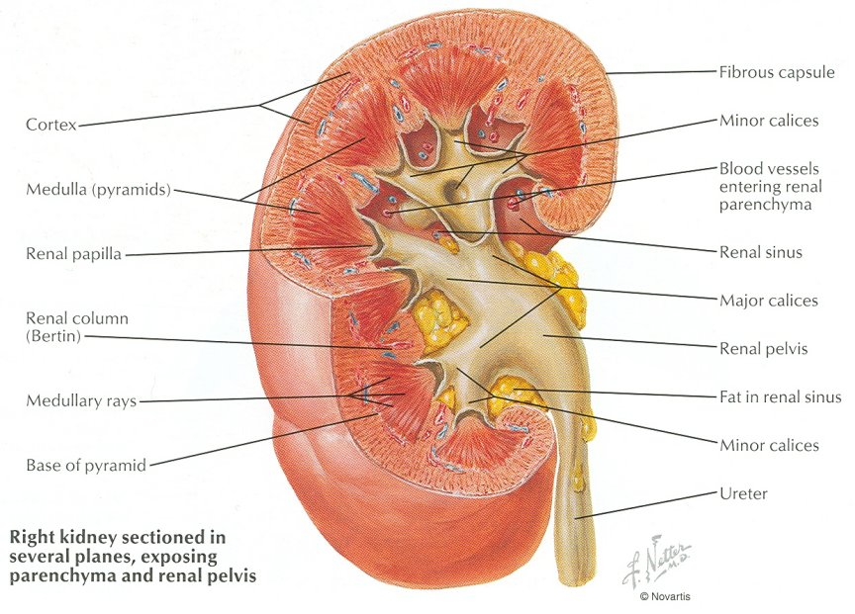
Tubules in the deep medulla
Remember that the nephrons in the kidney are oriented such that the loops of Henle are located in the medulla (and medullary rays). The turn of the loops are closest to the pelvis. This portion of the medulla that contains the thin limbs of the loop of Henle is a region I refer to as the “deep” medulla (toward the papilla). The deep medulla also has collecting ducts that will ultimately drain into the minor calyx. Because the loops and collecting ducts in the deep medulla are straight, the capillaries are also straight, and are referred to as vasa recta (straight vessels).

Slide 25
Tubules in the deep medulla
Tubules in the deep medulla (outlined region)
--collecting ducts
--thin limbs of the loop of Henle
--vasa recta (shown in right drawings)
We will not ask you to differentiate the descending vs. ascending thin limbs of the loop of Henle.
Collecting ducts you have already seen. Both the thin limbs and vasa recta have simple squamous epithelium. However, cells of the thin limbs are a little thicker than your typical squamous cells, and vasa recta may have red blood cells.

Slide 26
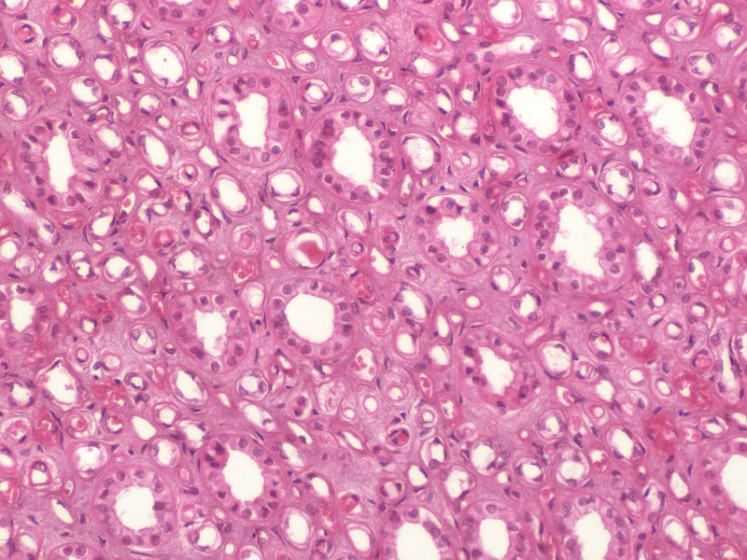
Tubules in the deep medulla
Tubules in the deep medulla
--collecting ducts (red) – note small, cuboidal cells, pale cytoplasm, borders between cells visible
--thin limbs of the loop of Henle (blue) – cells are officially squamous, but they are a little thicker than endothelial cells, no RBCs in the lumen
--vasa recta (purple) – flat endothelial cells, RBC in lumen

Slide 27
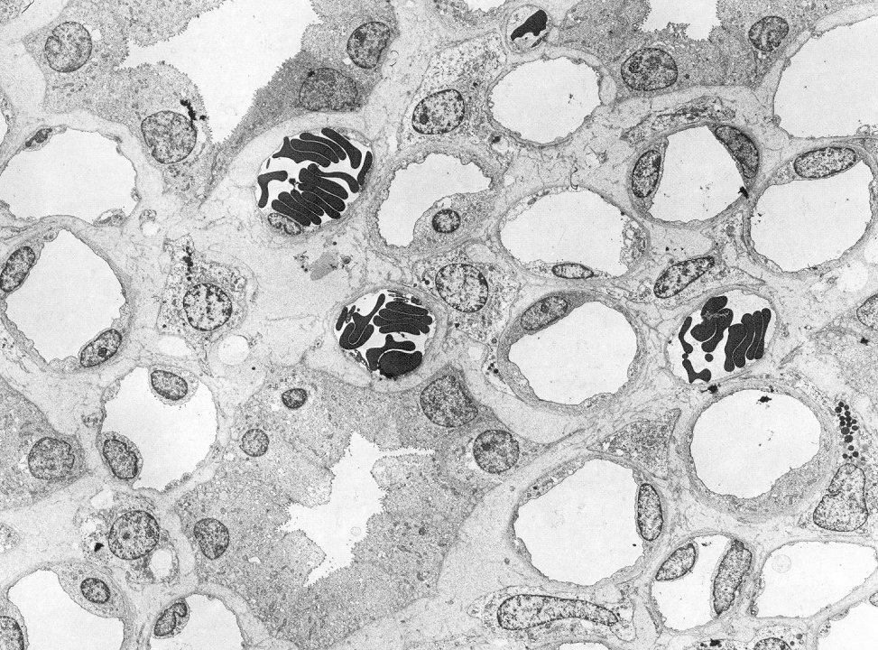
Tubules in the deep medulla
Tubules in the deep medulla
--collecting ducts (red)
--thin limbs of the loop of Henle (blue)
--vasa recta (purple)
Close examination here reveals the cells of the thin limb of the loop of Henle are slightly thicker than the endothelial cells of the vasa recta.
Can you find a vasa recta that lacks red blood cells? (advance slide for answer)
Vasa
Loop
Vasa
Vasa

Slide 28
Tubules in the deep medulla
Video showing deep medulla - SL116
Link to SL 116
Be able to identify:
Collecting duct
Thin limb of the loop of Henle
Vasa recta

Slide 29
The next set of slides is a quiz for this module. You should review the structures covered in this module, and try to visualize each of these in light and electron micrographs.
describe the gross anatomical features of the kidneys
Cortex
Medulla, including renal pyramid, renal papilla, renal columns
Hilus, sinus, renal pelvis, and major and minor calyces
recognize and discriminate between the pars convoluta and the pars radiata.
diagram blood circulation through the kidneys, and identify the major renal vessels on a histological section:
Renal artery and vein
Interlobar artery and vein
Arcuate artery and vein
Interlobular artery and vein
Afferent arteriole, glomerulus, efferent arteriole
Peritubular capillaries and vasa recta.
distinguish, at both the light and electron microscopic level, each of the following renal tubular structures:
proximal convoluted tubule
thick descending limb of the loop of Henle
thin limb of the loop of Henle
thick ascending limb of the loop of Henle
distal convoluted tubules
collecting (connecting) ducts, papillary ducts
Identify glomeruli at the light microscopic level, as well as identify each of the following in an electron micrograph:
endothelial cells
podocytes, including their primary and secondary pedicels (foot processes)
filtration slits
parietal epithelium
lamina densa
mesangial cells
blood space
urinary space.
Identify a juxtaglomerular apparatus, including the macula densa and juxtaglomerular cells

Slide 30
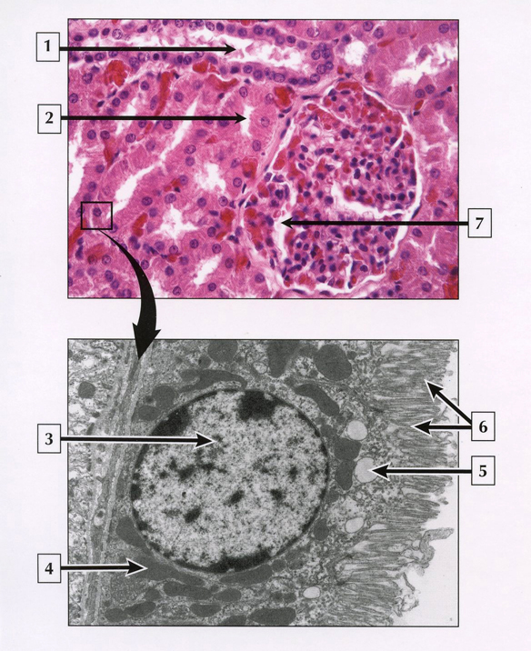
Final quiz
Self-check: Identify 1-6. (advance slide for answers)

Slide 31
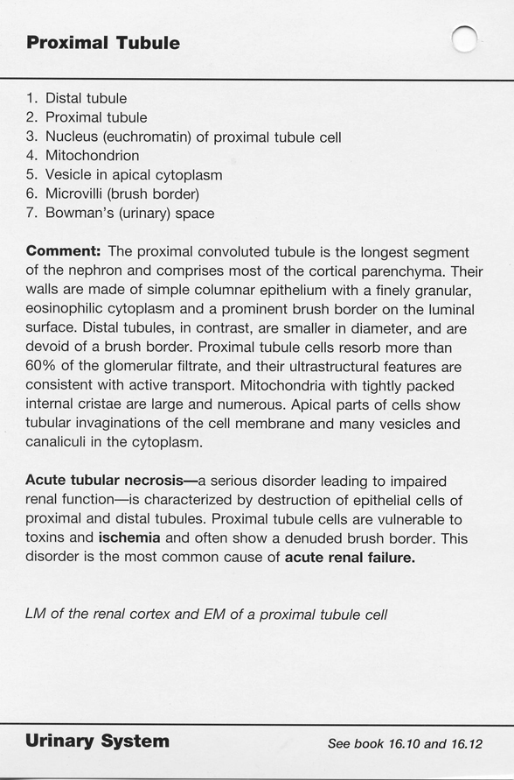
Final quiz

Slide 32
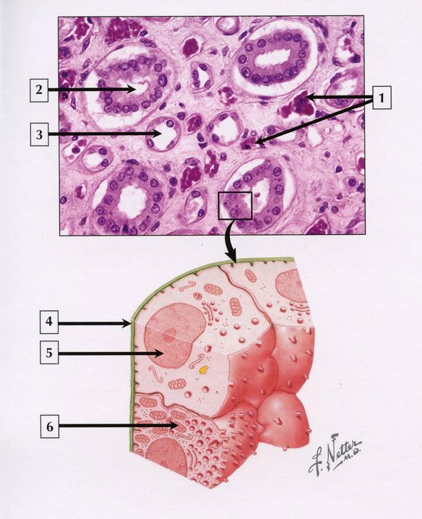
Final quiz
Self-check: Identify 1-4. (advance slide for answers)

Slide 33
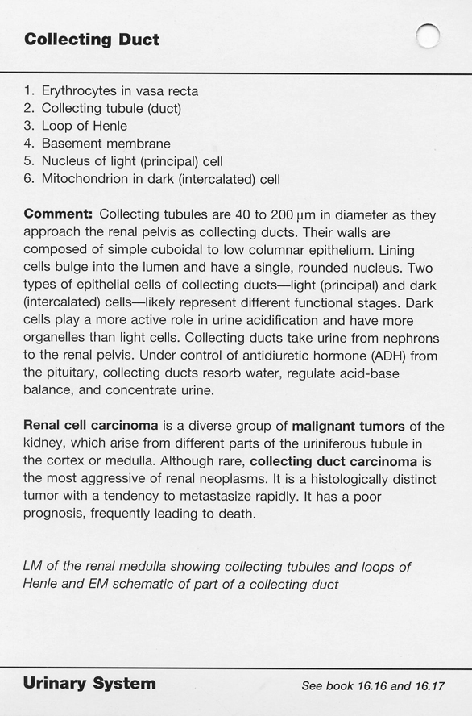
Final quiz

Slide 34
Final quiz
Self-check: Identify A and B. (advance slide for answers)
Collecting duct
A
Distal convoluted tubule / ascending thick limb
B

Slide 35
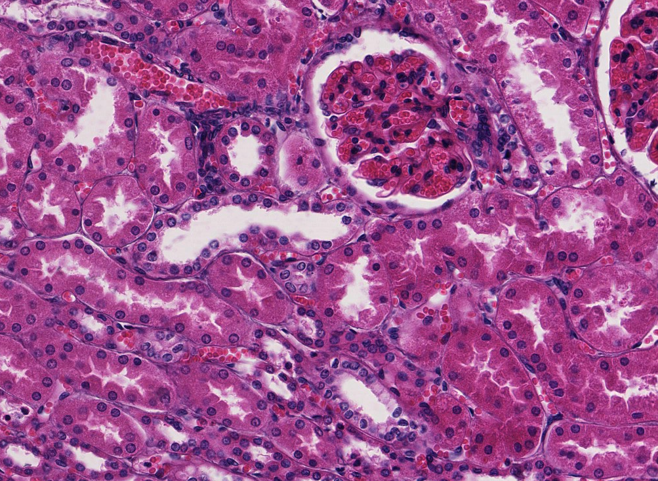
Final quiz
Self-check: Identify four structures. (advance slide for answers)
distal convoluted tubule
Peritubular capillary
Proximal convoluted tubule
Collecting duct

Slide 36
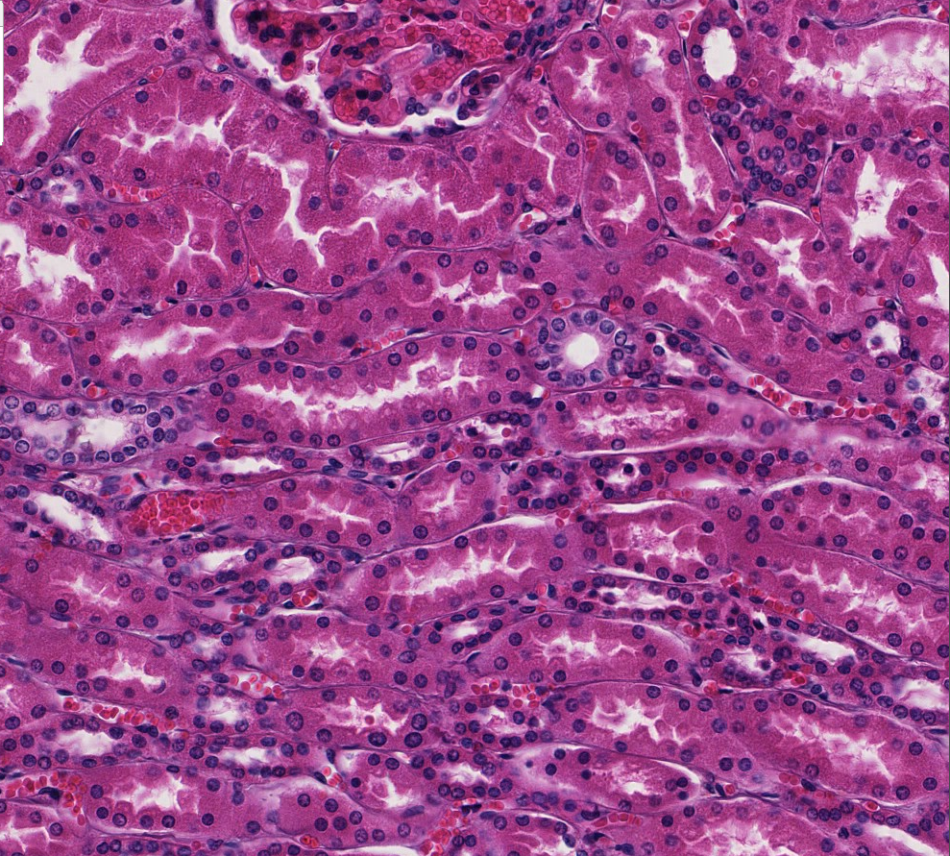
Final quiz
Self-check: Identify. (advance slide for answers)
Proximal convoluted tubule

Slide 37
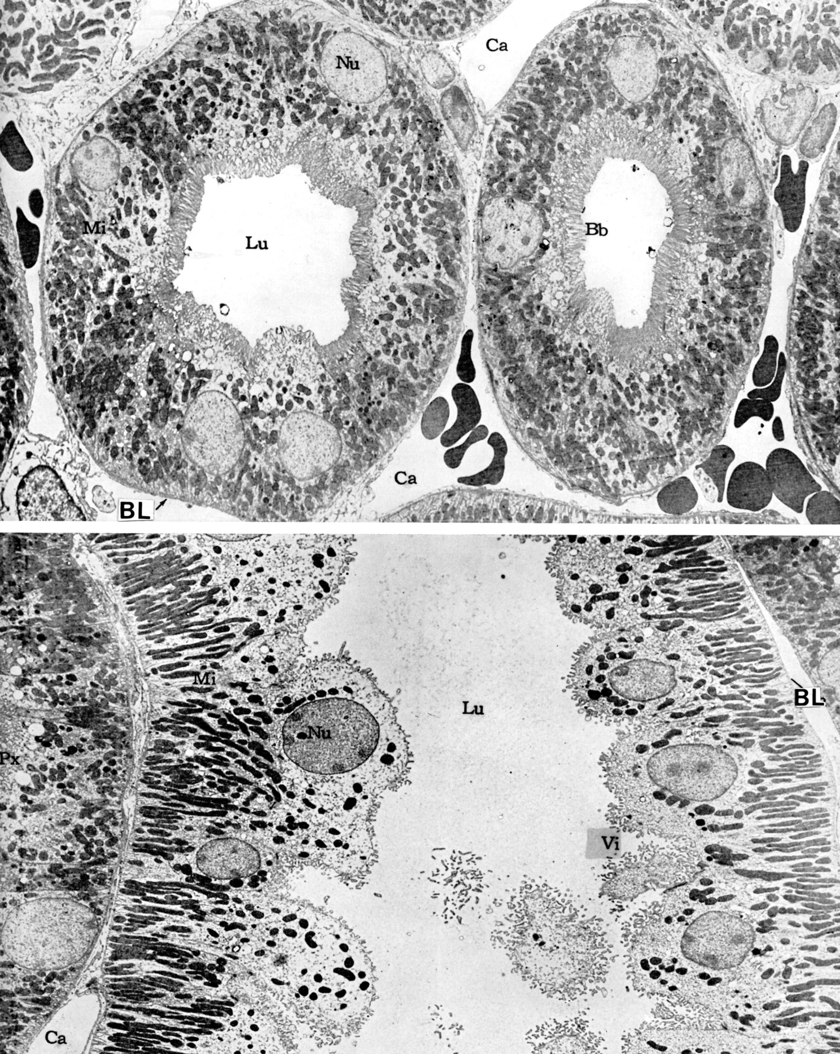
Final quiz
Self-check: Identify. (advance slide for answers)
Distal convoluted tubule / ascending thick limb

Slide 38
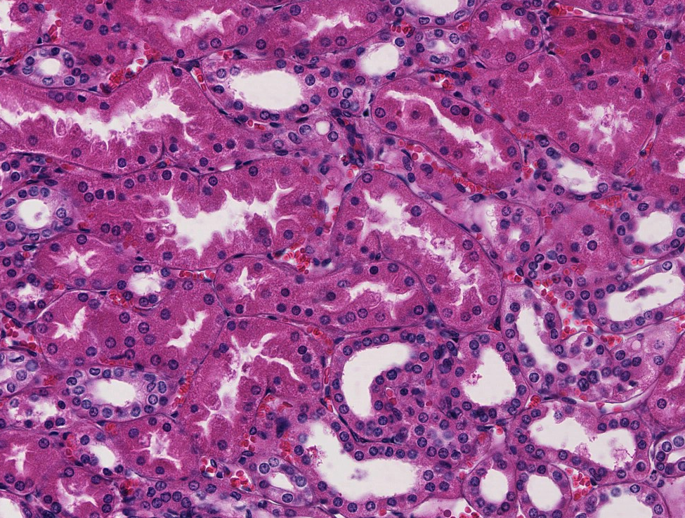
Final quiz
Self-check: Identify. (advance slide for answers)
Distal convoluted tubule

Slide 39
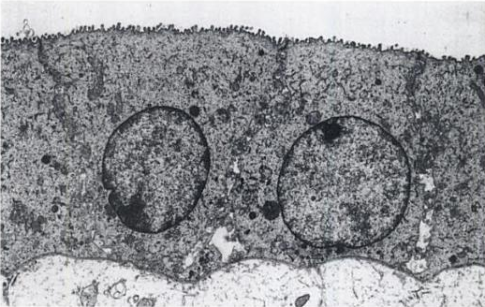
Final quiz
Self-check: Identify. (advance slide for answers)
Collecting duct
Schrier
Diseases of the Kidney and Urinary Tract

Slide 40
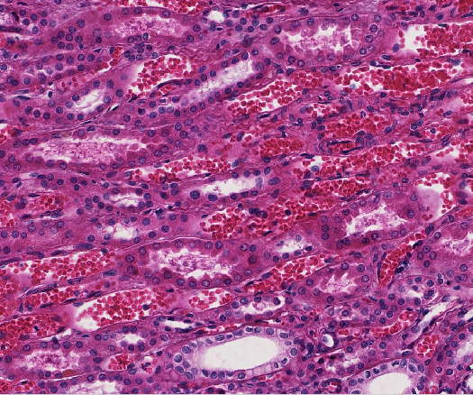
Final quiz
Self-check: Identify four structures. (advance slide for answers)
Ascending thick limb
X
Vasa recta
Descending thick limb
Collecting duct

Slide 41
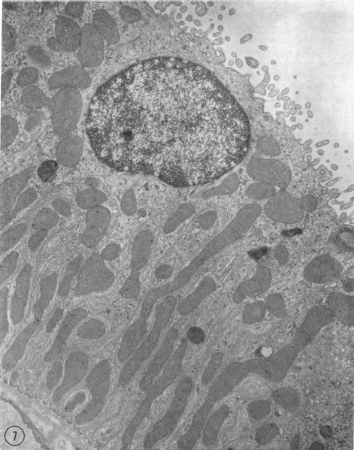
Final quiz
Self-check: Identify. (advance slide for answers)
distal convoluted tubule
or
ascending thick limb
Woodhall and Tisher
Journal of Clinical Investigation
52:3095

Slide 42
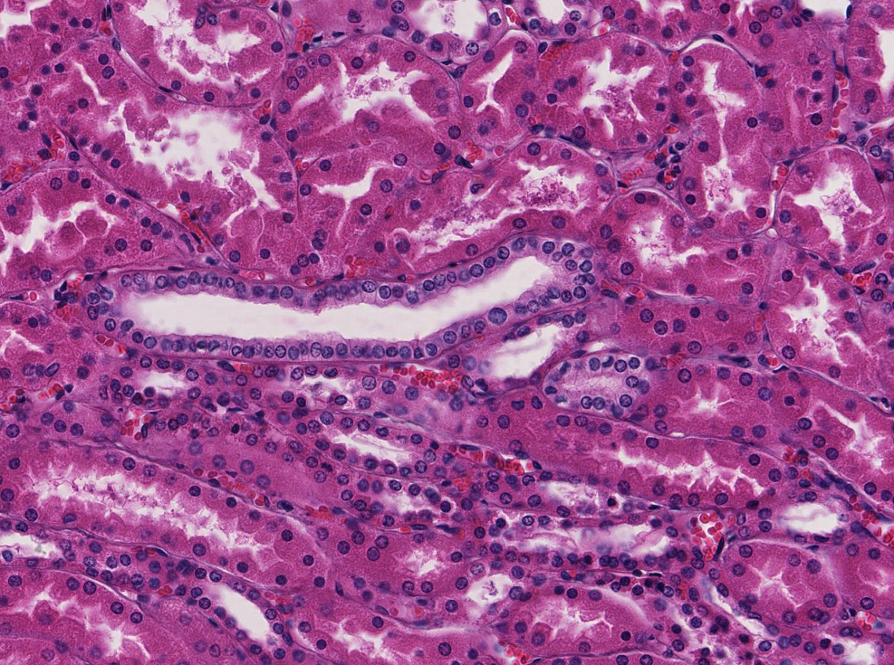
Final quiz
Self-check: Identify. (advance slide for answers)
Collecting duct

Slide 43
Final quiz
Self-check: Identify A and B. (advance slide for answers)
Proximal convoluted tubules / descending thick limbs
B
A

Slide 44
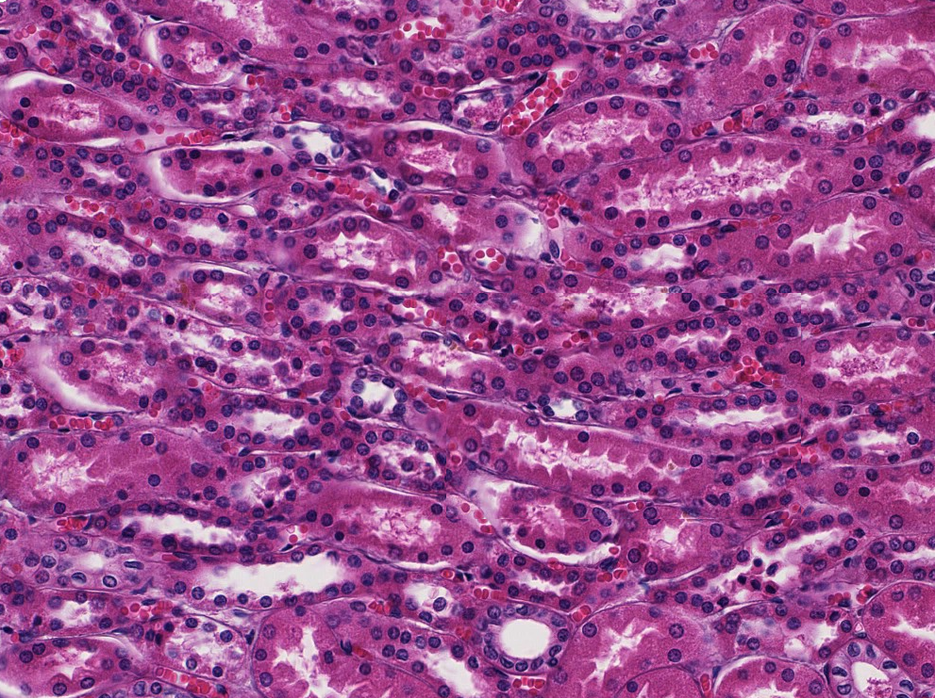
Final quiz
Self-check: Identify. (advance slide for answers)
Descending thick limb

Slide 45
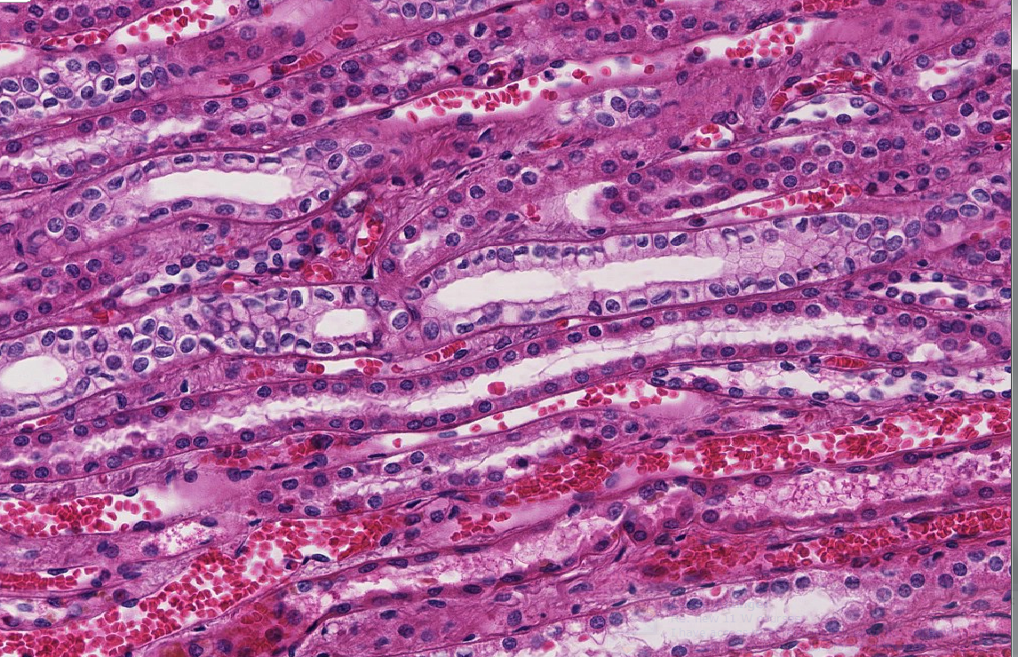
Final quiz
Self-check: Identify two. (advance slide for answers)
collecting duct
ascending thick limb

Slide 46
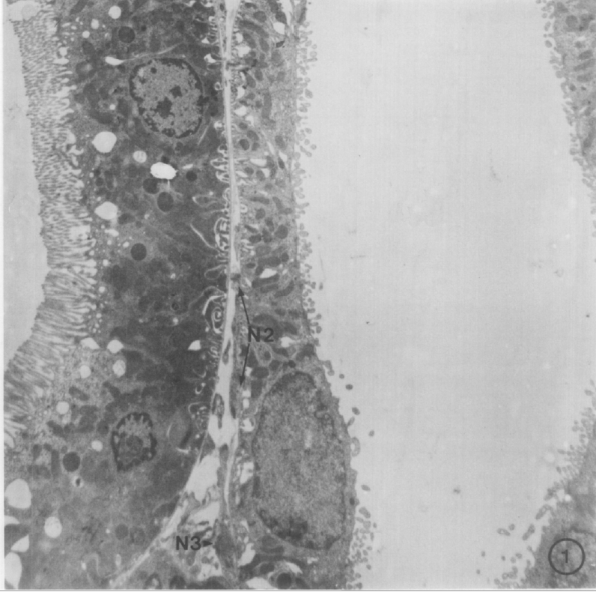
Final quiz
Self-check: Identify two. (advance slide for answers)
Proximal convoluted tubule
or
Descending thick limb
A
B
distal convoluted tubule
or
ascending thick limb
Barajas, et. al.
Journal of Ultrastructure Research Volume 77, Issue 3, December 1981, Pages 379-385

Slide 47
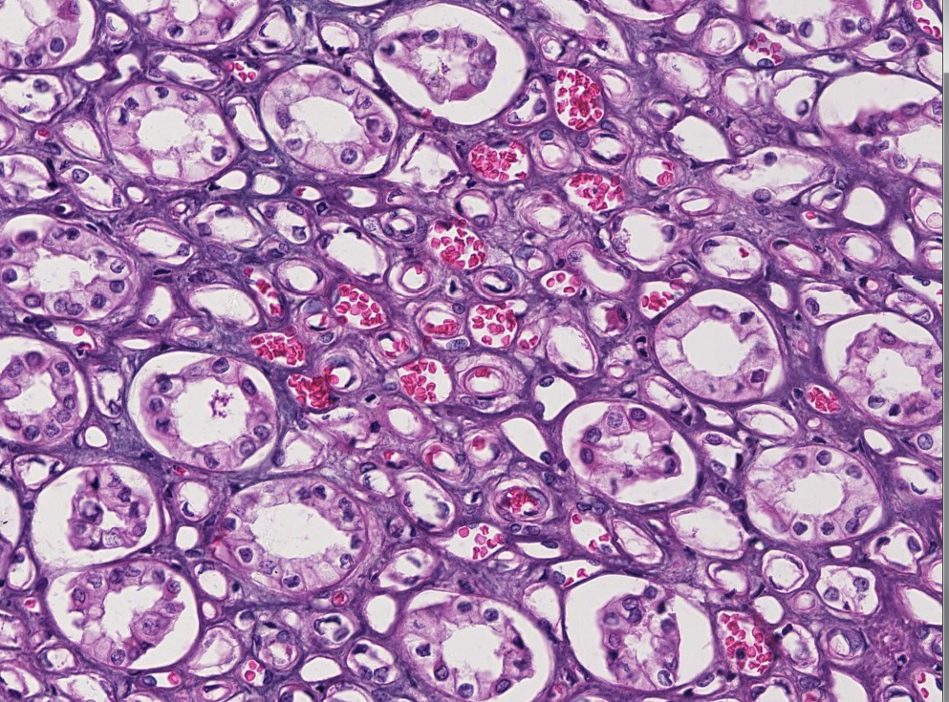
Final quiz
Self-check: Identify three structures. (advance slide for answers)
Thin limb
Vasa recta
Collecting duct

Slide 48
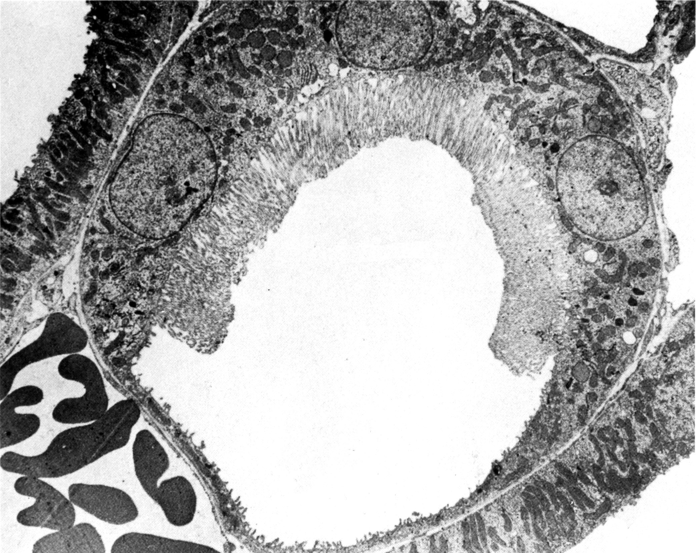
Final quiz
Self-check: Identify. (advance slide for answers)
Descending thick limb of the loop of Henle
Thin limb of the loop of Henle
Right at the transition between the two…..sweet!!!!

