Slide 1
The Kidney
Part Three – The Renal Corpuscle
Digital Laboratory
It’s best to view this in Slide Show mode, especially for the quizzes.
This module will take approximately 45 minutes to complete.

Slide 2
After completing this exercise, you should be able to (blue text in this module, tan text in subsequent kidney modules):
describe the gross anatomical features of the kidneys
Cortex
Medulla, including renal pyramid, renal papilla, renal columns
Hilus, sinus, renal pelvis, and major and minor calyces
recognize and discriminate between the pars convoluta and the pars radiata.
diagram blood circulation through the kidneys, and identify the major renal vessels on a histological section:
Renal artery and vein
Interlobar artery and vein
Arcuate artery and vein
Interlobular artery and vein
Afferent arteriole, glomerulus, efferent arteriole
Peritubular capillaries and vasa recta.
distinguish, at both the light and electron microscopic level, each of the following renal tubular structures:
proximal convoluted tubule
thick descending limb of the loop of Henle
thin limb of the loop of Henle
thick ascending limb of the loop of Henle
distal convoluted tubules
collecting (connecting) ducts, papillary ducts
Identify glomeruli at the light microscopic level, as well as identify each of the following in an electron micrograph:
endothelial cells
podocytes, including their primary and secondary pedicels (foot processes)
filtration slits
parietal epithelium
lamina densa
mesangial cells
blood space
urinary space.
Identify a juxtaglomerular apparatus, including the macula densa and juxtaglomerular cells

Slide 3
formation of the renal corpuscle
To understand the final structure of the renal corpuscle, it is useful to think about the end of the nephron during development.
Blood vessels in the connective tissue form a tuft of capillaries, the glomerulus, flanked by two arterioles (afferent and efferent). The afferent arteriole is a branch of an interlobular artery, while the efferent arteriole feeds the peritubular capillary plexus.
Note the endothelial cells of the glomerulus have a basement membrane (not shown).
Connective tissue
Basement membrane
Epithelial cells
Lumen of tubule (continuous with outside world)

Slide 4
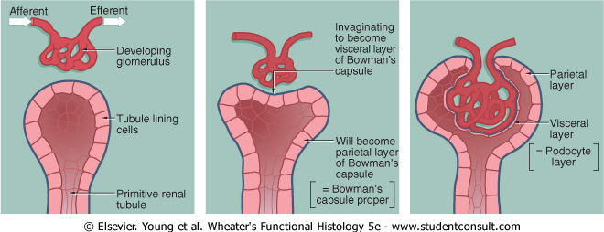
formation of the renal corpuscle
The renal tubule invaginates, forming a visceral and parietal layer of Bowman’s capsule. Cells of the visceral layer, called podocytes, cover the endothelial cells of the glomerulus. In many places, the connective tissue between the endothelial cells and podocyes is squeezed out, and the two basement membranes fuse to form a single, thick basal lamina, called the lamina densa.
Green represents connective tissue

Slide 5
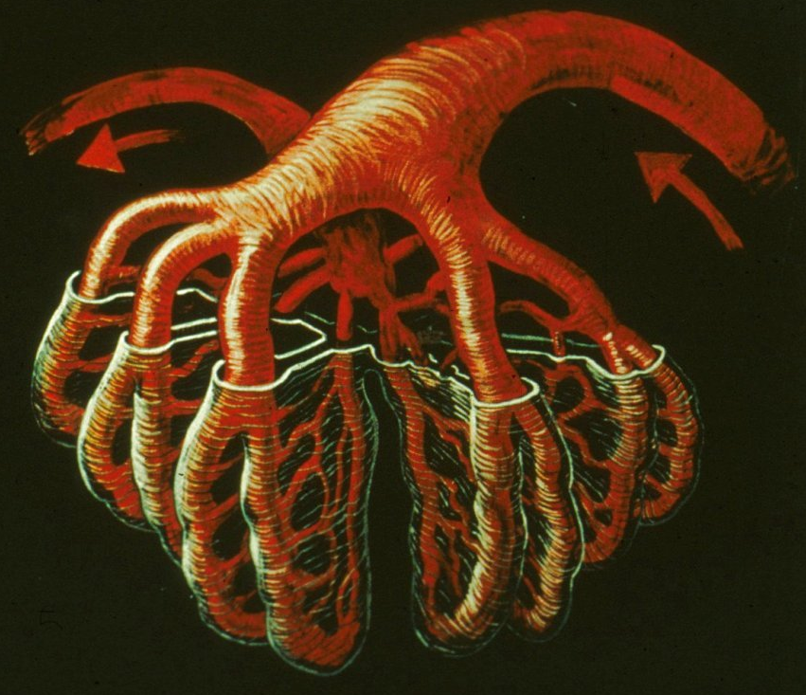
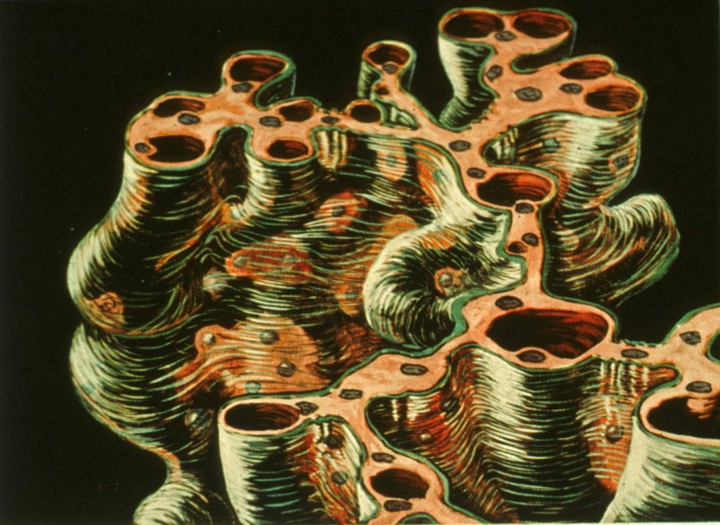
formation of the renal corpuscle
Really cool 3D views of the corpuscle, with blood vessels in red, the visceral layer looks like saran wrap.
Areas where basal lamina of endothelial cells and podocytes are fused.
The connective tissue in these locations is called mesangium, the cells called mesangial cells.

Slide 6
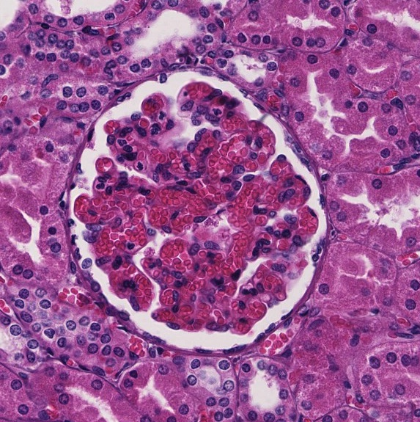
the renal corpuscle - Light micrographs
Light micrograph of a corpuscle. The tuft in the center contains the glomerulus, podocytes, and mesangial cells. The outer layer is the parietal cells.
Parietal cells
podocytes/endothelial cells/mesangial cells (cannot distinguish between these three in light micrographs)
Capsular space
Blood flows through the glomerular capillaries at relatively high pressure (for capillaries), forcing fluid into the capsular space. This fluid is provisional urine (aka ultrafiltrate) that flows into the proximal convoluted tubule.

Slide 7
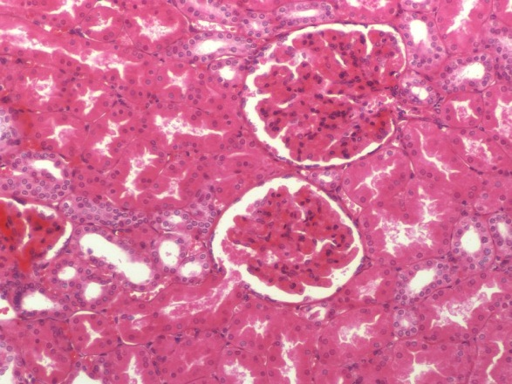
the renal corpuscle - Light micrographs
Some fortuitous sections of renal corpuscles demonstrate:
vascular pole –vessels enter and exit the corpuscle
urinary pole - proximal convoluted tubule drains capsular space
Many sections of renal corpuscles show neither of these (see previous slide).

Slide 8
the renal corpuscle - Light micrographs
Video showing corpuscles - SL116
Link to SL 116
Be able to identify:
Parietal cells
Capsular space
Vascular pole
Urinary pole

Slide 9
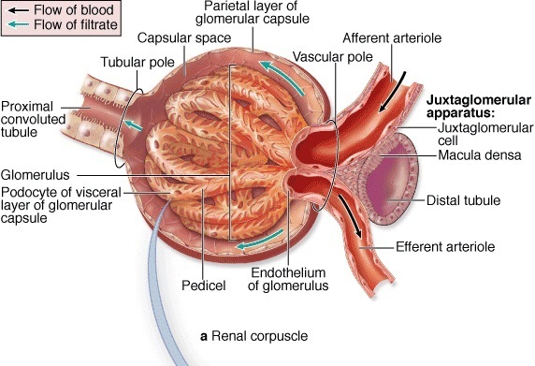
the renal corpuscle - ELECTRON micrographs
Although the structure of a corpuscle in light micrographs is fairly straightforward, important details are revealed in electron micrographs. This drawing reinforces key features of a corpuscle.
Endothelium of glomerulus
Podocyte of visceral layer of glomerular capsule
Parietal layer of glomerular capsule
Capsular space

Slide 10
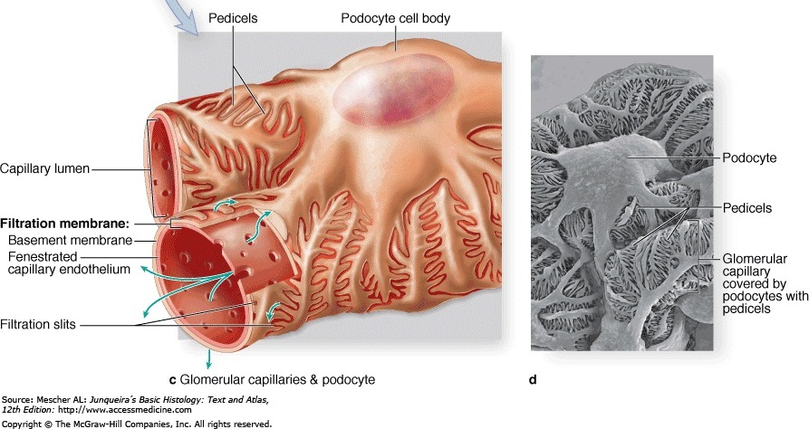
the renal corpuscle - ELECTRON micrographs
Below is a detailed drawing and scanning electron micrograph of glomerular capillary, viewed from within capsular space. Note:
The capillary endothelium is fenestrated (without diaphragms)
Podocytes are elaborate cells, with numerous extensions called pedicels (aka foot processes)
The pedicels of adjacent podocytes interdigitate; and the space between the pedicels are called filtration slits
Serum components pass through the fenestrations, basement membrane, and filtration slits to reach the capsular space.

Slide 11
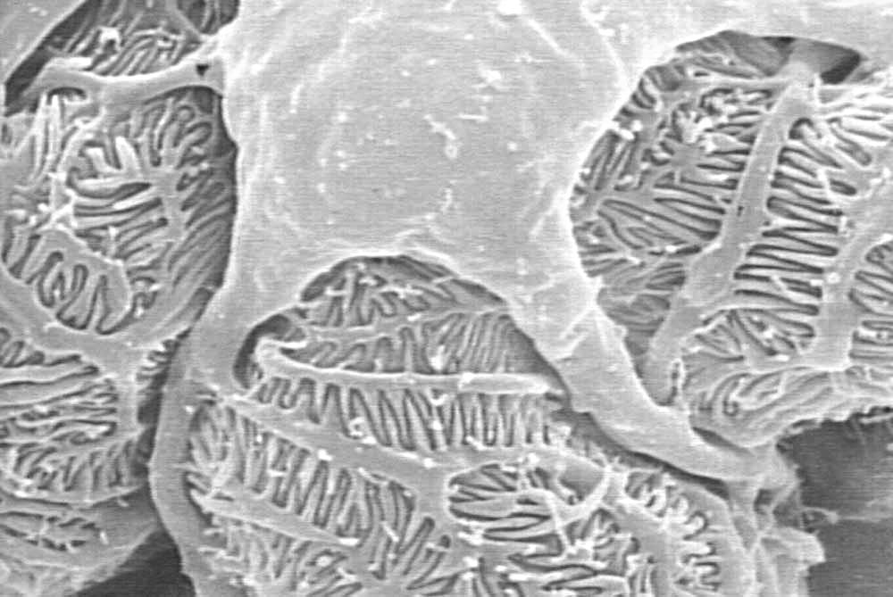
the renal corpuscle - ELECTRON micrographs
In this scanning electron micrograph, you are within the capsular (urinary) space, looking down on a podocyte. Note parts of podocyte:
“cell body”
1º pedicels
2º pedicels
Filtration slits
1º pedicels are the initial processes of the podocyte, 2º pedicels are the terminal processes that line the filtration slits.

Slide 12
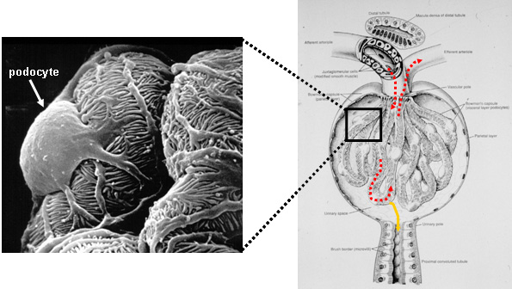
the renal corpuscle - ELECTRON micrographs
Another scanning electron micrograph of a podocyte:
The red dotted line indicates the direction of blood flow, the yellow line indicates provisional urine production and flow into the proximal convoluted tubule.

Slide 13
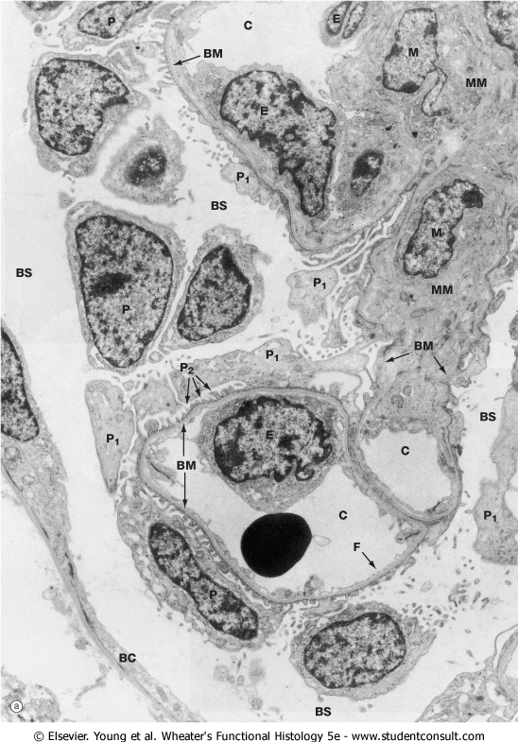
the renal corpuscle - ELECTRON micrographs
The electron micrograph to the right is a section similar to the blue line in the above drawing. It is a complicated image, so we’ll do it piece-meal in the next few slides. The outlined region is the “tuft” of capillaries and surrounding podocytes in the center of the corpuscle. The outer layer of the corpuscle is the parietal layer, labeled here as BC for Bowman’s capsule. The capsular space is indicated as well, labeled BS for Bowman’s space.

Slide 14
the renal corpuscle - ELECTRON micrographs
Within the tuft you can see the lumen of the capillaries, labeled C. The fenestrated endothelial cells line the capillary (E).

Slide 15
the renal corpuscle - ELECTRON micrographs
All of the cell fragments surrounding the capillaries belong to podocytes, shown in fragments due to plane of sectioning:
P indicates a podocyte nucleus
P₁ indicates a 1º pedicel
P₂ indicates 2º pedicels
The basement membrane (BM) is situated between the endothelial cells and podocytes.
Mesangial cells (M), and mesangial (extracellular) matrix (MM) are also indicated (more on those later).

Slide 16
the renal corpuscle - ELECTRON micrographs
Same image, with all labels indicated so you can put it all together:
BC = Bowman’s capsule (parietal layer)
BS = Bowman’s space (capuslar space)
P = podocyte
P₁ and P₂ = pedicils (1º and 2º)
C = capillary lumen
E = endothelial cell
F = fenestrations of endothelial cell
BM = basement membrane, actually basal lamina or lamina densa
M = mesangial cell; MM = mesangial matrix

Slide 17
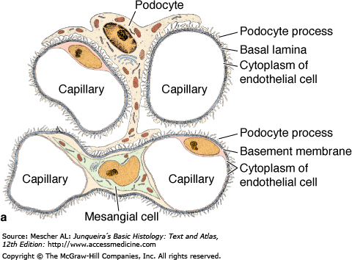
the renal corpuscle - ELECTRON micrographs
The drawing to the lower right will be used for orientation on the following slides. This drawing is similar to a cut through the glomerular capillaries as indicated by the blue line in the left image, but does not include the parietal layer. Therefore, the capsular space is all the space surrounding the capillaries/podocytes as indicated.
Capsular space
Capsular space
Capsular space
Capsular space
Capsular space
Capsular space

Slide 18
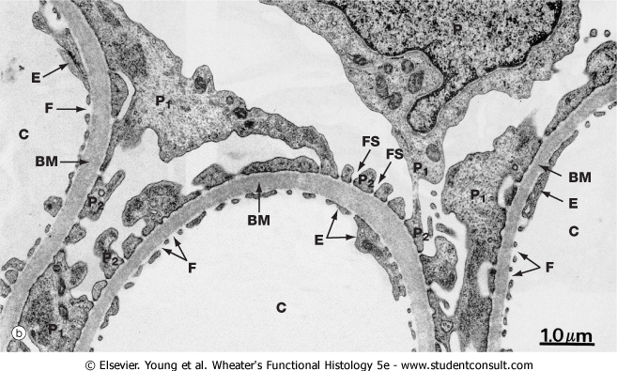
the renal corpuscle - ELECTRON micrographs
A magnified view of three loops of glomerular capillaries, note:
P = podocyte
P₁ and P₂ = pedicils (1º and 2º)
C = capillary lumen
E = endothelial cell
F = fenestrations of endothelial cell
BM = basement membrane
The basement membrane is actually a basal lamina. Because it is very thick in the corpuscle, it is also referred to as the lamina densa.
capsular space
Blue box is meant for approximate perspective, and doesn’t reflect exact orientation of capillaries.

Slide 19
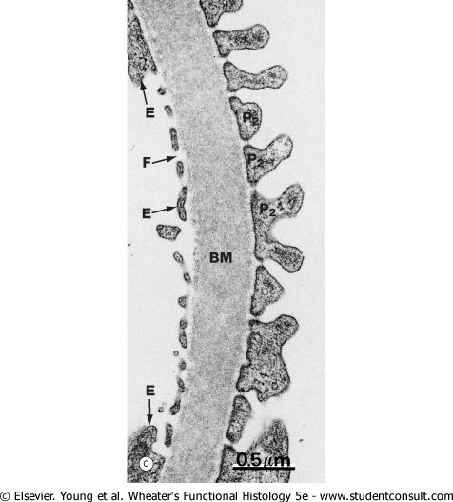
the renal corpuscle - ELECTRON micrographs
Further magnification focuses on the blood-urine filter. Note:
P₂ = 2º pedicels
E = endothelial cell
F = fenestrations of endothelial cell
BM = basement membrane (lamina densa)
Capsular space (provisional urine here)
Capillary lumen (blood here)

Slide 20
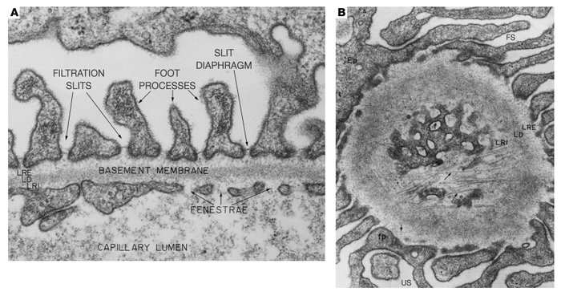
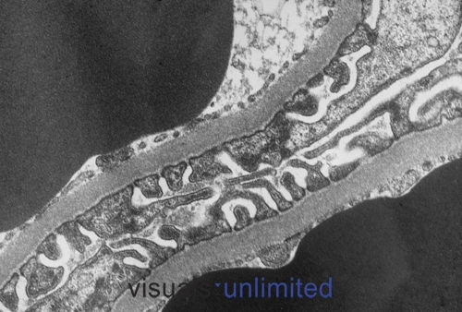
the renal corpuscle - ELECTRON micrographs
Some more challenging images of the blood-urine barrier:
podocyte
tangential cut of fenestrations
Capsular space
fp = foot processes of podocyte
FS = filtration slit
US = urinary space (capsular space)
RBC
Capsular space
RBC

Slide 21
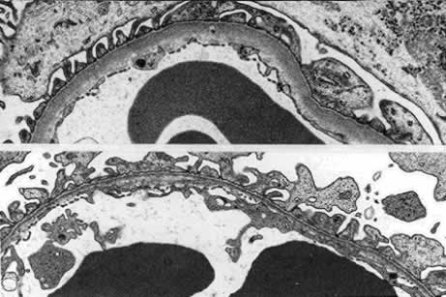
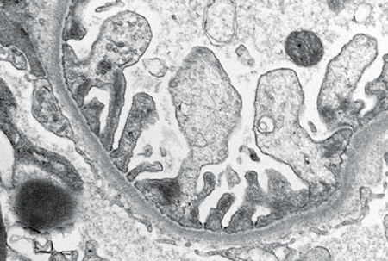
the renal corpuscle - ELECTRON micrographs
Some more challenging images of the blood-urine barrier.
RBC
Capsular space
RBC
RBC
Capsular space
When trying to figure out which side is which, I try to look for blood vessels. If they aren’t there, I move on and look for podocytes with their pedicels.

Slide 22
the renal corpuscle - ELECTRON micrographs
There is connective tissue between glomerular capillaries, called the mesangium. Cells within this connective tissue are mesangial cells.
The fused basal lamina splits on either side of the mesangium, so that there is a basal lamina between the endothelial cells and the mesangium, and between the podocytes and mesangium
(advance to see arrows)
Green represents connective tissue

Slide 23
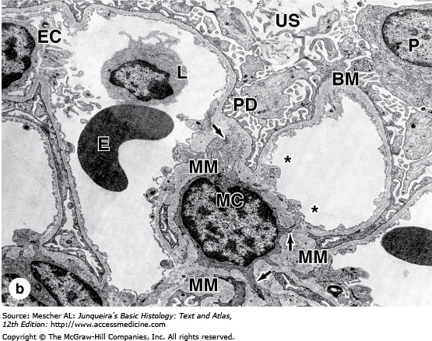
the renal corpuscle - ELECTRON micrographs
In this micrograph, note the fused basal lamina splits on either side of mesangium (purple and orange arrows indicate basal lamina that has split):
BM = basement membrane, actually basal lamina or lamina densa
MC = mesangial cell; MM = mesangial matrix
P = podocyte; PD = pedicels
E = erythrocyte
L = lymphocyte
EC = endothelial cell
US = urinary (capsular) space
Blue box is meant for approximate perspective, and doesn’t reflect exact orientation of capillaries.

Slide 24
the renal corpuscle – Macula densa
The distal convoluted tubule of the nephron loops toward the corpuscle and lies adjacent to the afferent arteriole at the vascular pole of the corpuscle.
Cells of the distal convoluted tubule adjacent to the afferent arteriole are the macula densa.
Cells of the afferent arteriole adjacent to the distal convoluted tubule are the juxtaglomerular cells.
Together, these form the juxtaglomerular apparatus, which is involved in regulating blood volume by releasing renin.

Slide 25
the renal corpuscle – Macula densa
Light micrograph showing macula densa cells (outlined in blue) of a distal convoluted tubule. The original image without the outline is to the right. What you are looking for is a distal convoluted tubule that is adjacent to the vascular pole of the corpuscle, and the macula densa cell nuclei “line up” adjacent to the corpuscle.

Slide 26
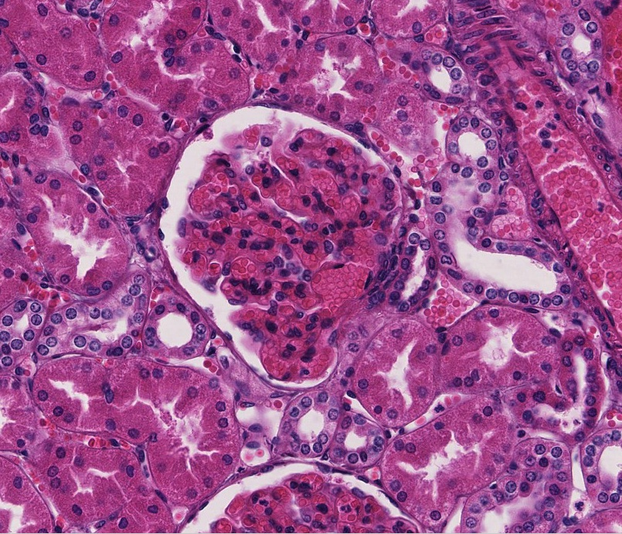
the renal corpuscle – Macula densa
Light micrograph showing macula densa cells (yellow arrows) of a distal convoluted tubule. The smaller nuclei just to the left of the macula densa are likely to be either mesangial cells (lacis cells) or juxtaglomerular cells, but you won’t have to specifically identify these.

Slide 27
the renal corpuscle – Macula densa
Video showing macula densa - SL116
Link to SL 116
Be able to identify:
macula densa

Slide 28
The next set of slides is a final quiz for this module. You should review the structures covered in this module, and try to visualize each of these in light and electron micrographs.
describe the gross anatomical features of the kidneys
Cortex
Medulla, including renal pyramid, renal papilla, renal columns
Hilus, sinus, renal pelvis, and major and minor calyces
recognize and discriminate between the pars convoluta and the pars radiata.
diagram blood circulation through the kidneys, and identify the major renal vessels on a histological section:
Renal artery and vein
Interlobar artery and vein
Arcuate artery and vein
Interlobular artery and vein
Afferent arteriole, glomerulus, efferent arteriole (on a typical section, you cannot distinguish between the afferent and efferent arteriole)
Peritubular capillaries and vasa recta.
distinguish, at both the light and electron microscopic level, each of the following renal tubular structures:
proximal convoluted tubule
thick descending limb of the loop of Henle
thin limb of the loop of Henle
thick ascending limb of the loop of Henle
distal convoluted tubules
collecting (connecting) ducts, papillary ducts
Identify glomeruli at the light microscopic level, as well as identify each of the following in an electron micrograph:
endothelial cells
podocytes, including their primary and secondary pedicels (foot processes)
filtration slits
parietal epithelium
lamina densa
mesangial cells
blood space
urinary space.
Identify a juxtaglomerular apparatus, including the macula densa and juxtaglomerular cells (juxtaglomerular cells are difficult to definitively identify)

Slide 29
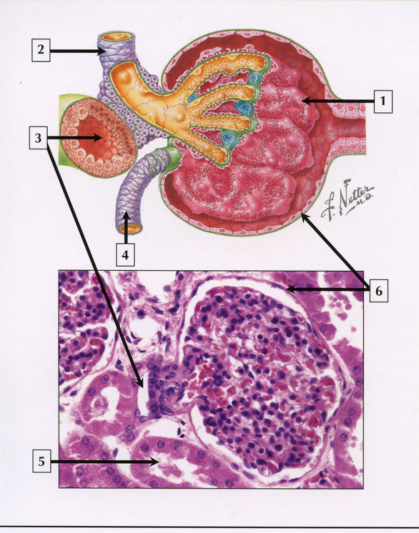
quiz
Self-check: Identify 1-6. (advance slide for answers)

Slide 30
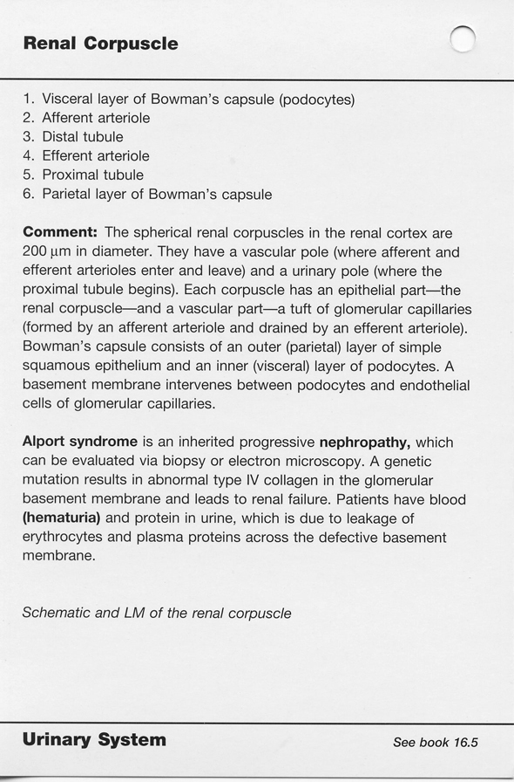
quiz

Slide 31
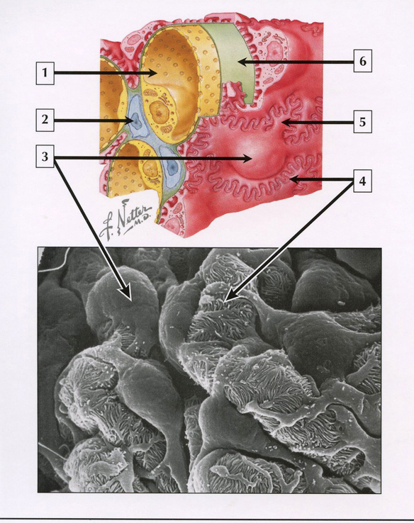
quiz
Self-check: Identify 1-6. (advance slide for answers)

Slide 32
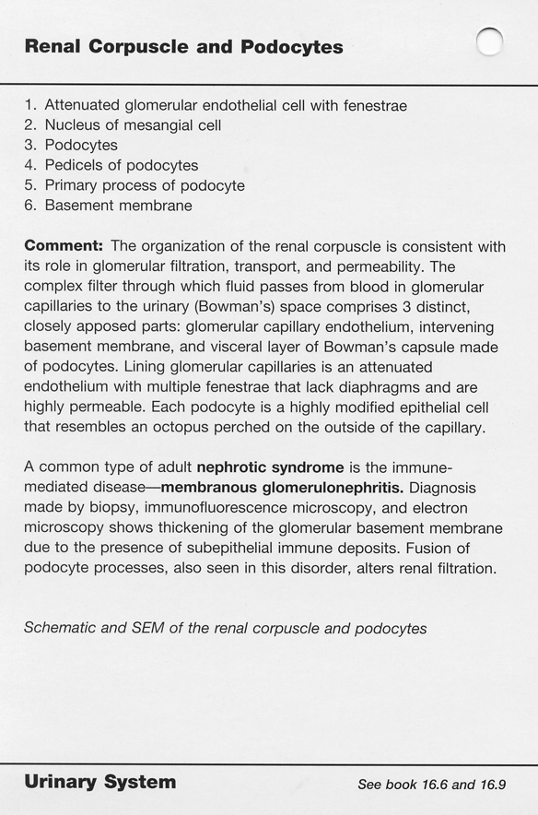
quiz

Slide 33
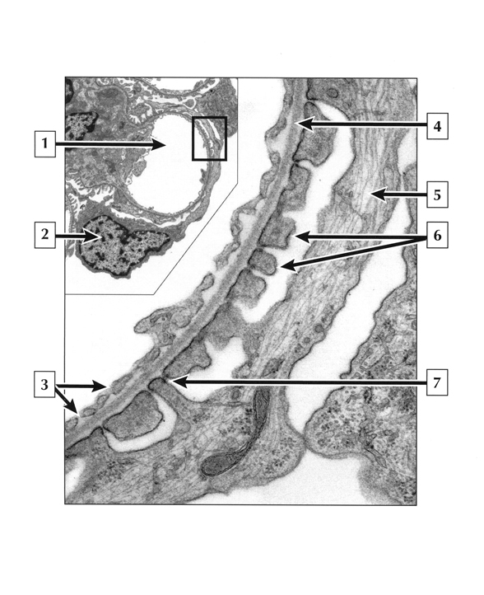
quiz
Self-check: Identify 1-7. Note 1 & 2 are part of low magnification view, rest of image is magnified view of what is within rectangle. (advance slide for answers)

Slide 34
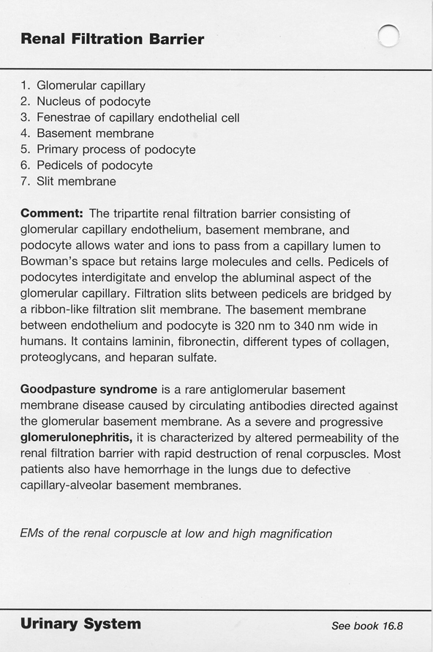
quiz

Slide 35
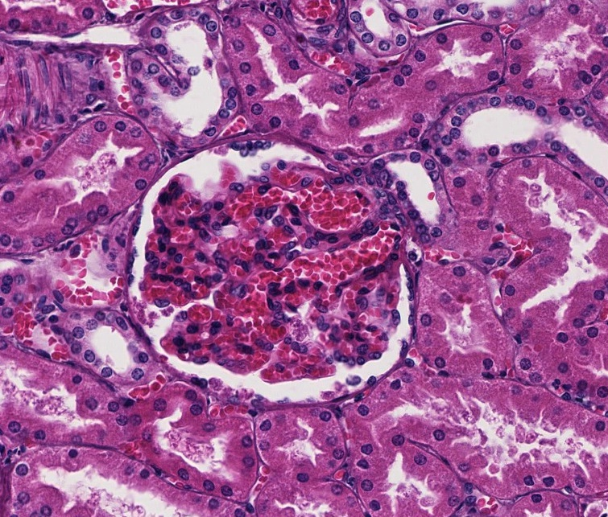
quiz
Self-check: Identify outlined structure. (advance slide for answers)
Macula densa

Slide 36
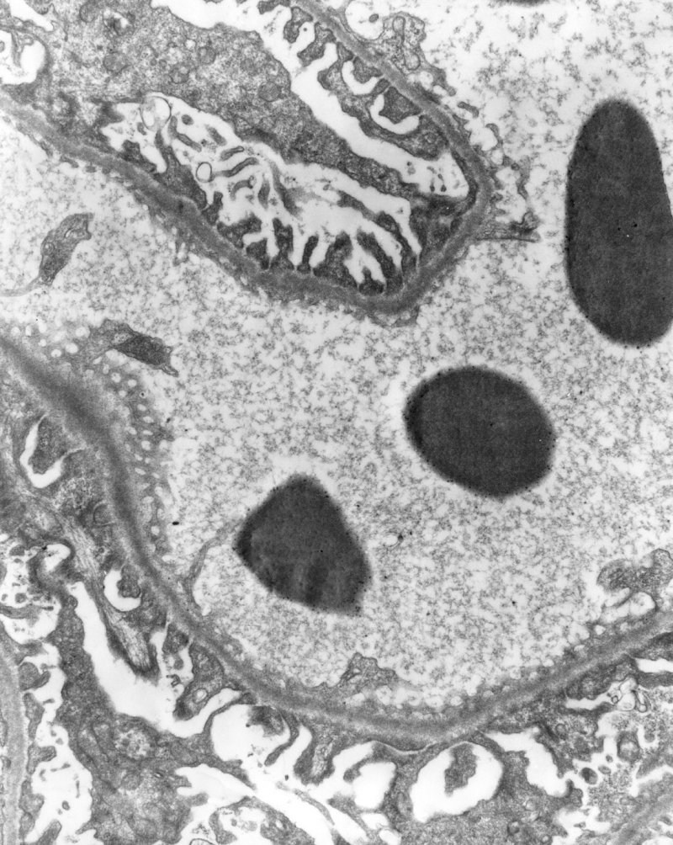
quiz
Self-check: Identify. (advance slide for answers)
1º pedicel of podocyte
2º pedicel of podocyte
Urinary (capsular) space
Fenestration in endothelial cell

Slide 37
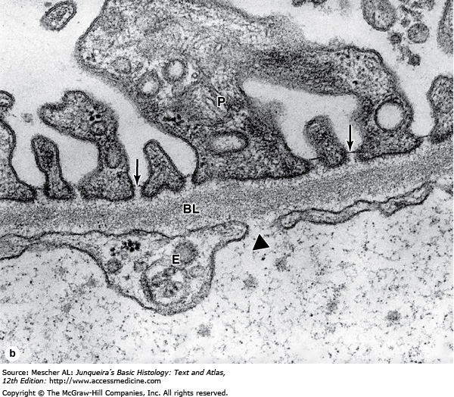
quiz
Self-check: Identify structures indicated by arrows and arrowhead. (advance slide for answers)
Note filtration slit diaphragm in filtration slit, and lack of diaphragm in fenestrated endothelium. Also note thick basal lamina (BL).
Filtration slit
Fenestration in endothelial cell

Slide 38
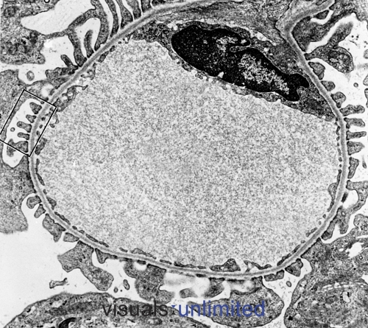
quiz
Self-check: Identify:
endothelial cell
podocyte
podocyte processes (pedicels)
capillary lumen
basal lamina
fenestrations
(advance slide for answers)

Slide 39
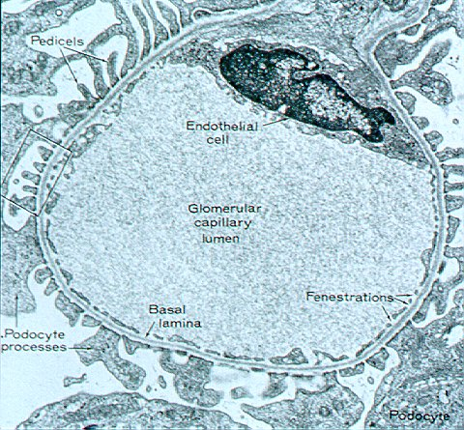
quiz

Slide 40
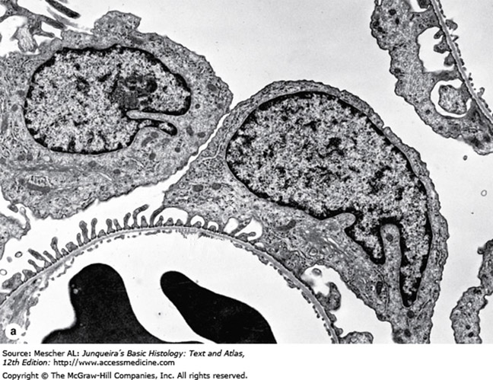
quiz
Self-check: Identify structures or spaces. (advance slide for answers)
X
X
blood
urinary space
podocyte
X

Slide 41
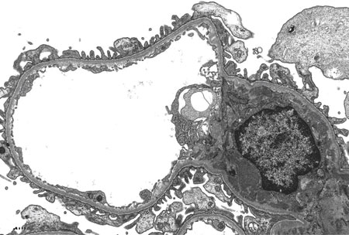
quiz
Self-check: Identify. (advance slide for answers)
X
endothelial cell

Slide 42
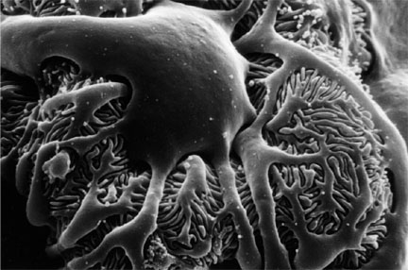
quiz
Self-check: Identify. (advance slide for answers)
1º pedicel of podocyte
podocyte
X
2º pedicel of podocyte

Slide 43
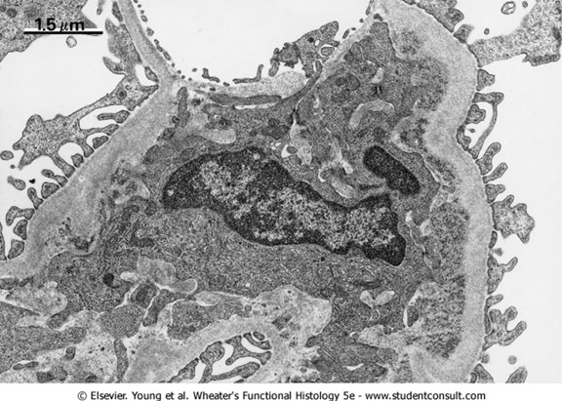
quiz
Self-check: Identify. (advance slide for answers)
X
Urinary space
blood
Mesangial cell
X
X

Slide 44
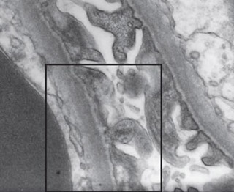
quiz
Self-check: Identify all structures within box. (advance slide for answers)

Slide 45
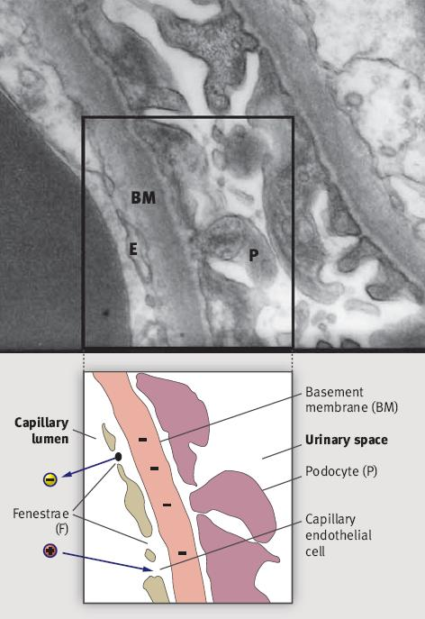
quiz
Pointer for capillary endothelial cell misses it’s mark

