Slide 1
The Kidney
Part One - Overview
Digital Laboratory
It’s best to view this in Slide Show mode, especially for the quizzes.
This module will take approximately 60 minutes to complete.

Slide 2
After completing this exercise, you should be able to (blue text in this module, tan text in subsequent kidney modules):
describe the gross anatomical features of the kidneys
Cortex
Medulla, including renal pyramid, renal papilla, renal columns
Hilus, sinus, renal pelvis, and major and minor calyces
recognize and discriminate between the pars convoluta and the pars radiata.
diagram blood circulation through the kidneys, and identify the major renal vessels on a histological section:
Renal artery and vein
Interlobar artery and vein
Arcuate artery and vein
Interlobular artery and vein
Afferent arteriole, glomerulus, efferent arteriole
Peritubular capillaries and vasa recta.
distinguish, at both the light and electron microscopic level, each of the following renal tubular structures:
proximal convoluted tubule
thick descending limb of the loop of Henle
thin limb of the loop of Henle
thick ascending limb of the loop of Henle
distal convoluted tubules
collecting (connecting) ducts, papillary ducts
Identify glomeruli at the light microscopic level, as well as identify each of the following in an electron micrograph:
endothelial cells
podocytes, including their primary and secondary pedicels (foot processes)
filtration slits
parietal epithelium
lamina densa
mesangial cells
blood space
urinary space.
Identify a juxtaglomerular apparatus, including the macula densa and juxtaglomerular cells

Slide 3
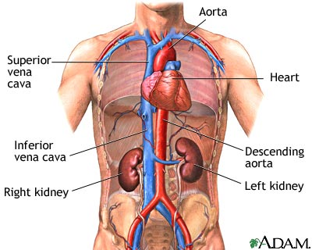
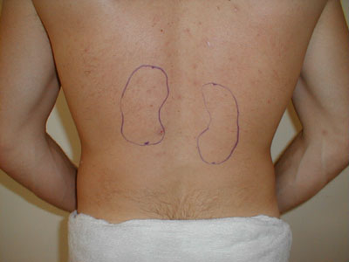
Gross anatomy OF THE kidney
Before delving into too much histology, let’s get an idea of where the kidneys are positioned in the body at the gross level.
This is a gross view of Adam’s kidneys.
This person has an unusual birthmark, showing the approximate location of his kidneys.

Slide 4
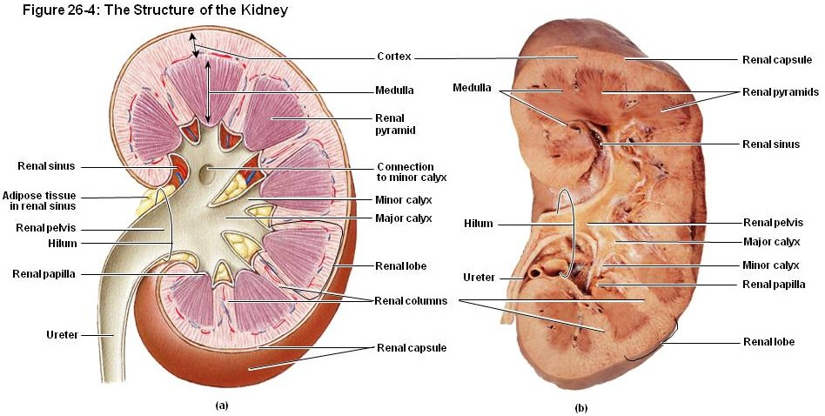
Gross anatomy OF THE kidney
Look and learn all labeled parts. Note:
the medulla is a region, and includes the medullary (renal) pyramids and renal columns.
the renal papilla is the tip of the renal pyramid
each pyramid/papilla drains into a minor calyx. Two or more minor calyces join to form a major calyx, major calyces ultimately join to form the renal pelvis.
the renal sinus is the space created when the fat between the calyces and renal vessels is dissected away.

Slide 5
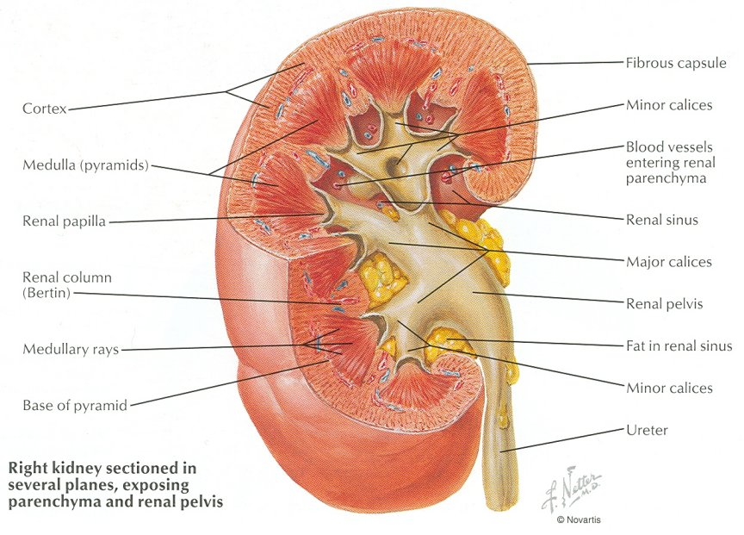
Gross anatomy OF THE kidney
Dr. Frank’s kidneys…

Slide 6
Gross anatomy OF THE kidney
Since you may have missed it, look at the label for renal lobe. This is indicating a region outlined with a thin black line. A renal lobe includes a renal pyramid, as well as it’s associated cortex (includes portions of the renal columns). All the nephrons in each lobe drain into the associated minor calyx.
Human kidneys have 10-20 of these lobes, all “pointing” to the renal pelvis. Think 3D here; you see about 8 or so lobes in these images, but some are situated either side of the section.

Slide 7
Gross anatomy OF THE kidney
The next slide is an annotated video, looking at a section of the kidney similar to the outlined region shown below. Note this section shows a complete lobe, with a second incomplete lobe, and a small portion of a third lobe.

Slide 8
Video of Gross Kidney – SL115
Link to SL 115
Be able to identify:
Renal lobe
Cortex
Medulla, including renal pyramid, renal papilla, renal columns
sinus, minor calyx

Slide 9
Gross anatomy OF THE kidney
Self-check: Identify 1-4. (advance slide for answers)

Slide 10
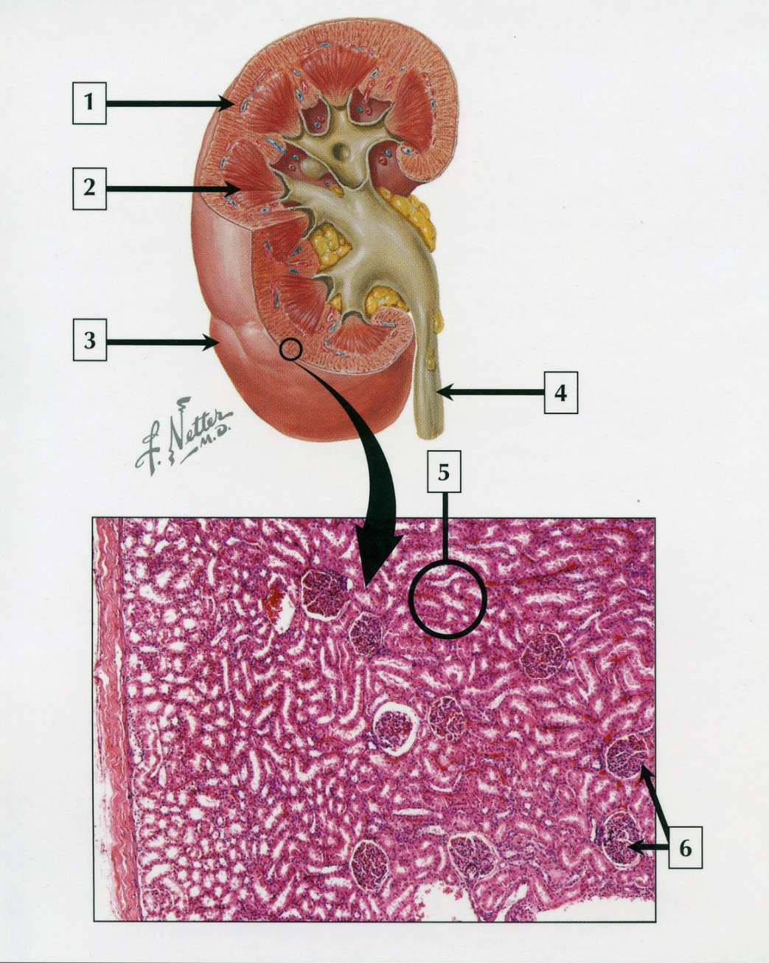
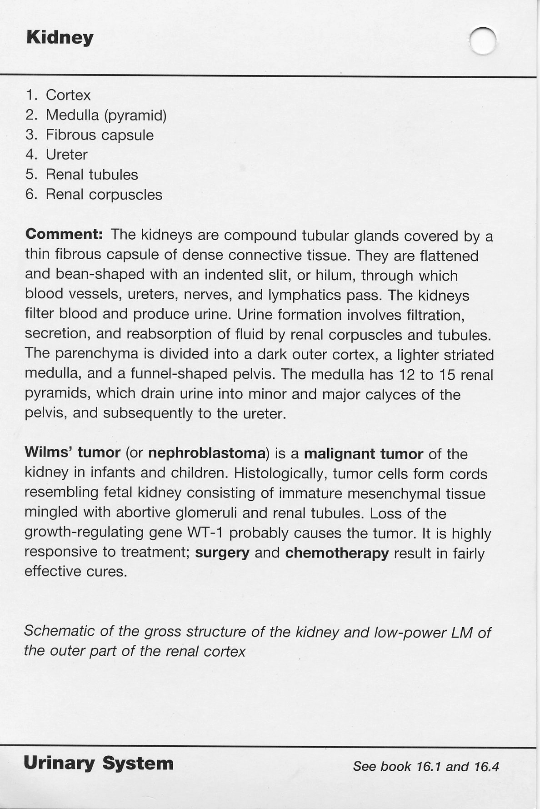
Gross anatomy OF THE kidney
Self-check answers

Slide 11
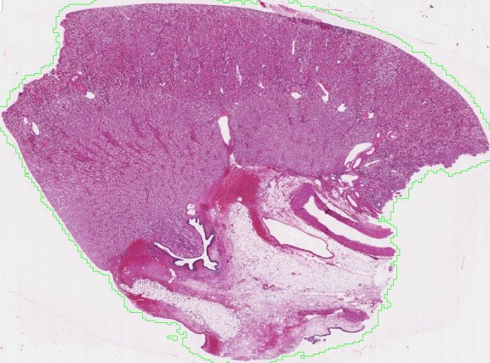
Gross anatomy OF THE kidney
Self-check: Identify outlined region and structure at arrow. (advance slide for answers)
(lumen of) minor calyx
sinus

Slide 12
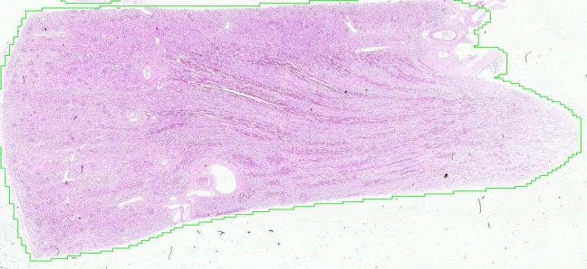
Gross anatomy OF THE kidney
Self-check: Identify outlined region. (advance slide for answers)
Medulla or medullary pyramid

Slide 13
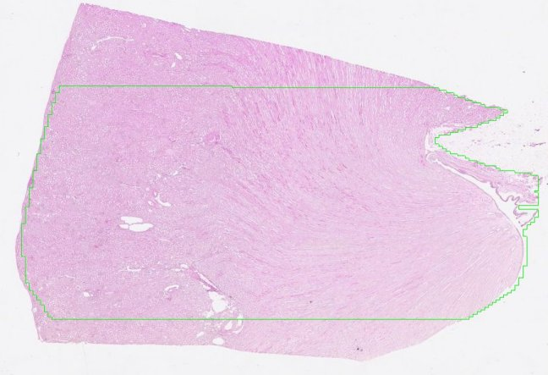
Gross anatomy OF THE kidney
Self-check: Identify regions. (advance slide for answers)
cortex
papilla

Slide 14
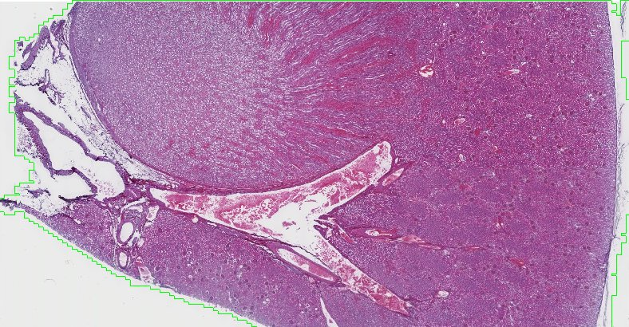
Gross anatomy OF THE kidney
Self-check: Identify region. (advance slide for answers)
Medulla (pyramid out of plane of section)

Slide 15
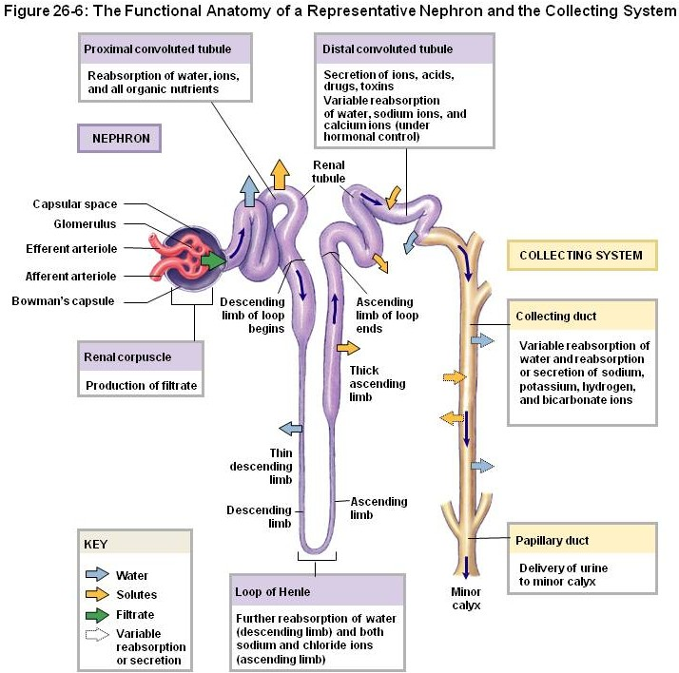
Overview of the microscopic anatomy OF THE kidney
Each kidney contains about 1 million tubules called nephrons, which are responsible for producing urine. Each nephron ultimately drains its product into the minor calyx.
Histologically, the parts of the nephron we will be examining are the:
renal corpuscle
proximal convoluted tubule (PCT)
loop of Henle
thick descending limb
thin limb (descending and ascending)
thick ascending limb
distal convoluted tubule (DCT)
collecting duct
Functional Overview: Blood is filtered by the renal corpuscle to produce provisional urine (aka ultrafiltrate). This fluid then flows down the tubular system (in the order listed), and the ultrafiltrate is modified by cells of the tubules.

Slide 16
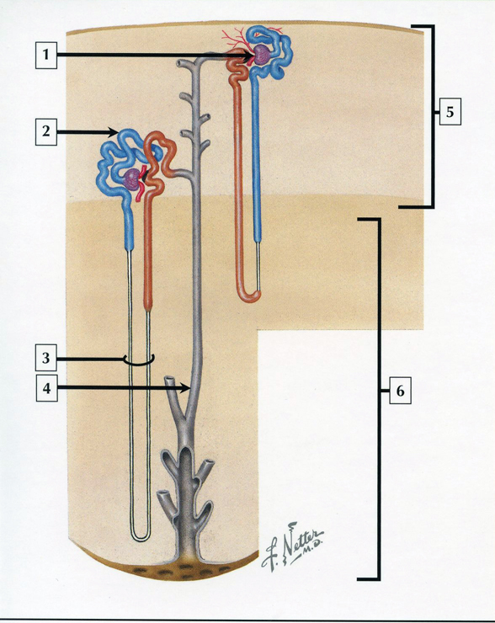
Overview of the microscopic anatomy OF THE kidney
Self-check: Identify 1-4. (advance slide for answers)

Slide 17
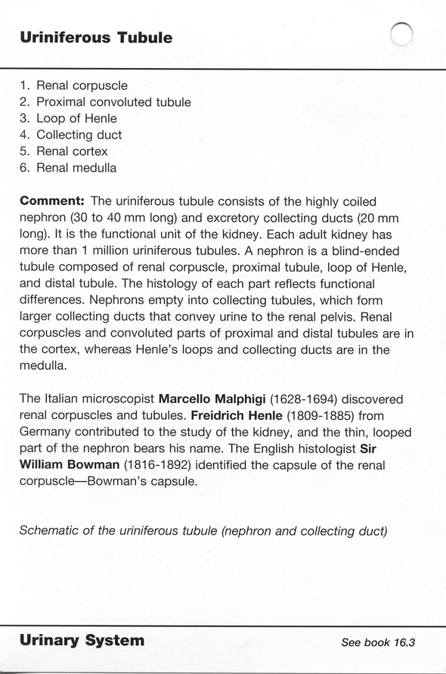
Overview of the microscopic anatomy OF THE kidney
Self-check answers

Slide 18
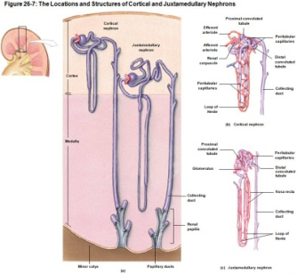
Overview of the microscopic anatomy OF THE kidney
As mentioned, all renal papillae are directed toward the renal pelvis. The nephrons within the kidney have a similar organization. As shown in this composite, nephrons around the kidney are oriented so that the tips of the loops of Henle are closest to the minor calyx, and all collecting ducts are directed toward the minor calyx that drains that lobe.
As mentioned, the kidney does have some thickness, so there are pyramids that “point” slightly into and out of the plane of this slide. But most are relatively along this sagittal plane.

Slide 19
Overview of the microscopic anatomy OF THE kidney
Therefore, nephrons are organized such that:
the coiled parts of the nephron (corpuscle, and proximal and distal convoluted tubules) are entirely in the cortex
the straight parts of the nephron (loop of Henle, collecting ducts)
fill up the medulla
extend into the cortex

Slide 20
Detailed Gross anatomy OF THE kidney
Reminder of a renal lobe….

Slide 21
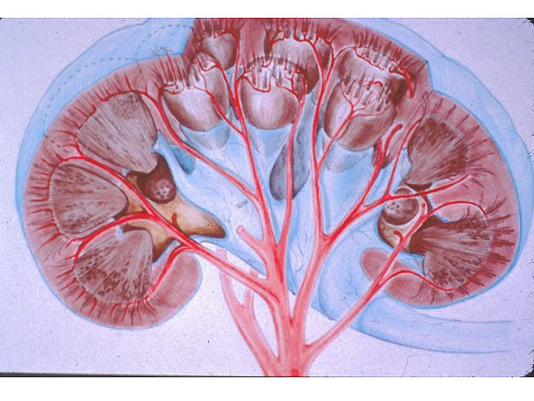
Detailed Gross anatomy OF THE kidney
The cortex of each lobe can be broken down into lobules (see blue rectangle in enlarged region to the right).
the core of each lobule is composed of straight portions of the nephron (loops of Henle, collecting duct) and is called the pars radiata or medullary rays (dark red lines within rectangle)
the periphery of each lobule (paler portion within rectangle) is composed of the coiled parts of the nephron (corpuscle, PCT, DCT) and is called the pars convoluta

Slide 22
Detailed Gross anatomy OF THE kidney
Video showing renal lobules - SL115
Link to SL 115
Be able to identify:
Pars convoluta
Pars radiata/medullary rays
lobule

Slide 23
Detailed Gross anatomy OF THE kidney
Video showing renal lobules - SL116
Link to SL 116
Be able to identify:
Pars convoluta
Pars radiata/medullary rays
lobule

Slide 24
Detailed Gross anatomy OF THE kidney
The next slide is a tangential cut through the cortex (yellow line), so that your viewpoint if from the direction of the arrow.
I hope by now you’re getting comfortable with this, so that you expect a tangential section through the cortex would show medullary rays (pars radiata) in cross-section, surrounded by pars convoluta. This is very similar to the lobules I showed at the end of the previous video.

Slide 25
Detailed Gross anatomy OF THE kidney
Video of tangential cut through cortex SL117
Link to SL 117
Be able to identify:
Pars convoluta
Pars radiata/medullary rays
lobule

Slide 26
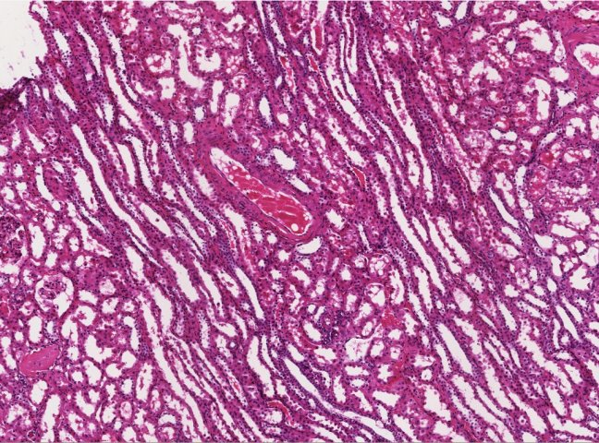
Detailed Gross anatomy OF THE kidney
Self-check: Identify medullary ray/pars radiata and pars convoluta. (advance slide for answers)
Regions in blue are medullary rays, parts in between are pars convoluta

Slide 27
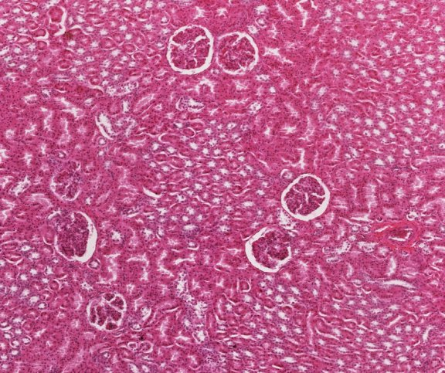
Detailed Gross anatomy OF THE kidney
Self-check: Identify outlined regions. (advance slide for answers)
Pars radiata/
medullary ray
Pars convoluta
Together, they are a renal ___________
Renal lobule

Slide 28
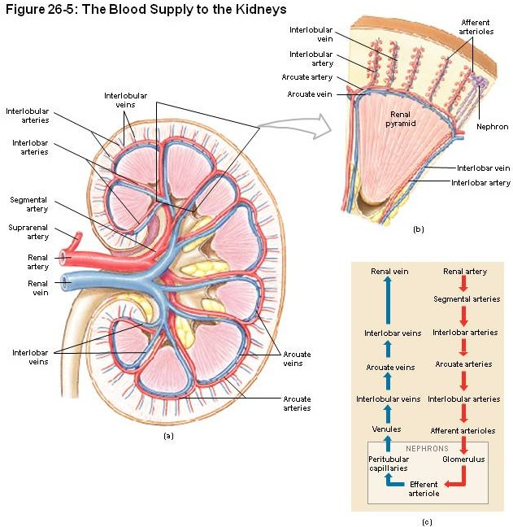
BLOOD SUPPLY OF THE kidney
The architecture of the renal blood vessels is quite organized to ensure efficient blood flow to each lobule.
Blood vessels enter / leave the kidney at the hilus. The renal artery branches into segmental arteries within the renal sinus. These segmental arteries give rise to interlobar arteries, which run in the renal columns between the renal pyramids. At the junction of the medulla and cortex, the interlobar arteries branch at right angles, forming arcuate arteries that run between the cortex and medulla. Coming off of the arcuate arteries at a right angle are interlobular arteries, which run in the cortex. All these arteries have accompanying veins.
Other renal vessels, such as afferent and efferent arterioles, peritubular capillaries, and vasa recta will be discussed in subsequent modules.

Slide 29
BLOOD SUPPLY OF THE kidney
As mentioned on the previous slide, renal vessels are named by their position within the kidney:
renal and segmental vessels are in the sinus
interlobar vessels are in the renal columns (between pyramids)
arcuate vessels are between the cortex and medulla
interlobular vessels are in cortex, between lobules
afferent and efferent arterioles bring blood to and from the glomerulus of the corpuscle, respectively
peritubular vessels are in the cortex
vasa recta are in the medulla

Slide 30
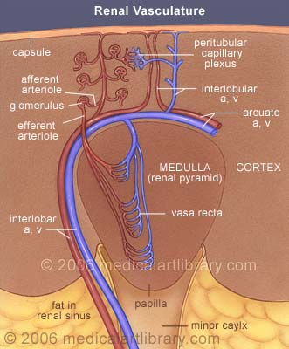
BLOOD SUPPLY OF THE kidney
When looking at slides, renal vessels are identified by their position:
renal and segmental vessels are in the sinus
interlobar vessels are in the renal columns (between pyramids)
arcuate vessels are between the cortex and medulla
interlobular vessels are in cortex, between lobules
afferent and efferent arterioles bring blood to and from the glomerulus of the corpuscle, respectively
peritubular vessels are in the cortex
vasa recta are in the medulla

Slide 31
BLOOD SUPPLY OF THE kidney
Self-check: Identify arrow. (advance slide for answers)
Interlobular artery
Interlobar artery
arcuate artery
Segmental (or renal) artery

Slide 32
BLOOD SUPPLY OF THE kidney
This drawing shows some of these vessels as you will see them on your slides – in section. But, the principles stay the same.
When looking at slides, renal vessels are identified by their position within the kidney:
renal and segmental vessels are in the sinus
interlobar vessels are in the renal columns (between pyramids)
arcuate vessels are between the cortex and medulla
interlobular vessels are in cortex, between lobules
peritubular vessels are in the cortex
vasa recta are in the medulla

Slide 33
BLOOD SUPPLY OF THE kidney
Video showing renal vessels - SL115
Note that this video only describes:
renal / segmental vessels
interlobar vessels
arcuate vessels
interlobular vessels
Other renal vessels, such as afferent and efferent arterioles, peritubular capillaries, and vasa recta will be discussed in subsequent modules.
Link to SL 115
Be able to identify:
Renal artery and vein (or segmental artery and vein)
Interlobar artery and vein
Arcuate artery and vein
Interlobular artery and vein

Slide 34
BLOOD SUPPLY OF THE kidney
Video showing renal vessels – SL116
Link to SL 116
Be able to identify:
Renal artery and vein (or segmental artery and vein)
Interlobar artery and vein
Arcuate artery and vein
Interlobular artery and vein

Slide 35
BLOOD SUPPLY OF THE kidney
When looking at slides, renal vessels are identified by their position:
renal and segmental vessels are in the sinus
interlobar vessels are in the renal columns (between pyramids)
arcuate vessels are between the cortex and medulla
interlobular vessels are in cortex, between lobules
peritubular vessels are in the cortex
vasa recta are in the medulla
I can’t stress enough that these vessels are not named because they look different from one another. Apart from size, they all look like any other artery or vein. If you try to name them by studying how they look individually, you will be staring for quite some time.
They are so-named because of their POSITION within the kidney.

Slide 36
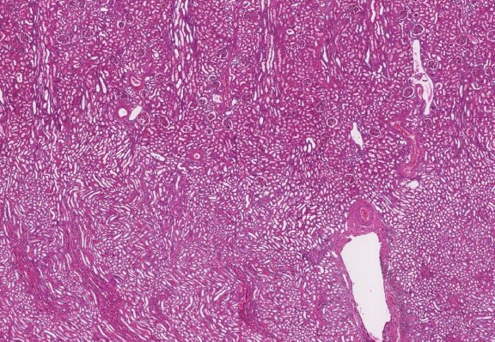
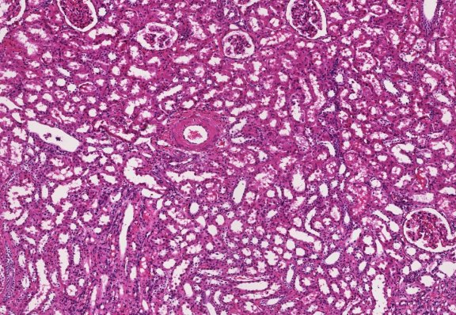
BLOOD SUPPLY OF THE kidney
Self-check: Identify the vessel indicated by the arrows. (advance slide for answers)
Arcuate artery – note it’s position between cortex and medulla

Slide 37
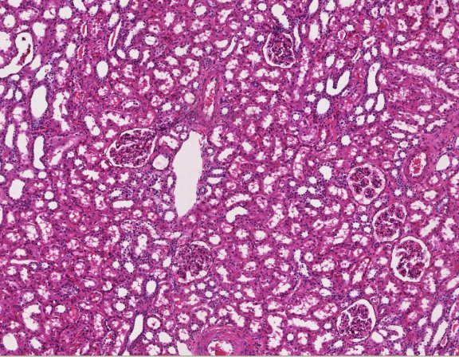
BLOOD SUPPLY OF THE kidney
Self-check: Identify the vessel indicated by the arrow. (advance slide for answers)
Interlobular artery – there are glomeruli all around, so even with this limited view, you know you are in the cortex
glomeruli

Slide 38
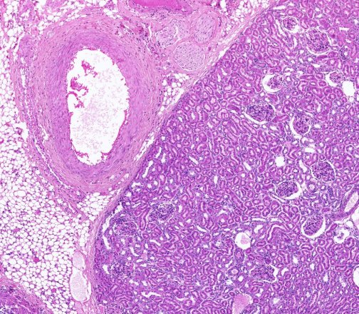
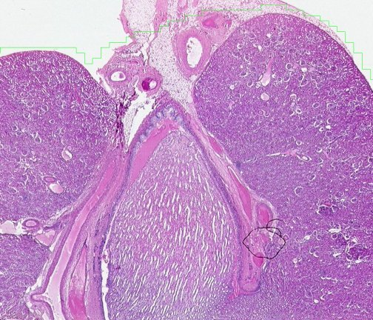
BLOOD SUPPLY OF THE kidney
Self-check: Identify the vessel indicated by the arrows. (advance slide for answers)
Renal or segmental artery

Slide 39
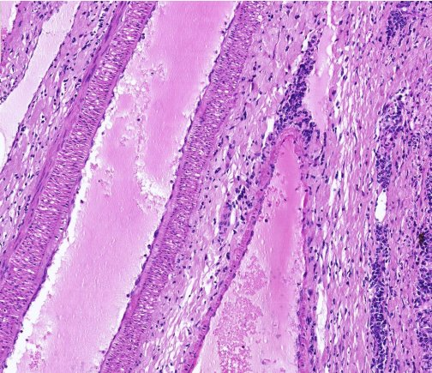
BLOOD SUPPLY OF THE kidney
Self-check: Identify the vessel indicated by the arrows. (advance slide for answers)
Interlobar vein

Slide 40
The next set of slides is a cumulative quiz for this module. Before continuing, we suggest you remind yourself of the list of objectives covered in this module (blue), and mentally visualize what each region or structure will look like:
describe the gross anatomical features of the kidneys
Cortex
Medulla, including renal pyramid, renal papilla, renal columns
Hilus, sinus, renal pelvis, and major and minor calyces
recognize and discriminate between the pars convoluta and the pars radiata.
diagram blood circulation through the kidneys, and identify the major renal vessels on a histological section:
Renal artery and vein
Interlobar artery and vein
Arcuate artery and vein
Interlobular artery and vein
Afferent arteriole, glomerulus, efferent arteriole
Peritubular capillaries and vasa recta.
distinguish, at both the light and electron microscopic level, each of the following renal tubular structures:
proximal convoluted tubule
thick descending limb of the loop of Henle
thin limb of the loop of Henle
thick ascending limb of the loop of Henle
distal convoluted tubules
collecting (connecting) ducts, papillary ducts
Identify glomeruli at the light microscopic level, as well as identify each of the following in an electron micrograph:
endothelial cells
podocytes, including their primary and secondary pedicels (foot processes)
filtration slits
parietal epithelium
lamina densa
mesangial cells
blood space
urinary space.
Identify a juxtaglomerular apparatus, including the macula densa and juxtaglomerular cells

Slide 41
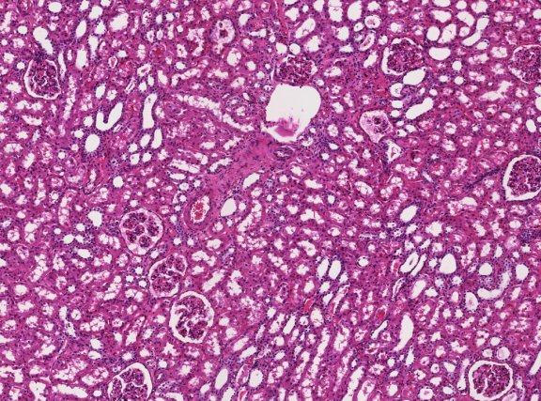
FINAL REVIEW
Self-check: Identify the vessel indicated by the arrow. (advance slide for answers)
Interlobular vein – there are glomeruli all around, so even with this limited view, you know you are in the cortex
glomeruli

Slide 42
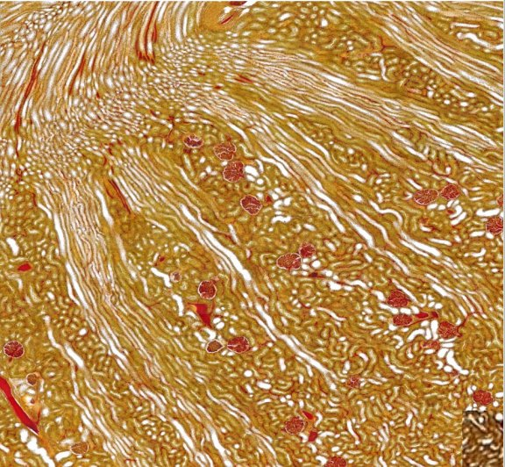
FINAL REVIEW
Self-check: Identify outlined region.
medullary ray
These are really sweet!!!

Slide 43
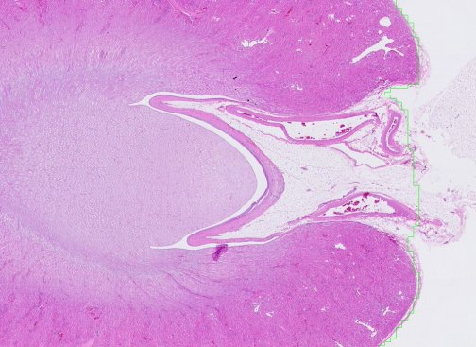
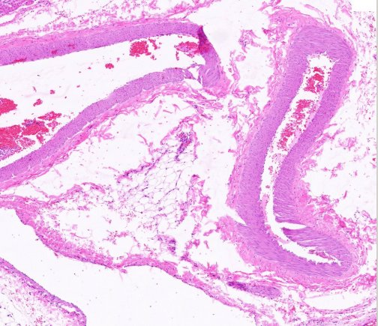
FINAL REVIEW
Self-check: Identify structure indicated by the arrows.
Renal (segmental) artery

Slide 44
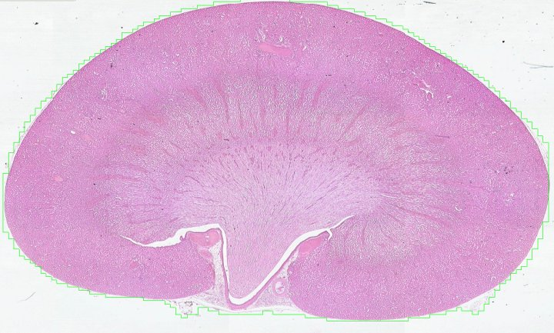
FINAL REVIEW
Self-check: Identify cortex, medulla, papilla, minor calyx, sinus. (advance slide for answers)
cortex
medulla
papilla
minor calyx
sinus

Slide 45
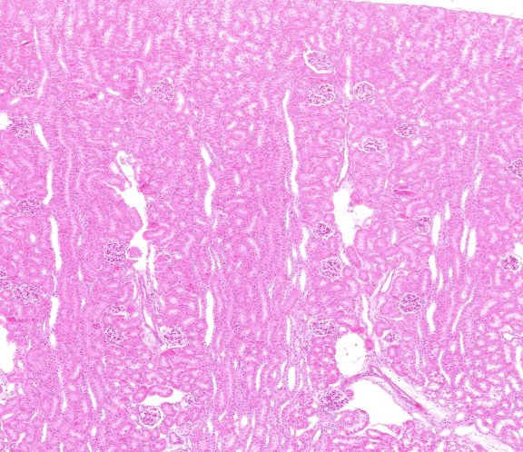
FINAL REVIEW
Self-check: Identify outlined regions.
(part of)
pars convoluta
lobule

Slide 46
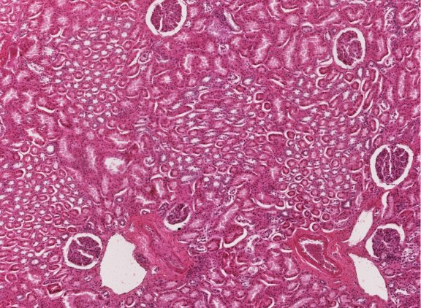
FINAL REVIEW
Self-check: Identify outlined structures and structure indicated by arrow.
Medullary ray (pars radiata)
Pars convoluta
Interlobular artery
This is a tangential cut through the cortex.

Slide 47
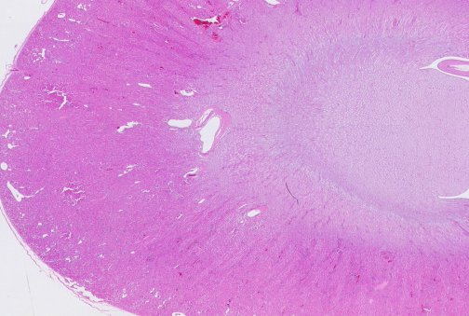
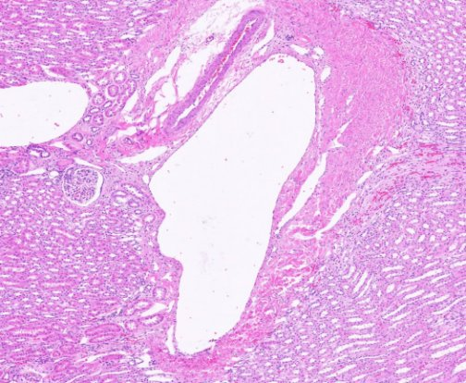
FINAL REVIEW
Self-check: Identify structure indicated by the arrows.
Arcuate vein

