Slide 1
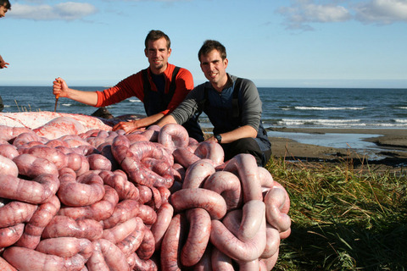
Intestines
Digital Laboratory
It’s best to view this in Slide Show mode, especially for the quizzes.
This module will take approximately 60 minutes to complete.

Slide 2
After completing this exercise, you should be able to:
Distinguish, at the light microscope level, each of the following:
  Small intestine
    Structures
      Plica, villi, microvilli (review)
      Intestinal crypts (of Lieberkühn)
      Cells
        Enterocytes (intestinal absorptive cells)
        Goblet cells
        Paneth cells
        Enteroendocrine cells (review, not covered in this module)
        Regions
          Duodenum
            Submucosal (Brunner’s) glands
            Ampulla of Vater
            Jejunum
            Ileum
              Peyer’s patches
    Large intestine
      Structures
        Intestinal crypts (of Lieberkühn)
        Teniae coli
        Cells
          Enterocytes (intestinal absorptive cells)
          Goblet cells
    Continues on next page…..

Slide 3
After completing this exercise, you should be able to:
Distinguish, at the electron microscope level, each of the following:
  Small intestine
    Enterocytes (intestinal absorptive cells)
      Microvilli (review, not covered in this module)
      Goblet cells
      Paneth cells
        Secretory granules
        Enteroendocrine cells (review, not covered in this module)
          Secretory granules
          Large intestine
            Enterocytes
            Goblet cells
            Enteroendocrine cells (review, not covered in this module)
Seems like a lot, but many of these are things you know, or can make the jump from what you know easily. Plus, many EM structures reinforce the light microscopy anyway.

Slide 4
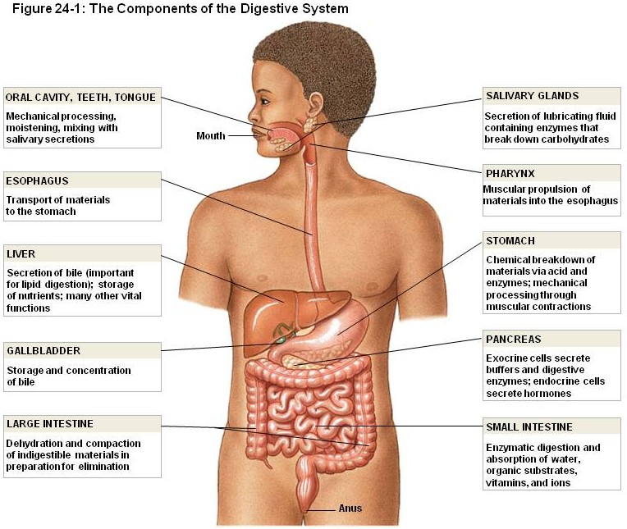
GASTROINTESTINAL SYSTEM ORGANS
The remaining modules in this block will discuss the organs of the gastrointestinal system. Although many texts begin with the oral cavity and proceed toward the anal canal, this first organ module will cover the small and large intestines.
As you know, the function of the GI tract is to break down and absorb nutrients. Since the intestines is largely involved in the process of absorption, it makes sense to begin here (or at least is a reasonable option).
In addition, the overview module spent a lot of time with the intestines as a model organ, so this is a nice transition.

Slide 5
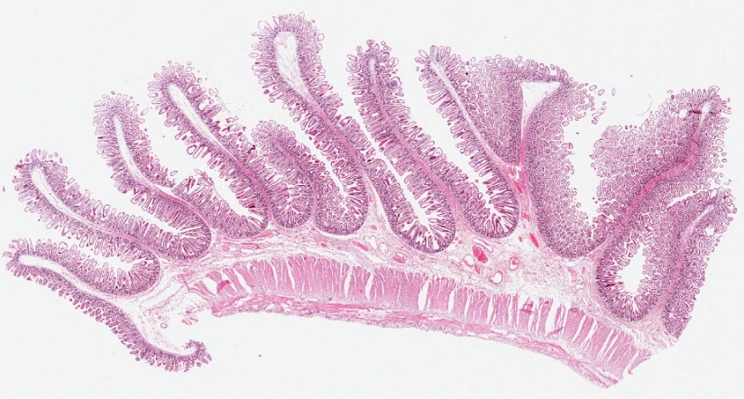
SMALL INTESTINE
This is a longitudinal section of the small intestine from the first module. Remind yourself of friends of yours...
submucosa
mucosa
Muscularis externa inner circular layer
Muscularis externa outer longitudinal layer

Slide 6
SMALL INTESTINE
This is a longitudinal section of the small intestine from the first module. Remind yourself of friends of yours...
Plica circularis
villus

Slide 7
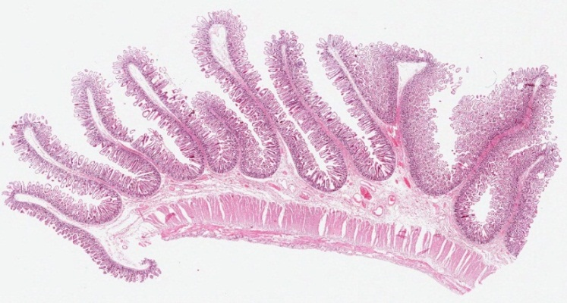
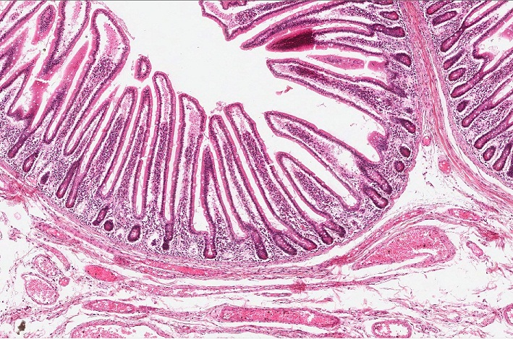
SMALL INTESTINE
In the first module, the epithelial invagination outlined in green was called a gland (generic term, applies to all organs of the GI tract).
In the small and large intestine, these glands are specifically referred to as intestinal crypts (of Lieberkühn)
villus
For the sake of completion, a gland is outlined in green. Glands project downward into the lamina propria from the base of the villi.

Slide 8
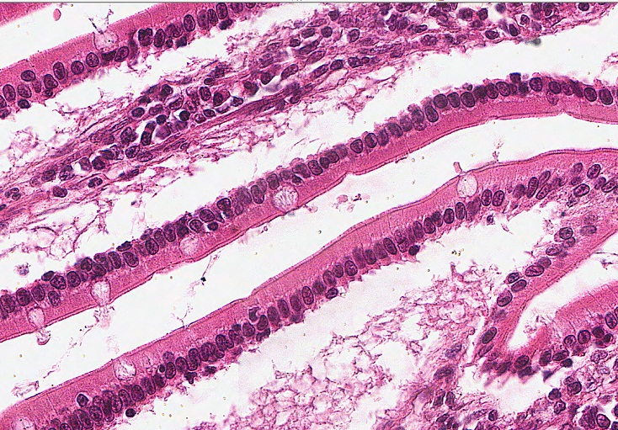
SMALL INTESTINE
Although the nerve/muscle tissues are involved in peristalsis, much of the “action” of the intestines happens in the mucosa, specifically the epithelium.
Cell types in the epithelium of the small intestine (focus on the ones in orange text):
Enterocytes / intestinal absorptive cells (two are outlined) absorb nutrients. They also express digestive enzymes in the brush border. They are the most numerous cell type in the small intestinal epithelium, are simple columnar, with eosinophilic cytoplasm and microvilli / brush border.
Goblet cells (arrows) are easily recognized because their numerous mucus-containing secretory granules wash out on H&E preparations.
Stem cells are located in the junction of the villi and crypts, but are not seen in H&E sections.
Enteroendocrine cells have already been discussed in the overview module.
Paneth cells will be discussed in later slides.
M cells are associated with antigen transport, have been considered in Fundamentals, are not easily seen on our slides, so not discussed here.

Slide 9
SMALL INTESTINE
Just a reminder of the microvilli / brush border (brackets) on the enterocytes (intestinal absorptive cells).
Note the height of the microvilli is approximately 1/10 the length of the nucleus (cilia are approximately 1/3 to 1/2). You can’t see individual microvilli, what you are seeing is the collective of numerous microvilli; this is termed the “brush border”.
brackets here

Slide 10
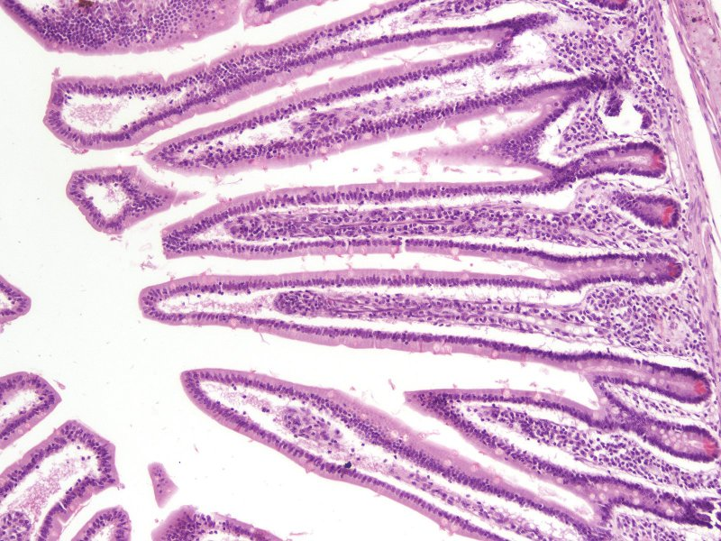
SMALL INTESTINE
Paneth cells are found at the base of the crypts (within outlined region) of the intestinal tract. They produce antibacterial proteins, such as lysozymes and α-defensins, which are released into the lumen of the intestinal tract. Their secretory granules are highly eosinophilic on H&E stained sections, and are located in the apical aspect of the cytoplasm. These cells are numerous in the small intestine, especially the cranial portion (closest to the stomach), become less numerous distally, and are rare in the large intestine.

Slide 11
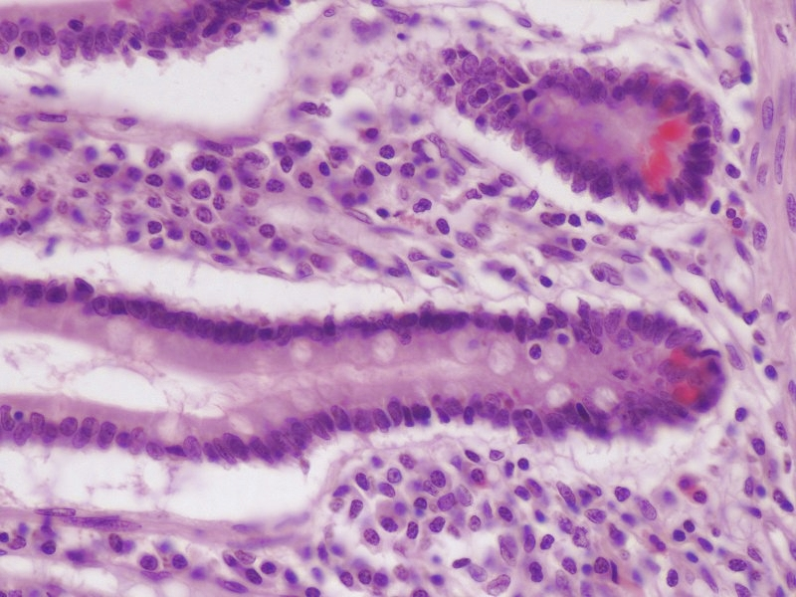
SMALL INTESTINE
Crypts at higher magnification. Note the Paneth cells (outlined) are at the base of the crypts. Their secretory granules are apically placed, and are brightly eosinophilic.
Just making sure you master the obvious…
Paneth cells secrete their product apically, into the lumen of the intestine. Therefore, you would expect to find secretory granules in these cells apical to their nucleus.
You already looked at enteroendocrine cells, which secrete their product basally, into the connective tissue. As you recall, their secretory granules were basally-located in the cytoplasm.
Lumen here somewhere
Lumen
Lumen
The nuclei in the outlined region outnumber the eosinophilic cytoplasms. That’s because there are other cells in the outlined region, such as enterocytes and enteroendocrine cells.

Slide 12
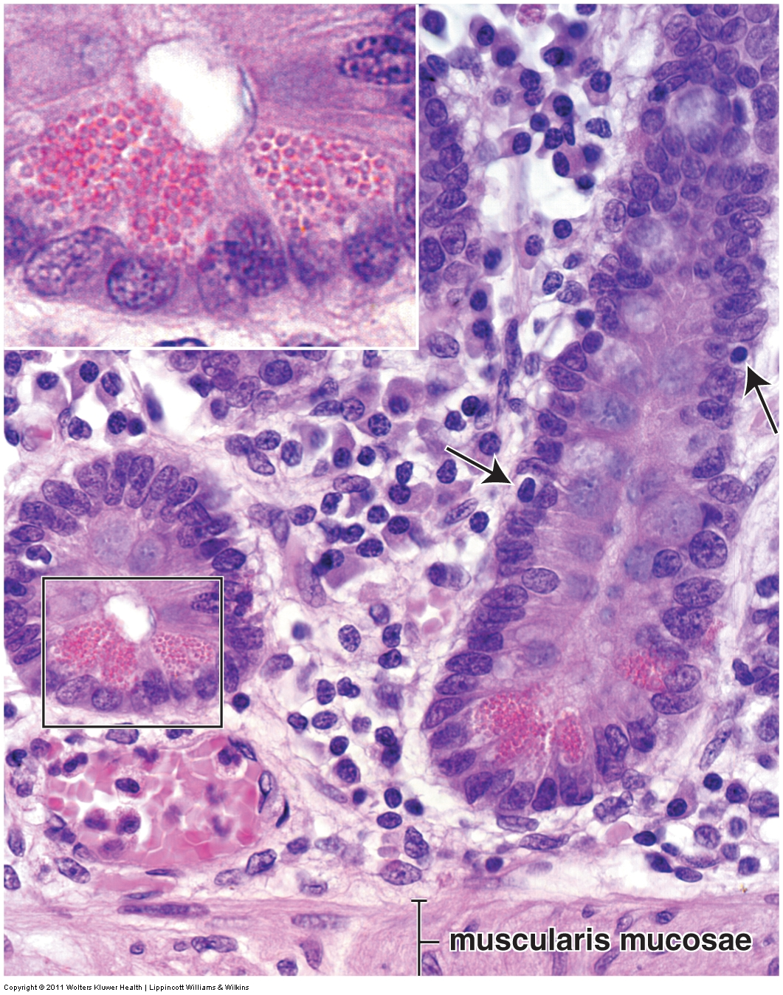
SMALL INTESTINE
This image of Paneth cells from your Ross text is totally sweet!!!!! Look at those granules!!!!

Slide 13
SMALL INTESTINE
Video of small intestine showing epithelial cell types – SL14
Link to SL 014
Be able to identify:
  Small intestine
    Enterocytes (intestinal absorptive cells)
    Goblet cells
    Paneth cells

Slide 14
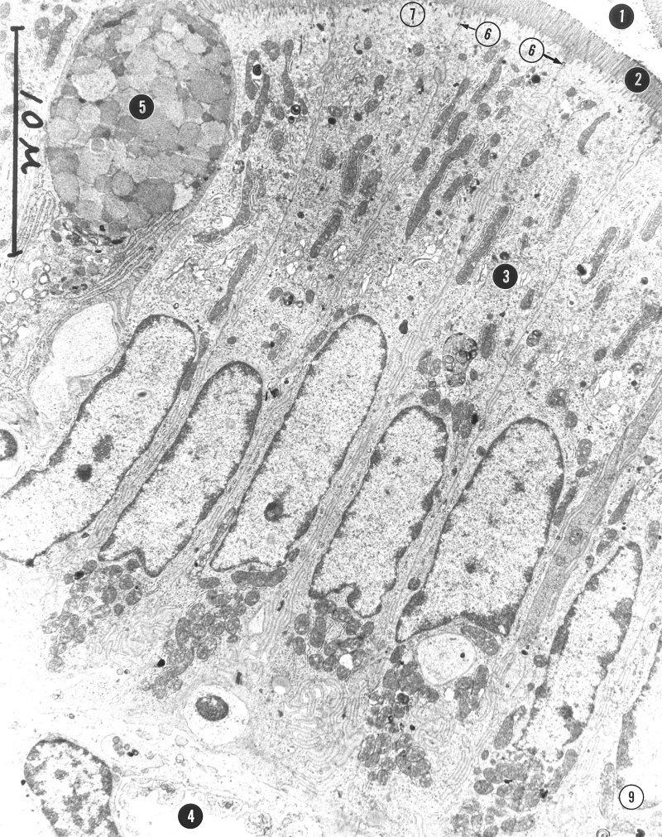
SMALL INTESTINE
Ho, hum, you’ve seen this multiple times before…..but now it is in in some context.
Cell types in the epithelium of the small intestine:
Enterocytes / intestinal absorptive cells (outlined cell is one of many, curved because of adjacent goblet cell). Note they are tall, columnar, with an elongated nucleus, numerous mitochondria, basally-located rough ER, a Golgi region (3), no obvious granules (constitutive secretion), abundant microvilli (2), and junctional complexes (6) between adjacent cells at the apical end.
Goblet cells (immediately to left of outlined enterocyte) are easily recognized because of their numerous, pale, mucus-containing secretory granules (5) in the apical region which preserve well in EMs.

Slide 15
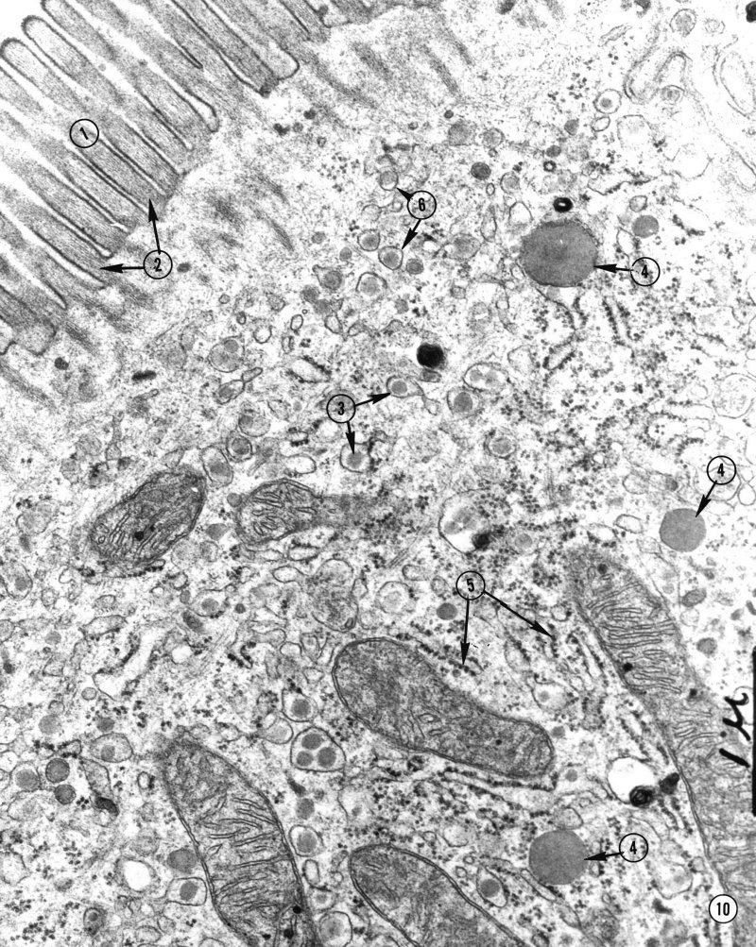
SMALL INTESTINE
More enterocytes you have seen. Note microvilli (1) with actin (2) as their core protein, rough ER (5).
Enterocytes absorb nutrients. This includes lipids in a meal, which are endocytosed into the smooth ER compartment; the lipid droplets are the gray structures at 3, surrounded by smooth ER membrane (tip of arrow at 6). There are also some free lipid droplets at 4.
These lipid-containing vesicles are transported to the Golgi apparatus for packaging with proteins to make chylomicrons, which are moved to the basal aspect of the cell, released into the connective tissue, and picked up by lymphatic channels in the lamina propria. More on this process in your live sessions.
So beautiful.

Slide 16
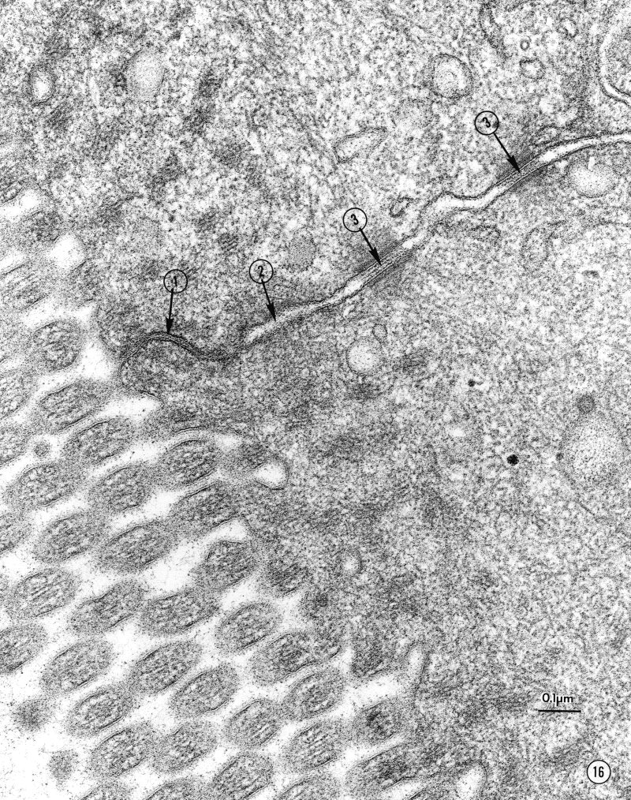
SMALL INTESTINE
Again, more enterocytes you have seen. Note the junctional complex:
Zonula occludens - tight junctions
Zonula adherens - belt desmosomes
Macula adherens - (spot) desmosomes

Slide 17
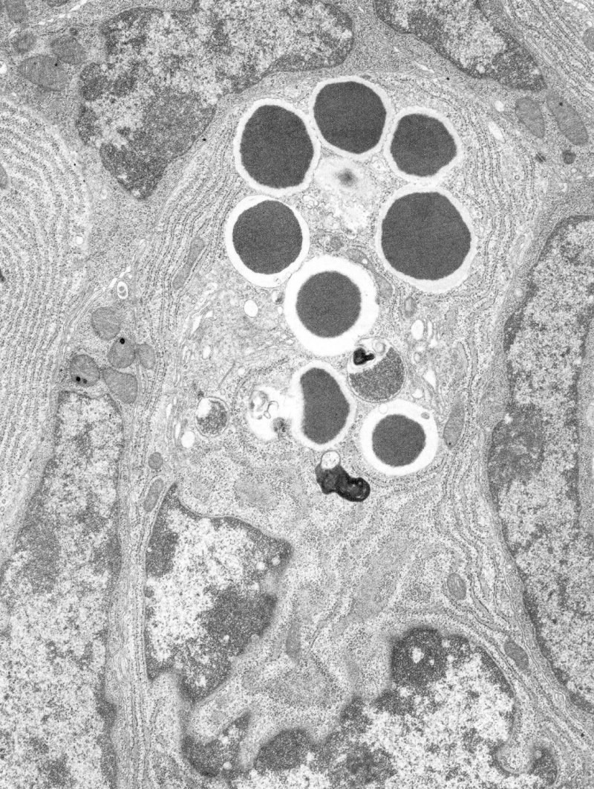
SMALL INTESTINE
EM of a Paneth cell (actually, looks like an entire cell in the center, and parts of two more to the left and upper right). Note the abundant rough ER and large, dark secretory granules.
The pale halo around the dark region in the secretory granule is a fixation artifact that occurs in secretory granules of many cell types, and is not necessarily specific for Paneth cells.
In this EM, it’s hard to tell which side is basal and which side is apical. In fact, with so many nuclei, it’s even hard to tell which nucleus belongs to the Paneth cells. Since you need to know orientation to differentiate Paneth cells from enteroendocrine cells, this is NOT a good quiz image.
Secretory granule
Secretory granule
Secretory granules are typically dark-staining in both Paneth and enteroendocrine cells, and are typically pale-staining (and typically more numerous) in goblet cells.
Lamina propria

Slide 18
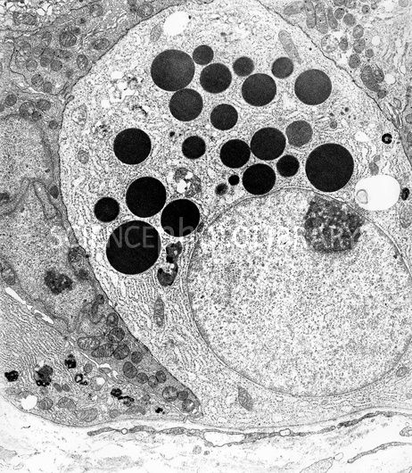
SMALL INTESTINE
This EM shamelessly stolen from SciencePhotoLibrary is a totally sweet EM of a Paneth cell. Note the connective tissue of the lamina propria, which signifies the basal aspect of the epithelium. This nicely demonstrates that the secretory granules in this Paneth cell are large, and situated in the apical aspect of the cell.
Lots of cells have dark granules (basophils, cells of the pituitary gland), so it helps to know the source of the tissue in these situations in order to identify the cell type.
On exams, either the image will provide clues sufficient to determine the source, or, if this is not the case, the question stem will indicate the source tissue.
Lamina propria

Slide 19
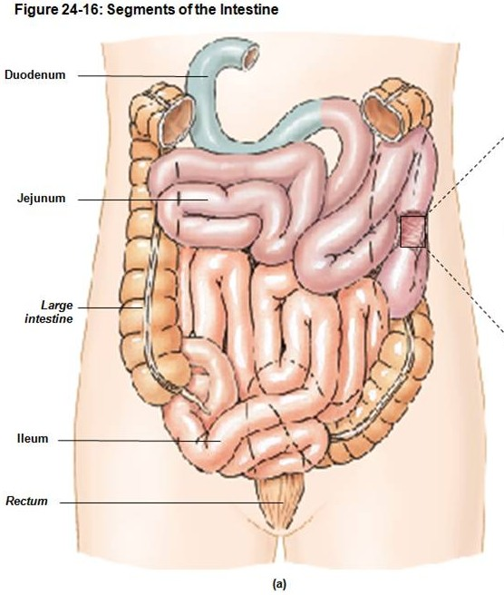
SMALL INTESTINE - REGIONS
The small intestine is divided into three parts. From cranial to caudal, they are:
duodenum - about 12 inches long, C-shaped
jejunum – middle segment
ileum – final segment, joins with the large intestine
These have some differences which are illustrated on the next slides. Some general differences that may not be blatantly obvious when looking at a single image or slide include:
A decrease in the number of Paneth cells
The jejunum has the most elaborate surface area modifications (plica, villi)

Slide 20
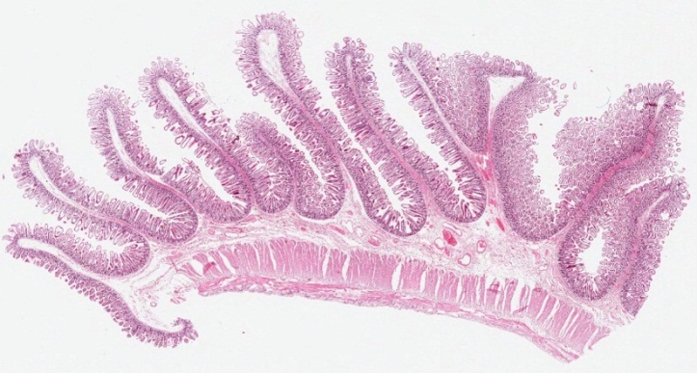
SMALL INTESTINE - JEJUNUM
Let’s start with the middle segment, the jejunum, because it is the one we have been considering, and it is the most generic (i.e. we will define the duodenum and ileum by adding identifying features specific to those regions).
The jejunum can be characterized by all the features mentioned in the previous slides: elaborate surface modifications (plica, villi), intestinal crypts, simple columnar epithelium with microvilli and goblet cells, numerous Paneth cells, distinct muscularis externa…..
I would say that the jejunum can be specifically identified as such because it has all these, AND lacks features of the duodenum and ileum, but you don’t know these yet, so please proceed to the next slide.

Slide 21
SMALL INTESTINE - JEJUNUM
Video of jejunum– SL14
Link to SL 014
Be able to identify:
  Small intestine
    jejunum

Slide 22
SMALL INTESTINE - JEJUNUM
Video of jejunum PAS stained – SL19
Link to SL 019
Be able to identify:
  Small intestine
    jejunum

Slide 23
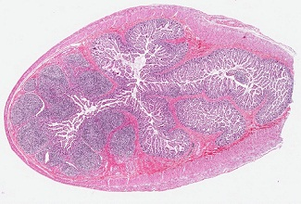
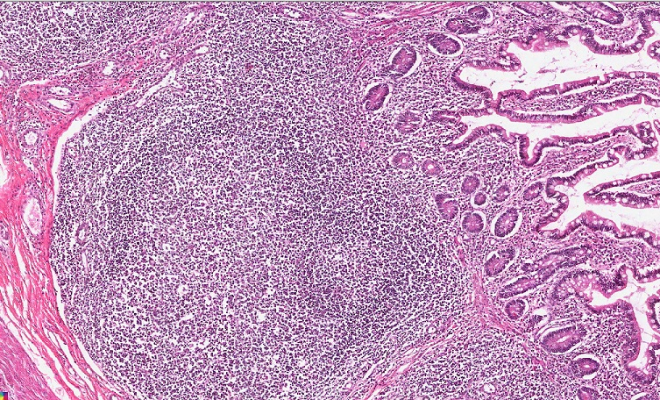
SMALL INTESTINE - ILEUM
The ileum can be identified because it has all the features of the small intestine, plus large regions of diffuse lymphoid tissue called Peyer’s Patches. These are located on the anti-mesenteric side of the ileum (the side opposite the mesentery).
Mesentery here
Lymphoid nodule of Peyer’s Patch
Since the lumen of the intestinal tract houses lots bacteria, both endogenous and exogenous, diffuse immune tissue is prominent throughout. Like the tonsils, the ileum is an area where this diffuse immune tissue exists in substantial amounts. It make perfect sense to have lots of immune tissue in the tonsils; after all, this is the gateway into the body. Not sure anyone knows why the ileum was selected for such a specialized role…maybe to prevent colonic bacteria from growing retrogradely into the small intestine?

Slide 24
SMALL INTESTINE - ILEUM
Video of ileum– SL11
Link to SL 011
Be able to identify:
  Small intestine
    Ileum
      Peyer’s Patches

Slide 25
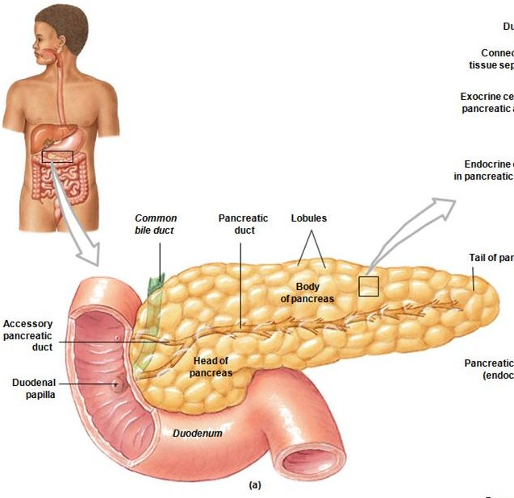
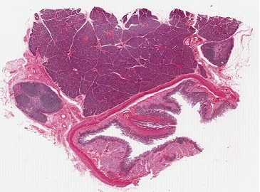
SMALL INTESTINE - DUODENUM
For orientation, our slide of the duodenum is of the left wall of the duodenum and includes the adjacent pancreas.
pancreas
lumen
lumen
This low power image from our slide has been turned 90º to have the same orientation as the drawing to the left.

Slide 26
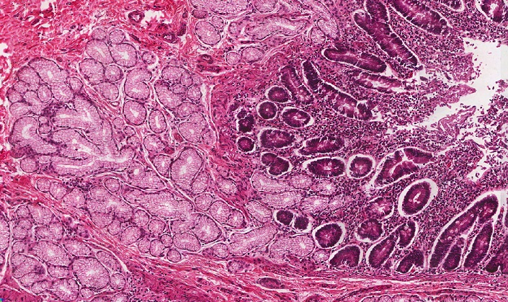
SMALL INTESTINE - DUODENUM
Because the duodenum is receiving acidic chyme from the stomach, and digestive secretions from the pancreas and liver, it secretes a tremendous amount of mucus for protection. Although goblet cells play some role here, submucosal glands (Brunner’s glands) within the duodenum provide the bulk of this mucus, and allow us to distinguish the duodenum from the rest of the intestinal tract.
pancreas
The mucosa of this preparation is not well preserved; therefore, villi and epithelial cells typical of the small intestine are not readily apparent on this slide.

Slide 27
SMALL INTESTINE - DUODENUM
Video of duodenum – SL54
Link to SL 054
Be able to identify:
  Small intestine
    Duodenum
      Submucosal (Brunner’s) glands

Slide 28
SMALL INTESTINE - DUODENUM
Another feature visible on our slides is the ampulla of Vater. The duodenum is the site of entry for secretions from the liver and pancreas. These reach the duodenum via the bile duct and pancreatic duct, respectively.
The ampulla of Vater is the dilation of these two ducts as they join together within the wall of the duodenum. The presence of the ampulla within the duodenal wall creates a bulge on the inner surface of the duodenum that is visible to the naked eye, called the major (greater) duodenal papilla. Release of liver and pancreatic secretions into the duodenum is controlled by the sphincter of Oddi, a specialization of the inner circular layer of the muscularis externa.
The sphincter of Oddi is relaxed by cholecystokinin, which is released by the duodenum in response to fatty acids in a meal. This relaxation allows bile and pancreatic secretions to enter the duodenum.
You will see the ampulla and papilla on our slides; the sphincter is not so obvious.

Slide 29
SMALL INTESTINE - DUODENUM
The ampulla of Vater (arrows) is the dilated duct, while the major (greater) duodenal papilla (outlined) is the bulge.
This low power image from our slide has been turned 90º to reflect the drawing to the left.

Slide 30
SMALL INTESTINE - DUODENUM
Video of duodenum showing the ampulla of Vater – SL54
Link to SL 054
Be able to identify:
  Small intestine
    Duodenum
      Ampulla of Vater

Slide 31
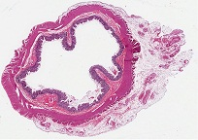
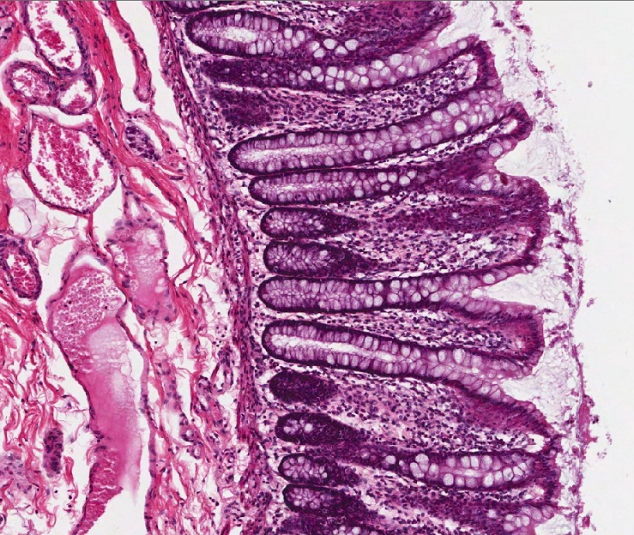
LARGE INTESTINE (COLON)
Similar to the regions of the small intestine, the large intestine can the thought of as a variation of a common theme. Therefore, the large intestine has features similar to the small intestine except that it:
--has numerous goblet cells
--lacks villi
--(mostly lacks Paneth cells)
The major function of the large intestine is to absorb water. What is happening in the lumen of the large intestine is the transition of undigested material from a liquid state to a solid state. Therefore, mucus from goblet cells is quite useful in easing passage of the solid mass, so the more the merrier. There are still enterocytes, which absorb water, among other things, just not as many.
And villi would be useless because they could not stand the sheer stress associated with stool movement.
Lumen is here

Slide 32

LARGE INTESTINE (COLON)
The outer longitudinal layer of the muscularis externa of the colon is thick in some regions, and very thin in others. The thickened regions are the teniae coli. Typically, three are present. On our slides, one is obvious (outlined). The other two are more ill-defined; it appears that they are fused together to make one larger structure (arrows).
Don’t lose any sleep over this; this has bothered me for years, but I have come to grips with it.

Slide 33
LARGE INTESTINE (COLON)
Video of large intestine (colon) – SL53
Link to SL 053
Be able to identify:
  large intestine (colon)
    Similar structures as small intestine
      Intestinal crypts (of Lieberkühn)
      Enterocytes
      Goblet cells (lots of these)
      Etc
                Lack of villi and very few Paneth cells
    Teniae coli

Slide 34
BONUS SLIDES
Video of the appendix – SL99
Video of the anal canal – SL182
Link to SL 099
Link to SL 182
Be able to identify:
  Nothing, these are just a couple cool slides that will help you understand other concepts in the gastrointestinal course.

Slide 35
The next set of slides is a quiz for this module. You should review the structures covered in this module, and try to visualize each of these in light and electron micrographs.
Distinguish, at the light microscope level, each of the following:
  Small intestine
    Structures
      Plica, villi, microvilli (review)
      Intestinal crypts (of Lieberkühn)
      Cells
        Enterocytes (intestinal absorptive cells)
        Goblet cells
        Paneth cells
        Enteroendocrine cells (review, not covered in this module)
        Regions
          Duodenum
            Submucosal (Brunner’s) glands
            Ampulla of Vater
            Jejunum
            ileum
              Peyer’s patches
    Large intestine
      Structures
        Intestinal crypts (of Lieberkühn)
        Teniae coli
        Cells
          Enterocytes (intestinal absorptive cells)
          Goblet cells
    Continues on next page…..

Slide 36
The next set of slides is a quiz for this module. You should review the structures covered in this module, and try to visualize each of these in light and electron micrographs.
Distinguish, at the electron microscope level, each of the following:
  Small intestine
    Enterocytes (intestinal absorptive cells)
      Microvilli (review, not covered in this module)
      Goblet cells
      Paneth cells
        Secretory granules
        Enteroendocrine cells (review, not covered in this module)
          Secretory granules
          Large intestine
            Enterocytes
            Goblet cells
            Enteroendocrine cells (review, not covered in this module)

Slide 37
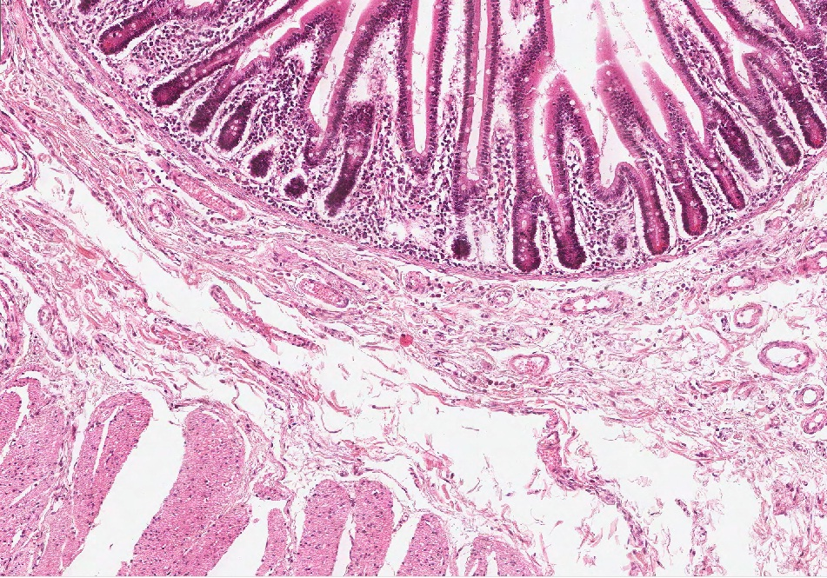
Final quiz
Self-check: Identify the organ from which this image was derived. (advance slide for answers)
jejunum

Slide 38
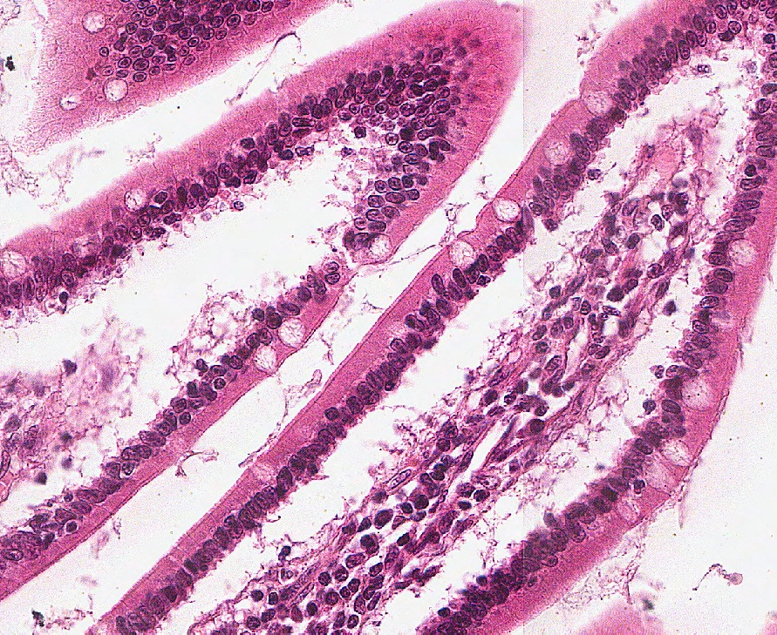
Final quiz
Self-check: Identify the cells indicated by the arrows. (advance slide for answers)
goblet cells

Slide 39
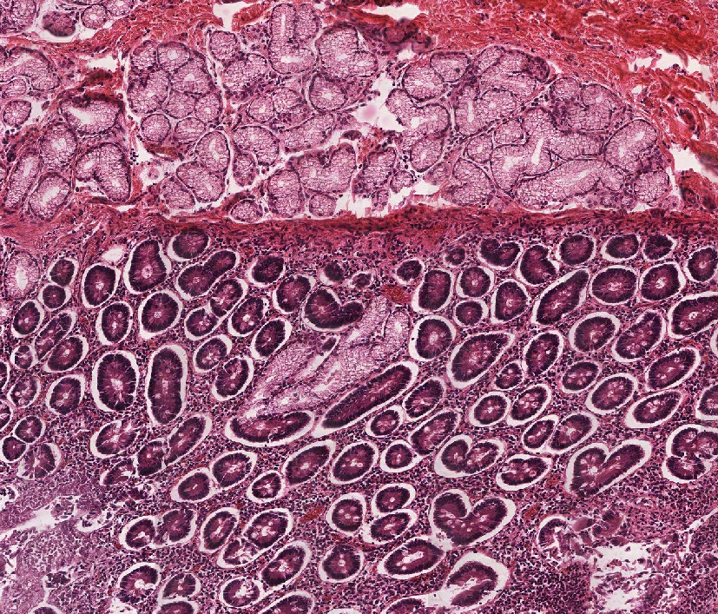
Final quiz
Self-check: Identify the organ from which this image was derived. (advance slide for answers)
duodenum

Slide 40
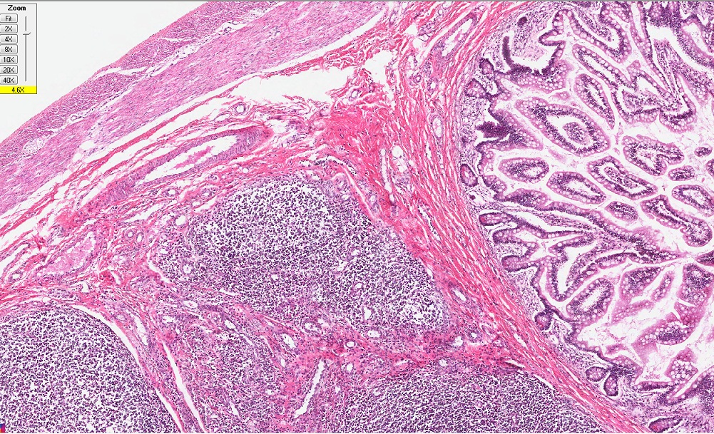
Final quiz
Self-check: Identify the outlined structures. (advance slide for answers)
Peyer’s Patches

Slide 41
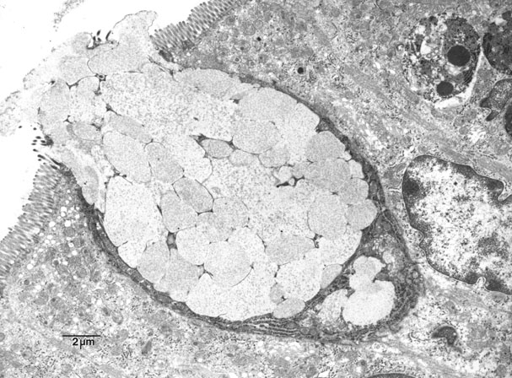
Final quiz
Self-check: Identify the cell indicated by the X. (advance slide for answers)
Goblet cell
X

Slide 42
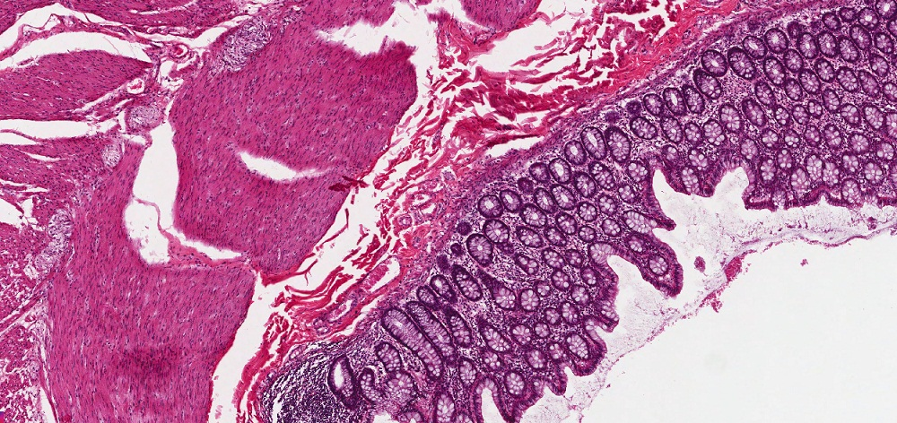
Final quiz
Self-check: Identify the organ from which this image was derived. (advance slide for answers)
Large intestine / colon

Slide 43
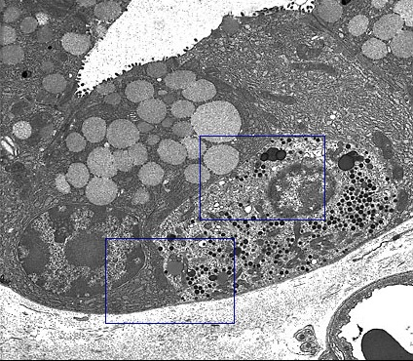
Final quiz
Self-check: Identify the cell indicated by the X in this micrograph from the small intestine. (advance slide for answers)
Enteroendocrine cell
X

Slide 44
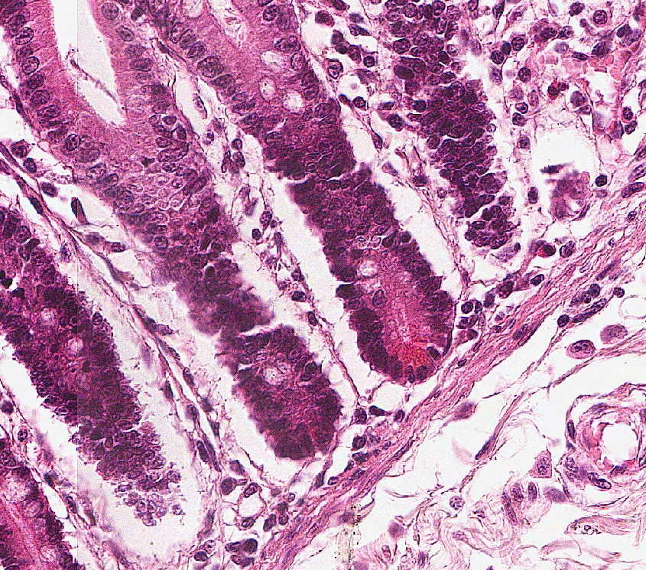
Final quiz
Self-check: Identify the outlined cells. (advance slide for answers)
Paneth cells

Slide 45
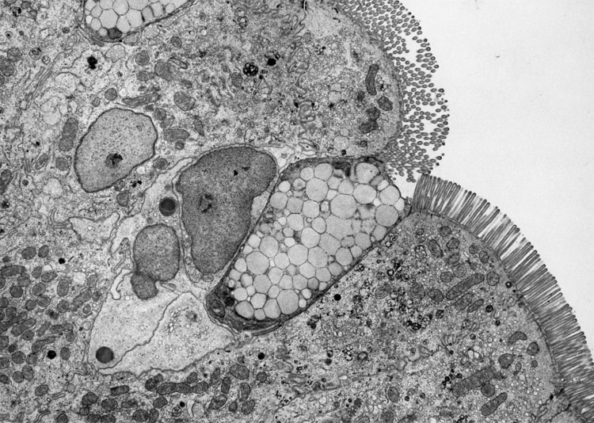
Final quiz
Self-check: Identify the outlined cell in this section of the small intestine. (advance slide for answers)
Enterocyte / intestinal absorptive cell
Microvilli in cross and longitudinal section right next to each other – you must be living right.

Slide 46
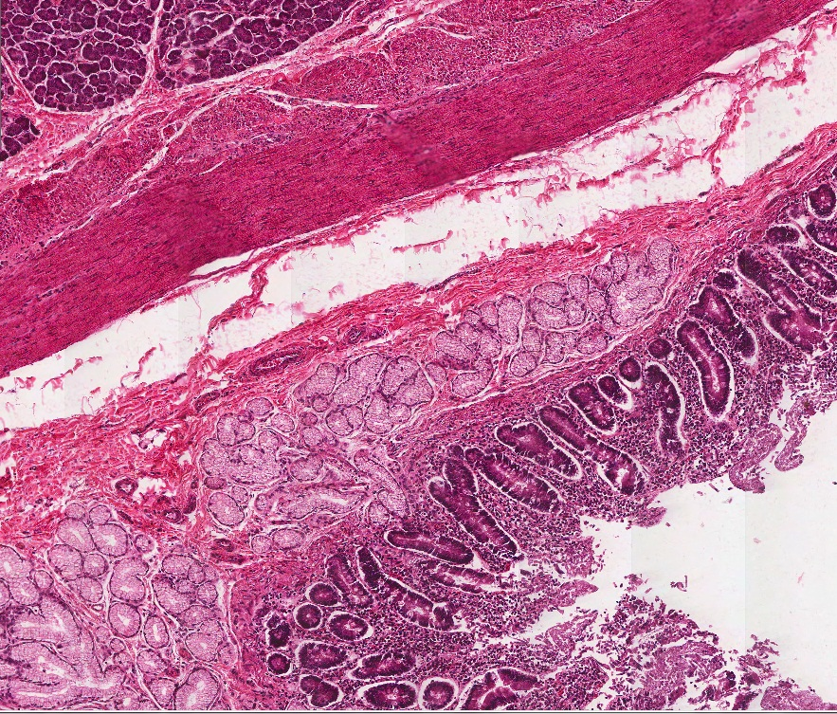
Final quiz
Self-check: Identify the outlined structures. (advance slide for answers)
Submucosal glands of the duodenum (Brunner’s glands)

Slide 47
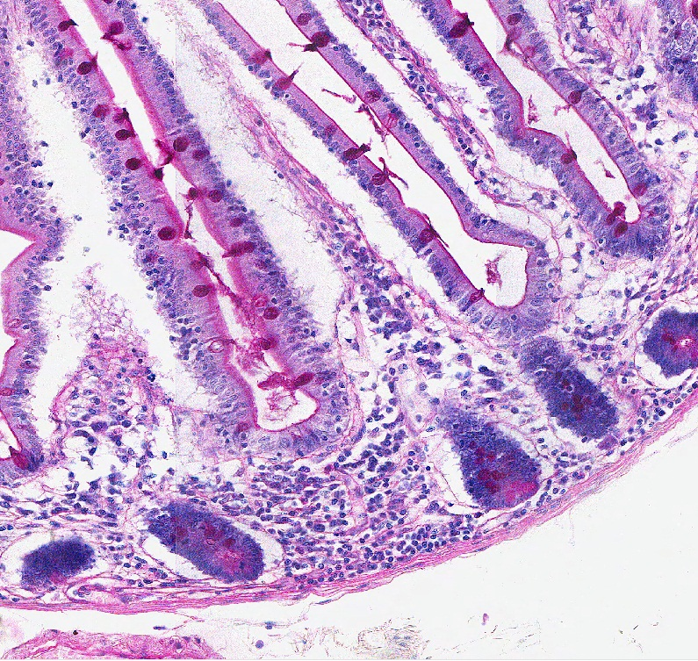
Final quiz
Self-check: Identify the cells indicated by the arrows. (advance slide for answers)
Goblet cells
This is PAS (look at goblet cells in villi), Paneth cells are lighter pink at the bottom of the glands

Slide 48
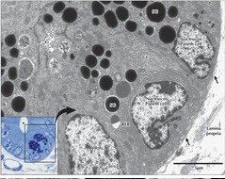
Final quiz
Self-check: Identify the cells labeled X in this micrograph from the small intestine. (advance slide for answers)
Paneth cells
X
X

Slide 49
Final quiz
Self-check: Identify the outlined structure. (advance slide for answers)
Intestinal crypts (intestinal glands)

Slide 50
Final quiz
Self-check: Identify the cells indicated by the arrows. (advance slide for answers)
Enterocytes / intestinal absorptive cells

Slide 51
Final quiz
Self-check: Identify the organ from which this image was derived. (advance slide for answers)
ileum

