Slide 1
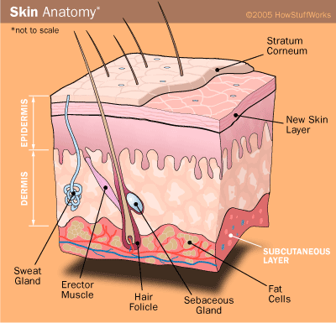
Integument
Digital Laboratory
It’s best to view this in Slide Show mode, especially for the quizzes.
This module will take approximately 90 minutes to complete.

Slide 2
After completing this exercise, you should be able to (page one of two):
Distinguish, at the light microscope level, each of the following and their specific features:
Layers of skin
Epidermis
Stratum basale
Stratum spinosum
Stratum granulosum
Stratum lucidum (thick skin only…not well defined on our slides)
Stratum corneum
Dermis
Papillary layer
Dermal papilla and epidermal pegs
Reticular layer
Hypodermis
Accessory structures
Hair
Follicle
Shaft
Matrix
Dermal papilla
Arrector pili muscle
Glands
Sebaceous glands
Sweat glands
Eccrine
Apocrine
Ducts (eccrine or apocrine not distinguishable)
Secretory cells and myoepithelial cells
Fibroblasts (in surrounding connective tissue)
Specialized sensory receptors
Meissner’s corpuscles
Pacinian corpuscles

Slide 3
After completing this exercise, you should be able to (page two of two):
Based on skin thickness and distribution of accessory structures, be able to distinguish:
Typical skin (e.g. forearm, leg, abdomen, back)
Scalp
Palms of hands / soles of foot
Axilla / groin
Distinguish, at the electron microscopic level, each of the following cells or structures
Layers of skin (see above, if provided enough context)
Cells
Keratinocytes
Desmosomes
Hemidesmosomes
Tonofibrils / tonofilaments
Keratohyalin granules
Melanosomes
Merkel cells
Secretory cells of glands
Myoepithelial cells of glands
Basal lamina / basement membrane

Slide 4
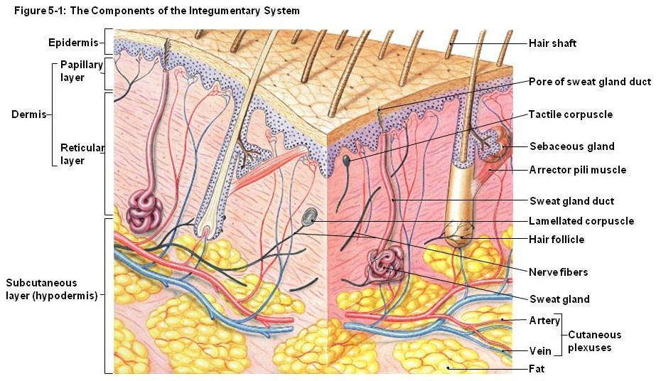
OVERVIEW OF THE INTEGUMENT
The integument consists of three regions:
Epidermis – stratified squamous keratinized epithelium
Dermis - loose and dense irregular connective tissue
Subcutaneous layer (hypodermis) – mostly adipose
Many authors do not include the subcutaneous layer as part of the integument, but we will here just for the sake of completeness.
The subcutaneous layer is the superficial fascia in Gross Anatomy.

Slide 5
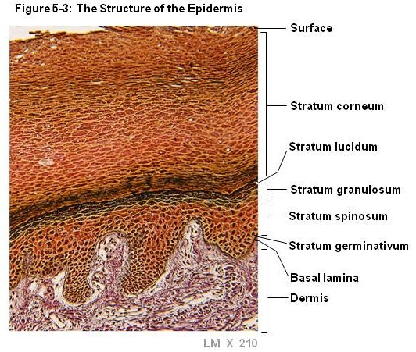
OVERVIEW OF THE INTEGUMENT
The epidermis is composed of 5 layers:
Stratum basale (stratum germinativum) – single layer of cuboidal basal stem cells
Stratum spinosum - cuboidal cells, some cell division, spinous connections between cells
Stratum granulosum – cells contain dense keratohyaline granules, cells becoming flat
Stratum lucidum – thick skin only, cells clear (we won’t see this layer on our slides)
Stratum corneum – cells have lost organelles, basically a bag of keratin

Slide 6
EPIDERMIS
Video showing layers of epidermis – SL25
Link to SL 025 and SL 026
Be able to identify:
Stratum basale
Stratum spinosum
Stratum germinativum
(FYI - Stratum lucidum - know where this should be )
Stratum corneum

Slide 7
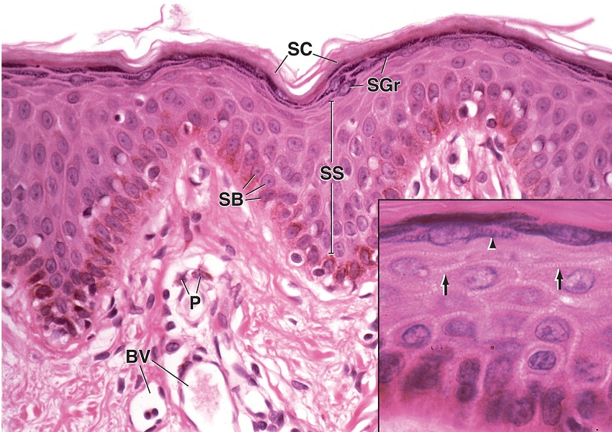
EPIDERMIS
The epidermis is composed of 5 layers:
Stratum basale (stratum germinativum) – single layer of cuboidal basal stem cells
Stratum spinosum - cuboidal cells, some cell division, spinous connections between cells
Stratum granulosum – cells contain dense keratohyaline granules, cells becoming flat
Stratum lucidum – thick skin only, cells clear (we won’t see this layer on our slides)
Stratum corneum – cells have lost organelles, basically a bag of keratin
Image of thin skin; many layers are thinner, stratum lucidum not present:
SB – stratum basale
SS – stratum spinosum
SG – stratum granulosum
SC – stratumcorneum
FYI (for the moment)…
BV – blood vessels
P – pigment
arrows – intercellular bridges arrowheads - granules

Slide 8
EPIDERMIS
Video showing layers of epidermis in thin skin – SL9
Link to SL 009 and SL 033 and SL 089
Be able to identify:
Stratum basale
Stratum spinosum
Stratum germinativum
Stratum corneum

Slide 9
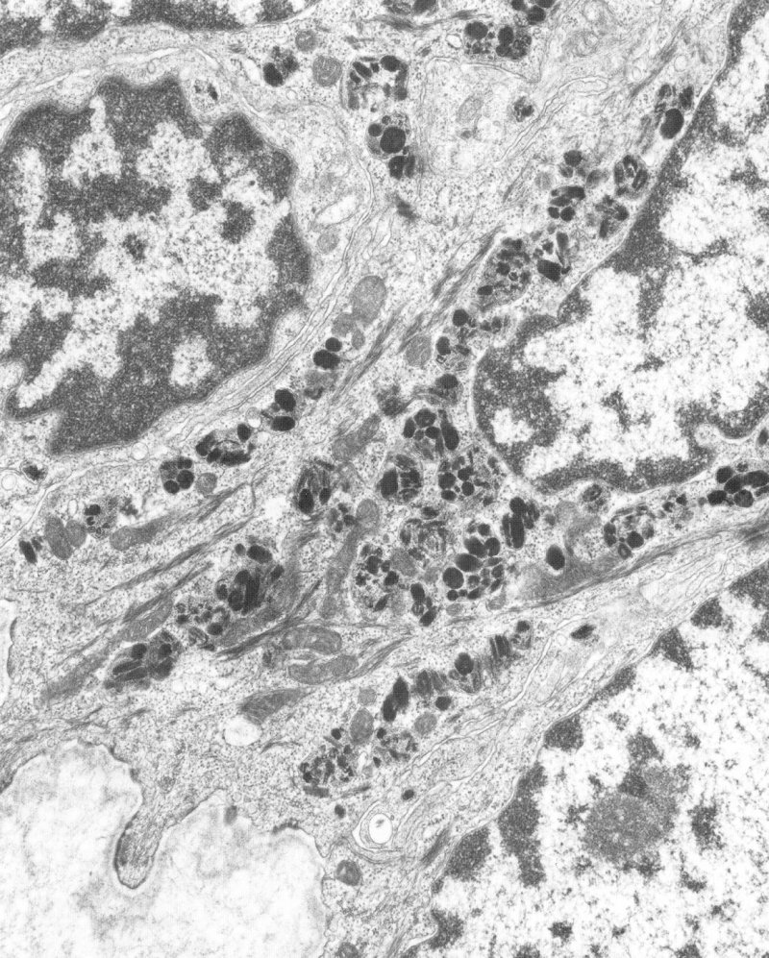
EPIDERMIS
Keratinocytes are the most prominent cell type in the epidermis. Keratinocytes in the stratum basale divide, and then progress upward through the epidermis toward the stratum corneum. As they progress, they receive melanosomes from melanocytes, and express keratin tonofilaments.
In this electron micrograph of the stratum basale (dermis at bottom-left), note the keratinocytes are characterized by having abundant keratin filaments, very electron-dense melanosomes, and desmosomes and hemidesmosomes.
X
X
Red X – keratinocyte nuclei
Orange outline – melanosomes
Red arrows – keratin (tonofilaments)
Green arrows – desmosomes
Orange arrows – hemidesmosomes
Blue arrows – basal lamina
dermis

Slide 10
EPIDERMIS
This is a micrograph from a light-skinned individual. Note that the individual melanosomes (red outlines) are clustered together within vesicles (orange outlines) for degradation. Micrographs from dark-skinned individuals will have melanosomes, but show no such packaging and degradation.
I don’t see the membrane of the vesicles either, but note how the melanosomes are clustered.

Slide 11
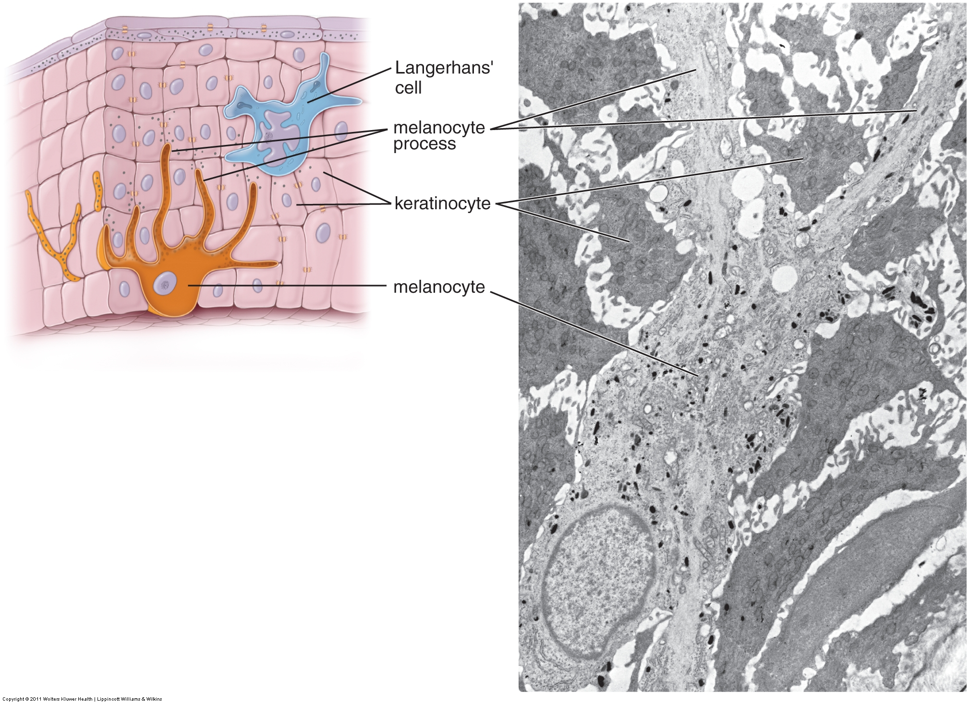
EPIDERMIS
Melanocytes produce pigment packaged as melanosomes. They then transfer these melanosomes to the keratinocytes. The melanin within the melanosomes protects the keratinocyte DNA from mutation caused by ultraviolet rays from the sun.
In this electron micrograph of the stratum basale, note that melanocytes are characterized by numerous processes that extend between the keratinocytes. In addition, melanocytes lack tonofilaments and desmosomes.

Slide 12
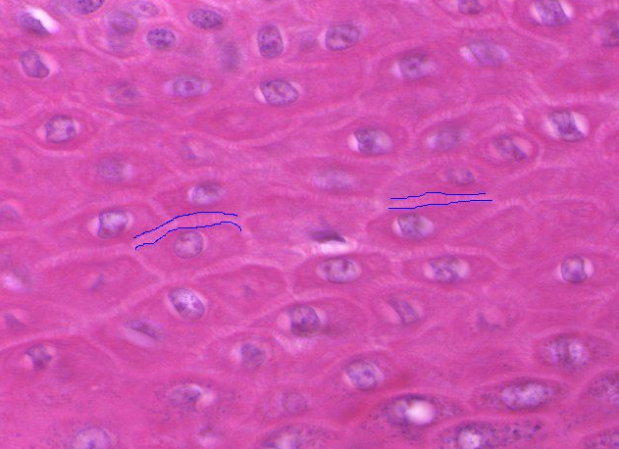
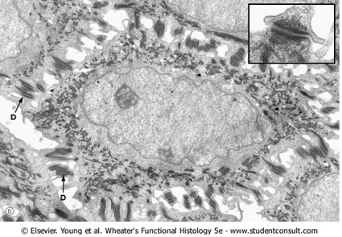
EPIDERMIS
The stratum spinosum is named for the spines that connect cells in light micrographs (fine vertical lines between blue lines in image to left). You can see in the electron micrograph that this is a fixation artifact. When cells are fixed, they shrink and pull apart, but remain attached where they are connected by desmosomes (D). Even the electron micrograph shows shrinkage, as demonstrated by the clear areas.
The structure outlined in the EM in red is equivalent to one of the pink vertical connections in the light micrograph. Don’t count these to compare; the light micrograph is thicker anyway.

Slide 13
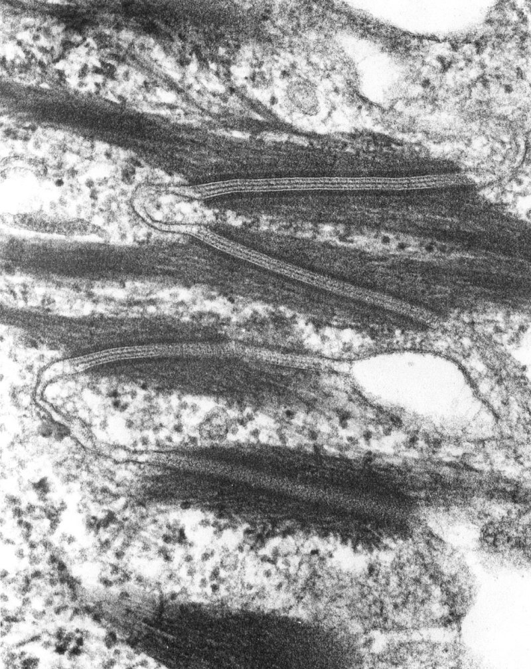
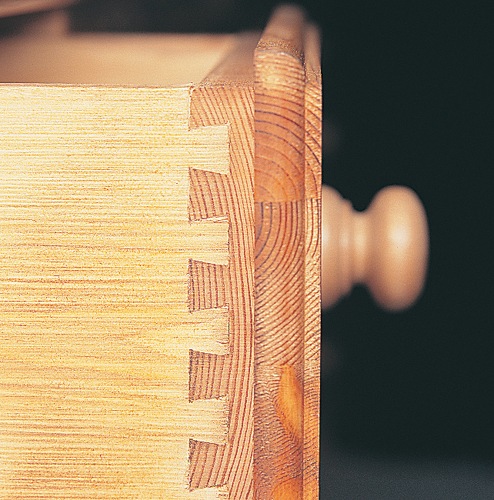
EPIDERMIS
High powered view of two adjacent keratinocytes (A and B). Note undulating membranes, which, like dovetailed joints in carpentry, provide better strength than a straight edge connection between the cells.
A
B

Slide 14
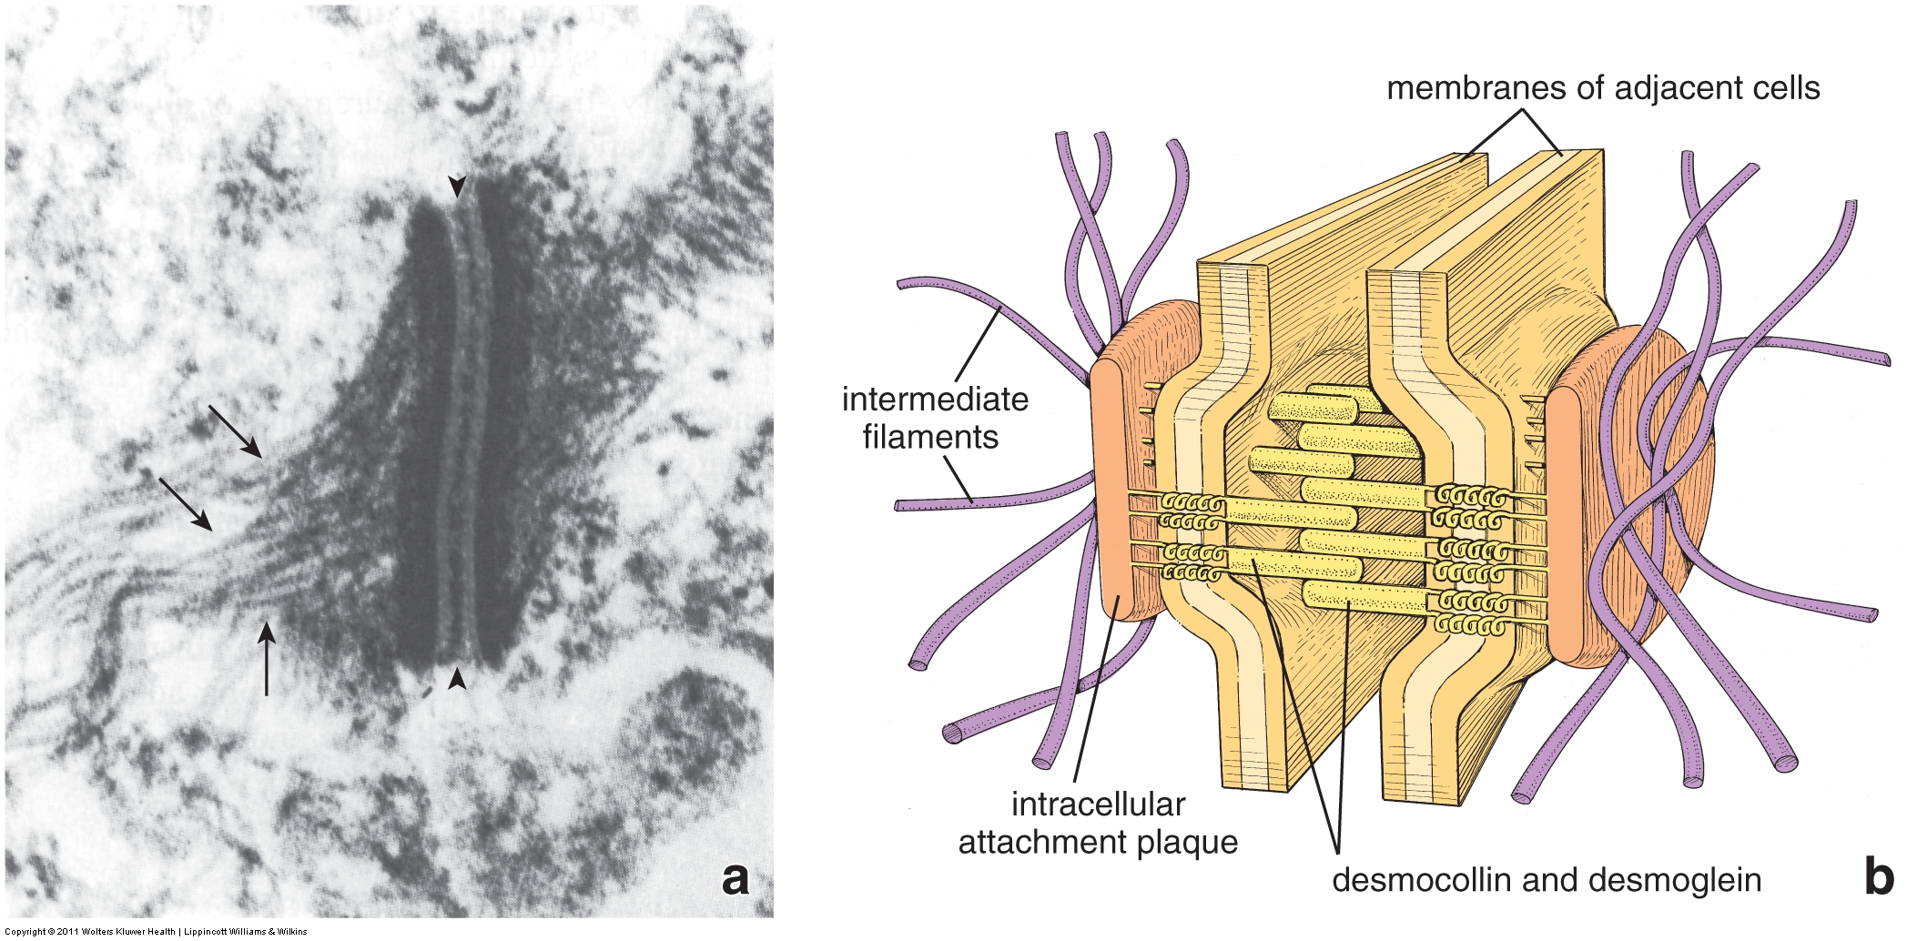
EPIDERMIS
In this electron micrograph and drawing, you can see that desmosomes are composed of transmembrane proteins (desmocollins and desmogliens) from adjacent cells. The cytoplasmic side of the plasma membrane of each cell has a dense intracellular plaque (bracket in EM), which is rich in desmoplakin, and to which the keratin (intermediate) filaments (arrows in EM) attach. The arrowhead indicates a density created by the overlap of the extracellular domains of the desmocollin and desmoglein of adjacent cells.

Slide 15
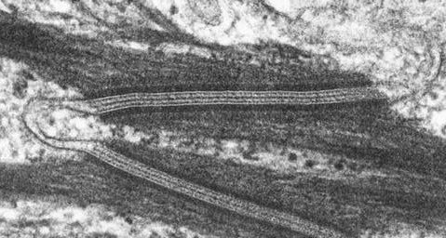
EPIDERMIS
Enlargement of adjacent keratinocytes (A and B). A and B are over keratin tonofilaments. The series of the red arrows are, from left to right:
Density from desmoplakin and associated proteins
Inner dark portion of plasma membrane
Outer dark portion of plasma membrane
Density caused by overlapping junctional proteins in extracellular space
B
A

Slide 16
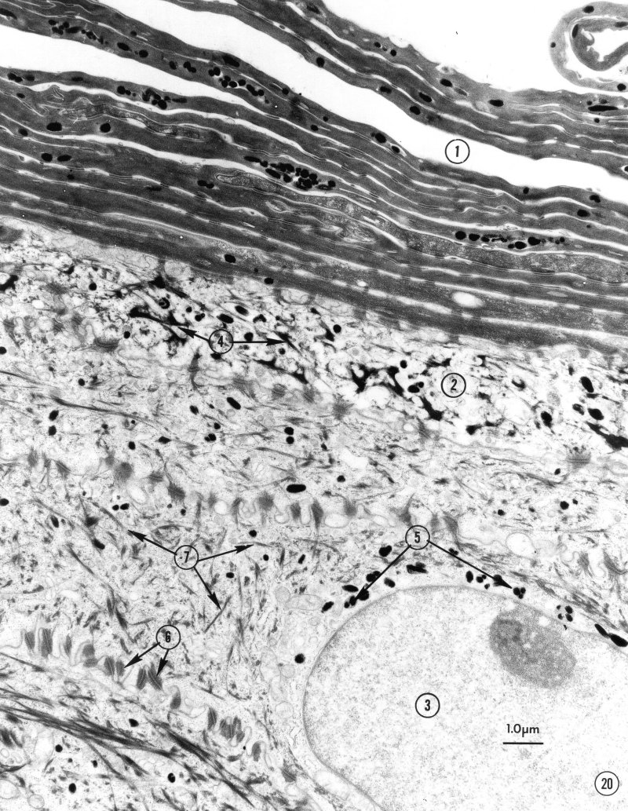
EPIDERMIS
Electron micrograph of upper regions of epidermis
Stratum corneum
Stratum granulosum
Keratinocyte of stratum spinosum
Keratohyalin granules
Melanosomes
Desmosomes
Keratin tonofilaments

Slide 17
EPIDERMIS
Higher magnification of stratum spinosum cells. Note desmosomes (6), keratin tonofilaments (7), and melanosomes (5).

Slide 18
EPIDERMIS
Higher magnification of the stratum granulosum (2). This layer is characterized by electron-dense keratinohyalin granules (4). Note that keratohyalin granules are irregular in shape; recall that melanosomes are oval.

Slide 19
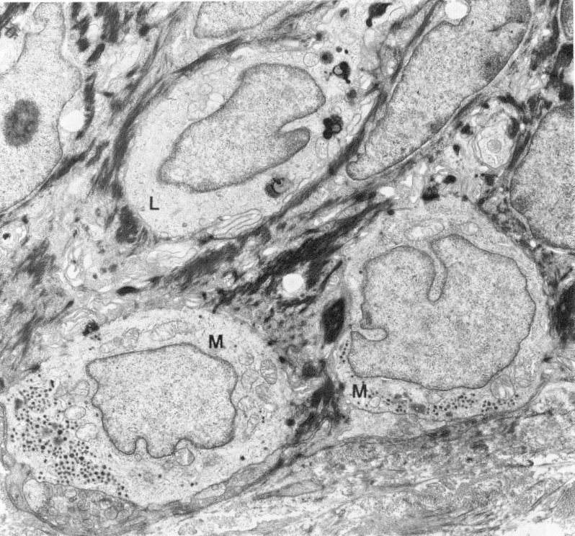
EPIDERMIS
FYI – Merkel cells (M) have secretory granules in their basal cytoplasm. Langerhans cells (L) typically have nuclei with multiple indentations.

Slide 20
DERMIS and HYPODERMIS
The dermis is composed of 2 layers:
Papillary layer– loose connective tissue
Reticular layer - dense irregular connective tissue
The hypodermis (subcutaneous layer) is composed mostly of adipose tissue.
Note that the epidermal-dermal junction undulates, creating epidermal ridges and dermal papilla.

Slide 21
DERMIS and HYPODERMIS
Video showing layers of dermis and hypodermis – SL25
Link to SL 025 and SL 026 and SL 009 and SL 033 and SL 089
Be able to identify:
Dermis
Papillary layer
Reticular layer
Epidermal ridges and dermal papilla
Hypodermis

Slide 22
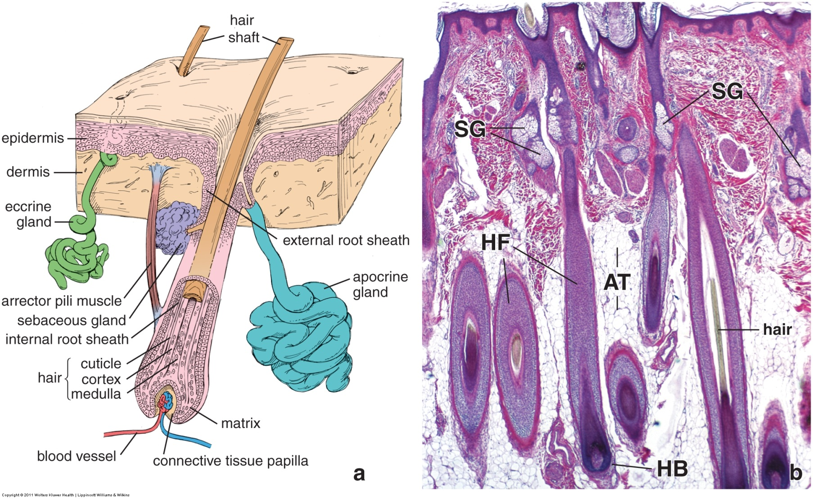
ACCESSORY STRUCTURES OF THE SKIN
Accessory structures of the skin include:
--the hair and hair follicle
--arrector pili muscles
--glands; sebaceous, eccrine, and apocrine

Slide 23
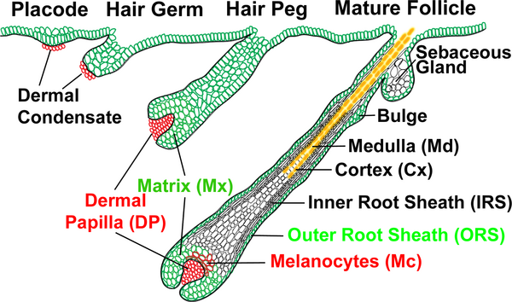
HAIR
The hair follicle develops through a complex set of interactions between the epithelium (green) and connective tissue (red and white). Histologically, the epithelial cells proliferate, and then project into the underlying connective tissue. Note that the basement membrane (black line at arrows) remains faithful to the epithelial invagination, separating the epithelium and connective tissue. Finally, at the deepest part of the hair follicle, a projection of the dermis called the dermal papilla develops; note again that the basement membrane remains faithful to the epithelial-connective tissue border. The matrix is a region of specialized epithelial stem cells that contribute to the hair.
Mark Hill
University of New South Wales

Slide 24
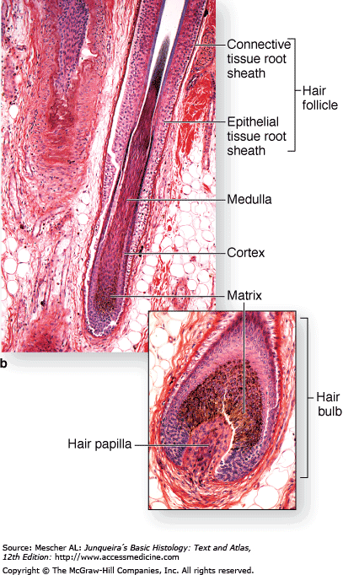
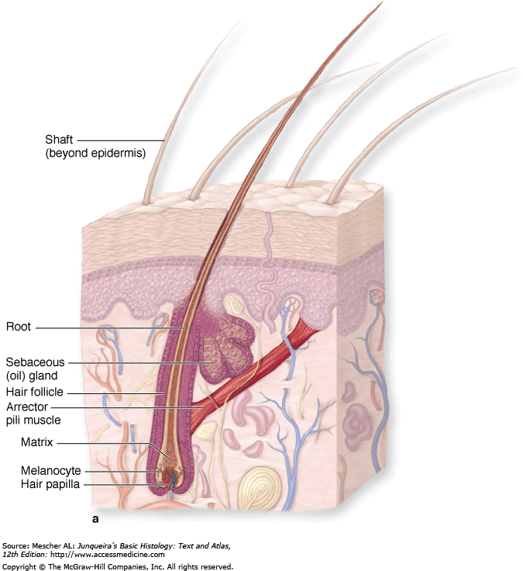
HAIR
Hair grows from most areas of the body. The major components of hair that we will be looking at are the:
Shaft – actual hair (FYI, the shaft specifically refers to hair above the sebaceous glands, the portion below these glands is the root)
Follicle – structure from which the hair grows
Matrix – epithelial stem cells that produce the hair
Hair (dermal) papilla – dermal region near matrix

Slide 25
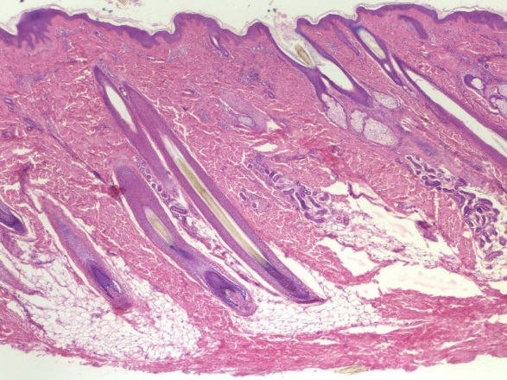
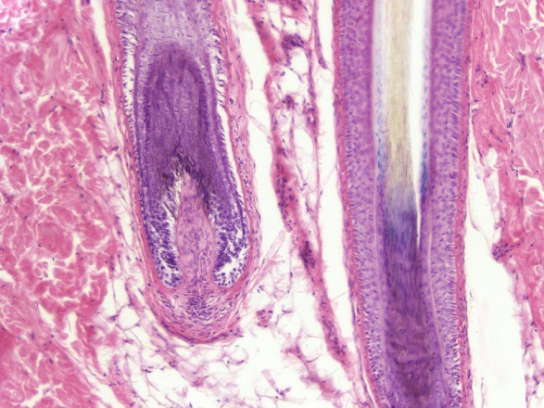
HAIR
Hair grows from most areas of the body. The major components of hair that we will be looking at are the:
Shaft (blue arrows) – actual hair
Follicle (red arrow) – structure from which the hair grows
Matrix (green arrow) – epithelial stem cells that produce the hair
Dermal (hair) papilla (orange arrow) – dermal region near matrix

Slide 26
HAIR
Video showing layers of hair – SL89
Link to SL 089 and SL 009 and SL 033
Be able to identify:
Hair shaft
Hair follicle
Dermal (hair) papilla
Matrix

Slide 27
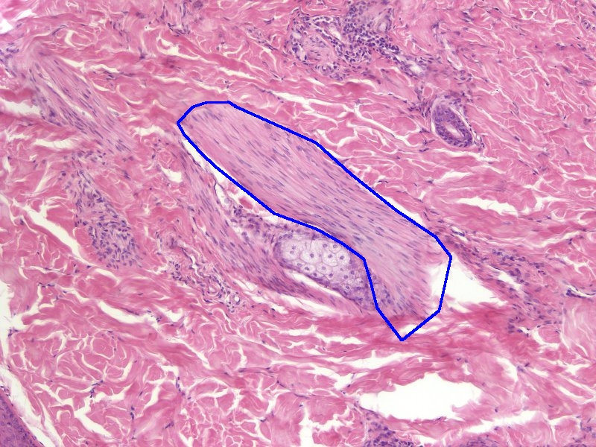
ARRECTOR PILI MUSCLES
Each hair follicle has an associated arrector pili muscle (outlined in blue). This smooth muscle attaches to the hair follicle and the dermis near the epidermis.

Slide 28
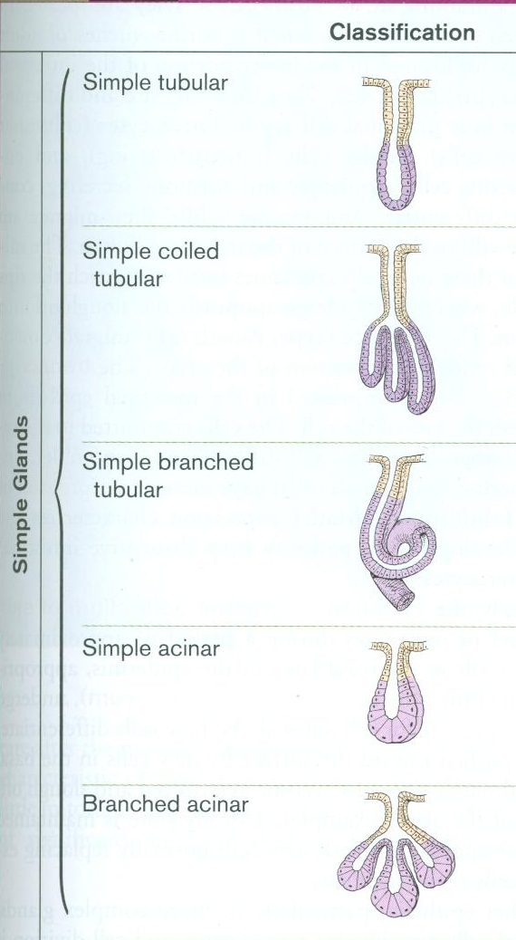
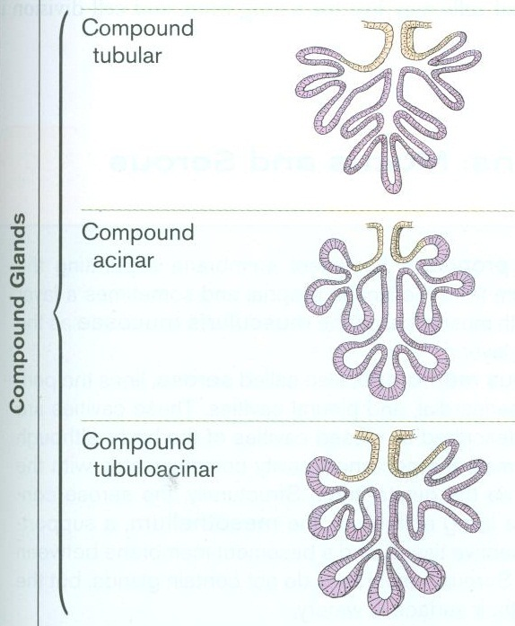
EXOCRINE GLANDS
Exocrine glands develop in much the same way as hair follicles. Epithelial cells (yellow and purple) proliferate, and then invaginate into the underlying connective tissue (white). Here, a lumen develops within the epithelial invagination, and the epithelial cells in the deeper regions become secretory cells (purple), while those closer to the main epithelium often form ducts (yellow) that connect the secretory cells to the surface.
Connective tissue
Connective tissue
These drawings do not show glandular development, but the end result. If you are confused as to how glands develop, go back to the hair follicle development slide; the basic features of development (epithelial proliferation, invagination) apply to both hair follicles and glands.

Slide 29
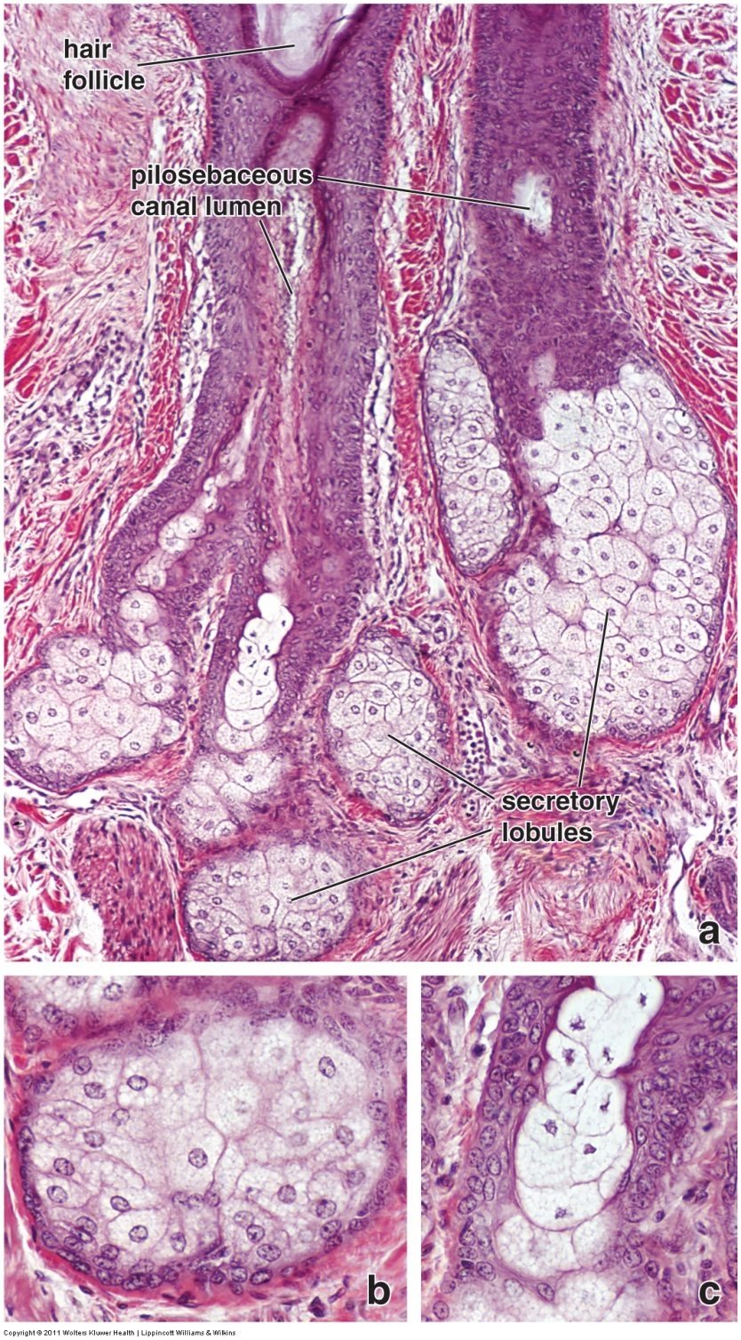
SEBACEOUS GLANDS
Most sebaceous glands (outlined) are associated with hair follicles. These glands produce an oily secretion, which makes these cells pale-staining. They secrete by the holocrine method; cells at the base of the gland (black arrows) proliferate and then accumulate product in their cytoplasm as they are pushed up toward the duct (labeled as pilosebaceous canal lumen). Cells then break open, releasing their secretory contents.

Slide 30
ARRECTOR PILI MUSCLE and SEBACEOUS GLANDS
Video showing sebaceous gland and arrector pili muscle – SL89
Link to SL 009 and SL 033 and SL 089
Be able to identify:
Sebaceous gland
Arrector pili muscle

Slide 31
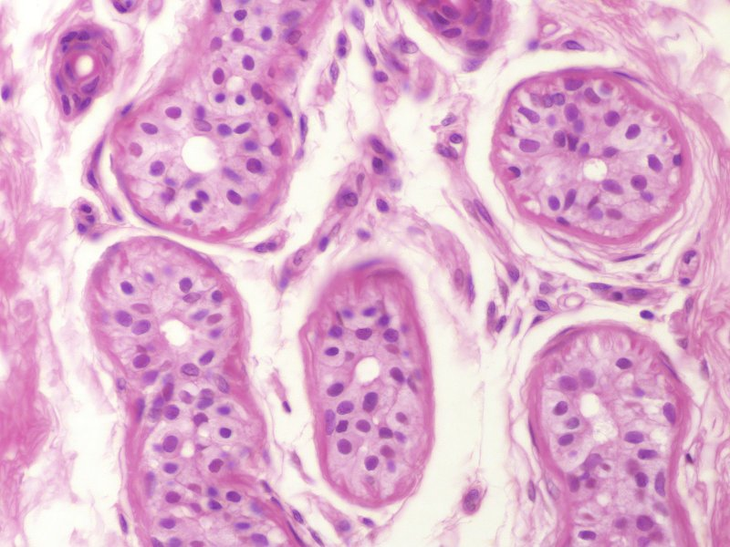
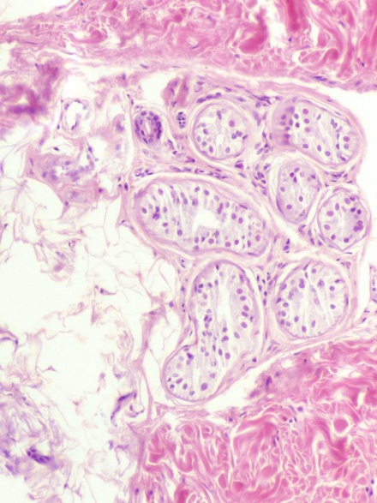
ECCRINE SWEAT GLANDS
Eccrine sweat glands (e.g. green outline) are found in most locations of the body. Though the staggered nuclei give the appearance of a pseudostratified epithelium, they are composed of a simple epithelium. The cells have a pale eosinophilic cytoplasm, and the lumen is small but distinct (if in the plane of section).

Slide 32
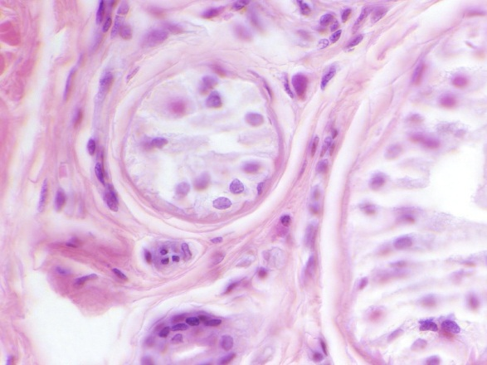
ECCRINE SWEAT GLANDS
Eccrine sweat glands (e.g. green outline) have two cell types:
Secretory cells (green arrow)(actually, these are divided into dark and light cells, but you do not need to distinguish these on our slides).
Myoepithelial cells (blue arrow) – these cells are epithelial, but contain contractile proteins; their nuclei are flattened against the basement membrane (red arrow).
Cells on the connective tissue side of the basement membrane are fibroblasts (orange arrow).

Slide 33
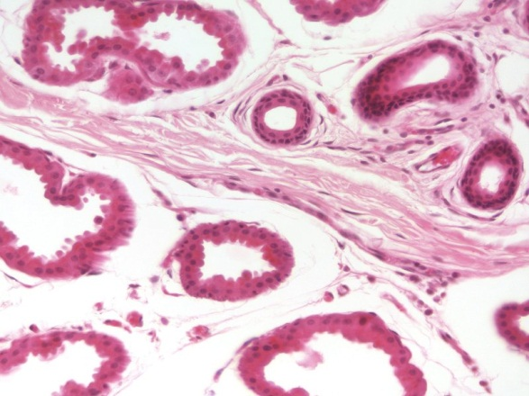
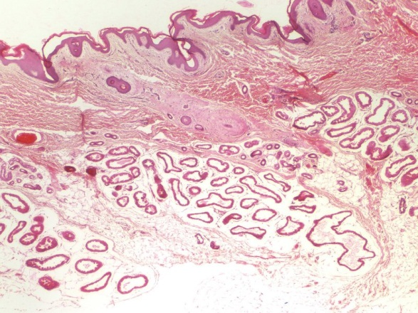
APOCRINE SWEAT GLANDS
Apocrine sweat glands (e.g. green outline) are found in select locations, notably the axilla and pubic regions (also the areola of the breast and the circumanal region). Like eccrine glands, apocrine glands are composed of a simple epithelium with myoepithelial cells. However, they are larger glands, with a wider lumen and an irregular apical border, and their cells have a more eosinophilic cytoplasm.

Slide 34
DUCTS
Ducts (e.g. green outline) for both eccrine and apocrine glands are smaller than these glands, have a narrow and distinct lumen, and are composed of a stratified cuboidal epithelium in which the cells stain eosinophilic. You do not have to distinguish whether ducts belong to eccrine or apical glands.

Slide 35
ECCRINE GLANDS, APOCRINE GLANDS, and DUCTS
Video showing eccrine glands, apocrine glands, and ducts – SL33
Link to SL 025 and SL 026 and SL 009 and SL 033 and SL 089
Be able to identify:
Eccrine glands
Secretory cells
Myoepithelial cells
Fibroblasts
Apocrine glands
Secretory cells
Myoepithelial cells
Fibroblasts
Ducts

Slide 36
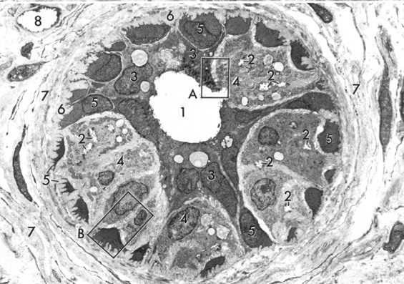
ECCRINE GLANDS, APOCRINE GLANDS, and DUCTS
Electron micrograph of eccrine gland.
lumen of gland
canaliculi (this is FYI, extracellular channels between cells connected to lumen)
secretory cells (FYI – dark cells)
secretory cells (FYI – light cells)
myoepithelial cells
basement membrane
connective tissue
capillary
Rhodin

Slide 37
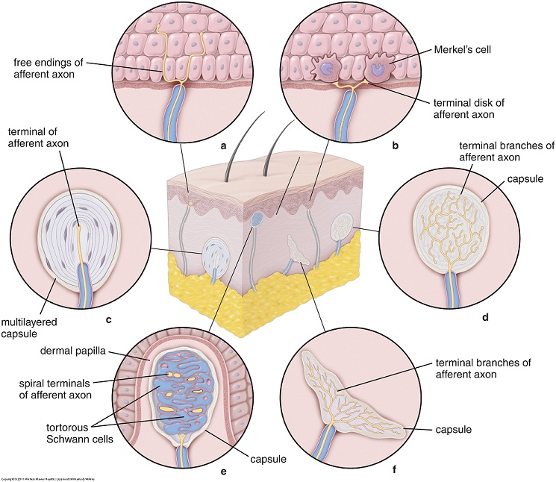
SKIN RECEPTORS
Obviously, there are a number of sensory receptors in skin that detect sensations of light touch, pressure, heat, cold, etc. Here, we will focus on two receptors that are readily visible on H&E slides; Meissner’s corpuscles (e) and Pachinian corpuscles (c).

Slide 38
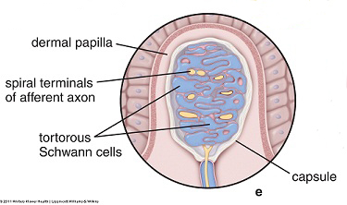
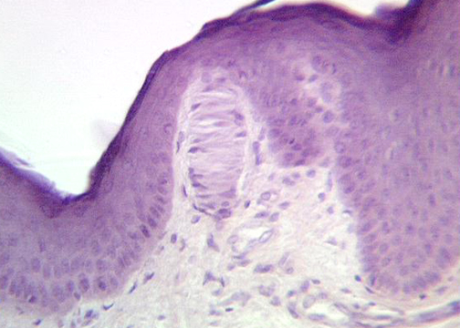
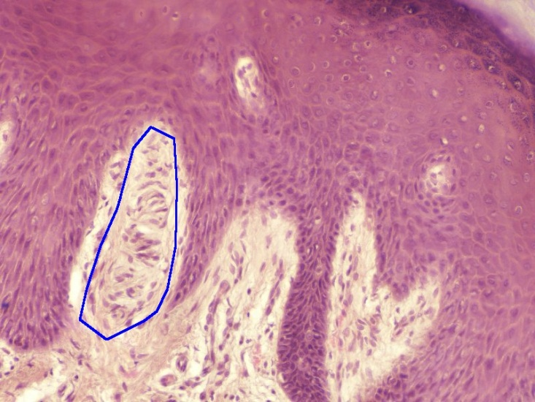
MEISSNER’S CORPUSCLES
Meissner’s corpuscles are touch receptors found in the dermal papilla. They are composed of an unmyelinated nerve ending that winds its way around flattened supportive cells.
Because the nerve ending spirals around kinda like a slinky, and the supportive cells are all oriented along the axis of the nerve ending (i.e. “horizontal), Meissner’s corpuscles stand out as oval structures in the dermal papilla with most of the nuclei in the same orientation. Yes, these are a little difficult to see (e.g. the one to the right).
Rutgers

Slide 39
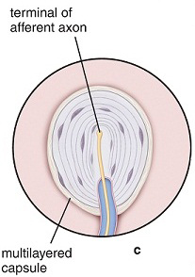
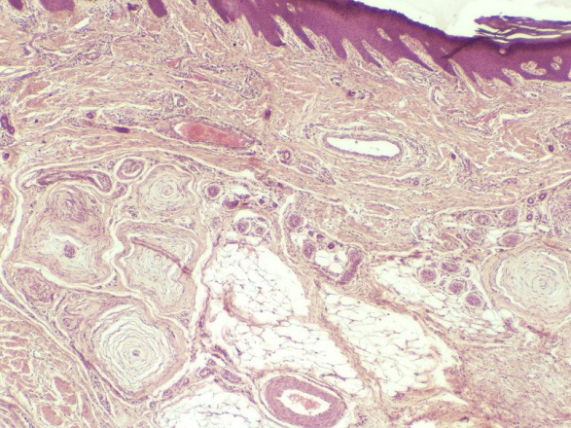
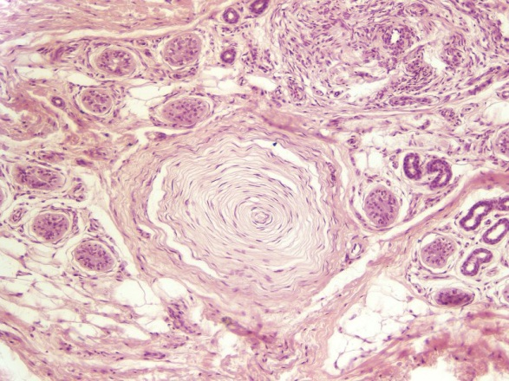
PACINIAN CORPUSCLES
Pacinian corpuscles are pressure receptors found in the deep dermis and hypodermis. They are composed of an unmyelinated nerve ending covered with lamella, forming a structure with the appearance of a cut onion. Pacinian corpuscles are very large, and can be seen on your slides with the naked eye (or at very low power with the digital slides).

Slide 40
PACINIAN and MEISSNER’S CORPUSCLES
Video showing Pacinian and Meissner’s corpuscles – SL178
Link to SL 178
Be able to identify:
Pacinian corpuscles
Meissner’s corpuscles

Slide 41
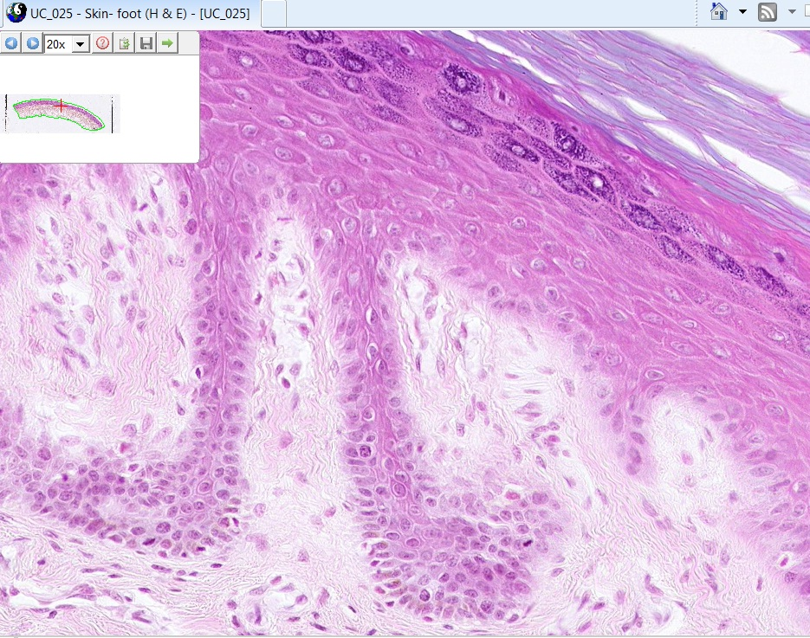
PACINIAN and MEISSNER’S CORPUSCLES
For fun, link to SL 025, examine every dermal papilla (seriously, it only takes a minute or two), and look carefully to find a very faint Meissner’s corpuscle. Advance slide for answer.

Slide 42
EMBRYONIC SKIN
Video showing embryonic skin – SL42
Link to SL 042
Be able to identify:
Nothing specific

Slide 43
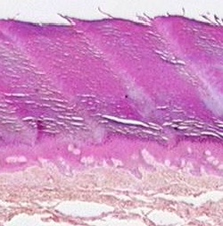
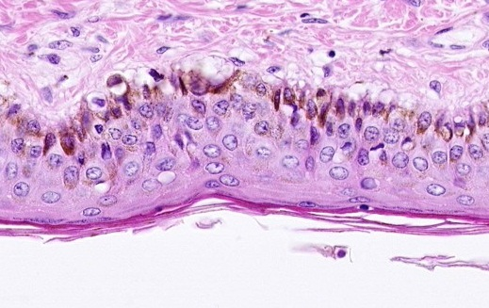
LOCATION OF SKIN SAMPLES
Based on the characteristic features of a skin sample, you should be able to tell us the location of the body from which that sample was taken. Here is a summary of the features and structures of the skin, and where in the body they are found:
Thick skin – palms of the hands, soles of the feet
Thin skin – everywhere else

Slide 44
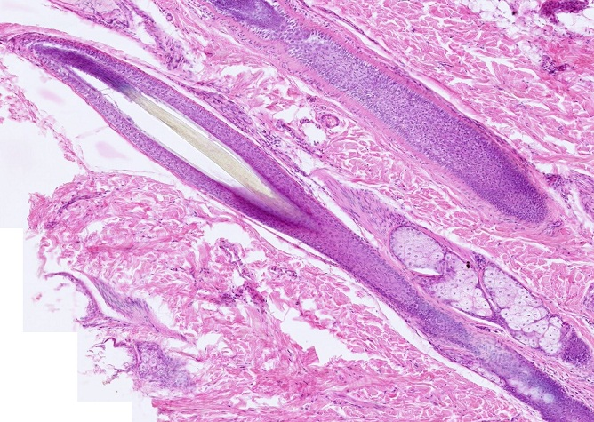
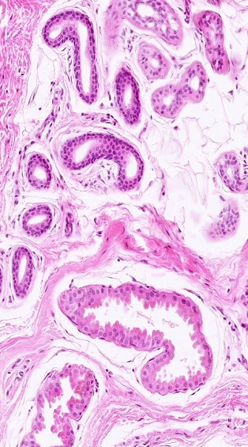
LOCATION OF SKIN SAMPLES
Hair – found in most of the body except thick skin
Sebaceous glands – found where hair is located, some places that lack hair (anus, but we don’t have slides of that)
Eccrine sweat glands – found in most of the body
Apocrine sweat glands – axilla, pubic, nipple, circumanal region

Slide 45
The next set of slides is a quiz for this module. Before continuing, we suggest you remind yourself of the list of objectives covered in this module, and mentally visualize what each region or structure will look like:
Distinguish, at the light microscope level, each of the following and their specific features:
Layers of skin
Epidermis
Stratum basale
Stratum spinosum
Stratum granulosum
Stratum lucidum (thick skin only…not well defined on our slides)
Stratum corneum
Dermis
Papillary layer
Dermal papilla and epidermal pegs
Reticular layer
Hypodermis
Accessory structures
Hair
Follicle
Shaft
Matrix
Dermal papilla
Arrector pili muscle
Glands
Sebaceous glands
Sweat glands
Eccrine
Apocrine
Ducts (eccrine or apocrine not distinguishable)
Secretory cells and myoepithelial cells
Fibroblasts (in surrounding connective tissue)
Specialized sensory receptors
Meissner’s corpuscles
Pacinian corpuscles

Slide 46
After completing this exercise, you should be able to (page two of two):
Based on skin thickness and distribution of accessory structures, be able to distinguish:
Typical skin (e.g. forearm, leg, abdomen, back)
Scalp
Palms of hands / soles of foot
Axilla / groin
Distinguish, at the electron microscopic level, each of the following cells or structures
Layers of skin (see above, if provided enough context)
Cells
Keratinocytes
Desmosomes
Hemidesmosomes
Tonofibrils / tonofilaments
Keratohyalin granules
Melanosomes
Merkel cells
Secretory cells of glands
Myoepithelial cells of glands
Basal lamina / basement membrane

Slide 47
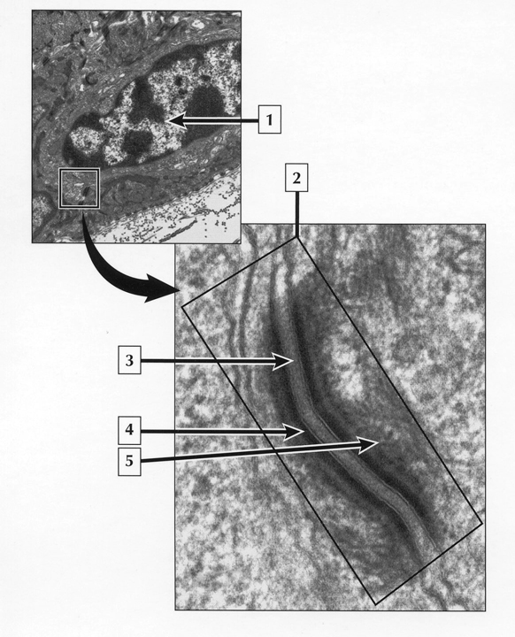
QUIZ
Self-check: Identify structure in the lower image. (advance slides for answers)
desmosome

Slide 48
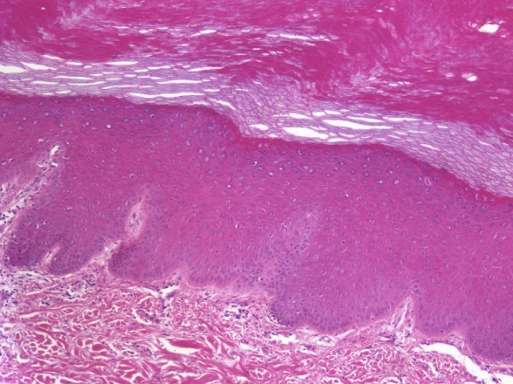
QUIZ
Self-check: Identify the region indicated by the bracket. (advance slides for answers)
Stratum spinosum

Slide 49
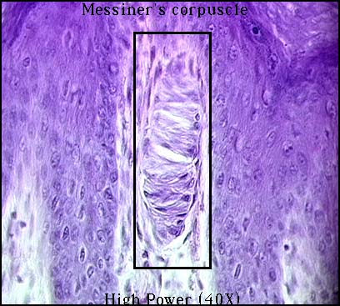
QUIZ
Self-check: Identify the outlined structure. (advance slides for answers)
Meissner’s corpuscle

Slide 50
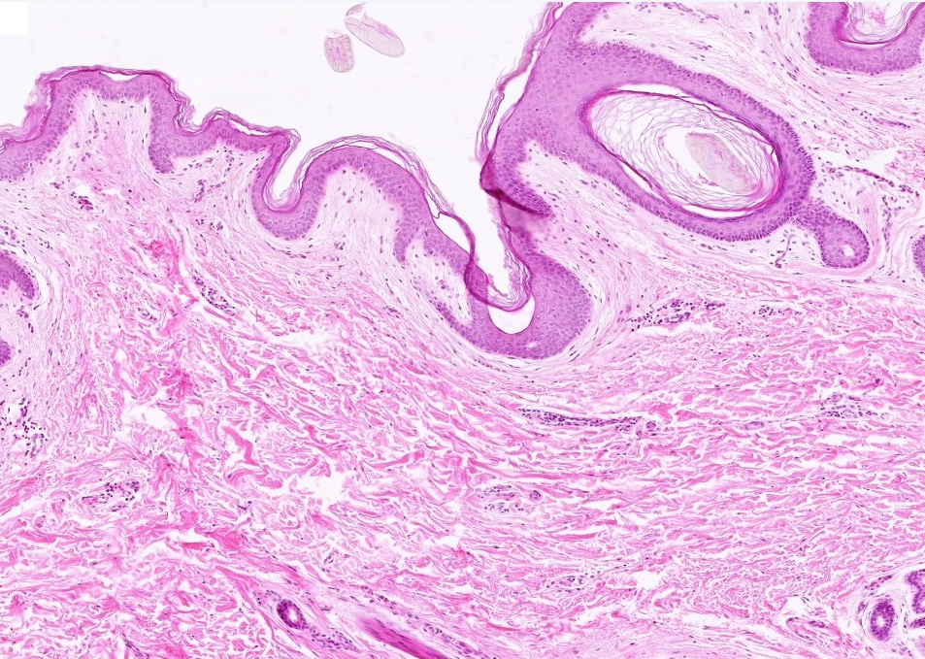
QUIZ
Self-check: Is this thick or thin skin? (advance slides for answers)
Thin skin

Slide 51
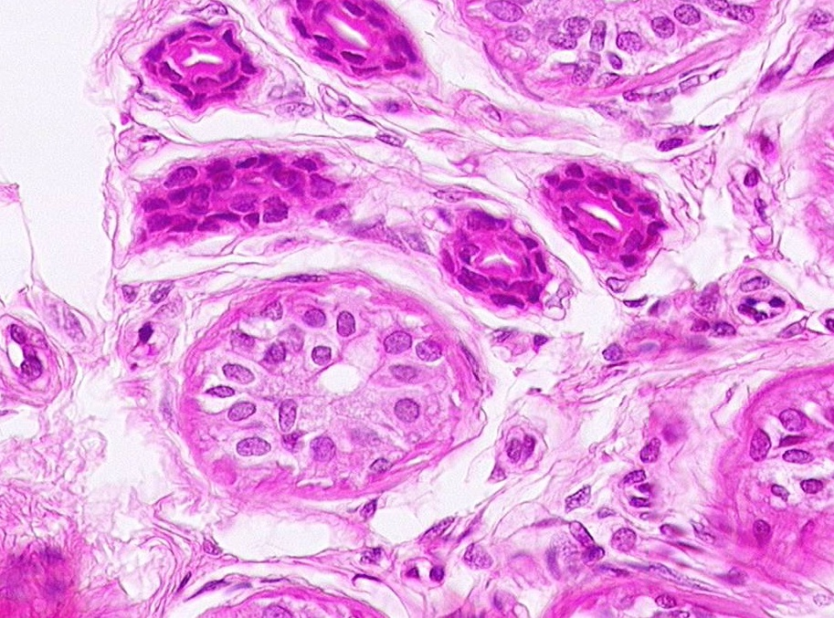
QUIZ
Self-check: Identify the outlined structure. (advance slides for answers)
duct

Slide 52
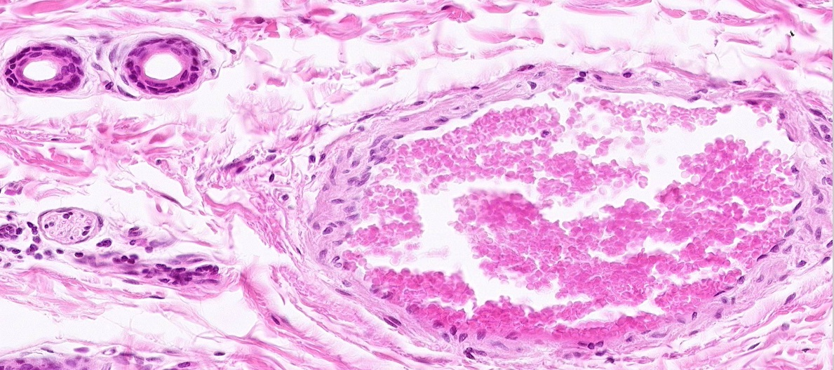
QUIZ
Self-check: Identify the outlined structure. (advance slides for answers)
Peripheral nerve

Slide 53
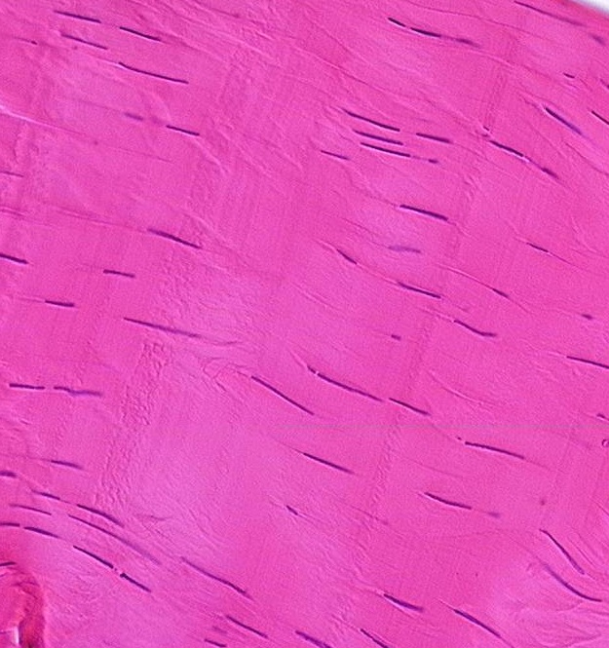
QUIZ
Self-check: Identify the tissue on this slide. (advance slides for answers)
Dense regular connective tissue

Slide 54
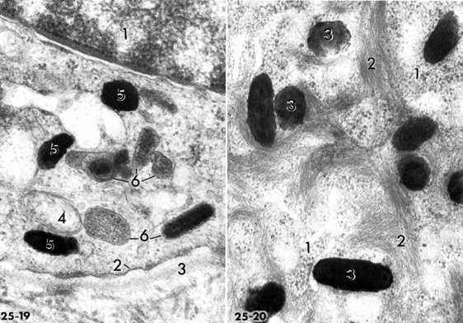
QUIZ
Self-check: These images were taken from keratinocytes. Was the sample taken from a light-skinned or dark-skinned individual?
(advance slides for answers)
dark-skinned

Slide 55
QUIZ
Self-check: Identify the outlined structure. (advance slides for answers)
Dermal papilla

Slide 56
QUIZ
Self-check: Identify the outlined structure. (advance slides for answers)
Pacinian corpuscle

Slide 57
QUIZ
Self-check: Identify the outlined structure. (advance slides for answers)
Hair follicle

Slide 58
QUIZ
Self-check: Identify the outlined structures. (advance slides for answers)
vein

Slide 59
QUIZ
Self-check: Identify the region indicated by the bracket. (advance slides for answers)
Stratum corneum

Slide 60
QUIZ
Self-check: Identify the outlined structures. (advance slides for answers)
Apocrine glands

Slide 61
QUIZ
Self-check: Identify the structures indicated by the red arrows. (advance slides for answers)
desmosomes

Slide 62
QUIZ
Self-check: Identify the structure indicated by the arrow. (advance slides for answers)
Hair shaft

Slide 63
QUIZ
Self-check: Identify the large structure in this image. Identify cells at 3. (advance slides for answers)
Apocrine gland
3 = myoepithelial cells

Slide 64
QUIZ
Self-check: Identify the outlined structure. (advance slides for answers)
Sebaceous gland

Slide 65
QUIZ
Self-check: Identify the region indicated by the bracket. (advance slides for answers)
Stratum basale

Slide 66
QUIZ
Self-check: Identify the outlined region. (advance slides for answers)
Zone of calcification (zone of calcified cartilage)

Slide 67
QUIZ
Self-check: Identify the outlined structure. (advance slides for answers)
eccrine gland

Slide 68
QUIZ
Self-check: Identify the cell indicated by the arrow. (advance slides for answers)
myoepithelial cell

Slide 69
QUIZ
Self-check: Identify the outlined structure? (advance slides for answers)
Dermal papilla (of hair follicle)

Slide 70
QUIZ
Self-check: Identify the tissue on this slide. (advance slides for answers)
fibrocartilage

Slide 71
QUIZ
Self-check: Identify structure #2 (advance slides for answers)
keratin filaments / tonofibrils

Slide 72
QUIZ
Self-check: Identify the outlined structure. (advance slides for answers)
osteoid

Slide 73
QUIZ
Self-check: Identify the outlined structure. (advance slides for answers)
Mucus glands (this is a section from a bronchus)

Slide 74
QUIZ
Self-check: In this micrograph from the skin, identify the cell, the nucleus of which is indicated at 1. (advance slides for answers)
keratinocyte

Slide 75
QUIZ
Self-check: In this micrograph from a sweat gland, identify cell at 4. (advance slides for answers)
Myoepithelial cell

Slide 76
QUIZ
Self-check: Identify the outlined region. (advance slides for answers)
Papillary layer of dermis

Slide 77
QUIZ
Self-check: Identify the outlined structure. (advance slides for answers)
Eccrine gland

Slide 78
QUIZ
Self-check: Identify the outlined structure. (advance slides for answers)
Epidermal ridges / epidermal pegs / rete pegs

Slide 79
QUIZ
Self-check: Identify the outlined structures. (advance slides for answers)
ducts

Slide 80
QUIZ
Self-check: Identify the cells indicated by the arrows. (advance slides for answers)
osteoblasts

Slide 81
QUIZ
Self-check: Identify the outlined region. (advance slides for answers)
Reticular layer of dermis

Slide 82
QUIZ
Self-check: Identify the outlined structure. (advance slides for answers)
duct

Slide 83
QUIZ
Self-check: Identify the outlined structure. (advance slides for answers)
Arrector pili muscle

Slide 84
QUIZ
Self-check: Identify the structures indicated by the red arrows. (advance slides for answers)
Keratin tonofilaments

Slide 85
QUIZ
Self-check: Identify the cell indicated by the arrow. (advance slides for answers)
Fibroblast (probably)

Slide 86
QUIZ
Self-check: Identify the outlined region? (advance slides for answers)
matrix

Slide 87
QUIZ
Self-check: Identify the structures at the tips of the arrows. (advance slides for answers)
Keratohyaline granules

Slide 88
QUIZ
Self-check: Identify the region indicated by the brackets. (advance slides for answers)
Stratum granulosum

Slide 89
QUIZ
Self-check: Identify the structure in this image. (advance slides for answers)
Sebaceous gland – this is a tough one, but maybe you saw the small basal cell (1), and the washed-out inclusions that increase in number, and the increase in cell size, as you move from 1-3.

Slide 90
IDENTIFYING REGIONS OF SKIN
As a final task, if given a slide of skin, you should be able to tell us the region of the body from which it came. Review the rules:
Thick skin - palms of hands and soles of feet
Apocrine glands – axilla, pubic, areola of breast, circumanal region
Hair – everywhere, except thick skin, dense in scalp, with some variation, also axilla, groin
Answers on next slide.
This SL 033 is a section from ____________________
This SL 089 is a section from ____________________
This SL 025 is a section from ____________________
This SL 009 is a section from ____________________

Slide 91
IDENTIFYING REGIONS OF SKIN
Axilla, groin (areola, circumanal)
This SL 033 is a section from ____________________
Scalp (best answer)
This SL 089 is a section from ____________________
Palm of hand, sole of feet
This SL 025 is a section from ____________________
Anything not one of above is acceptable, (ear, forearm, leg, face, etc.) – this happens to be the ear
This SL 009 is a section from ____________________

