Slide 1
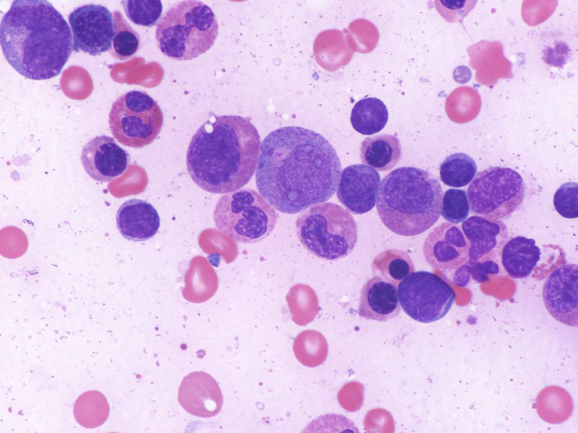
Hematopoiesis: Red Blood Cells Digital Laboratory
It’s best to view this in Slide Show mode, especially for the quizzes.
This module will take approximately 75 minutes to complete.

Slide 2
After completing this exercise, you should be able to:
Distinguish, at the light microscope level, each of the following::
Stages in erythroid development
Proerythroblast
Basophilic erythroblast
Polychromatophilic erythroblast
Orthochromatophilic erythroblast
Reticulocyte
Mature red blood cell

Slide 3
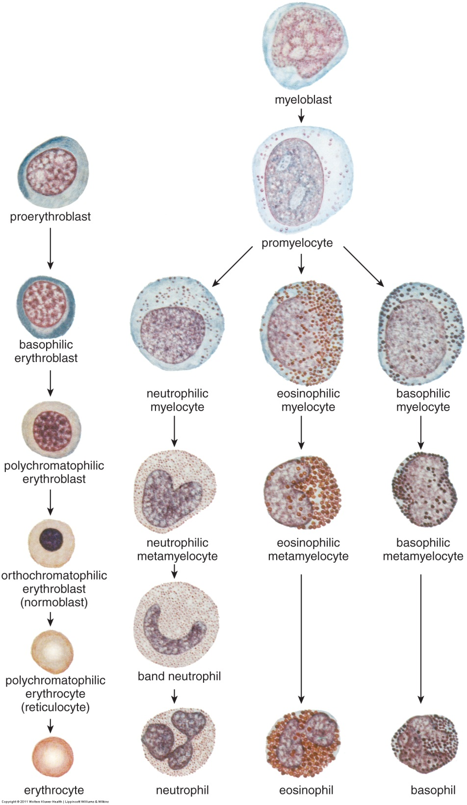
HEMATOPOIESIS
The image to the left shows the major stages of blood cell development that we will identify in these modules:
This module will focus on the development of red blood cells (RBCs) (left column).
A key difference between development of RBCs and granulocytes is that RBCs lack cytoplasmic granules.
Another thing to keep in mind when studying RBC precursors is that the final cell, the erythrocyte, is essentially a bag of hemoglobin, a soluble cytosolic protein. Therefore, early RBC precursor cells will contain numerous free ribosomes necessary for hemoglobin synthesis, and, therefore, will have intense cytoplasmic basophilia. As the cells mature, they produce hemoglobin, with a concomitant reduction in the number of ribosomes; therefore, you expect maturing red blood cells to gradually become less basophilic and more eosinophilic.
Finally, mature RBCs lack a nucleus. During RBC development, the nucleus gradually condenses until it is fully compact. This chromatin form is removed from the cell when nearly mature.

Slide 4
HEMATOPOIESIS – RED BLOOD CELLS
Proerythroblast
--large cell
--large round nucleus
--nucleoli (at least one)
--fine chromatin pattern
--basophilic cytoplasm
--absence of granules
If you don’t readily recognize these features in this cell, you should return to the Hematopoiesis: Overview module.

Slide 5
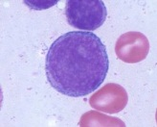
HEMATOPOIESIS – RED BLOOD CELLS
Proerythroblast
--large cell
--large round nucleus
--nucleoli (at least one)
--fine chromatin pattern
--basophilic cytoplasm
--absence of granules
Myeloblast
--large cell
--large round nucleus
--nucleoli (at least one)
--fine chromatin pattern
--basophilic cytoplasm
--absence of granules
Those of you that are astute scholars are probably screaming “Hey Lowrie, these cells have the same features. How do I tell them apart.” If you weren’t an astute scholar screaming this, you can scream it now, I won’t know the difference.
Turns out, to create the list for the proerythroblast, I cut and pasted the list for the myeloblast from the previous module. There is indeed at least one way to differentiate these cells (see next slide), but, for our course, we don’t ask you to do so.
However, since we like to get ONE answer to grade on our practical exams, we ask you to know what “blasts” look like. In exams, we would ask “This cells is in the erythrocyte series. Identify this cell.” or something like that. In this case, myeloblast would not be correct.

Slide 6
HEMATOPOIESIS – RED BLOOD CELLS
Proerythroblast
--large cell
--large round nucleus
--nucleoli (at least one)
--fine chromatin pattern
--basophilic cytoplasm
--absence of granules
Myeloblast
--large cell
--large round nucleus
--nucleoli (at least one)
--fine chromatin pattern
--basophilic cytoplasm
--absence of granules
For the curious, many of you might have noticed that this proerythroblast has more intense cytoplasmic basophilia than the myeloblast. That’s because proerythroblasts have more intense cytoplasmic basophilia than myeloblasts – due to more ribosomes.
Personally, though I hate picking colors for paint or weddings, I think the proerythroblast outshines the myeloblast. Its cytoplasm is such an awesome blue to look at, which makes for a much cooler cell. The myeloblast must be jealous.
This is like the efferent ductules being the ugly cousin of the epididymis. Just my quirk.

Slide 7
HEMATOPOIESIS – RED BLOOD CELLS
Basophilic erythroblast
--large cell
--large round nucleus
--absence of nucleoli
--clumpy chromatin pattern
--basophilic cytoplasm
--absence of granules

Slide 8
HEMATOPOIESIS – RED BLOOD CELLS
Video of proerythroblasts and basophilic erythroblasts – SL68
Link to SL 068 and SL 177
Be able to identify:
Proerythroblast
Basophilic erythroblast

Slide 9
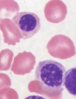
HEMATOPOIESIS – RED BLOOD CELLS
Basophilic erythroblast
--large cell
--large round nucleus
--absence of nucleoli
--clumpy chromatin pattern
--basophilic cytoplasm
--absence of granules
polychromatophilic erythroblast
--smaller cell
--smaller nucleus
--absence of nucleoli
--more clumpy chromatin pattern
--basophilic + eosinophilic cytoplasm
--absence of granules
orthochromatophilic erythroblast
--small cell
--small nucleus
--absence of nucleoli
--mostly clumpy chromatin pattern
--mostly eosinophilic cytoplasm
--absence of granules
Again, note the general trends here: cell gets smaller, nucleus gets smaller, chromatin condenses, so more clumps and less spaces, cytoplasm turns from blue to pink

Slide 10
HEMATOPOIESIS – RED BLOOD CELLS
Video of basophilic erythroblast → polychromatophilic erythroblast → orthochromatophilic erythroblast – SL177
Link to SL 068 and SL 177
Be able to identify:
Basophilic erythroblast
Orthochromatophilic erythroblast
Polychromatophilic erythroblast

Slide 11
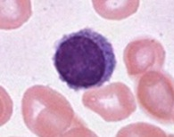
HEMATOPOIESIS – RED BLOOD CELLS
Many students get confused between maturing red blood cells and a lymphocyte (above). Recall that the lymphocyte has a small condensed nucleus, with a thin rim of blue cytoplasm. The cell in the RBC series that has a blue cytoplasm similar to the lymphocyte is the basophilic erythroblast. These two cells can be distinguished because the basophilic erythroblast is larger, with a larger nucleus, and a chromatin pattern that is clumpy but has a good number of clear areas within the nucleus. By the time the nucleus of the RBC condenses enough to look like the nucleus of the lymphocyte, the cell has already begun to synthesize hemoglobin, so it’s cytoplasm has enough eosinophilia to distinguish it from the basophilic cytoplasm of the lymphocyte.

Slide 12
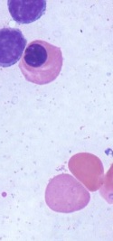
HEMATOPOIESIS – RED BLOOD CELLS
orthochromatophilic erythroblast
--small cell
--small nucleus
--absence of nucleoli
--mostly clumpy chromatin pattern
--mostly eosinophilic cytoplasm
--absence of granules
After the maturing RBC loses its nucleus, it is called a polychromatophilic erythrocyte, or reticulocyte, which is released into the circulation. The reticulocyte still has a small number of ribosomes, so although it is fairly eosinophilic, it is tinged with a little basophilia (the cell indicated by the arrow is probably a reticulocyte). Although this is a bone marrow smear, reticulocytes can be identified this way in peripheral blood (or at least we can guess which are reticulocytes).

Slide 13
HEMATOPOIESIS – RED BLOOD CELLS
Video of reticulocyte – SL21
Link to SL 021
Be able to identify:
Reticulocyte (actually, we never ask this on an exam, seriously)

Slide 14
HEMATOPOIESIS – RED BLOOD CELLS
Reticulocytes actually got this name because when supravital dyes stain the remaining ribosomes, it appears as a reticulum, as seen above.
Be VERY careful here. The polychromatophilic erythroCYTE (aka reticulocyte) is a different cell from the polychromatophilic erythroBLAST. Even if you try to avoid this by calling the polychromatophilic erythrocyte a reticulocyte, make sure you don’t get tripped up by calling the polychromatophilic erythroblast a polychromatophilic erythrocyte. OUCH!!!

Slide 15
HEMATOPOIESIS – RED BLOOD CELLS
Video of reticulocyte with supravital staining – SL22
Link to SL 022
Be able to identify:
Reticulocyte (we have used this slide on exams)

Slide 16
The next set of slides is a quiz for this module. You should review the structures covered in this module, and try to visualize each of these in light and electron micrographs.
Distinguish, at the light microscope level, each of the following::
Stages in erythroid development
Proerythroblast
Basophilic erythroblast
Polychromatophilic erythroblast
Orthochromatophilic erythroblast
Reticulocyte
Mature red blood cell

Slide 17
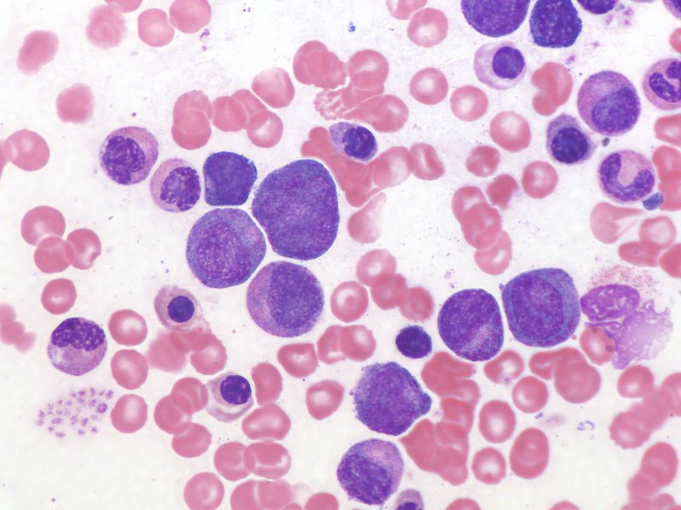
Final quiz
Self-check: Identify the cell indicated by the arrow. (advance slide for answer)
Neutrophilic myelocyte

Slide 18
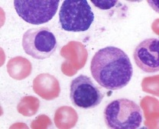
Final quiz
Self-check: Identify the cell indicated by the arrow. (advance slide for answer)
Orthochromatophilic erythroblast

Slide 19
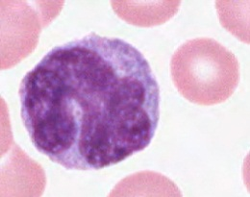
Final quiz
Self-check: Identify the cell indicated by the arrow. (advance slide for answer)
monocyte

Slide 20
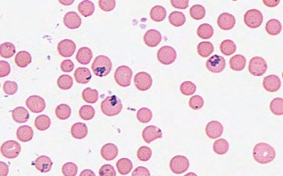
Final quiz
Self-check: Identify the cell indicated by the arrow. (advance slide for answer)
reticulocyte

Slide 21
Final quiz
Self-check: Identify the cell indicated by the arrow. (advance slide for answer)
basophilic erythroblast
(a small one)

Slide 22
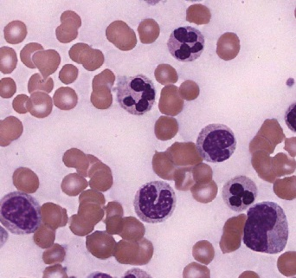
Final quiz
Self-check: Identify the cell indicated by the arrow. (advance slide for answer)
(almost) mature neutrophil

Slide 23
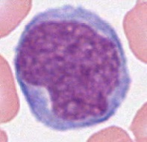
Final quiz
Self-check: Identify the cell indicated by the arrow. (advance slide for answer)
Myeloblast (or proerythroblast)

Slide 24
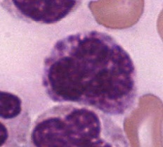
Final quiz
Self-check: Identify the cell indicated by the arrow. (advance slide for answer)
Basophilic somethingocyte

Slide 25
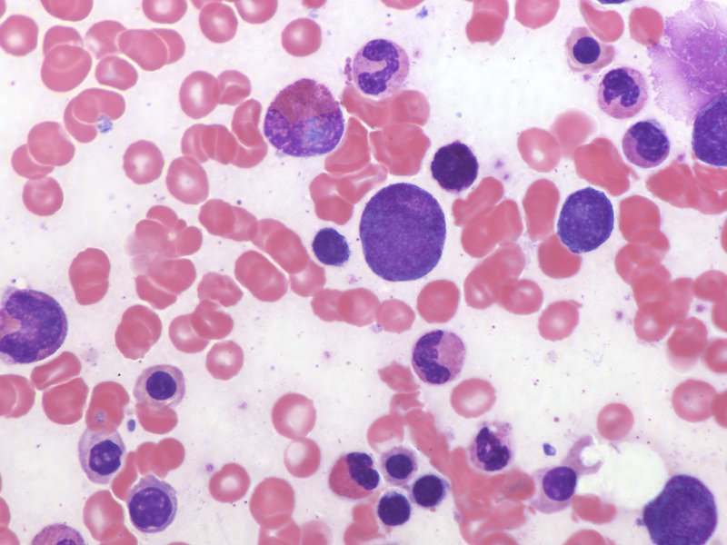
Final quiz
Self-check: Identify the cell indicated by the arrow. (advance slide for answer)
Neutrophilic band cell

Slide 26
Final quiz
Self-check: Identify the cell indicated by the arrow. (advance slide for answer)
Neutrophilic myelocyte

Slide 27
Final quiz
Self-check: Identify the cell indicated by the arrow. (advance slide for answer)
orthochromatophilic erythroblast

Slide 28
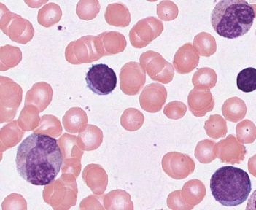
Final quiz
Self-check: Identify the cell indicated by the arrow. (advance slide for answer)
lymphocyte

Slide 29
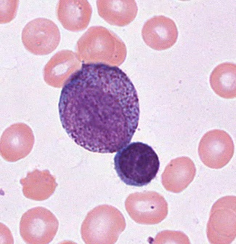
Final quiz
Self-check: Identify the cell indicated by the arrow. (advance slide for answer)
promyelocyte

Slide 30
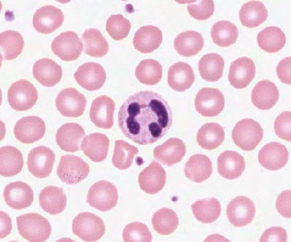
Final quiz
Self-check: Identify the cell indicated by the arrow. (advance slide for answer)
neutrophil

Slide 31
Final quiz
Self-check: Identify the cell indicated by the arrow. (advance slide for answer)
Neutrophilic metamyelocyte

Slide 32
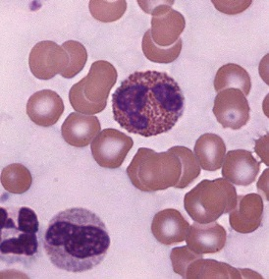
Final quiz
Self-check: Identify the cell indicated by the arrow. (advance slide for answer)
eosinophil

Slide 33
Final quiz
Self-check: Identify the cell indicated by the arrow. (advance slide for answer)
orthochromatophilic erythroblast

Slide 34
Final quiz
Self-check: Identify the cell indicated by the arrow. (advance slide for answer)
Polychromatophilic erythroblast

Slide 35
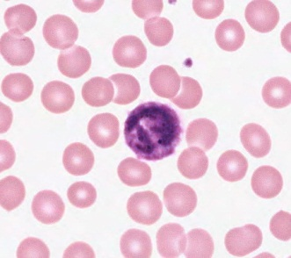
Final quiz
Self-check: Identify the cell indicated by the arrow. (advance slide for answer)
basophil

Slide 36
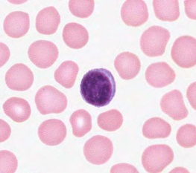
Final quiz
Self-check: Identify the cell indicated by the arrow. (advance slide for answer)
lymphocyte

Slide 37
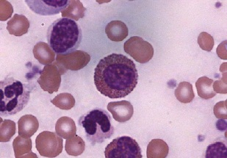
Final quiz
Self-check: Identify the cell indicated by the arrow. (advance slide for answer)
Eosinophilic myelocyte

Slide 38
Final quiz
Self-check: Identify the cell indicated by the arrow. (advance slide for answer)
lymphocyte

Slide 39
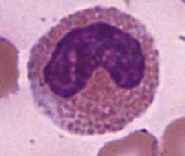
Final quiz
Self-check: Identify the cell indicated by the arrow. (advance slide for answer)
eosinophilic metamyelocyte

Slide 40
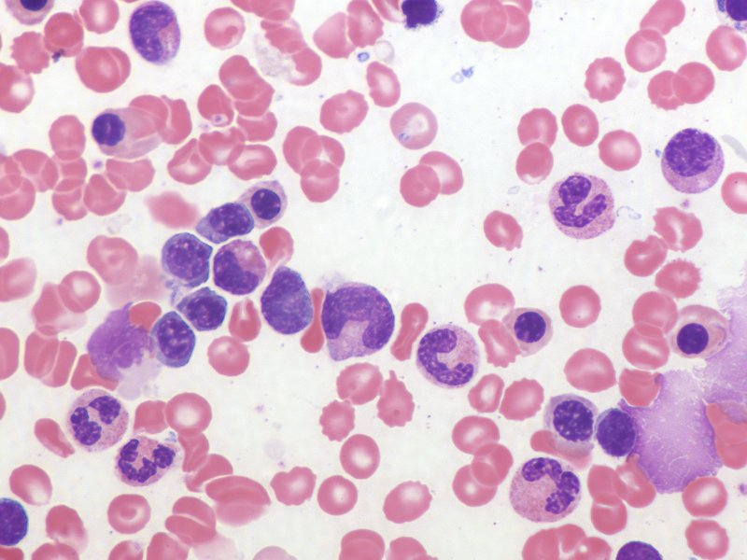
Final quiz
Self-check: Identify the cell indicated by the arrow. (advance slide for answer)
orthochromatophilic erythroblast

Slide 41
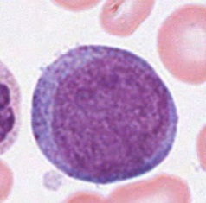
Final quiz
Self-check: Identify the cell indicated by the arrow. (advance slide for answer)
promyelocyte

Slide 42
Final quiz
Self-check: Identify the cell indicated by the arrow. (advance slide for answer)
platelet

Slide 43
Final quiz
Self-check: Identify the cell indicated by the arrow. (advance slide for answer)
polychromatophilic erythroblast

Slide 44
Final quiz
Self-check: Identify the cell indicated by the arrow. (advance slide for answer)
eosinophil

Slide 45
Final quiz
Self-check: Identify the cell indicated by the arrow. (advance slide for answer)
basophilic erythroblast

Slide 46
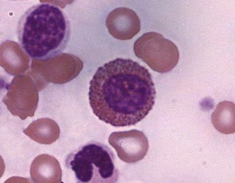
Final quiz
Self-check: Identify the cell indicated by the arrow. (advance slide for answer)
eosinophilic myelocyte

Slide 47
Final quiz
Self-check: Identify the cell indicated by the arrow. (advance slide for answer)
Polychromatophilic erythroblast

Slide 48
Final quiz
Self-check: Identify the cell indicated by the arrow. (advance slide for answer)
Neutrophilic myelocyte

Slide 49
Final quiz
Self-check: Identify the cell indicated by the arrow. (advance slide for answer)
polychromatophilic erythroblast

Slide 50
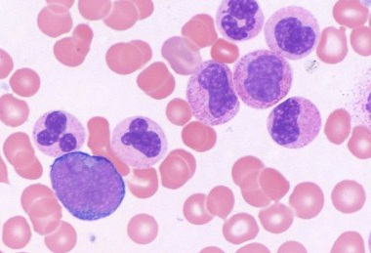
Final quiz
Self-check: This cell will eventually produce azurophilic granules. Identify the cell indicated by the arrow. (advance slide for answer)
myeloblast

Slide 51
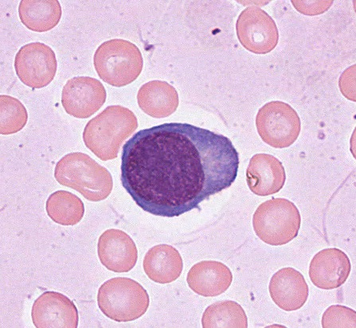
Final quiz
Self-check: Identify the cell indicated by the arrow. (advance slide for answer)
Plasma cell

Slide 52
Final quiz
Self-check: Identify the cell indicated by the arrow. (advance slide for answer)
Eosinophilic metamyelocyte

Slide 53
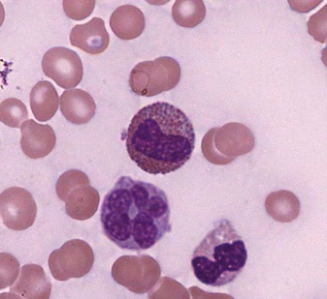
Final quiz
Self-check: Identify the cell indicated by the arrow. (advance slide for answer)
Eosinophilic metamyelocyte

Slide 54
Final quiz
Self-check: Identify the cell indicated by the arrow. (advance slide for answer)
orthochromatophilic erythroblast

Slide 55
Final quiz
Self-check: Identify the cell indicated by the arrow. (advance slide for answer)
Orthochromatophilic erythroblast

