Slide 1
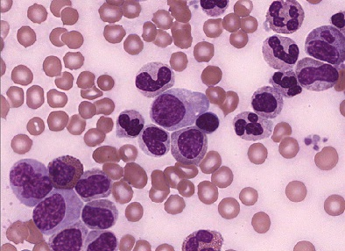
Hematopoiesis Overview
Digital Laboratory
It’s best to view this in Slide Show mode, especially for the quizzes.
This module will take approximately 75 minutes to complete.

Slide 2
After completing this exercise, you should be able to:
identify, at the light microscope level, each of the following:
Cytoplasmic granules
Azurophilic (nonspecific) granules
Basophilic granules
Eosinophilic granules
Neutrophilic granules
Nucleoli (warning, these ain’t your father’s nucleoli)
Nuclear shape
Round
Indented
Kidney bean-shaped
Band
Segmented
Chromatin pattern
Fine
Clumped
Cytoplasmic staining
Cytoplasmic basophilia
Cytoplasmic eosinophilia

Slide 3
Five cytological features are used to differentiate amongst developing blood cell types. They are:
cytoplasmic granules
presence or absence of nucleoli
shape of the nucleus
extent of nuclear chromatin clumping
degree of cytoplasmic basophilia
Note that blood cells are stained routinely with specific hematologic dyes, not H&E, and this results in a slightly wider range of coloration than seen with H&E. A new color is recognized - azure, a bluish purple. To view critical cytologic features of blood cells, images in your hematology lab modules are magnified to a much greater degree than seen in previous labs. To gauge relative magnification, red blood cells (7.5 µm in diameter) in the field of view are a good yardstick.

Slide 4
CYTOPLASMIC GRANULES

Slide 5
CYTOPLASMIC GRANULES
azurophilic (primary, or nonspecific) granules are purple and readily visualized because of their size. These cells have many; some are indicated at the arrows.
The azurophilic granules are described as nonspecific because their appearance during granulocyte maturation is no help in distinguishing amongst precursors of the neutrophil, eosinophil, and basophil lineage. The other three granules (on the following slides) are called specific because their appearance allows one to definitively place the cell in a specific granulocyte lineage.

Slide 6
CYTOPLASMIC GRANULES
eosinophilic granules are very large, red-pink, and have a glassy appearance. The two cells within the black circles are chock-full of these granules.

Slide 7
CYTOPLASMIC GRANULES
basophilic granules are very large and blue. In this mature basophil, note the large granules indicated by the black arrows.

Slide 8
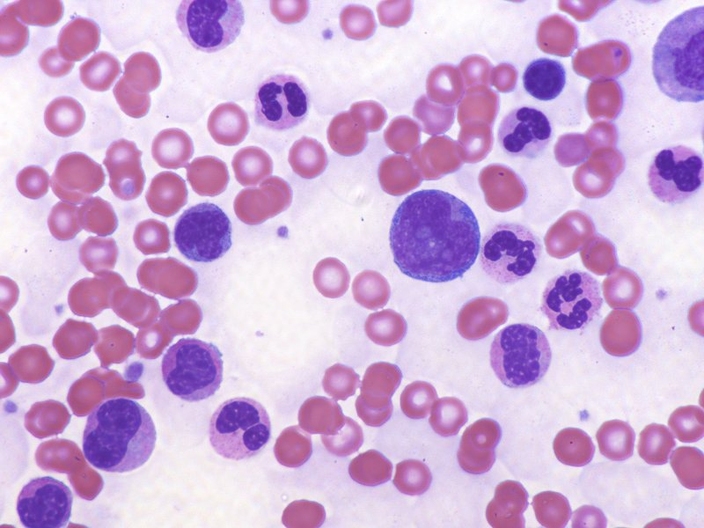
CYTOPLASMIC GRANULES
neutrophilic granules are too small (0.1-0.2 um) to be seen as individual structures with the light microscope. Their presence in neutrophilic granulocytes is signified by a salmon-colored appearance of the cytoplasm. As Cell A, a granulocyte precursor with a basophilic cytoplasm and many azurophilic granules, matures to stage B, then C, then D, synthesis of neutrophilic granules renders the cytoplasm pink.
B
C
C
D
A

Slide 9
CYTOPLASMIC GRANULES
Video of nonspecific (azurophilic, primary) granules – SL68
Video eosinophilic granules – SL177
Video basophilic granules – SL177
Video neutrophilic granules – SL177
Link to SL 068 and SL 177
Be able to identify:
Azurophilic (nonspecific, primary) granules
Specific granules
Eosinophilic granules
Basophilic granules
Neutrophilic granules (recognize the presence of these)

Slide 10
NUCLEOLI

Slide 11
NUCLEOLI
presence or absence of nucleoli – Cells in the earliest recognizable stages of blood cell development have nucleoli. With hematologic stains, these nucleoli appear as pale spots in a darker nuclear background; 1-3/nucleus may be apparent. Note that with histological stains you are familiar with thus far, nucleoli were seen as dark densities within a pale, euchromatic nucleus….the opposite is true here.
Advance slide to see arrows on nucleoli…I suggest toggling back and forth a few times.
Note: not all possible nucleoli are indicated.

Slide 12
NUCLEOLI
Video of nucleoli – SL177
Link to SL 177
Be able to identify:
nucleoli

Slide 13
NUCLEAR SHAPE

Slide 14
NUCLEAR SHAPE
In the early stages of all lineages of developing white blood cells, nuclei tend to be large and round. In the early stages below, the nuclear envelope is indicated by the tips of the red arrows. You may observe some irregularities caused by impinging adjacent cells and/or tissue preparation.
Advance slide to see arrows

Slide 15
NUCLEAR SHAPE
All recognizable cells in the red blood cell (RBC) lineage maintain a round shaped-nucleus during maturation, though the nuclei become significantly smaller. For example, the cell marked A is the earliest RBC precursor, and the cell marked D is the latest nucleated RBC precursor. B and C are intermediates. Again, the nuclear envelope is indicated by the tips of the arrows.
D
C
B
D
A

Slide 16
NUCLEAR SHAPE
Cells of the granulocyte lineages are quite different. During maturation, the early round nucleus (A) undergoes shape changes that include indentations (B) and then seg-mentation (C). This is easiest to see in neutrophils because nuclei are readily visible.
B
C
B
B
B
A

Slide 17
NUCLEAR SHAPE
In eosinophils and basophils, nuclei are less prominently segmented. In addition, the cytoplasmic granules often make it difficult to distinguish the exact shape of the nucleus. Nevertheless, these maturing forms do demonstrate nuclear indentation, as in the eosinophil to the right, and complete segmentation, as demonstrated by the basophil to the left.
eosinophil
neutrophil
basophil

Slide 18
NUCLEAR SHAPE
Video of nuclear shape – SL177
Link to SL 177
Be able to identify:
Appreciate changes in nuclear shape
Round
Indented
Kidney-bean
Band
Segmented

Slide 19
CHROMATIN

Slide 20
CHROMATIN
The chromatin content of the nucleus is described as either fine (thread-like), or clumped. In the early stages of blood cell development shown here (when nucleoli are visible) the chromatin in the remainder of the nucleus is fine. In the circled cell on the right, a few azurophil granules overlie the nucleus. These must be mentally subtracted in assessing the chromatin pattern.

Slide 21
CHROMATIN
As blood cells mature, chromatin often becomes clumped. A good example of this is shown in the basophilic erythroblast (red arrow)….the clumping of the chromatin in this nucleus results in a distinctive dark, ropy pattern (solid black arrows) that leaves some areas white (dashed black arrows). An earlier stage of erythroblast is shown to the left for comparison. A similar dark and ropy staining pattern due to condensation of chromatin also is easily seen in the nuclei of developing granulocytes (blue arrows). An extreme kind of condensation called pyknosis is seen in late stage erythroblasts (green arrows), in which the chromatin condenses completely and the nucleus is reduced in size.

Slide 22
CHROMATIN
Video of chromatin – SL177
Link to SL 177
Be able to identify:
Fibrillar chromatin
Clumpy chromatin

Slide 23
DEGREE
of
CYTOPLASMIC BASOPHILIA

Slide 24
CYTOPLASMIC BASOPHILIA
Generally speaking, immature cells have a basophilic cytoplasm due to large amounts of ribosomal RNA. In the case of erythroblasts preparing to make hemoglobin, this is in the form of free ribosomes. In granulocytes, the basophilia is due to rough ER. In these early cells outlined in blue, you can see the intense cytoplasmic basophilia.

Slide 25
CYTOPLASMIC BASOPHILIA
In general, as cells mature, there is a gradual decrease in the rRNA content and a concomitant increase of protein or organelles that render the cytoplasm less basophilic and more eosinophilic. In neutrophil development, the cytoplasm gets pinker due to accumulation of neutrophil granules. The cells on the left (pink asterisks) are in an early stage of development and have a roughly evenly blue cytoplasm. The two circled cells to the right have accumulated granules in the region of the Golgi, resulting in a prominent patch of pink (pink arrows) in the formerly exclusively blue cytoplasm. Gradually, the cytoplasm of the mature neutrophil appears to become exclusively pink (black arrows).
*
*

Slide 26
CYTOPLASMIC BASOPHILIA
In the developing RBC lineage, the rRNA and hemoglobin are cytosolic. Therefore, the mix of pink/blue color possibilities are greater than in the developing neutrophils. The erythrocyte cytoplasm is pure blue (red arrow) at early stages; as the cells mature (green arrow), eosinophilic hemoglobin is added, resulting in a dull purple or grey color. As the rRNA is lost in more mature cells, the cytoplasm becomes progressively pinker (blue arrow).
1
3
2

Slide 27
CYTOPLASMIC BASOPHILIA
Video of cytoplasm color change in the neutrophic series – SL177
Video of cytoplasm color change in the erythrocyte series part 1 – SL68
Video of cytoplasm color change in the erythrocyte series part 2 – SL177
Link to SL 177 and SL 068
Be able to identify:
Maturity of cell based on cytoplasmic basophilia/eosinophilia

Slide 28
The next set of slides is a quiz for this module. You should review the structures covered in this module, and try to visualize each of these in light.
identify, at the light microscope level, each of the following:
Cytoplasmic granules
Azurophilic (nonspecific) granules
Basophilic granules
Eosinophilic granules
Neutrophilic granules
Nucleoli (warning, these ain’t your father’s nucleoli)
Nuclear shape
Round
Indented
Kindey-bean-shaped
Band
Segmented
Chromatin pattern
Fine
Clumped
Cytoplasmic staining
Cytoplasmic basophilia
Cytoplasmic eosinophilia

Slide 29
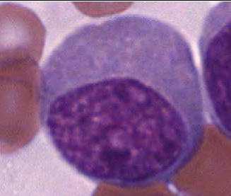
Final quiz
Self-check: Does this cell have nucleoli? If so, how many nucleoli do you see??
Yes
3 (though you may have seen more or less)

Slide 30
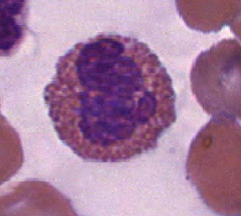
Final quiz
Self-check: Identify the structures at the tips of the arrows
eosinophilicgranules

Slide 31
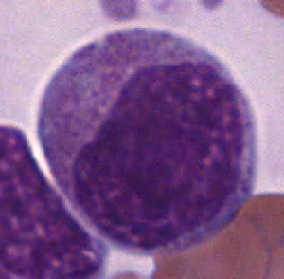
Final quiz
Self-check: Does the outlined cell have cytoplasmic granules? If so, what type?
Yes, it has a ton of nonspecific (azurophilic, primary) granules

Slide 32
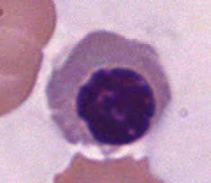
Final quiz
Self-check: On a scale of 1 to 10, 1 being the least mature, 10 being a red blood cell, where would you place this cell based on its cytoplasmic color?
7
(6-8)

Slide 33
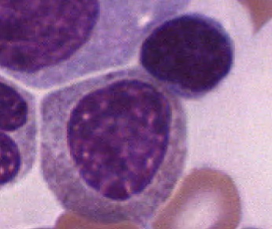
Final quiz
Self-check: Does the outlined cell have nucleoli? If so, how many nucleoli do you see??
No

Slide 34
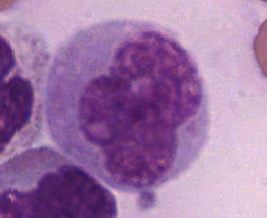
Final quiz
Self-check: Does this cell have nucleoli? If so, how many nucleoli do you see??
Yes
2

Slide 35
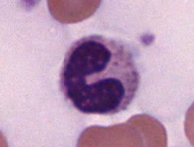
Final quiz
Self-check: What is the term that describes the shape of the nucleus of this cell?
band

Slide 36
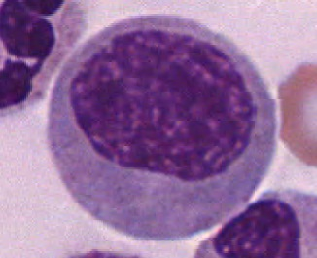
Final quiz
Self-check: Does this cell have nucleoli? If so, how many nucleoli do you see??
No

Slide 37
Final quiz
Self-check: Identify (yes, name) the outlined cell?
lymphocyte

Slide 38
Final quiz
Self-check: Identify the structures at the tips of the arrows
Nonspecific (azurophilic, primary) granules

Slide 39
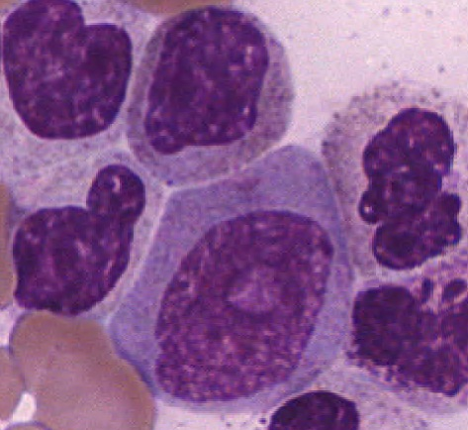
Final quiz
Self-check: Of cell A or B, which has the finer chromatin pattern? Which has the nucleolus?
B
A
B

Slide 40
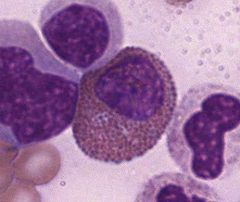
Final quiz
Self-check: Identify the structures at the tips of the arrows.
eosinophilic granules

Slide 41
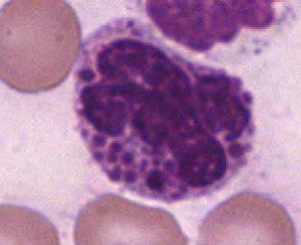
Final quiz
Self-check: Identify the structures at the tips of the arrows.
Basophilic granules

Slide 42
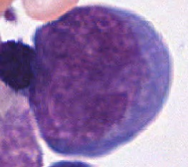
Final quiz
Self-check: On a scale of 1 to 10, 1 being the least mature, 10 being a red blood cell, where would you place this cell based on its cytoplasmic color?
1
(or 2)

Slide 43
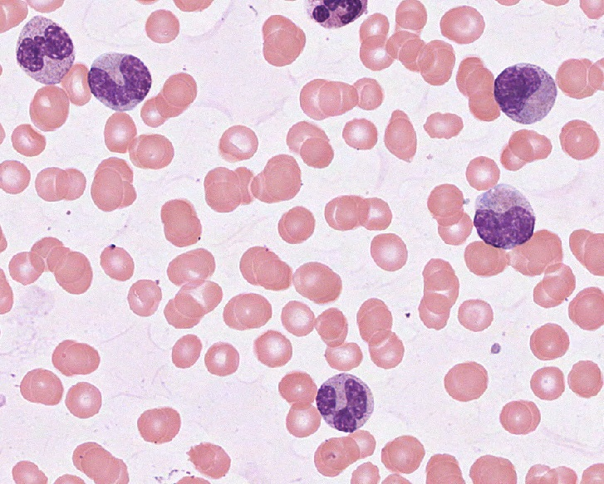
Final quiz
Self-check: Place these three cells (A-C) in the neutrophil series in order based on increasing maturity.
A
B
B, A, C
C

Slide 44
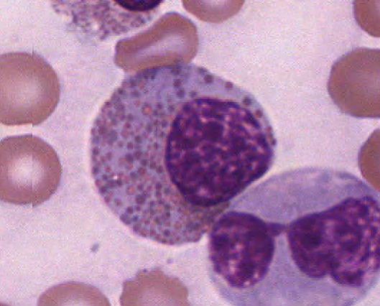
Final quiz
Self-check: Identify the structures at the tips of the arrows
eosinophilicgranules
Compare these to the granules in the WBC that is cut off at the top. Also, the “dude” in the bottom right looks soooo coooool in those shades.

Slide 45
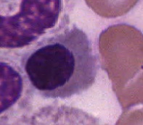
Final quiz
Self-check: On a scale of 1 to 10, 1 being the least mature, 10 being a red blood cell, where would you place this cell based on its cytoplasmic color?
5 or 6

Slide 46
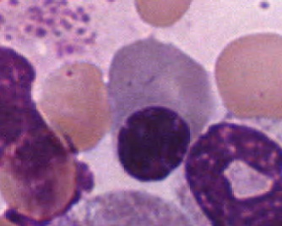
Final quiz
Self-check: Identify (yes, name) the outlined cell? This is for super-double bonus points.
Plasma cell

Slide 47
OK, I’ve squeezed out about as much as I could from this module. For the weekly quiz, expect some quiz questions similar to these. However, the ultimate goal is for you to identify specific cell types, which will be the focus of subsequent modules.

