Slide 1
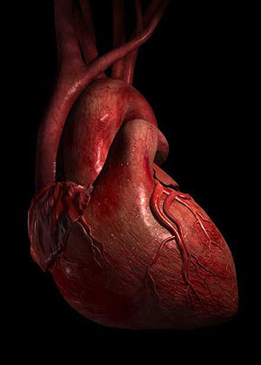
Heart
Digital Laboratory
It’s best to view this in Slide Show mode, especially for the quizzes.
This module will take approximately 45 minutes to complete.

Slide 2
After completing this exercise, you should be able to:
Distinguish, at the light microscope level, each of the following::
Cardiac muscle tissue
Layers
Endocardium
Myocardium
Epicardium
Ventricles
Atria
Valves
Atrioventricular
Semilunar
Annulus fibrosus
Purkinje fibers

Slide 3
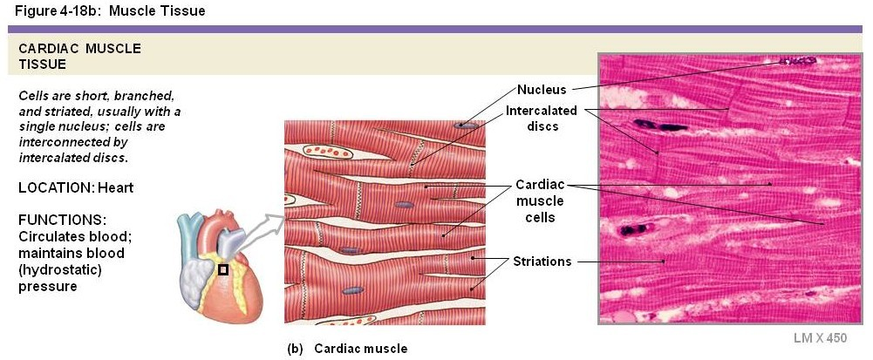
CARDIAC MUSCLE
Cardiac muscle is composed of smaller, branched muscle cells, which are connected to each other by intercalated discs. These intercalated disks, which are unique to cardiac muscle tissue, include adherent junctions for cell-cell strength, as well as gap junctions to allow electrical synchrony (so the cells contract at the same time). Similar to skeletal muscle, cardiac muscle fibers are packed with myofibrils, which are in-register, and give the tissue a striated appearance. Each cardiac muscle cell has a single nucleus that is centrally located.
When we say “smaller cells” for cardiac muscle, this is a comparison to skeletal muscle cells. Turns out, cardiac muscle cells are quite large when compared to most other cells, including smooth muscle. They just happen to be smaller than the very large skeletal muscle cells.

Slide 4
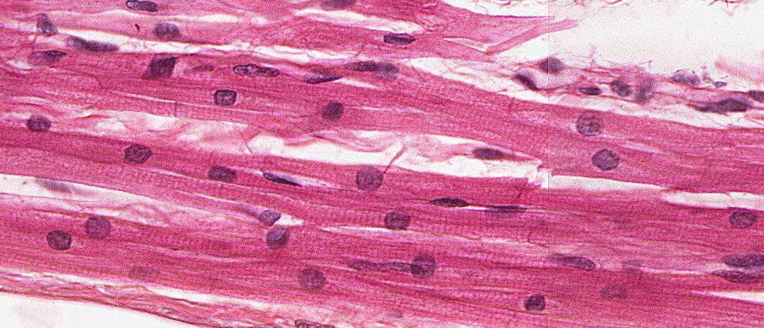
CARDIAC MUSCLE
Just like skeletal muscle, striations are readily apparent in cardiac muscle when viewed perpendicular to the orientation of the cells. This is because cardiac muscle is organized with myofibrils, sarcomeres, Z-lines, M-lines, etc., similar to skeletal muscle. Also like skeletal muscle, the fibers are long, with a consistent diameter throughout the length of the cell (green brackets). The diameter of each cell is similar, the slight variation due to sectioning (either through the thickest part of the cell, or catching the edge). However, the diameter of each cell (brackets) is much narrower than skeletal muscle.
This image gives you the impression that the diameter of each cell is comparable to the size of the nucleus. This is not the case; in fact, cardiac muscle cells are considered to have a fairly wide diameter relative to most cells (though much smaller than skeletal muscle). This will be better seen in cross-section.

Slide 5
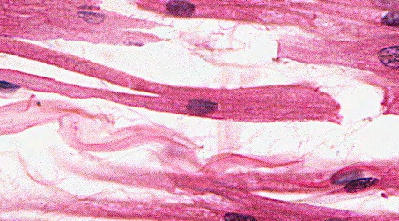
CARDIAC MUSCLE
Note also the centrally-located nuclei, and one per cell (though the later statement is hard to see). The nuclei here appear perfectly round, though typically they are oval, just not as elongated as seen in skeletal muscle. The ends of the cells are joined by intercalated disks (black arrows), which appear as dense bands in the same orientation as the striations. The cells are also branched, a nice example of a branched cell is in the insert in the upper left.

Slide 6
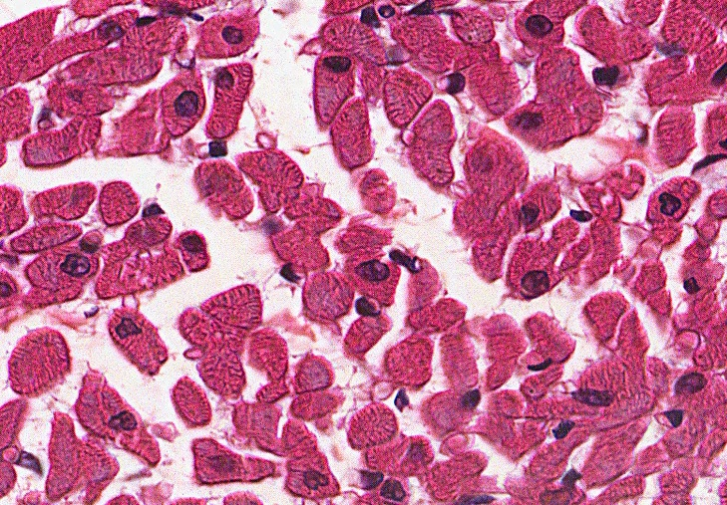
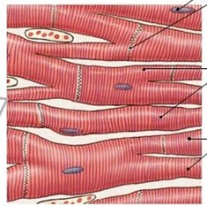
CARDIAC MUSCLE
This image is a cross-section through cardiac muscle tissue. Three cells are outlined, color coded to the section they represent in the cartoon to the right. You can see the centrally-located nuclei, although the nucleus is only visible in cells sectioned through the nucleus (black), while in other cells the nucleus is not in the same plane as the section (yellow).
Like skeletal muscle, cardiac muscle cells have approximately the same diameter throughout their length. Therefore, all cells have approximately the same diameter. Cells with oval shapes (purple) are due to sectioning through branch points.
The relatively large rim of cytoplasm around the nucleus will become useful when comparing to smooth muscle.

Slide 7
CARDIAC MUSCLE
Video of cardiac muscle – SL88
Link to SL 088
Be able to identify:
Cardiac muscle
Intercalated disks

Slide 8
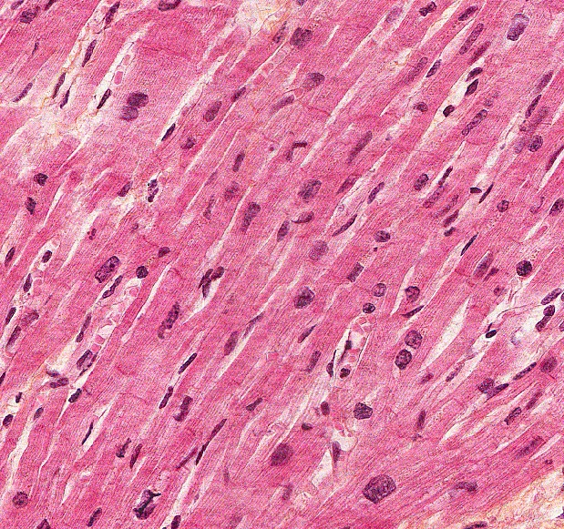
CARDIAC MUSCLE
In this specially-stained slide (Bencosme), intercalated disks are easier to see (arrows).

Slide 9
CARDIAC MUSCLE
Video of cardiac muscle showing intercalated disks – SL64
Link to SL 064
Be able to identify:
Cardiac muscle
Intercalated disks

Slide 10
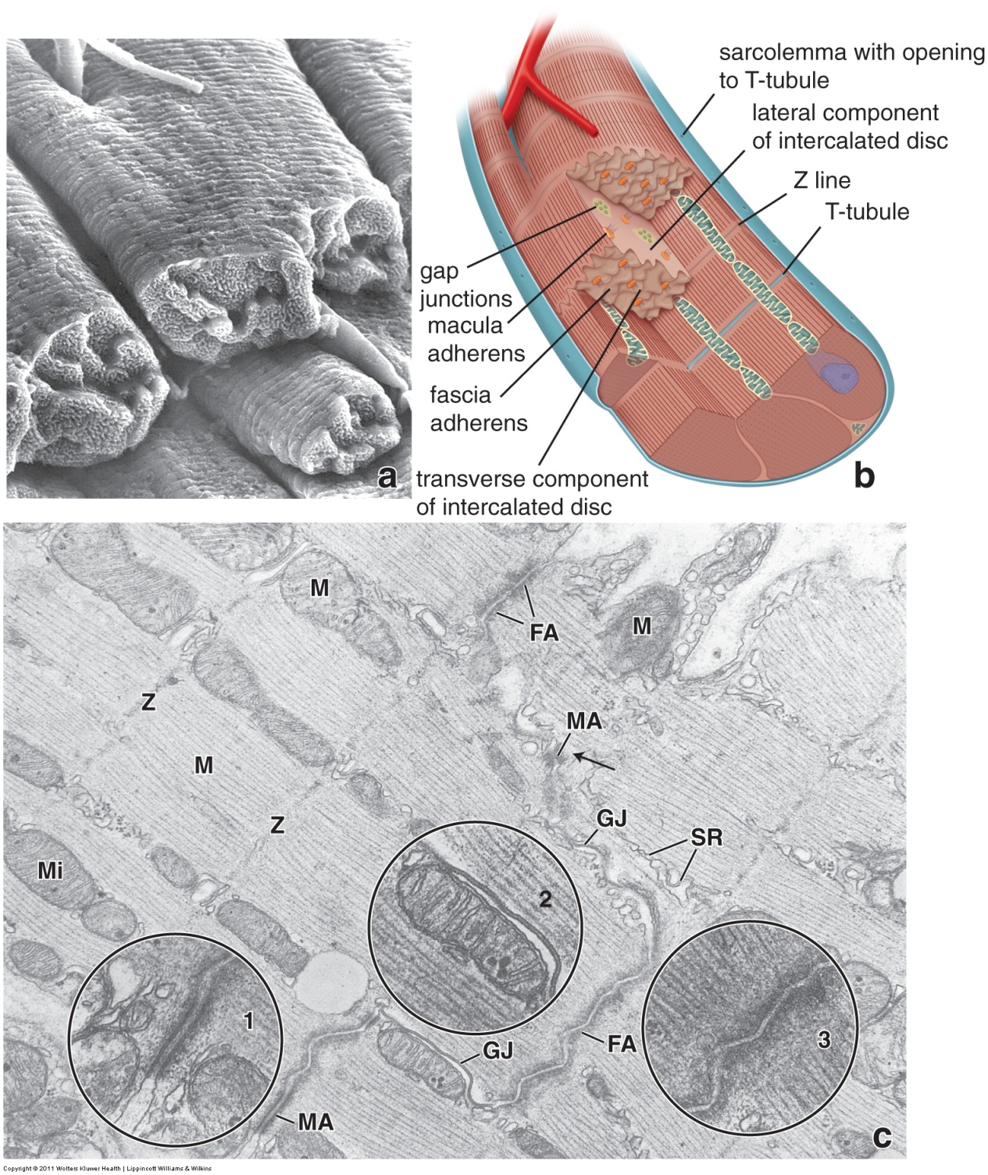
CARDIAC MUSCLE
A scanning electron micrograph (a) was taken from cardiac muscle specially prepared to remove connective tissue elements and separate cardiac muscle cells at their intercalated disks. The end of a cell is outlined. A cartoon (b) is labeled.
In the transmission electron micrograph (c), cells run longitudinally from upper left to lower right. A dotted red line (visible when you advance the slide) indicates an intercalated disk, which joins the cells “end-to-end”. Fascia adherens (FA) and macula adherens (MA) anchor the ends of cells together, while gap junctions (GJ), which are only on the “sides” of the disk, provide electrical continuity between the cells.
Fascia adherens is similar to the zonula adherens of epithelial cells.

Slide 11
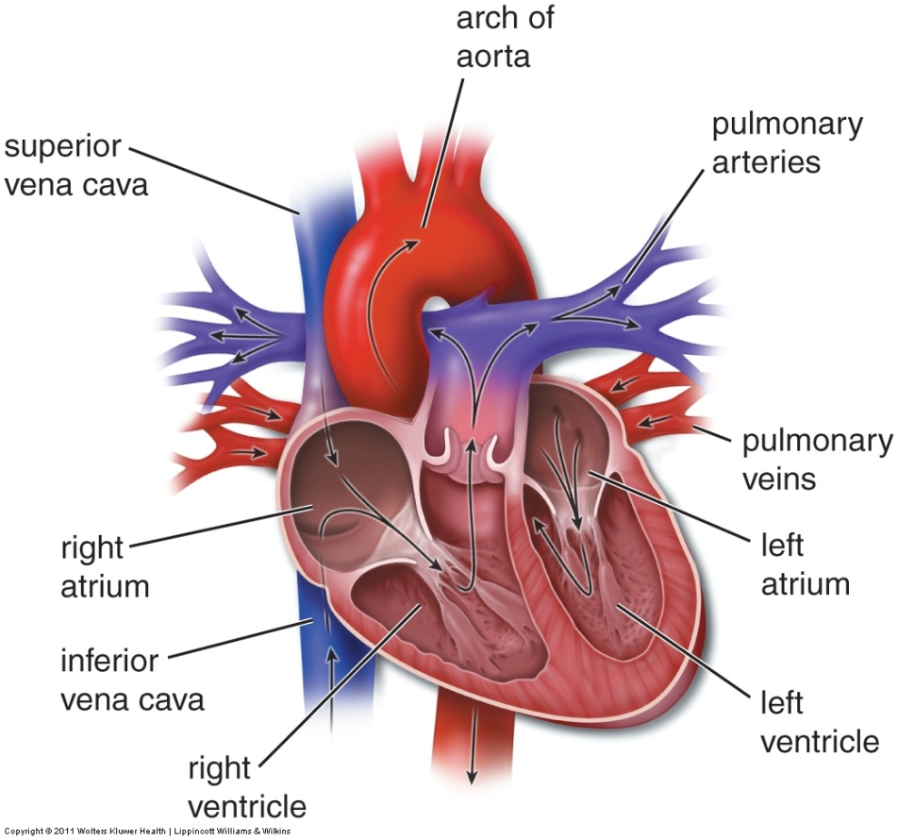
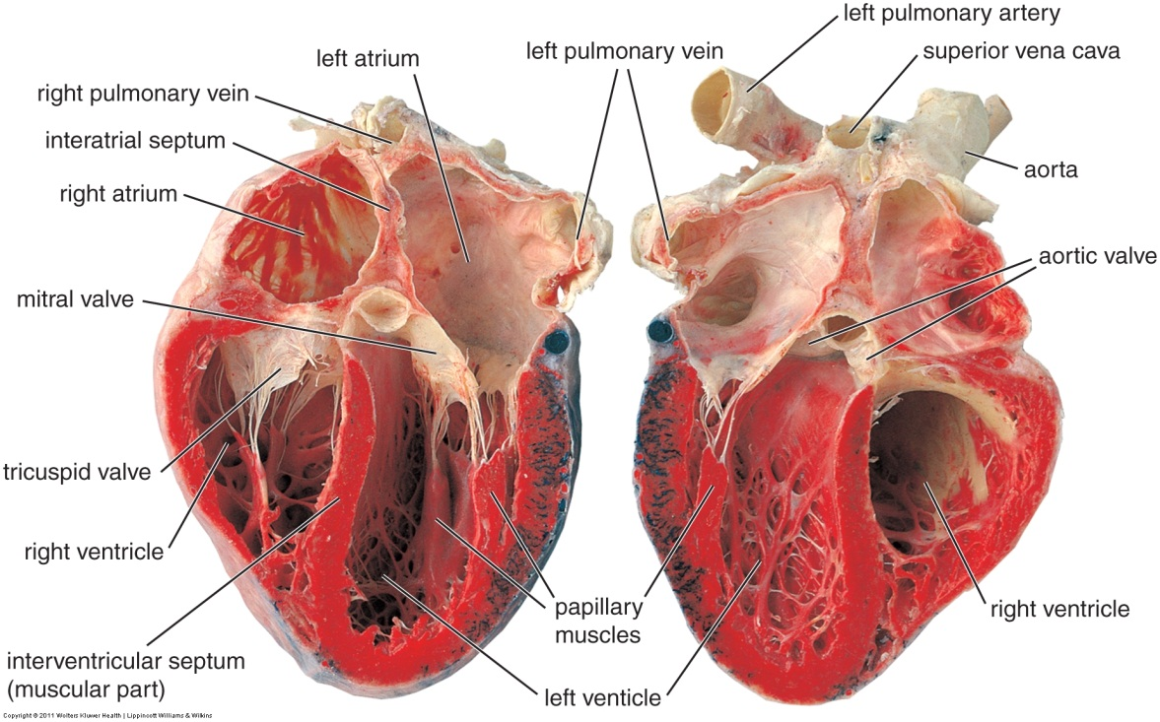
HEart
The heart is an in-line pump for the cardiovascular system, so it is continuous with the veins and arteries that are attached to it (vena cava, pulmonary veins, pulmonary artery, and aorta). As you know, the heart has four chambers; right atrium, left atrium, right ventricle, left ventricle. Atrioventricular valves separate the atria from the ventricles, while semilunar valves separate the ventricles from the pulmonary trunk / aorta.

Slide 12
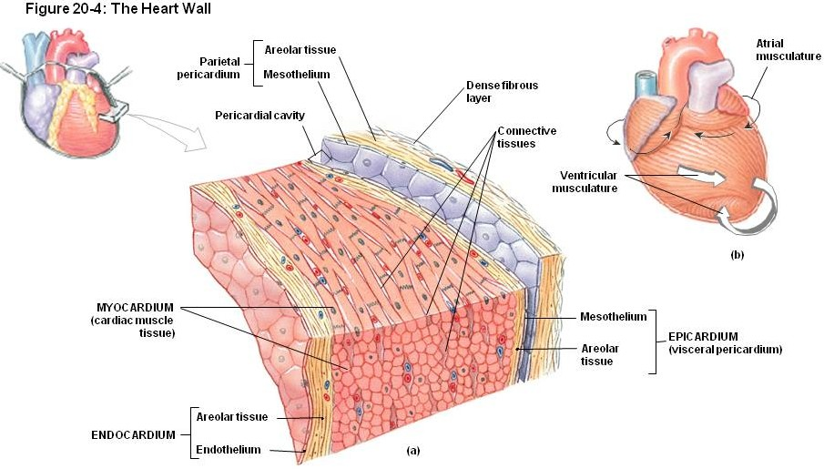
Heart – LAYERS OF THE HEART WALL
Similar to the vessels, the wall of the heart is organized into three layers;
Endocardium – which is a simple squamous endothelium (plus basement membrane) with an underlying subendocardial region consisting of connective tissue, smooth muscle, nerves.
Myocardium – cardiac muscle (with connective tissue elements)
Epicardium – mostly adipose tissue, with an outer visceral pericardium

Slide 13
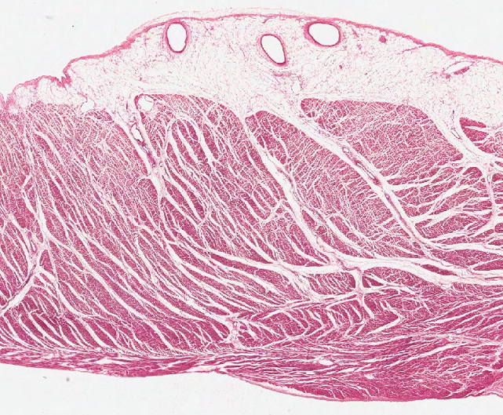
Heart – LAYERS OF THE HEART WALL
In this section through the wall of a ventricle, the lumen and pericardial cavity are indicated.
Endocardium – which is a simple squamous endothelium (plus basement membrane) with an underlying subendocardial region consisting of connective tissue, smooth muscle, nerves.
Myocardium – cardiac muscle (with connective tissue elements)
Epicardium – mostly adipose tissue, with an outer visceral pericardium
Pericardial cavity
Pericardial cavity
endocardium
myocardium
epicardium
Lumen of heart

Slide 14
Heart – LAYERS OF THE HEART WALL
Video of heart wall layers – SL88
Link to SL 088
Be able to identify:
Endocardium
Myocardium
Epicardium

Slide 15
Heart – LAYERS OF THE HEART WALL
In case it’s not obvious, the three layers are found in the walls of the heart. In the atrial and ventricular septa and papillary muscles, only the endocardium and myocardium are present. As we will see, valves have only structures from the endocardium (i.e. endothelium plus connective tissue).

Slide 16
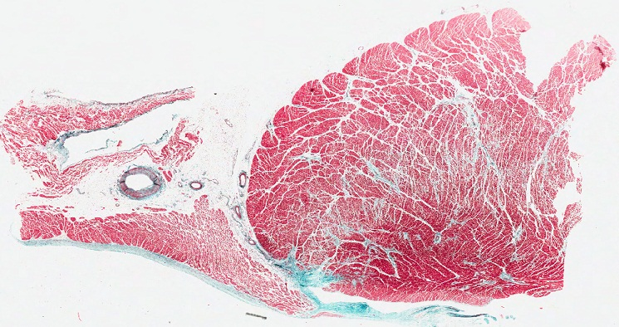
Heart CHambers
The section below is similar to the boxed region in the drawing to the left. The atrium, ventricle, and atrioventricular valve (arrows) are indicated. This slide was stained using a special stain (Trichrome) that is similar to H&E, but also gives connective tissue fibers an “aqua” color. This staining highlights connective tissue in the endocardium and valve.
Note that:
the myocardium in the ventricle is thicker than in the atrium
the endocardium is thicker in the atrium than in the ventricle
there are vessels in the epicardium…these are the coronary arteries and cardiac veins that supply the heart
Pericardial cavity
ventricle
atrium
Lumen of heart

Slide 17
Heart CHambers
Video of atrium and ventricle – SL63
Link to SL 063
Be able to identify:
Atrium
Ventricle
(layers of each chamber)

Slide 18
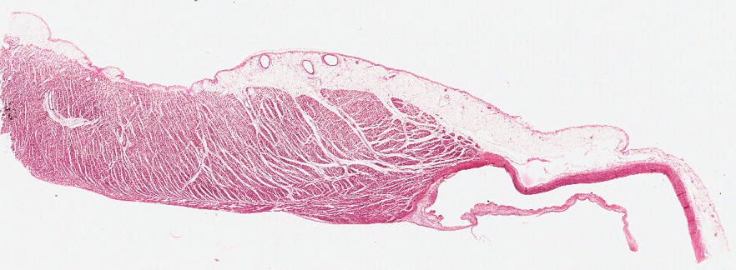
Heart CHambers
The section below is similar to the boxed region in the drawing to the left, so that it includes the wall of the right ventricle and pulmonary artery as indicated, as well as a semilunar valve (arrows).
Actually, the region in the box appears to include the atrial wall and the mitral valve, which are not on the slide. This is because the section is actually a sagittal slice taken of the anterior wall of the ventricle and artery (yellow line in image below).
Pericardial cavity
Right ventricle
Pulmonary artery
Lumen of heart

Slide 19
Heart CHambers
Video of right ventricle and pulmonary artery – SL88
Link to SL 088
Be able to identify:
Ventricle
Elastic artery
(layers of each chamber)

Slide 20
Heart CHambers
In the first heart slide, you identified the atrium, ventricle, and the AV valve, but we didn’t worry about whether this was the left or right side of the heart. (It’s the left, since the ventricular wall is very thick, and there are pulmonary veins near the atrium.) And below, we told you those were structures on the right side, but they could very well have been from the left. Ventricular thickness can help, but that varies, depending on the size of the source of the tissue (mouse, rat, human).
Fortunately, you don’t have to worry about determining side when looking at a histological slice. All we ask is that you identify atrium, ventricle, and their layers. In addition, for the valves, you should be able to distinguish atrioventricular valves from semilunar valves based on the structures that flank the valve. However, you won’t have to be more specific than that. We usually don’t penalize for being too specific, as long as your answer is possible. So if it’s an AV valve, and you call it the tricuspid, it will still be correct (but you better at least say AV valve, or one of the two named AV valves).
All this discussion is related to histological specimens. In the gross anatomy lab, you can and should be more specific, or you will be sorry.

Slide 21
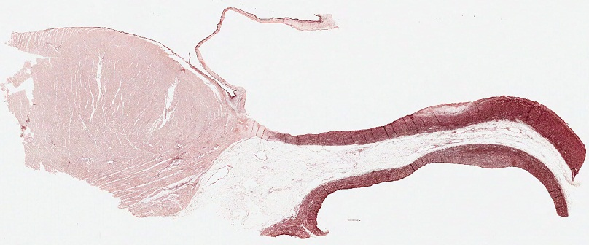
Heart CHambers
The section below is more difficult to visualize. The cut is similar to the yellow dotted line in the drawing, but the line runs posterior to the pulmonary artery. Recall that the aorta passes posterior to the pulmonary artery. This section is through the anterior wall of the left ventricle, aorta, and (aortic) semilunar valve (arrows), but includes the posterior wall of the pulmonary artery, as well as the connective tissue that is shared between these great vessels.
Lumen of heart
Lumen of aorta
Left ventricle
Wall of aorta
Wall of pulmonary artery
Lumen of pulmonary artery
Of course, this could be the right ventricle, with the vessels switched, but again, nothing to worry about.

Slide 22
Heart CHambers
Video of ventricle and two arteries – SL30
Link to SL 030
Be able to identify:
Ventricle
Elastic artery
(layers of each chamber)

Slide 23
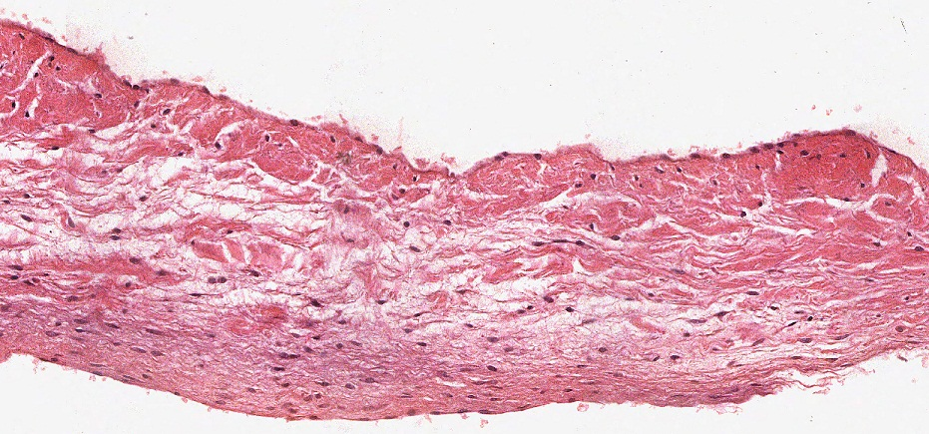
Heart valves and annulus fibrosus
A magnified view of a valve shows that it has a core of connective tissue, covered by endothelial cells (arrows) that are continuous with the endothelium of the chambers.

Slide 24
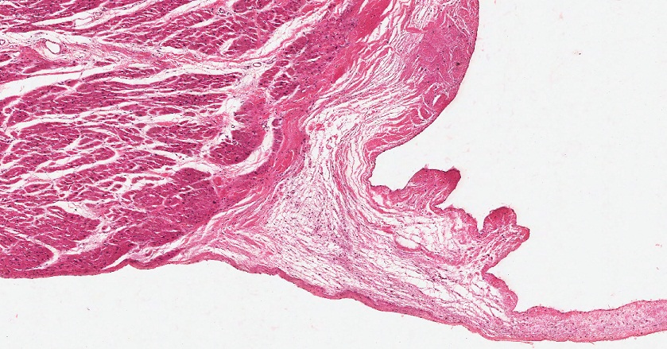
Heart valves and annulus fibrosus
At the base of the valve, there is a thickening of connective tissue called the annulus fibrosus.
We’ll show you the annulus fibrosus on the slides now, followed by a more detailed description of its structure and function.

Slide 25
Heart valves and annulus fibrosus
Video of valves and annulus fibrosus – SL88
Link to SL 088 and SL 063 and SL 030
Be able to identify:
Valve
Annulus fibrosus

Slide 26
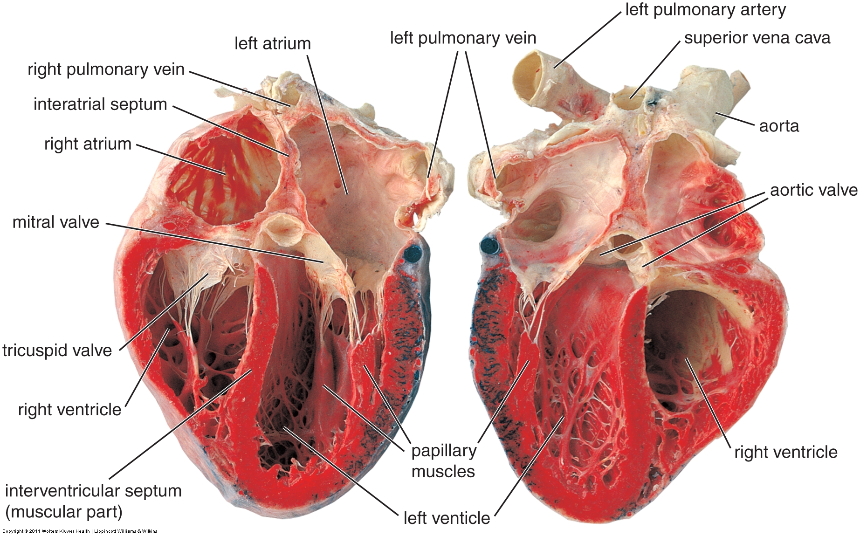
Heart valves and annulus fibrosus
The four valves are in approximately the same plane within the heart. More specifically, it’s the base of the valves that are in this same plane. Note that this is at the level of the coronary (atrioventricular) sulcus.

Slide 27
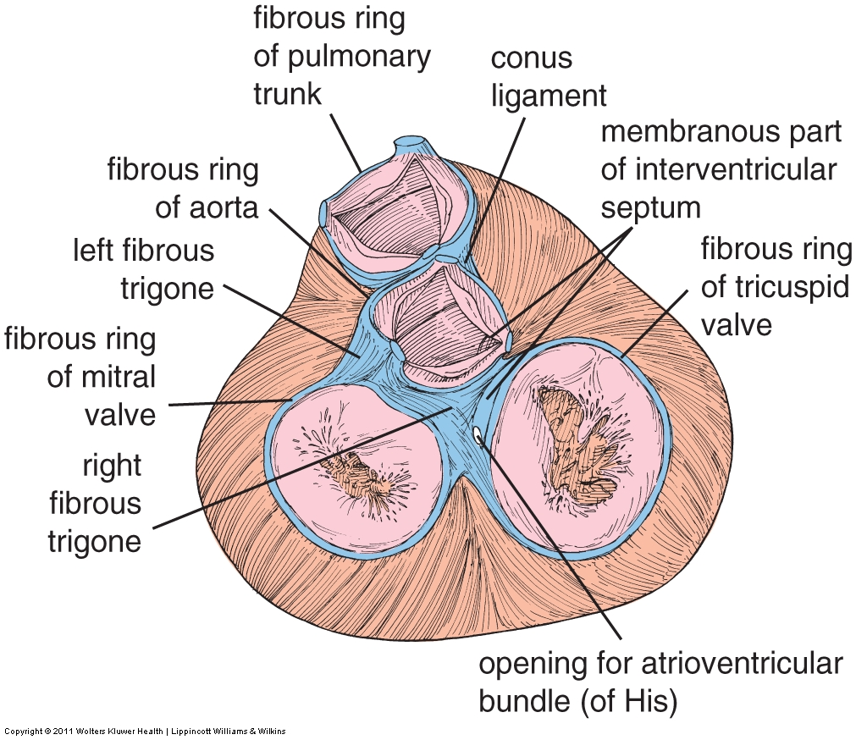
Heart valves and annulus fibrosus
This is a superior view of the heart, with the atria removed. Here, you can verify that the valves are indeed all in the same plane. The base of each valve is a ring, the annulus fibrosus (blue in the drawing). Each ring is connected to adjacent rings (by tissue called “trigones” in the figure), forming a set of four rings and connecting tissues, all composed of dense fibro-elastic connective tissue.
Structurally, the annulus fibrosus and interconnecting fibrous tissues provide a central anchor for the heart valves, as well as to the heart muscle of the atria and ventricles.
Functionally, this dense sheet of connective tissue electrically separates the atria from the ventricles so that they can beat as separate units.

Slide 28
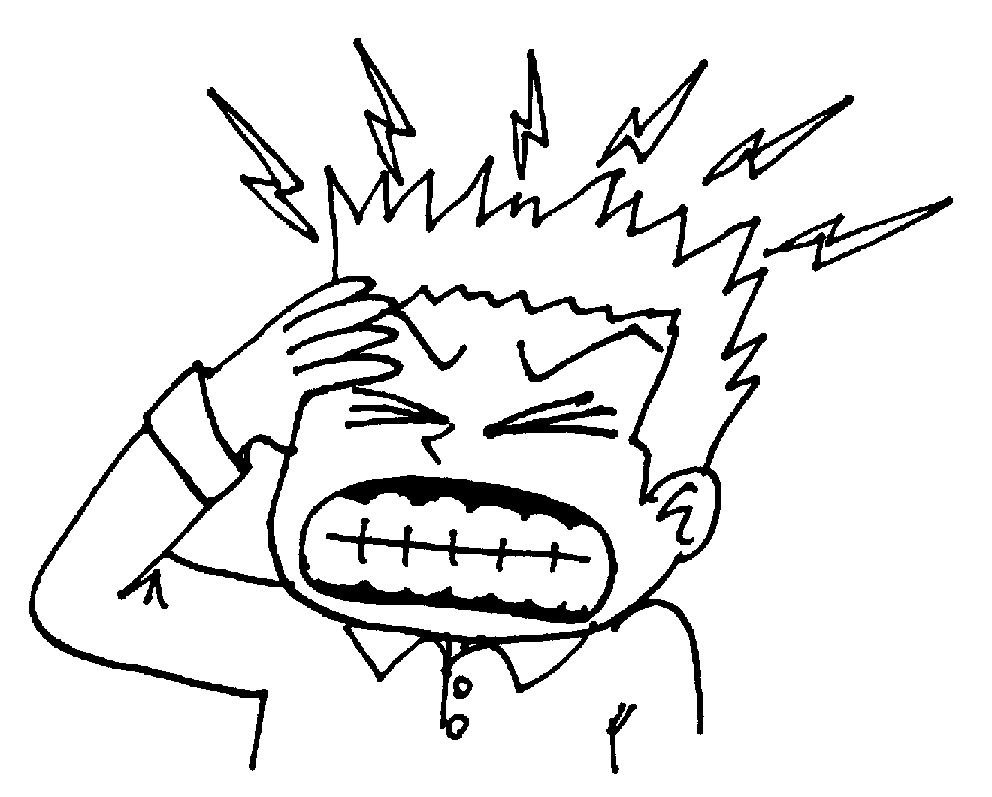
Heart valves and annulus fibrosus
The sections of the heart you have been looking at on your slides that cut through the valve also cut through the annulus as well. Here, the black line is attempting to show this; however, note that the top of the line should be oriented into the screen so that it cuts through the right ventricle, and the bottom portion of the line should be pointing toward you, so as to cut through the valve and pulmonary artery. The star in the histological section reminds you where the annulus is located.
Right ventricle
Pulmonary artery

Slide 29
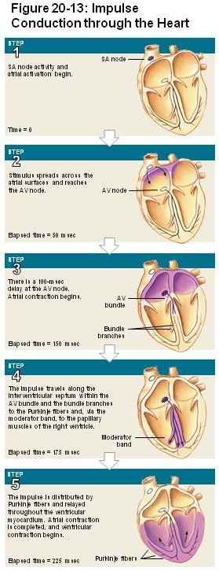
Heart – conducting system
The conducting system of the heart transmits electrical stimuli to cardiac muscle in a systematic fashion to maximize directional pumping of blood.
The stimulus is initiated by the sinoatrial (SA) node near the superior vena cava. Because cardiac muscle cells are connected by gap junctions, the impulse spreads from the SA node through the atria toward the ventricles (purple wave in image to the right). This causes a contraction wave that propels blood through the AV valves. However, this impulse does not pass directly to the ventricles due to the presence of the fibrous tissue of the annulus.
Impulses reach the atrioventricular (AV) node, which passes the impulse through the annulus fibrosus, and down the ventricular septum via the AV bundle and bundle branches, and finally into the remainder of the ventricular wall via Purkinje fibers. In this manner, ventricular contraction spreads as a wave from the apex toward the great arteries, propelling blood superiorly.

Slide 30
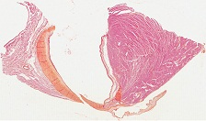
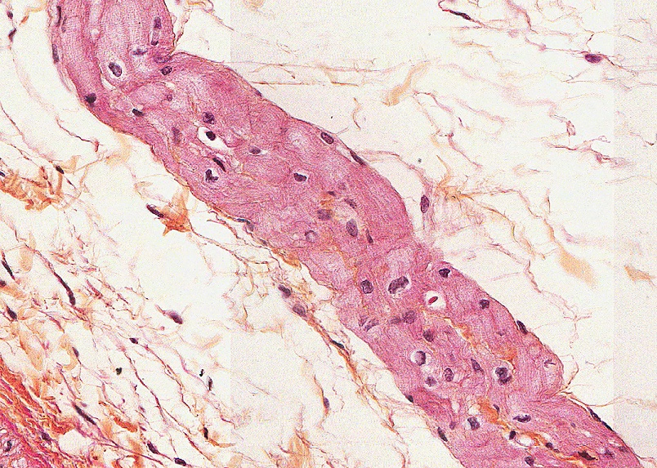
Heart – conducting system
In this slide, don’t worry about orientation or chamber identification. Suffice it to say that the region within the rectangle and shown below is part of the endocardium of a ventricle.
The cells in the outlined region are Purkinje fibers, modified cardiac muscle cells. They are easily identified because they have striations, and the cytoplasm near the nucleus contains glycogen, which washes away during tissue preparation.

Slide 31
Heart – conducting system
Video of Purkinje fibers – SL64
Link to SL 064
Be able to identify:
Purkinje fibers

Slide 32
The next set of slides is a quiz for this module. You should review the structures covered in this module, and try to visualize each of these in light and electron micrographs:
Distinguish, at the light microscope level, each of the following::
Cardiac muscle tissue
Layers
Endocardium
Myocardium
Epicardium
Ventricles
Atria
Valves
Atrioventricular
Semilunar
Annulus fibrosus
Purkinje fibers

Slide 33
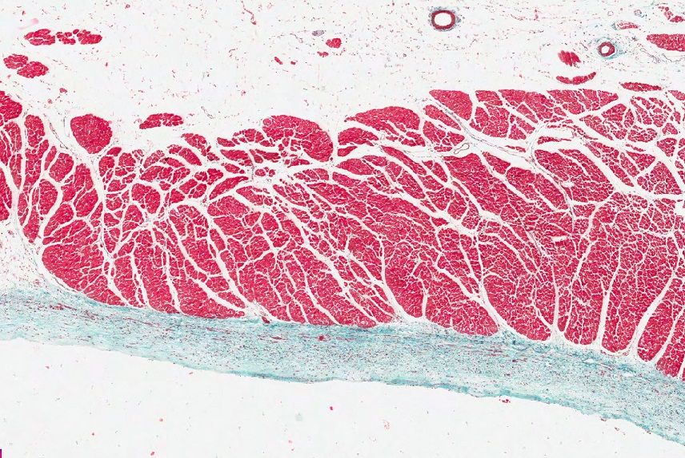
Final quiz
Self-check: Identify the REGION indicated by the bracket (advance slide for answer)
myocardium

Slide 34
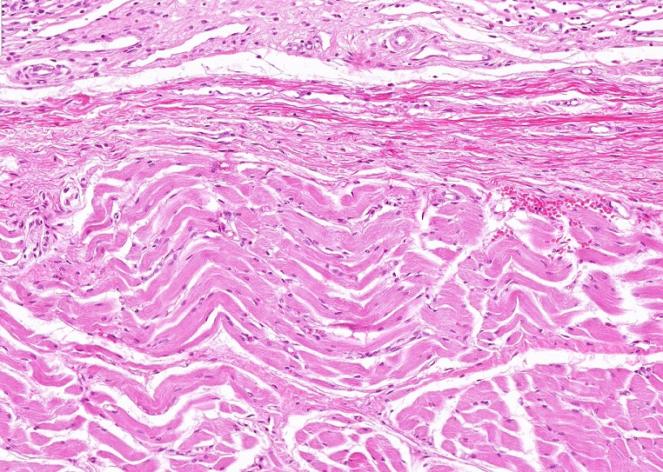
Final quiz
Self-check: Identify the outlined TISSUES. (advance slide for answers)
Dense irregular connective tissue (elastic tissue)
Skeletal muscle

Slide 35
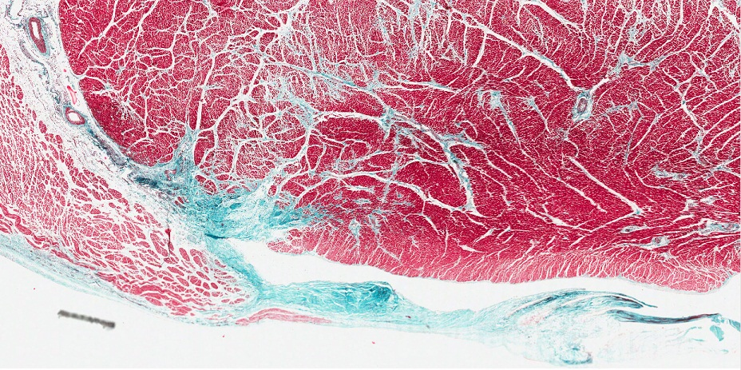
Final quiz
Self-check: Identify the structure indicated by the arrows (advance slide for answer)
Annulus fibrosus

Slide 36
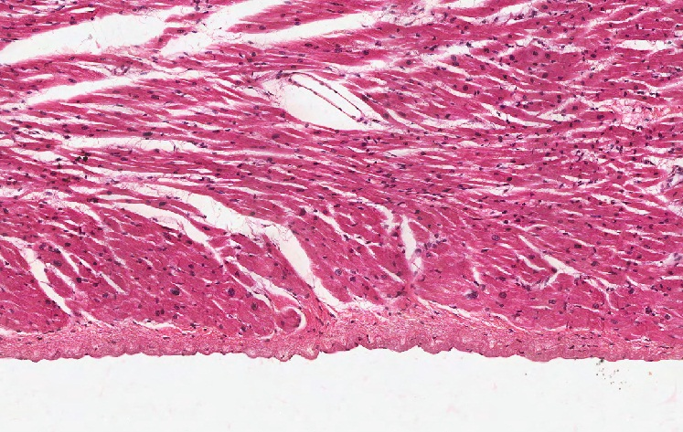
Final quiz
Self-check: Identify the REGION indicated by the bracket (advance slide for answer)
endocardium

Slide 37
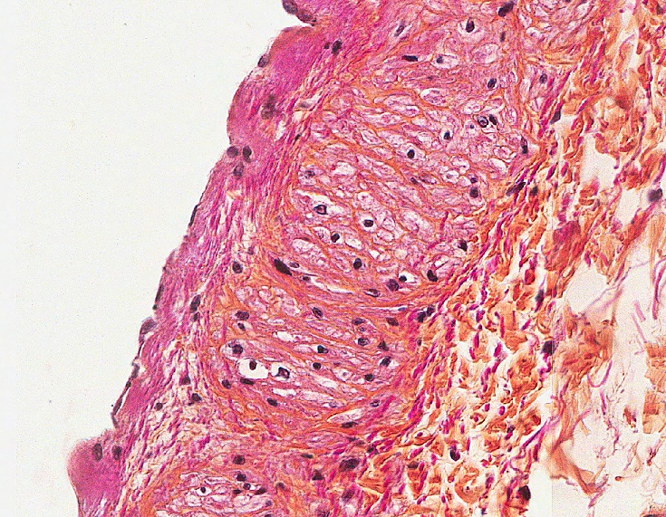
Final quiz
Self-check: Identify the outlined structure (advance slide for answer)
Purkinje fibers

Slide 38
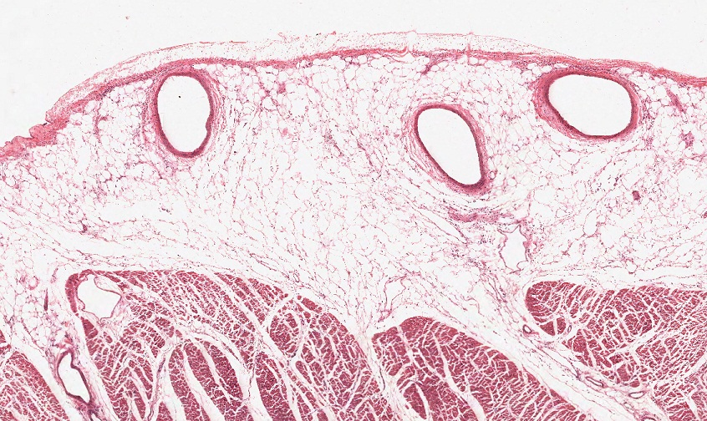
Final quiz
Self-check: Identify the REGION indicated by the bracket (advance slide for answer)
epicardium

Slide 39
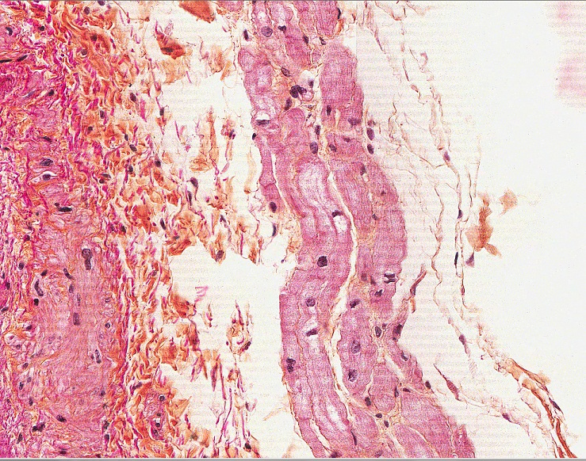
Final quiz
Self-check: Identify the outlined structure (advance slide for answer)
Purkinje fibers

Slide 40
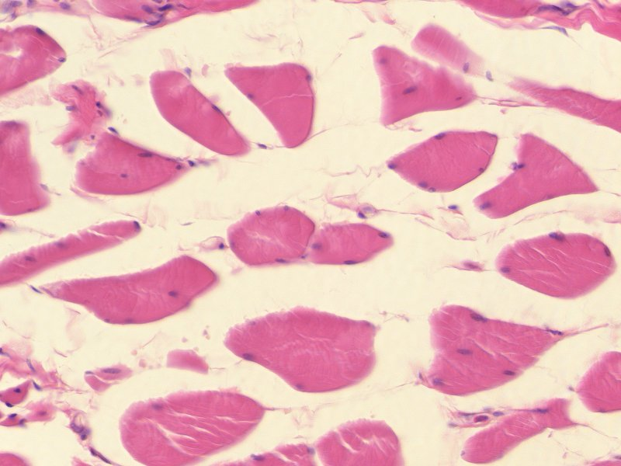
Final quiz
Self-check: Identify the tissue. (advance slide for answers)
skeletal muscle

Slide 41
Final quiz
Self-check: Identify the outlined structure (advance slide for answer)
Atrioventricular valve

Slide 42
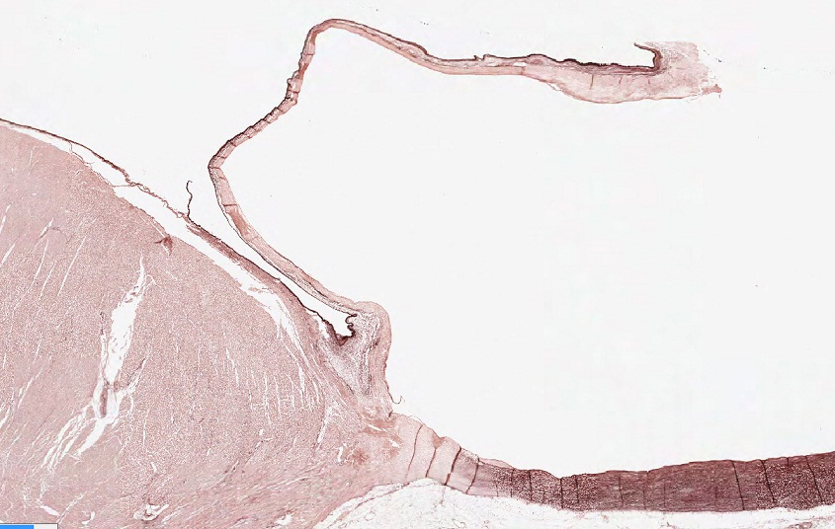
Final quiz
Self-check: Identify the outlined structure (advance slide for answer)
Annulus fibrosus

Slide 43
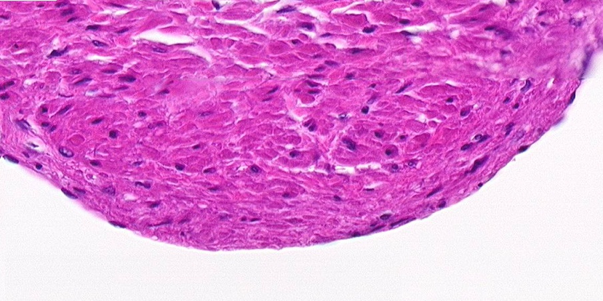
Final quiz
Self-check: Identify the TISSUE in the outlined region. (advance slide for answers)
Smooth muscle

Slide 44
Final quiz
Self-check: Identify the REGION indicated by the bracket (advance slide for answer)
epicardium

Slide 45
Final quiz
Self-check: Identify the structure indicated by the arrows (advance slide for answer)
Semilunar valve

Slide 46
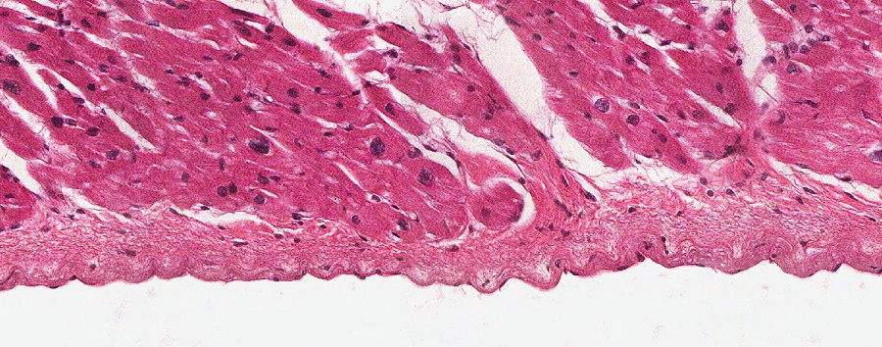
Final quiz
Self-check: Identify the CELLS indicated by the arrows (advance slide for answer)
Endothelial cells

Slide 47
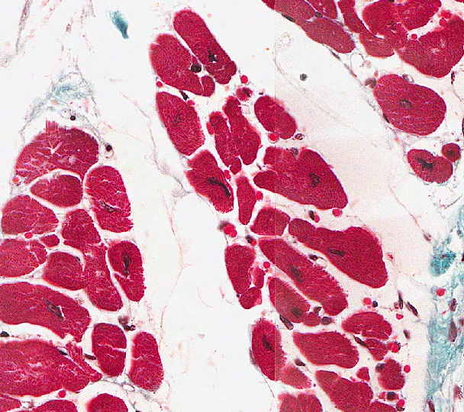
Final quiz
Self-check: Identify the predominant TISSUE on this slide (advance slide for answer)
Cardiac muscle

Slide 48
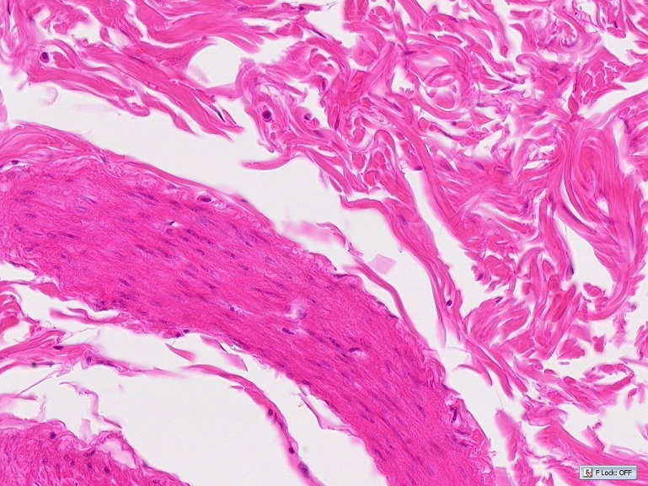
Final quiz
Self-check: Identify the outlined TISSUES. (advance slide for answers)
Dense irregular connective tissue
Smooth muscle

Slide 49
Final quiz
Self-check: Identify the REGION indicated by the bracket (advance slide for answer)
endocardium

