Slide 1
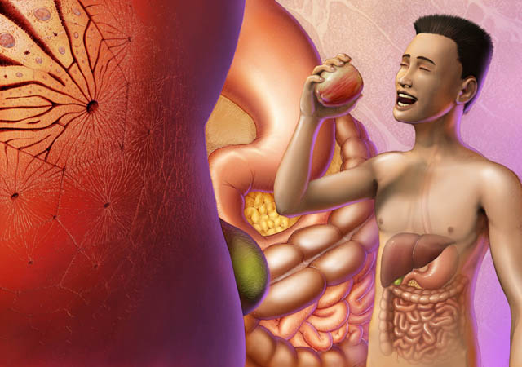
Overview of the Gastrointestinal System
Digital Laboratory
It’s best to view this in Slide Show mode, especially for the quizzes.
This module will take approximately 60 minutes to complete.

Slide 2
After completing this exercise, you should be able to:
Describe the general organization of the gastrointestinal system
Main pathway
Accessory organs
Distinguish, at the light microscope level, each of the following:
Layers of the gastrointestinal tract
Mucosa
Epithelium
Lamina propria
Muscularis mucosa
Submucosa
Muscularis
Inner circular layer
Outer longitudinal layer
Adventitia / serosa
Elaborations of the gastrointestinal tract that increase surface area
Plica
Villi
Microvilli (brush border)
Neural and endocrine structures of the gastrointestinal tract
Enteric nervous system
Myenteric plexus
Submucosal plexus
Enteroendocrine cells (with special staining)
Distinguish, at the electron microscope level, each of the following:
Enteroendocrine cells

Slide 3
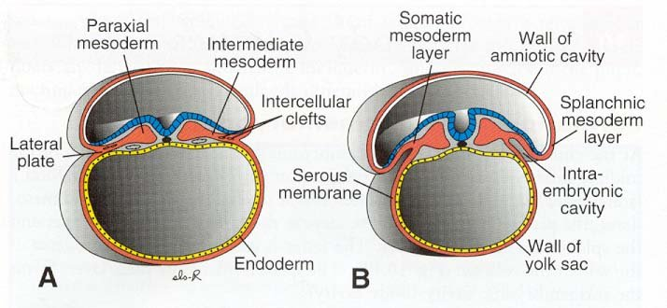
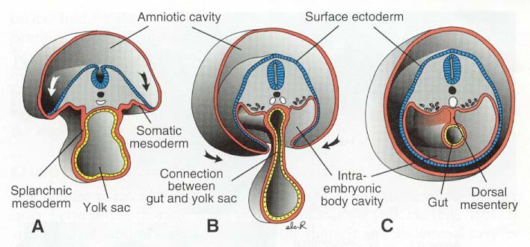
ORGANIZATION OF THE GASTROINTESTINAL SYSTEM
In order to understand the gastrointestinal system, we need to briefly review embryology.
Fortunately, we don’t have to think too hard here. The only tissues we have to worry about here are the intraembryonic endoderm (black arrows), the splanchnic mesoderm, and the intraembryonic coelom (and maybe the dorsal mesentery).
Give yourself a moment to recall that during embryonic folding, the gut tube forms by “rolling up” of the endoderm and splanchnic mesoderm. We’ll hit this again in a later embryology lecture.

Slide 4
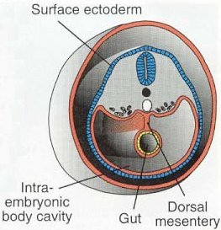
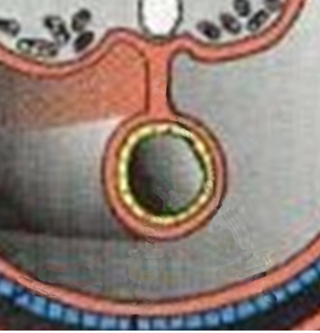
ORGANIZATION OF THE GASTROINTESTINAL SYSTEM
So the gut tube is just that, a tube, with a space in the middle called the lumen where Big Macs and curly fries go to die.
--The endoderm (yellow) consists of epithelial cells. The type of epithelium varies in different parts of the tube.
--Splanchnic mesoderm actually forms two tissues:
--the bulk is mesenchyme, which is embryonic connective tissue that will form connective tissue, vessels, smooth muscle
--the outer region is a mesothelium (epithelium derived from mesoderm)..usually this is simple squamous, and provides a slick surface for peristalsis (movement)
lumen
FYI….The inner lining of the body wall is also a mesothelium.

Slide 5
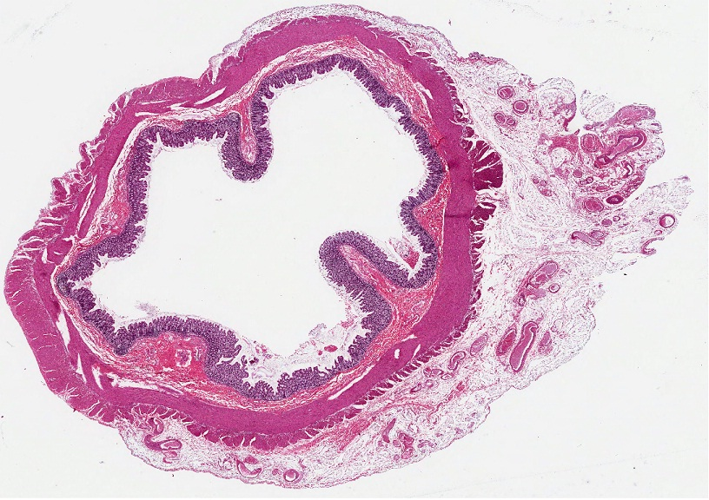
ORGANIZATION OF THE GASTROINTESTINAL SYSTEM
A look at the real thing in cross-section…
Mesothelium (from splanchnic mesoderm) lines the outside of the tube – touches peritoneal fluid
Epithelium (from endoderm) lines the inside of the tube – touches Big Macs and your digestive juices
(almost) everything between the epithelial layers is derived from mesenchyme (splanchnic mesoderm) and is indicated by the brackets –this is connective tissue, smooth muscle, vessels
lumen

Slide 6
ORGANIZATION OF THE GASTROINTESTINAL SYSTEM
Video of colon showing basic origin of GI tissues– SL53
Link to SL 053
Be able to identify:
Nothing really, just get the general scheme

Slide 7
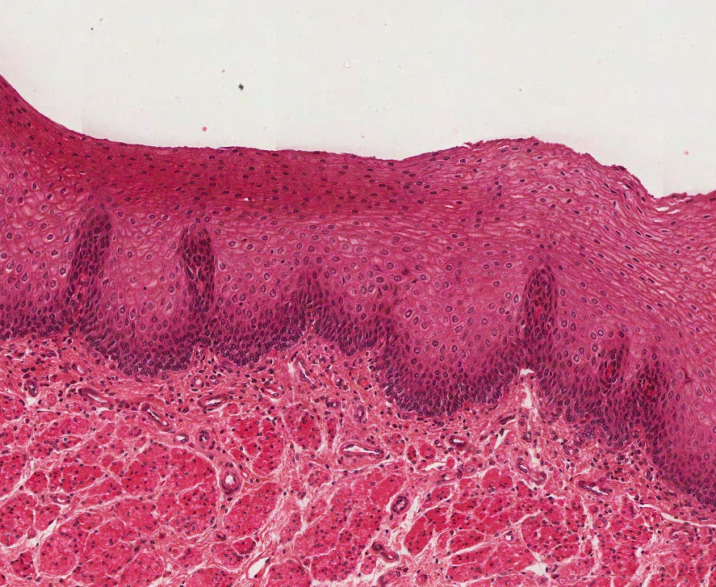
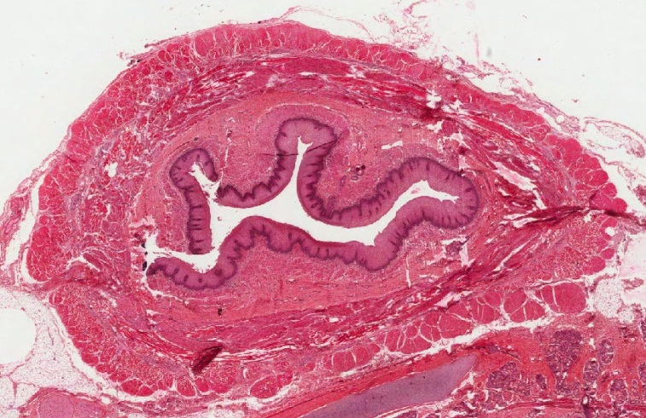
ORGANIZATION OF THE GASTROINTESTINAL SYSTEM
A couple things here…
As was mentioned in the previous video, the border between the epithelium and underlying connective tissue (i.e. the basement membrane) undulates extensively in the colon. However, here in the esophagus, it is very easily seen, and is indicated by the dotted line.
lumen
Please tell me that you immediately recognize the epithelium above the dotted line, and the connective tissue (and smooth muscle) below it. If you don’t, hate to say it, but you need to take Fundamentals again.

Slide 8
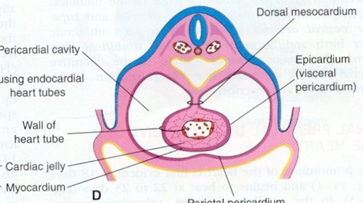
ORGANIZATION OF THE GASTROINTESTINAL SYSTEM
A couple things here…
esophagus
The esophagus and other parts of the gut tube we will mention later are not suspended by dorsal mesentery, but are embedded in the dorsal body wall. Therefore, these regions of the gut tube are not covered by a mesothelum on their outer surface.
lumen
This will have ramifications later when we identify the layers of the gut tube.

Slide 9
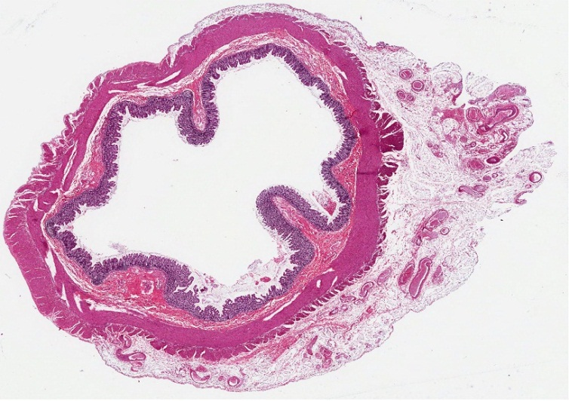
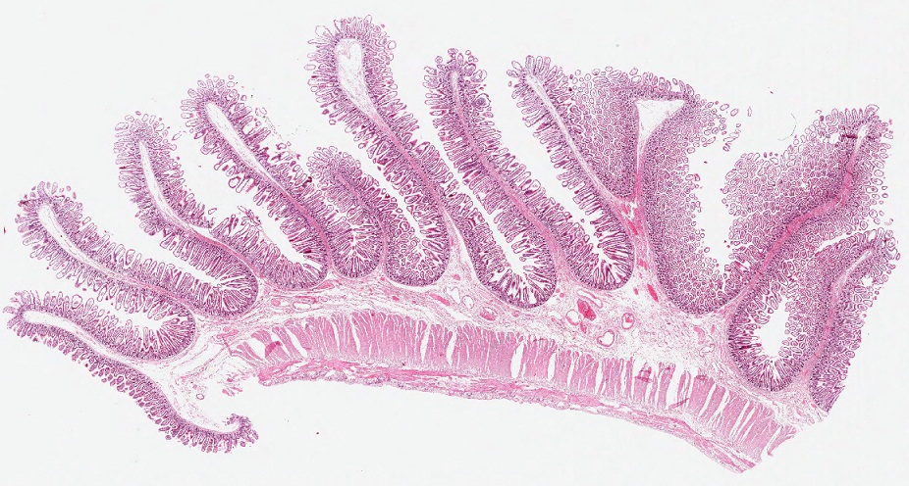
ORGANIZATION OF THE GASTROINTESTINAL SYSTEM
A couple things here…
Lumen is here
Lumen is here
You will be seeing some slides with only one “wall” of the GI tract, similar to the one on the top right. It’s easy to think of these sections as simply being a portion of the cross sectional slides, similar to the region in the dashed boxes in the upper left and lower right images. However, keep in mind that these could very well be longitudinal sections similar to the cut that would be made by the red line to the right. In fact, the upper right image is just such a section. We’ll explain later in the module how to tell the difference.
lumen

Slide 10
ORGANIZATION OF THE GASTROINTESTINAL SYSTEM
A couple things here…
lumen
The “looped” structure is the dorsal mesentery, which is connected to the dorsal body wall and, therefore, is a region where the tube is NOT covered by mesothelium because the mesothelium is reflected onto the dorsal body wall to become parietal peritoneum (the mesothelial reflection is represented by the blue arrows).
This will make more sense as you dissect and get some embryology under your belt.
If this hurts too much, forget it for now, but come back to it later in the block.

Slide 11
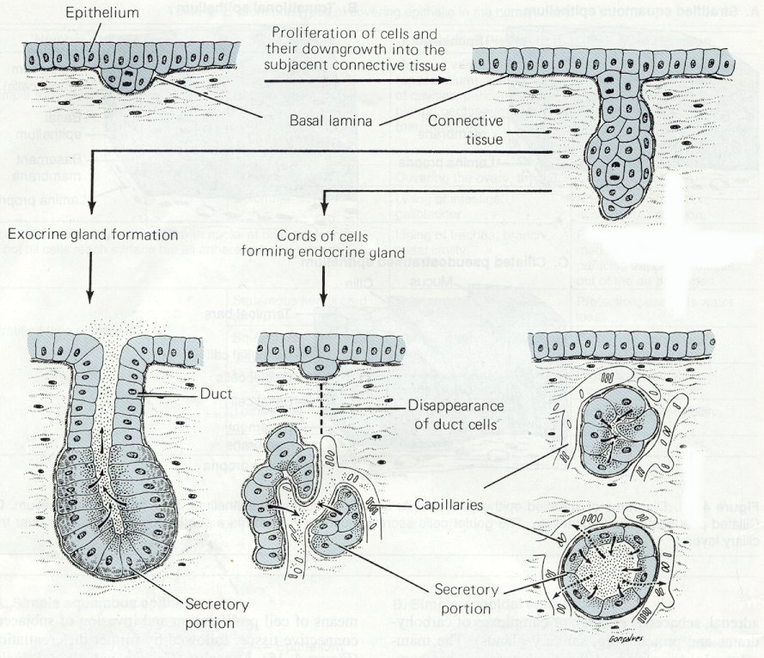
GLANDS OF THE GASTROINTESTINAL SYSTEM
Glands in the body develop through an interaction of an epithelium and underlying connective tissue. The epithelial cells that line the surface of the body (e.g. epidermis of skin, inner lining of the gut) proliferate, and then invaginate into the underlying connective tissue. Note the basement membrane invaginates with the epithelium. From here, two things can happen:
For exocrine gland formation, a lumen develops, and secretory cells secrete their substances out their apical side (arrows, left drawing).
For endocrine glands, the secretory cells lose their connection to the original epithelium, forming clusters of cells that secrete product out their basal side (arrows, middle drawing), across the basement membrane, and into the bloodstream.

Slide 12
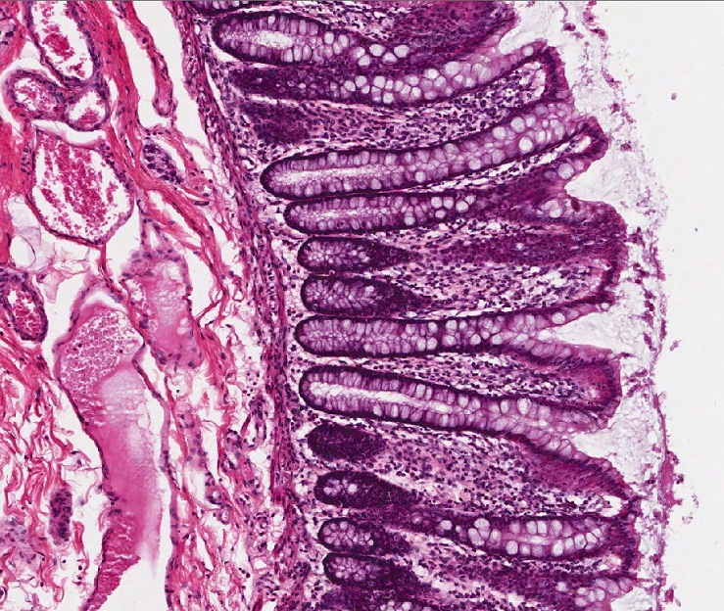
GLANDS OF THE GASTROINTESTINAL SYSTEM
The epithelium of the digestive tract often forms simple glands in which the surface epithelial cells invaginate into the underlying connective tissue. Where present, there are usually a ton of these glands, which obscures the structure a little bit. However, if you look around, you can isolate a place where you can see the overall glandular structure.
Colonic glands are simple tubular; one is outlined by the rectangle. Here, you can easily follow the surface epithelial cells into the underlying connective tissue and back up to the surface (see next slide if confused). Neighboring glands are not bad either, and show different perspectives.
Lumen is here
The colon has tons of goblet cells (quite a useful thing).
Also, note the connective tissue is very cellular; most of these are white blood cells protecting against intestinal bacteria and Big Mac bugs.

Slide 13
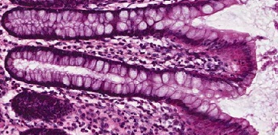
GLANDS OF THE GASTROINTESTINAL SYSTEM
Here I made our featured gland really big, and then labeled epithelial cells with numbers so you can follow a single layer of epithelial cells “down” (1-3), to the bottom of the gland (4) and back “up” to the surface (5-7), where it will continue back down to form the adjacent gland.
The dark purple line is the basement membrane (orange arrows), which follows the epithelium faithfully, separating it from the underlying connective tissue.
Lumen is here
7
4
5
3
6
2
7
Lumen is here
1
If you already “got” this concept, sorry, just have to make sure everyone is up to speed with this.

Slide 14
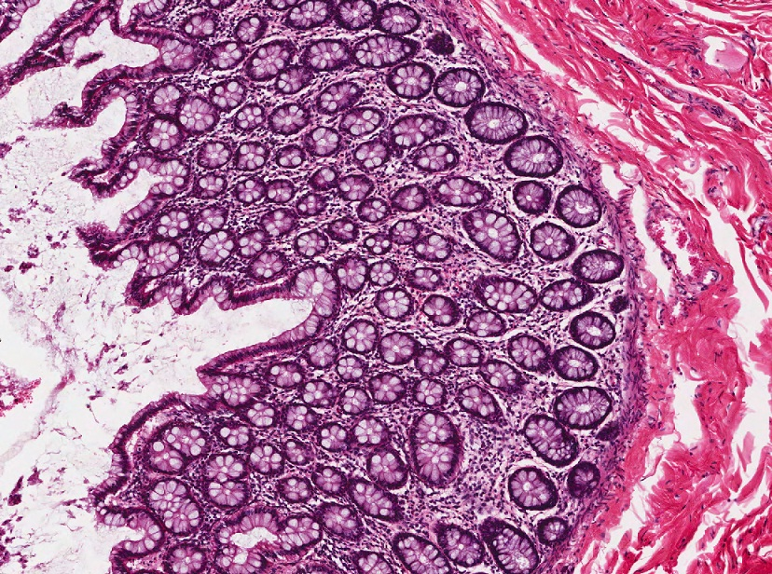
GLANDS OF THE GASTROINTESTINAL SYSTEM
In this region, the glands are cut more in cross section. You can see the lumen of many of them (yellow arrows). Orange arrows indicate the basement membrane.
Lumen is here

Slide 15
GLANDS OF THE GASTROINTESTINAL SYSTEM
Video of colon showing basic GI glands - SL53
Link to SL 053
Be able to identify:
Simple tubular glands

Slide 16
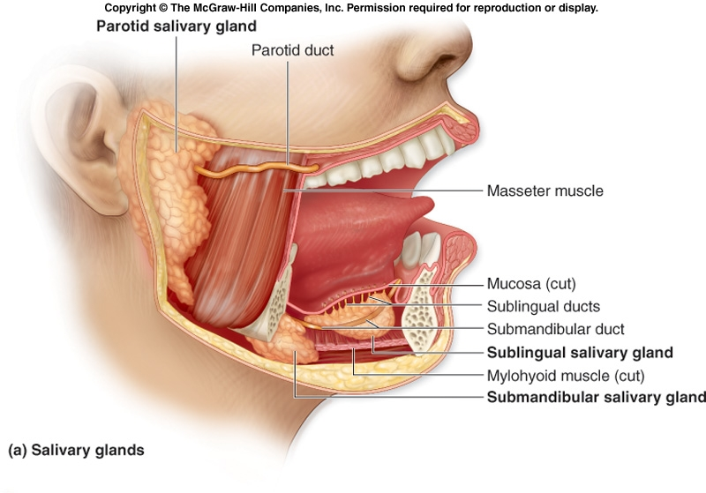
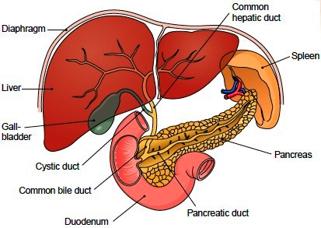
GLANDS OF THE GASTROINTESTINAL SYSTEM
The depth of invagination of the epithelial cells varies. Some glands are shorter, as in the colon, while others grow into the deeper regions of the digestive tract wall. Still others grow out from the wall of the digestive tract to form separate organs, as is the case with the salivary glands, liver and gall bladder, and pancreas. For the most part, these organs are large expansions of epithelial cells, supported by connective tissue, and are connected to the main digestive tract by ducts. More on these in later modules.
Way.
So, the liver is a giant gland??? No way.

Slide 17
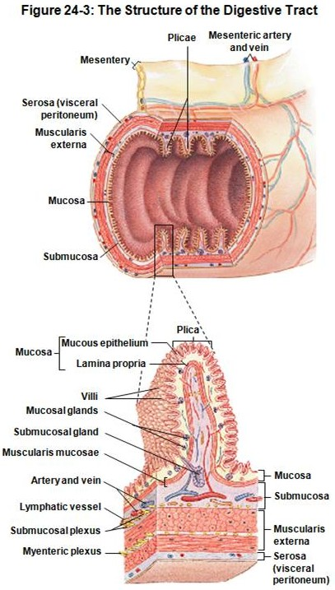
BASIC STRUCTURE OF THE GASTROINTESTINAL TRACT
The wall of digestive tract in most regions is composed of 4 layers:
Mucosa
Epithelium – exact type varies depending on location
Lamina propria – loose connective tissue with vessels, nerves, lymphatics, glands
Muscularis mucosa – smooth muscle
Submucosa – denser connective tissue with larger vessels, nerves, lymphatics, glands
Muscularis externa – composed of smooth or skeletal muscle:
inner circular layer
outer longitudinal layer
Serosa (if intraperitoneal, i.e. suspended by dorsal mesentery) or adventitia (if retroperitoneal, i.e. in the dorsal body wall)

Slide 18
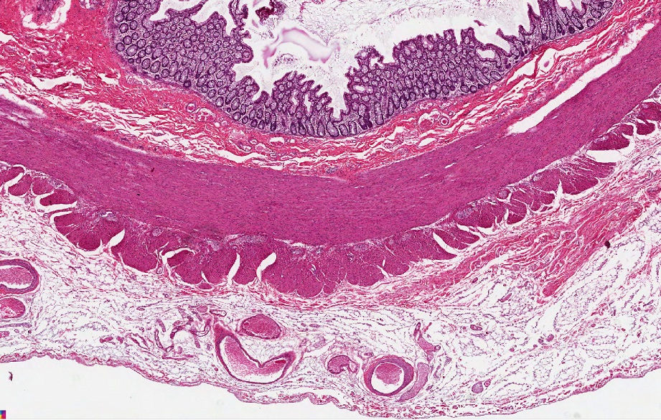
BASIC STRUCTURE OF THE GASTROINTESTINAL TRACT
The wall of digestive tract in most regions is composed of 4 layers:
Mucosa (black bracket)
Epithelium – exact type varies depending on location
Lamina propria – loose connective tissue with vessels, nerves, lymphatics, glands
Muscularis mucosa – thin smooth muscle
Submucosa (blue bracket) – denser connective tissue with larger vessels, nerves (mostly parasympathetic), lymphatics, glands
Muscularis externa (green bracket) – composed of thick smooth or skeletal muscle:
inner circular layer
outer longitudinal layer
Serosa (red bracket ) (if intraperitoneal, i.e. suspended by dorsal mesentery) or adventitia (if retroperitoneal, i.e. in the dorsal body wall)
Look above. Same text, but added identifiers for each region (i.e. black bracket, blue bracket, etc.)

Slide 19
BASIC STRUCTURE OF THE GASTROINTESTINAL TRACT
Video of colon showing basic GI structure - SL53
Link to SL 053
Be able to identify:
Mucosa
Submucosa
Muscularis externa
Adventitia / serosa

Slide 20
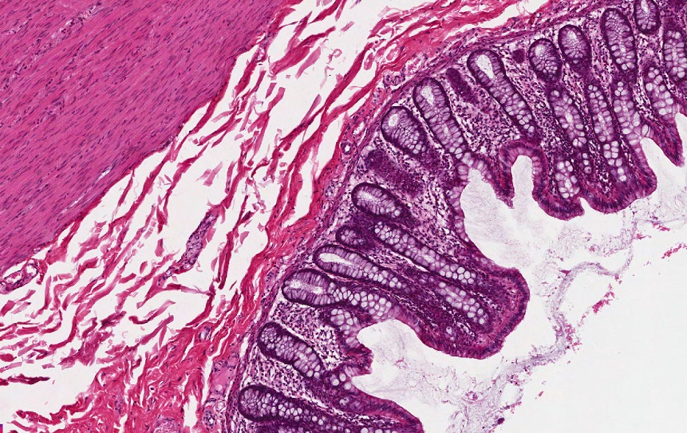
BASIC STRUCTURE OF THE GASTROINTESTINAL TRACT
Focusing on the two innermost layers, look for the muscularis mucosa (yellow arrows), a thin layer of smooth muscle that separates the mucosa (black bracket) from the submucosa (blue bracket).
Not much more to say about these two layers than hasn’t already been said:
--the mucosa is an epithelium, underlying connective tissue (i.e. lamina propria), and the muscularis mucosa
--the submucosa is denser connective tissue
Note the lamina propria and submucosa are loaded with vessels, lymphatics, and nerves.

Slide 21
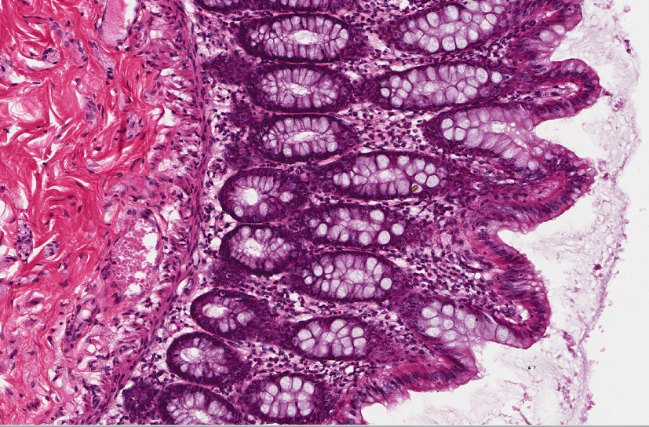
BASIC STRUCTURE OF THE GASTROINTESTINAL TRACT
Just making sure….
submucosa
epithelium
epithelium
epithelium
Lamina propria
epithelium
This fuzz is just stuff stuck on the gut wall – ignore it.
The muscularis mucosa (yellow arrows) is a very thin layer of smooth muscle in most places. As you’ll see, it doesn’t work very hard. It’s job is to make the villi in the intestine move a little. Pretty pathetic.
(BTW, the esophagus has a thick muscularis mucosa, but don’t think about that now.)

Slide 22
BASIC STRUCTURE OF THE GASTROINTESTINAL TRACT
Video of colon showing the mucosa and submucosa - SL53
Link to SL 053
Be able to identify:
Mucosa
Epithelium
Lamina propria
Muscularis mucosa
Submucosa

Slide 23
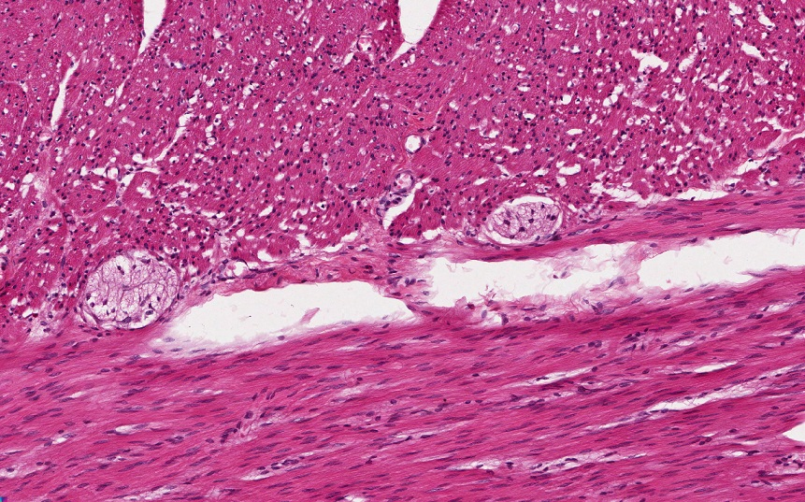
BASIC STRUCTURE OF THE GASTROINTESTINAL TRACT
Focusing on the muscularis externa, you can see that it is very thick muscle. It is usually smooth muscle (stomach, intestines), but is skeletal muscle in the very upper portion of the gastrointestinal tract (pharynx, upper esophagus).
The muscularis externa has two portions:
--an inner circular layer, the muscle cells are oriented so that they “wrap around” the tube
--an outer longitudinal layer, the muscle cells are in the same orientation as the tube
The structures circled in black are autonomic ganglia. More on those later.
Outer longitudinal layer
Inner circular layer

Slide 24
BASIC STRUCTURE OF THE GASTROINTESTINAL TRACT
Video of colon showing the muscularis externa - SL53
Link to SL 053
Be able to identify:
Muscularis externa
Inner circular layer
Outer longitudinal layer
Autonomic plexus

Slide 25
BASIC STRUCTURE OF THE GASTROINTESTINAL TRACT
So, in a cross-section of the gut as shown here, the inner circular layer of smooth muscle shows a longitudinal view of the smooth muscle cells, while the outer longitudinal layer shows smooth muscle cells cut in cross section.
Outer longitudinal layer
Inner circular layer

Slide 26
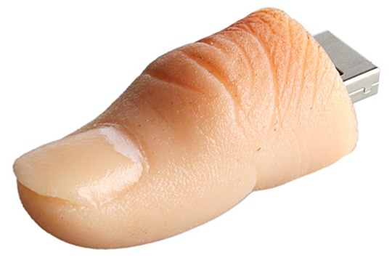
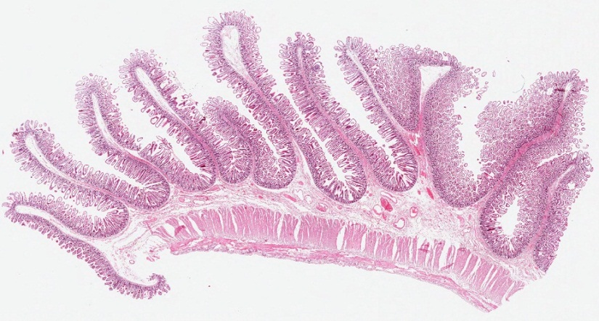
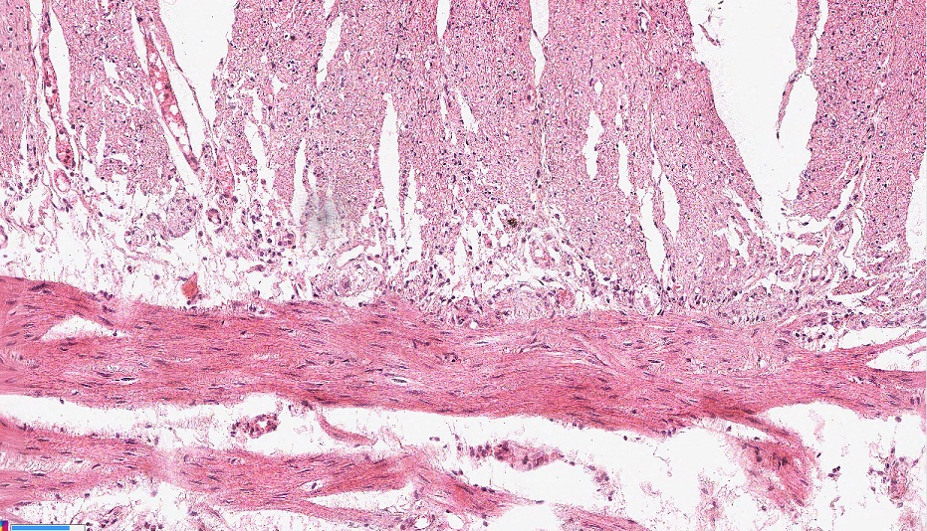
BASIC STRUCTURE OF THE GASTROINTESTINAL TRACT
And, in our intestine cut longitudinally, the inner circular layer is cut in cross section, and the outer longitudinal layer is cut longitudinally.
So, now you know how to tell whether a specimen of the GI system is a longitudinal section or a cross section of a gut tube. Bet that was worth a year’s tuition.
Food goes this way
Rule of thumb…
The orientation of the section taken from the gut is the same as the orientation of the outer longitudinal layer of the muscularis externa in that section.
Inner circular layer
Outer longitudinal layer

Slide 27
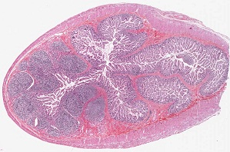
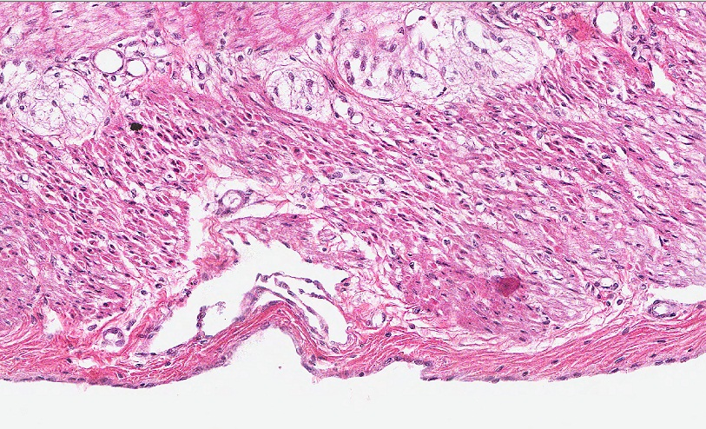
BASIC STRUCTURE OF THE GASTROINTESTINAL TRACT
And, finally, the outer layer is either an adventitia or serosa depending on whether it includes a mesothelial layer.
--adventitia is just connective tissue
--serosa is connective tissue covered by mesothelium
Don’t make it more complicated than it is; it’s really that easy.
Inner circular layer
Outer longitudinal layer
Here, the outer layer of this portion of the gut tube (red bracket) is covered by a simple squamous mesothelium (black arrows), so it is a serosa. This portion of the intestine is suspended from the dorsal body wall by a mesentery.

Slide 28
BASIC STRUCTURE OF THE GASTROINTESTINAL TRACT
Video of ilium showing the serosa – SL11
Link to SL 011
Be able to identify:
serosa

Slide 29
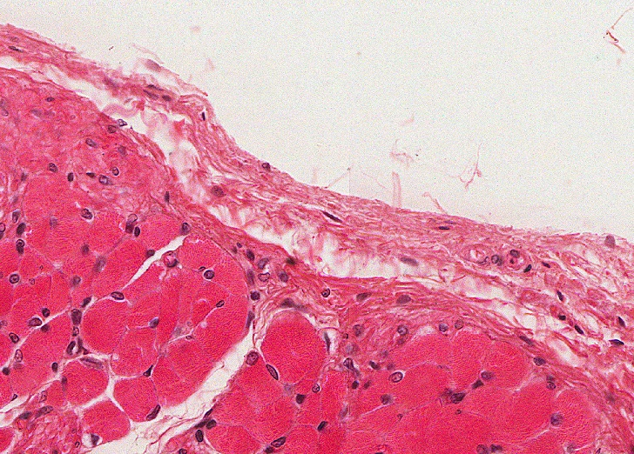
BASIC STRUCTURE OF THE GASTROINTESTINAL TRACT
esophagus
The esophagus and other parts of the gut tube we will mention later are not suspended by dorsal mesentery, but are embedded with the dorsal body wall. Therefore, these regions of the gut tube are not covered by a mesothelium on their outer surface, so their outer surface is an adventitia (red bracket).
lumen
Outer longitudinal layer (yep, skeletal muscle here)

Slide 30
BASIC STRUCTURE OF THE GASTROINTESTINAL TRACT
Video of esophagus showing the adventitia – SL15A
Link to SL 015A
Be able to identify:
adventitia

Slide 31
BASIC STRUCTURE OF THE GASTROINTESTINAL TRACT
One final note about adventitia / serosa. In many cases, the mesothelium of a serosa will not be well preserved, or the connective tissue of an adventitia might look pretty smooth like it is covered with epithelium. I just showed you perfect examples.
Don’t get too bent out of shape about this. It’s really not that critical. We are pointing out the differences because:
--you will hear and read about these terms
--it helps understand the gross anatomy and embryology of the GI tract (intraperitoneal vs. retroperitoneal)

Slide 32
SURFACE MODIFICATIONS OF THE GASTROINTESTINAL TRACT
The primary function of the intestinal tract is to break down organic molecules in the lumen, and to absorb these products of digestion, as well as vitamins, minerals, electrolytes, and water. A large surface area is necessary to accomplish this task. The site of these processes is the apical membrane of the epithelial cells of the mucosal surface.
Increase in surface area is most elaborate in the small intestine, and occurs at three levels:
Plica circularis – gross level
Villi – microscopic level
Microvilli – cellular level
Organs of the tract that are not involved in digestion or absorption, such as the esophagus, do not require such an elaborate mucosal morphology.

Slide 33
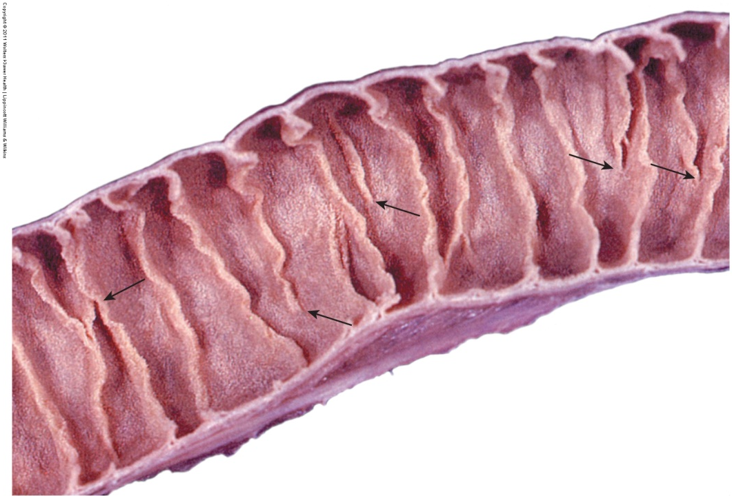
SURFACE MODIFICATIONS OF THE GASTROINTESTINAL TRACT
Increase in surface area is most elaborate in the small intestine, and is at three levels:
Plica circularis – gross level
Villi – microscopic level
Microvilli – cellular level
Plica circulares (aka valves of Kerckring) are circular folds that extend about 1/2 to 2/3 the way around the inner surface of the intestine. The black arrows indicate places where the folds end.
The small intestine does not stretch like the stomach; so these folds are permanent.
As you can see, grossly the plica circulares are visible, but fairly small. In the histology world, these are BIG structures (one is outlined to the right).

Slide 34
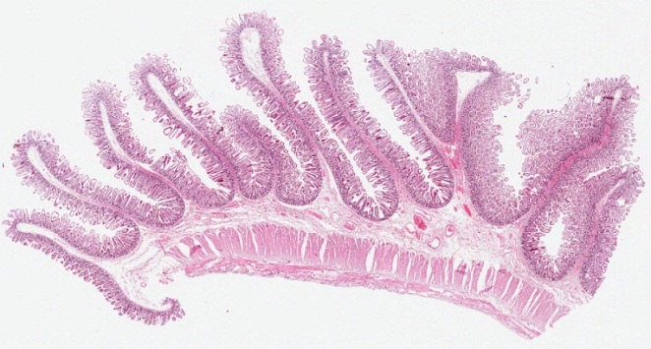
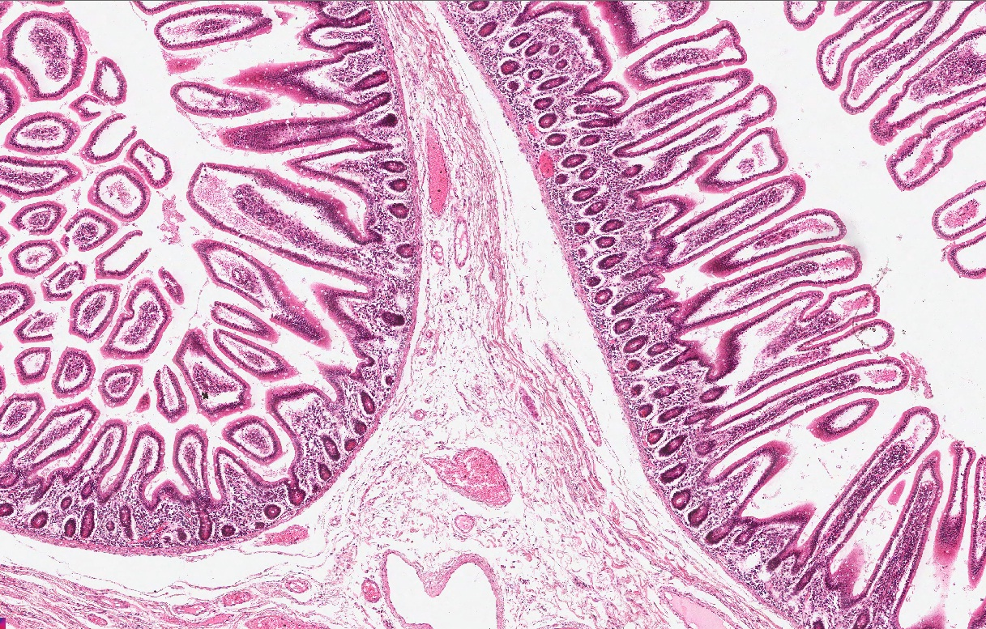
SURFACE MODIFICATIONS OF THE GASTROINTESTINAL TRACT
Increase in surface area is most elaborate in the small intestine, and is at three levels:
Plica circularis – gross level
Villi – microscopic level
Microvilli – cellular level
Closer examination shows that, histologically, the plica are large undulations of the mucosa. Here, you can see the muscularis mucosa (arrows) following the lamina propria faithfully into the plica and back down. The core of a plica is connective tissue of the submucosa.

Slide 35
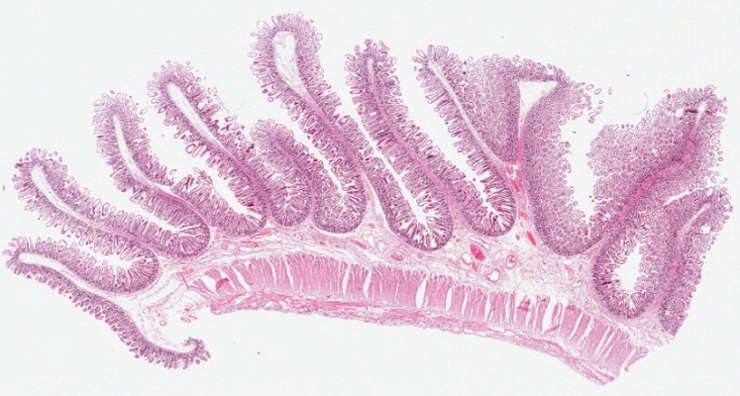
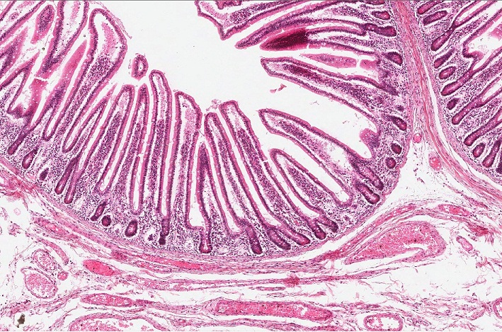
SURFACE MODIFICATIONS OF THE GASTROINTESTINAL TRACT
Increase in surface area is most elaborate in the small intestine, and is at three levels:
Plica circularis – gross level
Villi – microscopic level
Microvilli – cellular level
Villi (one is outlined in brown) are undulations of the mucosa, and contain a core of lamina propria covered by epithelial cells.
For the sake of completion, a gland is outlined in green. Glands project downward into the lamina propria from the base of the villi.

Slide 36
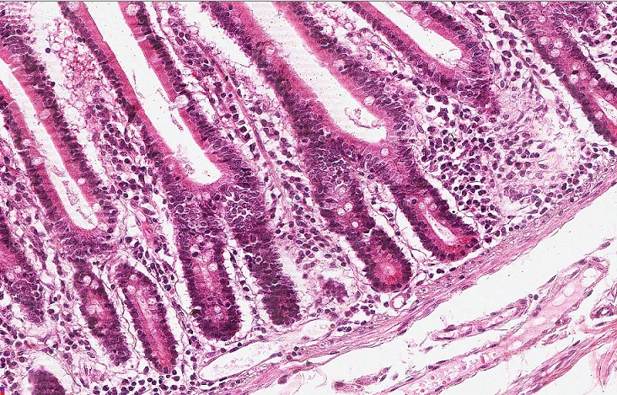
SURFACE MODIFICATIONS OF THE GASTROINTESTINAL TRACT
Increase in surface area is most elaborate in the small intestine, and is at three levels:
Plica circularis – gross level
Villi – microscopic level
Microvilli – cellular level
The true core of each villus is a thin wisp of muscularis mucosa (yellow arrows) that extends at right angles from the main layer of muscularis mucosa (black arrows).
As the epithelial cells absorb food, the local concentration of nutrients on their apical surface will decrease. These thin wisps of smooth muscle move the villi up and down, exposing the epithelial cells to “fresh” nutrients.
“After eating spinach, these little extensions of the muscularis mucosa are “pumping iron”.”
--John Michaels, PhD
Lamina propria

Slide 37
SURFACE MODIFICATIONS OF THE GASTROINTESTINAL TRACT
Increase in surface area is most elaborate in the small intestine, and is at three levels:
Plica circularis – gross level
Villi – microscopic level
Microvilli – cellular level
We said that plica can be easily seen at the gross level, and villi are microscopic. Even though you don’t see individual villi at the gross level, collectively, they give the intestinal surface a “velvety” texture.
These folds would be like plica.

Slide 38
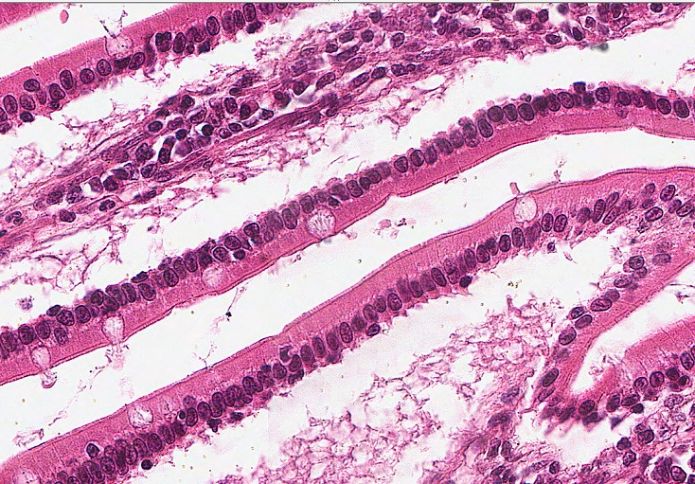
SURFACE MODIFICATIONS OF THE GASTROINTESTINAL TRACT
Increase in surface area is most elaborate in the small intestine, and is at three levels:
Plica circularis – gross level
Villi – microscopic level
Microvilli – cellular level
As you know, microvilli are surface modifications of the plasma membrane. These are on the apical surface of the epithelial cells of the small intestine, and are best seen in electron micrographs (two slides forward).
Here, note the size of the box in the upper right is small, but probably not small enough. In the lower right image showing portions of two villi, two very tiny brackets in the center of the image are indicating the microvilli. The next slide shows this region using artificial magnification.

Slide 39
SURFACE MODIFICATIONS OF THE GASTROINTESTINAL TRACT
Increase in surface area is most elaborate in the small intestine, and is at three levels:
Plica circularis – gross level
Villi – microscopic level
Microvilli – cellular level
Note the height of the microvilli is approximately 1/10 the length of the nucleus (cilia are approximately 1/3 to 1/2). You can’t see individual microvilli, what you are seeing is the collective of numerous microvilli; this is termed the “brush border”.
brackets here

Slide 40
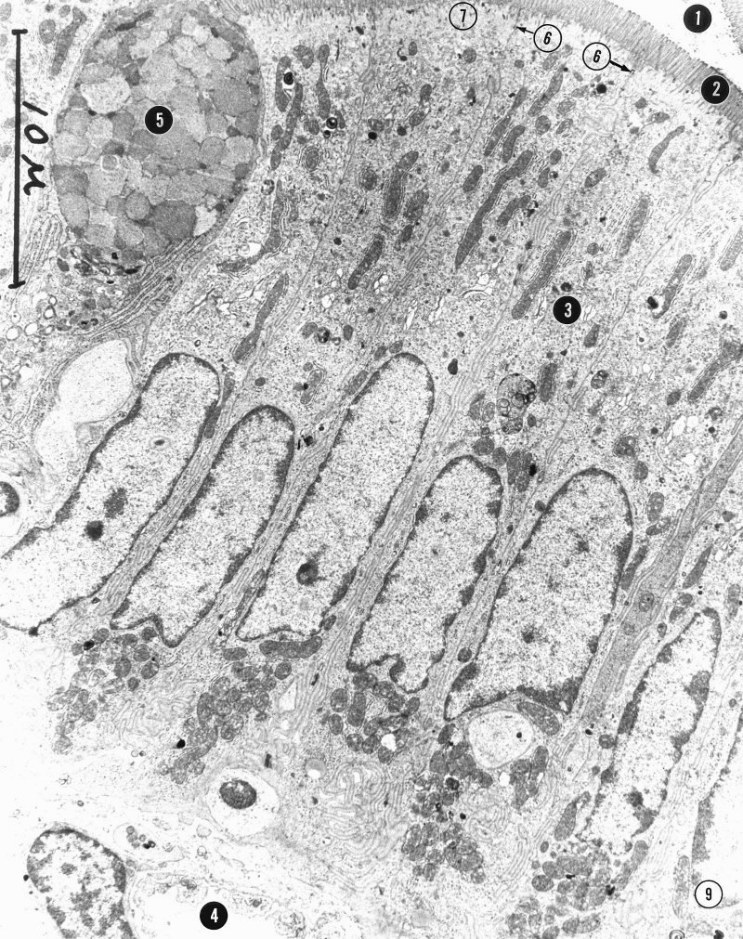
SURFACE MODIFICATIONS OF THE GASTROINTESTINAL TRACT
Increase in surface area is most elaborate in the small intestine, and is at three levels:
Plica circularis – gross level
Villi – microscopic level
Microvilli – cellular level
To the right is an electron micrograph of the intestinal epithelium; an equivalent view in a light micrograph is shown below. Microvilli are indicated at #2.
#1 – intestinal lumen
#3 – Golgi region
#4 – capillary in lamina propria
#5 – goblet cell
#6 – junctional complex
#7 – terminal web

Slide 41
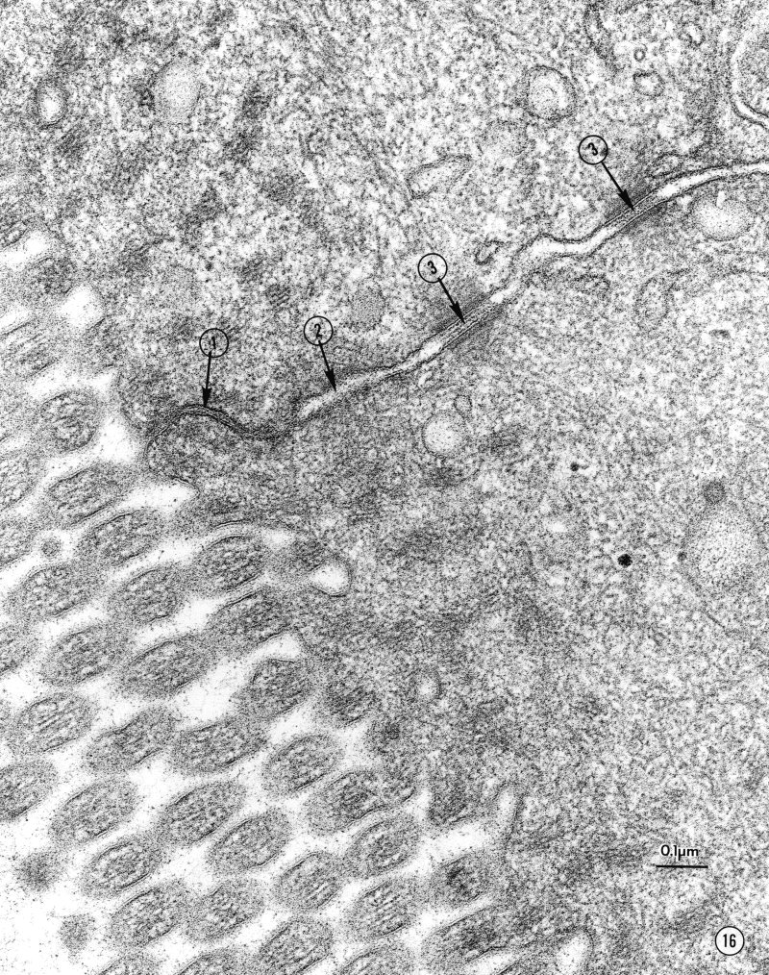
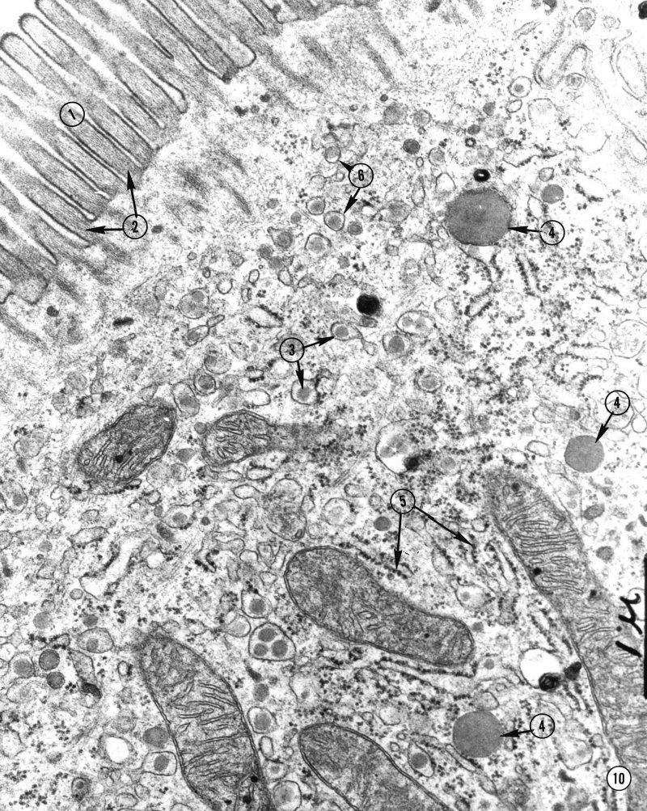
SURFACE MODIFICATIONS OF THE GASTROINTESTINAL TRACT
More views of microvilli (brackets) from your EM packet. Recall that their core is composed of actin microfilaments.

Slide 42
SURFACE MODIFICATIONS OF THE GASTROINTESTINAL TRACT
Video of jejunum showing the surface modifications – SL14
Link to SL 014
Be able to identify:
Plica circularis
Villi
Microvilli

Slide 43
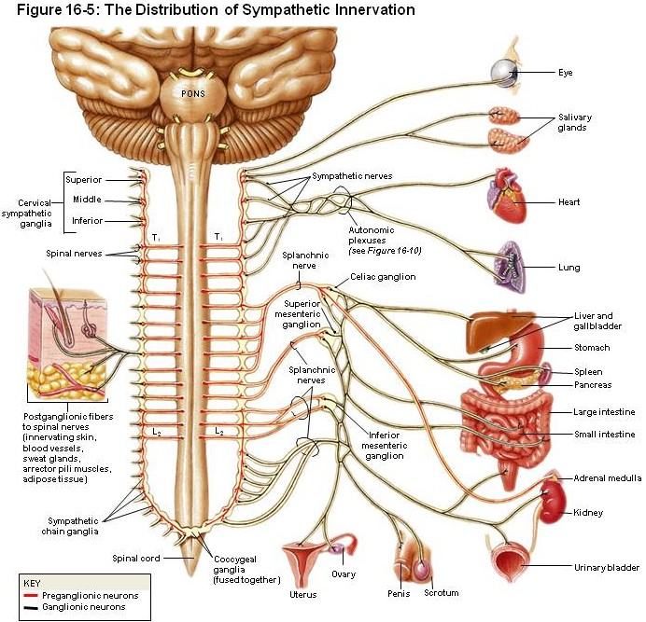
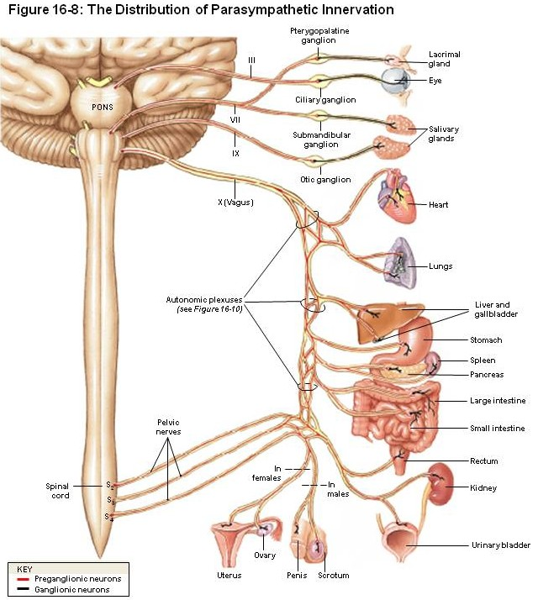
INNERVATION OF THE INTESTINE
Since the gastrointestinal tract is mostly visceral, it is innervated by the autonomic nervous system. A quick review of the anatomy of the autonomic nervous system reveals that neural structures within the wall of the GI tract include:
--postganglionic sympathetic axons
--preganglionic parasympathetic axons
--parasympathetic ganglia
--postganglionic parasympathetic axons
--afferent fibers
Remember sympathetic ganglia are outside the target organ, parasympathetic ganglia of the intestine are in the wall of the target organ.

Slide 44
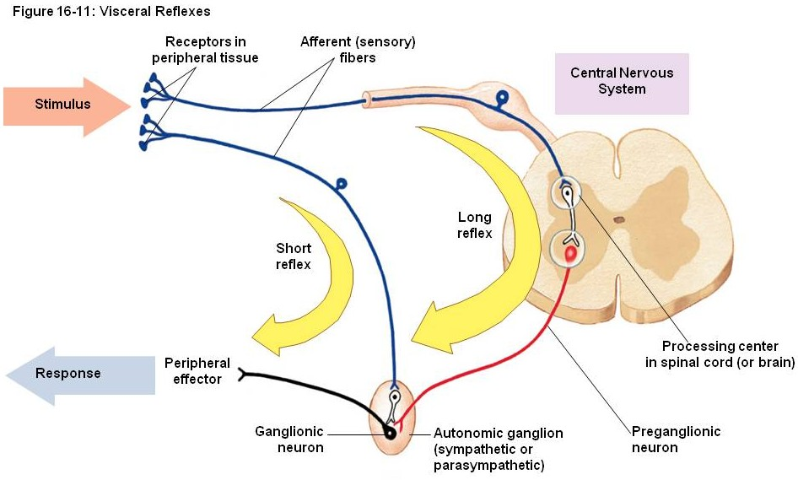
INNERVATION OF THE INTESTINE
Also, keep in mind that, although smooth muscle contraction (peristalsis) and glandular secretion in the gastrointestinal tract is controlled to some extent by the central nervous system (long reflex in drawing below), there is a system of short loop reflexes in which the afferent neurons that detect food and stretch directly stimulate postganglionic neurons in autonomic ganglia.
Since these ganglia belong predominantly to the parasympathetic system, these loops never leave the wall of the intestinal tract. To restate, the afferent sensory nerve, the interneurons in the postganglionic parasympathetic ganglion, and the postganglionic parasympathetic neurons are entirely with the wall of the digestive tract. This gives rise to the concept of an enteric nervous system, a system of neurons entirely within the digestive tract that can operate relatively independent from the central nervous system.
Enteric nervous system is not on your key word list for this module, but you will hear about it 1,000,000 times, so you better know it.

Slide 45
INNERVATION OF THE INTESTINE
Although these nerves can be found everywhere in the wall of the gastrointestinal system, the named structures that you can easily see histologically are the ganglia:
--the myenteric plexus (aka Auerbach’s plexus, black arrows) is located between the inner circular and outer longitudinal layers of the muscularis externa
--the submucosal plexus (aka Meissner’s plexus) is located in the submucosal layer
A plexus is a network of axons and ganglia.
The myenteric plexus is really easy to find, the submucosal plexus more challenging.

Slide 46
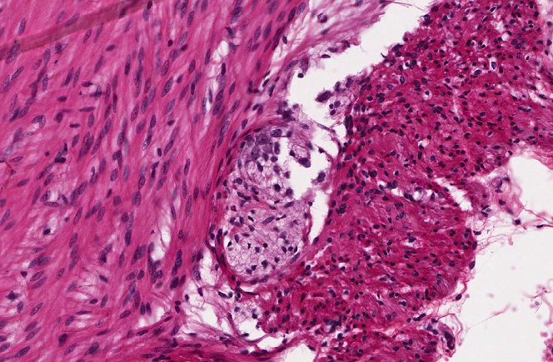
INNERVATION OF THE INTESTINE
Although these nerves can be found everywhere in the wall of the gastrointestinal system, the named structures are:
--the myenteric plexus (aka Auerbach’s plexus, black arrows) is located between the inner circular and outer longitudinal layers of the muscularis externa
--the submucosal plexus (aka Meissner’s plexus) is located in the submucosal layer
Here, part of the myenteric plexus is outlined in yellow. In the upper left portion of this ganglion (dotted yellow outline), you can see the basophilia of a 5-6 neuronal cell bodies.
Muscularis externa inner circular layer
Muscularis externa outer longitudinal layer

Slide 47
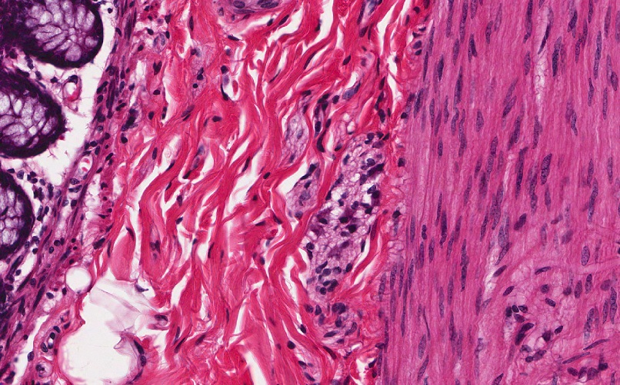
INNERVATION OF THE INTESTINE
Although these nerves can be found everywhere in the wall of the gastrointestinal system, the named structures are:
--the myenteric plexus (aka Auerbach’s plexus, black arrows) is located between the inner circular and outer longitudinal layers of the muscularis externa
--the submucosal plexus (aka Meissner’s plexus) is located in the submucosal layer
Here, the submucosal plexus is outlined in yellow. 3 or 4 basophilic neuronal cell bodies are near the center (dotted yellow outline). Note the position of this ganglion within the submucosa.
mucosa
submucosa
Muscularis externa inner circular layer

Slide 48
INNERVATION OF THE INTESTINE
Video of colon showing enteric nervous system – SL53
Link to SL 053
Be able to identify:
Enteric nervous system
Myenteric plexus
Submucosal plexus

Slide 49
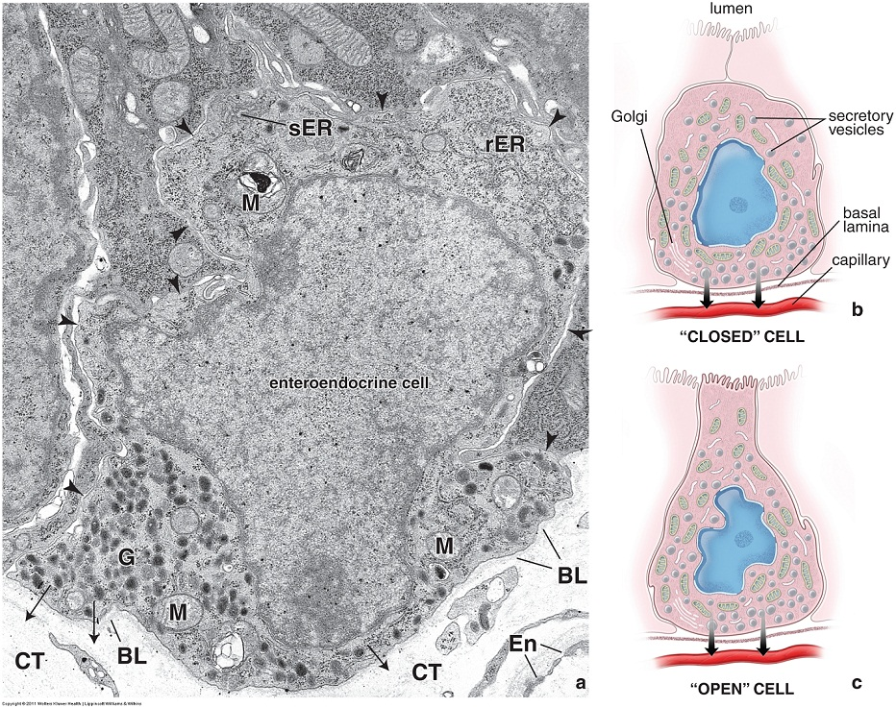
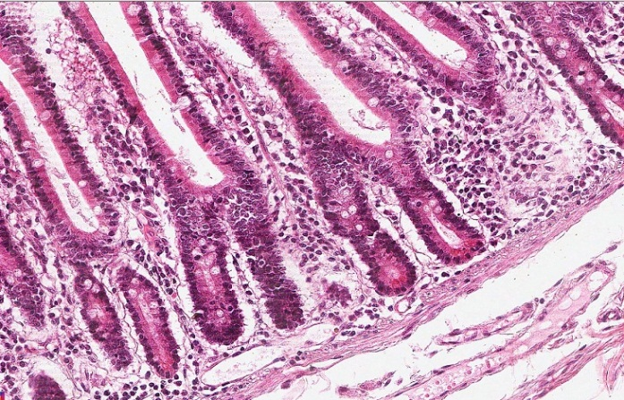
ENDOCRINE SECRETIONS OF THE INTESTINE
Not only does the gastrointestinal tract respond to neural stimulation, but it also secretes, and responds to, endocrine signals. The epithelial cells in the gastrointestinal tract that release these hormones are called enteroendocrine cells. These hormones are released into the underlying connective tissue, and either act locally on glands and smooth muscle, or diffuse into the bloodstream to be carried to other organs.
The EM to the right shows an enteroendocrine cell. For orientation, note that this cell is at the basal aspect of the gland. The basal side of the cell is toward the bottom of the micrograph, note the basal lamina (BL) and connective tissue (CT) of the underlying lamina propria. Because the cell secretes its product into the lamina propria, secretory vesicles (G) are on the basal side of the cell. The cell may or may not reach the lumen (closed or open orientation to the right).
These cells release products basally, so they really don’t need to reach the apical surface, unless they are detecting luminal contents which stimulate them to secrete their products.

Slide 50
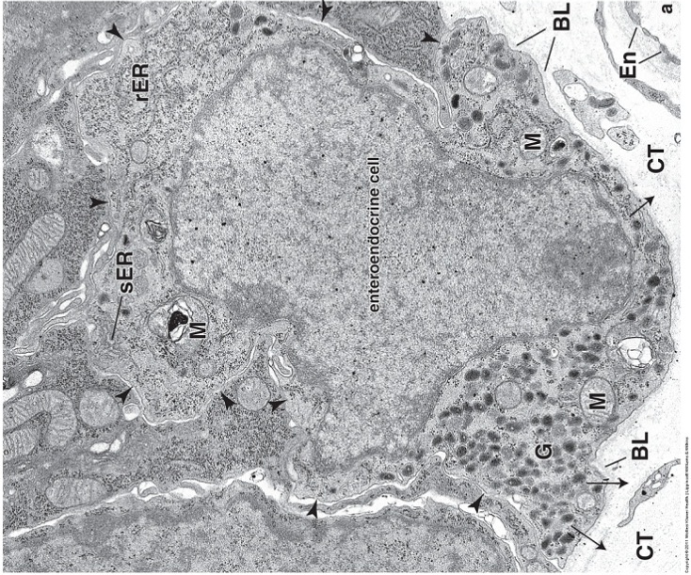
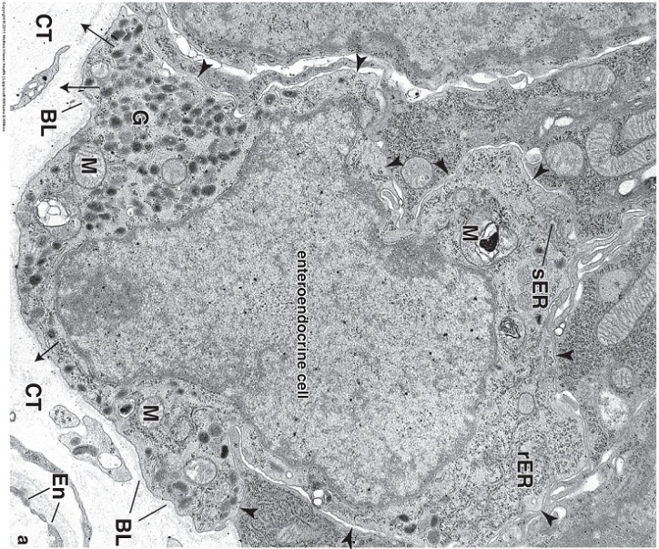
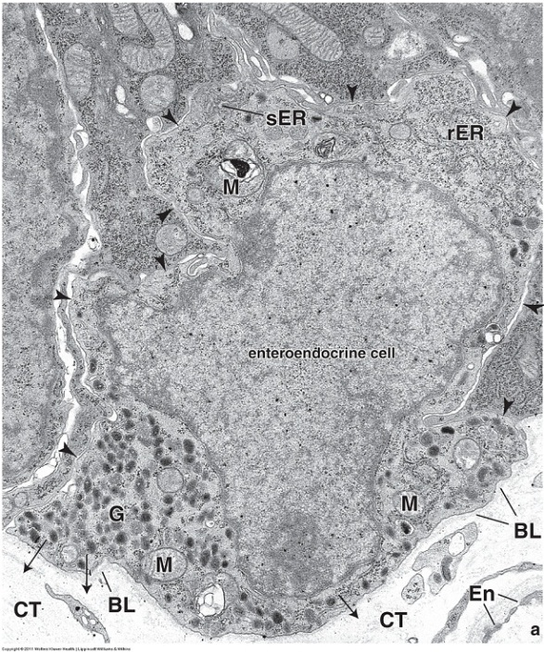
ENDOCRINE SECRETIONS OF THE INTESTINE
Just to make sure you understand basal and apical sides of these cells, here are a few ways the cell in the EM could be oriented, depending on its position in the gland. Apical side of the cell toward the lumen, basal side toward the connective tissue.
A few enteroendocrine cells can be found in the epithelium of the villi, but most are with the glands. Makes sense based on the direction of secretion.

Slide 51
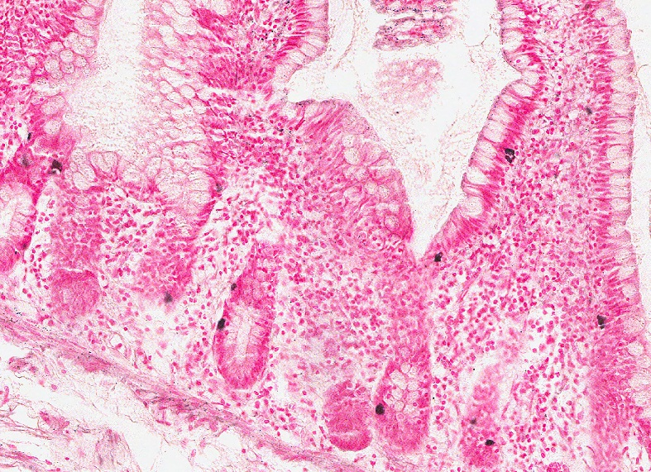
ENDOCRINE SECRETIONS OF THE INTESTINE
Enteroendocrine cells cannot be distinguished from other cell types of the epithelium on routine H&E staining. However, their secretory granules react with special silver stains. Note the staining is on the basal aspect of these cells.
Because they pick up the silver stain, these cells are also called argentaffin cells. I wouldn’t learn that term for this module, but you might hear it.

Slide 52
ENDOCRINE SECRETIONS OF THE INTESTINE
Video of ileum showing enteroendocrine cells – SL95
Link to SL 095
Be able to identify:
Enteroendocrine cells

Slide 53
The next set of slides is a quiz for this module. You should review the structures covered in this module, and try to visualize each of these in light and electron micrographs.
Describe the general organization of the gastrointestinal system
Main pathway
Accessory organs
Distinguish, at the light microscope level, each of the following:
Layers of the gastrointestinal tract
Mucosa
Epithelium
Lamina propria
Muscularis mucosa
Submucosa
Muscularis
Inner circular layer
Outer longitudinal layer
Adventitia / serosa
Elaborations of the gastrointestinal tract that increase surface area
Plica
Villi
Microvilli (brush border)
Neural and endocrine structures of the gastrointestinal tract
Enteric nervous system
Myenteric plexus
Submucosal plexus
Enteroendocrine cells (with special staining)
Distinguish, at the electron microscope level, each of the following:
Enteroendocrine cells

Slide 54
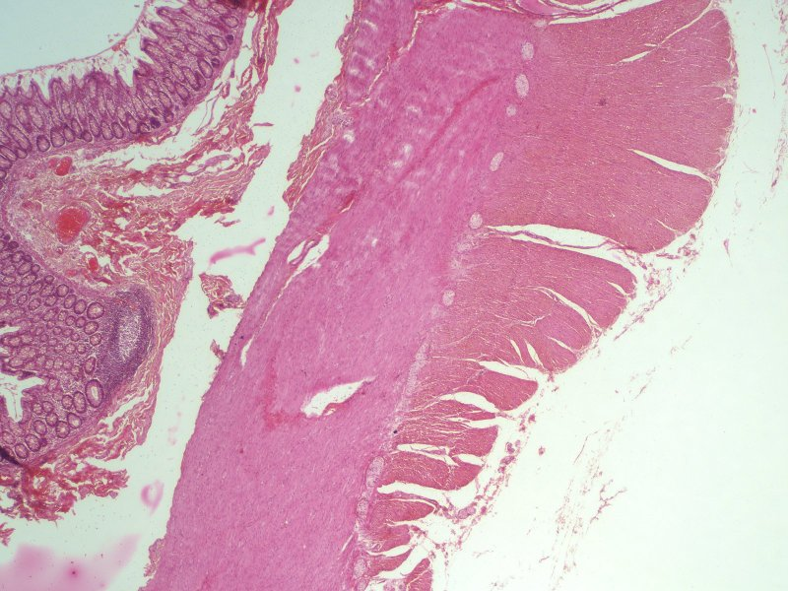
Final quiz
Self-check: Identify the region indicated by the brackets. (advance slide for answers)
mucosa

Slide 55
Final quiz
Self-check: Identify the region indicated by the brackets. (advance slide for answers)
submucosa

Slide 56
Final quiz
Self-check: Identify the cells at the tips of the arrows. (advance slide for answers)
Enteroendocrine cells

Slide 57
Final quiz
Self-check: Identify the structures between the arrows. (advance slide for answers)
cilia

Slide 58
Final quiz
Self-check: Identify the outlined structures. (advance slide for answers)
(intestinal) glands

Slide 59
Final quiz
Self-check: Identify the region indicated by the brackets. (advance slide for answers)
Muscularis externa outer longitudinal layer

Slide 60
Final quiz
Self-check: Identify the region indicated by the Xs(advance slide for answers)
Lamina propria
X
X

Slide 61
Final quiz
Self-check: Identify the structure indicated by the brackets. (advance slide for answers)
Muscularis mucosa

Slide 62
Final quiz
Self-check: Identify the region indicated by the brackets. (advance slide for answers)
Muscularis externa outer longitudinal layer

Slide 63
Final quiz
Self-check: Identify the structures indicated by the bracket. (advance slide for answers)
cilia

Slide 64
Final quiz
Self-check: Identify the region indicated by the brackets and arrow. (advance slide for answers)
submucosa

Slide 65
Final quiz
Self-check: Identify the region indicated by the brackets. (advance slide for answers)
Muscularis externa inner circular layer

Slide 66
Final quiz
Self-check: Identify the outlined structures. (advance slide for answers)
villi

Slide 67
Final quiz
Self-check: Specifically identify the outlined structures. (advance slide for answers)
Myenteric plexus

Slide 68
Final quiz
Self-check: Identify the region indicated by the brackets. (advance slide for answers)
Muscularis externa inner circular layer

Slide 69
Final quiz
Self-check: Identify the region indicated by the X (advance slide for answers)
submucosa
X

Slide 70
Final quiz
Self-check: Villi or glands? (advance slide for answers)
villi

Slide 71
Final quiz
Self-check: Identify the region indicated by the brackets. (advance slide for answers)
mucosa

Slide 72
Final quiz
Self-check: Identify the outlined structures. (advance slide for answers)
(intestinal) glands

Slide 73
Final quiz
Self-check: Identify the region indicated by the brackets. (advance slide for answers)
mucosa

Slide 74
Final quiz
Self-check: Identify the region indicated by the brackets. (advance slide for answers)
Muscularis mucosa
Golly, that’s a biggun’

Slide 75
Final quiz
Self-check: Identify the structures between the arrows. (advance slide for answers)
Microvilli (brush border)

Slide 76
Final quiz
Self-check: Identify the region indicated by the brackets. (advance slide for answers)
Muscularis externa outer longitudinal layer

Slide 77
Final quiz
Self-check: Identify the region indicated by the brackets. (advance slide for answers)
Muscularis externa outer longitudinal layer

Slide 78
Final quiz
Self-check: Identify the region indicated by the brackets. (advance slide for answers)
Muscularis mucosa

Slide 79
Final quiz
Self-check: Identify the structures indicated by the brackets. (advance slide for answers)
microvilli

Slide 80
Final quiz
Self-check: Identify the region indicated by the brackets. (advance slide for answers)
submucosa

Slide 81
Final quiz
Self-check: Identify the region indicated by the brackets. (advance slide for answers)
submucosa

Slide 82
Final quiz
Self-check: Identify the region at X. (advance slide for answers)
Lamina propria
X

Slide 83
Final quiz
Self-check: Specifically identify the outlined structure. (advance slide for answers)
Myenteric plexus

Slide 84
Final quiz
Self-check: Identify the cells at the tips of the arrows. (advance slide for answers)
Enteroendocrine cells

Slide 85
Final quiz
Self-check: Identify the outlined structures. (advance slide for answers)
villi

Slide 86
Final quiz
Self-check: Identify the region indicated by the brackets. (advance slide for answers)
mucosa

Slide 87
Final quiz
Self-check: Identify the region indicated by the brackets. (advance slide for answers)
Muscularis externa inner circular layer

Slide 88
Final quiz
Self-check: Identify the region indicated by the brackets and arrow. (advance slide for answers)
submucosa

Slide 89
Final quiz
Self-check: Identify the outlined structure. (advance slide for answers)
Plica circularis

Slide 90
Final quiz
Self-check: Identify the outlined structure. (advance slide for answers)
(intestinal) gland

Slide 91
Final quiz
Self-check: Identify the region indicated by the brackets. (advance slide for answers)
adventitia

Slide 92
Final quiz
Self-check: Villi or glands? (advance slide for answers)
glands

Slide 93
Final quiz
Self-check: Identify the region indicated by the Xs(advance slide for answers)
Lamina propria
X
X

