Slide 1
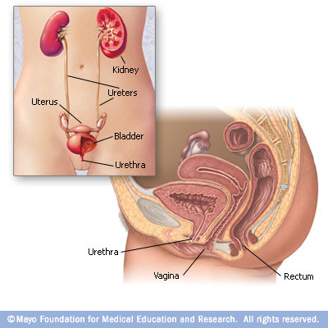
Extrarenal Passages
Digital Laboratory
It’s best to view this in Slide Show mode, especially for the quizzes.
This module will take approximately 40 minutes to complete.

Slide 2
After completing this exercise, you should be able to:
describe the basic three-layered structure of the extrarenal passages: mucosa, muscularis, adventitia
Calyxes
Ureter
urinary bladder
(female) urethra.

Slide 3
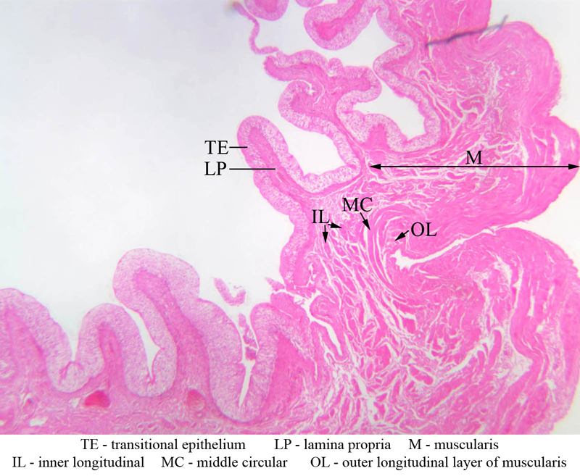
Organization of extra-renal passages
The major functions of the extra-renal passages include:
Transport and storage of urine
Maintenance of the ionic composition of the urine produced by the kidneys
To achieve these goals, the extra-renal passages have the following basic structure:
A mucosa, which consists of
transitional epithelium
lamina propria – an irregular connective tissue
A muscularis layer - composed of smooth muscle
An adventitia - composed of irregular connective tissue
The qualities of each layer will vary somewhat depending on function. For example, the bladder will have a thick muscularis layer for urination (micturition).
The transitionial epithelium:
can stretch to allow filling (bladder)
is resistant to osmotic movement of ions and water, maintaining the concentration of urine produced by the kidneys
urine

Slide 4
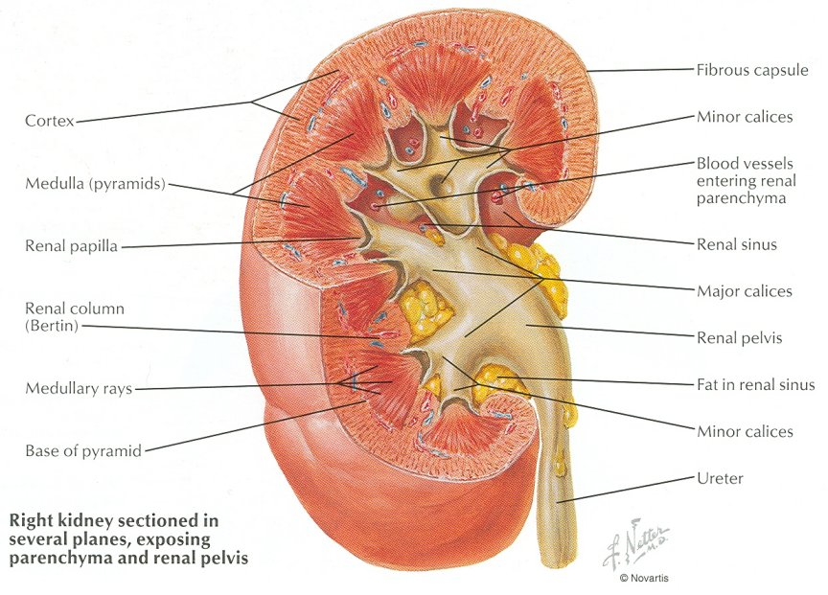
Minor calyx
Urine passes out of the collecting ducts (papillary ducts) and into the minor calyces, and from there flows through the major calyces into the renal pelvis.

Slide 5
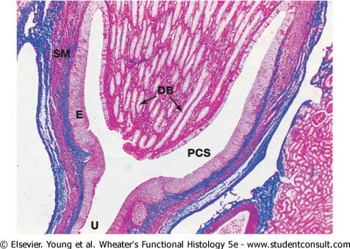
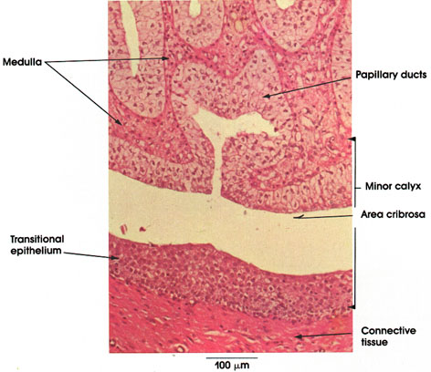
Minor calyx
In these images, you can see a minor calyx (labeled PCS on the Wheater’s image)
The major calyces and renal pelvis have histological features similar to the minor calyx, but without the papilla.

Slide 6
Minor calyx
Video of Minor Calyx – SL115
Link to SL 115
Be able to identify:
Minor calyx
Transitional epithelium

Slide 7
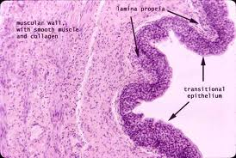
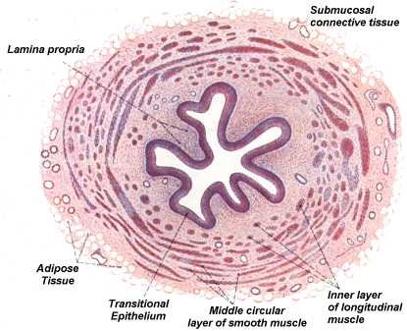
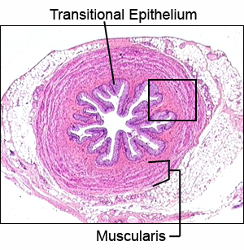
ureter
The three-layered histology of the extra-renal passages (mucosa, muscularis, adventitia) is more apparent in the ureter and bladder.

Slide 8
ureter
Video of Ureter – SL18
Link to SL 018
Be able to identify:
ureter
mucosa
transitional epithelium
lamina propria
muscularis
adventitia

Slide 9
Urinary bladder
The urinary bladder also has the characteristic three-layered histology of the extra-renal passages (mucosa, muscularis, adventitia). Here, the muscularis layer is quite thick to propel urine during micturition, and has three layers of smooth muscle.

Slide 10
Urinary bladder
Video of Urinary Bladder – SL179
Link to SL 179
Be able to identify:
Urinary bladder
mucosa
transitional epithelium
lamina propria
muscularis
adventitia

Slide 11
Urinary bladder
Video of Urinary Bladder (baby) – SL57
Link to SL 057
Be able to identify:
Urinary bladder
mucosa
transitional epithelium
lamina propria
muscularis
adventitia

Slide 12
bladder
A final, minor note on the bladder:
The abdominal cavity is lined with an epithelium, called peritoneum, that lines the outer surface of the abdominal organs (visceral peritoneum, red arrow), and the inner surface of the abdominal wall (parietal peritoneum, yellow arrow). This should be review from when you studied the gastrointestinal tract.
Because of it’s position in the pelvic cavity, only a portion of the bladder is covered by peritoneum. Sections through most of the bladder (e.g. green line) do not include this peritoneal epithelium. In these cases, the outer layer of the bladder is simply connective tissue, and we call this outer layer an adventitia. However, a section near the apex of the bladder (blue line in image) will have an outer layer composed of connective tissue covered with parietal epithelium – we call this layer a serosa. Again, this is similar to what you learned in the GI section.
The scanned digital slides have an adventitia as an outer layer. Some glass slides have a serosa.

Slide 13
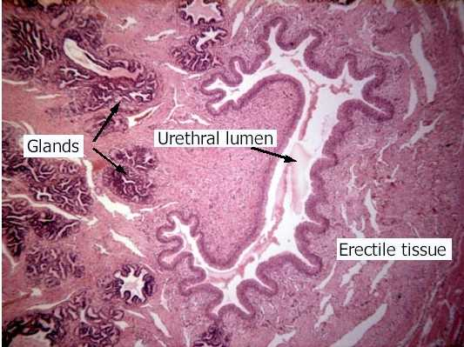
urethra
The histological features of the urethra are different from other extra-renal structures:
The epithelium of the urethra near the bladder is transitional, but most of the urethra is lined by stratified squamous non-keratinized epithelium.
Small mucous glands may be present, but typically are not obvious on our slides.
The lamina propria has an abundant venous plexus
The smooth muscle is less developed, and may be interspersed with skeletal muscle of the pelvic floor (e.g. urogenital diaphram)

Slide 14
Urethra
This section of the female urethra also includes the anterior wall of the vagina (see blue line in image). Therefore, you will see a cross section through the urethra - the lower portion of the slide, including the epithelium at the bottom, will be from the anterior wall of the vagina.

Slide 15
Urethra (female)
Video of Urethra – SL120
Link to SL 120
Be able to identify:
Urethra
mucosa
Epithelium (transitional or stratified squamous)
lamina propria
muscularis
adventitia

Slide 16
The next set of slides is a quiz for this module. You should review the structures covered in this module, and try to visualize each of these in light and electron micrographs.
describe the basic three-layered structure of the extrarenal passages: mucosa, muscularis, adventitia
Calyxes
Ureter
urinary bladder
(female) urethra.

Slide 17
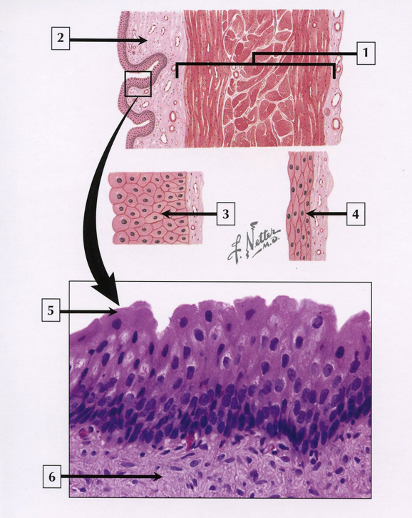
quiz
Self-check: Identify structures 1-6. (advance slide for answers)

Slide 18
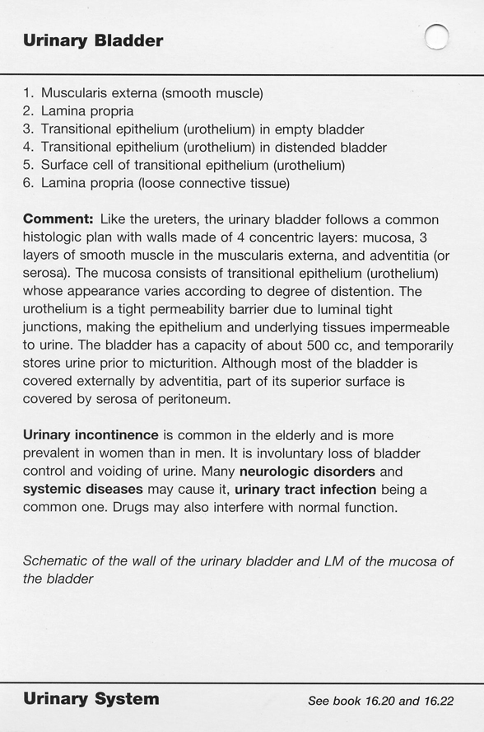
quiz
Self-check answers

Slide 19
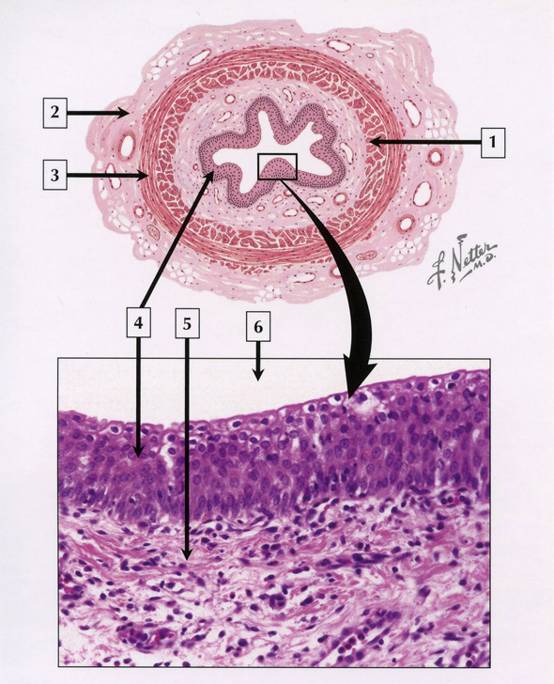
quiz
Self-check: Identify the entire structure, and structures 1-6. (advance slide for answers)

Slide 20
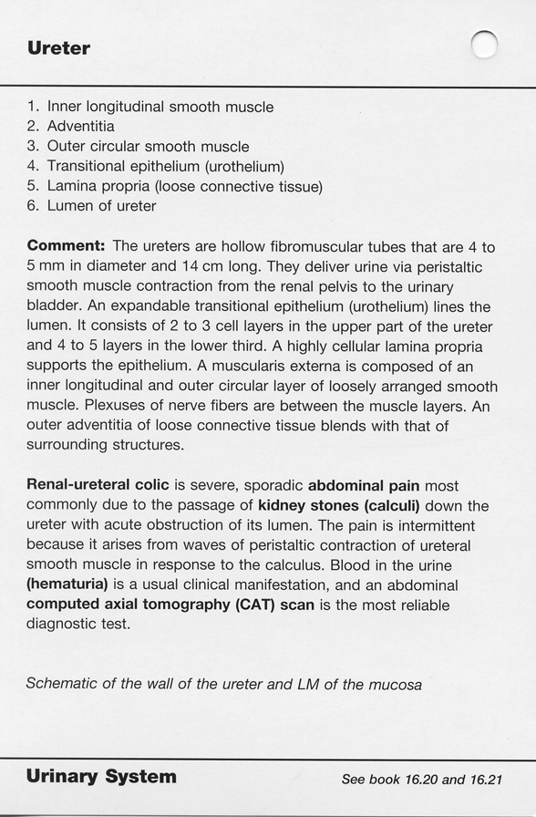
quiz
Self-check answers

Slide 21
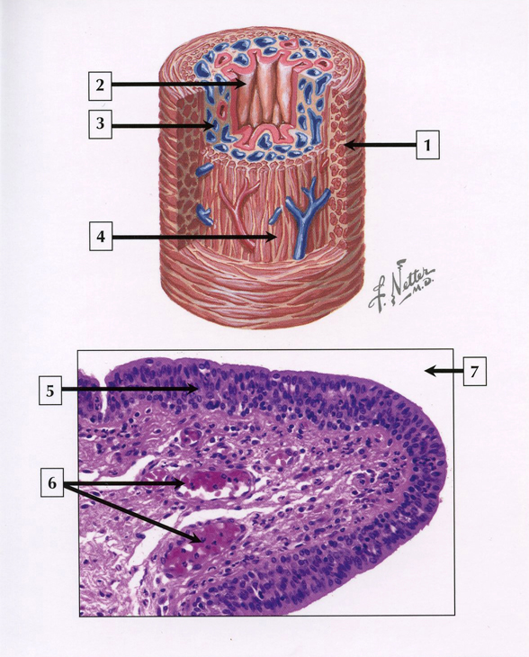
quiz
Self-check: Identify the entire structure, and structures 1-6. (advance slide for answers)

Slide 22
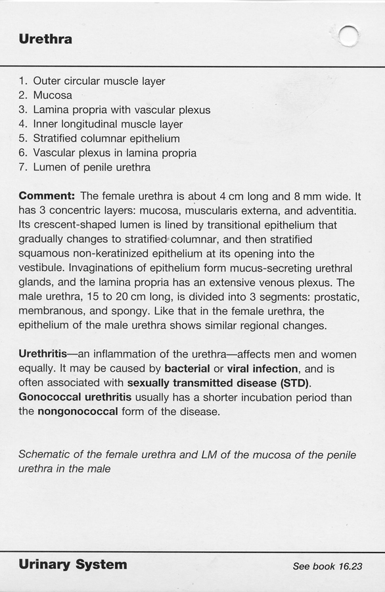
quiz
Self-check answers
Note: the epithelium of the urethra varies considerably

Slide 23
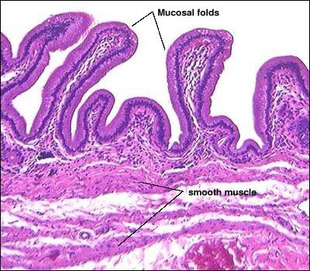
quiz
Self-check: Identify the entire structure.
bladder

Slide 24
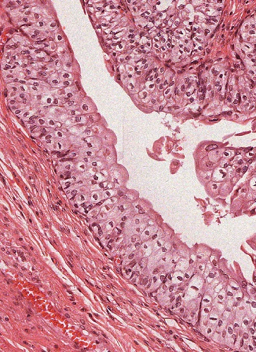
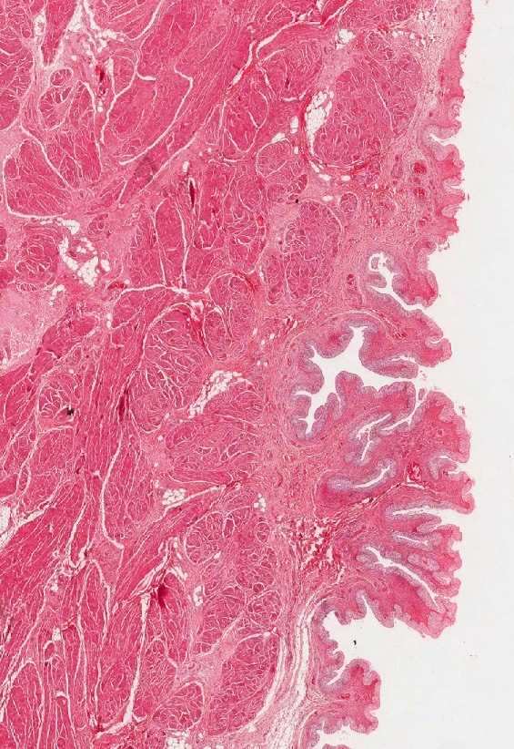
quiz
Self-check: Identify the entire structure.
bladder

Slide 25
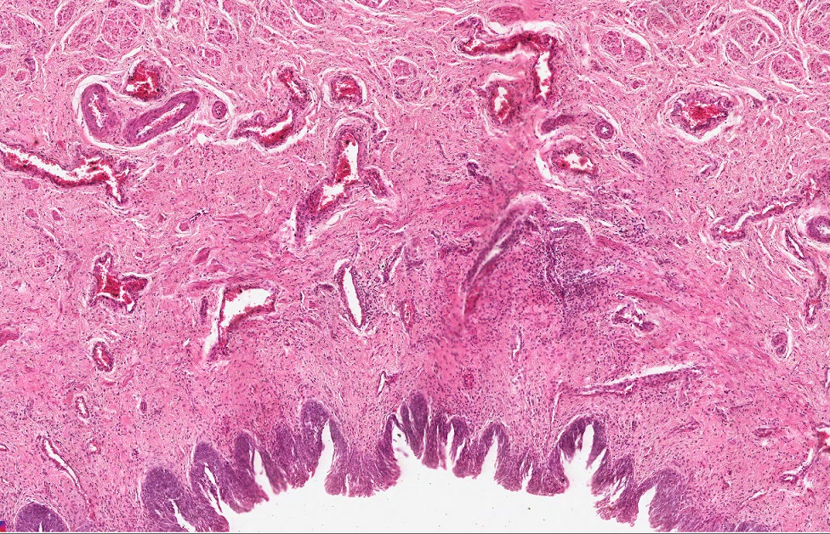
quiz
Self-check: Identify the entire structure.
urethra

Slide 26
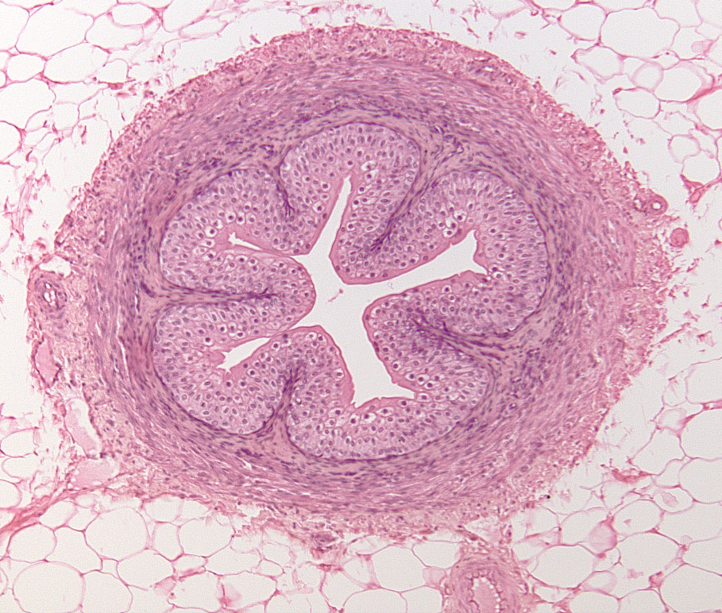
quiz
Self-check: Identify the entire structure.
ureter
Note that, like the bladder, the ureter can also have substantial adipose in the adventitia.

Slide 27
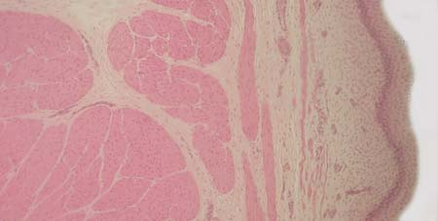
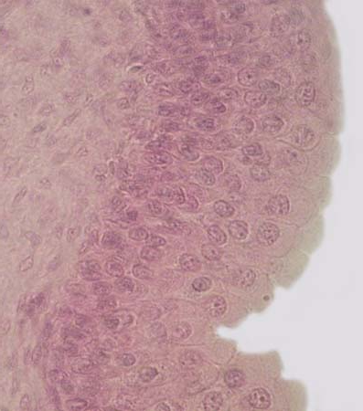
quiz
Self-check: Identify the entire structure from which these images were taken.
bladder

Slide 28
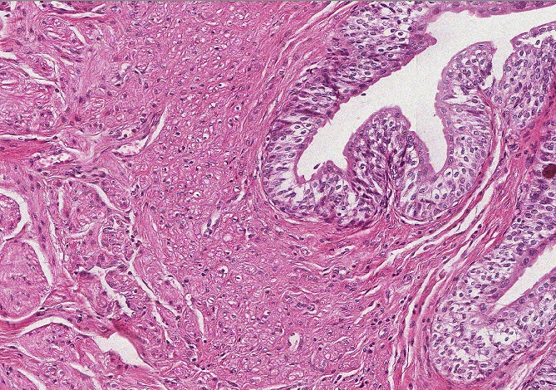
quiz
Self-check: Identify the entire structure.
ureter

Slide 29
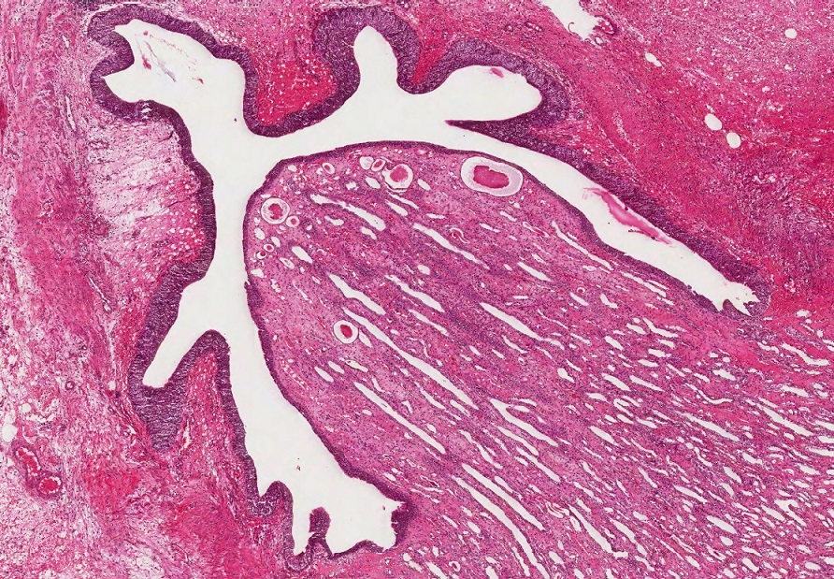
quiz
Self-check: Identify the structure indicated by the arrows.
Minor calyx

