Slide 1
Exocrine Pancreas
Digital Laboratory
It’s best to view this in Slide Show mode, especially for the quizzes.
This module will take approximately 30 minutes to complete.

Slide 2
After completing this exercise, you should be able to:
Distinguish, at the light microscope level, each of the following:
Exocrine Pancreas
Serous acini
Ducts
Intercalated ducts
Centroacinar cells
Excretory ducts

Slide 3
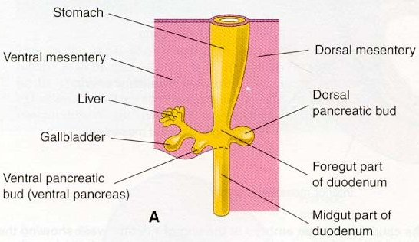
EMBRYOLOGY OF THE PANCREAS, LIVER, AND GALL BLADDER
When creating a module of the accessory organs of the gastrointestinal tract, one can hardly resist the urge to discuss a little embryology. Recall that the early gut tube has an inner lining of endoderm (an epithelium), surrounded by mesenchyme (embryonic connective tissue). It is suspended from the body wall by mesenteries, which are composed of mesenchyme.
The pancreas, liver, and gall bladder are glands, and, therefore, are evaginations of the endoderm into the mesenchyme of the duodenum. These organs grow out of the duodenal wall and into the connective tissue of the mesentery. The pancreas and liver are huge endodermal outgrowths, so when looking at these organs, most of what you will see are epithelial cells, with sparse connective.
You’ve seen this already; salivary glands are mostly acini, which are epithelium. There is connective tissue between the acini, but in the main lobes and lobules, it’s pretty sparse.

Slide 4
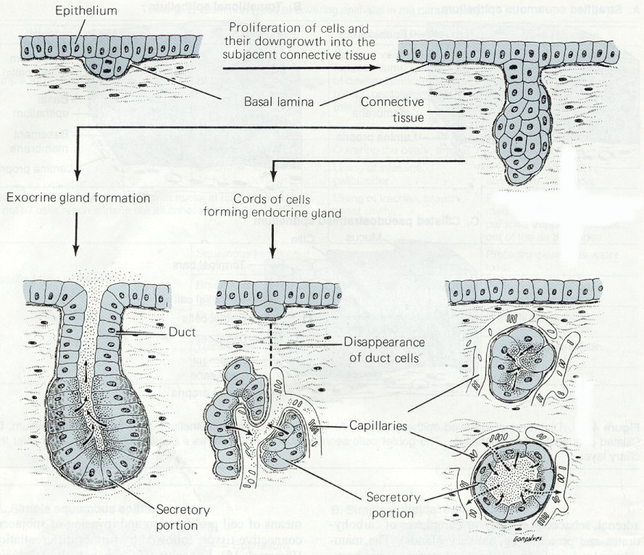
GLANDS
The liver and pancreas are glands, so a review of the histology of gland development is useful. The gall bladder develops in a similar manner.
Glands in the body develop through an interaction of an epithelium and underlying connective tissue. Here, the epithelial cells that line the inner surface of the duodenum proliferate, and then invaginate (evaginate) into the underlying connective tissue. Note the basement membrane invaginates with the epithelium. From here, two things can happen:
For exocrine gland formation, a lumen develops, and secretory cells secrete their substances out their apical side (arrows).
For endocrine glands, the secretory cells lose their connection to the original epithelium, forming clusters of cells that secrete out their basal side, across the basement membrane, and into the bloodstream.
In the pancreas, some cells become exocrine, while others become endocrine. In the liver, the same cells (hepatocytes) remain structurally exocrine, but perform both exocrine and endocrine functions.

Slide 5
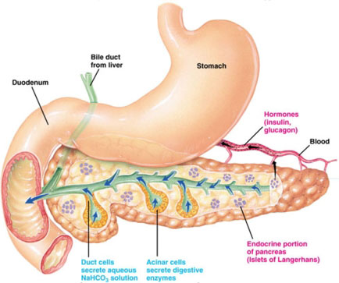
PANCREAS
This excellent image shows the pancreas (and liver) developing from the duodenum, and, therefore, is connected to it by the pancreatic ducts. The glandular cells in the pancreas are either exocrine (acinar) or endocrine (Islets of Langerhans).
from:
www.gopetsamerica.com
seriously
The arrows indicate the direction of product secretion. Again, note that exocrine secretion is apical; product is secreted into a lumen that ultimately leads to the duodenal lumen. Endocrine products are released “basally”, into the connective tissue and bloodstream.

Slide 6
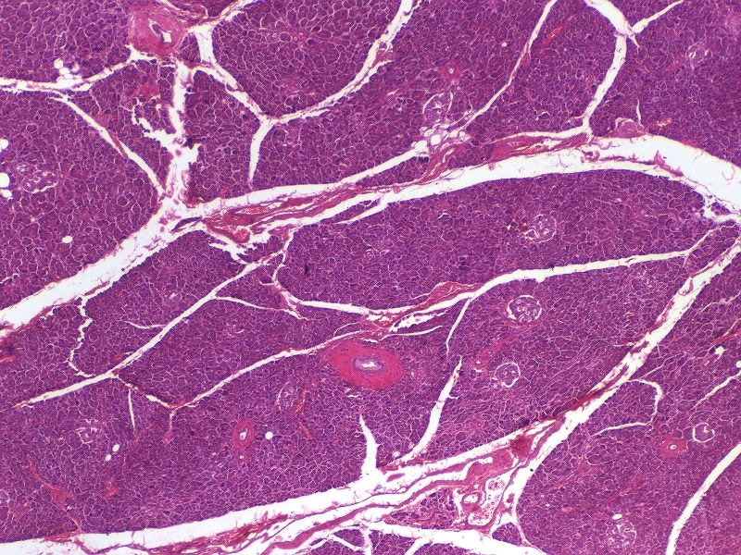
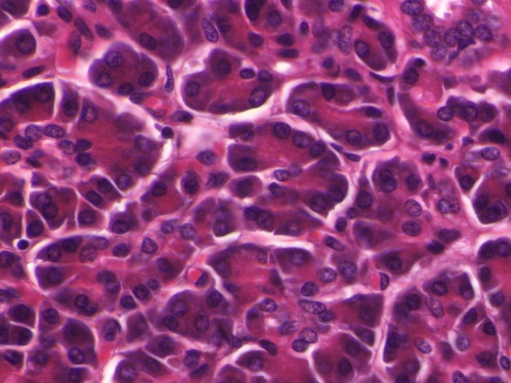
EXOCRINE PANCREAS
The exocrine portion of the pancreas secretes a large amount of digestive enzymes. In general, the features of the exocrine pancreas are quite similar to the salivary glands; cells organized into acini, nuclei in the basal aspect of the cell. These cells also have cytoplasmic basophilia around the nucleus, and eosinophilia in their apical cytoplasm. I hope you immediately recognize that this staining is much more intense than you have seen in the salivary glands; this is because the pancreas is producing large quantities of digestive enzymes.
This particular slides is a little overstained. Nevertheless, intense staining in the pancreas is the norm.

Slide 7
EXOCRINE PANCREAS
Video of pancreatic acini – SL108
Video of pancreatic acini – SL54
Link to SL 108 and SL 054
Be able to identify:
Exocrine pancreas (serous acini)

Slide 8
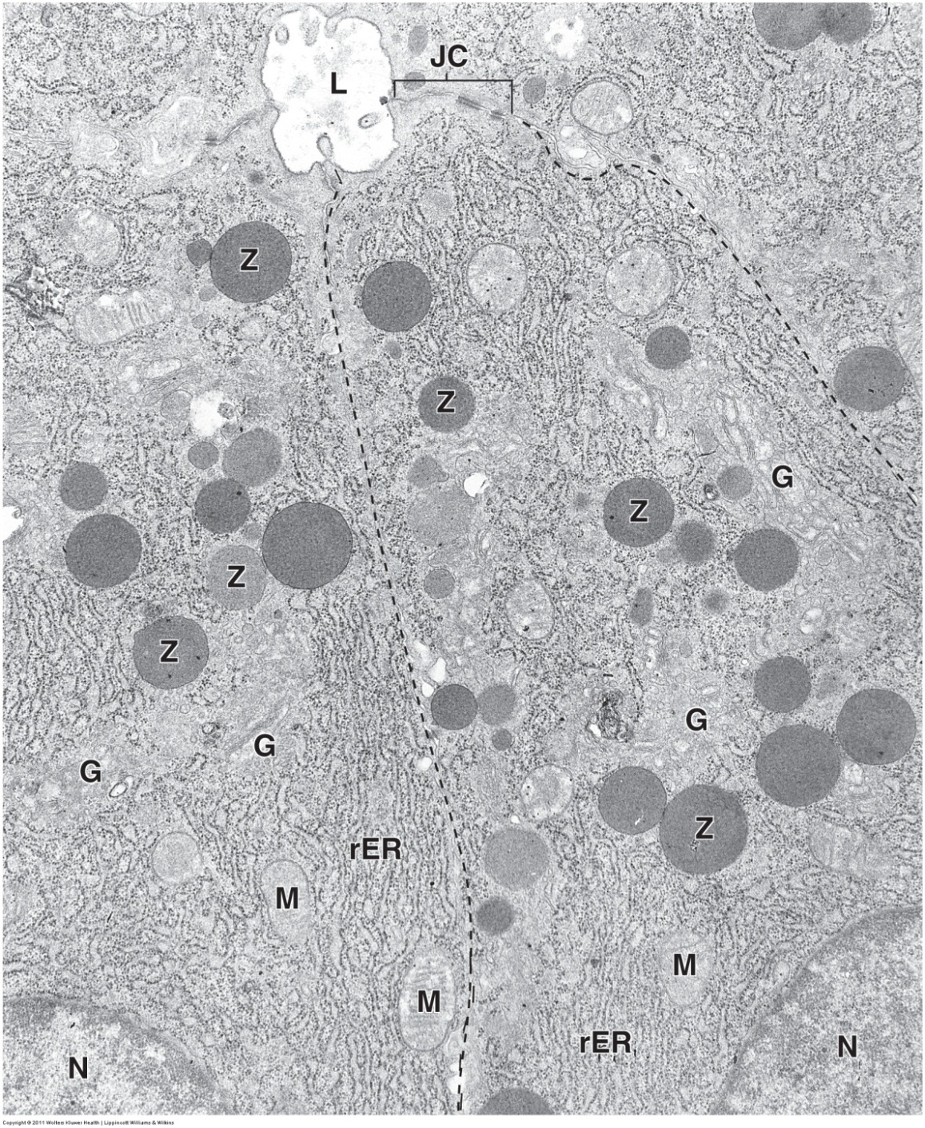
EXOCRINE PANCREAS
Similar to what we have seen in the salivary glands and chief cells of the stomach, the acinar cells of the pancreas have the characteristic features of protein-secreting cells.
L = lumen
N = nucleus
M = mitochondria
JC = junctional complex
G = Golgi apparatus
Z = zymogen (secretory) granules
rER = rough endoplasmic reticulum

Slide 9
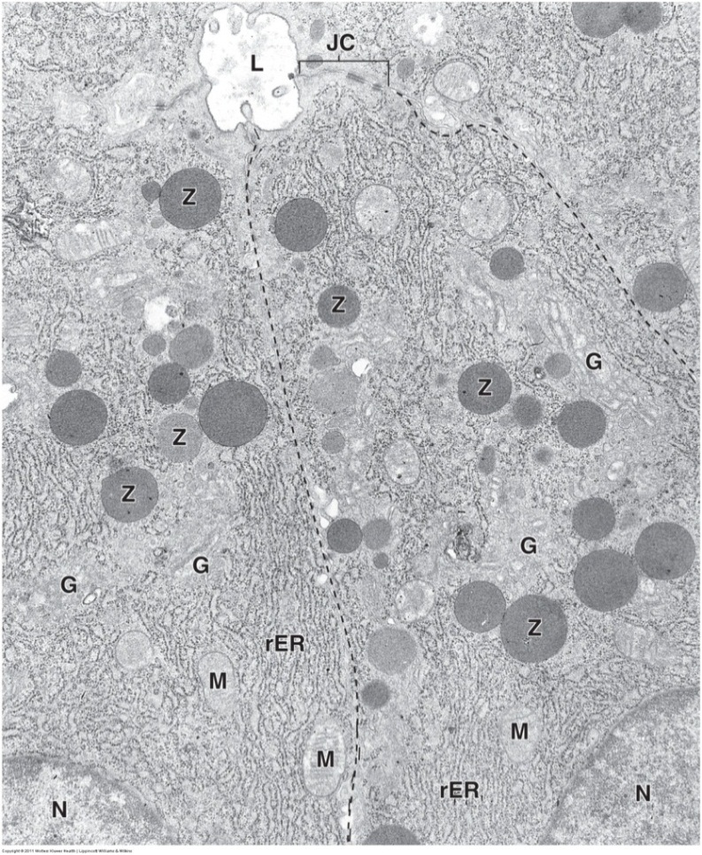
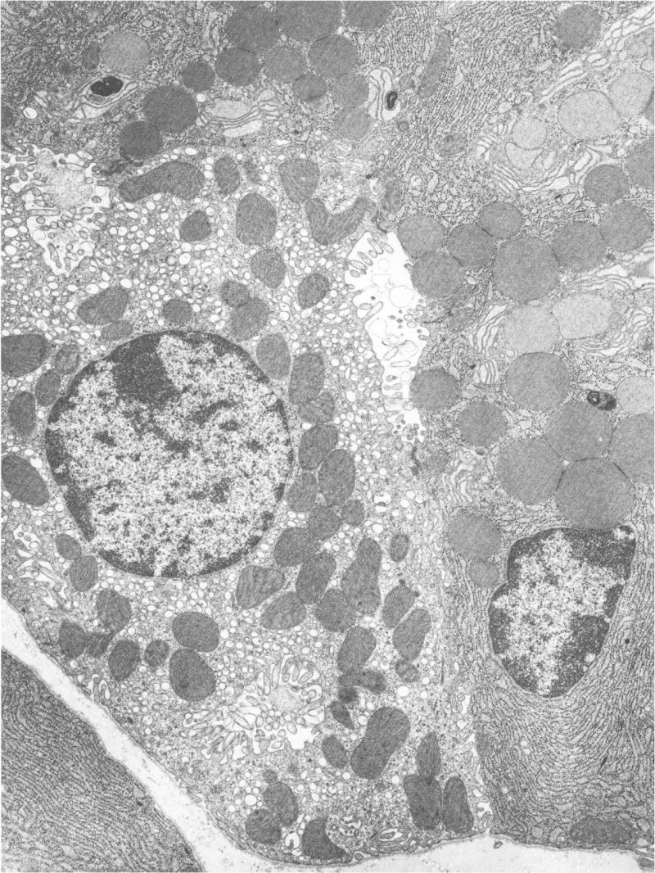
EXOCRINE PANCREAS
As you are probably figuring out about now, the presence of rER, Golgi, and secretory granules is characteristic of all cells that are involved in regulated protein secretion. Here, these pancreatic acinar cells produce lots of protein, so their rER is prominent, and their granules are large. Unfortunately, this is also true for chief cells (image below).
However, note that you should be able to identify both of these as protein-secreting cells, and, based on the presence of the lumen and position of the granules, be able to generate a list of possible options for the identity of these cells, while ruling out others (i.e. rule out endocrine pancreas based on the lumen, rule out enteroendocrine cells based on the position of the granules).
Chief cell
In terms of deciding which tissue is the source of an image, this will depend on surrounding cells or structures in the image. For example, in the case of the chief cell, the adjacent parietal cell, which you should recognize, is a giveaway. If a specific identity of a cell is required and the source of the tissue cannot be determined from the image, the source of the image will be provided.

Slide 10
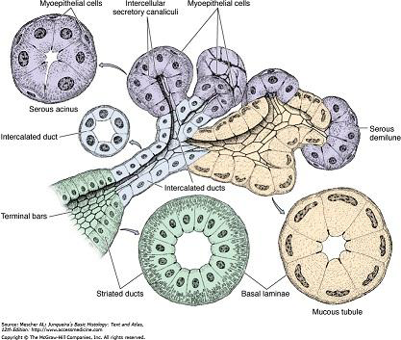
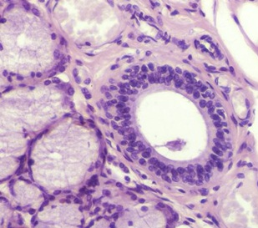
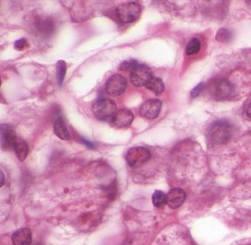
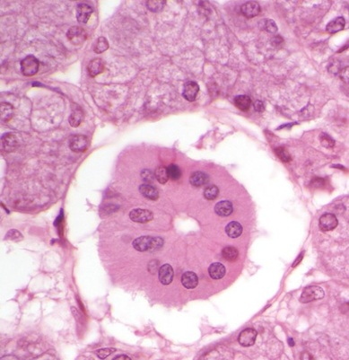
EXOCRINE PANCREAS - DUCTS
Recall that the duct system in salivary glands consisted of:
Intercalated ducts, which were simple conduits for fluid.
Striated ducts, which had epithelial cells with numerous basolateral infoldings for ion transport.
Excretory ducts, in which the epithelium became stratified and the surrounding connective tissue was more prominent.
excretory
striated
intercalated

Slide 11
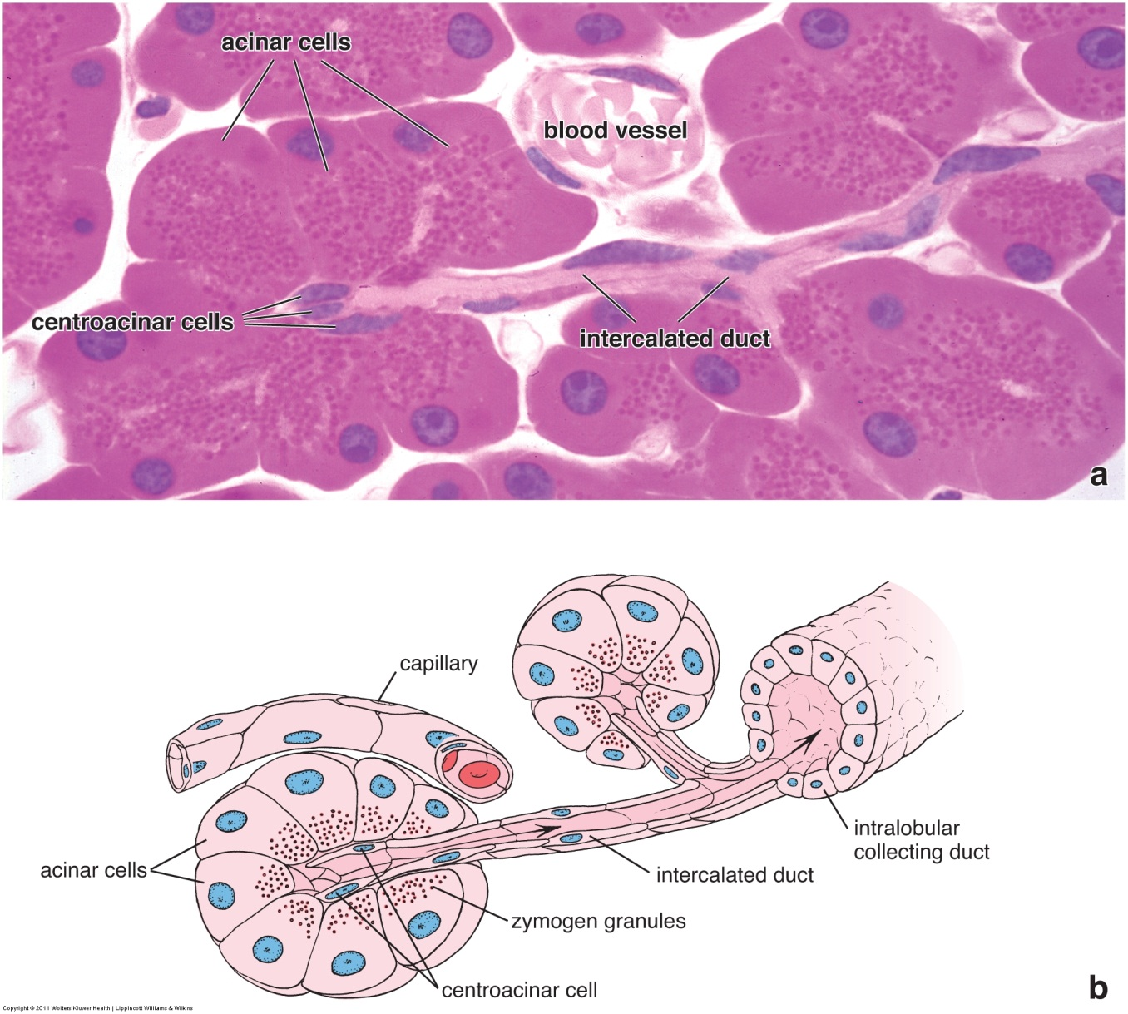
EXOCRINE PANCREAS - DUCTS
In the pancreas, the duct system is slightly different:
The intercalated ducts begin within the acinus; duct cells of this initial portion are referred to as centroacinar cells. The intercalated ducts of the pancreas (including the centroacinar cells) are not mere conduits of fluid, but release a bicarbonate secretion that helps neutralize acidic chyme from the stomach.
There are no striated ducts in the pancreas.
The epithelium of the excretory ducts (labeled intralobular collecting duct) remains simple throughout, all the way to the duodenum. (This is also true of the biliary system; gall bladder and bile ducts.)

Slide 12
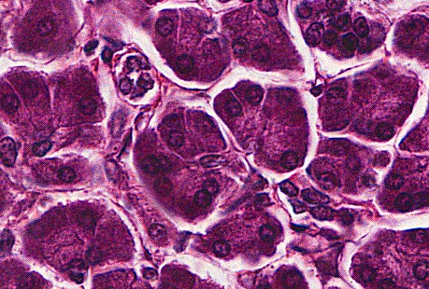
EXOCRINE PANCREAS - DUCTS
The previous image of an intercalated duct from the Ross text is outstanding. Intercalated ducts are challenging to find on our slides.
In the center of this image, you can see two adjacent acini (blue dashed semicircles) that appear to have intercalated ducts connecting them (their ducts are merging). A centroacinar cell nucleus (arrow) is visible in the left acinus. The structure outlined in yellow is likely a cross-section of an intercalated duct. Note that the cells lining the intercalated ducts are very low cuboidal, and do not stain as intensely as the acinar cells.
The intercalated duct cells, including the centroacinar cells, secrete bicarbonate. Since they are not major protein-secreting cells, it makes sense that these cells are pale, especially in comparison to the intensely-stained acinar cells.

Slide 13
EXOCRINE PANCREAS - DUCTS
Since actual intercalated ducts are difficulty to find, what you will want to look for are centroacinar cells within excretory acini. These can be seen as individual (arrows) or clusters (outlined) of nuclei within the center of an acinus. Again, note the pale staining of the cytoplasm in these cells, especially in the context of the dark-staining acinar cells.

Slide 14
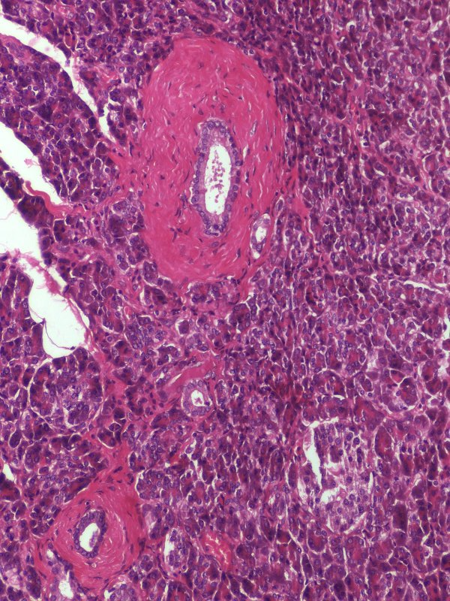
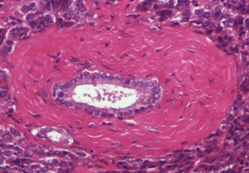
EXOCRINE PANCREAS - DUCTS
The excretory ducts of the pancreas (and liver) are lined by a simple epithelium throughout. Here, you can see a smaller duct (blue outline) and two larger ducts (yellow outline). Note that even the ducts with extensive connective tissue support maintain a simple epithelial lining.
Enlargement of the upper duct (below) demonstrates that the epithelial cells exhibit pale eosinophilic cytoplasm.

Slide 15
EXOCRINE PANCREAS
Video of pancreatic ducts – SL54
Link to SL 108 and SL 054
Be able to identify:
Intercalated ducts (if you can find one)
Centroacinar cells
Excretory ducts

Slide 16
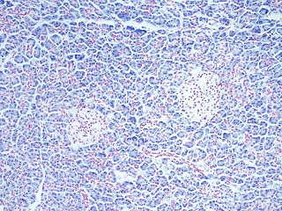
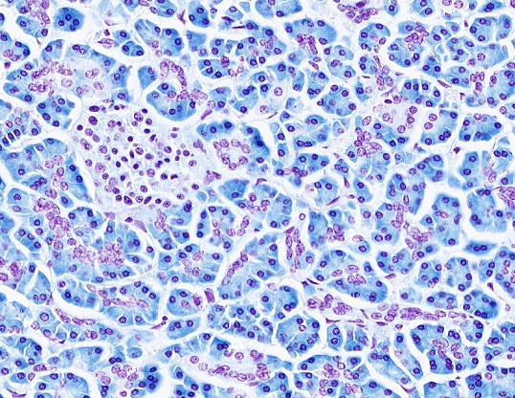
PANCREAS – RNA STAIN
To underscore the difference in exocrine and endocrine pancreatic cells, and to highlight centroacinar cells, this slide was specially prepared so that:
DNA is stained red
RNA is stained blue
Although the cytoplasm of the pancreatic islet cells (islet outlined in solid red) do exhibit RNA staining, the exocrine acinar cell cytoplasm contains much more RNA. Furthermore, this slide more clearly demonstrates centroacinar cells (red dotted outline). An intercalated duct (arrows) is also visible.

Slide 17
PANCREAS – RNA STAIN
Video of pancreas RNA stain – SL002A
Link to SL 002A
Be able to identify:
Serous acini
Intercalated ducts
Centroacinar cells
Pancreatic islets (of Langerhans)

Slide 18
The next set of slides is a quiz for this module. You should review the structures covered in this module, and try to visualize each of these in light and electron micrographs.
Distinguish, at the light microscope level, each of the following:
Exocrine Pancreas
Serous acini
Ducts
Intercalated ducts
Centroacinar cells
Excretory ducts

Slide 19
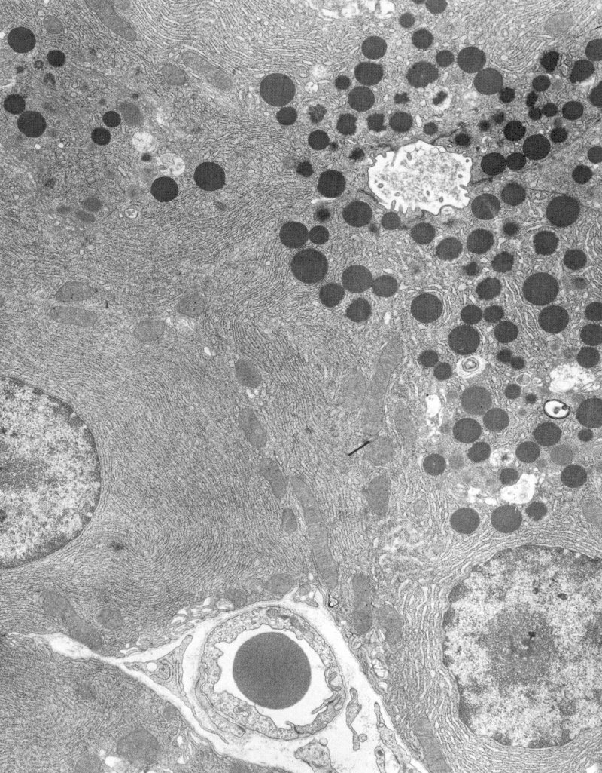
Final quiz
Self-check: In this image from the pancreas, the lumen is indicated (L). Identify the cells in this micrograph (advance slide for answers).
Aciniar cells (exocrine pancreas)
L

Slide 20
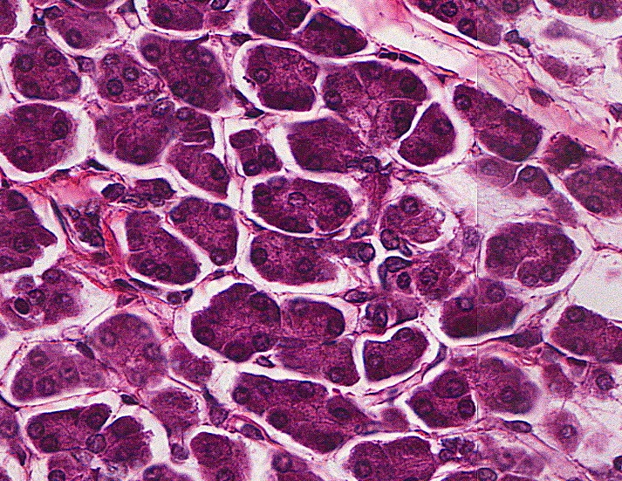
Final quiz
Self-check: Identify the cell indicated by the arrow (advance slide for answers).
Centroacinar cell

Slide 21
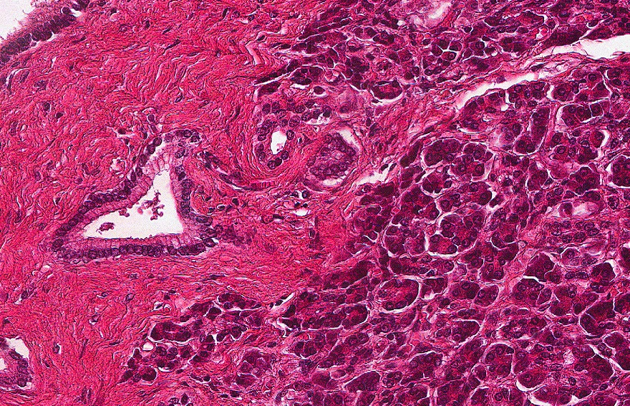
Final quiz
Self-check: Identify the outlined structure. (advance slide for answers).
(pancreatic) Excretory duct

Slide 22
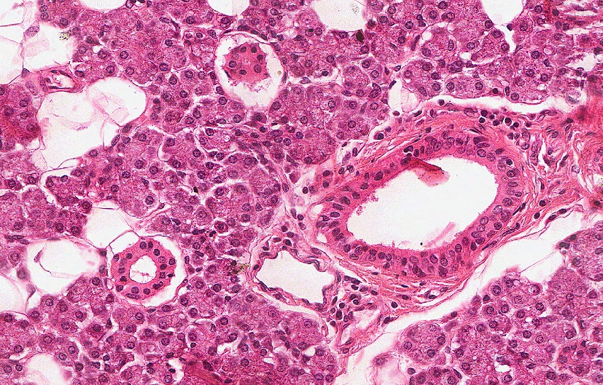
Final quiz
Self-check: Identify the organ on this slide. (advance slide for answers).
Parotid gland

Slide 23
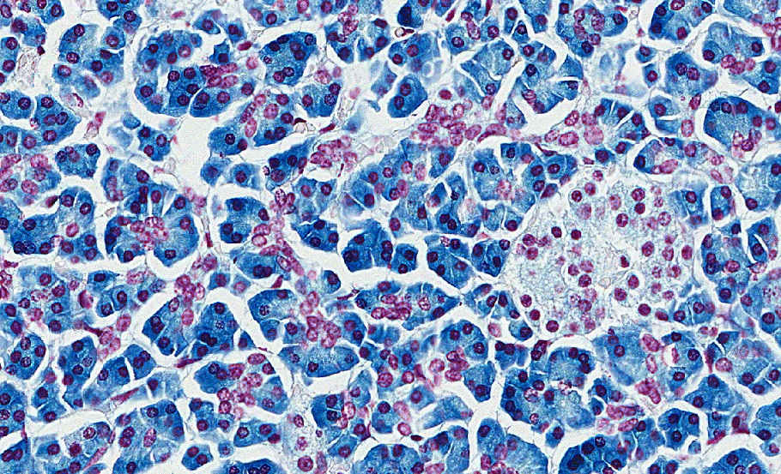
Final quiz
Self-check: Identify the outlined cells (advance slide for answers).
Aciniar cells (exocrine pancreas)

Slide 24
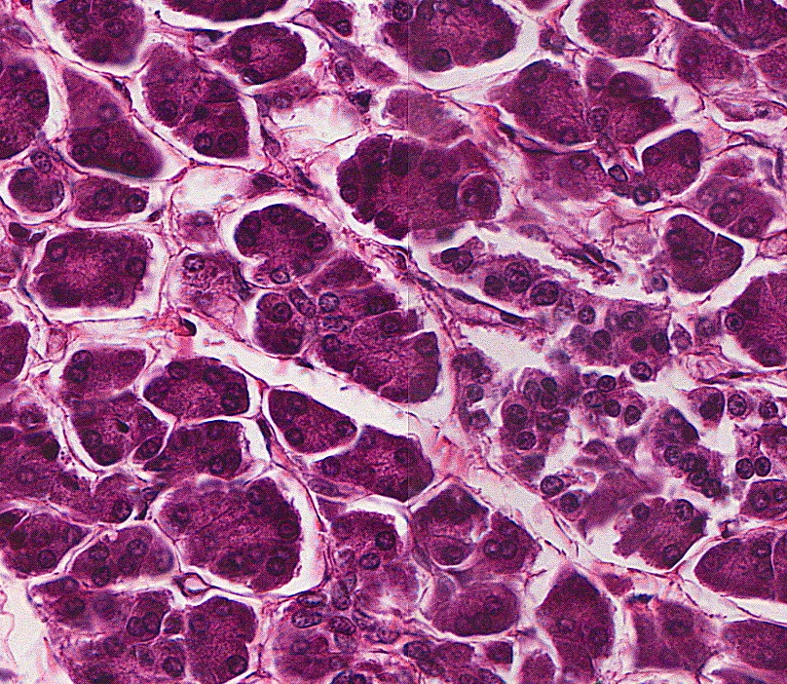
Final quiz
Self-check: Identify the outlined cells (advance slide for answers).
Centroacinar cells

Slide 25
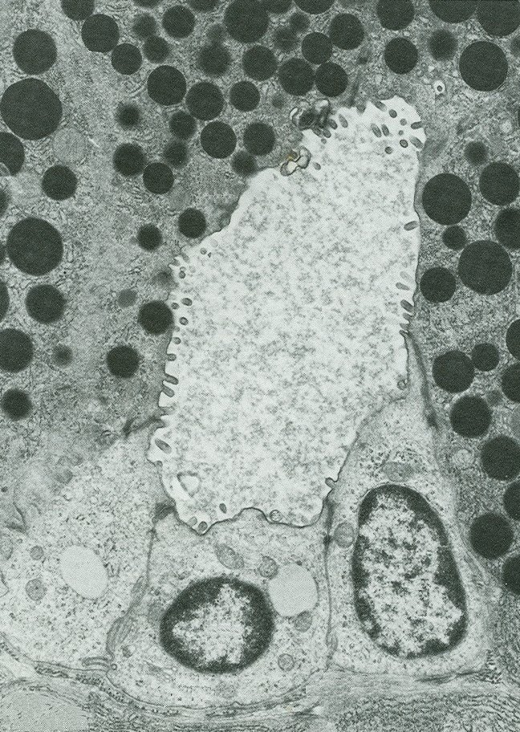
Final quiz
Self-check: In this image from the pancreas, identify cells at X. (advance slide for answers).
Centroacinar cells
X
X

Slide 26
Final quiz
Self-check: Identify the outlined cells (advance slide for answers).
Aciniar cells (exocrine pancreas, acinus)

Slide 27
Final quiz
Self-check: Identify the outlined cells (advance slide for answers).
Centroacinar cells

