Slide 1
An Introduction to
Electron Microscopy
many of the images within this module are courtesy of Robert R. Cardell, Ph.D. and originally were taken from :
Fine Structure of Cells and Tissues
by Keith R. Porter and Mary A. Bonneville
Because these electron micrograph (EM) images are very detailed, you should view this demonstration in the Slide Show view. Click the Slide Show tab, then select From Beginning (or for the true geek, the little projector icon in the lower right). After that, your up/down arrows will advance or retreat the demonstration.

Slide 2
Comparing Light and
Electron Microscopy

Slide 3
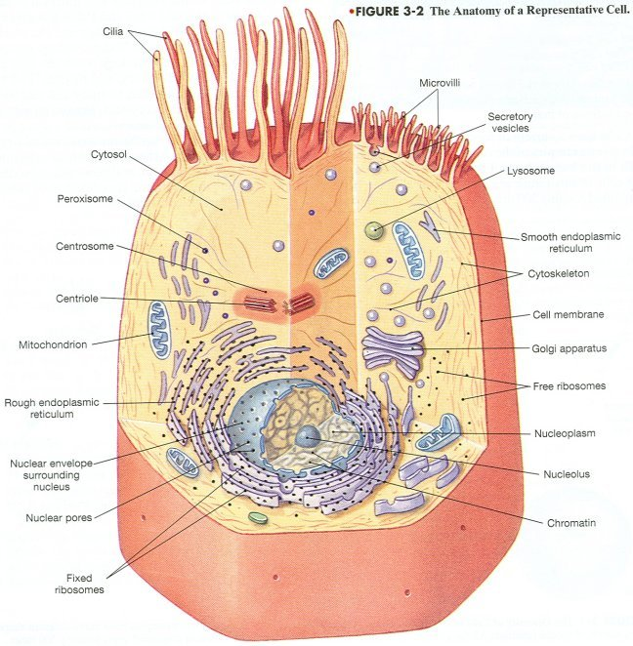
This is a drawing of a typical cell. Note the numerous organelles. The first session gave you a brief description of the function of these organelles. This module will help you learn to interpret electron micrographs (i.e. identify the structures you see). Subsequent sessions will provide more details on the structure and function of these organelles. Spend a moment now and (re)-familiarize yourself with the basic layout of the cell.

Slide 4
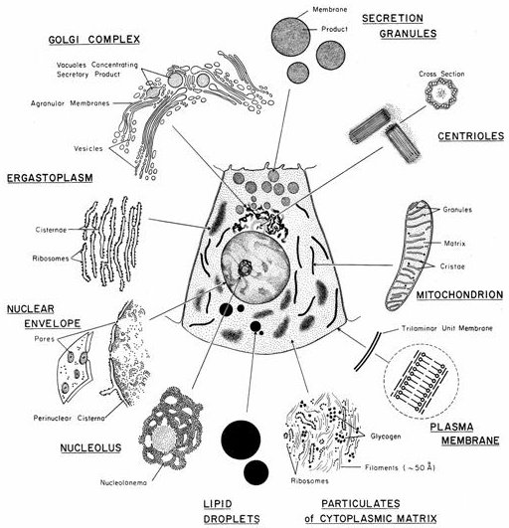
This is another drawing with the cell in the center, surrounded by sketches of the appearance of its organelles in the electron microscope. Note that the term “ergastoplasm” is the older term for “rough endoplasmic reticulum”.

Slide 5
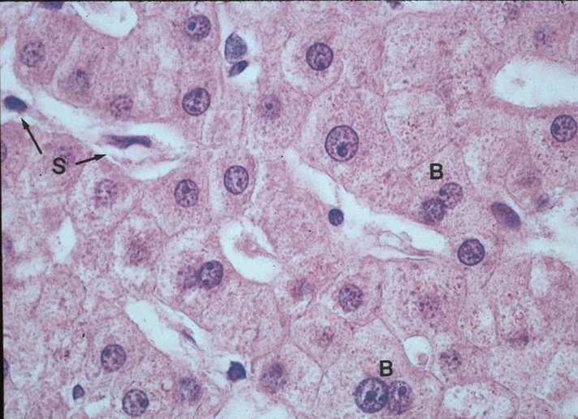
As you know, human cells come in many shapes and sizes. One cell commonly used in EM study is the hepatocyte, or liver cell, which is approximately 30 µm in diameter, and contains most of the organelles discussed in this introduction to EM. The image above is an H&E light micrograph showing liver cells at high power. The plasma membrane of a single hepatocyte is indicated by the blue arrows, and its nucleus is indicated by the green arrows. With the light microscope, you typically see individual cells, nuclei, and the nucleolus (dark spot within nucleus), but organelles appear only as small dots or are not visible at all.

Slide 6
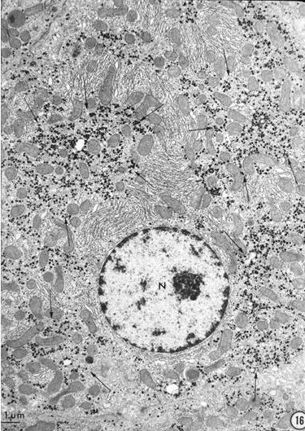
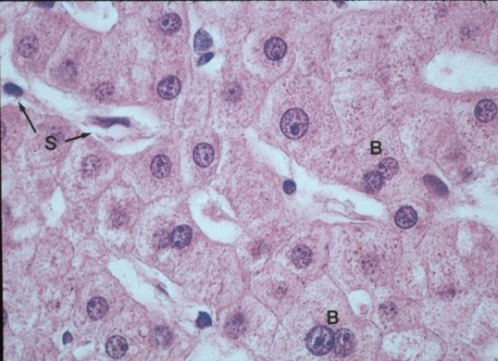
The hot-pink box around the cell to the right in this and subsequent slides indicates the approximate field of view for the EM on that screen. Note that some of the pink boxes on future slides may get really small.
This is a transmission electron micrograph (TEM) in which most of a single hepatocyte takes up the whole image. This relatively low magnification for an EM is comparable to the higher magnifications of the light microscope. You should also appreciate that, not only do we see the nucleus (bounded by the red arrows), but there are many cellular organelles in the cytoplasm that were not visible with the light microscope.

Slide 7
Size Matters

Slide 8
A first step in interpreting EMs is to get a sense for the relative magnification of the image. Many images have a scale bar on them, but many do not. For our course, you will never be asked on an exam to provide the magnification of an image either specifically, or even in general. However, in order to effectively interpret any EM, you will definitely need to have a general sense of whether the EM in question shows a relatively large or small area. To put this differently, your first goal when you look at any EM is to decide which of the following hot pink squares corresponds most closely to the field of view in your EM.
A
C
E
B
D
Great, but how is this done?

Slide 9
To become proficient at determining the field of view of EMs, it is helpful if you can readily identify certain cellular components. Then, combined with your knowledge of the relative sizes of these components, the remaining features of the EM can be deduced. You can use any structures you want to achieve this goal. However, three structures that are likely to be easy to recognize and also provide a good range of differing sizes are the nucleus, mitochondria, and ribosomes.

Slide 10
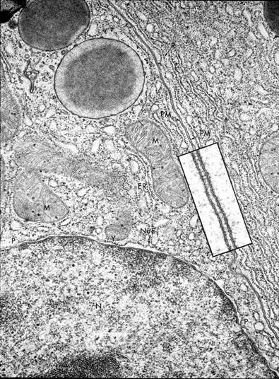
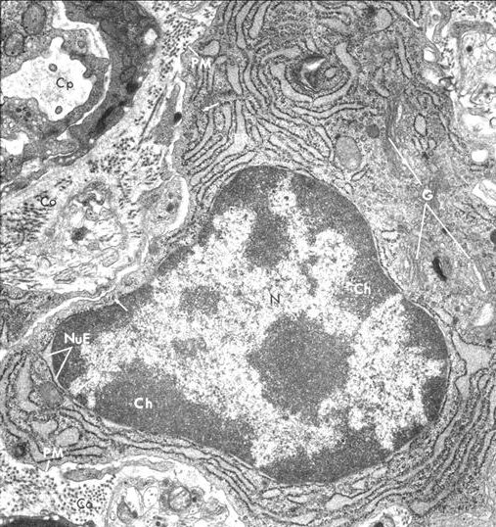
The nucleus contains the genetic material. As you will see shortly, this genetic material can be condensed (dark) or decondensed (pale).
The nucleus is easily the largest structure in most cells (~8 µm in diameter). It has dark clusters just inside its border and possibly a dark spot in the center. Pale regions are found within the central portion of the nucleus.
entire nucleus
part of nucleus

Slide 11
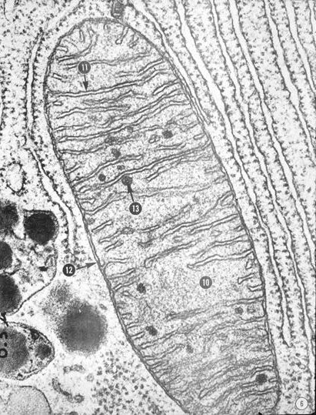
Mitochondria (0.5 – 1 µm wide) are smaller than nuclei. They are usually oblong structures (but will appear round if sectioned tangentially), with an outer membrane that defines it and an inner membrane that folds up into shelf-like ridges.
part of nucleus
mitochondria

Slide 12
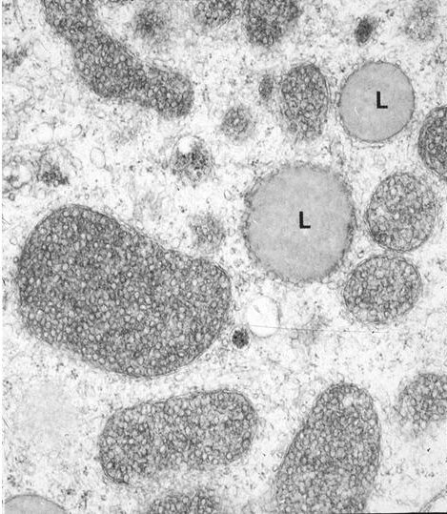
In some cells, the inner membrane of mitochondria forms tubes instead of shelf-like structures. However, you won’t have to worry about that until later.
mitochondria

Slide 13
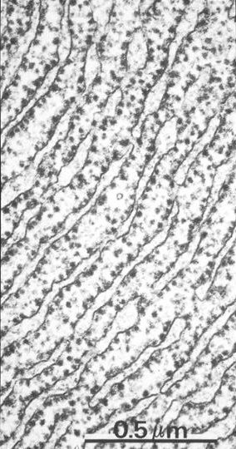
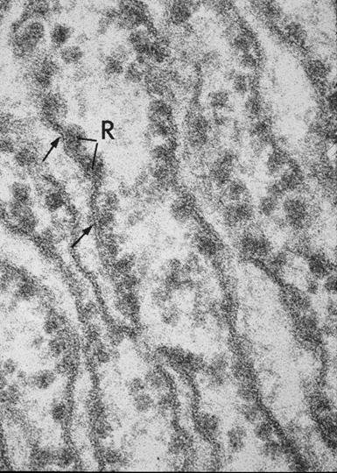
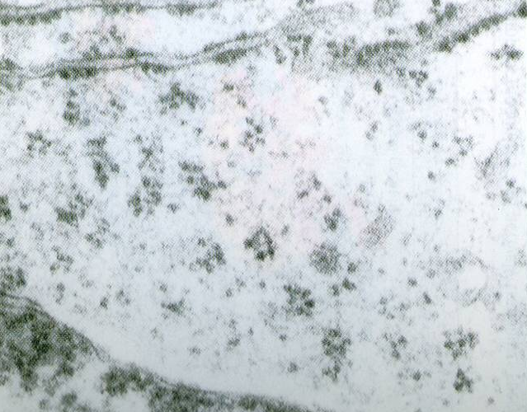
Ribosomes (20-30 nm) are much smaller than mitochondria or nuclei. They appear as fairly dense, spherical structures that are either free in the cytoplasm (lower right image) or attached to the membranes of rough endoplasmic reticulum.
mitochondrion
ribosomes

Slide 14
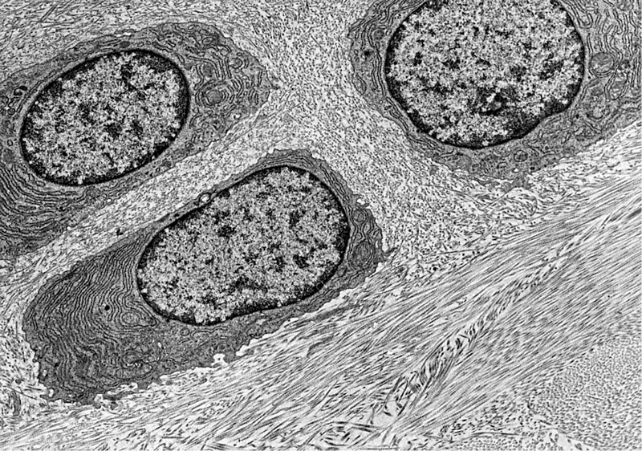
Putting it all together, the next three slides go from a low magnification EM to successively higher magnification EMs, identifying whole cells and our three organelles along the way.
whole cell
nucleus
mitochondria
ribosomes

Slide 15
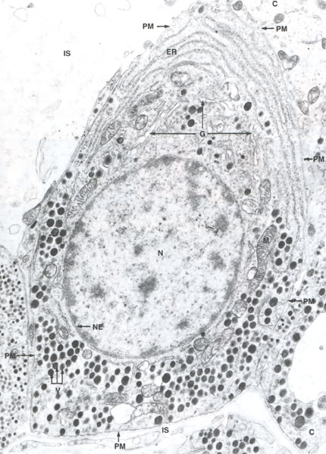
whole cell
nucleus
mitochondria
ribosomes

Slide 16
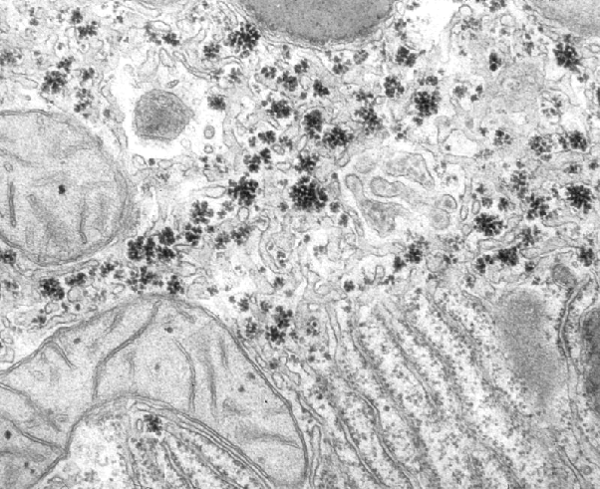
whole cell
nucleus
mitochondria
ribosomes

Slide 17
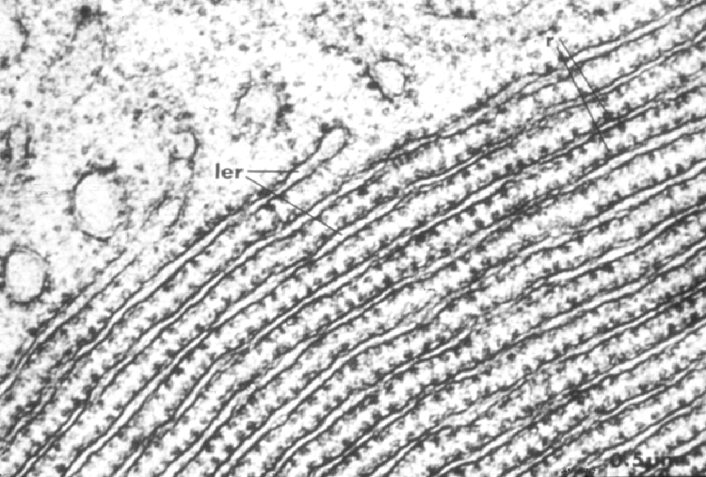
whole cell
nucleus
mitochondria
ribosomes

Slide 18
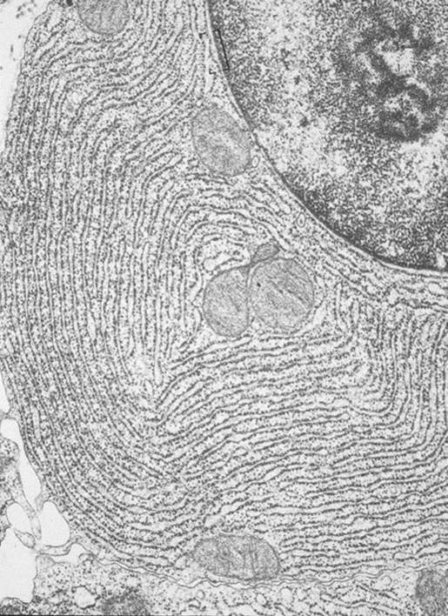
Now, test yourself. The EM below has a field of view that best matches the hot-pink box associated with which letter (A-D)? (advance the slide for the answer)
A
part of nucleus
B
C
C
D
mitochondrion

Slide 19
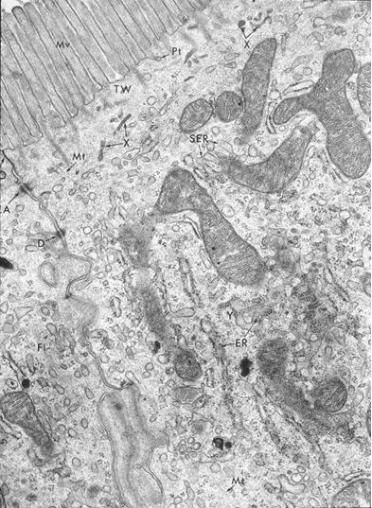
Now, test yourself. The EM below has a field of view that best matches the hot-pink box associated with which letter (A-D)? (advance the slide for the answer)
A
B
mitochondria
C
D
D

Slide 20
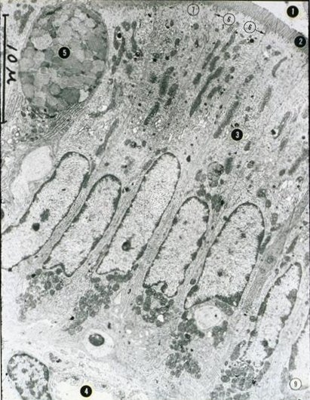
Now, test yourself. The EM below has a field of view that best matches the hot-pink box associated with which letter (A-D)? (advance the slide for the answer)
whole cell
A
B
C
nuclei
A
D

Slide 21
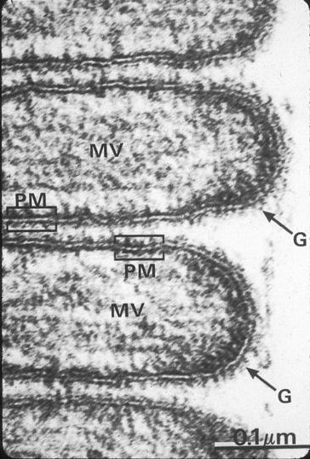
Now, test yourself. The EM below has a field of view that best matches the hot-pink box associated with which letter (A-D)? (advance the slide for the answer)
A
B
C
D
This one is difficult. However, since you cannot see any of the recognizable organelles, you might be thinking that this is a region of the cell much smaller than the box indicated by D. If so, you would be correct (more on this slide later).

Slide 22
Membranes

Slide 23
As you have probably noted, the outer border of cells is demarcated by a membrane, the plasma membrane (red arrows). Also note that the organelles within the cell are partitioned off from the cytoplasm by similar membranes (green arrows). All of these membranes appear as single dense lines at this magnification.

Slide 24
At low magnifications, the plasma membranes of adjacent cells that are close together appear as a single line (red arrows). These adjacent plasma membranes can be seen continuing between the nuclei, but are harder to discern on the other (lower) side due to the fact that they have numerous infoldings.

Slide 25
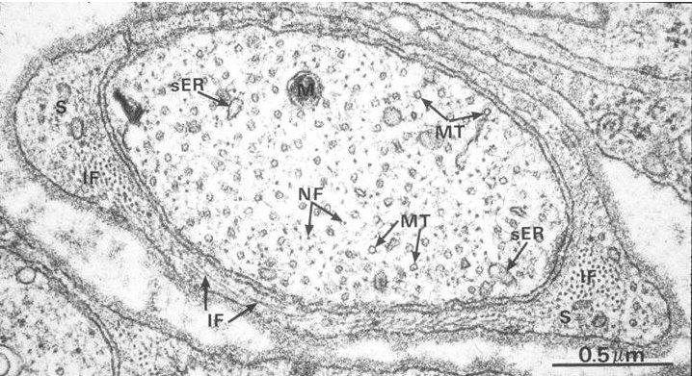
The details of this image aren’t critical for this discussion. For now, suffice it to say that this is a process (an axon) of one cell surrounded by a supporting cell. The plasma membrane of the axon is a single dark line indicated by the red arrows, and the membrane of the supporting cell is indicated by the green arrows. Where the two cells’ membranes are adjacent, each membrane is a dark line, while the intercellular space is the intervening paler region. At this magnification, this “dark-light-dark” appearance indicates two separate membranes.

Slide 26
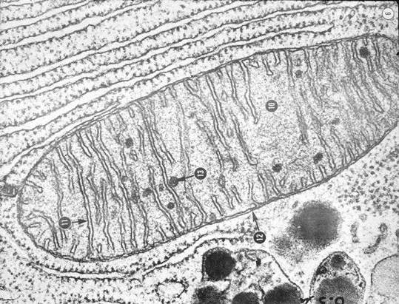
In this image of a mitochondrion and some rough endoplasmic reticulum, you see the membranes of these organelles as single dark lines. Again, at this magnification, where two membranes are close together, the membranes and the intervening space creates a “dark-light-dark” appearance. Also notice some places where the membranes get “fuzzy”…these indicate places where the plane of the membrane is not at right angles to the plane of the section.

Slide 27
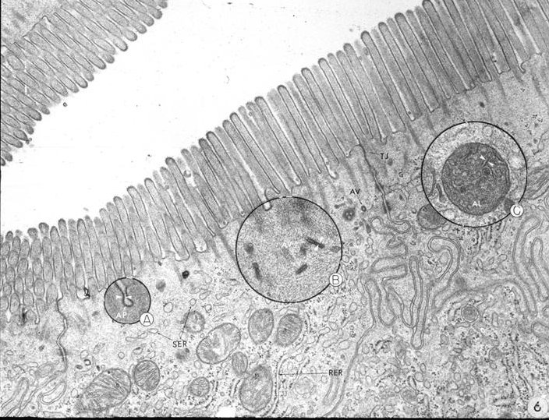
Here’s an image in which the dark line indicating the plasma membrane has numerous undulations, creating a cell surface feature known as microvilli. These fingerlike projections of the plasma membrane have a core of cytoplasm (and supporting proteins). The red arrows indicate the tips of the microvilli.

Slide 28
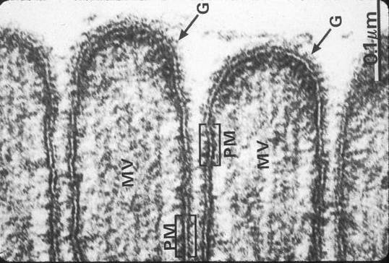
This is an EM of the tips of the microvilli. You can guess that this is a highly magnified image by the absence of any of our featured organelles. The plasma membrane of this cell is between the red arrows. At this magnification, it is revealed that the membranes that appeared as single lines at lower magnifications in the previous images actually have a pale central region. Here, the “dark-light-dark” pattern represents one plasma membrane, not two. The thickness of the plasma membrane and other membranes in the cell is approximately 10 nm.

Slide 29
The Organelles

Slide 30
The Organelles
more about the nucleus

Slide 31
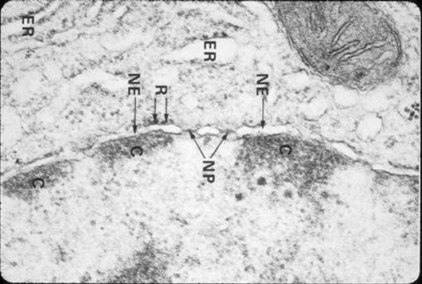
The nucleus – We have already discussed some features of the nucleus, including its round or oblong structure. The nucleus is bounded by two membranes, indicated by the red arrows in the image on the right. If you look very closely, you will see that the outer membrane is studded with a few ribosomes, making this part of the nuclear membrane similar to rough endoplasmic reticulum. There are channels through the nucleus, called nuclear pores (NP), through which the cytoplasm and nucleoplasm communicate.

Slide 32
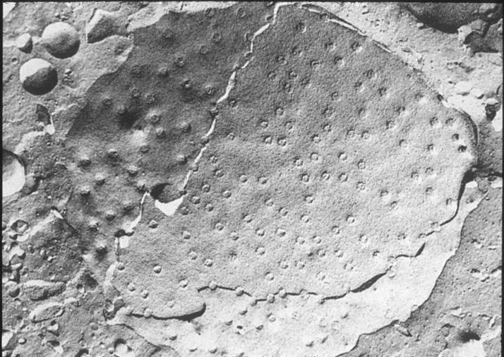
The nucleus – A freeze-fracture EM of the nuclear membrane demonstrates the two nuclear membranes and nuclear pores.

Slide 33
The nucleus – One of the hallmark EM features of the nucleus is the genetic material. The condensed genetic material is relatively inactive in terms of gene expression and is referred to as heterochromatin, while the decondensed genetic material is undergoing gene expression and is referred to as euchromatin.

Slide 34
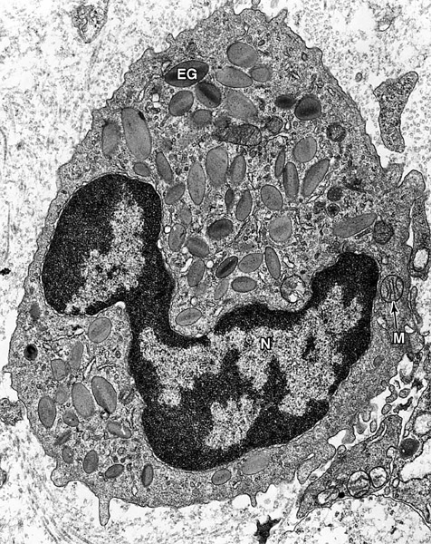
The nucleus – The activity of a cell can be ascertained by examining the relative amounts of heterochromatin and euchromatin. The cell to the left is an eosinophil, which is relatively inactive. The cell on the right is a hepatocyte, one of the most active cells in the body. The hepatocyte has much more euchromatin, while the eosinophil has much more heterochromatin.
There are many other features of a cell, such as the amount of rough endoplasmic reticulum, that give clues about that cell’s relative activity level.

Slide 35
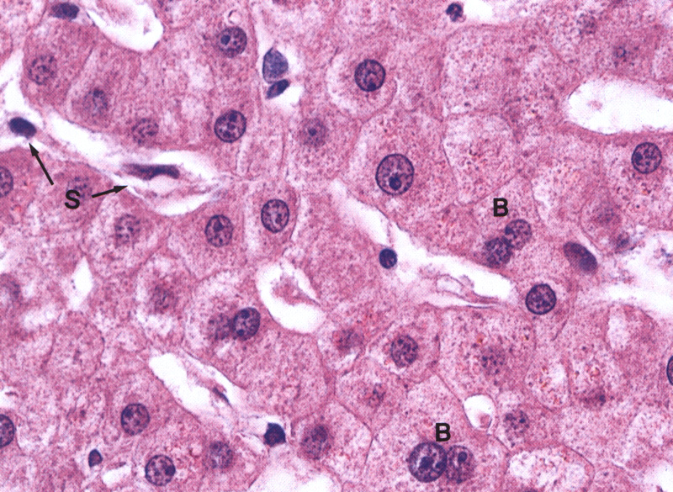
Hematoxylin and eosin (H&E) of hepatocytes – Recall from session on light microscopy that a pale staining nucleus (e.g. red arrow) was characteristic of an active cell when using the light microscope. As mentioned on the previous slide, this parallels the observation on EM.

Slide 36
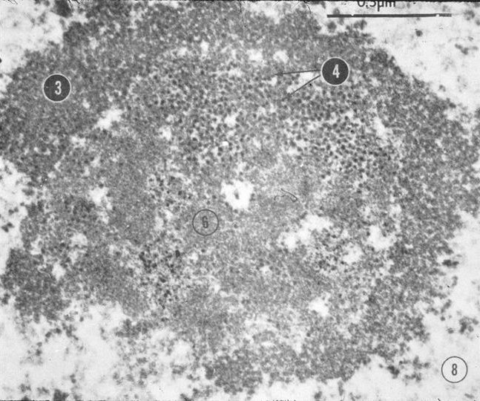
The nucleus – As you may have noticed, active cells with mostly euchromatin in the nucleus typically have a dark region in the center of the nucleus. This region, the nucleolus (red arrow), is involved in the synthesis of rRNA and the assembly of ribosome subunits. The image to the right is an enlarged view of the nucleolus; you do not need to know the regions of the nucleolus (3, 4, 6 in right image).

Slide 37
The Organelles
smooth endoplasmic reticulum,
rough endoplasmic reticulum,
and the Golgi apparatus

Slide 38
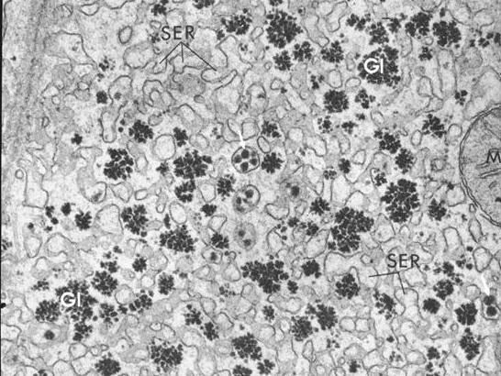
Smooth endoplasmic reticulum (sER) – Smooth endoplasmic reticulum is a membrane bound organelle which forms a network of many branched tubules. The lumen of the sER is indicated by the tips of the leaders in the EM below. In three dimensions, this network of tubules somewhat resembles the branches of a tree, so that when viewed in sections (as in TEM), sER appears as numerous small, somewhat round structures. Unlike rough endoplasmic reticulum (rER), the membrane of sER is ribosome-free. sER is often found near glycogen granules (Gl). sER is involved in many biochemical pathways, many of which involve lipids. SER is continuous with rER.

Slide 39
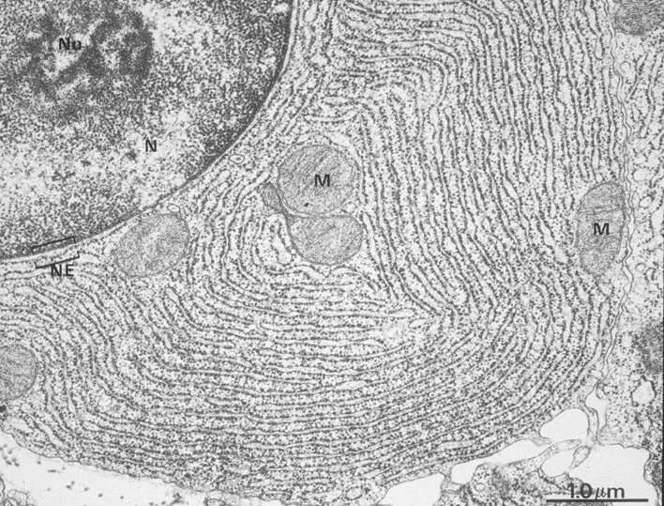
Rough endoplasmic reticulum (rER) – Rough endoplasmic reticulum is fairly easily recognized under higher magnification (left image) due to the fact that the ribosomes stud the cytoplasmic face of its membrane. However, even at low magnification where the ribosomes are less obvious (right image), rER is easy to recognize because it tends to form stacks of plates that appear as linear tubes when sectioned.
rER fills virtually all of the circle, except where mitochondria (M) are indicated
lumen of rER

Slide 40
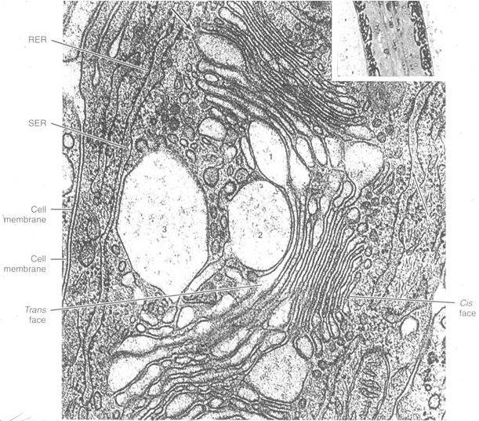
the Golgi apparatus – On EM, a good image of the Golgi apparatus appears as a hybrid of rER and sER; It is stacked into plates like rER, but is not studded with ribosomes. The stacks of membranes tend to bow to one side (here the concavity is toward the left), helping you determine the cis and trans faces. The outer edges of the Golgi plates are swelled into characteristic cisterna.

Slide 41
the Golgi apparatus – The previous slide had a nice image of the Golgi apparatus. Unfortunately, the Golgi apparatus in most cells is much more difficult to visualize. However, note that rER and Golgi are partners in crime (see two slides forward); therefore, where there is rER, there must be Golgi. In this plasma cell that is loaded with rER, the location of the Golgi (G) can be deduced as the region just above and to the right of the nucleus where rER is absent (and you can make out a few of the plates in section).

Slide 42
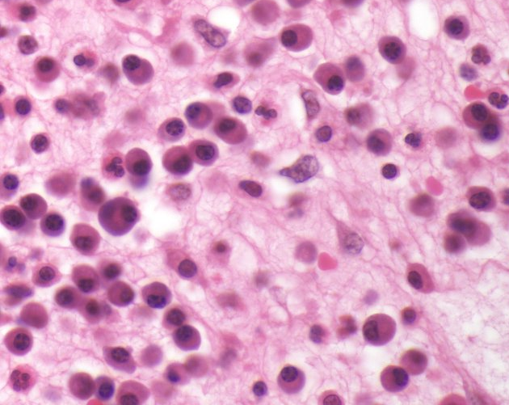
rER and Golgi – When viewing the same type of plasma cell stained with H&E (e.g. green circle), you can see the intense cytoplasmic basophilia in these cells. This is due to the abundant rER in the cytoplasm of these cells. More subtle is that the presence of the Golgi adjacent to the nucleus in these cells produces an area that is less intensely basophilic (because it is an rER void). This region is referred to as a Golgi ghost.

Slide 43
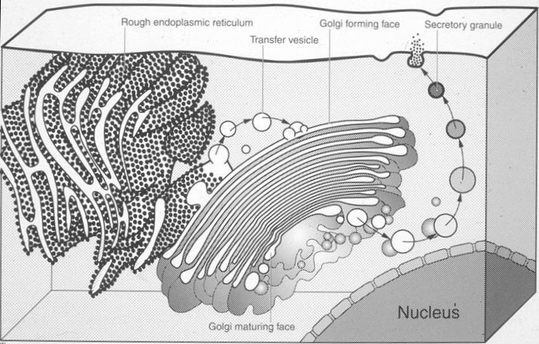
rER and Golgi – To preview upcoming sessions, proteins synthesized on ribosomes that stud the rER are inserted into its lumen. From here, vesicles containing these proteins bud from the rER and fuse with the cis face of the Golgi. Further processing involves movement of the protein through the Golgi (from the cis to the trans face). Finally, the processed protein is packaged in a vesicle that leaves the trans Golgi and is targeted to another cellular location or to the cell surface.

Slide 44
Mitochondria – we have already mentioned many of the features of mitochondria, including their inner and outer membranes.
part of nucleus
mitochondria

Slide 45
We’ve already mentioned much about ribosomes. They appear as dense granules, and are much easier to spot studding rough endoplasmic reticulum than to definitively identify as free ribosomes.
ribosomes

Slide 46
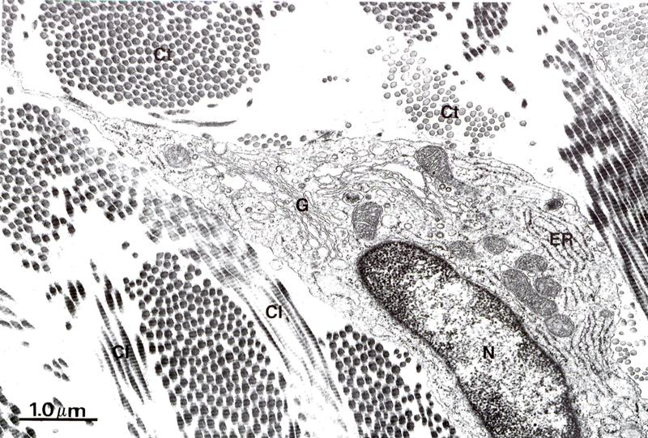
extracellular matrix – The cell in this EM is outlined roughly in green…its plasma membrane is more specifically indicated in places by the arrows. Everything outside the cell is the extracellular matrix, recognized by the absence of cellular organelles. Although much of the extracellular region is clear, it also contains darkly staining structures (here it is collagen).

Slide 47
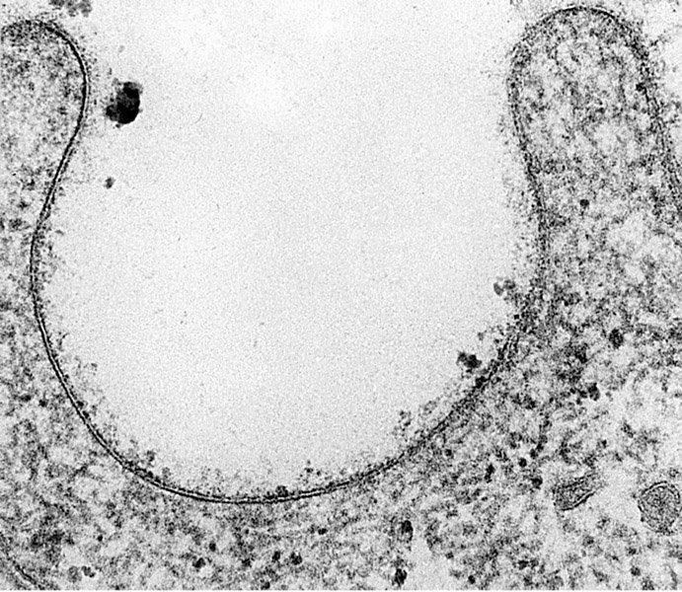
extracellular matrix – In this highly magnified image of the plasma membrane, the extracellular matrix is pale. The cytoplasmic side of the plasma membrane is generally much darker, and, even at this magnification, will show cytoskeletal elements and/or organelles.
extracellular

Slide 48
Other organelles, such as lysosomes, secretory granules, peroxisomes, and lipid droplets, as well as cytoskeletal elements and inclusions, will be examined in a later module.

Slide 49
Final Quiz

Slide 50
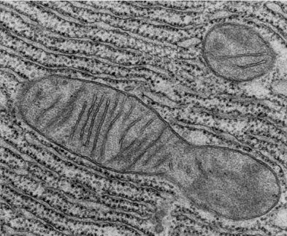
Identify the structures indicated. (advance the slide for the answer)
rough endoplasmic reticulum (rER)
mitochondrion

Slide 51
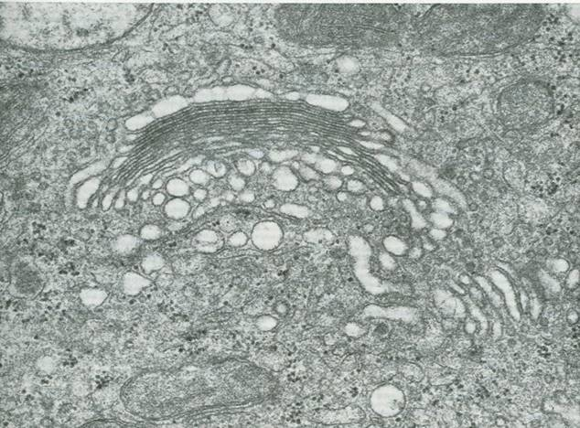
Identify the structure indicated. (advance the slide for the answer)
Golgi apparatus

Slide 52
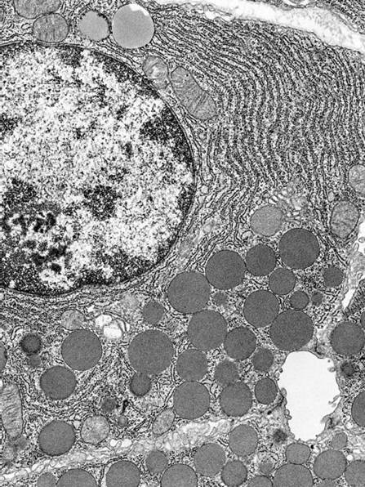
Identify the structures indicated. (advance the slide for the answer)
rER
nucleus
mitochondrion

Slide 53
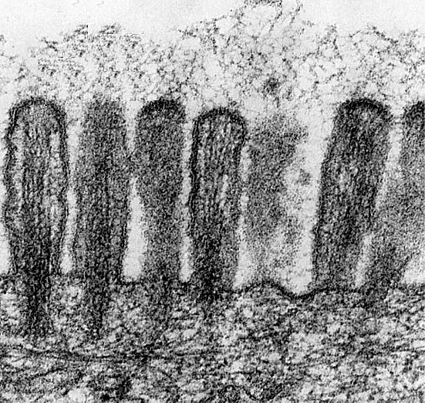
Identify A. (advance the slide for the answer)
extracellular space
A

Slide 54
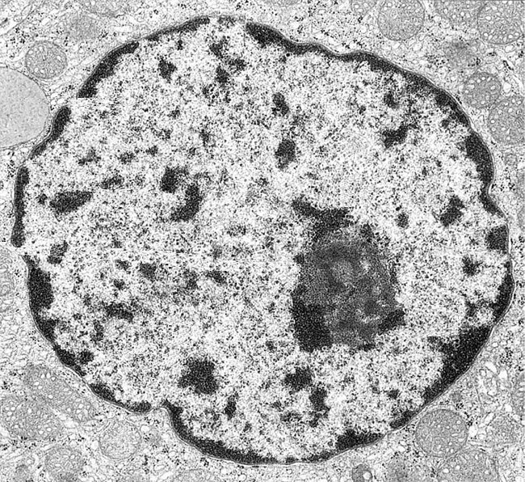
Identify the structures indicated. What is the significance of each? (advance the slide for the answer)
euchromatin – decondensed (active) genetic material
nucleolus – ribosome assembly
heterochromatin – condensed (inactive) genetic material

Slide 55
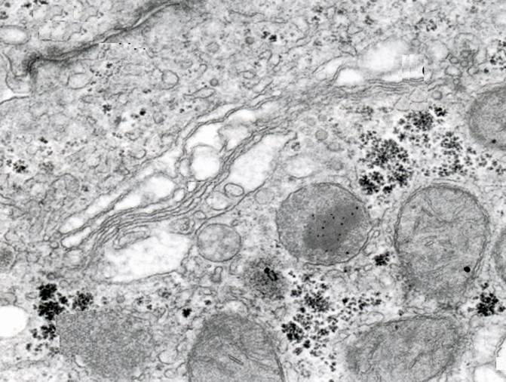
Identify the structures indicated. (advance the slide for the answer)
Golgi apparatus (this is tough)

Slide 56
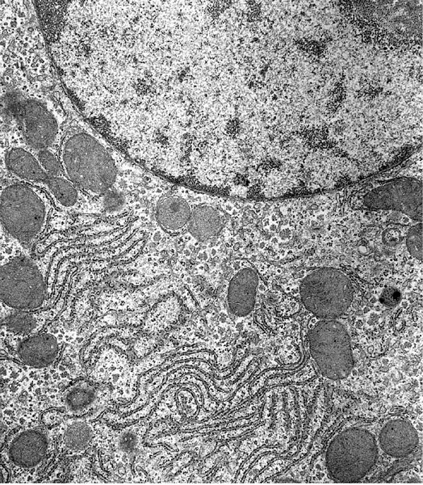
Identify the structures indicated. (advance the slide for the answer)
nucleus
rough endoplasmic reticulum

Slide 57
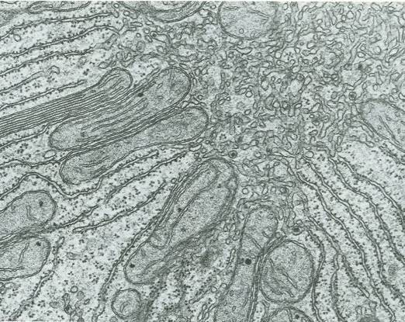
Identify the structures indicated. (advance the slide for the answer)
smooth endoplasmic reticulum
mitochondria

