Slide 1
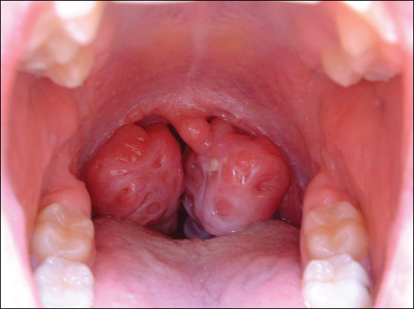
Diffuse Immune Tissues: Digital Laboratory
It’s best to view this in Slide Show mode, especially for the quizzes.
This module will take approximately 45 minutes to complete.

Slide 2
After completing this exercise, you should be able to:
Distinguish, at the light microscope level, each of the following::
Diffuse lymphoid tissue
Palatine tonsils
Stratified squamous epithelium
Connective tissue septa
Crypts
Nodules
Primary
Secondary
Germinal centers
Corona
Cell types
Blast forms of lymphocytes
Mitotic figures
Macrophages (tingible macrophages)
(reticular or dendritic cells)
(Plasma cells)
Pharyngeal tonsils
Same as palatine tonsil, except covered with stratified squamous epithelium and pseudostratified ciliated columnar epithelium with goblet cells
Distribution of T and B cells using immunostaining
Distinguish, in electron micrographs, each of the following :
Be able to interpret electron micrographs of lymphoid organs if given the source tissue

Slide 3
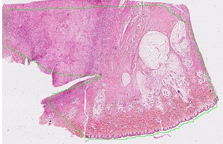
Diffuse lymphoid tissue
inflammation
This is a slide from the skin, the epithelium is at the bottom of the slide.
Recall that organs of our body that are exposed to the outside world (either directly or indirectly) are lined with epithelia, which separates spaces of the outside world from the underlying connective tissues. This is the case for the skin, digestive tract, respiratory tract, and urinary system, and the epithelia play a role in keeping pathogenic agents from accessing the underlying connective tissues. As we mentioned in a previous module, when the epithelium is breached, white blood cells migrate to the area in large numbers, creating a site of inflammation.

Slide 4
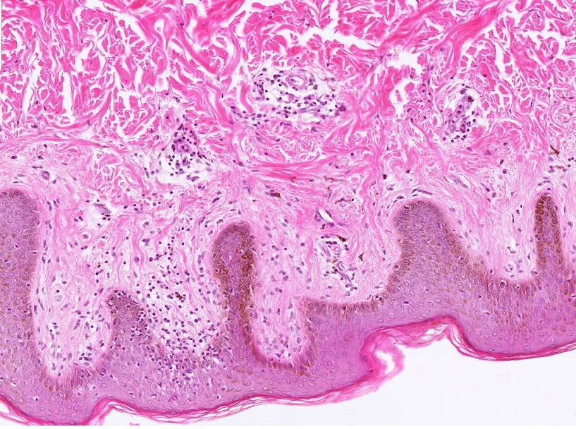
Diffuse lymphoid tissue
However, even in areas where the epithelium is not visibly breached, smaller numbers of white blood cells are seen in the underlying connective tissue . These regions are referred to as diffuse lymphoid tissue. Note the density of the white blood cells varies.

Slide 5
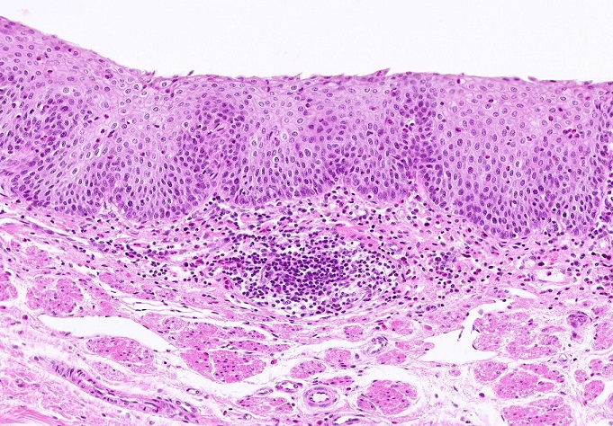
Diffuse lymphoid tissue
Remember that many of these cells are lymphocytes, and when they crowd together like this, it gives the region an overall basophilic appearance when compared to the surrounding connective tissue.
In this slide from the esophagus, you can see diffuse lymphoid tissue both within and surrounding the outlined region. In the outlined region, the white blood cells have become more aggregated, forming a round structure referred to as a nodule (aka follicle) For reasons we will explain later, histologists refer to this as a primary nodule because the density of the white blood cells is relatively consistent throughout the nodule.

Slide 6
Diffuse lymphoid tissue
Also, don’t forget that diffuse immune tissue is transient. It’s likely that this area was not infiltrated a day or two ago (more or less), and the white blood cells here will either perish or leave the area soon.
However, a tissue that is exposed to the outside world will always have some diffuse lymphoid tissue in its connective tissue.

Slide 7
Diffuse lymphoid tissue
Video of esophagus showing diffuse lymphoid tissue – SL16
Link to SL 016
Be able to identify:
Diffuse lymphoid tissue
Nodules (primary)

Slide 8
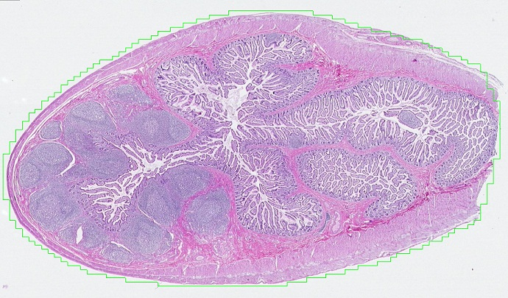
Specialized Diffuse lymphoid tissue – peyer’s patches
We’ll study the intestine later. The lumen is the convoluted space, which is lined by a simple columnar epithelium with goblet cells.
In certain regions of the body, notably the digestive tract, diffuse lymphoid tissue and lymphoid nodules are more consistent features. Here in the ilium of the small intestine, large nodules (two are outlined) are numerous. These are referred to as Peyer’s Patches. Even at this low magnification, you can see that most of the nodules have a paler central region. This pale region is referred to as a germinal center, and nodules with a germinal center are called secondary nodules.

Slide 9
Specialized Diffuse lymphoid tissue – peyer’s patches
Video of ilium showing Peyer’s Patches – SL11
Link to SL 011
Be able to identify:
Diffuse lymphoid tissue (Peyer’s Patches)
Nodules (secondary)

Slide 10
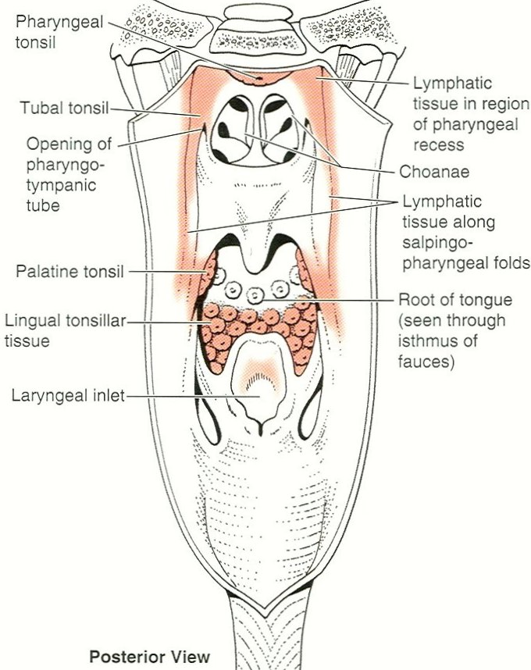
Specialized Diffuse lymphoid tissue – Tonsils
This image is a posterior view, with the posterior wall of the pharynx opened up to show the nasal, oral, and laryngeal openings. Tonsillar tissue is colored.
The pharynx, the common tube for the digestive and respiratory tracts, is “guarded” by a ring of tonsils (called the ring of Waldeyer). These structures are strategically placed to initiate an immune response to antigens that are entering the body. The major features of this ring are the singular pharyngeal and lingual tonsils, and the paired palatine tonsils.

Slide 11
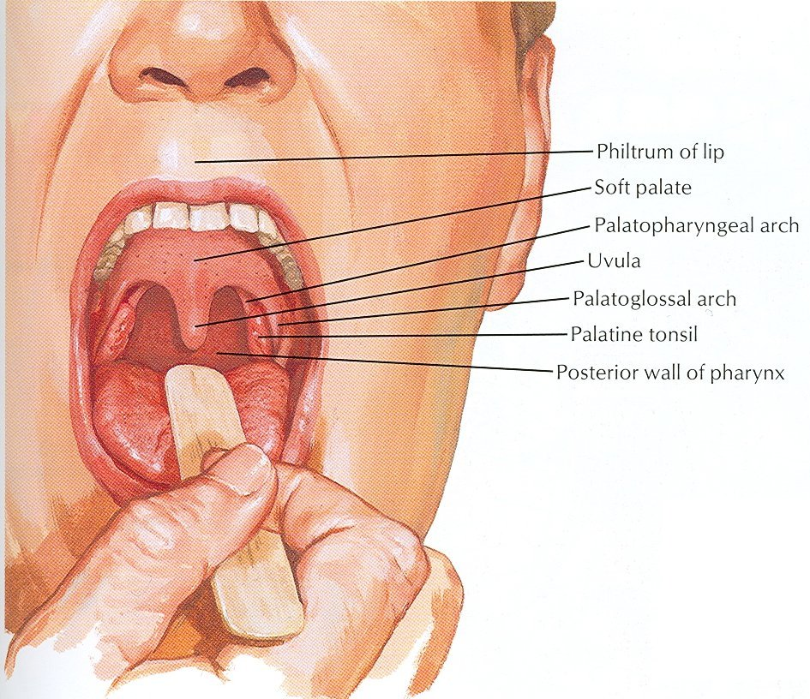
Specialized Diffuse lymphoid tissue – palatine Tonsils
The clinical view of the palatine tonsils shows them situated between the palatoglossal and palatopharyngeal arches.
If you look closely, you can see that the tonsils are “pitted”.

Slide 12
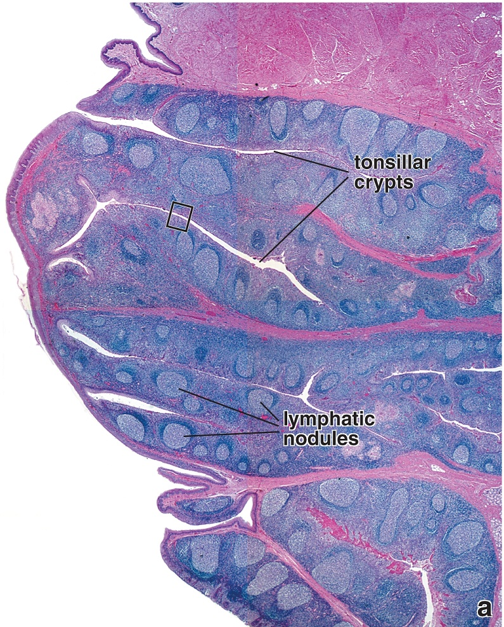
Specialized Diffuse lymphoid tissue – palatine Tonsils
The digestive tract is lined by a mucosa, an epithelium with underlying connective tissue.
As part of the lining of the digestive tract, the tonsils are essentially a mucosa populated by abundant diffuse lymphoid tissue and numerous lymphoid nodules.
Lumen of oral cavity
As we mentioned on the previous slide, the tonsils are “pitted”. These deep invaginations of the epithelium are called tonsillar crypts. Due to sectioning, some are obviously connected to the lumen of the oral cavity, while others appear embedded within the tonsil but are nonetheless connected to the oral cavity in a different plane.
Connective tissue septa (black arrows) partition the tonsil from the deeper aspect.
Lumen of oral cavity

Slide 13
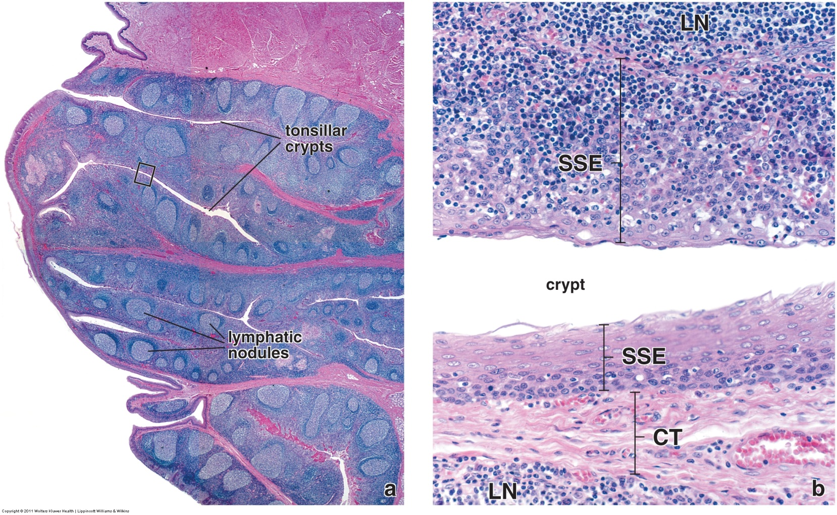
Specialized Diffuse lymphoid tissue – palatine Tonsils
Lumen of oral cavity
Lumen of oral cavity
In this nice image from your text, you can see that the crypts are lined by stratified squamous epithelium (non-keratinized, SSE). Typically, the epithelium of the crypts will be less stratified relative to the epithelium of the oral cavity or esophagus (less friction). In many regions, the underlying nodules have “grown into” the epithelium (upper wall of crypt), obscuring the typical appearance of the epithelium and its border with the connective tissue.

Slide 14
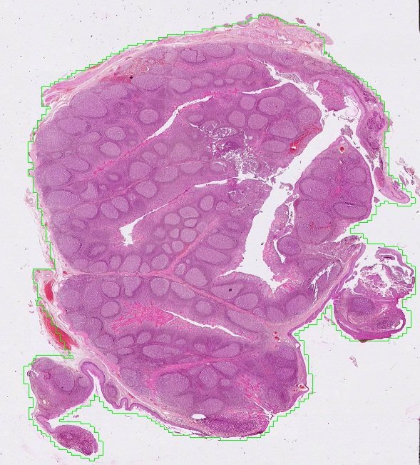
Specialized Diffuse lymphoid tissue – palatine Tonsils
In our slide, the surface epithelium is more torn than the previous slide. Nevertheless, you will see regions of the palatine tonsil covered with stratified squamous (non-keratinized) epithelium (black arrows).
Tonsillar crypts (yellow arrows) and septa (green arrows) are indicated.
Lumen of oral cavity

Slide 15
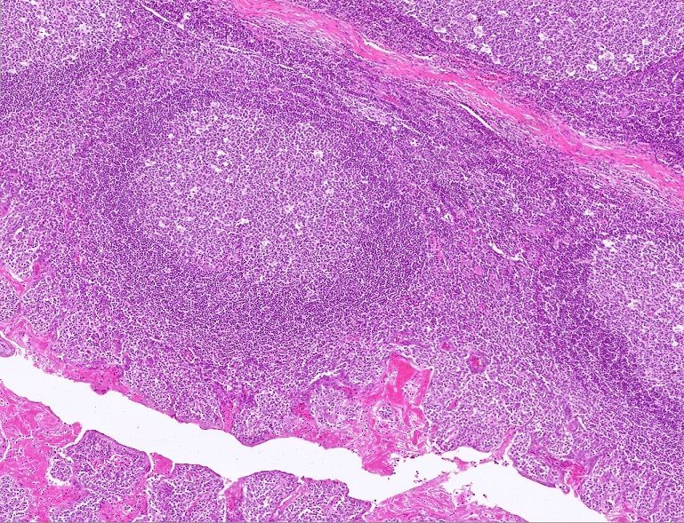
Specialized Diffuse lymphoid tissue – palatine Tonsils
This higher magnification shows both a tonsillar crypt (yellow arrows) and septum (green arrows). Note the crypt has a lumen, lined by a fairly disrupted epithelium, while the septum is composed of dense irregular connective tissue.

Slide 16
Specialized Diffuse lymphoid tissue – palatine tonsils
Video of palatine tonsil showing orientation, crypts and septa – SL75
Link to SL 075
Be able to identify:
Palatine tonsil
Crypts
Septa

Slide 17
Specialized Diffuse lymphoid tissue – palatine Tonsils
Most of the nodules in the tonsils are secondary nodules, with pale germinal centers. Rare primary nodules (black arrow) may be seen, though it’s possible that these could be cuts through the edge of a secondary nodule
As we will see in the next set of slides, primary nodules consist of unstimulated lymphocytes. Because these “resting” cells are small, they are closely packed; thus the dark appearance of these nodules.
Stimulation of lymphocytes with antigen causes them to proliferate. Dividing lymphocytes are larger than their unstimulated counterparts, and, therefore, germinal centers are lighter because the nuclei in these regions are further apart (because the cells are larger).

Slide 18
Specialized Diffuse lymphoid tissue – palatine Tonsils
Germinal center
Secondary nodules (black outline) are defined by their paler central region called the germinal center. The darker region is typically thicker on one side of the nodule; this region is referred to as the corona.

Slide 19
Specialized Diffuse lymphoid tissue – palatine tonsils
Video of palatine tonsil showing nodules – SL75
Link to SL 075
Be able to identify:
Palatine tonsil
Primary nodules
Secondary nodules
Germinal center
Corona

Slide 20
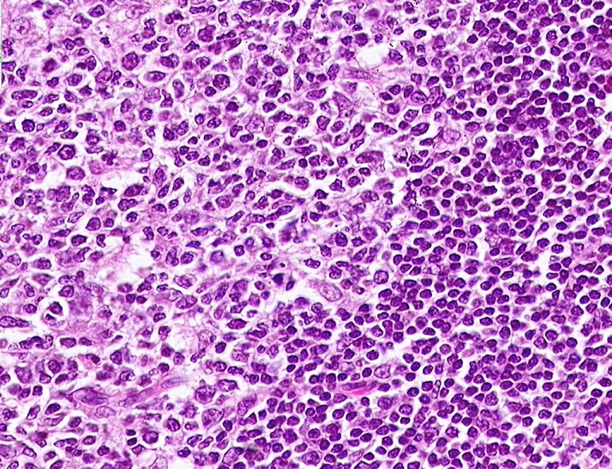
Specialized Diffuse lymphoid tissue – palatine Tonsils
Focusing in on a high magnification image of a secondary nodule, you can see that the outer region of the nodule (outlined) is filled with unstimulated (“resting”) small lymphocytes, each demonstrating a condensed, heterochromatic nucleus and thin rim of cytoplasm.

Slide 21
Specialized Diffuse lymphoid tissue – palatine Tonsils
In contrast, lymphocytes in the germinal center (outlined) have been stimulated to proliferate. Although many of these cells are enlarged, the cells that demonstrate the largest nuclei (arrows) are clearly dividing cells and are referred to as blast forms.

Slide 22
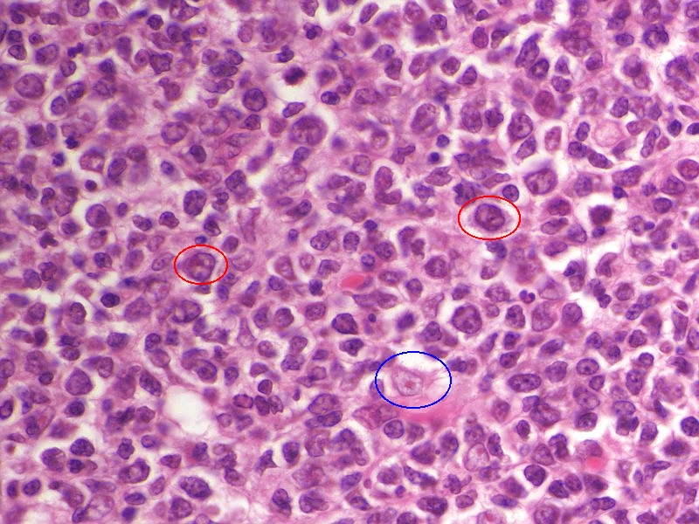
Specialized Diffuse lymphoid tissue – palatine Tonsils
In this high magnification of a germinal center, blast cells are outlined in red. Note the large euchromatic nucleus and very slightly more substantial cytoplasm. (when compared to unstimulated lymphocytes). A macrophage is indicated (blue outline) for comparison; note the very euchromatic nucleus and prominent nucleolus in the macrophage, as well as the pale-eosinophilic cytoplasm.

Slide 23
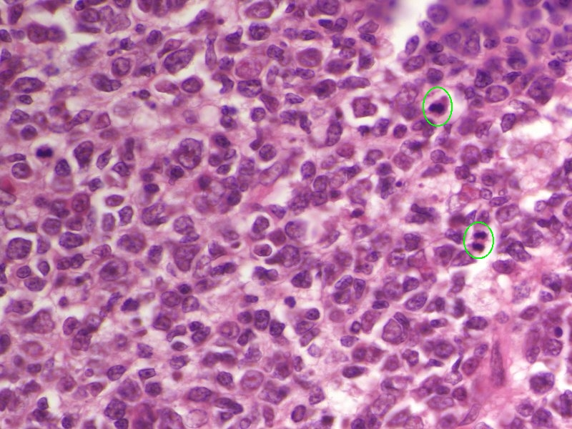
Specialized Diffuse lymphoid tissue – palatine Tonsils
In this region of the germinal center, you can see two mitotic figures (green outline), reinforcing the notion that lymphocytes are undergoing proliferation in the germinal center.

Slide 24
Specialized Diffuse lymphoid tissue – palatine Tonsils
This image indicates several more macrophages (red arrows) to compare to the blast forms of lymphocytes (black arrows).

Slide 25
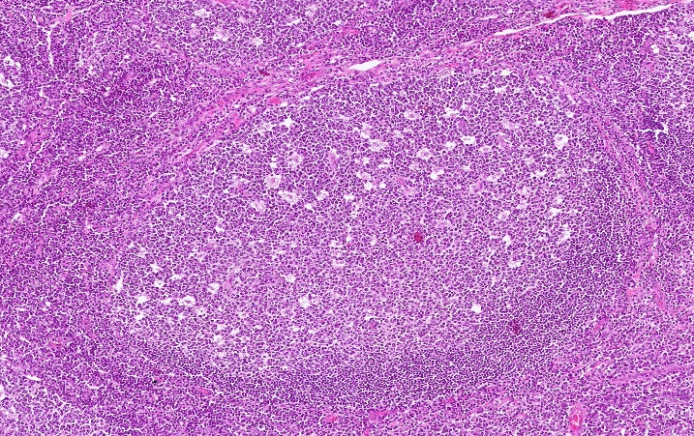
Specialized Diffuse lymphoid tissue – palatine Tonsils
Dude, I totally see, like, stars, man, don’t you?
Macrophages are large cells, and, therefore, occupy a space relatively devoid of lymphocytes. Therefore, under low or medium magnification, the location of the macrophages appears pale when compared to the packed in lymphocytes (even paler than the germinal center itself). Some histologist way back when looked at this and imagined a “starry sky” appearance. They are also referred to as “tingible” macrophages.

Slide 26
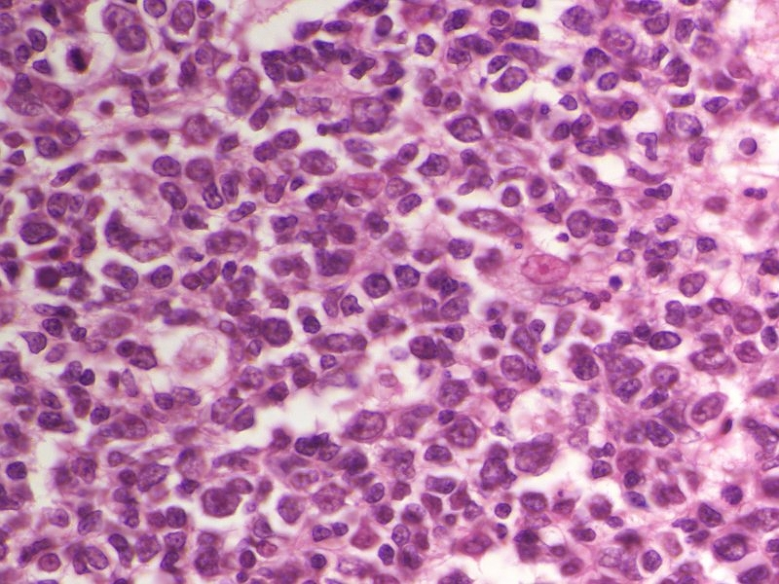
Specialized Diffuse lymphoid tissue – palatine Tonsils
That macrophage indicated by the red arrow is totally awesome!!!
I hope you were sitting down when you saw it.
Finally, tapered cells with relatively flattened nuclei can also be seen (yellow arrows). These belong to one of several different cells (you do NOT need to distinguish between these):
reticular cells – fibroblast-like cells that synthesize the collagen framework
dendritic cells – process and present antigens to lymphocytes
follicular dendritic cells – trap and present antigens to lymphocytes

Slide 27
Specialized Diffuse lymphoid tissue – palatine tonsils
Video of palatine tonsil showing cell types – SL75
Link to SL 075
Be able to identify:
Palatine tonsil
Small lymphocytes
Blast forms
Macrophages (tingible macrophages)
(Reticular or dendritic cells - don’t need to distinguish, but ID them from lymphocytes and macrophages)
(Plasma cells are rarely seen in germinal centers, so don’t look for them)

Slide 28
Specialized Diffuse lymphoid tissue – pharyngeal tonsils
The nasal cavity is lined by respiratory epithelium, namely pseudostratified ciliated columnar epithelium with goblet cells. This epithelium is useful to trap and remove particulate matter in inspired air.
The oral cavity and pharynx are lined by stratified squamous non-keratinized epithelium, which helps to resist friction from passing food.
The pharyngeal tonsils are histologically similar to the palatine tonsils, with one major exception. They are situated in the transition zone between the nasal cavity and pharynx. Therefore, although a portion of the pharyngeal tonsil (the lower portion, red arrow) is lined by stratified squamous non-keratinized epithelium, at least part of it (the upper, “nasal” portion, black arrow) is lined by respiratory epithelium.
Also, the spaces equivalent to crypts of the palatine tonsils are wider here, so the term crypts is typically not used for the pharyngeal tonsils.

Slide 29
Specialized Diffuse lymphoid tissue – pharyngeal tonsils
The nasal cavity is lined by respiratory epithelium, namely pseudostratified ciliated columnar epithelium with goblet cells. This epithelium is useful to trap and remove particulate matter in inspired air.
The oral cavity and pharynx are lined by stratified squamous non-keratinized epithelium, which helps to resist friction from passing food.
The pharyngeal tonsils are histologically the same as the palatine tonsils, with one exception. They are situated in the transition zone between the nasal cavity and pharynx. Therefore, although a portion of the pharyngeal tonsil (the lower portion, red arrow) is lined by stratified squamous non-keratinized epithelium, at least part of it (the upper, “nasal” portion, black arrow) is lined by respiratory epithelium.
This is the only real distinction between these two structures; but those who want credit on exams will be aware of this.

Slide 30
Specialized Diffuse lymphoid tissue – palatine tonsils
Video of pharyngeal tonsil– SL76
Link to SL 076
Be able to identify:
Pharyngeal tonsil
Respiratory epithelium
All other structures same as palatine tonsils

Slide 31
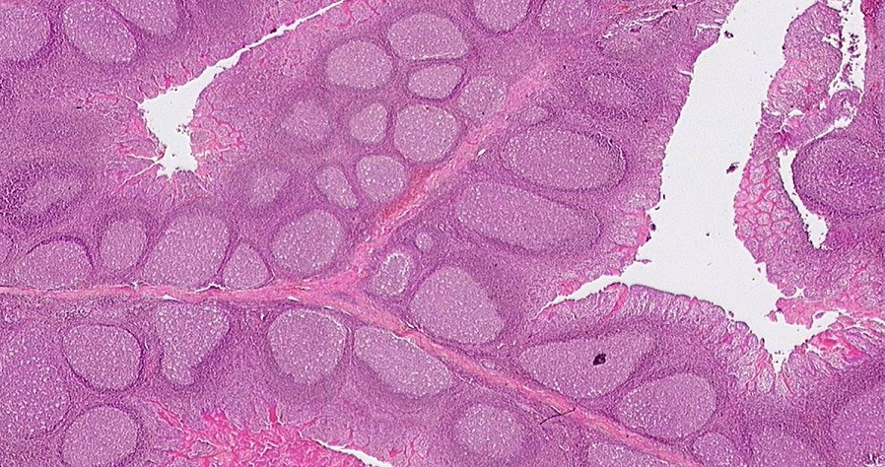
Specialized Diffuse lymphoid tissue – T cell And B cell localization
In the tonsils, B lymphocytes are more concentrated in the nodules, while T lymphocytes are concentrated in the regions between the nodules. However, in standard H&E sections, this is not apparent because B and T cells are indistinguishable.

Slide 32
Specialized Diffuse lymphoid tissue – T cell And B cell localization
Anti-B cell antibody
Anti-T cell antibody
We can determine the cellular distribution of B and T lymphocytes using immunocytochemistry. In this slide, slices of palatine tonsil were incubated with antibodies to a specific marker for B cells (left) or T cells (right). After washing, a secondary antibody conjugated to horseradish peroxidase was used, after which the location of the antibodies (and, therefore, the cell-specific markers) was visualized using a substrate that turns brown in the presence of the enzyme. This confirms the localization of B cells to the nodules, and T cells to the region between the nodules (paranodular region). Note that this localization is not exclusive, i.e. some B cells are found between nodules, and T cells within nodules.

Slide 33
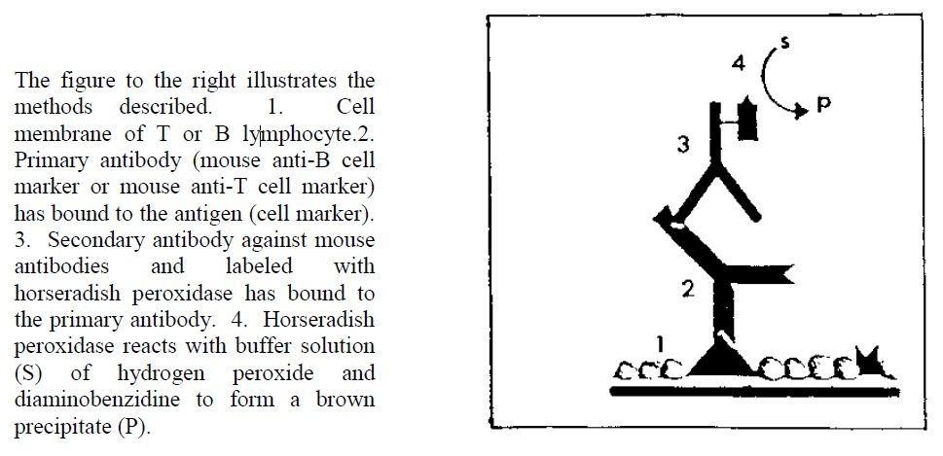
Specialized Diffuse lymphoid tissue – T cell And B cell localization
This drawing reviews immunocytochemistry if you need to recall this procedure.

Slide 34
Specialized Diffuse lymphoid tissue – T cell And B cell localization
Video of palatine tonsil immunocytochemistry – SL170
Link to SL 170B and SL 170T
Be able to identify:
Localization of B and T lymphocytes using immunocytochemistry

Slide 35
The next set of slides is a quiz for this module. You should review the structures covered in this module, and try to visualize each of these in light and electron micrographs:
Distinguish, at the light microscope level, each of the following::
Diffuse lymphoid tissue
Palatine tonsils
Stratified squamous epithelium
Connective tissue septa
Crypts
Nodules
Primary
Secondary
Germinal centers
Corona
Cell types
Blast forms of lymphocytes
Mitotic figures
Macrophages (tingible macrophages)
(reticular or dendritic cells)
(Plasma cells)
Pharyngeal tonsils
Same as palatine tonsil, except covered with stratified squamous epithelium and pseudostratified ciliated columnar epithelium with goblet cells
Distribution of T and B cells using immunostaining
Distinguish, in electron micrographs, each of the following :
Be able to interpret electron micrographs of lymphoid organs if given the source tissue

Slide 36
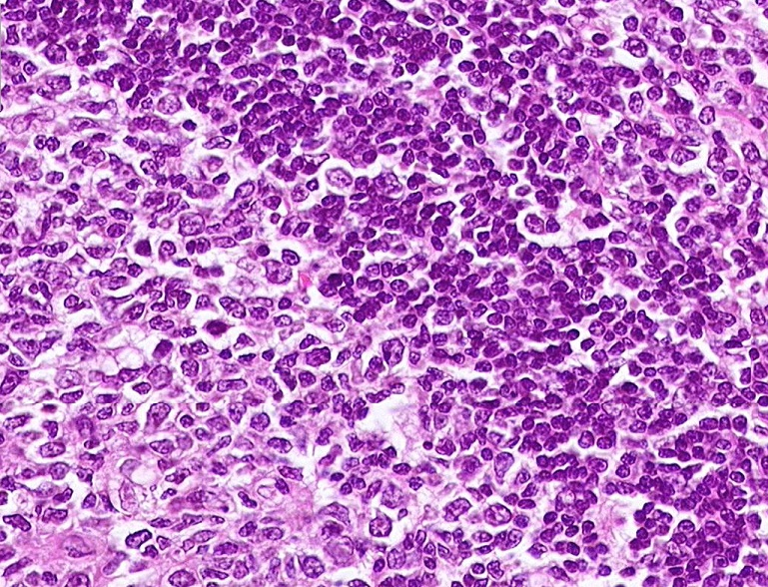
Final quiz
Self-check: Identify the cells indicated by the arrows. (advance slide for answer)
B lymphocytes (unstimulated)

Slide 37
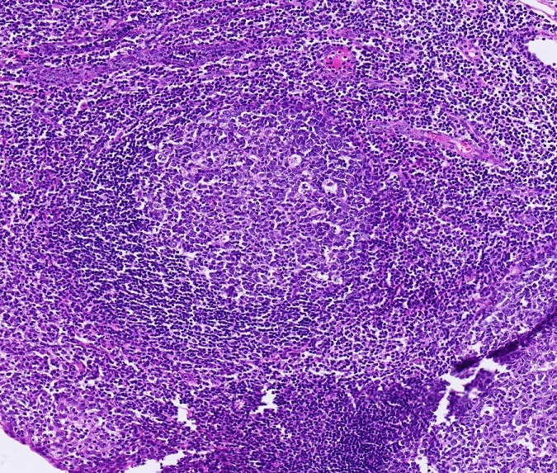
Final quiz
Self-check: Identify the outlined region. (advance slide for answer)
corona

Slide 38
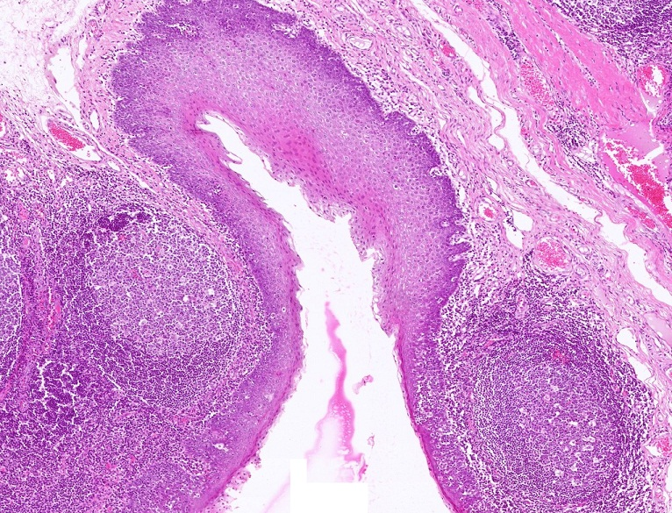
Final quiz
Self-check: Identify the structure / organ. (advance slide for answer)
Palatine tonsil

Slide 39
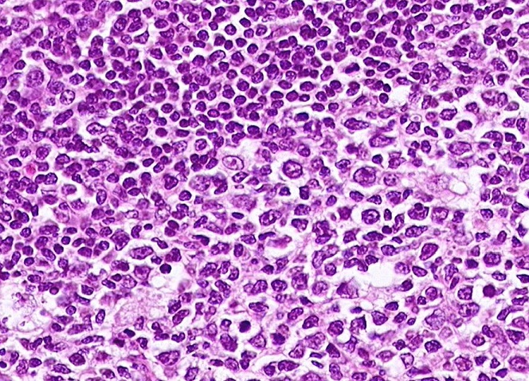
Final quiz
Self-check: Identify the cell indicated by the arrow. (advance slide for answer)
macrophage

Slide 40
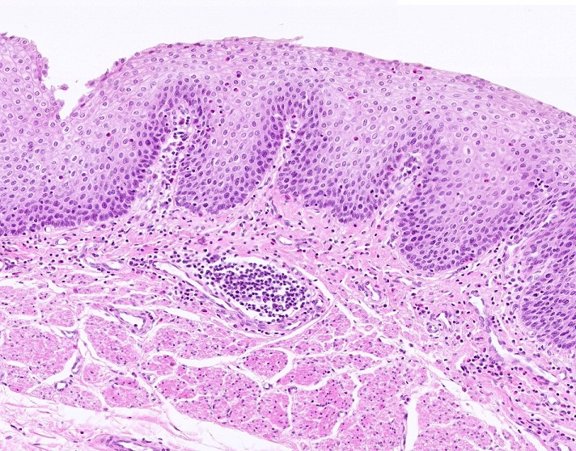
Final quiz
Self-check: The outlined region is more concentrated in B or T cells? (advance slide for answer)
macrophage
B

Slide 41
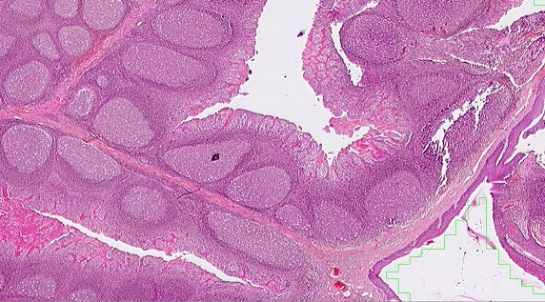
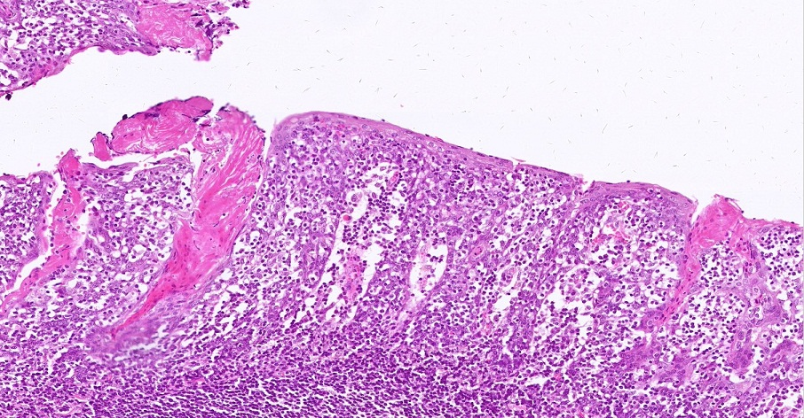
Final quiz
Self-check: Identify the space indicated by the X. (advance slide for answer)
Crypt (tonsillar crypt)
X

Slide 42
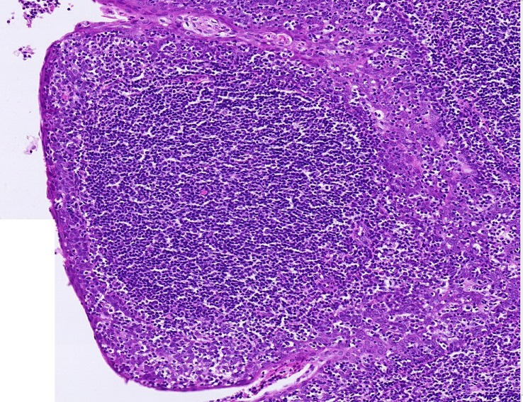
Final quiz
Self-check: Identify the outlined structure. (advance slide for answer)
Primary nodule

Slide 43
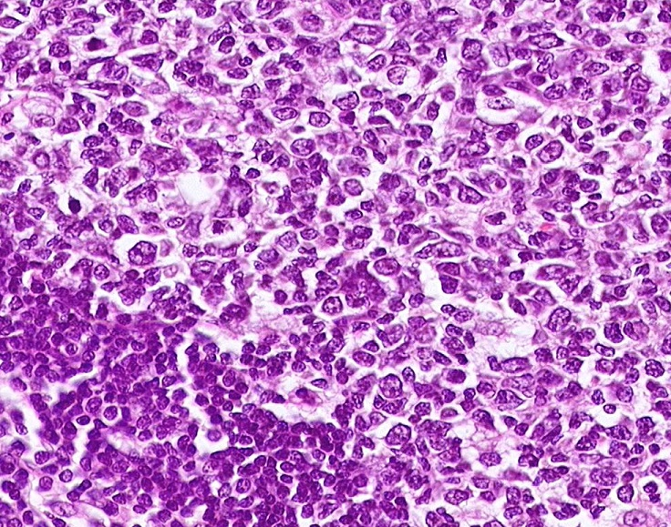
Final quiz
Self-check: Identify the cells indicated by the arrows. (advance slide for answer)
Blast cells (lymphoblasts)

Slide 44
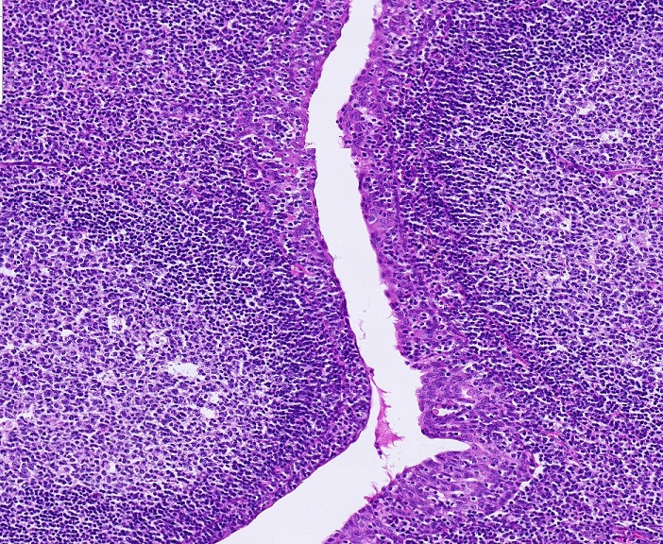
Final quiz
Self-check: Identify the space indicated by the arrows. (advance slide for answer)
Crypt (tonsillar crypt)

Slide 45
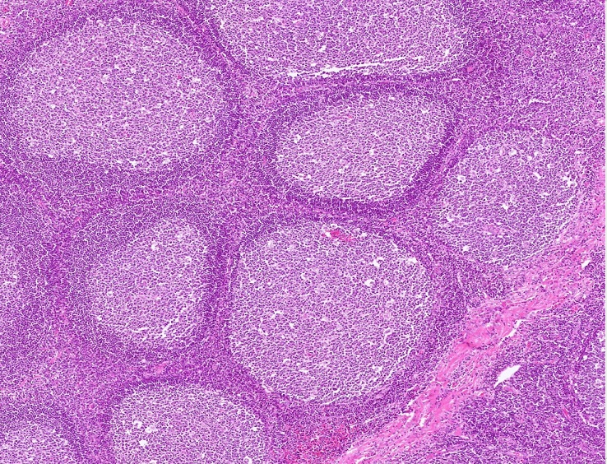
Final quiz
Self-check: Which region is most concentrated in T lymphocytes. (advance slide for answer)
C
A
C
B
D

Slide 46
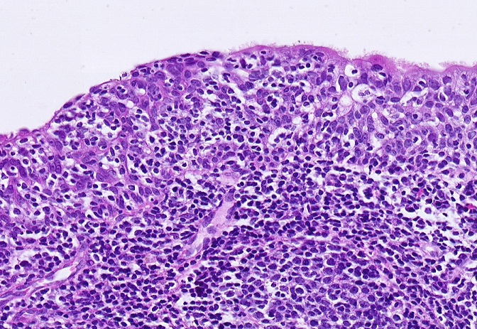
Final quiz
Self-check: Identify the structure / organ. (advance slide for answer)
Pharyngeal tonsil

Slide 47
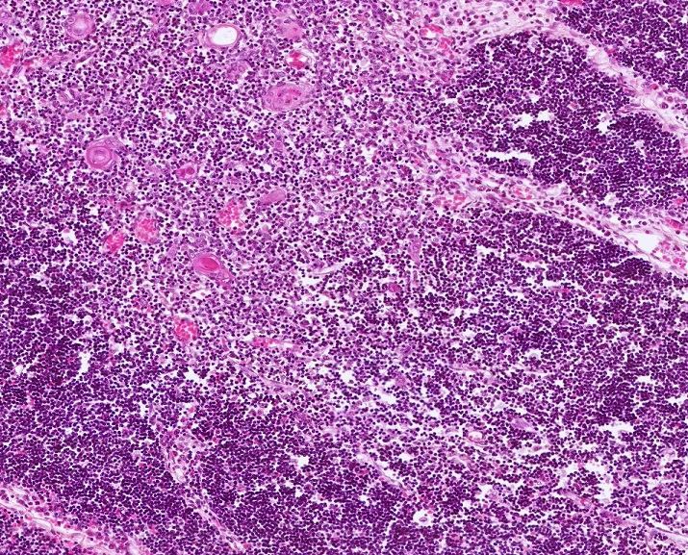
Final quiz
Self-check: Identify the structure / organ. (advance slide for answer)
thymus

Slide 48
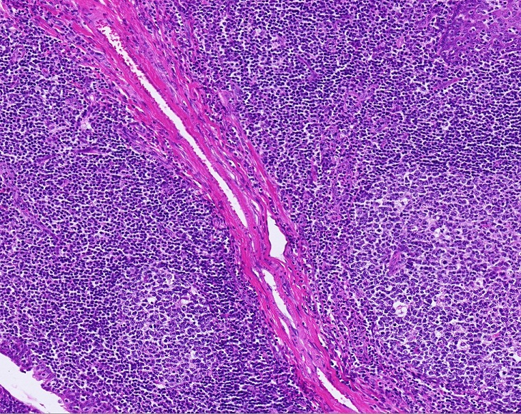
Final quiz
Self-check: Identify the structure indicated by the arrows. (advance slide for answer)
Connective tissue septum

Slide 49
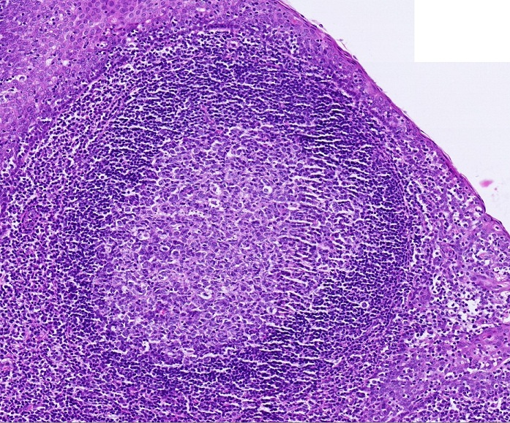
Final quiz
Self-check: Identify the outlined region. (advance slide for answer)
Germinal center

Slide 50
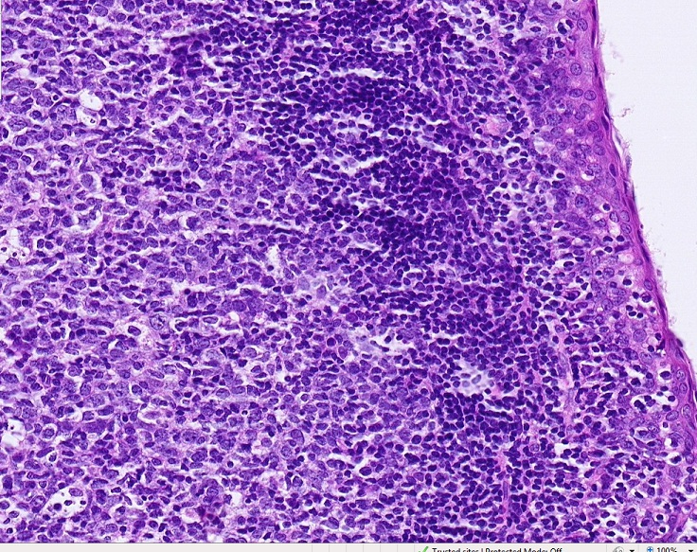
Final quiz
Self-check: Identify the outlined region. (advance slide for answer)
Germinal center

Slide 51
Final quiz
Self-check: Identify the cell indicated by the arrow. (advance slide for answer)
macrophage

Slide 52
Final quiz
Self-check: Identify the outlined structure. (advance slide for answer)
Secondary
nodule

Slide 53
Final quiz
Self-check: Identify the outlined region. (advance slide for answer)
corona

Slide 54
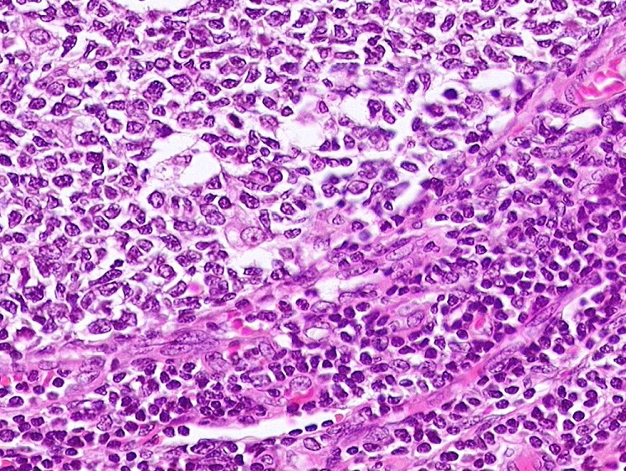
Final quiz
Self-check: Identify the cell indicated by the arrow. (advance slide for answer)
macrophage

