Slide 2
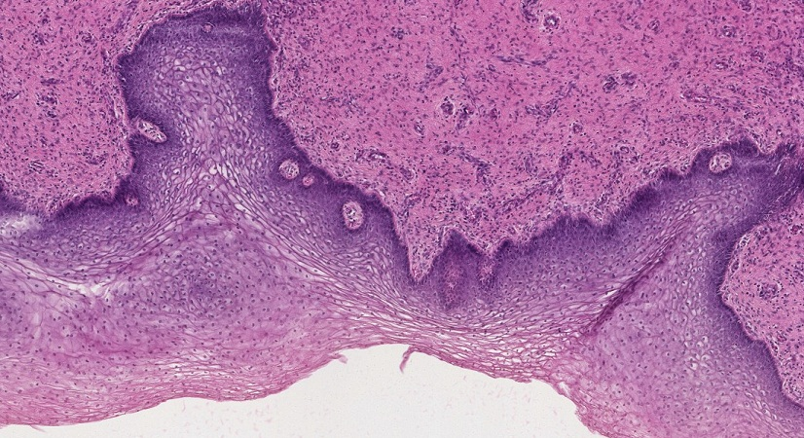
Final quiz
Self-check: Identify the organ on this slide. (advance slide for answers)
vagina

Slide 3
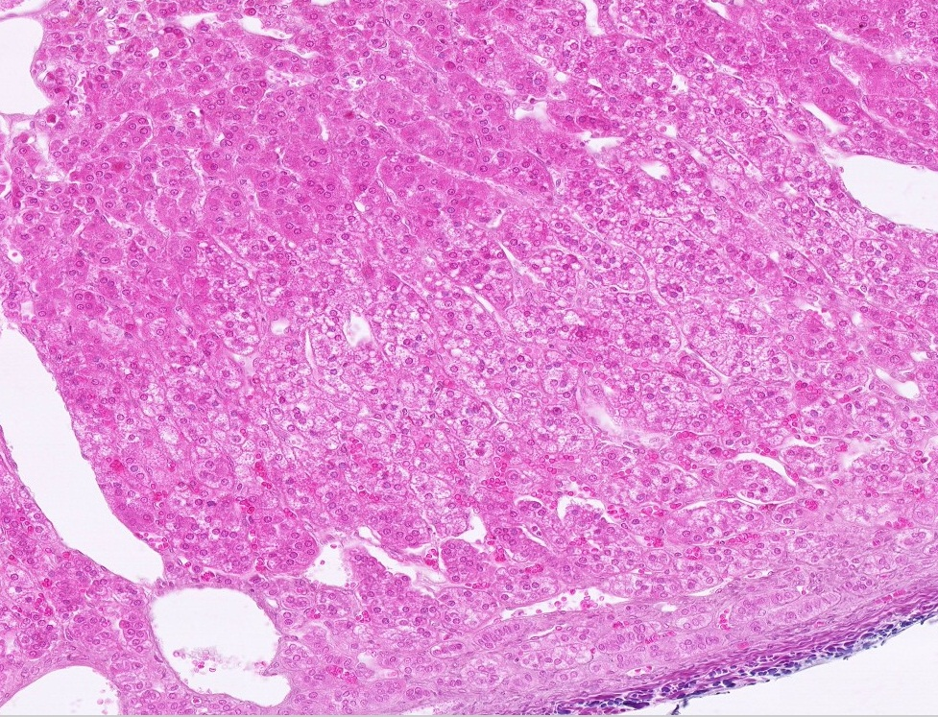
Final quiz
Self-check: Identify the organ on this slide. (advance slide for answers)
Adrenal gland

Slide 4
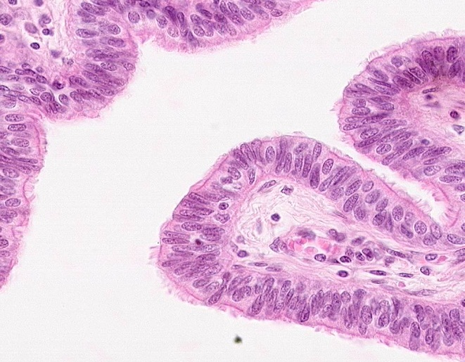
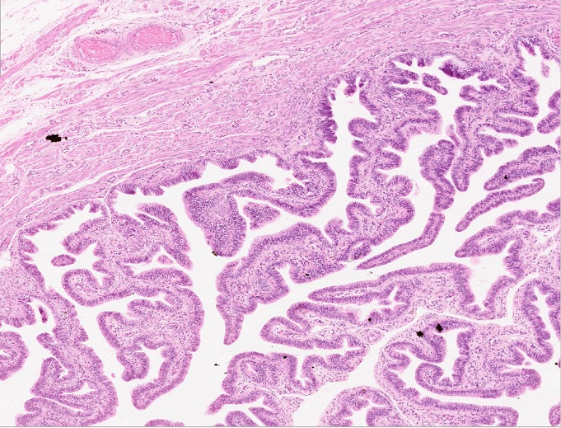
Final quiz
Self-check: Identify the organ on this slide. (advance slide for answer)
oviduct

Slide 5
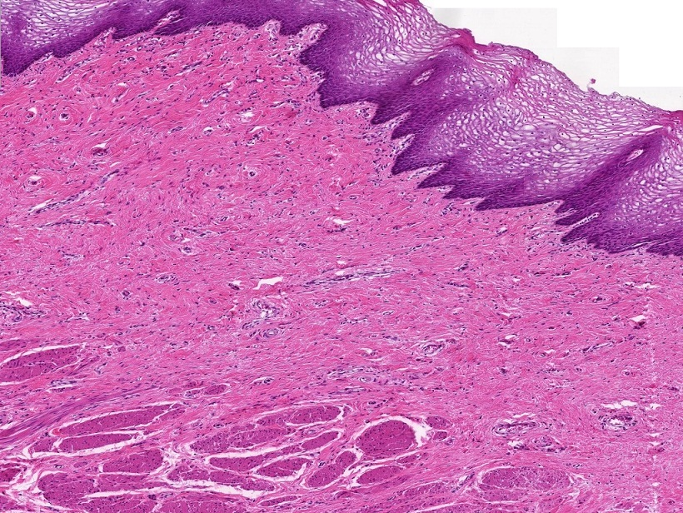
Final quiz
Self-check: Identify the organ on this slide. (advance slide for answer)
vagina

Slide 6
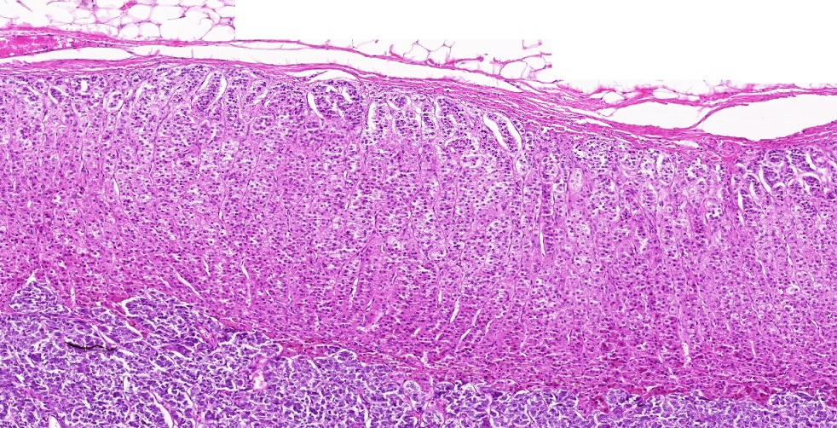
Final quiz
Self-check: Identify the organ on this slide. (advance slide for answer)
Adrenal gland

Slide 7
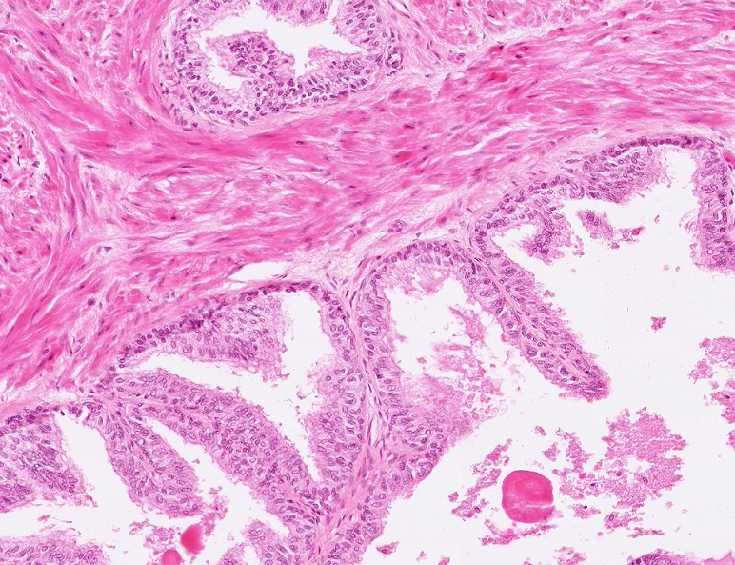
Final quiz
Self-check: Identify the organ on this slide. (advance slide for answers)
Prostate gland

Slide 8
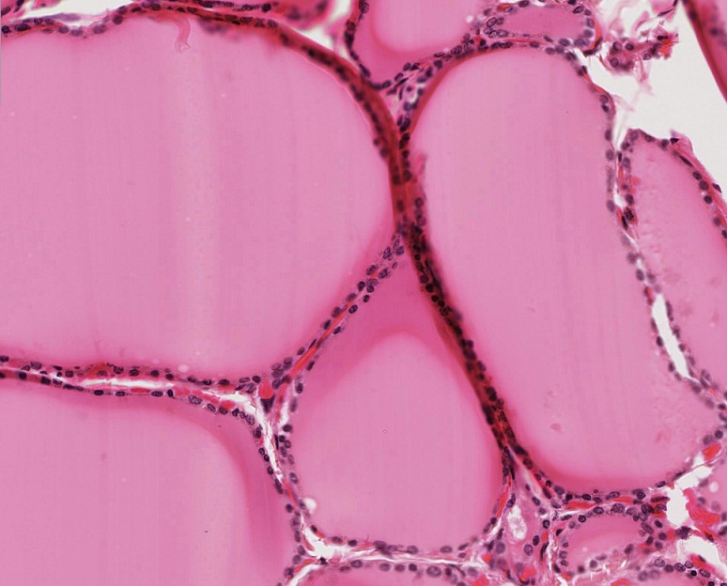
Final quiz
Self-check: Identify the organ. (advance slide for answer)
Thyroid gland

Slide 9
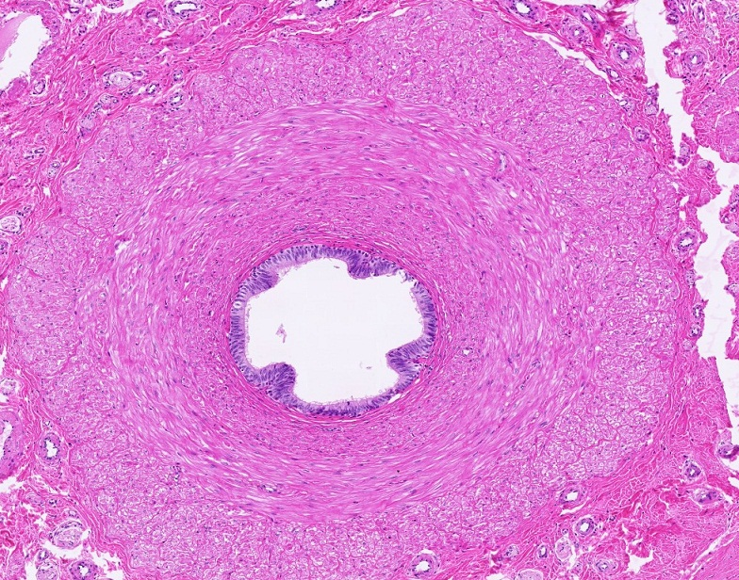
Final quiz
Self-check: Identify the organ on this slide. (advance slide for answer)
Vas deferens

Slide 10
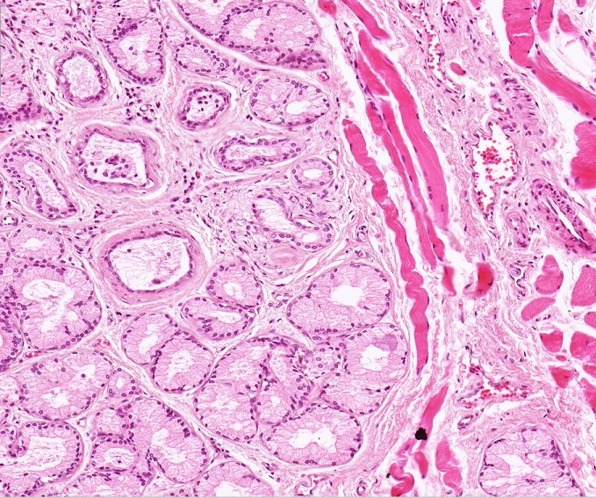
Final quiz
Self-check: Identify the organ on this slide. (advance slide for answers)
Bulbourethral gland

Slide 11
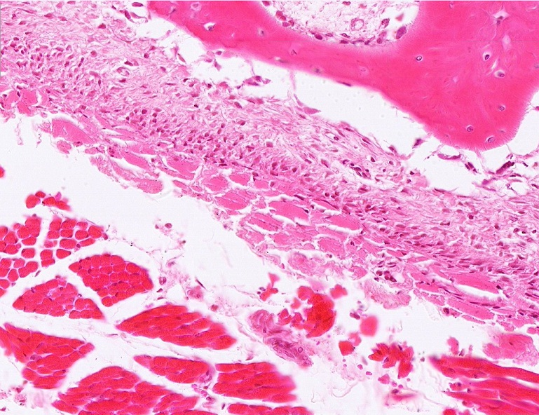
Final quiz
Self-check: Identify outlined TISSUE. (advance slide for answer)
Skeletal muscle

Slide 12
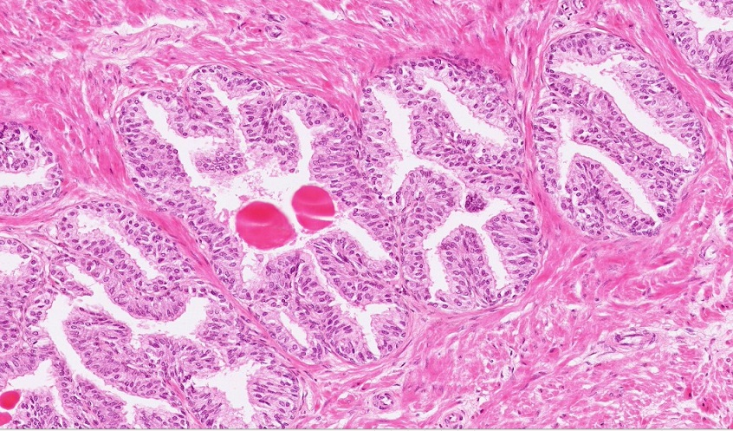
Final quiz
Self-check: Identify the organ. (advance slide for answer)
prostate gland

Slide 13
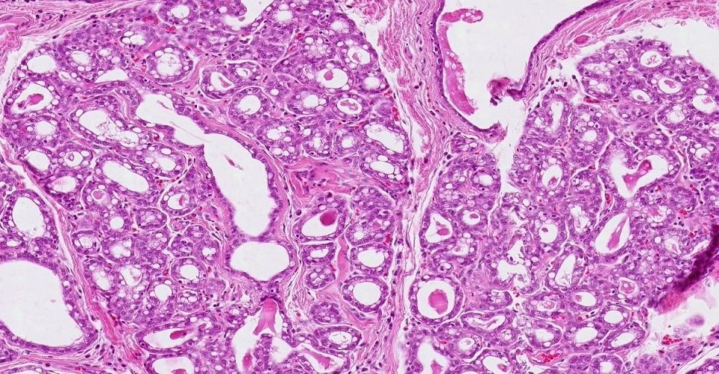
Final quiz
Self-check: Identify the organ on this slide. (advance slide for answer)
Mammary gland from a lactating woman

Slide 14
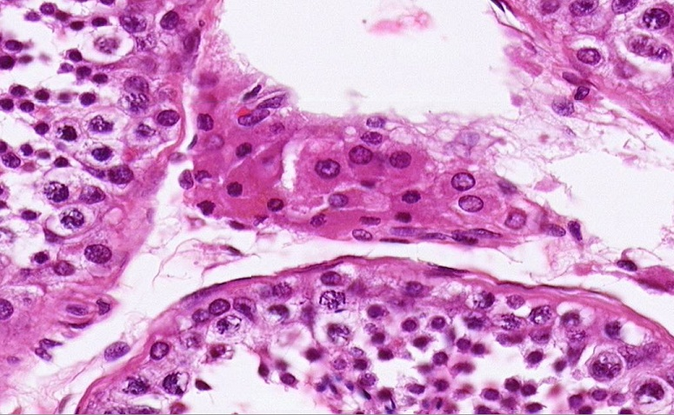
QUIZ
Self-check: Identify the cells indicated by the arrows. (advance slides for answers)
Leydig cells

Slide 15
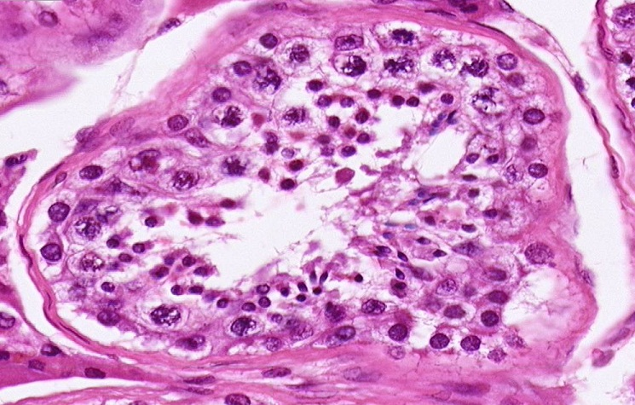
QUIZ
Self-check: Identify the cells indicated by the arrows. (advance slides for answers)
Primary spermatocytes

Slide 16
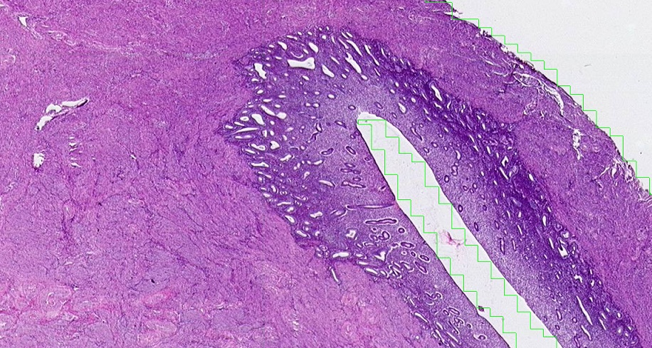
Final quiz
Self-check: Identify the organ. (advance slide for answer)
Uterus – proliferative phase

Slide 17
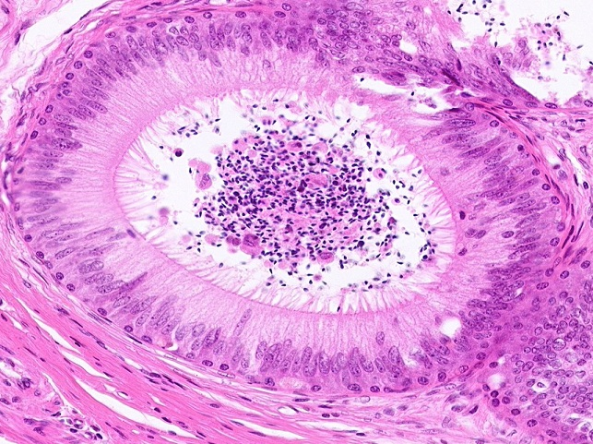
QUIZ
Self-check: Identify. (advance slides for answers)
epididymis

Slide 18
QUIZ
Self-check: Identify the cells indicated by the arrows. (advance slides for answers)
Sertoli cells

Slide 19
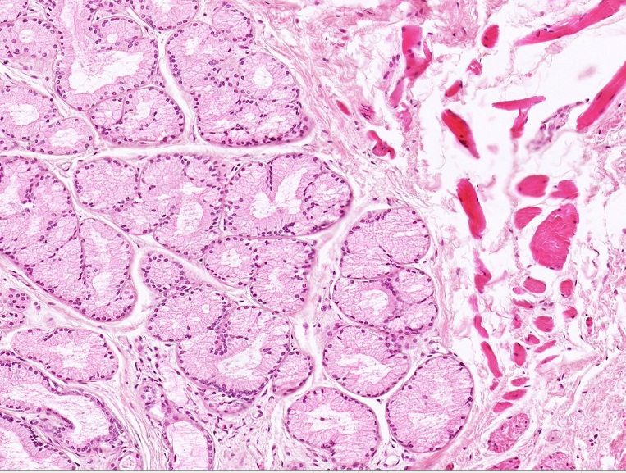
QUIZ
Self-check: Identify. (advance slides for answers)
Bulbourethral gland

Slide 20
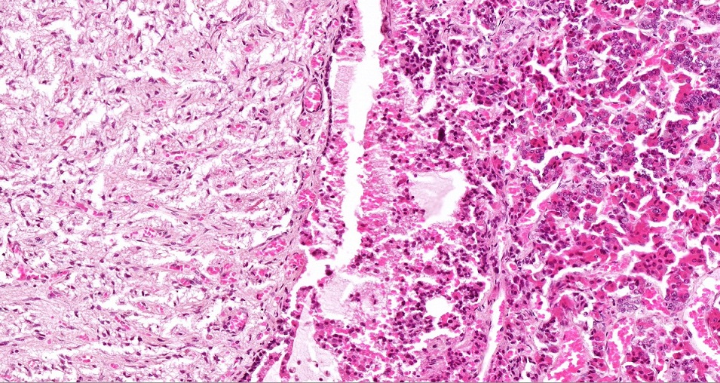
Final quiz
Self-check: Identify the organ. (advance slide for answer)
pituitary gland

Slide 21
QUIZ
Self-check: Identify the cells indicated by the arrows. (advance slides for answers)
spermatids

Slide 22
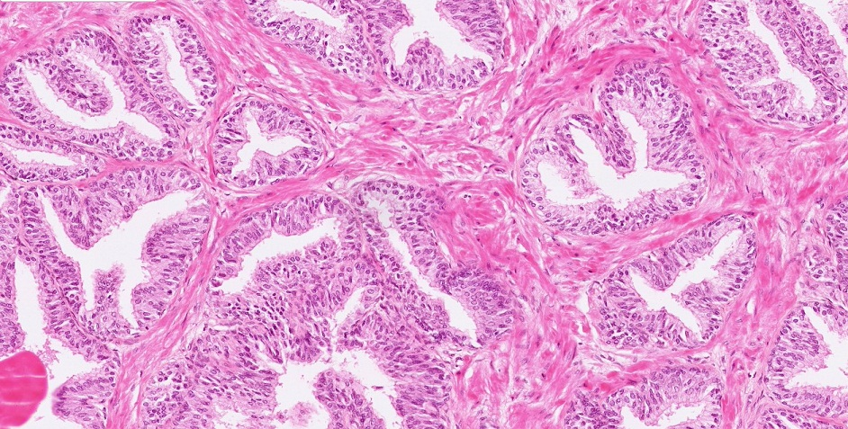
QUIZ
Self-check: Identify. (advance slides for answers)
Prostate gland

Slide 23
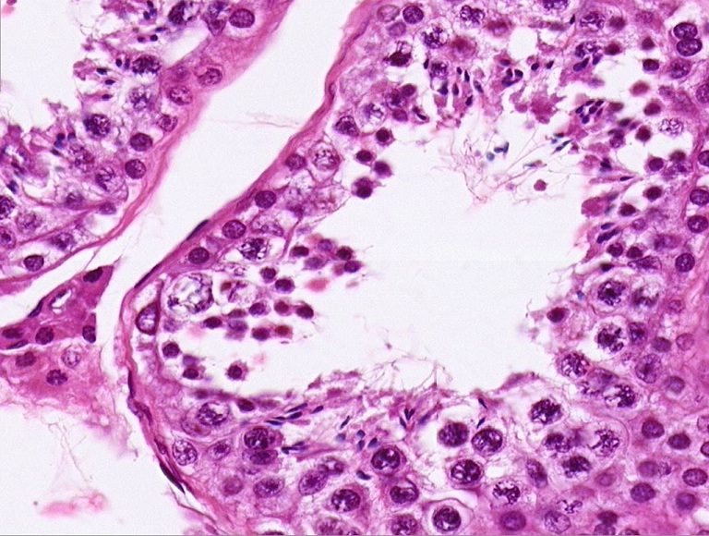
QUIZ
Self-check: Identify the cells indicated by the arrows. (advance slides for answers)
Myoid cells of the testis

Slide 24
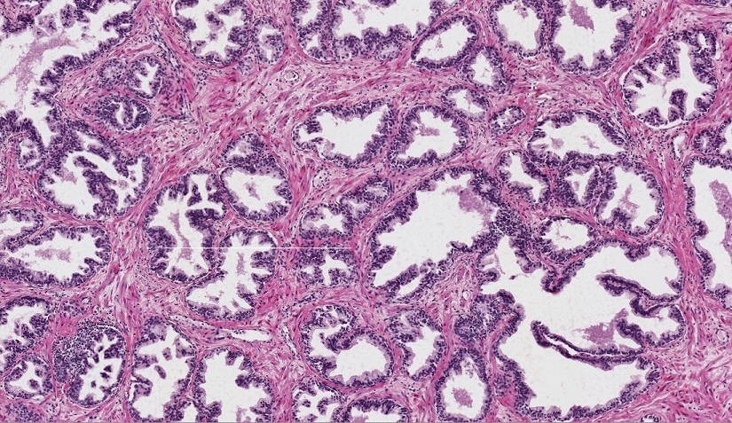
Final quiz
Self-check: Identify the organ. (advance slides for answers)
Prostate gland

Slide 25
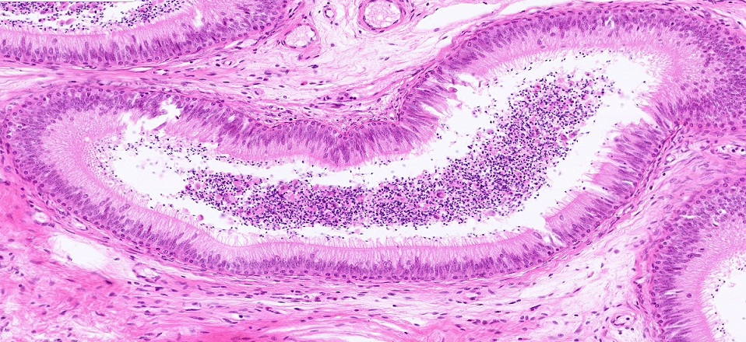
Final quiz
Self-check: Identify the organ. (advance slide for answer)
epididymis

Slide 26
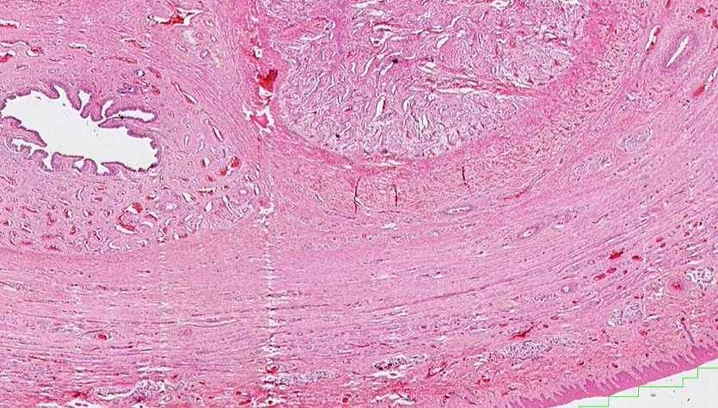
Final quiz
Self-check: Identify the organ. (advance slides for answers)
penis

Slide 27
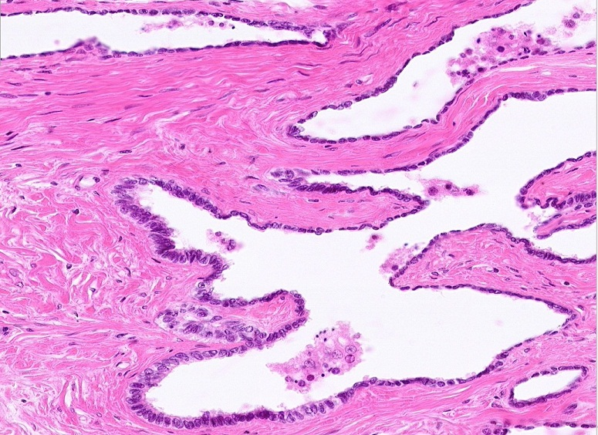
Final quiz
Self-check: Identify the organ on this slide. (advance slide for answers)
Rete testis

Slide 28
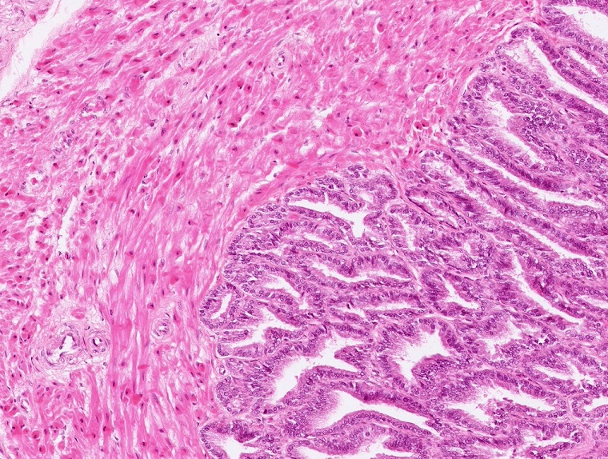
Final quiz
Self-check: Identify the organ on this slide. (advance slide for answers)
Seminal vesicle

Slide 29
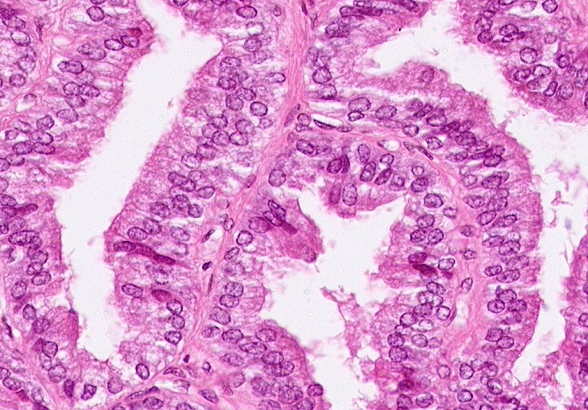
Final quiz
Self-check: Identify the organ on this slide. (advance slide for answers)
Seminal vesicle

Slide 30
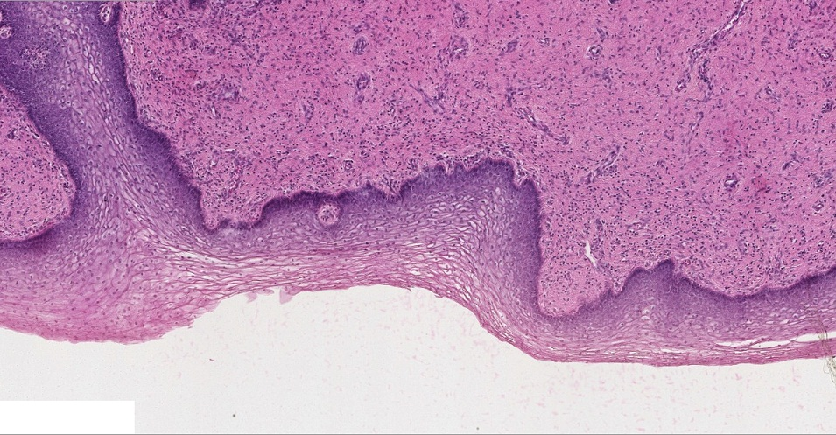
Final quiz
Self-check: Identify the organ. (advance slide for answer)
vagina

Slide 31
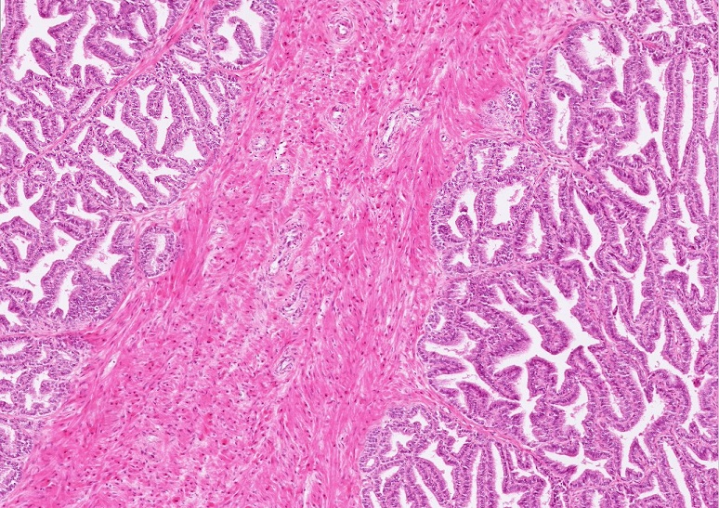
Final quiz
Self-check: Identify the organ on this slide. (advance slide for answers)
Seminal vesicle

Slide 32
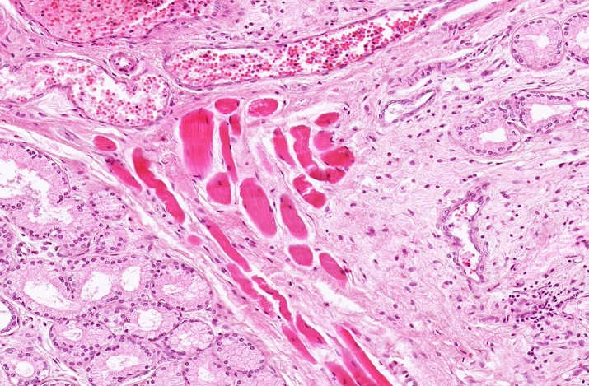
Final quiz
Self-check: Identify the organ on this slide. (advance slide for answers)
Bulbourethral gland

Slide 33
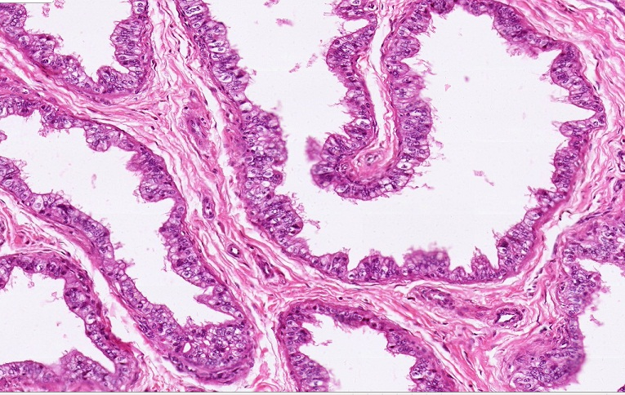
Final quiz
Self-check: Identify the organ on this slide. (advance slide for answers)
Efferent ductules

Slide 34
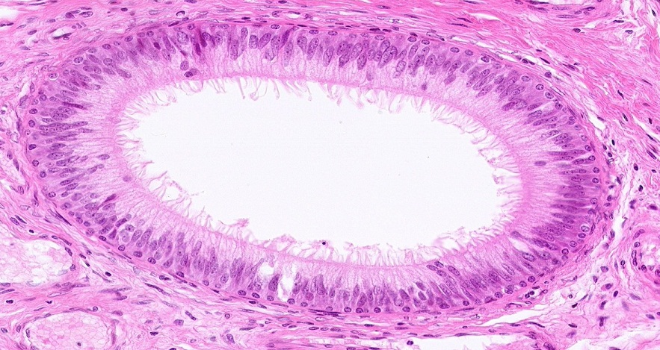
Final quiz
Self-check: Identify the organ on this slide. (advance slide for answers)
epididymis

Slide 35
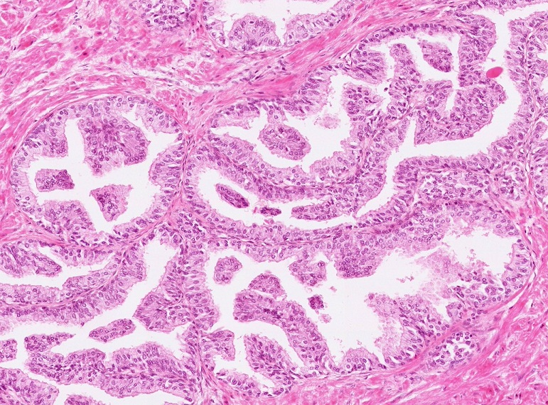
Final quiz
Self-check: Identify the organ on this slide. (advance slide for answers)
Prostate gland

