Slide 1
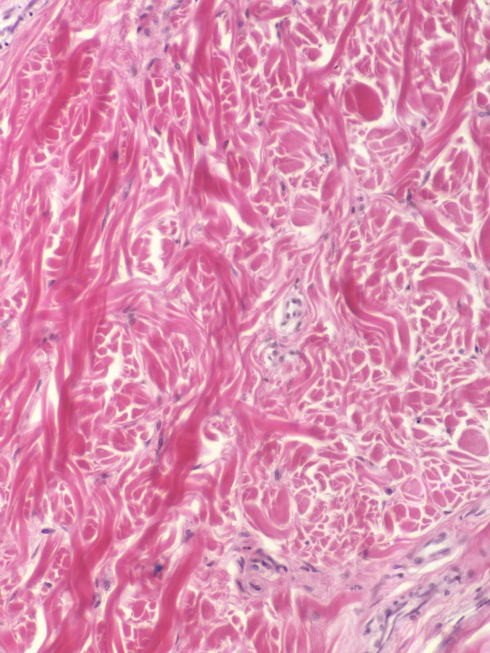
Connective Tissues (generic)
Digital Laboratory
It’s best to view this in Slide Show mode, especially for the quizzes.
This module will take approximately 60 minutes to complete.

Slide 2
After completing this exercise, you should be able to:
Distinguish, at the light microscope level, each of the following components of connective tissue:
Collagen fibers
Elastic fibers (may need special stains)
Reticular fibers (seen with special stains only)
Fibroblasts
Mast cells (distinguished only with special stains - metachromasia)
Ground substance
Distinguish, at the light microscope level, each of the following types of connective tissue:
Loose (areolar)
Dense irregular
Dense regular (e.g. tendon)
Elastic tissue
Distinguish, at the electron microscope level, each of the following components of connective tissue:
Collagen fibers
Elastic fibers
Fibroblast
Basal lamina

Slide 3
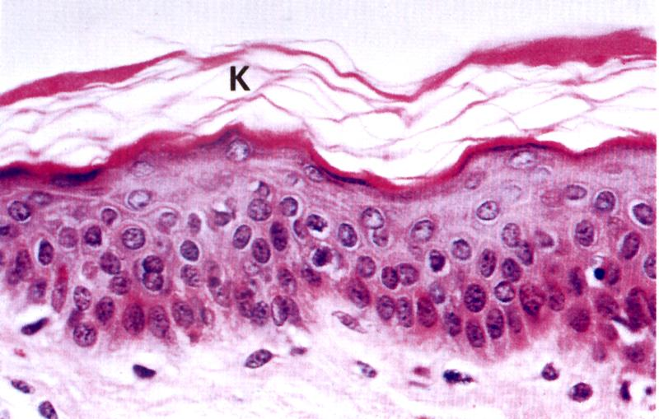
Before analyzing connective tissue (CT) in detail, it helps to first recognize that a tissue is indeed some form of CT. Unlike epithelia, which are composed of many cells with little extracellular matrix, CTs typically are composed of a few cells, with lots of extracellular matrix. On an H&E slide, this is readily apparent by comparing the number of nuclei in epithelia and CT:
K = keratinized, but you already knew this
epithelium
connective tissue
nuclei
Border between epithelium and connective tissue

Slide 4
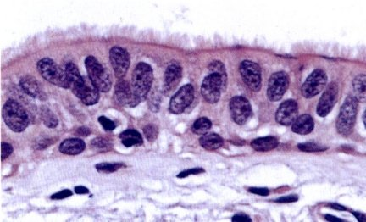
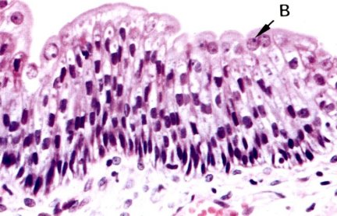
Two more examples of epithelia and connective tissue. It helps to remember that epithelia line a lumen, or space.
Also note that epithelial cells tend to have more cytoplasm, which stains eosinophilic, while connective tissue cytoplasm is pale or sparse.
a space
epithelium
connective tissue
another space
epithelium
connective tissue

Slide 5
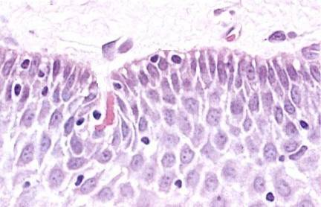
A little easy, but just in case, which areas of the slide are epithelial, and which are connective tissue? (advance PPT for answers)
connective tissue
epithelium
Yeah we cropped away the space…OOOOOOH tricky.

Slide 6
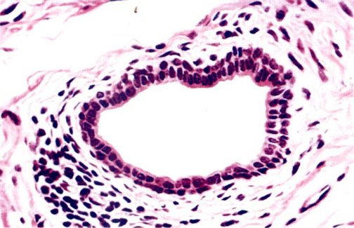
Another one for the ages…
the space
Epithelium is between the dashed blue lines.
Connective tissue is everything else (except the space).
Note the area to the lower left with a number of nuclei. This is an area of connective tissue infiltrated with white blood cells.

Slide 7
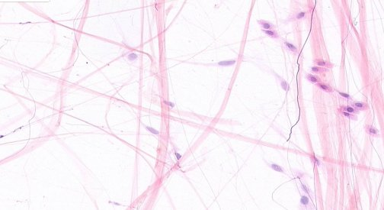
Lets look at some of the components of connective tissue.
FIBERS: collagen fibers are thick and pink (purple block arrows)
reticular fibers, are present, but not visible without special stains
elastic fibers are thin and purple (black block arrows; not visible with standard H&E, but here stained with resorcin)
CELLS: A fibroblast is indicated; note its tapered appearance.
To the right, note the cells in military formation; these are probably white blood cells.
MATRIX: The clear spaces are filled with ECM, and in life contain water, ions, GAGs, etc., also called ground substance
fibroblast cytoplasm and nucleus

Slide 8
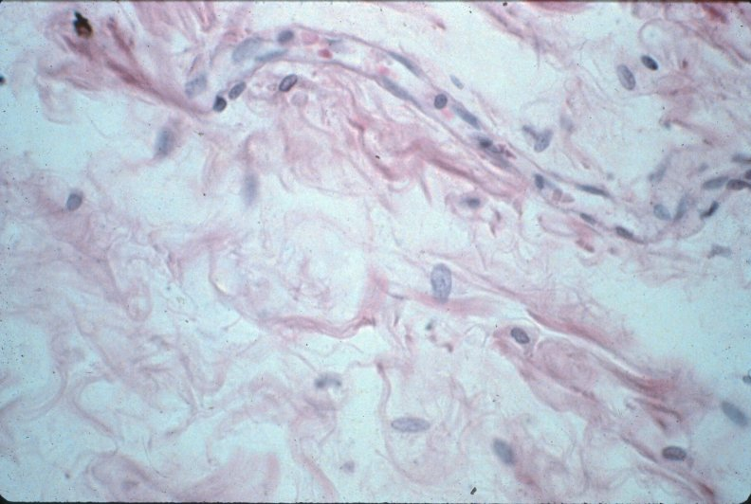
Fibers of connective tissue - collagen
COLLAGEN FIBERS
Two more views of connective tissue, focusing on collagen fibers, which appear as pink threads. Note the thickness and abundance of collagen fibers varies. The purple arrows indicate collagen fibers cut in cross section. The top of the left image shows an undulating blood vessel.

Slide 9
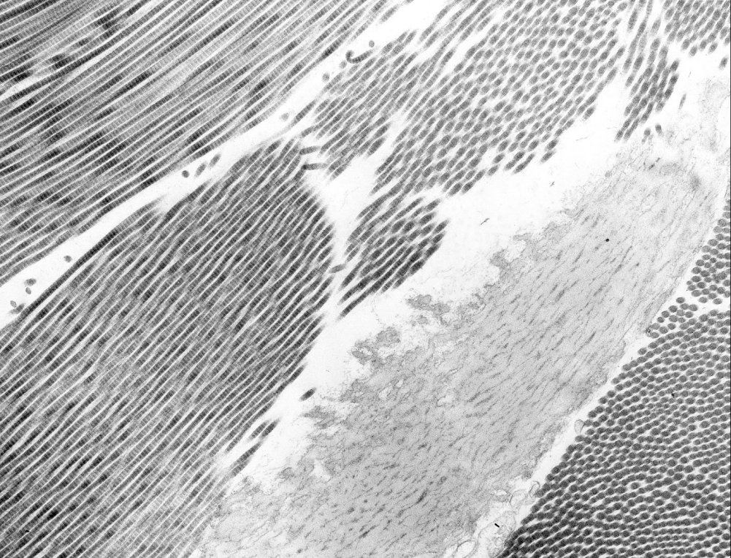
Fibers of connective tissue - collagen
In this electron micrograph from connective tissue, note the collagen fibers in longitudinal section (red circle) and in cross section (green circle).

Slide 10
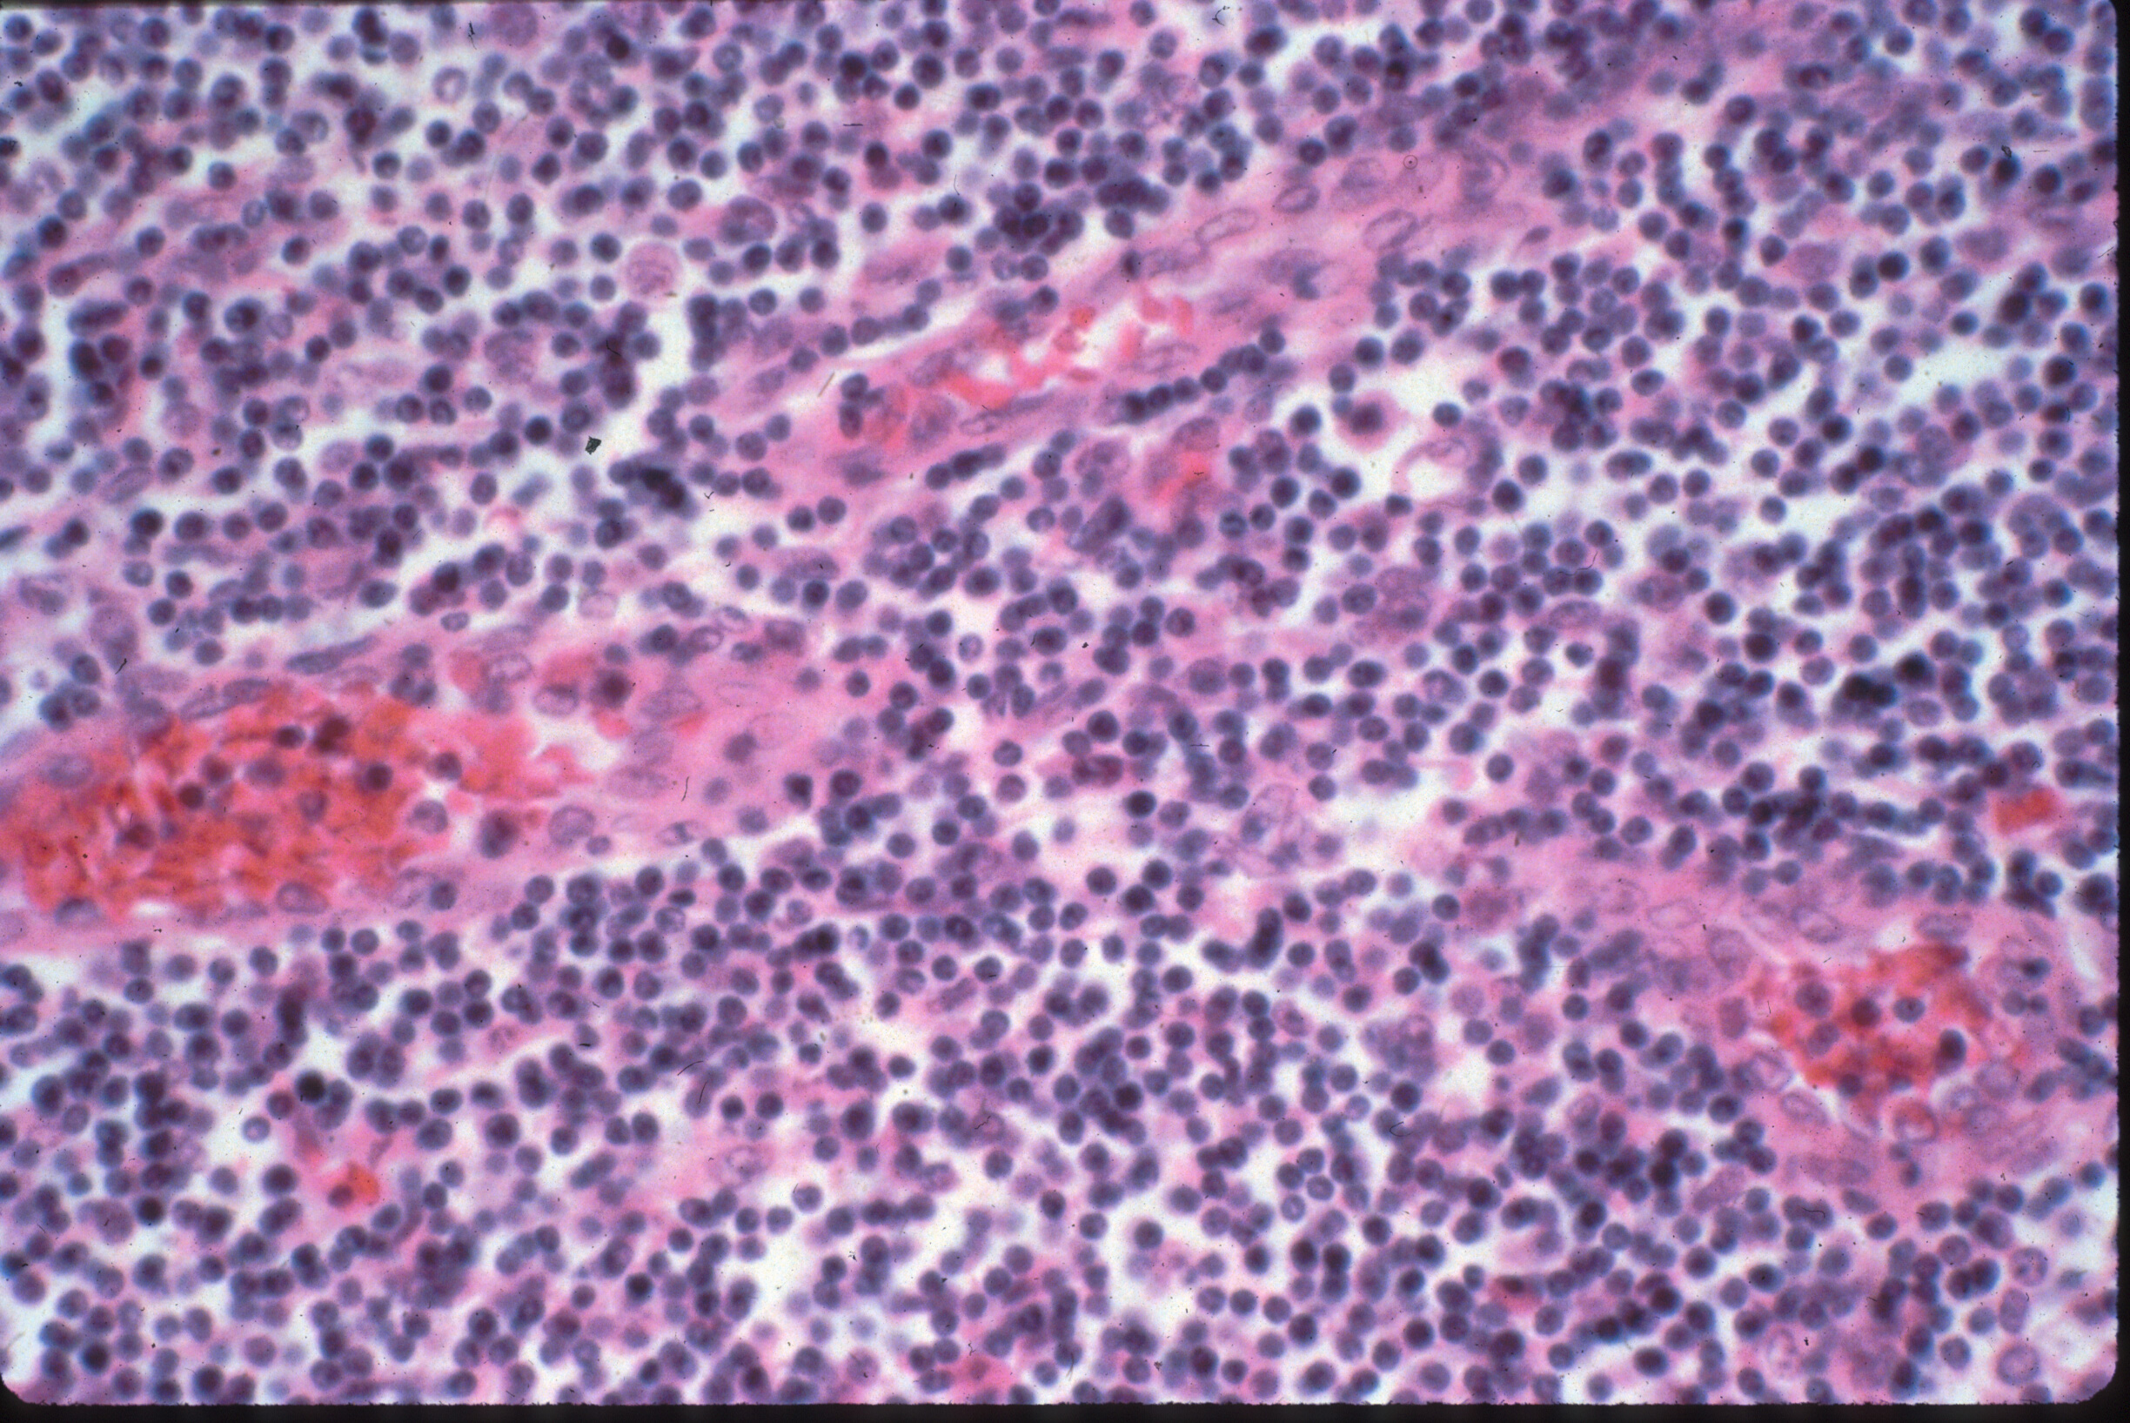
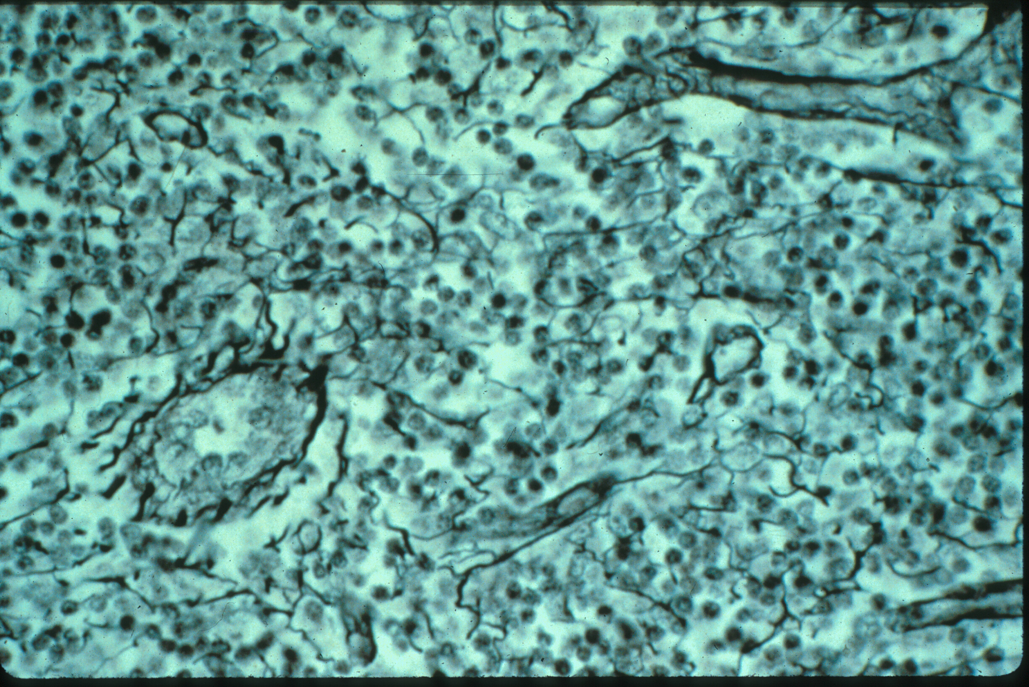
Fibers of connective tissue – reticular fibers
Although the proteins making up reticular fibers are homologous to those that make up collagen fibers, reticular fibers are much thinner, and, therefore, are not visible in routine H&E stained images (left). The numerous purple dots are nuclei of lymphocytes.
Special stains, e.g. silver stains, are used to visualize reticular fibers (right, yellow arrows).

Slide 11
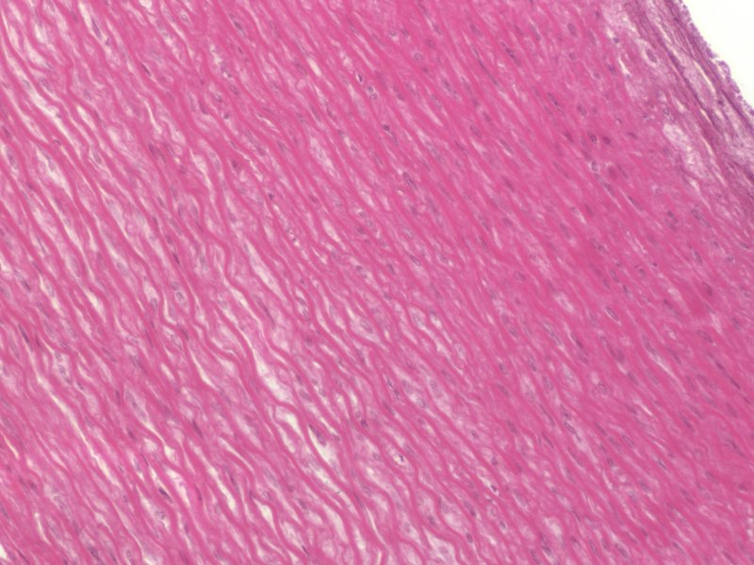
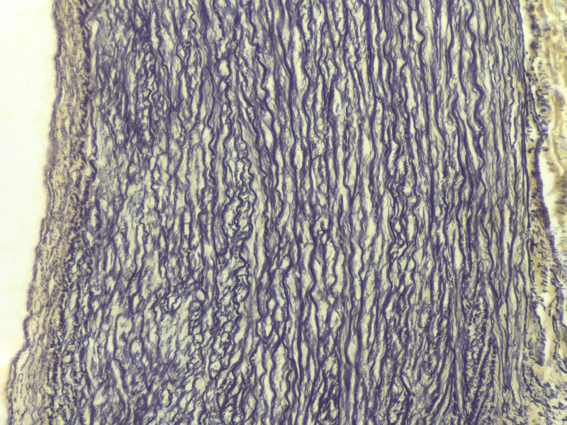
Fibers of connective tissue – elastic fibers
0
Elastic fibers are also fairly thin, and often do not show up well on routine H&E sections. However, in tissues such as large elastic arteries, they form prominent sheets that are readily apparent on H&E (left image, blue arrows) or with special stains (right image, resorcin stain, yellow arrows)

Slide 12
Fibers of connective tissue – elastic fibers
0
elastin core
microfibrils
In this electron micrograph from connective tissue, note the amorphous elastic tissue (green circle), consisting of dark microfibrils within a pale elastin core.

Slide 13
Fibers of connective tissue
Video of connective tissue spread showing collagen and elastic fibers – SL1
Link to SL 001
Be able to identify:
Collagen fibers
Elastic fibers

Slide 14
Fibers of connective tissue
Video of salivary gland showing collagen fibers – SL91
Link to SL 091
Be able to identify:
Collagen fibers
Simple cuboidal epithelium (review)
Simple columnar epithelium (review)
Stratified cuboidal/columnar epithelium (review)

Slide 15
Fibers of connective tissue
Video of hilus (root) of lung showing collagen fibers – SL24
Link to SL 024
Be able to identify:
Collagen fibers
Pseudostratified epithelium (review, very poor prep)
Serous glands (review)
Mucous glands (review)

Slide 16
Fibers of connective tissue
Video of elastic artery (H&E) showing elastic fibers – SL31
Link to SL 031
Be able to identify:
Elastic fibers

Slide 17
Fibers of connective tissue
Video of elastic artery (H&E) showing elastic fibers (resorcin stain) – SL184
Link to SL 184
Be able to identify:
Elastic fibers

Slide 18
Fibers of connective tissue
Video of spleen showing reticular fibers (silver stain) – SL32
Note: Resorcin staining of elastic fibers, and silver stains for reticular fibers, both show black threads that appear similar. While it is true that the elastic fibers shown here are thicker, that is not always the case. Therefore, for these special stains, you will be told what fibers are being highlighted. Note that this does not apply to the connective tissue spread (SL1), in which you should recognize collagen and elastic fibers.
Link to SL 032
Be able to identify:
Reticular fibers

Slide 19
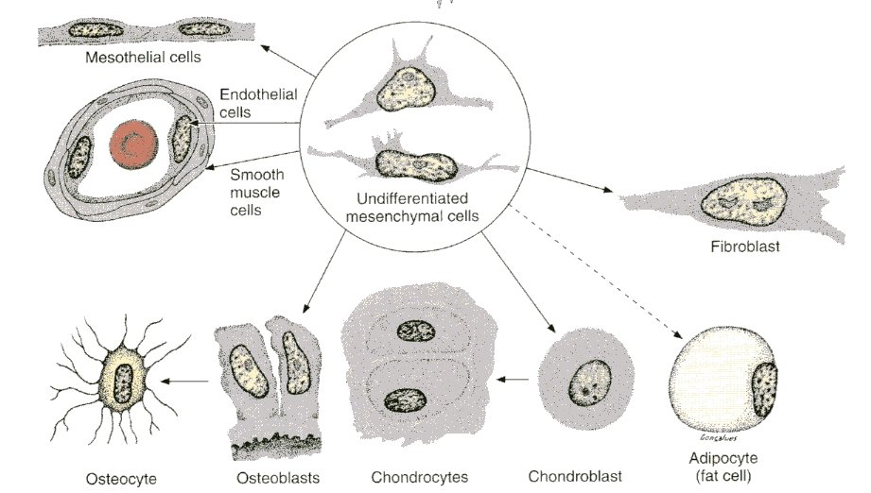
CONNECTIVE TISSUE ORIGIN
Almost all connective tissues and some other tissues are derived from an embryonic precursor tissue called mesenchyme. This tissue is composed of mesenchymal cells surrounded by a matrix with very few fibers.

Slide 20
CONNECTIVE TISSUE ORIGIN
Video of umbilical cord showing mesenchyme – SL35
Note: Mesenchyme is characterized by a near absence of connective tissue fibers, while loose connective tissue (shown later in this module) has some collagen and elastic fibers (though less than dense connective tissues).
Link to SL 035
Be able to identify:
Mesenchyme
Mesenchymal cells

Slide 21
CELLS OF CONNECTIVE TISSUE - FIBROBLASTS
Fibroblasts are derived from mesenchymal cells and are the “resident” generic connective tissue cells that produce most, if not all, of the fibers and matrix.
fibroblast cytoplasm and nucleus

Slide 22
CELLS OF CONNECTIVE TISSUE - FIBROBLASTS
Video of connective tissue spread showing fibroblasts - SL1
Link to SL 001
Be able to identify:
fibroblasts

Slide 23
CELLS OF CONNECTIVE TISSUE - FIBROBLASTS
Video of salivary gland showing fibroblasts – SL91
Link to SL 091 and SL 024
Be able to identify:
fibroblasts

Slide 24
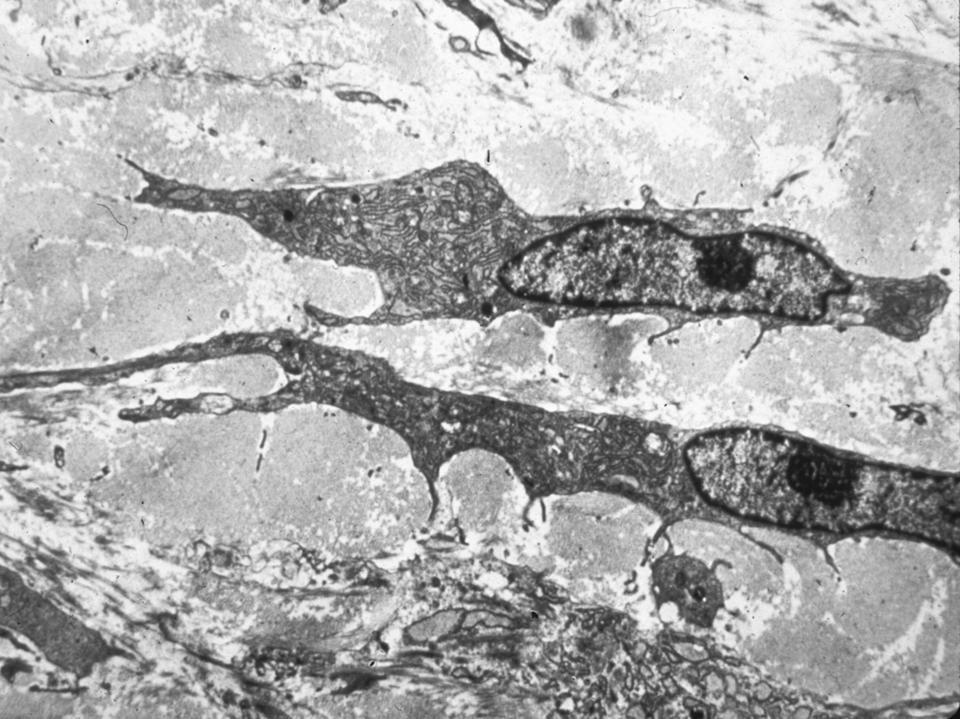
CELLS OF CONNECTIVE TISSUE - FIBROBLASTS
0
In electron micrographs, fibroblasts are spindle-shaped cells. Active fibroblasts will have a good amount of RER and Golgi necessary for synthesis of the extracellular fibers that the secrete. Quiescent fibroblasts will have less RER and Golgi.

Slide 25
CELLS OF CONNECTIVE TISSUE - FIBROBLASTS
0
Side-by-side images showing a light micrograph, and an EM corresponding approximately to the region within the box.

Slide 26
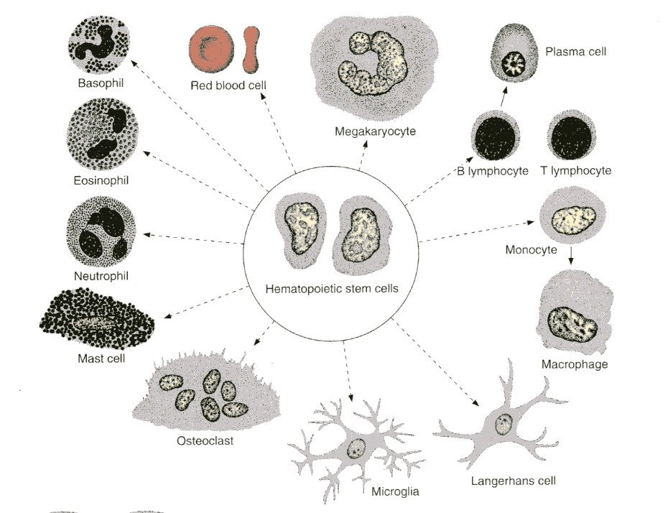
CELLS OF CONNECTIVE TISSUE - IMMUNE
0
Most of the other cells in connective tissues are not permanent residents, but immune cells that are “visiting”.

Slide 27
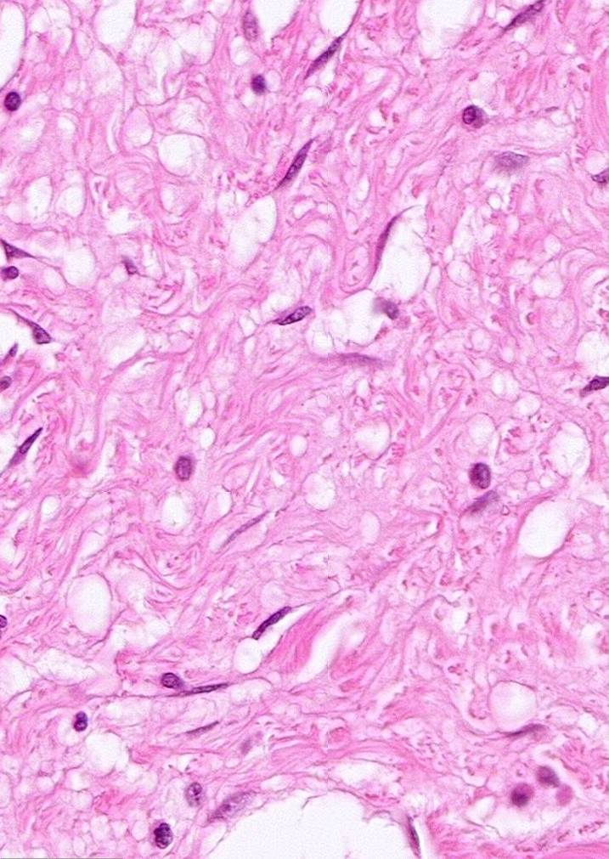
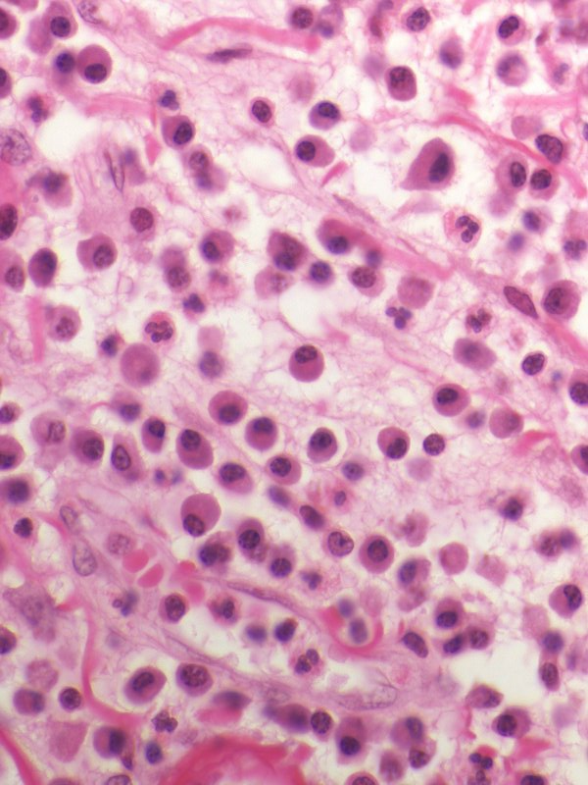
CELLS OF CONNECTIVE TISSUE - IMMUNE
Most of the other cells in connective tissues are not permanent residents, but immune cells that are “visiting”. The image to the left is connective tissue; most of the cells you see are fibroblasts (green arrows). To right image is inflammation; this tissue used to look like the left image, but white blood cells, notably plasma cells (red arrows) and neutrophils (orange arrows) have infiltrated in response to an infection.

Slide 28
CELLS OF CONNECTIVE TISSUE - IMMUNE
Video of inflammation – SL125
Link to SL 125
Be able to identify:
Nothing specific now, just a preview to inflammation, which you will learn about later

Slide 29
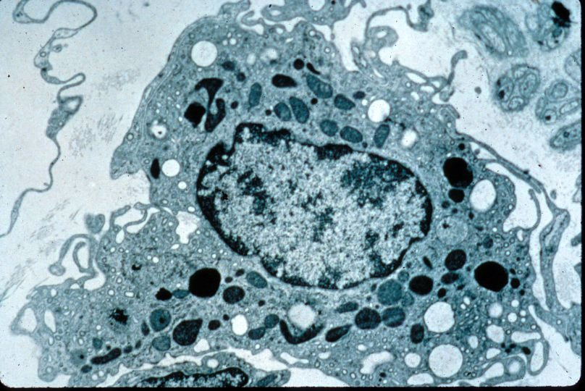
CELLS OF CONNECTIVE TISSUE - IMMUNE
Macrophages are derived from monocytes and are found in many tissues throughout the body. The name (big eater) aptly describes their characteristic phagocytic capacity. Macrophages play roles in inflammation and in immune responses.
Macrophages

Slide 30
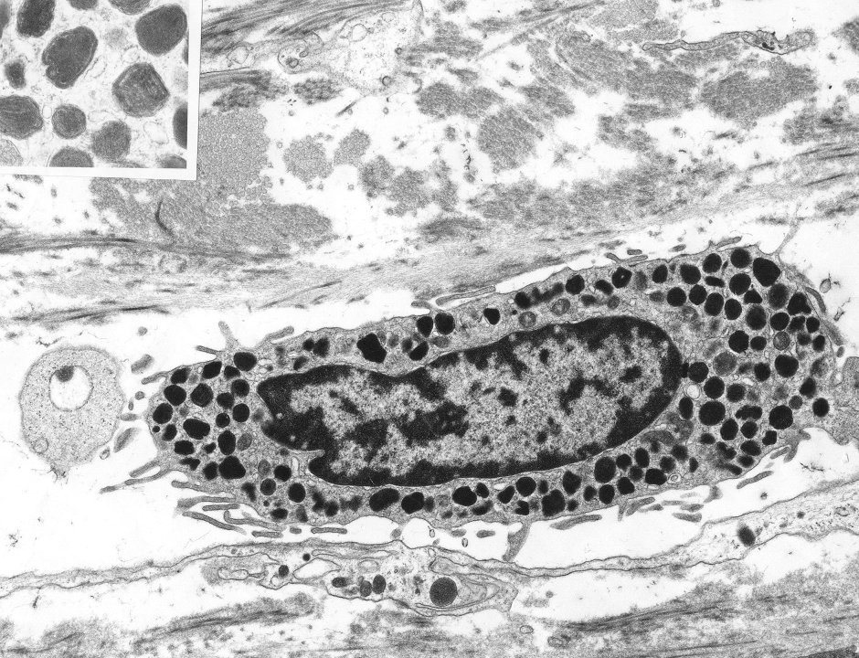
CELLS OF CONNECTIVE TISSUE - IMMUNE
Mast cells are immune cells that play a role in inflammation, and have secretory granules (arrows) containing histamine and heparin.

Slide 31
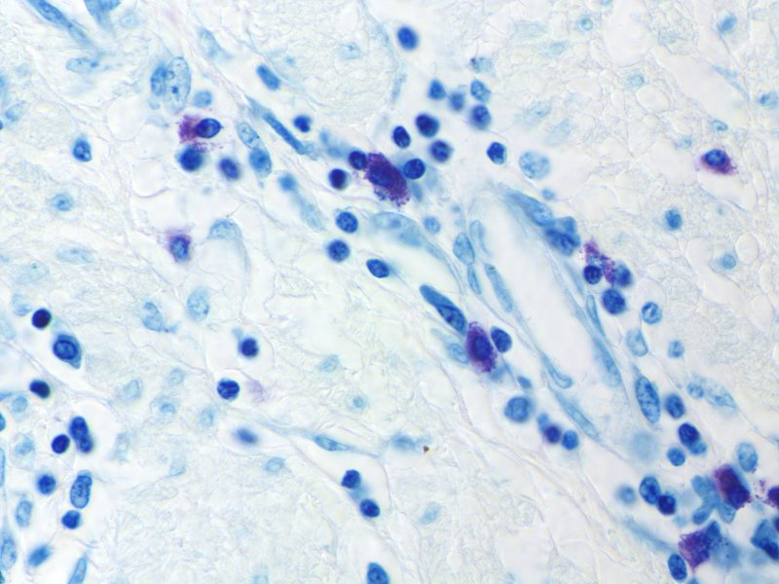
CELLS OF CONNECTIVE TISSUE - IMMUNE
0
In this specimen stained with the dye toluidine blue, many structures are stained blue. However, the components of the mast cell granules turn the dye a purple color (the color change of the dye is called metachromasia).

Slide 32
CELLS OF CONNECTIVE TISSUE - IMMUNE
Video of connective tissue spread showing mast cells – SL118
Link to SL 118
Be able to identify:
Mast cells (FYI, the color on this digital slide is not optimal, but you can see mast cells if you look carefully.)

Slide 33
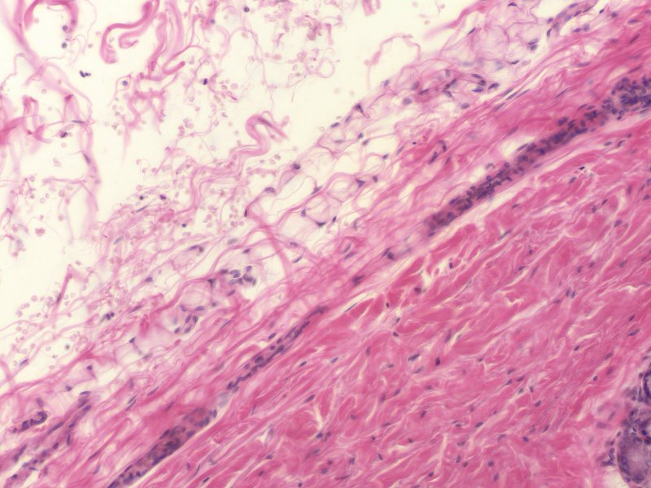
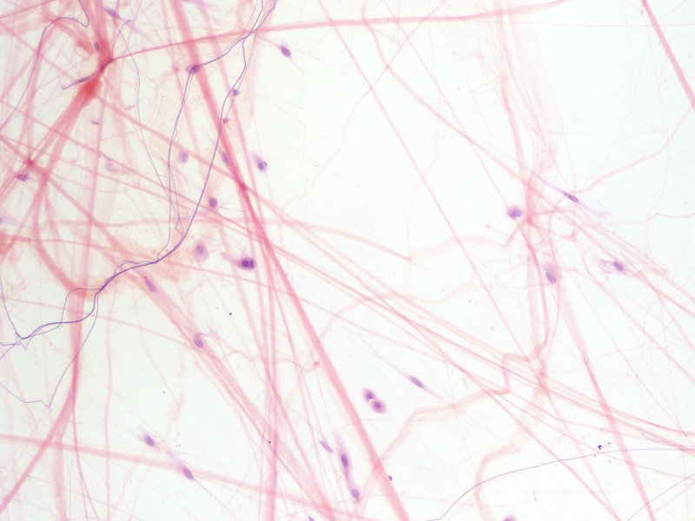
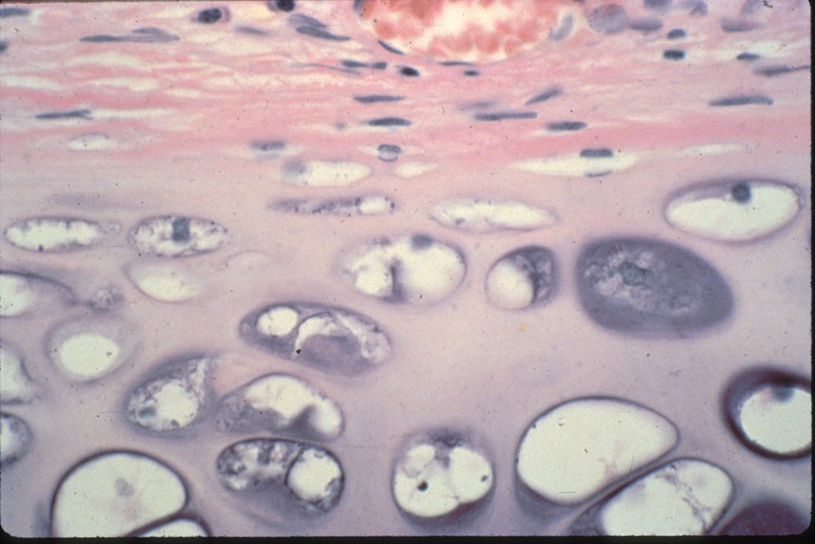
GROUND SUBSTANCE OF CONNECTIVE TISSUE
The ground substance of connective tissue is the extracellular matrix (ECM) component that fills in the spaces between the fibers and cells. It contains water, ions, GAGs, and other molecules. The components vary considerably, and account for the fact that matrix (and connective tissues) can vary from fluid (left, also blood plasma) to solid (right).

Slide 34
CLASSIFICATION OF CONNECTIVE TISSUE
Connective tissue can be classified into generic and specialized :
Generic connective tissues
--Loose (aka areolar, includes reticular, elastic, maybe mesenchyme)
--Dense irregular (aka dense irregular)
--Dense regular (aka dense regular)
We care about these today
Specialized connective tissues
--adipose
--cartilage (hyaline, elastic, fibrous)
--bone
--blood
These will be covered later.

Slide 35
It’s all about the extracellular stuff
Generic connective tissues
--Loose (aka areolar, includes reticular, elastic, maybe mesenchyme)
--Dense irregular (aka dense irregular)
--Dense regular (aka dense regular)
If we overanalyze this a bit, the two variables we are using to differentiate these tissues are:
1. the density and thickness of the extracellular fibers (loose vs. dense)
2. the orientation of the fibers (irregular vs. regular)
Of course, if we have two variables, with two possibilities each, that should leave us with a fourth generic connective tissue type, which would be “loose regular”. As we will see, from a functional standpoint, this tissue type would be ridiculous. Note that loose connective tissue is irregular, even though we don’t say this as part of the name because loose regular does not exist.

Slide 36
CLASSIFICATION OF CONNECTIVE TISSUE
Loose connective tissue (aka areolar)
appearance – more space than collagen or reticular fibers, fibers thin, so it is loose
fibers oriented in all directions (but we don’t say irregular, remember?)
function – not very strong, but usually is well vascularized. Found as filler, especially useful right under epithelia, which has no blood vessels of its own.
(this is not H&E, but is a special stain similar to H&E that shows elastic fibers as black threads).

Slide 37
CLASSIFICATION OF CONNECTIVE TISSUE
Fibroblast nuclei
(fibroblast cytoplasm hard to see)
the space
collagen
more Loose connective tissue (aka areolar) (everything that’s not epithelium)
appearance – more space than collagen or reticular fibers, fibers thin, so it is loose
fibers oriented in all directions (but we don’t say irregular, remember?)
function – not very strong, but usually is well vascularized.
Hey look, it’s right “under” the epithelium!!!!

Slide 38
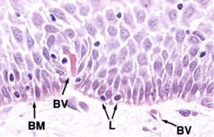
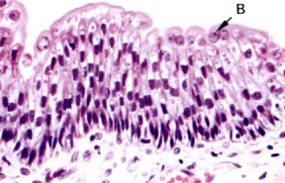
CLASSIFICATION OF CONNECTIVE TISSUE
Well, I’ll be darned if all these epithelia don’t have loose connective tissue right underneath them. Must be a good strategy for delivering nutrients to the epithelia, which were too stupid to have their own blood vessels. (Either that, or the blood vessels would disrupt the epithelial tissues‘ “barrier” quality.)

Slide 39
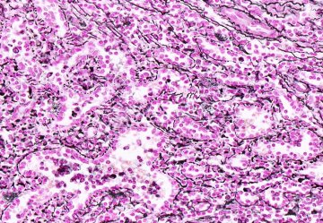
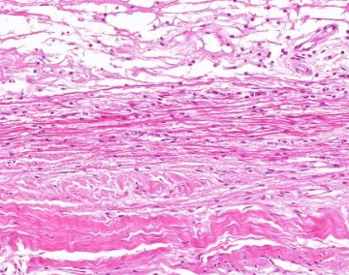
CLASSIFICATION OF CONNECTIVE TISSUE
All connective tissues vary to some extent in the amount of collagen fibers, reticular fibers, and elastic fibers. This is especially true for the loose connective tissues. These variations give these tissues slightly different functional features, and in some cases, alternate names.
Reticular tissue – the reticular fibers in this special stain are black. (nuclei are red)
Elastic tissue – the elastic fibers are the bright eosinophilic bands you see.
Though the elastic fibers look a little like collagen from the previous slides, elastic fibers tend to be “shinier”, especially when you lower the condenser on your microscope.
Both of these are really cute variations of loose connective tissue

Slide 40
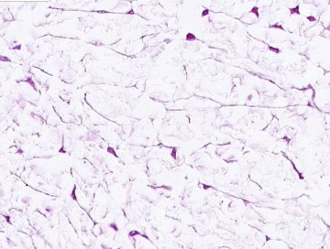
CLASSIFICATION OF CONNECTIVE TISSUE
Mesenchyme is undifferentiated connective tissue that can give rise to all connective tissue types, including the generic types as well as the specialized ones (e.g. cartilage, bone, etc.). Because it has few extracellular fibers, it’s tempting to call this loose connective tissue. DON’T DO THIS!!!. And don’t call loose connective tissue mesenchyme. They don’t get along and are very insulted when you do this.
Although mesenchyme is EXTREMELY cool when discussing Embryology, and we do look at it in Histology, it probably won’t appear on your exam because it’s too tricky.

Slide 41
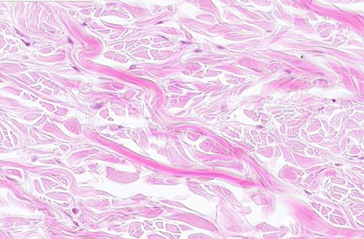
CLASSIFICATION OF CONNECTIVE TISSUE
OK, back to our classification scheme. More pictures…
Fibroblast nuclei
Collagen fibers:
Longitudinal
Cross section
oblique
Dense irregular connective tissue
appearance – less space, many (type I) collagen fibers, many are thick, so it is dense
collagen fibers oriented in all directions, so it is irregular
function – strong in multiple directions, but usually is not as well vascularized as loose

Slide 42
CLASSIFICATION OF CONNECTIVE TISSUE
Video of salivary gland showing loose and dense irregular connective tissues – SL91
Link to SL 091
Be able to identify:
Loose connective tissue
Dense irregular connective tissue

Slide 43
CLASSIFICATION OF CONNECTIVE TISSUE
Video of salivary gland showing loose and dense irregular connective tissues – SL125
Link to SL 125
Be able to identify:
Loose connective tissue
Dense irregular connective tissue

Slide 44
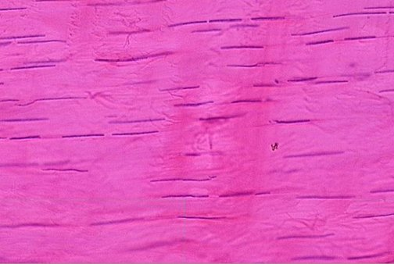
CLASSIFICATION OF CONNECTIVE TISSUE
Fibroblast nuclei
Collagen fibers
(basically everywhere)
Dense regular connective tissue
appearance – no space, many thick (type I) collagen fibers packed so tightly, it’s hard to see individual fibers, so it is dense
collagen fibers oriented in one direction, this is difficult to appreciate because the individual collagen fibers are hard to see, but look how the fibroblast nuclei have to orient and narrow to accommodate, so it is regular
function – strong in one direction (e.g. tendon, ligament), but usually very poorly vascularized, so it takes a long time to heal

Slide 45
CLASSIFICATION OF CONNECTIVE TISSUE
Video of tendon showing dense regular connective tissue – SL27
Link to SL 027
Be able to identify:
Dense regular connective tissue

Slide 46
The next set of slides is a quiz for this module. You should review the structures covered in this module, and try to visualize each of these in light and electron micrographs.
Distinguish, at the light microscope level, each of the following components of connective tissue:
Collagen fibers
Elastic fibers (may need special stains)
Reticular fibers (seen with special stains only)
Fibroblasts
Mast cells (seen in special stain stains only - metachromasia)
Ground substance
Distinguish, at the light microscope level, each of the following types of connective tissue:
Loose (areolar)
Dense irregular
Dense regular (e.g. tendon)
Elastic tissue
Distinguish, at the electron microscope level, each of the following components of connective tissue:
Collagen fibers
Elastic fibers
Fibroblast
Basal lamina

Slide 47
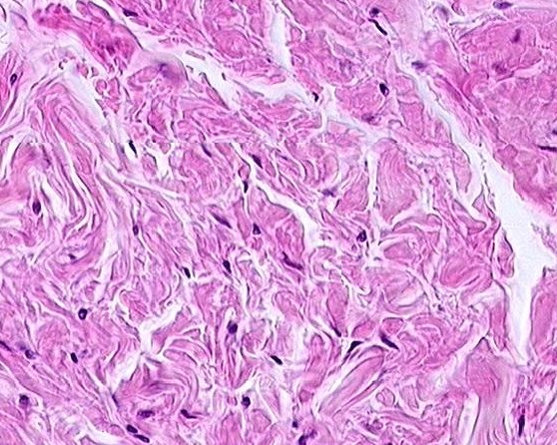
Final quiz
Self-check: Identify the tissue. (advance slide for answers)
Dense irregular connective tissue

Slide 48
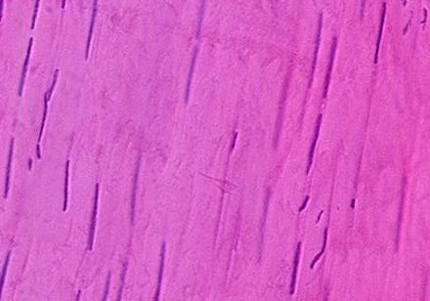
Final quiz
Self-check: Identify the tissue. (advance slide for answers)
dense regular connective tissue

Slide 49
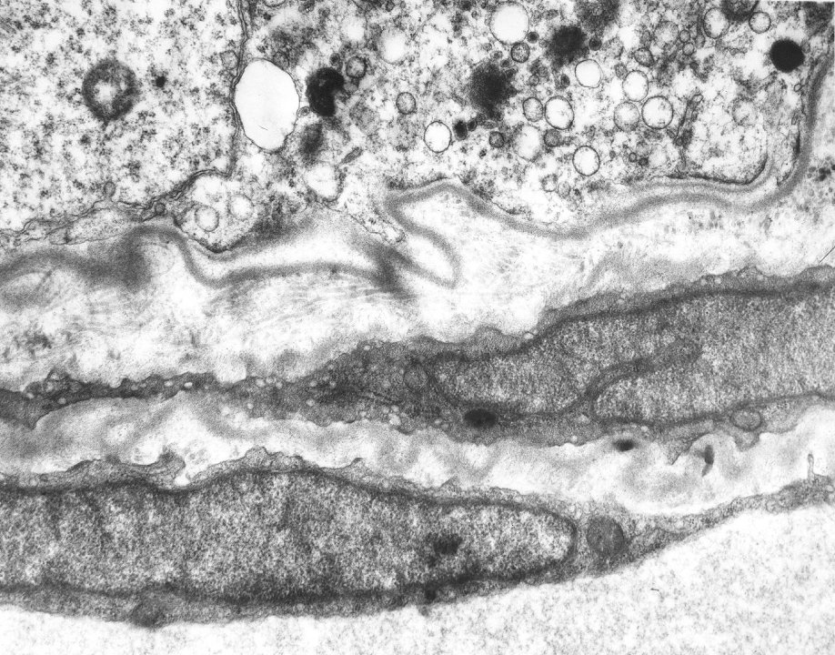
Final quiz
Self-check: Identify cells A and B. Identify structure at arrows and . (advance slide for answers)
Epithelial cells
A
A
Basal lamina
B
fibroblasts
Reticular (collagen) fibers
B

Slide 50
Final quiz
Self-check: This tissue had been previously injured. What is the significance of the structure at the arrow? (advance slide for answer)
Synthesis of a new basal lamina.

Slide 51
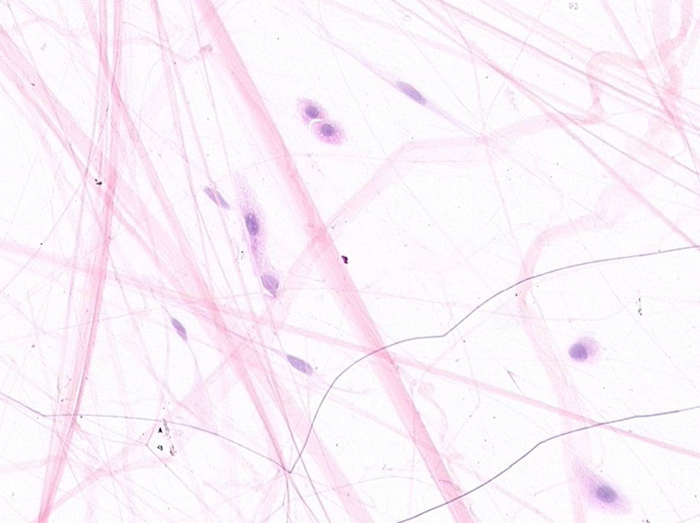
Final quiz
Self-check: Identify all structures or cells. (advance slide for answers)
Probably immune cells
Collagen fiber
Elastic fiber
fibroblast

Slide 52
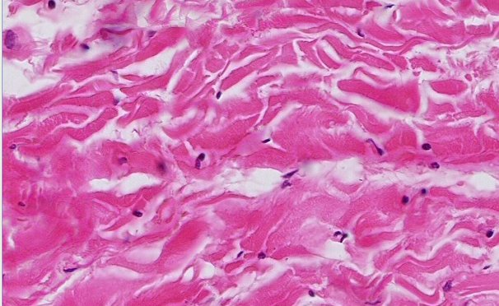
Final quiz
Self-check: Identify the tissue. (advance slide for answers)
Dense irregular connective tissue
The fibers look a little more oriented from right to left, but not all of them are.

Slide 53
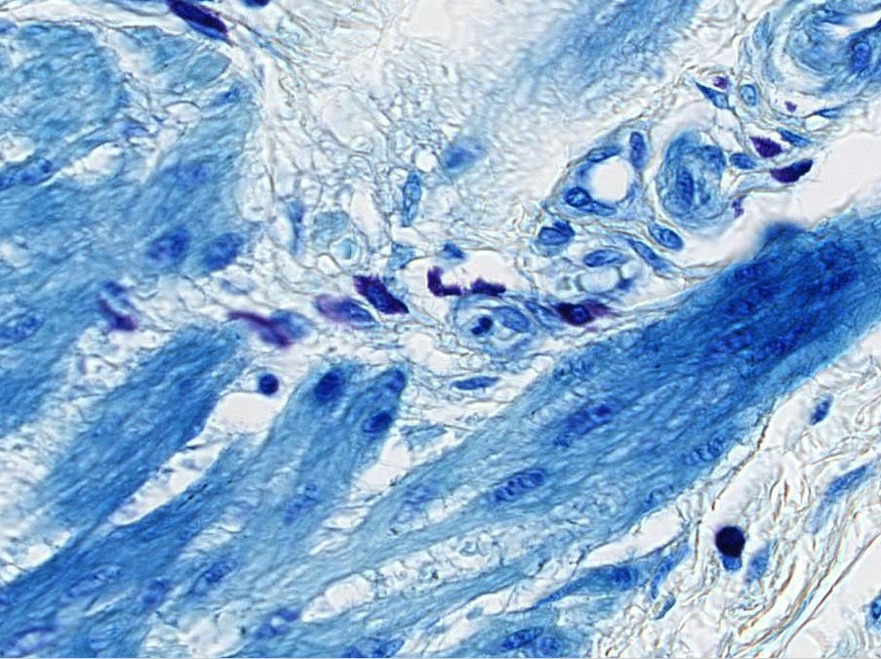
Final quiz
Self-check: Identify the cell indicated by the arrow. (advance slide for answers)
Mast cell

Slide 54
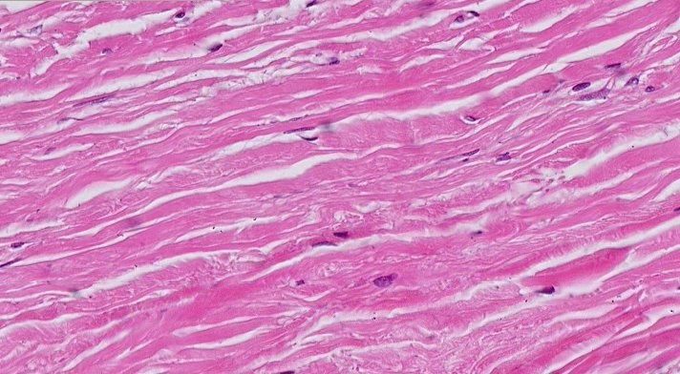
Final quiz
Self-check: Identify the tissue. (advance slide for answers)
Dense irregular connective tissue
Even more fiber orientation, but still a few are non-conforming, and not tightly packed with elongated fibroblast nuclei.
Not the best example of dense irregular connective tissue.

Slide 55
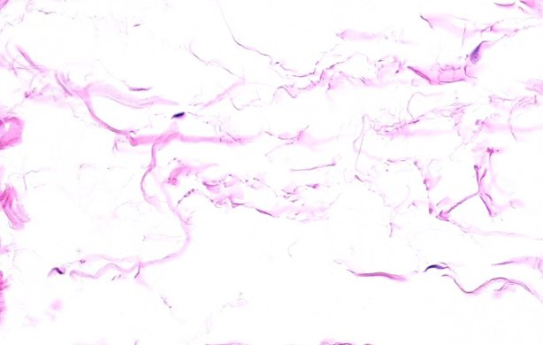
Final quiz
Self-check: Identify the tissue. (advance slide for answers)
loose connective tissue

Slide 56
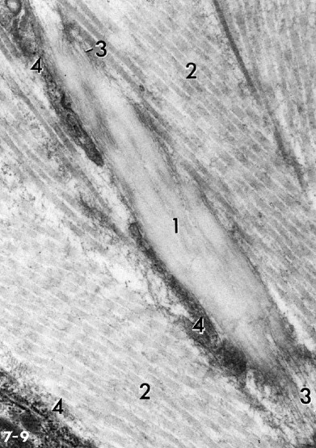
Final quiz
Self-check: Identify 1-2. (advance slide for answers)
Elastin
Collagen fibers in longitudinal section

Slide 57
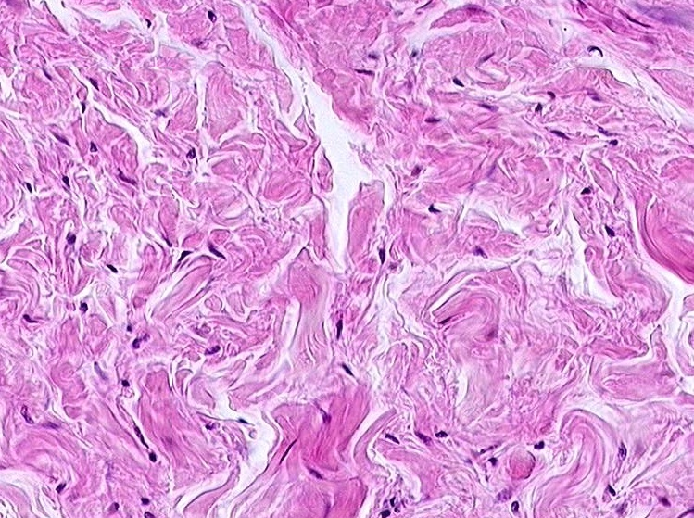
Final quiz
Self-check: Identify all structures or cells. (advance slide for answers)
Collagen fibers
Ground substance
fibroblasts

Slide 58
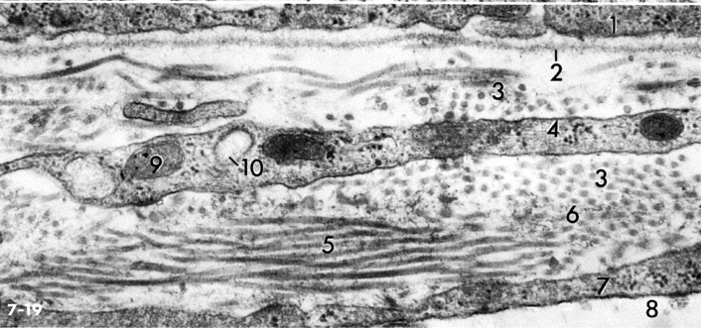
Final quiz
Self-check: Identify 2-4. (advance slide for answers)
Basal lamina
Reticular (collagen) fibers
Fibroblast

Slide 59
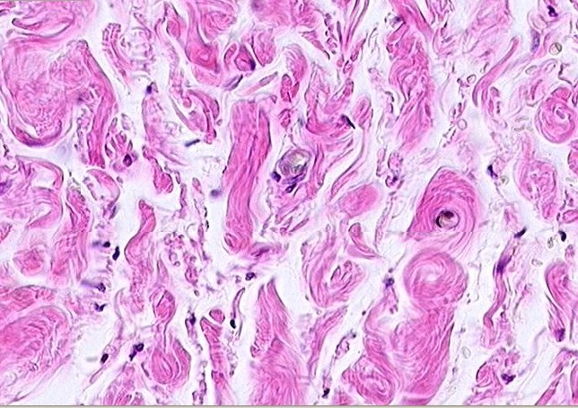
Final quiz
Self-check: Identify the tissue. (advance slide for answers)
Dense irregular connective tissue
Yeah, a few more spaces, but the collagen fibers are still thick

Slide 60
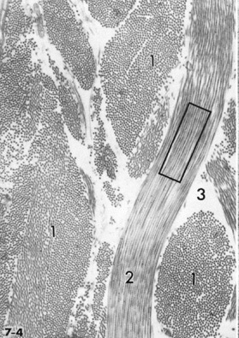
Final quiz
Self-check: Identify 1-3. (advance slide for answers)
Collagen fibers in cross section
Collagen fibers in longitudinal section
Ground substance

Slide 61
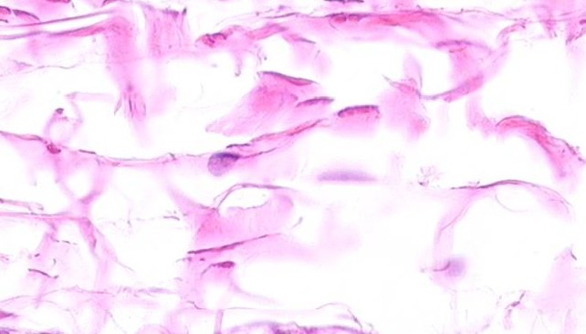
Final quiz
Self-check: Identify the tissue. (advance slide for answers)
loosy-densy connective tissue
So far, we have been dealing with extremes. In reality, much generic connective tissue is something in between, as seen here. Obviously, “loosy-densy” is not an official term, neither is “loosly-dense”, or “densely-loose”, but they all fit. You’ll see this type of generic connective tissue throughout the course, except on exams.
(Do you think we want to argue with medical students about this???)

