Slide 1
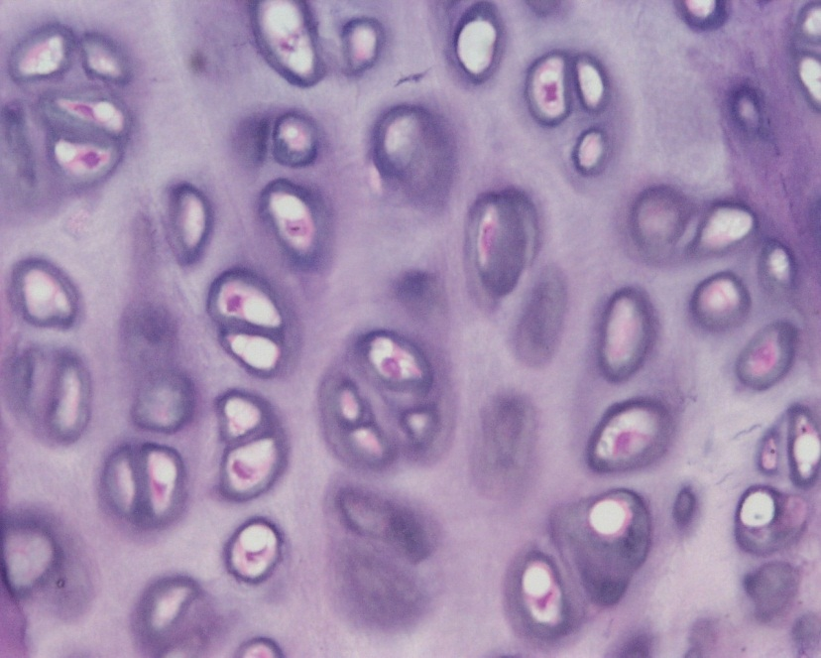
Cartilage
Digital Laboratory
It’s best to view this in Slide Show mode, especially for the quizzes.
This module will take approximately 40 minutes to complete.

Slide 2
After completing this exercise, you should be able to:
Distinguish, at the light microscope level, each of the following::
Cartilage
Hyaline
Lacunae
Chondrocytes
Isogenous groups
Matrix
Perichondrium
Elastic
Same as hyaline + elastic fibers
Fibrocartilage
Same as hyaline + collagen fibers - perichondrium

Slide 3
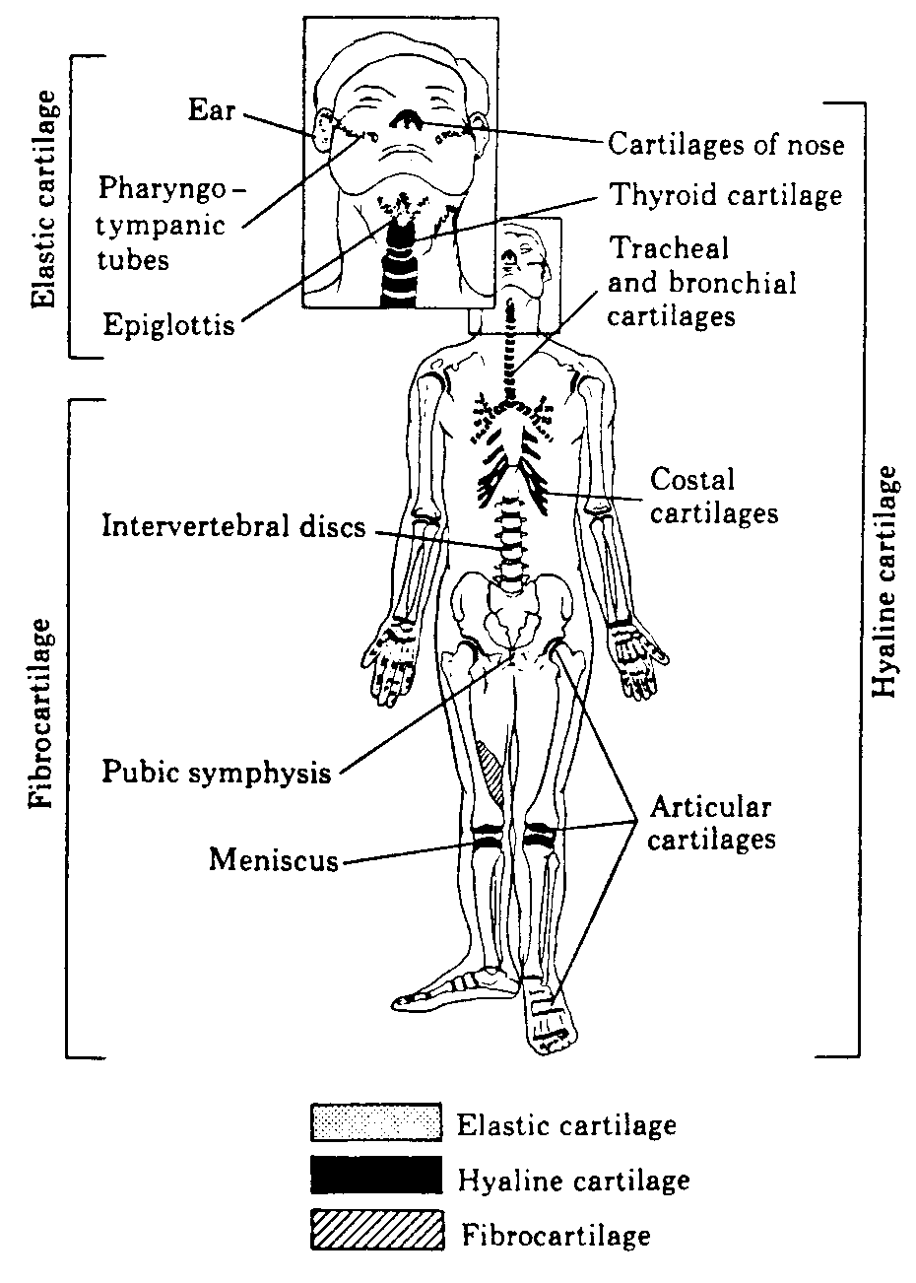
Cartilage - distribution
Cartilage is found in numerous places throughout the body, most notably on the ends of bones, the ear and nose, and the upper respiratory tract. There are three types of cartilage, hyaline, elastic, and fibrocartilage.
Elastic and fibrocartilage can be thought of as modifications of hyaline cartilage. Therefore, this module will describe cartilage by using hyaline cartilage as a model, and then discuss how elastic and fibrocartilage differ from hyaline cartilage.

Slide 4
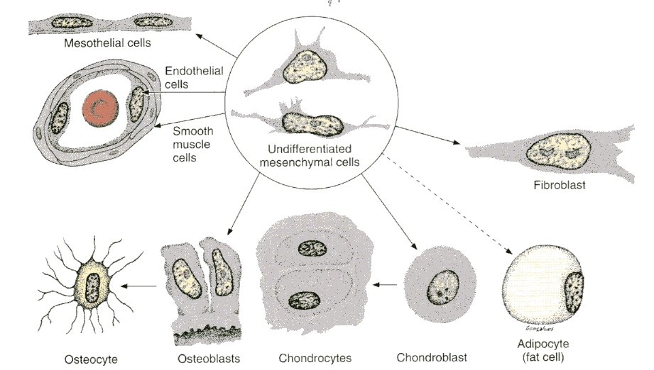
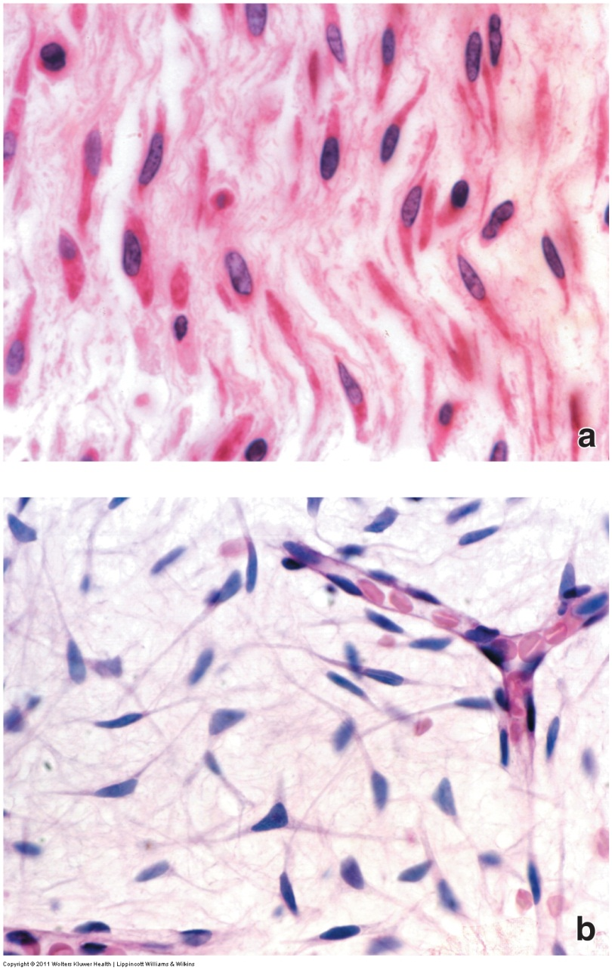
CONNECTIVE TISSUE ORIGIN
This concept is review (or at least should be)
Almost all connective tissues and some other tissues are derived from an embryonic precursor tissue called mesenchyme. This tissue is composed of mesenchymal cells, within a matrix with very few fibers.
In the images to the right, the top image is mesenchyme from a fetus, while the bottom is from the umbilical cord. Both have spindle-shaped cells, with extracellular matrix that is relatively clear because it contains few fibers and abundant ground substance.

Slide 5
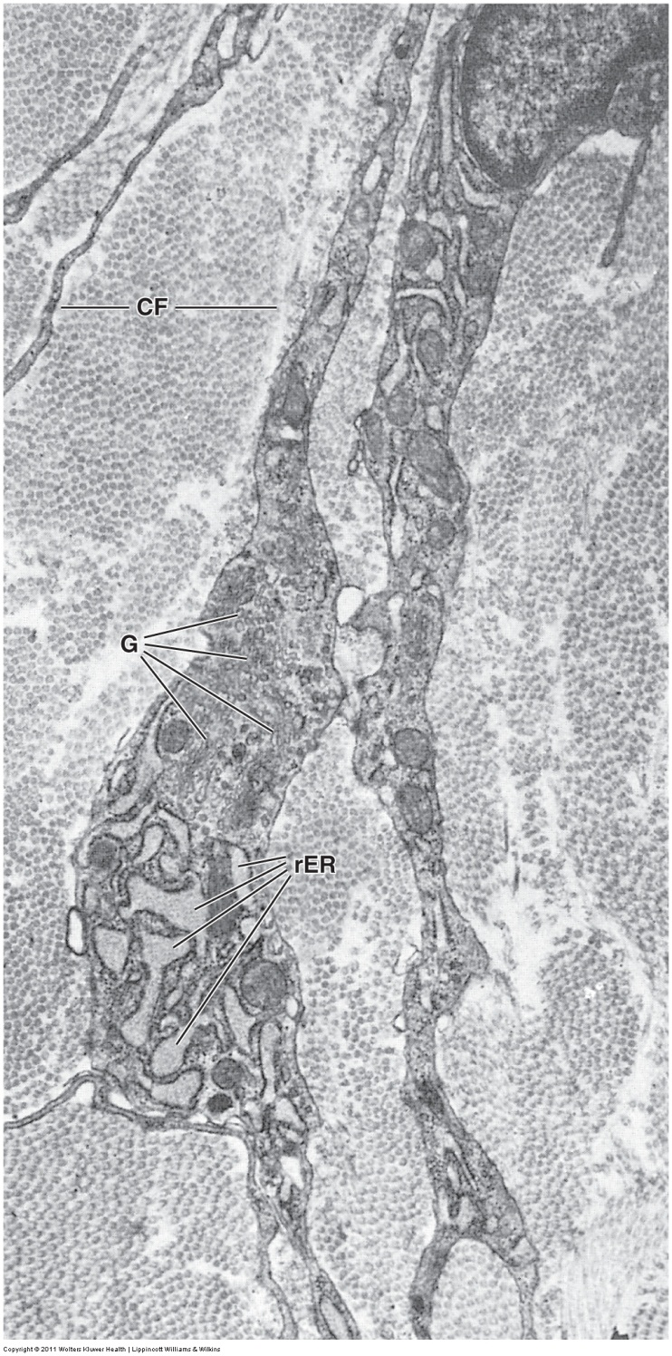
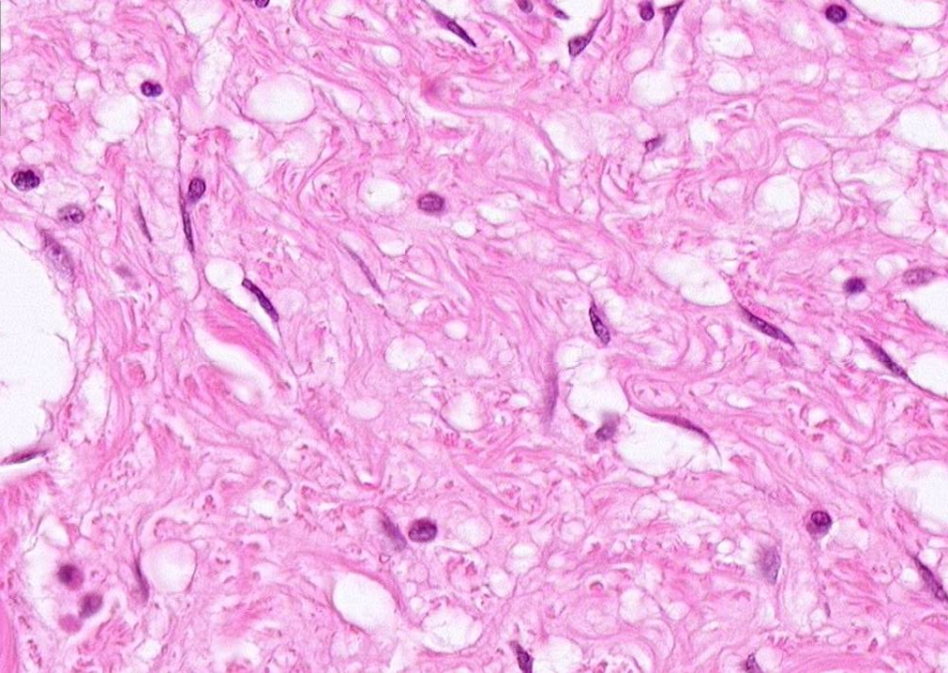
CONNECTIVE TISSUE - GENERIC
F
This concept is review (or at least should be)
To form “generic” connective tissues (loose, dense irregular, dense regular), mesenchymal cells mature into fibroblasts (F, green arrows), which are characterized by well-developed rough endoplasmic reticulum (rER) and a Golgi apparatus (G) necessary to secrete the components of the extracellular matrix (e.g. collagen fibers, CF).

Slide 6
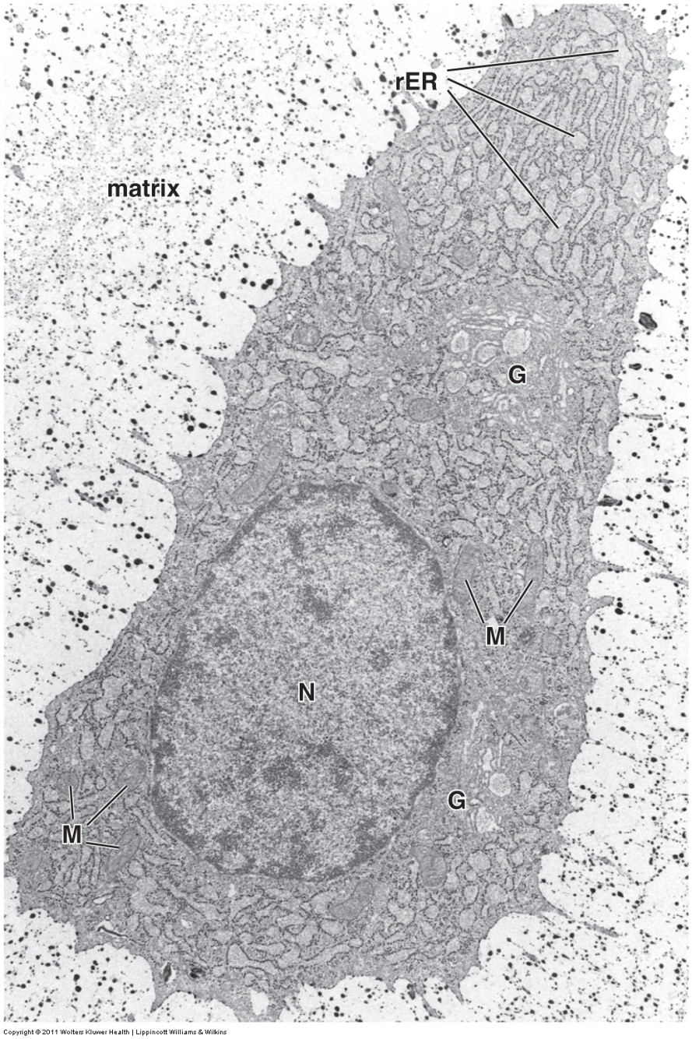
Cartilage
To form cartilage, mesenchymal cells develop into chondroblasts, which, as you can see in the image to the right, are cuboidal, and do not have long, spindly processes characteristic of fibroblasts. Like fibroblasts, chondroblasts develop elaborate rough endoplasmic reticulum (rER) and Golgi (G); however, the matrix they secrete is rich in type II collagen and proteoglycans, forming a semi-solid matrix. When this matrix solidifies, the cell becomes “trapped” in a space within its own matrix called a lacuna. Once trapped, chondroblasts are referred to as chondrocytes.
As we will see, the cell isn’t completely trapped, since the matrix is not rigid.
The cell can continue to grow and divide, “pushing out” against the flexible matrix.

Slide 7
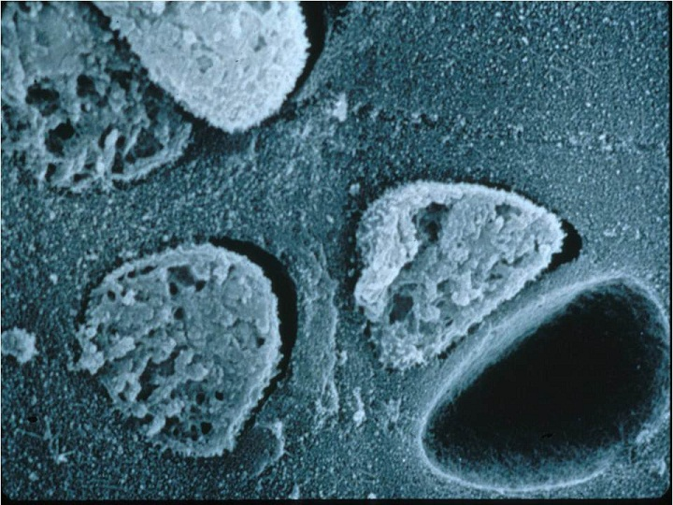
Cartilage
This scanning EM of a section of cartilage shows chondrocytes embedded within the matrix. One cell has fallen out of the tissue during sectioning, creating a lacuna.
matrix
chondrocyte
lacuna
So, the lacuna doesn’t really exist, it’s just the space left behind when the cell either falls out or shrinks away from the matrix. This lacuna thing happens because fixation shrinks the tissue, and the matrix, being fairly rigid, shrinks less than the cells within the matrix. So the cells “pull away” from the matrix during fixation. Tissue preparation for EM usually results in less shrinkage than tissue prep for light microscopy, so we will see more shrinkage and empty lacuna in the upcoming light micrographs.
So, even though lacunae do not really exist, you should appreciate the fact that the presence of lacunae in prepared slides is a powerful criteria for narrowing down a tissue to either cartilage or bone.

Slide 8
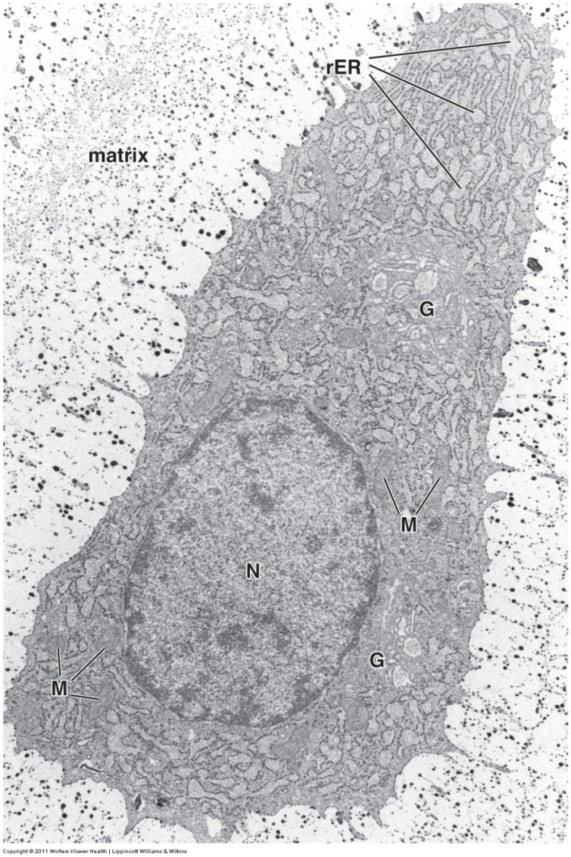
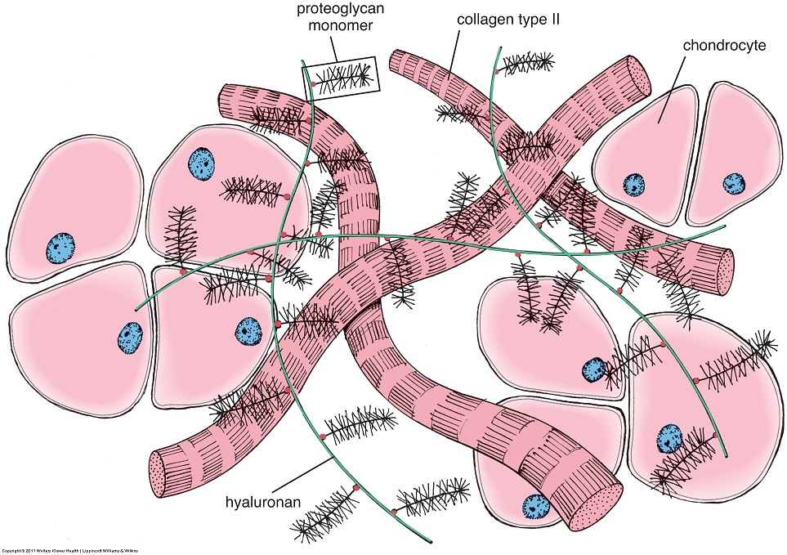
Cartilage
The components of the matrix provide the unique functional properties of cartilage. The collagen fibers provide a scaffold to support the proteoglycans (glycosaminoglycans). The charged proteoglycans repel each other, creating spaces filled with water. This structure provides rigidity as well as a porosity that enhances diffusion (cartilage contains no blood cells, so the living chondrocytes depend on diffusion from adjacent tissues to provide nutrients and remove waste).

Slide 9
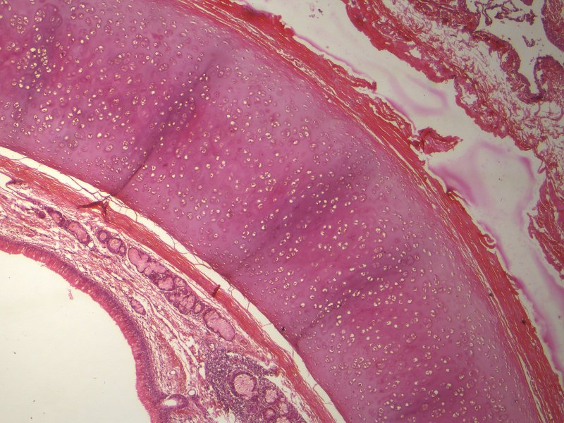
Cartilage – Hyaline cartilage
Old friends of yours
As we mentioned, we’ll begin with hyaline cartilage (it’s sort of the generic cartilage). At low power, you can see this piece of hyaline cartilage surrounded by connective tissues, mucus glands, and an epithelium. Surrounding the cartilage is a specialized connective tissue called the perichondrium (brackets).
hyaline
cartilage
Old friends of yours
You’re used to seeing collagen fibers on H&E (e.g. dense irregular connective tissue). However, type II fibers found in cartilage are small, and not visible in the matrix.
Some initial hints that you might be looking at cartilage…
The numerous spaces you see within the cartilage are the lacunae, however; note that later we will see that bone has lacunae also
The matrix of cartilage is semi-solid, and when sectioned appears smooth or “glassy”.

Slide 10
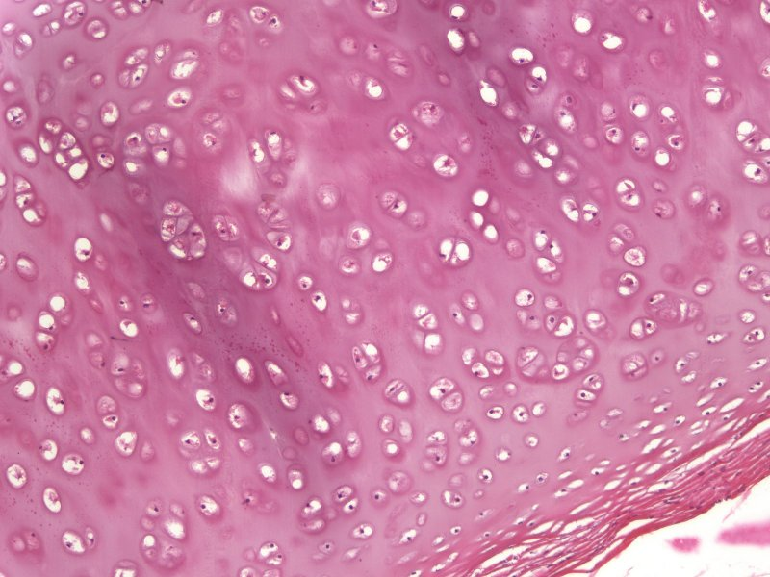
Cartilage – Hyaline cartilage
matrix
matrix
matrix
Smooth and glassy – don’t you get the feeling that if you could rub your finger across the cartilage matrix, it would be smooth???
matrix
At higher magnification, you can clearly see empty lacunae (blue arrows) as well as lacuna with chondrocytes within them (green arrows). The matrix is smooth and glassy; the intense basophilia is due to abundant glycosaminoglycans (GAGs) secreted by the chondrocytes. The perichondrium is indicated by the yellow brackets.

Slide 11
Cartilage – Hyaline cartilage
matrix
matrix
matrix
The distribution of GAGs is such that there is a higher concentration of these molecules in the matrix adjacent to the lacunae, as well as in the center of the piece of cartilage (relative to the edge). This results in more basophilia near the lacunae (capsular matrix), as well as more basophilia in the center of the cartilage (better appreciated in the low power image in the upper left).

Slide 12
Cartilage – Hyaline cartilage
The perichondrium (yellow bracket) is a specialized connective tissue that consists of two layers. The outer, fibrous portion (green bracket) looks like dense irregular connective tissue, while the inner, cellular portion (just below green bracket) is the location where cells are beginning to differentiate into chondroblasts (note blue dots are nuclei). Secretion of matrix by cells adjacent to the cartilage contributes to appositional growth of cartilage (growth by adding cartilage onto the surface of existing cartilage).

Slide 13
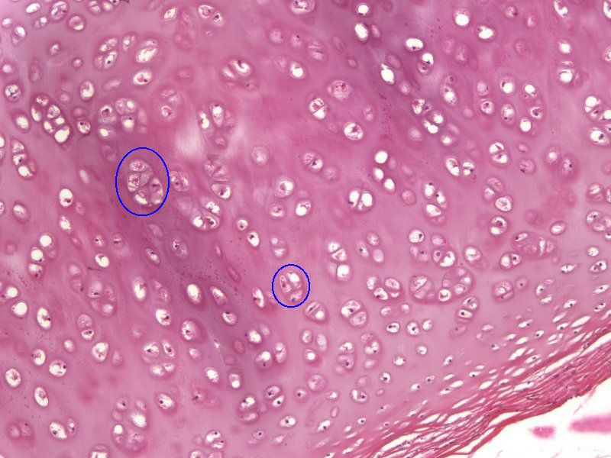
Cartilage – Hyaline cartilage
As we mentioned, cells within cartilage continue to secrete matrix and divide. This growth is referred to as interstitial growth of cartilage. As cells within the semi-solid matrix divide, the resulting daughter cells cannot spread out as readily as cells in other tissues. This creates clusters of cells, called isogenous groups (or isogenous nests, blue ovals).

Slide 14
Cartilage – Hyaline cartilage
One functional note: The perichondrium is rich in blood vessels. The cartilage lacks blood vessels, but its matrix is enriched with glycosaminoglycans, so diffusion of nutrients and waste products between the perichondrium and the chondrocytes is quite efficient.

Slide 15
Cartilage – Hyaline cartilage
Video of hyaline cartilage – SL20
Link to SL 020
Be able to identify:
Hyaline cartilage
Lacunae
Chondrocytes
Matrix
Perichondrium
Isogenous groups (nests)

Slide 16
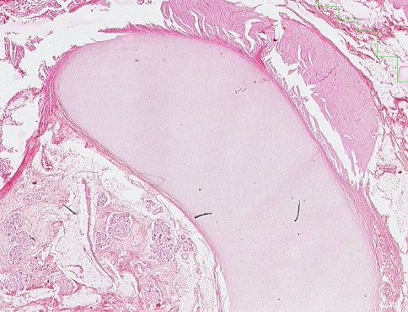
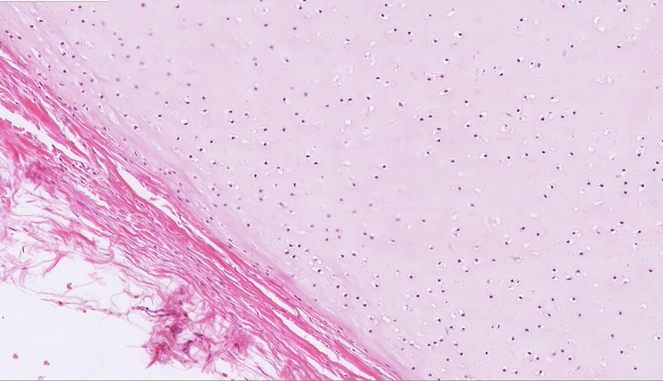
Cartilage – DEVELOPING cartilage
As one would expect, developing cartilage will have features similar to mature cartilage, such as cells within lacuna. However, you would be correct if you predicated that developing cartilage would have less intense basophilia (less GAGs) and fewer isogenous cell nests.

Slide 17
Cartilage – DEVELOPING cartilage
Video of developing cartilage – SL36A
Developing cartilage is challenging to identify. Therefore, I wouldn’t expect to see it on an exam at all.
Link to SL 036A and SL 036B
Be able to identify:
Nothing specific

Slide 18
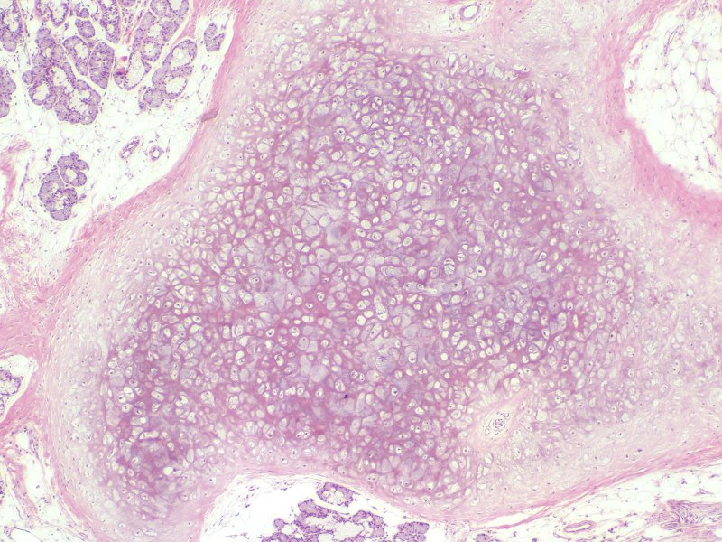
Cartilage – Elastic cartilage
Elastic cartilage is essentially hyaline cartilage + elastic fibers added to the matrix. Obviously, this provides more elasticity for structures such as the ear and nose.
Elastic cartilage typically has a similar number of cells as hyaline cartilage, and has a perichondrium.
Don’t confuse yourself. Elastic cartilage is hyaline cartilage plus elastic fibers. Therefore, like all cartilage, the matrix of elastic cartilage still has type II collagen and proteoglycans, in addition to elastic fibers. It’s really that easy.

Slide 19
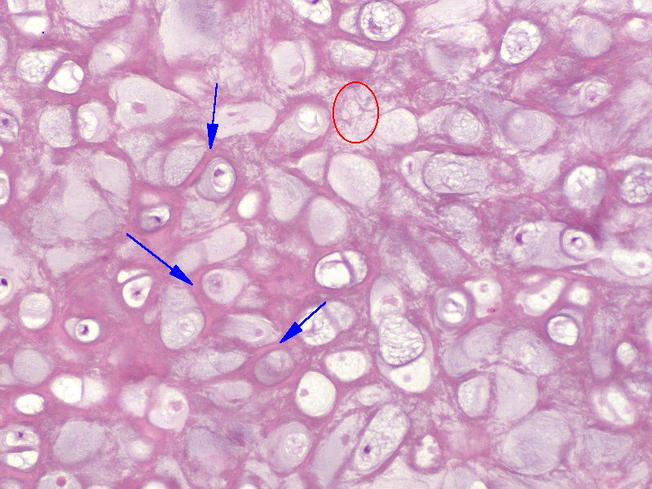
Cartilage – Elastic cartilage
At higher magnification, you can see thin elastic fibers (red oval) and larger elastic bundles (blue arrows) in the matrix.
Remember, type II collagen fibers, which are characteristic of cartilage, are too thin to see in standard H&E slides. Type II fibers are still there, but the fibers that you can see in this slide are elastic fibers. If you are a gunner, you can go to the lab, get out this slide, and lower your condenser to show that these fibers are refractile (shiny).

Slide 20
Cartilage – Elastic cartilage
Video of elastic cartilage – SL17
Link to SL 017
Be able to identify:
Elastic cartilage
Lacunae
Chondrocytes
Matrix
Perichondrium
Isogenous groups not as obvious here

Slide 21
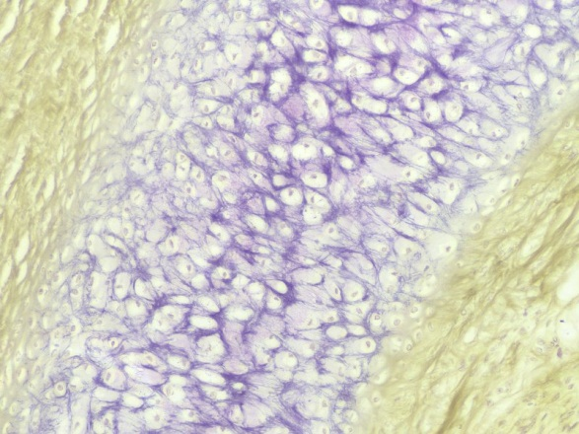
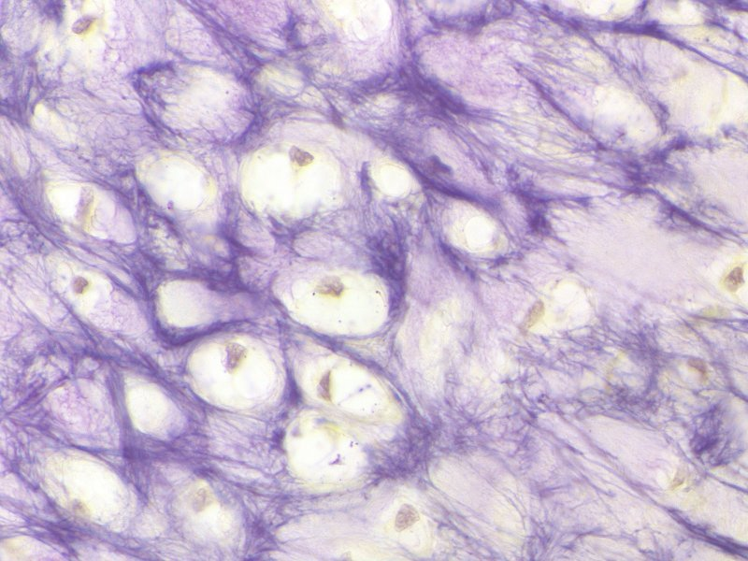
Cartilage – Elastic cartilage
Special stains can be used to highlight the elastic fibers in elastic cartilage. Here, the elastic fibers are purple, and show thin fibers and thicker bundles, similar to what we saw on H&E slides. The cells (brownish-yellow) are poorly preserved within their lacunae.

Slide 22
Cartilage – Elastic cartilage
Video of elastic cartilage resorcin – SL184
Link to SL 184
Be able to identify:
Elastic cartilage
Elastic fibers

Slide 23
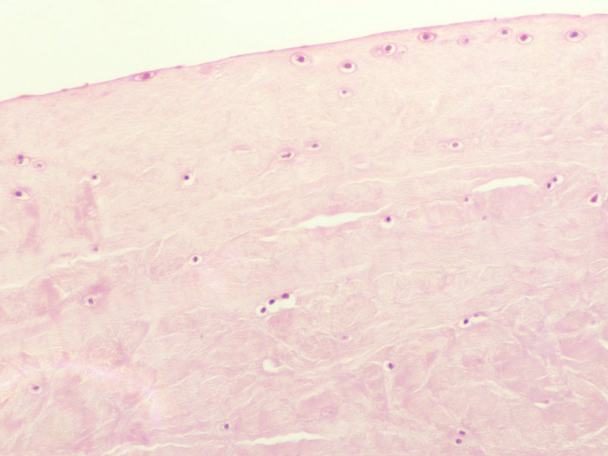
Cartilage – Fibrocartilage
This is the edge – no perichondrium
Fibrocartilage (fibrous cartilage) is essentially hyaline cartilage + type I collagen fibers added to the matrix. Obviously, this provides more tensile strength, and is found in intervertebral disks and pubic symphysis.
Fibrocartilage often has fewer cells than hyaline or elastic cartilage, with fewer isogenous nests, and lacks a perichondrium.
Don’t confuse yourself. Fibrocartilage is hyaline cartilage plus type I collagen. Therefore, like all cartilage, the matrix of fibrocartilage still has type II collagen and proteoglycans, in addition to type I collagen. It’s really that easy.
What’s also easy is to say “type I cartilage” or “elastic collagen” on an exam, so be careful.

Slide 24
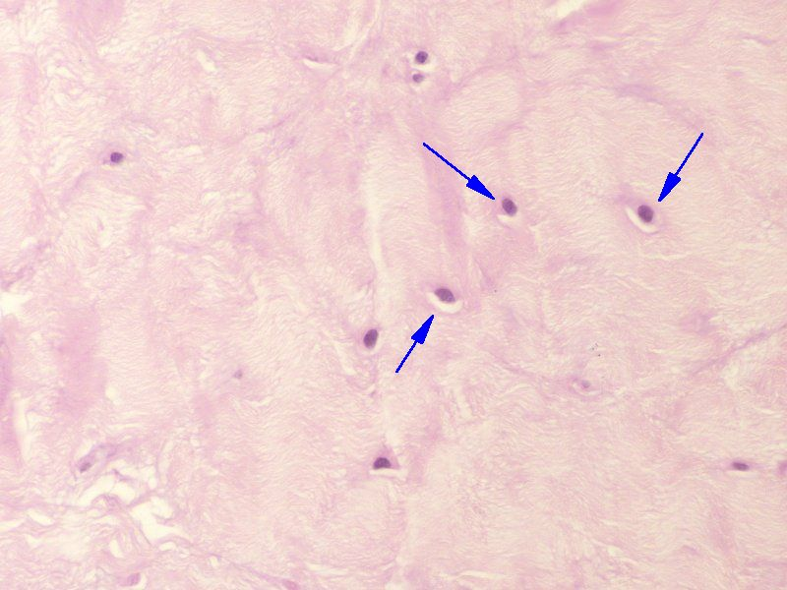
Cartilage – Fibrocartilage
At higher magnification, you can see cells within lacunae (blue arrows). The matrix has bundles of collagen fibers, which, unfortunately, makes fibrocartilage look more like dense irregular connective tissue than cartilage.
Remember, type II collagen fibers, which are characteristic of cartilage, are too thin to see in standard H&E slides. Type II fibers are still there, but the fibers that you can see here are type I collagen fibers.

Slide 25
Cartilage – Fibrocartilage
Video of fibrocartilage – SL37
Link to SL 037
Be able to identify:
Fibrocartilage
Lacunae
Chondrocytes
Matrix

Slide 26
The next set of slides is a quiz for this module. You should review the structures covered in this module, and try to visualize each of these in light and electron micrographs.
Distinguish, at the light microscope level, each of the following::
Cartilage
Hyaline
Lacunae
Chondrocytes
Isogenous groups
Matrix
perichondrium
Elastic
Same as hyaline + elastic fibers
Fibrocartilage
Same as hyaline + collagen fibers - perichondrium

Slide 27
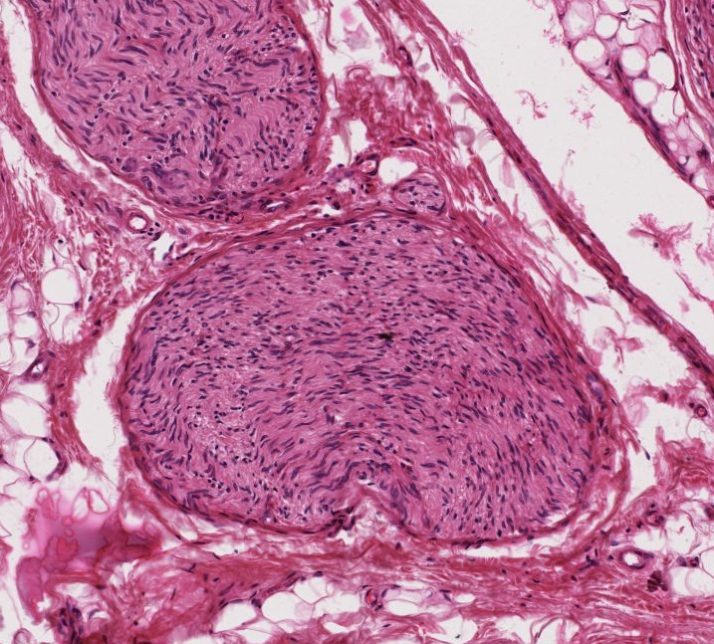
Final quiz
Self-check: Identify the outlined structure. (advance slide for answer)
Peripheral nerve

Slide 28
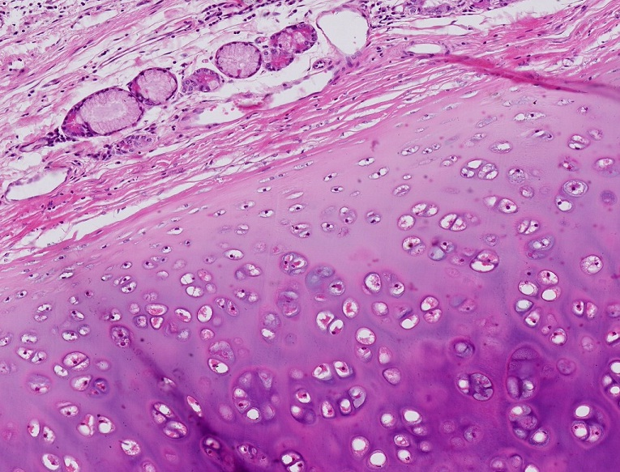
Final quiz
Self-check: Identify the structure between the arrows. (advance slide for answer)
perichondrium

Slide 29
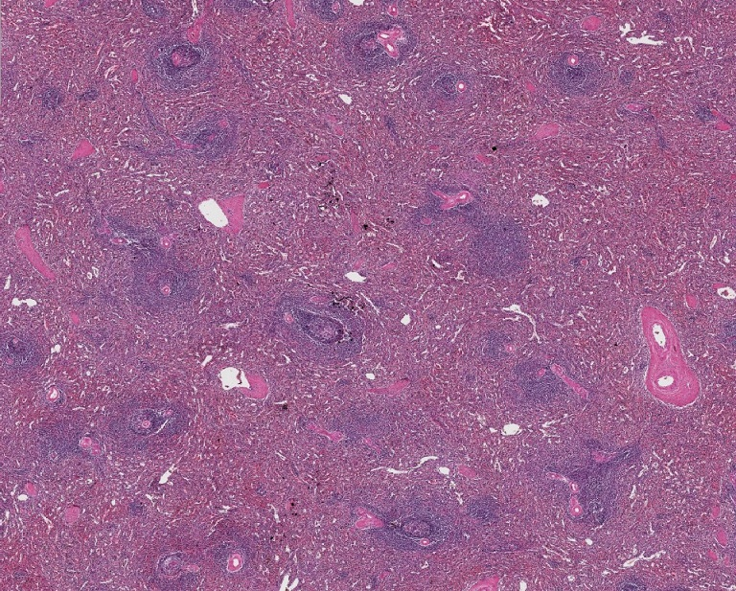
Final quiz
Self-check: Identify the organ on this slide. (advance slide for answer)
spleen

Slide 30
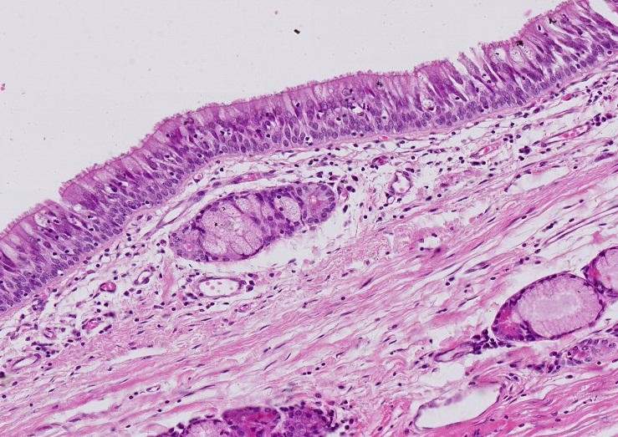
Final quiz
Self-check: Identify the epithelium closest to the arrows. (advance slide for answer)
Pseudostratified (columnar, ciliated, with goblet cells)

Slide 31
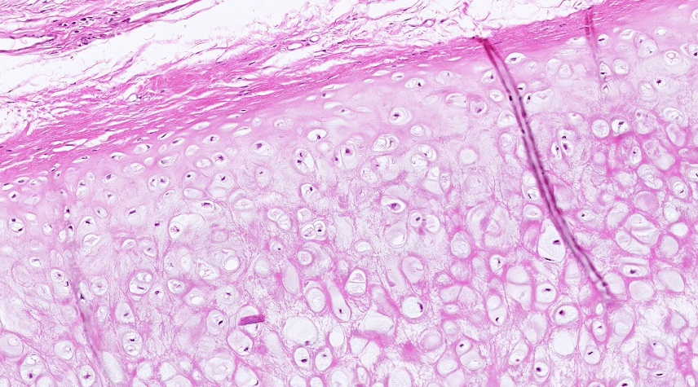
Final quiz
Self-check: Identify the outlined structure. (advance slide for answer)
elastic cartilage

Slide 32
Final quiz
Self-check: Identify the outlined structures. (advance slide for answer)
Mucous glands (with serous demilnes)

Slide 33
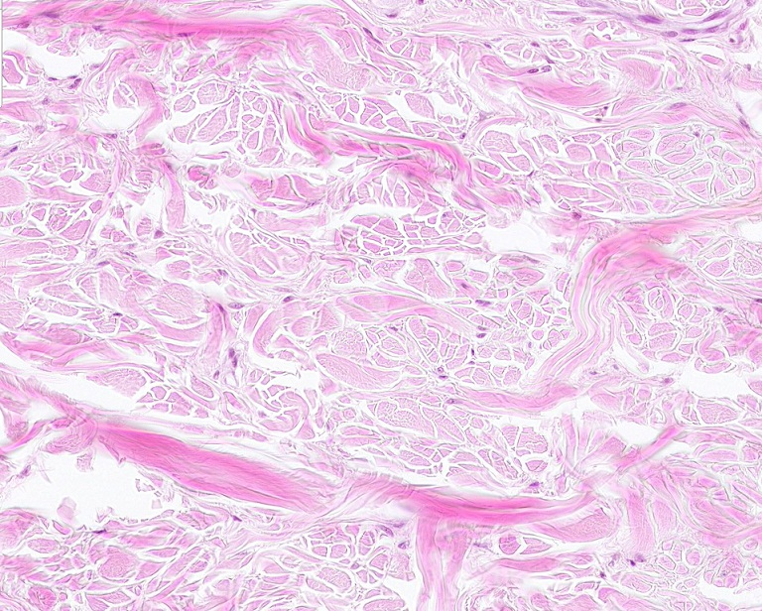
Final quiz
Self-check: Identify the tissue on this slide. (advance slide for answer)
Dense irregular connective tissue

Slide 34
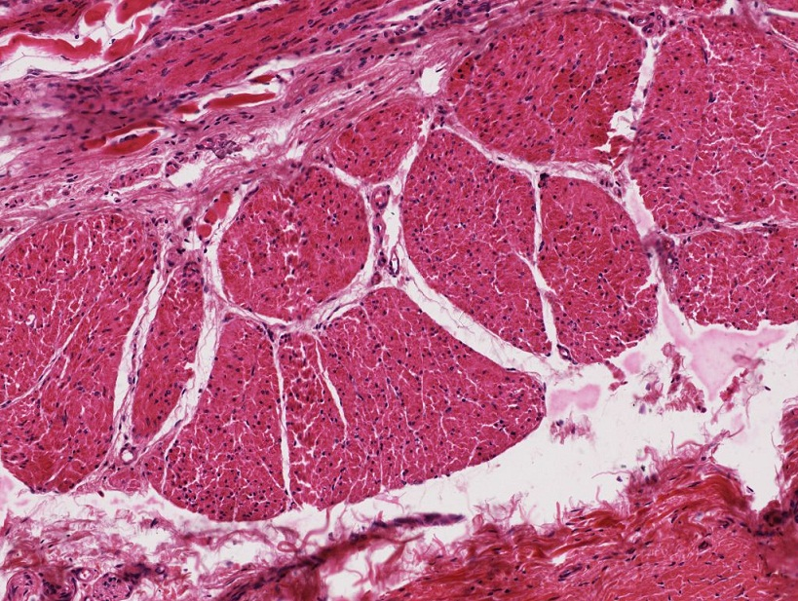
Final quiz
Self-check: Identify the outlined tissue. (advance slide for answer)
Smooth muscle

Slide 35
Final quiz
Self-check: Identify the outlined structure. (advance slide for answer)
Hyaline cartilage

Slide 36
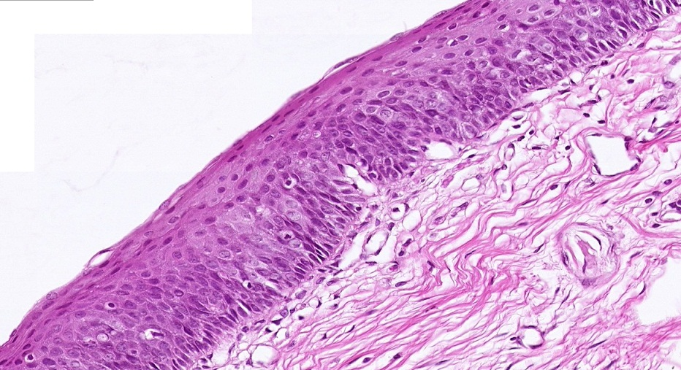
Final quiz
Self-check: Identify the epithelium closest to the arrows. (advance slide for answer)
Stratified squamous (non-keratinized)

Slide 37
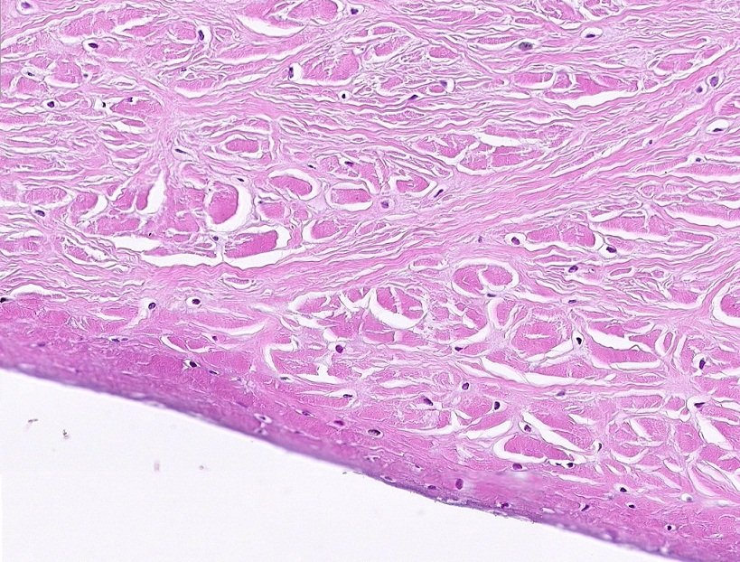
Final quiz
Self-check: Identify the tissue on this slide. (advance slide for answer)
fibrocartilage

Slide 38
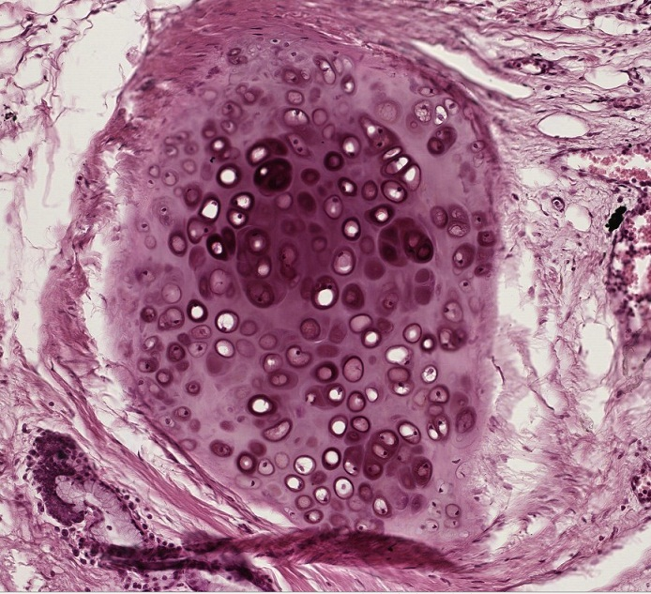
Final quiz
Self-check: Identify the predominant structure on this slide. (advance slide for answer)
Hyaline cartilage

Slide 39
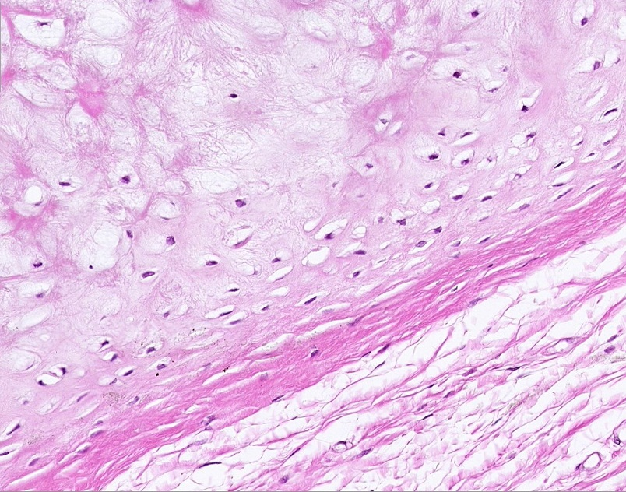
Final quiz
Self-check: Identify the outlined structure. (advance slide for answer)
elastic cartilage

Slide 40
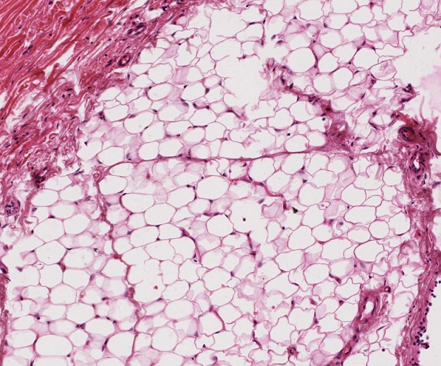
Final quiz
Self-check: Identify the tissue in the outlined region. (advance slide for answer)
Unilocular adipose

Slide 41
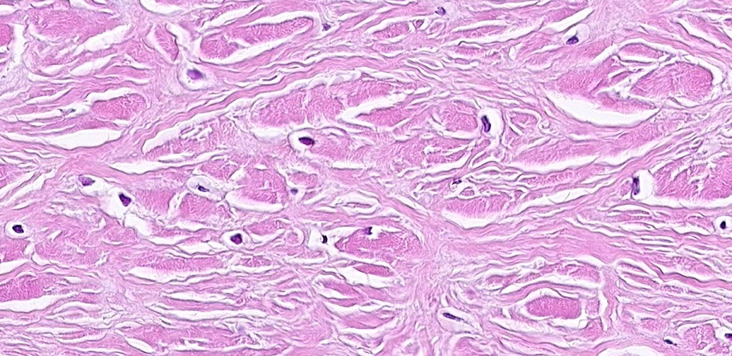
Final quiz
Self-check: Identify the tissue on this slide. (advance slide for answer)
fibrocartilage

Slide 42
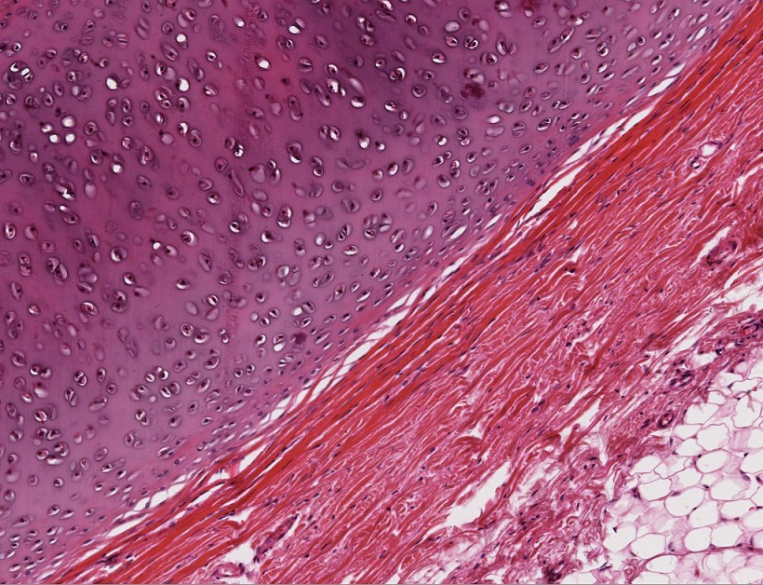
Final quiz
Self-check: Identify the tissue in the outlined region. (advance slide for answer)
Hyaline cartilage

Slide 43
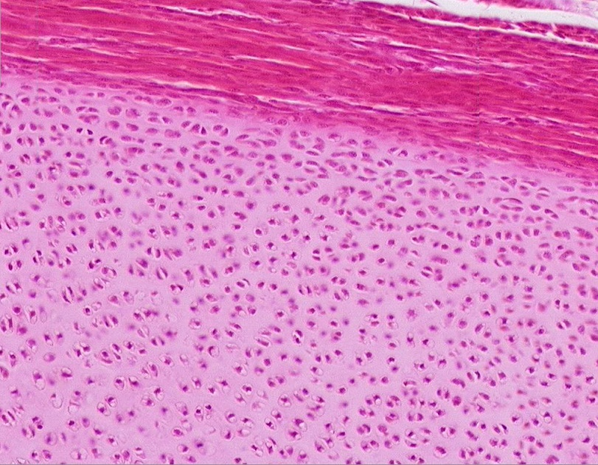
Final quiz
Self-check: Identify the tissue on this slide. (advance slide for answer)
Hyaline cartilage
(yeah, this is immature, I promise I won’t put immature on exam ☺)

Slide 44
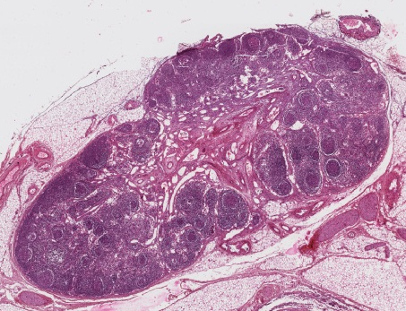
Final quiz
Self-check: Identify the predominant structure on this slide. (advance slide for answer)
Lymph node

Slide 45
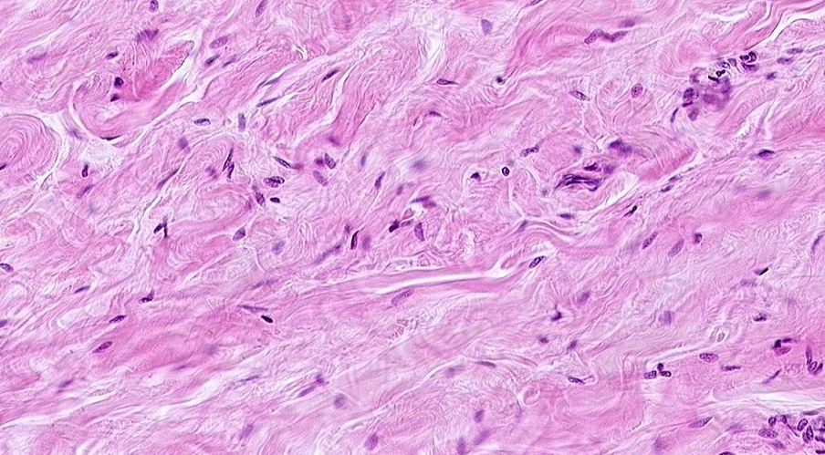
Final quiz
Self-check: Identify the tissue on this slide. (advance slide for answer)
Dense irregular connective tissue

