Slide 1
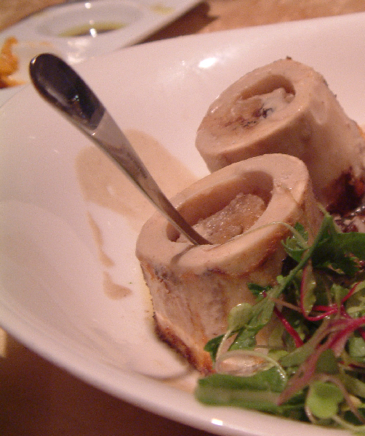
Blood Cell Production: Bone Marrow and Thymus
Digital Laboratory
It’s best to view this in Slide Show mode, especially for the quizzes.
This module will take approximately 20 minutes to complete.

Slide 2
After completing this exercise, you should be able to:
Distinguish, at the light microscope level, each of the following::
(Bone Marrow)
Thymus
Capsule
Trabeculae
Cortex
Medulla
Lobules
Hassal’s corpuscles
Epithelial reticular cells
Lymphocytes
Distinguish, in electron micrographs, each of the following :
Be able to interpret electron micrographs of lymphoid organs if given the source tissue

Slide 3
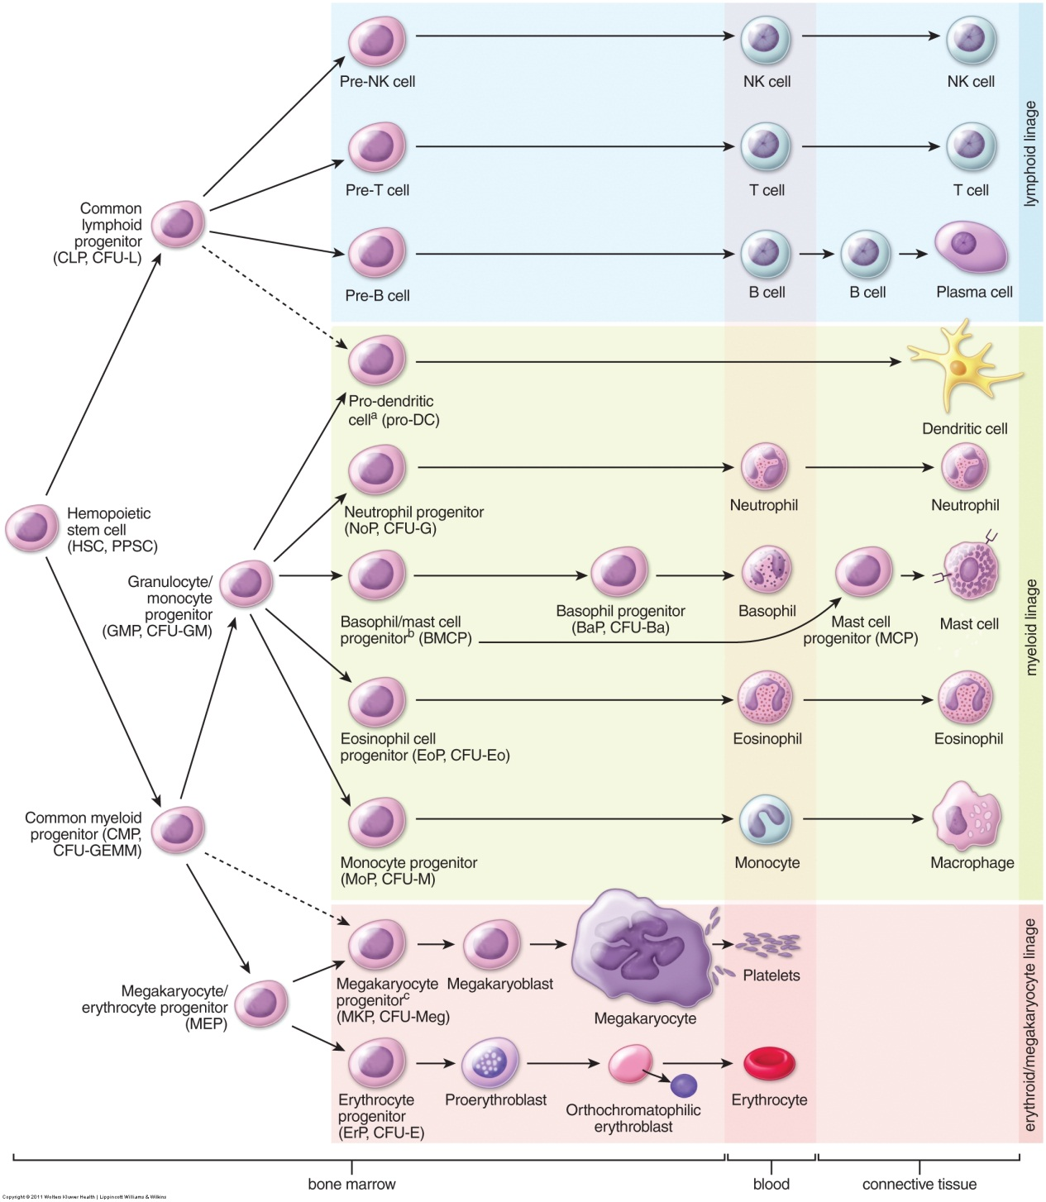
Production of blood cells – bone marrow
Blood cells develop in the bone marrow from a common precursor. Once mature, these cells leave the bone marrow and enter the bloodstream, and then the tissues (note brackets at the bottom). We have already looked at these mature blood cells in the bloodstream.
As you can see, development of mature blood cells from a common precursor in the bone marrow is quite complicated (and this figure doesn’t show most of the details). Fortunately, we will put this off until the Hematology course in the Fall.

Slide 4
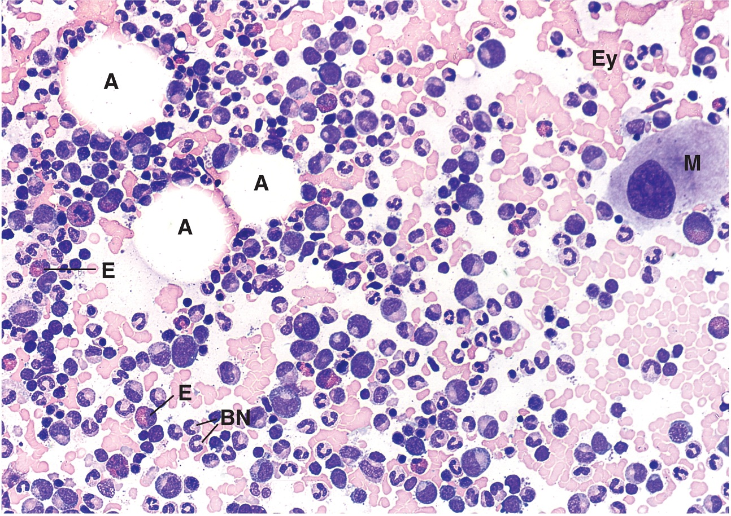
Production of blood cells – bone marrow
Just so you’re not left totally in the dark…
This is a section of red bone marrow. The nucleated cells are developing blood cells in various stages of development.
A = adipose
M = megakaryocyte ( produces platelets)
Ey = erythrocytes
E = developing eosinophils
BN = developing neutrophils
I repeat, this is all FYI…..for now.

Slide 5
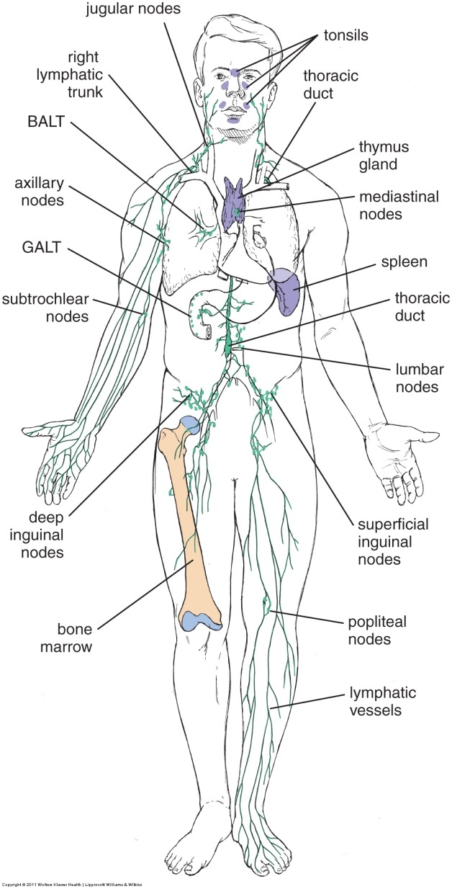
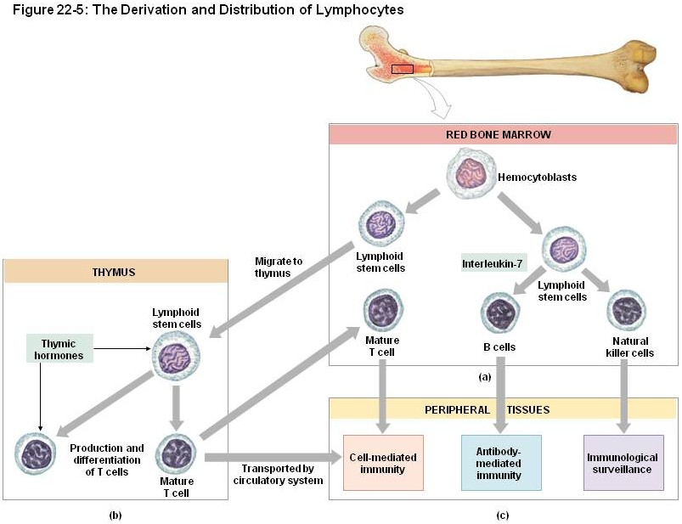
Production of blood cells – THymus
This bone marrow box only shows lymphocytes; obviously, other WBCs, RBCs, platelets are developing here too.
Most blood cells are mature when they are released into the blood from the bone marrow. The notable exception to this are cells of the T cell lineage, which undergo further maturation in the thymus. This is a complicated and not well understood selection process that involves removal of T cells that would bind to self antigen if released into the general circulation. The details are beyond the scope of this module, but will be discussed in class.
In blood smears, T cells that are in transit from the bone marrow to the thymus are indistinguishable from mature T cells that have passed through the thymus, as well as from other non-T cell lymphocytes (e.g. B cells). However, functionally, these cells are immature and will not initiate an immune response.

Slide 6
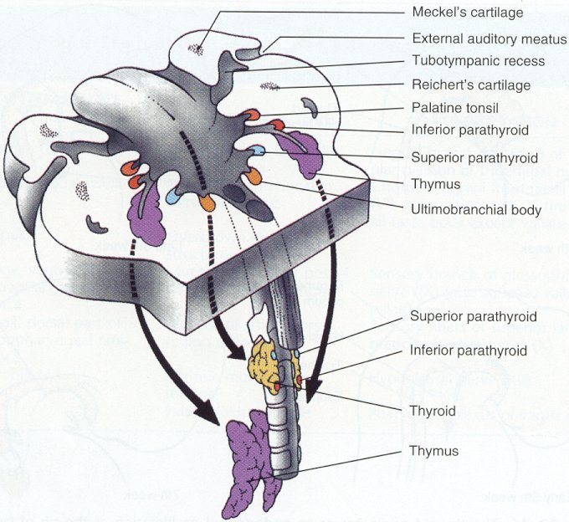
Production of blood cells – THymus
Within the oral cavity, there are lateral outpouchings referred to as the pharyngeal pouches (more on these next year). These spaces are lined by epithelial cells, surrounded by connective tissue. The thymus develops from the 3rd pharyngeal pouches, which pinch off from the oral cavity, and migrates into the neck, anterior to the trachea where they fuse into a single organ.
The epithelial cells, called epithelial reticular cells, maintain connections with each other (e.g. desmosomes) to form a network, the “lumen” of which becomes occupied by T cells from the bone marrow. Epithelial reticular cells not only provide the blood-thymus barrier (a protected environment that appears necessary for T cell maturation), but are involved in the antigen-presentation necessary for T cell selection.
These epithelial cords are surrounded by connective tissue that forms a capsule around the entire organ, as well as partitions that divide the epithelial cords into lobules. Blood vessels reach the thymus through these connective tissue elements.
tongue

Slide 7
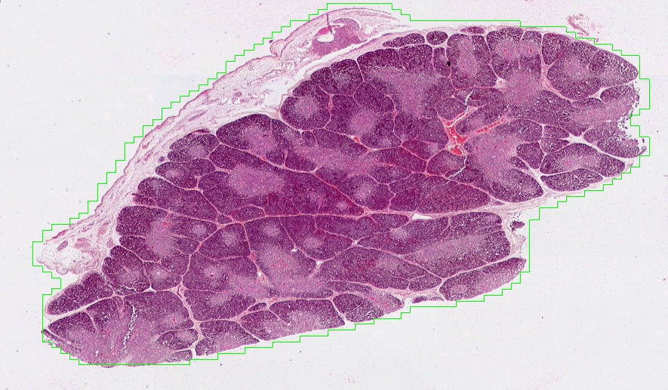
Production of blood cells – THymus
cortex
medulla
The thymus is surrounded by a connective tissue capsule (blue arrows, thickness varies due to tissue removal). Extensions of the capsule, called trabeculae (yellow arrows), partition the thymus into lobules (yellow outline) that vary in size, though some of this variation is due to sectioning. Each lobule has a darker outer portion, the cortex, containing more immature T cells, and a lighter medulla where more mature T cells are located. The trabeculae do not penetrate through the entire organ, so that the lobules are not completely separate structures. The medulla is a single, convoluted structure, the extensions of which are covered by cortical tissue.

Slide 8
Production of blood cells - thymus
Video of overview of the thymus – SL81
Link to SL 081
Be able to identify:
Thymus
Capsule
Trabecula
Cortex
Medulla
Lobules

Slide 9
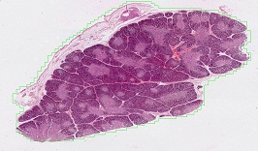
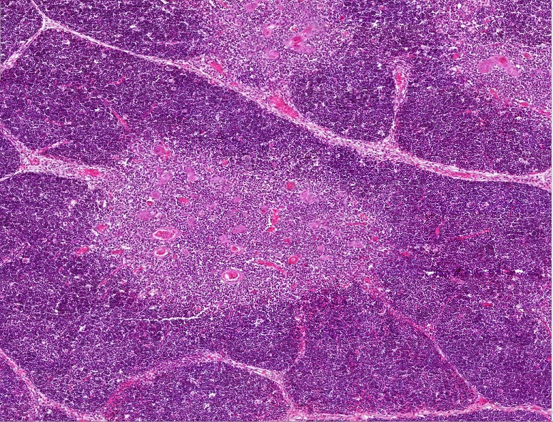
Production of blood cells – THymus
cortex
medulla
cortex
cortex
cortex
A medium power view of a lobule, showing the cortex and medulla. Recall from the connective tissue and blood (inflammation) labs that when there are white blood cells in a region, the clustering of numerous nuclei of these cells creates a darker basophilic region. In this case, T cells are more closely packed in the cortex relative to the medulla, giving it a darker stain.

Slide 10
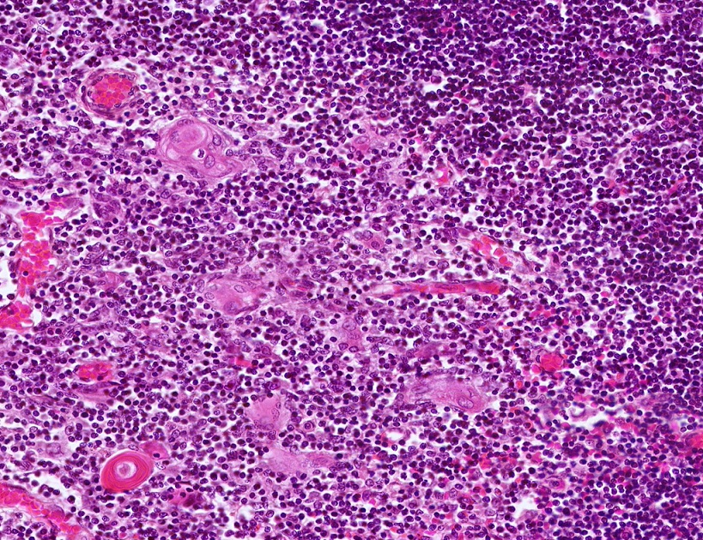
Production of blood cells – THymus
cortex
medulla
In this high powered image from the thymus, the cortex and medulla are indicated. The numerous small nuclei are T lymphocytes, which are more numerous in the cortex. Epithelial reticular cells (black arrow) are seen more easily in the medulla, characterized by a large, euchromatic nucleus and abundant, pale-eosinophilic cytoplasm. Many of these cells have begun to cluster together in a concentric arrangement to form structures called Hassall’s corpuscles (yellow outline), a characteristic feature of the thymus.

Slide 11
Production of blood cells - thymus
Video of details of the thymus – SL81
Link to SL 081
Be able to identify:
Thymus
Lymphocytes
Epithelial reticular cells
Hassall’s corpuscles

Slide 12
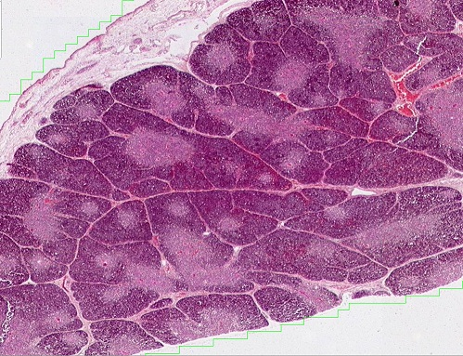
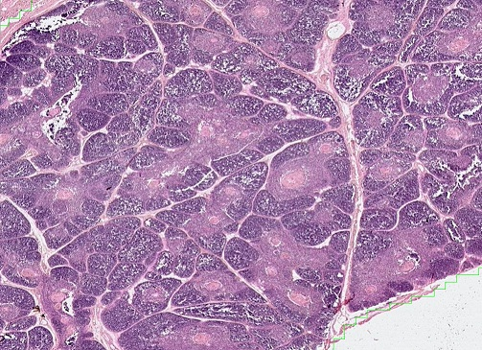
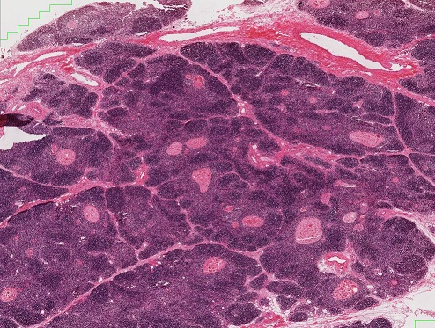
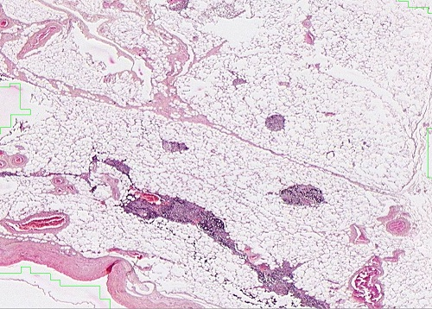
Aging of the THymus
Premature baby
4-year-old child
You won’t have to worry about dating the thymus. (In fact, some of you already have a significant other.)
Furthermore, since the aged thymus is largely replaced by adipose tissue, it would be difficult to definitively identify an adult thymus.
17-year-old
36-year-old
As the thymus ages, it undergoes histological changes. Continued formation of Hassal’s corpuscles (black arrows), and an increase in the size of these structures, occurs throughout early childhood and adolescence. These corpuscles undergo “keratinization”, so that larger corpuscles have little cellularity. During adult life, the thymus undergoes involution, being replaced by adipose tissue, until it no longer resembles the thymus at all.
“Keratinization”? Yes, like the keratinization in stratified squamous keratinized epithelium.

Slide 13
Production of blood cells
Video of the thymus of a premature baby – SL81
Video of the thymus of a 3-year-old – SL80
Video of the thymus of a 17-year-old – SL82
Video of the thymus of a 36-year-old – SL34
Link to SL 081 and SL 080 and SL 082 and SL 034
Be able to identify:
Thymus
Nothing new that is specific, just appreciate the changes in the thymus during aging

Slide 14
The next set of slides is a quiz for this module. You should review the structures covered in this module, and try to visualize each of these in light and electron micrographs.
Distinguish, at the light microscope level, each of the following::
(Bone Marrow)
Thymus
Capsule
Trabeculae
Cortex
Medulla
Lobules
Hassal’s corpuscles
Epithelial reticular cells
Lymphocytes
Distinguish, in electron micrographs, each of the following :
Be able to interpret electron micrographs of lymphoid organs if given the source tissue

Slide 15
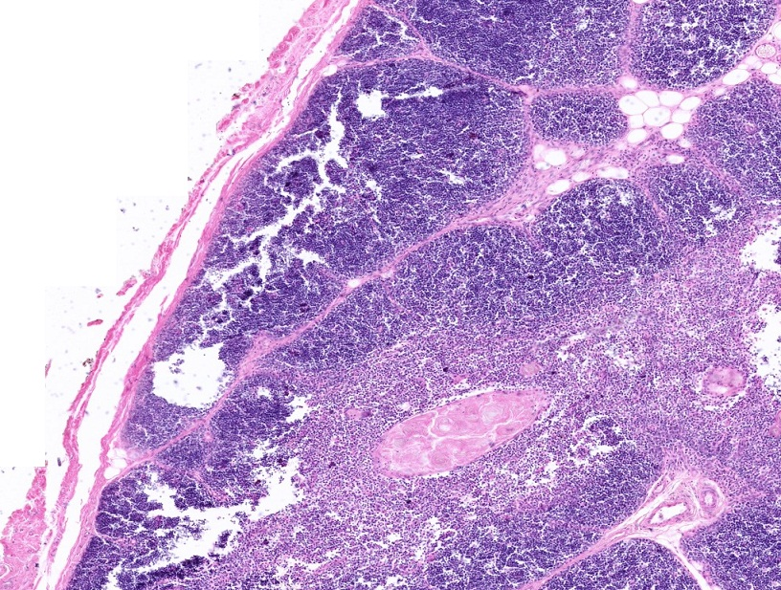
Final quiz
Self-check: Identify all structures. (advance slide for answer)
Unilocular adipose
trabeculae
capsule
Hassell’s corpuscle

Slide 16
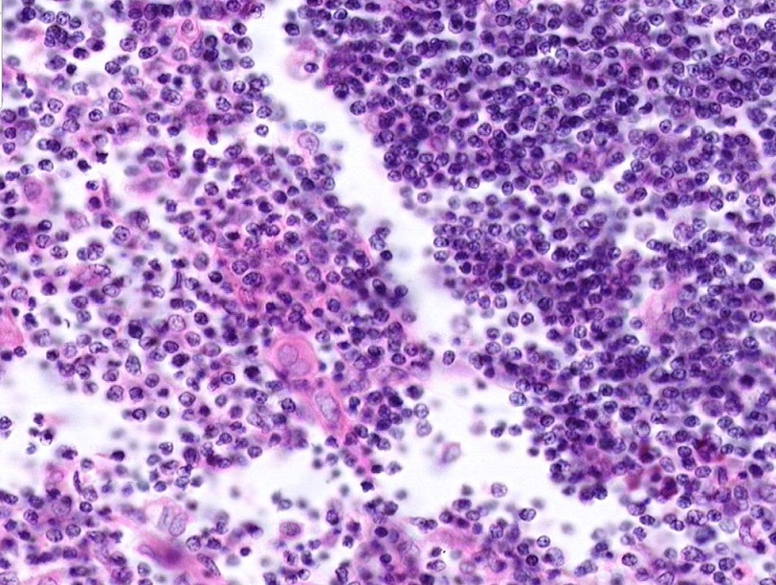
Final quiz
Self-check: Identify the regions. (advance slide for answer)
cortex
medulla

Slide 17
Final quiz
Self-check: Identify the cells. (advance slide for answer)
Lymphocytes (T cells)
Epithelial reticular cells (these are awesome!!!)

Slide 18
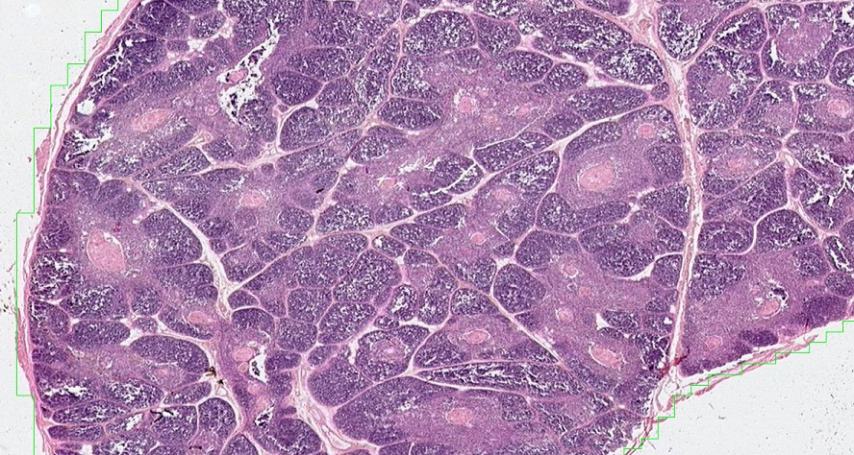
Final quiz
Self-check: Identify the organ and region. (advance slide for answer)
thymus
lobule

Slide 19
OK, this quiz feels pretty pointless right now. Let’s wait until we have more immune organs to confuse you with.

