Slide 1
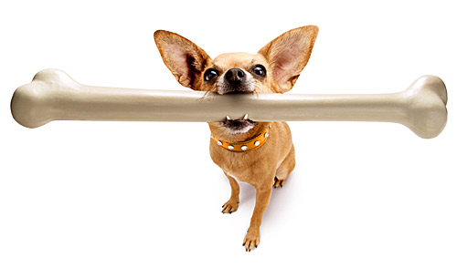
Bone Development
Digital Laboratory
It’s best to view this in Slide Show mode, especially for the quizzes.
This module will take approximately 60 minutes to complete.

Slide 2
After completing this exercise, you should be able to:
Distinguish, at the light microscope level, each of the following::
Review cells of bone
Bone formation
Intramembranous
Spicule or trabecula
Osteoid
Calcified bone matrix
Endochondral
Hyaline cartilage
Calcified cartilage
Osteoid
Calcified bone matrix
Metaphyseal plate
Zone of resting cartilage
Zone of proliferation
Zone of hypertrophy
Zone of calcification
Zone of bone deposition
Distinguish, at the electron microscope level, each of the following::
Review cells of bone
Osteoid
Calcified bone matrix

Slide 3
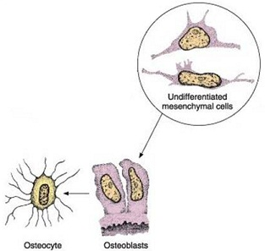
Bone matrix secretion
osteoblasts – these cells are actively secreting bone matrix, which includes:
--type I collagen
--inorganic calcium, (Ca⁺⁺), and phosphate, (PO₄)⁻³, in large crystals called hydroxyapatite
So, I presume you’re thinking of osteoblasts as cells that are actively secreting components of bone matrix, and, therefore, would have abundant rER and a prominent Golgi apparatus for collagen production. If this is the case, you are correct.
The other identifying factor for osteoblasts is the presence of calcified bone. Is bone matrix electron dense? Or electron lucent? How will this matrix appear on H&E?
Remember these statements from the bone histology module?
There is an issue about the timing of secretion (i.e. type I collagen is secreted earlier than the inorganic component), but that can wait until the next module.

Slide 4
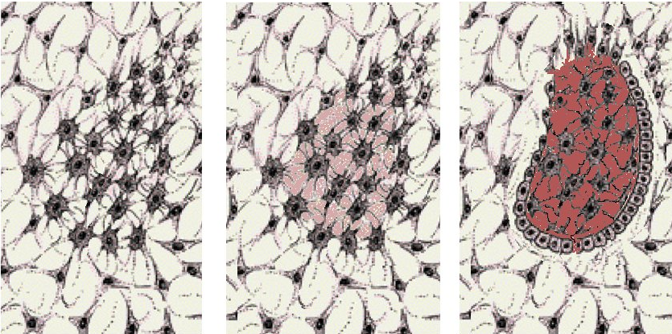
Bone matrix secretion
In this drawing, osteoblasts have clustered together (left image), and begin forming bone by secreting osteoid, which is rich in type I collagen (middle image, osteoid in pink). The osteoblasts then secrete inorganic components, which deposit on the collagen fibers, making calcified bone matrix (magenta in right image).
Note how the osteoblasts extend processes that connect with adjacent osteoblasts before secreting matrix components (left image). The matrix calcifies around the osteoblasts and their processes, creating lacuna and canaliculi. Smart osteoblasts.

Slide 5
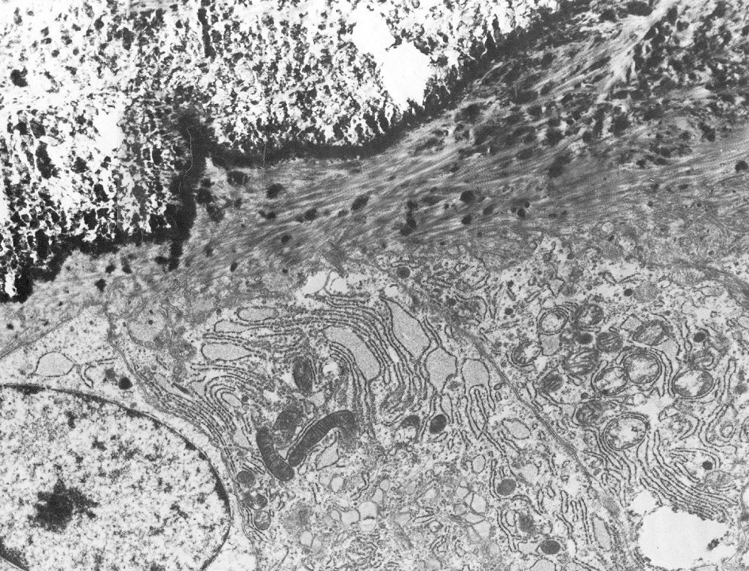
Bone matrix secretion
In this image, you can see that the matrix immediately adjacent to the edge of the osteoblasts (brackets) consists of (mostly) collagen fibers, again, referred to as osteoid. Further away from the osteoblasts, the calcified matrix is dark, except where it has washed away on tissue preparation.
Calcified matrix
Somewhere around here is the plasma membrane of the osteoblasts
osteoblasts

Slide 6
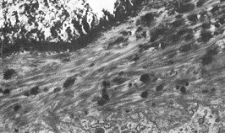
Bone matrix secretion
A little fuzzy when enlarged, but they sure look like collagen fibers to me (there’s a lot of them, just a few are indicated).

Slide 7
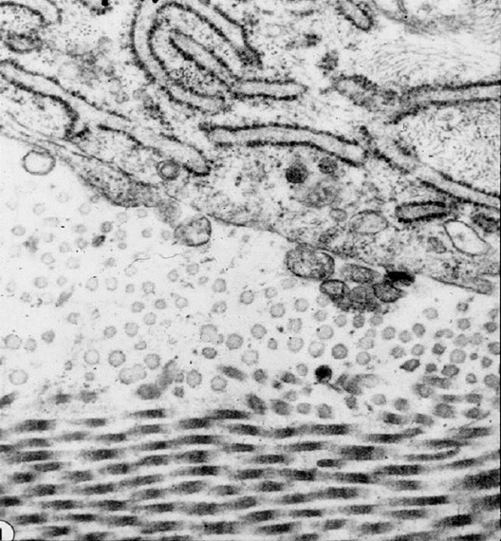
Final quiz
Self-check: Identify the protein in the outlined region. (advance slide for answer)
osteoblast
Type I collagen
We didn’t look at this yet in detail for osseous tissue, but you should still recognize collagen.
Remember this from the quiz? Here you should recognize the type I collagen fibers of the osteoid in cross- and longitudinal-sections, adjacent to the osteoblast.

Slide 8
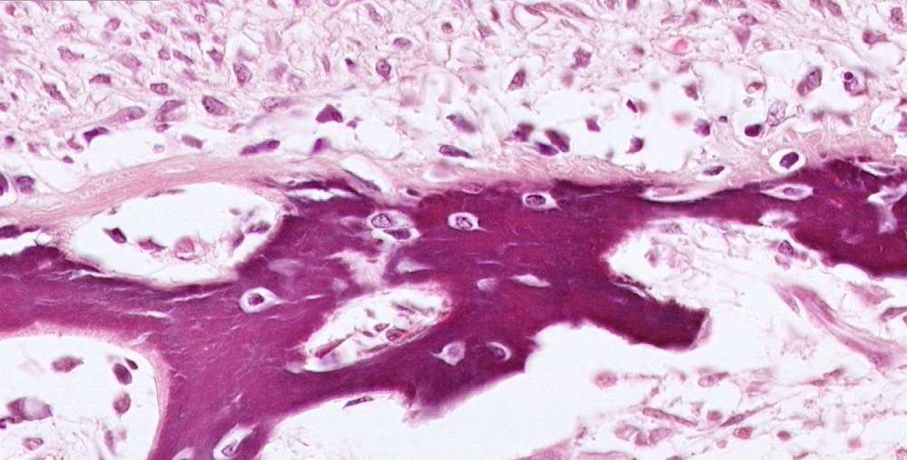
Bone matrix secretion
Since collagen is protein, it is eosinophilic on H&E-stained sections. Here, you can see the pale pink osteoid between the arrows, either on the outer surface of the bright purple calcified bone (black arrows), or as a piece that hasn’t calcified (blue arrows).
Calcified bone
Calcified bone
Calcified bone

Slide 9
Bone matrix secretion
Video of osteoid – SL42
Link to SL 042
Be able to identify:
Osteoid
Calcified bone

Slide 10
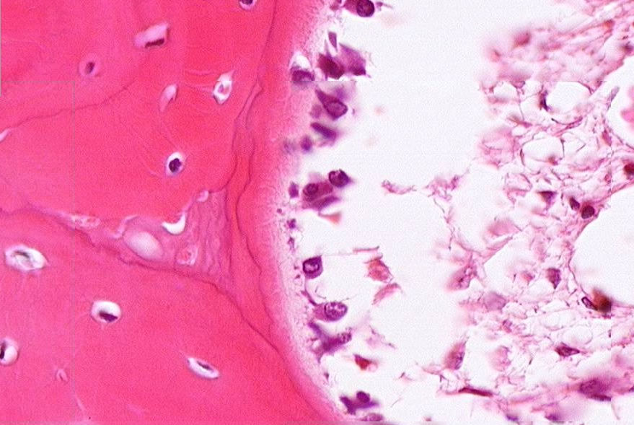
Bone matrix secretion
Other slides of bone have osteoid that is paler, making it more difficult to see (between arrows). However, it’s position between the osteoblasts and calcified bone make identification possible.
Still, if I’m a busy student who is looking for high yield things to study, I would be more interested in the osteoid from SL42.

Slide 11
Bone matrix secretion
Video of osteoid – SL41
Link to SL 041
Be able to identify:
Osteoid
Calcified bone

Slide 12
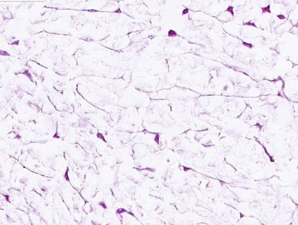
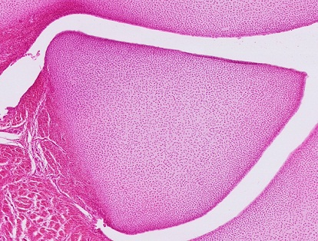
Bone development
Bone is formed from two distinct processes:
--intramembranous ossification, in which bone develops from embryonic mesenchyme
--endochondral ossification, in which bone develops from hyaline cartilage
mesenchyme
Just a technicality, but you know cartilage is derived from mesenchyme. So, ultimately, all bone is derived from mesenchyme. And, you might remember that in some places, esp. the head and neck, neural crest cells contribute to mesenchyme.
developing hyaline cartilage

Slide 13
Intramembranous ossification
We have already seen this earlier in this module. In intramembranous bone formation, mesenchymal cells cluster together, and then mature first into osteoprogenitor cells, and then into osteoblasts (left image). The region where this is occurring is often referred to as a center of ossification. After clustering and extending processes that make contact with their neighbors, osteoblasts secrete the characteristic molecules of bone matrix; first the organic osteoid (middle image, pink), and then the inorganic component (right image, magenta). Many of the osteoblasts become trapped in lacunae, and their processes are housed in canaliculi.

Slide 14
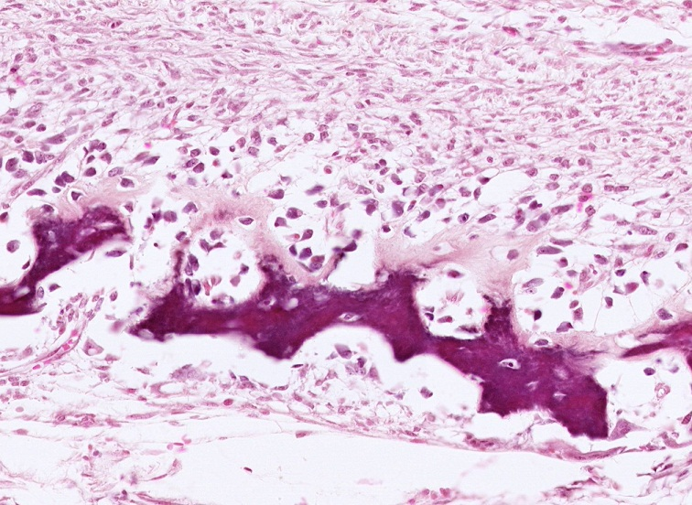
Intramembranous ossification
Here we can see bone formed through intramembranous ossification. Previously, this entire region was mesenchyme. Mesenchymal cells differentiated, and then secreted bone matrix. The osteoblasts along the edge of bone will continue to secrete matrix components, so that each piece of bone can grow through appositional growth (growth by adding to the surface of an existing piece of bone). Osteoclasts (not shown) degrade the bone during remodeling.
mesenchyme
You can even see osteoblasts / osteocytes in the process of becoming trapped in osteoid (black arrows), as well as osteoid becoming calcified (blue arrows). Sweet!!!
osteoid
Calcified bone
mesenchyme

Slide 15
Intramembranous ossification
If you step back in terms of magnification to look at the big picture, early intramembranous bone formation occurs in spots or regions within the mesenchyme (blue blobs represent bone spicules).
Here the yellow is an area of mesenchyme. Blue blobs were mesenchyme, but now are bone spicules.
Further development includes enlargement of existing spicules (blue blobs), with some adding additional projections (greenish blobs), and the appearance of additional bone spicules (light-blue blobs).
In fact, they all grow and add projections, but we just wanted to highlight the process by focusing on two here that add projections while they grow.

Slide 16
Intramembranous ossification
Eventually, continued enlargement of existing pieces and new centers of ossification will connect the smaller pieces of bone to form single, larger pieces (dark blue blob). Once formed, this piece can get thicker through appositional bone formation, new spicules of bone can grow in the surrounding mesenchyme and eventually connect to the larger mass, etc.
In fact, the appearance of spicules, enlargement of spicules, and fusion with adjacent spicules to form larger pieces is all happening at the same time. Furthermore, osteoclasts will always be remodeling. How dynamic.

Slide 17
Intramembranous ossification
Video of intramembranous ossification – SL42
Link to SL 042
Be able to identify:
Intramembranous ossification
Review bone cells
Spicule or trabecula
Osteoid
Calcified bone matrix

Slide 18
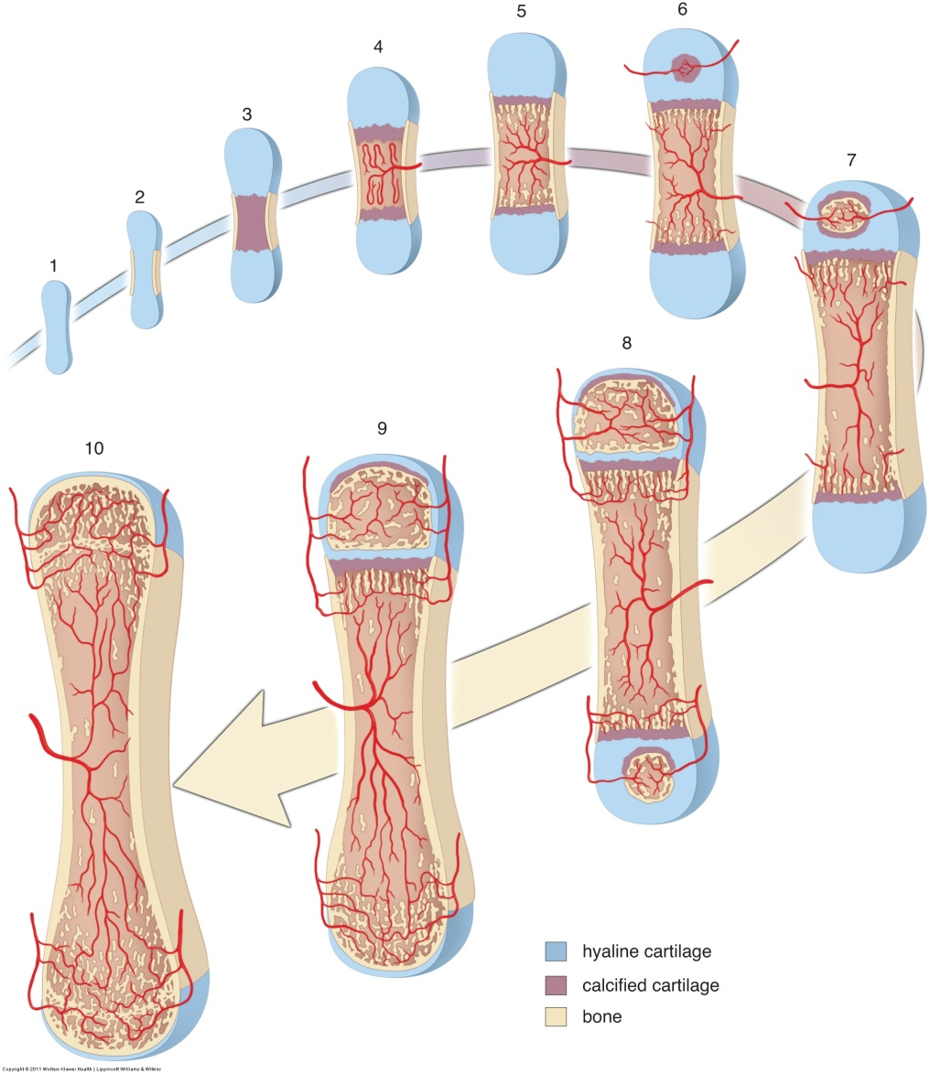
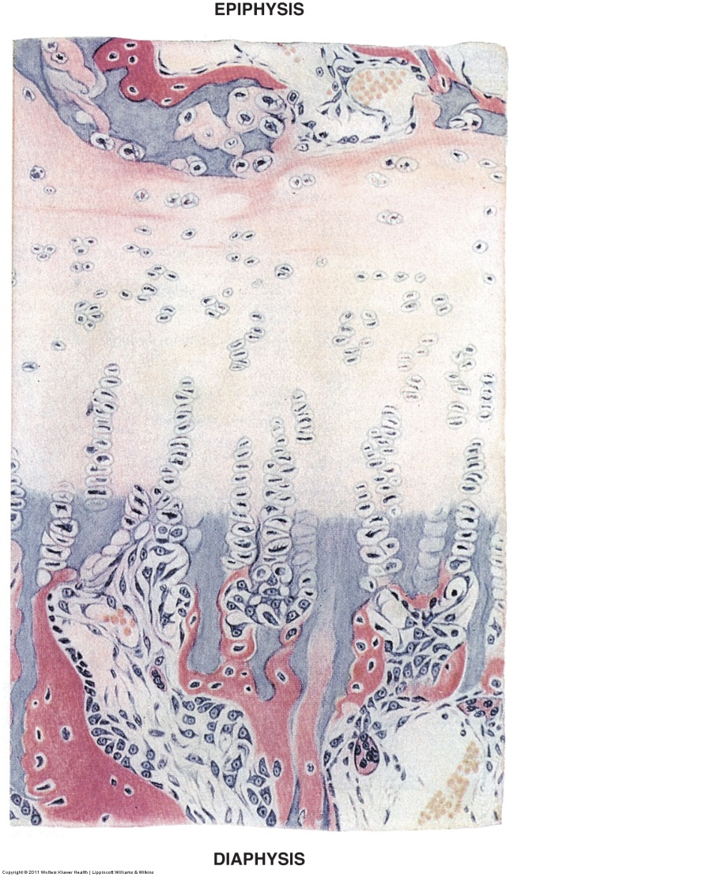
Endochondral ossification
Endochondral ossification is development of bone from a framework of hyaline cartilage. This is a very complicated process, and not all features will be covered in this module. Here we present an overview; just enough information to allow you to recognize endochondral ossification, and some of its details, on a slide.
Remember endochondral ossification is characteristic of long bones such as the humerus.

Slide 19
Endochondral ossification
First the big picture:
As we said, endochondral ossification is the formation of bone from a hyaline cartilage model. Obviously, we start with a long piece of hyaline cartilage. This cartilage can grow both appositionally and interstitially and will continue to do so during its conversion to bone. In fact, it’s actually the growth of cartilage that allows bones to grow lengthwise before maturity (more on that later).
The conversion of cartilage to bone begins in the middle of the diaphysis, at the primary ossification center. This conversion initially occurs radially from the center of the shaft, but because the bone is long, ultimately, conversion from this primary ossification center occurs lengthwise in two directions (toward each epiphysis).

Slide 20
Endochondral ossification
In each epiphysis, secondary ossification centers develop. These also grow radially, as shown in the diagram (steps 6-8). At birth (or in some cases after birth), each epiphysis has two regions of hyaline cartilage remaining:
At the ends, this hyaline cartilage will remain forever as joint cartilage, which covers the ends of long bones.
At the meeting of the primary and secondary ossification centers; these are the epiphyseal growth plates (or metaphyses or metaphyseal plate). Here, cartilage will continue to proliferate, and become converted to bone, allowing the bone itself to elongate. After puberty, bone overgrows the cartilage, and lengthwise growth of the bone stops, leaving a thickened region of osseous tissue called the epiphyseal line.
Joint cartilage

Slide 21
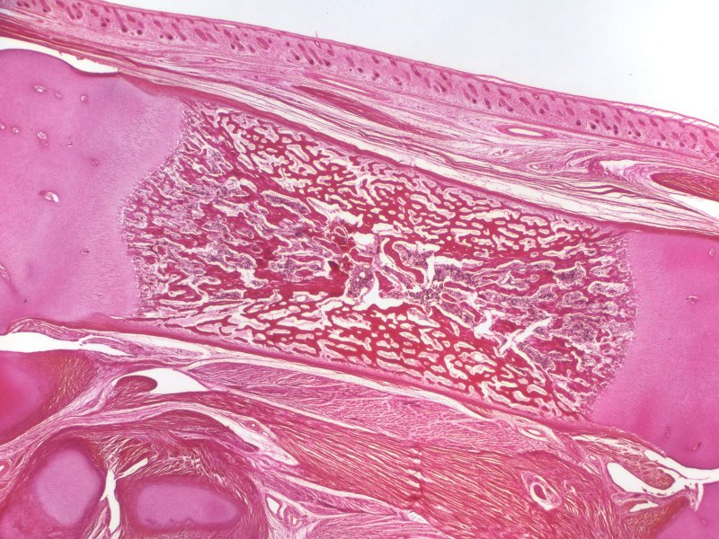
Endochondral ossification
This low magnification image from a developing bone is similar to stage 5 from the drawing on the previous page. The epiphyses consist of hyaline cartilage. The numerous dark spicules of bone (arrows) that have already formed from endochondral ossification fill the shaft where the marrow cavity will eventually form. The two yellow boxes indicate the metaphyses, places where cartilage is being converted to bone; these are the focus of the next several slides.
In case it is not obvious, the two regions in the yellow boxes are mirror-images of each other. The metaphysis to the left is moving toward the left as the cartilage there is growing and being replaced by bone, while the one on the right is moving to the right.
Hyaline cartilage
Hyaline cartilage

Slide 22
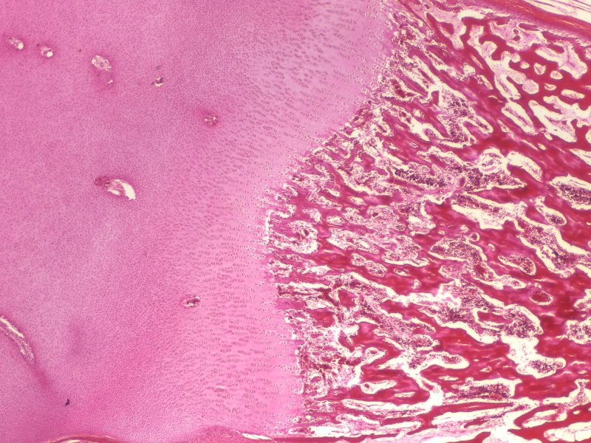
Endochondral ossification
Just an orientation slide, making sure you are grounded in the fact that in the upcoming images we will be looking at the metaphysis on the left of this developing bone. As an overview, the hyaline cartilage will grow, and as it does so, it is replaced by osseous tissue.
Hyaline cartilage
Then rotate 90°
Hyaline cartilage

Slide 23
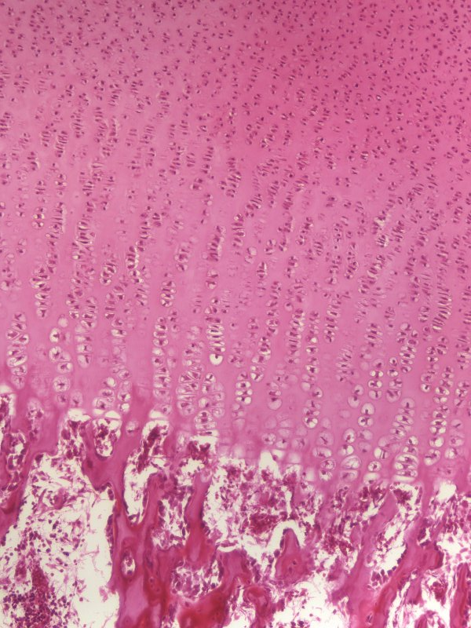
Endochondral ossification
Hyaline cartilage
Higher magnification of the same region from the previous slide, turned 90º clockwise so the left portion of the slide on the previous page is now at the top.
Of course, this could also be the right side of the bone turned 90º counterclockwise, right???
Go back and forth to the previous slides until you’re sure.

Slide 24
Endochondral ossification
Hyaline cartilage
The conversion of cartilage to bone occurs in the metaphysis (yellow box). This process occurs in 5 stages:
cartilage is growing
chondrocyte division becomes oriented longitudinally
chondrocytes swell
the cartilage becomes calcified
bone is laid down
In a snapshot of a growing bone, i.e. like this slide, these processes manifest as regions in the metaphysis. These regions (and their names) will be described in more detail on the next set of slides.

Slide 25
Endochondral ossification
1. Zone of reserve (resting) cartilage
This region is similar to the hyaline cartilage you have looked at previously; many chondrocytes in lacunae, clear matrix with glassy appearance and no visible fibers.
As indicated above, this region is referred to as “resting cartilage”. This is unfortunate, because, as you know, chondrocytes in hyaline cartilage are actively dividing and secreting matrix; this is the case here as well. In fact, it is the growth of this cartilage that is responsible for the lengthwise growth of long bones during childhood. In response to this, some authors call this the zone of reserve cartilage, which, at least to me, doesn’t solve the misconception.

Slide 26
Endochondral ossification
2. Zone of proliferation
Here, division of chondrocytes is oriented so that progeny separate from each other along the long axis of the bone, creating columns of progeny (two such columns are outlined in blue).
Yep, it’s still growing cartilage like the zone of resting cartilage. It is the orientation of cell division that is the difference.

Slide 27
Endochondral ossification
3. Zone of hypertrophy
Chondrocytes in this region have enlarged. Not so obvious is that the cartilage matrix necessarily has thinned.

Slide 28
Endochondral ossification
Darker here than here
4. Zone of calcification
The cartilage matrix becomes calcified
Yes, this is indeed calcified cartilage, meaning type II collagen + GAGs + calcium.
Like calcified matrix in bone, calcified cartilage matrix is darker than its un-calcified counterpart (i.e. darker than the matrix in the zone of proliferation).

Slide 29
Endochondral ossification
5. Zone of bone deposition
Chondrocytes die. Some cartilage matrix is removed by osteoclasts, while bone matrix is deposited on top of the remaining pieces of calcified cartilage

Slide 30
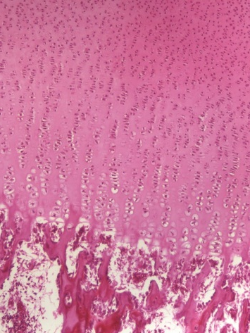
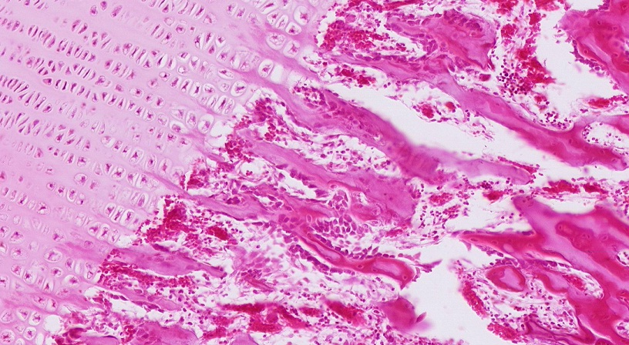
Endochondral ossification
Closer view of the zone of bone deposition. Note that:
--osteoclast degradation is targeted to occur in columns along the same orientation as the cell columns created by chondrocytes in the zone of proliferation (see green arrows for path of osteoclast). This leaves spicules of cartilage that are “vertically” oriented (black arrows), and upon which bone matrix is added.

Slide 31
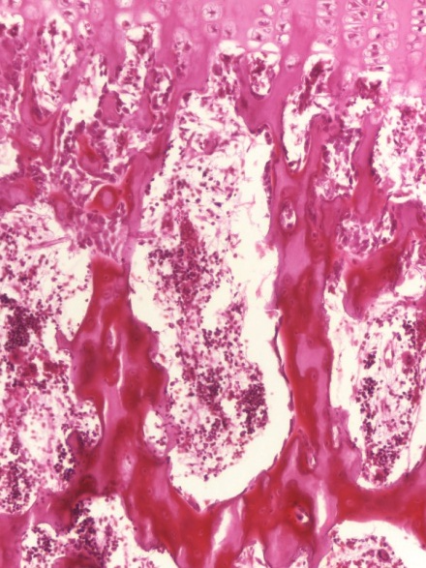
Endochondral ossification
Closer view of the zone of bone deposition. Note that:
--the core of the spicules in this region is calcified cartilage (Xs, trace central core up to the matrix in the zone of calcification). The darker magenta is calcified bone matrix that has been deposited onto the surface of these spicules of calcified cartilage by osteoblasts (black arrows indicate osteoblasts). In some places, you can see paler osteoid between the osteoblasts and dark calcified bone matrix.
X
X
X

Slide 32
Intramembranous ossification
Video of endochondral ossification – SL43
Link to SL 043
Be able to identify:
endochondral ossification
Review bone cells
Hyaline cartilage
Calcified cartilage
Osteoid
Calcified bone matrix
Metaphyseal plate
Zone of resting cartilage
Zone of proliferation
Zone of hypertrophy
Zone of calcification
Zone of bone deposition

Slide 33
Endochondral ossification
One thing I forgot to mention at the end of the video:
After (and while) osteoblasts lay down bone matrix onto spicules of calcified cartilage, osteoclasts continue to remodel the newly formed tissue, chewing up pieces of this cartilage/bone composite so that, eventually, it is completely converted to bone.
X
X
X

Slide 34
Endochondral ossification
X
Two final notes about the metaphysis.
In a slide such as this we define five zones (and will do so for exams). However, similar to processes such as mitosis, there is a gradual transition from one zone to the next, so there are no absolute borders between these zones, and the borders between zones certainly do not form straight lines.
In this static slide, we see five zones. However, from the perspective of one region / area / or cell, the region or cell passes through the five stages temporally. For example, the tissue at X is in the resting cartilage stage, and will sequentially transition through the stages of proliferation, hypertrophy, cartilage calcification, and bone deposition. In this way, the metaphysis is like a traveling wave that follows the proliferating cartilage.

Slide 35
The next set of slides is a quiz for this module. You should review the structures covered in this module and try to visualize each of these in light and electron micrographs.
Distinguish, at the light microscope level, each of the following::
Review cells of bone
Bone formation
Intramembranous
Spicule or trabecula
Osteoid
Calcified bone matrix
Endochondral
Hyaline cartilage
Calcified cartilage
Osteoid
Calcified bone matrix
Metaphyseal plate
Zone of resting cartilage
Zone of proliferation
Zone of hypertrophy
Zone of calcification
Zone of bone deposition
Distinguish, at the electron microscope level, each of the following::
Review cells of bone
Osteoid
Calcified bone matrix

Slide 36
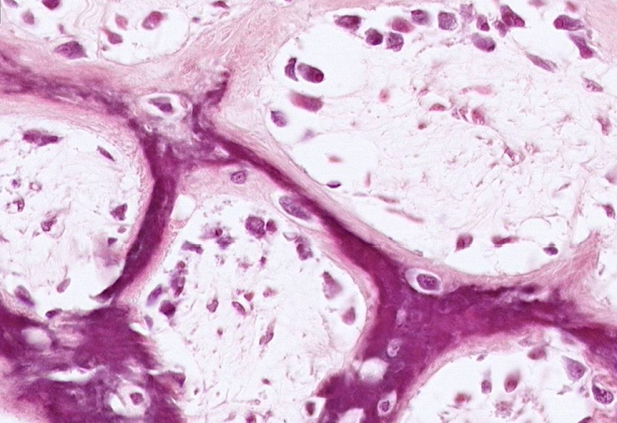
Final quiz
Self-check: Identify the substance in the outlined region. (advance slide for answer)
osteoid

Slide 37
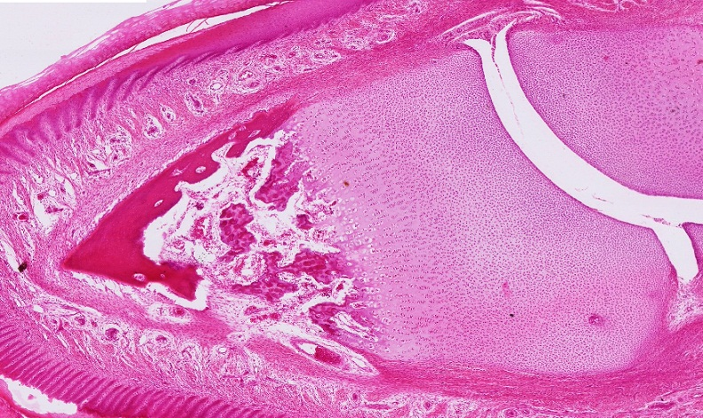
Final quiz
Self-check: What PROCESS is occurring on this slide. (advance slide for answer)
Endochondral ossification

Slide 38
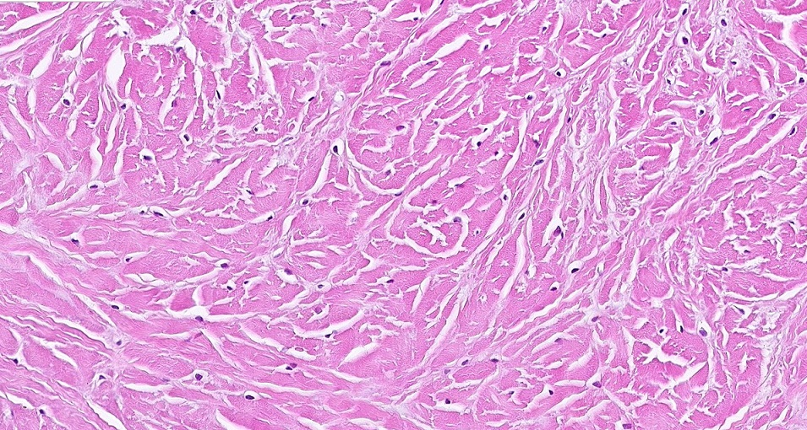
Final quiz
Self-check: Identify the tissue on this slide. (advance slide for answer)
Fibrous cartilage

Slide 39
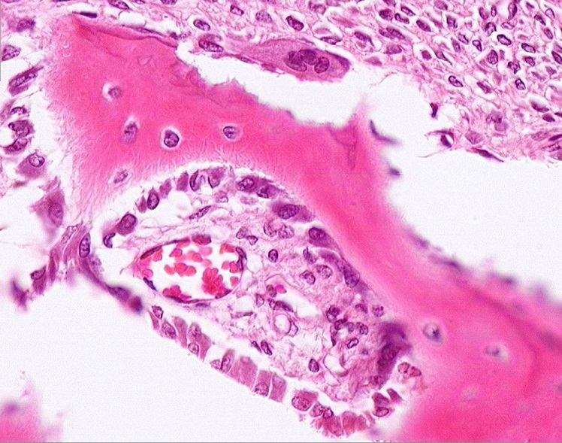
Final quiz
Self-check: Identify the cells indicated by the arrows. (advance slide for answer)
osteoblasts

Slide 40
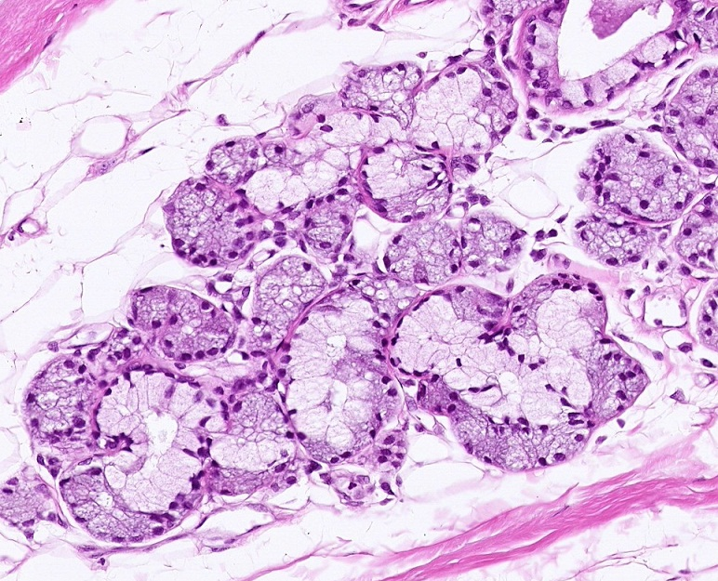
Final quiz
Self-check: Identify the outlined tissue. (advance slide for answer)
Mucous and serous glands

Slide 41
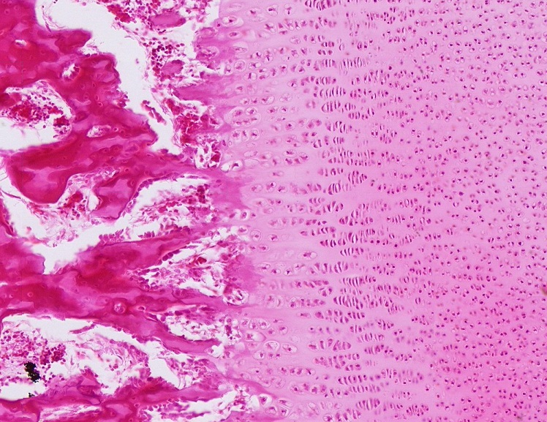
Final quiz
Self-check: Identify the outlined region. (advance slide for answer)
Zone of calcification

Slide 42
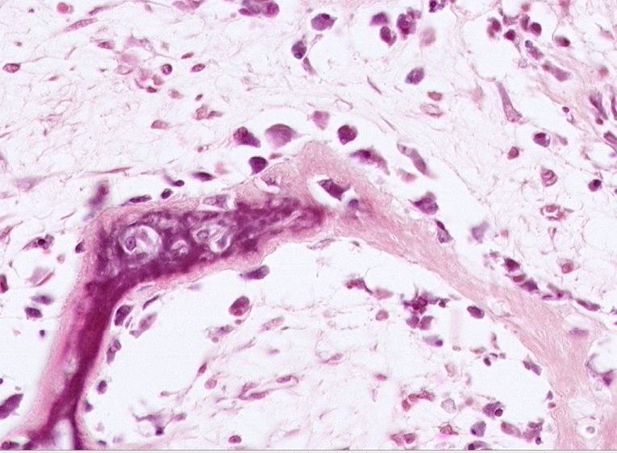
Final quiz
Self-check: Identify the cells indicated by the arrows. (advance slide for answer)
osteocytes

Slide 43
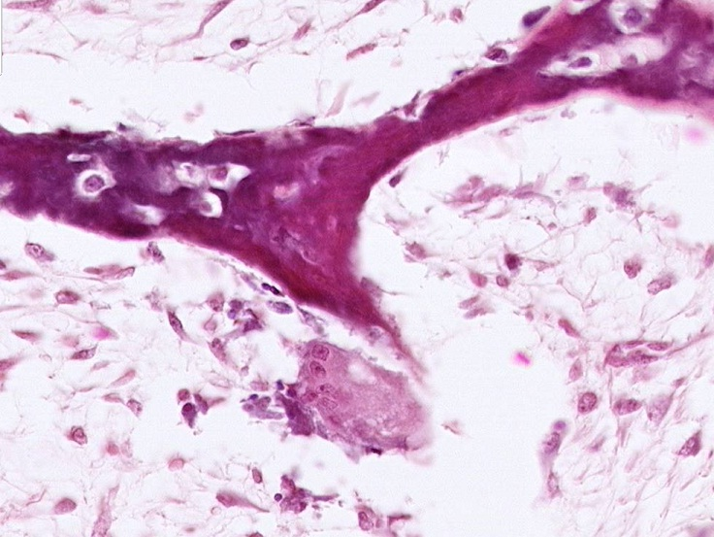
Final quiz
Self-check: Identify the cell indicated by the arrow. (advance slide for answer)
osteoclast

Slide 44
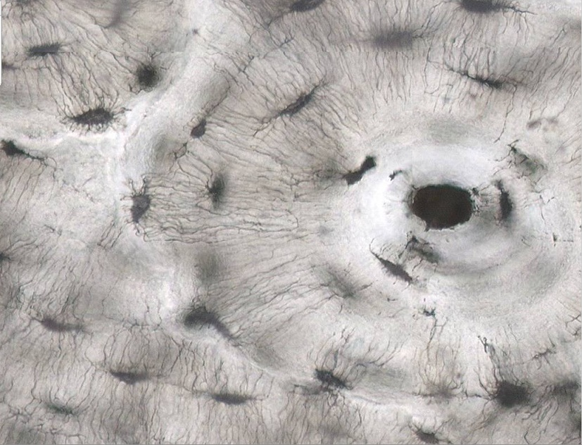
Final quiz
Self-check: Identify the structures indicated by the arrows. (advance slide for answer)
canaliculi

Slide 45
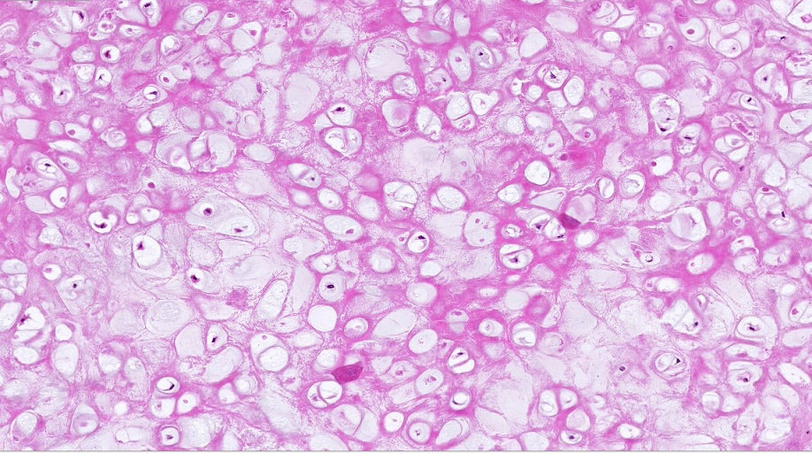
Final quiz
Self-check: Identify the tissue on this slide. (advance slide for answer)
elastic cartilage

Slide 46
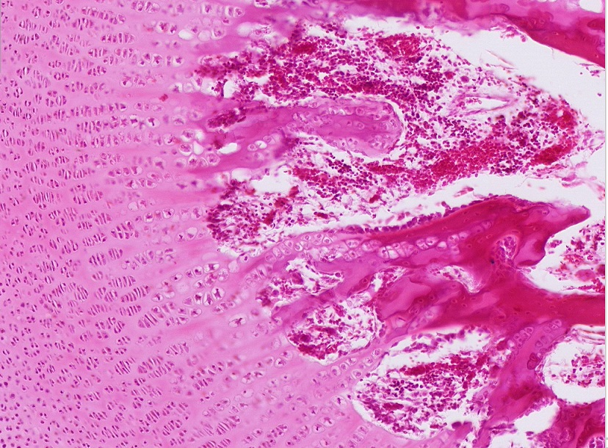
Final quiz
Self-check: Identify the outlined region. (advance slide for answer)
Zone of resting cartilage

Slide 47
Final quiz
Self-check: Identify the tissue in the outlined region. (advance slide for answer)
mesenchyme

Slide 48
Final quiz
Self-check: Identify the outlined region. (advance slide for answer)
Zone of bone deposition

Slide 49
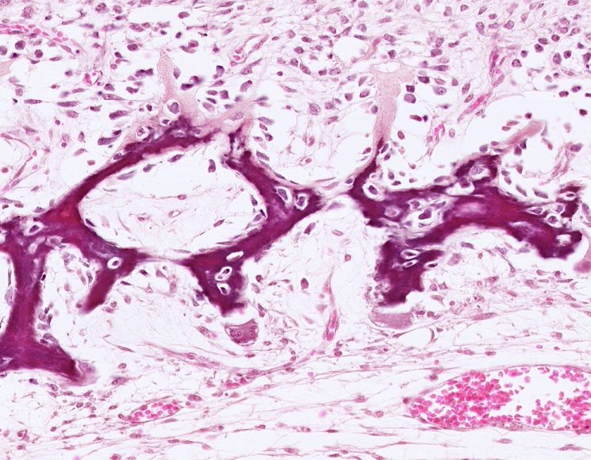
Final quiz
Self-check: What PROCESS is occurring on this slide. (advance slide for answer)
Intramembranous ossification

Slide 50
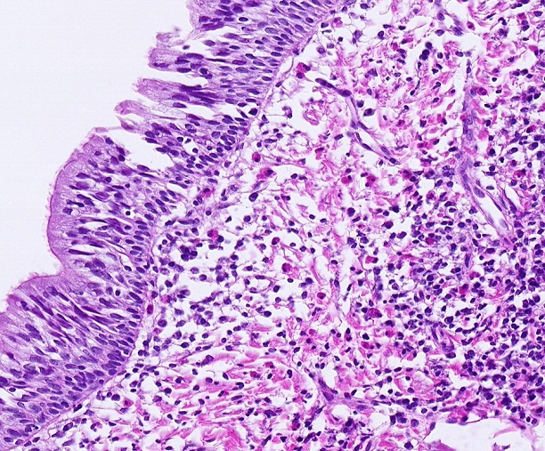
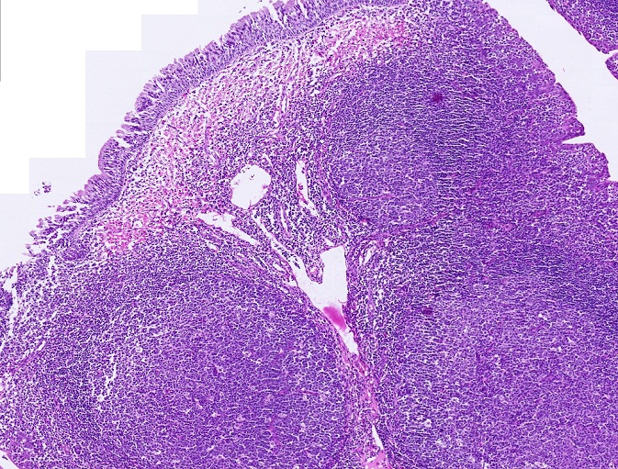
Final quiz
Self-check: Identify the organ on this slide. (advance slide for answer)
Pharyngeal tonsil

Slide 51
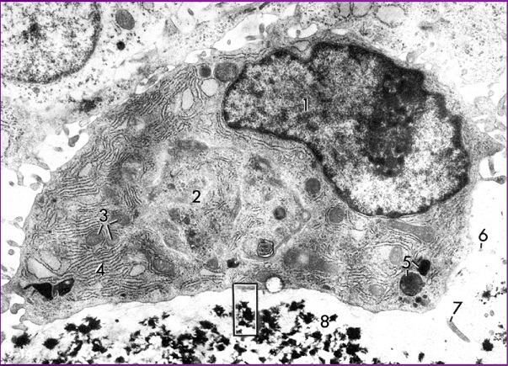
Final quiz
Self-check: Identify the cell in this image. (advance slide for answer)
osteoblast

Slide 52
Final quiz
Self-check: Identify the outlined region. (advance slide for answer)
Zone of hypertrophy

Slide 53
Final quiz
Self-check: Identify the substance in the outlined region. (advance slide for answer)
osteoid

Slide 54
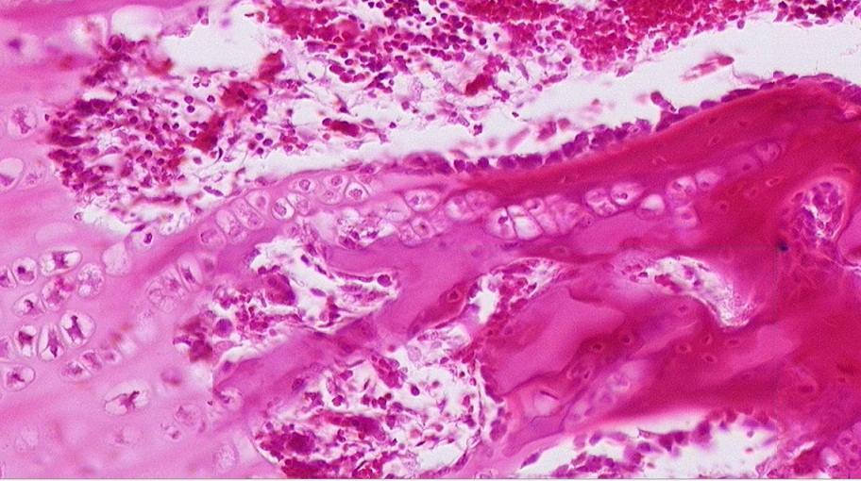
Final quiz
Self-check: Identify the cells indicated by the arrows. (advance slide for answer)
osteoblasts

Slide 55
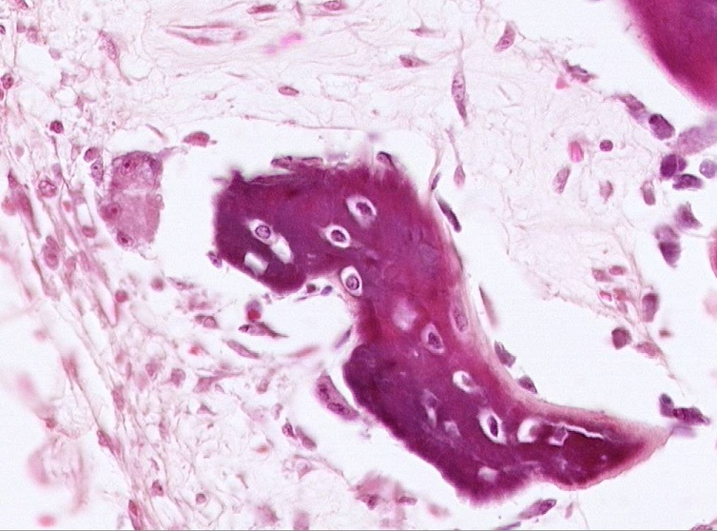
Final quiz
Self-check: Identify two tissues on this slide. (advance slide for answer)
mesenchyme
bone

Slide 56
Final quiz
Self-check: Identify the outlined region. (advance slide for answer)
Zone of proliferation

Slide 57
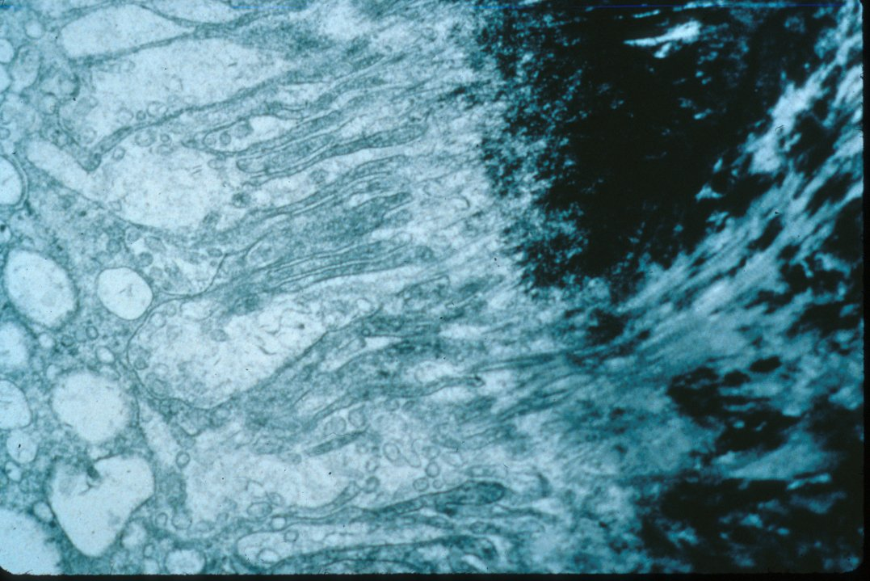
Final quiz
Self-check: Identify the cell in this image. (advance slide for answer)
osteoclast

Slide 58
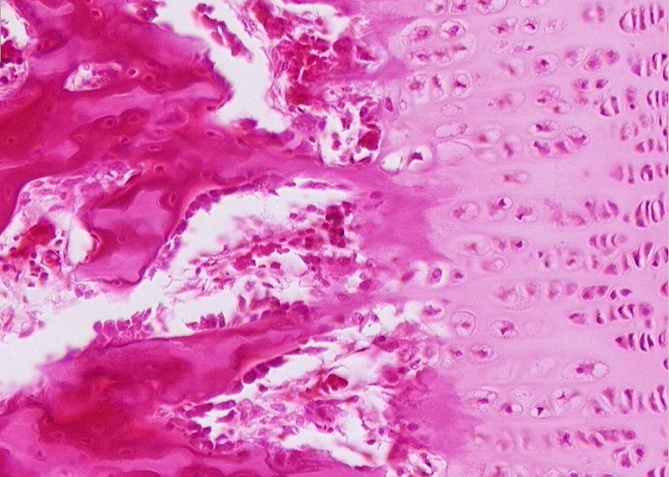
Final quiz
Self-check: The outlined regions contain what type of collagen? (advance slide for answer)
Type II collagen (this is calcified cartilage)

Slide 59
Final quiz
Self-check: Identify the substance in the outlined region. (advance slide for answer)
Calcified bone matrix

Slide 60
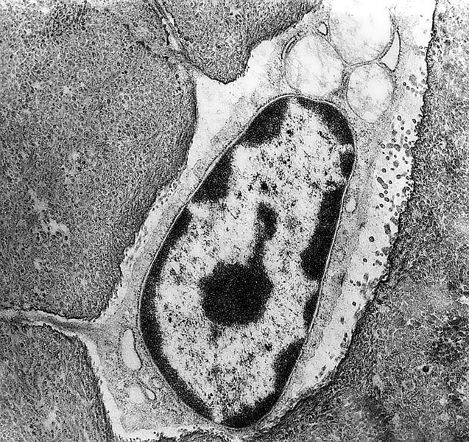
Final quiz
Self-check: Identify the cell in this image. (advance slide for answer)
osteocyte

Slide 61
Final quiz
Self-check: Identify the cell indicated by the arrow. (advance slide for answer)
osteoclast

Slide 62
Final quiz
Self-check: Identify the outlined region. (advance slide for answer)
Zone of proliferation

Slide 63
Final quiz
Self-check: Identify the cells indicated by the arrows. (advance slide for answer)
osteoblasts

Slide 64
Final quiz
Self-check: The outlined region contains what type of collagen? (advance slide for answer)
Type I collagen (this is calcified bone)

