Slide 1
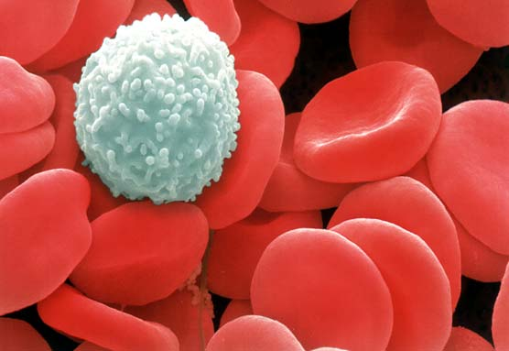
Blood
Digital Laboratory
It’s best to view this in Slide Show mode, especially for the quizzes.
This module will take approximately 60 minutes to complete.

Slide 2
After completing this exercise, you should be able to:
Distinguish, at the light microscope level, each of the following::
In a normal blood smear
Red blood cells
Platelets
White blood cells
Eosinophils
Basophils
Neutrophils
Lymphocytes
Monocytes
In peripheral tissues (inflammation)
Erythrocytes
Lymphocytes
Neutrophils
Plasma cells
Macrophages
Eosinophils
Distinguish, in electron micrographs, each of the following :
Red blood cells
Platelets
White blood cells
Eosinophils
Basophils
Neutrophils
Lymphocytes
Monocytes

Slide 3
Components of Blood
You probably know that blood is composed of formed elements (cells or cell fragments) and plasma. From a histological standpoint, the main task when analyzing blood smeared on a slide is to identify the formed elements. These formed elements are:
red blood cells (erythrocytes) – involved in oxygen transport
platelets (thrombocytes) – involved in clotting
white blood cells (leukocytes) – involved in immunity
As we will see, there are 5 types of white blood cells that you need to distinguish, and will be the focus of this module. Although red blood cells and platelets will be studied later in the year, their identification is trivial, so we will identify them now as well.

Slide 4
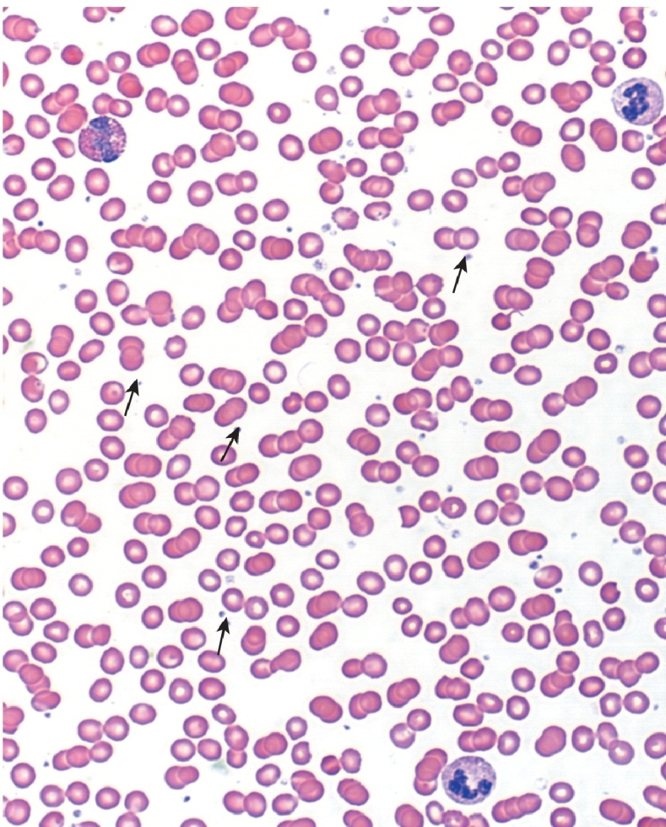
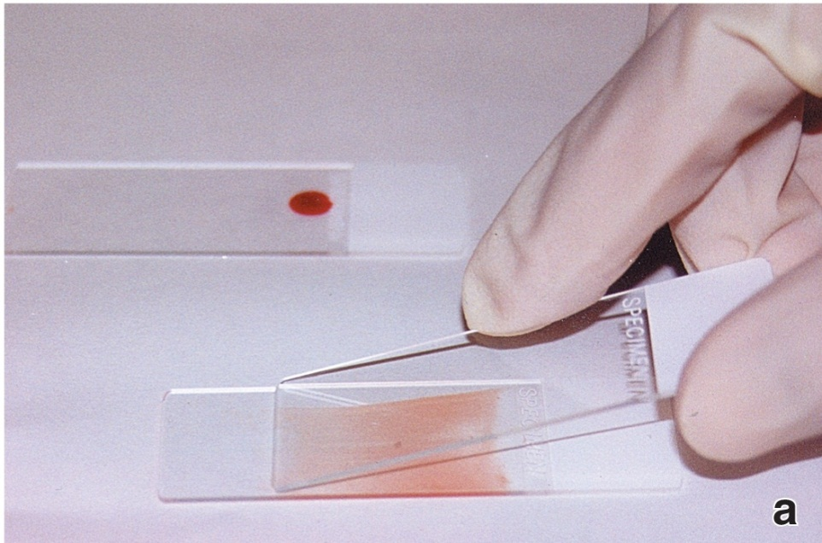
Components of Blood
Blood slides are prepared by smearing blood onto a slide, creating a gradient of cell density. Special stains (e.g. such as Wright’s stain, Giemsa stain) are then used, which are similar to H&E (nucleus blue, cytoplasm pink), but with additional dyes that visualize azurophilic (dark blue to purple) granules in white blood cells.

Slide 5
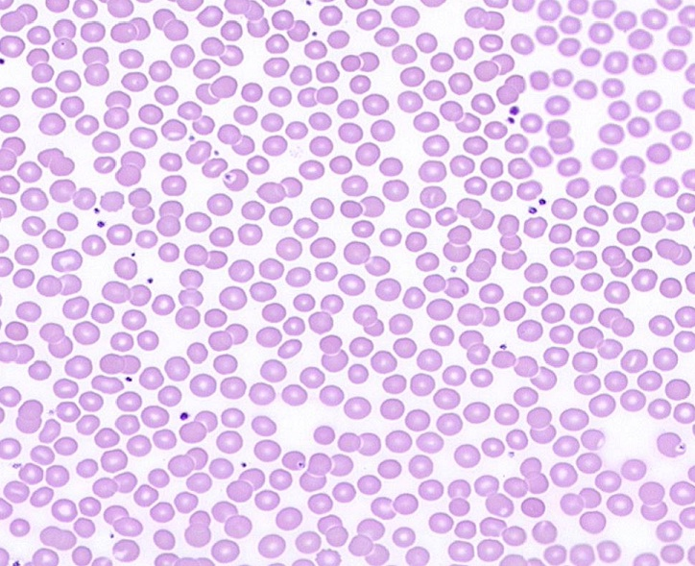
Components of Blood – Red Blood Cells
The most common formed element in the blood are red blood cells. These elements are biconcave, 7-8 µm. disks. The diameter of red blood cells (double arrow) is useful to keep in mind when estimating the size of neighboring structures.

Slide 6
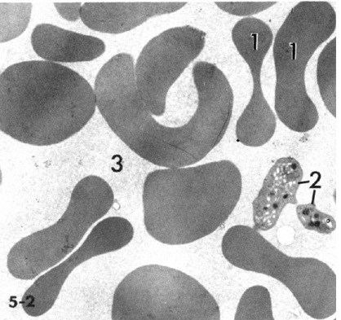
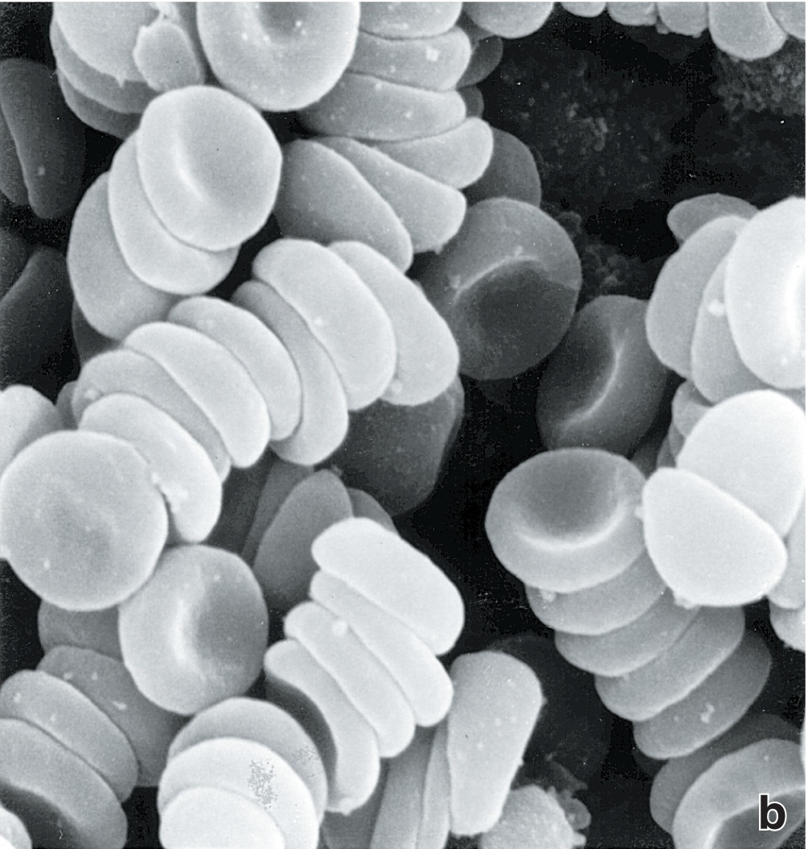
Components of Blood – Red Blood Cells
Red blood cells lack organelles, and are full of hemoglobin. Therefore, in transmission electron micrographs, they appear as disks with homogenous, electron-dense cytoplasm (1). The scanning EM to the right shows the 3-dimensional shape of these cells.

Slide 7
Components of Blood – Platelets
Platelets (arrows) are cell fragments that vary in size, but are smaller than red blood cells.

Slide 8
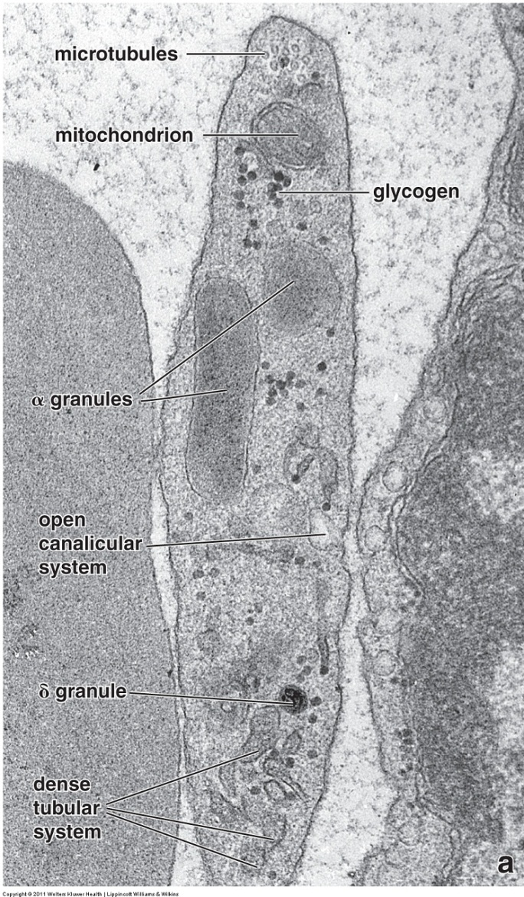
Components of Blood – Platelets
In electron micrographs, you can see a platelet that contains a fair number of cellular organelles, including granules that show up as basophilic in the cytoplasm of these elements in light micrographs. Though not obvious at the magnification used for this EM, platelets have a well-developed glycocalyx.

Slide 9
Components of Blood
red Blood Cells and platelets
Video of blood smear showing red blood cells and platelets – SL21
Note: Ideally, blood smears are best observed under oil at 1000X magnification. Because this is a digital lab, we will use a combination of digital slides at 400X (dry) with still images of blood cells taken using 1000X oil magnification.
Link to SL 021
Be able to identify:
Red blood cells
Platelets

Slide 10
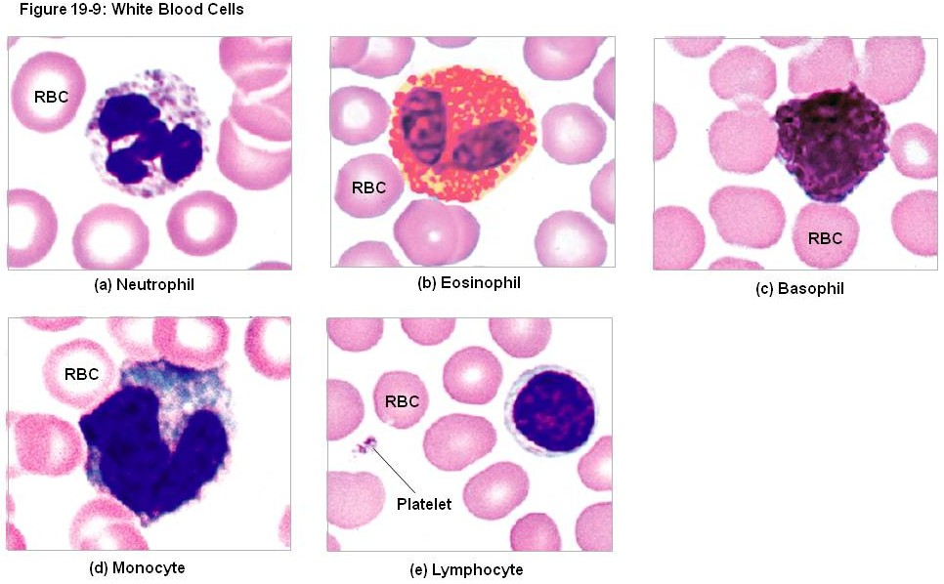
Components of Blood – White blood Cells
White blood cells can be broken down into two categories:
Granulocytes, which contain abundant granules in their cytoplasm (top row)
Agranulocytes, which have few cytoplasmic granules (bottom row)
Note that, though they vary in size and appearance, all white blood cells are larger than red blood cells.
From Martini: Fundamentals of Anatomy and Physiology

Slide 11
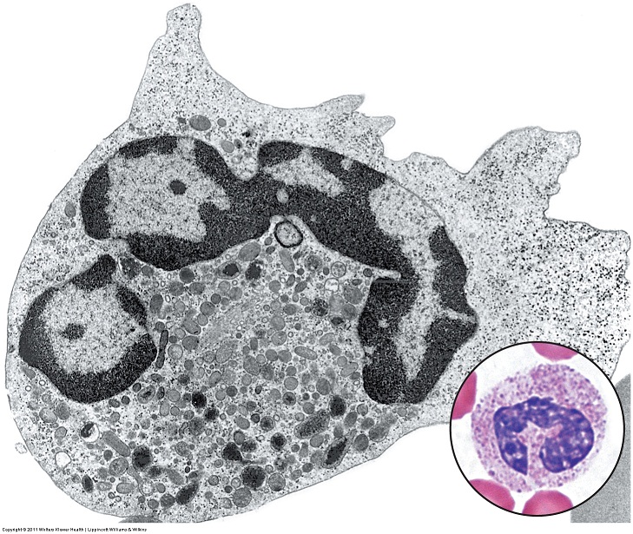
Components of Blood – Neutrophils
Neutrophils are 10-12 µm. in diameter and contain numerous small granules (vesicles in center-bottom of EM). Azurophilic (purple) granules are just large enough to see in the light microscope (arrows); there are also smaller granules that cannot be seen individually in the light microscope, but collectively give the cytoplasm an overall pale eosinophilic (salmon) color. Since mature neutrophils in the blood have already produced the granules they will need, they lack significant rough ER and Golgi, and, therefore, show little to no cytoplasmic basophilia. The granules in neutrophils are used to destroy bacteria that they have phagocytosed.
The nucleus is typically segmented, or polymorphonuclear; these cells are often called “polys” or “segs” by clinicians. Note that the segmented appearance may produce more than one nuclear profile in thin sections on electron micrographs. The DNA in the nucleus is “clumpy”.

Slide 12
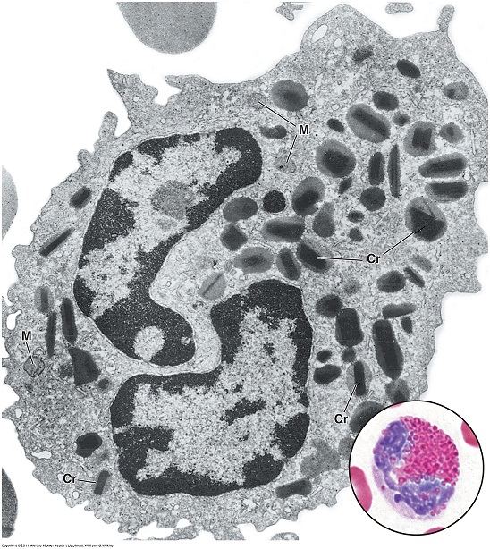
Components of Blood – eosinophils
Eosinophils are also 10-12 µm. in diameter and contain numerous large granules within their cytoplasm (they have a few smaller granules as well). The large granules contain a characteristic central crystalloid region (Cr) rich in a protein called major basic protein, which gives these granules their intense, refractory eosinophilia in the light microscope (blue arrow). Eosinophils are involved in inflammation and destruction of large parasites.
The nucleus is characteristically bi-lobed. The DNA in the nucleus is “clumpy”.

Slide 13
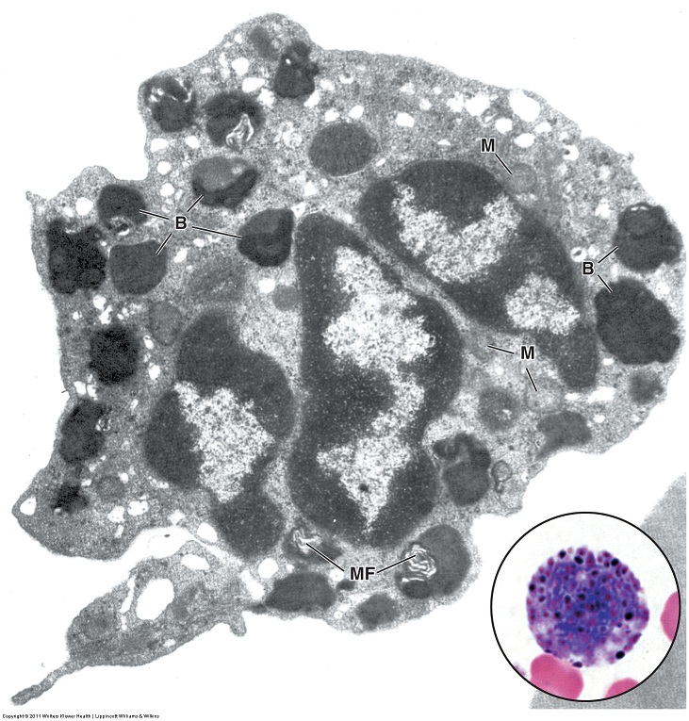
Components of Blood – basophils
Basophils are similar to mast cells found in tissues. They are 10-12 µm. in diameter and contain numerous large granules within their cytoplasm (B, they have a few smaller granules as well). The large granules here contain highly sulfated glycosaminoglycans, notably heparin and heparin sulfate, which are intensely basophilic (blue arrows). The heparin and histamine in these granules play a role in inflammation.
The nucleus is characteristically bi-lobed, though the presence of the large basophilic granules often obscures the nucleus. The DNA in the nucleus is “clumpy”.
Many EMs of basophils depict the granules as homogenously stained, large structures, instead of the heterogenous granules seen here that look more like secondary lysosomes than secretory granules. You should keep this little tidbit in mind (you might need to remember this within the hour).
The contents of basophilic granules tends to “wash out” during glass slide blood smear preparation. Therefore, you will sometimes see basophils that appear devoid of granules, which, obviously, makes those cells hard to definitively ID.

Slide 14
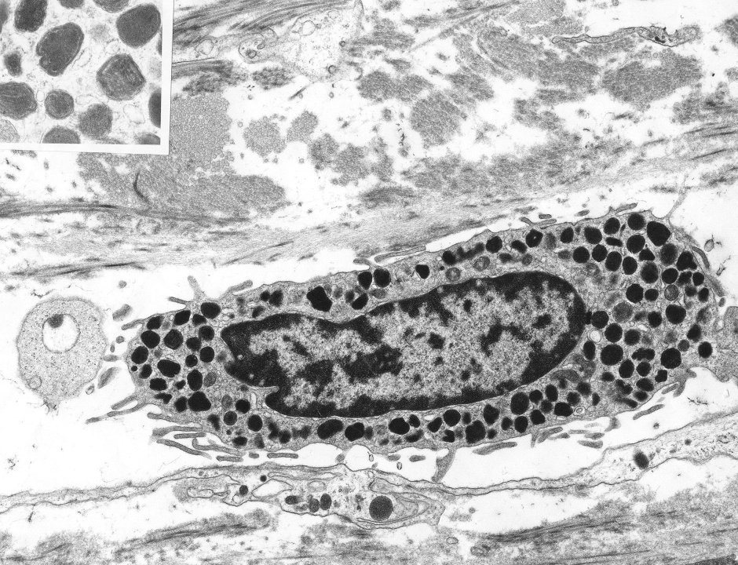
CELLS OF CONNECTIVE TISSUE - IMMUNE
Mast cells are immune cells that play a role in inflammation and have secretory granules (arrows) containing histamine and heparin.
This mast cell from the connective tissue lab might give you a better idea of what basophilic granules might look like in terms of their homogenous appearance. However, note that basophilic granules are much larger, and, therefore, there are much fewer of them in each cell.

Slide 15
Components of Blood
Granulocytes
Video of blood smear showing neutrophil – SL21
Video of blood smear showing eosinophil – SL21
Video of blood smear showing basophil – SL21
Link to SL 021
Be able to identify:
Neutrophils
Eosinophils
Basophils

Slide 16
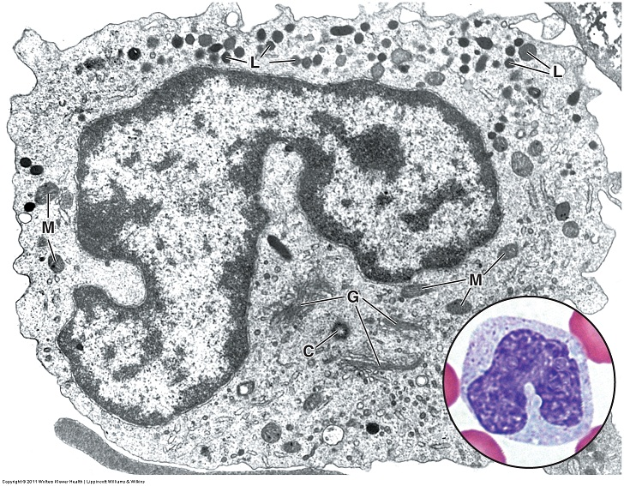
Components of Blood – monocytes
Although monocytes are officially agranulocytes, you can clearly see in the electron micrograph that they do indeed have lysosomal granules (L), a few are apparent as azurophilic granules in the light micrograph (blue arrows). Monocytes have the potential to produce proteins; therefore, they have rough ER and Golgi profiles, so they typically demonstrate pale cytoplasmic basophilia. Monocytes are the largest white blood cells (18µm). When they leave the bloodstream, they mature into macrophages, which are active in phagocytosis and antigen presentation
The nucleus is typically horseshoe-shaped, with a finer chromatin pattern.

Slide 17
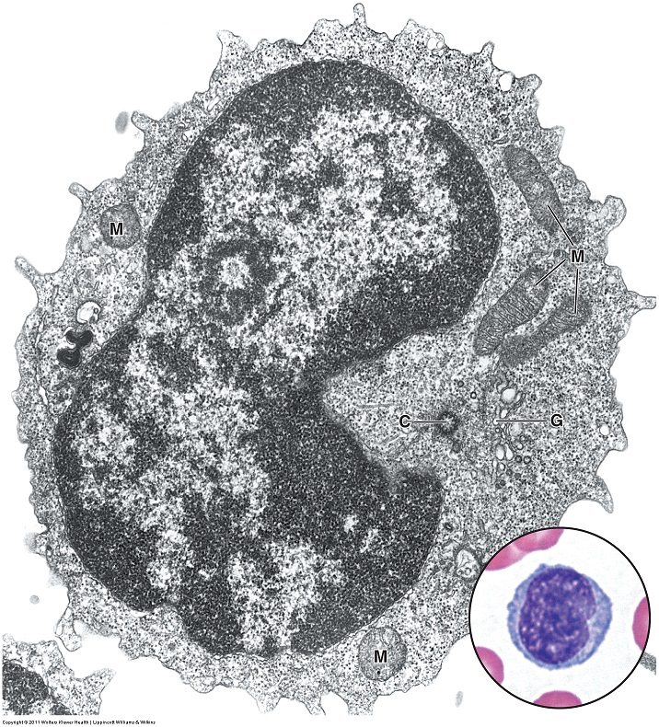
Components of Blood – lymphocytes
Most lymphocytes in the blood have very little cytoplasm; therefore, most are slightly larger than a red blood cell. (The one shown here is “medium-sized”). They have no granules to speak of. Like monocytes, lymphocytes have the potential for protein synthesis, so they will contain some rough ER and Golgi, which gives the thin rim of cytoplasm they do have a basophilic color. Lymphocytes are involved in specific immunity.
The nucleus is round, with a fine chromatin pattern.

Slide 18
Blood cells in tissues
Video of blood smear showing monocyte – SL21
Video of blood smear showing lymphocyte – SL21
Link to SL 021
Be able to identify:
Monocytes
Lymphocytes

Slide 19
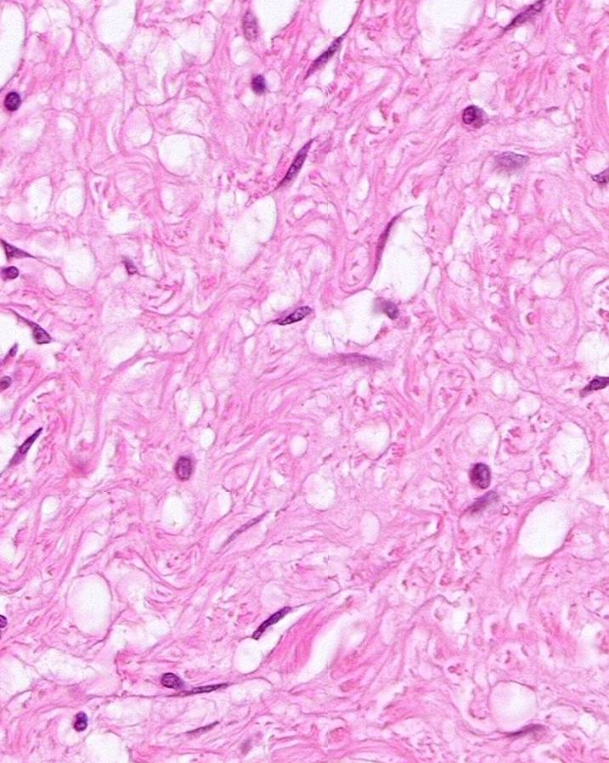
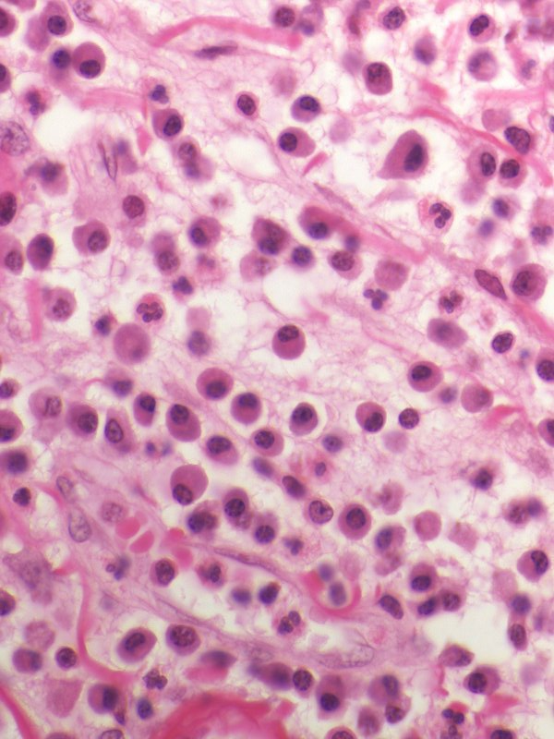
White blood cells in tissues
As pointed out in the connective tissue lab, “native” connective tissue consists of fibroblasts (green arrows) surrounded by extracellular matrix (collagen, elastin, fluid). White blood cells leave the circulation and migrate into connective tissues (red and orange arrows). This happens in small numbers throughout the body, but it is most apparent in tissues in which inflammation has occurred. As we will see, the appearance of these cells in normal H&E stained tissues is slightly different from, but parallel to, their appearance in Wright’s-stained blood smears.

Slide 20
White blood cells in tissues - neutrophils
Recall that neutrophils have a segmented nucleus and a pale eosinophilic cytoplasm. These features are readily apparent in tissue sections once you know what to look for (yellow arrows).
Red blood cells

Slide 21
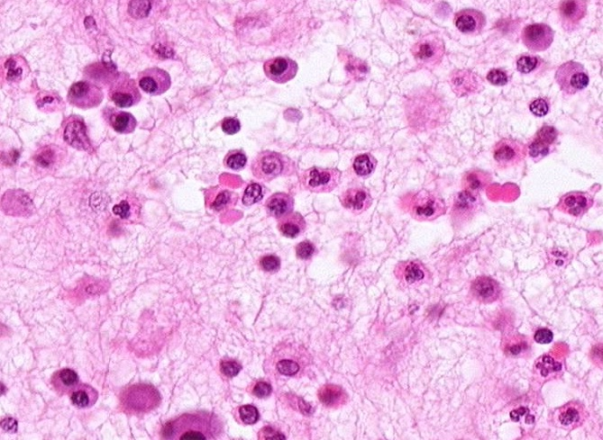
White blood cells in tissues – erythrocytes and lymphocytes
Recall that lymphocytes have a small, round nucleus and sparse cytoplasm. They are not as common as other cells in peripheral tissues. The cells indicated by the green arrows are most likely lymphocytes.
Red blood cells are eosinophilic disks, and are most often seen in blood vessels (blood vessel not obvious here).

Slide 22
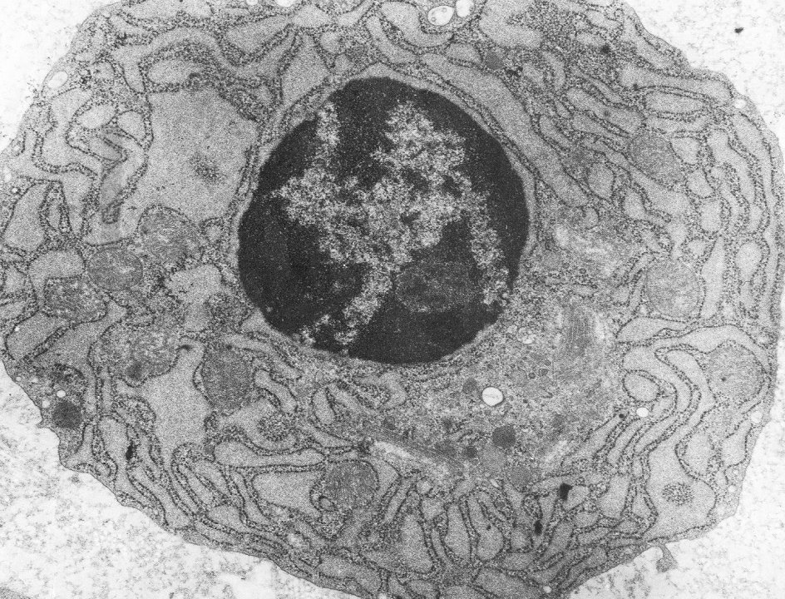
White blood cells in tissues – Plasma Cells
Some lymphocytes mature into antibody-secreting plasma cells. Because these cells are actively secreting an enormous amount of protein, their cytoplasm is loaded with rough ER. The corresponding Golgi apparatus (red outline) is not “textbook” in appearance, but is deduced as the only region in the cytoplasm lacking rough ER. Because the nucleus is expressing only a few genes, it has a large amount of heterochromatin for such an active cell. The euchromatic DNA often takes on the appearance of radial spokes (clock-faced nucleus).
What would you expect this cell to look like in the light microscope?

Slide 23
White blood cells in tissues – Plasma Cells
In H&E-stained sections, plasma cells (red arrows) have intense cytoplasmic basophilia (compare to red blood cells and neutrophils). Careful observation reveals a paler perinuclear region (blue arrow in inset) indicating the location of the Golgi apparatus. This region is paler than the surrounding cytoplasm because the Golgi is a relatively ribosome-free zone. Also note the relatively heterochromatic nuclei; some cells may demonstrate the classic “clock-faced” appearance.

Slide 24
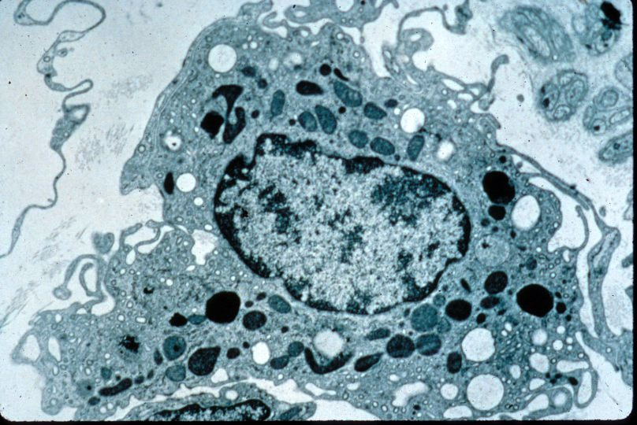
White blood cells in tissues - Macrophages
When monocyes migrate into the tissues, they become macrophages, which are large cells with a large, euchromatic nucleus, many processes extending from the plasma membrane, and numerous lysosomes in various states.
What would you expect this cell to look like in the light microscope?
Macrophages

Slide 25
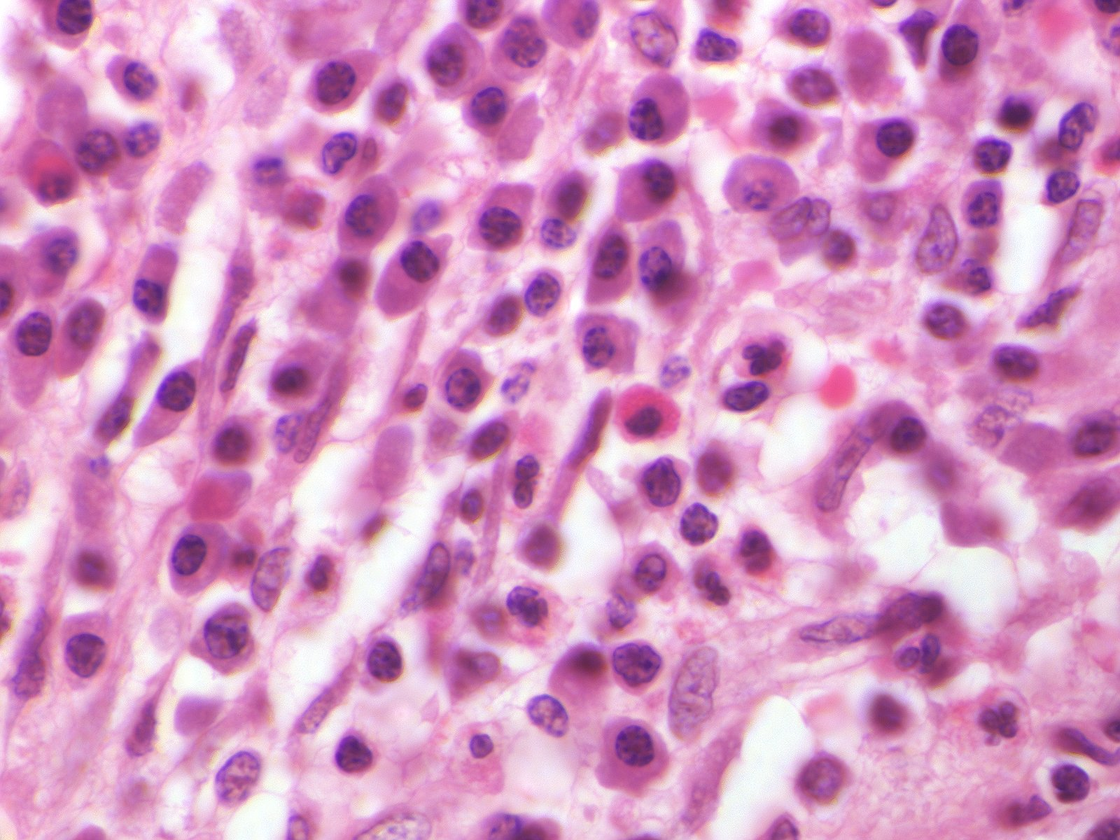
White blood cells in tissues - macrophages
In tissue sections, macrophages are recognized by their large, euchromatic nuclei (the tips of the green arrows are indicating the nuclear envelope), with a prominent nucleolus (black arrow), surrounded by an extensive, ill-defined, frothy cytoplasm.

Slide 26
White blood cells in tissues
Video orientating you to SL125
Video of inflammation showing red blood cells, lymphocytes, neutrophils, plasma cells, and macrophages – SL125
Link to SL 125
Be able to identify:
Erythrocytes
Lymphocytes
Neutrophils
Plasma cells
Macrophages
Fibroblasts
(Eosinophils)

Slide 27
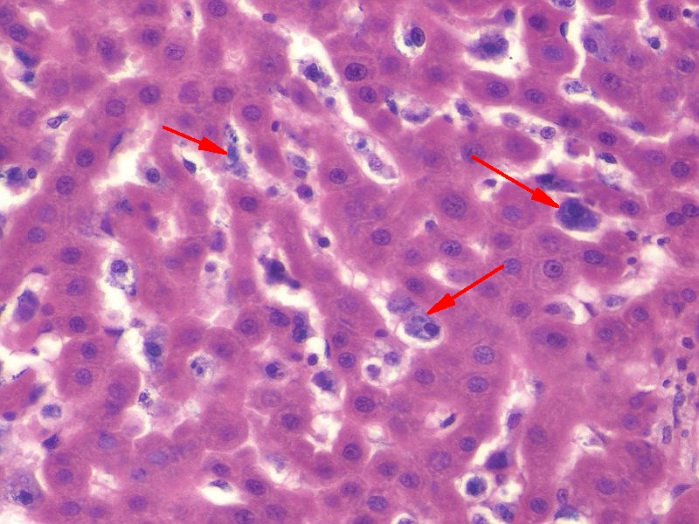
White blood cells in tissues - Macrophages
Macrophages that reside in specific tissues and organs are given special names. Here in the liver, the resident macrophages are called Kupffer cells, and are involved in liver-specific functions such as red blood cell turnover.
Macrophages in other organs have special names, such as Langerhans cells in the skin. Don’t worry about learning them now; these will be encountered as we continue our romantic journey through the organ systems.
Macrophages’ phagocytotic nature can be used to help visualize these cells specifically. This slide was prepared from an animal given the dye trypan blue. This dye is taken up by the macrophages, making their visualization obvious.

Slide 28
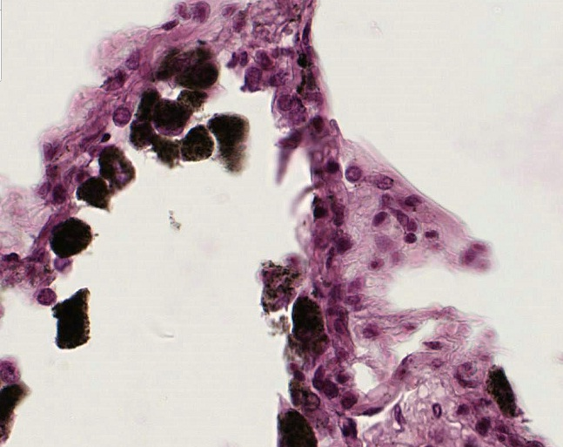
White blood cells in tissues - Macrophages
Macrophages’ in the lung accumulate inhaled debris as part of their normal function, making them dark and easy to identify (arrows and outlined region). Not surprisingly, these cells are called dust cells.

Slide 29
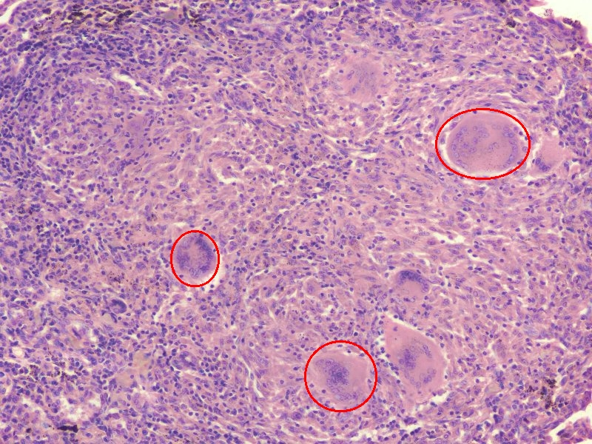
White blood cells in tissues – Macrophages in Pathology
Again, for this module, focus on recognizing typical macrophages in tissues (as we did in the video a few slides back). These macrophage variations will be encountered again with each organ system. We just introduce them here so you can appreciate the awesomeness of these fantastic cells.
In response to pathology (here tuberculosis), macrophages’ in the lung can also fuse together to form multinuclear masses.

Slide 30
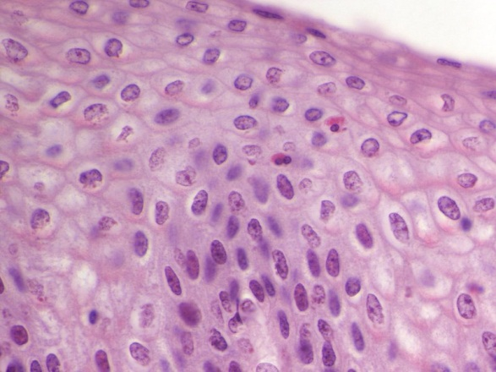
White blood cells in tissues - eosinophils
As you know, in blood smears eosinophils are recognized by their large, intensely eosinophilic granules and bilobed nucleus. This translates into H&E-stained tissues nicely. Here in this image from the esophagus, the eosinophils have infiltrated into the epithelium.
Note that one of the lobes of a bilobed nucleus may be out of the plane of section.

Slide 31
White blood cells in tissues - eosinophils
Video showing eosinophils in the esophagus – SL16
Link to SL 016
Be able to identify:
Eosinophils

Slide 32
The next set of slides is a quiz for this module. You should review the structures covered in this module, and try to visualize each of these in light and electron micrographs.
Distinguish, at the light microscope level, each of the following::
In a normal blood smear
Red blood cells
Platelets
White blood cells
Eosinophils
Basophils
Neutrophils
Lymphocytes
Monocytes
In peripheral tissues (inflammation)
Erythrocytes
Lymphocytes
Neutrophils
Plasma cells
Macrophages
Eosinophils
Distinguish, in electron micrographs, each of the following :
Red blood cells
Platelets
White blood cells
Eosinophils
Basophils
Neutrophils
Lymphocytes
Monocytes

Slide 33
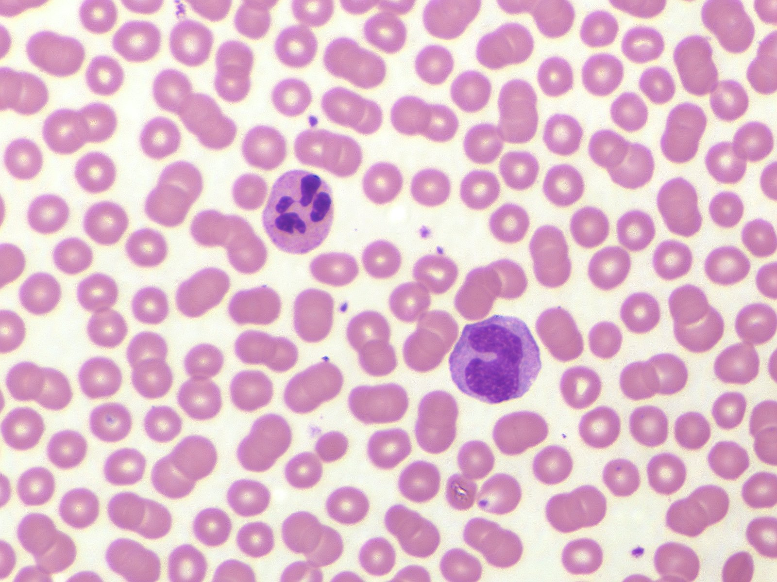
Final quiz
Self-check: Identify the cells. (advance slide for answer)
BTW, if you missed these, it’s probably best if you just quit now.
Red blood cells
platelets

Slide 34
Final quiz
Self-check: Identify the cells. (advance slide for answer)
neutrophil
monocyte
This monocyte has that funny pink tone to it. However, notice the pink in our RBCs is a little intense, suggesting that there is a little over-staining of eosin in this slide.

Slide 35
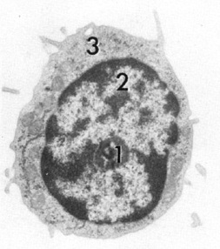
Final quiz
Self-check: Identify the cell. (advance slide for answer)
lymphocyte

Slide 36
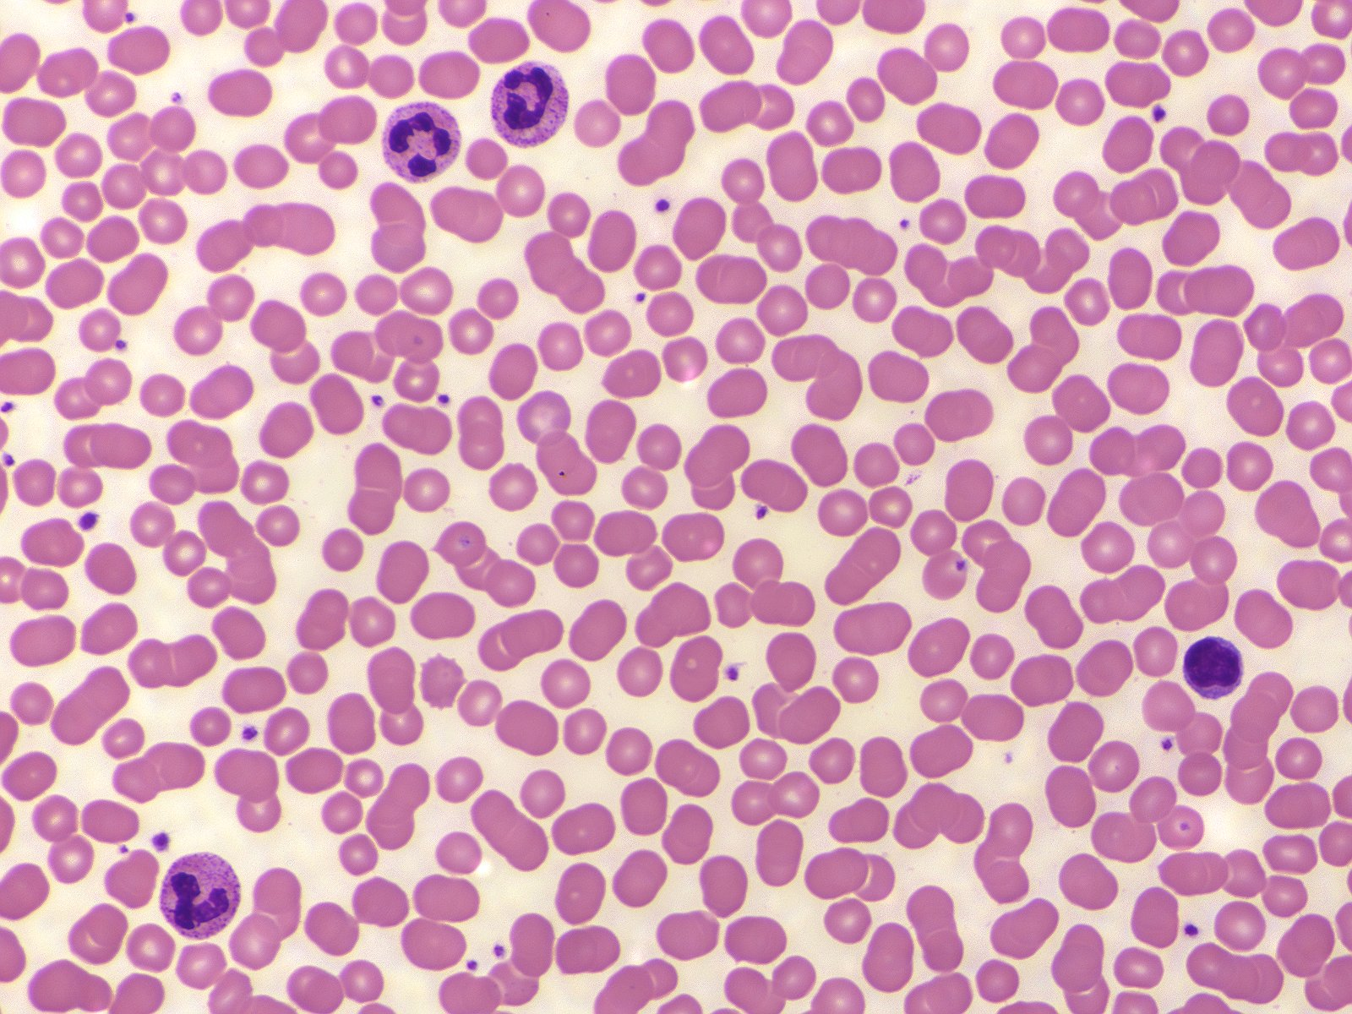
Final quiz
Self-check: Identify the cells. (advance slide for answer)
neutrophils
lymphocyte
Notes:
.

Slide 37
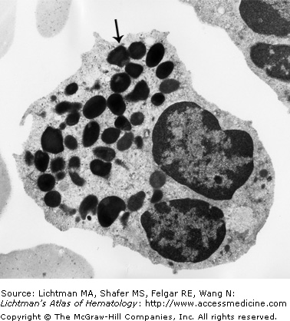
Final quiz
Self-check: Identify the cell. (advance slide for answer)
basophil

Slide 38
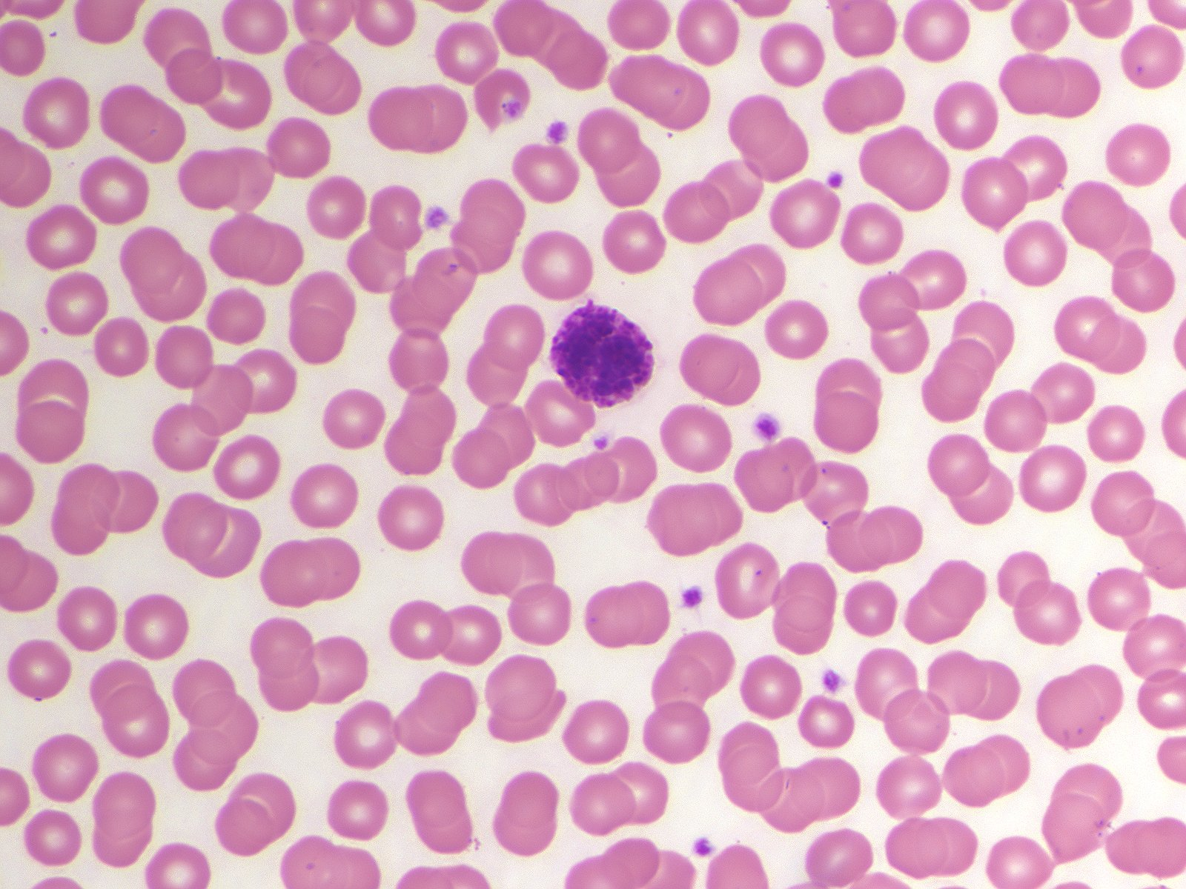
Final quiz
Self-check: Identify the cells. (advance slide for answer)
basophil

Slide 39
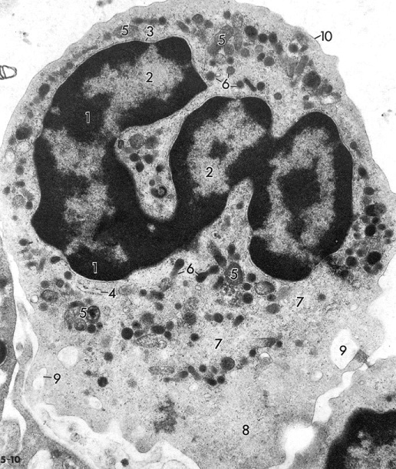
Final quiz
Self-check: Identify the cell. (advance slide for answer)
neutrophil

Slide 40
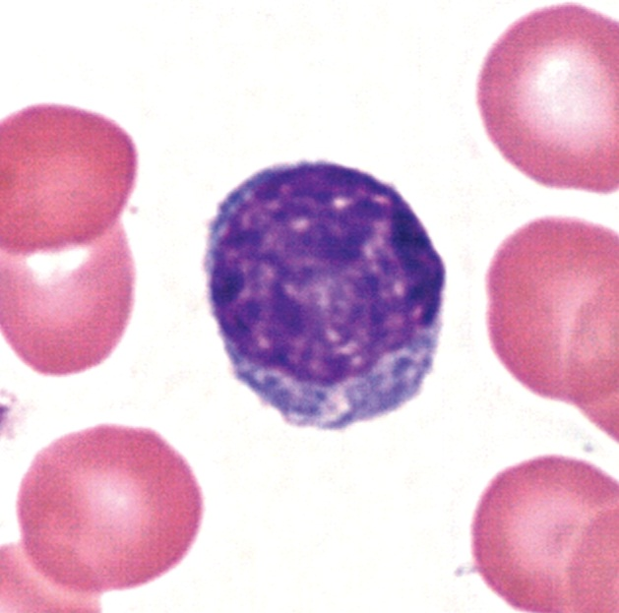
Final quiz
Self-check: Identify the cell. (advance slide for answer)
lymphocyte

Slide 41
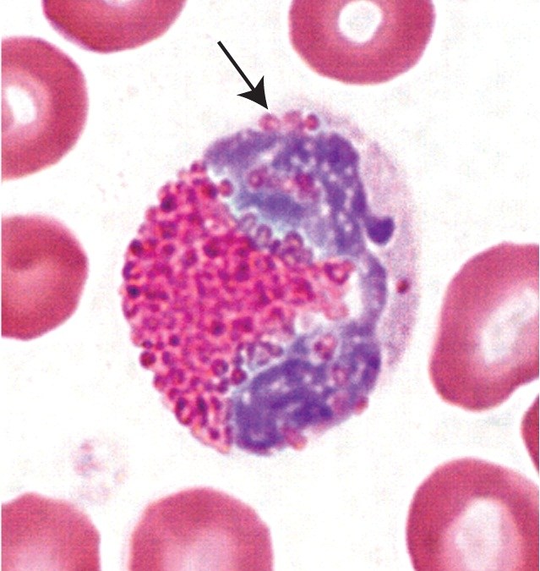
Final quiz
Self-check: Identify the cell. (advance slide for answer)
eosinophil

Slide 42
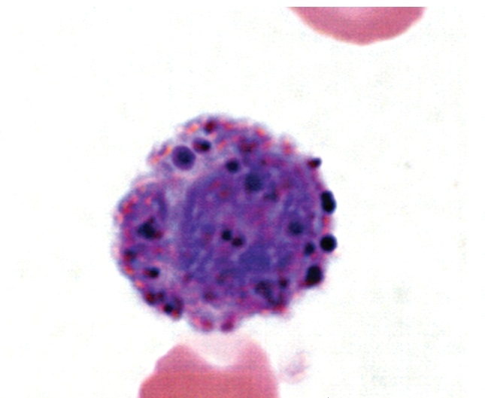
Final quiz
Self-check: Identify the cell. (advance slide for answer)
basophil

Slide 43
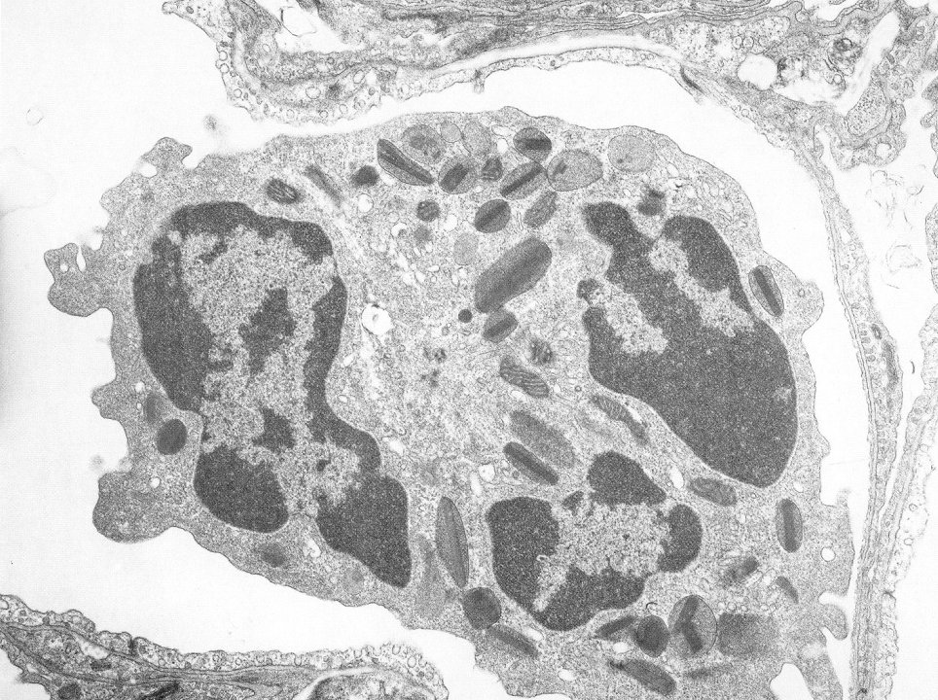
Final quiz
Self-check: Identify the predominant cell. (advance slide for answer)
eosinophil

Slide 44
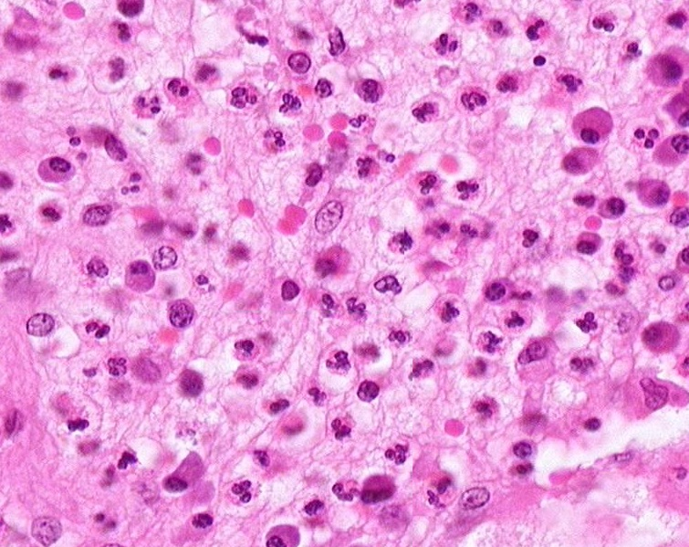
Final quiz
Self-check: Identify the cells. (advance slide for answer)
macrophage
Red blood cell
Plasma cell

Slide 45
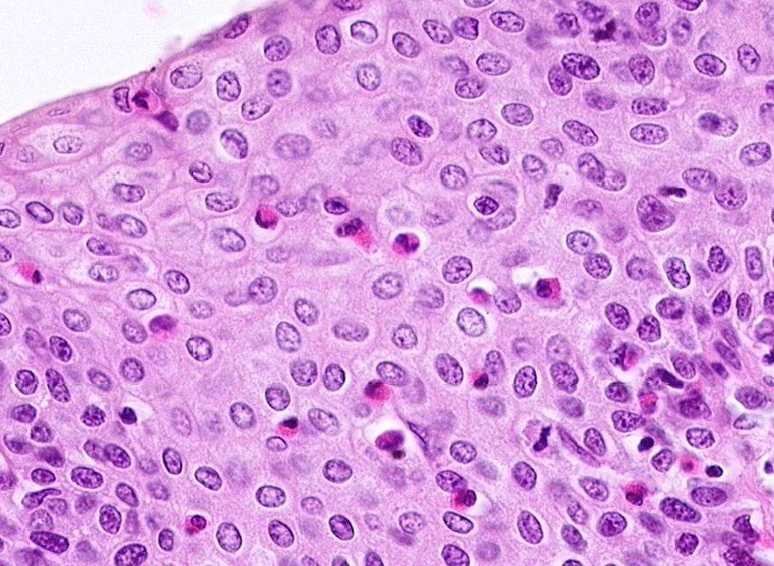
Final quiz
Self-check: Identify the cells. (advance slide for answer)
eosinophils

Slide 46
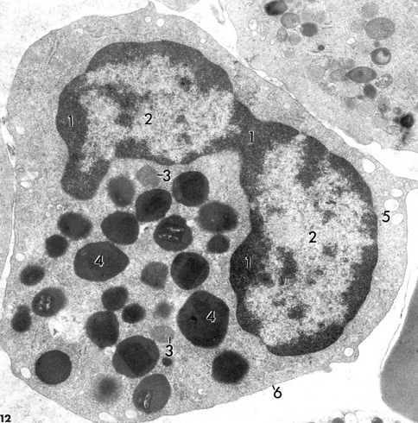
Final quiz
Self-check: Identify the cell. (advance slide for answer)
eosinophil
Look closely to see the crystalloid.

Slide 47
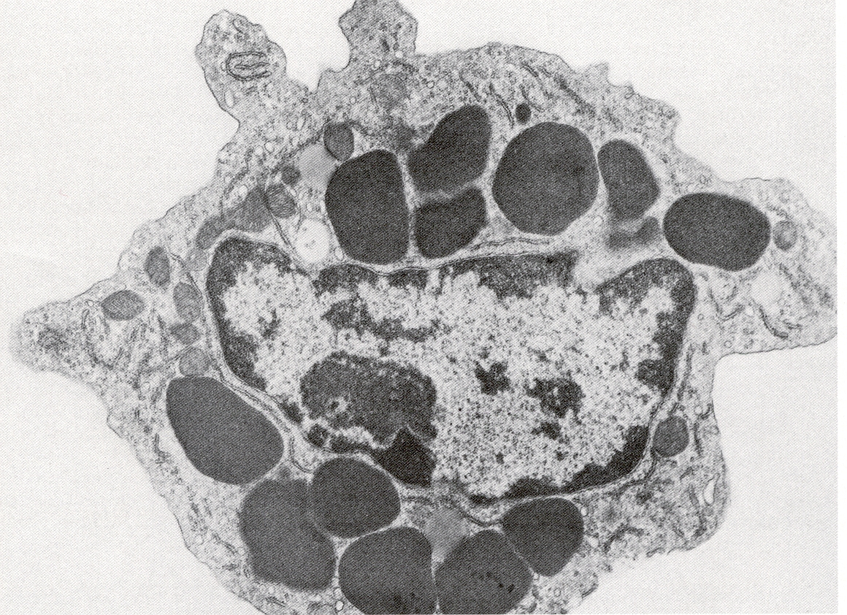
Final quiz
Self-check: Identify the cell. (advance slide for answer)
basophil

Slide 48
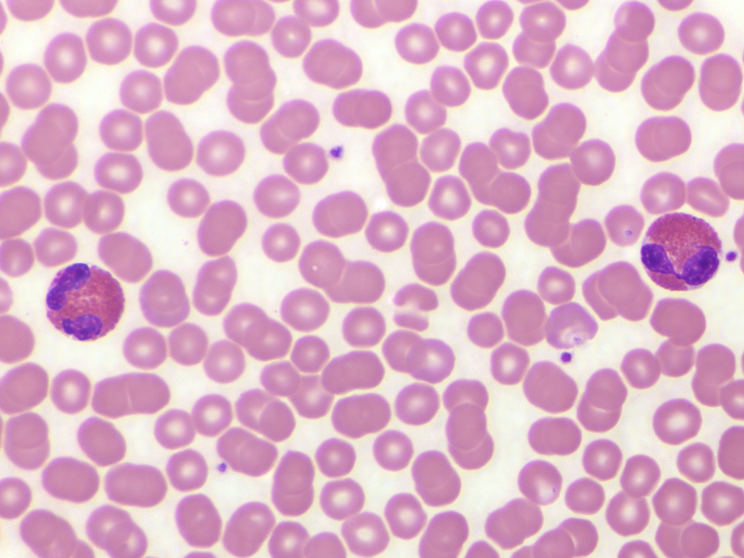
Final quiz
Self-check: Identify the cells. (advance slide for answer)
eosinophils

Slide 49
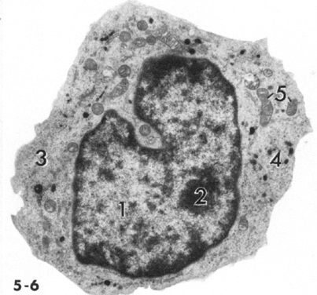
Final quiz
Self-check: Identify the cell. (advance slide for answer)
monocyte

Slide 50
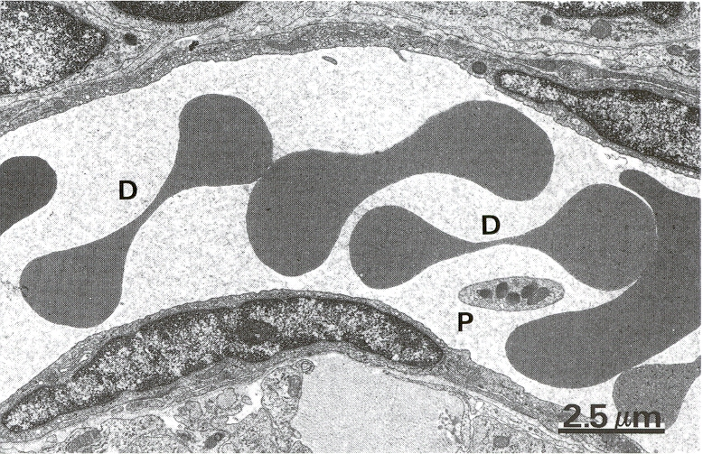
Final quiz
Self-check: Identify the cells. (advance slide for answer)
Red blood cells
platelet

Slide 51
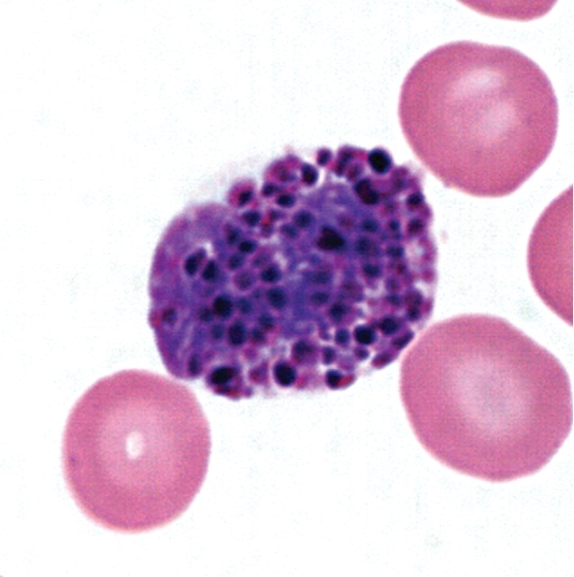
Final quiz
Self-check: Identify the cell. (advance slide for answer)
basophil

Slide 52
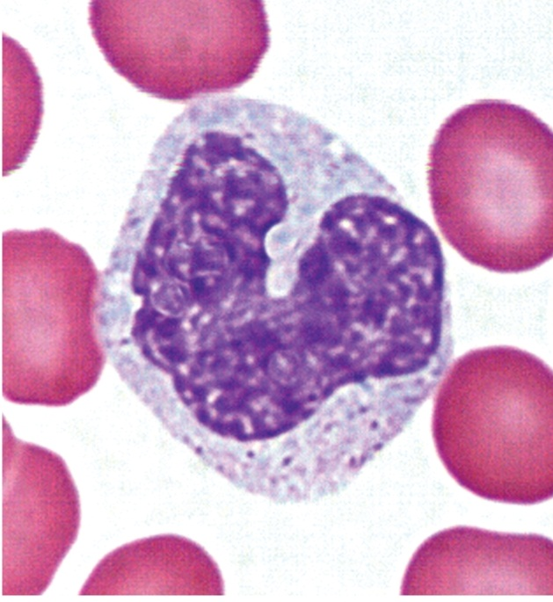
Final quiz
Self-check: Identify the cell. (advance slide for answer)
Monocyte

Slide 53
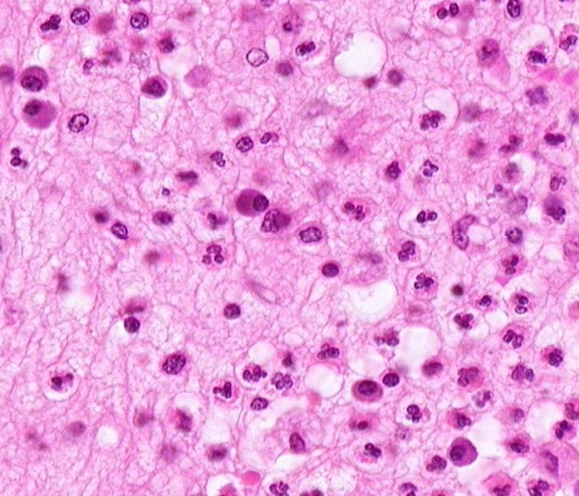
Final quiz
Self-check: Identify the cells. (advance slide for answer)
Plasma cell
neutrophil

Slide 54
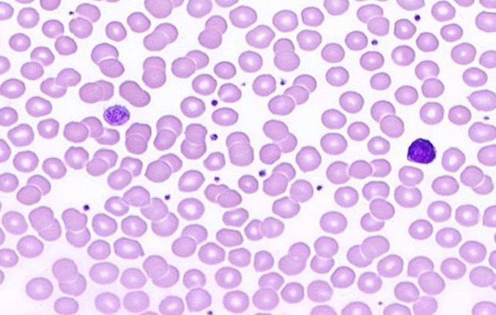
Final quiz
Self-check: Identify the formed element. (advance slide for answer)
Large platelet
A little unfair. This is a very big platelet. However, look closely – that’s not really a nucleus. Plus, a lymphocyte is to the right for comparison.

Slide 55
Final quiz
Self-check: Identify the cell. (advance slide for answer)
eosinophil
A little tricksy, but note the intense eosinophilia, which is closer in color to the red blood cells, more eosinophilic than the neutrophil.

