Slide 1
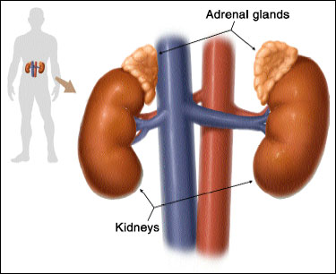
Adrenal Gland
Digital Laboratory
It’s best to view this in Slide Show mode, especially for the quizzes.
This module will take approximately 40 minutes to complete.

Slide 2
After completing this exercise, you should be able to:
identify, at the light microscope level, each of the following:
Adrenal gland
Cortex
Zona glomerulosa
Zona fasciculata
Zona reticularis
Medulla
Medullary cells (chromaphin cells)
Central vein
Smooth muscle
identify, at the electron microscope level
Adrenal gland
Cortex vs. medulla

Slide 3
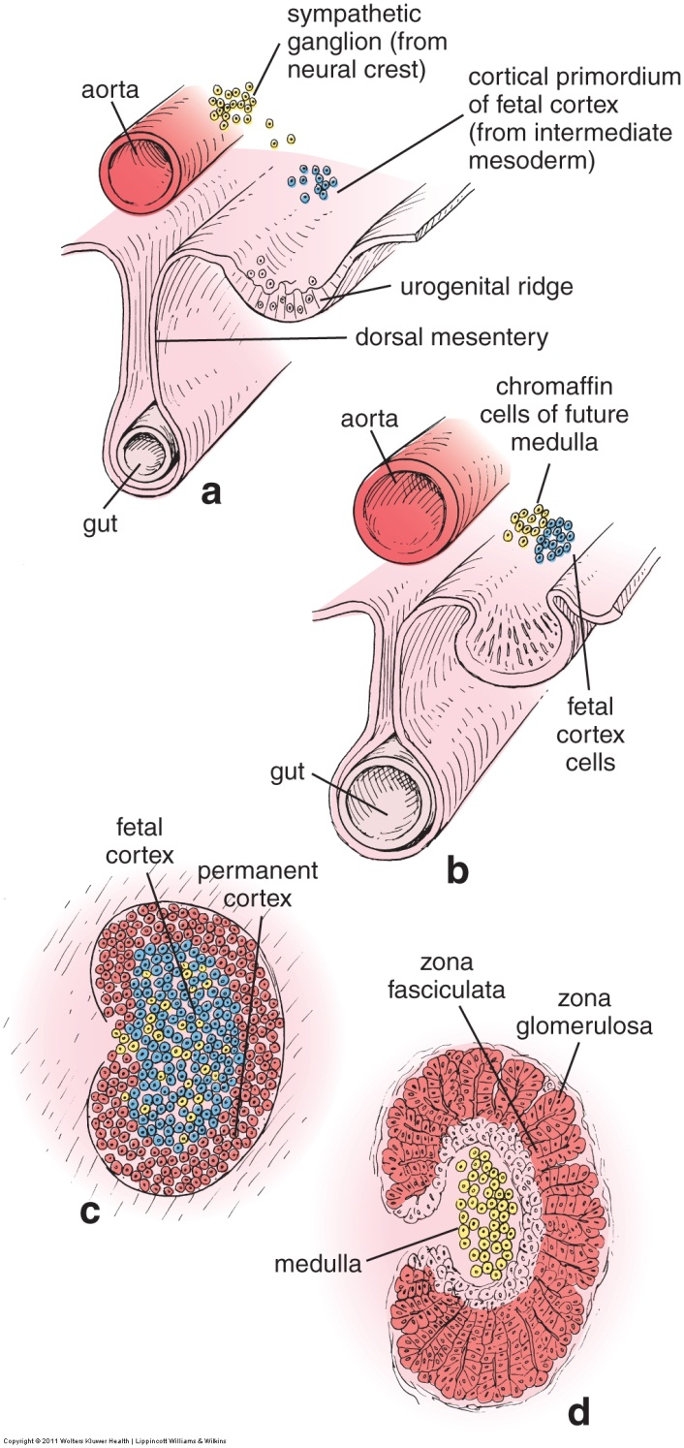
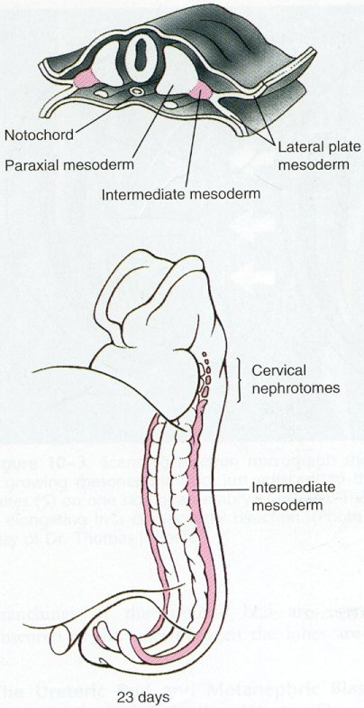
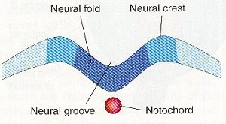
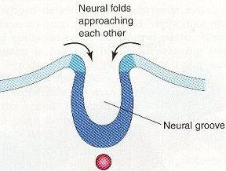
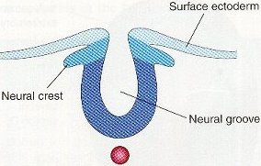
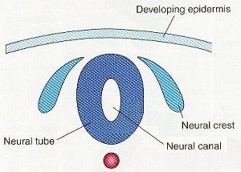
ADRENAL GLAND DEVELOPMENT
The adrenal glands are located in the posterior abdominal wall, situated above the kidneys. They develop from two tissues:
Intermediate mesoderm, which forms the adrenal cortex
Neural crest cells, which form the adrenal medulla

Slide 4
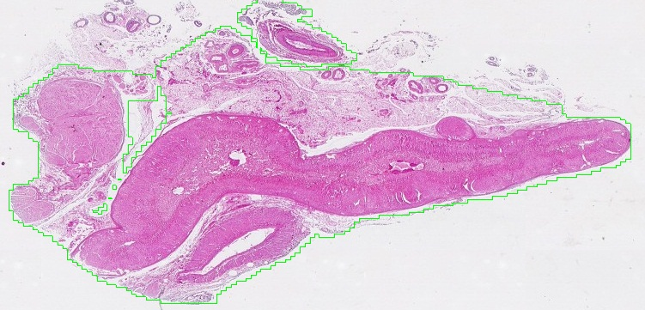
ADRENAL GLAND OVERVIEW
Adrenal gland outlined in green above, and dashed blue below.
In both cases, the border between the medulla and cortex is indicated by the tips of the arrows.
Connective tissue and other stuff
Because the adrenal gland is derived from two different sources, the cortex and medulla are histologically and functionally distinct:
The adrenal cortex (outer portion) – secretes steroid hormones
The adrenal medulla (inner portion) – secretes epinephrine and norepinephrine

Slide 5
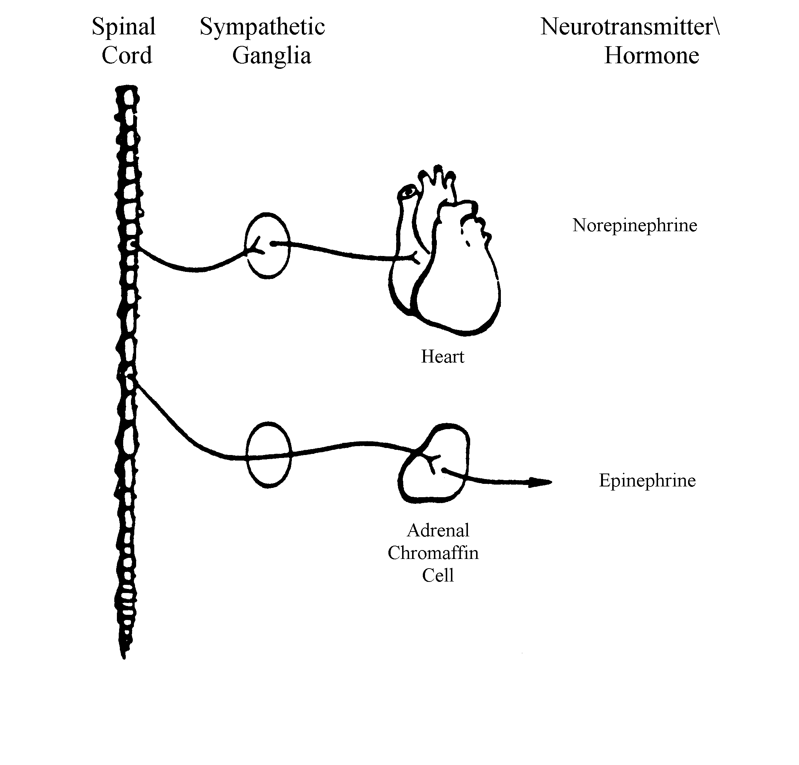
The main cells of the medulla, the chromaffin cells, can be thought of as modified post-ganglionic sympathetic neurons. Compare the sympathetic innervation of other organs (for example, the heart, below) to that of the adrenal to see why.
e.g., symp. chain ganglion
Symp. stimulation elicits a targeted response of the heart
Pre-ganglionic
Symp. neuron
Post-ganglionic
Symp. neuron
Pre-ganglionic symp. neuron
Norepinephrine
Symp. stimulation elicits a widespread response

Slide 6
ADRENAL GLAND OVERVIEW
Video of adrenal gland showing overview – SL127
Video of adrenal gland showing overview – SL52
Link to SL 127 and SL 052
Be able to identify:
Adrenal gland
Cortex
Medulla

Slide 7
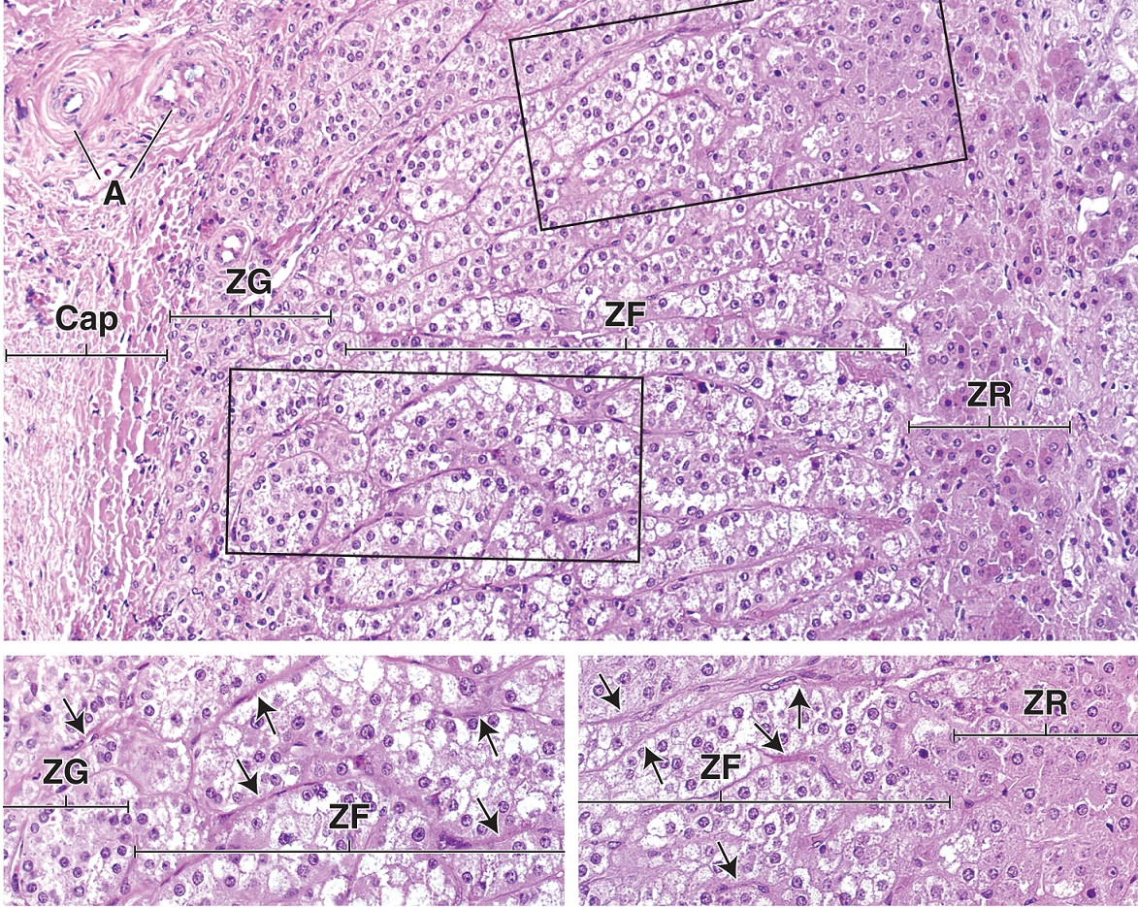
ADRENAL GLAND - CORTEX
Cap = capsule
A = arteriole
The adrenal cortex can be divided into three zones:
Zona glomerulosa (ZG) – secretes mineralcorticoids, mainly aldosterone
Zona fasciculata (ZF) – secretes glucocorticoids, mainly cortisol
Zona reticularis (ZR) – secrete weak androgens
The steroid-secreting cells in all three regions contain lipid droplets , making them pale in H&E stained sections (lipid is extracted away). Note, however, that the fasciculata is the palest, and the reticularis is darkest. Cells in the glomerulosa and reticularis tend to organize in round clusters, but cells in the fasciculata organize into columns.

Slide 8
ADRENAL GLAND -CORTEX
Video of adrenal gland showing cortex – SL127
Video of adrenal gland showing cortex – SL52
Link to SL 127 and SL 052
Be able to identify:
Adrenal cortex
Zona glomerulosa
Zona fasciculata
Zona reticularis

Slide 9
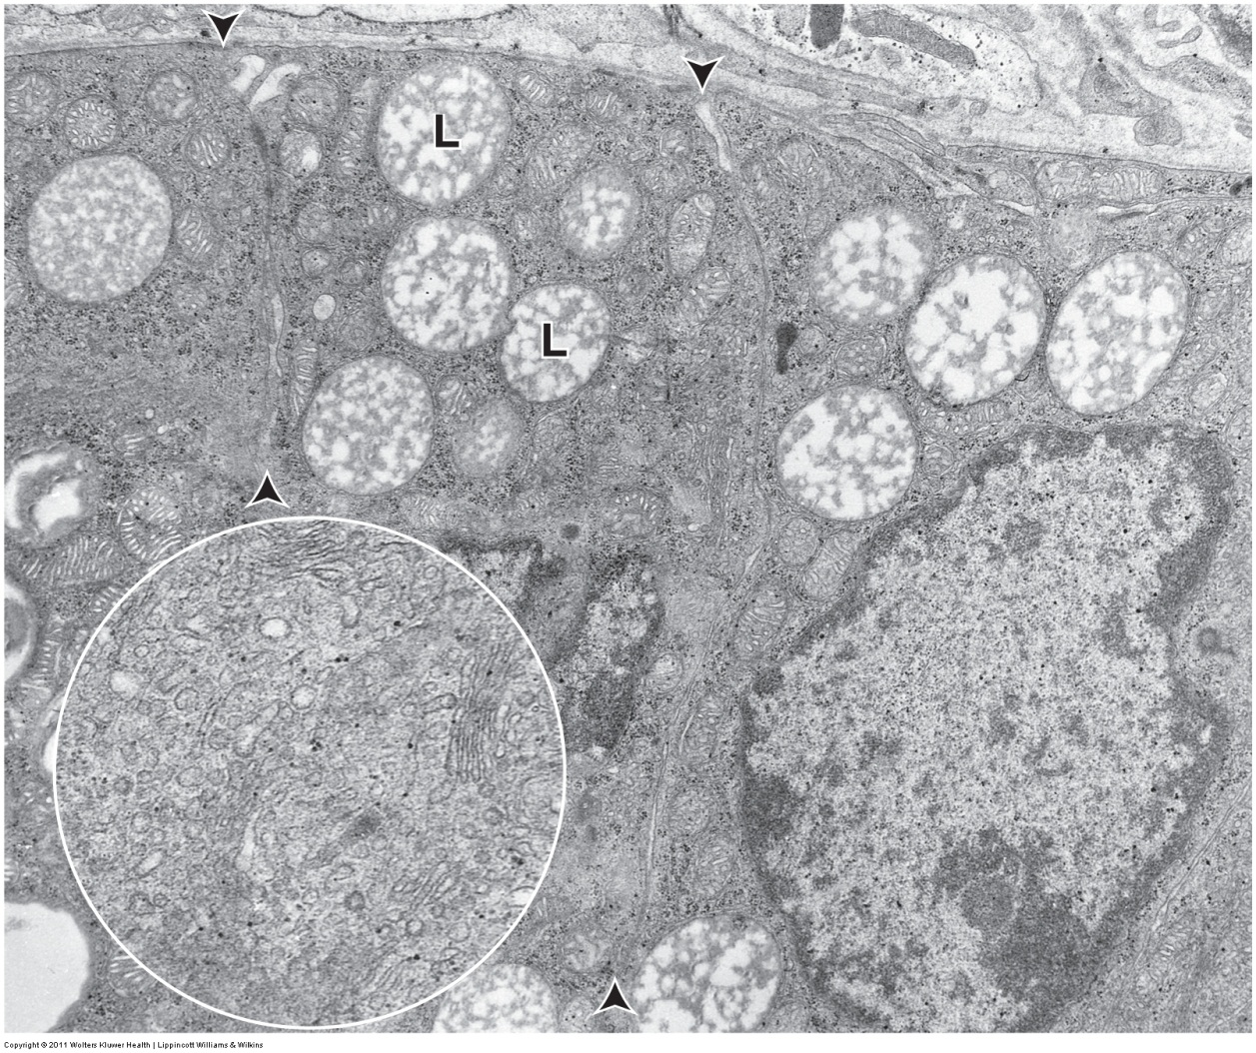
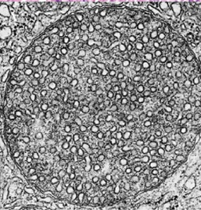
ADRENAL GLAND - CORTEX
Arrowheads indicate borders between adjacent cells.
Circle inset contains enlarged region of cell cytoplasm.
This is an electron micrograph of the zona fasciculata. Three characteristic features are typical of steroid-secreting cells:
Numerous lipid droplets - labeled L, poor preparation of this tissue gives them their unusual appearance here
Smooth endoplasmic reticulum – shown in the inset
Mitochondria with tubular cristae – red arrows, an enlarged view of a similar mitochondrion is to the right, note sectioned tubular cristae are round, and not “shelf-like” as in typical mitochondria

Slide 10
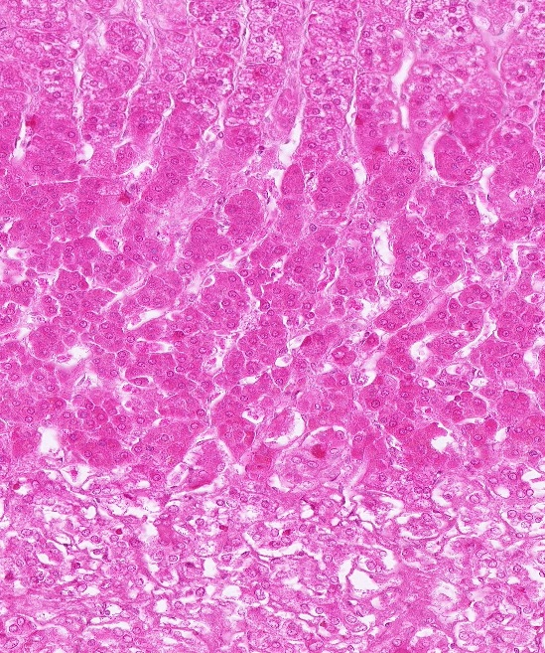
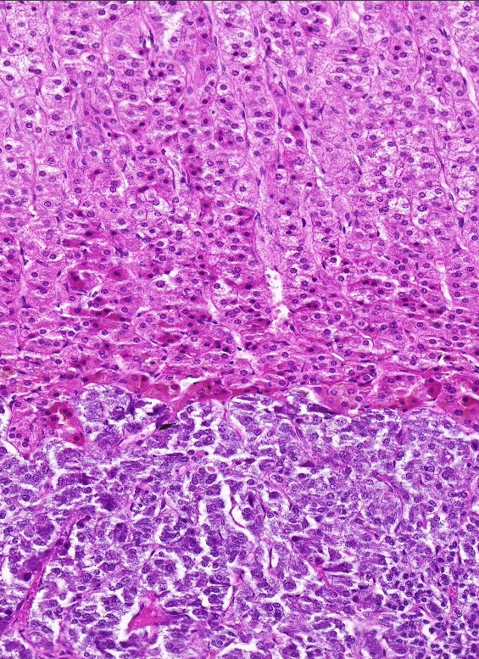
ADRENAL GLAND - MEDULLA
The adrenal medulla (brackets) secretes epinephrine and norepinephrine. It typically does not preserve well, so it’s organization and staining is not well-demonstrated on most slides. Nevertheless, because it is adjacent to, and stains “differently” from the cortex, it is readily identified.

Slide 11
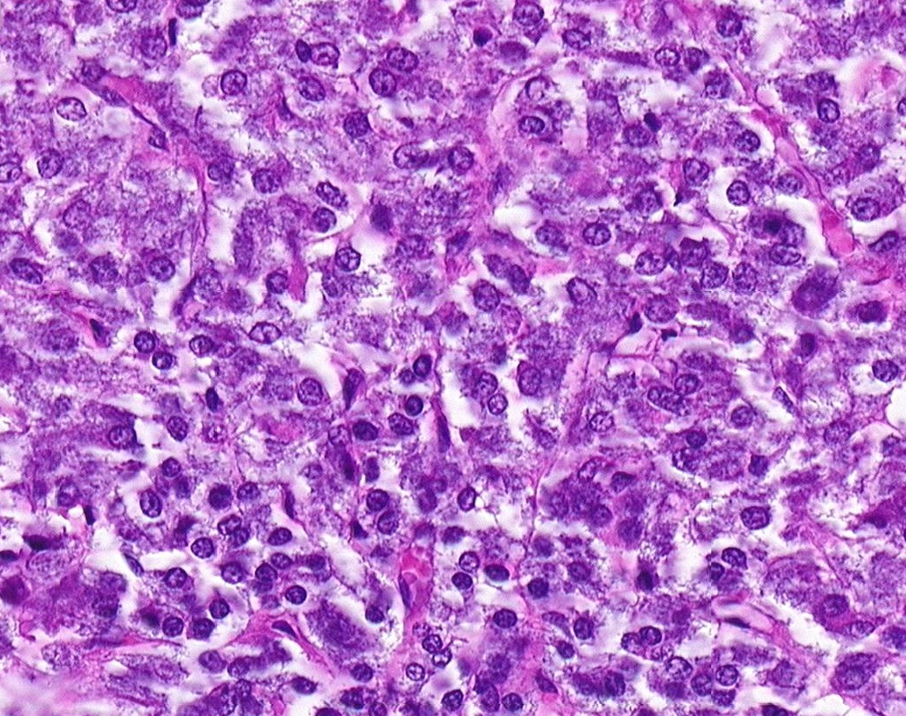
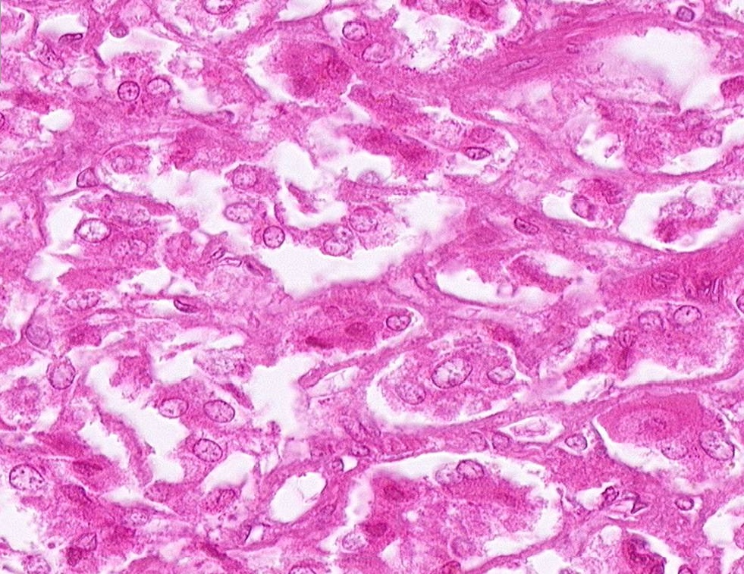
ADRENAL GLAND - MEDULLA
Both of these images are from the adrenal medulla. The one on the right is the adrenal slide in which the hematoxylin is understained. As you can see, the chromaffin cells vary in size and staining intensity, both between specimens and on the same section. Typically, their nuclei are relatively euchromatic, though many remain small.
Honestly, by themselves, these cells don’t have much to hang your hat on. The best way to identify adrenal medulla is in the context of the entire adrenal gland.

Slide 12
ADRENAL GLAND - MEDULLA
Video of adrenal gland showing medulla – SL127
Video of adrenal gland showing medulla – SL52
Link to SL 127 and SL 052
Be able to identify:
Adrenal medulla
Medullary (chromaffin) cells

Slide 13
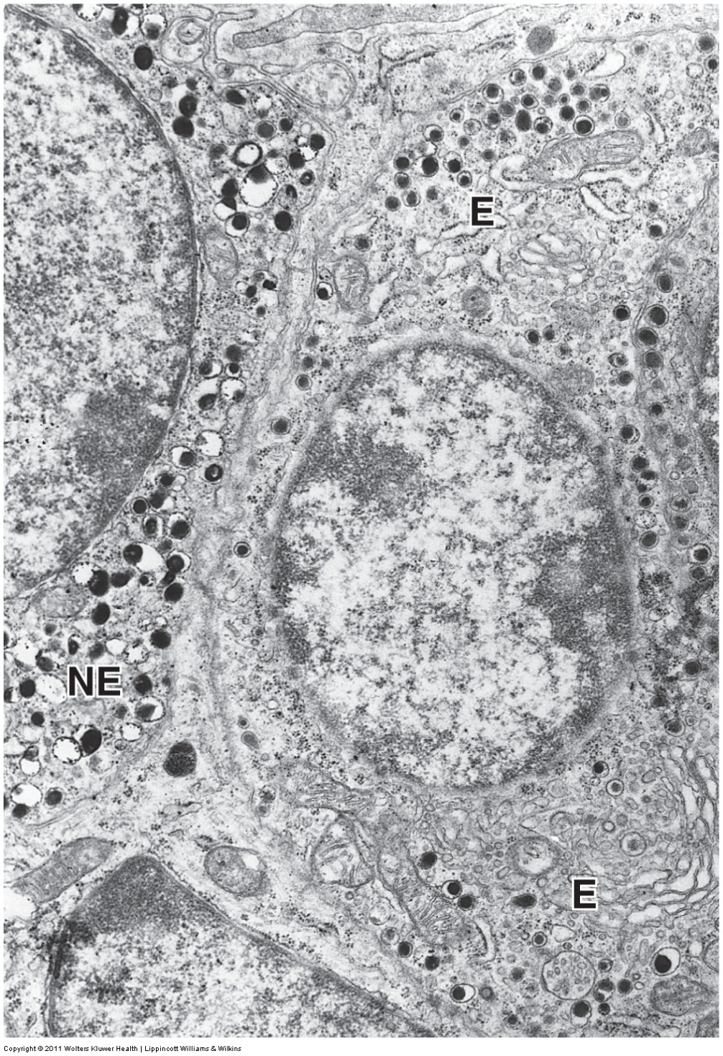
ADRENAL GLAND - MEDULLA
In electron micrographs, abundant dense secretory granules are seen in chromaffin cells of the adrenal medulla. The norepinephrine (NE) granules can be distinguished from those containing epinephrine (E) because they are denser, but we do not require you to make this distinction.
Particularly note the difference between these cells of the adrenal medulla, which contain dense secretory granules, from cells of the adrenal cortex, which have lipid droplets, SER, and mitochondria with tubular cristae.
If you have been paying attention, you might be thinking: “These cells look a lot like those in the anterior pituitary. How do I know which is which?”
The answer is you really can’t at this high magnification unless you are told the source of the tissue. The same is true if you compare cells of the adrenal cortex with other steroid-secreting cells (e.g. Leydig cells/secrete testosterone) you will see later.

Slide 14
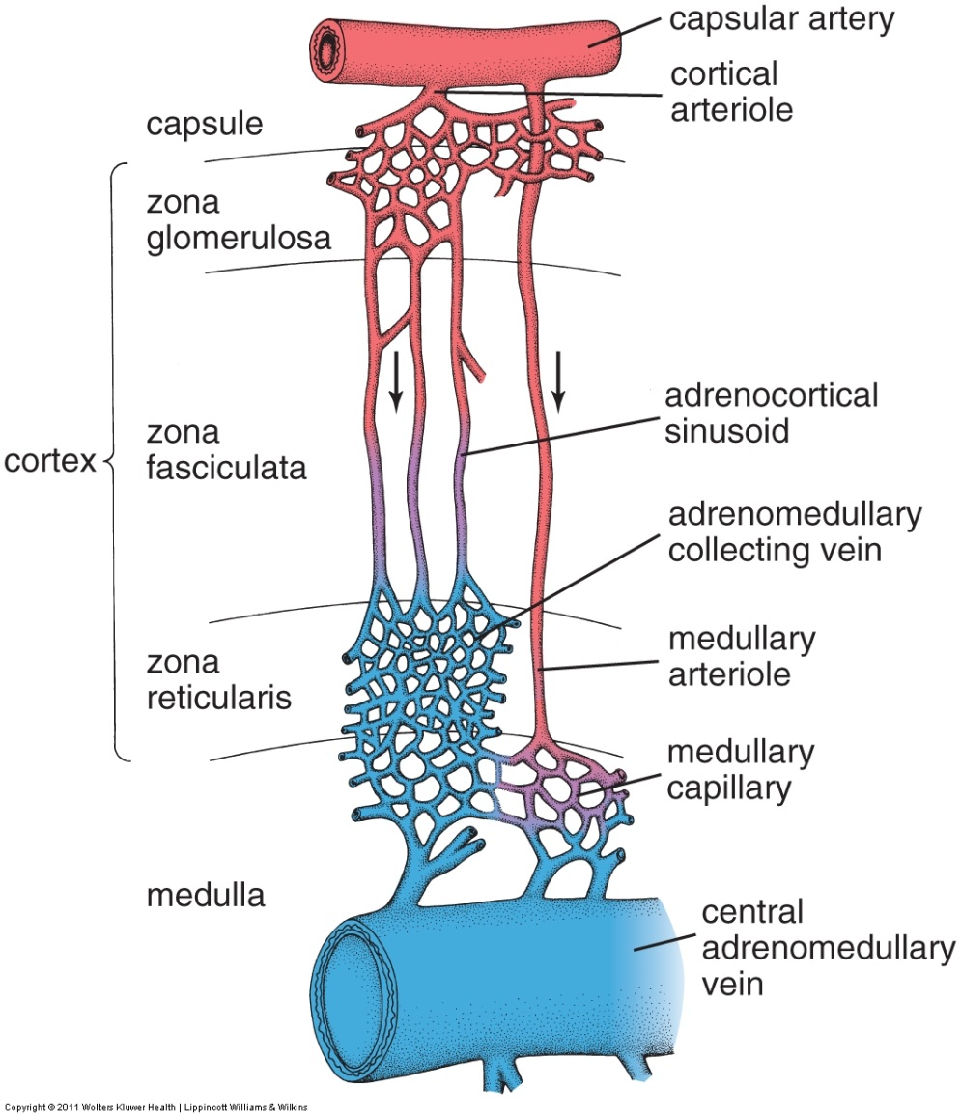
ADRENAL GLAND – BLOOD SUPPLY
Like all endocrine organs, the adrenal gland has a rich blood supply, highlighted by capillaries that are fenestrated. In the adrenal cortex, like the anterior pituitary, the vessels are referred to as sinusoids. (Again, we will discuss the different types of capillaries in the cardiovascular block.)
The adrenal medulla receives both direct arterial blood (unbranched vertical vessel on the right side of the drawing), as well as blood that has already percolated through the cortex, picking up steroid hormones (left vertical vessels). Because of this circulatory arrangement, although the cortex and medulla are derived from different tissues embryologically and release distinct types of hormones, the activity of the cortex has an influence on the activity of the medulla.
The capillaries in the cortex tend to match the organization of the cells; convoluted vessels in the glomerulosa and reticularis, longitudinal vessels in the fasciculata.

Slide 15
ADRENAL GLAND – BLOOD SUPPLY
Video of adrenal gland showing sinusoids – SL127
Video of adrenal gland showing sinusoids – SL52
Link to SL 127 and SL 052
Be able to identify:
Sinusoids (not in the objectives, but you are scholars of histology)

Slide 16
ADRENAL GLAND – BLOOD SUPPLY
Another unusual feature of adrenal circulation is the central medullary vein, which drains blood from the adrenal gland. Veins typically have very little smooth muscle. The central medullary vein, however, has thick bundles of smooth muscle that run longitudinally. Contraction of these muscles reduces the size of the adrenal gland; it is thought that this action enhances the release of hormones from the adrenal medulla.

Slide 17
ADRENAL GLAND – BLOOD SUPPLY
Video of adrenal gland showing the central vein – SL127
Video of adrenal gland showing the central vein – SL52
Link to SL 127 and SL 052
Be able to identify:
Central medullary vein
Smooth muscle

Slide 18
The next set of slides is a quiz for this module. You should review the structures covered in this module, and try to visualize each of these in light and electron micrographs.
identify, at the light microscope level, each of the following:
Adrenal gland
Cortex
Zona glomerulosa
Zona fasciculata
Zona reticularis
Medulla
Medullary cells (chromaphin cells)
Central vein
Smooth muscle
identify, at the electron microscope level
Adrenal gland
Cortex vs. medulla

Slide 19
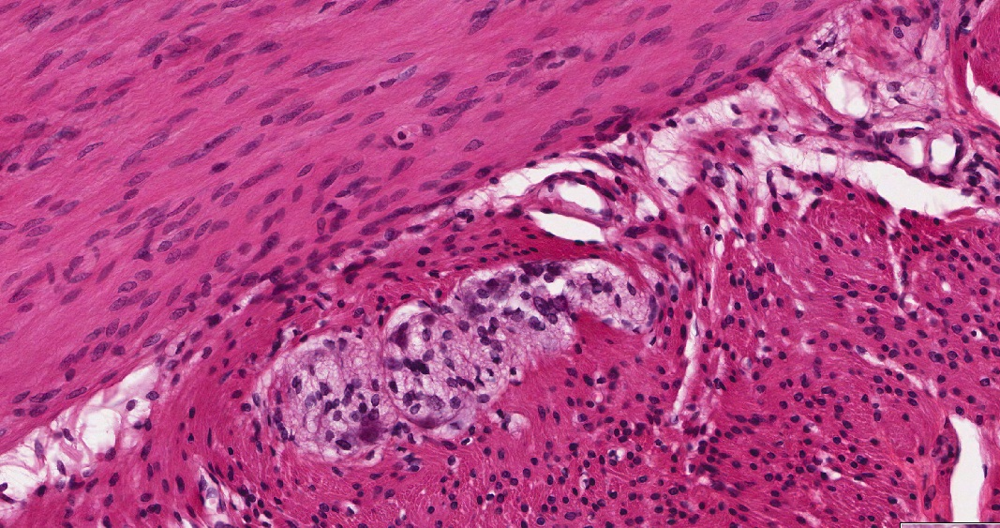
Final quiz
Self-check: Identify the tissue. (advance slide for answers)
Smooth muscle
Smooth muscle

Slide 20
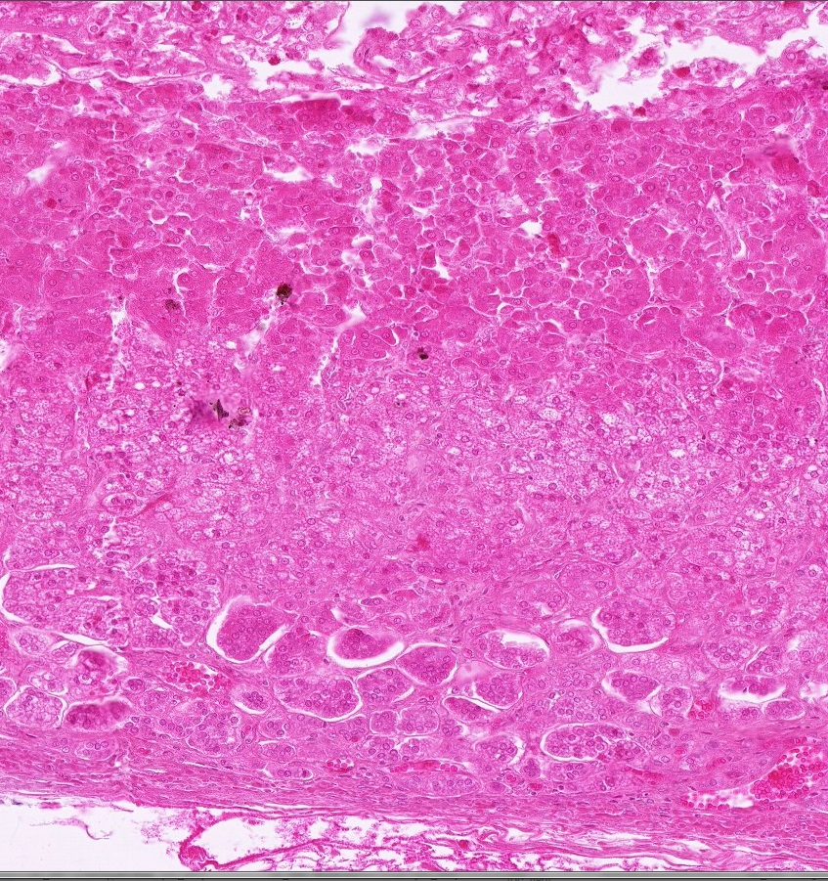
Final quiz
Self-check: Identify the region. (advance slide for answers)
Zona reticularis

Slide 21
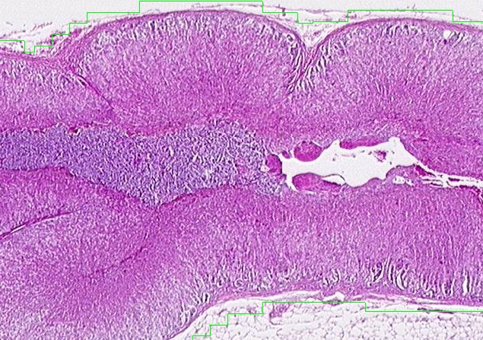
Final quiz
Self-check: Identify the outlined region. Be specific. (advance slide for answers)
Adrenal medulla

Slide 22
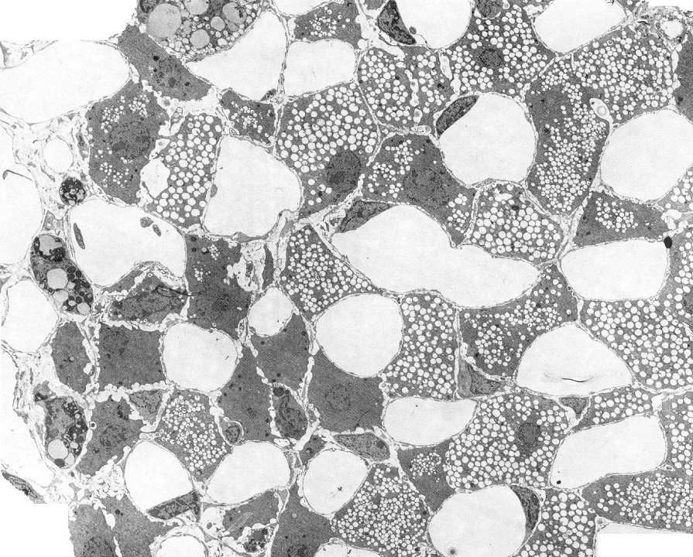
Final quiz
Self-check: If this image was taken from the adrenal gland, from which part of that gland could this have been obtained. (advance slide for answers)
Cortex
Any of the three zones would be acceptable. This happens to show mostly fasciculata – note the large number of lipid droplets in the cells.

Slide 23
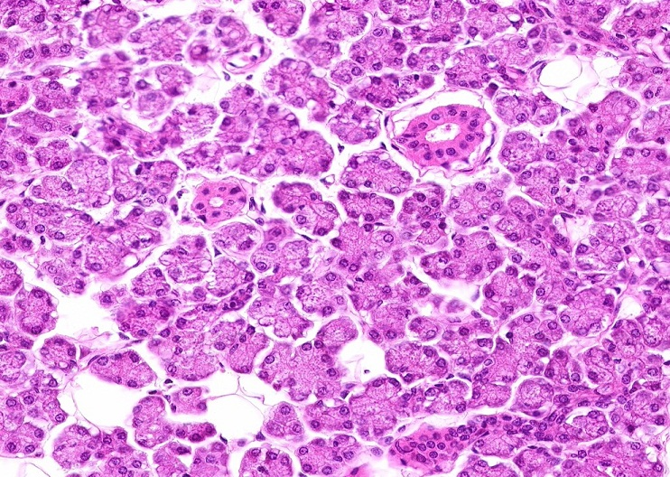
Final quiz
Self-check: Identify the predominant tissue in this image. (advance slide for answers)
Serous gland / serous acini / parotid gland

Slide 24
Final quiz
Self-check: Identify region. (advance slide for answers)
Zona fasciculata

Slide 25
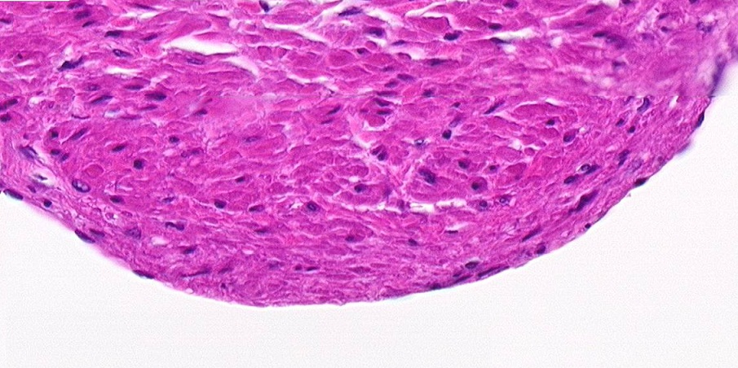
Final quiz
Self-check: Identify the tissue in the outlined region. (advance slide for answers)
Smooth muscle

Slide 26
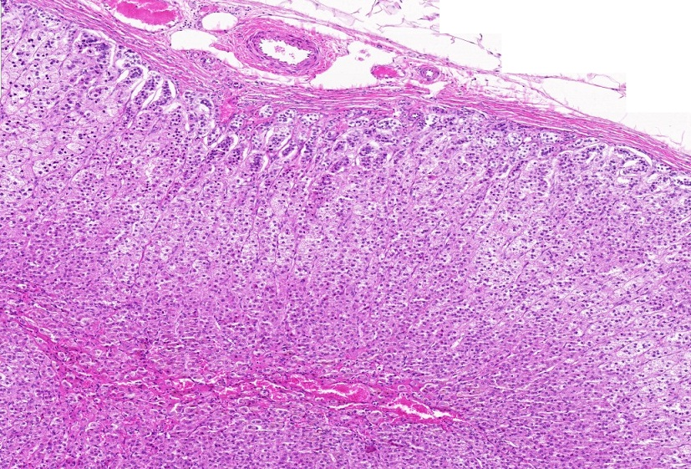
Final quiz
Self-check: Identify the region indicated by the brackets. (advance slide for answers)
Zona reticularis

Slide 27
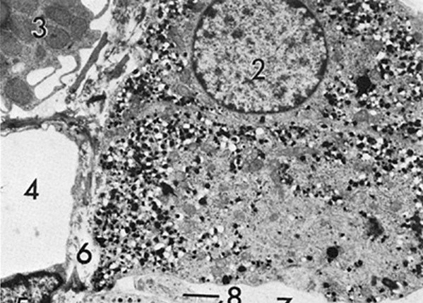
Final quiz
Self-check: This is a section from the adrenal gland. Identify the region from which this was taken. Identify 4. (advance slide for answers)
4. Blood vessel
Adrenal medulla

Slide 28
Final quiz
Self-check: Identify the region indicated by the brackets. (advance slide for answers)
Zona fasciculata

Slide 29
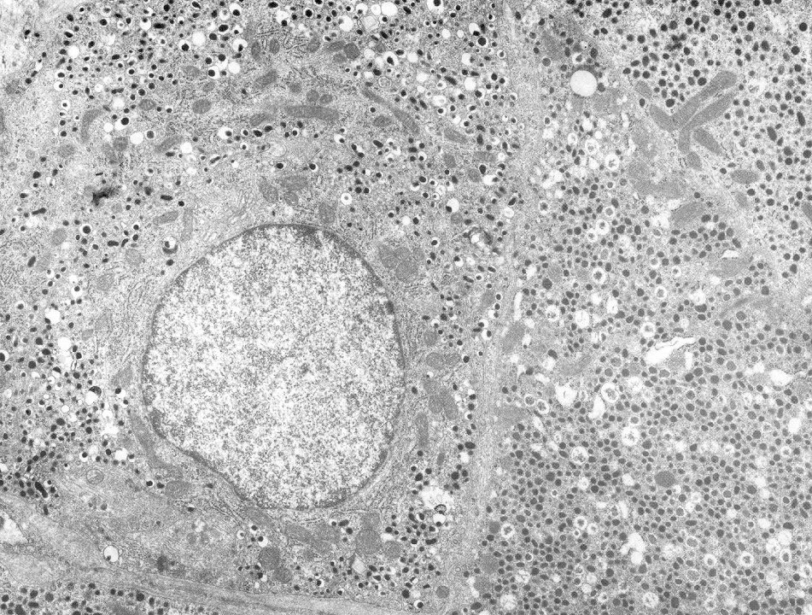
Final quiz
Self-check: If this image was taken from the adrenal gland, from which part of that gland could this have been obtained. (advance slide for answers)
Adrenal medulla

Slide 30
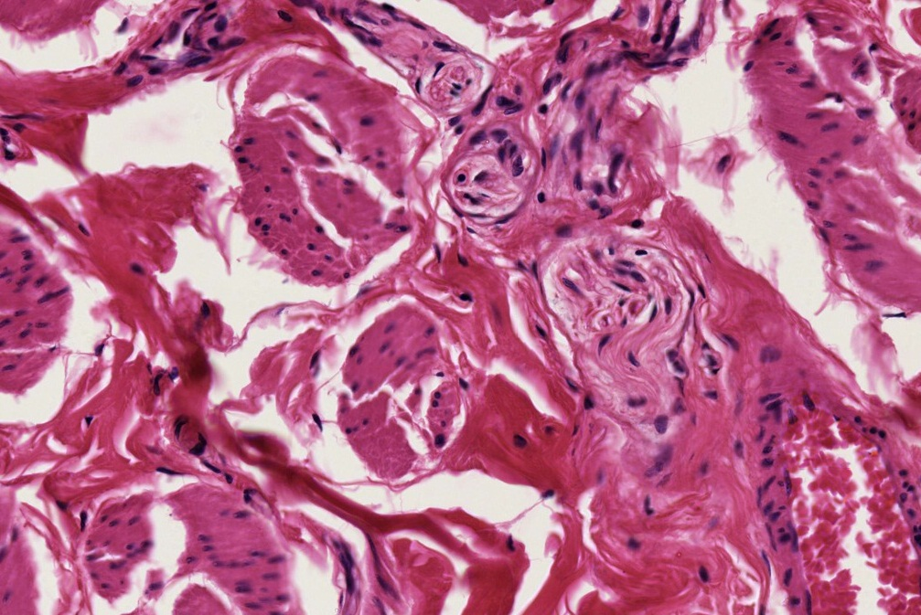
Final quiz
Self-check: Identify the outlined tissues. (advance slide for answers)
Smooth muscle
Dense irregular connective tissue
Peripheral nerve

Slide 31
Final quiz
Self-check: Identify the region. (advance slide for answers)
Adrenal medulla

Slide 32
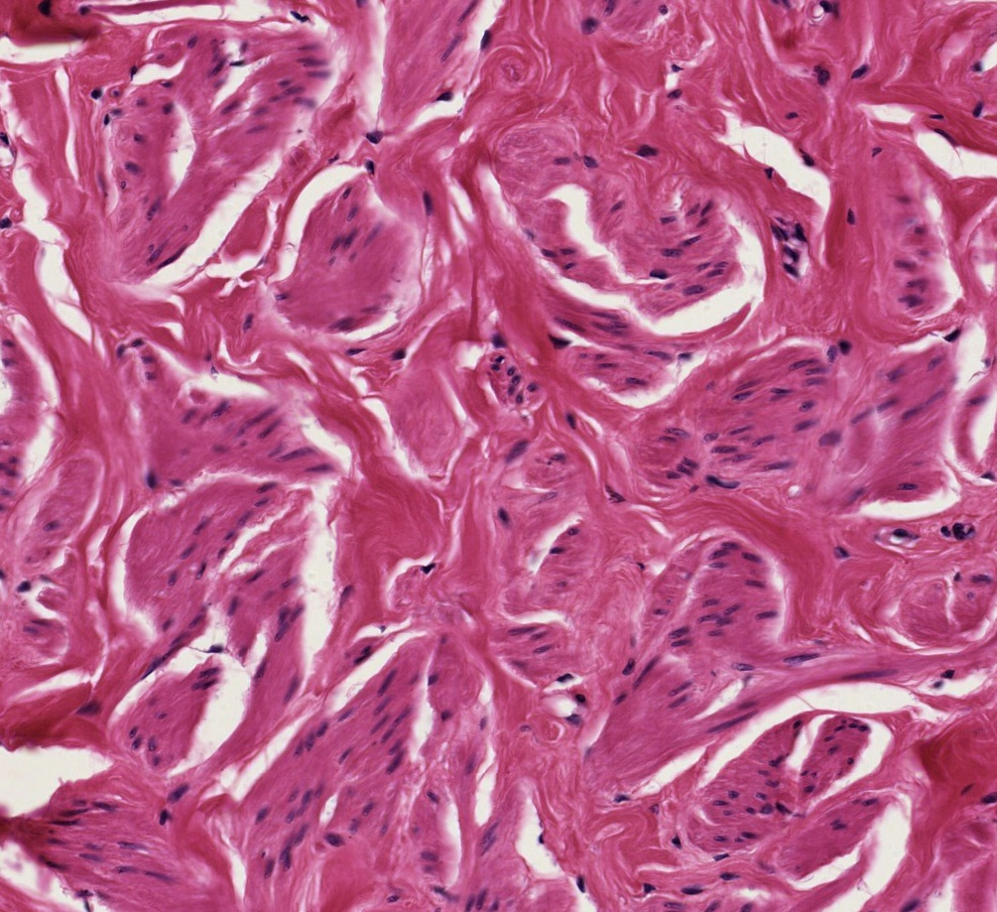
Final quiz
Self-check: Identify the tissue in the outlined region. (advance slide for answers)
Dense irregular connective tissue

Slide 33
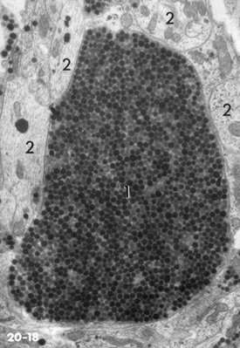
Final quiz
Self-check: This is a section from the posterior pituitary (neurohypophysis). Identify the predominant structure in this image. (advance slide for answers)
Herring body

Slide 34
Final quiz
Self-check: Identify the tissue closest to the arrows. (advance slide for answers)
Simple squamous epithelium

Slide 35
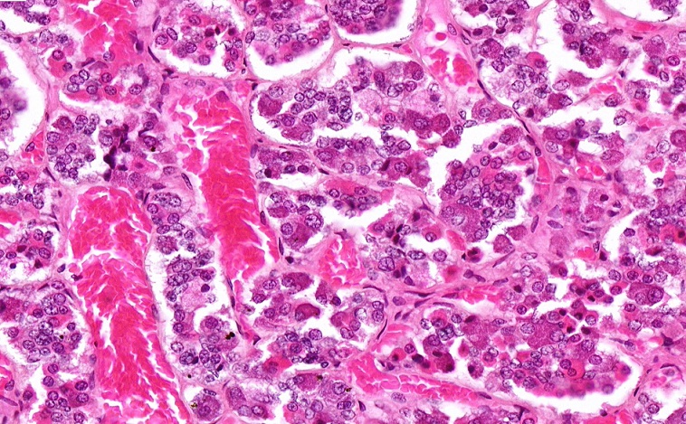
Final quiz
Self-check: Identify the organ. Be specific. (advance slide for answers)
Anterior pituitary

Slide 36
Final quiz
Self-check: Identify the region. (advance slide for answers)
Zona glomerulosa

Slide 37
Final quiz
Self-check: Identify the region indicated by the brackets. (advance slide for answers)
Zona glomerulosa

Slide 38
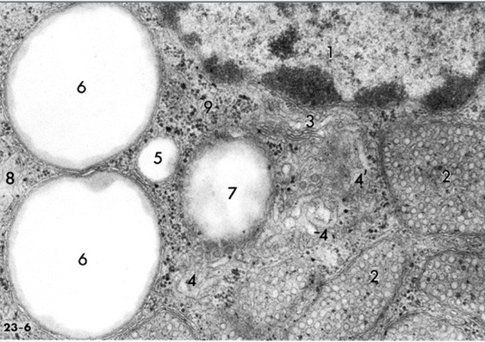
Final quiz
Self-check: This is a from the adrenal gland. Identify the region from which this was taken. Identify 2, 3, 6, and 7. (advance slide for answers)
Adrenal cortex (any of the three regions)
2. Mitochondria with tubular cristae
3. Golgi apparatus
6 & 7 Lipid droplets

Slide 39
Final quiz
Self-check: Identify the outlined structure. Be specific. (advance slide for answers)
Central vein of the adrenal gland

