Slide 1
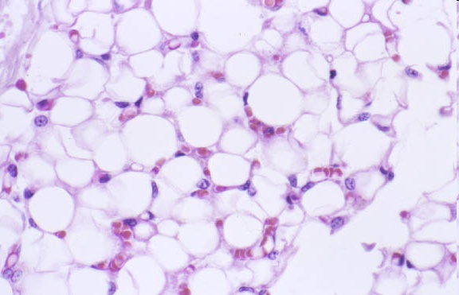
Adipose Tissue
Digital Laboratory
It’s best to view this in Slide Show mode, especially for the quizzes.
This module will take approximately 30 minutes to complete.

Slide 2
After completing this exercise, you should be able to:
Distinguish, at the light microscope level, each of the following components of adipose tissue:
Adipose tissue
Unilocular (WAT)
Multilocular (BAT and developing WAT)
Immunocytochemistry to differentiate white adipose tissue (WAT) and brown adipose tissue (BAT) in humans
Describe the distribution of white adipose tissue (WAT) and brown adipose tissue (BAT) in humans

Slide 3
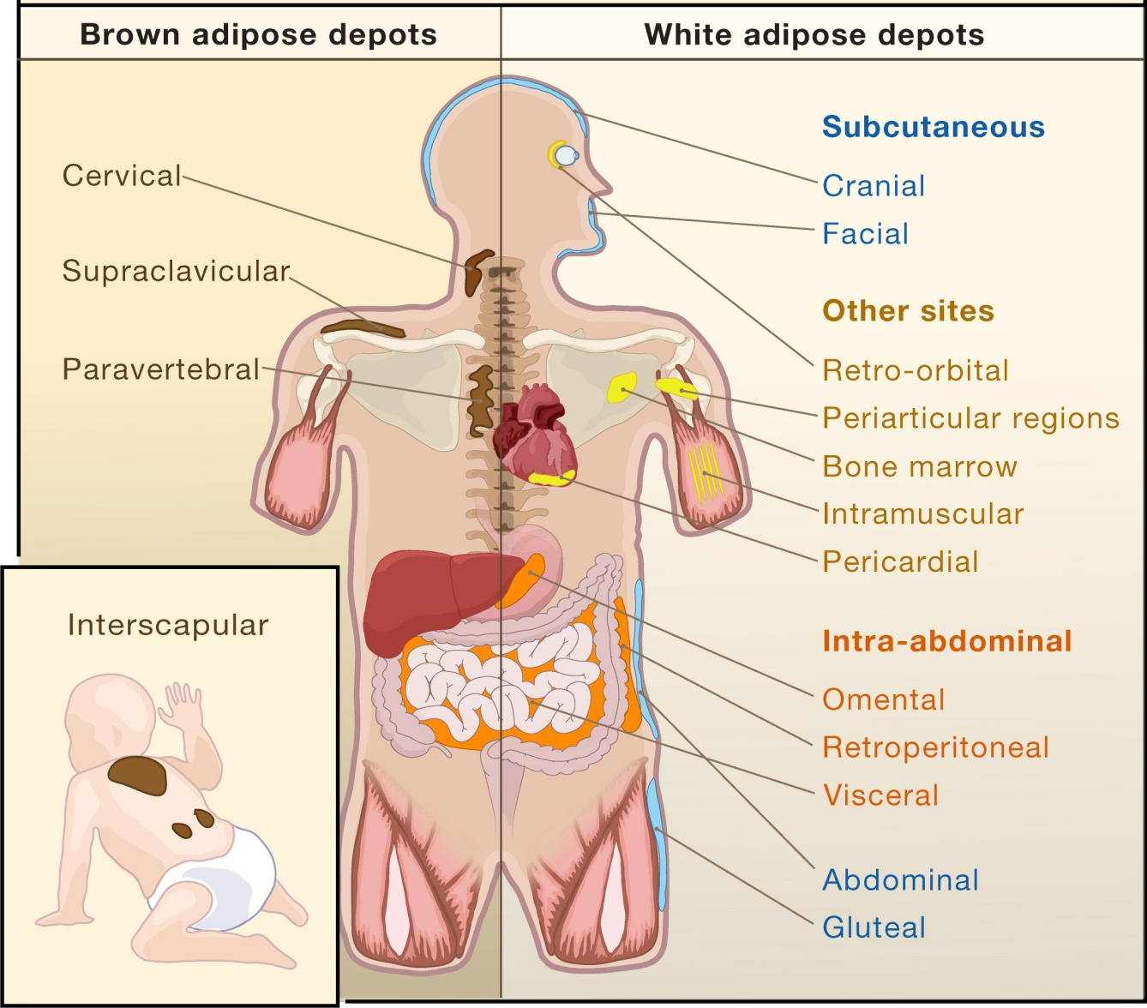
Adipose tissue
White adipose tissue (WAT) and brown adipose tissue (BAT) are distributed differently in the body, are histologically distinct and serve very different functions.
WAT is also termed unilocular adipose tissue because each cell contains a single large droplet of fat, which displaces other organelles to the cell periphery. In contrast, BAT cells contain many small fat droplets (thus, also termed multilocular fat)

Slide 4
Unilocular Adipose tissue (WAT)
0
A section of adipose tissue, showing the large, unilocular adipocytes (an example of one cell is in shaded circle) – sometimes described as “signet rings”, because the large lipid droplet displaces the nucleus (green arrow) and remainder of the cytoplasm (red arrow) to the edge of the cell. The clear areas in the section are truly empty, because the triglycerides in the fat droplet are soluble in the organic solvents used during processing of the section, and are therefore removed from the section.
Many small blood vessels are also evident (blue arrows) – typical of WAT, which is richly vascularized. Sympathetic nerve endings (not visible in H&E) are also present.
Lipid droplet
http://pathology.mc.duke.edu/research/Histo_course/whitefat.jpg
There are thin layers of loose connective tissue between the cells here as well (e.g. a larger region is outlined). Because the cytoplasm of the adipocytes and the collagen fibers of the connective tissue are both eosinophilic, it’s often difficult to tell the exact border between the two.

Slide 5
Unilocular Adipose tissue (WAT)
Video of aged thymus showing unilocular adipose tissue – SL34
Link to SL 034
Be able to identify:
Unilocular adipose tissue

Slide 6
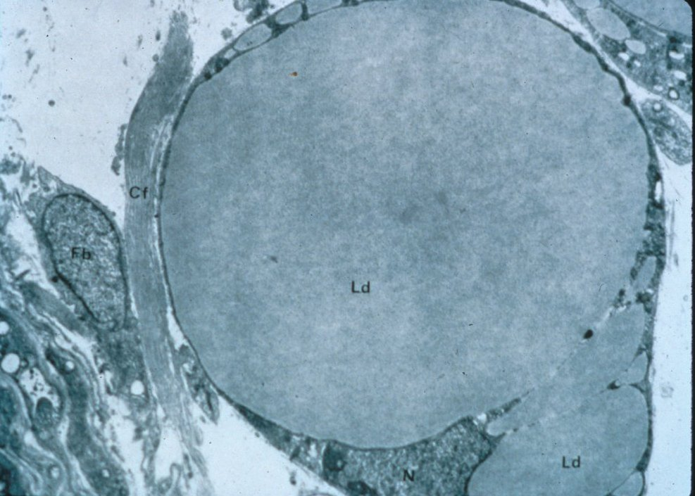
Unilocular Adipose tissue (WAT)
0
This transmission EM shows a single unilocular adipose cell. One large lipid droplet (Ld) is evident, although the EM shows that “unilocular” cells also contain smaller droplets that may be in the process of coalescing with the large droplet. The droplet squeezes the cytoplasm (arrows) and nucleus (N, cropped at bottom) to the periphery of the cell, resulting in the so-called “signet ring” morphology.
All cellular organelles (Golgi, rER, mitochondria) are present, although not abundant. A collagen fiber (Cf) and fibroblast (Fb) surrounding the cell are also present.

Slide 7
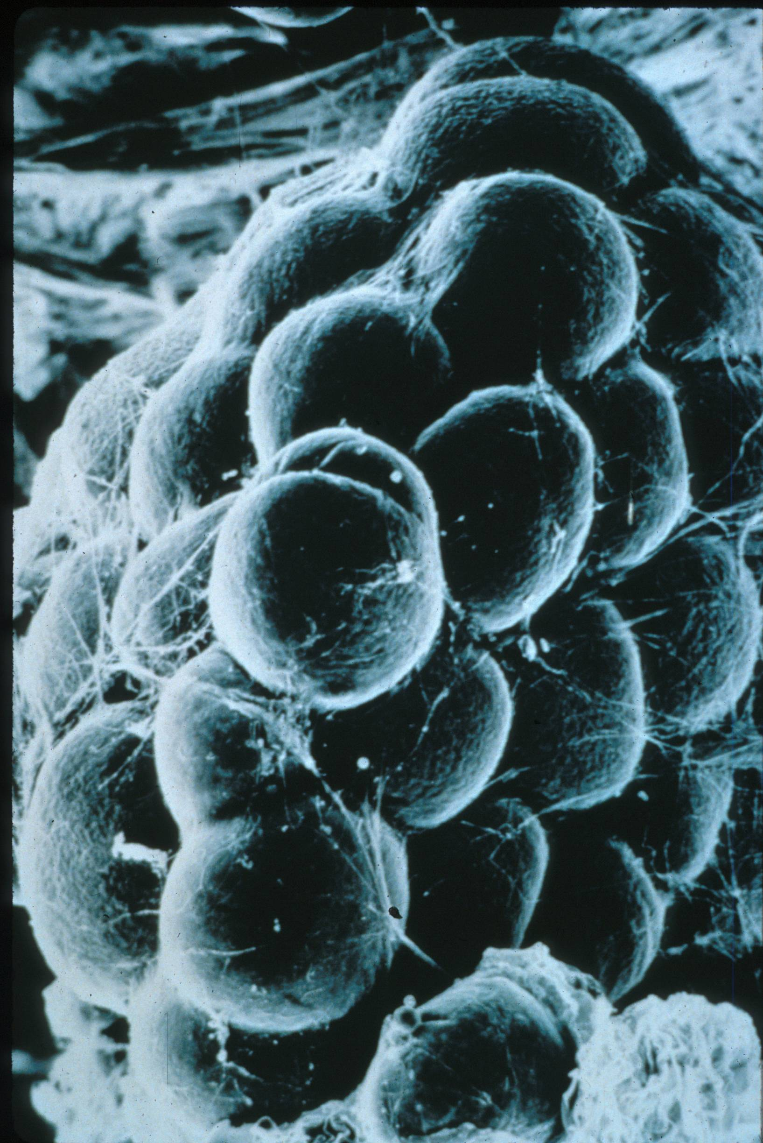
Unilocular Adipose tissue (WAT)
0
This scanning EM shows a cluster of unilocular adipocytes – which appear as spheres. Each spherical unilocular cell is almost entirely composed of a large, single droplet of fat, which is liquid at body temperature.
Reticular fibers, which look like small threads, enmesh the adipocytes.

Slide 8
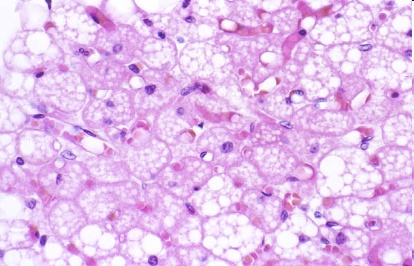
multilocular Adipose tissue (bAT)
In contrast to the unilocular WAT cells, multilocular adipocytes contain many small fat droplets (these are the clear areas). Two cells have been outlined, each containing 10-20 visible droplets. Note that, in contrast to WAT, nuclei of BAT cells are round or oval and often centrally located (green arrows).
Many capillaries and small vessels are evident.
http://pathology.mc.duke.edu/research/Histo_course/brownfat.jpg
The nuclei that you see around the periphery of the adipocytes (e.g. red arrow) likely belong to fibroblasts of the connective tissue between the adipose cells, or endothelial cells of the blood vessels.

Slide 9
multilocular Adipose tissue (bAT)
Video of axilla showing multilocular adipose tissue – SL12
Link to SL 012
Be able to identify:
multilocular adipose tissue

Slide 10
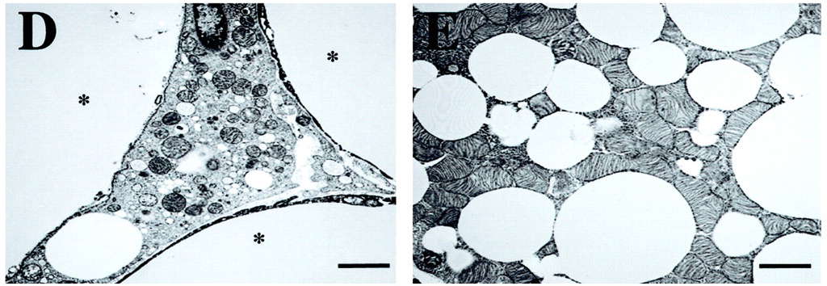
multilocular and unilocular Adipose tissue
E
Molecular Endocrinology November 1, 2002 vol. 16 no. 11 2618-2627
Transmission Electron Micrographs (TEMs) showing part of 3 white adipocytes (D) and a brown adipocyte (E) in the mammary gland. Three large fat droplets from three different unilocular white adipocytes are seen in panel D and indicated by asterisks. Note the numerous mitochondria enriched in cristae in brown adipocyte cytoplasm (panel E).

Slide 11
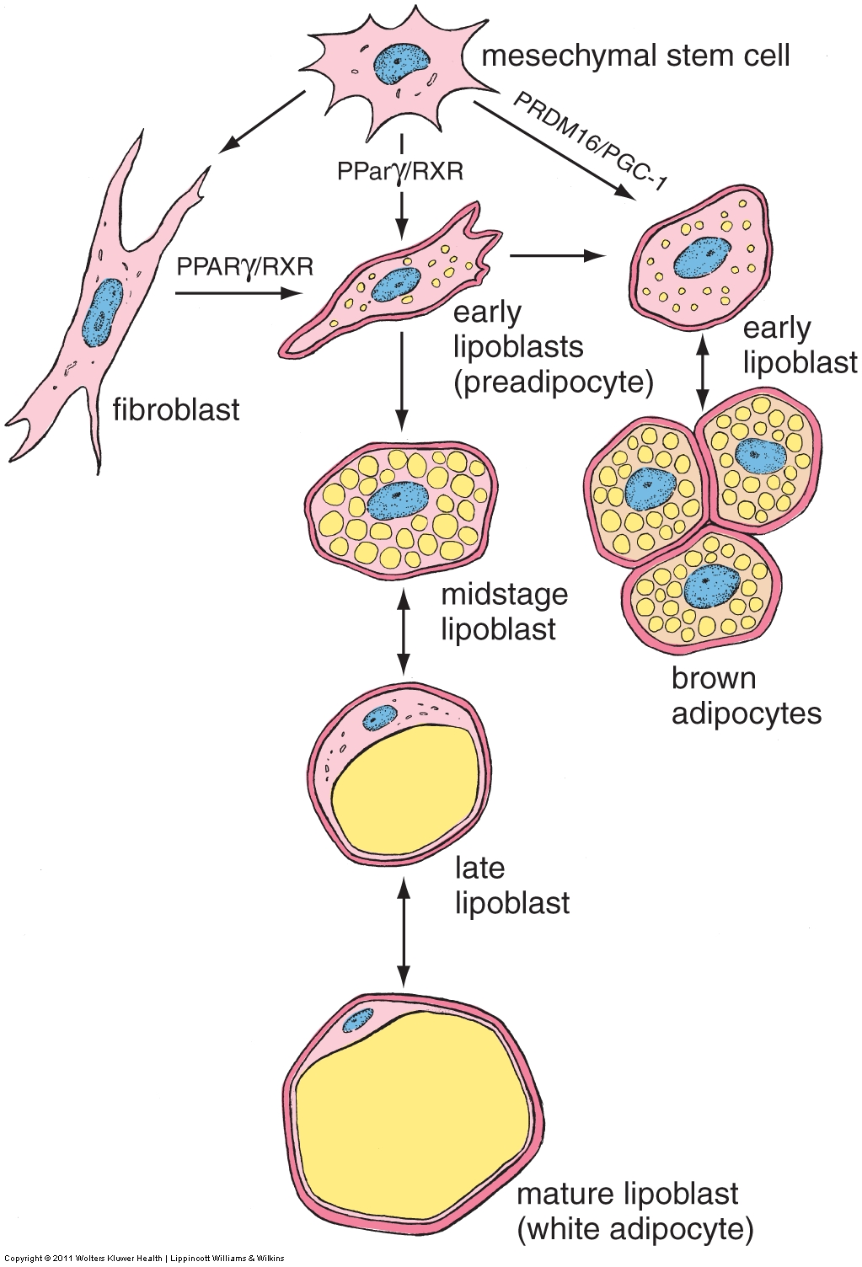
There is one caveat to the categorization of adipose tissue: Developing white fat cells are multilocular!
multilocular and unilocular Adipose tissue
As you can see in the drawing on the left, both types of adipose cells begin as multilocular. The lipid droplets in BAT remain separate, while those in WAT coalesce to form one large droplet in mature cells.
Thus, when looking at slides, it’s probably best to use the terms “unilocular adipose” and “multilocular adipose”. If you say “white adipose” or “brown adipose”, we’ll presume you mean “unilocular” and “multilocular”, respectively. You may qualify your statement by saying “either brown fat or developing white fat” if the tissue is multilocular.

Slide 12
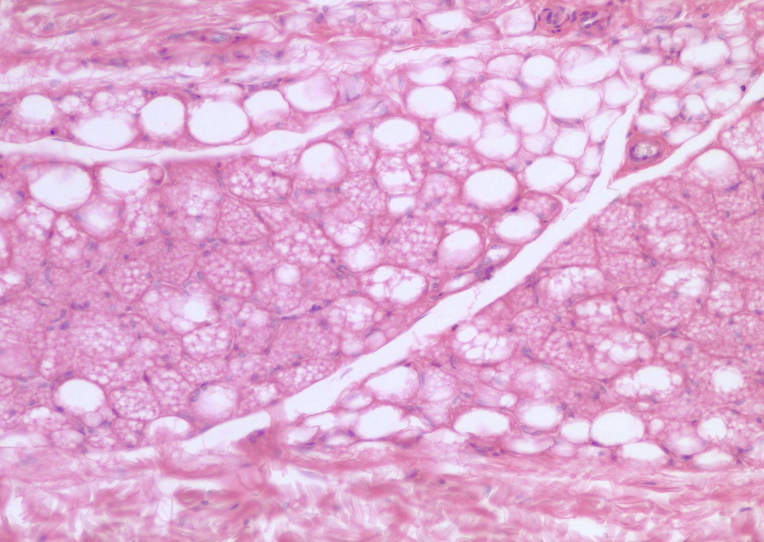
multilocular and unilocular Adipose tissue
Here’s an example of developing white fat. You can clearly see that this tissue contains both unilocular and multilocular cells. Eventually, this entire tissue will consist of unilocular adipose tissue.
As mentioned above, from a practical standpoint, you would call the area outlined in blue unilocular adipose, and the area outlined in green multilocular adipose.

Slide 13
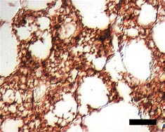
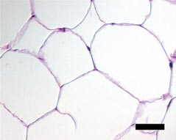
multilocular and unilocular Adipose tissue
BAT
WAT
UCP-1
As mentioned on the previous slides, when you see multilocular adipose stained with H&E, you cannot definitely say whether it is brown fat or developing white fat. However, you can distinguish the two with special staining procedures such as histochemistry. In this example, both tissues were stained for uncoupling protein (UCP-1), which shows up as brown in this preparation.
Uncoupling protein (UCP-1) is found in mitochondria of BAT cells but not WAT cells (it is not found in developing white fat either). This protein dissipates the proton gradient before it can be used to provide the energy for oxidative phosphorylation, resulting in production of heat instead of ATP.

Slide 14
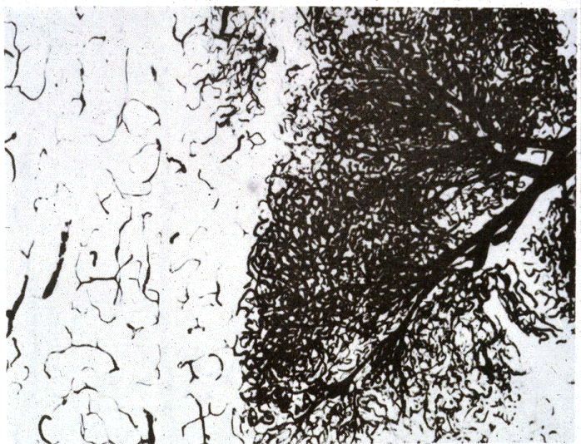
Both WAT and BAT are highly vascularized; BAT especially so.
0
Here, vessels are visualized by injection of an opaque dye
In BAT, the vasculature distributes the heat generated during arousal from hibernation in animals, or from cold- or diet-induced thermogenesis in man.
The vasculature conveys fatty acids to WAT for storage as triglycerides and, during mobilization, distributes the hydrolyzed fatty acids and glycerol to other tissues.
WAT
BAT

Slide 15
The next set of slides is a quiz for this module. You should review the structures covered in this module, and try to visualize each of these in light and electron micrographs.
Distinguish, at the light microscope level, each of the following components of adipose tissue:
Adipose tissue
Unilocular (WAT)
Multilocular (BAT and developing WAT)
Immunocytochemistry to differentiate white adipose tissue (WAT) and brown adipose tissue (BAT) in humans
Describe the distribution of white adipose tissue (WAT) and brown adipose tissue (BAT) in humans

Slide 16
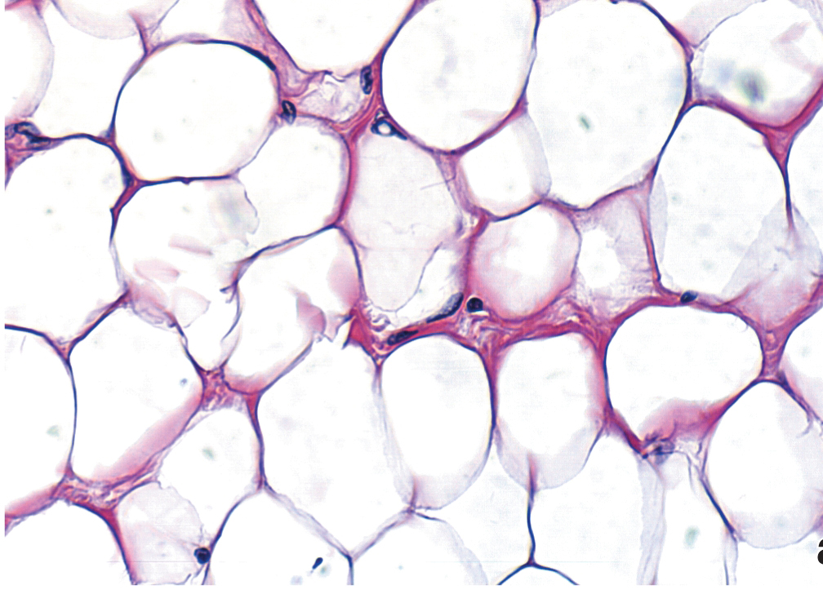
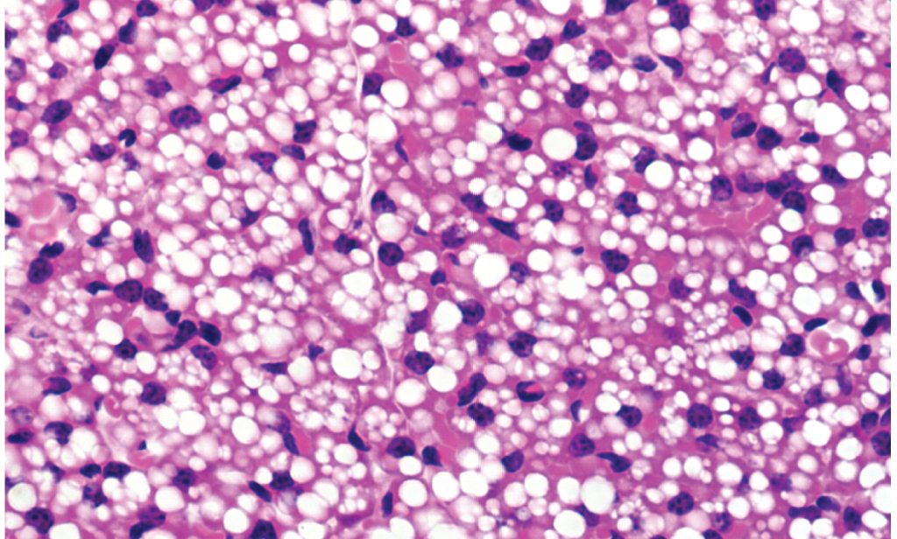
Final quiz
Self check:
Identify the indicated tissues
Upper panel =
Lower panel =
Which tissue has more blood vessels?

Slide 17
Final quiz
Self check:
Identify the indicated tissues
Upper panel = WAT or unilocular fat
Lower panel = Multilocular fat – this is BAT, but could be developing WAT
Which tissue has more blood vessels? BAT

Slide 18
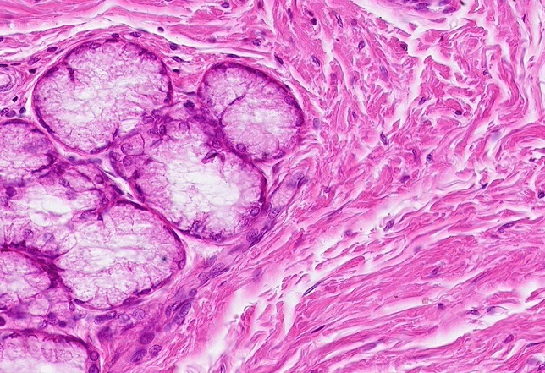
Final quiz
Self-check: Identify the outlined tissues. (advance slide for answers)
Dense irregular connective tissue
Mucus glands

Slide 19
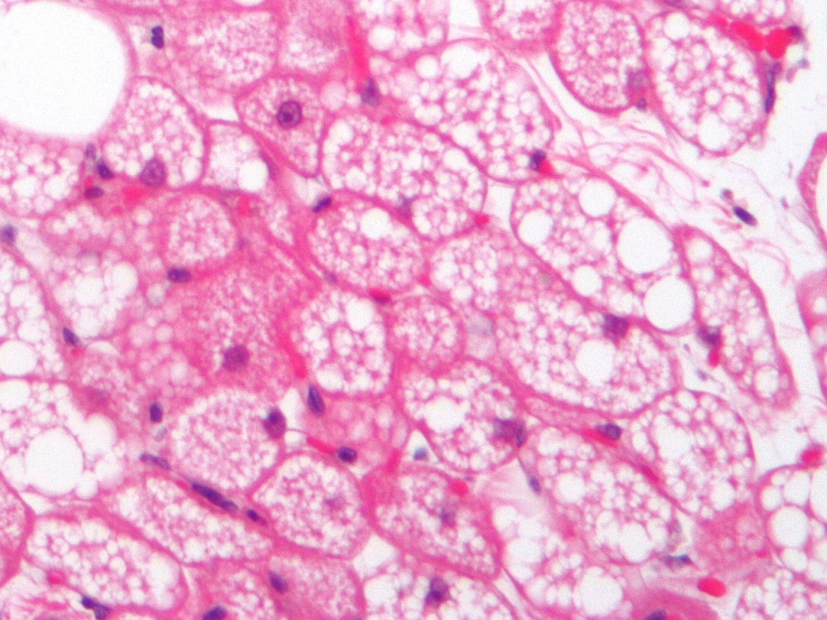
Final quiz
This H&E section is taken from a tumor called a hibernoma.
From what normal tissue is the tumor derived?
Why is it called a “hibernoma”?
Copright © 2011 Nephron. Permission is granted to copy, distribute and/or modify this image under the terms of the GNU Free Documentation License Version 1.2 ( http://www.gnu.org/copyleft/fdl.html )

Slide 20
Final quiz
This H&E section is taken from a tumor called a hibernoma.
From what normal tissue is the tumor derived?
Brown Adipose Tissue
Why is it called a “hibernoma”?
Because BAT was first characterized as being important in generating heat during the arousal of animals from hibernation.
Copright © 2011 Nephron. Permission is granted to copy, distribute and/or modify this image under the terms of the GNU Free Documentation License Version 1.2 ( http://www.gnu.org/copyleft/fdl.html )

Slide 21
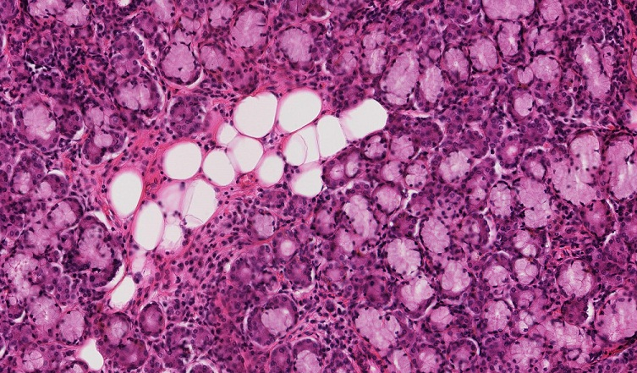
Final quiz
Self-check: Identify the outlined tissues. (advance slide for answers)
Unilocular adipose
Mucus glands

Slide 22
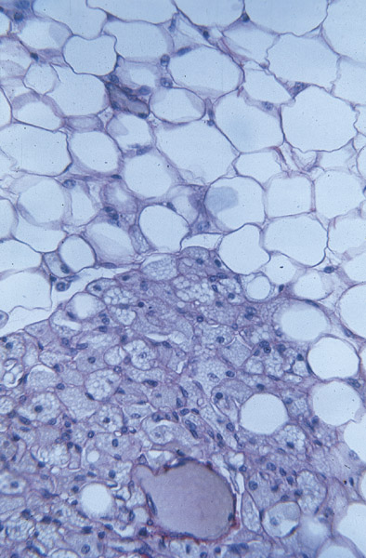
Final quiz
0
Self check: Identify the tissues indicated at left
1 =
2 =
1
2

Slide 23
Final quiz
0
Self check: Identify the tissues indicated at left
1 = WAT, or unilocular fat
2 = Multilocular fat, either BAT or developing WAT
1
2
Notes:
23

Slide 24
Final quiz
0
Self check:
How could you determine whether the indicated tissue is BAT or developing WAT?
Notes:
24

Slide 25
Final quiz
0
Self check:
How could you determine whether the indicated tissue is BAT or developing WAT?
Label sections with antibodies to UCP-1, found in mitochondria of BAT cells, but not WAT, as shown at left
UCP-1
BAT
WAT
Notes:
25

