Slide 1
Welcome! UC College of Medicine Women in Medicine & Science Chapter Meeting
With Special Guest, Dr. William Ball
Dean of the College of Medicine
January 31, 2018

Slide 2
Thank you, LEAF, for providing lunch!! AGENDA
Welcome & Introductions
Erin Haynes, DrPH
WIMS in the College of Medicine
Dean William Ball, MD

Slide 3
UC College of Medicine WIMS

Slide 4
Group on Women in Medicine & Science
Advances the full and successful participation and inclusion of women within academic medicine by addressing gender equity, recruitment and retention, awards and recognition, and career advancement.
Advocates for women’s advancement and leadership may become members of GWIMS; those members may be either from the faculty or administration at AAMC member medical schools and teaching hospitals.
https://www.aamc.org/members/gwims/about/

Slide 5
WIMS Goals per AAMC
Create a support system for other women faculty
Facilitate schedule women faculty interest meetings
Facilitate networking events for faculty and trainees
Connect with other local women’s groups in the community
Share GWIMS newsletters
Encourage mentorship for women faculty
Nominate women for awards and leadership positions

Slide 6
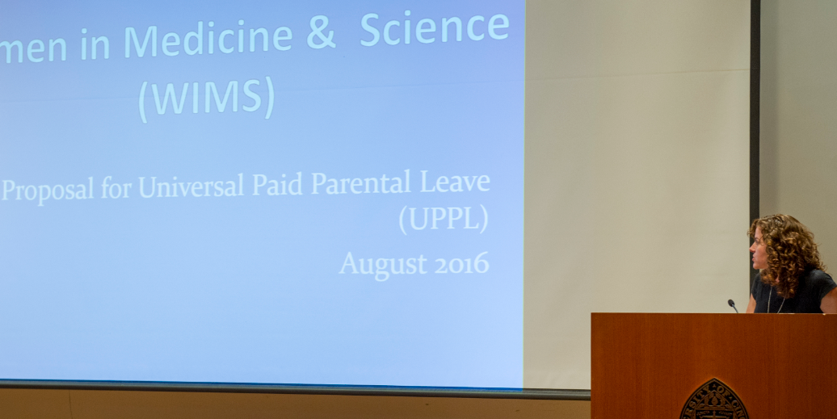
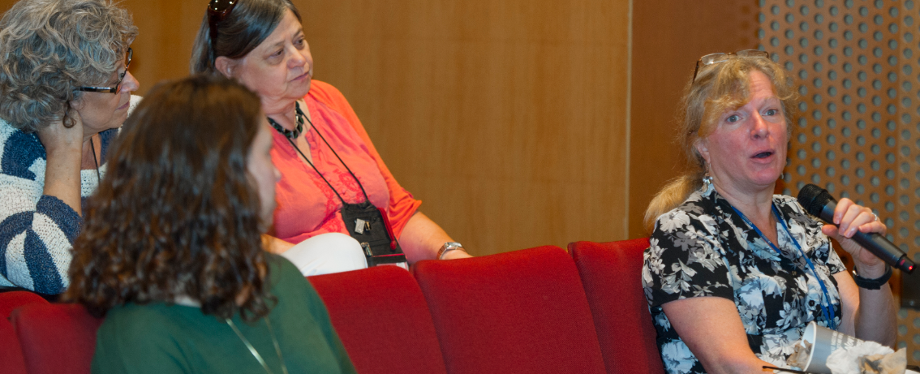
UC COM WIMS Begins! (Est. Sept 2015)
UC COM WIMS is dedicated to the recruitment, advancement and retention of all women faculty and trainees in the College of Medicine. Our overall goal is to advance the careers and leadership skills of our members.
MISSION
Be proactive and constructive in establishing and advancing the careers of women in medicine and science through encouraging growth, facilitating mentoring, providing opportunities for networking, and teaching skills necessary to achieve professional development;
Educate women on relevant UC Policies and Procedures for career development and advancement;
Enhance the work environment for women.

Slide 7
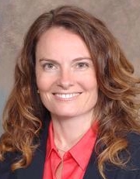
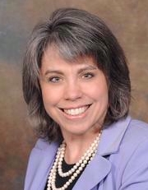
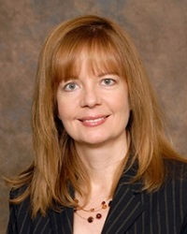
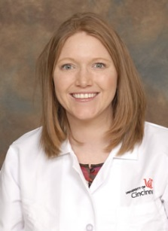
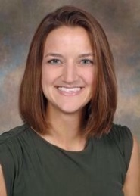
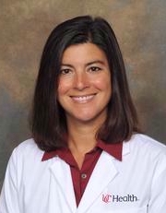
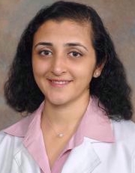
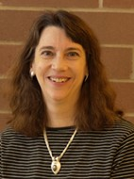
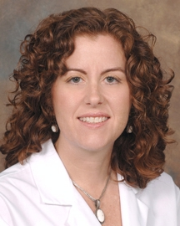
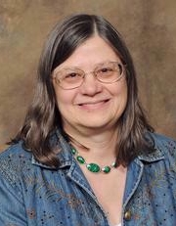
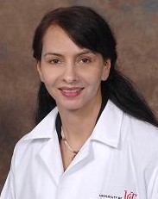
WIMS Executive Committee
Associate Dean of Faculty Development & Women’s Initiatives
Dawn Kleindorfer, MD
Professor
Department of Neurology & Rehabilitation Medicine
President
Erin Haynes, DrPH
Associate Professor
Department of
Environmental Health
President-Elect
Amy Bunger, PhD
Assistant Professor
Department of
Medical Education
Secretary
Jennifer Forrester, MD
Assistant Professor
Department of Internal Medicine
Secretary-Elect
Heather Christensen, PhD
Assistant Professor-Educator
Department of Medical Education
Treasurer
Mercedes Falciglia, MD
Associate Professor
Department of Internal Medicine
Treasurer-Elect
Vinita Takiar, MD
Assistant Professor
Department of Radiation Oncology
Basic Science Representative
Sarah Pixley, PhD
Associate Professor
Department of Molecular & Cellular Physiology
Clinical Science Representative
Jennifer Cavitt, MD
Associate Professor
Department of Neurology & Rehabilitation Medicine
Basic Science Representative
Alison Weiss, PhD
Professor
Department of Molecular Genetics, Biochemistry & Microbiology
Clinical Science Representative
Pamposh Kaul, MD
Associate Professor
Department of Internal Medicine

Slide 8
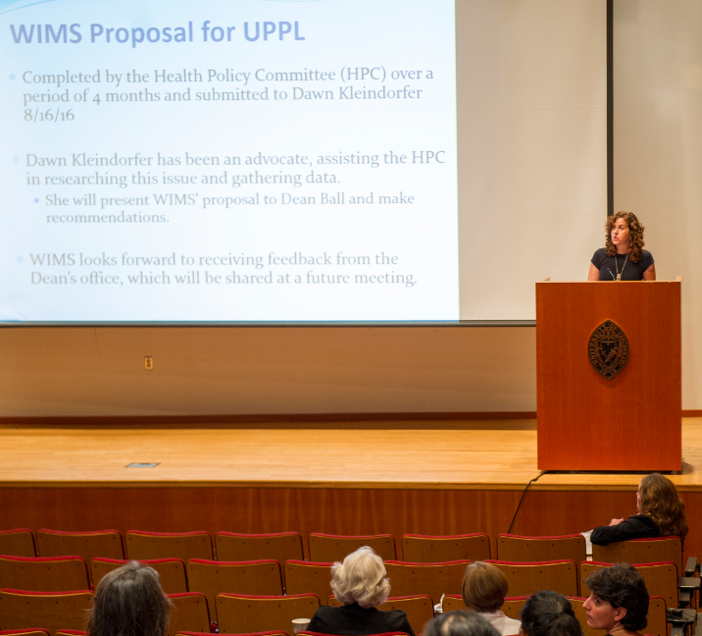
WIMS Sub-Committees
Mentoring Committee
Promote professional and personal development of women faculty members through offering mentoring services to all UC COM WIMS members.
Chair: Zalfa Abdel-Malek, PhD, Zalfa.Abdel-Malek@uc.edu
Fundraising Committee
Plan, implement, and execute all fundraising initiatives in order to solicit funds for UC COM WIMS organization.
Chair: Erin Haynes, DrPH, Erin.Haynes@uc.edu
Health Policy Committee
Addresses current and missing health policies that align with the WIMS mission and vision.
“Make UC COM the best place for parents to work”.
Co-Chairs: Jennifer Cavitt, MD, Jennifer.Cavitt@uc.edu
Vinita Takiar, MD, Vinita.Takiar@uc.edu

Slide 9
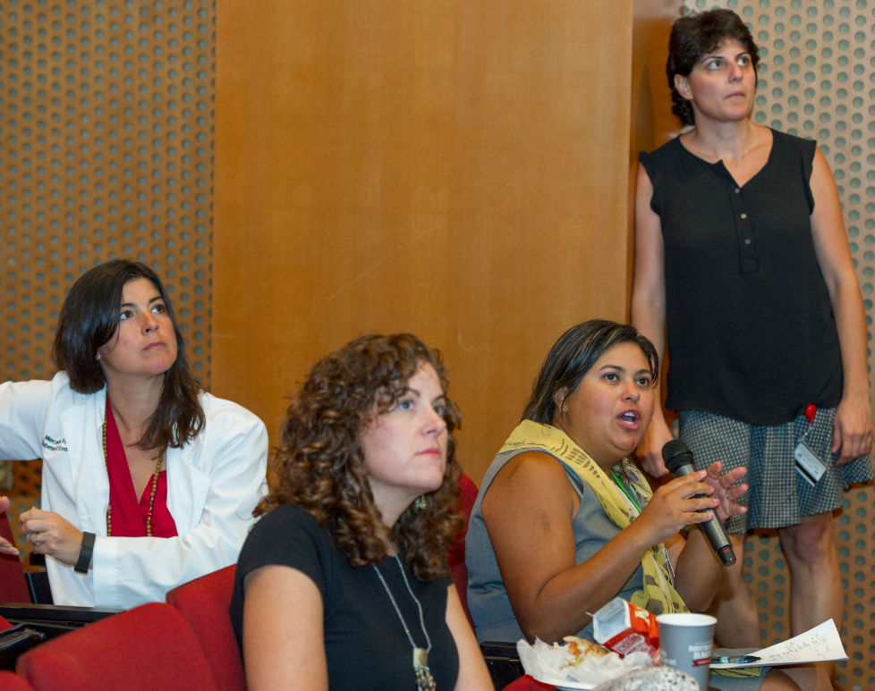
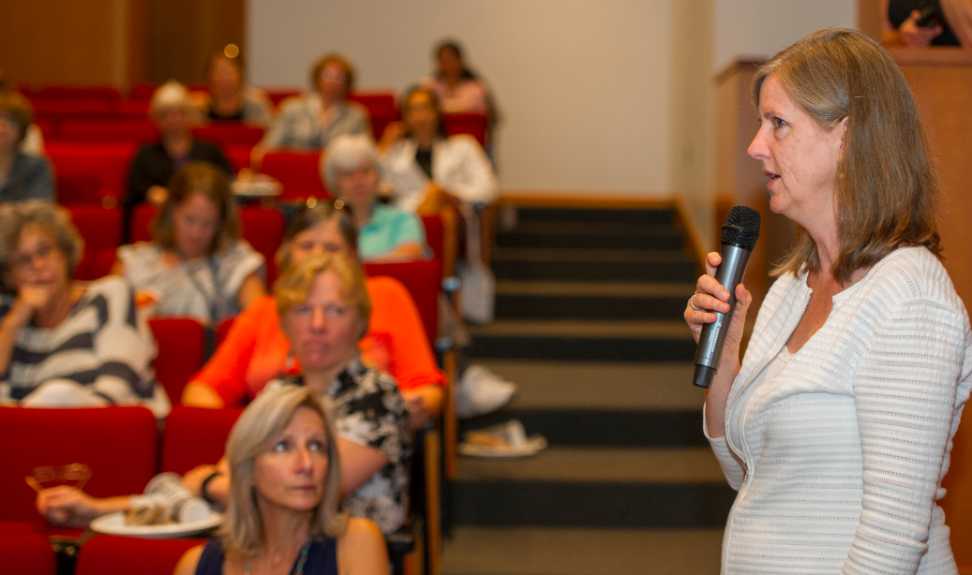
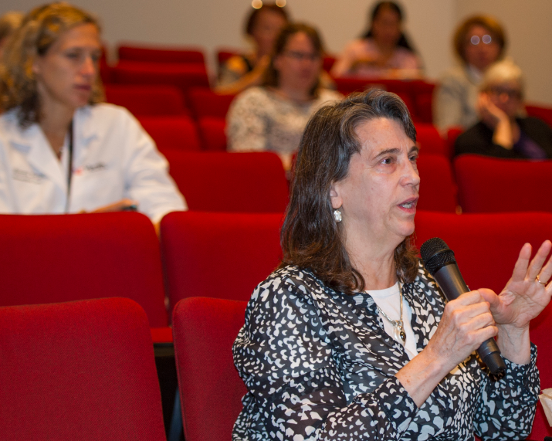
Brief Facts
Established:
September 30, 2015
Meetings:
15; entering our 3rd
Academic Year
Members:
90
Meetings funded by:
LEAF & CCTST

Slide 10
Accomplishments To-Date

Slide 11
!!!

Slide 12
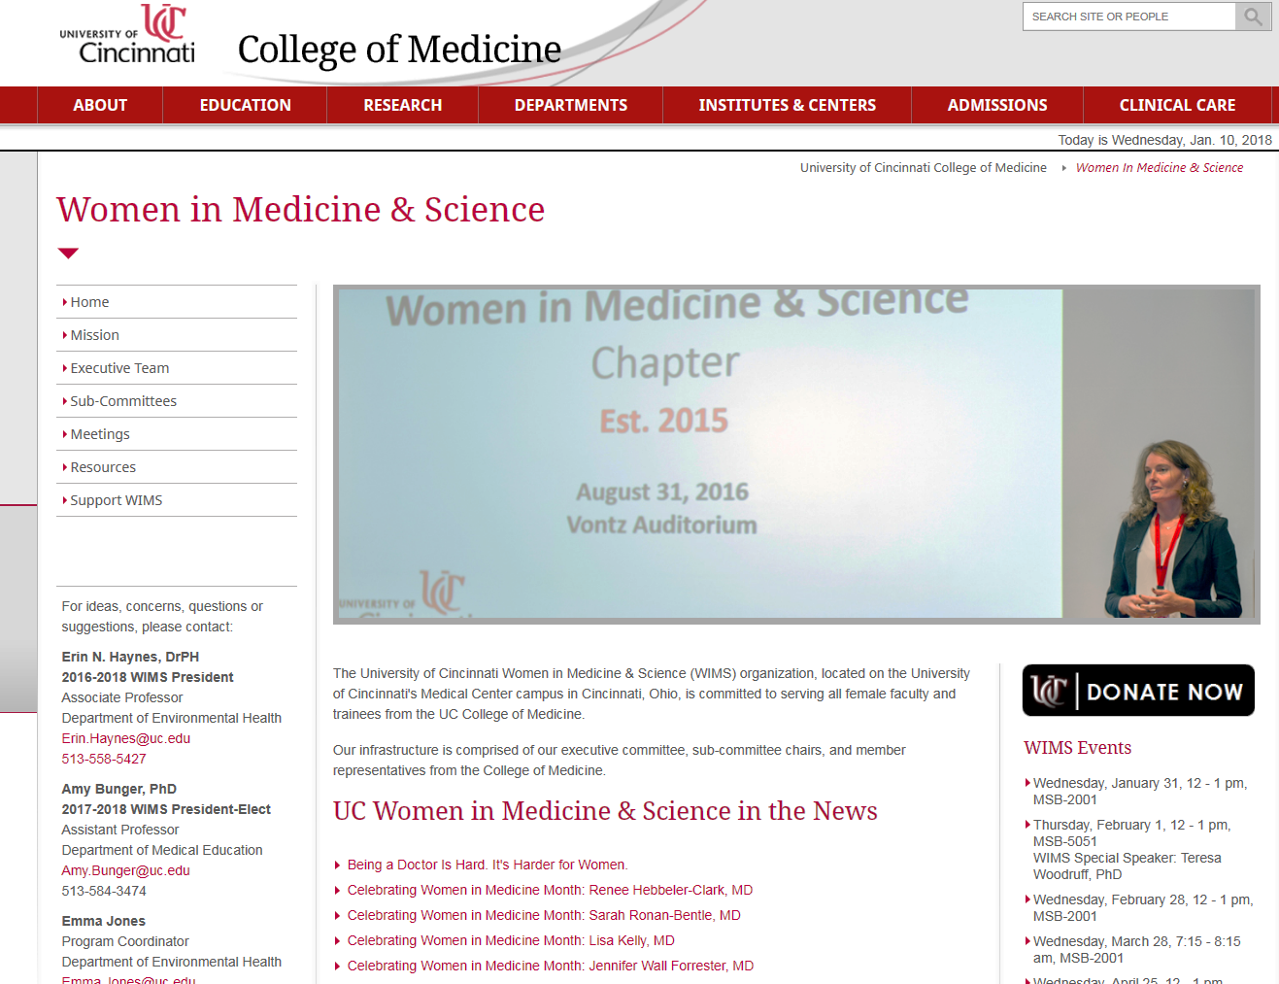
WIMS Website
https://med.uc.edu/WIMS

Slide 14
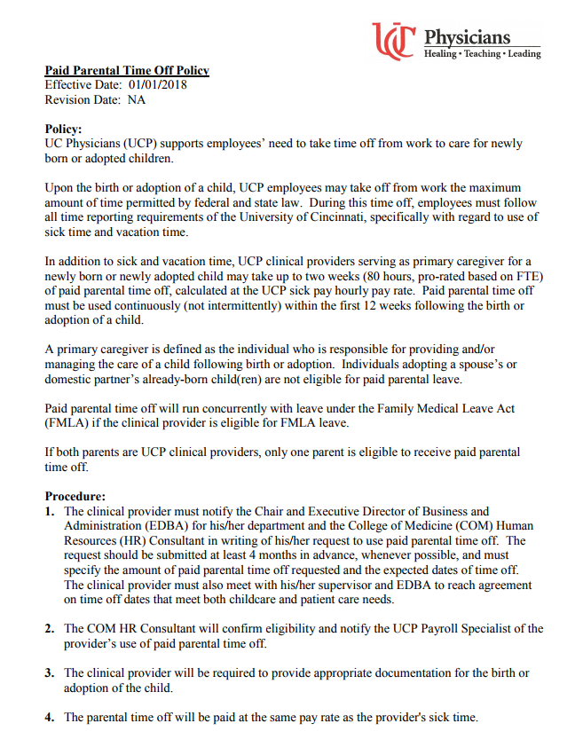
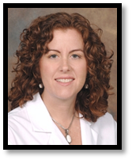
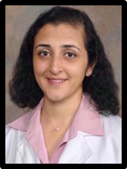
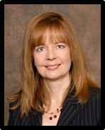
WIMS Health Policy Committee
http://files.constantcontact.com/a6e2fe00701/dd888219-63dc-48b9-8864-550aa1e18c70.pdf

Slide 16
Accomplishments To-Date, Continued…
Created a WIMS Fund (requiring $5,000 in private donations)
-UC Foundation

Slide 17
Huge “thank you!!” to the First Four Fabulous Friends of WIMS
Amy Bunger, PhD
Patricia Carey, MD
Erin Haynes, DrPH
Sarah Pixley, PhD

Slide 18
Accomplishments To-Date, Continued…
Creating Named Mentorship Awards - $50,000

Slide 19
WIMS Meetings 2018
Date/Time | Location | Topic & Speaker
Feb 1 12-1pm | MSB 5051 | 3 Breakthroughs that will Change our Lives in the Next 10 years Teresa Woodruff, PhD Northwestern University
February 28 12-1 | MSB 2001 | Negotiate Like a Girl Jane Sojka, PhD UC College of Business
March 28 12-1 | MSB 3051 | Head Games Jane Sojka, PhD UC College of Business
April 25 12-1 | MSB 2001 | Communicate with Power Jane Sojka, PhD UC College of Business
May 30 12-1 | MSB 2001 | Faculty Burnout Jennifer Molano, MD UC College of Medicine
**Note: Time of meeting has been changed.
Dr. Sojka’s talk will be recorded and posted for viewing.
Meetings -- 4th Wednesday of each month

Slide 20
Vision for 2018 & Beyond

Slide 21
WIMS wants to make positive climate impacts &
WIMS has membership to make this happen
Suggestion:
Regular communication with the Dean

