Slide 1
Telling Your Story:
Working With the News Media
Women In Medicine and Science
September 27, 2018

Slide 2
Why Work With the Media
Provide expert analysis and commentary
Help the public understand the situation
Help the media get the story right
Promote and support your institution
Get your message out
The media will get the story with or without you
Participating will help get your voice heard

Slide 3
Your Public Information Officer
Public Information Officer (PIO) =
PR Person
Communications Officer
Media Relations
Public Affairs
Establish a working relationship with your PIO
Alert them to your communications needs
Your communications needs
Trends in your field
Interview requests you receive

Slide 4
How a PIO Can Help You
Advise you on media relations
Connect you with news media
Schedule interviews
Prepare you for an interview or news conference
Gather background about a reporter or news outlet
Conduct mock interviews for you
Be with you during the interview
Monitor the media process

Slide 5
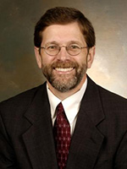
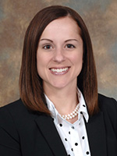
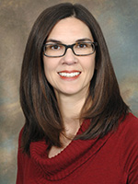
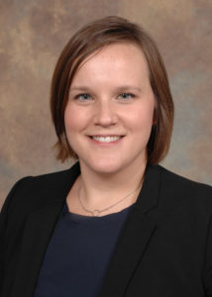
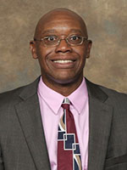
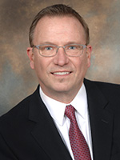
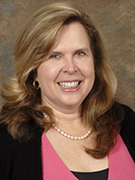
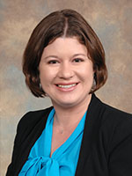
Who Are The PIOs?
Richard Puff
Kelly Martin
Alison Sampson
Katie Pence
Cedric Ricks
Bill Bangert
Angela Koenig
Amanda Nageleisen

Slide 6
How the Media Works
Reporters live on deadlines … even with the 24-hour news cycle
Reporters are just doing their jobs like you
Most are very good at their profession
Reporters are not out to get you
Most reporters care about the job they do … and want to get the story right
They truly need you as a source

Slide 7
What is News?
Anything editors and reporters feel will interest their readers and viewers
Trends
Breakthroughs
Controversy
Bad things
Anything unusual

Slide 8
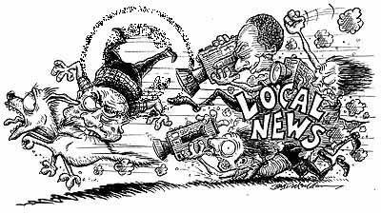
“When a dog bites man, nobody cares.
But when a man bites a dog …
now that’s news!”

Slide 9
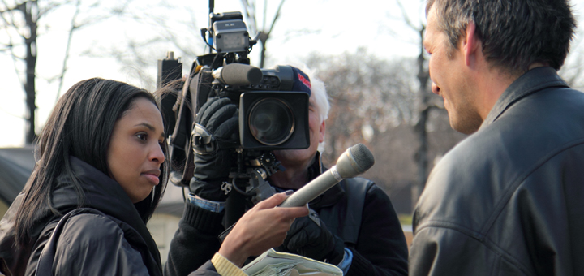
The Successful Interview

Slide 10
Interview Basics
Always tell the truth
Be prepared
It’s OK to say “I don’t know”
You can always get back to the reporter
Stay on message
Know the audience
Have a reason for being interviewed
Let the reporter know how much time you have

Slide 11
Scheduling An Interview
Please work with your PIO before scheduling an interview
They can prepare you
You don’t have to do the interview – ok to say no if the risk outweighs the reward
Keep in mind that reporters have deadlines and can’t always put off interviews for days
Reporters are generally happy to schedule their interviews
Notes:
Tell the reporter you can’t talk at that moment but will get back to them shortly. This gives you time to collect your thoughts and contact your communications office for assistance.

Slide 12
Prepare for Your Interview
Know what topic the reporter wants to discuss
Phone or face-to-face?
Broadcast or print?
Think about what you want to get out of the interview
Prepare 3 to 5 points you want to get across during the interview
Ask who else will be interviewed
Interview on your time when you are ready

Slide 13
Question and Answer
Listen to the reporter’s questions
Have a conversation with the reporter
Listen – Think – Respond
Q = A + 1
Q is the question
A is your answer
1 is a bridge to your point or agenda

Slide 14
Q = A + 1
Question: How did this error happen?
Answer: We’re not certain how it happened, but …
+ 1 : … we are still investigating the cause and will cease this procedure until we know exactly what happened.

Slide 15
Don’t …
… give personal opinions … you are speaking for your institution, not yourself
… speculate
… respond to third-party discussions
… respond to blind sources (material you haven’t seen)
… go off the record
… use jargon
… fill the silence

Slide 16
Don’t …
… speak in monotone – add inflection
… talk down to the reporter
… use non-words such as “um” or “uh”
… let the reporter put words in your mouth
… ever respond “no comment”
…speak about specific patients (HIPAA)

Slide 17
Always …
Be empathetic
Speak clearly
Use analogies …
Explain technical terms
Finish your answers if interrupted
Ask them to repeat a question if you don’t understand
Speak in conclusions and then support them with concise, quotable details

Slide 18
Always …
Be passionate and “jazzed” about what you are discussing
Say only what you would be comfortable seeing in print or hearing on air
Look at the reporter … the camera will find you
Maintain eye contact
Be confident, but not cocky
Turn off cell phones and pagers

Slide 19
At the End of Your Interview
Review your main points
Cover any items the reporter did not ask about
Ask the reporter if there’s anything they don’t understand
Remind them how to contact you again if they have additional questions
Offer to proof facts or quotes
Ask when the story will appear/air

Slide 20
When You Do An Interview …
You might be the entire story
Your comments might become an 8-second soundbite
You may headline the 6 o’clock news
You may never be mentioned by name
Your information may be used as background to guide a story in the right direction

Slide 21
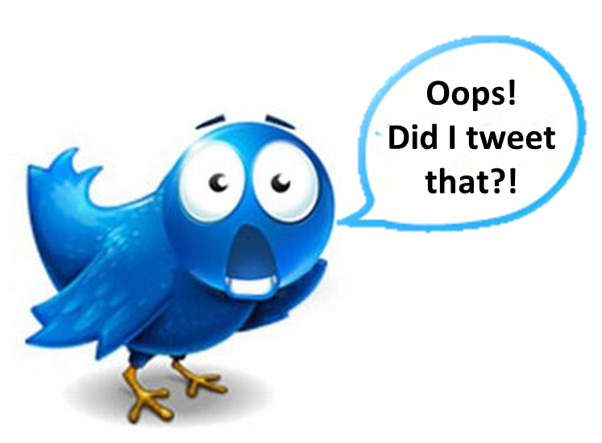
Notes:
Be careful what you put out on social media
You could be recognized as speaking for your institution when it comes to professional-related topics.
Things can go viral … quickly
You can’t always pull them back
Follow your interview rules … if you don’t want to see it in print, don’t say it.

Slide 22
Thank you!
Richard Puff
Assistant Vice President
Academic Health Center Public Relations
558-0448
richard.puff@uc.edu
@UChealthnews
Kelly Martin
Senior Director
UC Health Communications
585-5411
kelly.martin@uchealth.com
@UC_Health

