Slide 1
Research Lunch & Learn Epic Research Recruitment Tools

Slide 2
Overview
Outreach Options
Epic Options
How to decide which tool
Find Patients in Epic – Intro
Translate Protocols into Epic Data
How to request Epic tools
Working with IS+T
Contacts

Slide 3
Outreach Methods/Options
Outside of Epic
Brochures, Flyers, Letters , Bulk Mailing
Epic
MyChart – Epic Reporting Workbench
Point of Care Alert- Provider Facing Alert
Silent Point of Care Alert- Epic IB message
the best practices re Research Recruitment – which ones >??
Search Charts
Find Patients
Epic
Reporting Workbench- own search ( minimal # pts- 20 ( out 50 )
Search My Patients ( Provider)
Diagnosis
Meds
Labs
Search All Patients
Outreach Methods
MyC→ Volume key ( age appropriate) ?
(pros: speed of reach to large vol at 1 time, provides a list of contacted patients)
( now avail cell phone)
Point of Care → Provider facing
( cons: requires patient onsite to trigger) and Provider review required w patient)
( pro: target patients at point of care- Specialty Dept restricted )
E.g.: CA specialty Provider to see CA Trials
Silent Point of Care → Broad search key (non MyC users)

Slide 5
Non Epic Outreach Tools
Printed Recruitment materials (Tear pads, Flyers, Brochures, Posters, Door/Wall Clings)
Online Recruitment Options (ResearchMatch, StudyKik, TrialFacts, CCHMC Listserv, UC Health The Link Featured Study, OCR Study of the Month)
Paid Advertising (Social Media, Newspaper, Radio/TV Commercials)
Upcoming Lunch & Learn: ResearchMatch Demonstration and Recruitment Options Overview
April 2021

Slide 6
Epic Outreach tools
MyChart
Point of Care
In Basket-Silent Point of Care
Notes:
We’ll discuss the Workflow for each of these and Show you what they look like …

Slide 7
MyChart Recruitment Message
CRC will – work with OCR to identify Inclusion/exclusion criteria ( one time)
Ongoing….
CRC - run a report to send messages to potential prescreened patients
CRC- Receive In Basket messages for patient responses ( interested, declines, or both) .[Pool]
Notes:
Requires IRB Approved Patient Facing Message – which will be created by IST
The OCR will set up a Epic Reporting WorkBench Report with the Coordinator to include inclusion exclusion criteria
Then Coordinator can run the report any time, repeatedly
Coordinator will prescreen the patients in the report to pick- best matches
Coordinator will then Select the target patients and send a MyChart message
An enrollment Status of “ Contacted-Pending Response is created for the patient on the Study
Coordinators will receive patient Interested/Declined response to Epic In Basket and they can followup with patient
Coordinators should update the patient’s interested/declined in Epic – this will allow you to monitor the success of the tool to your study

Slide 8
MyChart message-Patient Facing
Notes:
When patient receives a MyChart Recruitment Message- they see an Icon on their home page in “Research” section
If they have their MyChart set to send messages to their phone- they will get a phone message that something has updated in their MyChart
When they select the Research Page- they can see the above Research MyChart Message- includes Patient Facing Description and Interested/Decline response options

Slide 9
Point of Care – Provider Facing
CRC will – work with IST to identify Inclusion/exclusion criteria ( one time)
Ongoing….
MD – will review Provider facing message with patients
CRC- Receive In Basket messages for patient responses ( interested, declines, or both) .[Pool]
Notes:
Point of Care Recruitments are Provider Facing BPA Alerts
To set this up
Coordinator works with IST to create the Alert Trigger with desired Inclusion/Exclusion Criteria
Once in Production… The Provider ( typically MDs) will be able to see the Alert that the patient is a potential candidate for the specific Research Study
The MD will review the “Provider Facing Description” with the patient and select the patients Interested/Declined response ….see image on next slide

Slide 10
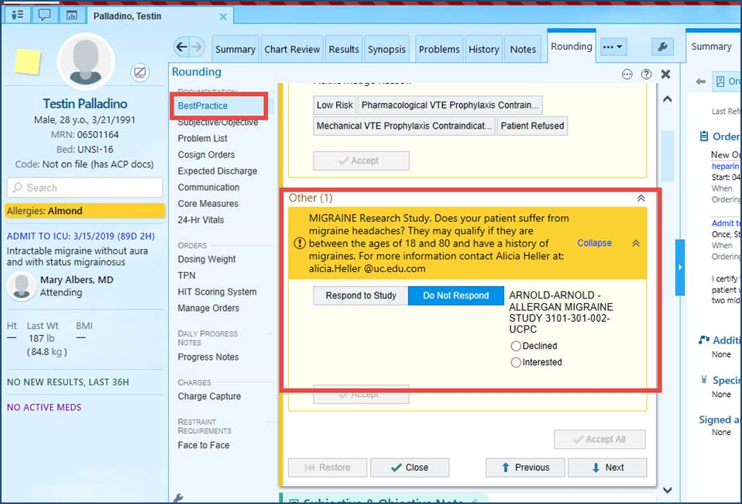
Inpatient-Provider Facing- Rounding
Notes:
Inpatient Provider Workspace shows BPA Alerts in the Rounding Activity

Slide 11
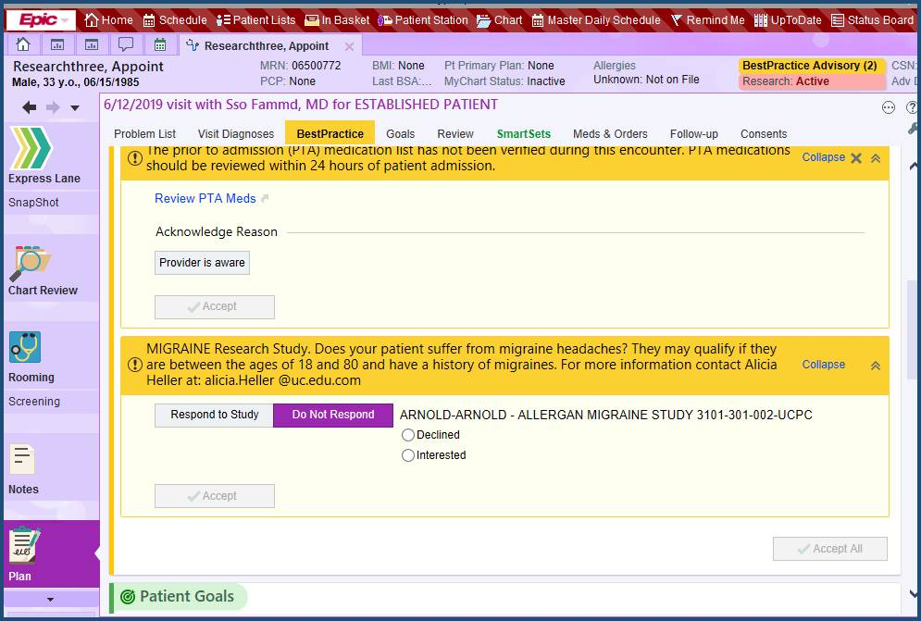
Point of Care- Provider facing – Plan Activity
Notes:
Ambulatory Providers see the BPA Alerts/Research Point of Care Alerts in the Plan Activity during a Office Visit

Slide 12
Silent Point of Care – IB Messages
CRC will – work with IST to identify Inclusion/exclusion criteria ( one time)
Ongoing….
System – will send IB message when onsite patient chart is opened
CRC- Receive In Basket messages for patient responses ( interested, declines, or both) .[Pool]
Notes:
“Silent Point of Care” is Similar to “Point of Care” –
Inclusion/Exclusion patient criteria are setup
The Alert is set to Trigger when a particular chart Activity is opened
But …the Alert Never presents to the Provider - rather the “System” auto sends a Epic In Basket Message to the Coordinator (Pool)
When the patient chart Activity is opened during the encounter
Research Recruitment Message might say….”Potential Candidate for XYZ Study “
Coordinators can then Followup with the patient and update Epic with the patient’s enrollment status

Slide 13
In Basket Research Recruitment Messages
Notes:
Managing Messages in In Basket is important to keep the volume down
Sending to “Pools” is recommended – A Pool is an In Basket “Group” that several coordinators can access
They can be setup for your “Team”- Cancer Team 1 Cancer Team 2 – then multiple study recruitment messages can go to that Pool and you can monitor several studies from the same Pool
When Coordinators leave or are added to your team- they simply need to check themselves into or out of the “Pool”

Slide 14
My Chart Point of Care
Submission is reviewed by OCR- bi weekly
IRB Approved Pt Facing message / HIPAA waiver submission
Approval of final Message built by IST team
MyC- Work with OCR regarding Inclusion /Exclusion Criteria Report used to send messages to patients
CRC- Running Reports → creates Enrollments status_ contacted response
CRC- IB Pt Message responses are reviewed
CRC- Maintain pt status in Epic can
PDF ( Find Patients Report)
Submission is reviewed by OCR- bi weekly
Provider Facing message - with study description
Approval of final Message built by IST team
POC- Work with IST regarding Inclusion/Exclusion Criteria used to trigger messages to patients
Approve final build.
CRC- IB Pt Message responses are reviewed
CRC- Maintain pt status in Epic can
PDF ( Find Patients Report)
Notes:
The process for requesting Epic Recruitment Tools is identical
The completion of the build is slightly different
MyChart- Recruitments- you will work with IST- for Patient Facing Description – then with OCR to specify the Inclusion /Exclusion Criteria for the final report that you will use to search patients and selectively send the Messages
Point of Care /Silent Point of Care- you will work entirely with IST who will set the Alert into Production

Slide 15
How to Decide Which Tools…………. General Considerations
Patients Base (know your patients and when to capture them)
Admitted vs recently discharged
Ambulatory setting
Age
Provider Base (have you worked with your provider?)
Are they aware of the requested tools? This will increase tool success.
Study Duration
Urgency /Prioritization
Do NOT cut and paste in the inclusion/ exclusion criteria
Notes:
Lots of things to think about- what's the best way
Rule 1- everything IS flexible
Rule 2- if first tool does not yield results- others can also be considered
That said …..
Consider
Patients:
where it is used- On-site patients? – Does the patient need to present a result that requires Immediate intervention ?
Is the patient a likely MyC user – demographics
Providers:
Who will see it first- will the Facing Providers be Familiar with your Specialty and can they comfortable/successfully speak to patients about your studies ?
Other:
Number of patients you are seeking- and how quick are they needed (Study recruitment period) – only 3 month recruitment period and large number? → My Chart?

Slide 16
How to Decide which tool to use ….
Recruitment tool
MyChart
MyC Active?
Age, Demographics
Need to quickly reach out to large volume of patients
Point of Care
Patient will be onsite
Silent Point of Care
Provider will review with patient
Age (patient age is NOT appropriate for MyChart)
Large patient volume
Notes:
MyC→ Is Volume key ? Is patient MyC appropriate ?
pros: speed of reach to large vol at 1 time,
provides a list of contacted patients
now avail cell phone
Can repeat recruitment efforts by simply re- running the report
Considerations : requires patients active on MyC
Point of Care → Provider facing
pro: target patients at point of care- Specialty Dept restriction is recommended – ( E.g.: CA specialty Provider to see CA Trials
considerations: requires patient onsite to trigger
requires Provider to review w patient
Silent Point of Care → Triggers In Basket Message to Team Pool
pro: Can target broader facility that specialty department
Useful for patients who may not be appropriate for MyC
Considerations: Requires patient onsite to trigger

Slide 17
How to Decide which tool to use ….
MyC→ Is Volume key ? Is patient MyC appropriate ?
pros: speed of reach to large vol at 1 time,
provides a list of contacted patients
now avail cell phone
Can repeat recruitment efforts by simply re- running the report
Considerations : requires patients active on MyC
Point of Care → Provider facing
pro: target patients at point of care- Specialty Dept restriction is recommended – ( E.g.: CA specialty Provider to see CA Trials
considerations: requires patient onsite to trigger
requires Provider to review w patient
Silent Point of Care → Triggers In Basket Message to Team Pool
pro: Can target broader facility that specialty department
Useful for patients who may not be appropriate for MyC
Considerations: Requires patient onsite to trigger

Slide 18
Finding Patients in Epic
Epic is like a File Cabinet System with patient data stored in discrete files and connected
To Find patients that meet specific criteria we need to …..
Define the Patient criteria that is stored in discrete fields
Search the discrete data
Notes:
Sample of Discrete Data: -
Balance search results with mix of specific and narrow
Diagnosis= ICD 10 Code (Narrow scope) - on Problem List OR on Medical History
Diagnosis Group= list of related ICD 10 Codes ( broad scope) – on Medical History , problem List
Lab Component = Potassium > 5.5 mmol/L in last 60 day
Medication Name = Metformin ER 500MG Tablet Extended Release 24H ( narrow specific)
Medication Pharmaceutical Class = Antihyperglycemi ( broad scope)
Medication Generic Name = Metformin HCL ( broad scope)

Slide 19
Notes:
Epic Data File Cabinet- EPT (Patient Record) → connects to numerous File Drawers that contain discrete data

Slide 20
Discrete Data ….
Balance search with mix of specific ( narrow) and broad
Diagnosis
Diagnosis= specific ICD 10 Code (Narrow scope) - on Problem List OR on Medical History
Diagnosis Group= list of related ICD 10 Codes ( broad scope) – on Medical History , problem List
Labs
Lab Component = Potassium > 5.5 mmol/L in last 60 day
Medications
Medication Name = Metformin ER 500MG Tablet Extended Release 24H ( narrow specific)
Medication Pharmaceutical Class = Antihyperglycemi ( broad scope)
Medication Generic Name = Metformin HCL ( broad scope)
Notes:
Sample Discrete Data
Diagnosis= ICD 10 Codes – get some from PI and work with IST to look at Lists of Codes or “Diagnosis Concepts” which are very large lists of related diagnoses
Labs Results are called “Lab Components” – get a sample of Labs in which the component might be included – (i.e. K+ component is included in Potassium Order and BNP Order
Medications- are very specific in Epic- so a 50mg does is separate from a 25mg does medication order – get a sampling

Slide 21
Translate Protocols to Epic Data

Slide 22
Translating Protocol into Discrete Data Criteria –typical criteria

Slide 23
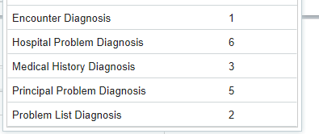
1-Diagnosis Options- types, where +when
4 types:
Consider when a Diagnosis is placed..
Encounter- current encounter at end /after visit when MD is completing charts
Hospital Problem- current encounter
Principle Problem- current encounter ( e.g. Main problem of Admission/encounter)
Medical History- any encounter- Active and Resolved Problem list Dx
Problem List- any encounter- Active
Notes:
Keep the Workflow in mind as you select which type of diagnosis we should query
Encounter Diagnosis is typically entered to the chart- at the end of the visit sometimes for Appointments- its even after the pt has walked out the door – so if a new Diagnosis gets added after the pt leaves- this wont trigger the pt
Medical History- includes Active and resolved problems
Problem List – actives only- but the Providers are responsible for maintaining these- if they don’t “resolved” the problem- the patient may show they have an active Problem- when in fact- it was resolved
It is possible to target any combination or All of these

Slide 24
Diagnosis- ICD-10 ( Specific )
Notes:
We must identify specific Diagnosis Codes to search a patients inclusion/exclusion diagnosis
Balance your search – specific v broad
Your PI may know the exact ICD codes most commonly used
Specific Diagnosis- you can target a specific ICD-10 – but if many are used then we might also potentially miss patients
Flexible to change

Slide 25
Diagnosis Groupers- (Custom Specific list)
Notes:
We can create a list of specific Dx codes
Your PI may know the exact ICD codes most commonly used
Flexible to change

Slide 26
Diagnosis Concept
Notes:
We can also use…..”Diagnosis Concepts” – these are Groups of ICD 10 codes common to a type of Diagnosis-
When using a concept grouper- you will get a more broad reach than listing a few specific Dx
Results- some patients will match what’s in the concept list – that wont match what you want
Your PI may know the exact ICD codes most commonly used
Flexible to change

Slide 27
2-Medications Options
Specific Medication- as ordered by the MD- sample patient is helpful
Medication Grouper- list of several specific medications
Generic Mediation Search - every Medication has…..
Simple Generic Name of Medication
Pharmaceutical Class of Medication
Pharmaceutical subclass of Medication
We can assist in determining these if we have a Specific Medication
Work with your PI for sample medications in Epic- IST can work with you to ID Generic Name and Pharm class
Notes:
Epic Medication orders are extremely specific
All Medications include a Specific Order ID and…….within that the following…….
Simple Generic Name of Medication
Pharmaceutical Class of Medication
Pharmaceutical subclass of Medication
Your PI may know if he wants to target specific medications or a pharmaceutical Class or subclass
If you have a specific Medication Order identified- we can look up the Single Generic Name for all such meds or the pharm class

Slide 28
Medication- Specific – there are many Lasix meds
Notes:
Sample – Lasix has 24 specific medications in Epic
Its part of the Pharmaceutical Class know as Loop Diuretics- we could use Loop Diuretics as an Inclusion or exclusion criteria

Slide 29
Lab Results – K+
Lab results are components
K+ potassium result - may be included in more than one order
Orders: K+, Renal Panel
Ambulatory order v IP Order
If you are wanting as many K+ values as possible ask you PI what labs would be typical to find this component-
IST will then determine the actual Result Component names
Notes:
If you want a Result component of K+ for example keep in mind that a lab result component may be included in numbers “Lab Orders”
a) a Potassium order-
b) a Renal Panel Order
Because differing Lab Orders contain similar components and are resulted by difference Lab Agencies – our lab Orders may have differing “Lab Component Names”
It is most helpful when wanting a Lab result Value- to get a list of Lab Orders that are likely to include the result you are looking for-
IST can then assist in being sure to include all the “Lab Component Names” in our inclusion/exclusion criteria

Slide 30
Flowsheets- BMI
If you are wanting flowsheet data documented in a chart- let us know Where it is documented in the chart ( finding a sample patient with the data is helpful )
We can help translate this to the exact Flowsheet row/ discrete data item
Notes:
If you are wanting flowsheet data documented in a chart- let us know Where it is documented in the encounter
We can help translate this to the exact Flowsheet row/ discrete data item

Slide 31
Finding Patients in Epic Database
Methods:
CHI- ( SQL search) –Extract patients- has access to our data base for data extraction
Epic Reporting Workbench- Extract patients -for Epic operational purposes- to allow actions
AMB Manager Followups- Patient Base- My Patients ( typically )
IP Manager Compliance Monitoring , monthly reporting
Operational
Epic Slicer Dicer – Extract overview of populations in our database with XYZ criteria
Analytic- How many patients in DataModel…?

Slide 32
How to Request Epic Tools
New study
Place a request in Redcap
https://survey.uchealth.com/redcap/surveys/?s=RJXFKLN3C7
Ongoing study
Place a request in footprints
See Job Aide
Start at UCH Intranet Home Page
Note: IRB approval must be provided prior to going live.
Requests received are reviewed Bi Weekly on Thursdays OCR Approval Team( OCR/IST)

Slide 33
IS+T Service Request …start point UC Health Intranet Home Page

Slide 34
Working with IS+T
Epic tool request are reviewed every other Thursday
Items reviewed:
Number of patients needed
Inclusion/Exclusion criteria
Desired method consistent with nature of tool and effort of custom build
Request approved- building can start
Request denied- study will be notified build was denied and why.
Other options can be suggested.
To ensure timely completion of request, please respond timely to email questions.
Point of Care -builds take longer to complete than MyChart builds.
Approvals – email communications will occur throughout the build process for approval.
Please note: IS&T will attempt to follow up with ticket submitter 3x prior to closing ticket due to no response.
Priorities: FIFO
Expectations – both CRC and IST – start effort delivery - what to expect when working with IST
Start Stop Response times
Que
Simple statement: Submission and Approval Process / Review/Work validate details/ ( Bi Weekly review)
We request timely followup to ensure requests started are completed timely
Estimated Start Date:
IST Policy – 3x followup

Slide 35
Q+A
Questions?

Slide 36
Contacts-IS&T/Training
UC Health Epic support for Research
Epic IST Analysts:
Akke Wheatley Akke.wheatley@uchealth.com
Emily Ledney Emily.ledney@uchealth.com
Epic Trainers
Connie Stiles Connie.Stiles@uchealth.com
Angie Maccani Angie.Maccani@UChealth.com
( Training Depart: 585-MYTD)
Users may also contact us through the help desk (585-MYPC)
ask for any of the above resources by name

Slide 37
Contacts-OCR
Office of Clinical Research
MyChart- Requests/Reports :
Miranda Gulasy
Clinical Research Recruitment and Sponsor Relationship Administrator
ResearchMatch Liaison
t (513) 585-8215
c (513) 256-8906
miranda.gulasy@UCHealth.com
General Inquiries :
Nathaniel L Harris
Clinical Research Compliance Administration,
Education and Training
t (513)585-5410
c (513)331-1912
Nate.Harris@UCHealth.com
Zachary Johnson
Clinical Research Operation
Zachary.Johnson@UCHealth.com

