Slide 1
MyChart Recruitment

Slide 2
Accessing Report
1
2
3
Navigate to My Reports (can be accessed on toolbar or by searching “reports” in top right search bar)
In the Library tab, enter report name or ID # provided to you by the OCR (make sure to deselect “reports I own” under “Filters” on the right side of screen)
Run report

Slide 3
Find Patients
2
4
3
1
Confirm patient eligibility from the list
Apply filters if necessary
Select patient(s) for the study (Ctrl + click or Shift + click to multi-select)
Click “Send Recruitment Request”

Slide 4
Send Messages
1
2
3
Select study name (search PI last name or study short name and click magnifying glass)
Confirm patient facing message (provided by study team during setup, IRB approved)
Click “Accept” to send messages

Slide 5
Patient Facing Message

Slide 6
Responses
1
Responses come to inbasket in the “Research Recruitment” folder

Slide 7
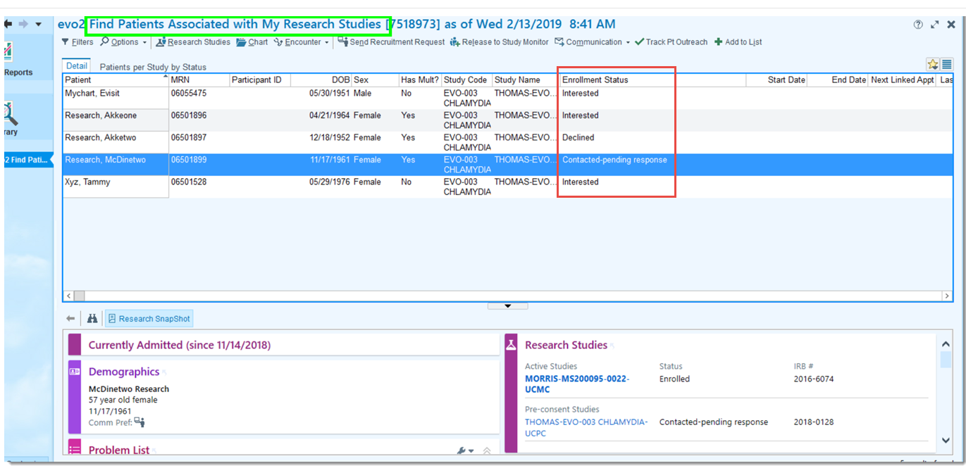
Track Patient Response
1
2
Use the “Find Patients Associated with My Research Studies (New)” report to track patient response
Patients are associated to the study in Epic as contacted-pending response, interested, declined depending on response

