Slide 1
Medical Student Scholars Program (MSSP)
Amy Guiot, MD, MEd
Director, MSSP, Electives, Intersession
Director, Pediatric Acting Internship and Electives
Associate Director, Pediatric Clerkship
Gina Burg
Program Director, UCCOM - Office of Medical Education
Medical Student Scholars Program
M3/4 Curriculum Support

Slide 2
Medical Student Scholars Program (MSSP)
PURPOSE:
To provide highly motivated students with a unique opportunity to explore a medical specialty in depth throughout their four years of medical school with a summer research experience culminating in publication and/or presentation.

Slide 3
MSSP Outcomes
Engage in preceptor-supervised educational experiences to expand fund of knowledge and skill set within a circumscribed area of interest longitudinally across M1 – M4.
Partake in clinical and didactic activities
Participate in scholarly research project
Present and publish scholarly work
Achieve designated MSSP Scholar at Honors Day (Graduation)

Slide 4
MSSP Tracks
Cardiovascular medicine
Child and adolescent health
Emergency medicine
Family Medicine
Geriatric health
Nephrology
Neuroscience
Psychiatry-behavioral neuroscience
Women’s health
Pulmonary
Summaries of each track can be found here: Medical Student Scholars Program

Slide 5
Min MSSP Requirements over 4 yrs
Didactic – 15 hours
Lectures/ conferences
Journal club
Specialty interest group meeting
MSSP group meetings
Other
Clinical
Shadowing – 10 hours
M3 specialty elective if applicable
M4 Elective
Scholarship – 200 hours
M1/2 Summer Scholarly Project
Research 101 course
Service / Leadership – 10 hours
Volunteer
Committee Member
Leadership roles
Mentorship

Slide 6
M1 Minimum Requirements
Participate in two “activities” per month averaged over a six month time period – any combination of above didactic, clinical, shadowing, service/leadership.
Meet a minimum of one time over the course of year one with their mentor
Complete the online course Research 101 prior to starting the summer research project.

Slide 7
Summer Research between M1 and M2
Research opportunity during the summer between M1 and M2
Minimum of 200 student work hours for research project
Culminate in a final project and at minimum be entered in the M2 Fall November Research and Service Symposium and/or M2 Spring research symposium of their choosing
Students should strive to present at local, regional, or national conferences.
Students should strive to publish.

Slide 8
M2 Minimum Requirements
Participate in two “activities” per month averaged over a six month time period – any combination of above didactic, clinical, shadowing, service/leadership.
Meet a minimum of one time over the course of year one with their mentor

Slide 9
M3 Requirements
May require students to participate in a specialty two week elective during M3. (CICU, MICU, EM, Geriatrics)
Students will be given priority to the specialty elective.
Continue mentoring at least twice/year for research and planning of M4 or residency

Slide 10
M4 Requirements
Complete minimum of two week with most MSSPs requiring four week clinical elective work in an area related to the track.
Students will be given priority to the elective.

Slide 11
MSSP Honors Notations
Students who successfully complete all MSSP requirements will have the MSSP distinction mentioned during the award of their medical degree at the College of Medicine’s Honors Day ceremony.
Students may comment in the noteworthy characteristic on the MSPE of their success with the MSSP
Students may utilize the honors section of the ERAS application to share their MSSP experience

Slide 12
Financial Support
Sponsoring departments are encouraged, but not required, to provide financial support for students participating in the summer component of their track.
All departments so far have provided summer stipends

Slide 13
Academic Expectations
Maintain good academic and professional standing to move on from year to year in the MSSP.
In the event that a student participating in the MSSP experiences academic difficulty at any time, consideration of withdrawal will be discussed with the MSSP director, student, and possibly advisor in the office of student affairs.

Slide 14
Enrollment
Variable number of students selected for each track
Students are selected by Jan 1 of M1 with clinical activities and mentoring spanning all 4 years and research during M1/M2 summer.
Students will be required to log all MSSP “activities” in MedOneStop

Slide 15
MSSP 2020 Enrollment
MSSP | Enrolled 2020
Cardiovascular Medicine | 1
Child and Adolescent Health | 29
Emergency Medicine | 3
Family Medicine | 8
Geriatrics | 7
Nephrology | 2
Mental Health – Psychiatric Behavioral Health | 9
Neuroscience | 19
Pulmonary | 1
Women’s Health | 6

Slide 16
Selection Process
Students apply via MedOneStop
Application opens August 24th
Submission deadline date October 8th
Decision date before January 1
Applicants can apply to two programs marking first and second choice
Applications are reviewed by individual MSSP departments to determine which candidates to accept
Applicants are interviewed by usually more than the MSSP director (i.e. co-director or committee)

Slide 17
Application
Very simple
After August 24th, Go to MedOneStop where majority/all of medical student information housed
Click on extracurricular tab
Click on MSSP Application/Tracking
Click on Apply Now and all contact information is automatically uploaded

Slide 18
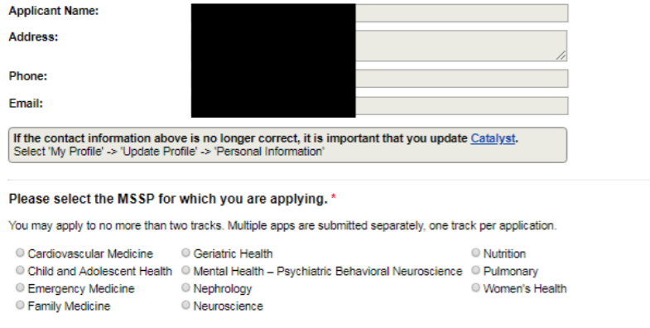
Application

Slide 19
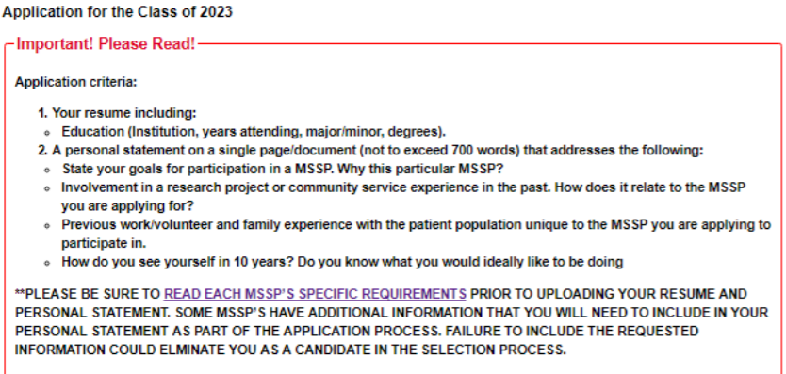
Application Instructions

Slide 20
Application

Slide 21
More information
August 24th at noon for more scoop at the MSSP /Student Director, Informational Session. This will be held as a hybrid event, you can attend in person (Kresge) or login to the WebEx from a different location. The session will be recorded!
Application instructions will be emailed after the informational session
Any other general questions please email amy.guiot@cchmc.org and Gina Burg gina.burg@uc.edu
Thank you!!

