Slide 1
UC College of Medicine Center for Addiction Research (CAR) Summer Speaker Series
Sponsored by: Center for Clinical & Translational Science & Training
July 10, 2024
12:00 – 1:00PM
This event is being recorded.
Participants can enable captions in the taskbar under more.

Slide 2
Center for Addiction Research (CAR)
The CAR was launched in October of 2020
Mission: to support cross-disciplinary collaborations across UC as well as with community partners, governmental institutions, and other academic institutions in order to accelerate scientific progress in addiction prevention and treatment
Twenty-nine faculty from six UC Colleges
CAR Website: https://med.uc.edu/institutes/CAR/home

Slide 3
CAR Website
Publications: https://med.uc.edu/institutes/CAR/publications
Projects:
https://med.uc.edu/institutes/CAR/projects
Communications:
https://med.uc.edu/institutes/CAR/communications
To become an affiliate member:
https://med.uc.edu/institutes/CAR/car-member-registration

Slide 4
The COM CAR Summer Speaker Series
Supported by an award from the Center for Clinical & Translational Science & Training
Thank you to Jen Rowe for planning assistance.

Slide 5
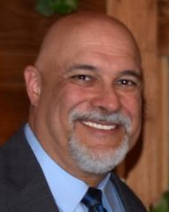
The COM CAR Summer Speaker Series
Special thank you for operational assistance from:
Jermaine Fields – UI/UX Lead, UC DTS Application & Software Development/ COM Web Development
Todd Schutter –Multi-Media Coordinator, UC DTS COM

Slide 6
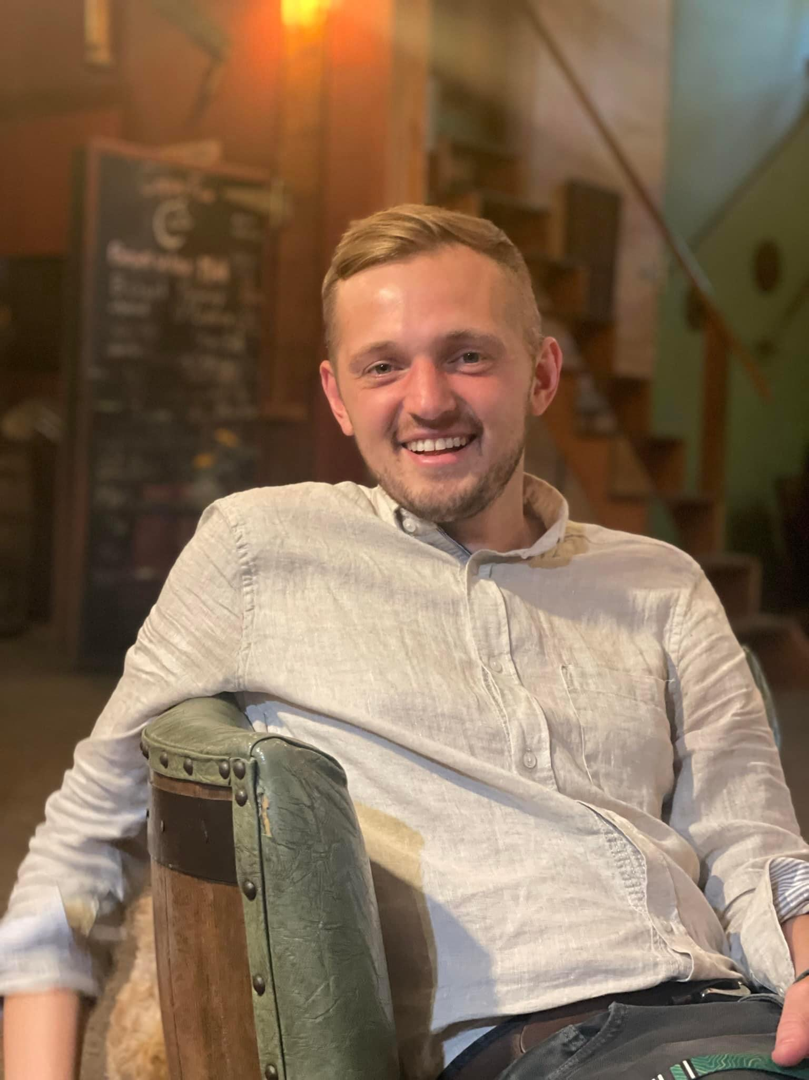
A Unique, Co-Designed Family-Based Therapy for Marginalized Women with Opioid Use Disorder and Justice-Involvement
Aaron Murnan, PhD, LMFT University of Cincinnati
Gwen England, MS
(CATCH) Sex Trafficking
Specialty Docket Program

Slide 7
Learning Objectives
Understand the shortcomings of traditional substance use treatment and criminal justice responses as well as research methodologies towards driving better substance use outcomes among this population.
Understand the unique considerations for implementing substance use interventions with women in the sex trade within criminal legal settings.
Describe the process for co-designing a family-systems intervention and integration into an existing sex trafficking specialty court program.
Recognize the process and benefits of community-partnered research methods in the context of substance use intervention research with uniquely marginalized populations.

Slide 8
A Unique, co-designed family-based therapy for marginalized women with opioid use disorder and justice-involvement
Aaron Murnan, PhD, LMFT murnanaw@ucmail.uc.edu
Assistant Professor
College of Nursing
Gwen england, MS gwen.england@fcmcclerk.com
Program Director – CATCH Court
Franklin County Municipal Court

Slide 9
Let’s talk about sex!

Slide 11
Sex Trafficking vs. prostitution in ohio
Postitution is defined:
Ohio Revised Code 2907.24:
No person… shall engage in sexual activity for hire.
Human Trafficking is defined:
Ohio Revised Code 2905.32:
(A) No person shall recruit, lure, entice, isolate, harbor, transport…another person knowing that the person will be compelled to engage in sexual activity for hire, engage in a performance that is obscene, sexually oriented, or nudity oriented, or be a model or participant in the production of material that is obscene, sexually oriented, or nudity oriented.
(B) … “Compelled” does not require that the compulsion be openly displayed or physically exerted. The element of “compelled” has been established if…the victim’s will was overcome by force, fear, duress, or intimidation.

Slide 12
Growing public health concern
2,000,000 women engaged in the sex trade in the US
4 million victims of sex trafficking, 90% women and children
Nearly half of women in substance use treatment report current or past involvement
Women with children
91% have children; 2.2-3.4 children on average
Adverse Childhood Experiences (ACEs) are common
Women often lose or relinquish custody of children

Slide 13
Why does it matter?
Risks associated with sex trade
Violent victimization; sexual assault; homicide
Poor physical (HIV/STIs) and mental health (trauma-related disorders, anxiety, depression, suicide attempts and ideation)
Severe substance use
Frequency and quantity
Disproportionate Opioid use & high rates of overdose
Risk exacerbated for marginalization
Criminalization & Stigmatization
Avoid health care providers and law enforcement officers

Slide 14
How do we successfully engage these Individuals?
Criminal Justice System
Emergency Room
Substance use Treatment

Slide 15
Substance use treatment & sex trade
Strong link between sex trade involvement and substance use
Desire for intervention
88% report desire to exit the sex trade and address substance use
Substance use primary barrier to exit
66% report prior unsuccessful treatment attempts
Limited success
Women can be engaged into and benefit from treatment
High recidivism rates & worse treatment outcomes
Little insight on effective strategies or adaptation to better meet their needs.

Slide 16
Understanding treatment disparities
Supported by Competitive Internal Dissertation award at The Ohio State University College of Education and Human Ecology

Slide 17
Prior Treatment Experiences
Incongruent Goals
Active Familial Influences
Unconditional Positive Regard
Family of Origin
Family of Origin
Substance use
Sex trading
Violence & Maltreatment
Prior Treatment Experiences
Judgement/Stigma
Active Familial Influences
Cultures of substance use
Relinquished custody of children
Incongruent Goals
Strict focus on substance use
Rebuild relationships and establish new family norms
Parenting Skills
Education and Employment
Love and Support
Unconditional Positive Regard
Notes:
=

Slide 18
Previous Treatment Experiences
“Just a bunch of high-born people telling me a bunch of bullshit, that they wanted to brainwash me..”
Negative experiences within treatment episodes
Distrust and of therapists (60%)
Strict focus on substance use (53%)
Stigma / judgmental treatment (40%)
Feelings of ostracization (27%)
Positive experiences within treatment episodes
Therapeutic relationships & treatment communities (87%)
Psycho-education / Knowledge (66%)
Trauma informed approaches (66%)

Slide 19
Sobriety (93%)
Rebuild relationships; build new family norms (60%)
Parenting skills (40%)
Interrupt intergenerational patterns (80%)
Love and support within family relationships (100%)

Slide 20
Families of Origin
Intergeneration Substance Use & Sex Trading
Substance Use (60% of participants)
Family Introduced Women to Sex Trading (20%)
Various Forms of Abuse and Neglect
Physical Abuse – (33%)
Sexual Abuse – (20%)
“I was groomed being in the trap house as a kid. I thought that was normal, that’s what I was raised in, my upbringing was like ‘I wanna be a drug dealer.’ Cuz I didn’t know you could go be a substance abuse counselor, I didn’t know you could be a teacher. I just thought that was the only life to live.”

Slide 21
‘I could say my mom human trafficked me. I mean, she’s the one that introduced me to that part of life you know - bringing men into my house, taking them up to my bathroom, taking me to trap houses and dope spots… it went from being that scared, scared girl to not understand ‘what the fuck is going on?’ to ‘okay I gotta do this, I gotta do this like she told me if I wanna get this money.’

Slide 22
Familial Influences on Treatment and Substance use
Family and romantic partners limited treatment success
Exit early (53%) – health issues; arrests; overdoses
Relapse (33%)
Challenges Re-integrating Post-Treatment
“Too good for them”
Lack of Support
Challenges with child’ caretaker
Difficulty repairing damaged relationships

Slide 23
“I still love those people. So I do catch a lot of slack from those people that are still active addiction. Now that you’re clean, you’re too good for somebody, or you’re too good to come over and stay and hang out. And that stuff really hurts me. They’re the people that I grew up with since I was very little. So it does hurt.”

Slide 24
Takeaways
1) Importance of non-judgmental, unconditional positive regard and building therapeutic rapport/alliance.
2) Family-based intervention may provide unique advantages
Incorporate and leverage family supports & motivation
Address family factors associated with substance use
Navigate re-integration, co-parenting and resistance

Slide 25
Effects of Family Therapy With Mothers Reporting Substance Use and Sex Trading
r01DA023062 – PI Slesnick

Slide 26
Family therapy Trial
Variable | Frequency (%) | Mean (SD)
Maternal Race
---Black | 23 (33.8%)
---White | 41 (60.3%)
---Other | 4 (5.9%)
Maternal Age |  | 33.8 (6.3)
# of children |  | 3.29 (1.6)
Child Age |  | 11.5 (2.3)
Child (Female) | 31 (45.6%)
Larger NIDA-trial data (n=183)
Mothers who self-reported sex trade involvement (n=68)
Eligibility Criteria
Mothers seeking substance use treatment
Have biological child - ≥ 50% custody
Child between ages 8-16
Analytical Approach
HLM and SEM models to examine the effects of treatment
Maternal substance use, depressive symptoms, and mother-child interactions

Slide 27
Beneficial Effects of Family Therapy
Home-Based Family Therapy
Greater reduction in maternal substance use (β = -.39 , SE = .18 , t = -1.13, p < .26)
Greater reductions in depressive symptoms (β = -7.97, SE = 3.60, t = -2.03 p < .04)
Greater improvements in mother-child autonomy relatedness (β = 1.56, SE = .85, t = -2.04,p = .066)
Office-Based Family Therapy
Greater improvement in mother-child autonomy-relatedness behavior (β = 2.08, SE = .078, t = 2.66, p = .008)
Reported less maternal undermining autonomy behaviors at 18 months (β = -1.08, SE = 0.53, t = -2.04, p = 0.04).

Slide 28
“Nothing About Us Without Us”
Values underlying the work

Slide 29
Cultivating autonomy through collaborative healing: CATCH court
Program Director: Gwen England
Judge: Jodi Thomas

Slide 30
Catch court est. 2009
First specialized docket response to the sex industry in the country.
Mentor court for Hamilton, Akron, and Cuyahoga human trafficking courts.
Current census: 57
Serves Franklin county municipal and common pleas courts.
2 years intensive probation
Voluntary

Slide 31
Where treatment and justice meet
Legal Components
Treatment Components
-Referral from a judge, prosecutor, defense counsel, law enforcement or treatment provider
-Plea guilty to eligible criminal charge
-2 years intensive probation
-Graduation
-Expungement
-Clinical assessment for mental and substance use disorder
-Long term treatment recommendations
-Weekly check ins with court staff/judge

Slide 32
Co-designing a Family intervention to support sustained changes in Opioid use
Supported by The National Institute on Drug Abuse (NIDA) – K23DA058053

Slide 33
Specific Aims
Aim 1: Identify intervention needs among women in the sex trade and a supportive family member through qualitative interviews (n=15 dyads) and innovative CBPR methodology to adapt a family intervention manual.
Aim 2: Create a co-design team comprised of researchers and women with lived experience from the community to co-design an adapted family intervention.
Aim 3: Conduct a feasibility trial in which family dyads (n=60) are randomized to participate in 1) adapted family intervention + treatment diversion program (MOUD & individual behavioral intervention) or 2) treatment diversion program only.

Slide 34
Mentorship Team
Drs. Melinda Butsch Kovacic; Jennifer Brown; Sarah Manchak; and Christine Wilder
Training Objectives
Community-Based Participatory Research (CBPR) & Co-Design Methodologies
ADAPT-ITT intervention adaptations and development methodologies
Research conducted within the criminal legal system, with emphasis on specialty court programs and treatment diversion programs

Slide 35
Co-Design Team
Who
4 women with lived experience
Treatment Program Director (Gwen)
Study PI (Me)
Structure
Meet monthly
Share decision-making regarding intervention design, development and evaluation
Topics Covered Thus Far
Recruitment and retention
Qualitative interview scripts (Aim1)
Co-design meeting structure & rules
Intervention Design
Ex: 1-on-1 feeding into family sessions
Ex: Selection criteria considerations for family who can participate
Selected baseline family intervention to adapt
Feedback on assessment forms
Existing Program Directors
Opioid Use Treatment Adaptation Specialists
Co-Design Team & Interviews
Co-designed family-based intervention

Slide 36
Aim 1 preliminary Data
Family Knowledge & Criteria for “Good” Family Candidates
Motivations and desires for a Family Program
Barriers to participation and benefit
Delivery Details

Slide 37
Who are “Good” Family Candidates
Leveraging existing family knowledge and lived experience
Flexibility and avoid one-size-fits-all criteria
Importance of Individual Education Sessions
CATCH participants have a year head start
Need to provide baseline education and establish relationships with family before we bring them and CATCH participants together.
Goals for Family Therapy
Treatment Knowledge permeated to other members
New Roles, Norms, and Interaction Patterns between Members
Interrupt Intergenerational Patterns / Repair Prior Relational Damage

Slide 38
Sustainability

Slide 39
Evolving Partnership with CATCH and others

Slide 40
Phase 1
Support with Recruitment
No shared decision-making or information sharing
Phase 2
Collaborating on recruitment and data collection efforts
Collaboration on decision-making regarding recruitment and research practices
Phase 3
Elevating and incorporating individuals with lived experience into our work
No insights into research questions or study design
Shared decision-making on research questions
Equality in decision making; information sharing; research questions & design

Slide 41
Examining Racial Disparities in Women’s referral to and success within Sex trafficking specialty court programs
Murnan, A., England, G., Boch, S., Qasem, I., Matthews, C., Bates, S., & Manchak, S. (2024). “They Don’t Give a Damn about Us”: A qualitative study on experiences and perceptions underlying racial disparities in sex trafficking specialty docket programs in Ohio. Journal of Human Trafficking.
Murnan, A., England, G., Boch, S., Matthews, C., Duah, H., Qasem, I., & Manchak, S. (under review). Examination of racial disparities in women’s matriculation through the criminal justice system and referral to human trafficking special docket court programs following a prostitution-related arrest. Social Sciences & Humanities Open.

Slide 42
Resources
Acknowledgements
Center for Clinical and Translational Science and Training
Community Engagement Core
Partnership Development Award - 2UL1TR001425-05A2
National Institute on Drug Abuse (NIDA) – K23058053
The Ohio State University College of Education and Human Ecology Dissertation Award
Co-Design Team
All of our Participants
All of Research Assistants, Students, and Staff that have supported these projects
Support of the College of Nursing
Data Safety Monitoring Board (Drs. Freiermuth; Norrod; and Butler)

Slide 43
Mentorship Team
Dr. Melinda Butsch Kovacic
Dr. Jennifer Brown
Dr. Sarah Manchak
Dr. Christine Wilder
Professor and Associate Dean, College of Allied Health Sciences, University of Cincinnati
Associate Director, Community Outreach and Engagement, University of Cincinnati Cancer Center
Professor, Department of Pediatrics, College of Medicine, University of Cincinnati
Division of Asthma Research, Cincinnati Children's Hospital Medical Center
Associate Professor of Psychological Sciences
Purdue University
Director of the Criminal Justice Research (CCJR)
Undergraduate Program Director in Criminal Justice
University of Cincinnati
Minnesota Regional Medical Director for Hazelden-Betty Ford Foundation

Slide 44
Q&A
Please unmute to ask a question OR type your question in the chat box.

Slide 45
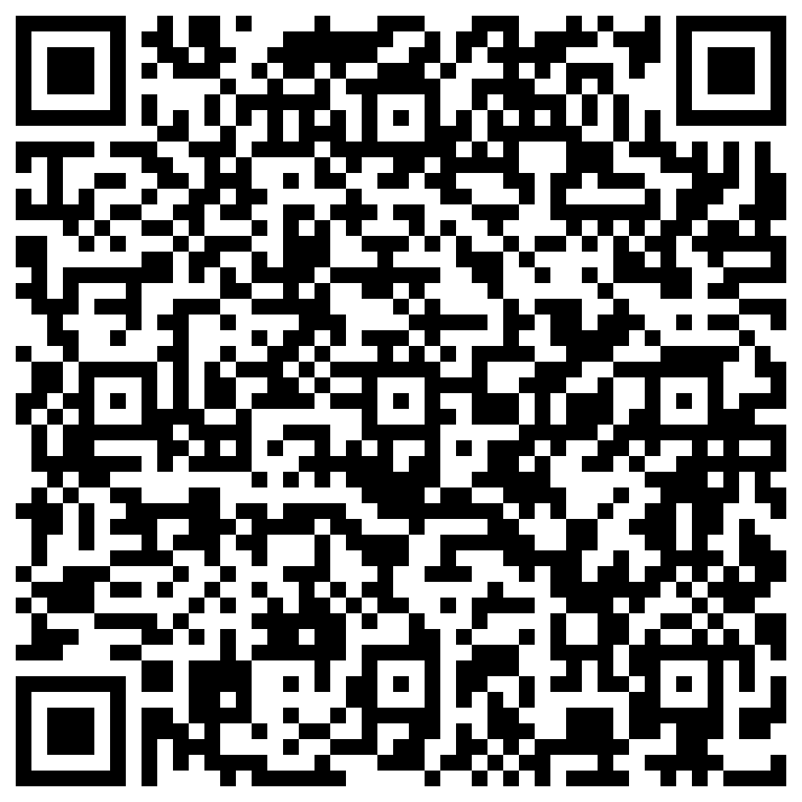
Thank you for joining us!
Please take a few moments to complete
the survey form. Scan the QR code below or use the survey link provided in the chat box, both will be emailed.
The form is required to complete if requesting CE credit for Psychology, Social Work, or Counseling.

Slide 46
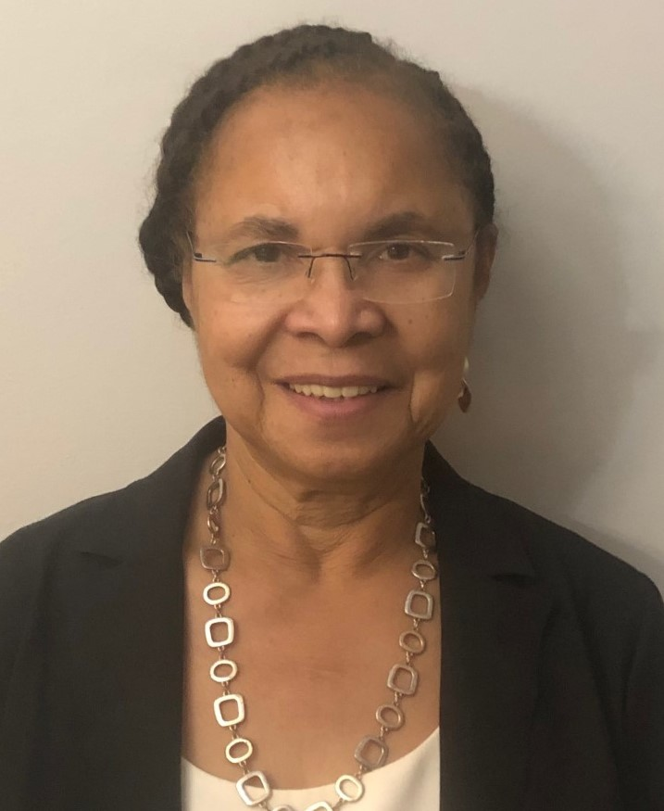
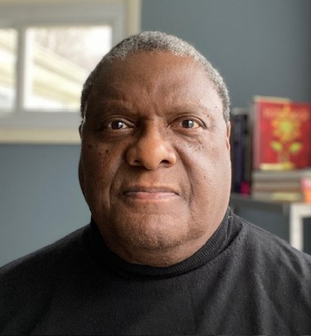
Social and Psychosocial Determinants of Treatment Response and Recovery Among Black Adults Who Use Substances
Wednesday, August 14, 2024: 12:00 – 1:00 PM
Dr. Kathy Burlew and Dr. Simeon Goodwin
Registration website: med.uc.edu/institutes/CAR/summer-speaker-series/speaker-series-2024

