Slide 1
UC College of Medicine Center for Addiction Research (CAR)
Summer Speaker Series
Sponsored by: Urban Health Pathway of Next Lives Here
June 15, 2022
12:00 – 1:00PM
This event is being recorded.

Slide 2
Center for Addiction Research (CAR)
The CAR was launched in October of 2020
Mission: to support cross-disciplinary collaborations across UC as well as with community partners, governmental institutions, and other academic institutions in order to accelerate scientific progress in addiction prevention and treatment
Twenty-eight faculty from four UC Colleges
CAR Website: https://med.uc.edu/institutes/CAR/home

Slide 3
CAR Website
Publications: https://med.uc.edu/institutes/CAR/publications
Projects:
https://med.uc.edu/institutes/CAR/projects
Communications:
https://med.uc.edu/institutes/CAR/communications
To become an affiliate member:
https://med.uc.edu/institutes/CAR/car-member-registration

Slide 4
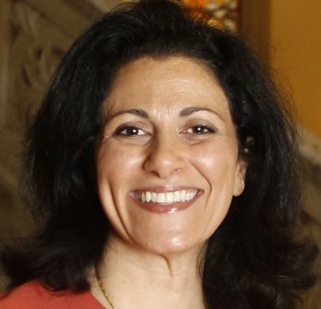
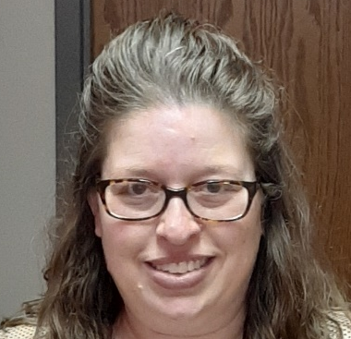
The COM CAR Summer Speaker Series
Sponsored by Urban Health Pathway of Next Lives Here
Thank you to the Planning Committee:
Dena Cranley
Jen Rowe

Slide 5
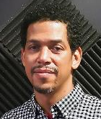
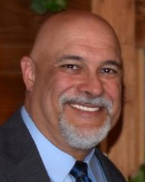
The COM CAR Summer Speaker Series
Special thank you for operational assistance from:
Jermaine Fields – UC IT User Interface and User Experience Developer
Todd Schutter - Multi-Media Coordinator, UC Information Technology

Slide 6
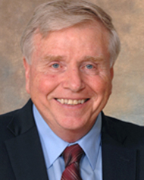
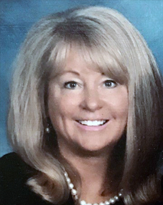
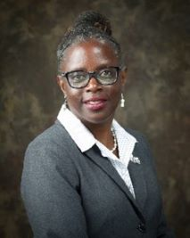
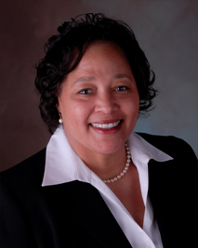
UC (HEALing Communities Study) + Hamilton County Addiction Response Coalition partnership to engage the African American community to prevent overdoses
Timothy Ingram, MS, RS
University of Cincinnati
Tina Ernst, Magistrate (Ret.) JD, BA
Patricia Brown, MBA, MSSA, LISW-S,
LICDC-CS
The Crossroads Center
Kamaria A. Tyehimba, PhD, LISW-S, LICDC-CS
Talbert House

Slide 7
Learning Objectives
Learn how the HEALing Community Studies partnered with the Hamilton County Addiction Response Coalition-African American Engagement Workgroup (AAEW) to develop a community-based SUD team for outreach, engagement, and retention services in 11 primary Black faith-based/church communities in Hamilton County.
Learn about the successes and challenges of engaging the African American Community to prevent overdoses and linkage to MOUD.
Learn about the stigma reduction and outreach efforts the AAEW provides.
Notes:
MOUD: Medication for Opioid Use Disorder

Slide 8
Ohio: The Epicenter of the Opioid Crisis
Notes:
Ohio remains at the forefront of the US Opioid crisis. In 2017, the CDC reported that Ohio was 2nd in unintentional drug OD fatalities.
The Year 2020 surpassed 2017 as the highest year for unintentional drug overdose deaths in Ohio, with 5,017 deaths and an age-adjusted rate of 45.6 deaths per 100,000 population. Preliminary OD death data for the U.S in 2021 shows a 14.9% increase in deaths compared with 2020 death data.

Slide 9
Notes:
Synthetic opioids have fueled much of the rapidly rising rates of unintentional OD fatalities and in the past 4 years, the impact has almost doubled with more than 70% of deaths are due in part to fentanyl and carfentanil exposure.
From 2019 to 2020, the number of fentanyl-related overdose deaths had the largest increase (32%), followed by deaths related to psychostimulants (28%).
• Heroin was the only drug category with decreases in the number of related deaths from 2019 to 2020. Heroin-related deaths decreased 41% during this time period.

Slide 10
Helping End Addiction Long-term
After a small decline in opioid overdose deaths from 2018-2019, in 2020 deaths continued to increase. Past efforts to prevent opioid overdose deaths have not worked well with Ohioans because of a lack of evidence-based approaches.
The Ohio HEALing Communities Study helps address this by working with existing local infrastructures and partnerships. These collaborations are led by a research plan that focuses on achieving a decrease in opioid misuse and overdose deaths.
Our study not only prioritizes which prevention and treatment strategies work best, but also how to best implement and sustain effective programming within Ohio HEALing communities. The knowledge we obtain on best prevention, implementation, and treatment practices will inform how we move forward as a state and a nation to reduce opioid overdose deaths.
Notes:
So, deaths continue to increase in Ohio. Past efforts to prevent opioid overdose deaths failed to impact Ohioans because of a lack of evidence-based approaches for assisting communities to implement a custom-designed response strategy.
The Ohio HEALing Communities Study strives to remedy this by improving existing local infrastructures and partnerships. These collaborations are led by a research plan that focuses on achieving a decrease in opioid misuse and overdose deaths using evidence-based prevention and treatment strategies.

Slide 11
Academic Infrastructure and Partners
The Ohio State University
University of Cincinnati
Case Western Reserve University
Ohio University
University of Toledo
Wright State University
RecoveryOhio
Ohio community coalitions
Notes:
The HCS is led by several Universities. OSU and UC are the co-principal investigators for the research study; Other partners include the several state agencies and of course the community coalitions.

Slide 12
HEALing Communities Study
Primary Hypothesis
The Communities That HEAL(CTH) intervention will reduce opioid-related overdose deaths by 40% over 3 years
Secondary Hypotheses
The CTH intervention will
  improve and expand access to opioid use disorder (OUD) treatment
  expand overdose prevention by increasing a) naloxone distribution and b) overdose prevention training.
  reduce the current opioid supply by decreasing high-risk opioid prescribing and dispensing practices.
  reduce nonfatal opioid overdose events.
Notes:
Thus, working together across academia, state and community coalitions, the overarching goal is to implement a community centered and engaged model that expands access to OUD treatment; increases naloxone availability in the community; decreases risky opioid prescribing and dispensing practices; With the overarching goal to reduce opioid deaths by 40% over 3 years.

Slide 13
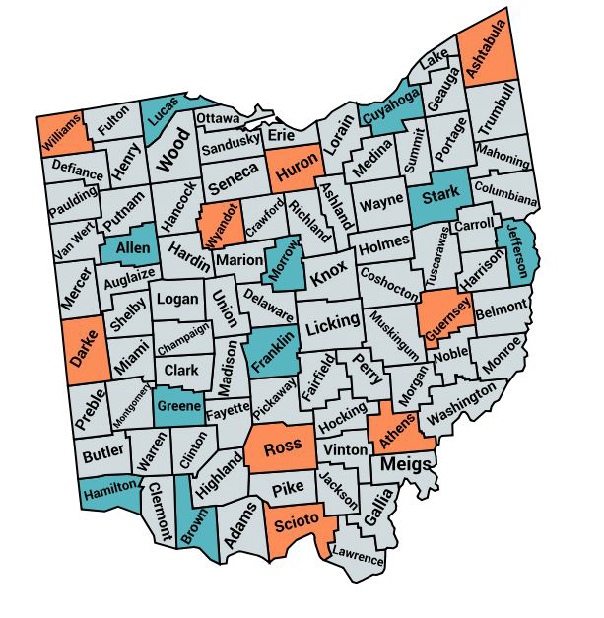
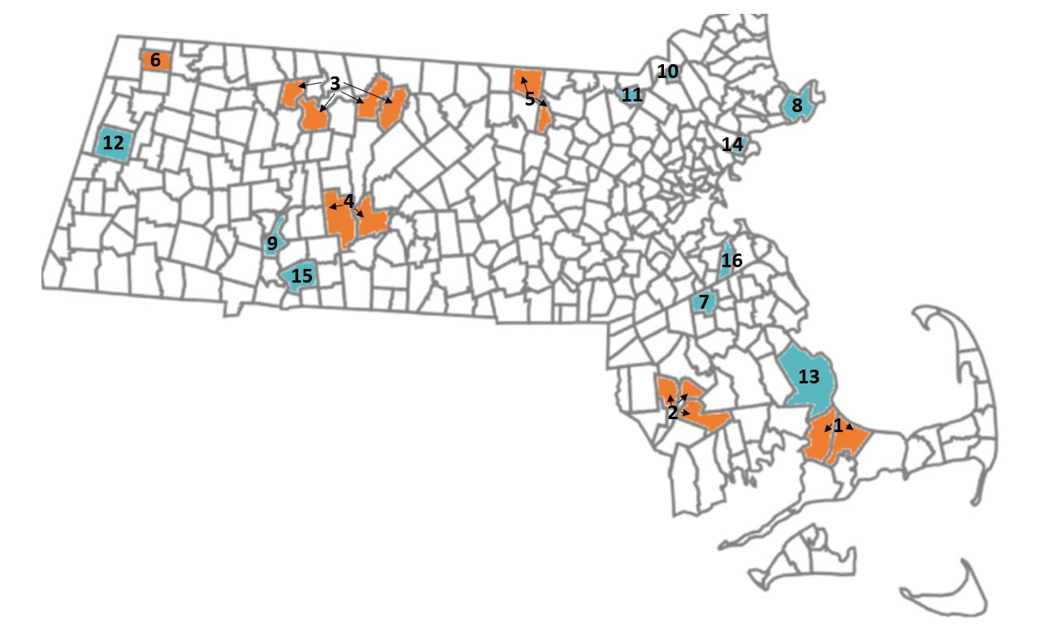
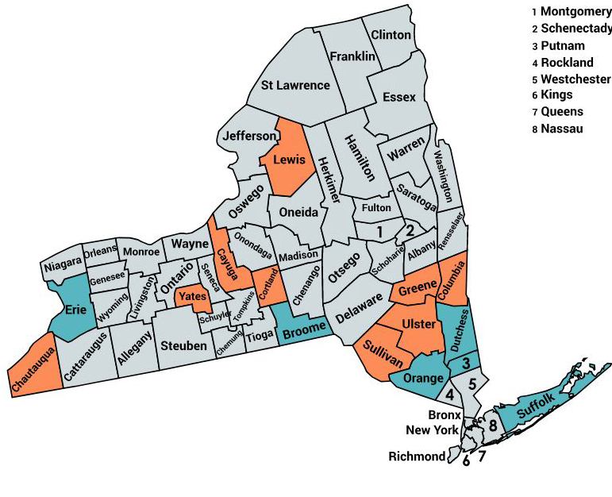
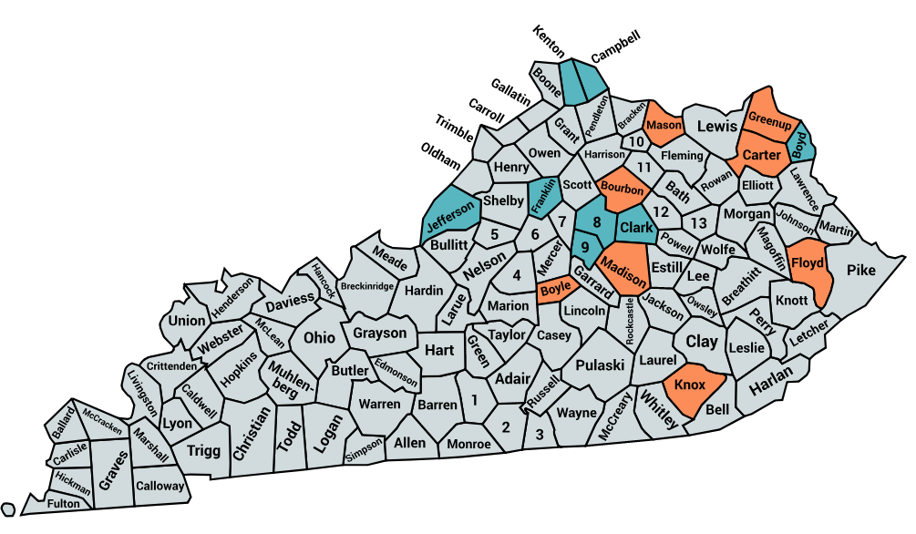
HCS-- A Single Study Across 4 States
The HEALing
Communities
Study
MASSACHUSETTS
OHIO
KENTUCKY
NEW YORK
Notes:
Healing Communities is a Single Study across 4 states and the knowledge gained is shared among the study participants.

Slide 14
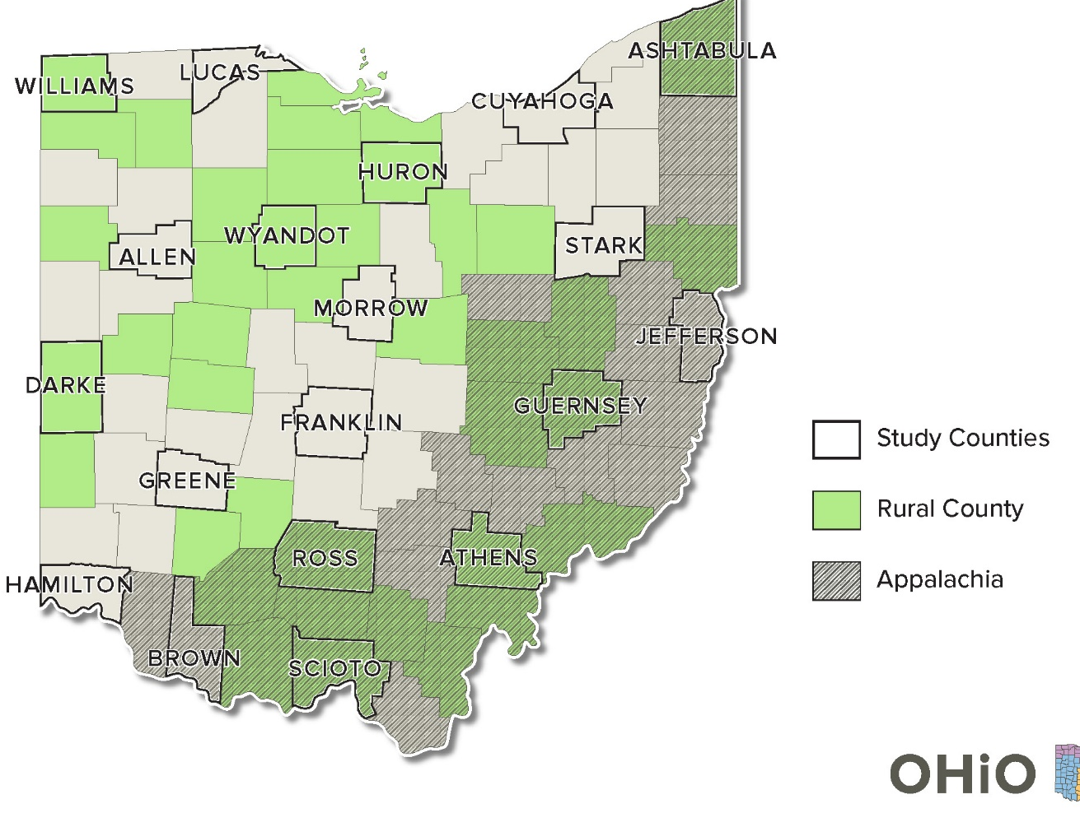
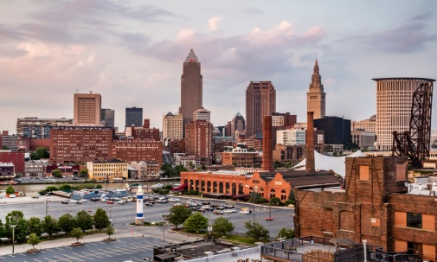
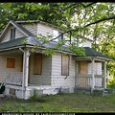
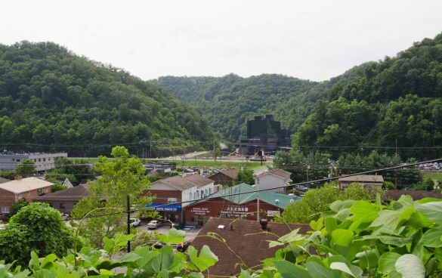

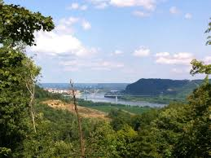
Ohio: A Microcosm of America
Notes:
The opioid epidemic crosses all regions of Ohio. Ohio’s demographics and social determinants of health do vary considerably from county to county. This variation presents several challenges and opportunities for HCS staff and the local coalitions they work with, in addressing the opioid epidemic.
Practically, every county in Ohio has been affected. In fact, >1/3 of Ohio’s 88 counties, report opioid-related death rates that exceed 25 per 100,000.

Slide 15
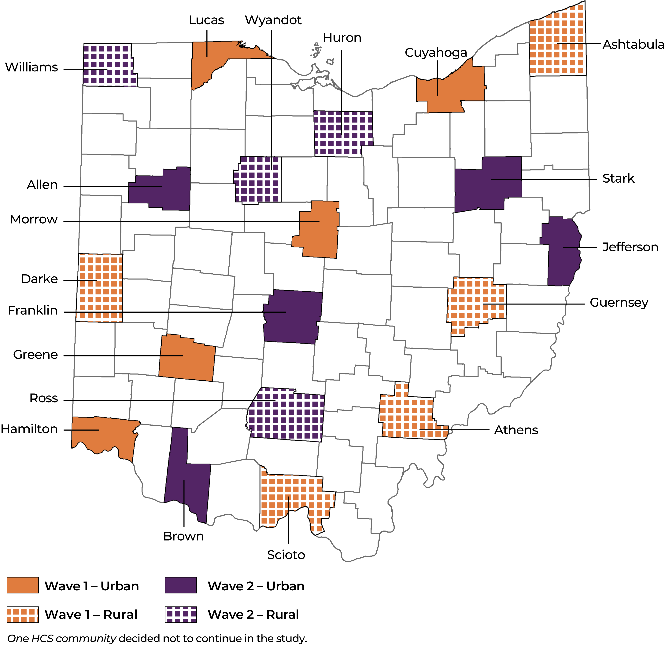
Notes:
The effects of the opioid epidemic in the African American population has sometimes, been overlooked by the local coalitions. Initially, this was true in one Healing community--Hamilton County, but not today.
Let me now turn over the presentation to Tina Ernst, a HCS Intervention Facilitator who has worked diligently with the Hamilton County Addiction Response Coalition and how her work, with others, led to a successful intervention in addressing OUD in the Hamilton County’s African –Am. population.

Slide 16
Tina Ernst, Magistrate (Ret.) JD, BA

Slide 17


COLLABORATIVE PARTNERSHIP
HEALing Communities Study (HCS) partnered locally with the Hamilton County Addiction Response Coalition (HC ARC) & African American Engagement Workgroup (AAEW)

Slide 18
Hamilton County Addiction Response Coalition – Historical Perspective
2014
Coalition forming
2015
Hamilton County Heroin Coalition
2016
Hamilton County vs. Carfentanil
2020
Rebranded as Hamilton County Addiction Response Coalition
2022
200% growth with 152 active community agencies and nearly 400 members

Slide 19
Hamilton County Addiction Response Coalition Engagement with HEALing Communities Study
Prevention
Treatment
Interdiction
Harm-Reduction
Community decisions driven by HC ARC
High priority to better serve African-Americans
Funds dedicated for community-based strategies led by African American Engagement Workgroup (AAEW)
Shared core values of equity and inclusion

Slide 20
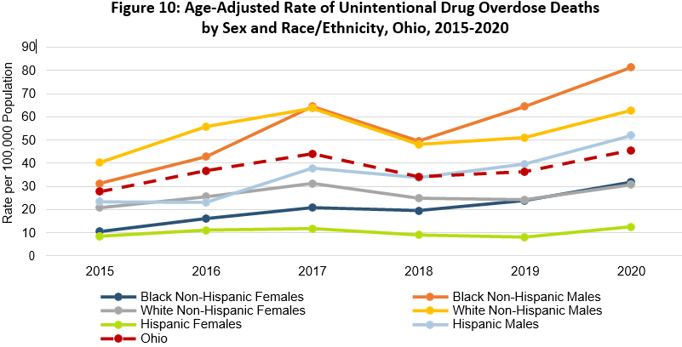
HC ARC Data-Driven Response to Overdose Death Rate Tripling Among Black Men 2015-2020
90

Slide 21
Strategy Design & Implementation Team
AAEW Co-Chairs
Dr. Kamaria Tyehimba
HC ARC Leadership & Community Leaders
HCS State Lead
John Young
HCS 3-Member Field Team
Tim Ingram
Community Engagement Facilitator: Terry Smith
Data Coordinator: Dr. Megan Lindstrom
Intervention Facilitator: Tina Ernst

Slide 22
Kamaria A. Tyehimba, PhD, LISW-S, LICDC-CS
Talbert House

Slide 23
History of African American
Engagement Workgroup
The African American Engagement Workgroup, formally the Opiate Addiction Equity Group (AAEW), was established in 2017 as a result of significant increase of drug overdose rates within the African American Communities surrounding Greater Cincinnati.

Slide 24
Founding Members
Hamilton County Mental Health and Recovery Services Board Vice President, Linda Gallagher
Hamilton County Addiction Response Coalition Director, John Young
Talbert House Addiction Services Director, Dr. Kamaria A. Tyehimba

Slide 25
Mission Statement
Ensure that the African America community is
aware that treatment is available, accessible,
and affordable.

Slide 26
AAEW Structure
Group of multidisciplinary volunteers focused on harm reduction, treatment and stigma in the Black community
Agency Collaborations:
    Caracole
    Corinthian Missionary Baptist Church Shelter House
    Greater Cincinnati Behavioral Health
    Greater New Hope Missionary Baptist Church
    Hamilton County Addiction Response Coalition (HC ARC)
    Hamilton County Mental Health and Recovery Services Board (HCMHRSB)
    Hamilton County Public Health
    Interact for Health
    Prevention First
    Sunrise Behavioral Health
    Talbert House Services
    The Crossroads Center
    Urban Minority Alcoholism and Drug Abuse Outreach Programs (UMADAOP)

Slide 27
Why Focus on the African American Community?
Death rates for African Americans were tripling each quarter and continue to rise.
Overdose and death rates were under reported.
Opioid epidemic is seen as a disease and created a perception for segregation.
African Americans were not utilizing/entering treatment at the same rate of other populations. Addiction in the Black community historically was treated by criminal justice system.
Opioids have been considered a drug that is not used by African Americans, “It’s not our problem”.
48% of the overdose deaths are African Americans.

Slide 28
Journey to Engaging the
African American Community
Focus Groups
Summits
Ministers
Sequential Intercept Mapping
  Sequential Intercept Mapping Process
    Ability to engage a more diverse audience.
    Challenged the pervasive thoughts around opioids on African Americans.
    Provided the ability to “count” and secure data which supported the need for funding to access treatment.

Slide 29
Journey to Engaging the
African American Community
Summit: BUILDING PREVENTION WITH FAITH
A Faith-Based Substance Use/Misuse
Prevention Toolkit
119 Multicultural Churches Participated
Coalitions Were Built
Walnut Hills
The Greater New Hope MBC
Avondale
Tryed Stone New Beginning Church

Slide 30
AAEW partners with HEALing Communities for Harm Reduction
AAEW Fast track Naloxone Distribution and Deterra Bag
  Started with the “Why” related to Narcan
  “First Aid Kit”
  Influenced by real examples
  We learned more than we shared
Partnered with churches, barbershops, beauty salons, recreation centers, corner stores, gas stations and other natural environments in the Black community
Hosted community conversations
Went to neighborhood and school reunions
Distributed 660 Narcan kits in 4 months

Slide 31
Patricia Brown, MBA, MSSA, LISW-S, LICDC-CS
The Crossroads Center

Slide 32

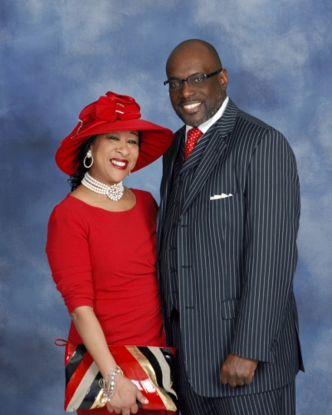
Faith-Based Initiative
Faith-Based Planning Process Core Team:
The Greater New Hope MBC, Rev. Donald E. Jones,
Talbert House, and Prevention First
Corinthian MBC, Rev. Kazava Smith,
The Crossroads Center, and UMADAOP

Slide 33
Faith-Based Initiative
Engaged nine other churches to support this initiative
In-person presentations
Scripted messaging
Provided testimony and research information
Developed a welcoming process to receive guests at the lead churches.
Each church has champions to provide substance abuse first aide.
Guests have immediate access into treatment.

Slide 34
Faith-Based Implementation
Scripted weekly post and advertisements from the pulpit
Posting on Church Facebook accounts
Weekly communication alert to churches
Weekly meetings
Monthly large group updates
Youth Summit planning

Slide 35
What We Learned
Language – words matter
Stigma is real (guilt and shame)
Historical context – drug of choice and how people are treated
Accept and apologize
Teach and train – Good Samaritan Law
Nothing about us without us – Voice and Choice

Slide 36
What We Learned
Leader that is connected to and has passion for faith-based care.
Resources follow vision.
Accept all who want to participate because they bring value to the group.
With AAEW we are “Better Together”.
Collectively we bridge the gaps.
AAEW allows us to hold one another accountable for what we say we are going to do.

Slide 37
A Very Special Thank You to the Churches Participating in the Faith-Based Initiative
Name of Church | Pastor
Christ Temple Full Gospel Baptist Church | Rev. Peter Mingo
The Greater New Hope Missionary Baptist Church | Rev. Dr. Donald E. Jones, Sr.
Living God Church | Rev. Sil Watkins
Rose Chapel Missionary Baptist Church | Rev. Mark Flagg
House of Joy | Rev. Todd O'Neal
New Jerusalem Baptist Church | Rev. Damon Lynch Jr.
Corinthian Missionary Baptist Church | Rev. K.Z. Smith
Greater Faith Ministries Church | Rev. Anthony Hudson
Revive Church | Rev. Kirk Kirkland
Truth & Destiny | Rev. Lesley Jones
New Prospect Baptist Church | Rev. Damon Lynch III

Slide 38
Q&A
Please unmute to ask a question OR type your question in the chat box.

Slide 39
Thank you for joining us!
Please take a few moments to complete
the survey form. The survey link is provided
in the chat box.
The form is required to complete if requesting CE credit for Psychology, Social Work, or Counseling.

Slide 40
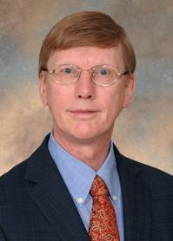
Development of a Recombinant Humanized
Anti-Cocaine Monoclonal Antibody
Wednesday, July 20, 2022: 12:00 – 1:00 PM
Andrew Norman, PhD
Registration website: med.uc.edu/institutes/CAR/summer-speaker-series/speaker-series-2022

