Slide 1
UC College of Medicine Center for Addiction Research (CAR) Summer Speaker Series
Sponsored by: Urban Health Pathway of Next Lives Here
July 14, 2021
12:00 – 1:00PM
This event is being recorded.

Slide 2
Center for Addiction Research (CAR)
The CAR was launched in October of 2020
Mission: to support cross-disciplinary collaborations across UC as well as with community partners, governmental institutions, and other academic institutions in order to accelerate scientific progress in addiction prevention and treatment
Thirty faculty from five UC Colleges
CAR Website: https://med.uc.edu/institutes/CAR/home

Slide 3
The COM CAR Summer Speaker Series
Sponsored by Urban Health Pathway of Next Lives Here
Thank you to the Planning Committee:
Dena Cranley
Kelly Lyle
Jen Rowe

Slide 4
The COM CAR Summer Speaker Series
Special thank you for operational assistance from:
Jermaine Fields – UC IT User Interface and User Experience Developer
Suki Jeffrey - Art Director, UC Academic Health Center Public Relations
Todd Schutter - Multi-Media Coordinator, UC Information Technology

Slide 5
Prenatal Opioids, Mothers, and Babies
Stephanie Merhar, MD
Cincinnati Children's Hospital Medical Center
Angie Scroggins, MSN, RN
St. Elizabeth Healthcare
Lucy Rolfes, BSN, RN
St. Elizabeth Healthcare

Slide 6
Learning objectives
To discuss the effects of maternal opioid use on the infant and the mother-infant dyad.
To discuss ways which maternal treatment programs can help mothers parent their infants.
To discuss current research studies on women using opioids during pregnancy and their infants.

Slide 7
Definitions
NAS = neonatal abstinence syndrome
Not specific to opioids
Can occur after in utero exposure to benzodiazepines, selective serotonin uptake inhibitors (SSRIs), and nicotine
NOWS = neonatal opioid withdrawal syndrome
currently preferred term to use when infants develop withdrawal symptoms after in utero opioid exposure

Slide 8
Scope of the problem
From 2004-2013, the rate of NICU admissions nationwide for NOWS increased from 7 cases per 1000 admissions to 27 cases per 1000 admissions
Median length of stay increased from 13 days to 19 days
Total percentage of NICU days that were attributed to NOWS increased from 0.6% to 4.0%
8 centers in the study reported that more than 20% of all NICU days were attributed to NOWS
NEJM April 2015
Notes:
From 2004 through 2013, the rate of NICU admissions for the neonatal abstinence syndrome increased from 7 cases per 1000 admissions to 27 cases per 1000 admissions; the median length of stay increased from 13 days to 19 days (P<0.001 for both trends). The total percentage of NICU days nationwide that were attributed to the neonatal abstinence syndrome increased from 0.6% to 4.0% (P<0.001 for trend), with eight centers reporting that more than 20% of all NICU days were attributed to the care of these infants in 2013.

Slide 9
Opioid exposure rate per 1,000 births Cincinnati Region (564% increase)

Slide 10
Neonatal opioid withdrawal syndrome
Characterized by behavioral dysregulation
Occurs within 2-3 days of birth for infants exposed chronically to opioids in utero
Signs and symptoms:
altered sleep
high muscle tone
tremors
irritability
poor feeding
vomiting, diarrhea
sweating
tachypnea

Slide 11
Care for infants with NOWS
Historically infants were separated from their mothers and taken to the neonatal intensive care unit (NICU) to monitor for withdrawal symptoms
Infants scored every 3-4 hours by nurses using the Finnegan score, developed in 1974
Points assigned for each item based on its perceived severity
Classically scores >8 x 3 or >12 x 2 have been used as a threshold for pharmacologic treatment with opioid replacement (morphine, methadone, buprenorphine)
Concerns have arisen about length of the tool, its inherent subjectivity and the tendency of the tool to overestimate the need for pharmacologic therapy

Slide 12
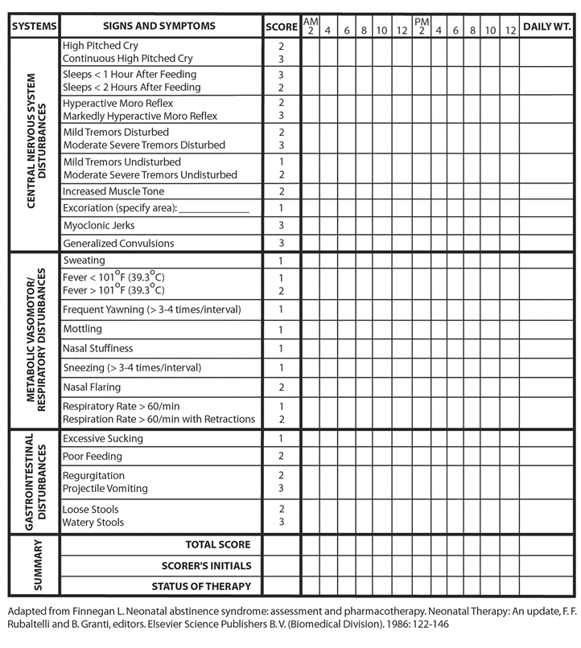

Slide 13
Care for infants with NOWS
In recent years, a larger focus has been on non-pharmacologic care for infants with NOWS
Swaddling
Skin to skin contact
Non-nutritive sucking
Quiet, low-stimulus environment

Slide 14
Percent needing pharmacologic treatment Cincinnati Region (39% decrease)

Slide 15
Maternal bonding and NOWS
Although many mothers with substance use disorders are able to provide home environments and parenting that support their children's development, some are at greater risk for maladaptive parenting
Studies on maternal perspectives about parenting have shown limited understanding of basic child development and ambivalent feelings about having/keeping children
Mothers with substance use disorders have demonstrated lower levels of sensitivity and responsiveness to their young children’s emotional cues and marked oscillation between intrusive, over-controlling behavior and passive withdrawal
Suchman 2016, Mayes 2002, Murphy 1999, Hans 1999, Burns 1997

Slide 16
The neuroscience of addiction and parenting
Chronic substance use often results in the release of excessive amounts of pleasure-inducing neurotransmitters such as dopamine in the brain that trigger dramatic changes in neural circuitry
Dopamine and other neurotransmitters play an important role in rewarding human behaviors that are essential for survival (e.g., caring for offspring)
When the brain becomes flooded with dopamine (as with drug use), it adapts by making the neurotransmitter less available for uptake and absorption
Behaviors such as caregiving that are ordinarily reinforced with intense experiences of pleasure are now experienced as neutral or stressful
Suchman and DeCoste 2018

Slide 17
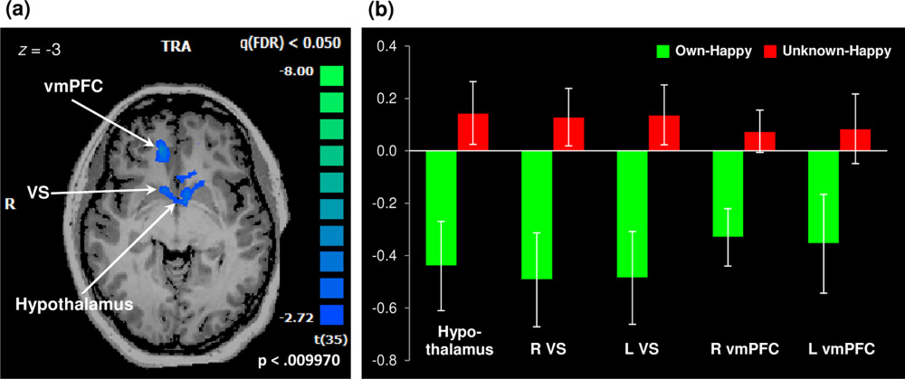
The neuroscience of addiction and parenting
Emerging evidence from neuroimaging studies now suggests that mothers with histories of chronic substance misuse experience less neural reward in response to viewing their own infant’s face than mothers with no substance misuse history
Kim 2017
Notes:
Reduced maternal brain response in mothers with addictions evidenced by a single cluster of deactivation observed for the own-happy versus unknown-happy contrast, encompassing the hypothalamic, bilateral VS, and bilateral vmPFC regions (258 voxels, P < 0.01, FDR-corrected q < 0.05; Panel A). Striking deactivation is observed when mothers with addictions view their own infant's smiling faces, compared with unknown infant faces (Panel B).

Slide 18
A shift in our thinking…

Slide 19
Parental presence
“YOU ARE THE PRIMARY TREATMENT FOR YOUR BABY”
This message should be emphasized starting prenatally, through the labor and delivery process, and postpartum
Study of 86 pharmacologically treated infants on a pediatric inpatient unit
Documented parental presence every 4 hours
Maximum parental presence was associated with a shorter length of hospital stay, fewer days of infant opioid therapy, and lower Finnegan scores
Howard MB et al, Hosp Pediatr, 2017

Slide 20
Location of care
Keep the dyad together
Postpartum unit
Pediatric inpatient unit
NICU or Special Care Nursery with rooming-in capacity

Slide 21
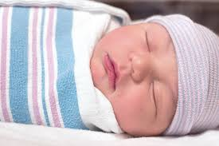
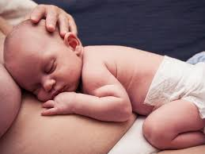
Change in approach
“You are the PRIMARY treatment for your baby”
Prenatal preparation
Change in messaging
Educate community partners

Slide 22
Eating, Sleeping, and Consoling Approach
Simplifies the evaluation of infants with a focus on function-based assessments
Emphasizes education, support, and empowerment of families in the care of their infants
Focuses on optimization of non-pharmacologic therapies as a first line of treatment
Notes:
Developed by Matt Grossman – over a 5 year period as a QI initiative

Slide 23
Development of ESC Care Tool
Based on ESC approach developed by Dr. Matthew Grossman at Yale-New Haven Children’s Hospital
Formal collaboration with Children’s Hospital at Dartmouth-Hitchcock and Boston Medical Center to develop structured ESC Care Tool to standardize definitions, clinical assessment and care approach
Standardized trainings, in-hospital field testing, and iterative improvements in ESC Care Tool and training materials

Slide 24
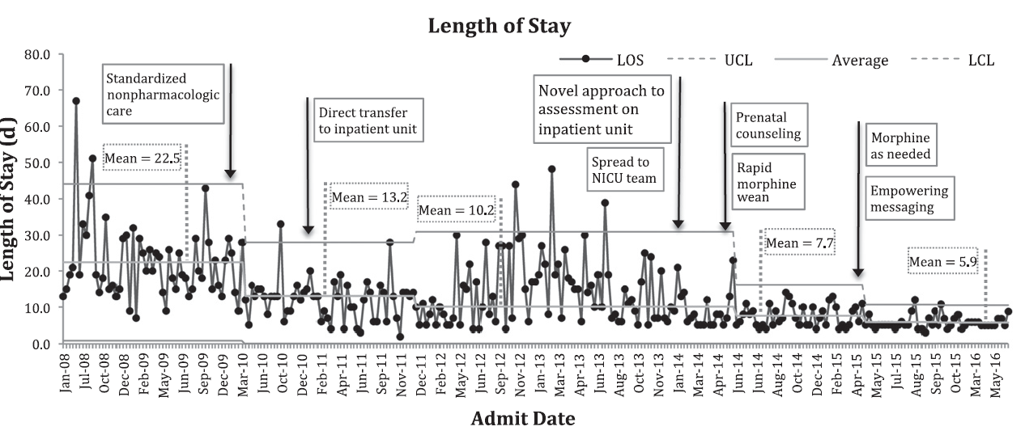
-- Morphine Rx decreased: 98%→73%→28%→14%
-- LOS decreased: 22.4 days to 5.9 days
-- Hospital costs decreased: $44,824 → $10,289
https://pediatrics.aappublications.org/content/139/6/e20163360

Slide 25
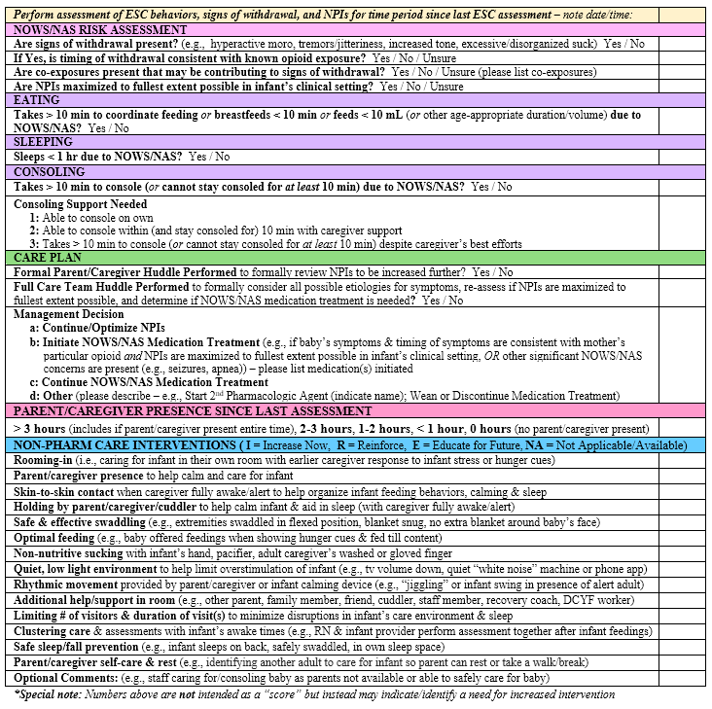

Slide 26
Eat Sleep Console study
Cluster randomized study – each of 24 sites is randomized to switch from Finnegan scoring to the ESC approach at a different time
Information about in-hospital outcomes (including opioid treatment, length of stay) collected under waiver of consent
Consent obtained for follow up study
Evaluating family outcomes – e.g. bonding
Caregiver attachment
Parenting sense of competence
Caregiver depression
Infant sleep
Safety outcomes -- readmissions, death
Neurodevelopmental outcomes until age 2
All follow up is by electronic survey until in-person visit at age 2

Slide 27
OBOE
Study design
Longitudinal cohort study of 200 opioid-exposed infants and 100 controls over the first 2 years of life
MRI scans at 0-1 months, 6 months, 24 months of age
Developmental screening and home visit at 12 months
Developmental testing (Bayley) at 24 months
Caregiver questionnaires
Study objectives
Evaluate the effects of prenatal opioid exposure on the trajectory of brain development over the first 2 years of life
Examine associations with developmental and neurobehavioral outcomes
Explore how specific factors (differing antenatal and postnatal exposures, severity of neonatal opioid withdrawal, maternal stress/depression/parenting) modify effects of opioid exposure on brain development

Slide 28
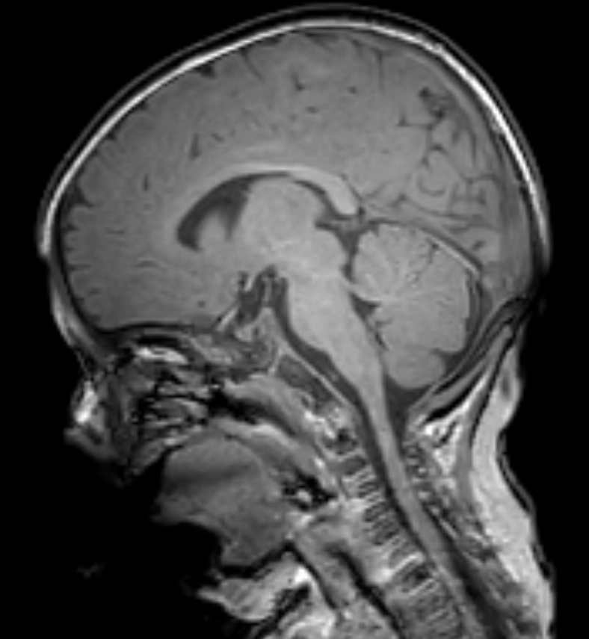
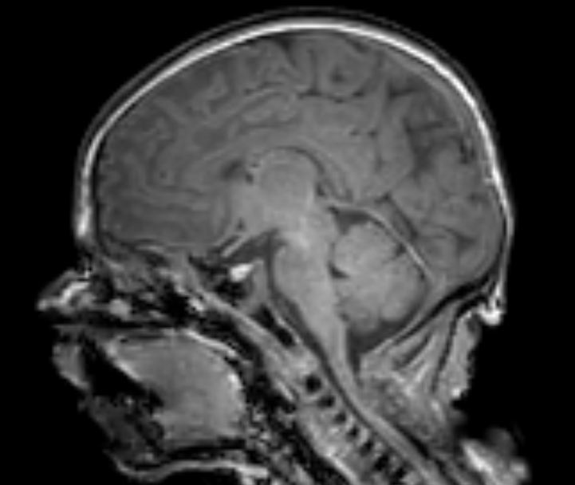
Opioid-exposed, 1 month of age
Opioid-exposed, 6 months of age

Slide 29
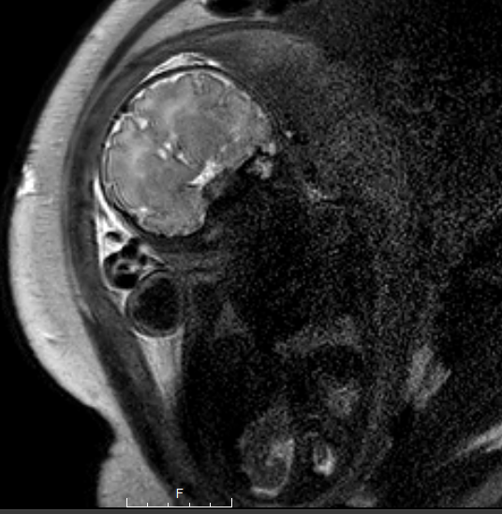
HEALthy Brain and Child Development: fetal imaging
Study design: single fetal MRI between 24-36 weeks gestation in mothers using opioids during pregnancy and control mothers
Study objective: to compare brain volumes, cortical folding, placental health, and white matter integrity in fetuses exposed to opioids versus controls

Slide 30
To contact or for patient/self referrals please email Babysteps@stelizabeth.com or call 859-301-2500.

Slide 31
What we do
St. Elizabeth’s vision to lead our communities to become the healthiest in America is supported by our commitment to quality care and community outreach. We work to connect our women with existing community resources to meet their needs. We link them with local recovery meetings, medical providers, faith-based support organizations, and healthy lifestyle groups.
We serve all women with Substance Use Disorder (SUD) who are currently pregnant or who are parenting for the first two years. We offer all services free to anyone, regardless of where they plan to deliver or where they receive MAT treatment.

Slide 32
What we do
Goals
to reduce stigma among care providers through education and involvement in processes
to get women engaged in recovery efforts early and support sustained recovery
to reduce the rate of Neonatal Opiate Withdrawal Syndrome (NOWS)
to ensure women are given the opportunity to parent their children
Simply put - #1 priority is removing obstacles to successful recovery, pregnancy and delivery

Slide 33
Who we are
Our staff comes from the community they serve. They know the area and what community resources are available. The nurses have OB and/or behavioral health backgrounds and focus on education and case management. The peer supports have been through local recovery processes and can lead and support women as they navigate through the process. Baby Steps has five years of successful programming with proven outcomes.
What do our team members do?
Clinical Nurse Liaisons
Peer Support Specialists
NOWS Community Nurse
Women stay engaged due to a comfort level with a known and established team. They refer to others and help us reach those in need.

Slide 34
Program Overview

Slide 35
Outcomes
What have we seen so far?
In 2020 we had 730 women referred, 488 were 1st time referrals, 64% were referred prenatally. Once enrolled they stayed engaged in programming for average of 276 days.
18% had no prenatal care
Smoking: 84%
142 new MAT patients
70% of mothers whose babies treated for NOWS were Hep C positive, but most didn’t know what to do or what follow-up was needed for her and her baby
Parenting Outcomes – of the 153 moms who delivered - 74% of babies were discharged home to mom and additional 17% to mom w/supervision. Continued parenting:
1 month 89%
12 months 87%

Slide 36
NOWS Community Nurse
Nursing background in Neonatal Intensive Care Unit (NICU) where I took care of many NOWS/NAS infants in the hospital. The role as NOWS Community Nurse Educator, gives me the opportunity to prepare women for their hospital stay. Experience has shown that reducing stress and anxiety about the hospital stay can make women with SUD more successful in maintaining sobriety and a healthy pregnancy.
Signs and symptoms of opiate withdrawal in newborns
Eat, Sleep, Console model of care or the Finnegan Scoring Tool (delivery hospital dependent)
Dispel common myths about breastfeeding while on MAT & expedite lactation services post-delivery
The hospital social workers role and possibility of DCBS involvement

Slide 37
NOWS Community Nurse
What it looks like if the baby goes to the NICU
What to do if there is delayed onset of NOWS symptoms
Cincinnati Children’s Opiate Exposed Follow-up clinic
Cincinnati Children’s Research Studies
Advocate for them while in the hospital
Address questions or concerns

Slide 38
Q&A
Please unmute to ask a question OR type your question in the chat box.

Slide 39
Thank you for joining us!
Please take a few moments to complete
the survey form. The survey link is provided
in the chat box.
The form is required to complete if requesting CE credit for Social Work or Counseling.

Slide 40
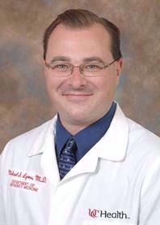
“QRT+”: Role of Academic and Community Partnership in Evolution of Outreach Intervention to Engage Individuals in Treatment for Opioid Use Disorder
Wednesday, August 11, 2021: 12:00 – 1:00 PM
Michael Lyons, MD & Col. Thomas W. Synan, Jr., Chief of Police
Registration website: https://med.uc.edu/institutes/CAR/speaker-series

