Slide 1
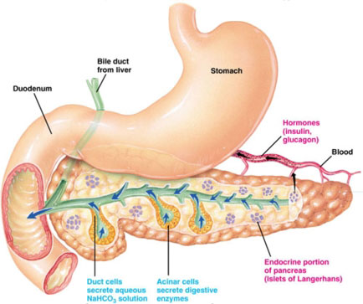
Pancreatic Islets
(Islets of Langerhans)
Digital Laboratory
It’s best to view this in Slide Show mode, especially for the quizzes.
This module will take approximately 10 minutes to complete (seriously, and it’s all review).

Slide 2
After completing this exercise, you should be able to:
identify, at the light microscope level, each of the following:
Pancreas
Serous acini
Pancreatic islets (Islets of Langerhans)

Slide 3
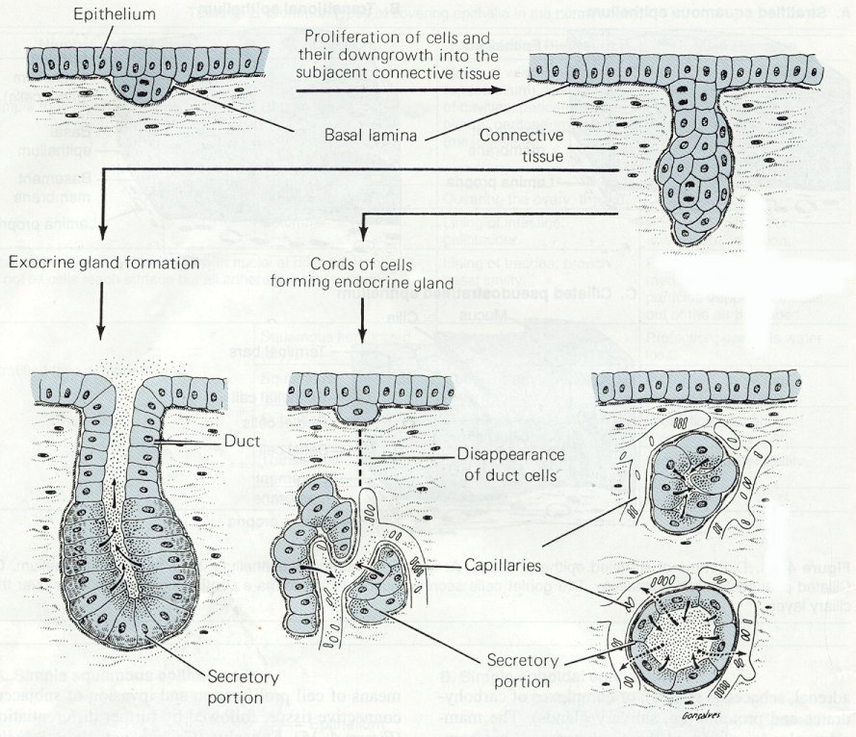
GLANDS
Glands in the body develop through an interaction of an epithelium and underlying connective tissue. The epithelial cells that line the surface of the body (e.g. epidermis of skin, inner lining of the gut) proliferate, and then invaginate into the underlying connective tissue. Note the basement membrane invaginates with the epithelium. From here, two things can happen:
For exocrine gland formation, a lumen develops, and secretory cells secrete their substances out their apical side (arrows).
For endocrine glands, the secretory cells lose their connection to the original epithelium, forming clusters of cells that secrete out their basal side, across the basement membrane, and into the bloodstream.
In the pancreas, some cells become exocrine, while others become endocrine.

Slide 4
PANCREAS
from:
www.gopetsamerica.com
seriously
This image shows the stomach and the beginning of the small intestine, the duodenum. The pancreas (and liver) develop from the duodenum, and, therefore, are connected to it by ducts. The glandular cells in the pancreas are either exocrine (acinar) or endocrine (Islets of Langerhans).

Slide 5
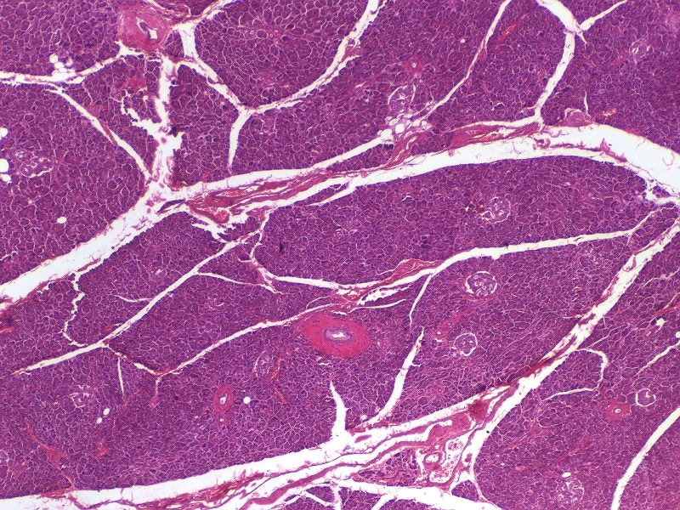
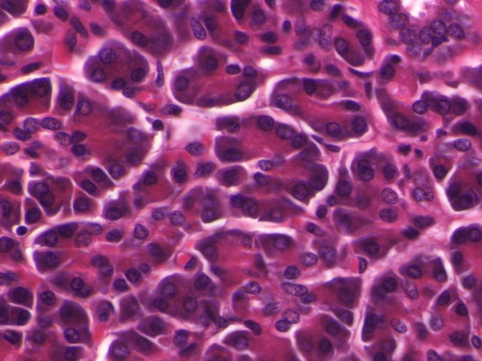
EXOCRINE PANCREAS
The exocrine portion of the pancreas secretes a large amount of digestive enzymes. The details of these cells will be worked out in the Gastrointestinal Block, but you should recognize a cluster of serous acini when you see one.
Because these cells synthesize a ton of digestive enzymes (proteins), they exhibit intense cytoplasmic basophilia on their basal side, and intense cytoplasmic eosinophilia on their apical side. I hope you remember why they stain this way.

Slide 6
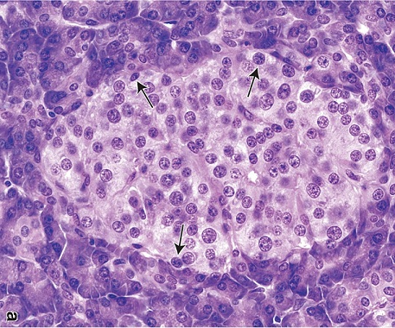
ENDOCRINE PANCREAS
Exocrine acini
Exocrine acini
Exocrine acini
Exocrine acini
The endocrine portion of the pancreas forms clusters of cells called pancreatic islets (Islets of Langerhans - yellow outline). Although the cells within the islets secrete protein hormones, and, therefore, exhibit cytoplasmic basophilia and eosinophilia, their staining is not nearly as intense as that of the exocrine acinar cells. (FYI arrows are identifying possible α cells, really can’t say for sure)
If you stop to think about it, this makes sense. Protein hormone production does require rER, Golgi, secretory vesicles; therefore, Islet cells will exhibit some staining characteristics. However, you don’t need much hormone to circulate in the body and elicit an appropriate response in target cells. After all, it’s only a message.
The exocrine acinar cells, however, have to deal with large volumes of meals daily (especially on holidays). They need to secrete a ton of digestive enzymes, so they contain more rER, Golgi, and secretory vesicles than islet cells, and, therefore, stain much more intensely.

Slide 7
ENDOCRINE PANCREAS
Video of pancreatic islets – SL108
Video of pancreatic islets – SL54
Yeah, I know, I missed an obvious islet in the second video, but it wasn’t very nice, was it?
Link to SL 108 and SL 054
Be able to identify:
Exocrine pancreas (serous acini)
Pancreatic Islets (Islets of Langerhans)

Slide 8
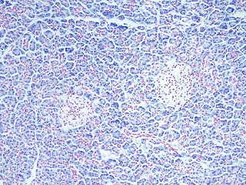
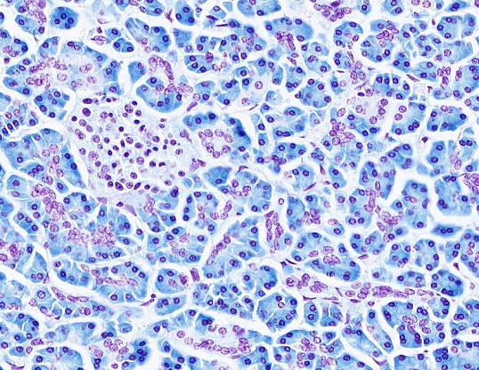
PANCREAS – RNA STAIN
To underscore the difference in exocrine and endocrine pancreatic cells, this slide was specially prepared so that:
DNA is stained red
RNA is stained blue
Note that, although the cytoplasm of the pancreatic islet cells do exhibit RNA staining, the exocrine acinar cell cytoplasm contains much more RNA

Slide 9
MALE REPRODUCTIVE SYSTEM
Video of pancreatic islets RNA – SL2A
Link to SL 002A
Be able to identify:
Exocrine pancreas (serous acini)
Pancreatic Islets (Islets of Langerhans)

Slide 10
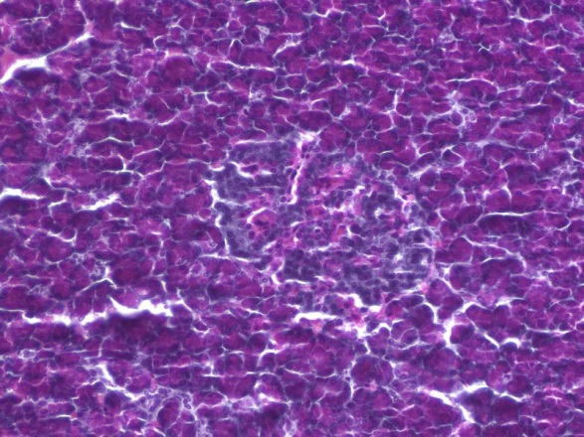
ENDOCRINE PANCREAS – SPECIAL STAIN
Exocrine acini
Exocrine acini
Exocrine acini
Exocrine acini
Routine H&E cannot distinguish between the different cells within the islets of Langerhans. However, this specially-stained slide shows:
α cells – stained red, secrete glucagon
β cells – stain blue, secrete insulin
δ cells (and other islet cells) - not specially stained here, release somatostatin

Slide 11
ENDOCRINE PANCREAS
Video of pancreatic islets special staining – SL109
Link to SL 109
Be able to identify:
Nothing specific, just realize cells in the pancreatic islets can be specifically identified with special stains, antibodies, etc.

Slide 12
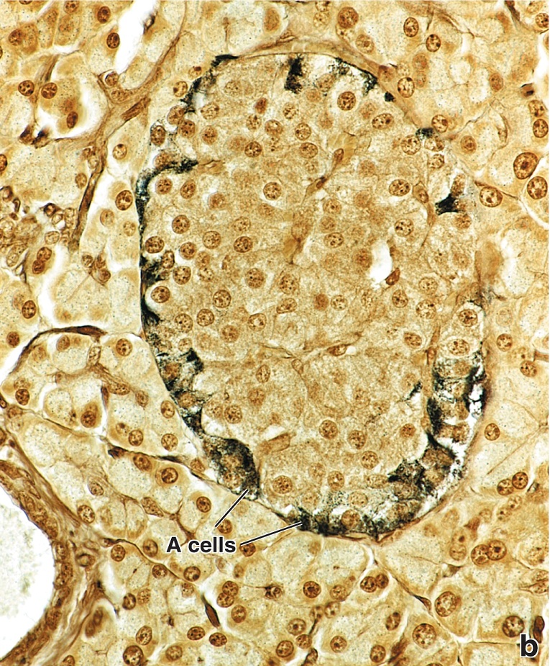
ENDOCRINE PANCREAS – SPECIAL STAIN
This is another special stain for your viewing pleasure.

Slide 13
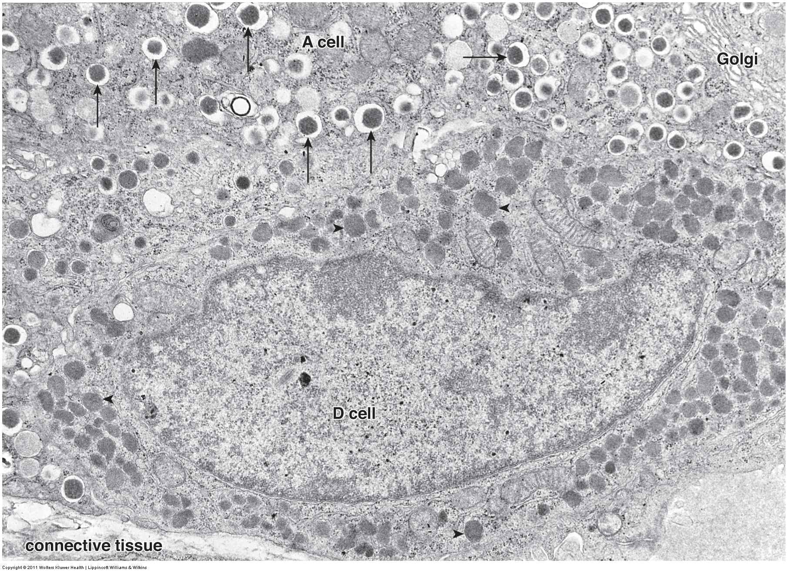
ENDOCRINE PANCREAS
Just FYI, this EM demonstrates that cells from the Islets of Langerhans have the protein machinery expected of cells with regulated secretion: rER (not easily seen), Golgi, secretory granules (arrows)

Slide 14
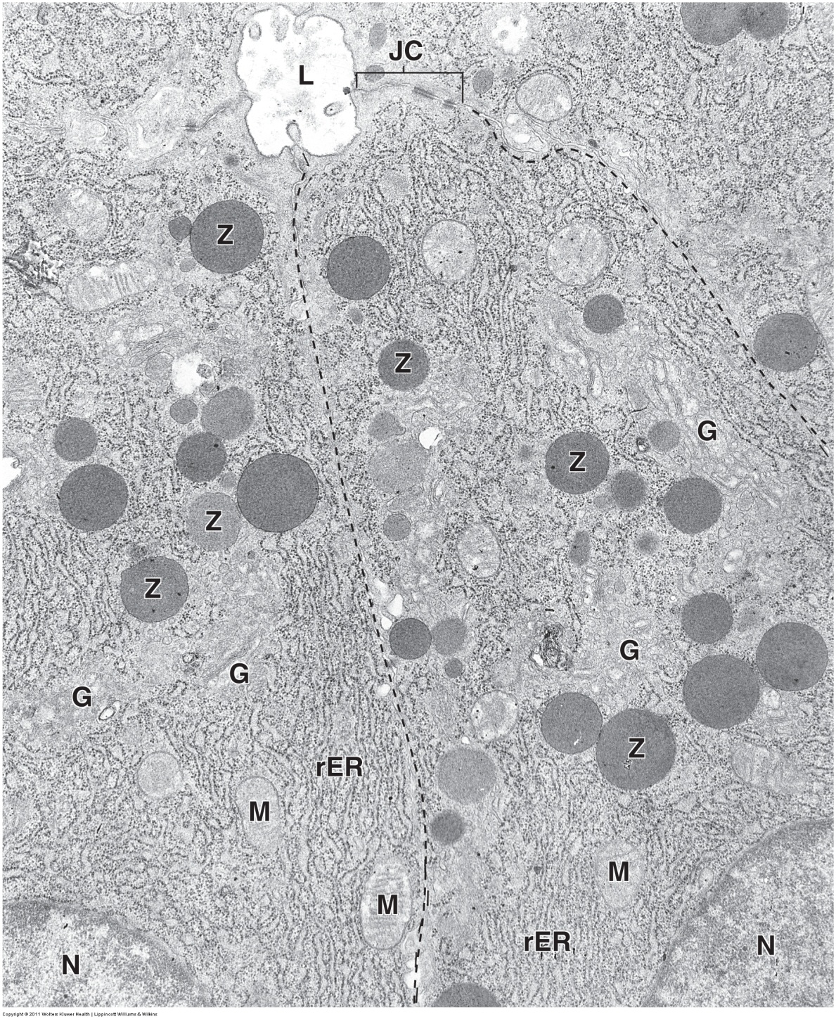
EXOCRINE PANCREAS
FYI again, for reference, this is a portion of the exocrine pancreas, with the lumen (L) of an acinus shown. Note that the acinar cells exhibit more elaborate rER, Golgi, and much larger secretory granules (Z, they are called zymogen granules).
Similar to what you encountered with the pituitary, etc., it’s often difficult to definitively identify similar cells on EM. In other words, rER, Golgi, secretory granules; the cell definitely is involved in regulated secretion, but it could be in a number of places. In this case, the presence of the lumen and the fact that the granules are toward the apical side of the cell is helpful in narrowing it down, but it does not completely rule out other tissues you will see, such as salivary glands.
However, note that you certainly should be able to compare protein-secreting cells from steroid-secreting cells. In addition, once we learn about these exocrine cells in detail, if you were shown two EM images similar to the ones in this module, and you had to match them to exocrine or endocrine pancreas, we would hope you could do so. Or maybe that lumen and apical granules would help you when comparing to cells with granules on their basal side.

Slide 15
The next set of slides is a quiz for this module. You should review the structures covered in this module, and try to visualize each of these in light and electron micrographs.
identify, at the light microscope level, each of the following:
Pancreas
Serous acini
Pancreatic islets (Islets of Langerhans)

Slide 16
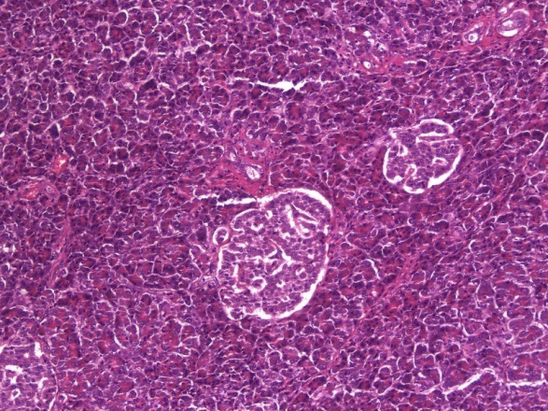
Final quiz
Self-check: Identify the organ and structure. (advance slide for answers). Do NOT let me down – this is for all the marbles.
Pancreas
Islet of Langerhans

