Slide 1
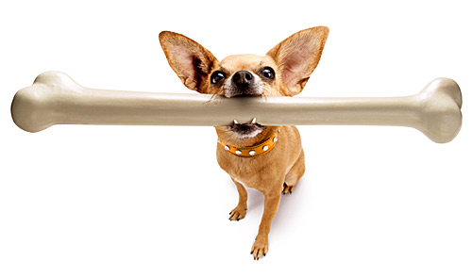
Bone Histology
Digital Laboratory
It’s best to view this in Slide Show mode, especially for the quizzes.
This module will take approximately 60 minutes to complete.

Slide 2
After completing this exercise, you should be able to:
Distinguish, at the light microscope level, each of the following::
Bone at the level of an organ
Diaphysis
Epiphysis
Endosteum
Periosteum
Cells of bone
Osteoblasts
Osteocytes
Osteoclasts
Cancellous (spongy) bone
Includes Lacunae (with osteocytes), canaliculi
Compact bone
Haversian system (osteons)
Haversian canal
Lacunae (with osteocytes)
Canaliculi
(Resorption canals)
(Volkmann’s canals)
Lamellae
Concentric
Interstitial
(Outer Circumferential)
(Inner Circumferential)
Distinguish, at the electron microscope level, each of the following::
Osteoblasts
Osteoclasts
Bone

Slide 3
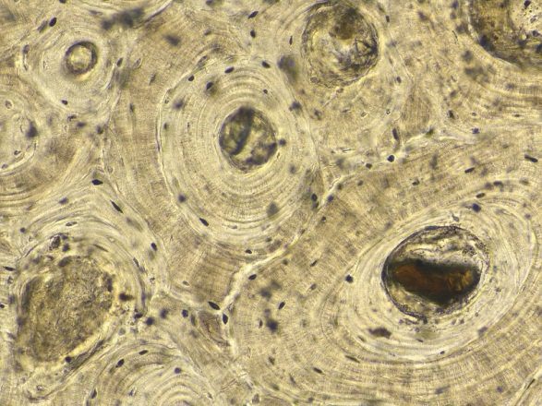
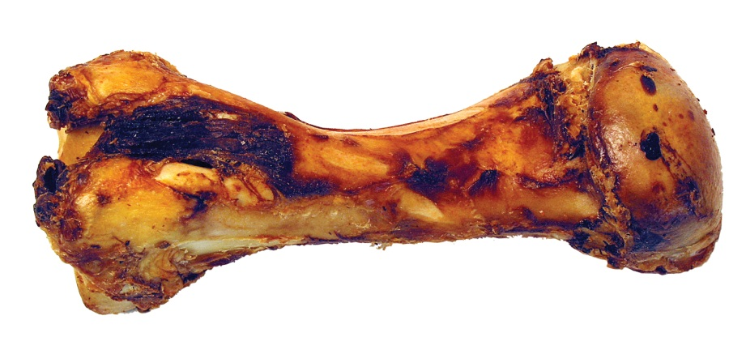
Bone vs. bone
First, a little clarification of the difference between the histological term bone, aka osseous tissue, and a bone (e.g. humerus).
The histological terms bone or osseous tissue describe a tissue ultimately derived from mesenchyme, and consisting of bone cells (osteoblasts, osteocytes) within a calcified extracellular matrix secreted by those cells. In this regard, bone or osseous tissue is similar to dense irregular connective tissue or cartilage.
A bone (humerus, scapula) is a gross structure composed of osseous tissue, but, in the living, also includes connective tissues, blood vessels, and adipose or marrow that are an integral part of the bone.

Slide 4
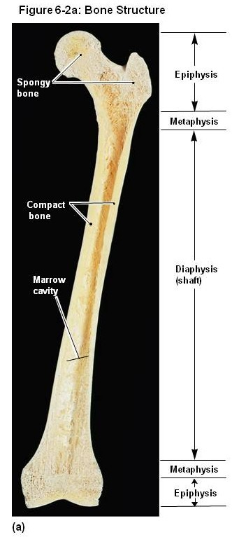
Bones
Long bones such as this femur have a diaphysis (shaft) and an epiphysis (head) at each end.
When bones are sectioned as shown here, one can see a space in the center of the diaphysis called the marrow (medullary) cavity, which would house red or yellow bone marrow. The outer portion of the entire bone is solid osseous tissue; this region is referred to as compact bone. In the center of the epiphyses, and adjacent to the marrow cavity, is spongy (cancellous) bone, which consist of spicules of osseous tissue with spaces between them which, in the living, are also filled by red or yellow marrow.
If you are at all fuzzy about this, we have sectioned bones in the anatomy labs, and encourage you to go down and see one for yourself.
This image is a dried bone, and, therefore, is showing only the extracellular matrix of the osseous tissue of the bone. The cells, as well as the other connective tissues, blood vessels, adipose, marrow, are gone.

Slide 5
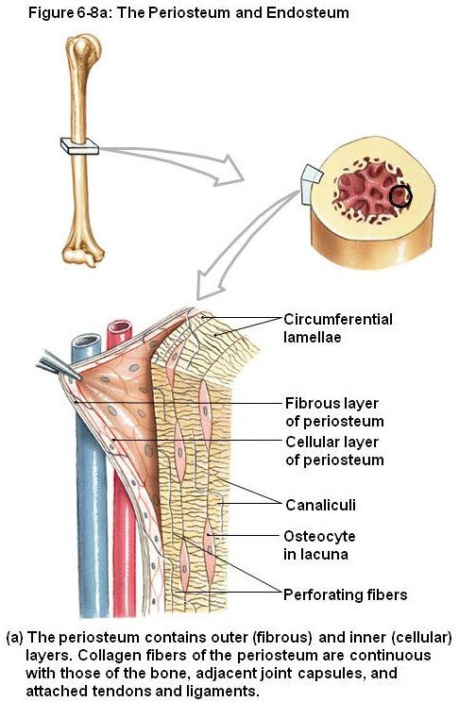
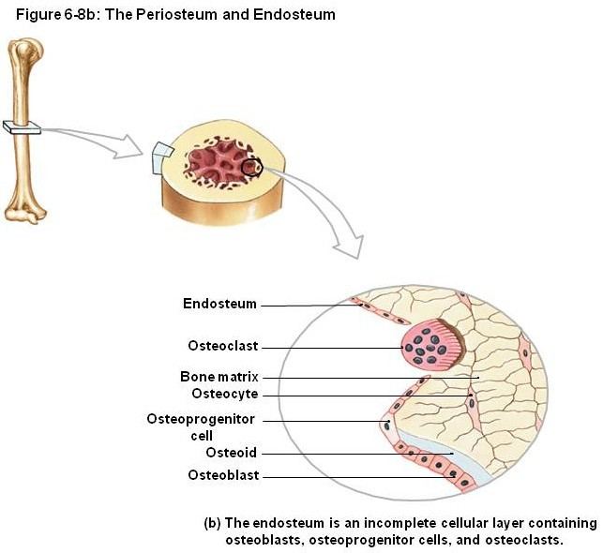
Bones
Like cartilage, the outer portion of a bone is lined by a dense irregular connective tissue called a periosteum. The marrow cavity is lined by a similar layer of connective tissue referred to as an endosteum.

Slide 6
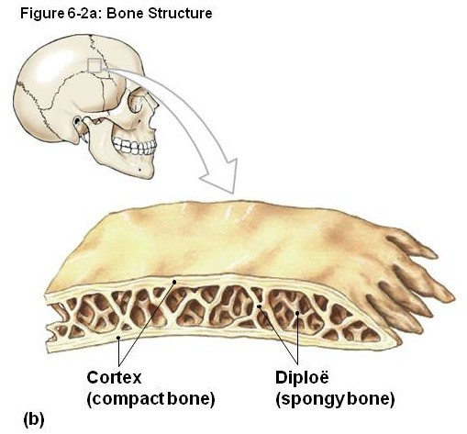
bones
The organization of flat bones, such as those in the skull, is similar to that of long bones, with the exception that there is no medullary cavity (marrow still occupies the spaces between the spicules of spongy bone in the central region, which is called the diploë).

Slide 7
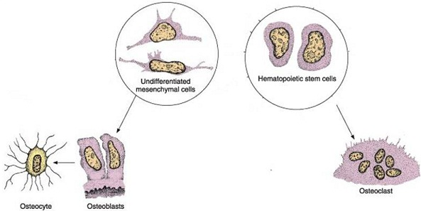
Cells of osseous tissue
The cells within osseous tissue can be divided into two groups, based on lineage and function:
1. The bone-makers are derived from mesenchyme, and mature in the following sequence:
mesenchymal cells – precursors for connective tissue cells, you met these already
osteoprogenitor cells – cells that have committed to the bone lineage, but haven’t begun to secrete bone matrix yet
osteoblasts – cells that have begun to secrete the characteristic matrix of bone
osteocytes - cells trapped within the matrix that they secreted
2. The bone-breakers, namely osteoclasts, which are derived from bone marrow.
Confused….probably. Let’s look at these in more detail.
makers
breakers

Slide 8
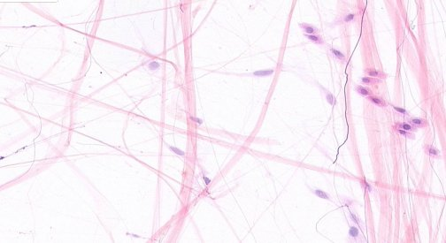
Cells of osseous tissue – progenitor cells
mesenchymal cells - you met these already
osteoprogenitor cells – cells that have committed to the bone lineage, but haven’t begun to secrete bone matrix yet
From a histological standpoint, both of these are relatively undifferentiated cells that will look a lot like, and are histologically indistinguishable from, fibroblasts (fibroblasts indicated by green arrows). Mesenchymal cells are in embryonic mesenchyme, while osteoprogenitor cells are typically located within the periosteum and endosteum.
loose connective tissue
Since mesenchymal cells, fibroblasts, and osteoprogenitor cells look the same, you don’t have to distinguish between them on our slides. ☺

Slide 9
Cells of osseous tissue - osteoblasts
osteoblasts – these cells are actively secreting bone matrix, which includes:
--type I collagen
--inorganic calcium, (Ca⁺⁺), and phosphate, (PO₄)⁻³, in large crystals called hydroxyapatite
So, I presume you’re thinking of osteoblasts as cells that are actively secreting components of bone matrix, and, therefore, would have abundant rER and a prominent Golgi apparatus for collagen production. If this is the case, you are correct.
The other identifying factor for osteoblasts is the presence of calcified bone. Is bone matrix electron dense? Or electron lucent? How will this matrix appear on H&E?
There is an issue about the timing of secretion (i.e. type I collagen is secreted earlier than the inorganic component), but that can wait until the next module.

Slide 10
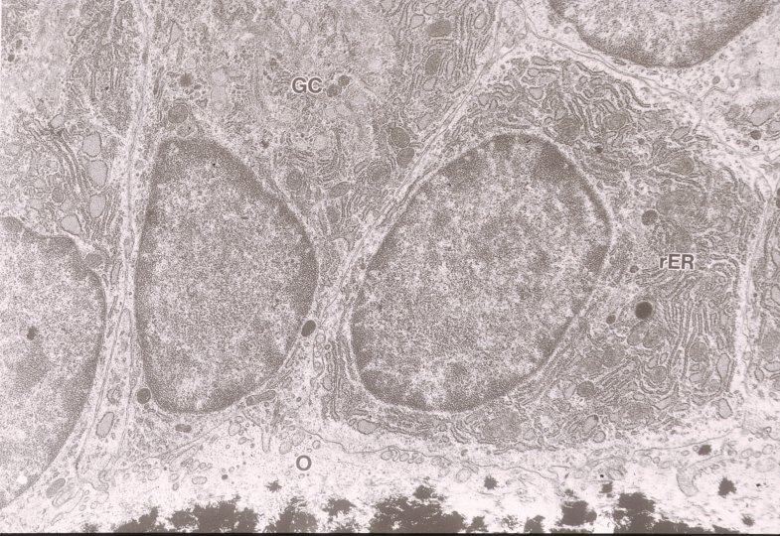
Cells of osseous tissue - osteoblasts
osteoblasts – In this electron micrograph, you can see 2-4 cuboid-shaped osteoblasts. Note the extensive rough endoplasmic reticulum (rER) and well-developed Golgi region (GC).
The electron-dense flaky material at the bottom of the slide is calcified matrix. (Ignore the big O, for now).
You’ve seen lots of cells with abundant rER and Golgi (plasma cells, chondroblasts), but the presence of these organelles in a cell adjacent to electron-dense bone matrix is a dead-giveaway.

Slide 11
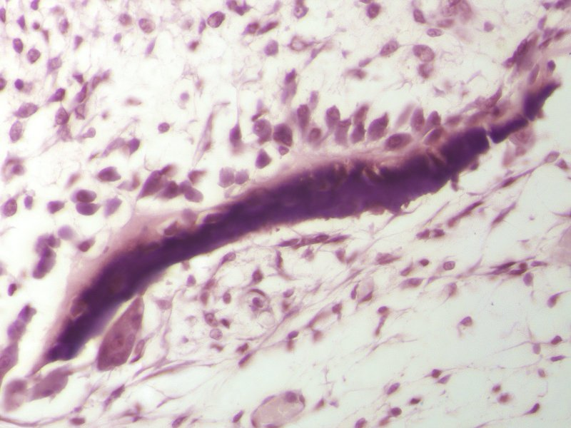
Cells of osseous tissue - osteoblasts
osteoblasts – In this light micrograph, the abundant rER in the osteoblasts (arrows) gives them an intense cytoplasmic basophilia. The osteoblasts are adjacent to bone, to which they are adding matrix components. The cells farther away from the bone are mesenchymal cells/fibroblasts/osteoprogenitor cells.
Calcified bone tends to vary in it’s staining, from pink to purple. Whatever the color, the staining of calcified bone is typically dark or intense. This contrasts with cartilage, which typically has a less intensely-stained matrix.
Note the pink region along the upper edge of this piece of bone…we’ll get back to that in the next module.
bone

Slide 12
Cells of osseous tissue - osteocytes
What is not shown on this slide are cell processes of the osteoblasts that extend toward, and make contact with, processes of adjacent osteoblasts. As these osteoblasts secrete bone matrix, they become trapped in lacunae, becoming osteocytes (arrows, better examples on next slide). The connections between adjacent bone cells are crucial for allowing transport of nutrients and waste products.
Chondrocytes trapped in lacunae do not need cell-cell processes because diffusion is efficient in cartilage matrix. However, calcification of bone matrix prevents diffusion (as well as movement). Therefore, these cell-cell contacts must be made before the matrix surrounding these cells calcifies.
bone

Slide 13
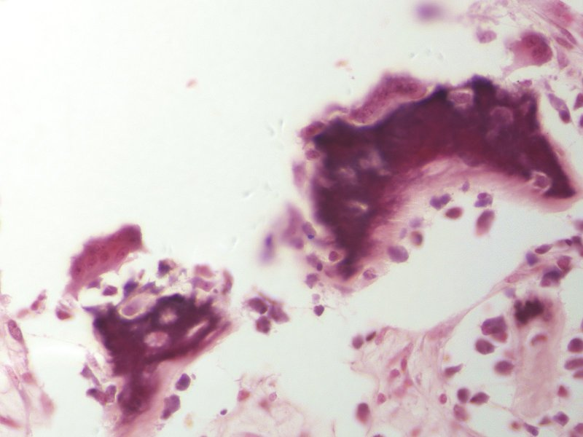
Cells of osseous tissue - osteocytes
Here is a similar image of bone showing osteocytes (arrows) that have become trapped in their lacunae. Cell processes between adjacent cells and from cells to the surrounding connective tissue still exist, but are not visible.
bone

Slide 14
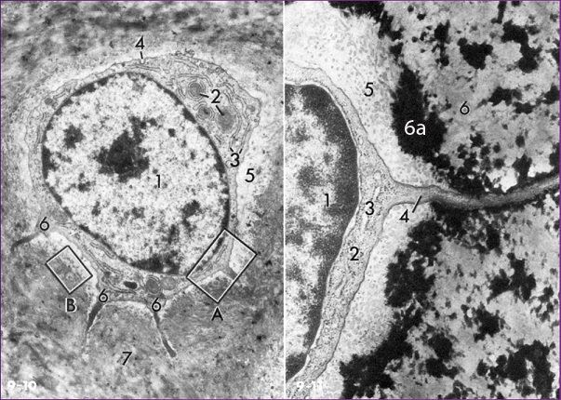
Cells of osseous tissue - osteocytes
These electron micrographs show osteocytes within lacuna. The EM to the right is similar to the region within the box at A in the left image. Note the osteocyte nucleus (1), lacuna (5), and the cell process (right image, 4) extending from the osteocyte. Much of the matrix is calcified (7 in left image, 6a and 6 in right image); electron dense nature of calcified matrix best demonstrated in region 6a in the right image. Area at 6 in right image is a region of bone matrix that has been decalcified during tissue preparation.
This osteocyte has less extensive rER and Golgi than when it was an osteoblast. In fact, since the matrix is solidified, this cell can’t secrete much additional matrix like a chondrocyte. Although the osteocyte is still active, it is less active than it once was. Therefore, in a sense, an osteocyte is “retired”.

Slide 15
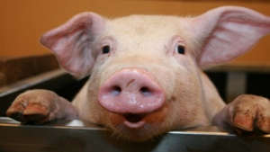
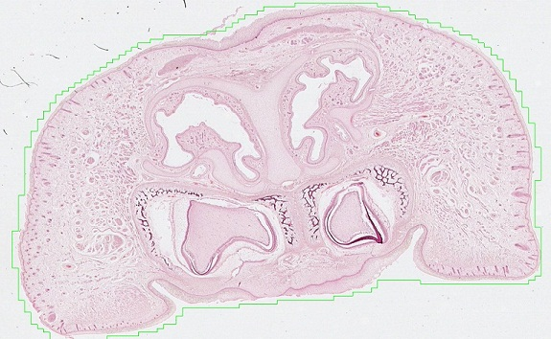
Cells of osseous tissue
The next slide is an H&E section through a fetal pig snout. For orientation, note that the slide only contains the upper jawbone (maxilla) and is a coronal section. Note nasal cavity, oral cavity, developing teeth, and regions of bone development (outlined).
Obviously, we’ll be looking at this slide again when we cover bone development in the next module.
Nasal cavity
Nasal cavity
tooth
tooth
Oral cavity

Slide 16
Cells of osseous tissue – bone makers
Video of osteoblasts, osteocytes, bone – SL42
Link to SL 042
Be able to identify:
Osteoblasts
Osteocytes
Bone

Slide 17
Cells of osseous tissue – bone makers
Video of osteoblasts, osteocytes, bone – SL41
This slide is a cross-section through the shaft of a bone.
Link to SL 041
Be able to identify:
Osteoblasts
Osteocytes
Bone

Slide 18
Cells of osseous tissue – bone makers
Video of osteocytes, bone – SL39
Link to SL 039
Be able to identify:
Osteoblasts not easily seen
Osteocytes
Bone

Slide 19
Cells of osseous tissue - osteoclasts
Osteoclasts are derived from hematopoietic stem cells in bone marrow, and are closely related to the monocyte/macrophage lineage. Osteoclasts arise from fusion of multiple cells (a syncytium, like syncytiotrophoblast – how exciting is that). Therefore, they are large, multinuclear cells.

Slide 20
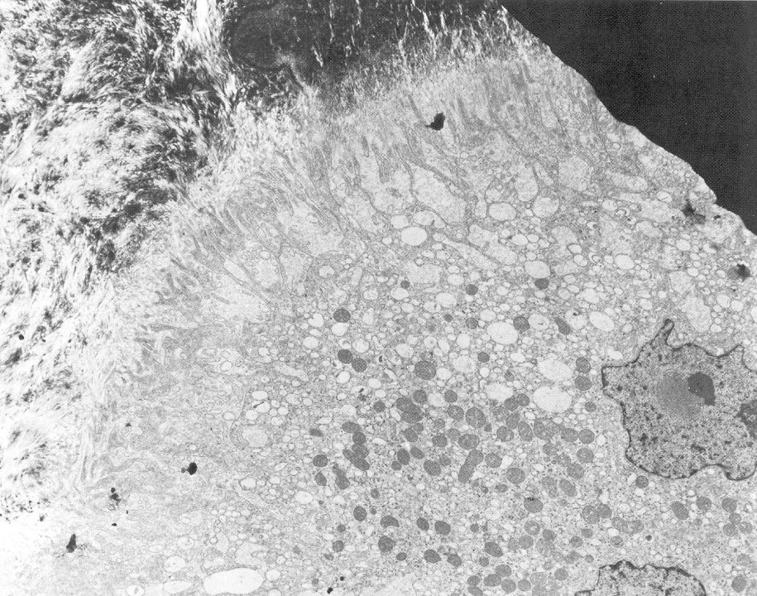
Cells of osseous tissue - osteoclasts
Osteoclasts degrade bone. To do this, they produce numerous secretory lysosomes (clear vesicles, hundreds of them in the outlined region) which are released into the extracellular space. The plasma membrane adjacent to the bone is extremely undulated, which increases the surface area for proton pumps and release of the secretory lysosomes. This undulated region is referred to as a ruffled border (bracket).
This dark area is not bone, but rather part of grid tissue is placed on during preparation
bone
Identification summary:
Osteoblasts are cells with rER and Golgi, adjacent to bone.
Osteoclasts are multinuclear, with lots of secretory vesicles and a ruffled border, adjacent to bone.
nucleus
mitochondria
nucleus

Slide 21
Cells of osseous tissue - osteoclasts
In H&E sections, osteoclasts (blue arrows) are large cells, with multiple nuclei, and eosinophilic cytoplasm (due to numerous secretory vesicles). As they degrade the bone, they create a depression, called a Howship’s lacuna (black arrows) that they are typically located within. Osteoblasts are indicated with green arrows for comparison.
Not bone, part of grid tissue is placed on during preparation
Identification summary:
Osteoblasts are cuboidal, typical-sized cells, single nuclei, basophilic cytoplasm.
Osteoclasts are very large, multinuclear, with eosinophilic cytoplasm.
Note basophilia / eosinophilia is relative, so it helps to compare cells, i.e. compare osteoblasts to osteoclasts on the same image.

Slide 22
Cells of osseous tissue – bone breakers
Video of osteoclasts – SL42
Link to SL 042
Be able to identify:
Osteoclasts

Slide 23
Cells of osseous tissue – bone breakers
Video of osteoclasts – SL41
Link to SL 041
Be able to identify:
Osteoclasts

Slide 24
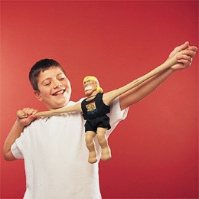
A quick stretch

Slide 25
Organization of bone
Now that we have described the cells and matrix, let’s look at how the two types of bone, spongy and compact, are organized.
Recall that compact bone is on the outside of a bone, while the inside lining the marrow cavity, the inside of the epiphysis, and the middle portion of a flat bone all are spongy bone.
The “spaces” between bone spicules / trabeculae in spongy bone is occupied by mesenchyme, marrow, adipose, or connective tissue.
Pieces of bone are referred to as spicules or trabecula. Trabecula are typically larger than spicules, but people use these terms pretty much interchangeably.

Slide 26
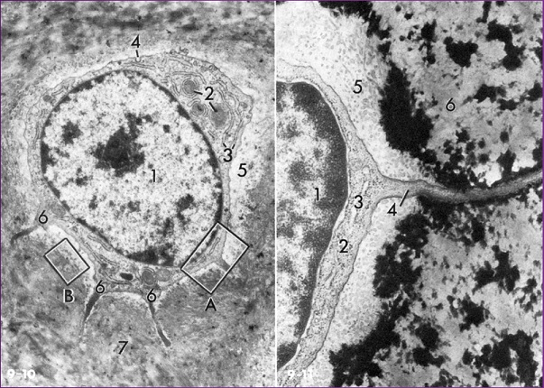
Organization of bone
Since diffusion cannot occur through calcified bone matrix, osteocytes in lacunae need to maintain contact with tissues that contain blood vessels, or with other osteocytes, to obtain nutrients and eliminate waste. In this regard, recall that osteocytes have cellular processes (4 in right image). These processes extend into spaces within the matrix called canaliculi.
So, just like lacunae, canaliculi are “spaces” in the bone matrix. They are long, narrow tunnels, and contain osteocyte cell processes. Lacunae are round, and contain the part of the osteocyte with the nucleus (i.e. the osteocyte “cell body”).
Of course, when the cells and cell processes are present, there is no space at all.

Slide 27
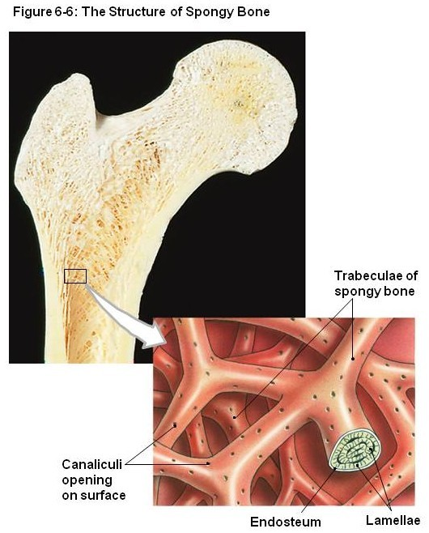
Organization of bone – spongy bone
In spongy bone, the spicules / trabeculae are not thick. Therefore, the osteocytes within are usually near enough to the edge of the osseous spicule that their cell processes can reach to the surface to access nutrients from the tissue (e.g. marrow) between the spicules. Alternatively, a chain of a few osteocytes can pass nutrients to an osteocyte in the middle of a spicule.
In this cartoon, you can see trabeculae of bone with openings for canaliculi.
Note: This drawing shows spongy bone organized into lamellae (which are characteristic of compact bone, described next). Organization into lamella is not characteristic of spongy bone, as this slide would suggest.

Slide 28
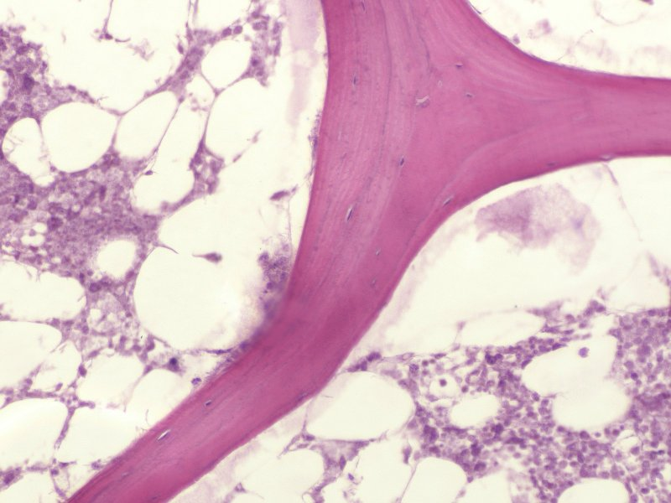
Organization of bone – spongy bone
In this light micrograph of a bone spicule, osteocytes within lacuna are indicated (black arrows). Each osteocyte maintains contact to the adjacent marrow through canaliculi, which are not visible in this slide.
spicule / trabecula
marrow
marrow

Slide 29
Organization of bone – spongy bone
Video of spongy bone – SL39
Link to SL 039
Be able to identify:
Spongy bone
Osteocyte
Lacunae

Slide 30
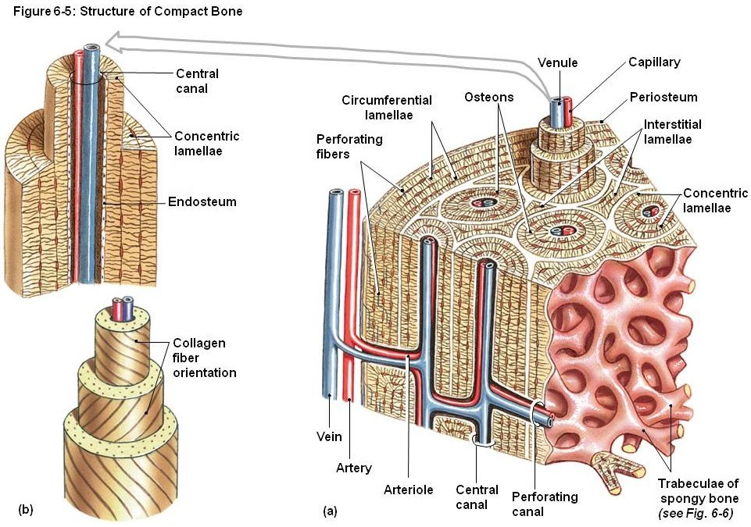
Organization of bone – compact bone
Compact bone is thicker than spicules of spongy bone, so it needs to have more organization to deliver nutrients to osteocytes. This is accomplished by a series of osteons (aka Haversian systems), which are “tubes” of osseous tissue that run lengthwise along the long axis of a bone. Each osteon is composed of several concentric lamellae (rings). In the center of each osteon is a central (Haversian) canal, which contains connective tissue, including blood vessels that feed the osteocytes within the osteon.

Slide 31
Organization of bone – compact bone
Two osteons are outlined below. Each is shown consisting of 3 concentric lamellae. The lamellae between the osteons are incomplete, and referred to as interstitial lamellae. In the outer and inner portions of this wedge of bone, large inner and outer circumferential lamellae are present.
outer
The inner and outer circumferential lamellae go all the way around the shaft of the bone.
Inner circumferential lamellae (blue bracket)

Slide 32
Organization of bone – compact bone
In this enlarged portion of the drawing, we can see one complete osteon. The osteocytes within their lacunae (blue arrows) are situated in the borders between the lamellae. Osteocyte processes extend into canaliculi (red arrows), which connect adjacent lacunae, but also connect the inner lacunae to the central canal. Nutrients from the vessels in the central canal are passed to osteocytes in the inner layer, which then pass nutrients to osteocytes in the outer layers; thus, all osteocytes in an osteon receive their nutrients from the vessels within the central canal.
In this drawing, yellow (and white) is bone matrix.
Each osteocyte process extends ½ way through a canaliculus, so that the tips of two processes from adjacent osteocytes meet in the middle.
Nutrient and waste movement occurs via diffusion in the small space between the cell processes and calcified matrix, as well as via gap junctions made by the adjacent osteocytes.

Slide 33
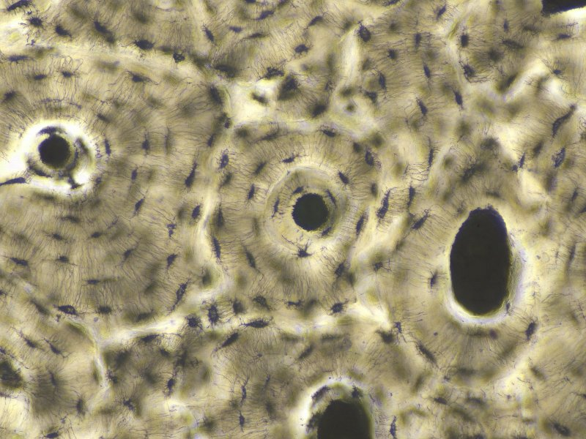
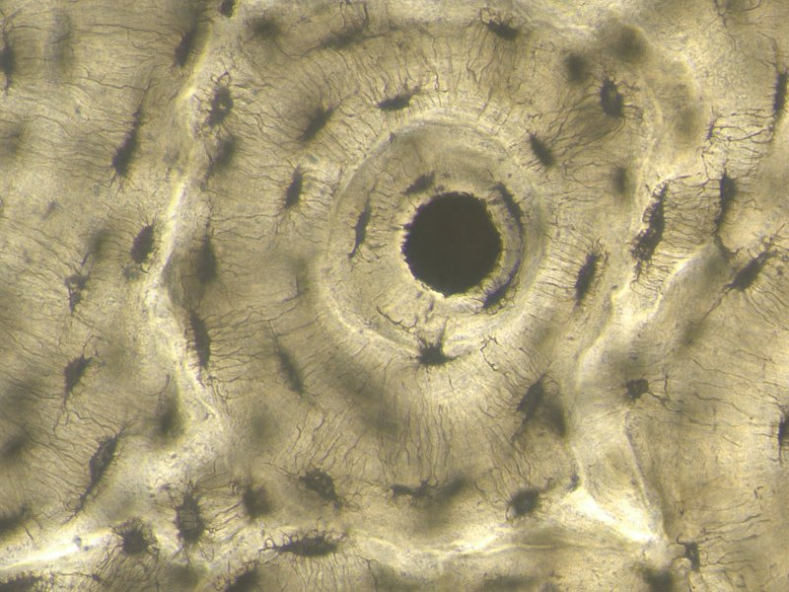
Organization of bone – compact bone
Below is an image from a thick section of a dried piece of compact bone. The osteocytes have degenerated, leaving the bone matrix. The tissue was then ground down, creating dust that filled in all the spaces where cells and connective tissue once existed. An osteon is outlined in the left image, and enlarged in the image to the right. The central (Haversian) canal, lacunae (blue arrows) and canaliculi (red arrows) are indicated.
central canal

Slide 34
Organization of bone – compact bone
Video of ground compact bone – SL38
Link to SL 038
Be able to identify:
Osteon
Central (Haversian) canal
Concentric lamella
Lacuna
Canaliculi
Interstitial lamella

Slide 35
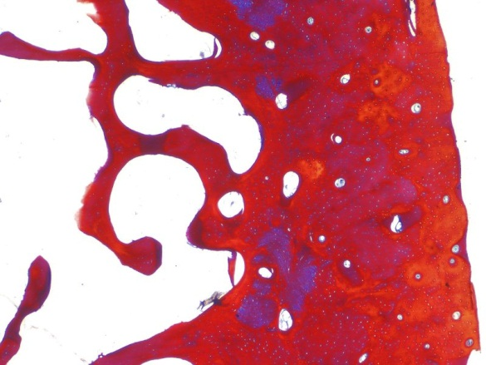
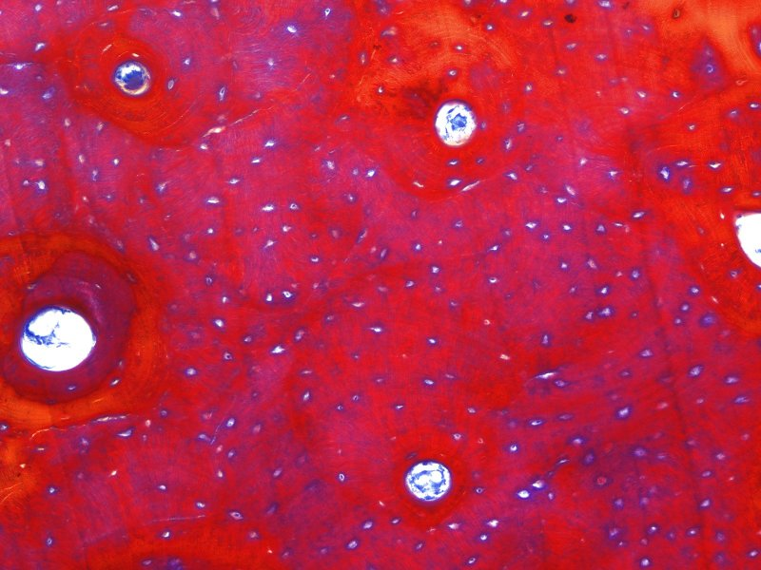
Organization of bone – compact bone
This slide has some unusual staining which is not relevant to understanding the organization of compact bone. You can guesstimate the approximate border of an osteon (outlined), and can see central canals (Xs) and lacunae (blue arrows). Canaliculi and lamella are not visible.
X
X

Slide 36
Organization of bone – compact bone
Video of compact bone – SL40
Link to SL 040
Be able to identify:
Osteon
Central (Haversian) canal
Lacuna

Slide 37
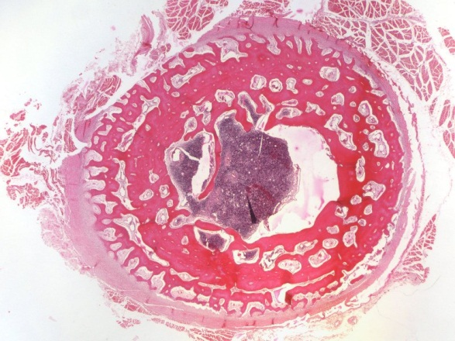
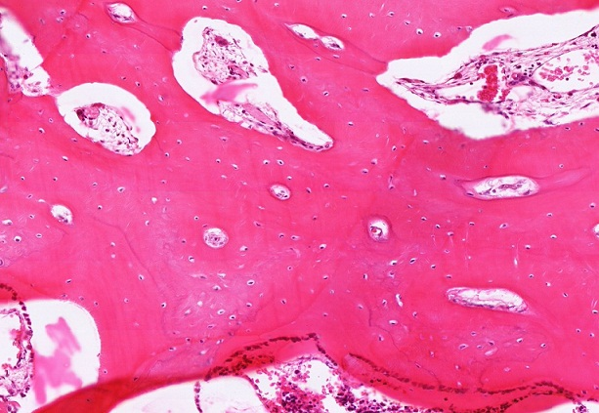
Organization of bone – compact bone
On this slide, you can see the approximate border of an osteon (outlined), and can see central canals (Xs) and osteocytes within lacunae (blue arrows). Canaliculi and lamellae are not visible. The larger, irregular tunnels are resorption canals (R), which are features of bone remodeling that is beyond the scope of these modules.
R
R
X
X

Slide 38
Organization of bone – compact bone
Video of compact bone – SL41
Link to SL 041
Be able to identify:
Osteon
Central (Haversian) canal
Osteocytes within lacuna
(Resorption canals)

Slide 39
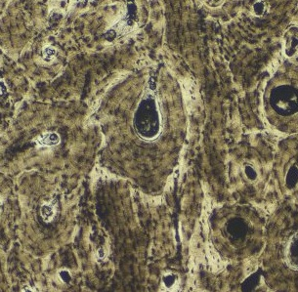
Organization of bone – Volkmann’s Canals
As we mentioned, osteons, and thus Haversian canals, run parallel to the long axis of the bone. These, and the vessels within them, are connected to each other, and to the outside tissue and marrow cavity, by Volkmann’s (perforating) canals, which run perpendicular to the long axis of the bone. These are difficult to find; one such canal is indicated by the red arrow in the image to the right.

Slide 40
Organization of bone – volkmann’s canals
Video of Volkmann’s canal – SL38
You can find Volkmann’s canal candidates on all your slides, but do not grow old looking for them.
Link to SL 038
Be able to identify:
Volkmann’s canal

Slide 41
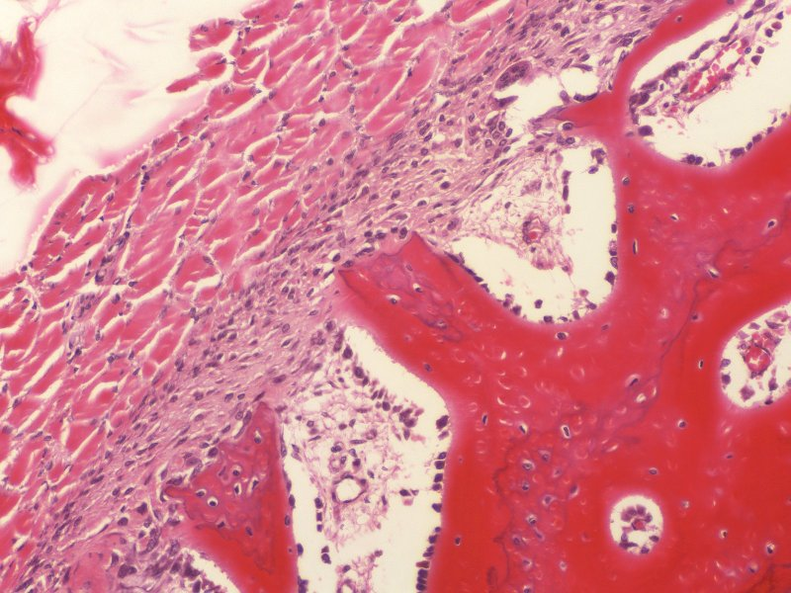
Organization of bone – periosteum and endosteum
We mentioned that bone, like cartilage, contains a surrounding layer, which for bone is called the periosteum. This periosteum is well-developed, with an obvious cellular (black bracket) and fibrous (blue bracket) regions. There is also an endosteum along the inner lining of the bone, adjacent to the marrow cavity.
Marrow cavity

Slide 42
Organization of bone – periosteum and endosteum
Video of periosteum and endosteum – SL41
Link to SL 041
Be able to identify:
Periosteum
Endosteum

Slide 43
The next set of slides is a quiz for this module. You should review the structures covered in this module and try to visualize each of these in light and electron micrographs.
Distinguish, at the light microscope level, each of the following::
Bone at the level of an organ
Diaphysis
Epiphysis
Endosteum
Periosteum
Cells of bone
Osteoblasts
Osteocytes
Osteoclasts
Cancellous (spongy) bone
Includes Lacunae (with osteocytes), canaliculi
Compact bone
Haversian system (osteons)
Haversian canal
Lacunae (with osteocytes)
Canaliculi
(Resorption canals)
(Volkmann’s canals)
Lamellae
Concentric
Interstitial
(Outer Circumferential)
(Inner Circumferential)
Distinguish, at the electron microscope level, each of the following::
Osteoblasts
Osteoclasts
Bone

Slide 44
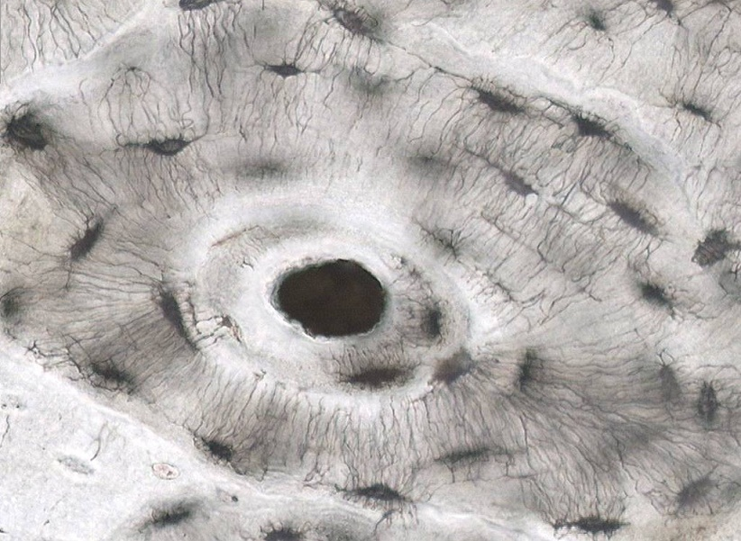
Final quiz
Self-check: Identify the structures indicated by the arrows. (advance slide for answer)
canaliculi

Slide 45
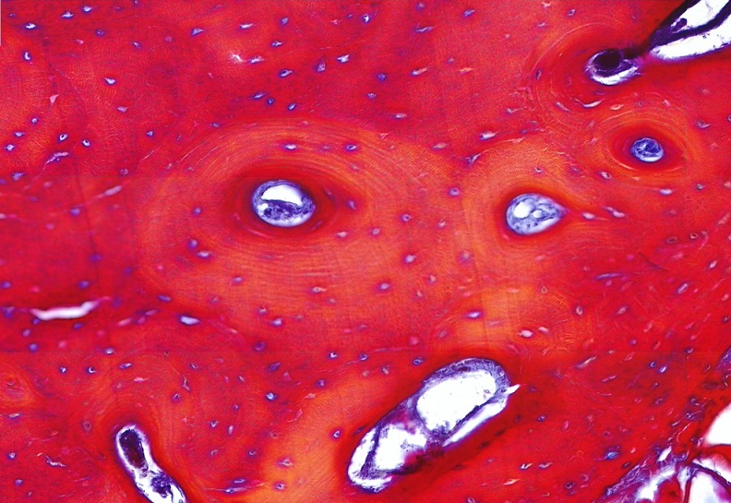
Final quiz
Self-check: Identify the outlined structure. (advance slide for answer)
osteon

Slide 46
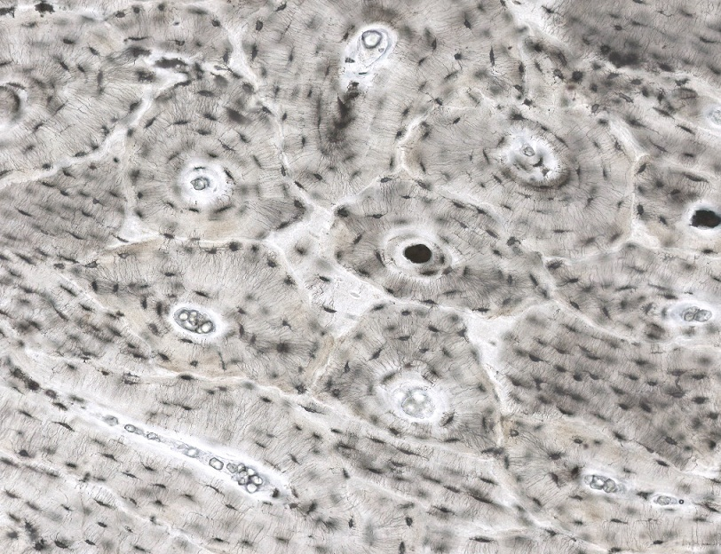
Final quiz
Self-check: Identify the outlined regions. (advance slide for answer)
Interstitial lamella

Slide 47
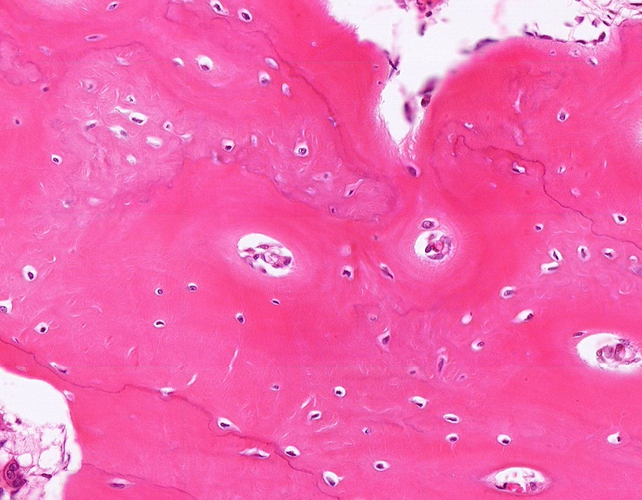
Final quiz
Self-check: Identify the structure indicated by the arrows. (advance slide for answer)
Haversian canal

Slide 48
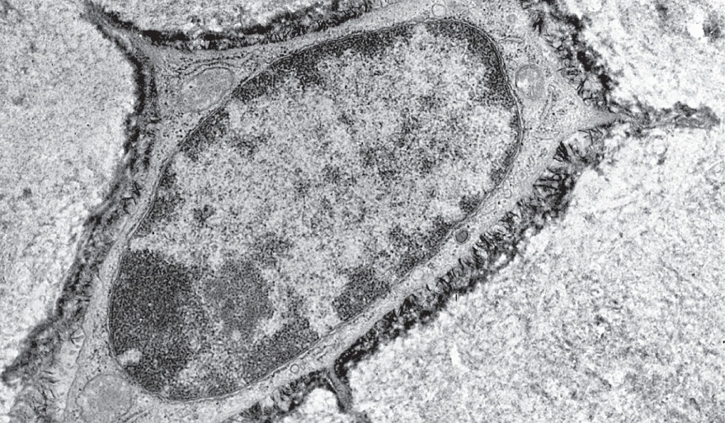
Final quiz
Self-check: Identify the cell in this image. (advance slide for answer)
osteocyte

Slide 49
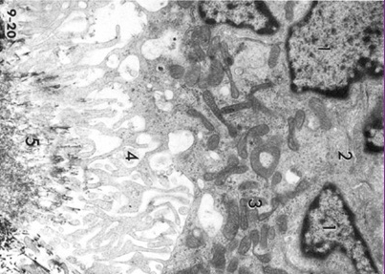
Final quiz
Self-check: Identify the cell in this image. (advance slide for answer)
osteoclast

Slide 50
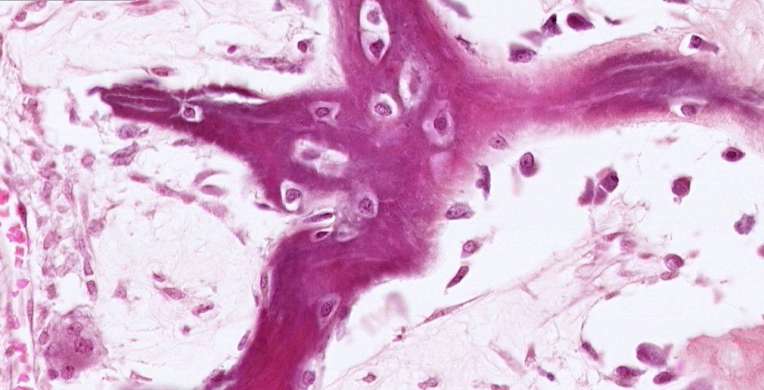
Final quiz
Self-check: Identify the cells indicated by the arrows. (advance slide for answer)
osteocytes

Slide 51
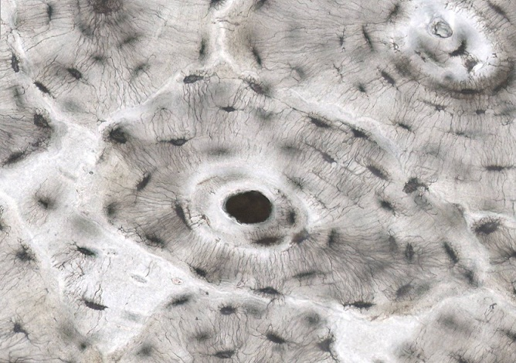
Final quiz
Self-check: Identify the structures indicated by the arrows. (advance slide for answer)
lacunae

Slide 52
Final quiz
Self-check: Identify the structure indicated by the arrows. (advance slide for answer)
Osteocytes in lacunae

Slide 53
Final quiz
Self-check: Identify the outlined TISSUE. (advance slide for answer)
Bone or osseous tissue

Slide 54
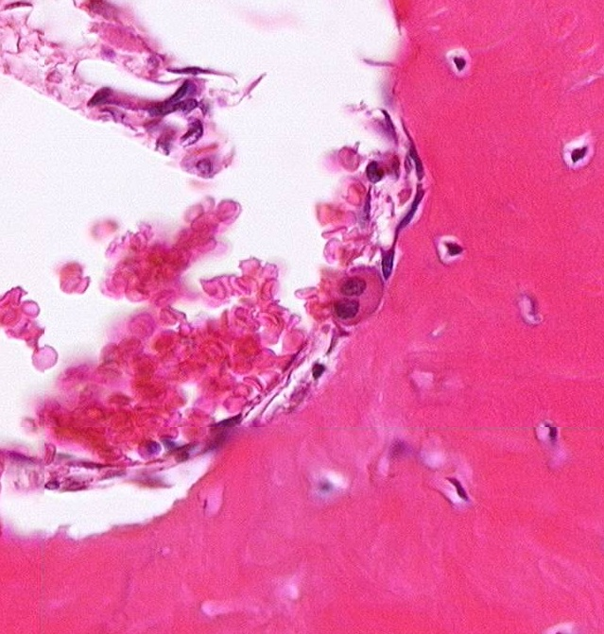
Final quiz
Self-check: Identify the cell indicated by the arrows. (advance slide for answer)
osteoclast

Slide 55
Final quiz
Self-check: Identify the structures indicated by the arrows. (advance slide for answer)
lacunae

Slide 56
Final quiz
Self-check: Identify the structure indicated by the arrows. (advance slide for answer)
Haversian canal

Slide 57
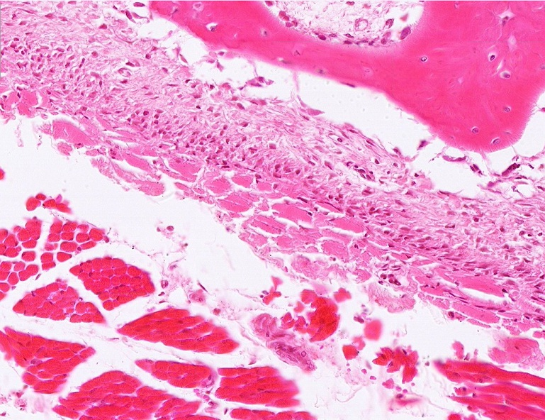
Final quiz
Self-check: Identify outlined TISSUE. (advance slide for answer)
Bone or osseous tissue

Slide 58
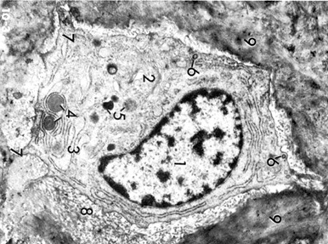
Final quiz
Self-check: Identify the cell in this image from bone. (advance slide for answer)
osteocyte

Slide 59
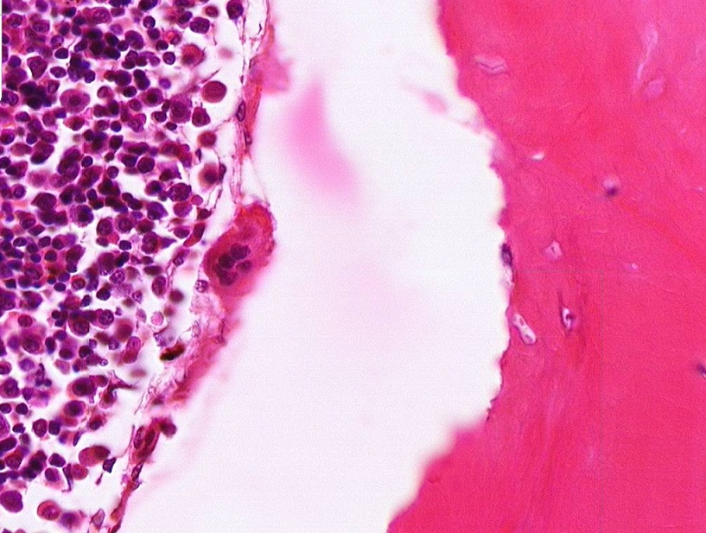
Final quiz
Self-check: Identify the cell indicated by the arrows. (advance slide for answer)
osteoclast

Slide 60
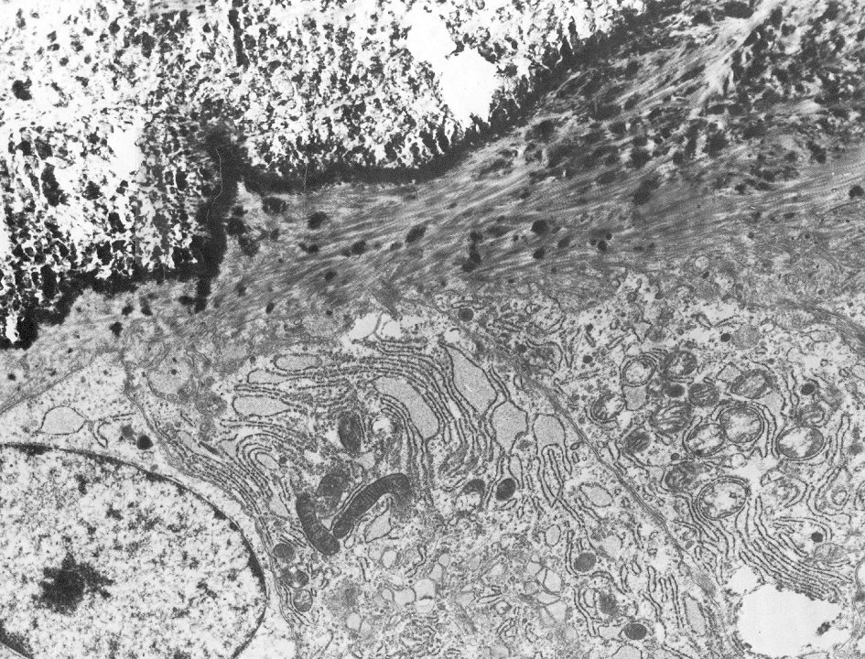
Final quiz
Self-check: Identify the cells in this image. (advance slide for answer)
osteoblasts

Slide 61
Final quiz
Self-check: Identify outlined structure. (advance slide for answer)
periosteum

Slide 62
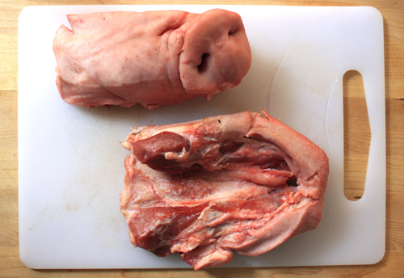
Final quiz
Self-check: Identify the structures on this slide. (advance slide for answer)
Pig snouts

Slide 63
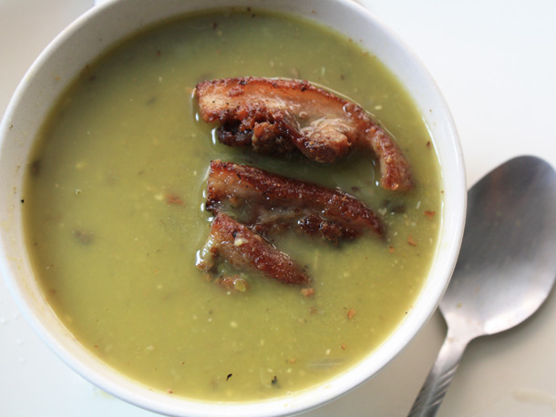
Final quiz
Self-check: Identify. (advance slide for answer)
Pig snout soup

Slide 64
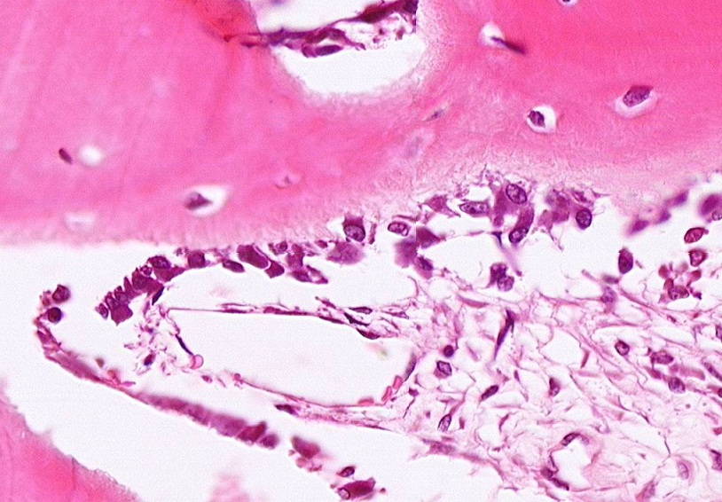
Final quiz
Self-check: Identify the cells indicated by the arrows. (advance slide for answer)
osteoblasts

Slide 65
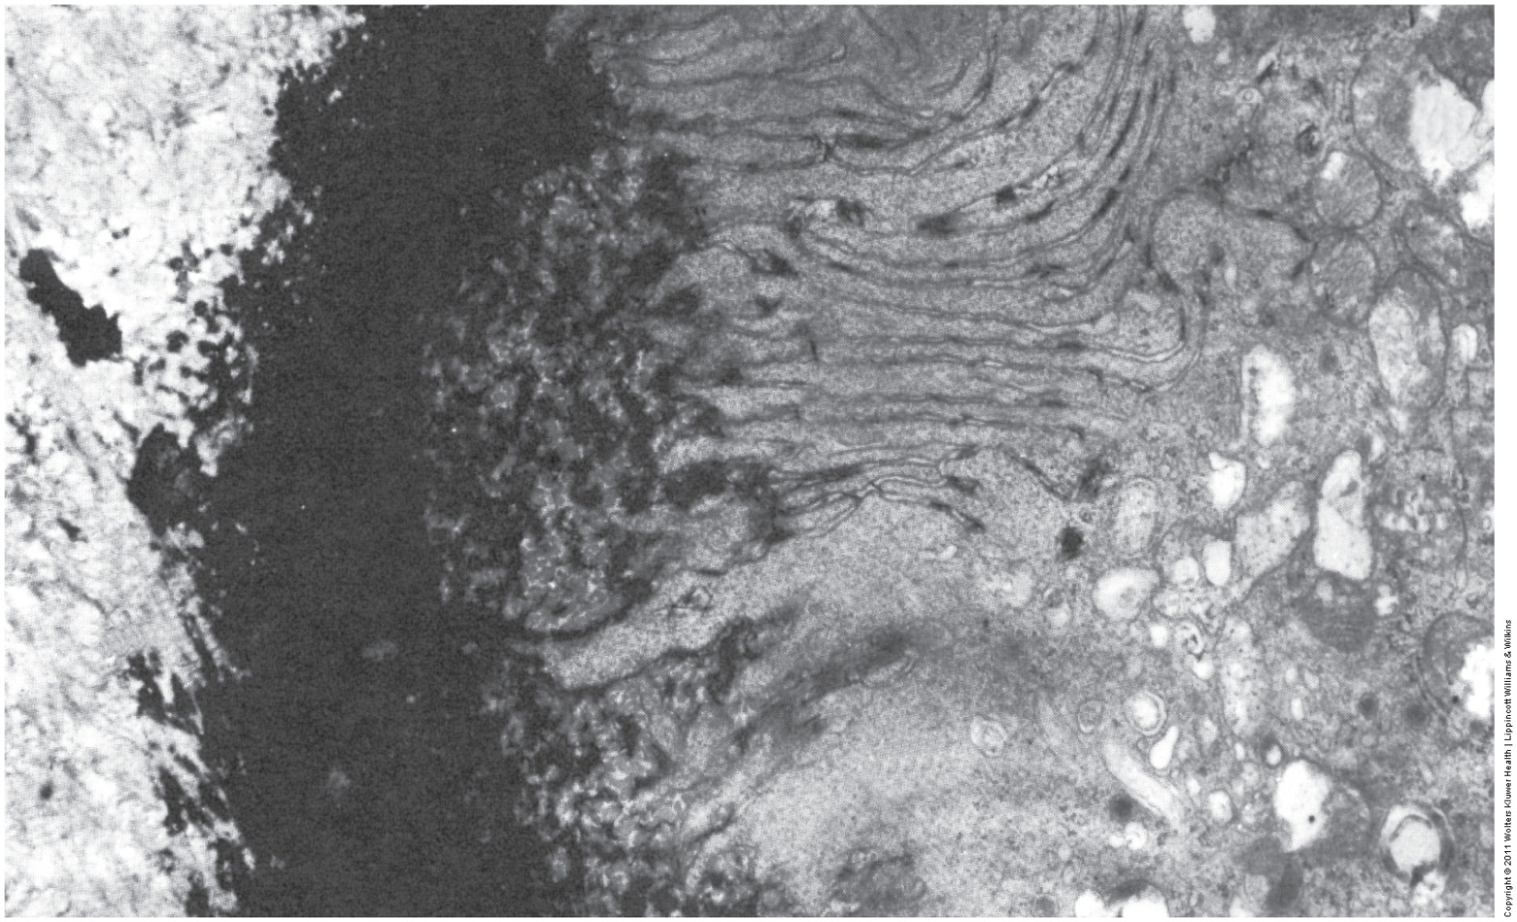
Final quiz
Self-check: Identify the cell in this image. (advance slide for answer)
osteoclast

Slide 66
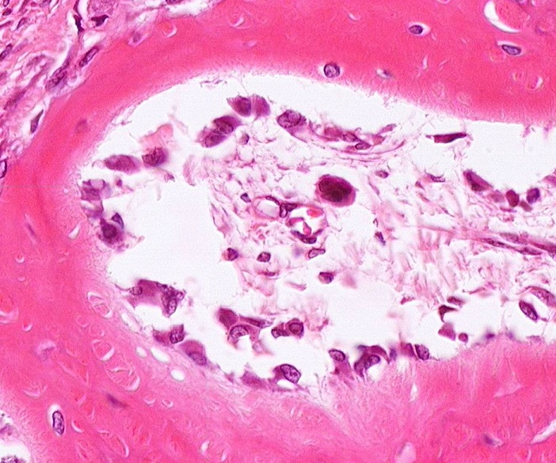
Final quiz
Self-check: Identify the cells indicated by the arrows. (advance slide for answer)
osteoblasts

Slide 67
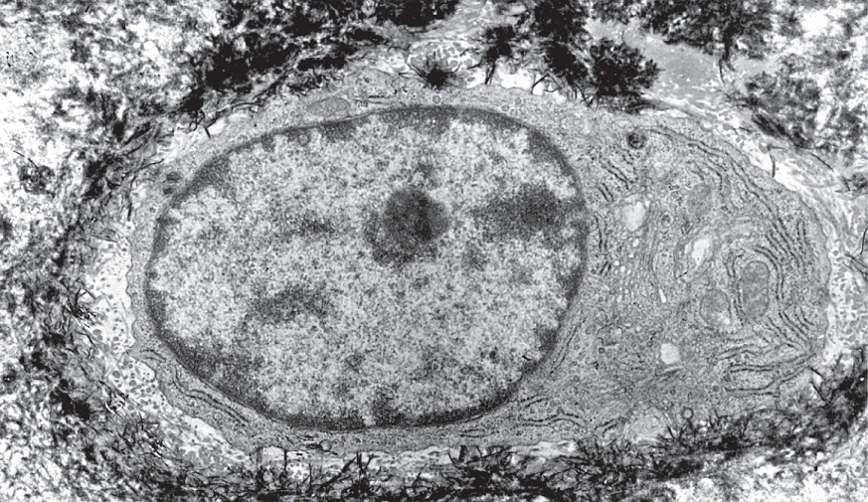
Final quiz
Self-check: Identify the cell in this image. (advance slide for answer)
osteocyte
Yep, not the best example, no visible cell processes, and does have a good amount of rER, but it’s still surrounded by calcified matrix. It’s a youngun’.

Slide 68
Final quiz
Self-check: Identify the structure indicated by the arrows. (advance slide for answer)
Haversian canal

Slide 69
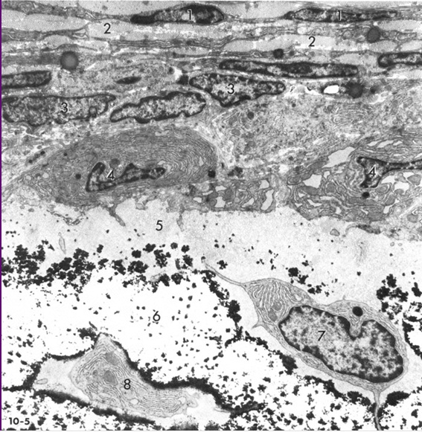
Final quiz
Self-check: Identify the cells at #4 and #7. (advance slide for answer)
osteoblasts

Slide 70
Final quiz
Self-check: Identify the cell indicated by the arrows. (advance slide for answer)
osteoclast

Slide 71
Final quiz
Self-check: In living tissue, what would be located in the structure indicated by the arrows? (advance slide for answer)
osteocyte

Slide 72
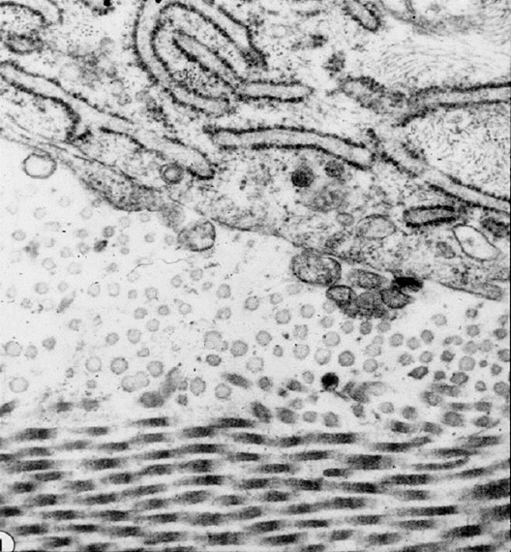
Final quiz
Self-check: Identify the cell in this image taken from bone. (advance slide for answer)
osteoblast

Slide 73
Final quiz
Self-check: Identify the protein in the outlined region. (advance slide for answer)
Type I collagen
We didn’t look at this yet in detail for osseous tissue, but you should still recognize collagen.

Slide 74
Final quiz
Self-check: Identify outlined structure. (advance slide for answer)
endosteum

Slide 75
Final quiz
Self-check: In living tissue, what would be located in the structures indicated by the arrows? (advance slide for answer)
Cell processes of osteocytes

Slide 76
Final quiz
Self-check: Identify the cells indicated by the arrows. (advance slide for answer)
osteoblasts

Slide 77
Final quiz
Self-check: In living tissue, what would be located in the structure indicated by the arrows? (advance slide for answer)
Connective tissue, blood vessels

Slide 78
Final quiz
Self-check: Identify 2 or 3 TISSUES on this slide. (advance slide for answer)
Cancellous (spongy) bone, bone marrow with adipose tissue

Slide 79
Final quiz
Self-check: Identify the region indicated by the bracket. (advance slide for answer)
Periosteum
This was tough, just seeing if you could figure it out.
Note osteocyte in lacuna (8), osteoblasts (4 and 7), and the flatter cells at the top.

